Slide 1
Lesson 24.3
Ecological Roles of Fungi

Slide 2
Objectives
Describe mutualistic relationships of fungi with plant roots and photosynthetic organisms.
Describe the different types of fungal infections in humans.
Describe the importance of fungi in the chemical and pharmaceutical industries.
Describe the importance of fungi to the balance of the environment.
Discuss the role of fungi as model organisms.

Slide 3
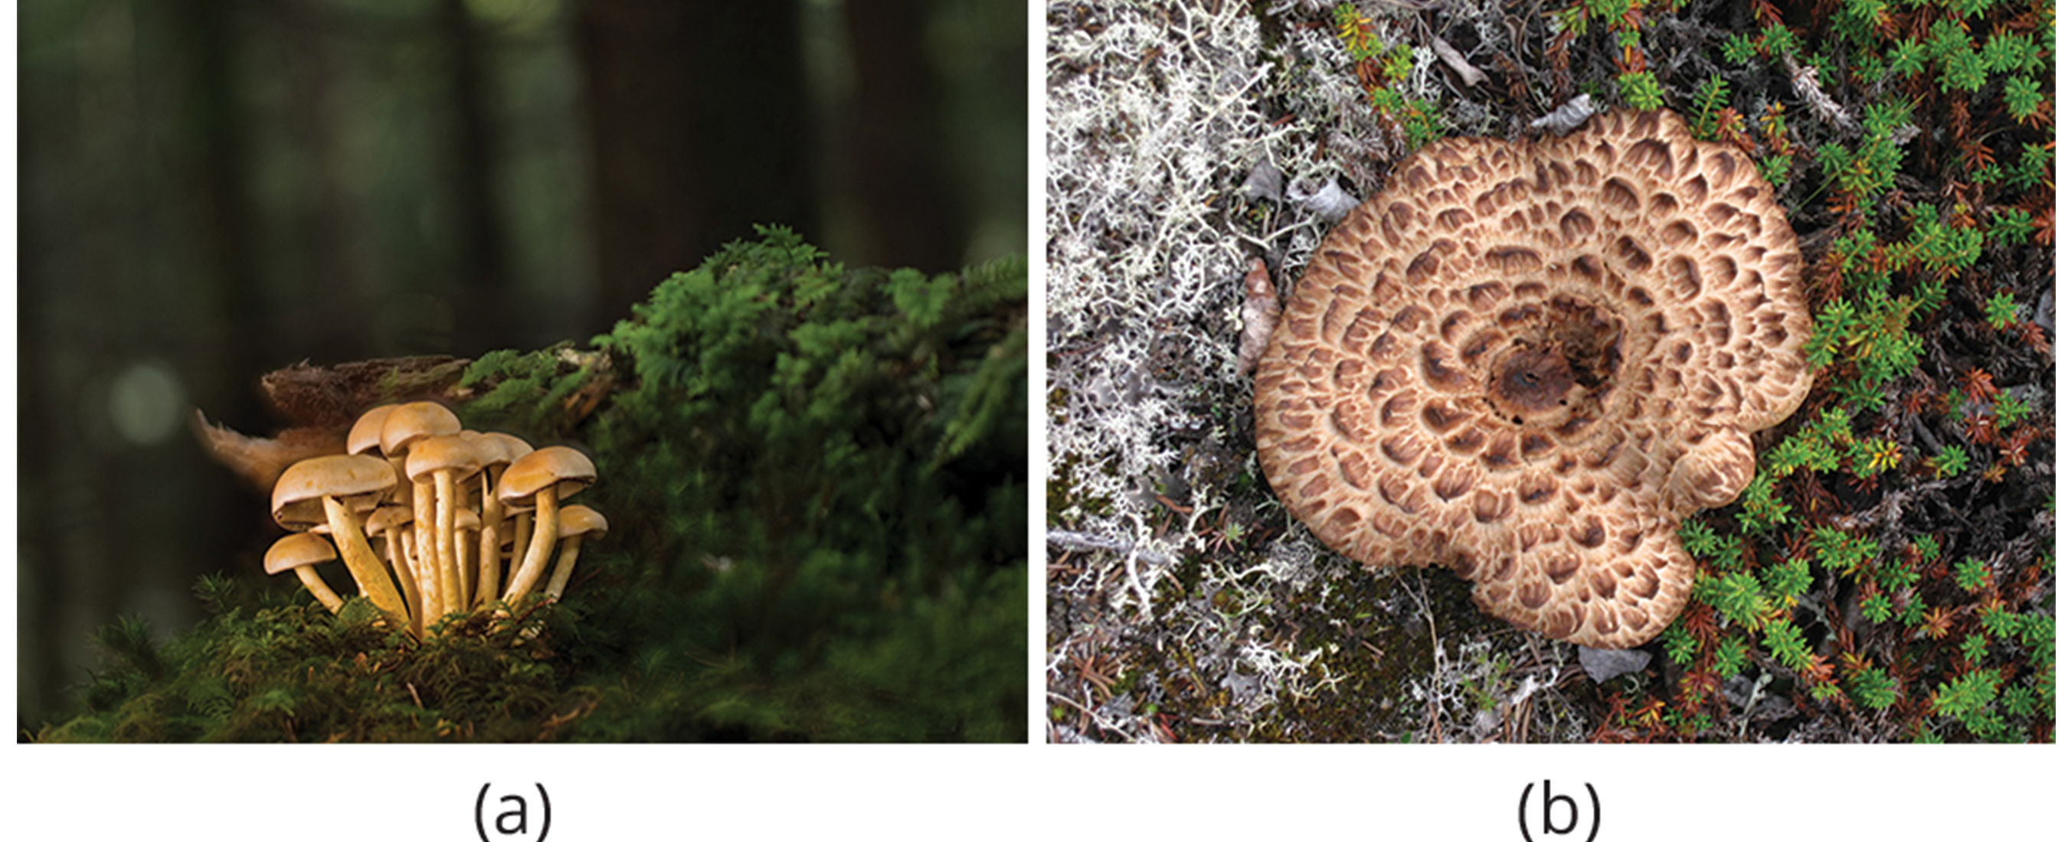
Ecological Roles of Fungi
Crucial role in balance of ecosystems
Colonize most habitats, preferring dark, moist conditions
Can thrive in hostile environments (e.g., tundra) because of symbiosis with photosynthetic organisms like algae to produce lichens
Act as major decomposers, breaking down organic matter with versatile metabolism
24.3 Figure 1: (a) While mushrooms prefer moist soil, others, (b) such as the Sarcodon mushroom and the white Cladina lichen, can tolerate harsher ecosystems, like the tundra.
adege on Pixabay. "White mushrooms."
Western Arctic National Parklands on Wikimedia Commons. "Sarcodon mushroom in white Cladina lichen and crowberry."

Slide 4
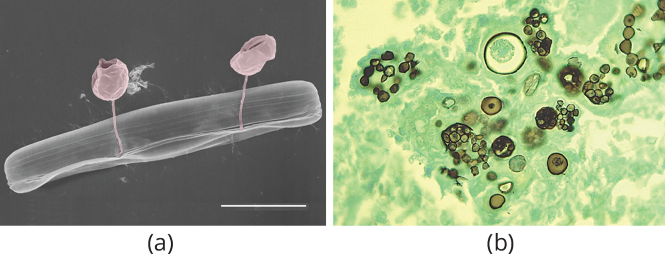
Habitats
Primarily humid and cool environments with organic matter but can colonize many different kinds of habitats
Chytrids: Mostly aquatic
Coccidioides immitis (causes pneumonia): Dry and sandy soil
Parasitic fungi: Coral reefs in the ocean
Most members of kingdom Fungi: Forest floor; dark, damp environment rich in decaying debris from plants and animals
Play a major role as decomposers and recyclers, supplying nutrients to other kingdoms
24.3 Figure 2: (a) A pennate diatom infected with two chytrid-like fungal pathogens. (b) A mature spherule with Coccidioides immitis endospores in an infected lung.
Estelle S. Kilias, Leandro Junges, Luka Šupraha, Guy Leonard, Katja Metfies & Thomas A. Richards on Wikimedia Commons. "Pennate diatom infection."
CDC on Wikimedia Commons. "Coccidioides immitis endospores."

Slide 5
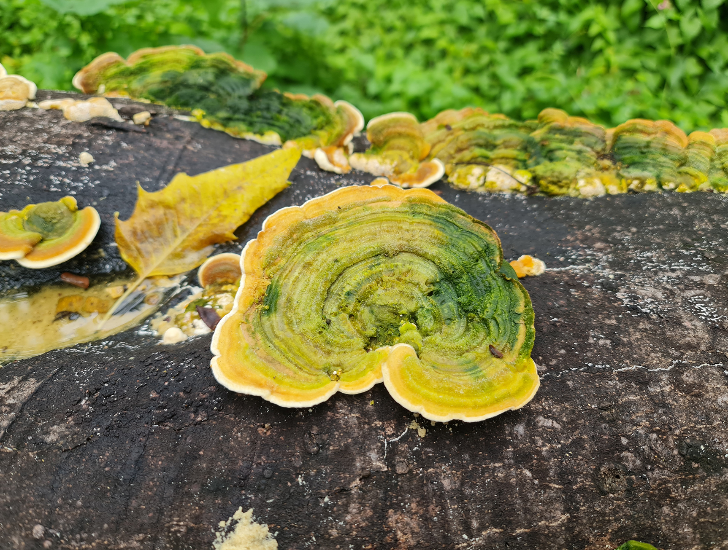
Decomposers and Recyclers₁
Nitrogen and phosphorus needed by biological systems but not abundant in the environment
Released by fungi from decaying matter to be used by living organisms
Essential process for growth
24.3 Figure 3: Fungi are an important part of ecosystem nutrient cycles. These bracket fungi growing on the side of a tree are the fruiting structures of a basidiomycete. They receive their nutrients through their hyphae, which invade and decay the tree trunk.
Lollykaps on Wikimedia Commons. "Bracket mushroom."

Slide 6
Decomposers and Recyclers₂
Ability to degrade large and insoluble molecules due to mode of nutrition (digestion precedes ingestion)
Produce exoenzymes to digest nutrients
Enzymes either released into substrate or bound to outside of fungal cell wall
Large molecules broken down into small ones, which are transported into cell by system of protein carriers in cell membrane
Dependent on presence of water, making active growth dependent on water

Slide 7
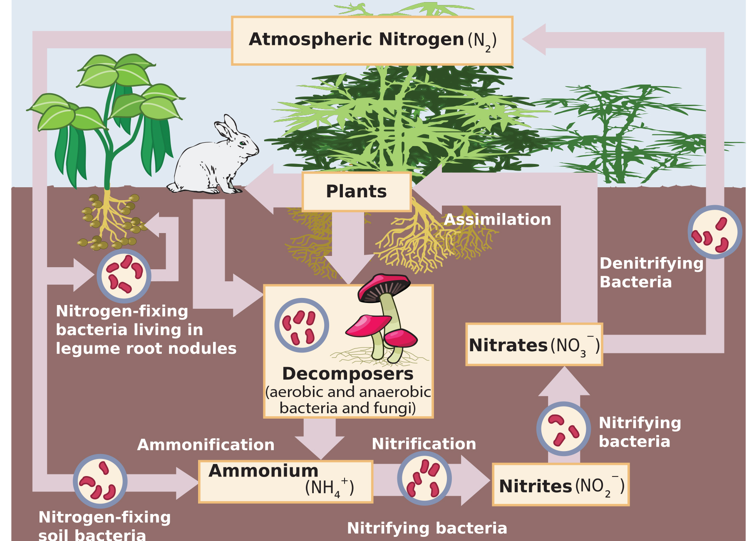
24.3 Figure 4
EPA on Wikimedia Commons. "Nitrogen cycle."
Notes:
Free-living bacteria or fungi break down animal and plant proteins from decaying organisms and nitrogenous waste products to release energy. As a result of decomposition, nitrogen is released as ammonium, and plants assimilate it in the form of nitrate.

Slide 8
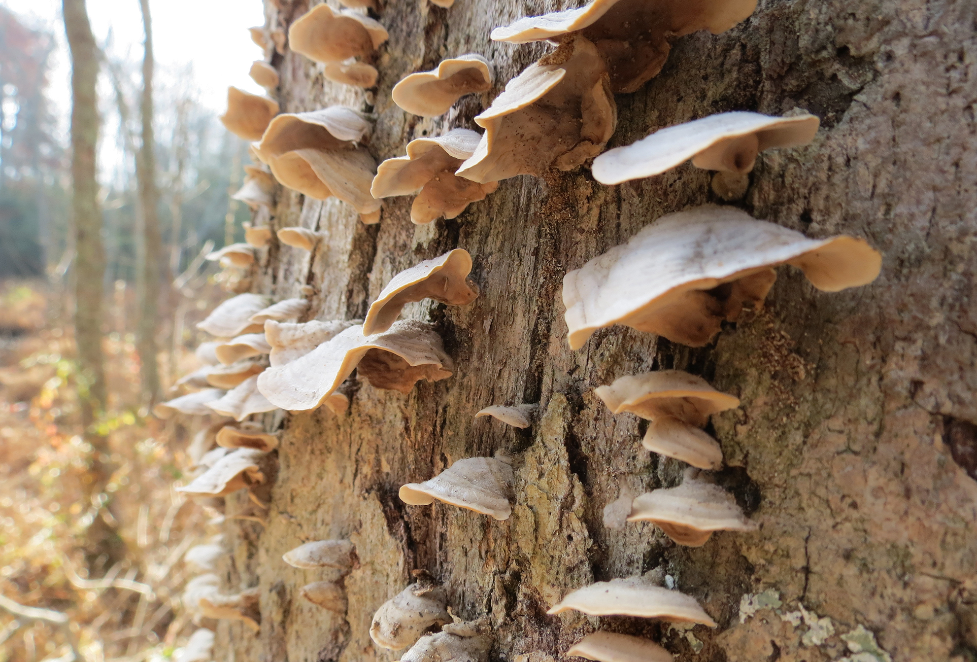
Decomposers and Recyclers₃
Help maintain sustainable environment
Replenish environment with nutrients
Interact directly with other organisms in beneficial or damaging ways
24.3 Figure 5: Shelf fungi, so called because they grow on trees in a stack, attack and digest the trunk or branches of a tree. While some shelf fungi are found only on dead trees, others can parasitize living trees and cause eventual death, making them serious tree pathogens.
vastateparkstaff on Wikimedia Commons. "Shelf fungi."

Slide 9
Mutualistic Relationships
Symbiosis: (plural, symbioses) close interaction between individuals of different species over an extended period of time that impacts the abundance and distribution of the associating populations
Does not describe type or quality of interaction
Mutualistic: When both members benefit
Have mutualistic associations with many types of organisms (e.g., cyanobacteria, algae, plants, animals)

Slide 10
Fungus/Plant Mutualism₁
Mycorrhizae: symbiotic relationship between fungal hyphae, which provide soil minerals to the plant, and plant roots, which provide carbohydrates to the fungus
90% of vascular plants have mycorrhizal partners
Fungal mycelia use network of hyphae and large surface area in contact with soil to channel water and minerals from soil to plant
Plant supplies products of photosynthesis (glucose and oxygen) to fungus

Slide 11
Fungus/Plant Mutualism₂
Ectomycorrhizae: a type of mycorrhizae in which fungi form a dense sheath around roots and penetrate root tissue but do not penetrate cells
Fungi envelope roots in sheath called a mantle
Create Hartig net
Hartig net: network of hyphae where the hyphae grow from the mantle into the root and envelope the outer layers of the root cells
Fungal partner can be Ascomycota, Basidiomycota, or Zygomycota phyla
Endomycorrhizae: a type of mycorrhizae in which fungi are embedded within root tissue and penetrate the cells (also, arbuscular mycorrhizae)
Grow inside root in branched structure (arbuscule), which penetrates root cells between cell wall and plasma membrane and is site of metabolic exchanges between fungus and host
Fungal partner all from Glomeromycota phyla

Slide 12
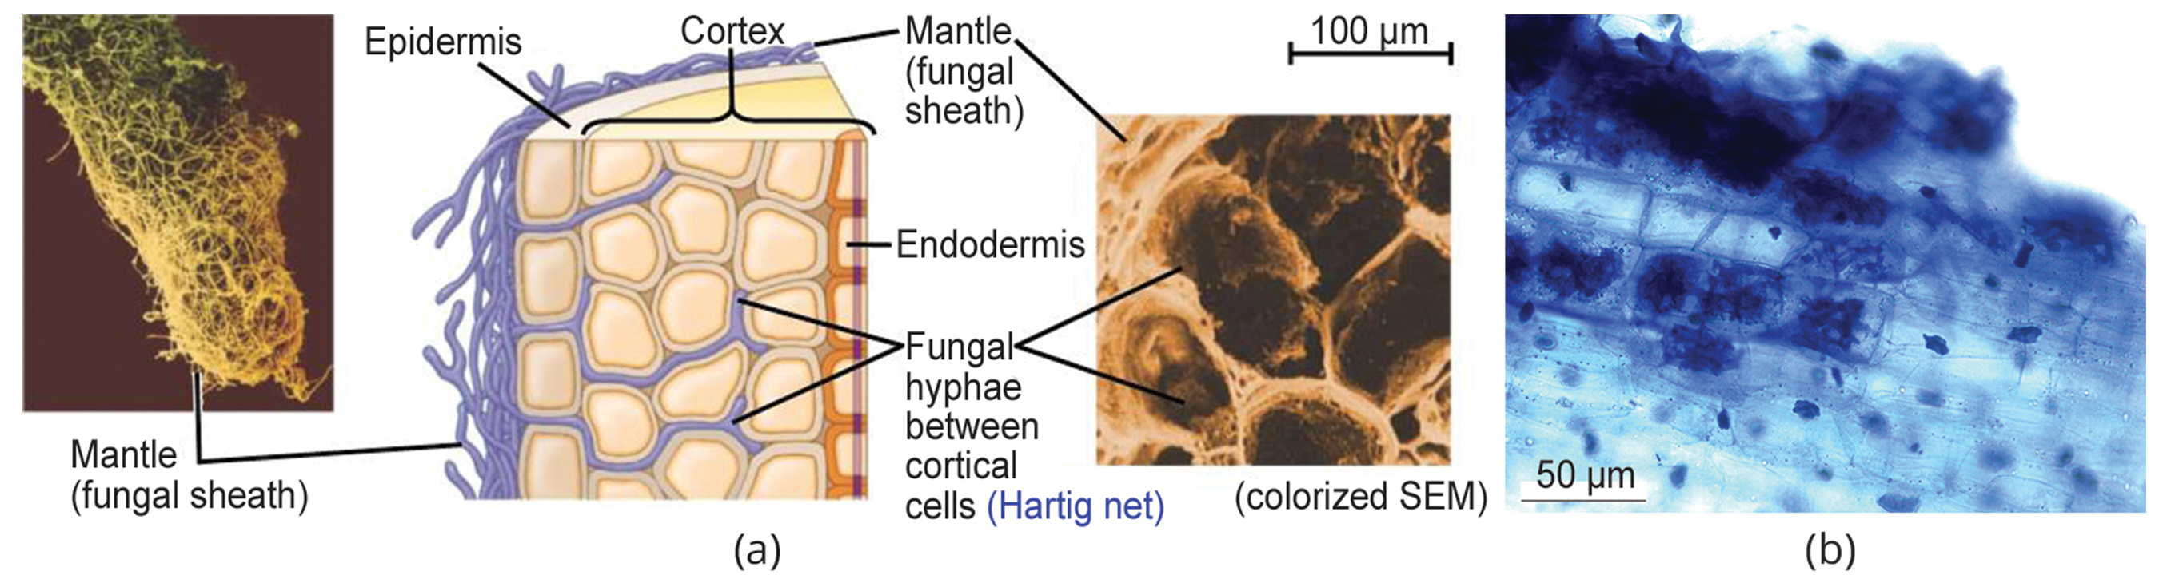
24.3 Figure 6
Atrebe10 on Wikimedia Commons. "Ectomycorrhizal morphology."
Rajarshi Rit on Wikimedia Commons. "Endomycorrhizae."
Notes:
Ectomycorrhizae and (b) arbuscular mycorrhizae, or endomycorrhizae, have different mechanisms for interacting with the roots of plants

Slide 13
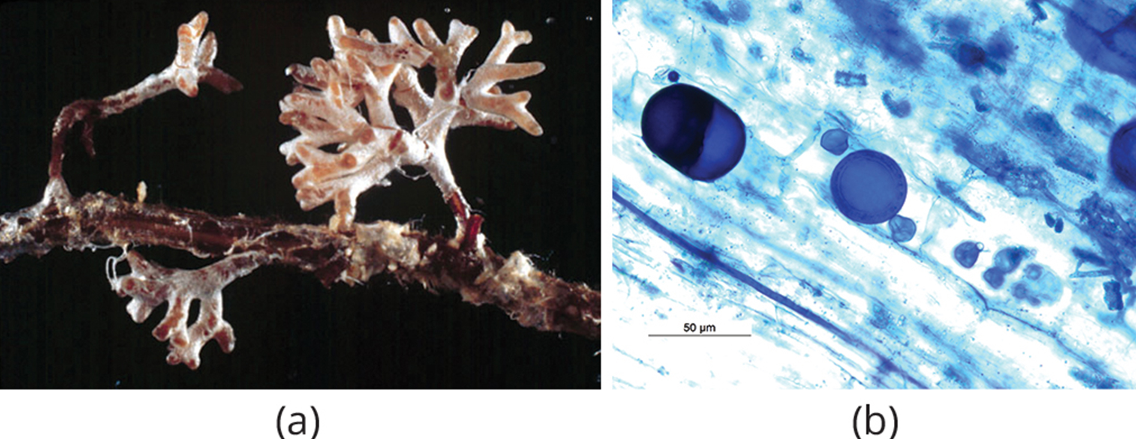
Fungus/Plant Mutualism₃
Orchids rely on mycorrhizal fungi
Are epiphytes (plants that grow on other plants without acting as parasites)
Seeds will not germinate without mycorrhizal partner (usually basidiomycete)
Fungal symbionts support growth by providing carbohydrates and minerals
Endophytes: fungi that live inside tissue without damaging the host plant
Release toxins to repel predators or to deal with stressful environments (e.g., infection by microorganisms, drought, heavy metals)
24.3 Figure 7: The (a) infection of Pinus radiata (Monterey pine) roots by the hyphae of Amanita muscaria (fly amanita) causes the pine tree to produce many small, branched rootlets. The Amanita hyphae cover these small roots with a white mantle. (b) Spores (the round bodies) are evident in this light micrograph of an arbuscular mycorrhiza by a fungus on the root of Macrotyloma uniflorum.
Randy Molina on Wikimedia Commons. "Pinus radiata infection."
Rajarshi Rit on Wikimedia Commons. "Macrotyloma uniflorum."

Slide 14
Group Activity₁
As a group, draw a scheme of the evolution of mycorrhizal symbioses from early plants to trees. Include geological eras, types of plants or algae, and evolutive traits of each stage.

Slide 15
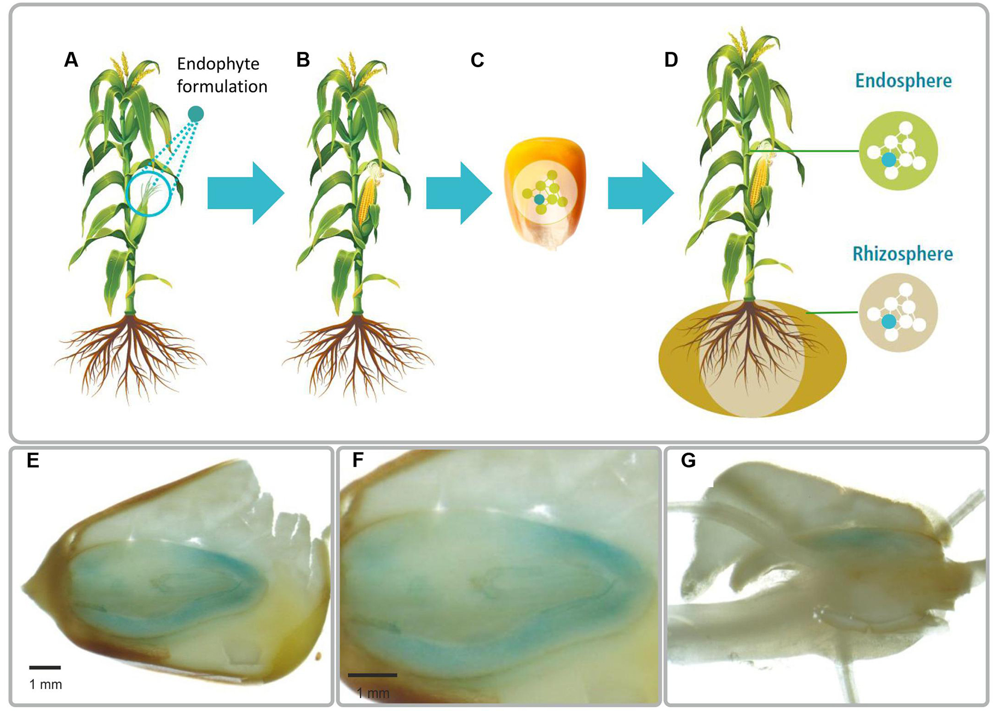
24.3 Figure 8
Birgit Mitter, Nikolaus Pfaffenbichler, Richard Flavell, Stéphane Compant, Livio Antonielli, Alexandra Petric, Teresa Berninger, Muhammad Naveed, Raheleh Sheibani-Tezerji, Geoffrey von Maltzahn and Angela Sessitsch on Wikimedia Commons. "Plant beneficial bacteria into plant seed."
Notes:
Figure 8: Some plants have fungi inside their tissue. Endophytes proliferate during germination and colonize the offspring generation. These light microscopy images show mature corn kernels colonized by Parabukholderia phytofirmans.

Slide 16
Evolution Connection₁
Coevolution of Land Plants and Mycorrhizae
Mycorrhizae: Coevolution between roots of vascular plants and fungi
Theory:
Fungi instrumental in evolution of root system in plants and contributed to success of angiosperms (flowering plants)
Bryophytes (mosses and liverworts) have underground rhizoids instead of root system and cannot survive in dry areas; have arbuscular mycorrhizae to aid in nutrient acquisition
True roots first appeared in ancestral vascular plants
Developed system of thin extension from roots that gave them greater surface area of contact with fungal partners than rhizoids of mosses and liverworts
Allowed plants to obtain more water and nutrients
Fungi preceded invasion of ancestral freshwater plants onto dry land
First association between fungi and photosynthetic organisms on land was mosslike plants and endophytes

Slide 17
Evolution Connection₂
Coevolution of Land Plants and Mycorrhizae
Benefits of endophyte and rhizoid interactions led to present-day mycorrhizae
90% of vascular plants have associations with fungi in rhizosphere
Fungi display characteristics of ancestral fungi:
Produce simple spores
Show little diversification
No sexual reproductive cycle
Need mycorrhizal association
Allowed plants into new habitats and increased uptake of nutrients, which gave them advantage over plants without symbiotic relationships

Slide 18
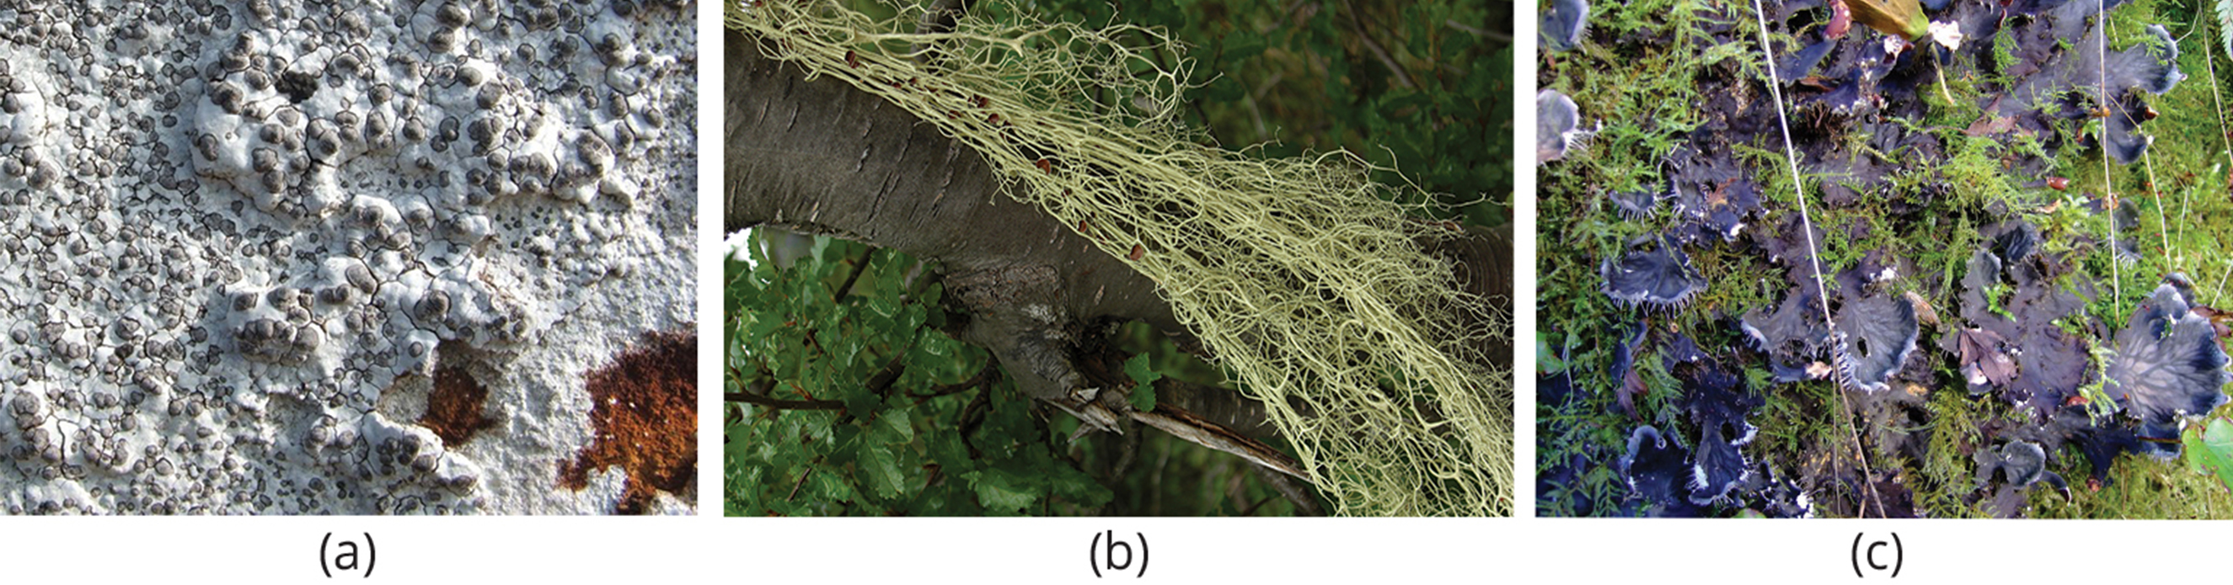
Lichens₁
Lichen: close association of a fungus with a photosynthetic alga or bacterium that benefits both partners
Display range of color and textures and survive in unusual and hostile habitats
Cover rocks, gravestones, tree bark, and ground in tundra where plant roots cannot penetrate
Can survive extended periods of drought and become active once water is available
24.3 Figure 9: Lichens have many forms. They may be (a) crust-like, (b) hairlike, or (c) leaflike.
Lairich Rig on Wikimedia Commons. "Crust-like lichen."
Jason Hollinger on Wikimedia Commons. "Hairlike lichen."
ceridwen on Wikimedia Commons. "Dog lichen."

Slide 19
Lichens₂
Not a single organism but example of mutualism in which fungus (usually Ascomycota or Basidiomycota) lives in physical and physiological relationship with photosynthetic organism (eukaryotic alga or prokaryotic cyanobacterium)
Neither can survive without other
Thallus: Body of lichen formed of hyphae wrapped around photosynthetic partner
Photosynthetic organism provides fixed carbon and energy in carbohydrates
Some cyanobacteria also fix nitrogen
Fungus supplies minerals and protection from dryness and excessive light by encasing algae in mycelium; also attaches lichen to substrate

Slide 20
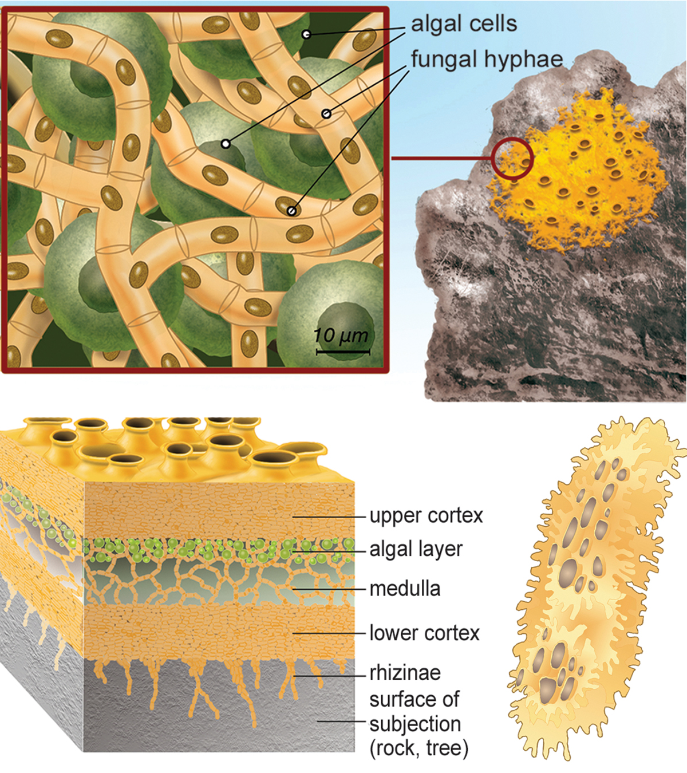
24.3 Figure 10
Notes:
Figure 10: This cross section of a lichen thallus shows the upper cortex of fungal hyphae, which provides protection; the algal layer where photosynthesis occurs; the medulla of fungal hyphae; and the lower cortex, which also provides protection and may have rhizines to anchor the thallus to the substrate.

Slide 21
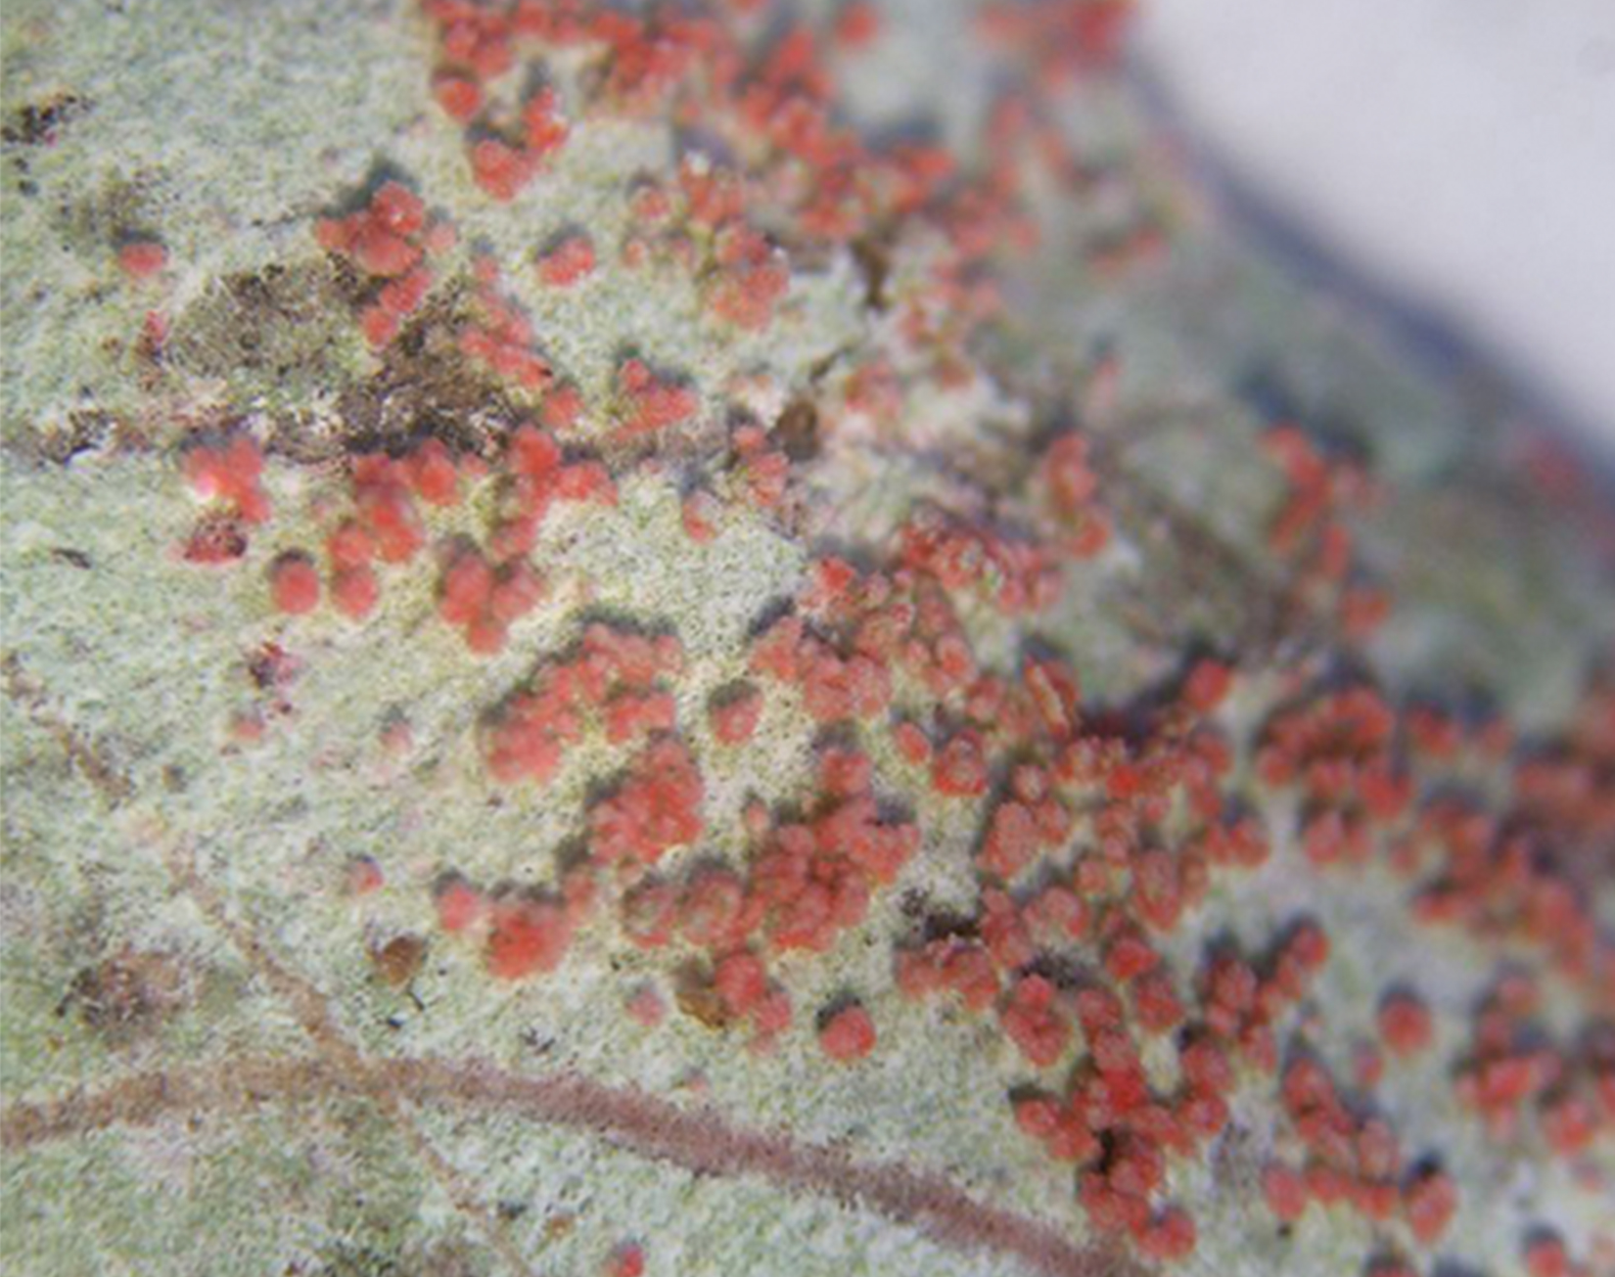
Lichens₃
Thallus grows slowly (a few millimeters per year)
Fungus and alga participate in formation of soredia
Soredia: clusters of algal cells and mycelia that allow lichens to propagate
Dispersed by wind and water to form new lichens
Extremely sensitive to air pollution (e.g., abnormal levels of nitrogenous and sulfurous compounds), used to measure air quality by abundance and health of lichens
Fill many ecological roles:
Food for caribou and reindeer
Provide cover for invertebrates
As dyes for wool
Pigments in litmus paper
24.3 Figure 11: Cottony red soredia from Cryptothecia rubrocincta
Jason Hollinger on Wikimedia Commons. "Christmas lichen."

Slide 22
Fungus/Animal Mutualism₁
Have evolved mutualisms with insects in Arthropoda (joint-legged invertebrates with chitinous exoskeleton)
Give arthropods protection from predators and pathogens
Receive nutrients and a way to disseminate spores into new environments
Example: Basidiomycota and scale insects
Mycelium covers and protects insect colonies
Scale insects help with flow of nutrients from parasitized plant to fungus

Slide 23
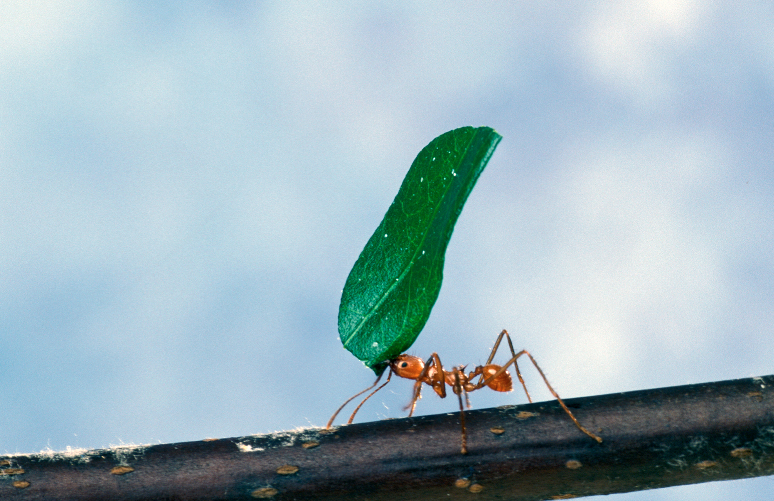
Fungus/Animal Mutualism₂
Example: Leaf-cutter ants farming fungi
Ants cut disks of leaves from plants and pile them up in subterranean gardens
Fungi cultivated in disk gardens, digesting cellulose that ants cannot break down
Smaller sugar molecules then produced and consumed by fungi, which are then consumed by ants
Ants prey on competing fungi
24.3 Figure 12: A leaf-cutter ant transports a leaf that will feed a farmed fungus.
Scott Bauer on Wikimedia Commons. "Leaf-cutter ant."

Slide 24
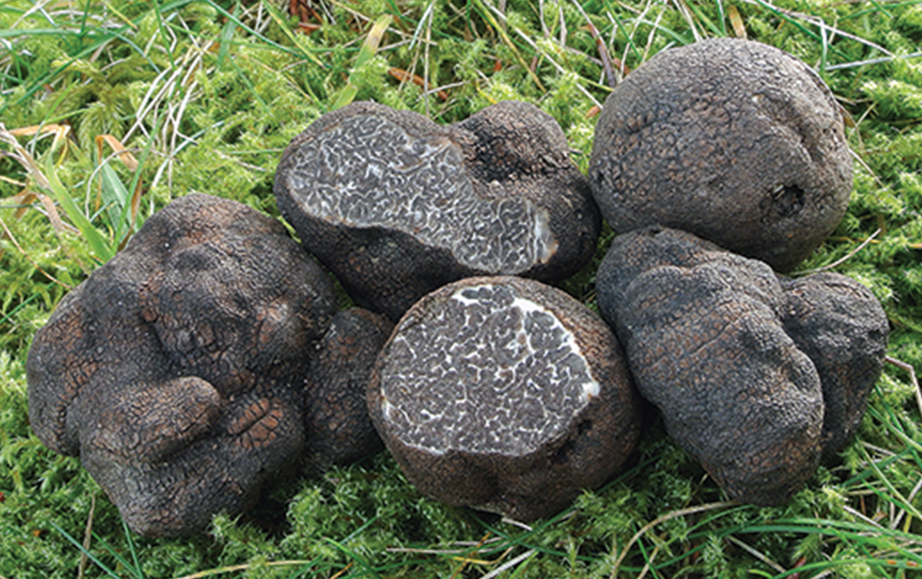
Fungivores
Animal dispersal important because animals carry fungal spores considerable distances
Not completely degraded in animal gastrointestinal tract and able to germinate when passed in feces
Some require passage through digestive system of herbivores to complete life cycle
Example: Black truffle (fruiting body of underground ascomycete)
Almost all truffles are ectomycorrhizal with close association to trees
Animals eat truffles and disperse spores
Truffle hunters are female pigs because fungus releases volatile compound closely related to male pig pheromone
24.3 Figure 13: Fruit bodies of the smooth black truffle Tuber macrosporum
Nicolò Oppicelli on Wikimedia Commons. "Black truffles."

Slide 25
Fungi Parasites and Pathogens
Parasitism: symbiotic relationship in which one member of the association benefits at the expense of the other
Parasites and pathogens harm host
Pathogens cause disease or damage to host tissues or physiology
Parasites cause damage and death from competition for nutrients or other resources
Commensalism: symbiotic relationship in which one member benefits while the other member is not affected

Slide 26
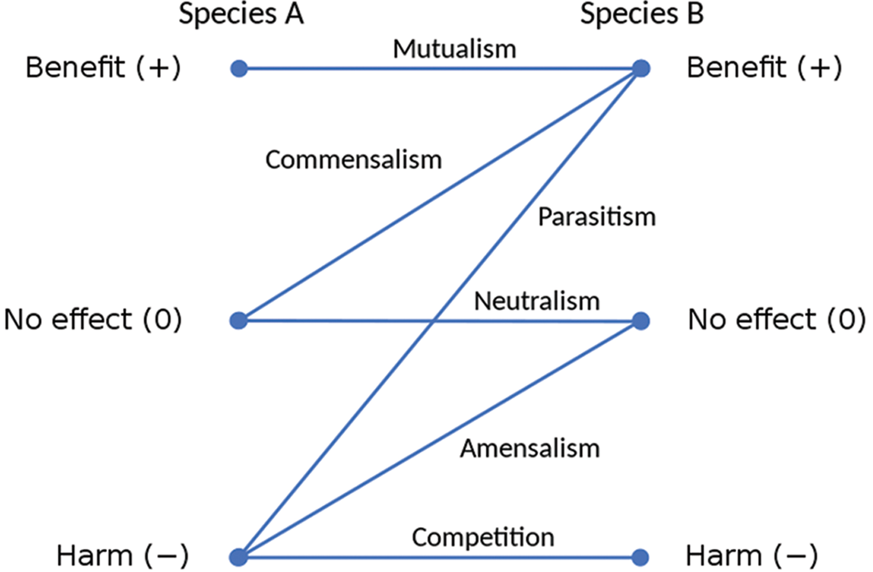
24.3 Figure 14
Ian Alexander on Wikimedia Commons. "Symbiotic relationships."
Notes:
Figure 14: Scheme of the different types of symbioses

Slide 27
Group Activity₂
As a group, find examples of mutualism, commensalism, and parasitism in fungi.

Slide 28
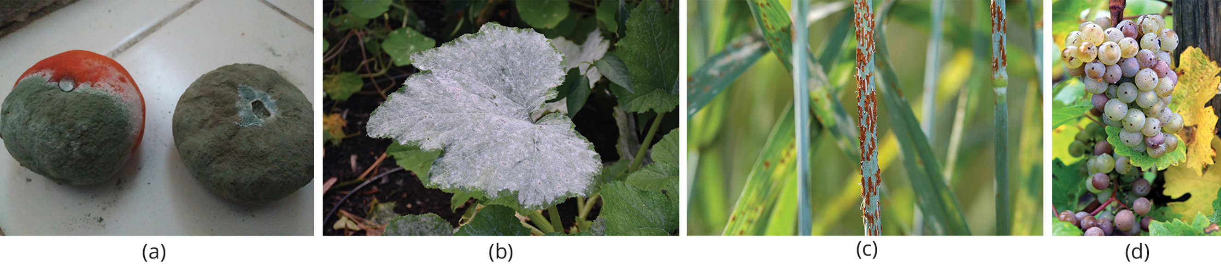
Plant Parasites and Pathogens₁
As plant pathogen:
Cause tissue decay and eventual death to host
Spoil crops by producing potent toxins to damage and kill host
Responsible for food spoilage and rotting of stored crops
24.3 Figure 15: Some fungal pathogens include (a) green mold on tangerines, (b) powdery mildew on a squash leaf, (c) stem rust on a wheat plant, and (d) grey rot on a grape cluster. In wet conditions, Botrytis cinerea, the fungus that causes grey rot, can destroy a grape crop. However, controlled infection of grapes by Botrytis results in noble rot, a condition that produces strong and much-prized dessert wines.
Satirdan kahraman on Wikimedia Commons. "Mold tangerine."
Dmitry Brant on Wikimedia Commons. "Powdery mildew on squash leaf."
Yue Jin on Wikimedia Commons. "Stem rust."
Rob & Lisa Meehan on Wikimedia Commons. "Grey rot on grapes."

Slide 29
Plant Parasites and Pathogens₂
As plant pathogen:
Example: Claviceps purpurea
Causes ergot (disease of cereal crops)
Reduces yield of cereals
Source of ergot's alkaloid toxin disease (ergotism)
Symptoms: Convulsions, hallucinations, gangrene, loss of milk in cattle
Active ingredient (lysergic acid), which is precursor to LSD
Example: Smuts, rusts, and powdery mildew
Aflatoxins: toxic and carcinogenic compounds released by fungi of the genus Aspergillus
Nuts and grains tainted by aflatoxins, causing recalls
Ruins producers and causes food shortages in developing countries

Slide 30
Animal and Human Parasites and Pathogens₁
Mycoses: (singular, mycosis) infectious diseases caused by fungi
Results from infection and direct damage due to growth and infiltration of fungus
Attack animals directly by colonizing and destroying tissues
Mycotoxicosis: poisoning by a fungal toxin (mycotoxins) released in food
Mycetismus: ingestion of toxins in poisonous mushrooms
Hypersensitivity to molds and spores can cause allergic reactions
Treatment:
Very difficult to treat because fungi are eukaryotes
Antibiotics only target prokaryotic cells
Compounds that kill fungi can also kill host

Slide 31
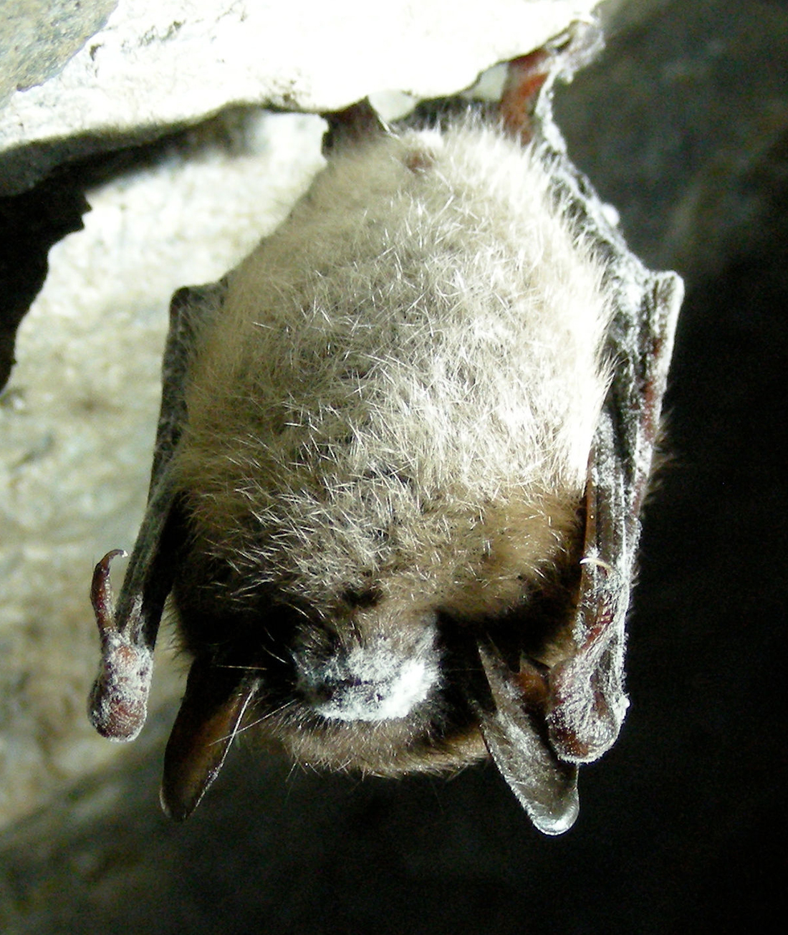
Animal and Human Parasites and Pathogens₂
Superficial mycoses:
On animal's skin (cutaneous mycoses)
Examples:
Decline in frog population caused (in part) by chytrid fungus Batrachochytrium dendrobatidis
Infects skin in frogs and interferes with cutaneous gaseous exchange (essential to amphibian survival)
White-nose syndrome
Appears as white ring around mouth of bat
Caused by cold-loving fungus Pseudogymnoascus destructans (disseminates deadly spores in caves where bats hibernate)
24.3 Figure 16
United States Fish and Wildlife Service on Wikimedia Commons. "White-nose syndrome."

Slide 32
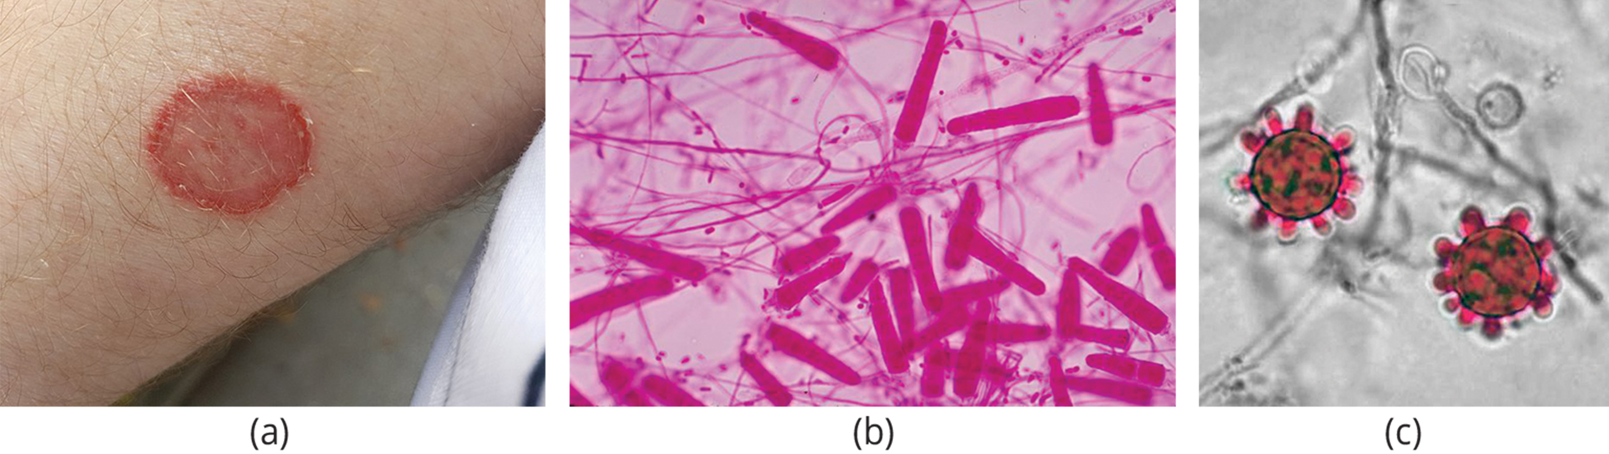
Animal and Human Parasites and Pathogens₃
Superficial mycoses of epidermis, hair, and nails rarely spread to underlying tissue
Often misnamed "dermatophytes"
Also called ringworms (leave red ring on skin)
Secrete extracellular enzymes that break down keratin (protein in hair, skin, and nails), causing conditions like athlete's foot and jock itch
Treatment:
Usually with over-the-counter topical creams and powders
More persistent infections may need prescription oral medications
Antifungals target unique features of fungal cells (like cell wall)
24.3 Figure 17: (a) Ringworm presents as a red ring on skin. (b) Trichophyton mariatii, shown in this bright field light micrograph, causes superficial mycoses on the scalp and skin. (c) Histoplasma capsulatum is an ascomycete that infects airways and causes symptoms similar to influenza.
Asurnipal on Wikimedia Commons. "Ringworm infection."
CDC on Wikimedia Commons. "Trichophyton mariatii."
AJC1 on Wikimedia Commons. "Histoplasma capsulatum."

Slide 33
Animal and Human Parasites and Pathogens₄
Systemic mycoses:
Spread to internal organs through respiratory system
Example:
Coccidioidomycosis (valley fever)
Resides in dust, and once inhaled, spores develop in lungs and cause symptoms like tuberculosis
Histoplasmosis
Caused by Histoplasma capsulatum
Grows as yeast in human host, causing pulmonary infections and swelling of membranes of brain and spinal cord
Treatment requires antifungal medication with serious side effects

Slide 34
Animal and Human Parasites and Pathogens₅
Opportunistic mycoses:
Caused by fungi with low inherent virulence (do not generally cause disease in humans)
Can develop into infection in people with compromised immune systems (such as patients in late stages of AIDS)
Example: Yeast Candida sp.
Naturally occurring on and in humans
Can grow unchecked and infect vagina or mouth (oral thrush) if pH of surrounding environment, person's immune defenses, or normal population of bacteria are altered
A type of systemic mycoses (include any mycoses caused by pathogenic fungi or opportunistic fungi)
Opportunistic mycoses only caused by opportunistic fungi

Slide 35
Table 1: Systemic and Opportunistic Mycoses
 | Systemic Mycoses | Opportunistic Mycoses
Definition | deep infections caused by opportunistic and primary fungal pathogens | type of systemic mycoses caused by normal flora that become opportunistic in immunocompromised patients
Agent | opportunistic or primary fungal pathogens | opportunistic fungal pathogens
Host | healthy or immunocompromised host | immunocompromised host

Slide 36
Animal and Human Parasites and Pathogens₆
Mycetismus:
Occur when poisonous mushrooms are eaten
Causes human fatalities during mushroom-picking season
Edible fruiting bodies resemble highly poisonous ones

Slide 37
Group Activity₃
Dutch Elm Disease
Dutch elm disease is a fungal infestation that affects many species of elm (Ulmus) in North America. The fungus infects the vascular system of the tree, which blocks water flow within the plant and mimics drought stress. Accidently introduced to the United States in the early 1930s, it decimated American elm shade trees across the continent. It is caused by the fungus Ophiostoma ulmi. The elm bark beetle acts as a vector and transmits the disease from tree to tree. Many European and Asiatic elms are less susceptible to the disease than American elms. Working with your group members, research why European and Asiatic elms are less affected by Dutch Elm disease than are American elm trees. What mechanisms do they have to protect against infection? Is there any evidence that some American elms have similar mechanisms? Prepare a short report describing your findings.

Slide 38
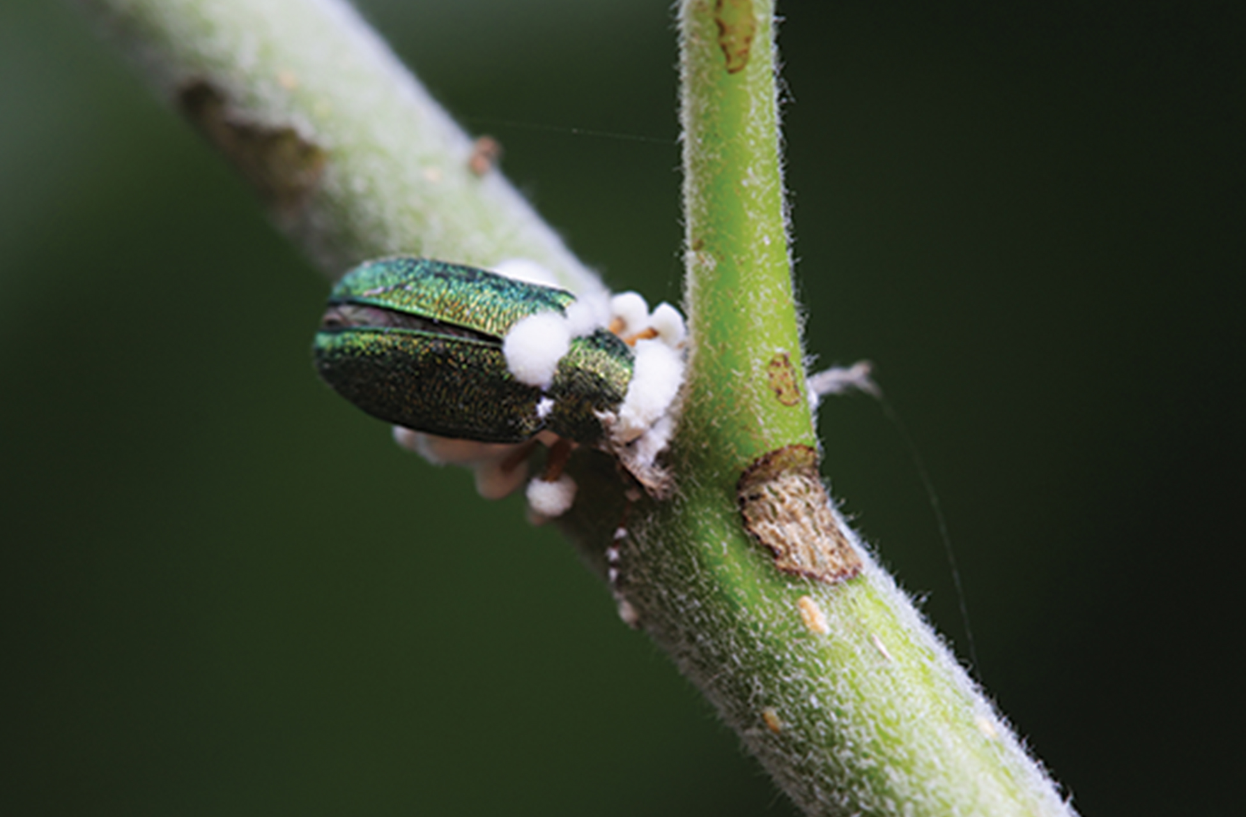
Importance of Fungi in Human Life₁
Influence well-being of human populations as part of nutrient cycle in ecosystems
As animal pathogens:
Help control population of damaging pests
Specific to insects they attack and do not infect other animals or plants
Potential microbial insecticides
Example: Beauveria bassiana being tested as possible biological control agent for emerald ash borer (beetle that feeds on ash trees)
24.3 Figure 18

Slide 39
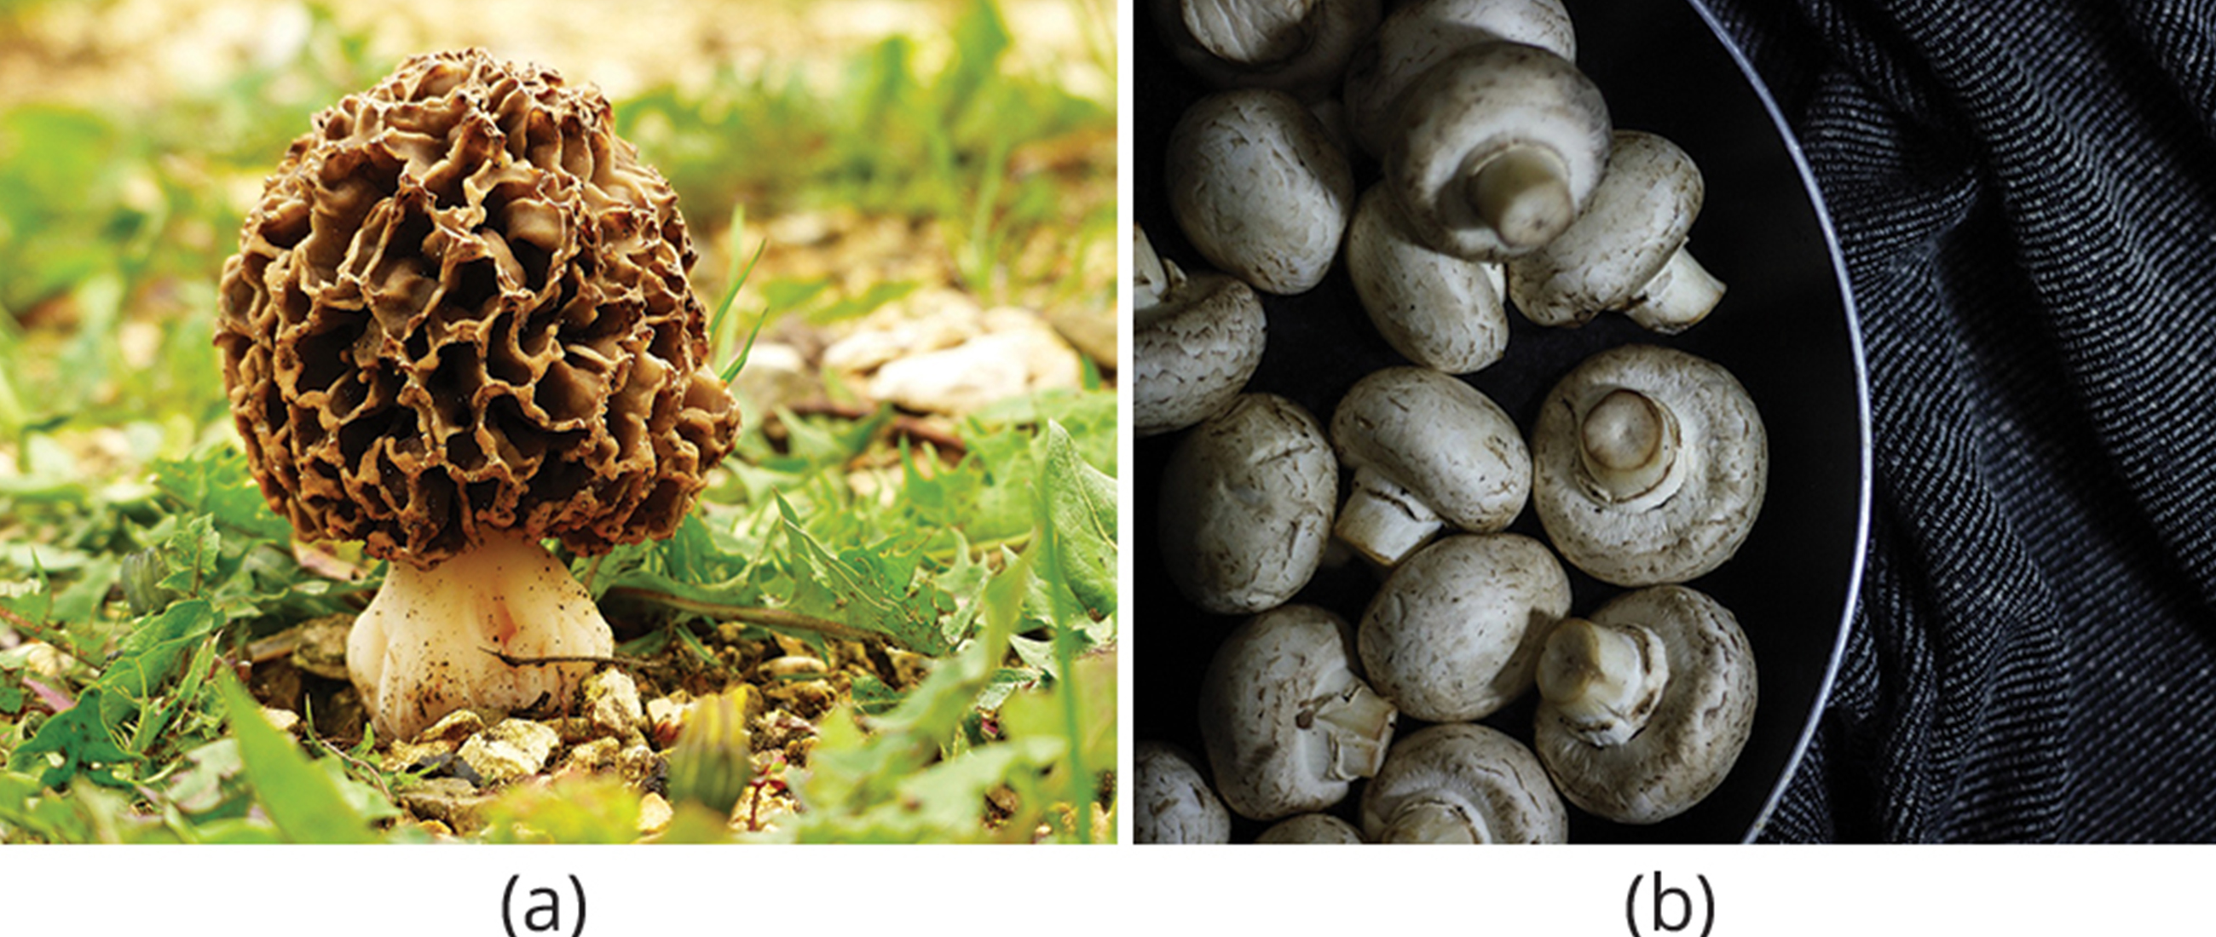
Importance of Fungi in Human Life₂
Mycorrhizal relationship essential for plant productivity of farmland
Without it, 80–90% of trees and grasses die
Prominent in human diet
Examples: Morels, shiitake mushrooms, chanterelles, truffles
Agaricus camperstris (meadow mushroom) used in many dishes
Penicillium used in cheese ripening
24.3 Figure 19: (a) The morel mushroom is an ascomycete greatly appreciated for its delicate taste. (b) Agaricus bisporus (button mushrooms) are very commonly eaten.
JaStra on Pixabay. "Morel mushroom."
gentinabdanurendra on Pixabay. "Button mushrooms."

Slide 40
Importance of Fungi in Human Life₃
Used in fermentation
Yeasts used to ferment sugars into CO₂ and ethyl alcohol under anaerobic conditions
Saccharomyces cerevisiae (brewer's yeast) one of first examples of biotechnology patenting
Commercial importance of secondary metabolites
Naturally occurring antibiotics produced by fungi kill or inhibit bacterial growth, limiting competition in environment
Penicillin and cephalosporins isolated from fungi
Also include cyclosporine (reduces risk of rejection after organ transplant), precursors of steroid hormones, and ergot alkaloids to stop bleeding
Psilocybin: Compound found in Psilocybe semilanceata and Gymnopilus junonius used for hallucinogenic properties

Slide 41
Importance of Fungi in Human Life₄
Model organism for research (as eukaryotic organisms)
Examples:
Neurospora crassa (red bread mold) led to advances in modern genetics
S. cerevisiae was starting point in discovering analogous human genes
Yeast cell used for recombinant in DNA technology experiments
Produces and modifies proteins in similar manner to human cells
Grow easily in culture
Short generation time
Amendable to genetic modification

Slide 42
Summary
Ubiquitous decomposers found in cool, dark, moist environments with decaying organic matter
Play vital roles in nutrient cycling
Form mutualistic relationships like mycorrhizal associations with plant roots, ants farming fungi, and symbiotic lichens with alga or cyanobacterium
Parasites that can devastate crops, spoil food, and cause infections (mycoses) in plants and animals, including humans
Superficial mycoses affect skin, systemic mycoses spread through body
Difficult to cure because fungi are eukaryotes
Important in human life as decomposers maintaining ecosystems, mycorrhizal fungi required for plant growth, food sources (mushrooms, fermentation), and sources of medicines like antibiotics and anticoagulants (secondary metabolites of fungi)
Model organisms for studying eukaryotic genetics and metabolism

Slide 43


End of Hawkes Learning PowerPoint

