Slide 1
Lesson 25.1
Ancestry and Characteristics of Land Plants

Slide 2
Objectives
Describe the adaptations that allowed plants to colonize the land.
Describe the timeline of plant evolution and the impact of land plants on other living things.
Describe the traits shared by green algae and land plants.
Discuss the challenges to plant life on land.
Explain why charophytes are considered the closest algal relative to land plants.

Slide 3
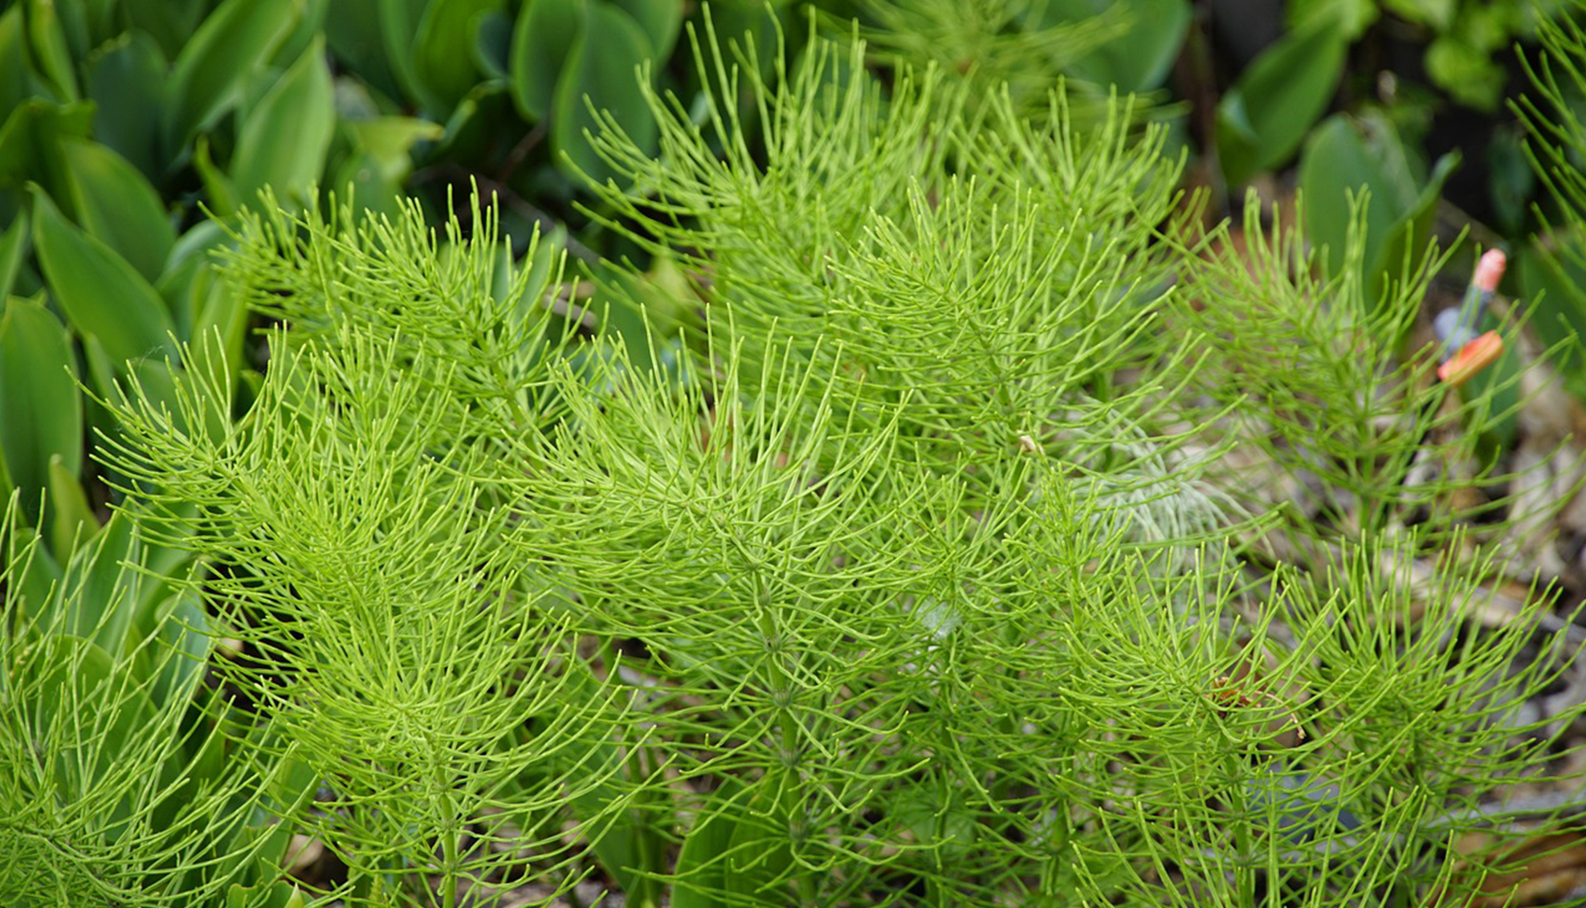
Seedless Plants₁
Include mosses and horsetails
Represent only small fraction of plants in the environment
Dominated landscape 300 million years ago, grew in large swampy forests in Carboniferous Period
Decomposition created large deposits of coal
25.1 Figure 1: Seedless plants, like these horsetails (Equisetum sp.), thrive in moist, shaded environments under a tree canopy where humidity is predominant.
beauty_of_nature on Pixabay. "Horsetails."

Slide 4
Seedless Plants₂
Evolutionary theory: All plants (including some green algae and land plants) are monophyletic
Monophyletic: descendants of a single common ancestor
Had to evolve strategies for moving from water to land:
Avoid drying out
Disperse reproductive cells in air
Structural support
Capturing and filtering sunlight
Still require moist environments for reproduction

Slide 5
Streptophytes₁
All photosynthetic eukaryotes used to be classified as kingdom Plantae
Brown and golden algae reclassified to protist supergroup Chromalveolata (lack structural and biochemical traits of plants)
True plants (along with red and green algae) in eukaryote supergroup Archaeplastida
Contain carotenoids and chlorophyll a and b
Store carbohydrates as starch
Cells contain chloroplasts and cell walls contain cellulose

Slide 6
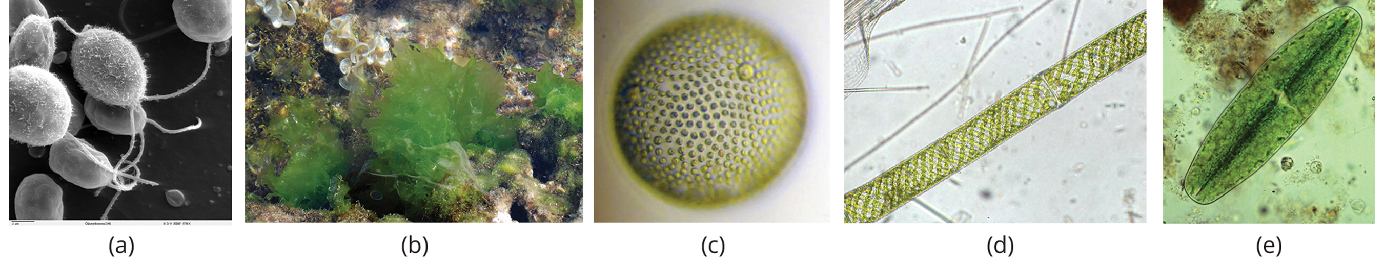
Streptophytes₂
Green algae:
Divided into chlorophytes and charophytes
Chlorophyte: comprises most of the green algae
Include genera Chlorella, Chlamydomonas, Ulva, and Volvox
Charophyte: other term for green algae; considered the closest relative of land plants
Include desmids and genera Spirogyra, Coleochaete, and Chara
25.1 Figure 2: Chlorophyta include (a) Chlamydomonas, (b) Ulva, and (c) Volvox. Charophyta include (d) Spirogyra and (e) desmids. Desmids and Chlamydomonas are single-celled organisms, Spirogyra forms chains of cells, Volvox forms spherical colonies, and Ulva forms multicellular structures resembling leaves although the cells are not differentiated as they are in higher plants.
Dartmouth Electron Microscope Facility on Wikimedia Commons. "Chlamydomonas."
Tigerente on Wikimedia Commons. "Ulva lactuca."
craigpemberton on Wikimedia Commons. "Volvox sp."
Keisotyo on Wikimedia Commons. "Spirogyra sp."
derekkeats on Wikimedia Commons. "Clostarium."

Slide 7
Streptophytes₃
Green algae:
Some are single celled (e.g., Chlamydomonas and desmids); adds to ambiguity of green algae classification because plants are multicellular
Some form colonies (e.g., Volvox)
Some are multicellular (e.g., Ulva)
Some have long filament of colonial cells (i.e., Spirogyra)
Most live in fresh water, brackish water, seawater, or snow patches
Few can survive on soil if moist

Slide 8
Streptophytes₄
Land plants in sister group of charophytes
Cells in charophytes and land plants divide along phragmoplasts
Phragmoplast: plant cell specific structure in which microtubules parallel to the spindle act as a scaffold for cell plate assembly and cell wall separation for the formation of the daughter cells
In charophytes, cell plate is organized by phycoplast
Phycoplast: plant cell specific structure in which microtubules are perpendicular to the spindle
Only charophytes and land plants have plasmodesmata
Plasmodesma: (plural, plasmodesmata) channel that passes between adjacent plant cells' cell walls, connects their cytoplasm, and allows transporting of materials from cell to cell
In chlorophytes, intercellular connections not present in mature multicellular forms
Charophytes and land plants show apical growth (growth from tips of plant rather than throughout plant body)
Charophytes and land plants now part of new monophyletic group called Streptophyta

Slide 9
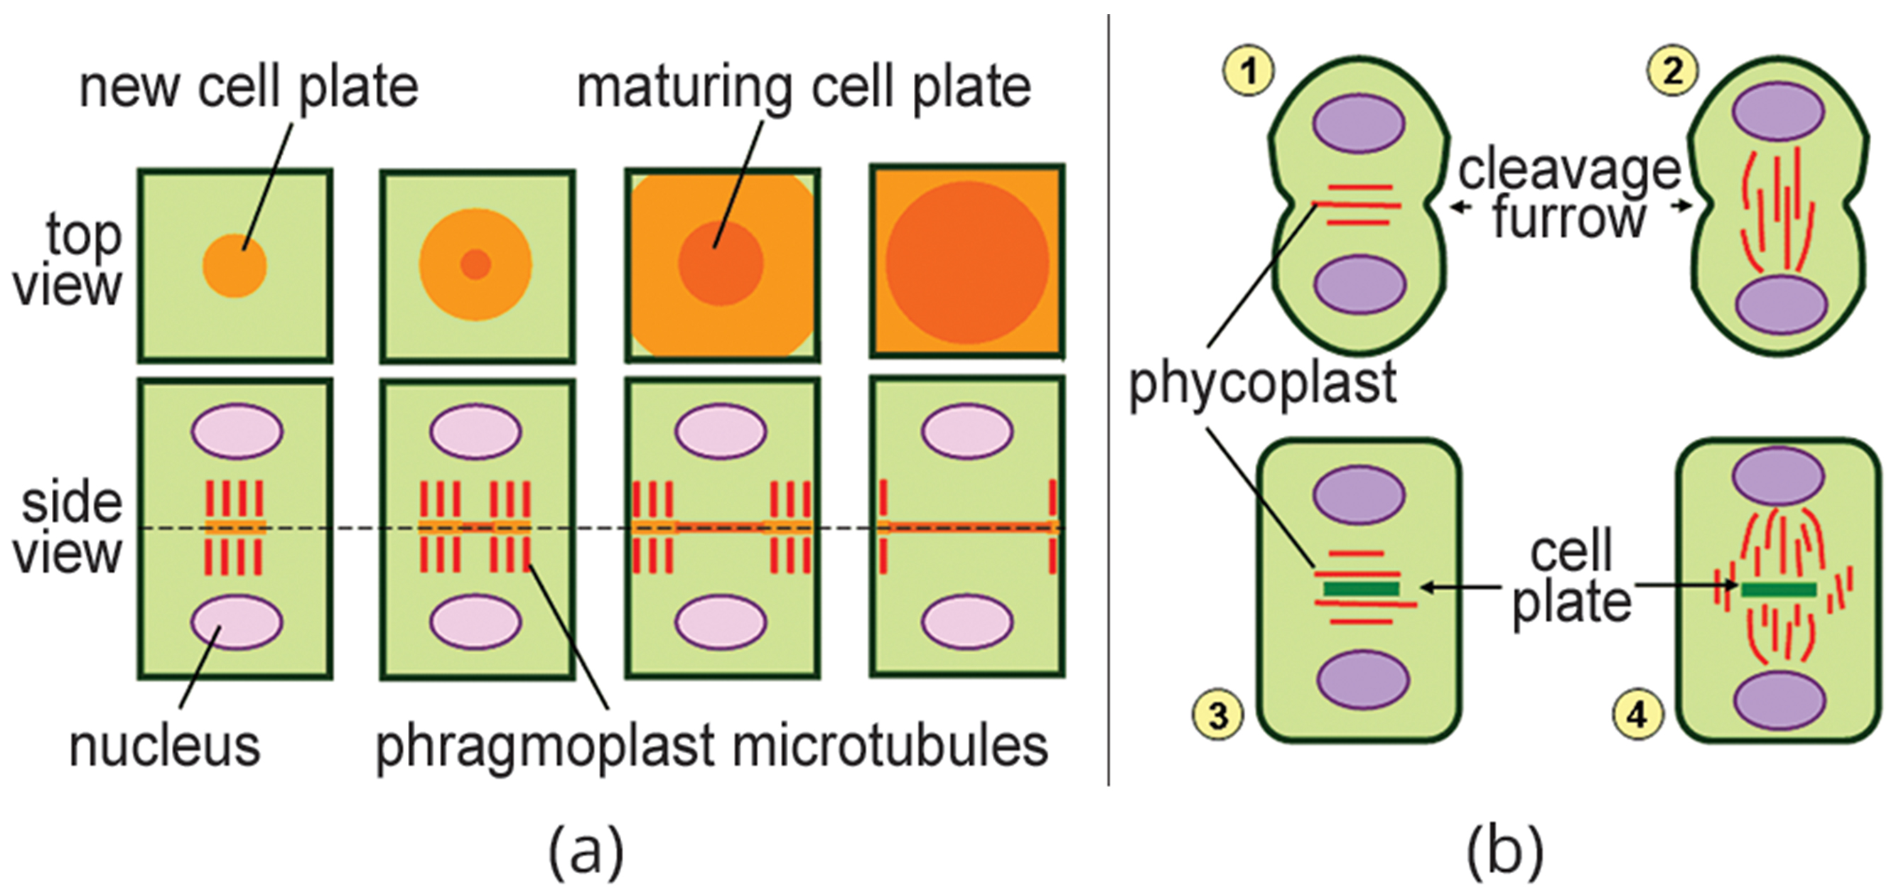
25.1 Figure 3
Tameeria on Wikimedia Commons. "Phragmoplast."
Tameeria on Wikimedia Commons. "Phycoplast."
Notes:
Figure 3: (a) Charophytes divide along phragmoplast and (b) chlorophytes divide, forming a phycoplast.

Slide 10
Reproduction of Green Algae
Reproduce both asexually (fragmentation or dispersal of spores) or sexually (producing gametes that fuse during fertilization)
Single-celled organisms (e.g., Chlamydomonas): No mitosis after fertilization
Multicellular Ulva: Sporophyte grows by mitosis after fertilization (alternation of generations)
Sporophyte: multicellular diploid life-cycle stage that produces haploid spores by meiosis
Both Chlamydomonas and Ulva: Produce flagellated gametes

Slide 11
Charophytes₁
Closest living relative of land plants
Includes orders like Charales, Zygnematales, Coleochaetales
Charales:
Traced back 420 million years
Live in range of freshwater habitats
Vary in size from few millimeters to a meter in length

Slide 12
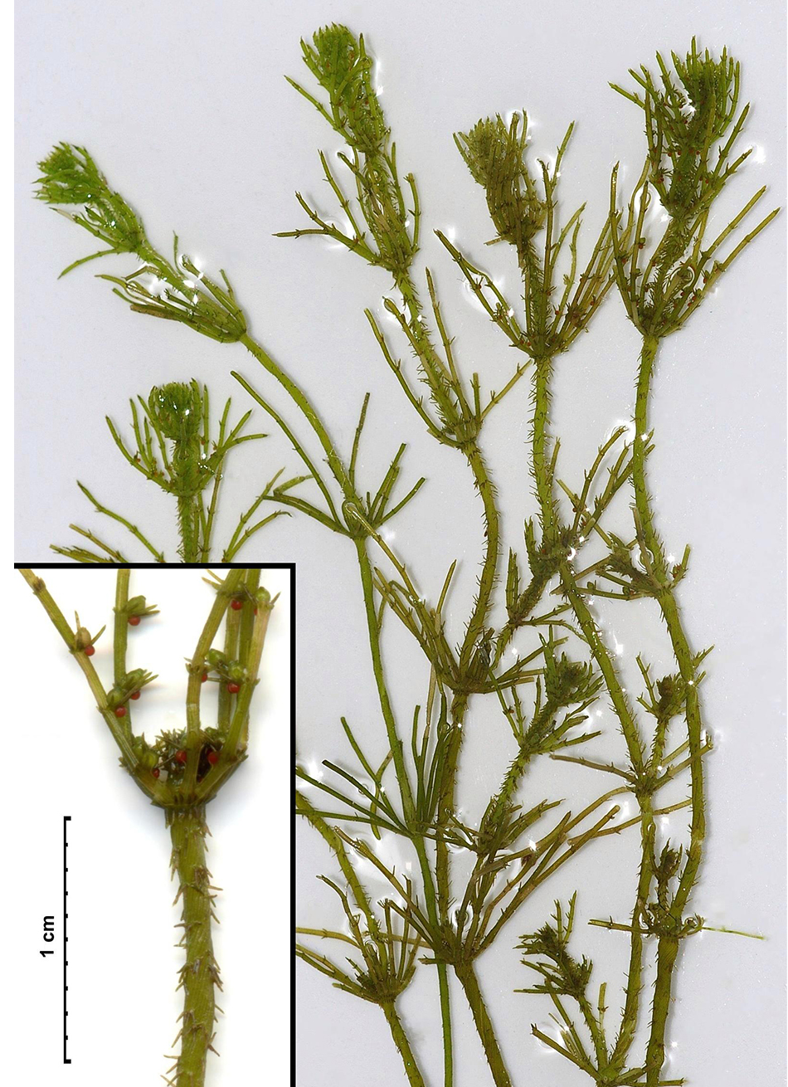
Charophytes₂
Charales:
Representative genus: Chara
Called muskgrass or skunkweed because of foul smell
Large cells form thallus; branches rising from nodes are made of smaller cells
Male and female reproductive structures found on nodes; sperm have flagella
Looks like some land plants, but stem has no supportive tissue
25.1 Figure 4: The representative alga, Chara, is a noxious weed in Florida, where it clogs waterways.
Christian Fischer on Wikimedia Commons. "Chara hispida."

Slide 13
Charophytes₃
Charales:
Produce compounds lignin and sporopollenin and form plasmodesmata that connect cytoplasm of adjacent cells
Life cycle haplontic, but egg forms in protected chamber on haploid parent plant
Haplontic: haploid stage is the dominant stage

Slide 14
Charophytes₄
Coleochaetes:
Branches or disc-like multicellular forms
Reproduce sexually and asexually
Life cycle is haplontic
Zygnematales:
Include genus Spirogyra and desmids
More closely related to embryophytes than Charales or Coleochaetales
Embryophyte: other name for land plant; embryo is protected and nourished by the sporophyte

Slide 15
Early Plant Life
Kingdom Plantae includes 374,000 species (260,000 of those seed plants)
Includes mosses, ferns, conifers, flowering plants
Land plants arose within Archaeplastida, which includes red algae (Rhodophyta) and two groups of green algae (Chlorophyta and Charaphyta)
Only green algae share common characteristics with land plants (e.g., using chlorophyll a and b plus carotene in same proportion as plants)

Slide 16
Group Activity
Based on what you know about green algae, do you think green algae should be excluded entirely from the plant kingdom? Discuss your thoughts as a group.

Slide 17
Evolution Connection₁
Algae and Evolutionary Paths to Photosynthesis
Disagreement on how algae should be classified:
As plants
Only green algae in kingdom Plantae
Only charophytes among plants
Related to evolutionary paths to photosynthesis taken by different types of algae
All photosynthetic and contain chloroplasts but didn't become photosynthetic the same way
Archaeplastida:
Became photosynthetic by forming endosymbiotic relationship with green, photosynthetic bacterium 1.65 billion years ago
Evolved into red and green algae then mosses, ferns, gymnosperms, and angiosperms
Monophyletic

Slide 18
Evolution Connection₂
Algae and Evolutionary Paths to Photosynthesis
Outside Archaeplastida:
Includes brown and golden algae of stramenopiles
Became photosynthetic by secondary, or tertiary, endosymbiotic events (engulfed cells that already contained endosymbiotic cyanobacterium)
Parallel to Archaeplastida in terms of autotrophy (ability to produce organic compounds like sugar) but did not expand to same extent or colonize the land
Scientists consider only charophytes as plants
Common ancestor of charophytes and land plants excludes other members of Archaeplastida
Charophytes share other features with land plants

Slide 19
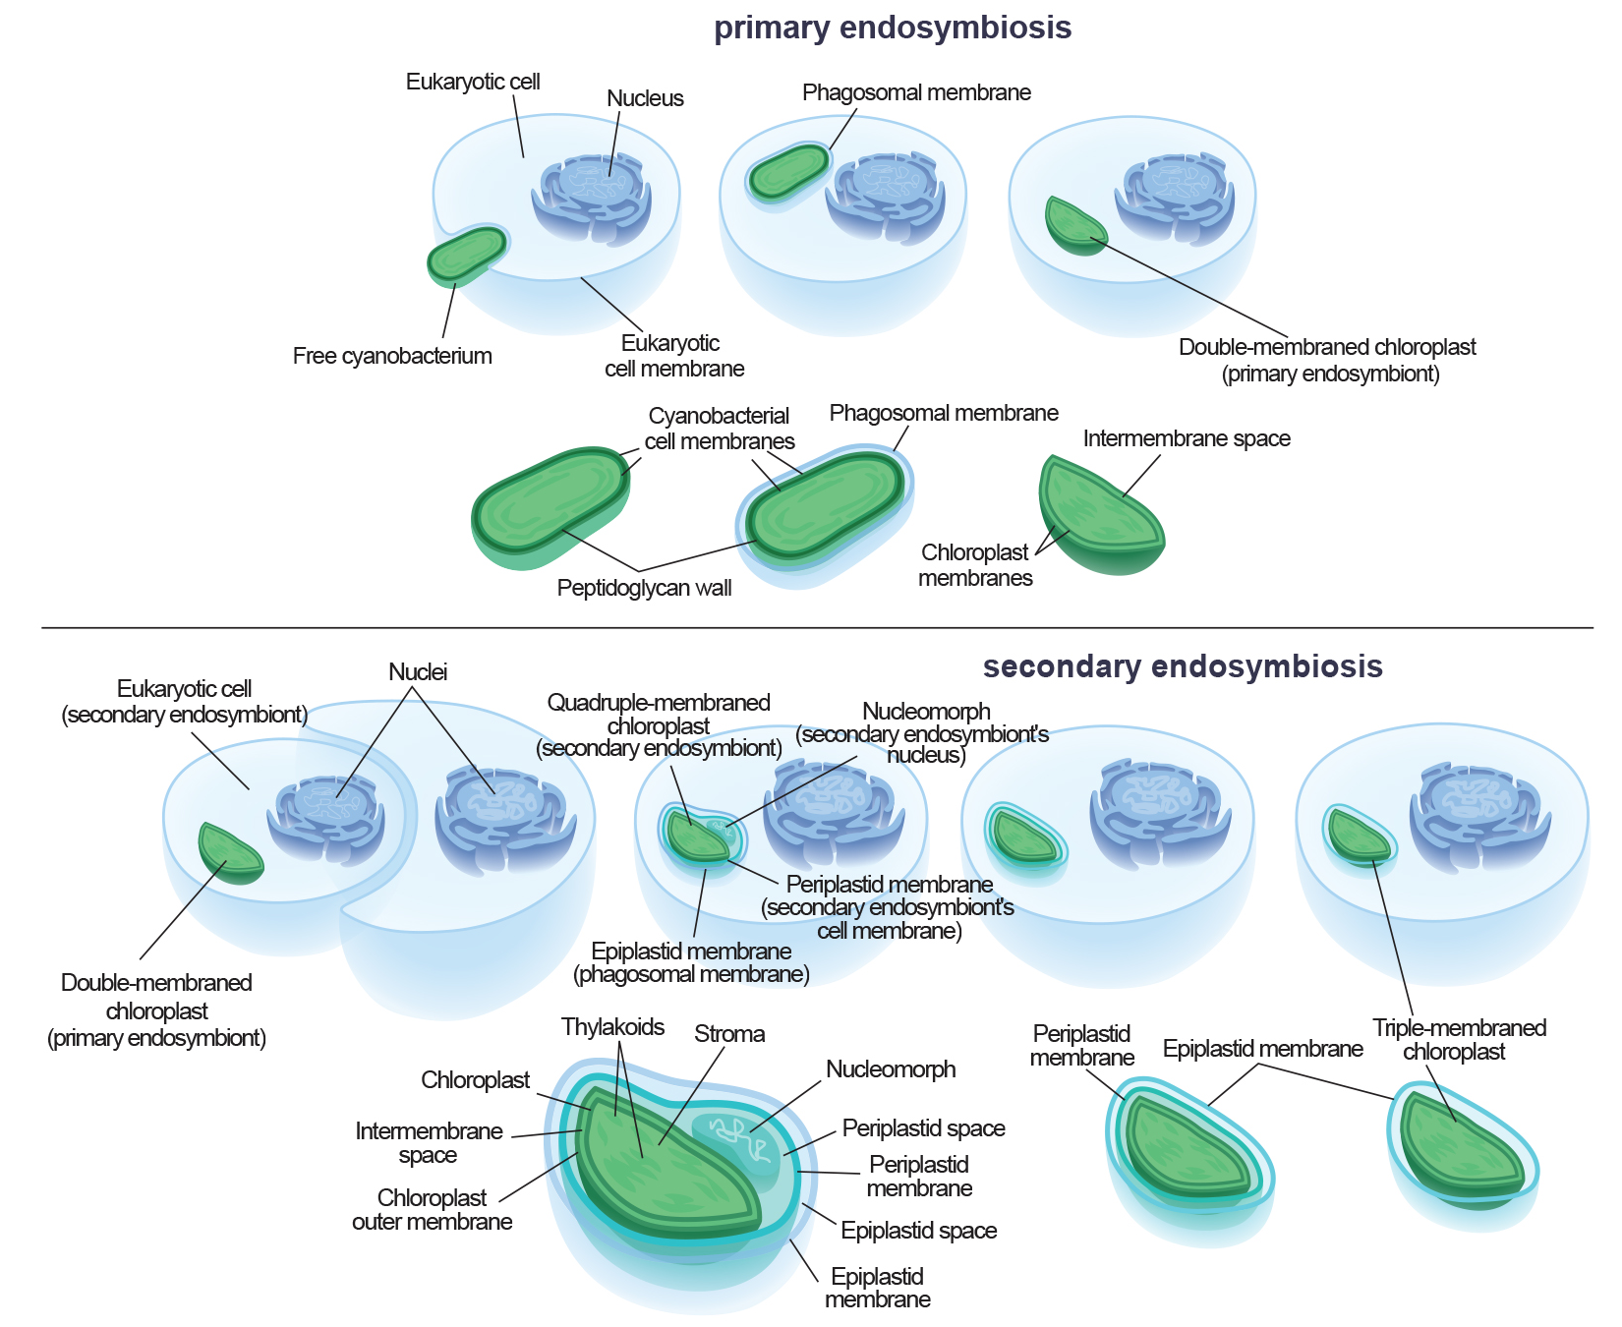
25.1 Figure 5
Kelvinsong on Wikimedia Commons. "Endosymbiosis diagram."
Notes:
Figure 5: This shows primary endosymbiosis between a eukaryotic cell and a photosynthetic bacterium. Secondary endosymbiosis occurs between a eukaryotic cell and a cell that already contains endosymbiotic bacterium.

Slide 20
Plant Adaptations to Life on Land₁
Water important to survival
Provides medium for molecules to diffuse and metabolic reactions to take place
Essential role in cells
Even if close to water, aerial structures dry out
Provides support and buoyancy
Buoyancy: property of floating on the surface of a liquid
Challenges:
Plants need structural support on land in medium that does not give same lift as water
Also exposed to mutagenic radiation because air does not filter out UV rays like water does
Male gametes must reach female gametes using new strategies; swimming no longer an option
Gametes and zygotes must be protected from desiccation
Developed strategies to overcome challenges but not all at the same time

Slide 21
Plant Adaptations to Life on Land₂
Advantages of life on land:
Sunlight abundant
Water acts as filter, altering quality of light absorbed by chlorophyll
CO₂ more readily available in air since it diffuses faster in air than in water
No predators initially (plants moved to land before animals)

Slide 22
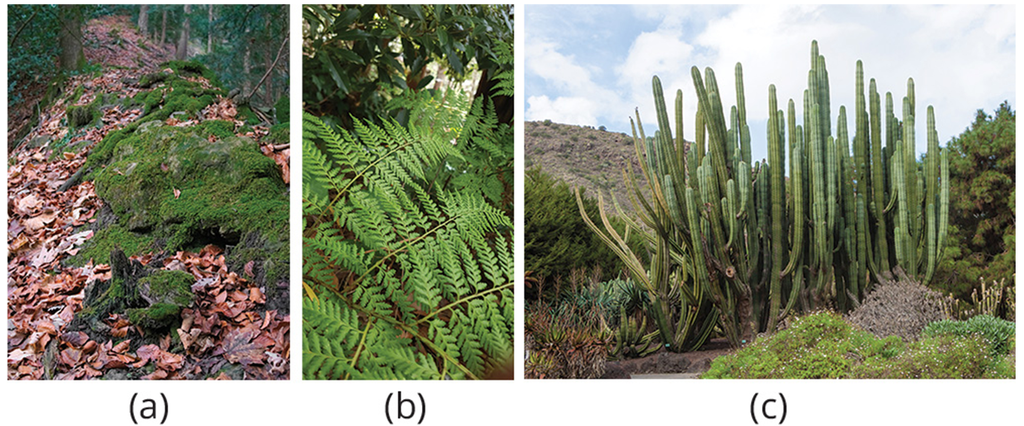
Plant Adaptations to Life on Land₃
Early land plants lived close to water and developed strategies to combat dryness
Tolerance
Example: Mosses dry out and turn brown and brittle but revive when water is available
Colonize environments with high humidity and droughts uncommon
Example: Ferns (early lineage of plants) thrive in damp, cool places (e.g., understory of temperate forests)
Resistance to desiccation
Gave them ability to move away from water
Example: Cacti minimize water loss to survive in dry environments
25.1 Figure 6: (a) Mosses have survival tolerance to weather conditions. (b) Ferns develop in cool places. (c) Cacti can survive in environments with little water.
Daniel Kraft on Wikimedia Commons. "Growing moss."
CupcakePerson13 on Wikimedia Commons. "Ferns."
H. Zell on Wikimedia Commons. "Pachycereus weberi."

Slide 23
Plant Adaptations to Life on Land₄
Most successful adaptation solution was development of new structures that gave advantages when colonizing new and dry environments
Alternation of generations (sporophyte in which spores are formed and gametophyte that produces gametes)
Gametophyte: multicellular stage of the plant that gives rise to haploid gametes or spores
Apical meristem tissue (region of cells capable of division and growth in roots and shoots)
Waxy cuticle resistant to desiccation (absent from some mosses)
Cell walls with lignin to support structures off the ground
All adaptions here absent from green algae
Some adaptations absent from mosses

Slide 24
Alternation of Generations₁
All sexually reproducing organisms have haploid (one set of chromosomes) and diploid (two sets of chromosomes) cells in life cycle
Haplontic life cycles have haploid stage dominant
Only diploid cell is zygote, which undergoes immediate meiosis to restore haploid state
Diplontic life cycles have diploid stage dominant
Diplontic: diploid stage is the dominant stage
Only haploid cells are gametes, which combine to restore diploid state when needed
Example: Humans
Alternation of generation: Life cycle in which organism has both haploid and diploid multicellular stages
Found in all plants
Haplodiplontic: haploid and diploid stages alternate

Slide 25
Alternation of Generations₂
Multicellular haploid form (gametophyte) followed by multicellular diploid form (sporophyte)
Gametophyte gives rise to gametes (reproductive cells) by mitosis
Evolution marked by increasing prominence of sporophyte generation
Barely noticeable in nonvascular plants
Nonvascular plant: plant that lacks vascular tissue, which is made up of specialized cells for the transport of water and nutrients
In seed plants, sporophyte phase can be a tree (e.g., sequoias and pines)

Slide 26
Alternation of Generations₃
Protection of embryo is major requirement for land plants
Must be sheltered from desiccation and other environmental hazards
In both seed and seedless plants: Female gametophyte provides protection and nutrients to embryo as it develops into sporophyte
Unique feature gave land plants alternate name of embryophytes
Embryophyte: other name for land plant; embryo is protected and nourished by the sporophyte

Slide 27
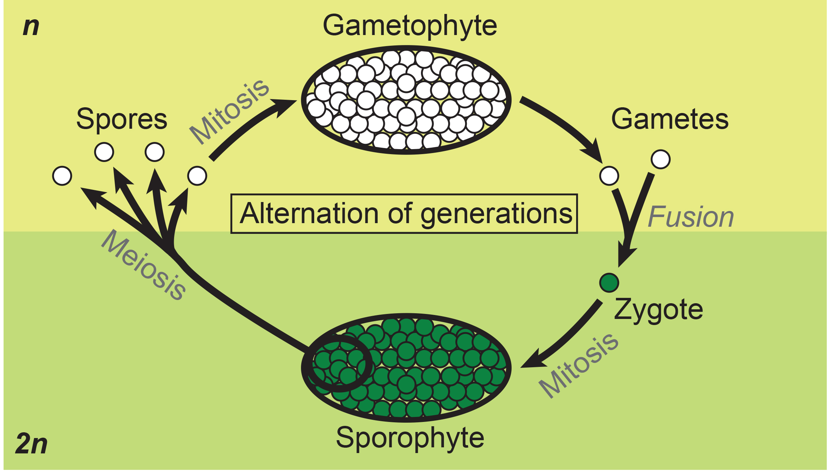
25.1 Figure 7
Peter Coxhead on Wikimedia Commons. "Alternation of generations."
Notes:
Figure 7: Alternation of generations between the 1n gametophyte and 2n sporophyte is shown. Mitosis occurs in both gametophyte and sporophyte generations. Diploid sporophytes produce haploid spores by meiosis, while haploid gametophytes produce gametes by mitosis.

Slide 28
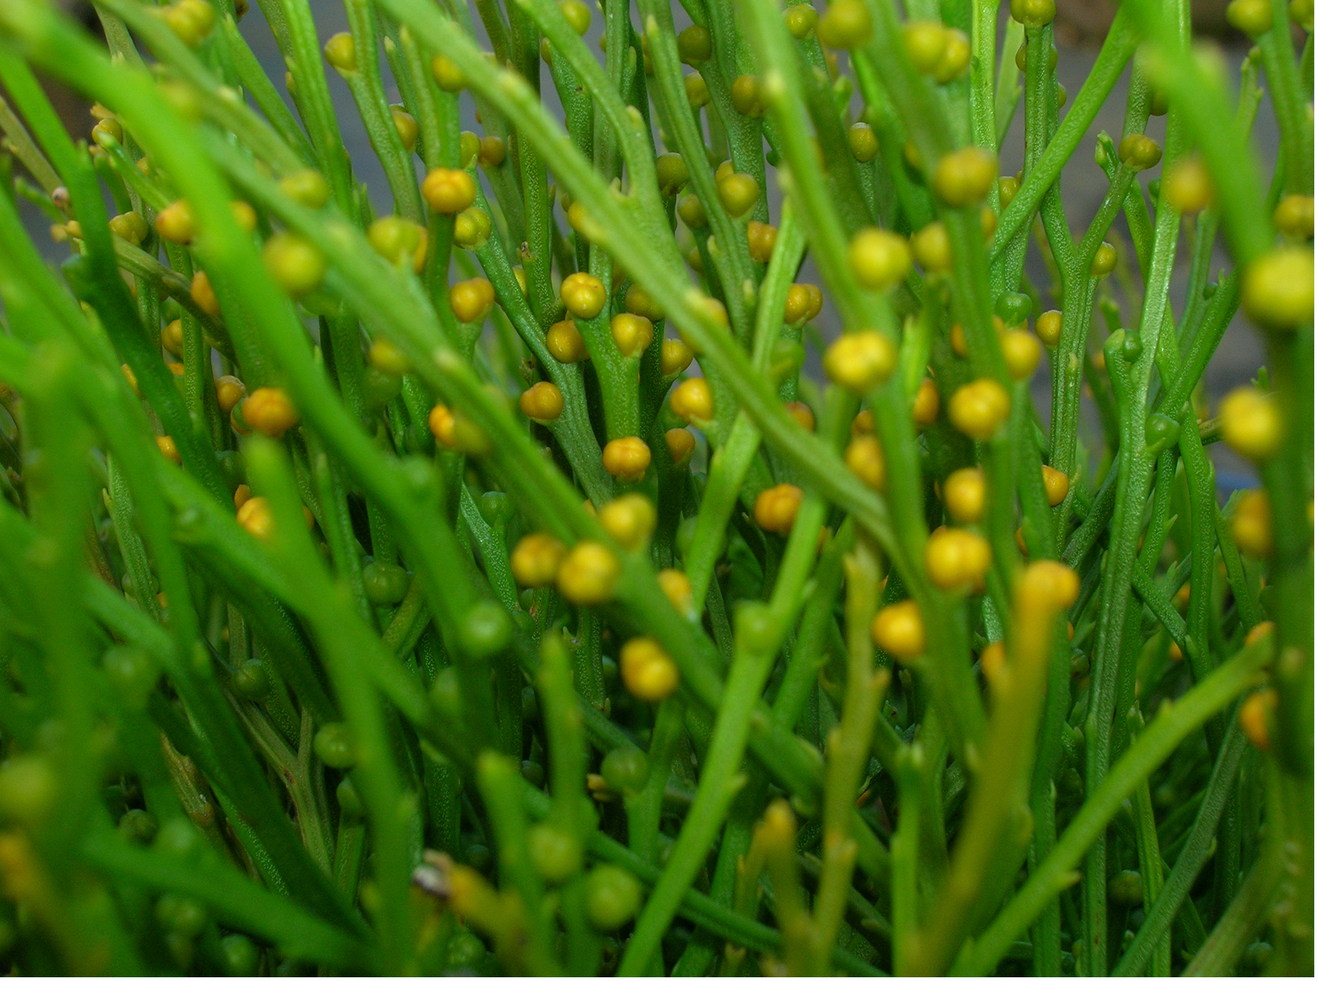
Sporangia in Seedless Plants₁
Sporophyte:
Diploid and results from syngamy (fusion) of two gametes
Bears sporangia
Sporangium: (plural, sporangia) reproductive sac that contains spores
Inside multicellular sporangia, diploid sporocytes produce haploid spores (2n reduced to 1n)
Sporocyte: diploid cell that produces spores by meiosis
Chromosome number can exceed 2n due to polyploidy
Examples: Durum wheat (tetraploid), bread wheat (hexaploid), ferns (1,000-ploid)
Chromosome number halved in gametophyte
25.1 Figure 8: Spore-producing sacs that grow at the ends of long, thin stalks in Psilotum nudum
Forest and Kim Starr on Wikimedia Commons. "Whisk fern."

Slide 29
Sporangia in Seedless Plants₂
Sporophyte:
Spores released by sporangia and dispersed into environment, where haploid spore germinates and generates multicellular gametophyte by mitosis
Gametophyte supports zygote formed from fusion of gametes and resulting sporophyte (vegetative form)

Slide 30
Sporangia in Seedless Plants₃
Homosporous: produces one type of spore
Resultant gametophyte produces both male and female gametes (usually on same individual)
Example: Nonvascular plants
Gametophyte is dominant generation in life cycle
Heterosporous: produces two types of spores
Microspore: a spore that germinates into a male gametophyte; a male spore
Usually smaller in size
Megaspore: a spore that germinates into a female gametophyte; a female spore
Usually larger in size
Examples: A few seedless vascular plants and all seed plants
Sporophyte is dominant generation in life cycle

Slide 31
Sporangia in Seedless Plants₄
Spores of seedless plants surrounded by thick cell walls containing sporopollenin
Sporopollenin: tough polymer surrounding the spore
Found in walls of pollen grains
Characterized by long chains of organic molecules (e.g., fatty acids and carotenoids [orange, yellow, and red pigments]), which gives pollens their yellow color
Resistant to chemical and biological degradation
Toughness explains existence of well-preserved pollen fossils
Charophyte Coleochaetes forms spores with sporopollenin like land plants

Slide 32
Gametangia in Seedless Plants
Gametangium: (plural, gametangia) structure on the gametophyte in which gametes are produced
Precursor cells give rise to gametes by mitosis
Antheridium: male gametangium
Releases sperm
Seedless plants produce sperm with flagella that enable swimming in moist environment to archegonium
Archegonium: female gametangium
Embryo develops inside archegonium as sporophyte
Prominent in seedless plants but absent or rudimentary in seed plants

Slide 33
Table 1: Main Differences between Gametophytes and Sporophytes
 | Gametophyte | Sporophyte
Definition | haploid phase of plants; produces the gametes and zygote that gives rise to the sporophyte | diploid phase of plants; produces spores that develop the gametophyte
Development | germination of a haploid spore | zygote
Cell Division | mitosis | meiosis
Reproduction | sexual | asexual
Products | male and female gametes | spores
Generation | fertilization of gametes | germination of spores
Life Cycle | sexual phase of the life cycle of the plant | asexual phase of the life cycle of the plant

Slide 34
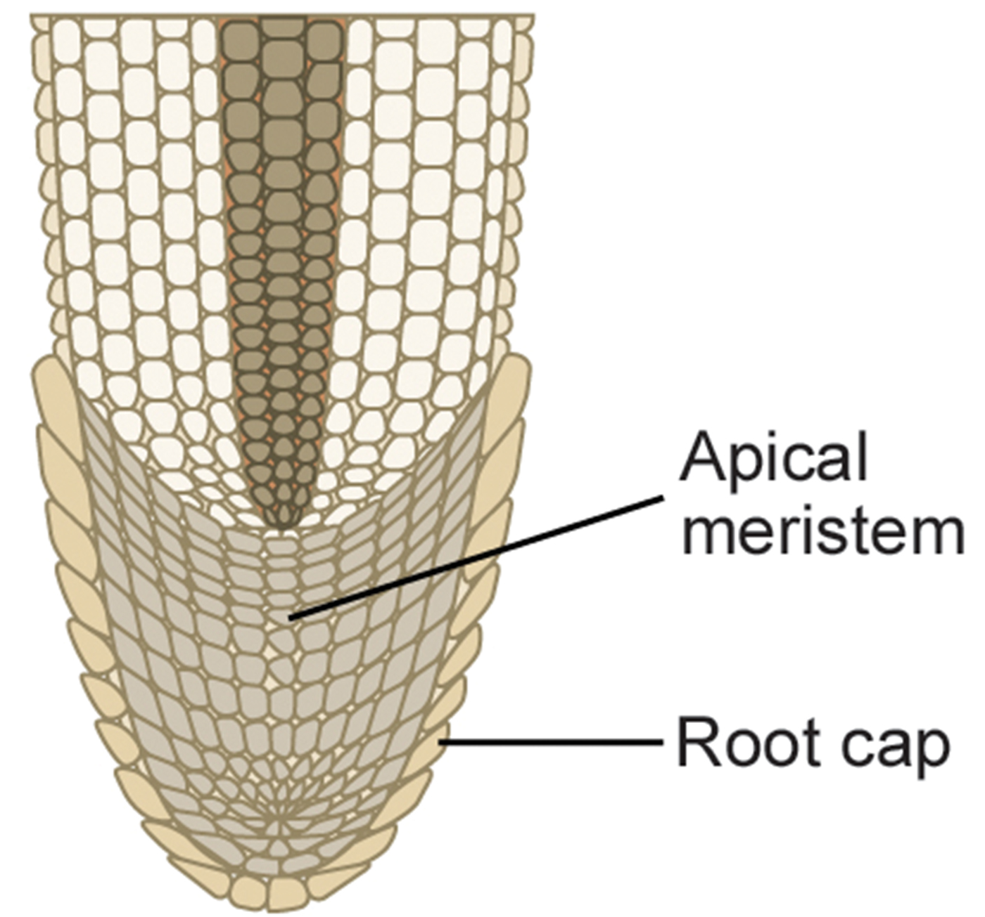
Apical Meristems
Shoots and roots increase in length through rapid cell division in apical meristem
Apical meristem: meristematic tissue located at the tips of stems and roots; enables a plant to extend in length
Made of undifferentiated cells that continue to proliferate throughout the life of plant
Gives rise to all specialized tissues
Elongation of shoots and roots allows access to additional space and resources (i.e., light for the shoot, water and minerals for the roots)
Separate meristem (lateral meristem) produces cells that increase diameter of tree trunks
25.1 Figure 9: Addition of new cells in a root occurs at the apical meristem. Subsequent enlargement of these cells causes the organ to grow and elongate. The root cap protects the fragile apical meristem as the root tip is pushed through the soil by cell elongation.
CNX OpenStax on Wikimedia Commons. "Root tip."

Slide 35
Additional Land Plant Adaptations₁
Development of new organs and structures as plants gained independence from constant water
Early land plants did not grow more than few inches off ground, competing for sunlight
Developed shoot and grew taller
Air offers less support than water
Developed more rigid molecules in stems and tree trunks
Diffusion for distribution of water and nutrients limited size
Developed conductive tissue (vascular tissue)

Slide 36
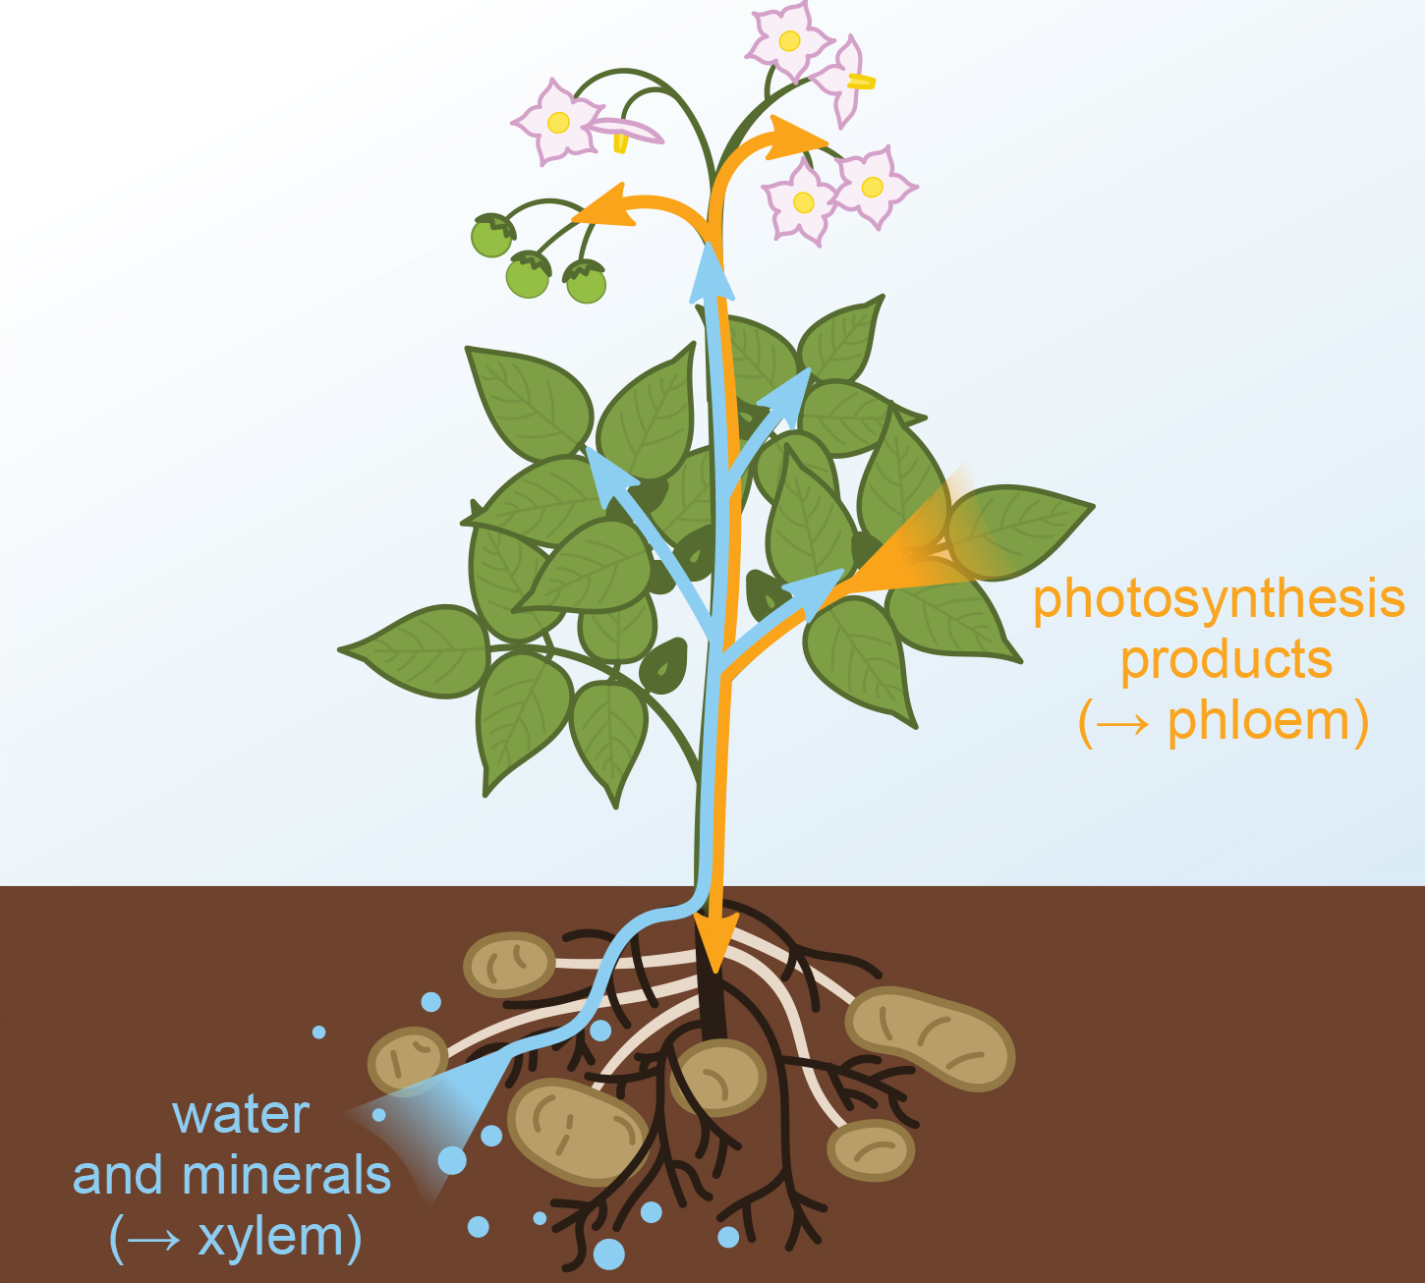
Additional Land Plant Adaptations₂
Vascular system:
Contains xylem and phloem
Xylem: tissue responsible for long-distance transport of water and nutrients and provides physical support to the plant; reinforced with lignin
Lignin: complex polymer impermeable to water
Hydrophobic polymers help prevent seepage of water across xylem cell walls
Phloem: tissue responsible for the transport of sugars, proteins, and other solutes
Tissues extend into root, which evolved to take up water and minerals from soil and anchor increasingly taller shoot in soil
25.1 Figure 10: Xylem transports water and minerals from the roots to the rest of the plant. Phloem transport nutrients generated from photosynthesis in the leaves to other plant structures.
Nefronus on Wikimedia Commons. "Xylem and phloem diagram."

Slide 37
Additional Land Plant Adaptations₃
Cuticle: the waxy, waterproof covering on the surface of plants' organs, such as leaves and shoots, that prevents the loss of water
Also prevents intake of CO₂ needed for synthesis of carbohydrates through photosynthesis; stomata appeared to deal with this
Stomata: a tiny pore in the leaf of a plant that allows the exchange of gases between the leaf and the atmosphere
UVB light (harmful to all organisms) filtered by water
No way to filter this in land plants
Evolved pathways that synthesized protective chemical compounds called flavonoids and other pigments to absorb light in UV range and protect aerial parts from photodynamic damage

Slide 38
Additional Land Plant Adaptations₄
Cannot avoid predation entirely
Developed ability to synthesize poisonous secondary metabolites (complex organic molecules, like alkaloids, with noxious smells and unpleasant taste) to deter predators
Can cause severe disease and death
Humans have used compounds for drugs, medications, or spices
Need to encourage predation for some plants to get assistant for dispersing pollen grains, fruit, or seeds
Developed sweet and nutritious metabolites to lure animals

Slide 39
Science and You₁
Career: Paleobotanist
Study extinct plants through analysis of fossilized plant specimens retrieved from field studies, reconstituting morphology of extinct species
Trace evolution of plants by following modifications in plant morphology and finding connections between existing plants by identifying common ancestors with same traits
Try to find transitional species to bridge gaps in development
Collect fossil specimens and place them in context of geological sediments and other fossilized organisms surrounding them
Fossils form when organisms are trapped in sediments or environments where shapes are preserved
Notes:
This is included as a relevant application for this topic.

Slide 40
Science and You₂
Career: Paleobotanist
Use analytical chemistry and molecular biology to study fossils
Requires environment free of oxygen since oxidation and degradation of material through activity of microorganisms depend on it
Example: Identification of oleanane
Appeared to be unique to flowering plants but recovered from sediments from Permian Period, earlier than flowering plants
Also study fossil DNA to build plant lineages from analysis of evolutionary relationships
Some skepticism about conclusions from analysis of molecular fossils; high risk of degradation and contamination
Notes:
This is included as a relevant application for this topic.

Slide 41
Evolution of Land Plants₁
Paleozoic divided into six periods (Cambrian, Ordovician, Silurian, Devonian, Carboniferous, and Permian)
Colonization of land by plants emerged in Ordovician (470 million years ago)
Nonvascular plants dated to Ordovician (488 to 444 MYA)
Plants emerged as early as Cambrian (520 MYA) according to genomic data
Vascular plants dated to Silurian (444 to 420 MYA)
Richest source of information through fossils: Rhynie chert (sedimentary rock deposit found in Rhynie, Scotland)

Slide 42
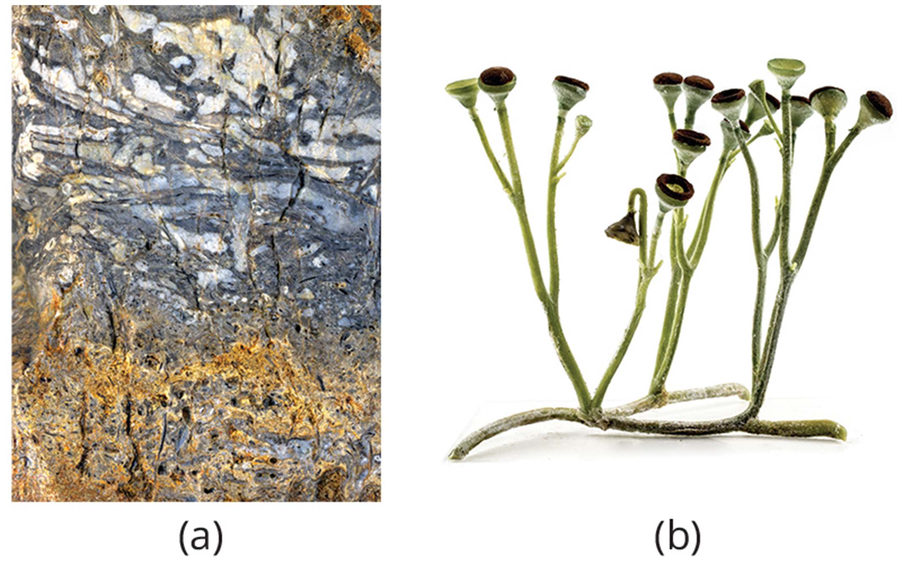
Evolution of Land Plants₂
Extinct: no-longer-existing species; only found as fossils
Extant: still-living species
Extinct vascular plants:
Lacked true leaves and roots
Formed low vegetation mats similar to mosses, reaching 1 meter in height
Example: Cooksonia
Silurian Period
Well-preserved examples
Show slender branching stems ending in sporangia
Possessed vascular tissues
25.1 Figure 11: (a) This Rhynie chert contains fossilized material from vascular plants. (b) This is a reconstruction of Cooksonia, where the plant forms inside the circle.
James St. John on Wikimedia Commons. "Rhynie chert."
Matteo De Stefano/MUSE on Wikimedia Commons. "Cooksonia sp."

Slide 43
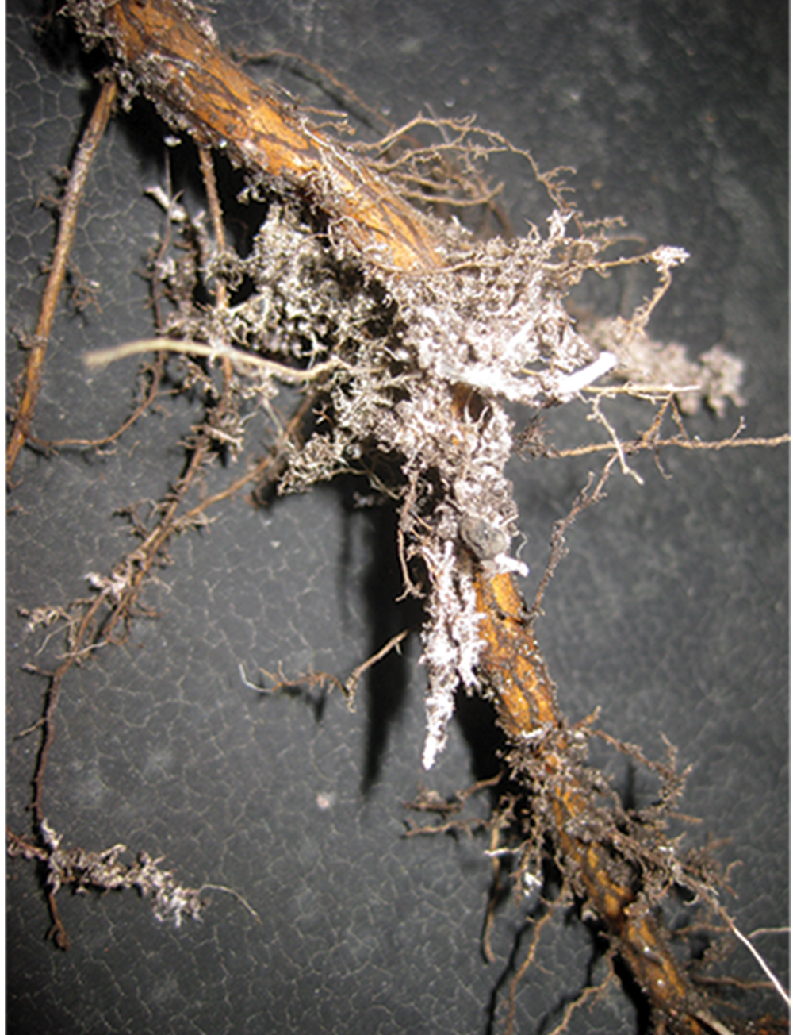
Evolution of Land Plants₃
Population of ferns, horsetails, and seed plants (eventually trees and forests) appeared on land at end of Devonian Period (420 to 359 MYA)
Enriched atmosphere with oxygen, leading to more air-breathing animals on dry land
Established symbiotic relationships with fungi, creating mycorrhizae (fungal network of filaments that increases efficiency of plant root system, and plants provide fungi with byproducts of photosynthesis)
25.1 Figure 12: Mycorrhizae shows the association between roots and fungi.
Wilhelm Zimmerling PAR on Wikimedia Commons. "Mycorrhizae."

Slide 44
The Major Divisions of Land Plants₁
Subphylum Streptophyta and called streptophytes
Streptophytes: group that includes green algae and land plants
Land plants classified by absence or presence of vascular tissue
Nonvascular plant: plant that lacks vascular tissue, which is made up of specialized cells for the transport of water and nutrients
Examples: Liverworts, mosses, and hornworts (seedless)
Appeared early in land plant evolution
Vascular plant: plant containing a network of cells that conducts water and solutes through the organism
Appeared in Silurian Period (444 to 420 MYA) similar to lycophytes
Examples: Club mosses, pterophytes (ferns, horsetails, and whisk ferns)
Seedless vascular plant: plant that does not produce seeds (includes lycophytes and pterophytes)

Slide 45
The Major Divisions of Land Plants₂
Seed plants (spermatophytes): Form largest group of existing plants
Include gymnosperms (e.g., conifers with naked seeds) and angiosperms (flowering plants; most successful of all plants that protect seeds inside chambers at center of flower with walls that develop into fruit)

Slide 46
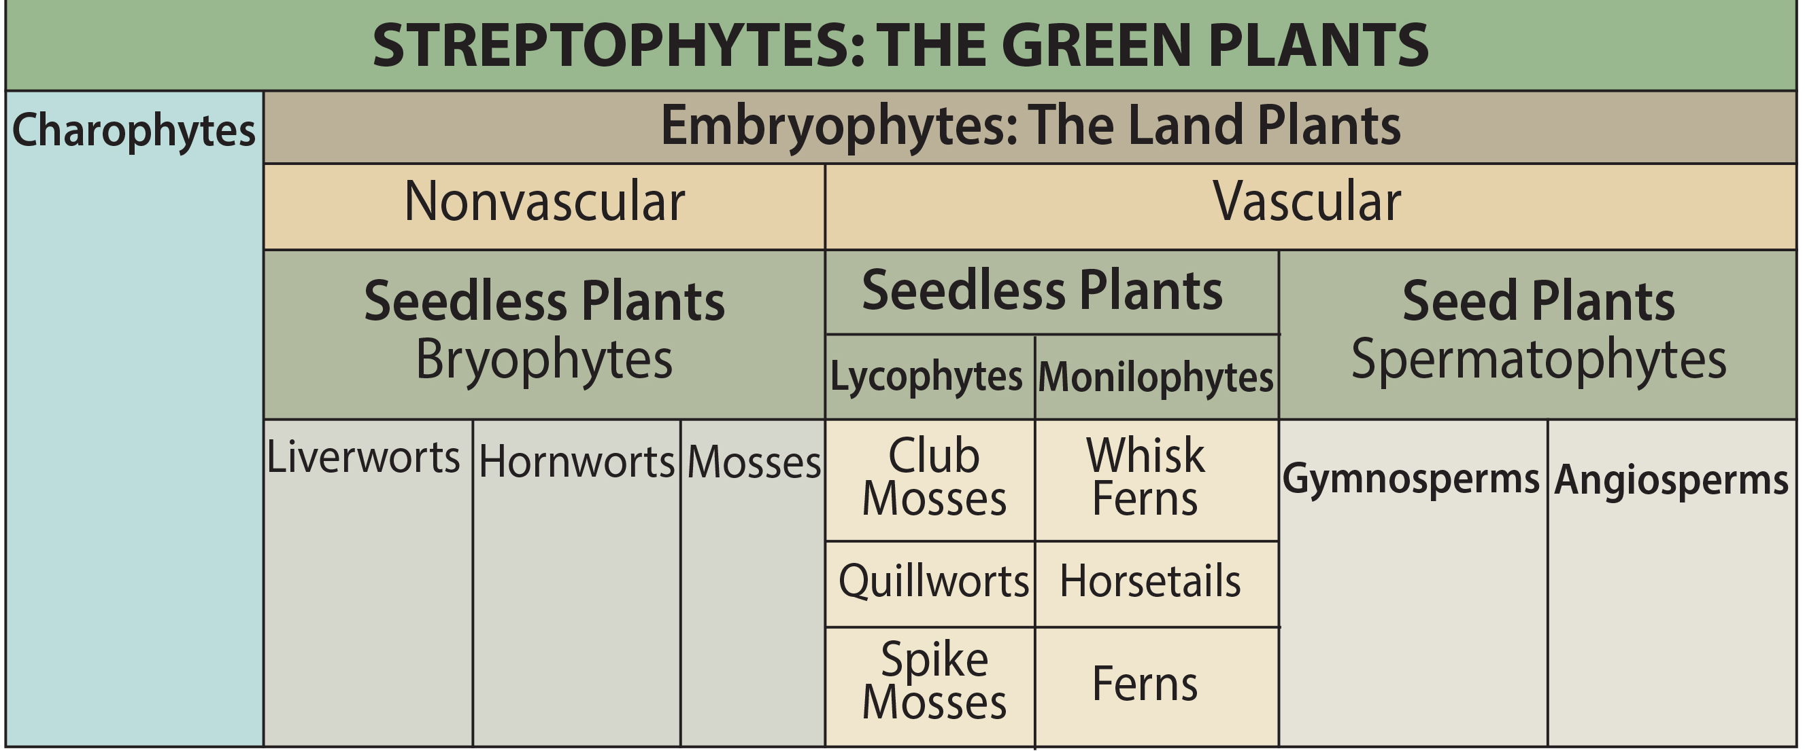
25.1 Figure 13
CNX OpenStax on Wikimedia Commons. "Streptophytes."
Notes:
Figure 13: This shows the major divisions of green plants.

Slide 47
Summary₁
Charophytes (green algae):
Share more traits with land plants than other algae groups based on structural features and DNA analysis
Includes Charales, Coleochaetales, and Zygnematales
Form sporopollenin and precursors of lignin, and phragmoplasts have flagellated sperm
Do not exhibit alternation of generations

Slide 48
Summary₂
Land plants:
Acquired traits to make it possible to colonize land and survive out of water and appeared 470 MYA in Ordovician Period
Have following characteristics:
Alternation of generations, with haploid plant called gametophyte and diploid plant called sporophyte
Formation of haploid spores in sporangium
Formation of gametes in gametangium
Protection of embryo
Apical meristem
Adaptations:
Vascular tissues
Roots
Leaves
Cuticle cover
Tough outer layer that protects spores

Slide 49

End of Hawkes Learning PowerPoint

