Slide 1
Lesson 25.2
Bryophytes: Mosses and Their Relatives

Slide 2
Objectives
Chart the development of land adaptations in the bryophytes.
Describe the distinguishing traits of liverworts, hornworts, and mosses.
Describe the events in the bryophyte life cycle.
Identify the main characteristics of bryophytes.

Slide 3
Bryophytes: Mosses and Their Relatives₁
Closest extant (living) relatives of early terrestrial plants
First ones (liverworts) appeared in or before Ordovician Period (470 MYA)
Lack lignin (structural polymer that makes plants woody or rigid) or other resistant structures
Hard to form fossils because of this but because of tough and stable nature of sporopollenin, spores can fossilize

Slide 4
Bryophytes: Mosses and Their Relatives₂
Fossil evidence:
Pollen fossils:
From 476 MYA
Resemble spores produced by liverwort, suggesting presence of nonvascular plants in Ordovician Period
Evidence of vascular plant spread by end of Silurian Period (420 MYA)
Imperfect fossil record means evolutionary history not fully determined
Some evidence suggests bryophytes and vascular plants are sister lineages diverged from terrestrial, nonvascular ancestor (500 MYA, end of Cambrian Period)
May have colonized land earlier than indicated by fossil record

Slide 5
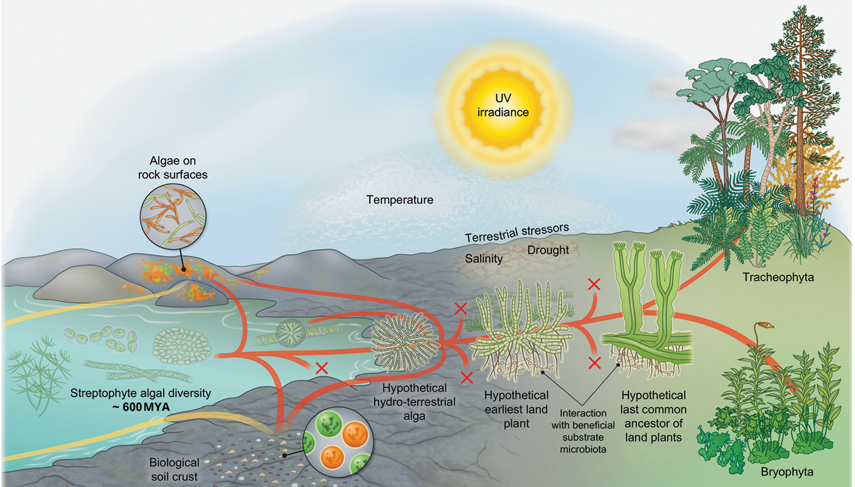
25.2 Figure 1
Janine M R Fürst-Jansen, Sophie de Vries and Jan de Vries on Wikimedia Commons. "Earliest plant life."
Notes:
Figure 1: Members of the earliest land plants acquired adaptive terrestrial traits that led to the evolution of bryophytes.

Slide 6
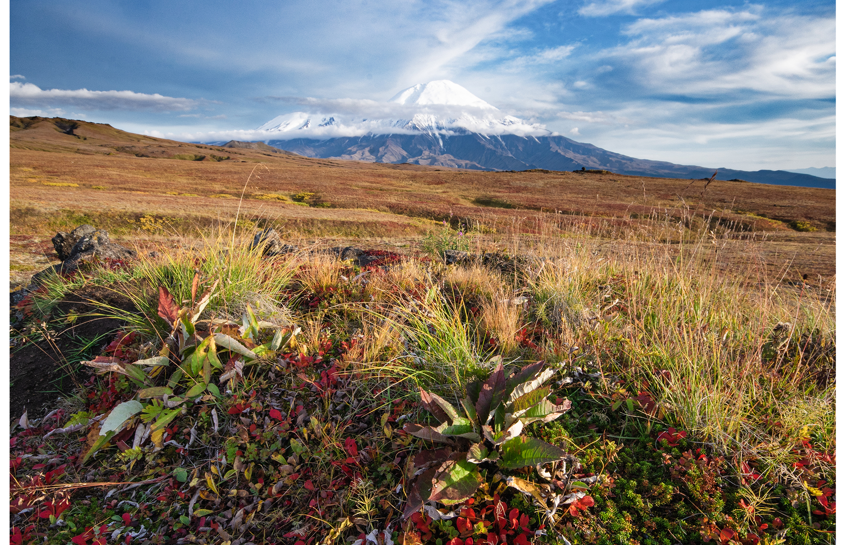
Bryophytes: Mosses and Their Relatives₃
Over 25,000 species
Thrive in damp habitats like tundra but some in deserts
Dominant flora in tundra because of small size and resistance to drying out, giving them an advantage
Lack lignin and do not have tracheids
Tracheid: xylem cell with thick secondary walls that helps transport water
Water and nutrients circulated with specialized conducting cells
25.2 Figure 2: Typical vegetation in a tundra ecosystem where bryophytes grow
Anton Korablev on Wikimedia Commons. "Tundra."

Slide 7
Bryophytes: Mosses and Their Relatives₄
Conspicuous vegetative organs belong to haploid organism or gametophyte
Include photosynthetic leaflike structures, thallus, stem, and rhizoid
Thallus: vegetative tissue or the plant body
Rhizoid: filamentous outgrowth on the underside of the thallus in some lower plants that anchors the plant or conducts water
Male gametes swim with flagellum, dependent on water
Embryo remains attached to parent plant, which provides protection and nourishment
Sporophyte develops from embryo; barely noticeable
Sporophyte: multicellular diploid life-cycle stage that produces haploid spores by meiosis

Slide 8
Bryophytes: Mosses and Their Relatives₅
Sporangium present in bryophytes but absent in most algae
Sporangium: (plural, sporangia) reproductive sac that contains spores
Formation of haploid spores in sporangium characteristic of all land plants
Divided into three phyla:
Liverworts (Marchantiophyta)
Hornworts (Anthocerotophyta)
Mosses (true Bryophyta)

Slide 9
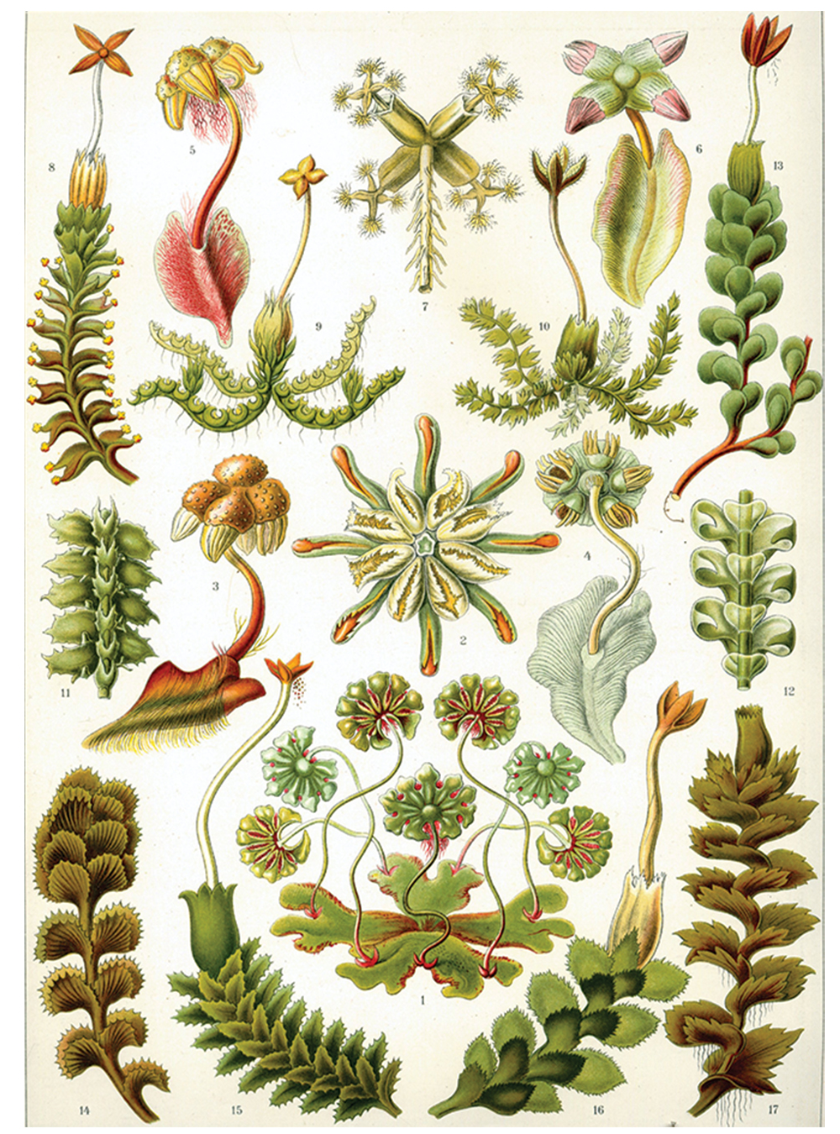
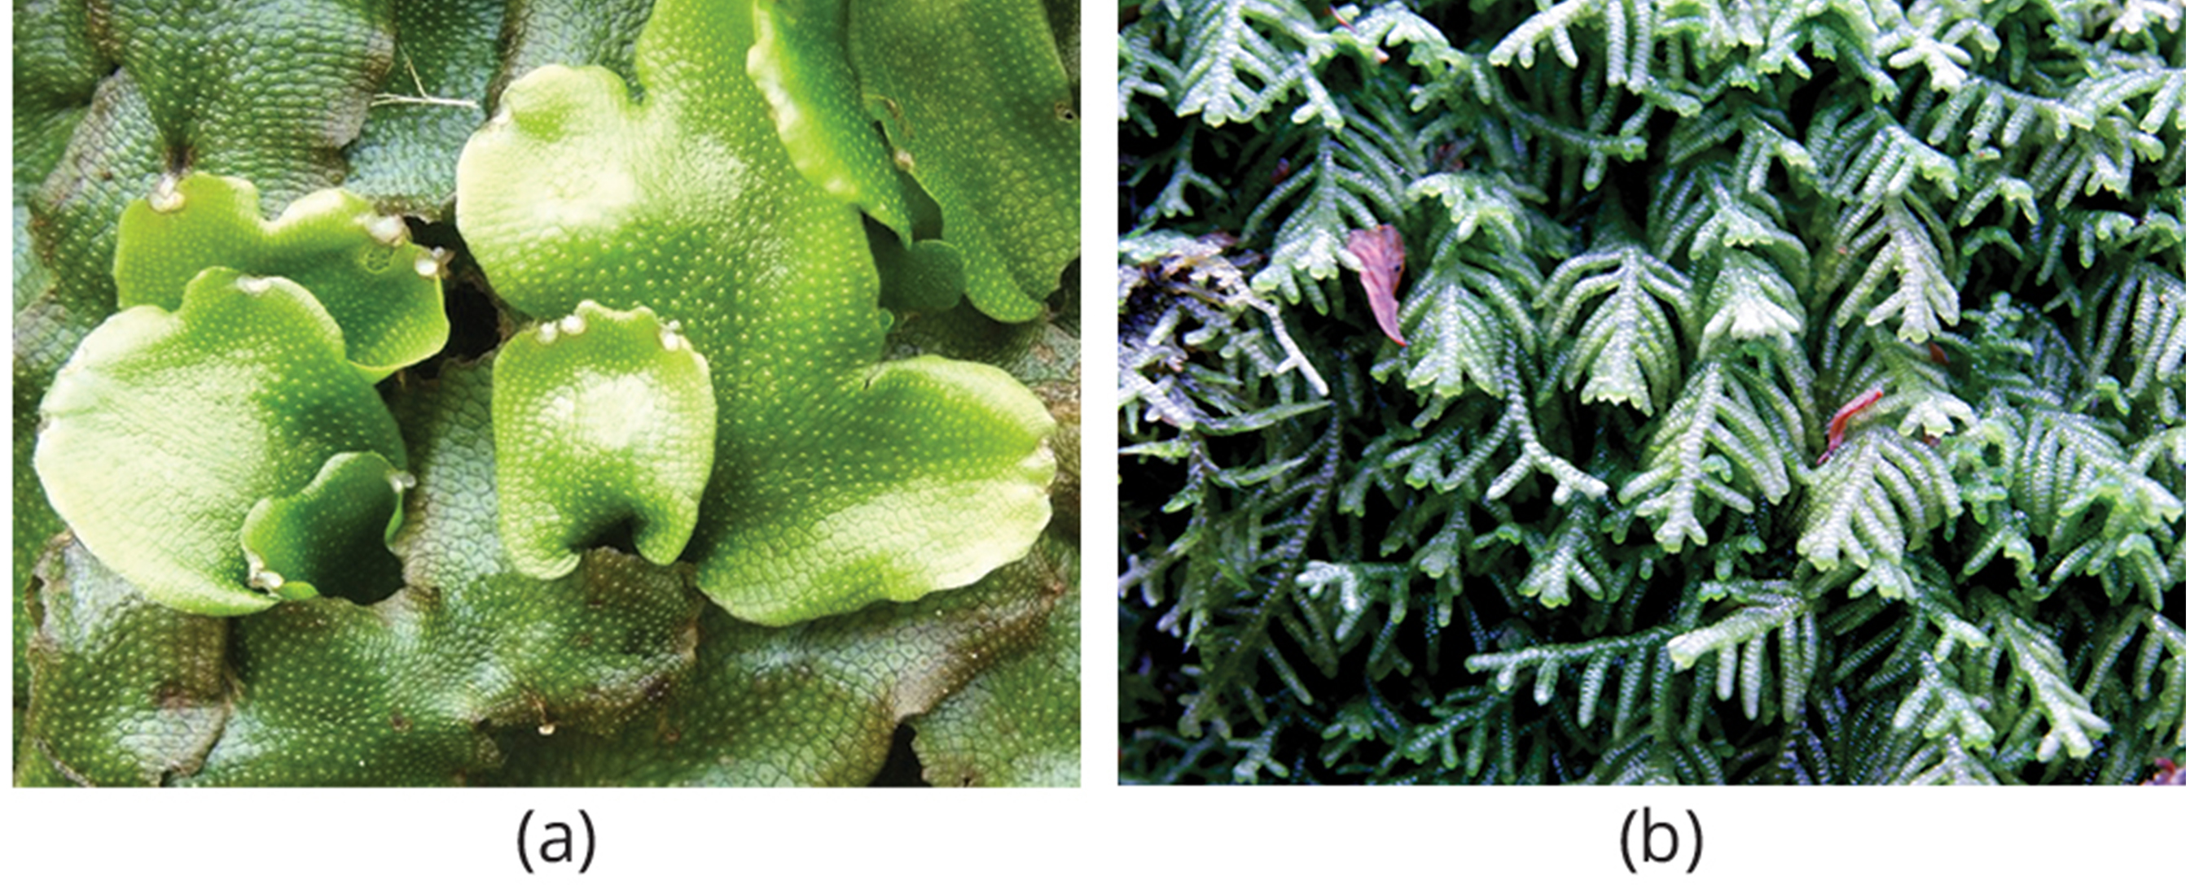
Liverworts₁
Liverworts: most primitive group of the nonvascular plants
Phylum: Marchantiophyta
Classified as plants most closely related to ancestor of vascular plants that adapted to terrestrial environments
Have colonized every terrestrial habitat on Earth with more that 7,000 existing species
Lobate liverworts: Tiny leaflike structures attached to a stalk
25.2 Figure 3: This drawing from 1904 shows the variety of forms of Marchantiophyta.
Kunstformen der Natur (1904) on Wikimedia Commons. "Hepaticae."
25.2 Figure 4: (a) A liverwort, Conocephalum conicum, displays its lobate, flat thallus. (b) This shows the leafy liverwort with leaflike structures.
Lairich Rig on Wikimedia Commons. "Liverwort."
Peter Woodard on Wikimedia Commons. "Liverwort."

Slide 10
Liverworts₂
Have openings in the thallus that allow for movement of gases throughout plant
Not stomata; do not actively open and close by action of guard cells
Thallus takes up water over entire surface and has no cuticle to prevent desiccation (why they prefer wet habitats)
Reproduction:
Haploid spores germinate into flattened thalli attached to substrate by thin, single-celled filaments
Gametophores grow from thallus and carry male and female gametangia (which develop on separate, individual plants or same plant, depending on species)
Flagellated male gametes develop within antheridia (male gametangia)
Female gametes develop within archegonia (female gametangia)
Male gametes swim with flagella to archegonium and fertilize
Diploid zygote (result of fertilization) grows into sporophyte contained in archegonium
Produces next generation of haploid spores by meiosis, disseminated by wind or water

Slide 11
Liverworts₃
Reproduction:
Spore dispersal facilitated by elaters
Elaters: structures that function in the dispersal of spores
Can reproduce asexually by breaking of branches or spreading of leaf fragments (gemmae—produced in a cup on surface of thallus), which are splashed out of cup by raindrops and land nearby to develop into gametophytes
Gemma: (plural, gemmae) leaf fragment that spreads for asexual reproduction

Slide 12
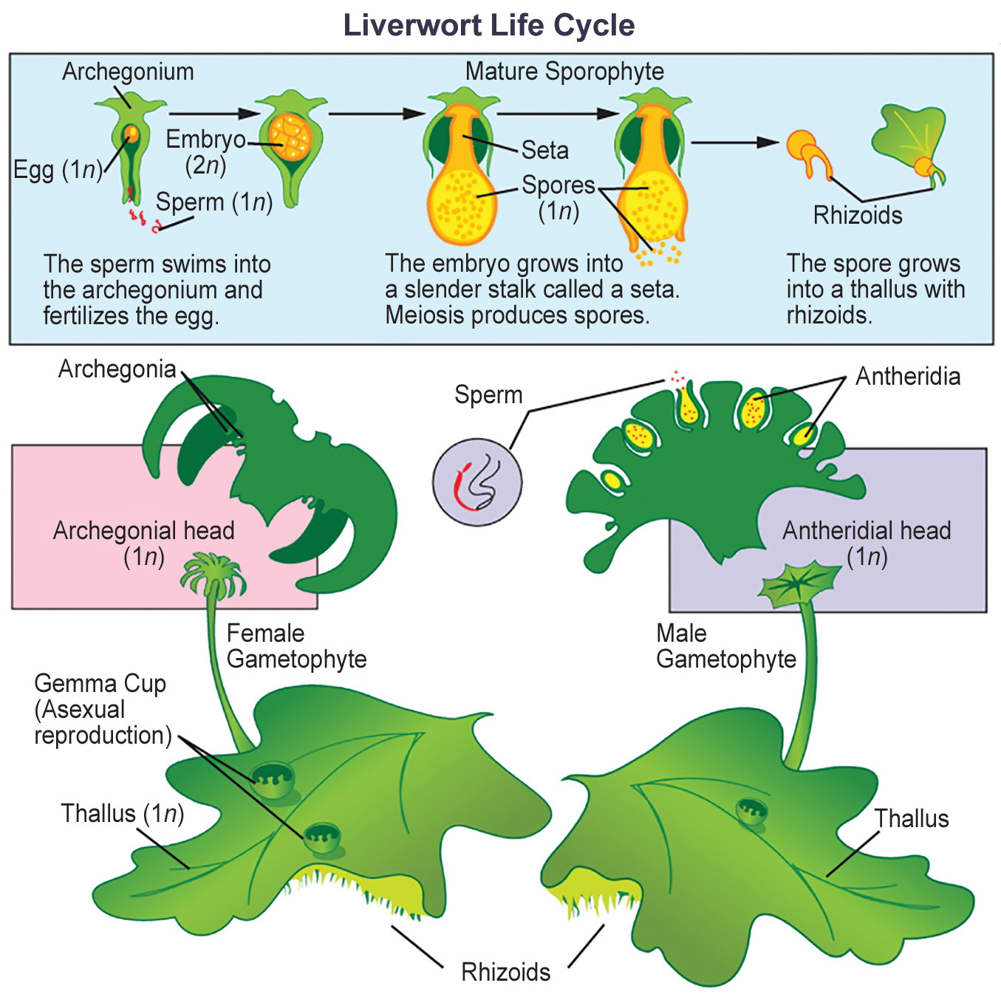
25.2 Figure 5
Mariana Ruiz Villarreal on Wikimedia Commons. "Liverwort life cycle."
Notes:
Figure 5: This image shows the life cycle of a typical lobate liverwort, in which antheridia and archegonia are produced on separate gametophytes.

Slide 13
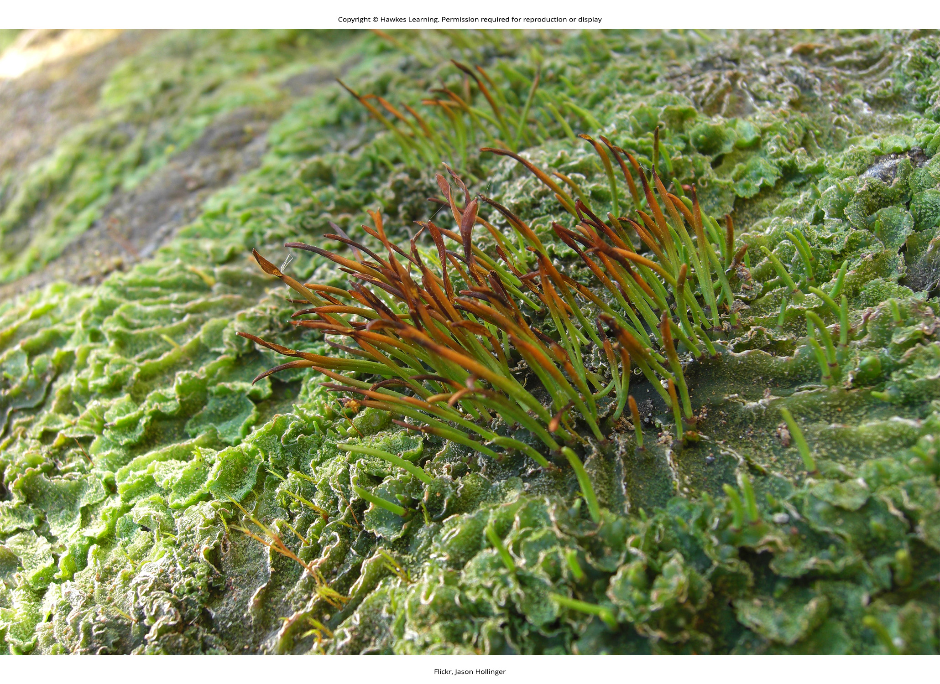
Hornworts₁
Hornworts: group of nonvascular plants in which stomata appear
Phylum: Anthocerotophyta
Defined by narrow, pipelike sporophyte
Colonized variety of habitats but never far from source of moisture
Short, blue-green gametophyte is dominant phase of life cycle
Sporophytes emerge from parent gametophyte and continue to grow
25.2 Figure 6: Hornworts grow a tall and slender sporophyte.
Jason Hollinger on Wikimedia Commons. "Hornwort."

Slide 14
Hornworts₂
Stomata abundant on sporophyte
Photosynthetic cells in thallus each contain single chloroplast
Meristem cells at base of plant keep dividing and adding to height of sporophyte
Growth pattern unique to hornworts
Many establish symbiotic relationships with nitrogen-fixing cyanobacteria
Reproduction:
Alternation of generations
Gametophytes grow as flat thalli on soil with embedded male and female gametangia
Flagellated sperm swim to archegonia and fertilize eggs
Zygote develops into long and slender sporophyte that eventually splits down the side, releasing spores
Pseudoelaters surround spores and propel them farther in environment
Pseudoelaters: surround the spores and help them propagate
Haploid spores germinate and give rise to next generation of gametophytes

Slide 15
Group Activity₁
As a group, take a cutting from a larger hornwort. Submerge the cutting in water (you may have to weigh it down) and observe its growth for one week. Take measurements and record your observations each day.
What were some things you noticed about your hornwort?
Did anything about its growth surprise you?

Slide 16
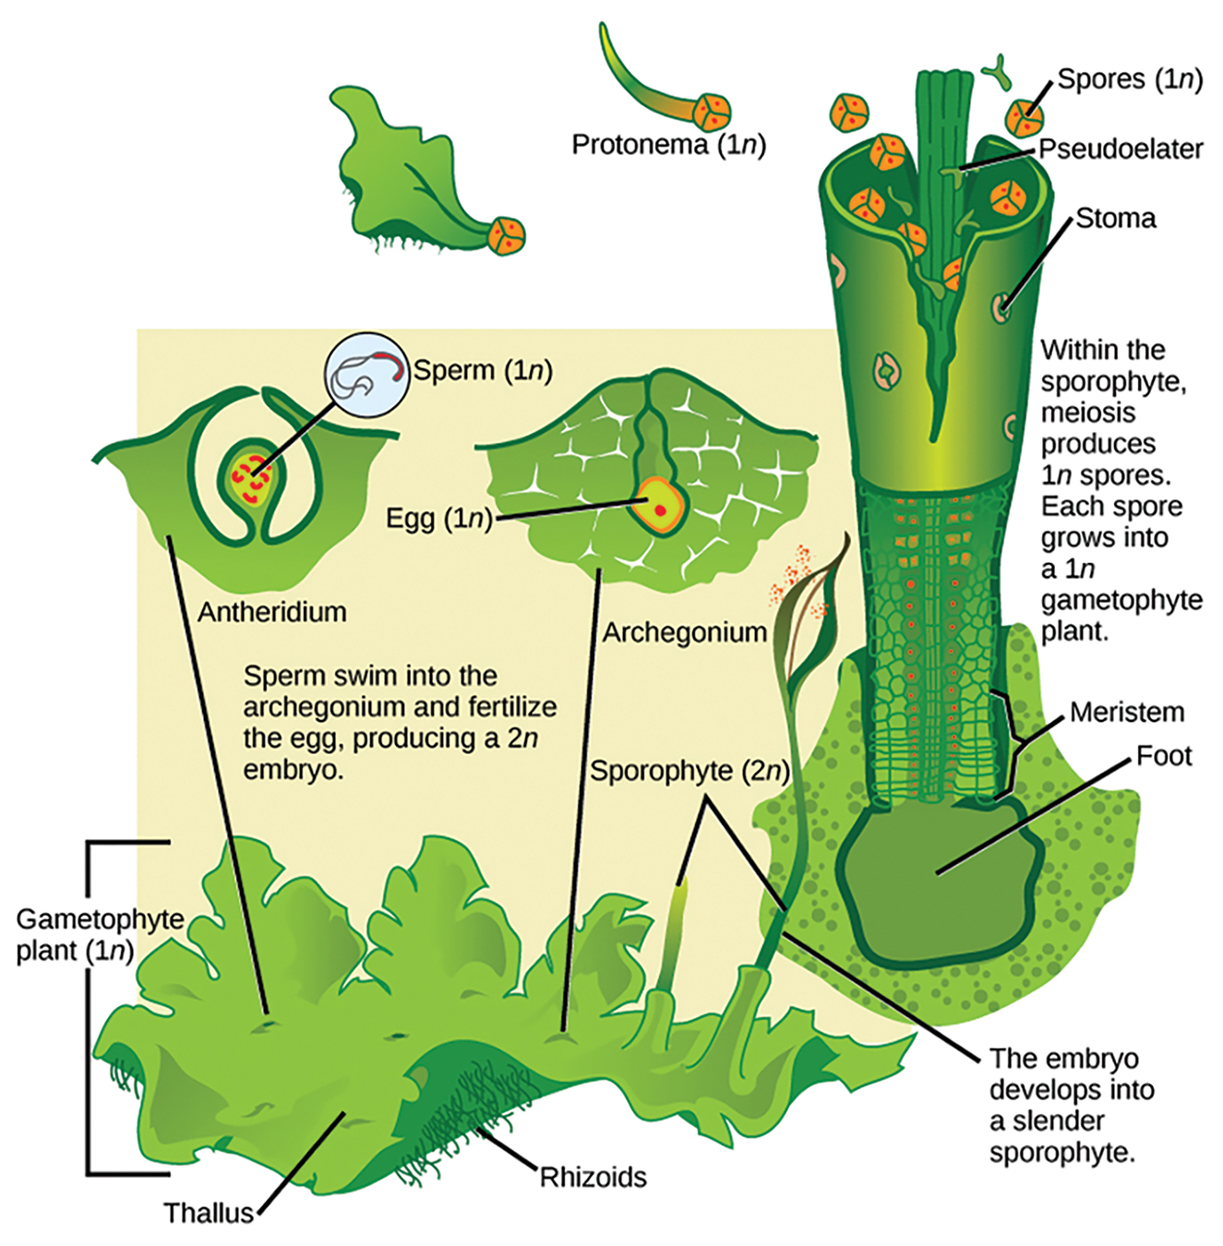
25.2 Figure 7
Mariana Ruiz Villarreal on Wikimedia Commons. "Hornwort reproductive cycle."
Notes:
Figure 7: The reproductive cycle of hornworts, where alternation of generations is shown

Slide 17
Think It Through₁
How can you distinguish a liverwort from a hornwort with the naked eye?
Notes:
Originally an On Your Own. This is included here to use as a talking point or for a think-pair-share activity.

Slide 18
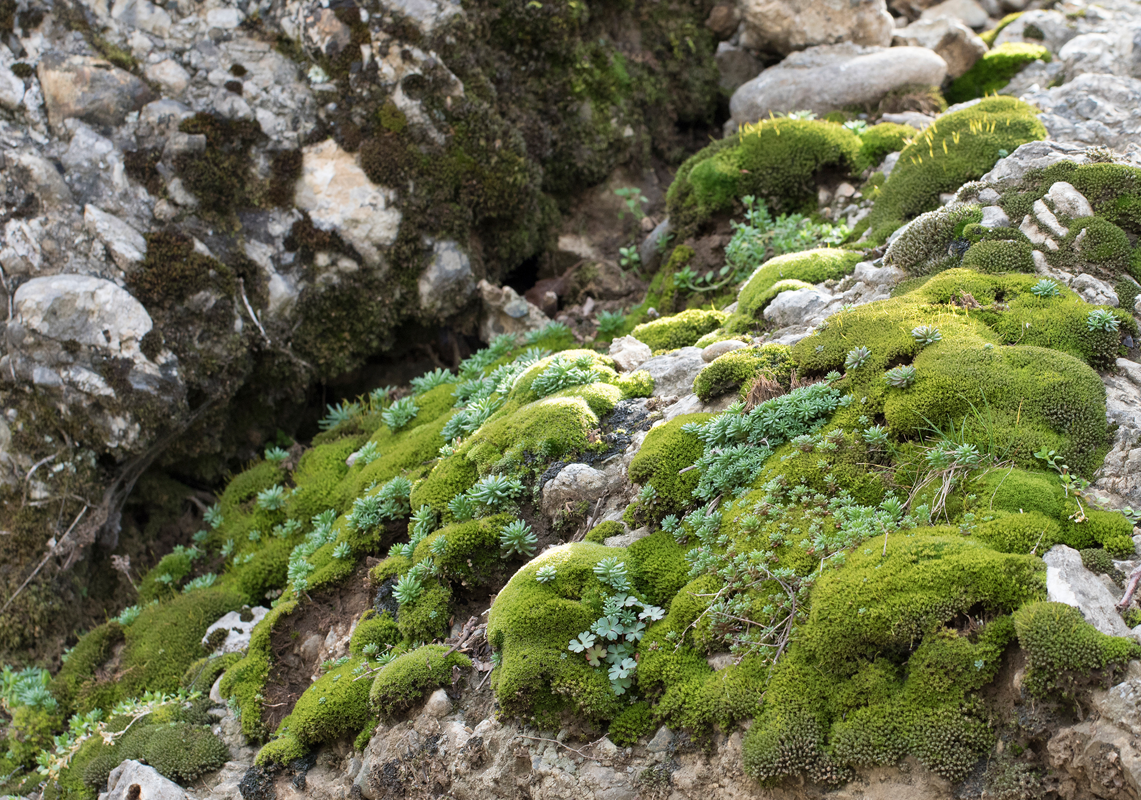
Mosses₁
Mosses: group of bryophytes in which a primitive conductive system appears
Most numerous of nonvascular plants (12,000 species)
Habitats vary (from tundra, where they are the main vegetation, to tropical forest understories)
In tundra: Mosses' shallow rhizoids allow for fastening to substrate without penetrating frozen soil
Beneficial for environment:
Slow down erosion
Store moisture and soil nutrients
Provide shelter for small animals
Provide food for large herbivores (e.g., musk ox)
Sensitive to pollution and can be used to monitor air quality
Sensitive to copper salts, which can destroy them
25.2 Figure 8: Mosses anchor to rocks to prevent erosion.
Zeynel Cebeci on Wikimedia Commons. "Moss on stones."

Slide 19
Mosses₂
Form diminutive gametophytes, which are dominant phase of life cycle
Green, flat structure with midrib (resemble true leaves but lack stomata and vascular tissue) attached in a spiral to central stalk
Some have small branches
Stomata only on sporophyte
Water and nutrients absorbed directly through gametophyte (lack vascular tissue)
Conductive system carries water and nutrients up gametophyte's stalk but does not extend into leaves)
Anchored to substrate by multicellular rhizoids (precursors of roots)
Originate from base of gametophyte but not the major route for absorption of water and minerals
Lack of true root system allows for easy removal

Slide 20
Think It Through₂
Mosses lack a vascular tissue to carry water and nutrients throughout the system, and instead, they absorb them directly.
How do you think the water and nutrients enter the plant and reach all the cells?
Notes:
Originally an On Your Own. This is included here to use as a talking point or for a think-pair-share activity.

Slide 21
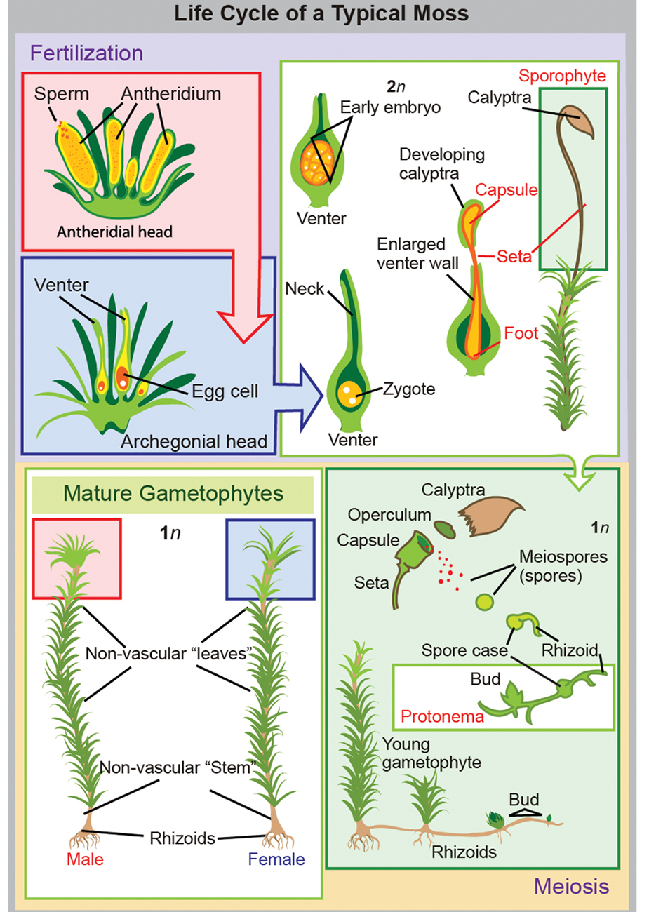
25.2 Figure 9
Mariana Ruiz Villarreal on Wikimedia Commons. "Moss reproductive cycle."
Notes:
Figure 9: Reproductive and life cycle of mosses

Slide 22
Mosses₃
Reproduction:
Alternation of generations
Haploid gametophyte (most familiar structure) germinates from haploid spore and forms protonema
Protonema: tangle of single-celled filaments that forms from the haploid spore
Cells like apical meristem divide and give rise to gametophore (consisting of photosynthetic stem and foliage-like structures)
Male and female gametangia develop at tip of separate gametophore
Antheridia (male organs) produce sperm cells
Archegonia (female organs) form egg at base (venter) of flask-shaped structure
Produce attractant substances, which get sperm to swim down neck to venter (egg-containing base of archegonium) and fertilize egg inside archegonium
Results in zygote that is protected by archegonium and divides and grows into sporophyte still attached by its base to gametophyte

Slide 23
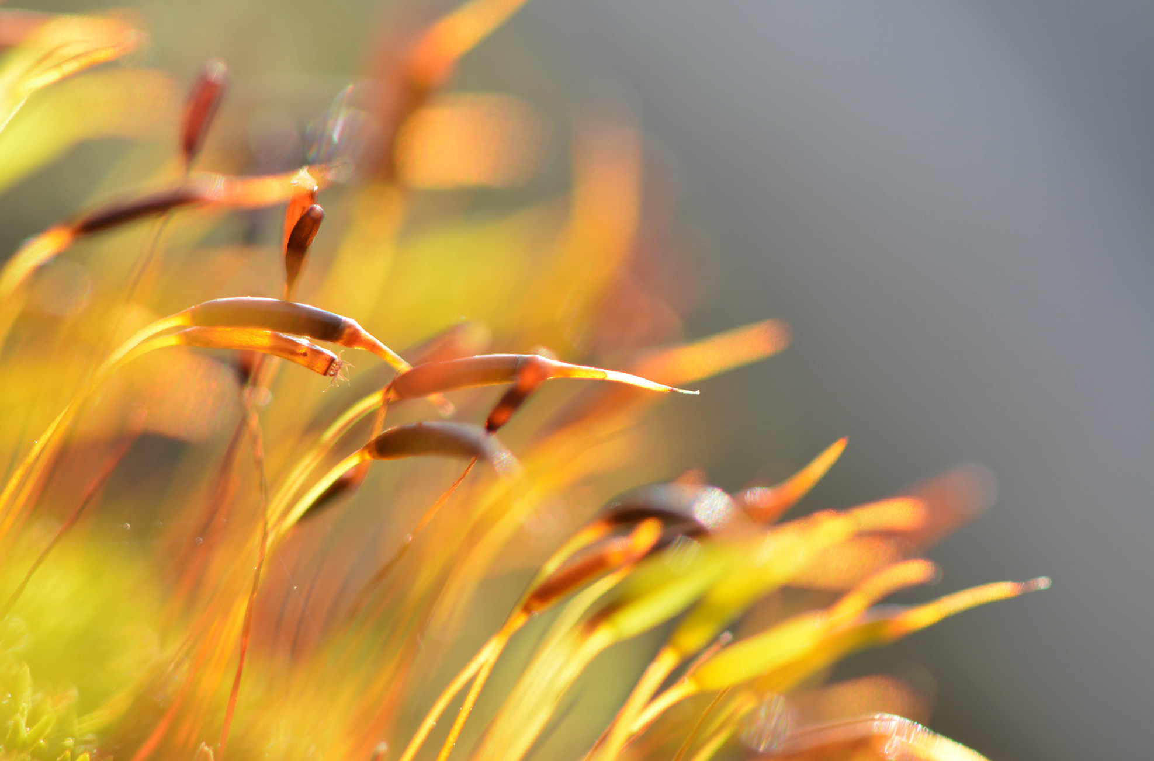
Mosses₄
Sporophyte dependent on gametophyte for nutrients
Seta contains tubular cells that transfer nutrients from base of sporophyte to sporangium or capsule
Seta/chaeta: (plural, setae/chaetae) chitinous projection from the cuticle
Capsule: case of the sporangium in mosses
25.2 Figure 10: Long slender stems, called setae, connected to capsules of the moss Tortula muralis are depicted. The operculum and remnants of the calyptra are visible in some capsules.
Lamiot on Wikimedia Commons. "Capsules of sporophytes."

Slide 24
Mosses₅
Spore mother cells in sporangium undergo meiosis to produce haploid spores
Sporophyte features that protect developing spores and aid in dispersal:
Calyptra covers sporangium
Calyptra: hoodlike structure that protects the capsule that contains the embryonic sporophyte
Operculum and calyptra fall off when spores are ready for dispersal
Operculum: apical portion of the moss capsule
Peristome opens and closes (depending on moisture levels) and periodically releases spores
Peristome: tissue that surrounds the opening of the capsule and allows the periodic release of spores

Slide 25
Group Activity₂
As a group, draw an evolutionary scale including geological time and plant evolution.
Where would you locate the three bryophyte phyla?
Do you think they appeared at different time points?

Slide 26
Table 1: Comparison of Characteristics of the Three Main Bryophyte Groups
 | Liverworts | Hornworts | Mosses
Gametophyte | flat or leafy | flat | erect stem and leaves
Sporophyte | yes | yes | yes
Stomata | no, only pores | yes | yes
Protonema | no | no | yes
Leaves | no | no | no
Chloroplasts (in a cell) | multiple | one large | multiple
Cuticle | no | yes | yes
Symbiotic Bacteria | yes | yes | yes

Slide 27
Summary
Seedless nonvascular plants:
Small
Gametophyte as dominant stage in life cycle
No vascular system or roots; absorb water and nutrients on exposed surfaces
Known as bryophytes
Include liverworts, hornworts, and mosses
Liverworts: Most primitive and closely related to first land plants
Hornworts: Developed stomata and possess single chloroplast per cell
Mosses: Have conductive cells and attach to substrate by rhizoids; colonize harsh habitats and regain moisture after drying out; sporangium is complex structure that allows for release of spores away from parent plant

Slide 28

End of Hawkes Learning PowerPoint

