Slide 1
Lesson 25.3
Seedless Vascular Plants: Ferns and Their Relatives

Slide 2
Objectives
Describe the life cycle of a fern.
Discuss how each trait is important for adaptation to life on land.
Explain the role of seedless plants in the ecosystem.
Identify the classes of seedless tracheophytes.
Identify the new traits that first appear in seedless tracheophytes.

Slide 3
Seedless Vascular Plants: Ferns and Their Relatives₁
Vascular plants (tracheophytes): Dominant, most conspicuous group of land plants
Tracheophyte: vascular plant
260,000 species make up more than 90% of Earth's vegetation
Success attributed to:
Ability to achieve enormous heights (competing successfully for light)
Photosynthetic organs as leaves
Pipelike cells or vascular tissues transport water, minerals, and fixed carbon organic compounds throughout organism

Slide 4
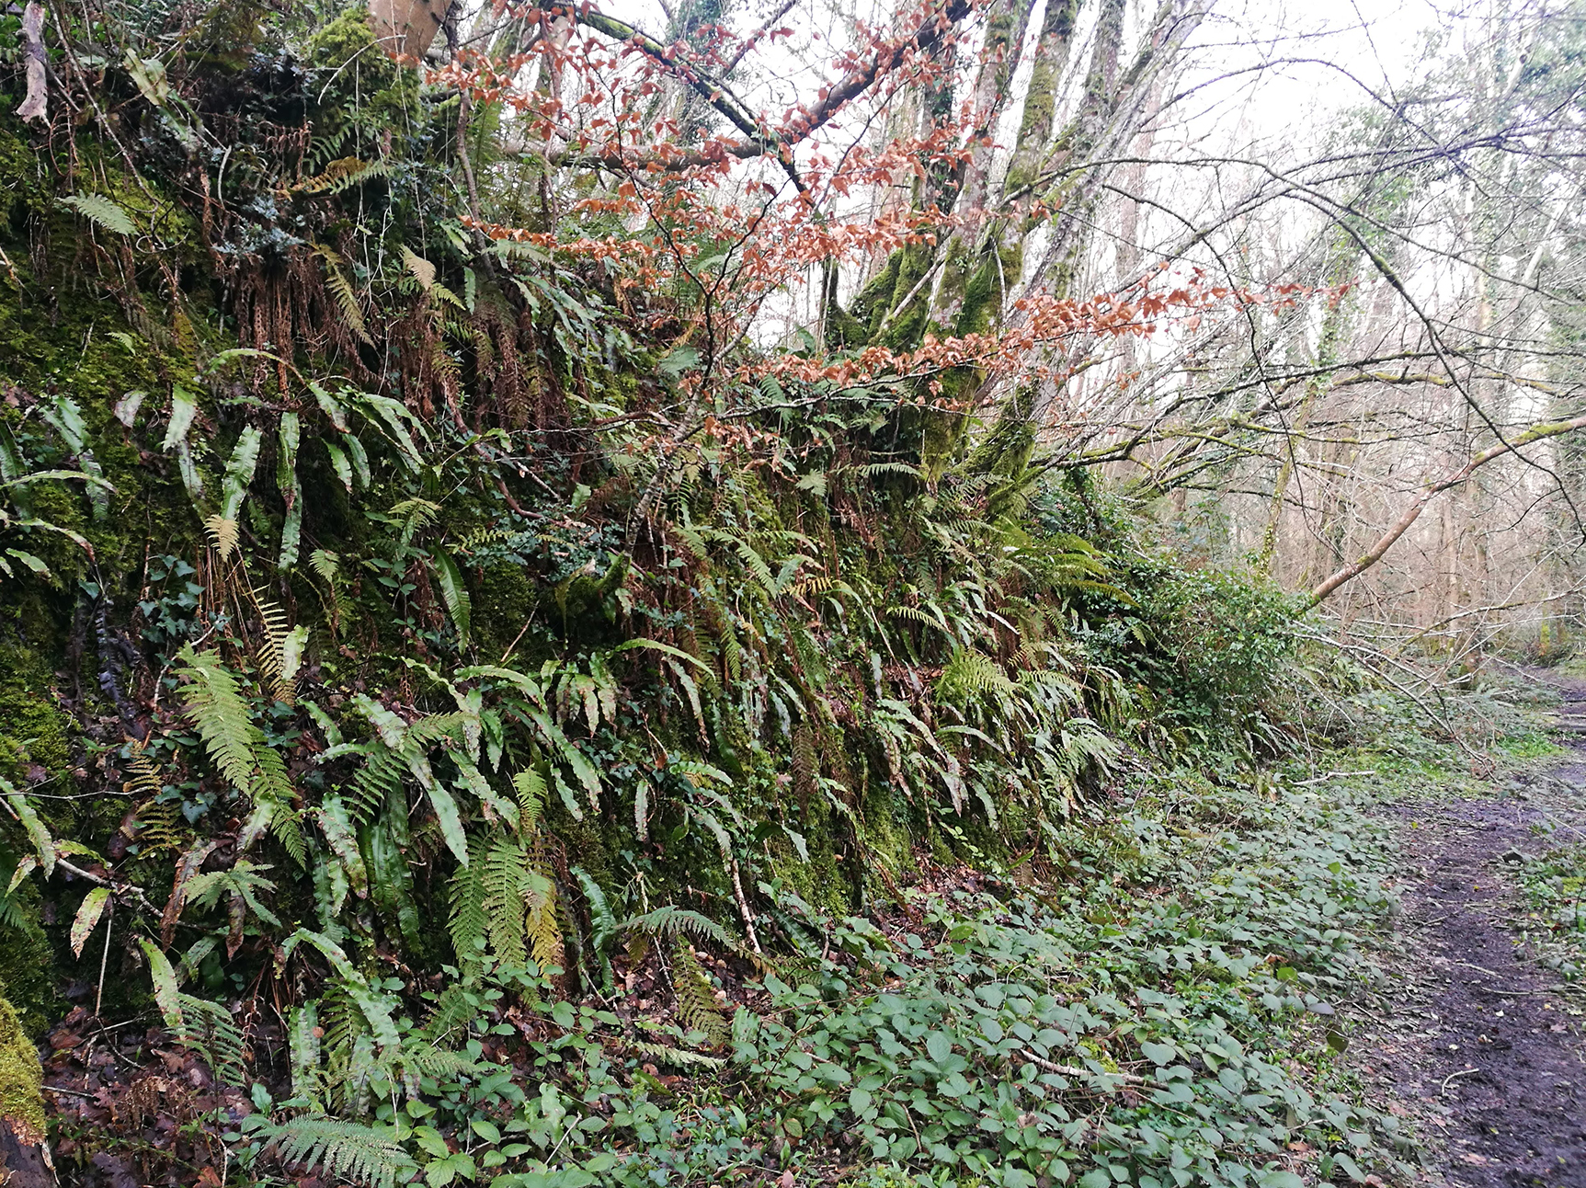
Seedless Vascular Plants: Ferns and Their Relatives₂
Increase in dominance of sporophyte generation
Diploid sporophyte is dominant phase of life cycle
Gametophyte is less conspicuous but independent of sporophyte
Depend on water during fertilization (flagellated sperm must swim to reach egg)
Explains why ferns and relatives are more abundant in damp environments
25.3 Figure 1: Ferns colonizing a damp forest.
Gaoithe on Wikimedia Commons. "Ferns and other plants."

Slide 5
Vascular Tissue: Xylem and Phloem₁
First plant fossils with vascular tissue date to Silurian Period (420 MYA)
Simplest arrangement of conductive cells shows pattern of xylem at the center surrounded by phloem (both parts of the vascular system of plants)

Slide 6
Vascular Tissue: Xylem and Phloem₂
Xylem: tissue responsible for long-distance transport of water and nutrients and provides physical support to the plant
Consists of conducting cells (tracheids) and supportive filler tissue (parenchyma)
Tracheid: xylem cell with thick secondary walls that helps transport water
Parenchyma: versatile tissue that fills soft parts of plants; it forms, among other things, the cortex and pith of stems, the cortex of roots, and the mesophyll of leaves
Conductive cells incorporate lignin into their walls (known as lignified)
Lignin: complex polymer impermeable to water; gives rigidity and strength to vascular tissue
Provide support to plant and allow it to grow tall
Gives selective advantage because they can reach unfiltered sunlight and disperse spores or seeds away from parent plant, expanding species' range
Allows them to outcompete shorter plants for water and nutrients in the soil

Slide 7
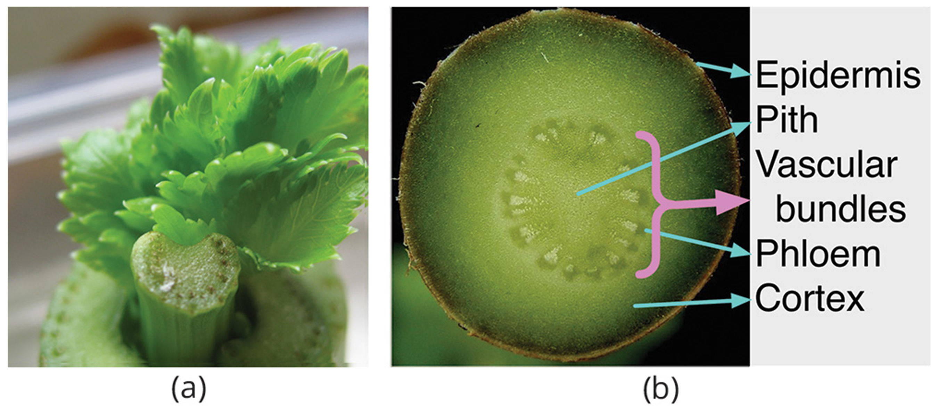
Vascular Tissue: Xylem and Phloem₃
Phloem: tissue responsible for the transport of sugars, proteins, and other solutes; divided into sieve elements (conducting cells) and cells that support sieve elements
Sieve elements: specialized cells that are important for the function of the phloem
25.3 Figure 2: This cross section of a celery stalk shows a number of vascular bundles. (a) The xylem is on the inner part of each bundle. (b) This cross section of Crassula ovata shows the phloem and the vascular bundles.
Chuck Spidell on Wikimedia Commons. "Celery."
Frank Vincentz on Wikimedia Commons. "Cross section of Crassula ovata."

Slide 8
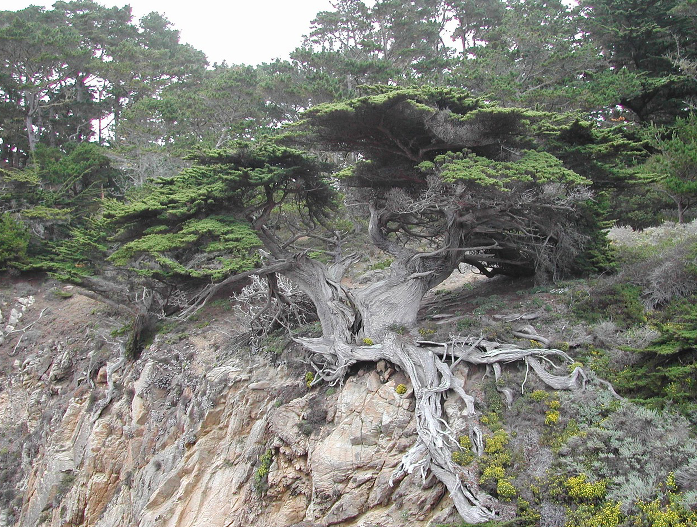
Roots: Support for the Plant
Not well preserved in fossil record
Earliest known root fossil dates to 400 MYA
Seems roots appeared later in evolution than vascular tissue (dated to 420 MYA)
Represent significant new feature of vascular plants
Transfer water and minerals from the soil to plant
Penetrate deep into soil to reach water
Stabilize plant by acting as ballast or anchor
Establish symbiotic relationship with fungi, forming mycorrhizae (which increase surface area for absorption of water, soil minerals, and nutrients)
Mycorrhizae: symbiotic relationship between fungal hyphae, which provide soil minerals to the plant, and plant roots, which provide carbohydrates to the fungus
25.3 Figure 3: This tree's root system shows how it can receive nutrients from a wide area, allowing the tree to continue growing even taller.
1cmathis on Pixabay. "Tree root system."

Slide 9
Leaves, Sporophylls, and Strobili₁
True leaves improved photosynthetic efficiency
Capture more sunlight with increased surface area by employing more chloroplasts to trap light energy and convert it to chemical energy
Chemical energy then used to fix atmospheric CO₂ into carbohydrates
Carbohydrates then exported to rest of the plant by conductive cells of phloem tissue
Two types of leaf morphology (microphylls and megaphylls) suggest leaves evolved independently
Microphyll: small size and simple vascular system with a single unbranched vein
Vein: bundle of vascular tissue made of xylem and phloem
Dated to 380 MYA in Devonian Period
Originated from flattening of lateral branches or from sporangia that lost reproductive capabilities
Seen in club mosses

Slide 10
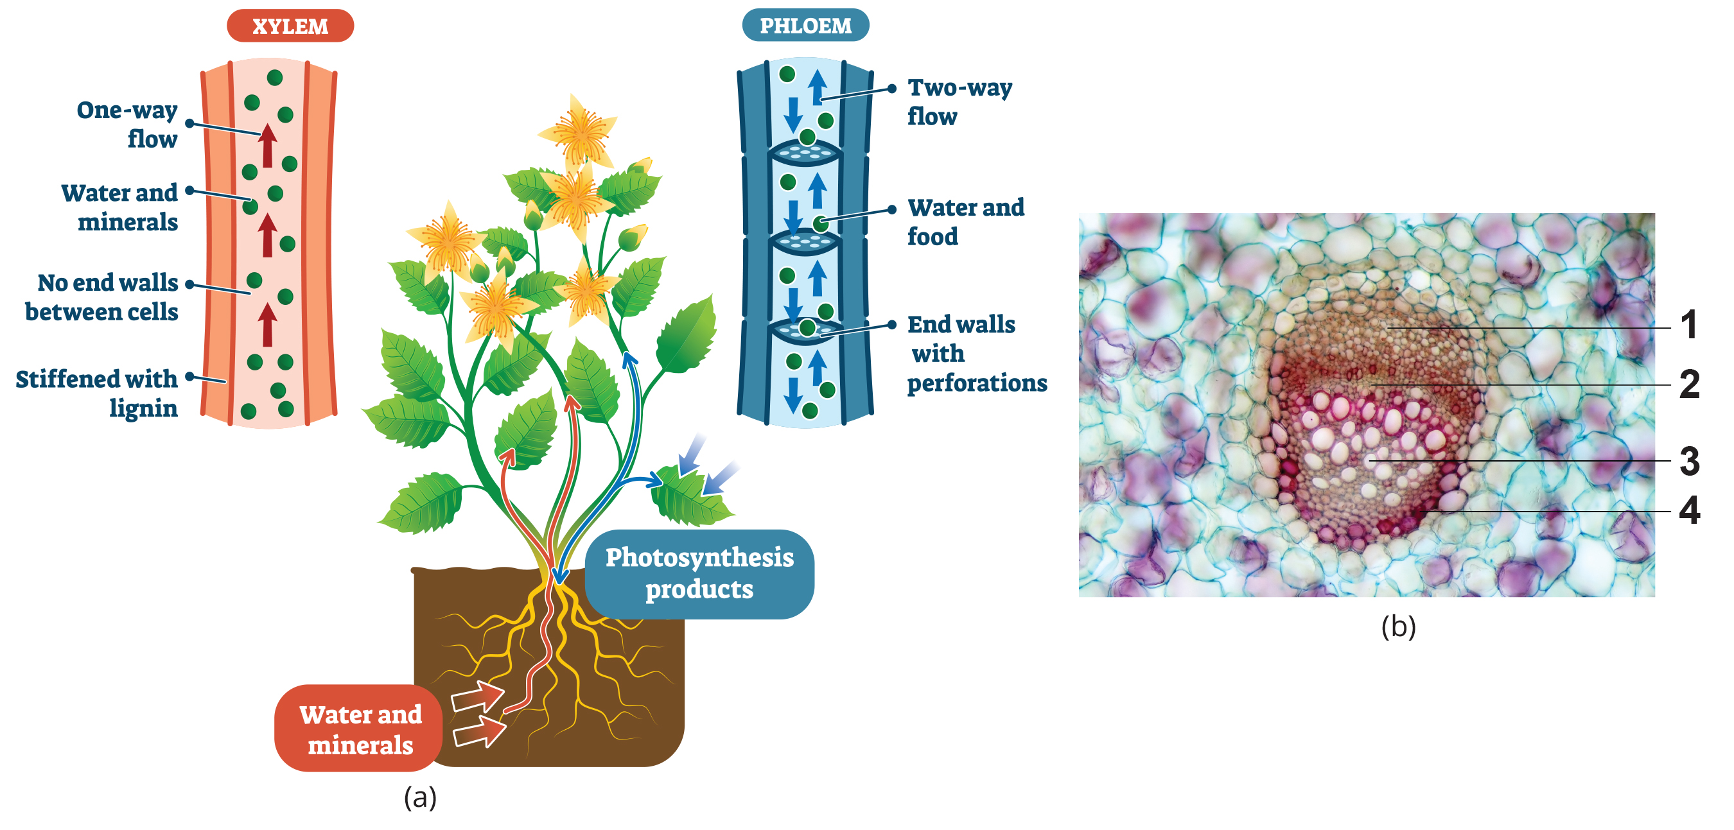
25.3 Figure 4
JonRichfield on Wikimedia Commons. "Cross section of stem cells in Rumex."
Notes:
Figure 4: (a) The xylem tissue is responsible for transporting water and minerals from the roots to the rest of the plant. It also provides structural support. The phloem cells (sieve elements) transport carbohydrates, sugars, proteins, and other solutes throughout the plant. (b) This image shows a cross section of stem cells in Rumex. The various tissue in the vascular bundle system are the phloem (labeled 1), cambium (which provides a layer between the xylem and the phloem; labeled 2), xylem (labeled 3), and the fibrous sheath (labeled 4).

Slide 11
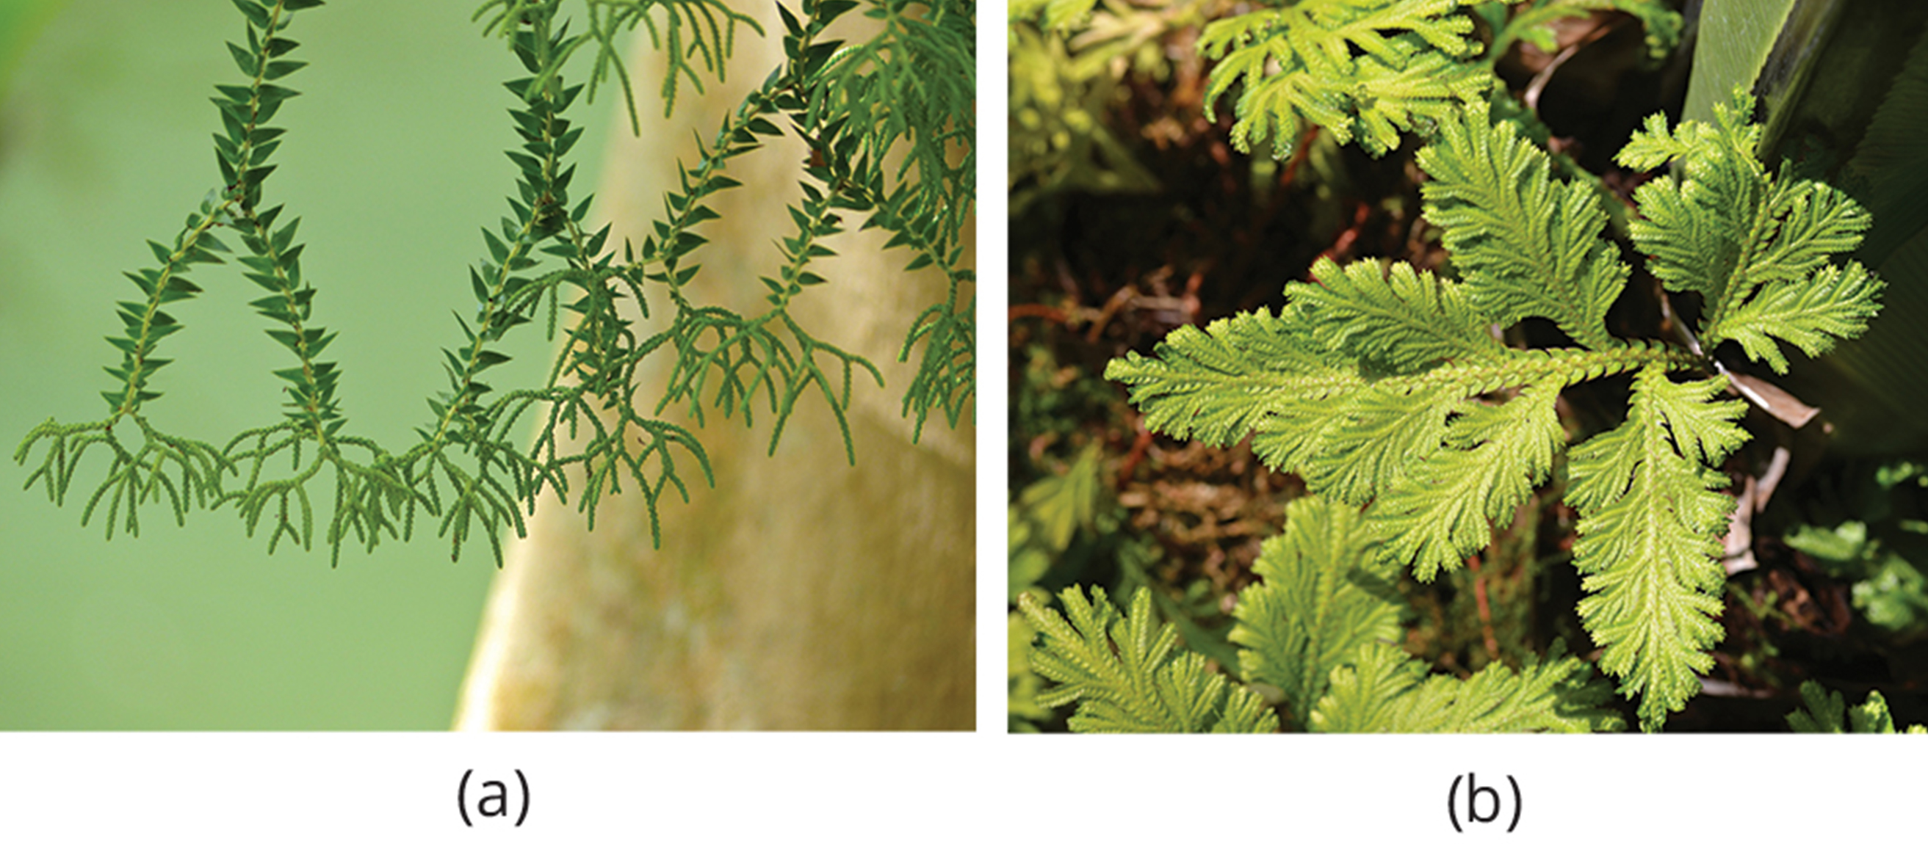
Leaves, Sporophylls, and Strobili₂
Microphylls preceded development of megaphylls
Megaphyll: larger leaves with a pattern of branching veins
Most likely appeared independently several times
Complex network of veins suggest several branches combined into flattened organ, with gaps between branches filled with photosynthetic tissue
Seen in ferns and more recent vascular plants
25.3 Figure 5: (a) Microphylls from the club moss Huperzia salvinioides. (b) Megaphylls from the fern Asplenium nidus.
Bernard DUPONT on Wikimedia Commons. "Epiphytic club moss."
Derek Ramsey on Wikimedia Commons. "Bird's-nest fern."

Slide 12
Leaves, Sporophylls, and Strobili₃
Sporophyll: leaf modified structurally to bear sporangia
Examples: Pinecones, mature fronds of ferns, flowers
Strobilus: (plural, strobili) plant structure with a tight arrangement of sporophylls around a central stalk, as seen in cones or flowers; the male strobilus produces pollen, and the female strobilus produces eggs
Example: Pinecones in conifers

Slide 13
Group Activity
The evolution of leaves and their relationship has been a matter of debate for the scientific community. As a group, look for evidence and decide whether megaphylls evolved from microphylls or evolved independently.

Slide 14
Ferns and Other Seedless Vascular Plants
Plants evolved vascular tissue, well-defined leaves, and root systems by late Devonian Period, which allowed increased height and size
Swamp forests of club mosses and horsetails emerged in Carboniferous Period (359 to 299 MYA)
Plants reached heights of more than 30 meters
Gave rise to extensive coal deposits
Sporophyte became dominant phase of life cycle for seedless vascular plants
Water still required for sperm transport
Most favor moist environment
Include club mosses, horsetails, ferns, and whisk ferns

Slide 15
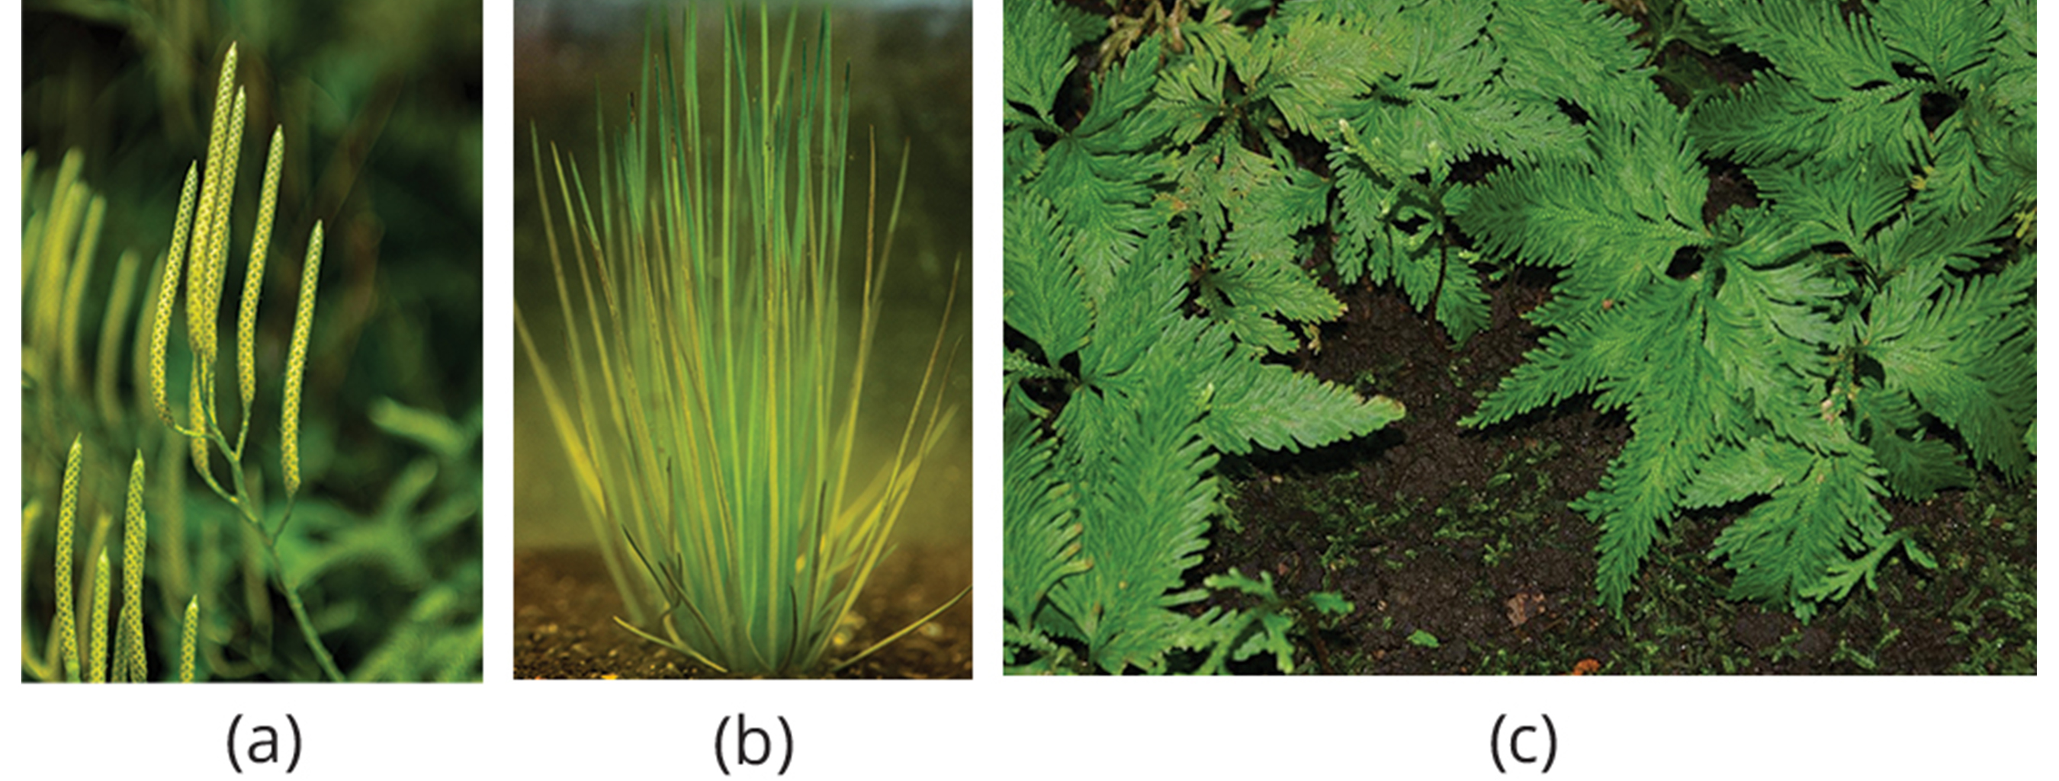
Phylum Lycophyta: Club Mosses₁
Club mosses: earliest group of seedless vascular plants (also, lycophytes)
Dominated during Carboniferous Period
Were tall and formed large swamp forests; today, small, evergreen plants with a stem (may be branched) and microphylls
Phylum Lycophyta: 1,200 species
Includes quillworts (Isoetales), club mosses (Lycopodiales), and spike mosses (Selaginellales)
Does not include true mosses or bryophytes
25.3 Figure 6: (a) In club mosses, such as Lycopodium clavatum, sporangia are arranged in clusters called strobili. (b) Isoetales, such as Isoetes japonica, commonly known as quillworts, are spore-producing plants and depend on water dispersion. (c) Selaginellales, such as Selaginella umbrosa are commonly called spike mosses. They have simple microphylls on branching stems.
Kingfiser on Wikimedia Commons. "Strobili of Lycopodium clavatum."
Kingfiser on Wikimedia Commons. "Isoetes japonica."
David J. Stang on Wikimedia Commons. "Spike moss."

Slide 16
Phylum Lycophyta: Club Mosses₂
Lycophyte: club moss
Reproduction:
Alternation of generations (like bryophytes, except sporophyte is dominant stage of life cycle)
Some (like club moss Lycopodium) produce gametophytes independent of sporophyte and develop underground or other locations where they form mycorrhizal associations with fungi
Sporophyte gives rise to sporophylls arranged in strobili
Sporangia develop within chamber formed by each sporophyll
Can be homosporous (one type of spore) or heterosporous (two types of spores)
Example: Spike moss Selaginella is heterosporous
Same strobilus will contain microsporangia, which produce spores that develop into male gametophyte, and megasporangia, which produce spores that develop into female gametophyte
Both gametophytes develop within strobilus

Slide 17
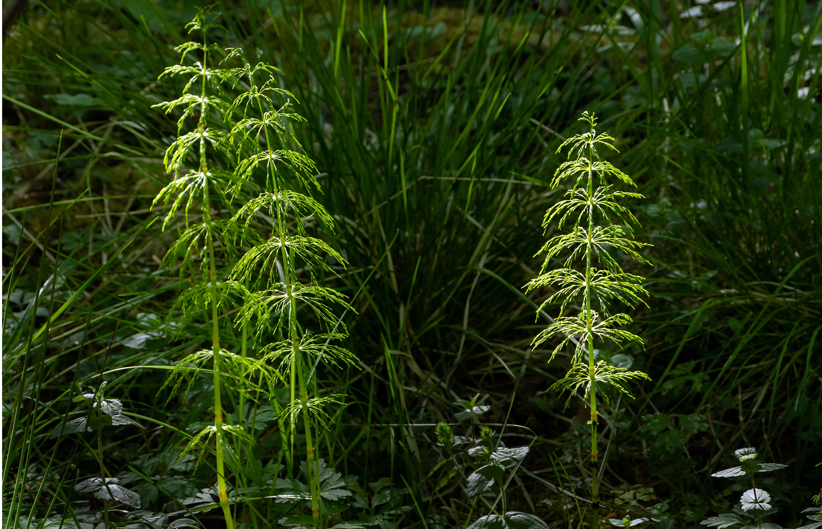
Phylum Monilophyta: Class Equisetopsida (Horsetails)₁
Phylum Monilophyta: Horsetails, whisk ferns, and ferns
Usually found in damp environment and marshes
Class Equisetopsida: Horsetails
Horsetail: seedless vascular plant characterized by joints
Survivor of large group of plants called Arthrophyta (produced large trees and entire swamp forests in Carboniferous Period)
25.3 Figure 7: Horsetails, named for the brushy appearance of the sporophyte, thrive in a marsh.
W. carter on Wikimedia Commons. "Wood horsetails."

Slide 18
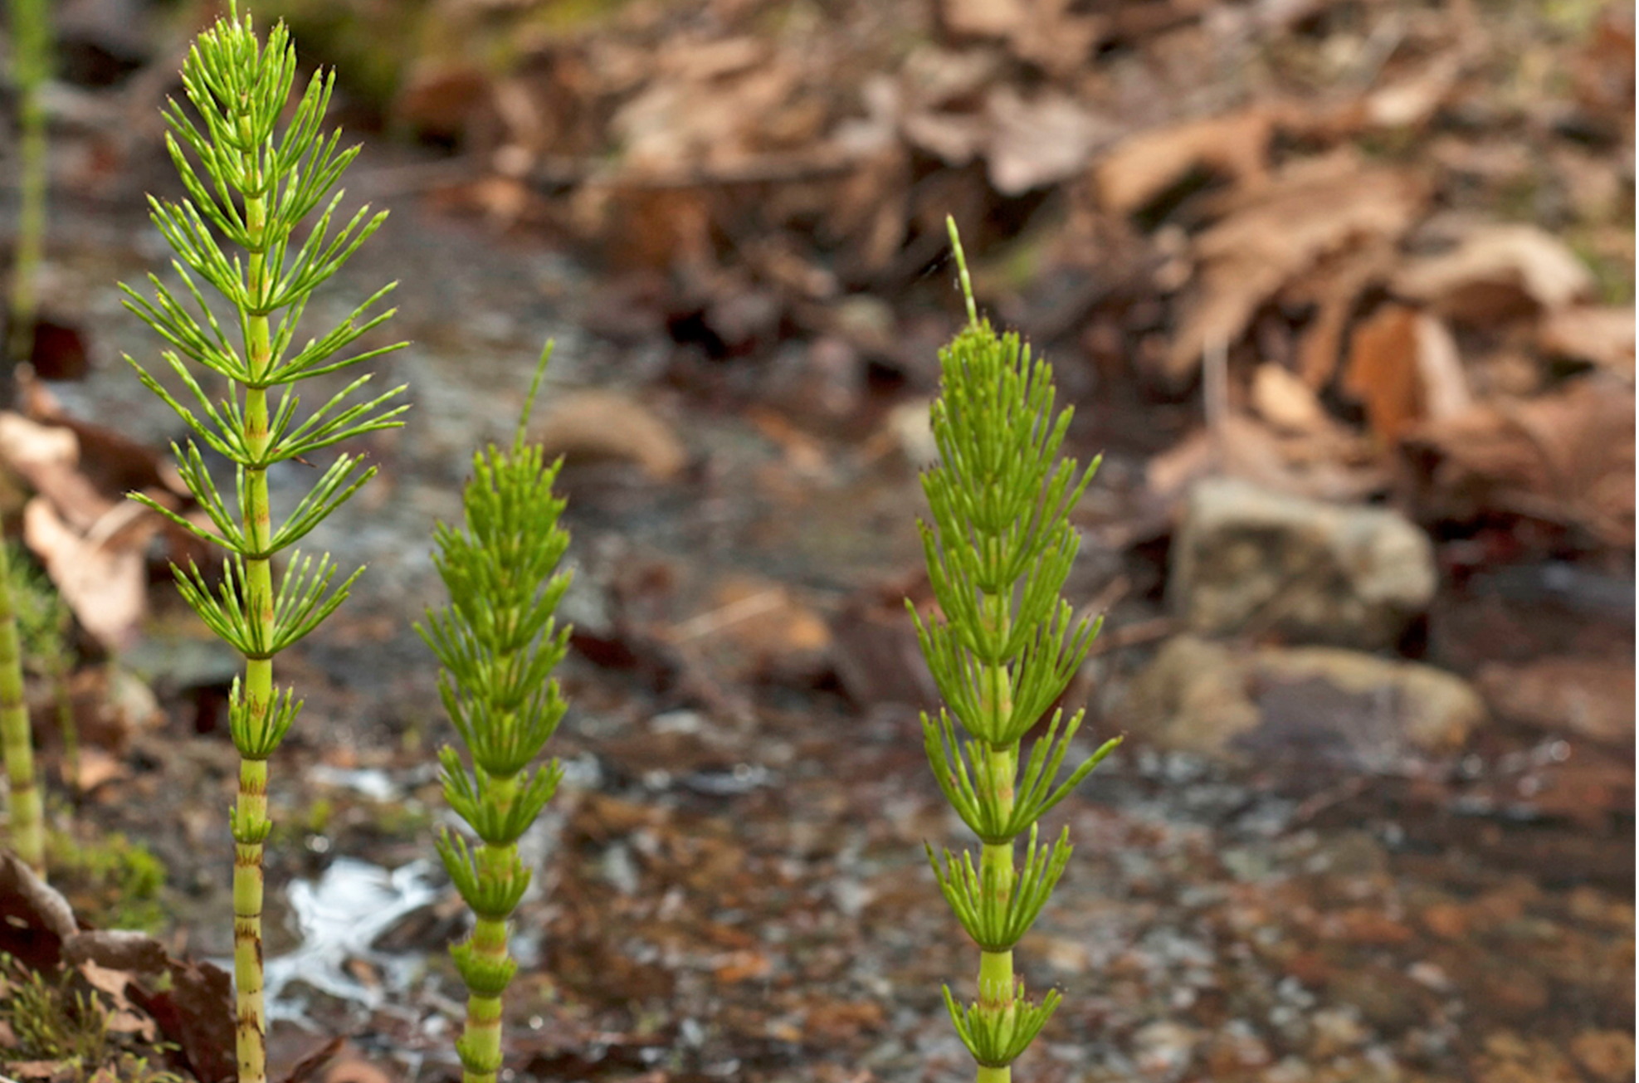
Phylum Monilophyta: Class Equisetopsida (Horsetails)₂
Stem characterized by joints or nodes
Leaves and branches come out as whorls from joints
Needle-shaped leaves do not do much photosynthesis; instead, most photosynthesis takes place in green stem
25.3 Figure 8: Thin leaves originating at the joints are characteristic of horsetails. Silica deposited in the cell walls make these plants abrasive. In fact, they were once used as scrubbing brushes and nicknamed scouring rushes.
Scott Darbey on Wikimedia Commons. "Horsetail."

Slide 19
Phylum Monilophyta: Class Equisetopsida (Horsetails)₃
Silica: mineral compound that serves to improve resistance against biotic and abiotic stresses
Collected by epidermal cells
Contributes to stiffness of horsetail plants
Underground stems (i.e., rhizomes) anchor plants to ground
Are homosporous
Spores attached to elaters
Elaters: structures that function in the dispersal of spores; spring open in dry weather and cast spores to distant locations
Spores germinate to produce small bisexual gametophytes

Slide 20
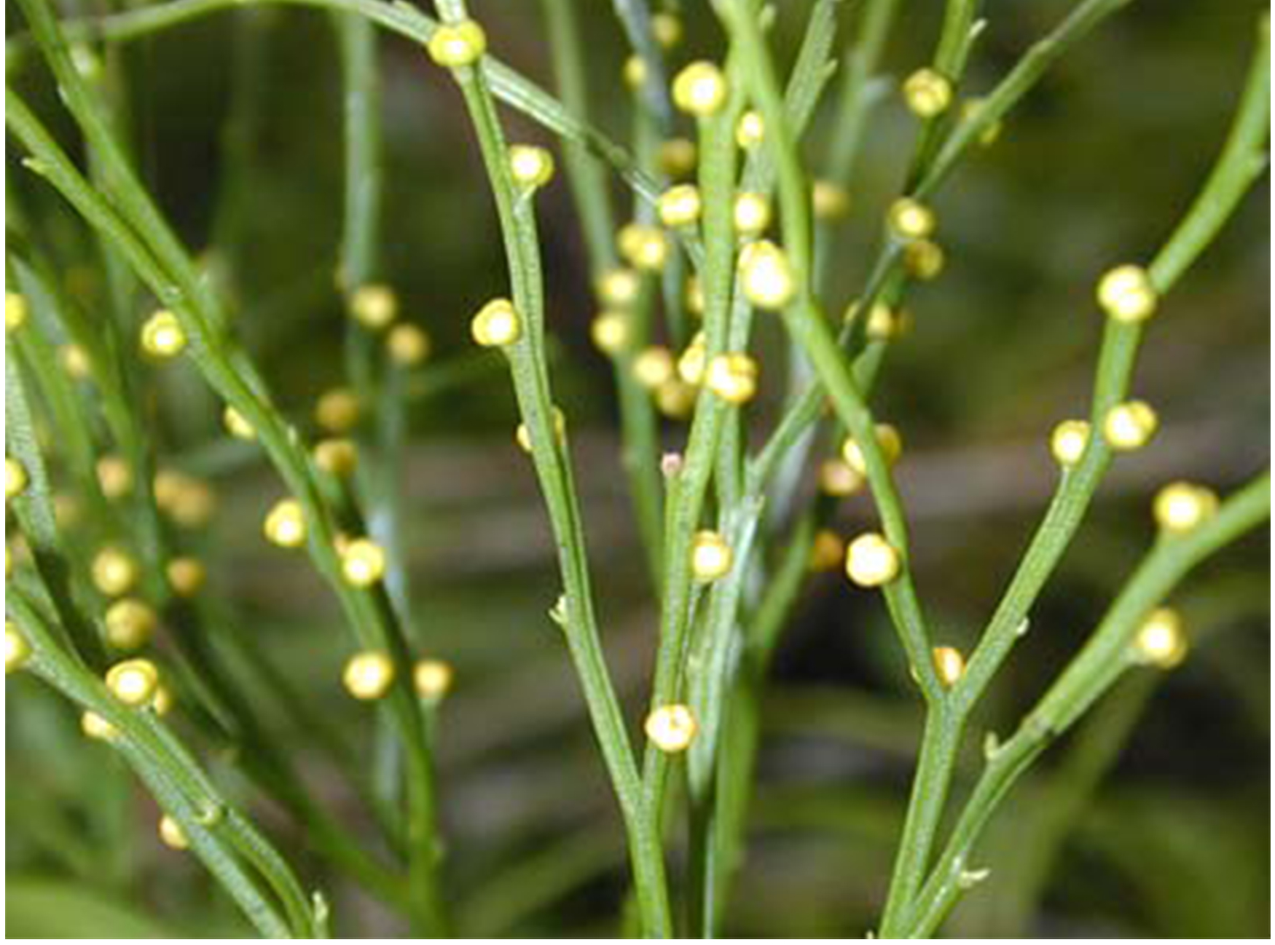
Phylum Monilophyta: Class Psilotopsida (Whisk Ferns)
Whisk fern: seedless vascular plant that lost roots and leaves by reduction (loss of trait inherited from ancestor due to lack of utility in present lineage)
Photosynthesis in stems, which branch dichotomously (split into two parts)
Small, yellow knobs form at tip of branch or branch node and contain sporangia
Spores develop into gametophytes that produce both male and female gametangia
Once considered to be more closely related to ancestral vascular plants than ferns
Comparative DNA analysis suggests loss of their leaves and roots over time, making them members of ferns
25.3 Figure 9: This whisk fern Psilotum nudum has conspicuous green stems with knob-shaped sporangia.
Eric Guinther on Wikimedia Commons. "Whisk fern."

Slide 21
Phylum Monilophyta: Class Polypodiopsida (True Ferns)₁
Fern: seedless vascular plant that produces large fronds; the most advanced group of seedless vascular plants
Most recognizable and most advanced; display characteristics of seed plants
More than 20,000 species live in habitats ranging from tropics to temperate forests
Some can survive in dry environments, but most restricted to moist, shaded places
Appeared during Devonian Period (419 MYA) and expanded during Carboniferous Period (359 to 299 MYA)

Slide 22
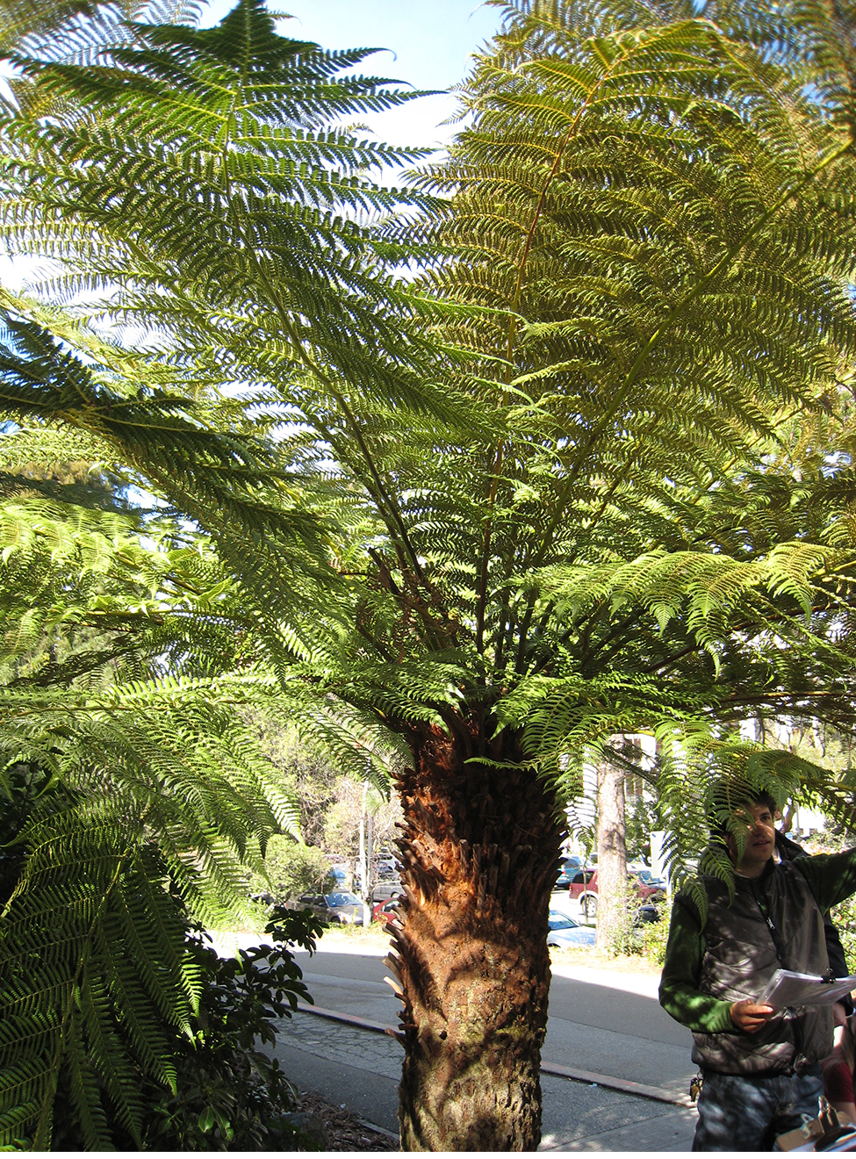
Phylum Monilophyta: Class Polypodiopsida (True Ferns)₂
Reproduction:
Sporophyte is dominant stage of life cycle
Consists of large compound megaphylls called fronds: the leaves of a fern
Either finely divided or broadly lobed
Photosynthetic organs and reproductive organs
Stem buried underground as rhizome (where adventitious roots grow to absorb water and nutrients from soil) or grow above ground as trunk in tree ferns
Adventitious: describes an organ that grows in an unusual place, such as roots growing from the side of a stem
25.3 Figure 10: Some specimens of this fern species can grow as tall as some trees.
josh jackson on Wikimedia Commons. "Tasmanian fern tree."

Slide 23
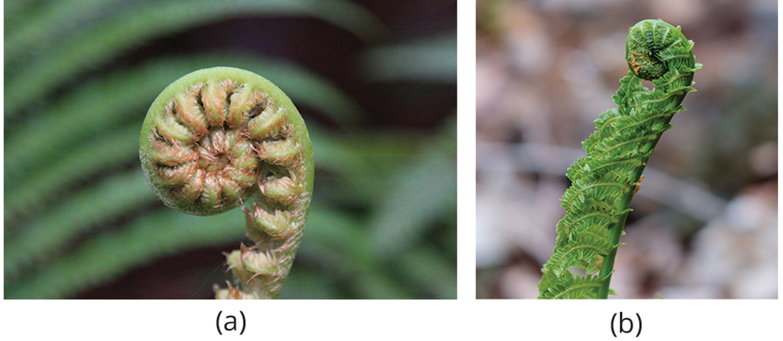
Phylum Monilophyta: Class Polypodiopsida (True Ferns)₃
Crozier: curled top of a young fern frond (also, fiddlehead)
Unrolls as frond develops
25.3 Figure 11: Croziers, or fiddleheads, are the tips of fern fronds.
Wingchi Poon on Wikimedia Commons. "Unfurling fiddlehead fern."
Sharon Mollerus on Wikimedia Commons. "Fiddlehead fern."

Slide 24
Phylum Monilophyta: Class Polypodiopsida (True Ferns)₄
Sori: cluster of sporangia in ferns
Located on underside of each mature fern frond
Most ferns are homosporous
Spores produced by meiosis and released in air from sporangium
Land on suitable substrate and germinate to form heart-shaped gametophyte (or prothallus), which attaches to ground by thin filamentous rhizoids
Gametophytes produce antheridia and archegonia
Sperm cells have multiple flagella and swim to archegonium, which releases chemoattractant
Zygote develops into fern sporophyte and emerges from archegonium of gametophyte
Antheridia and archegonia mature at different times, encouraging cross-fertilization

Slide 25
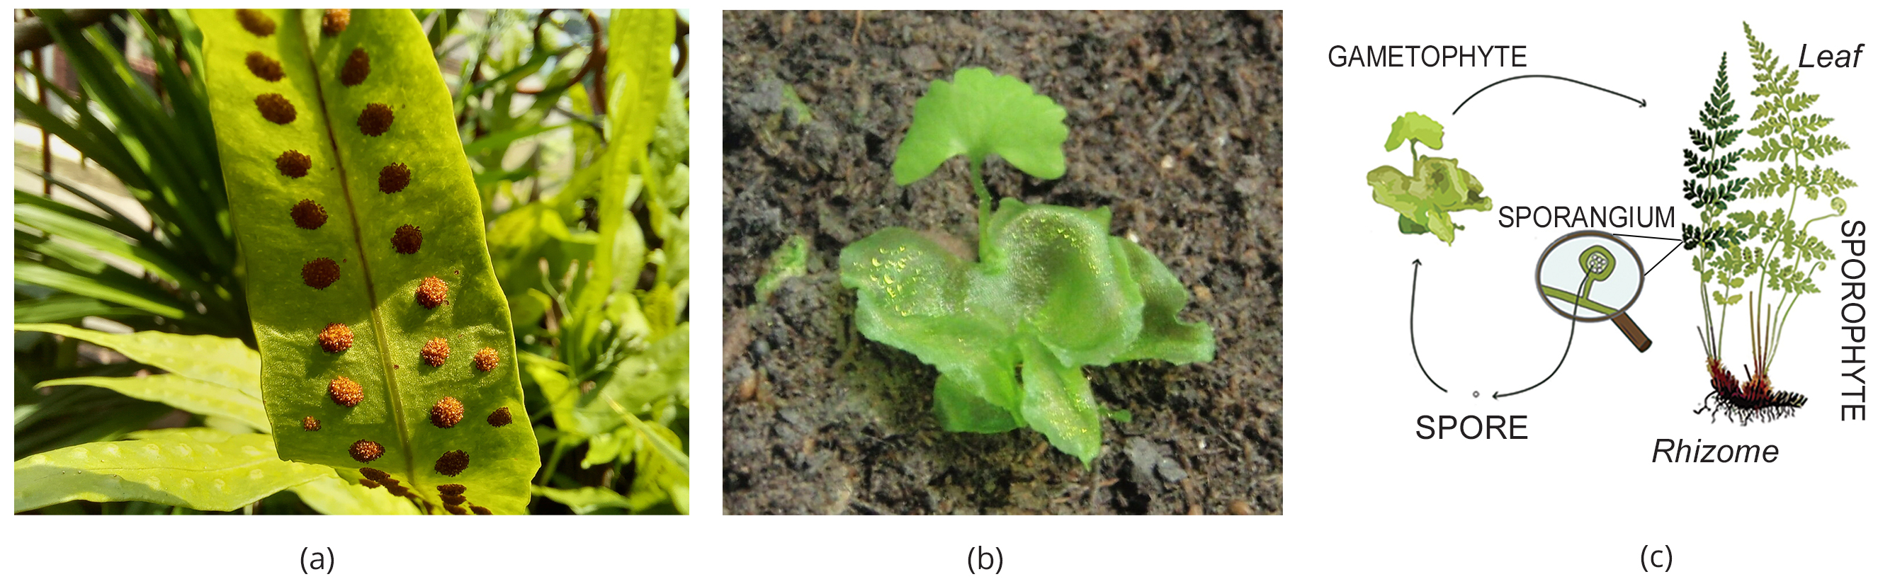
25.3 Figure 12
Vitaium on Wikimedia Commons. "Monarch fern sori."
Vlmastra on Wikimedia Commons. "Fern gametophyte and a young sporophyte."
Carl Axel Magnus Lindman on Wikimedia Commons. "Life cycle of pteridophyte."
Notes:
Figure 12: (a) Sori appear as small bumps on the underside of a fern frond. (b) Shown are a fern gametophyte and a young sporophyte. (c) This is the schematic life cycle of a fern.

Slide 26
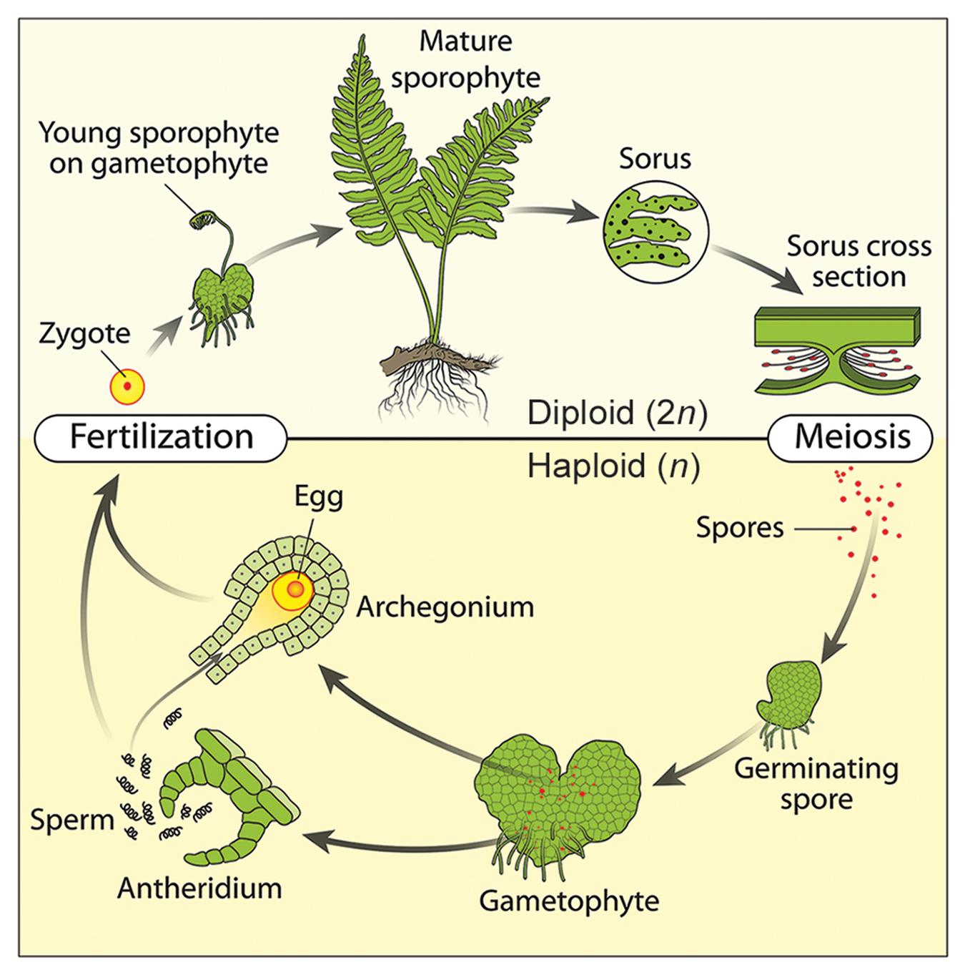
25.3 Figure 13
Notes:
Figure 13: This life cycle of a fern shows alternation of generations with a dominant sporophyte stage.

Slide 27
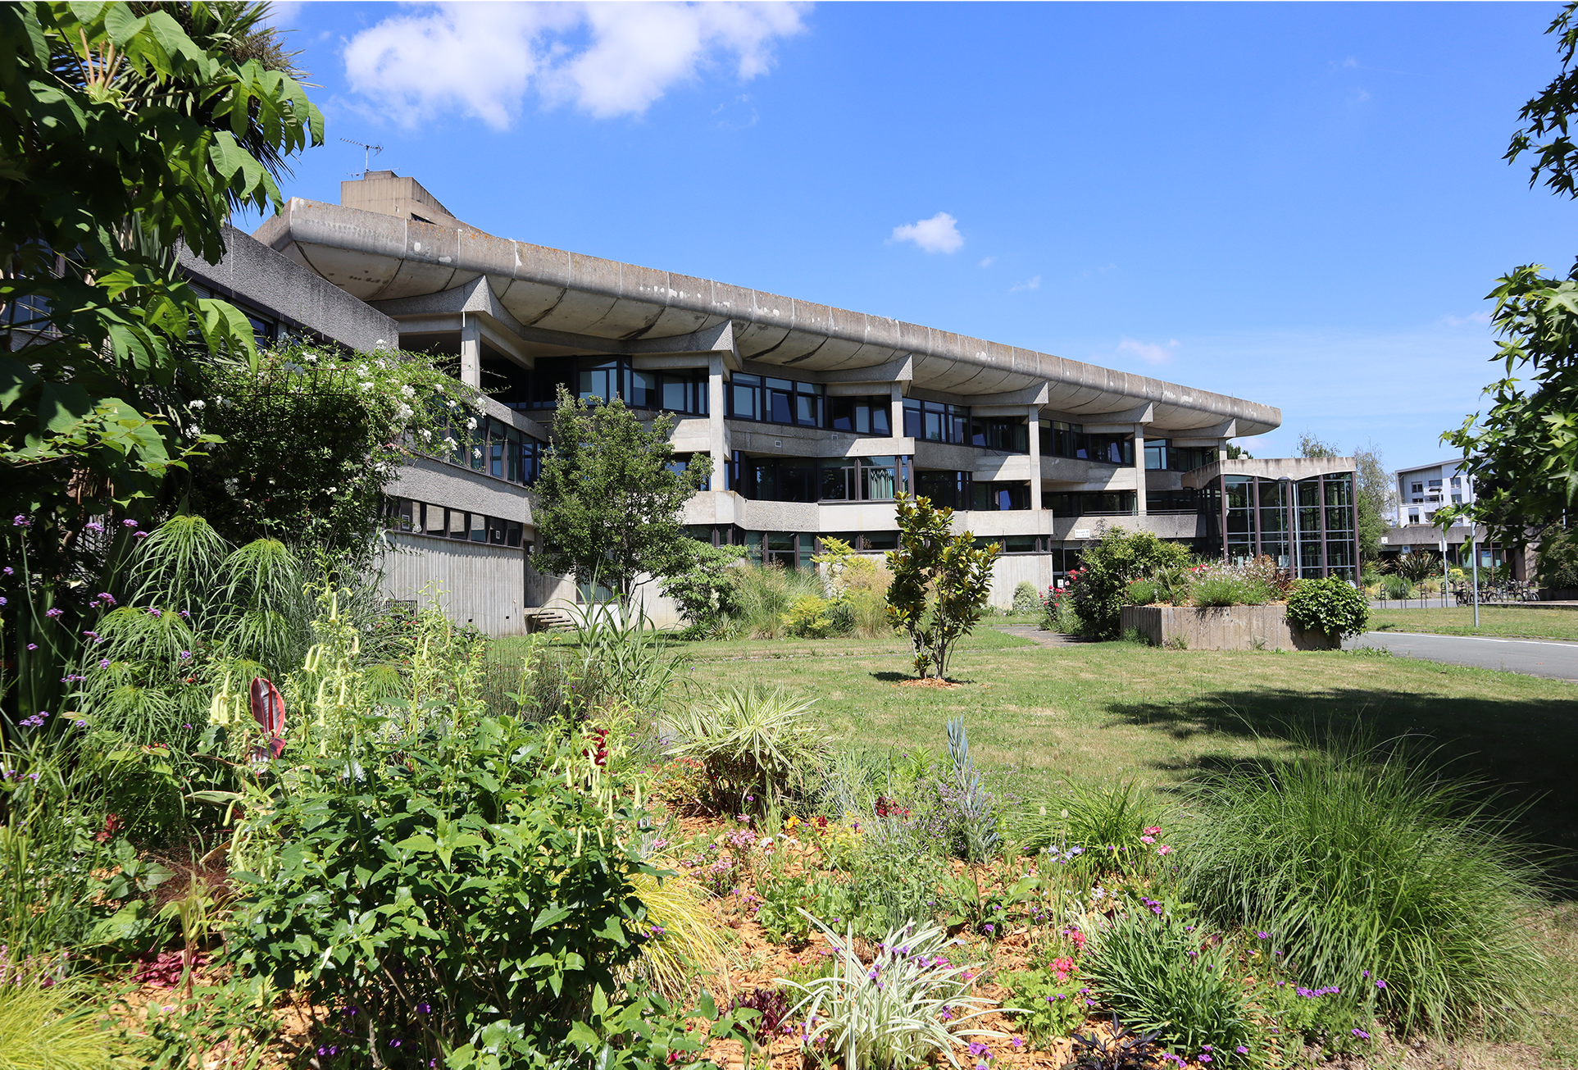
Science and You₁
Career: Landscape Designer
Notable examples:
Classical European gardens
Monticello (designed by Thomas Jefferson)
Central Park, NYC
Washington D.C. city plan
Plan and design outdoor spaces:
City parks and green spaces
Public gardens, parks, campuses
Private residential gardens
Natural areas like wetlands restoration
25.3 Figure 14: This landscaped border at the National Institute of Hygiene was designed by professional landscapers.
Alexb49 on Wikimedia Commons. "Landscaped home."
Notes:
This is included as a relevant application for this topic.

Slide 28
Science and You₂
Education requires multidisciplinary background:
Botany, soil science, plant pathology, entomology, horticulture
Architecture and design software skills
Knowledge of plant growth requirements, moisture levels, compatibility with different species, susceptibility to pathogens and pests
Example: Mosses and ferns thrive in shaded areas with fountains for moisture, but cacti do not
Key considerations include:
Plant biology: Light, moisture, space needs over time
Sustainable design balancing shapes, colors, biology
Blends art, architecture, and biology
Notes:
This is included as a relevant application for this topic.

Slide 29
The Importance of Seedless Plants₁
Important components of many ecosystems:
Mosses and liverworts are first macroscopic organisms to colonize an area during primary or secondary succession
Primary succession: succession on land that previously has had no life
Growth of mosses and liverworts helps break down rocks to form soil, facilitating growth of other plants
Secondary succession: succession in response to environmental disturbances that move a community away from its equilibrium; soil remains intact but wipes out existing species
Spores carried by wind, birds, or insects to begin colonization
Can grow in hostile environments
Bryophytes growing in tundra biomes (no roots and can dry and rehydrate quickly)

Slide 30
The Importance of Seedless Plants₂
Important components of many ecosystems:
Mosses at base of the food chain in tundra biome, providing food for herbivores, which provides food for primary consumers
Bryophytes make existing soil more amenable for colonization by other plants
Mosses replenish soil with nitrogen through symbiotic relationship with nitrogen-fixing cyanobacteria
Population of lichens and mosses declined in last century
No root systems and lack of cuticle means easier absorption of pollutants in rainwater
Disappearance of mosses considered biological indicator for pollution levels

Slide 31
Science and You₃
Mosses can be used as biomarkers to detect environmental pollution.
How would you use these organisms to detect contamination?
One answer can be to examine pollutant concentrations, such as heavy metals, in the tissue of the mosses close to an urban area (for example, close to a factory). By comparing them at varying distances from the area, you should be able to detect a decrease in metal concentrations in mosses the farther you collect them from the urban contaminated spot.
Notes:
This is included as a relevant application for this topic.

Slide 32
The Importance of Seedless Plants₃
Ferns contribute to environment by:
Promoting weathering of rock
Accelerating formation of topsoil
Topsoil: upper, outermost layer of soil
Slowing down erosion as rhizomes spread throughout the soil
Example: Water ferns of Azolla have nitrogen-fixing cyanobacteria and restore nitrogen to aquatic habitats

Slide 33
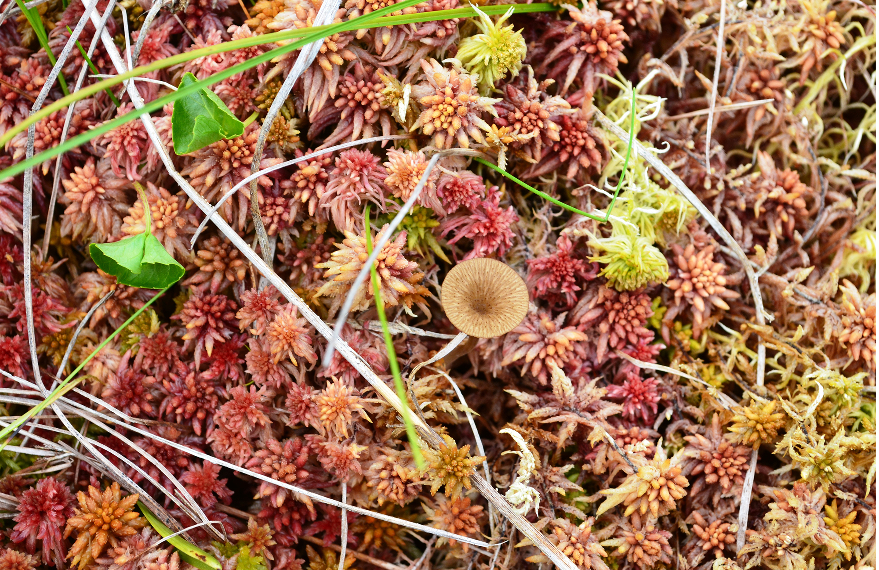
The Importance of Seedless Plants₄
Roles in human life:
Used as tools, fuel, and medicine
Example: Dried peat moss (Sphagnum)
Peat moss: Sphagnum moss; can be used as fuel and considered renewable resource
Bogs cultivated with cranberry and blueberry bushes
Ability to hold moisture makes it a common soil conditioner
Used in floral arrangements to maintain moisture
25.3 Figure 15: Sphagnum acutifolium is dried peat moss and can be used as fuel.
Virginia State Parks on Wikimedia Commons. "Sphagnum acutifolium."

Slide 34
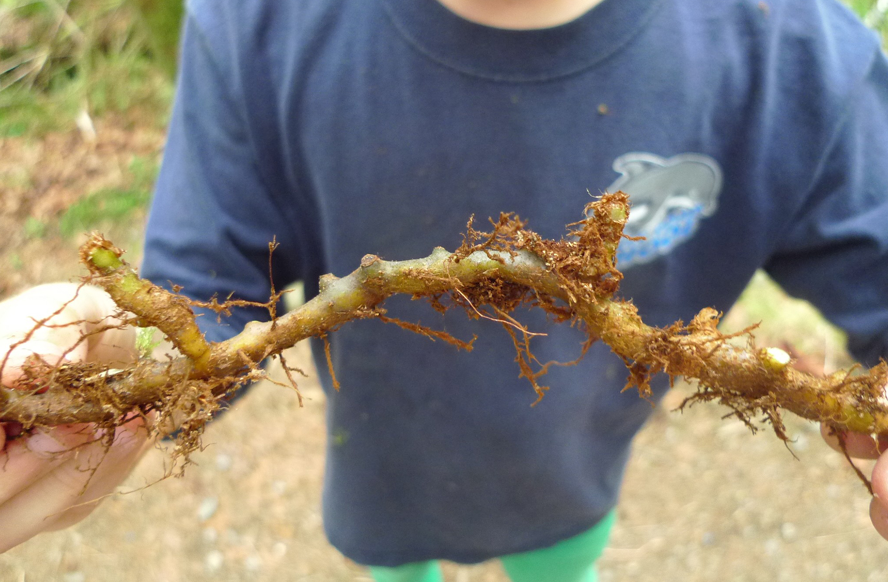
The Importance of Seedless Plants₅
Fronds of ferns used as ornamental plants
Thrive in low light and well suited as house plants
Fiddleheads of bracken ferns (Pteridium aquilinum) are traditional spring food for Native Americans and popular side dish in French cuisine
Licorice fern (Polypodium glycyrrhiza) is part of diet of Pacific Northwest coastal tribes because of the sweetness of rhizomes
Rhizome also used for medicinal purposes by Native Americans and used as remedy for sore throat
25.3 Figure 16: Polypodium glycyrrhiza, commonly known as licorice ferns, are native to western North America.
Kfediuk on Wikimedia Commons. "Polypodium glycyrrhiza."

Slide 35
The Importance of Seedless Plants₆
Greatest impact comes from extinct ancestors
Tall club mosses, horsetails, and treelike ferns in swampy forests of Carboniferous Period gave rise to large deposits of coal and other fossil fuels
Coal provided abundant source of energy during Industrial Revolution, which fueled rapid technological progress, growth of large cities, and degradation of the environment
Still prime source of energy and major contributor to global warming

Slide 36
Summary₁
Several features important to living on land:
Vascular tissue of xylem (water and mineral transport) and phloem (sugar and protein transport)
Leaves as large photosynthetic organs with roots to access water in ground
Microphylls: Small, uncomplicated leaves
Megaphylls: Large leaves with vein patterns
Sporophylls: Modified leaves that bear sporangia; arranged in cone structures called strobili
Sporophyte generation is dominant, enabled by supportive and conductive properties of vascular tissues

Slide 37
Summary₂
Major groups include:
Club mosses (most primitive)
Whisk ferns (lost leaves and roots by reductive evolution)
Horsetails
Ferns (most advanced group of seedless vascular plants; have fronds and sori)
Importance in balance of ecosystems:
Mosses pioneer succession, enrich soil, provide shelter and nutrients for animals in hostile environments; also biological indicators of pollution
Ferns provide natural habitats, stabilize soil, have decorative uses; also part of traditional medicinal practice
Other uses:
Culinary purposes
Fuels (fossil fuels derived from ancient seedless plants) used as energy source

Slide 38

End of Hawkes Learning PowerPoint

