Slide 1
Lesson 26.1
Evolution of Seed Plants

Slide 2
Objectives
Describe the significance of angiosperms bearing both flowers and fruit.
Describe the two major innovations that allowed seed plants to reproduce in the absence of water.
Discuss the purpose of pollen grains and seeds.
Explain when seed plants first appeared and when gymnosperms became the dominant plant group.

Slide 3
Seed Plants₁
Do not need water to reproduce
Play integral role by shaping physical terrain, influencing climate, and maintaining life
Used for nutrition, medicinal compounds, and source of manufactured products (e.g., timber, paper, dyes, textiles)

Slide 4
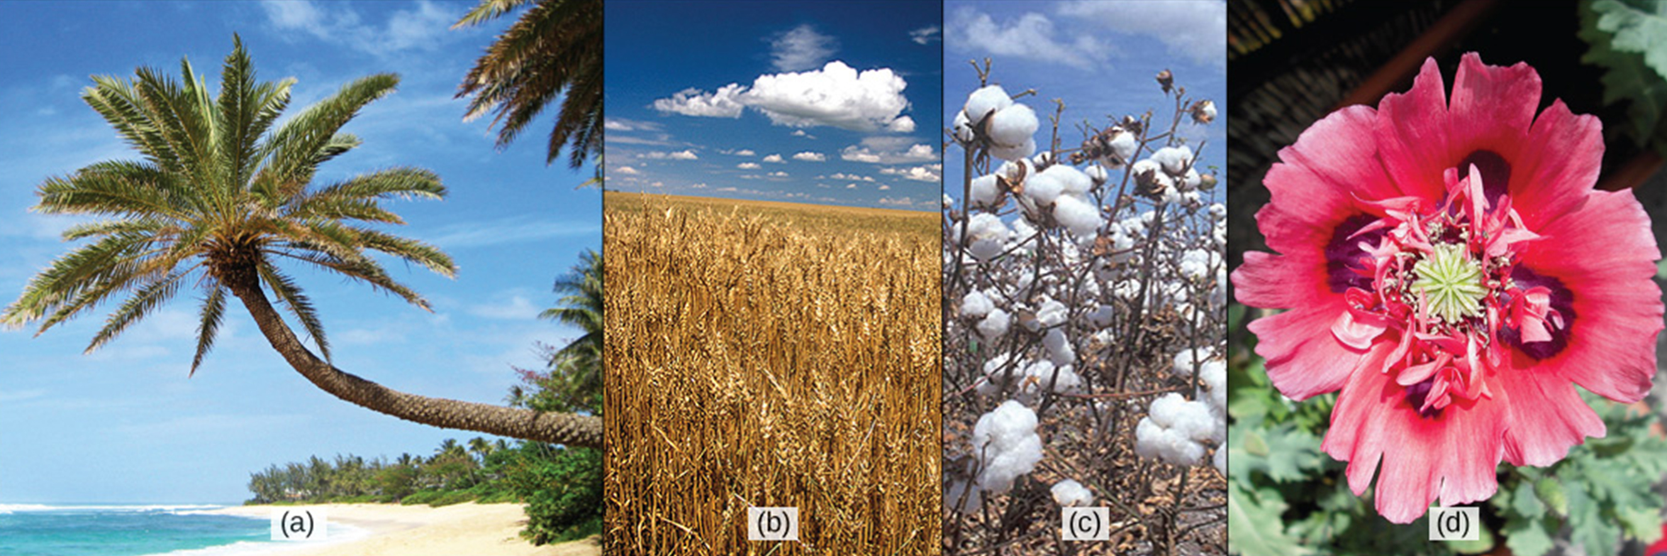
Seed Plants₂
Examples:
Palms: Provide rattans, oils, and dates
Grains (e.g., wheat): Food for humans and animals and fermented for alcoholic beverages
Cotton flower fruit: Harvested as boll and transferred into clothing or paper pulp
Opium poppy: Ornamental flower and source of opiate compounds
26.1 Figure 1: (a) Palm trees grow serve numerous purposes for food, shelter, and even transportation; (b) wheat is an important crop; (c) the cotton plant produces fibers that are woven into fabric; (d) the potent alkaloids of the opium poppy are both a medicinal remedy and a dangerously addictive drug.
Ryan Kozie on Flickr. "Palm tree."
USDA ARS modification of work by Stephen Ausmus. "Wheat."
CNX OpenStax on Wikimedia Commons. "Cotton." Modified.
Jolly Janner on Wikimedia Commons. "Poppy."

Slide 5
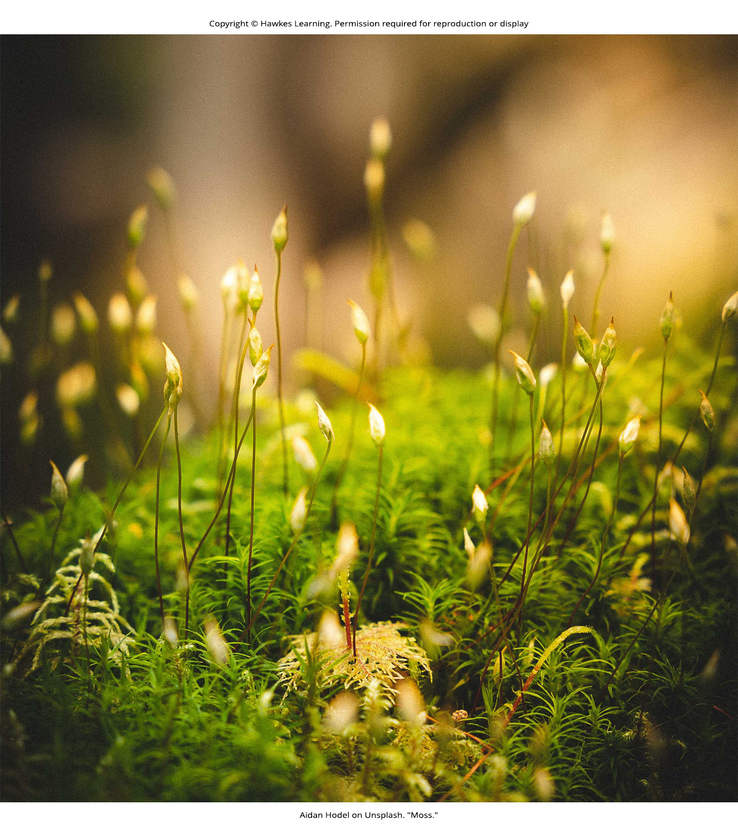
Evolution of Seed Plants₁
Spermatophyte: seed plant; from the Greek sperm- (seed) and -phyte (plant)
Includes gymnosperms (naked seed plants) and angiosperms (flowering plants)
Exhibit alternation of generations like bryophytes and pterophytes
Bryophytes (e.g., mosses, liverworts) and pterophytes (i.e., ferns) require water for reproduction, unlike gymnosperms and angiosperms
Flagellated sperm must swim to fertilize female gamete
26.1 Figure 2: Mosses are an example of a bryophyte.
Aidan Hodel on Unsplash. "Moss."

Slide 6
Evolution of Seed Plants₂
Notable features:
Dominant sporophyte generation
Reduction in size of gametophyte
Used to be conspicuous structure; now microscopic cluster of cells enclosed in tissues of sporophyte
Heterosporous instead of homosporous like club mosses and ferns
Homosporous: produces one type of spore
Heterosporous: produces two types of spores
Produce two types of spores
Megaspore: a spore that germinates into a female gametophyte; a female spore
Microspore: a spore that germinates into a male gametophyte; a male spore
Gametophytes mature within spores so not free-living

Slide 7
Reflection Question
Consider the plant life in your community, such as around your home or school.
Where might you find examples of bryophytes? Identify two specific locations.
Based on what you've learned about the environments in which these plants thrive and their unique requirements, explain why they would likely grow in the area you specified.
Notes:
The reflection question is included here to use as a talking point or for a think-pair-share activity.

Slide 8
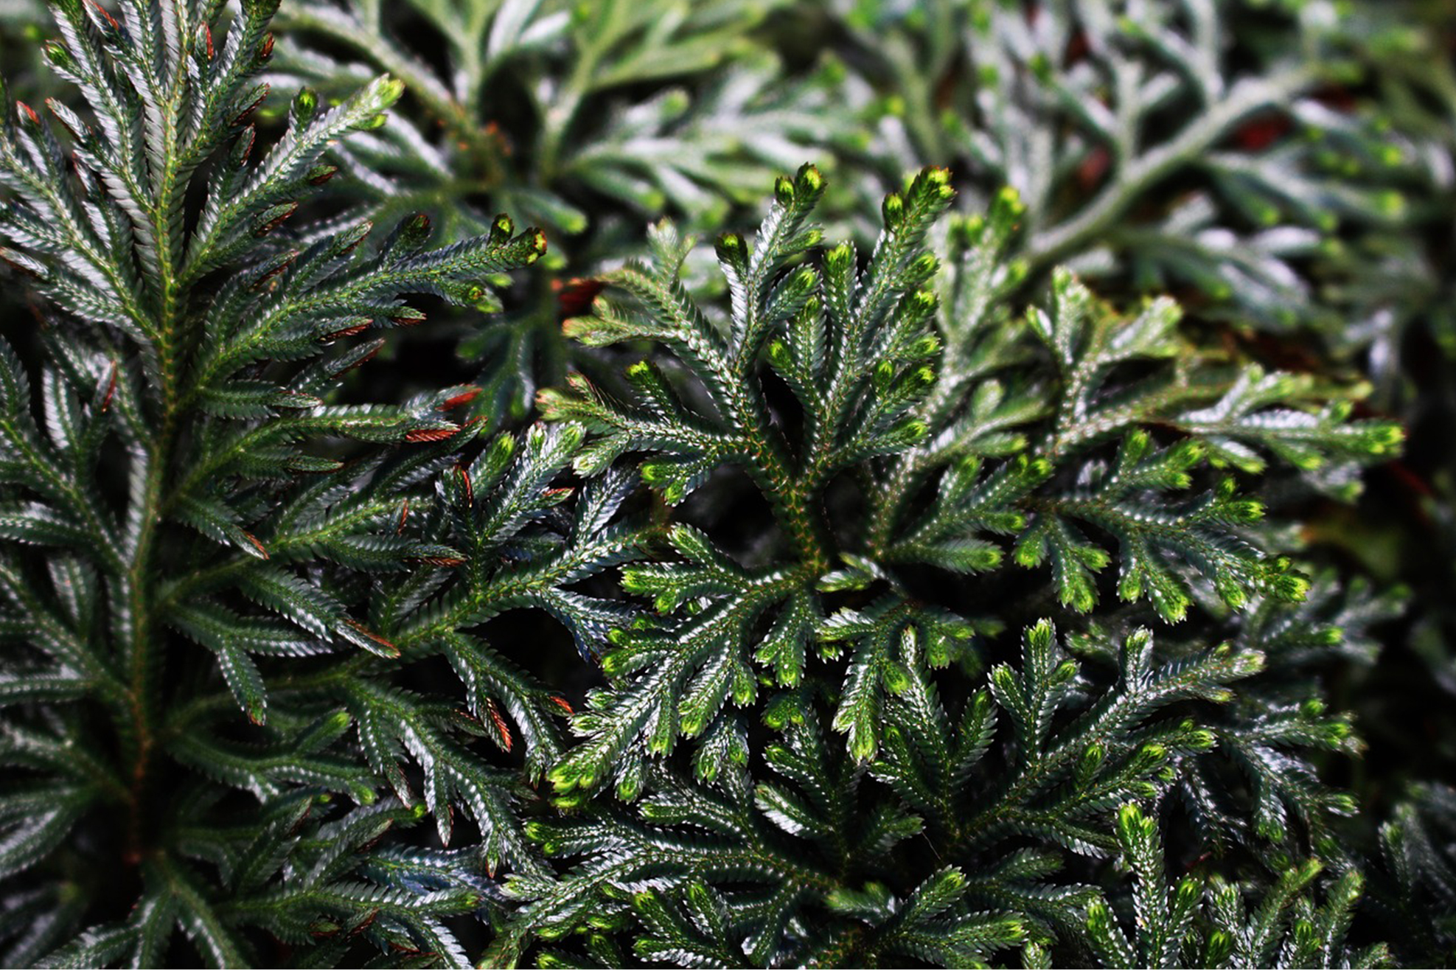
Evolution of Seed Plants₃
Ancestral heterosporous seedless plants (represented in modern day by plants like spike moss Selaginella) forerunners of seed plants
Selaginella life cycle:
Male and female sporangia develop within same stemlike strobilus
In male sporangium, multiple microspores produced by meiosis, resulting in small antheridium (male reproductive organ) contained in spore case
Antheridium released from strobilus and flagellated sperm are produced and leave spore case
26.1 Figure 3: Selaginella, or spike moss, remains a modern-day representative of the evolutionary forerunners of seed plants.
Nika_Akin on Pixabay. "Spike moss."

Slide 9
Evolution of Seed Plants₄
Selaginella life cycle:
In female sporangium, single megaspore mother cell undergoes meiosis to produce four megaspores
Gametophytes develop within megaspores, consisting of tissue to nourish embryo and a few archegonia (female reproductive organ)
May keep remnants of spore wall in megasporangium until after fertilization and embryo starts to develop
Different from organization of a seed since nutritive endosperm in a seed formed from single cell instead of multiple cells

Slide 10
Evolution of Seed Plants₅
Seeds and pollen distinguish seed plants from seedless vascular plants
Allowed seed plants to reduce or eliminate dependence on water for reproduction and live on dry land
Pollen grain: structure containing the male gametophyte of the plant; contains sperm (gametes)
Haploid cells encased in protective coat that prevents desiccation and mechanical damage
Can travel far from sporophyte, spreading plant's genes
Seeds provide embryo protection, nourishment, and mechanism to maintain dormancy (allowing for germination to occur when optimal)
Allow plants to disperse next generation through space and time
With these advantages, seed plants most successful and familiar group of plants

Slide 11
Think It Through₁
How are seeds and pollen grains similar? How are they different?
Notes:
Originally an On Your Own. This is included here to use as a talking point or for a think-pair-share activity.

Slide 12
Evolution of Seed Plants₆
Dated to 350 MYA
First reliable record date appearance to late Carboniferous Period (319 MYA)
Gymnosperms preceded by progymnosperms
Progymnosperm: transitional group of plants that resembled conifers because they produced wood, yet still reproduced like ferns
Dated to 380 MYA
At least some species were heterosporous
Example: Extinct Archaeopteris
Dominated in late Devonian Period
By early (Triassic, c. 252 MYA) and middle (Jurassic, c. 201 MYA) Mesozoic Era, landscape dominated by true gymnosperms instead
Angiosperms surpassed gymnosperms by middle Cretaceous Period (c. 100 MYA) in late Mesozoic Era
Today, most abundant and biologically diverse group in terrestrial biomes

Slide 13
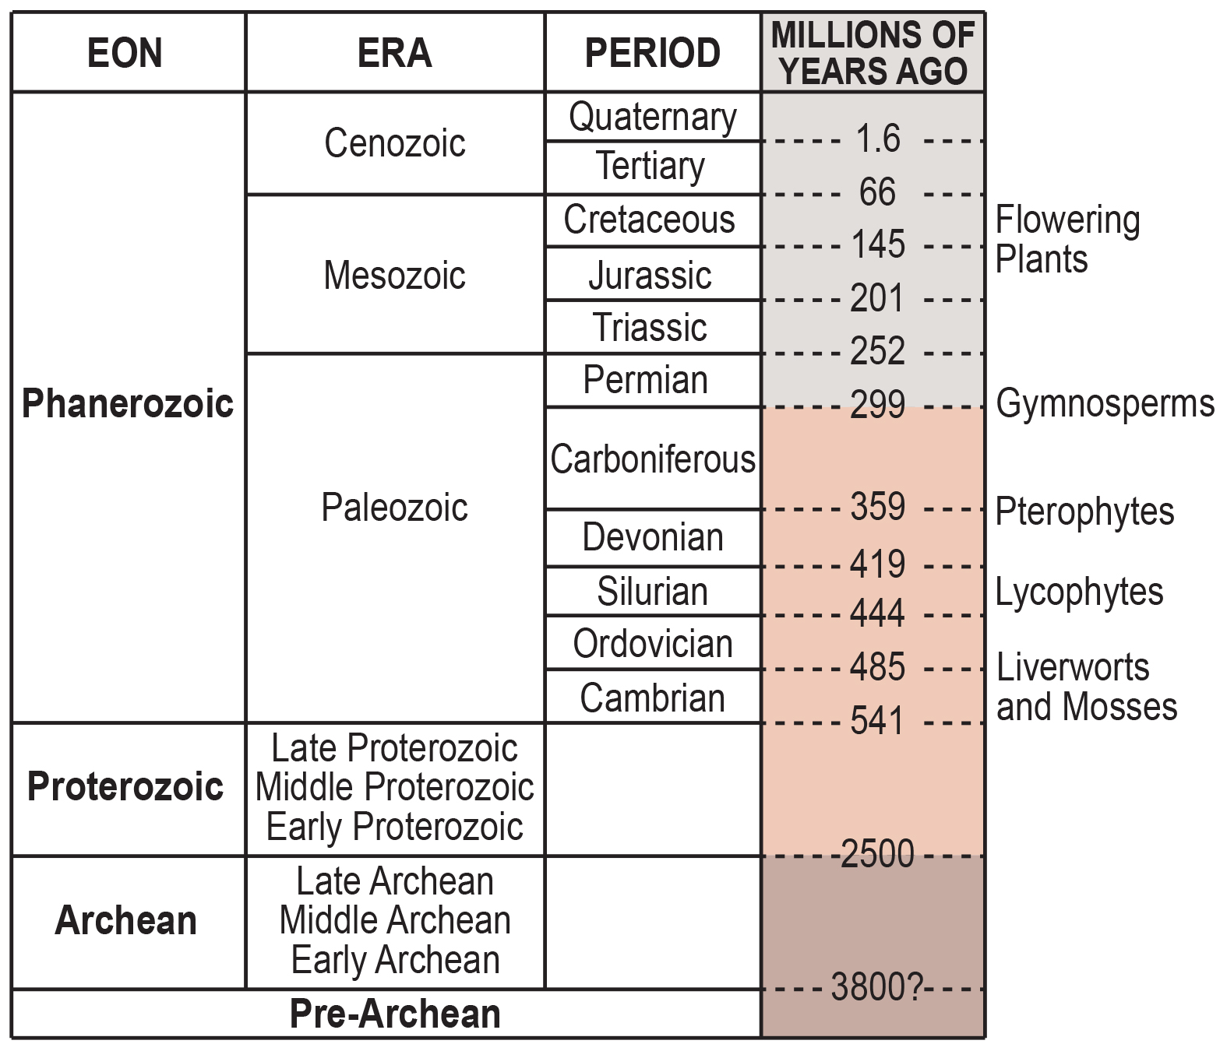
26.1 Figure 4
United States Geological Survey on Wikimedia Commons. "Plant timeline."
Notes:
Figure 4: Plant evolutionary timeline. Various plant species evolved in different eras.

Slide 14
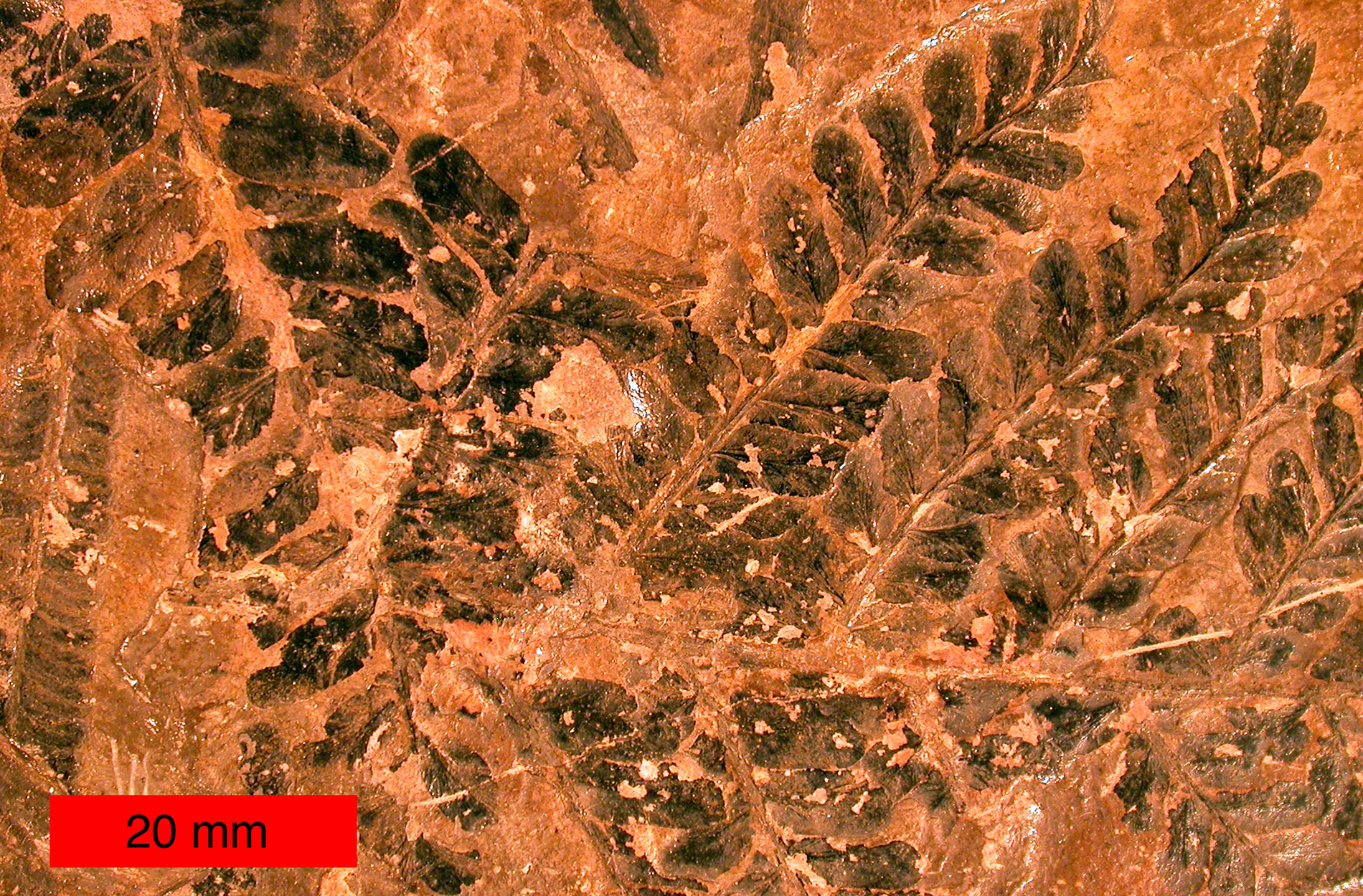
Evolution of Gymnosperms₁
Earliest known seed plant: Elkinsia polymorpha (seed fern) from Devonian Period (400 MYA)
Seed ferns produced seeds along branches in structures called cupules, which enclose and protect the ovule
Ovule: female gametophyte that develops into seed upon fertilization
Seed plants most like modern tree ferns became more numerous and diverse in coal swamps of Carboniferous Period
26.1 Figure 5: This fossilized leaf is from Neuropteris ovata, a seed fern that thrived during the Carboniferous Period (359 to 299 MYA).
Wilson44691 on Wikimedia Commons. "Fossil seed fern."

Slide 15
Evolution of Gymnosperms₂
First gymnosperms (progymnosperms) originated in Paleozoic Era during middle Devonian (380 MYA)
Wet Carboniferous Period followed, producing giant fern trees
Dry Permian Period after that, giving advantage to seed plants (better adapted to surviving dry spells)
Example: Ginkgoales (only surviving species is Ginkgo biloba)
First gymnosperms to appear in lower Jurassic
Expanded in Mesozoic Era (252 MYA), supplanting ferns and reaching greatest diversity
Jurassic Period: Age of cycads (gymnosperms like palm trees) and dinosaurs

Slide 16
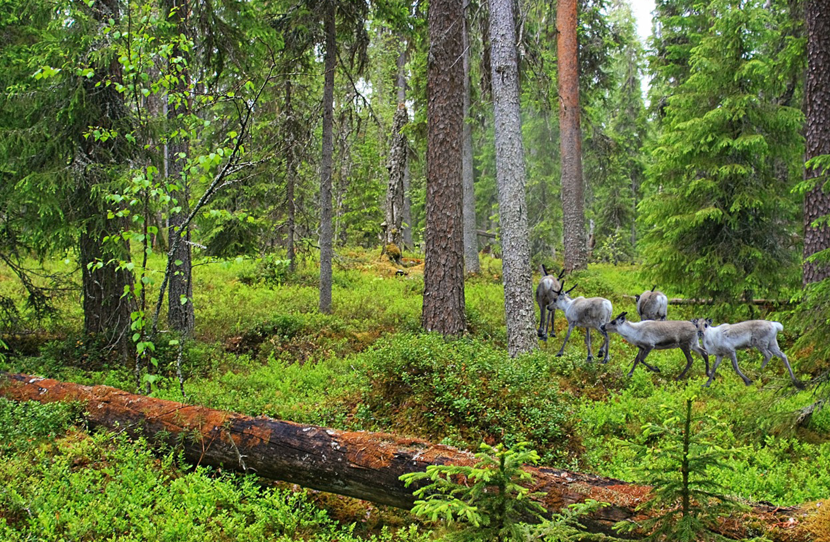
Evolution of Gymnosperms₃
Angiosperms (flowering plants) are major form of plant life; gymnosperms dominate in some ecosystems (e.g., taiga and alpine forests) because of adaptation to cold and dry growth conditions.
26.1 Figure 6: This boreal forest (taiga) has low-lying plants and conifer trees.
WalterBieck on Wikimedia Commons. "Reindeer."

Slide 17
Seeds and Pollen as an Evolutionary Adaptation to Dry Land₁
Bryophyte and fern spores: Haploid cells dependent on moisture for development of multicellular gametophytes
Seed plants:
Female gametophyte consists of egg and supportive cells, including endosperm-producing cell that supports embryo
After fertilization, diploid zygote produces embryo that grows into sporophyte when seed germinates
Storage tissue to sustain growth of embryo and protective coat gives seed advantage
Seed: structure containing the embryo, storage tissue, and protective coat
Hardened tissue prevents desiccation and frees embryo from need for constant supply of water
Remain in state of dormancy (induced by desiccation and hormone abscisic acid) until conditions become favorable
Carried by wind, water, or animals to expand geographic range, avoiding competition with parent plant

Slide 18
Seeds and Pollen as an Evolutionary Adaptation to Dry Land₂
Pollen grains:
Male gametophytes
Contain just a few cells
Distributed by wind, water, or animal pollinator
Protected from desiccation and can reach female organs without depending on water
After reaching female gametophyte, grows into pollen tube
Pollen tube: extension from the pollen grain that delivers sperm to the egg cell

Slide 19
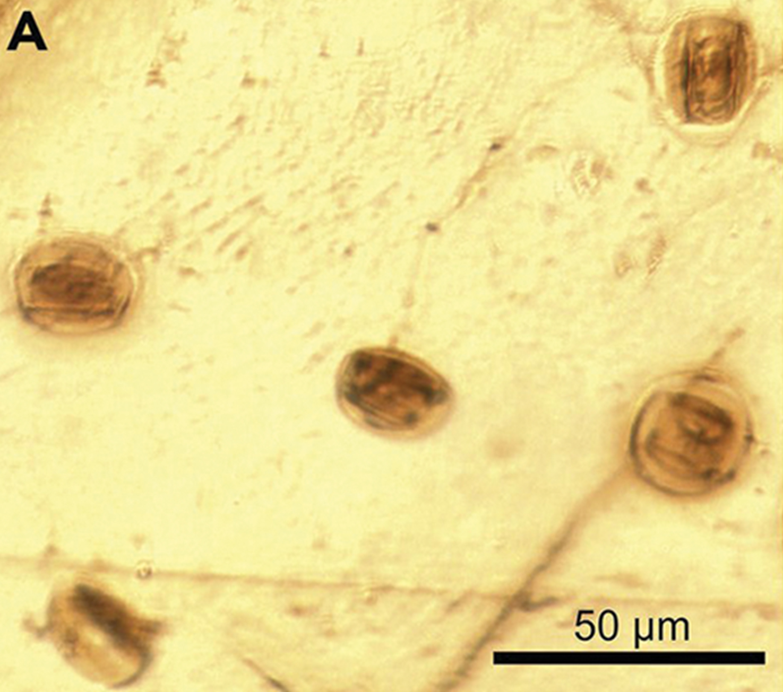
Seeds and Pollen as an Evolutionary Adaptation to Dry Land₃
Pollen grains:
Sperm of modern gymnosperms and all angiosperms lack flagella
Cycads, Ginkgo, and other primitive gymnosperms: Sperm still motile and use flagella to swim to female gamete but still delivered to female gametophyte enclosed in pollen grain
Grows or taken into fertilization chamber, where motile sperm released and swim short distance to egg
26.1 Figure 7: Cycadopites pollen subprolate (slightly elongated), rounded grains preserved within Burmese amber
Peris, D.; Labandeira, C. C.; Barrón, E.; Delclòs, X.; Rust, J.; Wang, B. (2020) on Wikimedia Commons. "Cycadopites."

Slide 20
Evolution of Angiosperms₁
200 MYA between appearance of gymnosperms and angiosperms
Angiosperm: flowering plant
Flower: branches specialized for reproduction found in some seed-bearing plants, containing either specialized male or female organs or both male and female organs
First appeared about 125 MYA in lower Cretaceous Period (late Mesozoic Era) and rapidly diversified by 100 MYA in middle Cretaceous Period
Early traces scarce
Fossilized pollen recovered from Jurassic attributed to angiosperms
Early Cretaceous rocks show imprints of leaves resembling angiosperm leaves
By mid-Cretaceous, diverse flowering plants appeared; also marked by appearance of modern groups of insects
Suggests pollinating insects played role in evolution of flowering plants

Slide 21
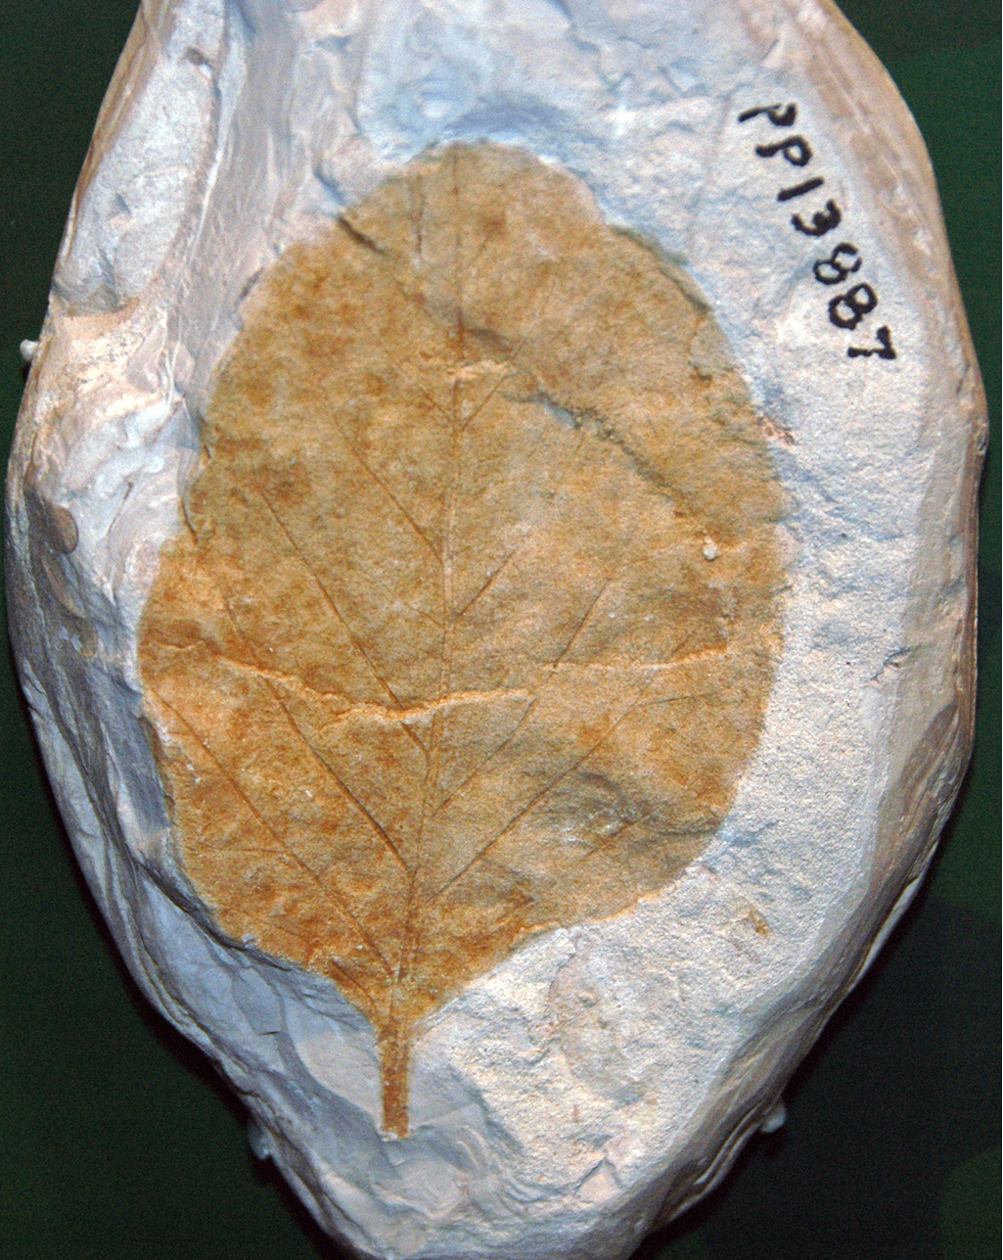
Evolution of Angiosperms₂
Comparative genomics and paleobotany (study of ancient plants) show evolution of angiosperms
Appeared after gymnosperms but not derived from gymnosperm ancestors
Formed sister clade (species and its descendants) parallel to gymnosperms
Innovative structures of flowers and fruit represent improved reproductive strategy to protect embryo and increase genetic variability and range
No current consensus on origin of angiosperms
Debate between angiosperms evolved from small woody bushes or related to ancestors of tropical grasses
Both have support in cladistics and woody magnoliid hypothesis (proposes early ancestors of angiosperms were shrubs like modern magnolia)
26.1 Figure 8: This fossilized magnolia leaf from the Cretaceous Period was found in Alabama, USA.
James St. John on Wikimedia Commons. "Fossil magnolia leaf."

Slide 22
Think It Through₂
Identify two plant structures that set angiosperms apart from gymnosperms. How has new genomic data changed our understanding of angiosperm evolution?
Notes:
Originally an On Your Own. This is included here to use as a talking point or for a think-pair-share activity.

Slide 23
Evolution of Angiosperms₃
Most primitive living angiosperm: Amborella trichopoda
Small plant native to rainforest of New Caledonia (island in South Pacific)
Genome shows it is related to all existing flowering plants and belongs to oldest confirmed branch of angiosperm family tree
Nuclear genome shows evidence of ancient whole-genome duplication
Mitochondrial genome:
Large and multi-chromosomal
Contains elements from mitochondrial genome of several other species (e.g., algae and moss)
Basal angiosperms have ancestral traits because they branched off early from phylogenetic tree
Modern angiosperms classified as either monocots or eudicots based on structure of leaves and embryos
Basal angiosperms (e.g., water lilies) considered more ancestral because they share morphological traits with monocots and eudicots

Slide 24
Flowers and Fruits as an Evolutionary Adaptation₁
Flowers produce gametes in separate organs, usually housed in flower
Fertilization and embryo development take place inside anatomical structure that provides stable system of sexual reproduction sheltered from environment
Most diverse phylum (300,000 species) after insects (1,200,000 species)
Flowers come in array of sizes, shapes, colors, smells, arrangements
Most have mutualistic pollinator with distinct features of flower reflecting nature of pollination agent
Relationship between pollinator and flower characteristics show coevolution

Slide 25
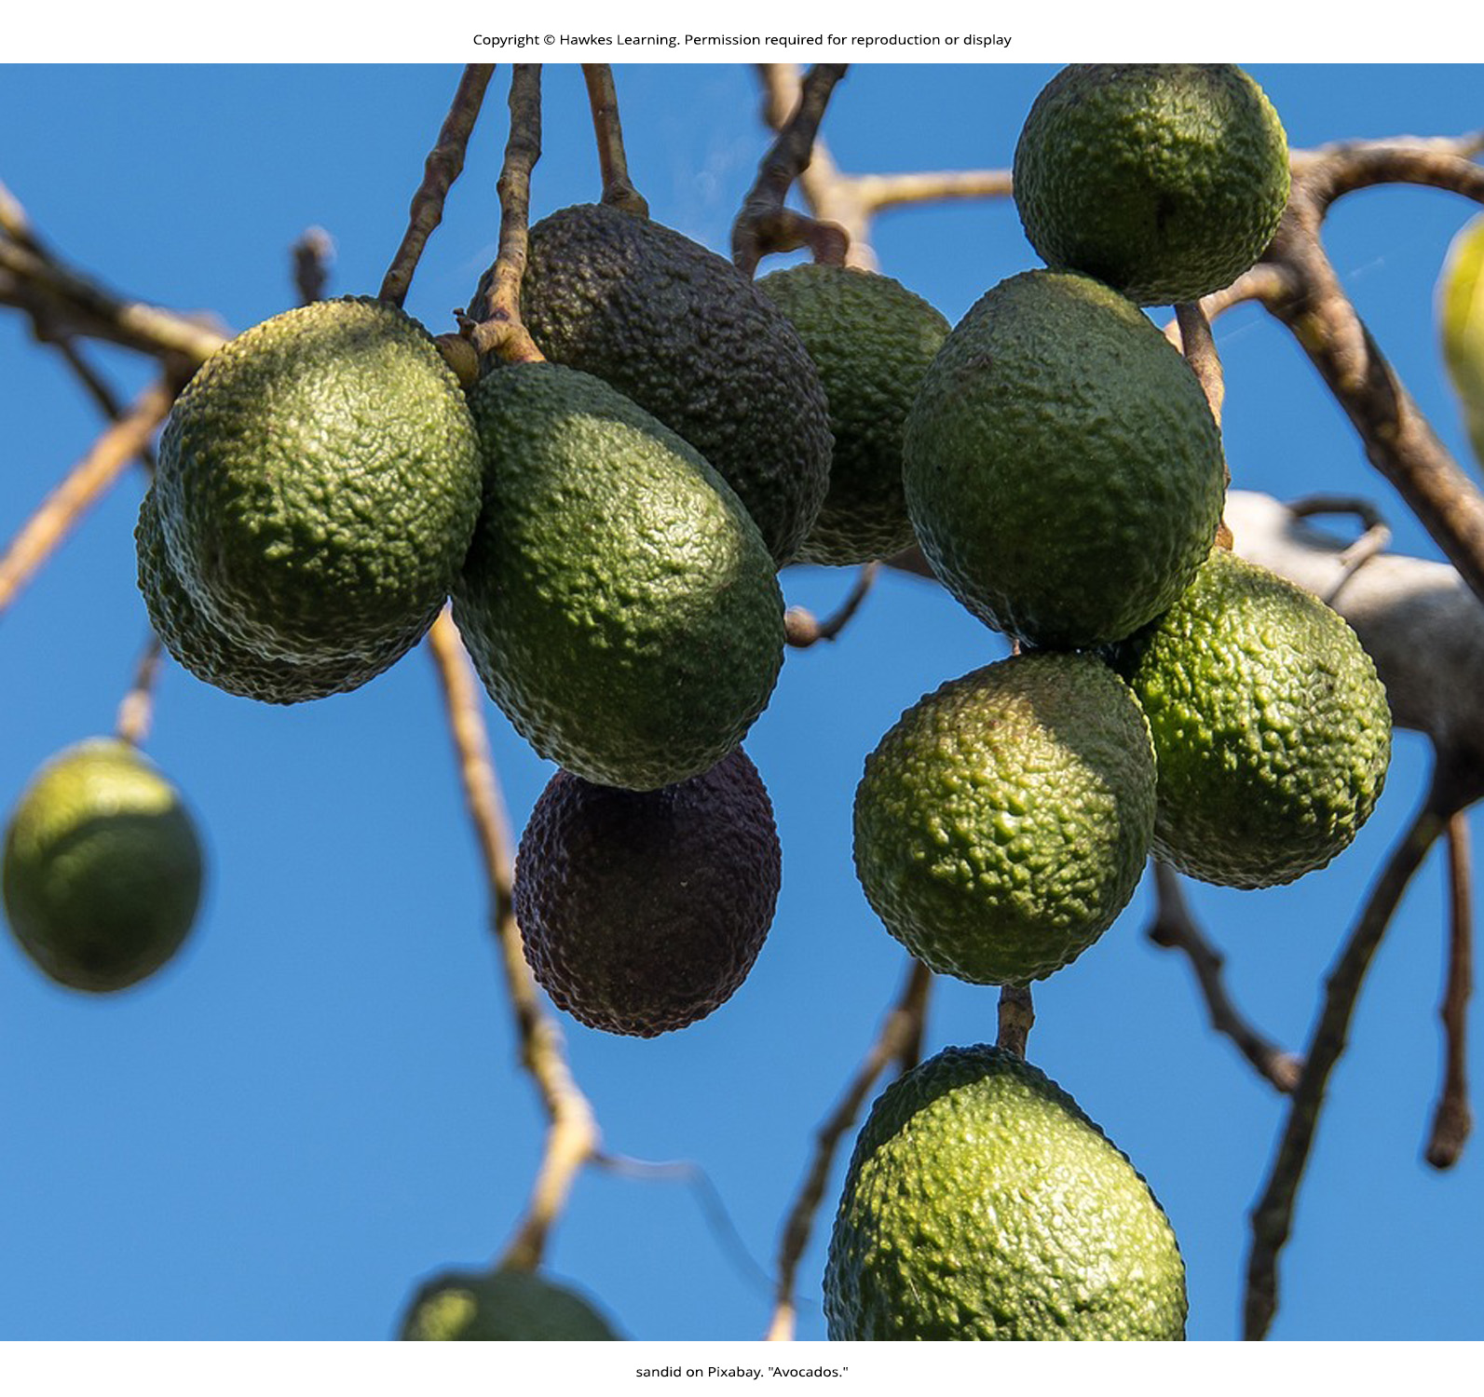
Flowers and Fruits as an Evolutionary Adaptation₂
Fruit: thickened tissue derived from ovary wall that protects the embryo after fertilization and facilitates seed dispersal
Not all fruits develop completely from ovary but from tissues adjacent to ovary (called false fruits or pseudocarps)
Can vary in appearance, size, smell, taste
Examples: Tomatoes, green peppers, corn, avocados
Act as agents of dispersal (carried by wind, animals through consumption of fruit)
Example: Cockleburs
Have stiff, hooked spines that hook into fur or clothing to ride with animal for long distances
George de Mestral (creator of Velcro) inspired by cockleburs
26.1 Figure 9: These Hass avocados are one example of a fruit. Fruits protect the seed and usually have adaptations to ensure the seeds' dispersal over a wide area.
sandid on Pixabay. "Avocados."

Slide 26
Evolution Connection₁
Building Phylogenetic Trees with Analysis of DNA Sequence Alignments
All living organisms display patterns of relationship derived from evolutionary history
Phylogeny: Science that describes relative relationships among organisms in terms of ancestral and descendant species
Phylogenetic trees: Treelike branching diagrams that depict relationships
Species or group of species: At tips of branches
Each branching point (node): Point at which single taxonomic group (taxon), like a species, separates into two or more groups of species
Built to describe relationships between species since Darwin's first sketch in Origin of Species

Slide 27
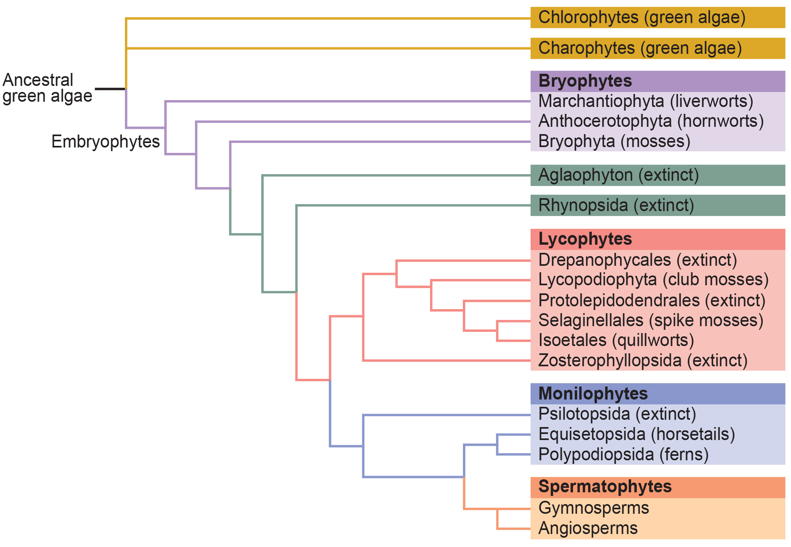
26.1 Figure 10
CNX OpenStax on Wikimedia Commons. "Phylogenetic tree, plants."
Notes:
Figure 10: This phylogenetic tree shows the evolutionary relationships of plants.

Slide 28
Evolution Connection₂
Building Phylogenetic Trees with Analysis of DNA Sequence Alignments
Traditional methods: Comparison of anatomical structures and embryonic develop, assuming closely related organisms share anatomical features from embryo development
Important because some traits disappear in adult but present in embryo (e.g., early human embryo has postanal tail like members of phylum Chordata)
Fossil records show intermediate stages that link ancestral form to descendants; many approaches based on fossil records alone are imprecise and lead to multiple interpretations

Slide 29
Evolution Connection₃
Building Phylogenetic Trees with Analysis of DNA Sequence Alignments
Molecular biology and computational analysis brought new generation of tree-building
Key assumption: Genes are essential proteins or RNA structures (e.g., ribosomal RNAs) inherently conserved because mutations could compromise survival of organism
DNA amplified by polymerase chain reaction (PCR) and sequenced, targeting mostly likely conserved regions
Genes in 18S ribosomal RNA and in chloroplasts frequently chosen for DNA alignment analysis
Sequences then compared to existing sequences in databases (e.g., National Center for Biotechnology Information)
Computational tools used to align and analyze sequences
Determine percentage of sequence identity (homology) and estimate evolutionary distance between two DNA sequences, reflecting time elapsed since organism separated from common ancestor
Technique confirmed Amborella trichopoda as most primitive angiosperm but rearranged other groups and relationships

Slide 30
Think It Through₃
How did the field of molecular biology lead to a new generation of phylogenetic tree-building?
Notes:
Originally an On Your Own. This is included here to use as a talking point or for a think-pair-share activity.

Slide 31
Summary₁
First appeared around 350 million years ago in Carboniferous Period
Two major innovations:
Seeds protect embryo and provide nutrients to support early growth of sporophyte
Allows delayed germination until optimal conditions
Pollen enables reproduction without water
Gametophytes shrank, while sporophytes became prominent
Diploid stage longest phase of life cycle
Gymnosperms appeared in drier Permian Period and dominated in Triassic Period
Pollen dispersed by wind and naked seeds developed in sporophylls of strobilus

Slide 32
Summary₂
Angiosperms bear flowers and fruit.
Flowers expand possibilities for pollination (especially by insects, which coevolved with them).
Fruit offer additional protection to embryo during development and assist with seed dispersal
Appeared during Mesozoic Era
Dominant plant life in terrestrial habitats

Slide 33

End of Hawkes Learning PowerPoint

