Slide 1
Lesson 26.2
Gymnosperms

Slide 2
Objectives
Describe the life cycle of a typical gymnosperm.
Discuss the type of seeds produced by gymnosperms, as well as other characteristics of gymnosperms.
Identify the geological era dominated by the gymnosperms and describe the conditions to which they were adapted.
List the four groups of modern-day gymnosperms and provide examples of each.

Slide 3
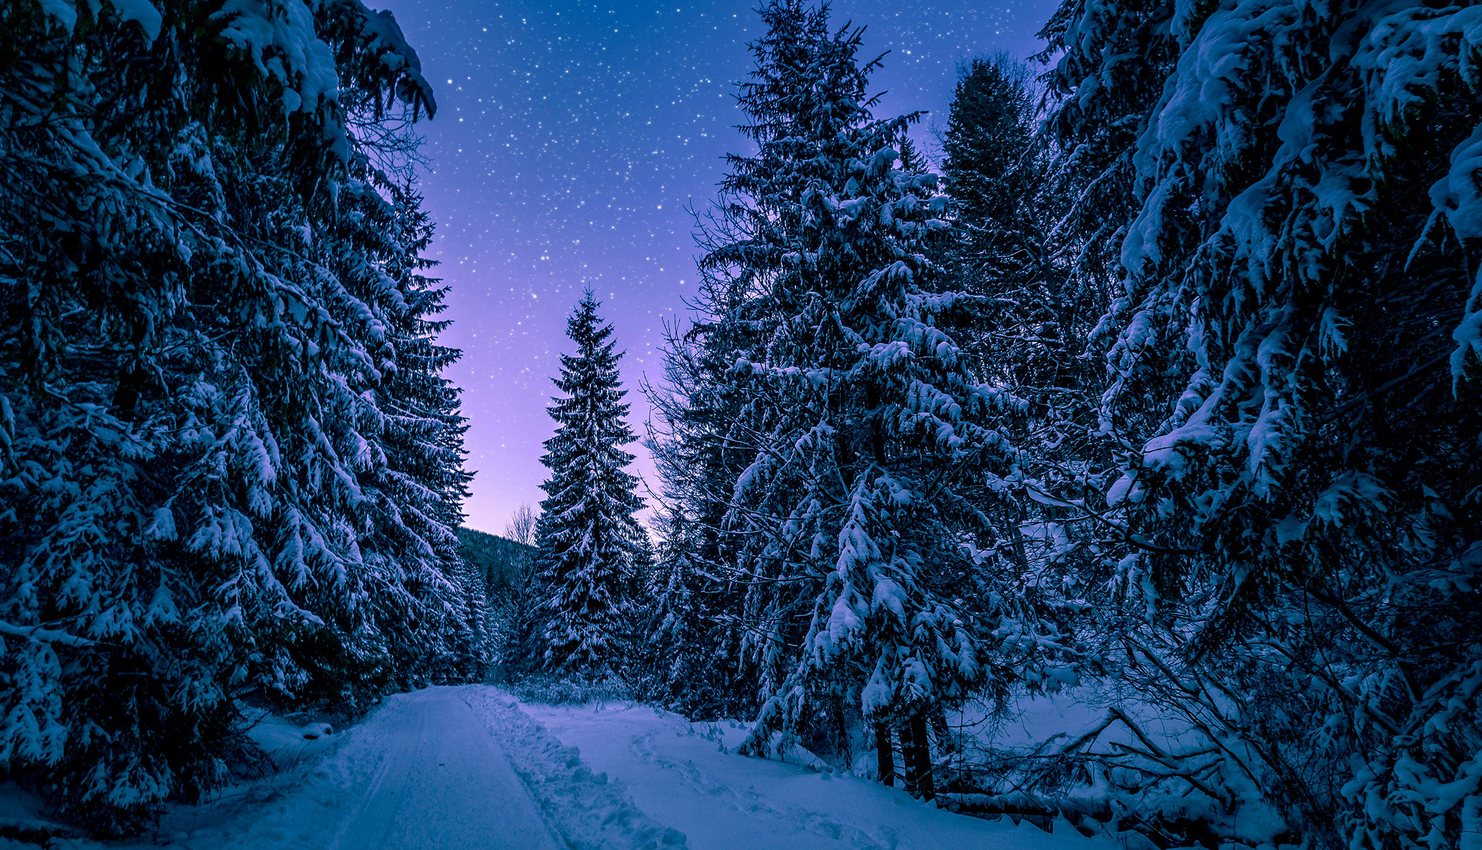
Gymnosperms₁
Gymnosperm: seed plant with naked seeds (seeds exposed on modified leaves or in cones)
Diverse group of seed plants
Two hypotheses of origins:
Anthophyte hypothesis: Angiosperms sister group of one group of gymnosperms (the Gnetales); makes gymnosperms a paraphyletic group (those in which not all descendants of single common ancestor included)
Gnetifer hypothesis: Suggests that gnetophytes sister to conifers; makes gymnosperms monophyletic and sister to angiosperms
26.2 Figure 1: Conifers in this Romanian forest are examples of gymnosperms.
Radu Andrei Razvan on Pexels. "Conifers."

Slide 4
Gymnosperms₂
Characteristics:
Naked seeds
Separate female and male gametophytes
Pollen cones and ovulate cones
Pollination by wind and insects
Tracheids (transport water and solutes in vascular system)
Seeds not enclosed in ovary; only partially sheltered by modified leaves called sporophylls
Strobilus: (plural, strobili) plant structure with a tight arrangement of sporophylls around a central stalk, as seen in cones or flowers; the male strobilus produces pollen, and the female strobilus produces eggs (e.g., pine cones)
Some seeds enveloped by sporophyte tissues upon maturation
Integument: layer of sporophyte tissue that surrounds the megasporangium and, later, the embryo

Slide 5
Gymnosperms₃
Dominant phylum in Mesozoic Era
Adapted to live where fresh water is scarce during part of the year or nitrogen-poor soil of bog
Prominent phylum in coniferous biome (taiga)
Evergreen conifers have selective advantage in cold and dry weather
Continue low levels of photosynthesis during cold months and take advantage of first days of spring
Disadvantage: Conifers more susceptible than deciduous trees to leaf infestations because conifers do not lose leaves all at one; cannot shed parasites and restart with fresh supply of leaves in spring

Slide 6
Gymnosperms₄
Life cycle:
Alternation of generations
Dominant sporophyte, where reduced male and female gametophytes reside
Heterosporous (produce two different types of spores)
Male and female reproductive organs form in cones or strobili
Either monoecious or dioecious
Monoecious: describes a species in which the male and female reproductive organs are on the same plant
Dioecious: describes a species in which the male and female reproductive organs are carried on separate specimens

Slide 7
Evolution Connection
Alternation of generations:
No animal equivalent
Alternation between diploid (sporophyte) generations and haploid (gametophyte) generations
All plants have both, but size and prominence of gametophyte shrinking over time
More primitive plants, most prominent gametophyte stages
Example: Mosses vs. pine trees
Mosses: Sporophyte and gametophyte generation equally prominent; gametophytes make up green leafy moss parts, sporophytes make up tall, capsule-tipped protrusions
Pine trees: Tree is sporophyte generation; gametophyte smaller and less prominent (on male cones, pollen is gametophyte generation because it produces sperm)

Slide 8
Life Cycle of a Conifer₁
Pine trees are conifers, carrying both male and female sporophylls on same mature sporophyte (monoecious)
Heterosporous (male microspores and female megaspores)
Male and female spores develop in different strobili, with small male cones and larger female cones
Male cones (staminate cones):
Microsporocyte: a diploid cell that undergoes meiosis to produce megaspores in a heterosporous plant
Consists of a few haploid cells enclosed in tough wall reinforced with sporopollenin (durable polymer resistant to degradation)
In spring, pollen released and carried by wind where some gametophytes land on female cone; pollination defined as initiation of pollen tube growth
Pollen tube develops slowly; generative cell in pollen grain produces two haploid sperm (generative nuclei) by mitosis
At fertilization, one haploid sperm nuclei unites with haploid nucleus of egg

Slide 9
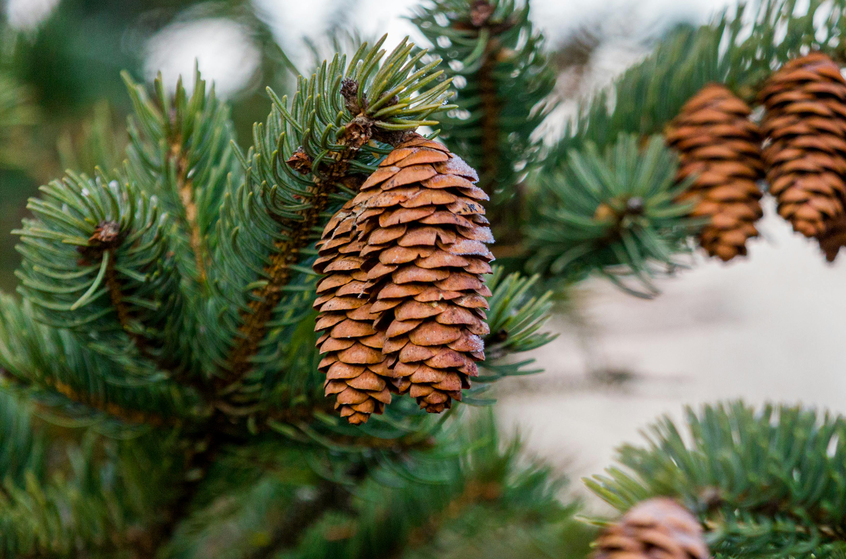
Life Cycle of a Conifer₂
Female cones (ovulate cones):
Ovulate cone: cone containing two ovules per scale
Each ovule has narrow passage (the micropyle) that opens near base of sporophyll, where pollen tube will grow
Megasporocyte: megaspore mother cell; diploid cell that undergoes meiosis to produce megaspores in a heterosporous plant
Three of four cells break down; surviving cell (megaspore) develops into female multicellular gametophyte, which encloses archegonium (reproductive organ that contains single large egg)
26.2 Figure 2: Female cones, also called ovulate cones, generally appear larger than the male cones, called pollen cones.
Sam Divita on Pexels. "Pine cones."

Slide 10
Life Cycle of a Conifer₃
Pollination:
Sticky pollination drop traps windblown pollen grains near opening of micropyle
Pollen tube formed and grows toward developing gametophyte
One generative (sperm) nuclei from pollen tube enters egg and fuses with egg nucleus as egg matures
Diploid egg gives rise to embryo, which is enclosed in seed coat of tissue from parent plant
Several eggs may form and fertilize, but only one survives in each ovule
Contains three generations of tissues:
Seed coat that originates from sporophyte tissue
Gametophyte tissues that provide nutrients
Embryo
Can take up to two years after pollination

Slide 11
Life Cycle of a Conifer₄
Sporophyte (2n) phase is longest
Gametophyte (1n)—produced by microspores and megaspores—much smaller that sporophyte
Takes more than a year between pollination and fertilization while pollen tube grows towards growing female gametophyte (1n), which develops from single megaspore
Slow growth allows female gametophyte time to produce eggs (1n)

Slide 12
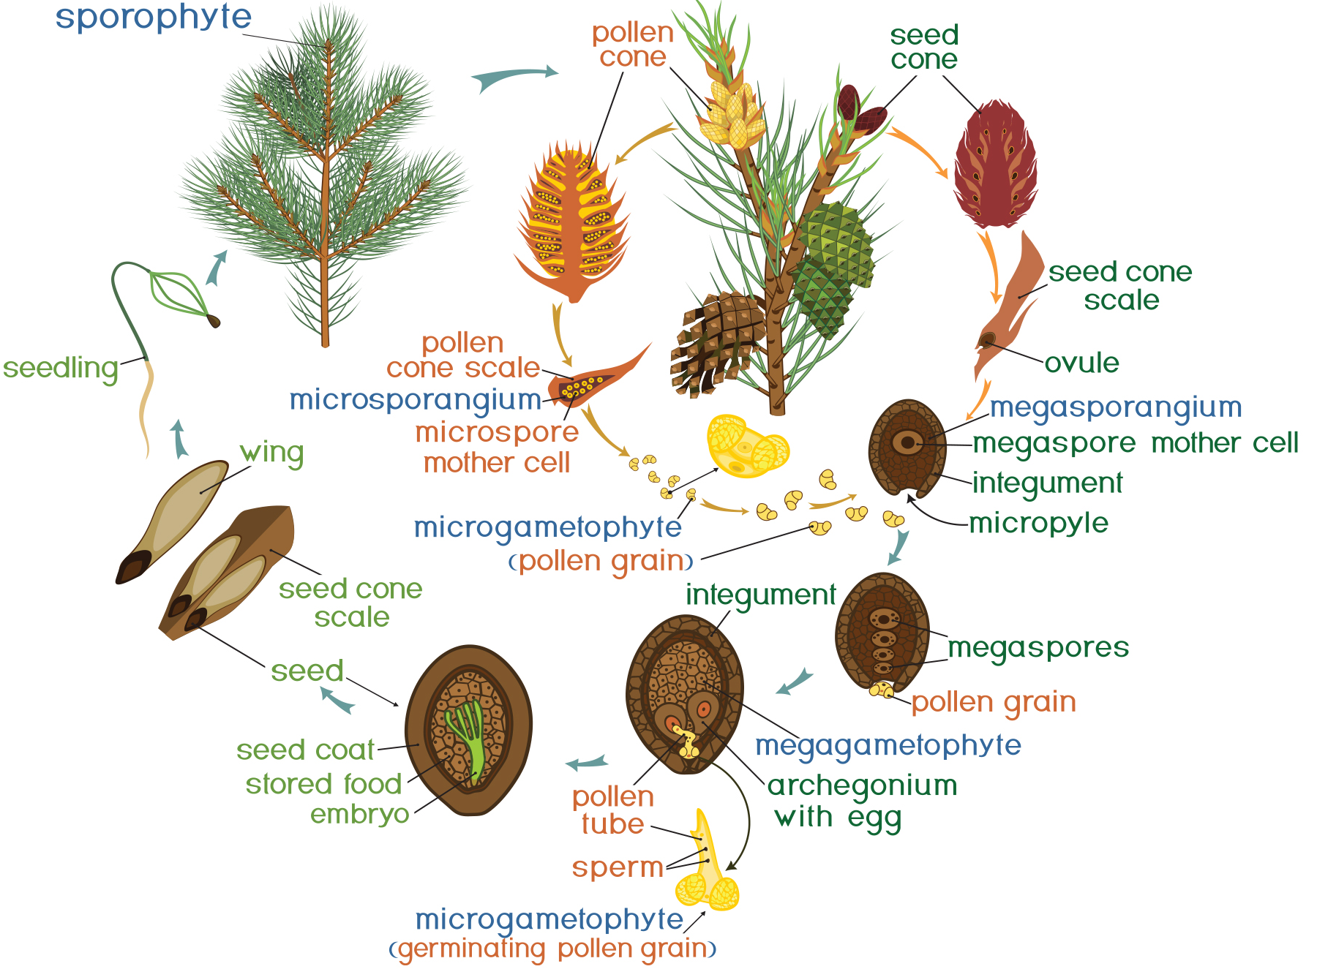
26.2 Figure 3
Notes:
Figure 3: Pollen from male cones blows up into upper branches where it fertilizes female cones. The megaspore shown in the image develops into the female gametophyte as the pollen tube slowly grows toward it, eventually fusing with the egg and delivering a male nucleus, which combines with the female nucleus of the mature egg.

Slide 13
Diversity of Gymnosperms
Four main phyla:
Coniferophyta
Cycadophyta
Ginkgophyta
Gnetophyta
Coniferophyta, Cycadophyta, and Ginkgophyta
Similar in pattern of seed development and production of secondary cambium (cells that generate vascular system of trunk or stem and partially specialized for water transportation)
Not closely related phylogenetically
Gnetophyta
Considered closest group to angiosperms because they produce true xylem tissue (with vessels and tracheids found in rest of gymnosperms)
Vessel elements may have arisen independently in two groups

Slide 14
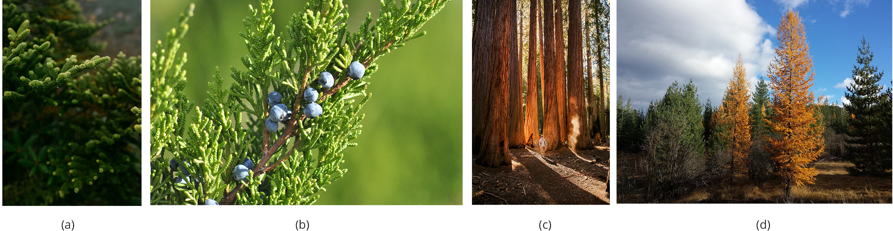
Conifers (Coniferophyta)₁
Conifer: dominant phylum of gymnosperms with the greatest variety of trees
Characteristics: Tall trees, scalelike or needlelike leaves, thick cuticle
26.2 Figure 4: Conifers are the dominant form of vegetation in cold or arid environments and at high altitudes. Shown here are the (a) evergreen spruce (Picea sp.), (b) juniper (Juniperus sp.), (c) coastal redwood or sequoia (Sequoia sempervirens), and (d) the tamarack (Larix laricina). Notice the deciduous yellow leaves of the tamarack.
Wes Hicks on Unsplash. "Evergreen spruce."
Alexey Kurilovich on Unsplash. "Juniper."
Joshua Earle on Unsplash. "Redwood."
junebab on Pixabay. "Tamarack."

Slide 15
Conifers (Coniferophyta)₂
Adaptations for cold and dry climates and high altitudes:
Narrow leaves and thick cuticle reduces water evaporation
Snow slides off needle-shaped leaves; keeps load light and reduces broken branches
Examples: Evergreen trees (pines, spruces, firs, cedars, sequoias, yews)
Some deciduous and lose leaves in fall
Examples: Bald cypress, dawn redwood, European larch, tamarack)
Harvested for paper pulp and timber
More primitive than wood of angiosperms (contains tracheids, but no vessel elements—referred to as "soft wood")

Slide 16
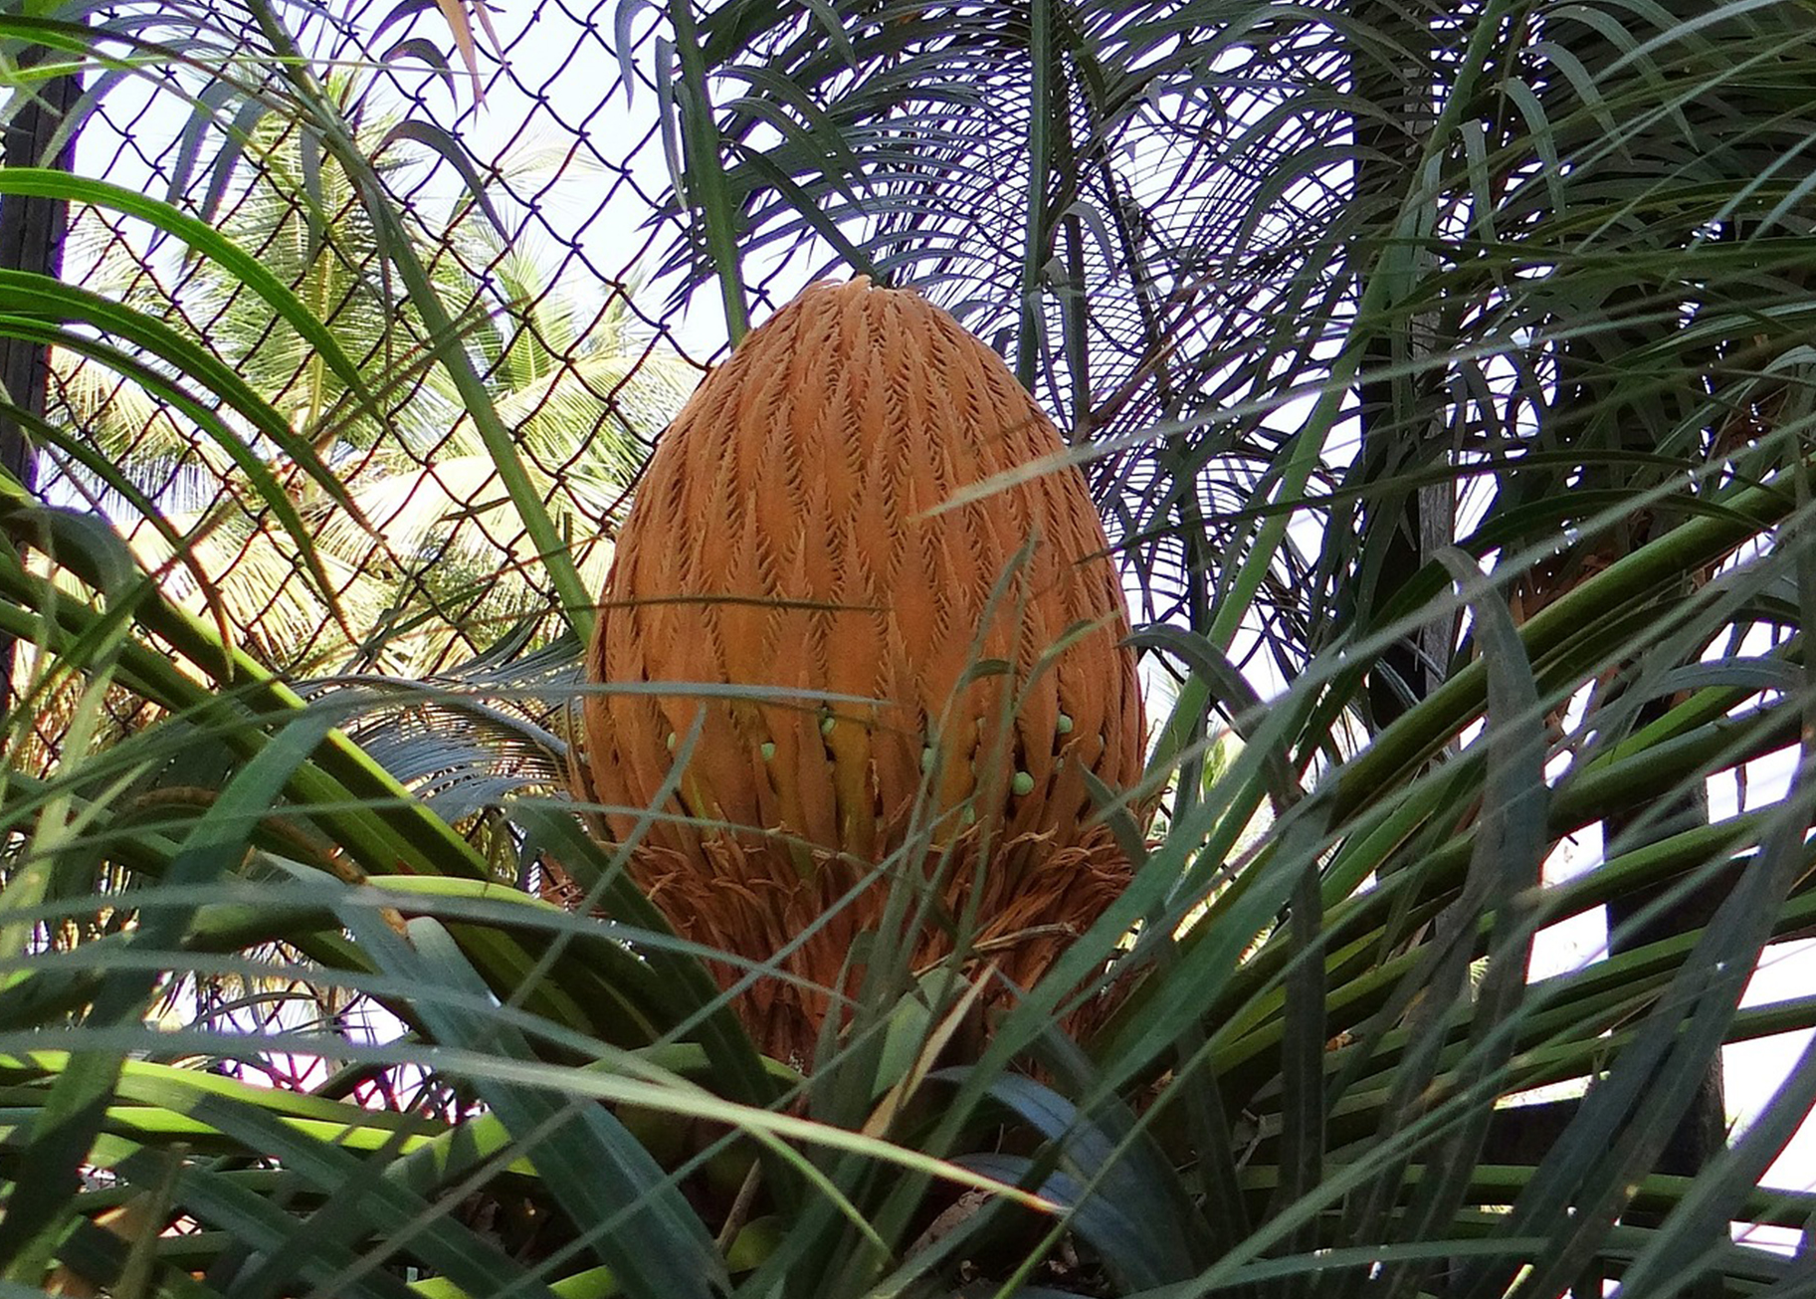
Cycads (Cycadophyta)
Cycad: gymnosperm that grows in tropical climates and resembles a palm tree; member of the phylum Cycadophyta
Thrive in mild climates
Often mistaken for palms because of shape of large, compound leaves
Bear large strobili or cones
May be pollinated by beetles rather than wind (unusual for gymnosperm)
Dominated Mesozoic Era; now reduced to about 100 species
Face possible extinction; some species protected through international conventions
Used as ornamental plants in tropical and subtropical gardens
26.2 Figure 5: This Sago palm from India, Cycas circinalis, has large cones.
Bishnu Sarangi on Pixabay. "Sago palm."

Slide 17
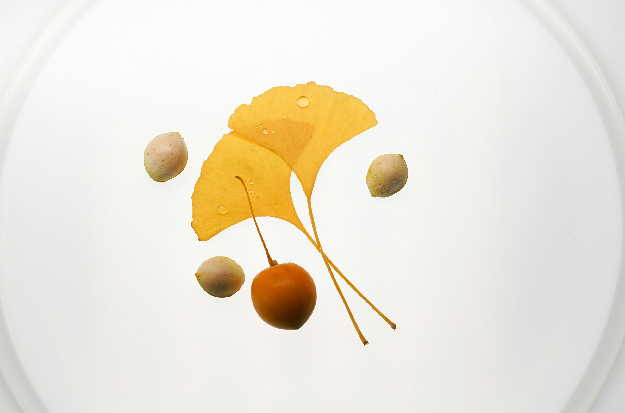
Ginkgophytes (Ginkgophyta)
Ginkgophyte: gymnosperm with one extant species, the Ginkgo biloba: a tree with fan-shaped leaves
Leaves feature dichotomous venation pattern and turn yellow in autumn and fall off
Male and female organs on separate plants
Cultivated by Chinese Buddhist monks, which ensured preservation
Planted in public spaces because of resistance to pollution
Gardeners only plant male trees; female plant has off-putting smell of rancid butter
26.2 Figure 6: The two yellow Ginkgo leaves show the tree's characteristic autumnal coloration. The image also depicts the seeds and fruit of Ginkgo biloba.
Olga Drach on Unsplash. "Ginkgo leaves."

Slide 18
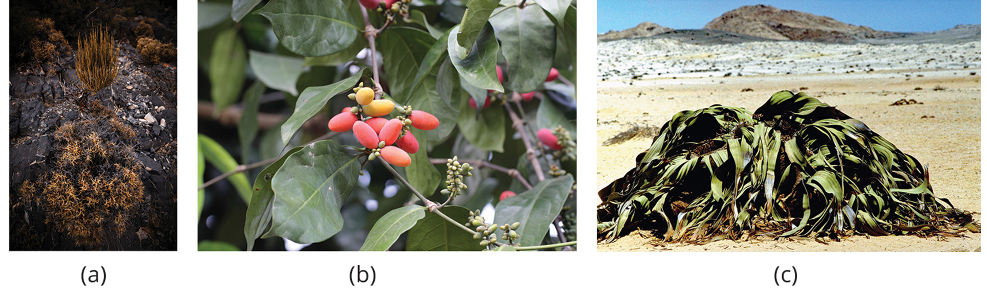
Gnetophytes (Gnetophyta)₁
Gnetophyte: gymnosperm shrub with varied morphological features that produces vessel elements in its woody tissues; the phylum includes the genera Ephedra, Gnetum, and Welwitschia
Debated phylogenetic position
Possession of vessel elements suggest close relation to modern angiosperms, but molecular analysis places them closer to conifers
Three living genera dissimilar; indicates group not monophyletic
Have broad leaves like angiosperms
26.2 Figure 7: (a) Ephedra viridis, known by the common name Mormon tea, grows on the West Coast of the United States and Mexico. (b) Gnetum gnemon grows in Indonesia. (c) The large Welwitschia mirabilis can be found in the Namib Desert.
Patrick Hendry on Unsplash. "Ephedra viridis."
gbohne on Wikimedia Commons. "Gnetum gnemon."
Robert Klaus on Pixabay. "Welwitschia mirabilis."

Slide 19
Gnetophytes (Gnetophyta)₂
Ephedra:
Found in dry areas of West Coast of United States and Mexico
Small, scalelike leaves are source of compound ephedrine (used a decongestant)
Similar to amphetamines in chemical structure and neurological effects
Restricted to prescription drugs
Gnetum:
Found in parts of Africa, South America, and Southeast Asia
Includes trees, shrubs, and vines
Welwitschia:
Found in Namib Desert
Possibly oddest member of group
Produces only two leaves, which grow continuously throughout life of plant
Produces male and female gametes on separate plants

Slide 20
Think It Through
List the remaining genera of gnetophytes living today.
Notes:
Originally an On Your Own. This is included here to use as a talking point or for a think-pair-share activity.

Slide 21
Summary
Gymnosperms:
Heterosporous seed plants that produce naked seeds
Originated in the Paleozoic Era and dominate in the Mesozoic Era
Modern gymnosperms classified into four phyla:
Coniferophyta (conifers)
Largest phylum
Predominant plants at high altitude and latitude
Cycadophyta (cycads)
Resemble palm trees
Grow in tropical climates
Ginkgophyta
Represented by Ginkgo biloba
Gnetophyta
Diverse group
Produce vessel elements in wood

Slide 22

End of Hawkes Learning PowerPoint

