Slide 1
Lesson 26.3
Angiosperms

Slide 2
Objectives
Describe the main parts of a flower and their functions.
Detail the life cycle of a typical angiosperm.
Discuss the similarities and differences between the two main groups of flowering plants.
Explain why angiosperms are the dominant form of plant life in most terrestrial ecosystems.

Slide 3
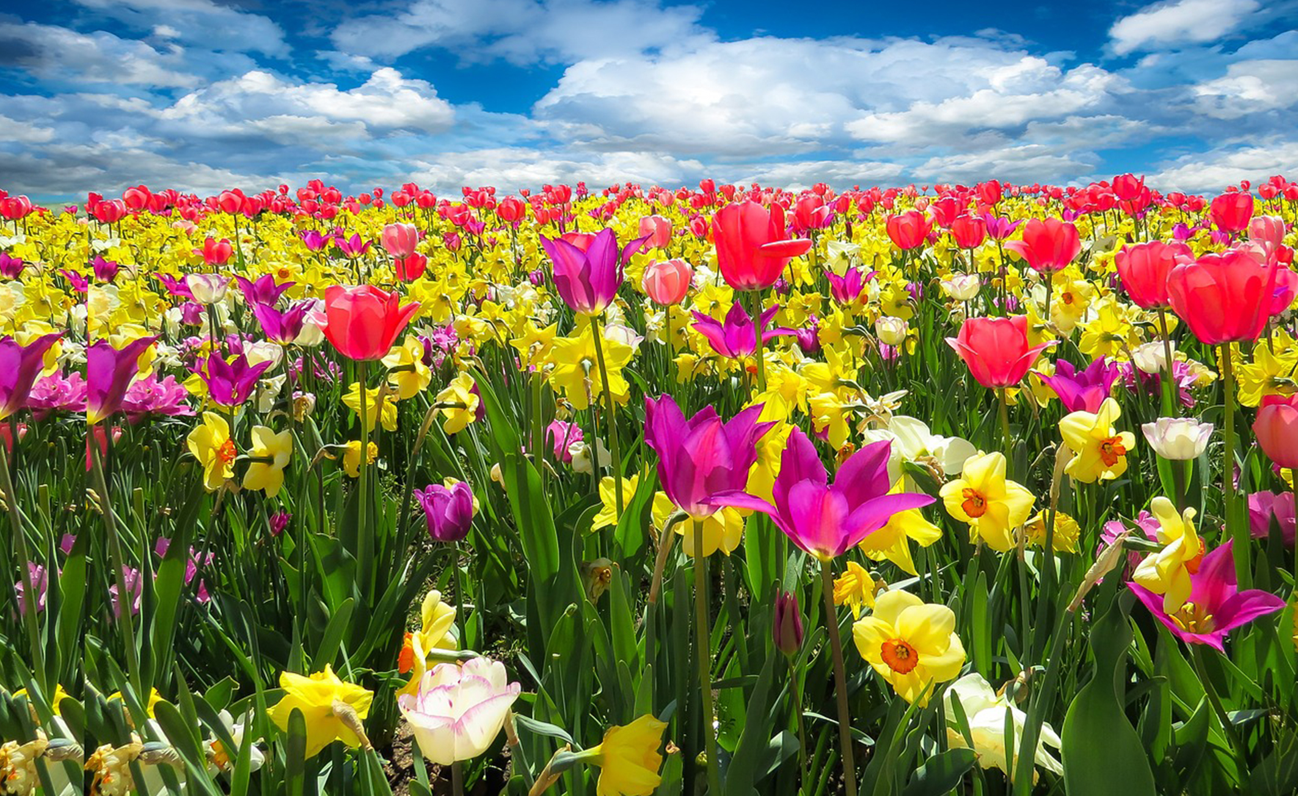
Angiosperms₁
Emerged during Jurassic Period
Flowering plants that evolved to dominate most terrestrial ecosystems
Second most diverse phylum (Anthophyta) after insects, with over 300,000 species
26.3 Figure 1: These tulips and daffodils are a few examples of angiosperms, or flowering plants.
blende12 on Pixabay. "Tulips and daffodils."

Slide 4
Angiosperms₂
Success attributed to two novel reproductive structures: flowers and fruits
Function of flowers:
Ensure pollination (often by arthropods)
Protect ovule and developing embryo inside receptacle
Colors and patterns offer specific signals to pollinating insects, birds, and bats, which coevolved with them
Example: Patterns in UV range of light only seen by arthropod pollinators
Advertisement of source of nectar
Scent attracts pollinators
Sweet scents: Bees, butterflies, moths
Fermentation or putrefaction scents: Flies, beetles
Function of fruit:
Seed protection and dispersal
Different structures and tissues on fruit (e.g., sweet flesh, wings, parachutes, spines that grab) reflect different dispersal strategies

Slide 5
Flowers₁
Modified leaves (sporophylls) organized around central receptacle
Vary in appearance, but all contain sepals, petals, carpels, and stamens
Peduncle (stalk) attaches flower to plant
Sepal: modified leaf that encloses the bud; outermost structure of a flower; located at base of peduncle; usually green photosynthetic organs
Calyx: whorl of sepals
Example: Sepals of lilies and tulips look identical to petals
Petal: modified leaf interior to the sepals; colorful petals attract animal pollinators; may display vivid colors to attract pollinators
Corolla: collection of petals
Perianth: part of the plant consisting of the calyx (sepals) and corolla (petals)
Sexual organs (female gynoecium and male androecium) located at center of flower
Sepals, petals, stamens attached to receptacle at base of gynoecium, but gynoecium may be located deeper in receptacle with floral structures attached to it

Slide 6
Flowers₂
Gynoecium: structure that constitutes the female reproductive organ (also, carpel); where eggs form
Innermost part of a perfect flower
Consists of one or more carpels
Carpel: single unit of the pistil; has stigma, style, and ovary; may be singular, multiple, or fused
Stigma: uppermost structure of the carpel where pollen is deposited either by wind or pollinating arthropod; sticky surface traps pollen grains
Style: long, thin structure that links the stigma to the ovary; where pollen tube will grow to reach the ovary
Each ovary has one or more ovules, which will develop into seed
Pistil: fused group of carpels

Slide 7
Flowers₃
Androecium: the group of stamens in a flower; stamens surround central carpel
Stamen: structure that contains the male reproductive organs; composed of filament and anther
Filament: thin stalk that links the anther to the base of the flower
Anther: saclike structure at the tip of the stamen in which pollen grains are produced
Where microspores are produced by meiosis and develop into haploid pollen grains, or male gametophytes

Slide 8
Think It Through₁
What are the primary functions of flowers for angiosperms?
What are the primary functions of fruits?
Notes:
Originally an On Your Own. This is included here to use as a talking point or for a think-pair-share activity.

Slide 9
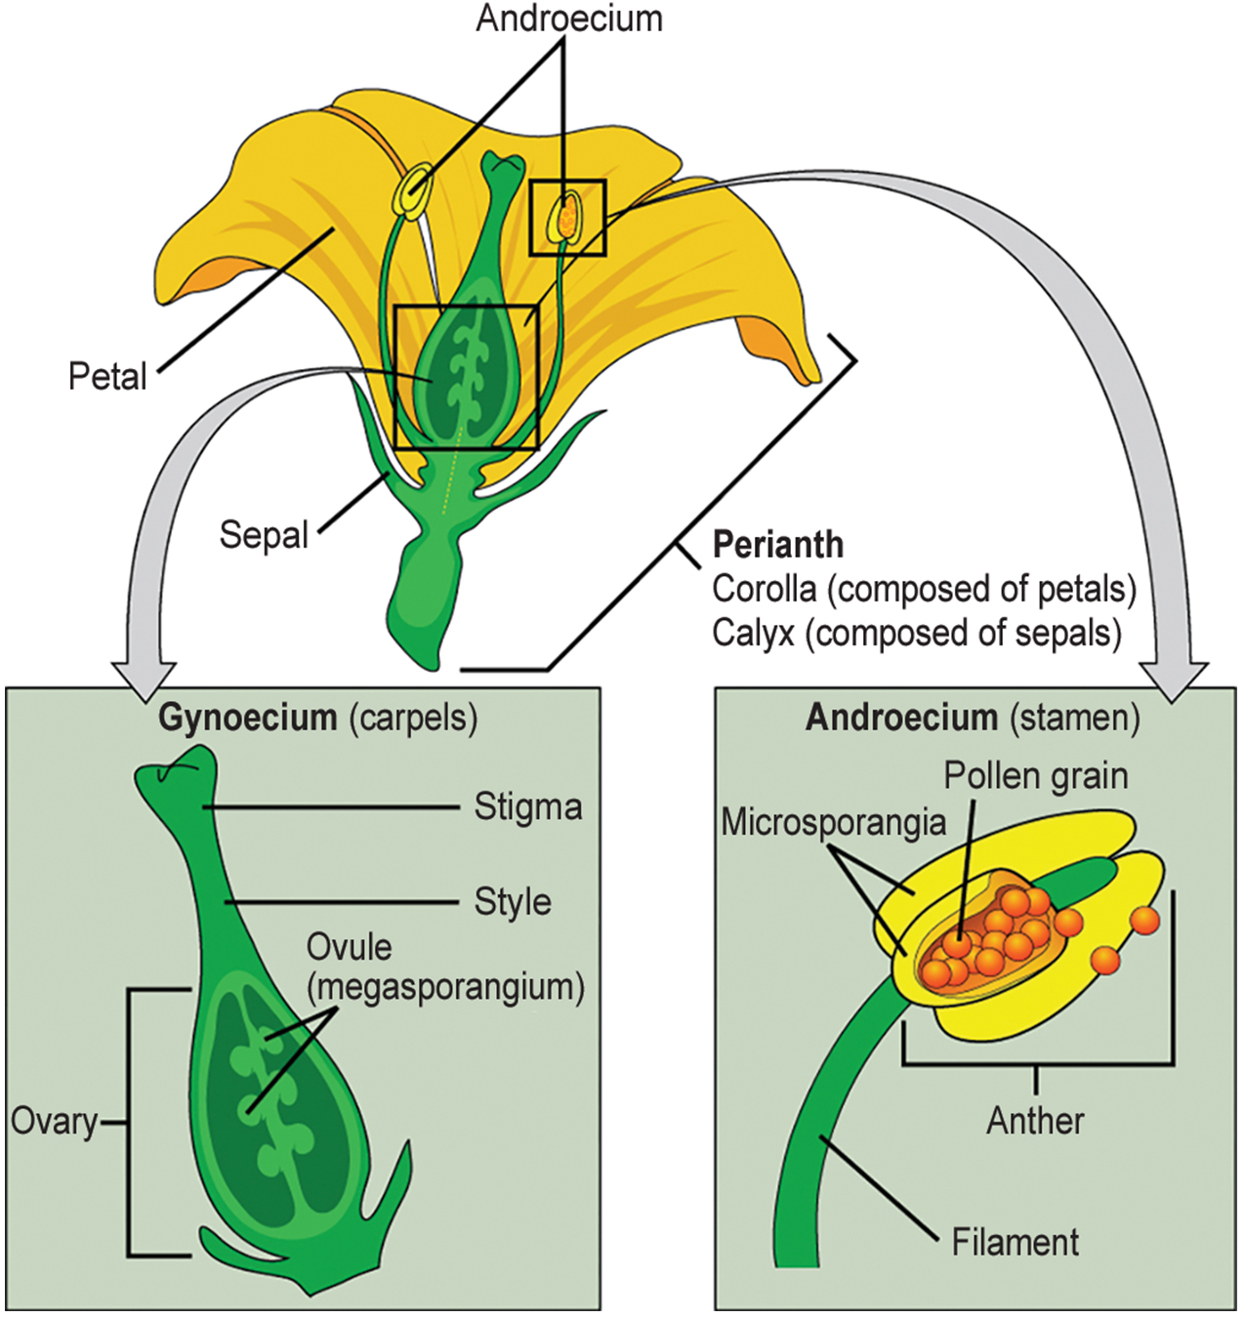
26.3 Figure 2
Mariana Ruiz Villarreal on Wikimedia Commons. "Flower structure."
Notes:
Figure 2: This image depicts the structure of a perfect flower. Perfect flowers produce both male and female floral organs.

Slide 10
Group Activity₁
As a class, go somewhere with flowers. The flowers can be inside or outside. Even artificial flowers will work if no real ones are available in your area. Bring a sketchbook and find a flower to draw. Is your flower a "perfect" flower? Explain your answer using arrows and captions to point out features you used to determine whether the flower was "perfect" or not. Then, discuss your findings as a group.

Slide 11
The Life Cycle of an Angiosperm₁
Sporophyte (adult) phase is dominant phase of life cycle
Heterosporous: Produce microspores, which generate pollen grains as male gametophytes, and megaspores, which form ovule that contains female gametophytes
Inside anther's microsporangia, male sporocytes divide by meiosis to generate haploid microspores, which undergo mitosis and generate pollen grains
Each pollen grain contains two cells: one generative (that divides into two sperm) and second cell (that becomes pollen tube cell)

Slide 12
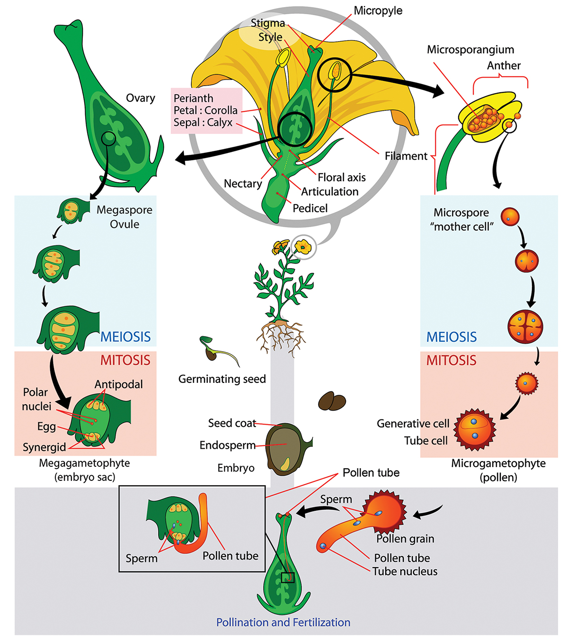
26.3 Figure 3
Mariana Ruiz Villarreal on Wikimedia Commons. "Flower structure."
Notes:
Figure 3: The life cycle of an angiosperm is shown. Anthers and carpels are structures that shelter the actual gametophytes: the pollen grain and embryo sac. Double fertilization is a process unique to angiosperms.

Slide 13
Think It Through₂
If a flower lacked a megasporangium, what type of gamete would not form?
If a flower lacked a microsporangium, what type of gamete would not form?
Notes:
Originally an On Your Own. This is included here to use as a talking point or for a think-pair-share activity.

Slide 14
The Life Cycle of an Angiosperm₂
Ovule, sheltered within ovary of the carpel, contains megasporangium protected by two layers of integuments and ovary wall
Ovary: chamber that contains and protects the ovule or female megasporangium
Each megasporangium contains diploid megasporocyte, which undergoes meiosis, creating four haploid megaspores (3 small, 1 large)
Large megaspore survives and divides mitotically three times to produce eight nuclei distributed to seven cells of female gametophyte or embryo sac
Three cells located at each pole of embryo sac
Three cells at one pole become egg and two synergids (small, short-lived cells that guide pollen tube for fertilization)
Three cells at opposite pole become antipodal cells (provide nourishment to egg cell)
Center cell contains remaining two nuclei (polar nuclei); eventually produces endosperm of seed

Slide 15
The Life Cycle of an Angiosperm₃
Mature embryo sac contains:
One egg cell
Two synergids (helper cells)
Three antipodal cells (which eventually degenerate)
One central cell with two polar nuclei
When pollen grain reaches stigma, pollen tube extends from grain, grows down style, and enters through micropyle (opening in integuments of ovule)
Two sperms then deposited in embryo sac

Slide 16
The Life Cycle of an Angiosperm₄
Double fertilization:
One sperm and egg combine, forming diploid zygote (the future embryo)
Other sperm fuses with polar nuclei, forming triploid cell that develops into endosperm (tissue that serves as food reserve for developing embryo)
Zygote develops into embryo with radicle (small root) and one (monocot) or two (dicot) leaflike organs called cotyledons
Cotyledon: primitive leaf that develops in the zygote; monocots have one cotyledon, and dicots have two cotyledons

Slide 17
The Life Cycle of an Angiosperm₅
Seed food reserves stored outside embryo in the form of complex carbohydrates, lipids, or proteins
Cotyledons serve as conduits to transmit broken-down food reserves from storage site inside seed to developing embryo
Seed consists of:
Toughened layer of integuments forming the coat
Endosperm with food reserves
Well-protected embryo at the center

Slide 18
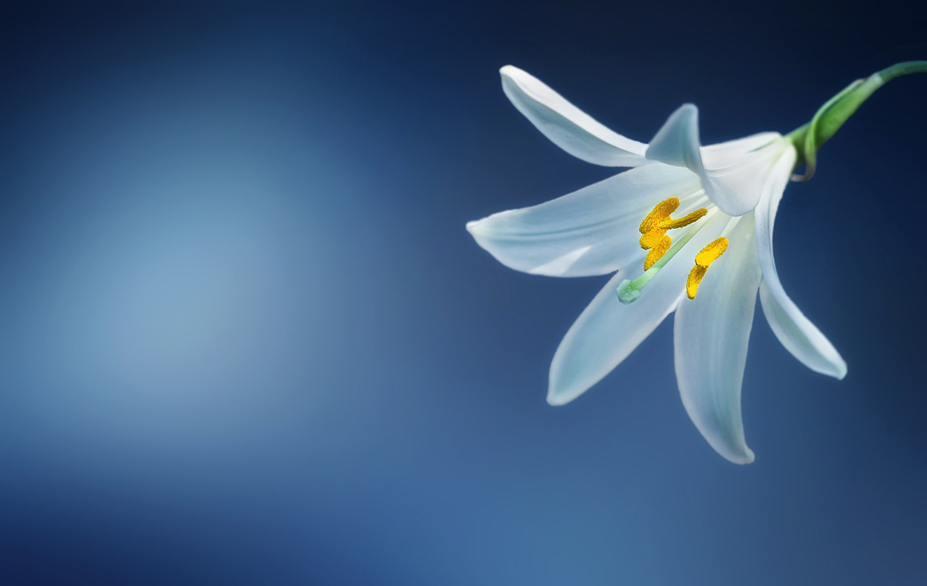
The Life Cycle of an Angiosperm₆
Most have perfect flowers (each flower has both stamens and carpels)
26.3 Figure 4: The Madonna lily, or white lily (Lilium candidum), has "perfect" flowers, meaning it has flowers with both stamens and carpels.
Bessi on Wikimedia Commons. "Madonna lily."

Slide 19
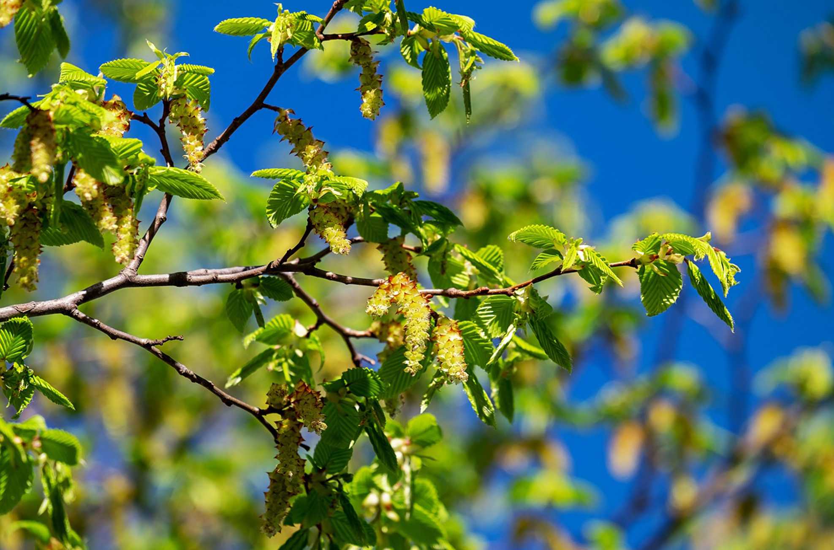
The Life Cycle of an Angiosperm₇
Monoecious plants: Male (staminate) and female (pistillate) flowers are separate but on same plant
Examples: Sweetgums (Liquidambar spp.), beeches (Betula spp.), and Carpinus betulus
Dioecious plants: Male and female flowers on separate plants
Examples: Willows (Salix spp.) and poplars (Populus spp.)
Only few species self-pollinate
Anatomical and environmental barriers promote cross-pollination mediated by physical agent (wind or water) or an animal (e.g., insect or bird)
Cross-pollination increases genetic diversity in species
26.3 Figure 5: The female inflorescences from a hornbeam (Carpinus betulus) are leafy and green, such as the inflorescence on the center-right branch tip. The male inflorescences are bigger, more prominent, and appear as long, yellow clusters like those shown in the center of this picture.
Couleur on Pixabay. "Hornbeam tree."

Slide 20
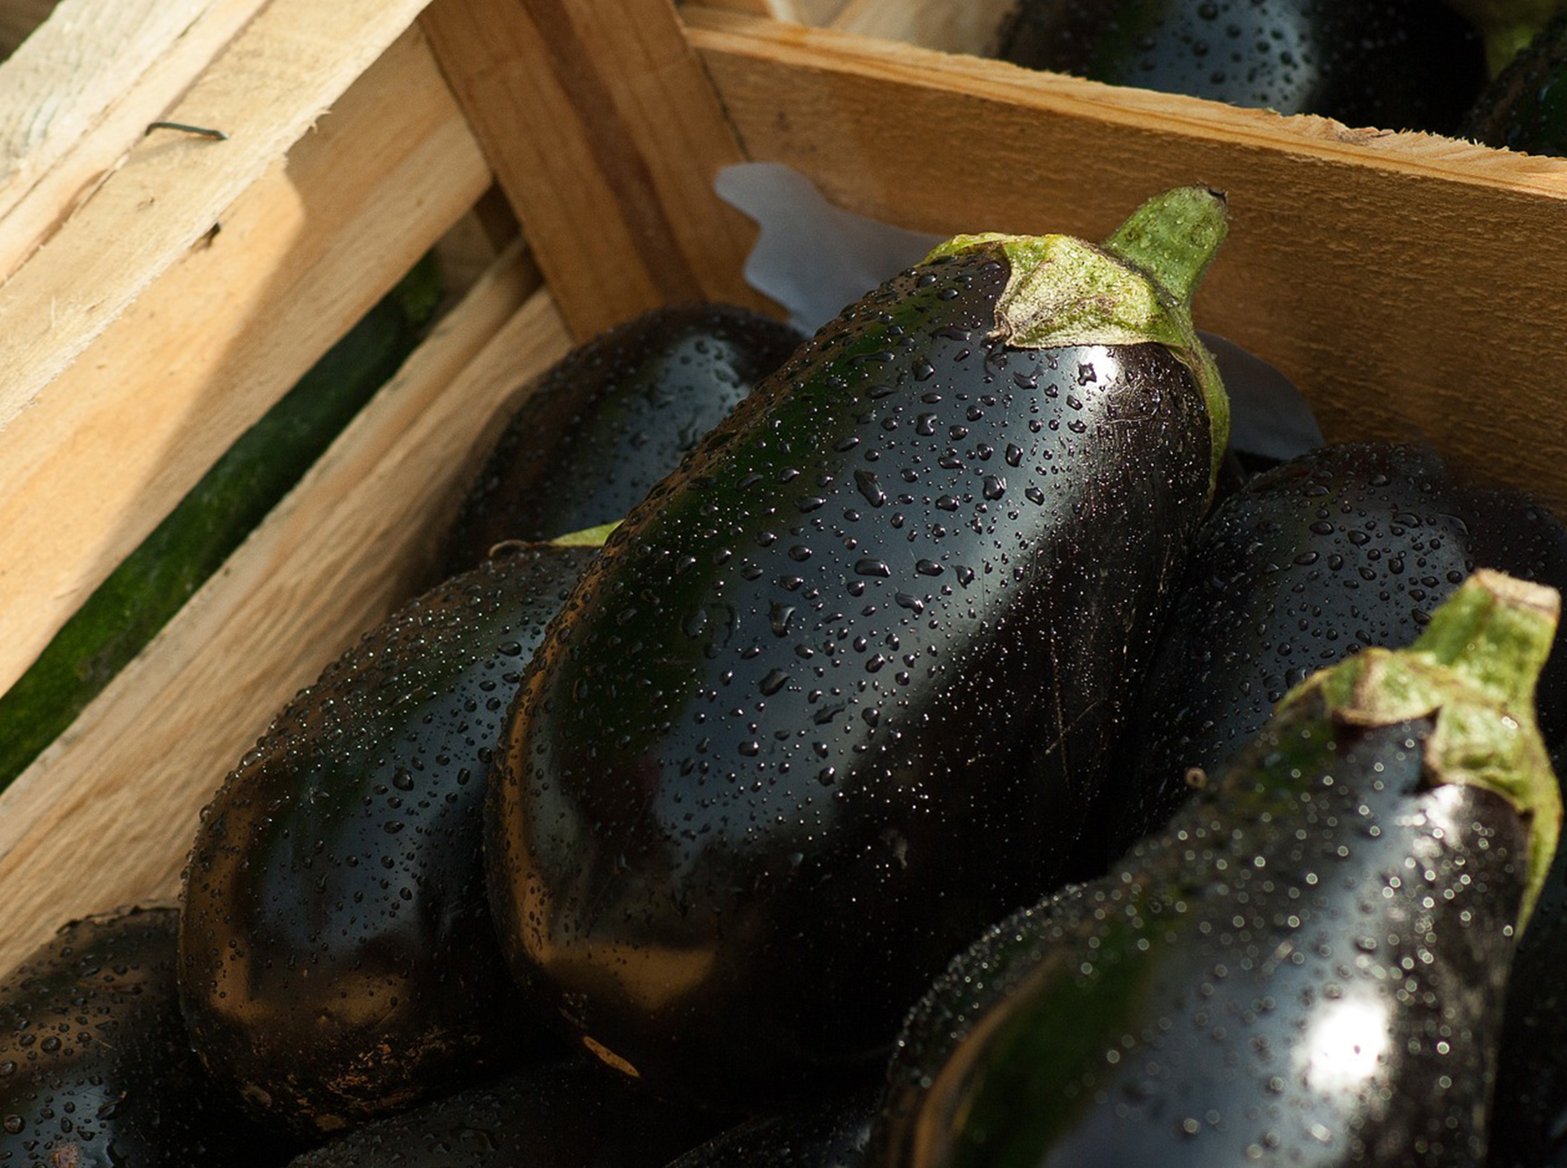
Fruit₁
As seed develops, walls of ovary thicken and form fruit
Seed forms in ovary, which enlarges as seeds grow
Examples: Eggplants, zucchini, string beans, tomatoes, bell peppers
All fruits because they contain seeds and derived from thick ovary tissue
Additional examples: Acorns (true nuts), winged maple helicopter seeds
Classification includes more than two dozen categories, with only a few as fleshy and sweet
26.3 Figure 6: Many foods that are commonly called vegetables, such as eggplants, are classified as fruits due to the fact that they contain plant seeds.
jacqueline macou on Pixabay. "Eggplants."

Slide 21
Fruit₂
Two categories: Fleshy or dry
Fleshy: Berries, peaches, apples, grapes, tomatoes
Dry: Rice, wheat, nuts
Not all fruits derived from ovary
Strawberries derived from ovary as well as receptacle (enlarged end of stalk or stem where flower is attached)
Apples formed from ovary, pericarp (ovary wall), and hypanthium (cuplike enlargement of receptacle)
Some derived from separate ovaries in single flower (e.g., raspberry)
Some form from clusters of flowers (e.g., pineapple)
Some have rinds (e.g., watermelon and orange)

Slide 22
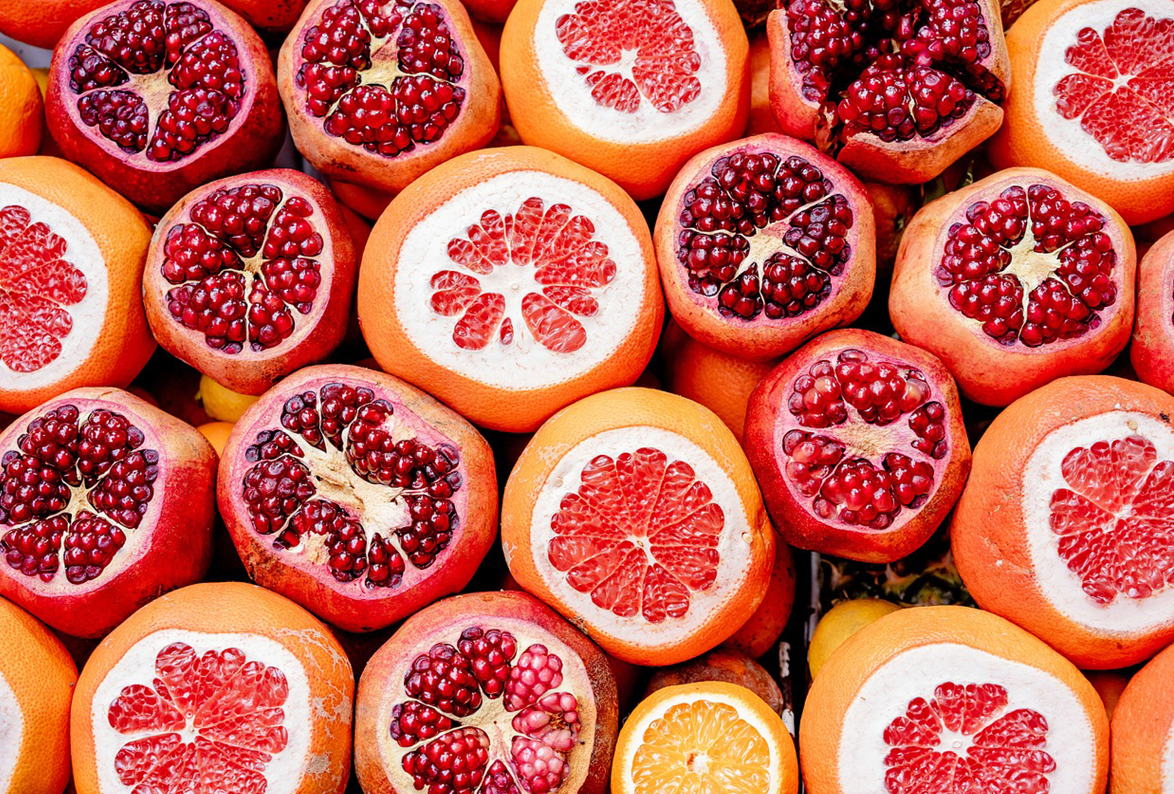
Fruit₃
Agents of seed dispersal
Variety of shapes and characteristics reflect mode of dispersal
Wind carries light, dry fruits of trees and dandelions
Water transports floating coconuts
Some attract herbivores with color or scent as food
Once eaten, tough, undigested seeds disperse through feces (endozoochory)
Some have burrs and hooks to cling to fur and ride on animals (epizoochory)
26.3 Figure 7: Oranges, grapefruits, and pomegranates are examples of fruits. The enticing taste of these fruits developed as an adaptation for seed dispersal.
Oleksandr Pidvalnyi on Pixabay. "Edible fruits."

Slide 23
Diversity of Angiosperms
Anthophyta: phylum to which angiosperms belong
Considered a monophyletic group (originating from single ancestor)
Three major groups: basal angiosperms, monocots, eudicots
Basal angiosperms: a group of plants that probably branched off before the separation of monocots and eudicots
Exhibit traits from both monocots and eudicots; categorized separately in most classification schemes
Includes Amborella, water lilies, Magnoliids (magnolia trees, laurels, spice peppers), and Austrobaileyales (e.g., star anise)
Monocots and eudicots differentiated based on structure of cotyledons, pollen grains, other structures
Monocots: Grasses, lilies
Eudicots: Multibranched group that includes roses, cabbages, sunflowers, mints, etc.

Slide 24
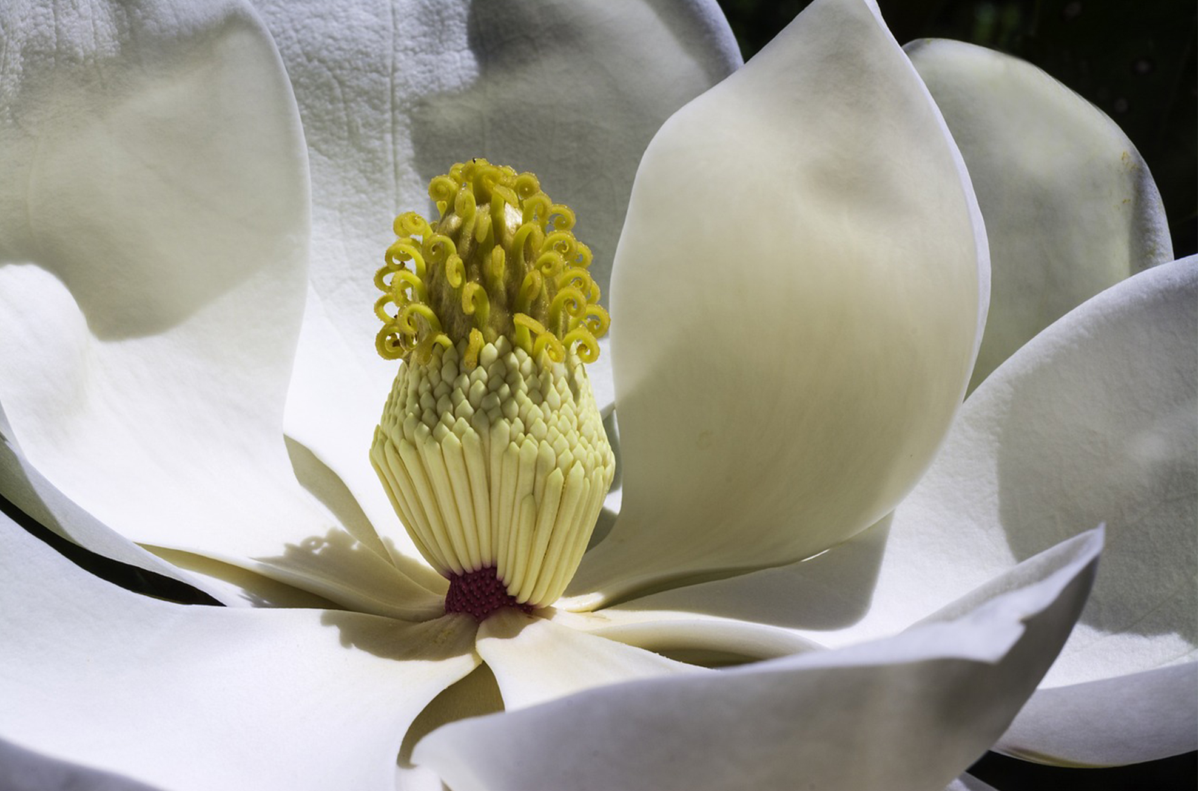
Basal Angiosperms₁
Magnoliidae: Magnolias, laurels, peppers
Magnolias:
Tall trees with dark, shiny leaves and large, fragrant flowers with many parts
Considered archaic
In outer whorl of flower, sepals and petals are undifferentiated and collectively called tepals
Reproductive parts arranged in spiral around cone-shaped receptacle, with carpels located above stamens
Aggregate fruit has one seed formed from each carpel
26.3 Figure 8: Magnolia grandiflora. A cluster of carpels (pistil) can be seen above the stamens, which have shed their pollen and begun to drop from the inflorescence. In the flower, the sepals and petals are undifferentiated and are collectively called tepals.
Jose Antonio Alba on Pixabay. "Magnolia flower."

Slide 25
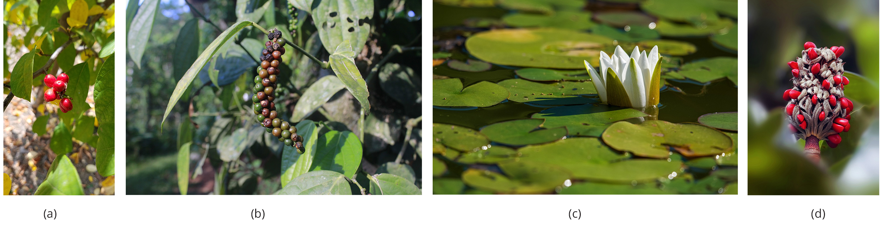
Basal Angiosperms₂
Laurel trees:
Produce fragrant leaves and small, inconspicuous flowers
Grow mostly in warmer climates
Small trees and shrubs
Includes bay laurel, cinnamon, spicebush, avocado tree
26.3 Figure 9: The (a) common spicebush belongs to the Laurales. (b) The fruit of the Piper nigrum plant is black pepper, the main product that was traded along spice routes. (c) The American white waterlily, Nymphaea odorata, has leaves that float on the surface of the water, and their roots are in the underlying soil at the bottom of the lake. (d) The aggregate fruit of a magnolia is shown.
Dan Keck on Wikimedia Commons. "Spicebush."
laviajera333 on Pixabay. "Black pepper."
NickyPe on Pixabay. "White waterlily."
Camera-man on Pixabay. "Magnolia fruit."

Slide 26
Monocots₁
Monocot: related group of angiosperms that produce embryos with one cotyledon and pollen with a single ridge
Veins run parallel to and along length of leaves
Flower parts arranged in three- or six-fold symmetry
True woody tissue rarely found in monocots
Example: Palm trees
Vascular and parenchyma tissues produced by primary and secondary thickening meristems form trunk
Pollen from first angiosperms likely monosulcate (containing single furrow or pore through outer layer); still seen in modern monocots
Vascular tissue of stem is scattered and not arranged in particular pattern; organized in ring in roots
Root system consists of multiple fibrous roots with no major tap root
Adventitious roots often emerge from stem or leaves

Slide 27
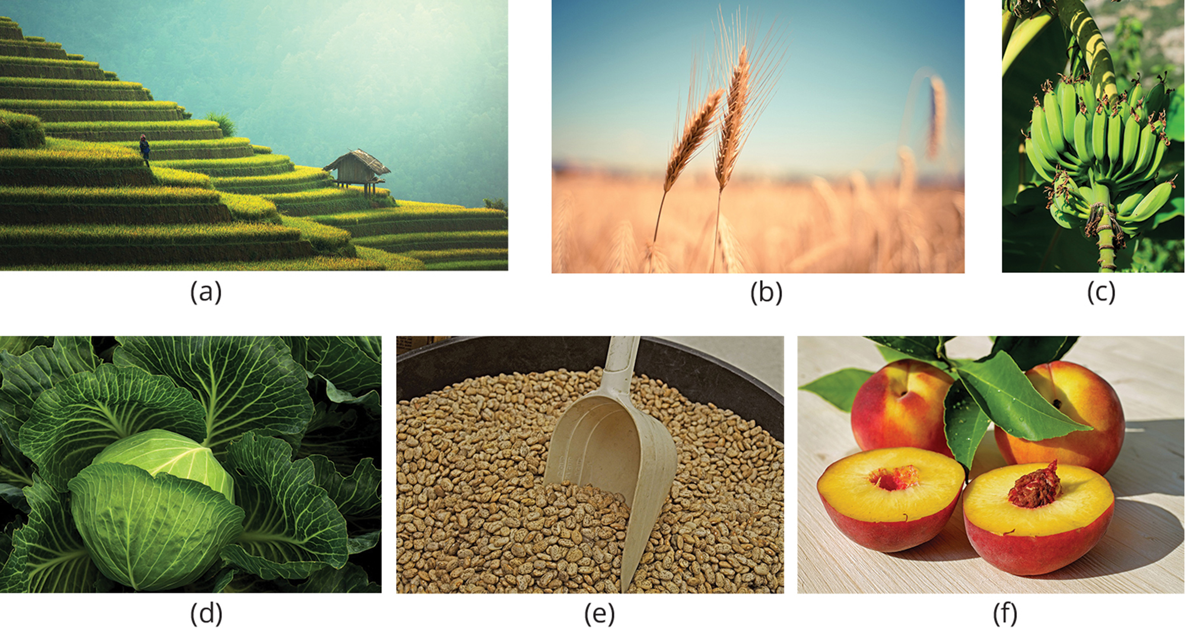
Monocots₂
Includes true lilies (Liliopsida), orchids, yucca, asparagus, grasses, palms, rice and other cereals, corn, sugar cane, tropical fruits (e.g., bananas and pineapples)
26.3 Figure 10: The world's major crops are flowering plants. (a) Rice, (b) wheat, and (c) bananas are monocots, while (d) cabbage, (e) beans, and (f) peaches are dicots.
Sasin Tipchai on Pixabay. "Rice."
picjumbo_com on Pixabay. "Wheat."
PublicDomainPictures on Pixabay. "Bananas."
Ulrike Leone on Pixabay. "Cabbage."
James_Maynard on Pixabay. "Pinto beans."
Couleur on Pixabay. "Peaches."

Slide 28
Eudicots
Eudicot: related group of angiosperms whose embryos possess two cotyledons; true dicots
Dicot: plants whose embryos possess two cotyledons
Veins form network in leaves
Flower parts come in four, five, or many whorls
Vascular tissue forms ring in stem
In monocots, vascular tissue scattered in stem
Can be herbaceous or produce woody tissues
Herbaceous: grasslike plant noticeable by the absence of woody tissue
Produce pollen that is trisulcate or triporate, with three furrows (grooves) or pores
Root system usually anchored by one main root developed from embryonic radicle
Comprise two-thirds of all flowering plants
Some may exhibit characteristics associated with monocots
Identification as monocot or eudicot not always clear

Slide 29
Group Activity₂
As a class, take a walk and work in pairs to complete the following scavenger hunt. Each pair must find an example of the following: a gymnosperm, an angiosperm, a dicot, and a monocot. Take a picture of each. You must find a unique plant for each category. For example, any monocot that you find must count toward either your monocot or angiosperm category, but not both.

Slide 30
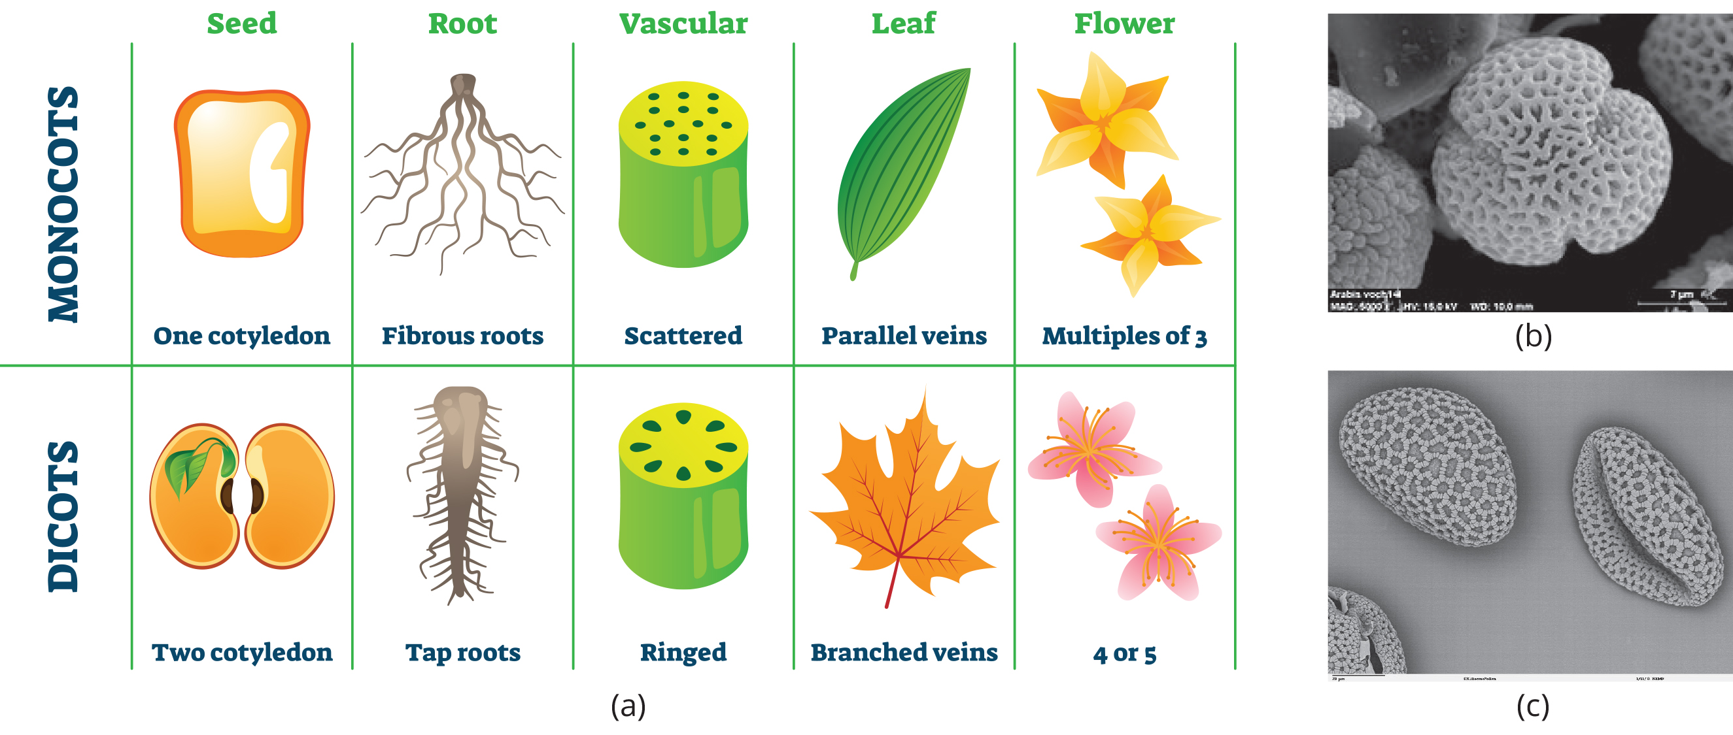
26.3 Figure 11
Marie Majaura on Wikimedia Commons. "Trisulcate pollen."
remf.dartmouth.edu. "Monosulcate pollen."
Notes:
Figure 11: (a) Monocots are characterized by having one cotyledon, parallel veined leaves, scattered vascular tissues within their stems, a network of fibrous roots, and three or multiples of three for flower parts. Eudicots are characterized by having two cotyledons, network or branched veined leaves, vascular tissues arranged in a ring pattern in the stems, a tap root with many lateral roots, and four or five (or multiples of four and five) flower parts and whorls. (b) Eudicots have trisulcate pollen, which has three or more furrows, (c) while monocots have monosulcate pollen, which has only one furrow.

Slide 31
Summary₁
Dominant form of plant life in most terrestrial ecosystems
Comprises 90% of all plant species
Includes most crops and ornamental plants
Success comes from flowers and fruits that protect reproduction from variability in environment
Flowers derived from modified leaves
Color and fragrance encourage species-specific pollination
Main parts are sepals and petals, which protect reproductive parts (stamens and carpels)
Stamens produce male gametes in pollen grains
Carpels contain female gametes (eggs inside ovules), within the ovary of carpel
Walls of ovary thicken after fertilization, ripening into fruit
Dispersed by wind, water, animals

Slide 32
Summary₂
Sporophyte dominate life cycle
Double fertilization unique to angiosperms
One sperm in pollen fertilizes egg, forming diploid zygote
One sperm combines with two polar nuclei, forming triploid cell that develops into food storage tissue (endosperm)
Divided into two main groups: monocots and eudicots
Divided according to number of cotyledons in seedlings
Basal angiosperms belong to older lineage than monocots and eudicots

Slide 33

End of Hawkes Learning PowerPoint

