Slide 1
Lesson 26.4
The Importance of Seed Plants

Slide 2
Objectives
Describe ways in which pollination occurs.
Discuss the roles that plants play in ecosystems and how deforestation threatens plant biodiversity.
Explain how angiosperm diversity is due, in part, to multiple complex interactions with animals.

Slide 3
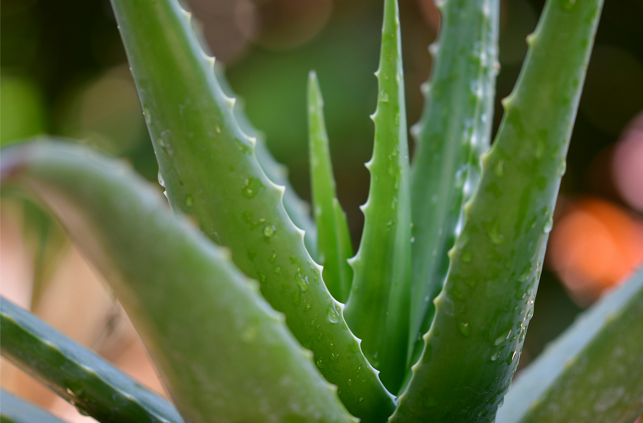
The Importance of Seed Plants
Key role in maintenance of terrestrial ecosystems
  Stabilization of soils
  Cycling of carbon
  Climate moderation
    Example: Large tropical forests (release oxygen and act as cardon dioxide sinks)
Provide shelter as well as food for herbivores, which feed carnivores
Secondary metabolites (organic compounds not directly essential for growth, development, reproduction) used for medicinal purposes and industrial production
All animal life dependent on plants for survival
26.4 Figure 1: Aloe vera—a succulent plant that grows in arid, hot climates—has been used medicinally for centuries as a skin treatment.
pisauikan on Unsplash. "Aloe vera."

Slide 4
Animals and Plants: Herbivory₁
Hypothesis: Flowering plants and insects coevolved
  Supported because both diversified in the middle Mesozoic Era
Diversity of plants and insects caused by pollination and herbivory
  Herbivory: the consumption of primary producers (such as plants)
  Coevolution of herbivores and plant defenses commonly observed in nature

Slide 5
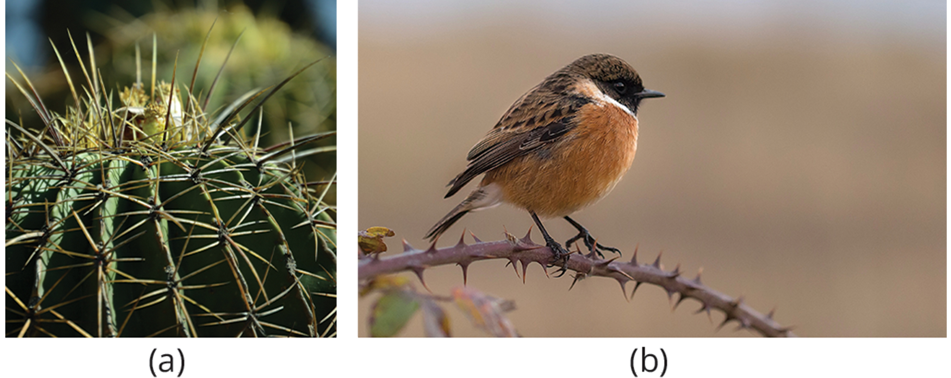
Animals and Plants: Herbivory₂
Plant defenses again herbivory:
Hide using camouflage or mimicry
Some seeds (e.g., acorns and unripened persimmon) high in alkaloids and unsavory to animals
Protected by bark, but some animals developed specialized mouth pieces to tear and chew vegetal material
Spines and thorns to deter most animals (except mammals with thick fur and birds with specialized beaks)
26.4 Figure 2: (a) Spines and (b) thorns are examples of plant defenses.
Miguel Á. Padriñán on Pexels. "Cactus."
DAMIANUM CASTRUM on Pexels. "Bird on thorny branch."

Slide 6
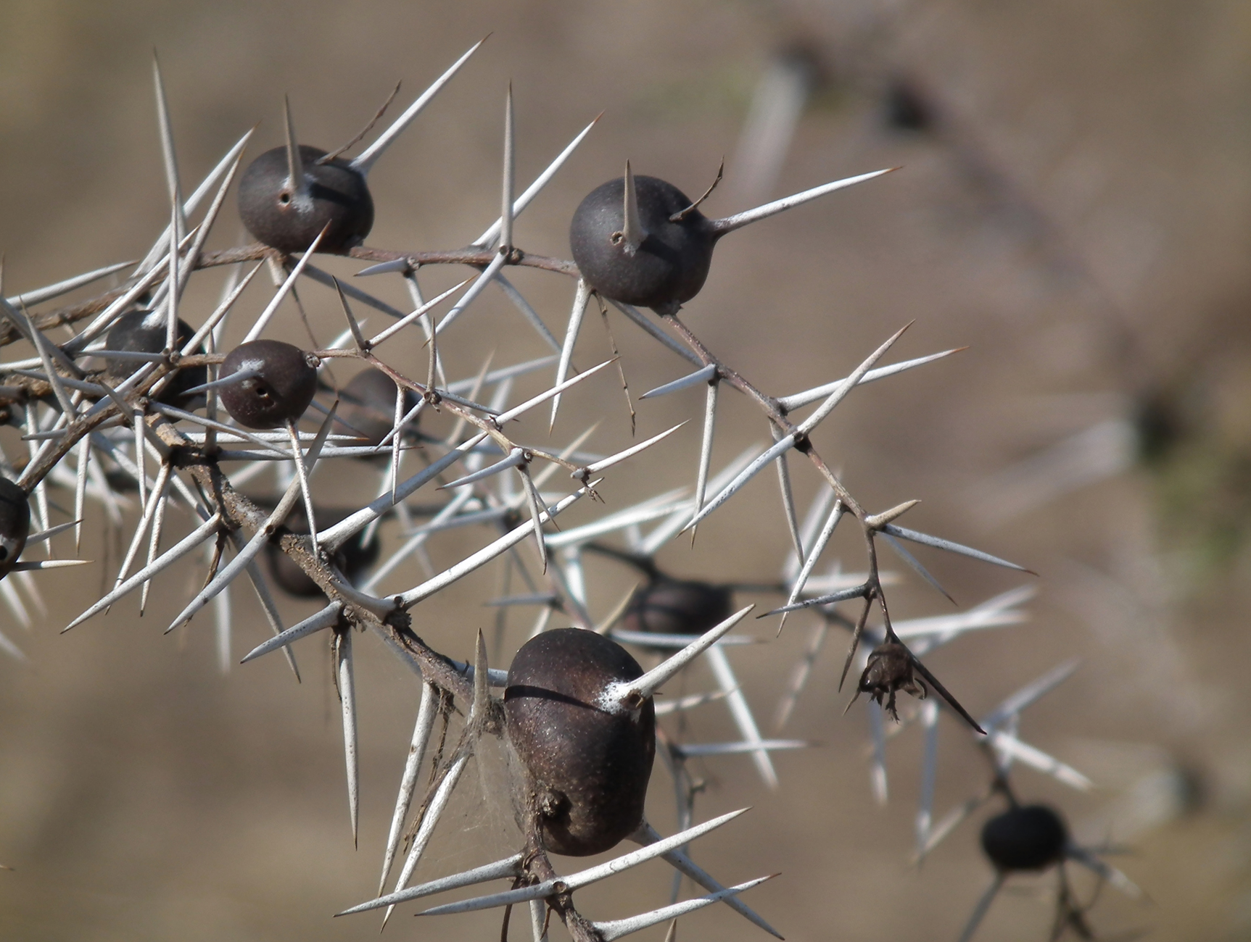
Animals and Plants: Herbivory₃
Herbivory exploited by seed plants for dispersal of fruits (mutualistic relationship)
  Plant offers nutritious food in return for spreading genetic material
Example of extreme coevolution (discovered by Daniel Janzen): Mexican acacia trees and acacia ants Pseudomyrmex spp. (myrmecophytism)
  Trees support ants with shelter and food
  Ants nest in hollows of large thorns on tree and feed on sugary secretions produced at ends of leaves, which also help to keep ants from interfering with insect pollinators
  Ants discourage herbivores (both invertebrates and vertebrates) by stinging and attacking leaf-eaters and predatory insects leaving eggs on the plants
  Ants help to remove potential plants pathogens (e.g., fungal growths)
26.4 Figure 3: The whistling thorn (Acacia drepanolobium) is a type of acacia from Tanzania.
Nevit Dilmen on Wikimedia Commons. "Whistling thorn."

Slide 7
Animals and Plants: Herbivory₄
Example of insect-plant coevolution:
  Bracken fern (Pteridium aquilinum) and insects
    Bracken ferns produce secondary plant compounds in adult fronds that serve as defensive compounds against non-adapted insect attacks
      Compounds: Cyanogenic glucosides, tannins, phenolics
    During fiddlehead/crozier stage, bracken secretes nutritious sugary and proteinaceous compounds from "nectaries" that attract ants and species of jumping spiders, which defend plant's croziers until fully unfolded
Opportunistic groups of protective arthropods reduce damage that otherwise would occur during early stages of growth

Slide 8
Animals and Plants: Pollination₁
Flowers pollinated by wind usually small, feathery, and visually inconspicuous
  Example: Grasses, large trees (oaks, maples, and birches)
    Produce large amounts of powdery pollen carried large distances by wind
80% of angiosperms depend on animals for pollination
  Pollination: transfer of pollen from the anther to the stigma
Many adaptations to attract pollinators
  200,000 plants dependent on animal pollination; plant needs to advertise to pollinators
  Possible to determine general type of pollinators favored by plant by observing flower's physical characteristics
    Many bird or insect-pollinated flowers secrete nectar
      Nectar: liquid rich in sugars produced by flowers to attract animal pollinators
    Also produce both fertile pollen for reproduction and sterile pollen rich in nutrients for birds and insects

Slide 9
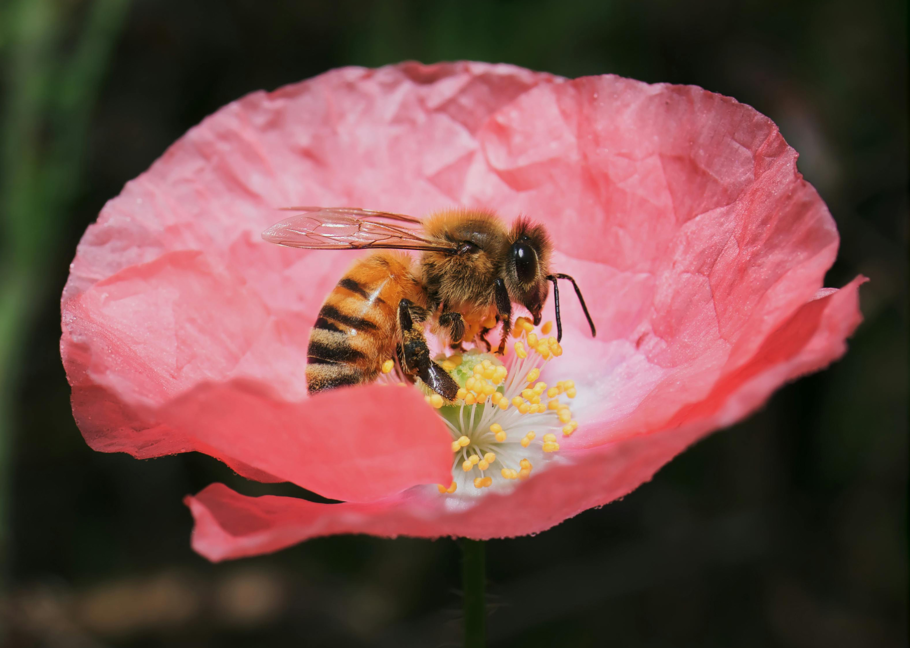
Animals and Plants: Pollination₂
Many butterflies and bees detect UV reflectance that helps with locating flower's center, where pollinating insects collect nectar while dusted with pollen
Large, red flowers with little smell and long funnel shape preferred by hummingbirds (have good color perception, poor sense of smell, and need strong perch)
White flowers that open at night attract moths
Other pollinating agents: Bats, lemurs, lizards
Any disruption to pollinating interactions (e.g., disappearance of bees from colony collapse disorders) can lead to disaster for agricultural industries dependent on pollinating crops
26.4 Figure 4: As a bee collects nectar from a flower, it is dusted by pollen, which it then disperses to other flowers.
Casia Charlie on Pexels. "Bee on flower."

Slide 10
Group Activity₁
Testing Attraction of Flies by Rotting Flesh Smell
Question: Will flowers that offer cues to bees attract carrion flies if sprayed with compounds that smell like rotten flesh?
Background: Visitation of flowers by pollinating flies is a function mostly of smell. Flies are attracted by rotting flesh and carrion, with the putrid odor seemingly the major attractant. The polyamines putrescine and cadaverine—the products of protein breakdown after animal death—are the source of the pungent smell of decaying meat. Some plants strategically attract flies by synthesizing polyamines similar to those generated by decaying flesh and thereby attract carrion flies.
Flies seek out dead animals because they normally lay their eggs on them and their maggots feed on the decaying flesh. Interestingly, time of death can be determined by a forensic entomologist based on the stages and type of maggots recovered from cadavers.

Slide 11
Group Activity₂
Testing Attraction of Flies by Rotting Flesh Smell
Hypothesis: Because flies are drawn to other organisms based on smell and not sight, a flower that is normally attractive to bees because of its colors will attract flies if it is sprayed with polyamines similar to those generated by decaying flesh.

Slide 12
Group Activity₃
Testing Attraction of Flies by Rotting Flesh Smell
Test the Hypothesis:
Select flowers usually pollinated by bees. White petunia may be a good choice.
Divide the flowers into two groups, and while wearing eye protection and gloves, spray one group with a solution of either putrescine or cadaverine. (Putrescine dihydrochloride is typically available in 98% concentration; this can be diluted to approximately 50% for this experiment.)
Place the flowers in a location where flies are present, keeping the sprayed and unsprayed flowers separated.
Observe the movement of the flies for one hour. Record the number of visits to the flowers using a table. Given the rapid movement of flies, it may be beneficial to use a video camera to record the fly-flower interaction. Replay the video in slow motion to obtain an accurate record of the number of fly visits to the flowers.
Repeat the experiment four more times with the same species of flower but using different specimens.
Repeat the entire experiment with a different type of flower that is normally pollinated by bees.

Slide 13
Group Activity₄
Testing Attraction of Flies by Rotting Flesh Smell
Results of Number of Visits by Flies to Sprayed and Control/Unsprayed Flowers
Trial # | Sprayed Flowers | Unsprayed Flowers
1
2
3
4
5

Slide 14
Group Activity₅
Testing Attraction of Flies by Rotting Flesh Smell
Analyze Your Data: Review the data you have recorded. Average the number of visits that flies made to sprayed flowers over the course of the five trials (on the first flower type) and compare and contrast this average to the average number of visits that flies made to the unsprayed/control flowers. Can you draw any conclusions regarding the attraction of the flies to the sprayed flowers?
For the second flower type used, average the number of visits that flies made to sprayed flowers over the course of the five trials and compare and contrast this average to the average number of visits that flies made to the unsprayed/control flowers. Can you draw any conclusions regarding the attraction of the flies to the sprayed flowers?
Compare and contrast the average number of visits that flies made to the two flower types. Can you draw any conclusions about whether the appearance of the flower had any impact on the attraction of flies? Did smell override any appearance differences, or were the flies attracted to one flower type more than another?

Slide 15
Group Activity₆
Testing Attraction of Flies by Rotting Flesh Smell
Form a Conclusion: Do the results support the hypothesis? If not, how can your observations be explained?

Slide 16
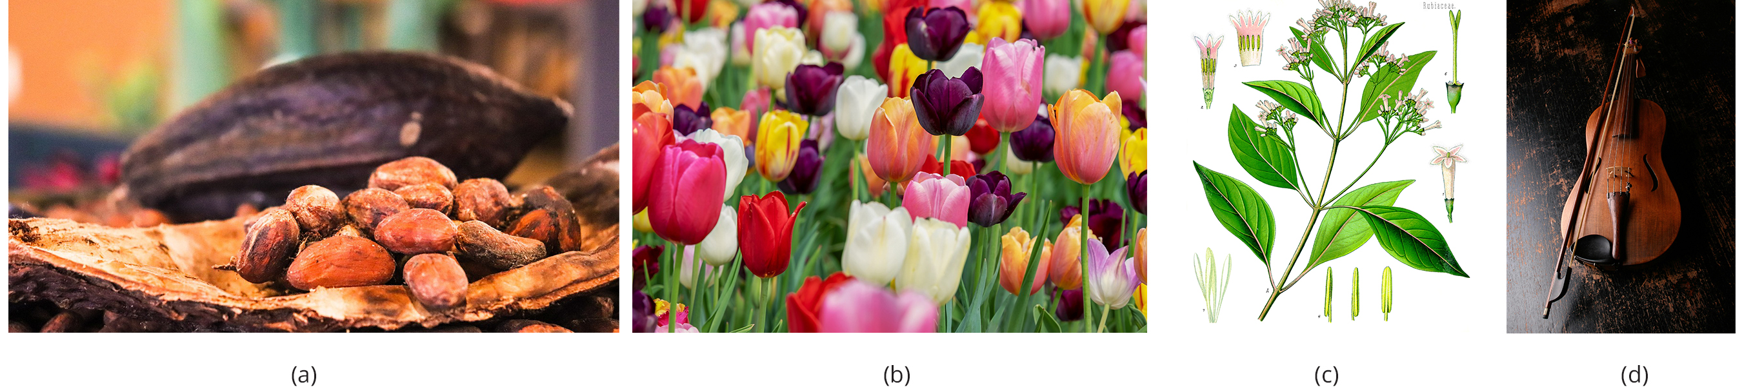
The Importance of Seed Plants in Human Life₁
Foundation of human diets worldwide
Crops dominate agricultural landscape
  Crop: cultivated plant
  Examples: Rice, wheat, potatoes
  Developed during agricultural revolution during transition from nomadic hunter-gatherers to horticulture and agriculture
  Cereals (rich in carbohydrates) provide staple of human diet
  Beans and nuts for protein
  Fats from crushed seeds (e.g., peanut, rapeseed [canola] oils) or fruits (e.g., olives)
  Animal husbandry consumes large quantities of crops
26.4 Figure 5: (a) Cacao beans combined with sugar, produce chocolate. (b) Flowers, like the tulip, are cultivated for their beauty. (c) Quinine, extracted from cinchona trees, is used to treat malaria, to reduce fever, and to alleviate pain. (d) This violin is made of wood from a tree.
allybally4b on Pixabay. "Cacao beans."
Couleur on Pixabay. "Tulips."
Franz Eugen Köhler on Wikimedia Commons. "Cinchona."
Pixabay on Pexels. "Violin."

Slide 17
The Importance of Seed Plants in Human Life₂
Fruits and vegetables provide nutrient macromolecules, vitamins, minerals, fiber
Sugar produced from monocot sugarcane and eudicot sugar beet
Drinks made from infusions of tea leaves, chamomile flowers, crushed coffee beans, powdered cocoa beans
Spices come from different plant parts
  Saffron and cloves are stamens and buds
  Black pepper and vanilla are seeds
  Bark of bush in Laurales family produces cinnamon
  Herbs come from dried leaves and fruit (e.g., red chili pepper)
  Oils from flowers and bark provide scent of perfumes

Slide 18
The Importance of Seed Plants in Human Life₃
Fermentation of plant-derived sugars and starches for alcoholic beverages
  Derived from fermentation of sugars from fruit (e.g., wines) and fermentation of carbohydrates from seeds (e.g., beers)
Providing wood as source of timber for construction, fuel, and material for furniture
Paper derived from pulp of coniferous trees
Cloth derived from fibers of seed plants (e.g., cotton, flax, hemp)
Textile dyes (e.g., indigo) used to be derived from plants until creation of synthetic chemical dyes
Ornamental plants for aesthetic and cultural purposes in public and private spaces

Slide 19
The Importance of Seed Plants in Human Life₄
Medicinal properties known since ancient times
  References in Egyptian, Babylonian, Chinese writings from 5,000 years ago
  Modern synthetic drugs derived or synthesized from plant secondary metabolites
  Same extract can be therapeutic at low doses, addictive at higher doses, potentially lethal at high concentrations

Slide 20
Table 1: Plant Origin of Medicinal Compounds and Medical Applications
Plant | Compound | Application
deadly nightshade (Atropa belladonna) | atropine | dilates eye pupils for eye exams
foxglove (Digitalis purpurea) | digitalis | treats heart failure and arrhythmias
yam (Dioscorea spp.) | steroids | steroid hormones: contraceptive pill and cortisone
Ephedra (Ephedra spp.) | ephedrine | decongestant and bronchiole dilator
Pacific yew (Taxus brevifolia) | taxol | cancer chemotherapy; inhibits mitosis
opium poppy (Papaver somniferum) | opioids | analgesic (reduces pain without loss of consciousness) and narcotic (reduces pain with drowsiness and loss of consciousness) in higher doses
quinine tree (Cinchona spp.) | quinine | antipyretic (lowers body temperature) and antimalarial
willow (Salix spp.) | salicylic acid (aspirin) | analgesic and antipyretic

Slide 21
Group Activity₇
Discuss in small groups specific ways that you depend on seed plants. Identify three specific seed plant examples. Then, design and illustrate a poster highlighting those seed plants and their usages. As an entire class, display your creations and take a few minutes to read and explore. Identify any plants that repeatedly appear on the different group posters.

Slide 22
Science and You₁
Career: Ethnobotanist
Studies interaction between particular culture and plants native to region
Plants major source of food, medicine, and influence in clothing and industry
Medicinal properties of plants recognized early on; replaced by synthetic chemicals in mid-1900s
Pharmacognosy: Branch of pharmacology that focuses on medicines derived from natural sources
Possible loss of human knowledge of plants and medicinal purposes as cultures disappear
Notes:
This is included as a relevant application for this topic.

Slide 23
Science and You₂
Career: Ethnobotanist
Ethnobotany is the study of plant use in particular cultures.
Needs to have knowledge of plant life and understanding and appreciation of diverse cultures and traditions
Amazon Rainforest home to incredible diversity of vegetation; considered untapped resource of medicinal plants
  Ecosystem and indigenous cultures threatened with extinction
Must acquire broad knowledge of plant biology, ecology, sociology
Plant specimens studied and collected as well as stories, recipes, and traditions linked to them
Plants seen as integral part of human culture
Multidisciplinary science: Convergence of molecular biology, anthropology, and ecology
Notes:
This is included as a relevant application for this topic.

Slide 24
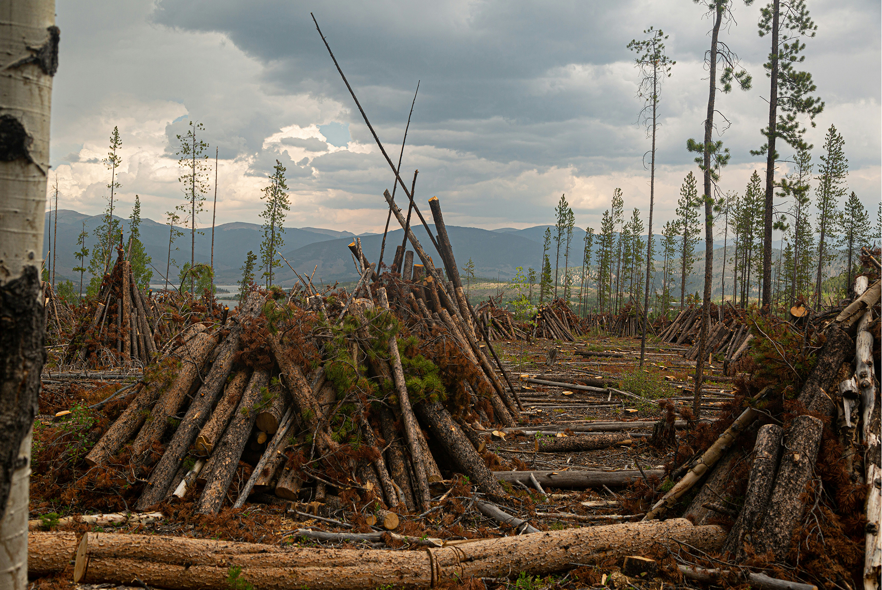
Biodiversity of Plants₁
Ensures resource for new food crops and medicines
Balances ecosystems, protects watersheds, mitigates erosion, moderates the climate, provides shelter for animals
Threats to plant diversity
  Explosion of human population, especially in tropical countries where birth rates and economic development are highest, leading to human encroachment into forested areas
  Feeding growing population needs arable land (land where crops can be grown), so forests are being cleared (deforestation)
26.4 Figure 6: Humans clear massive numbers of trees to obtain the arable land needed for growing crops.
Sebastian Kurpiel on Unsplash. "Clearing of trees."

Slide 25
Biodiversity of Plants₂
Threats to plant diversity:
Need for more energy to power larger cities, economic growth leads to dam construction, which floods ecosystems, and increased emissions of pollutants
Poachers log trees with precious wood
  Ebony and Brazilian rosewood (both endangered) almost extinct due to indiscriminate logging
  Continues due to difficulties with effective monitoring of forests and enforcing laws against illegal harvesting

Slide 26
Biodiversity of Plants₃
Plants becoming extinct at increasing rate
Disappearance of single plant can lead to extinction of connected animal species because of symbiotic relationships with seed plants and animals (predators or pollinators)
Many plant species not yet catalogued and place in ecosystem is unknown
  Threated by logging, habitat destruction, and loss of pollinators
  May become extinct before we understand possible impacts from disappearance
Efforts to preserve biodiversity
  Preserving heirloom seeds
    Heirloom seed: seed from a plant that was grown historically but has not been used in modern agriculture on a large scale
  Barcoding species
    Barcoding: molecular biology technique in which one or more short gene sequences taken from a well-characterized portion of the genome is used to identify a species

Slide 27
Summary
Angiosperm diversity due to interactions with animals
  Herbivory favored development of defense mechanisms in plants and avoidance of those mechanisms in animals
  Seed dispersal aided by animals that eat plant fruits
  Pollination (transfer of pollen to carpel) carried by wind or animals
    Fruits and seeds evolved adaptations to capture wind or attract animals
Plants play key role in ecosystems
  Source of food, medicinal compounds, raw materials for industries
Rapid deforestation and industrialization threaten biodiversity, which threatens ecosystem

Slide 28

End of Hawkes Learning PowerPoint

