Slide 1
Lesson 27.1
Characteristics of Animals

Slide 2
Objectives
Describe the roles that Hox genes play in development.
Explain the processes of animal reproduction and embryonic development.
List the features that distinguish the kingdom Animalia from other kingdoms.

Slide 3
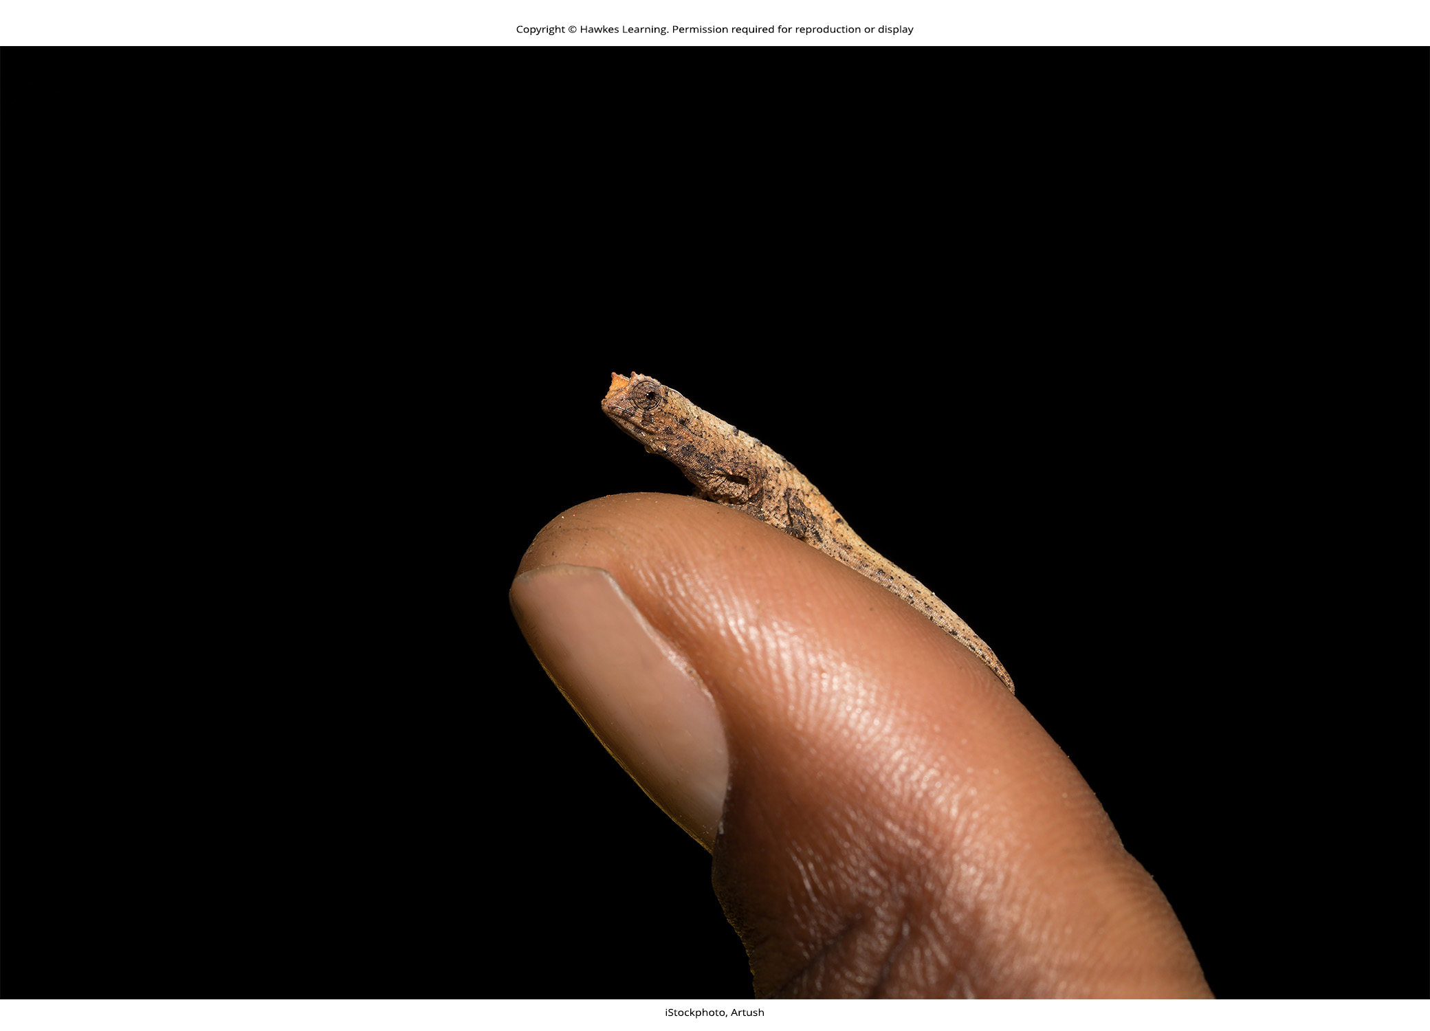
Introduction to Animal Diversity
Began over 600 million years ago in the ocean
Evolved to over 1 million identified extant (currently living) species, with estimates of 3–30 million total species
Vary in complexity; difficult to classify in unified system
Classification system based on anatomy, morphology, evolutionary history, features of embryological development, and genetic makeup
Constantly evolving as new information arises
27.1 Figure 1: The leaf chameleon (Brookesia micra) was discovered in northern Madagascar in 2012. At just over one inch long, it is the smallest known chameleon.

Slide 4
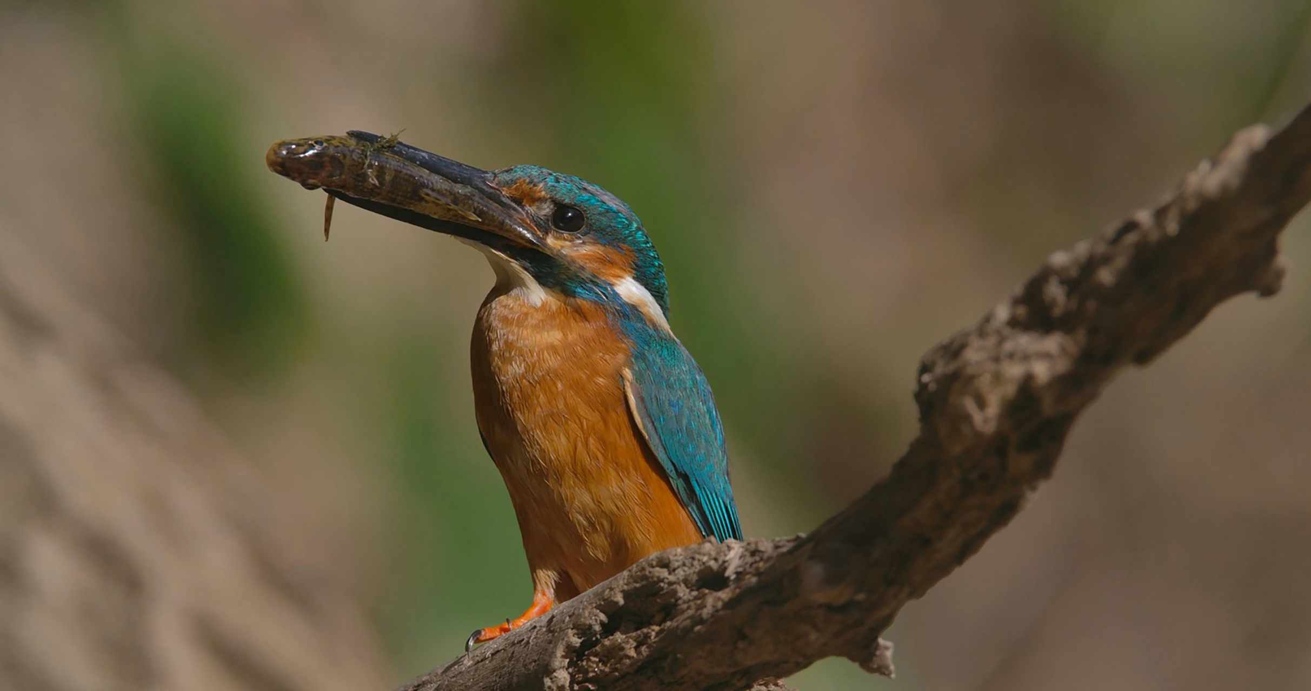
Characteristics of Animals₁
Two groups within domain Eukaryota that produced complex multicellular organisms
Plants from Archaeplastida
Animals (and close relatives, fungi) from Opisthokonta
Both have different lifestyles and different cellular histories as eukaryotes
Example: Opisthokonts share possession of single posterior flagellum in flagellated cells (e.g., sperm cells)
27.1 Figure 2: All animals are heterotrophic; they must ingest living or dead organisms for nutrients and energy. The kingfisher in this image is consuming its prey.
Rémi METIN on Unsplash. "Kingfisher."

Slide 5
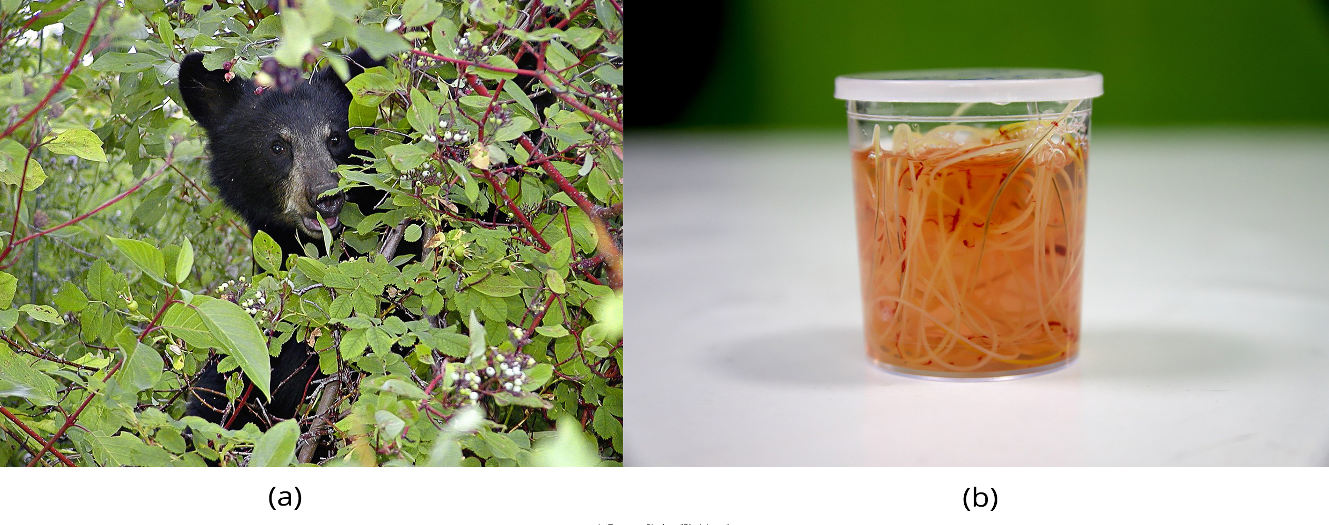
Characteristics of Animals₂
Most animals share features that distinguish them from other kingdoms
All are heterotrophic, requiring source of food from ingesting other living or dead organisms
Plants are autotrophic, synthesizing own nutrients through photosynthesis
Animals may be carnivores, herbivores, omnivores, or parasites
27.1 Figure 3: The (a) black bear is an omnivore, eating both plants and animals. This cub is eating berries. The (b) heartworm Dirofilaria immitis is a parasite that derives energy from its hosts. It spends its larval stage in mosquitoes and its adult stage infesting the hearts of dogs and other mammals, as shown here.
ArtTower on Pixabay. "Black bear."
Mirko Sajkov on Pixabay. "Heartworm parasites."

Slide 6
Characteristics of Animals₃
Most animals share features that distinguish them from other kingdoms
Almost all have complex tissue structure with differentiated and specialized tissues
Necessity for food means most are motile
Typically diplontic life cycle (diploid state multicellular, haploid state gametic with sperm or egg)
No alternation of generations
Some have multiple body forms, but all forms are diploid
Embryos go through developmental stages to establish determined and fixed body plan
Body plan: morphology or defining shape of an organism

Slide 7
Table 1: Key Differences in Plants and Animals
Features | Plants | Animals
Life Cycle | Alternation of generations: individuals alternate between a haploid generation (gametophyte) and a diploid generation (sporophyte). | No alternation of generations: individuals are usually diploid.
Reproduction | Both sexual and asexual reproduction | Mostly sexual reproduction; some vertebrates and many invertebrates are also capable of asexual reproduction.
Metabolism | photosynthetic | heterotrophic
Differentiated Cells and Specialized Tissues? | yes | yes
Domain | Eukaryota | Eukaryota
Cellular History/Kingdom | Archaeplastida | Opisthokonta

Slide 8
Complex Tissue Structures₁
Specialized tissues of animals associated with requirements and hazards of seeking and processing food
Evolved special structures with specific methods of food capture and complex digestive systems supported by accessory organs
Sensory structures help animals navigate environment, detect food sources, and avoid predators
Movement driven by muscle tissue attached to supportive structures (e.g., bone or chitin) coordinated by neural communication
Evolution of nerve and muscle tissues give ability to rapidly sense and respond to changes in environment; allows animals to survive when competing with other species for nutrition

Slide 9
Complex Tissue Structures₂
Animal tissue differs from other multicellular eukaryotes (i.e., plants and fungi)
No cell walls
Cell embedded with extracellular matrix (e.g., mature bone cells residing within mineralized organic matrix secreted by the cells)
Vertebrates
Bone tissue: Type of connective tissue that supports entire body structure
Need supportive tissues because of complex bodies and activities of vertebrates
Epithelial tissues: Cover and protect both external and internal body surfaces plus secretory functions
Include epidermis of the integument (lining of digestive tract and trachea) and layers of cells that make up structures (e.g., ducts of livers and glands of advanced animals)
Different types of tissue in true animals responsible for carrying out specific functions
Differentiation and specialization allow diversity

Slide 10
Complex Tissue Structures₃
Animal kingdom divided into five monophyletic clades:
Parazoa or Porifera (sponges)
Placozoa (tiny parasitic creatures that resemble multicellular amoebae)
Cnidaria (jellyfish and relatives)
Ctenophora (comb jellies)
Bilateria (all other animals)
Placozoa ("flat animal") and Parazoa ("beside animal") lack specialized tissues derived from germ layers of embryo but do have specialized cells that act functionally like tissues
Placozoa have only four cell types; sponges have almost two dozen
Other three clades do include animals with specialized tissues derived from germ layers of embryo
Superficially similar but Ctenophores only distantly related to Cnidarians
Ctenophores, Cnidarians, and Bilateria constitute Eumetazoa ("true animals")

Slide 11
Animal Reproduction and Development
Most are diploid (body [somatic] cells diploid; reproductive [gamete] cells haploid and produced through meiosis)
Exceptions:
Bees, wasps, ants: Male is haploid because it develops from unfertilized eggs
Most undergo sexual reproduction
Exceptions:
Cnidarians, flatworms, roundworms: Also undergo asexual reproduction (offspring originate from part of parental body of unfertilized egg)

Slide 12
Processes of Animal Reproduction and Embryonic Development₁
Sexual reproduction:
Haploid gametes of male and female combine in fertilization
Both male and female gametes required
Small motile male sperm fertilizes larger, sessile female egg
Produces zygote
Zygote: a diploid cell formed from the fusion of two haploid gametes; a fertilized egg

Slide 13
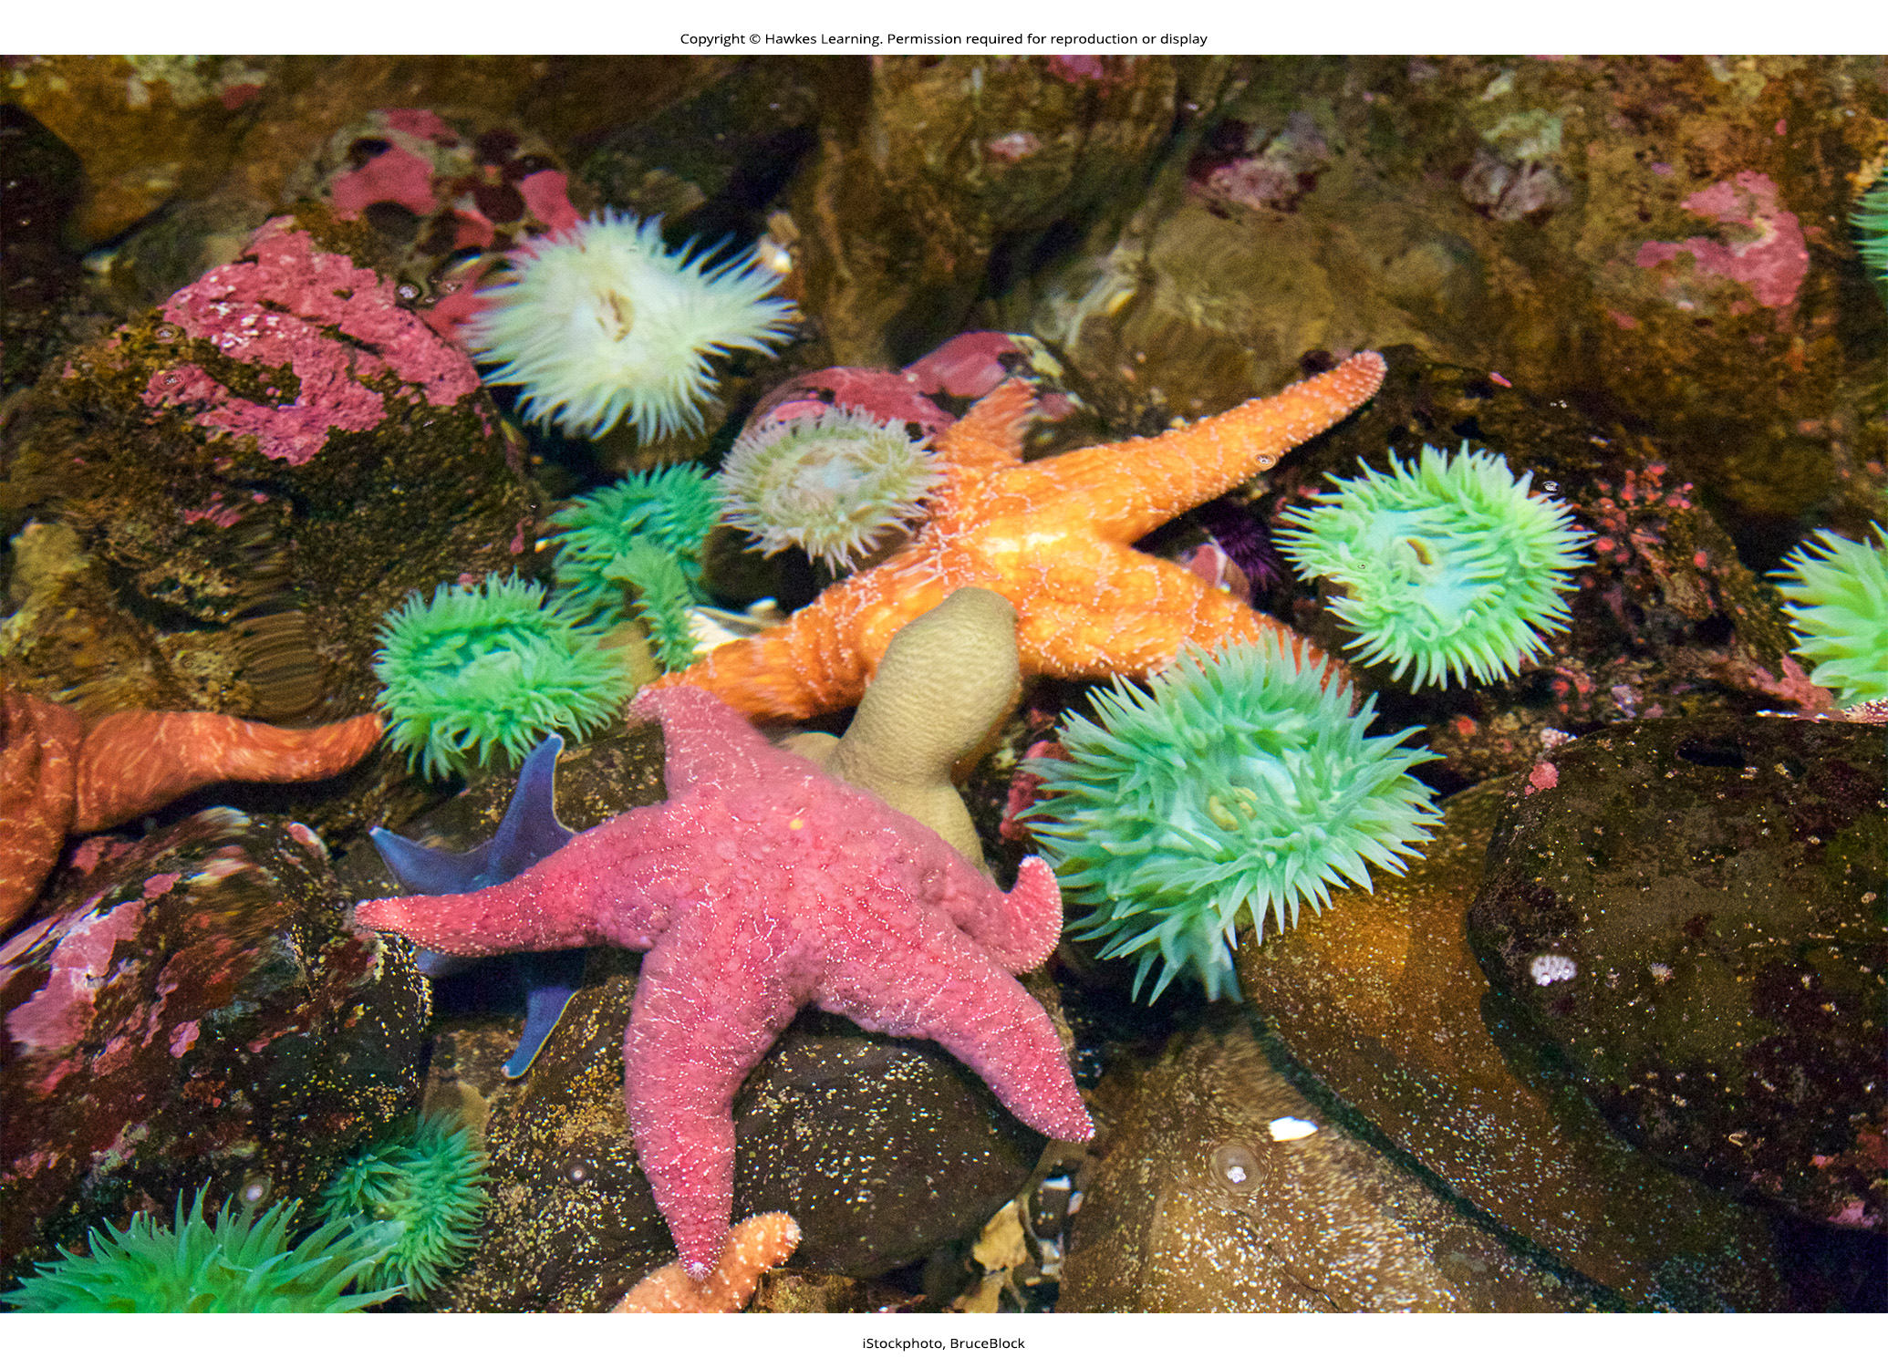
Processes of Animal Reproduction and Embryonic Development₂
Asexual reproduction:
Used by sea stars and sea anemones
Most common forms include budding and fragmentation (part of parent can separate and grow into new individual)
Produces genetically identical offspring (potentially disadvantageous because of potential buildup of deleterious mutations)
27.1 Figure 4: Some animal species can reproduce asexually, such as these sea stars and sea anemones.

Slide 14
Processes of Animal Reproduction and Embryonic Development₃
Uniparental reproduction (parthenogenesis):
Found in some insects and few vertebrates
Progeny develop from gamete without fertilization
Only produced from females because nutrients stored in egg
Haploid parthenogenesis:
Unfertilized eggs develop into male offspring while fertilized eggs develop into female offspring
Occurs mainly in social insects (e.g., bees and wasps)
Sex determination called haplodiploidy since females are diploid (with both maternal and paternal chromosomes), and males are haploid (with only maternal chromosomes)

Slide 15
Processes of Animal Reproduction and Embryonic Development₄
Uniparental reproduction (parthenogenesis):
Diploid parthenogenesis:
Found in fish, turkeys, rattlesnakes, whiptail lizards
Diploid offspring produced from haploid egg cell that duplicates its chromosomes or by fusion of two haploid egg cells
Sex of organism depends on sex-determination system of organisms
Examples:
Turkeys and rattlesnakes: Females have two different sex chromosomes (Z and W chromosomes); males have two of same sex chromosomes; offspring produced by parthenogenesis have identical chromosomes, making them all male
Sharks: Females have two X chromosomes; males have X and Y; females can only produce females because they only have X chromosomes
Produces offspring identical to parent, minimizing genetic diversity
Can ensure genetic propagation for animals with limited access to mates

Slide 16
Processes of Animal Reproduction and Embryonic Development₅
Zygote progresses through series of developmental stages during which primary germ layers (ectoderm, endoderm, mesoderm) establish and reorganize to form embryo
Germ layer: collection of cells formed during embryogenesis that will give rise to future body tissues; more pronounced in vertebrate embryogenesis
Animal tissues specialize and organize into organs and organ systems
Determine future morphology and physiology
Begins with cleavage
Cleavage: cell divisions subdividing a fertilized egg (zygote) to form a multicellular embryo
Differs from somatic cell division in that egg subdivided by successive cleavages into smaller and smaller cells with no actual cell growth; results in blastomeres

Slide 17
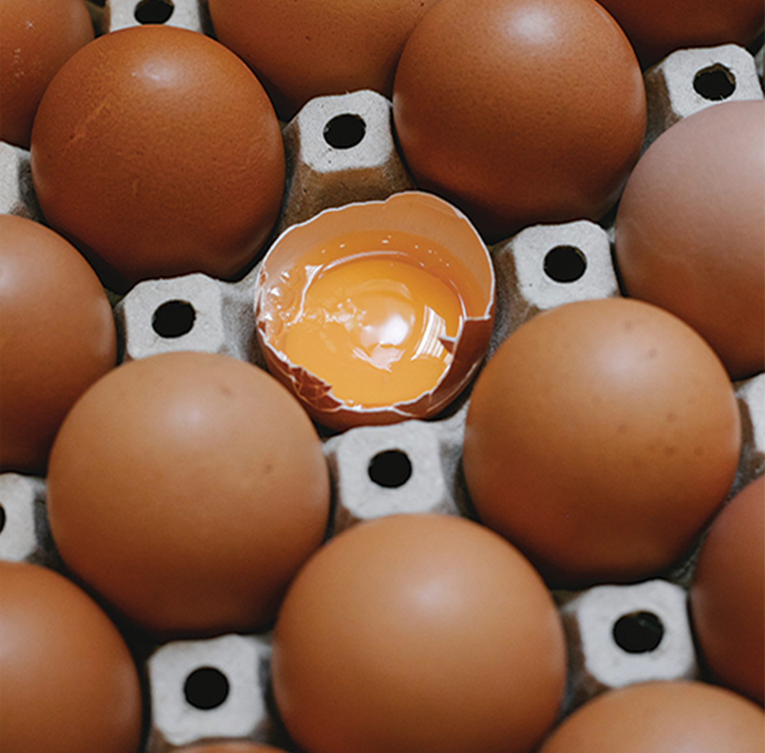
Processes of Animal Reproduction and Embryonic Development₆
Three cell divisions result in eight-celled structure
Morula (ball of cells) eventually formed followed by hollow blastula
Blastula: 16–32 cell stage of development of an animal embryo
Hollow only in invertebrates; eggs have small amounts of yolk
Vertebrate eggs have undivided yolk, with cells forming embryonic layer on surface of yolk (serves as food for developing embryo)
27.1 Figure 5: In a fertilized chicken egg, the yolk would serve as a food source for the developing embryo.
Klaus Nielsen on Pexels. "Eggs."

Slide 18
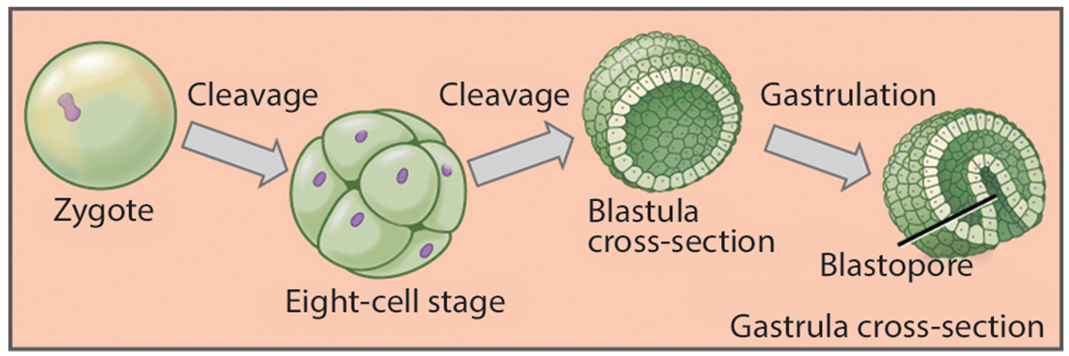
27.1 Figure 6
CNX OpenStax on Wikimedia Commons. "Embryonic development."
Notes:
Figure 6: During embryonic development, the zygote undergoes a series of mitotic cell divisions, or cleavages, that subdivide the egg into smaller and smaller blastomeres. Note that the eight-cell stage and the blastula are about the same size as the original zygote. In many invertebrates, the blastula consists of a single layer of cells around a hollow space. During a process called gastrulation, the cells from the blastula move inward on one side to form an inner cavity. This inner cavity becomes the primitive gut (archenteron) of the gastrula ("little gut") stage. The opening into this cavity is called the blastopore, and in some invertebrates, it is destined to form the mouth.

Slide 19
Processes of Animal Reproduction and Embryonic Development₇
Further cell division and cellular rearrangement leads to gastrulation, or gastrula stage
Gastrula: stage of animal development characterized by the formation of the digestive cavity
Results in formation of primitive gut (archenteron), or digestive cavity, and formation of embryonic germ layers
Germ layers programmed to develop into certain tissue types, organs, and organ systems during organogenesis
Organogenesis: formation of organs in animal embryogenesis
Diploblastic organisms: Two germ layers (endoderm and ectoderm)
Endoderm forms wall of digestive tract
Ectoderm covers surface of animal
Triploblastic organisms: Three germ layers (endoderm, ectoderm, mesoderm)
Mesoderm: Differentiates into various structures between ectoderm and endoderm, including lining of body cavity

Slide 20
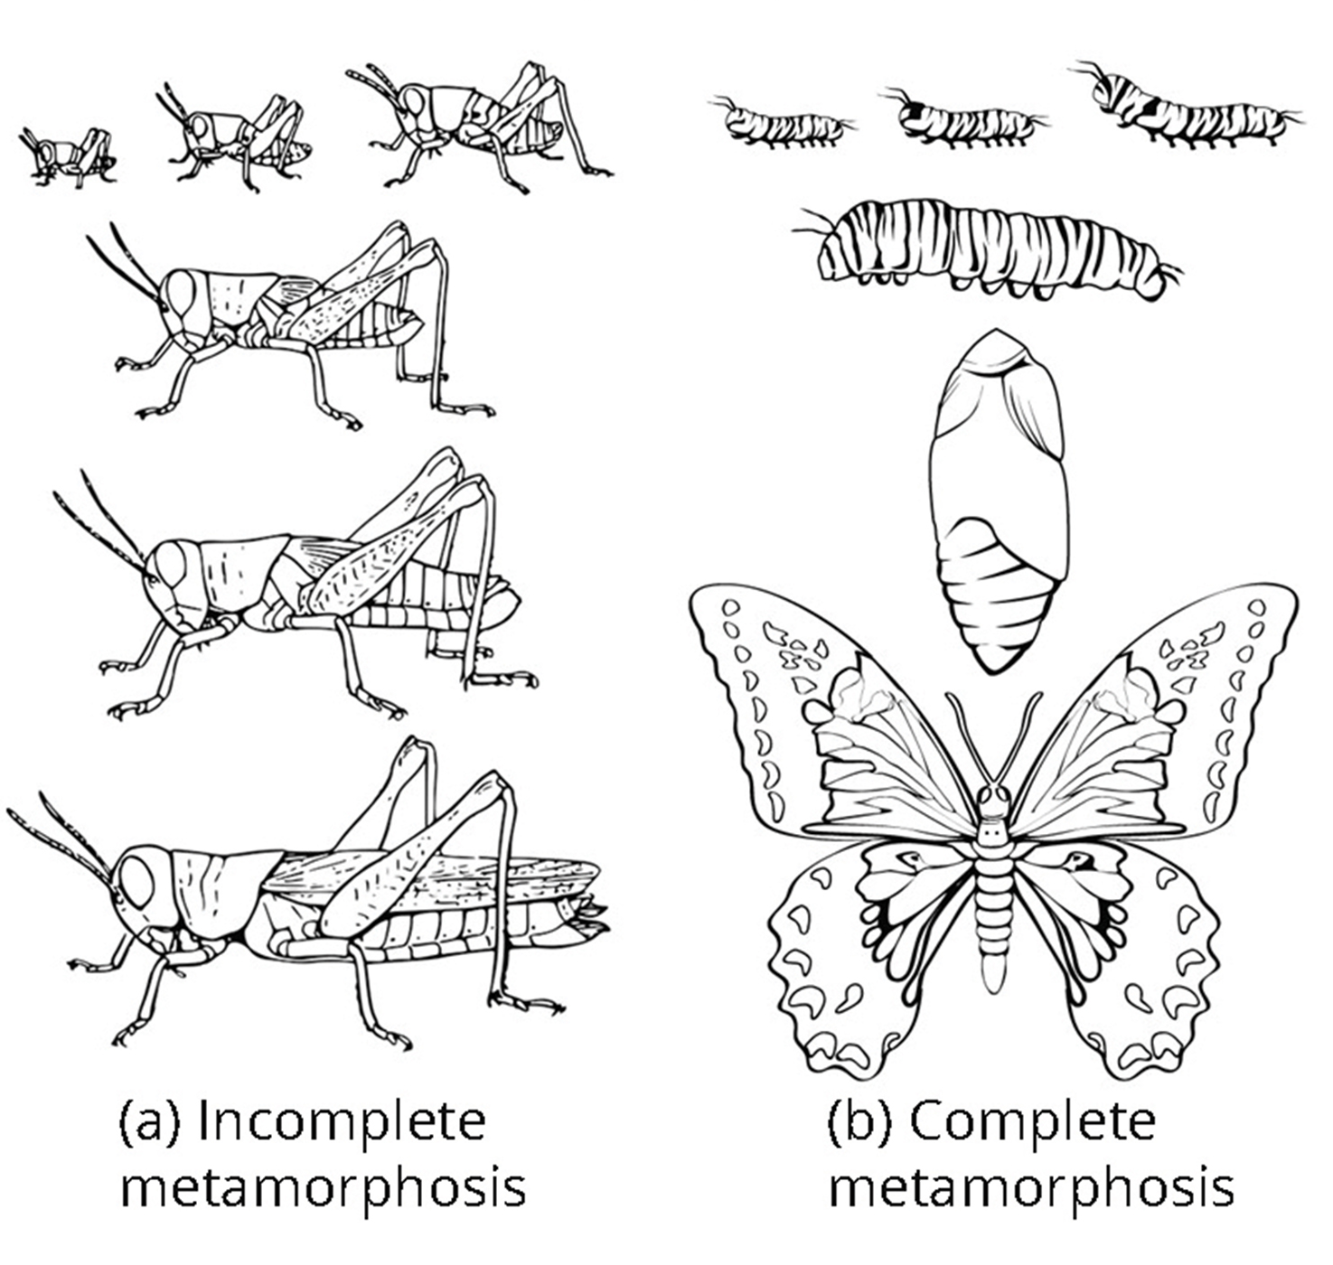
Processes of Animal Reproduction and Embryonic Development₈
Some produce larval forms different from adult
Incomplete metamorphosis: Young resemble wingless adults but grow larger with larger wing buds during molts until finally producing functional wings and sex organs during last molt
Example: Grasshoppers
Complete metamorphosis: Embryo develops into one or more feeding larval stages that differ greatly in structure and function from adult; adult body develops from one or more regions of larval tissue
Larva and adult may have different diets, limiting competition for food
Example: Some insects and echinoderms
Developmental stages of embryo mostly the same within animal kingdom
27.1 Figure 7
S.E. Snodgrass, USDA on Wikimedia Commons. "Metamorphosis."

Slide 21
Reflection Question
What are some animals in your community that undergo metamorphosis?
Notes:
The reflection question is included here to use as a talking point or for a think-pair-share activity.

Slide 22
The Role of Homeobox (Hox) Genes in Animal Development₁
Many animals share similar embryonic morphology and development but look different as adults
Discovered that homeotic genes determine animal structure and contain DNA sequences called homeoboxes
Christiane Nüsslein-Volhard and Eric Wieschaus introduced mutated genes into fruit flies and observed changes to their bodies; able to identify specific changes (e.g., number of body segments) based on mutations of specific genes, showing which genes controlled which aspects of development
Genes with homeoboxes encode protein transcription factors

Slide 23
The Role of Homeobox (Hox) Genes in Animal Development₂
Hox gene: master control gene that can turn on or turn off large numbers of other genes during embryogenesis (also, homeobox gene)
Responsible for determining general body plan (e.g., number of body segments, number and placement of appendages, and head-tail directionality)
First Hox genes sequenced from fruit fly (Drosophila melanogaster)
Single Hox mutation can result in extra pair of antennae or legs growing from head instead of antennae
Legs and antennae embryologic homologous structures and appearance dictated by origination within specific body segments of head and thorax during development
Hox genes known for virtually all animals

Slide 24
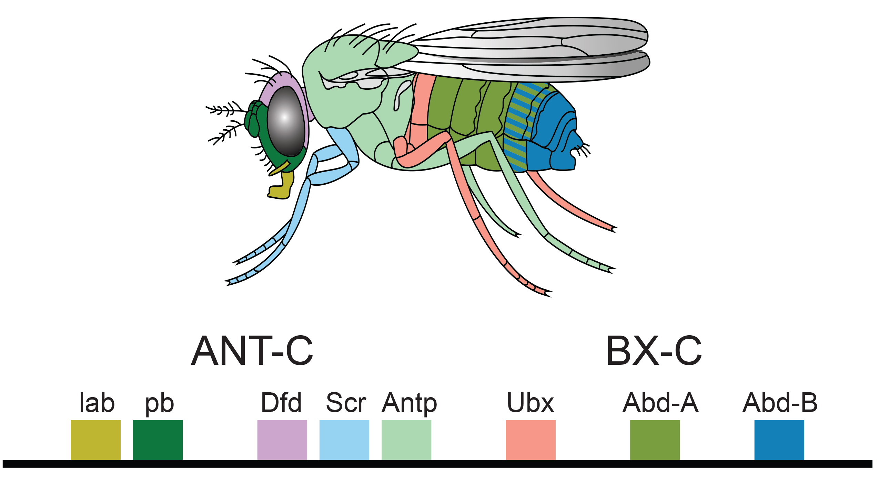
27.1 Figure 8
PhiLiP on Wikimedia Commons. "Hox genes of fruit fly."
Notes:
Figure 8: In Drosophila, the ANT-C (Antennapedia complex) cluster of Hox genes specifies the segments of the head and anterior thorax, while the BX-C (Bithorax complex) of Hox genes specifies the segments of the posterior thorax and abdomen.

Slide 25
Think It Through₁
Provide examples of how humans display each of the following features common to the animal kingdom.
Animals are multicellular.
Animals contain differentiated tissues.
Animals must obtain nutrients and energy by ingesting other organisms.
Animals undergo the same embryonic developmental stages.
Notes:
Originally an On Your Own. This is included here to use as a talking point or for a think-pair-share activity.

Slide 26
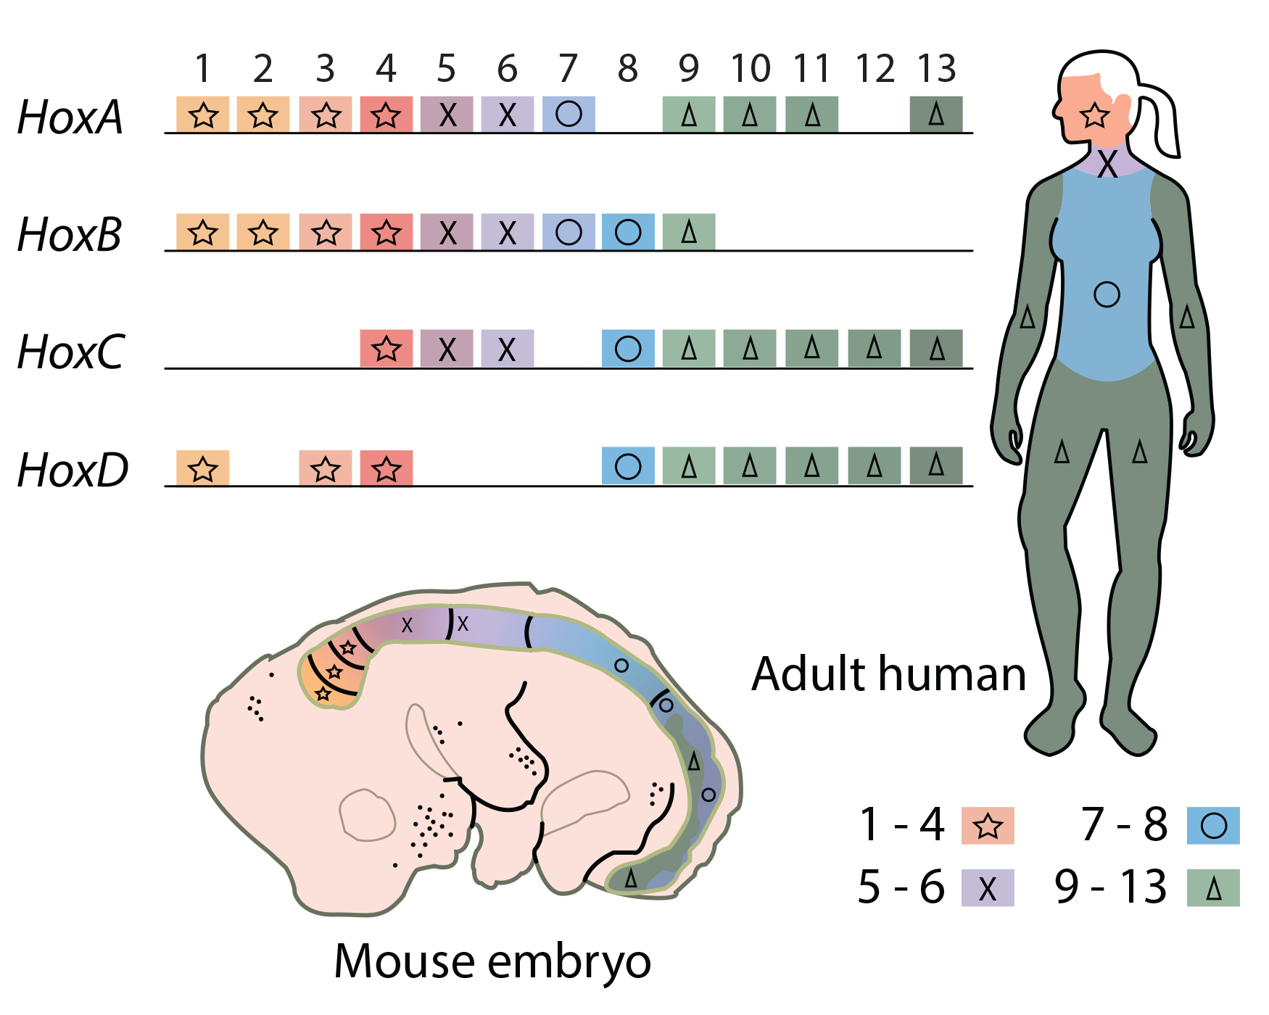
27.1 Figure 9
CNX OpenStax on Wikimedia Commons. "Hox genes." Modified.
Notes:
Figure 9: Hox genes are highly conserved genes encoding transcription factors that determine the course of embryonic development in animals. In vertebrates, the genes have been duplicated into four clusters on different chromosomes: HoxA, HoxB, HoxC, and HoxD. Genes within these clusters are expressed in certain body segments at certain stages of development. Shown here is the homology between Hox genes in mice and humans. Note how Hox gene expression, as indicated with different shading, occurs in the same body segments in both the mouse and the human. While at least one copy of each Hox gene is present in humans and other vertebrates, some Hox genes are missing in some chromosomal sets.

Slide 27
Think It Through₂
If a Hox 13 gene in a mouse were replaced with a Hox 1 gene, how might this alter animal development?
Notes:
Originally an On Your Own. This is included here to use as a talking point or for a think-pair-share activity.

Slide 28
The Role of Homeobox (Hox) Genes in Animal Development₃
Other genes other than Hox genes that control morphological development, but Hox genes are more powerful ("master control genes")
Can turn on or off large numbers of genes by encoding transcription factors that control expression of numerous other genes
Are homologous across animal kingdom (genetic sequences of Hox genes and positions on chromosomes similar across most animals [e.g., worms to flies, mice, humans]) due to inheritance from common ancestor
Order of genes reflects anterior-posterior axis of animal's body
One contribution to increased animal body complexity: Hox genes undergoing at least two to four duplication events during evolution, with additional genes allowing for more complex body types
Vertebrates: Four (or more) sets of Hox genes
Invertebrates: One set of Hox genes

Slide 29
The Role of Homeobox (Hox) Genes in Animal Development₄
Ctenophora and Porifera:
No Hox genes
Superficial similarities between Cnidaria (e.g., jellyfish) and Ctenophora (comb jellies), but only Cnidaria have Hox genes
Absence in Ctenophora means they might be basal animals (animals that form base of phylogeny; earliest or most ancestral animals) in spite of tissue differentiation
Placozoa once considered older but have at least one Hox gene
Also have similarities in genomic organization with Cnidaria and Bilateria, making the three groups the Parahoxozoa clade
Reclassification of animal kingdom still tentative

Slide 30
Summary
Range in complexity from simple sea sponges to human beings
Share certain features:
Eukaryotic
Multicellular
Heterotrophic
Ingest food
Usually motile with fixed body plan
Unique characteristic is presence of differentiated tissues (e.g., nerve, muscle, connective tissues) with specialized, specific functions
Most undergo sexual reproduction, with series of developmental embryonic stages similar across kingdom
Hox genes (transcriptional control genes) directs organization of major body plans and homologous across kingdom

Slide 31

End of Hawkes Learning PowerPoint

