Slide 1
Lesson 27.2
Classification of Animals

Slide 2
Objectives
Compare and contrast the embryonic development of protostomes and deuterostomes.
Explain the differences in animal body plans that support basic animal classification.

Slide 3
Classification of Animals
Exceptions to most classification rules
Traditionally classified according to body plan and developmental pathway
Major feature of body plan is symmetry (how body parts are distributed along major body axis)
Symmetrical animals: Can be divided into roughly equivalent halves along at least one axis
Developmental characteristics include:
Germ tissue layers formed during development
Origin of mouth and anus
Presence or absence of internal body cavity
Other features (e.g., larval types or use of periods of growth interspersed with molting)

Slide 4
Animal Characterization Based on Body Symmetry₁
Divided into three groups based on symmetry: radial, bilateral, and asymmetrical
Asymmetry:
Lack of symmetry (i.e., no clear left and right sides)
Seen in Parazoa (sponges) and Placozoa
Parazoa: group of animals without true differentiated tissues
Exception: Ancestral fossils of Parazoa showed bilateral symmetry
Radial symmetry: type of symmetry with multiple planes of symmetry, with body parts (rays) arranged around a central disk
Results in animals having top and bottom but no left and right nor front or back
Divided along oral/aboral axis (side with mouth as "oral side" and side without mouth as "aboral side") to produce mirror image
Seen in Cnidaria (e.g., jellyfish and adult sea anemones)
Equips sea creatures (may be sedentary, slow moving, or floating) to experience movement from all directions equally

Slide 5
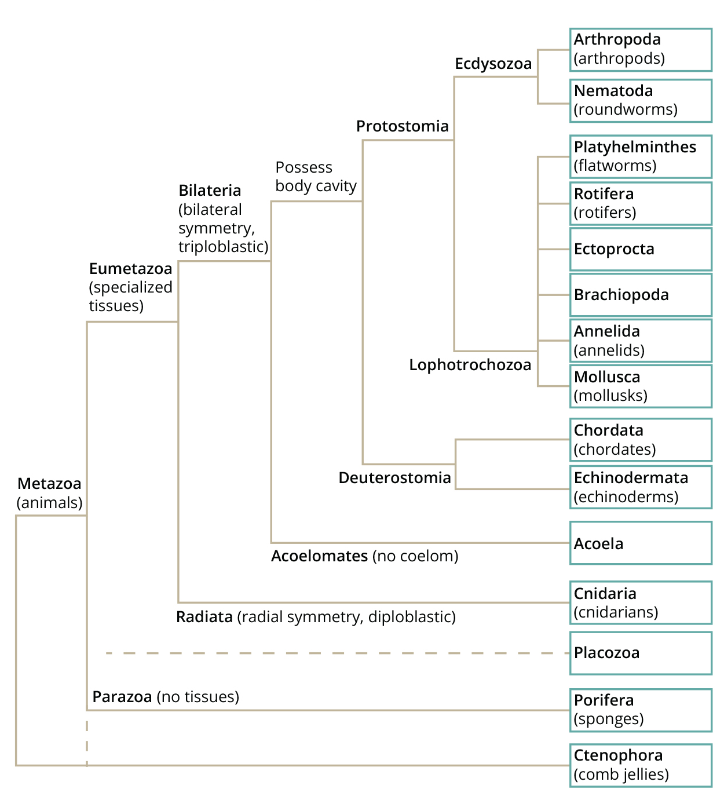
27.2 Figure 1
CNX OpenStax on Wikimedia Commons. "Phylogenetic tree of animals." Modified.
Notes:
Figure 1: The phylogenetic tree of animals is based on morphological, fossil, and genetic evidence. The Ctenophora and Porifera are both considered to be basal because of the absence of Hox genes in this group, but how they are related to the "Parahoxozoa" (Placozoa and Eumetazoa group combined), or to each other, continues to be a matter of debate.

Slide 6
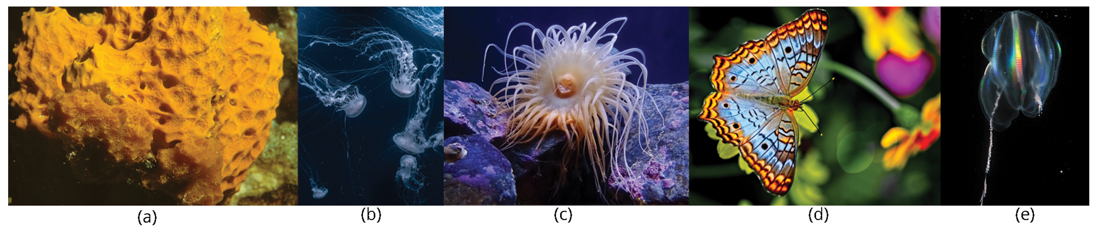
Animal Characterization Based on Body Symmetry₂
Examples:
Cnidaria: Radial or biradial symmetry
Ctenophores: Rotational symmetry
No single plane that divides animal into mirror images
Division of body along oral/aboral axis divides into two copies of same half, one copy rotated 180°
Bilateria: Bilateral symmetry
Echinodermata: Bilateral as larvae and metamorphose into radial adults
Symmetry suited to meet unique demands of lifestyle
27.2 Figure 2: The (a) sponge is asymmetrical. The (b) jellyfish and (c) anemone are radially symmetrical; the (d) butterfly is bilaterally symmetrical. Rotational symmetry is seen in the (e) ctenophore.
NOAA on Unsplash. "Sponge."
Joel Filipe on Unsplash. "Jellyfish."
Allan Pickering on Unsplash. "Anemone."
Alfred Schrock on Unsplash. "Butterfly."
Kevin Raskoff on Wikimedia Commons. "Ctenophore."

Slide 7
Animal Characterization Based on Body Symmetry₃
Bilateral symmetry: type of symmetry in which there is only one plane of symmetry, so the left and right halves of an animal are mirror images
Division along midsagittal plan
Examples: Butterfly, crab, human body
Have head and tail (anterior vs. posterior), front and back (dorsal vs. ventral), right and left
All Eumetazoa (except those with secondary radial symmetry) are bilaterally symmetrical
Evolution allowed for formation of anterior and posterior ends, promoting cephalization (collection of an organized nervous system at anterior end)
Allows for streamlined and directional motion
Evolutionarily promoted active and controlled directional mobility and increased sophistication of resource-seeking and predator-prey relationships

Slide 8
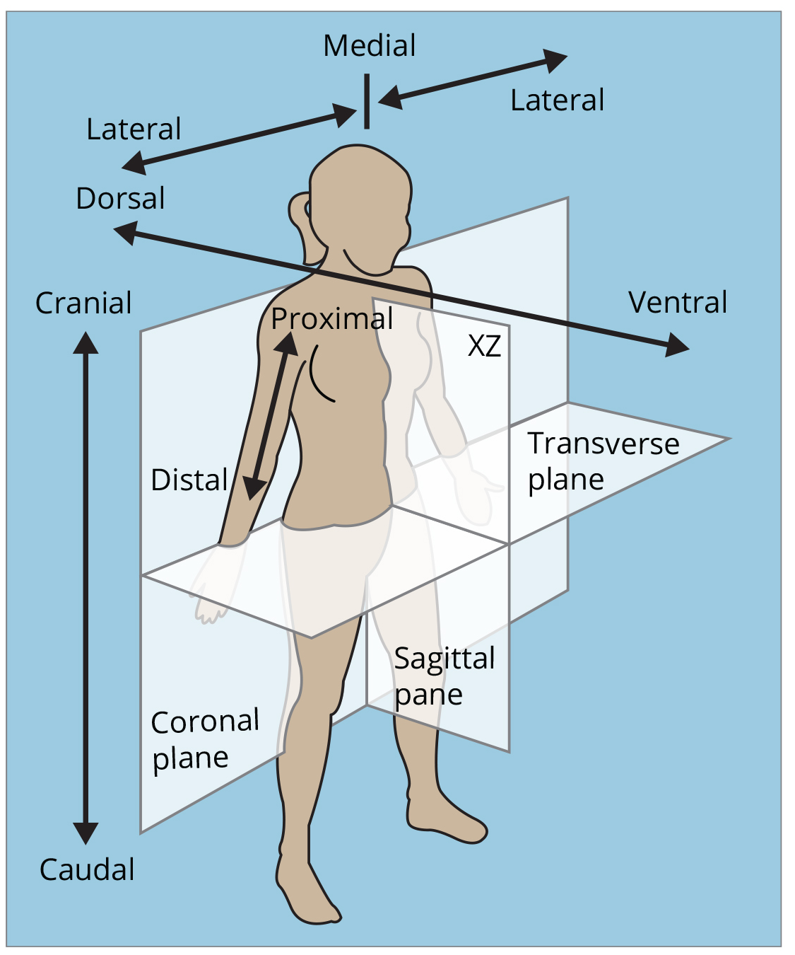
27.2 Figure 3
OpenStax. "Bilateral symmetry."
Notes:
Figure 3: The human body is bilaterally symmetrical, with a left and right half on either side of the midsagittal plane. Anatomists use additional planes, such as the transverse and coronal planes, to further divide the body and specify different regions.

Slide 9
Group Activity₁
As a group, research the different kinds of symmetry and find an animal example for each type. For each of your examples, determine if the animal shifts between types of symmetry as it grows.

Slide 10
Animal Characterization Based on Body Symmetry₄
Echinodermata (e.g., sea stars, sand dollars, sea urchins)
Displays radial symmetry as adults but larval stage (e.g., bipinnaria) displays bilateral symmetry until metamorphosis into radial symmetry (secondary radial symmetry)
Still classified as bilaterally symmetrical

Slide 11
Think It Through
Describe each animal's body symmetry as either bilateral, radial, or asymmetry.
Moon jellyfish, Aurelia aurita
Red tube sponge, Aplysina archeri
Impala, Aepyceros melampus
Common starfish, Asterias rubens
Notes:
Originally an On Your Own. This is included here to use as a talking point or for a think-pair-share activity.

Slide 12
Animal Characterization Based on Features of Embryological Development₁
Undergo separation of tissues into germ layers (formed during gastrulation) during embryonic development
Each germ layer becomes specific types of embryonic tissues and organs
Either two or three germ layers: diploblasts or triploblasts
Diploblast: animal that develops from two germ layers
Includes animals that display radial, biradial, or rotational symmetry
Develop two germ layers: An inner layer (endoderm or mesendoderm) and an outer layer (ectoderm)
Nonliving layer between endoderm and ectoderm; individual cells may be there but not coherent layer of tissue
Four diploblastic clades differ in complexity and developmental pathways (little information about Placozoa)
Triploblast: animal that develops from three germ layers
Includes more complex animals (usually bilateral symmetry)
Develop three germ layers: An inner layer (endoderm), an outer layer (ectoderm), and a middle layer (mesoderm)

Slide 13
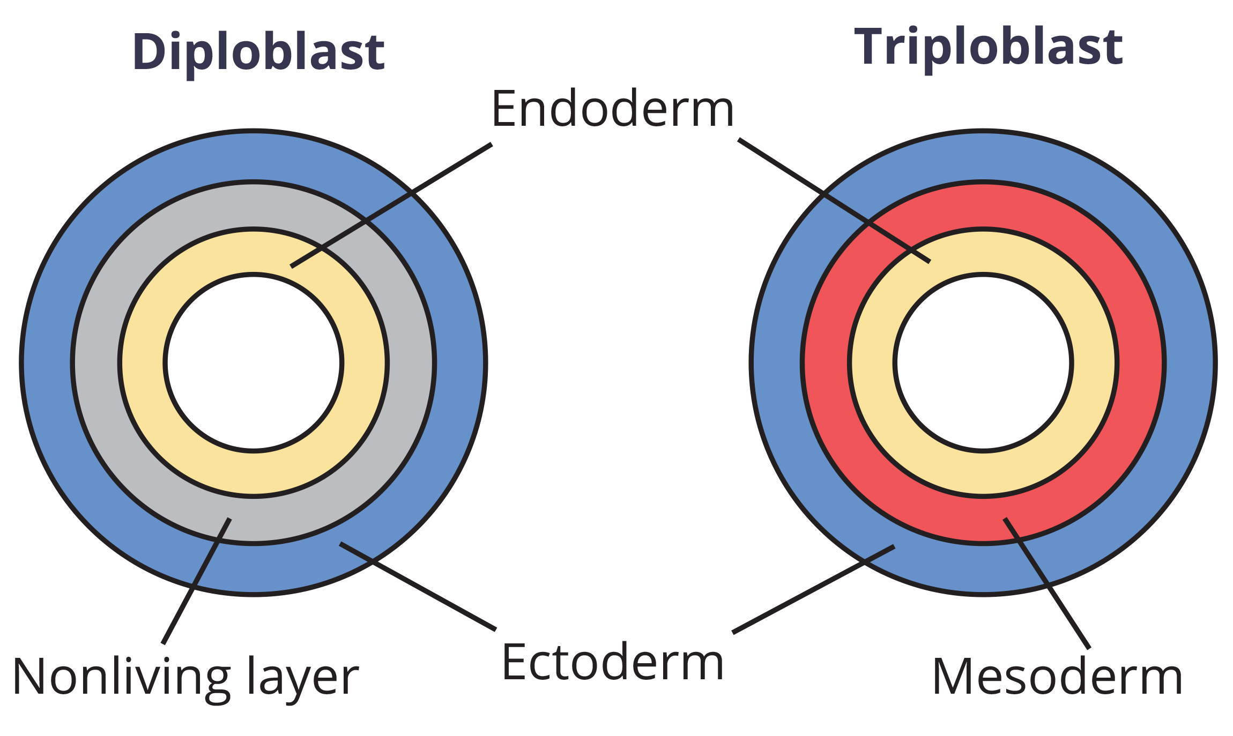
27.2 Figure 4
CNX OpenStax on Wikimedia Commons. "Embryonic germ layers." Modified.
Notes:
Figure 4: During embryogenesis, diploblasts develop two embryonic germ layers: an ectoderm and an endoderm, or mesendoderm. Triploblasts develop a third layer—the mesoderm—which arises from the mesendoderm and resides between the endoderm and ectoderm.

Slide 14
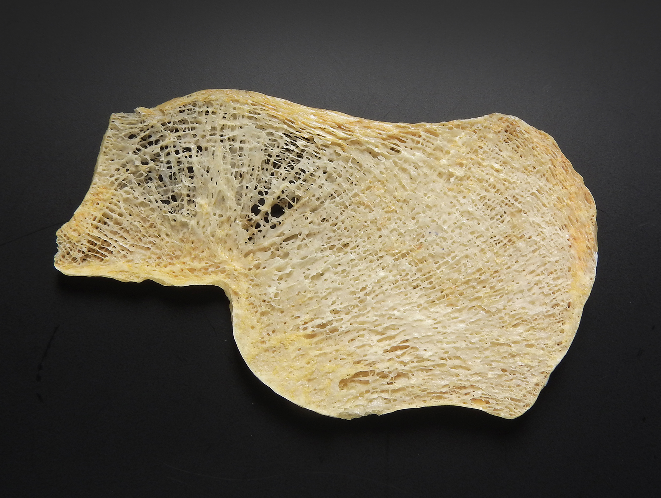
Animal Characterization Based on Features of Embryological Development₂
Each germ layer programmed to give rise to specific body tissues and organs, with certain variations
Endoderm: the innermost germ layer in an embryo, from which the lining of the digestive tract (e.g., stomach, intestines, liver, pancreas), the lining of the respiratory tract (e.g., trachea, bronchi, lungs), and some of the gastrointestinal organs are derived
Ectoderm: the outermost germ layer in an embryo, from which the nervous system and the outer epithelial covering of the body surface are derived
Mesoderm: the middle germ layer in a triploblast embryo, from which muscle (e.g., cardiac tissues, muscles of intestines), connective tissue (e.g., skeleton, blood cells), and most internal organs (e.g., kidneys, spleen) are derived
Diploblasts may have cell types with multiple functions (e.g., epitheliomuscular cells serving as covering and contractile cells)
27.2 Figure 5: The mesoderm is the third germ layer; it forms between the endoderm and ectoderm in triploblasts. This germ layer gives rise to all connective tissues, such as bone tissue.
MAKY.OREL on Wikimedia Commons. "Human bone tissue."

Slide 15
Group Activity₂
As a class, compare the order of the three germ layers—endoderm, mesoderm, and ectoderm—with the kinds of tissues each layer gives rise to. Consider the order of the layers and discuss how some tissue types maintain their layering order in the developed organism. For example, epithelial tissue is an outermost tissue layer in developed organisms, and this outermost layering makes sense, seeing as it stems from the outermost germ layer, the ectoderm. Identify a few more examples. Then, discuss some tissues that seem surprising in terms of the layer from which they arise.

Slide 16
Presence or Absence of a Coelom₁
Further subdivision of animals with three germ layers (triploblasts): Animals that develop internal body cavity derived from mesoderm (coelom) and animals that do not
Coelom: lined body cavity
Usually filled with fluid
Lies between visceral organs and body wall
Houses many organs (e.g., digestive, urinary, and reproductive systems; heart and lungs; major arteries and veins of circulatory system)
In mammals, coelom divided into thoracic cavity (houses heart and lungs) and abdominal cavity (houses digestive organs)
Thoracic cavity subdivided into pleural cavity (space for lungs to expand during breathing) and pericardial cavity (space for movements of heart)

Slide 17
Presence or Absence of a Coelom₂
Evolution of coelom produced functional advantages
Examples:
Provides cushioning and shock absorption for major organ systems it encloses
Organs housed within coelom can grow and move freely, promoting optimal organ development and placement
Provides space for diffusion of gases and nutrients and body flexibility, promoting improved animal motility

Slide 18
Presence or Absence of a Coelom₃
Acoelomate: animal without a body cavity
Mesoderm filled with tissue but still have gut cavity
Example: Phylum Platyhelminthes (flatworms)
Eucoelomate (true coelomates): animal with a body cavity completely lined with mesodermal tissue
Membrane also lines organs within coelom, connecting and holding them in position while allowing some freedom of movement
Examples: Annelids, mollusks, arthropods, echinoderms, chordates (group that includes humans)
Further characterized based on features of early embryological development
Pseudocoelomate: animal with a body cavity located between the mesoderm and endoderm
Not completely surrounded by mesodermal tissue
Still functionally a coelom but considered "false" coelom
Example: Phylum Nematoda (roundworms)

Slide 19
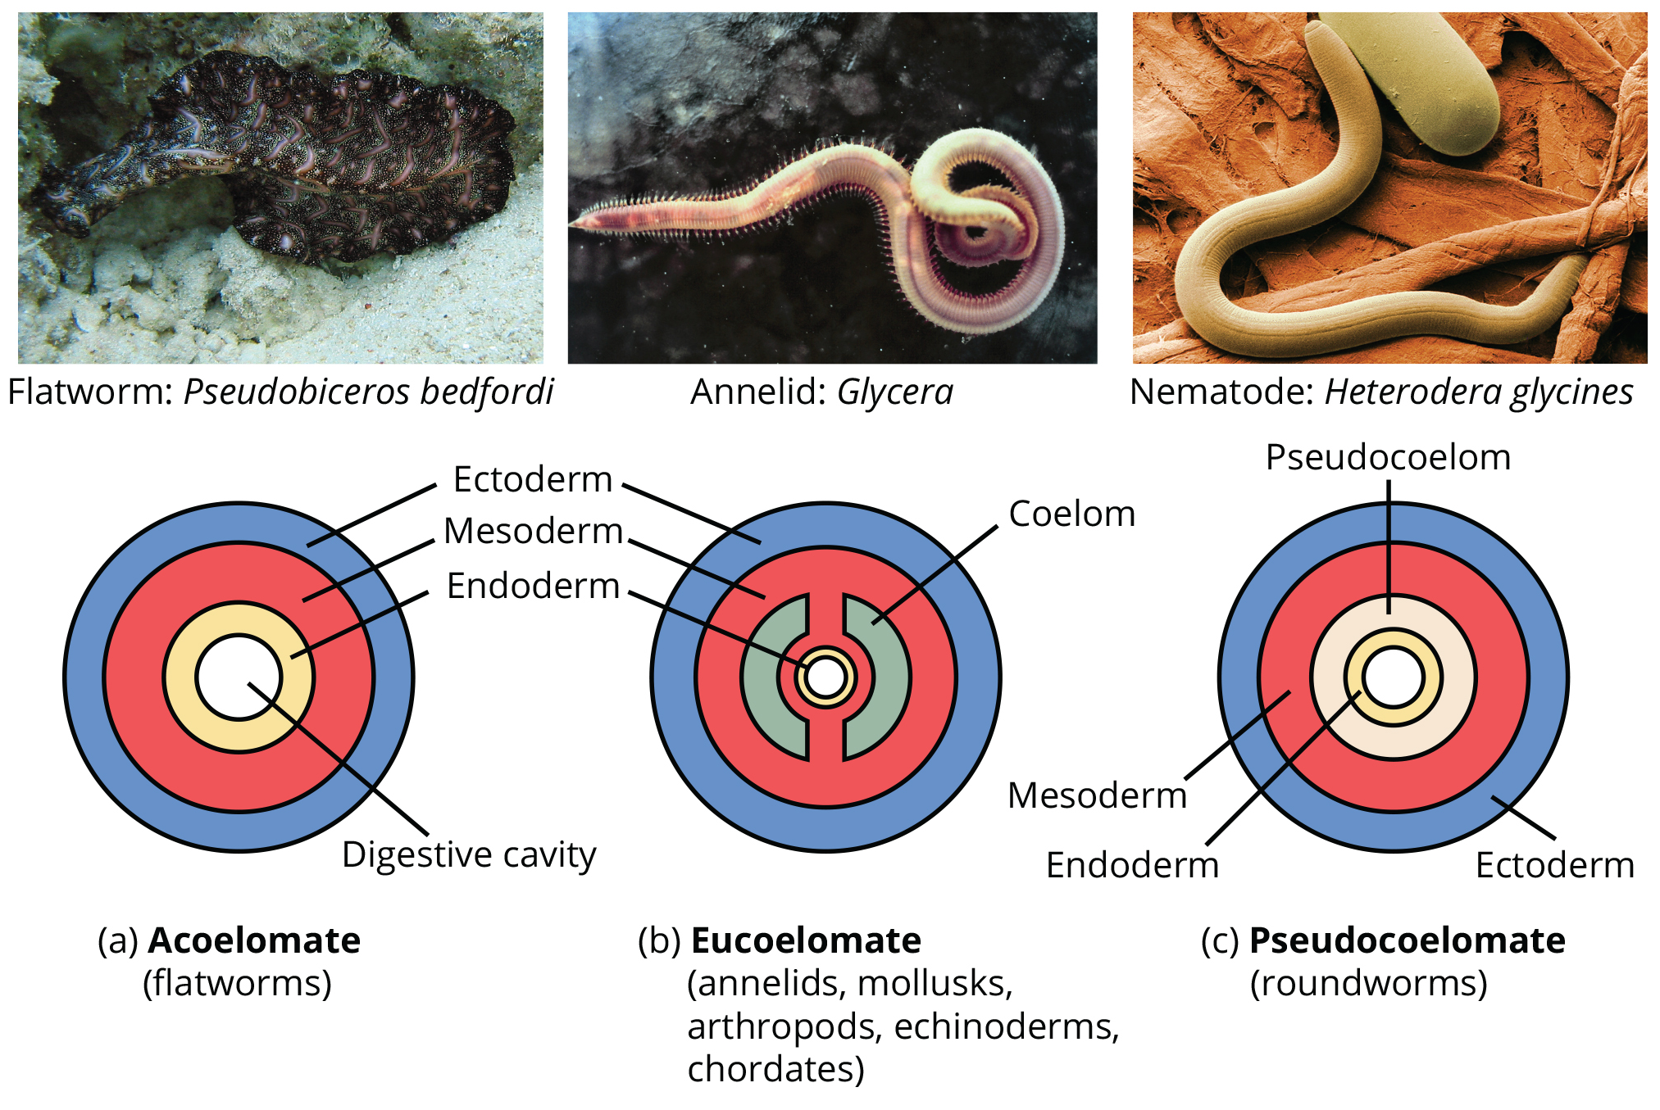
27.2 Figure 6
CNX OpenStax on Wikimedia Commons. "Triploblasts."
Notes:
Figure 6: Triploblasts may be (a) acoelomates, (b) eucoelomates, or (c) pseudocoelomates. Acoelomates have no body cavity. Eucoelomates have a body cavity within the mesoderm, called a coelom, in which both the gut and the body wall are lined with mesoderm. Pseudocoelomates also have a body cavity, but only the body wall is lined with mesoderm.

Slide 20
Embryonic Development of the Mouth₁
Bilaterally symmetrical, triploblastic eucoelomates further divided into two groups based on difference in origin of the mouth
When primitive gut forms, opening that first connects gut cavity to outside of embryo called blastopore
Blastopore: opening into the archenteron that forms during gastrulation
Most have openings at both ends of gut: Mouth at one end, anus on the other
One opening will develop near site of blastophore

Slide 21
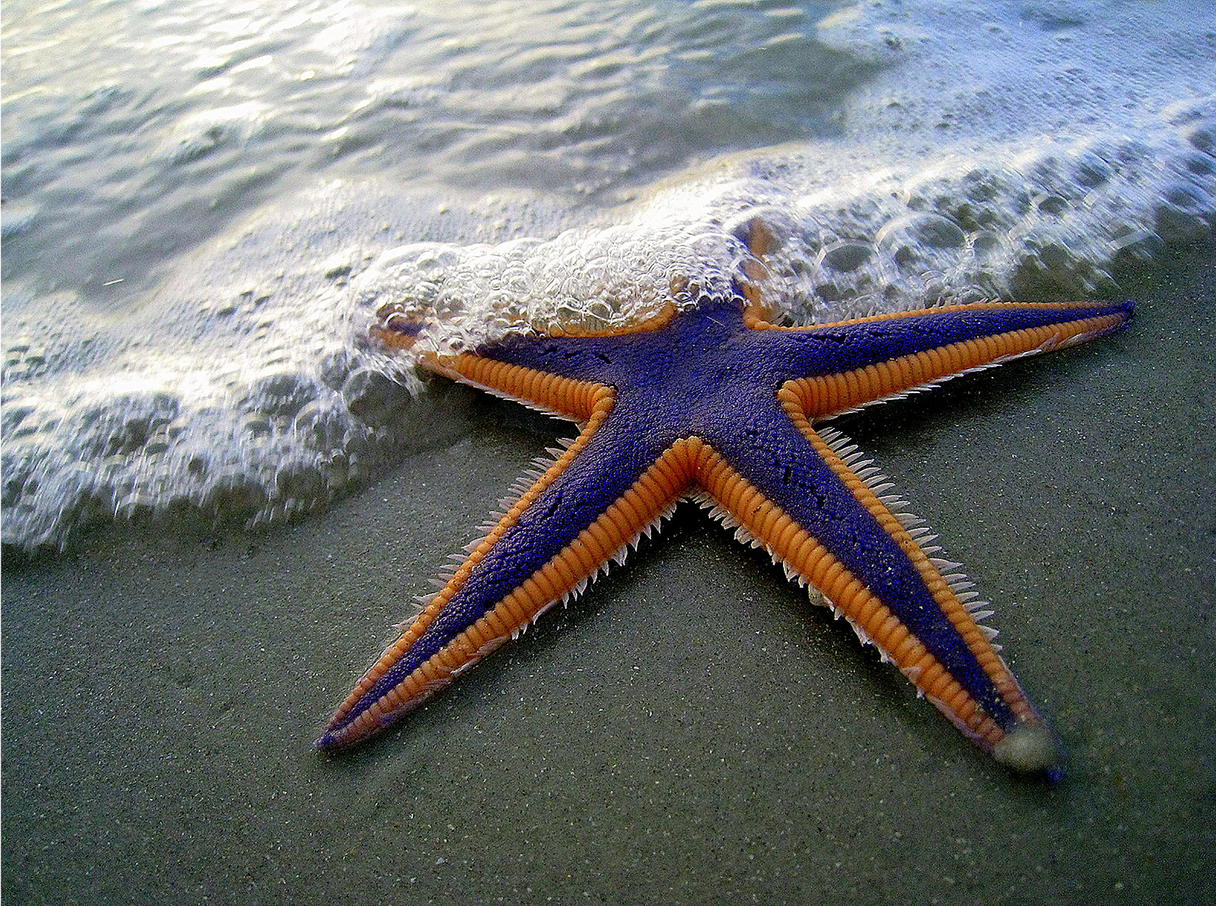
Embryonic Development of the Mouth₂
Protostome ("mouth first"): blastopore develops into the mouth of protostomes, with the second opening developing into the anus
Examples: Arthropods, mollusks, annelids
Deuterostome ("mouth second"): blastopore develops into the anus, with the second opening developing into the mouth
Include more complex animals (e.g., chordates) but also simple animals (e.g., echinoderms)
Theory remains under debate, but details of mouth and anus formation reflect general difference in organization of protostome and deuterostome embryos
27.2 Figure 7: Echinoderms are an example of a deuterostome.
Mark Walz on Pexels. "Sea star."

Slide 22
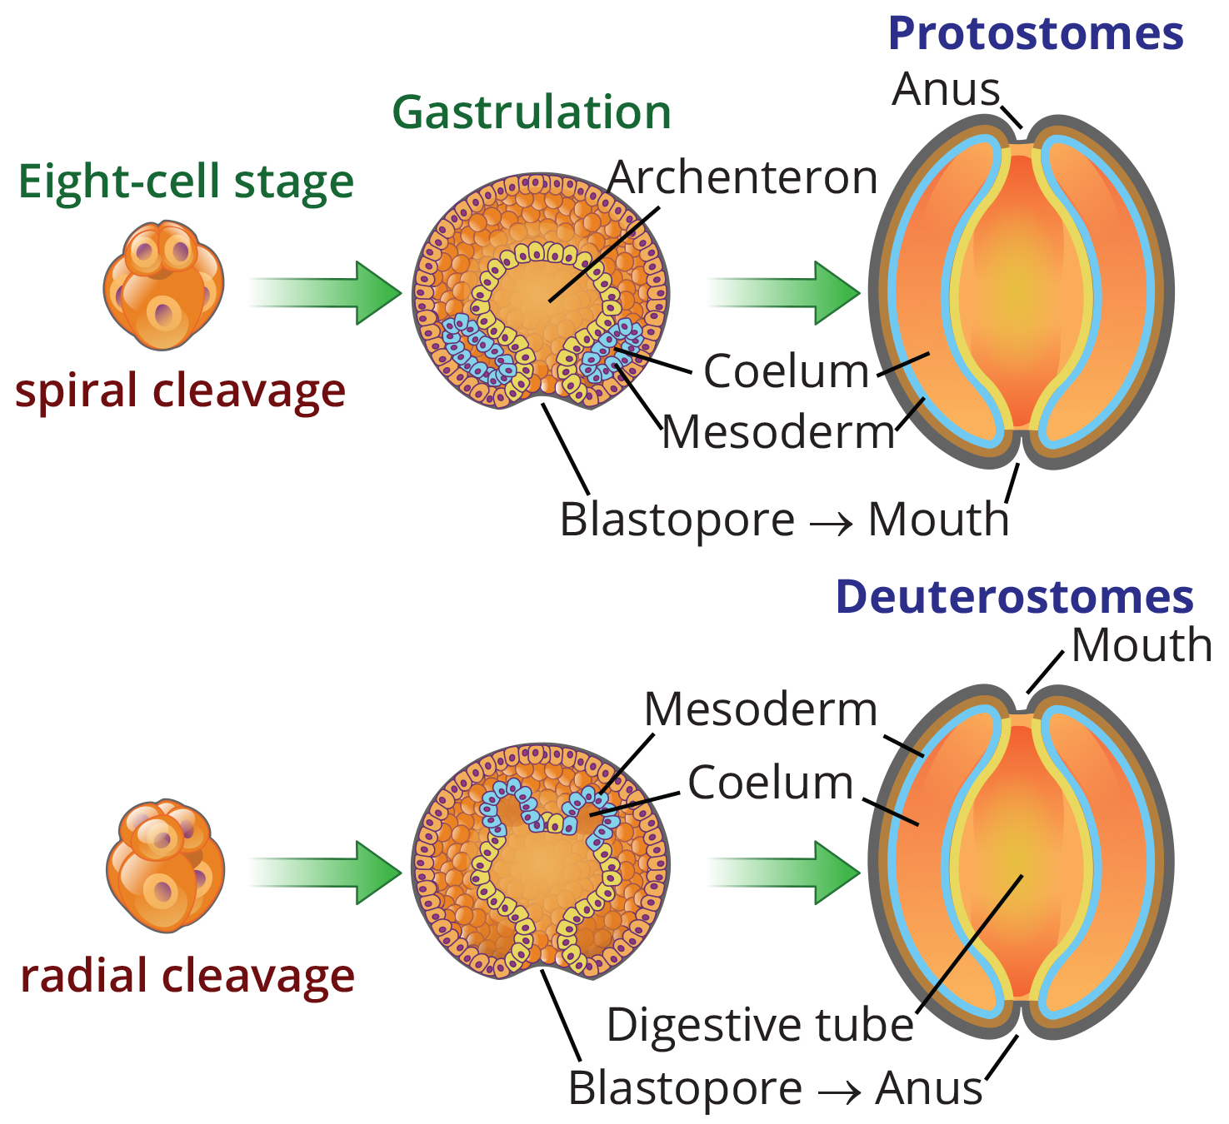
27.2 Figure 8
YassineMrabet on Wikimedia Commons. "Protostomes vs. deuterostomes." Modified.
Notes:
Figure 8: Eucoelomates can be divided into two groups based on their early embryonic development. In protostomes, the mouth forms at or near the site of the blastopore, and the body cavity forms by splitting the mesodermal mass in a process called schizocoely. In deuterostomes, the mouth forms at a site opposite the blastopore end of the embryo, and the mesoderm pinches off to form the coelom in a process called enterocoely.

Slide 23
Embryonic Development of the Mouth₃
One difference between protostomes and deuterostomes is method of coelom formation, beginning from gastrula stage
Coelom of protostomes formed through schizocoely
Schizocoely: during development of protostomes, a solid mass of mesoderm splits apart and forms the hollow opening of the coelom
Usually product of specific blastomeres (cells produced by early embryonic cleavage), which migrate into interior of embryo and form two clumps of mesodermal tissue
Within each clump, cavities develop and merge to form hollow opening of coelom
Coelom of deuterostomes formed through enterocoely
Enterocoely: mesoderm of deuterostomes develops as pouches that are pinched off from endodermal tissue; cavity contained within the pouches becomes the coelom
Pouches eventually fuse and expand to fill space between gut and body wall, forming coelom

Slide 24
Embryonic Development of the Mouth₄
Another difference between protostomes and deuterostomes is organization of embryos expressed during cleavage
Protostomes undergo spiral cleavage
Spiral cleavage: cells of one pole of the embryo are rotated or misaligned with respect to the cells of the opposite pole
Due to oblique angle of cleavage relative to two poles of embryo
Deuterostomes undergo radial cleavage
Radial cleavage: cleavage axes are parallel or perpendicular to the polar axis, resulting in the alignment of cells between the two poles

Slide 25
Embryonic Development of the Mouth₅
Another difference between types of cleavage in protostomes and deuterostomes relates to fate of resultant blastomeres
Protostomes also undergo determinate cleavage
Determinate cleavage: cleavage pattern in which developmental fate of each blastomere is tightly defined
Removal of blastomeres from embryo can result in missing structures and embryos that fail to develop

Slide 26
Embryonic Development of the Mouth₆
Another difference between types of cleavage in protostomes and deuterostomes relates to fate of resultant blastomeres
Deuterostomes also undergo indeterminate cleavage
Indeterminate cleavage: cleavage pattern in which individual blastomeres have the character of "stem cells" and are not yet predetermined to develop into specific cell types
Removal of blastomeres from embryo does not result in loss of embryonic structures
Example: Twins can be produced as result from blastomeres that separated from original mass of blastomere cells
If blastomeres are damaged during embryogenesis, adjacent cells compensate for missing cell; embryo not damaged
Cells referred to as undetermined cells
Reflected in existence of embryonic stem cells (have ability to develop into any cell type until fate is programmed at later developmental stage)

Slide 27
Evolution Connection₁
The Evolution of the Coelom
First step in classifying animals: Examine animal's body
Structure used in classification is body cavity (coelom)
Body cavity develops within mesoderm
Only triploblastic animals have body cavities (only Bilateria)
Other animals have gut either close to body wall or separated by jellylike material
Important for two reasons:
Fluid within body cavity protects organs from shock and compression
Muscle, connective tissue, and blood vessels (which develop in mesoderm) developing within lining of body cavity reinforce gut and body wall, aid in motility, and circulate nutrients

Slide 28
Evolution Connection₂
The Evolution of the Coelom
Major acoelomate group in Bilateria: Flatworms (both free-living and parasitic, like tapeworms)
Mesenchyme (connective tissue) fills space between gut and body wall
Two layers of muscle just under epidermis, but no muscle or mesodermal tissue around gut
Rely on passive diffusion for nutrient transport across body
Pseudocoelomates have body cavity between gut and body wall, but only body wall has mesodermal tissue
Mesoderm forms but without cavities
Major phyla: Rotifers and nematodes

Slide 29
Evolution Connection₃
The Evolution of the Coelom
Eucoelomates have true coelom
Includes all vertebrates, molluscs, annelids, arthropods, echinoderms
Schizocoels: Mesoderm splits to form body cavity
Includes mollusks, annelids, arthropods
Enterocoels: Mesoderm forms as two or more buds off gut separate and coalesce to form body cavity
Includes echinoderms and chordates
Coelom develops with mesoderm during embryogenesis
Mammals have subdivided body cavity with thoracic cavity separated from abdominal cavity
Pseudocoelomates may have eucoelomate ancestors and lost their ability to form complete coelom through mutations
Formation of coelom had large evolutionary impact on various species in animal kingdom

Slide 30
Summary
Classification based on body morphology, developmental pathways, and genetic affinities
Ongoing debates about relationships between Eumetazoa and more basal clades (Ctenophora, Porifera, and Placozoa)
Eumetazoa ("true animals") divided into radial and bilateral symmetry
Radial symmetry generally associated with simpler, nonmotile animals and the development of two germ layers, the endoderm and ectoderm (diploblasts)
Bilateral symmetry characterized by development of three germ layers (triploblasts) and presence or absence of coelom
Presence of coelom termed true coelomates or pseudocoelomates depending on how mesoderm lines body cavity
Divided into protostomes and deuterostomes based on developmental characteristics (i.e., differences in zygote cleavage, method of coelom formation, rigidity of developmental fate of blastomeres)

Slide 31

End of Hawkes Learning PowerPoint

