Slide 1
Lesson 27.3
Animal Phylogeny

Slide 2
Objectives
Describe some of the unresolved questions surrounding the Cambrian explosion.
Describe the features that characterized the earliest animals and approximately when they appeared on Earth.
Discuss the implications of mass animal extinctions that have occurred in evolutionary history.
Interpret the metazoan phylogenetic tree.
List some of the relationships within the modern phylogenetic tree that have been discovered as a result of modern molecular data.

Slide 3
Animal Phylogeny
Phylogeny: Tries to determine evolutionary relationships between phyla
Animal kingdom divided into 35–40 phyla
Develop phylogenetic trees, which serve as hypotheses about which species evolved from which ancestors
Traditional methods used only morphological characteristics and fossil record to determine phylogenetic relationships
May be misleading
Morphological characteristics (e.g., skin color, body shape, etc.) may evolve multiple times independently
Analogous characteristics appear similar, but evolution is different
Modern methods use genetic and molecular analyses with traditional morphological and fossil data
Evolutionary trees changing with growing understanding of genetics

Slide 4
Constructing an Animal Phylogenetic Tree₁
Evolutionary relationships among Metazoa determined by presence or absence of true differentiated tissues
Metazoa: group containing all animals
Eumetazoa: group of animals with true differentiated tissues
Porifera: phylum of animals with no true tissues but a porous body with rudimentary endoskeleton
Similarities between feeding cells of sponges (choanocytes) and choanoflagellate protists used to suggest Metazoa evolved from common ancestor resembling modern colonial choanoflagellates

Slide 5
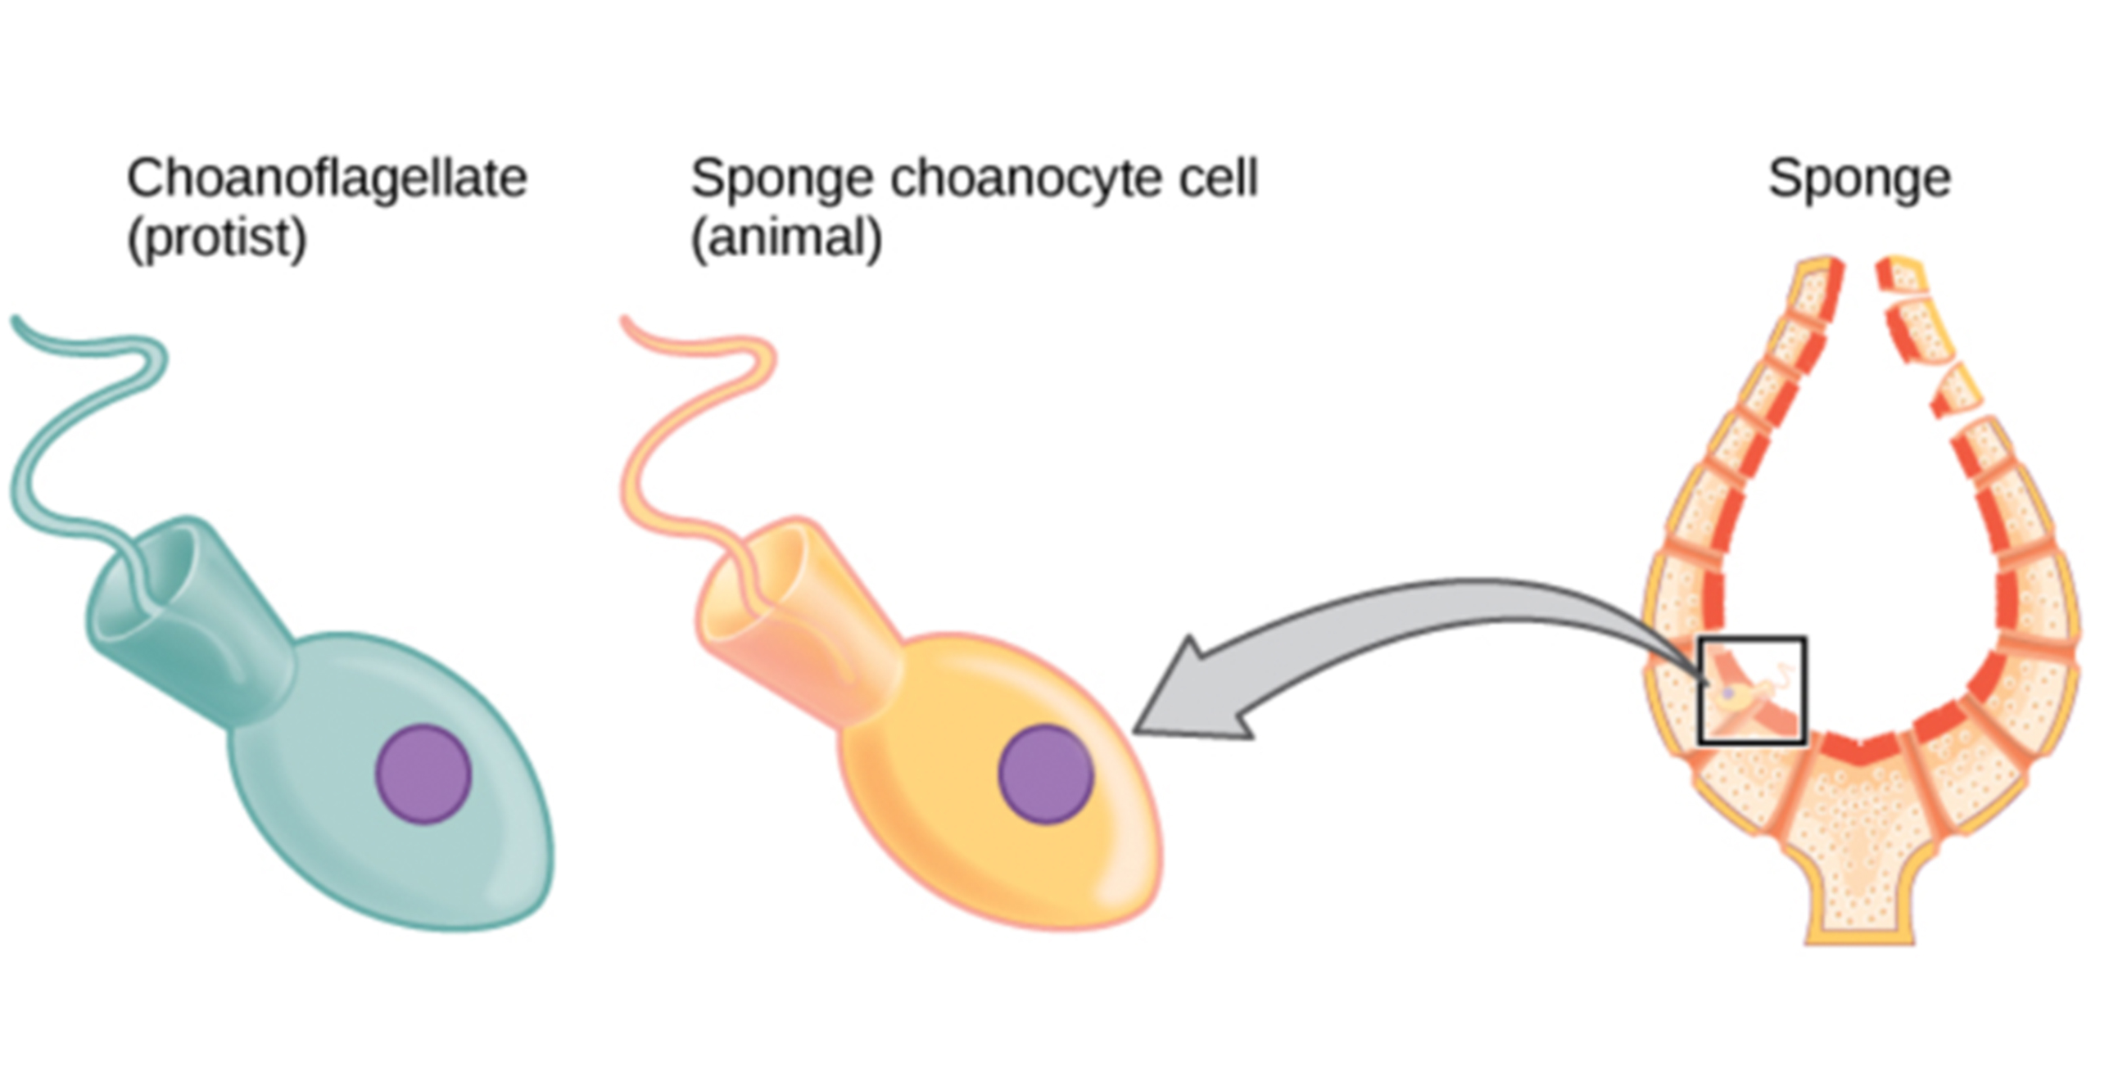
27.3 Figure 1
Clark MA, Choi J and Douglas M on Wikimedia Commons. "Choanoflagellates and choanocytes."
Notes:
Figure 1: Cells of the protist choanoflagellate clade closely resemble sponge choanocyte cells. Beating of choanocyte flagella draws water through the sponge so that nutrients can be extracted and waste removed.

Slide 6
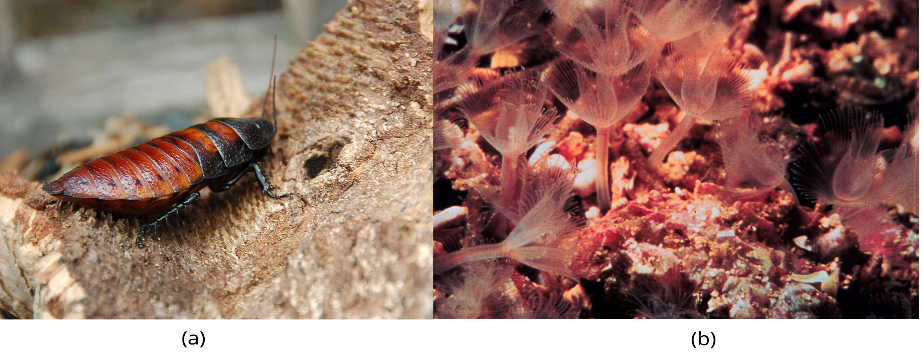
Constructing an Animal Phylogenetic Tree₂
Eumetazoa subdivided into Radiata (radially symmetrical) and Bilateria (bilaterally symmetrical)
Cnidarians and ctenophores are animal phyla with true radial, biradial, or rotational symmetry
All other Eumetazoa are Bilateria clade
Bilateria divided into deuterostomes (e.g., chordates and echinoderms) and two distinct clades of protostomes (e.g., ecdysozoans and lophotrochozoans)
Ecdysozoa: clade of protostomes that exhibit exoskeletal molting (ecdysis) (e.g., nematodes, arthropods)
Lophotrochozoa: clade of protostomes that exhibit a trochophore larvae stage or a lophophore feeding structure
27.3 Figure 2: Animals that molt their exoskeletons, such as these (a) Madagascar hissing cockroaches, are in the clade Ecdysozoa. (b) Phoronids are in the clade Lophotrochozoa. The tentacles are part of a feeding structure called a lophophore.
Almabes on Wikimedia Commons. "Madagascar hissing cockroach."
OAR/National Undersea Research Program (NURP) on Wikimedia Commons. "Phoronids."

Slide 7
Modern Advances in Phylogenetic Understanding Come from Molecular Analyses₁
Phylogenetic groupings continually debated
Phylogenetic animal tree modified by nucleic acid and protein analyses
Data comes from mitochondrial DNA, nuclear DNA, ribosomal RNA (rRNA), and cellular proteins
Examples of reclassification:
Lophophorates (e.g., brachiopods and bryozoans) thought to be primitive deuterostomes; rRNA reclassified them as protostomes, closely related to annelids and mollusks
Led to formation of Lophotrochozoa clade
Molecular data showing differences within lophotrochozoan group and problematic placement of Platyhelminthes phylum
Debate on whether phylum should be combined with Rotifera and belong to own clade of protostomes called Platyzoa

Slide 8
Modern Advances in Phylogenetic Understanding Come from Molecular Analyses₂
More examples of reclassification:
Molecular data led to rearrangement of relationships between mollusks, annelids, arthropods, and nematodes
Resulted in new ecdysozoan clade
Annelids and arthropods once thought to be closely related because of morphological similarities in segmented body types
Molecular evidence showed arthropods more closely related to nematodes (ecdysozoan clade), and annelids more closely related to mollusks, brachiopods, and other phyla in lophotrochozoan clade (making up the protostomes)
Emergence of new phylum of worm called Acoelomorpha
Used to be acoel flatworms belonged to Platyhelminthes because of similar flatworm morphology
Molecular analyses showed acoels represented living species of earliest divergent bilaterians
More research showed more closely related to deuterostomes
Placement of new phylum still disputed

Slide 9
Modern Advances in Phylogenetic Understanding Come from Molecular Analyses₃
More examples of reclassification:
Identification of Ctenophora (comb jellies) as basal clade of animal kingdom
Once considered a sister group of Cnidaria; sponges (Porifera) placed as basal group, sister to other animals
Presence of nerve and muscle cells in both Ctenophores and Cnidaria and absence in Porifera strengthened this view
Molecular analysis shows, however:
Many genes that support neural development are absent from Ctenophore genome
Muscle cells restricted to mouth and tentacles and derived from cells of mesoglea (connective tissue between the endoderm and ectoderm)
Mitochondrial genome of Ctenophore is small and lacks many genes found in other animal mitochondrial genomes
Absence of Hox genes from Ctenophores
Conclusion: Ctenophores should be considered basal or as sister group of Porifera, and evolution of specialized nerve and muscle tissue occurred more than once in history of animal life (though debate still continues)

Slide 10
Modern Advances in Phylogenetic Understanding Come from Molecular Analyses₄
Changes to phylogenetic tree difficult to track and understand and are evidence of the process of science
Data and analytical methods play significant role in phylogeny development and are not complete
Why we cannot dismiss a former phylogenetic tree as inaccurate
Example: Reanalysis of molecular evidence refuted proposition that comb jellies are phylogenetically oldest extant animal group; reaffirms traditional view that sponges were first phylum to diverge from common ancestor of metazoans

Slide 11
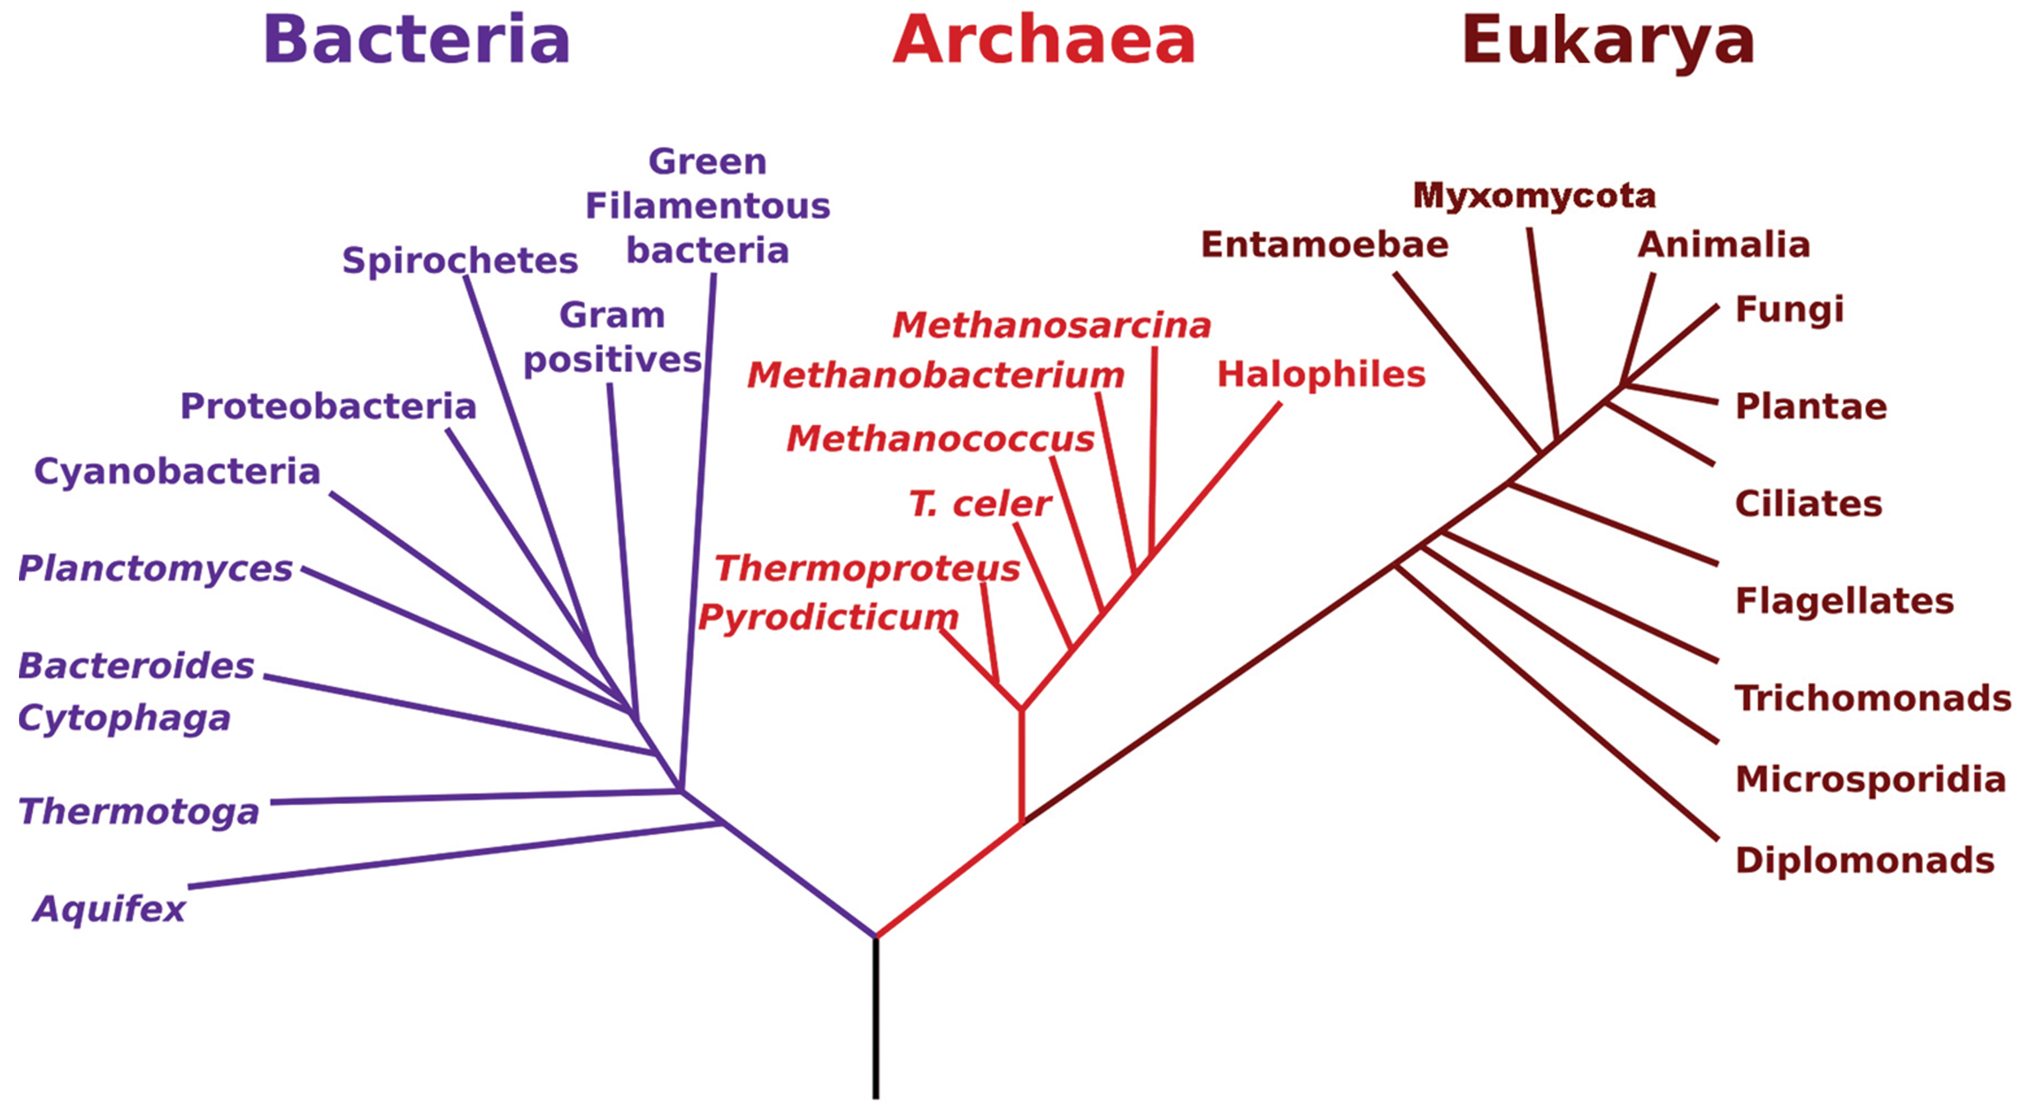
27.3 Figure 3
NASA on Wikimedia Commons. "Phylogenetic tree."
Notes:
Figure 3: The tree of life can be depicted in the form of a phylogenetic tree, where branch points represent nearest common ancestors and branch lengths represent evolutionary time scales.

Slide 12
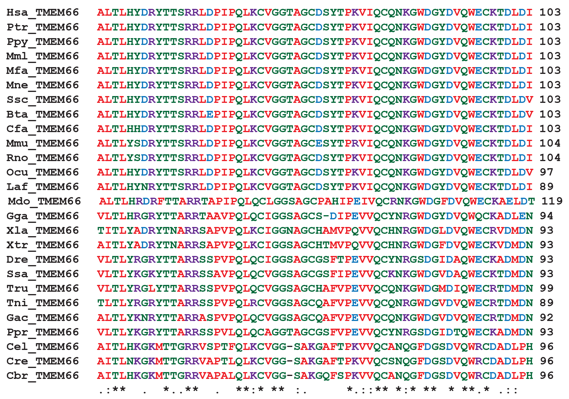
27.3 Figure 4
Wikid25 on Wikimedia Commons. "Multiple sequence alignments."
Notes:
Figure 4: Phylogenetic trees are derived from calculations based on multiple sequence alignments. Multiple sequence alignments compare protein and gene sequences to identify sites where mutations occur. Here, the sequences for a protein, TMEM66, are compared across species. [Hsa = Homo sapiens (humans), Mmu = Mus musculus (mouse), Cel = C. elegans (nematode worm)]

Slide 13
The Evolutionary History of the Animal Kingdom
Questions regarding origins and evolutionary history of animal kingdom continuing to be researched and debated as new fossil and molecular evidence is discovered:
How long have animals existed on Earth?
What were the earliest members of the animal kingdom?
What organism was their last common ancestor?
Modern fossil evidence suggests primitive animal species existed earlier than Cambrian Period of Paleozoic Era (530 MYA) when animal diversity increased

Slide 14
Precambrian Animal Life₁
Ediacaran Period: geological time period (635–541 million years ago) when the oldest definite multicellular organisms with tissues evolved; final period of late Proterozoic Neoproterozoic Era
Ediacaran fossils first found in Ediacara Hills of Southern Australia
No living representatives of this species
Fossils have impressions that look like feathers or coins
Believed that early animal life (Ediacaran biota) evolved from protists of the time

Slide 15
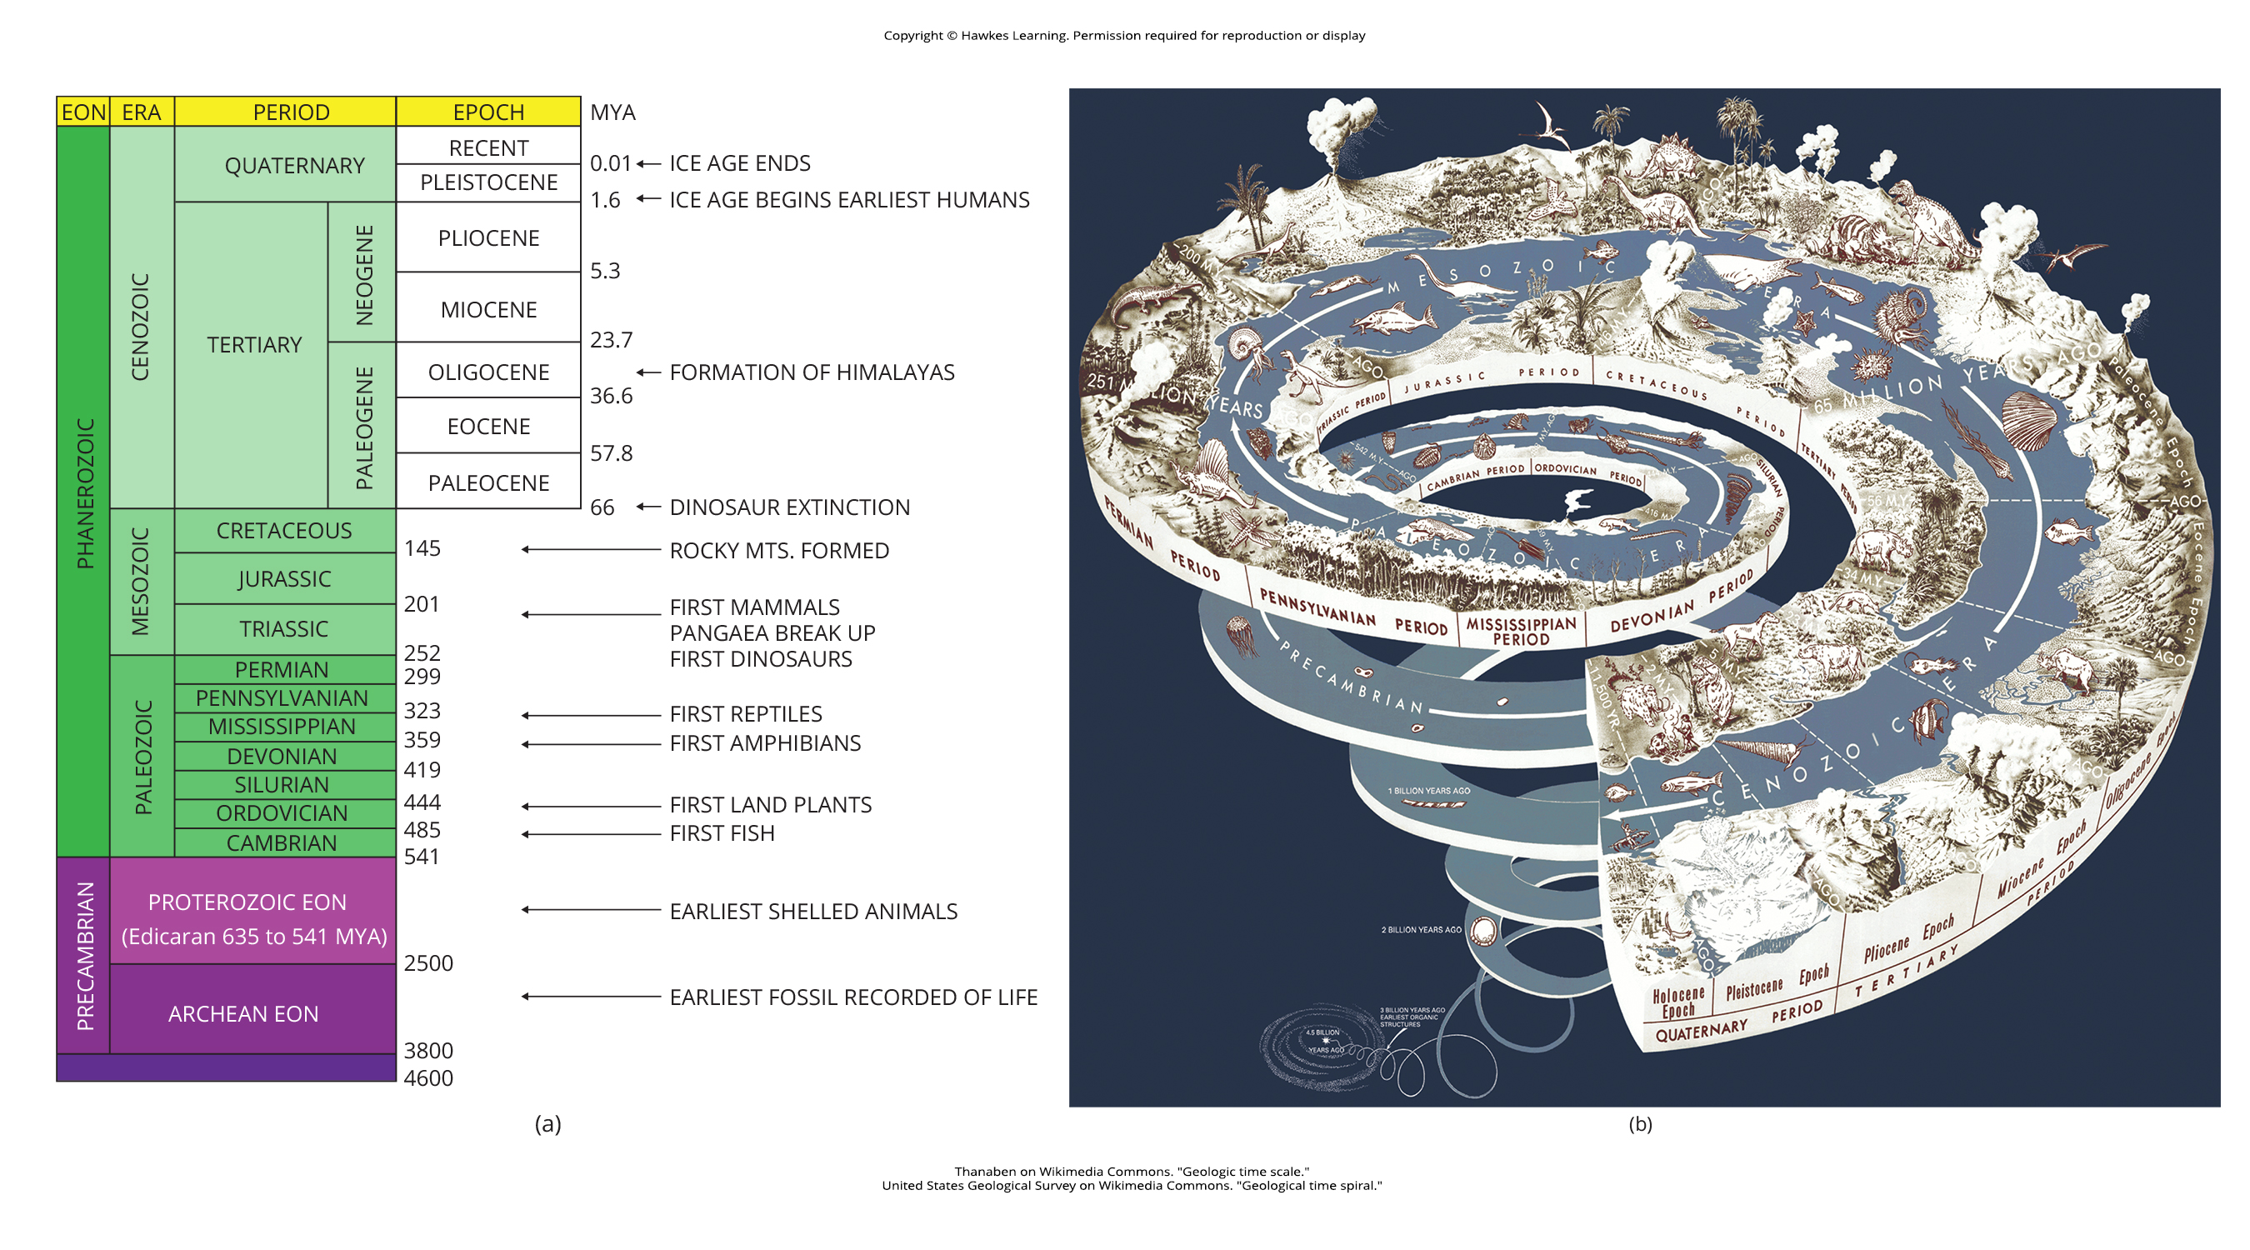
27.3 Figure 5a
Thanaben on Wikimedia Commons. "Geologic time scale."
Notes:
Figure 5: (a) Earth’s history is divided into eons, eras, and periods. Note that the Ediacaran Period starts in the Proterozoic eon and ends in the Cambrian Period of the Phanerozoic eon. Note that dates are indicated as million years ago (MYA

Slide 16
27.3 Figure 5b
United States Geological Survey on Wikimedia Commons. "Geological time spiral."
Notes:
Figure 5 (b) Stages on the geological time scale are represented as a spiral.

Slide 17
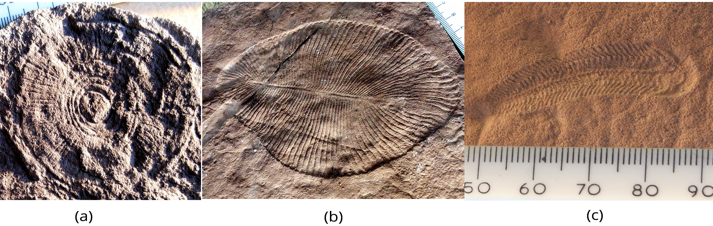
Precambrian Animal Life₂
Ediacaran biota ranged from few millimeters to over a meter for feather-like forms
Increasing evidence that more varied and complex animals lived during this time and even before Ediacaran Period
Recent fossil discoveries of oldest animals with hard body parts in South Australia
Coronacollina acula: spongelike fossils from 560 MYA and show existence of hard body parts and spicules extending 20–40 cm from thimble-shaped body (~5 cm long)
27.3 Figure 6: Fossils of (a) Cyclomedusa (up to 20 cm), (b) Dickinsonia (up to 1.4 m), and (c) Spriggina (up to 5 cm) date to the Ediacaran Period (541–635 million years ago).
Verisimilus on Wikimedia Commons. "Cyclomedusa fossil."
Verisimilus on Wikimedia Commons. "Dickinsonia fossil."
Merikanto~commonswiki on Wikimedia Commons. "Spriggina fossil."

Slide 18
Precambrian Animal Life₃
Recent fossil discovery of earliest animal species ever found
Validity still under investigation
Fossils appear to be small (1 cm long), spongelike creatures, irregularly shaped, with internal tubes or canals
From South Australia, dating to 650 MYA, placing it before ice age extinction event (transition period from Cryogenian Period to Ediacaran Period)
Cryogenian Period: geological period (720–635 million years ago) characterized by a very cold global climate
Prior to this discover, most believed that there was no animal life prior to Ediacaran Period; now believe animals evolved during Cryogenian Period

Slide 19
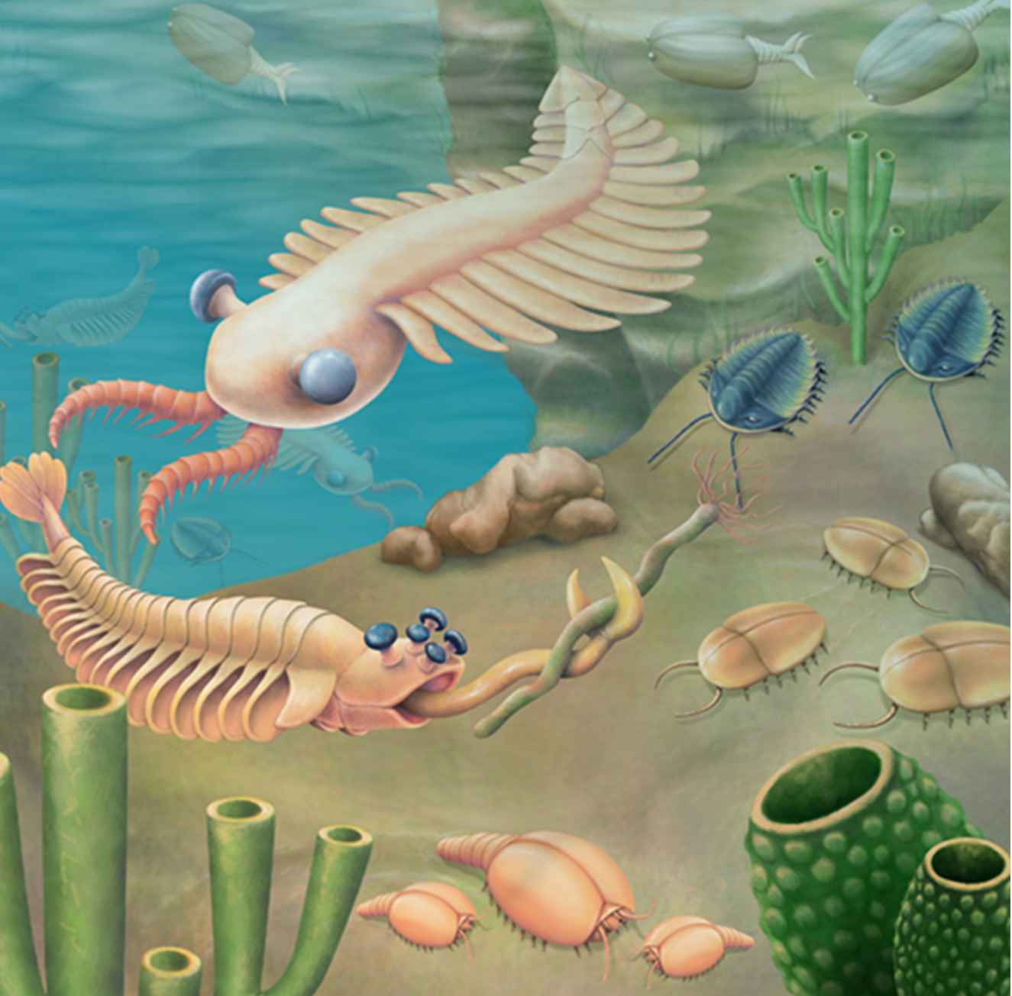
The Cambrian Explosion of Animal Life₁
Cambrian explosion: time during the Cambrian Period (541–485 million years ago) when most of the animal phyla in existence today evolved
Marked by rapid evolution of new animal phyla and rapid diversification of animals
Echinoderms, mollusks, worms, arthropods, and chordates arose
Top predator possibly arthropod-like creature named Anomalocaris (animal over a meter long with compound eyes and spiky tentacles)
All Cambrian animals already exhibited complex structures, meaning ancestors existed earlier
27.3 Figure 7: An artist's rendition depicts some organisms from the Cambrian Period. Anomalocaris is shown in the upper left quadrant of the picture.
CNX OpenStax on Wikimedia Commons. "Organisms from the Cambrian Period."

Slide 20
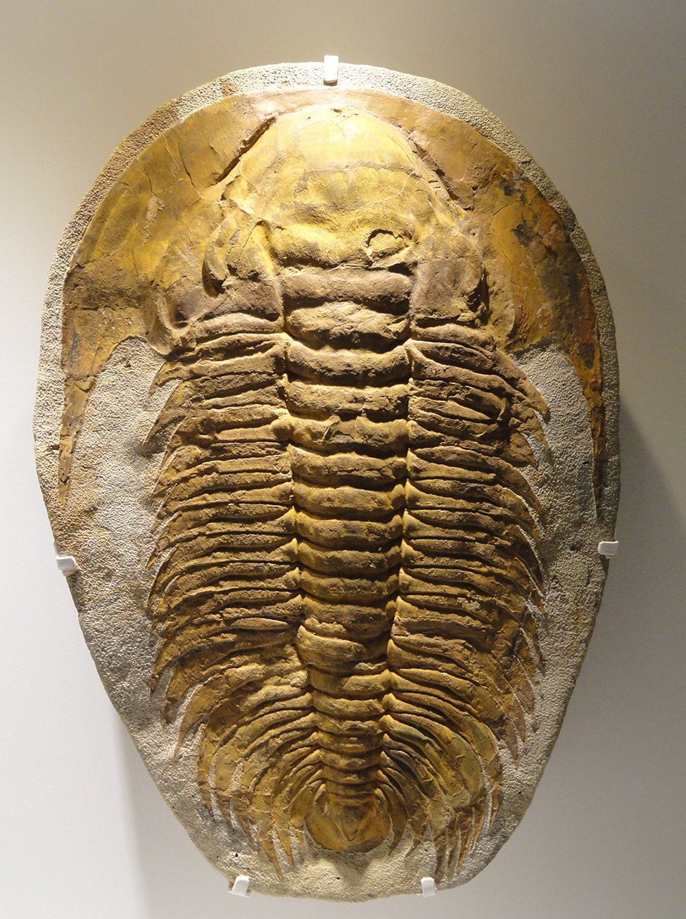
The Cambrian Explosion of Animal Life₂
Dominant species was trilobite (arthropod among first animals to have sense of vision)
Similar to modern horseshoe crabs
Thousands of different species identified in fossil sediments of Cambrian Period, but no species survive today
27.3 Figure 8: This fossil belongs to a trilobite, an extinct arthropod that appeared in the early Cambrian Period, 525 million years ago, and disappeared from the fossil record during a mass extinction at the end of the Permian Period, about 250 million years ago.
Daderot on Wikimedia Commons. "Trilobite fossil."

Slide 21
The Cambrian Explosion of Animal Life₃
Cause of Cambrian explosion still debated; may have been a number of interacting causes
Several hypotheses on cause:
Environmental changes created more suitable environment for animal life
Examples: Rising atmospheric oxygen levels and large increases in oceanic calcium concentrations
Expansive, continental shelf with shallow lagoons or pools provided living space for larger numbers of different types of animals
Ecological relationships between species (e.g., changes in food web, competition for food and space, predator-prey relationships) promoted sudden massive coevolution
Genetic and developmental reasons
Morphological flexibility and complexity afforded by Hox control genes provided opportunities for increases in animal morphologies
Any hypothesis must provide valid reasons for massive animal diversification and explain why it happened when it did
Evidence that supports and refutes all hypotheses described
Answer may be a combination of hypotheses

Slide 22
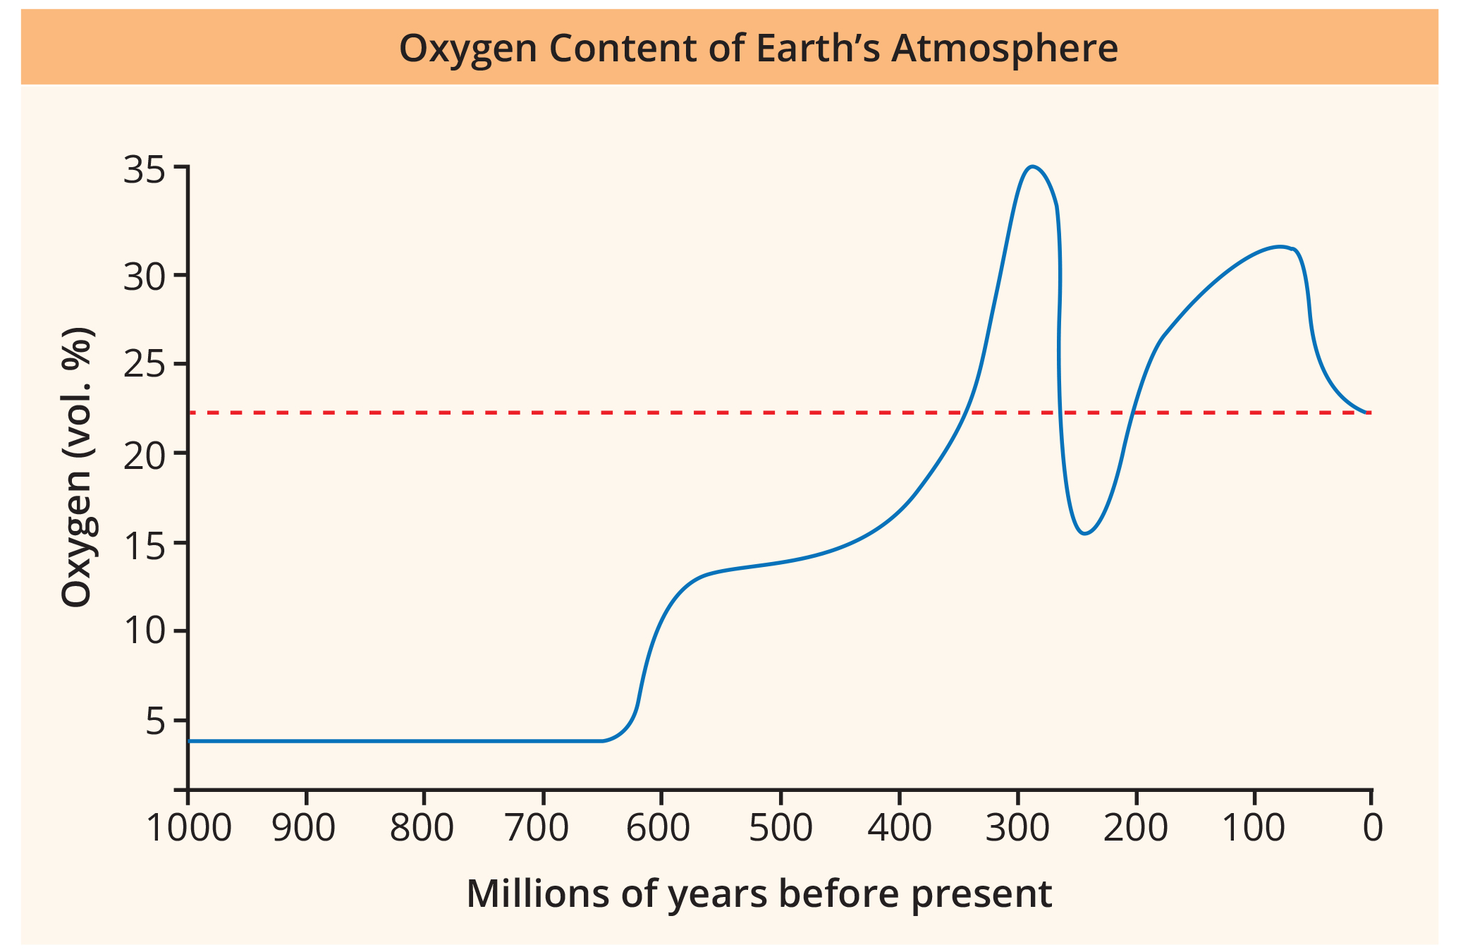
27.3 Figure 9
CNX OpenStax on Wikimedia Commons. "Oxygen in the atmosphere."
Notes:
Figure 9: The oxygen concentration in Earth’s atmosphere rose sharply around 300 million years ago.

Slide 23
The Cambrian Explosion of Animal Life₄
Unresolved questions remain:
Do not know how evolution of so many species occurred in such a short time
Question the validity because there is increasing evidence to suggest more animal life existed prior to Cambrian Period, and other similar explosions (or radiations) occurred later in history too
Diversification of animal species begun during Cambrian and continued into Ordovician
Most agree that Cambrian Period did mark a time of rapid animal evolution and diversification of body forms

Slide 24
Group Activity
Scientists hypothesize that oxygen levels in the atmosphere correlate with maximum body weight. In a group, brainstorm how oxygen levels in the atmosphere might be linked to the size of mammals.
For example, could the size of woolly mammoths vs. modern elephants be linked to lowering oxygen levels?
What other giant mammals once existed?

Slide 25
Post-Cambrian Evolution and Mass Extinctions₁
Continued animal evolution and diversification in post-Cambrian periods during Paleozoic Era
Animal phyla continued diversification, and new species adapted to new ecological niches (roles within environment)
Ordovician Period: Emergence of plant life on land
Allowed formerly aquatic species to move to land, feeding on plants or decaying vegetation
Continued changes in temperature and moisture throughout Paleozoic Era because of continental plate movements
Encouraged development of new adaptations to terrestrial life (e.g., limbed appendages in amphibians, epidermal scales in reptiles)

Slide 26
Post-Cambrian Evolution and Mass Extinctions₂
Cataclysmic events (e.g., volcanic eruptions, meteor strikes that obliterate life) can result in loss of diversity to some clades and opportunities for others to speciate to fill gaps in niches (mass extinctions)
Mass extinction: event or environmental condition that wipes out the majority of species within a relatively short geological time period
Can occur repeatedly
Possibly 20 major mass extinctions in history
Earliest: End of Precambrian Period (541 MYA); increased niche availability likely contributing to Cambrian explosion
Largest: End of Permian Period (and Paleozoic Era); loss of ~95% of extant species at that time
Some dominant phyla in oceans (e.g., trilobites) disappeared completely
Some dominant species on land (i.e., Permian reptiles) disappeared and let new line of reptiles emerge (i.e., dinosaurs)
Warm, stable climate of Mesozoic Era promoted explosive diversification of dinosaurs into every niche (i.e., land, air, water)
Plants radiated into new land and niches, creating complex communities of producers and consumers (allowing increased size)

Slide 27
Post-Cambrian Evolution and Mass Extinctions₃
Mass extinction at end of Cretaceous Period (closing Mesozoic Era)
Large meteor impact ejected volcanic ash into atmosphere, which blocked sunlight
Plants, herbivores, carnivores all died; dinosaurs lost dominance to warm-blooded mammals
Cenozoic Era (followed Mesozoic Era):
Mammals radiated into terrestrial and aquatic niches (once occupied by dinosaurs)
Birds (warm-blooded descendants of reptiles) took over air space
Dominance of flowering plants created new niches for pollinating insects, birds, mammals
Changes in species diversity promoted shift in geography (continental plates shifted), leaving some groups isolated or separated from other competitors
Further extinctions in late Cenozoic followed by speciation during ice ages; high latitudes covered with ice then retreated, leaving new spaces for colonization

Slide 28
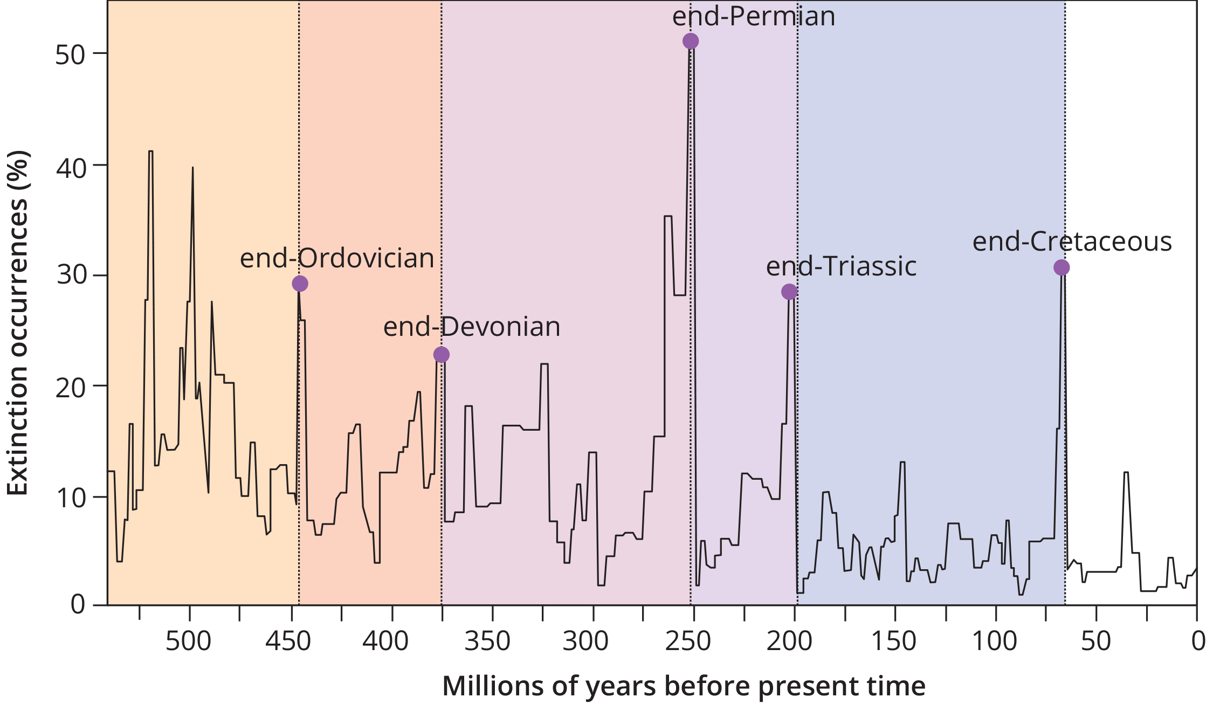
27.3 Figure 10
OpenStax. "Mass extinctions."
Notes:
Figure 10: Mass extinctions have occurred repeatedly over geological time.

Slide 29
Science and You₁
Career: Paleontologist
Study of prehistoric life through fossils to observe and explain how life evolved on Earth and how species interacted with each other and environment
Field originated from scientists in other disciplines, such as geology, who evaluated fossils to determine concepts of extended ages of the Earth, prehistoric life, and extinction
Aided by surprise discoveries of laypeople and concentrated efforts of self-taught scientists
Example: Mary Anning (well-known fossil hunter who discovered, cataloged, and diagrammed fossils of dinosaurs, like Plesiosaurus)
Notes:
This is included as a relevant application for this topic.

Slide 30
Science and You₂
Career: Paleontologist
Relies on varied knowledge and technology
Needs to be knowledgeable in mathematics, biology, ecology, chemistry, geology, biophysics, biochemistry, geographic information systems, data science, and others
May involve field studies (searching for and studying fossils)
Prepare fossils for further study and analysis
Study variety of life forms (plants, fungi, invertebrates, vertebrate fishes, amphibians, reptiles, birds, mammals)
Career path: Undergraduate degree in earth science or biology, graduate degree often necessary, work experience in museum or paleontology lab useful
Notes:
This is included as a relevant application for this topic.

Slide 31
Summary₁
Three main sources of data for phylogenetic tree:
Morphological information (includes developmental morphologies)
Fossil record data
Molecular data
Contributed to substantial modifications of relationships between animal phyla
Details of phylogenetic tree change as new data gathered

Slide 32
Summary₂
Cambrian explosion: Most rapid documented diversification and evolution of animal species during Cambrian Period of Paleozoic Era
Recent discoveries revealed additional, larger, more complex animals existed during Ediacaran Period (possibly earlier during Cryogenian Period)
Included emergence of majority of animal phyla we know today
Many unresolved questions
Remainder of Paleozoic Era: Marked by appearance of new classes, families, and species and early colonization of land by marine animals and semiaquatic arthropods (freshwater and marine)
Numerous mass extinction events, wiping out majority of extant species; some survived, allowing phyla to persist and continue to evolve

Slide 33

End of Hawkes Learning PowerPoint

