Slide 1
Lesson 28.1
The Sponges (Phylum Porifera)

Slide 2
Objectives
Describe the organizational features of the simplest multicellular organisms.
Explain the various body forms and bodily functions of sponges.

Slide 3
Invertebrates₁
Comprises nearly 97% of the animal kingdom
Invertebrata: category of animals that do not possess a cranium or vertebral column (also, invertebrates)
Have a variety of cells and tissues adapted for specific purposes with tissues unique to phyla
Shows a range of cellular differentiation within Opisthokonta, which has both unicellular and multicellular animals
Specializations include:
Cuticles for protection
Spines and tiny harpoons for defense
Toothy structures for feeding
Wings for flight
Exoskeleton for some, adapted for movement or attachment of muscles (e.g., clams and insects)
Secretory cells for producing venom, mucus, or digestive enzymes
Body plans modified and adapted to produce different forms (e.g., mollusks, annelids, arthropods, echinoderms)

Slide 4
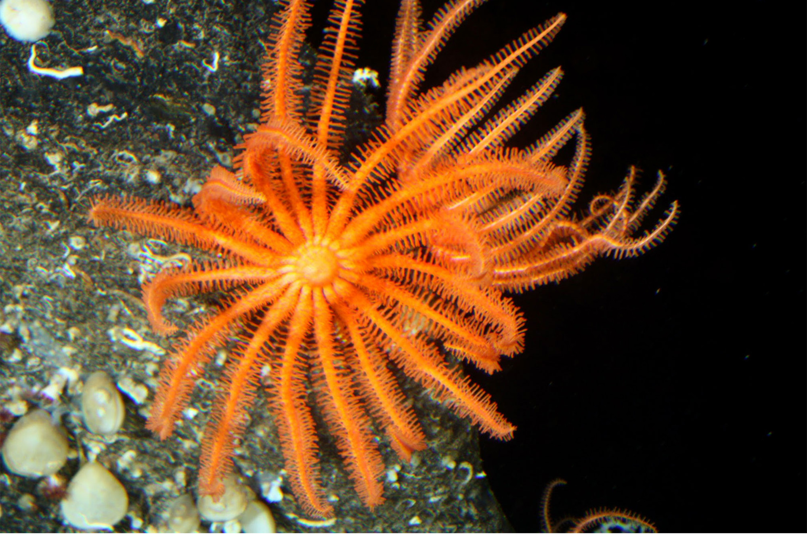
Invertebrates₂
Perhaps millions not classified
Phylogenetic relationships constantly updated
28.1 Figure 1: Nearly 97% of animal species are invertebrates, including this sea star (Novodinia antillensis).
NOAA on Wikimedia Commons. "Brisingid seastar."

Slide 5
The Sponges (Phylum Porifera)₁
Most do not have defined bony vertebral endoskeleton or bony cranium
Echinodermata: Ancestral group of deuterostome invertebrates; produce tiny skeleton "bones" called ossicles that make up true endoskeleton, covered by epidermis
Endoskeleton: skeleton of living cells that produces a hard, mineralized tissue located within the soft tissue of organisms

Slide 6
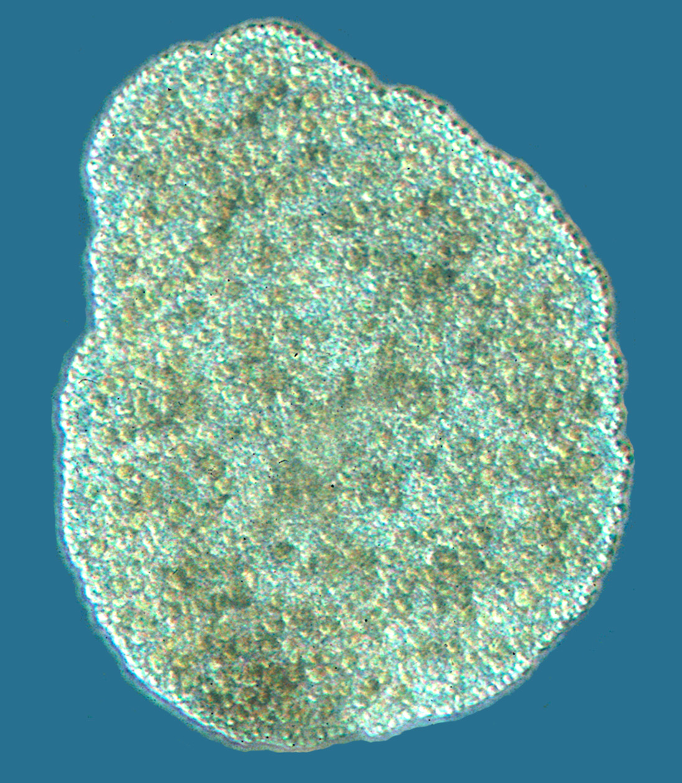
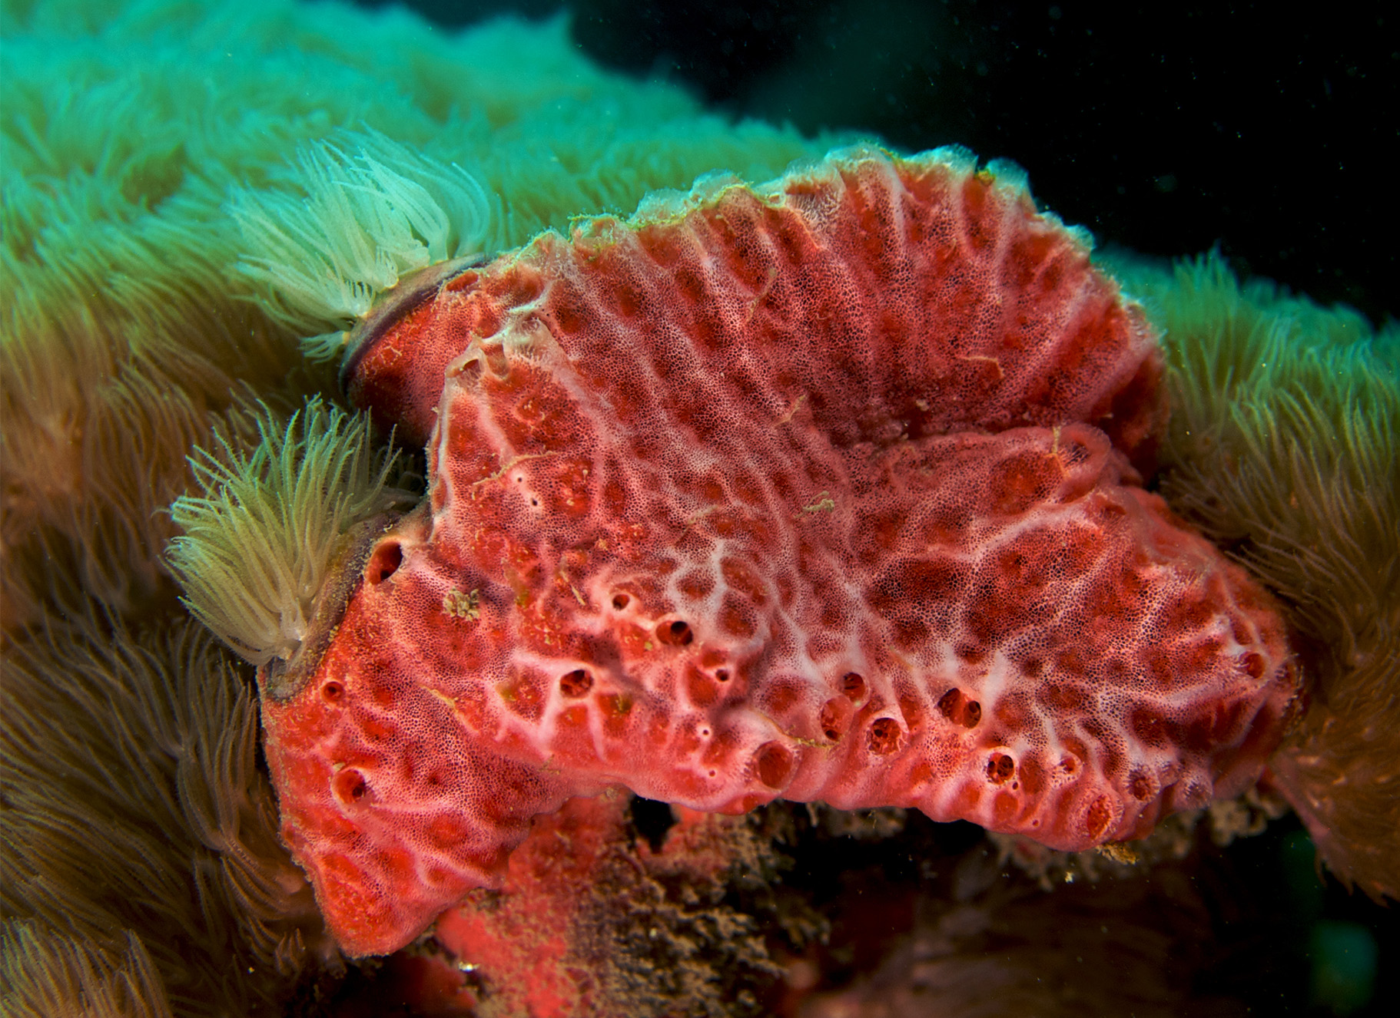
The Sponges (Phylum Porifera)₂
Sometimes classified within Parazoa
Currently includes phylum Placozoa, which contains three known species (e.g., Trichoplax adhaerens) and phylum Porifera (e.g., familiar sponges)
Porifera: phylum of animals with no true tissues but a porous body with rudimentary endoskeleton
Split between Parazoa and Eumetazoa (all animal clades above Parazoa) took place 940 MYA
28.1 Figure 3: Sponges, such as this pink lumpy sponge (Monachora unguifera), are members of the phylum Porifera, which contains the simplest invertebrates.
28.1 Figure 2: Trichoplax adhaerens are microscopic members of the phylum Placozoa. This organism is approximately 0.5 mm in diameter.
Bernd Schierwater on Wikimedia Commons. "Trichoplax adhaerens."
Nick Hobgood on Wikimedia Commons. "Pink lumpy sponge."

Slide 7
The Sponges (Phylum Porifera)₃
Do not:
Have "true" tissues embryologically homologous to other animals (e.g., insects and mammals)
Form a true gastrula (hollow, cup-shaped structure with two or three distinct layers of cells) during embryogenesis
Produce true endoderm or ectoderm
Do have specialized cells that perform specific functions like tissues
Example: External "pinacoderm" of sponge acts like epidermis
Functionally can be said to have tissues, but not embryologically homologous to ours

Slide 8
The Sponges (Phylum Porifera)₄
Sponge larvae (e.g., parenchymula and amphiblastula): Flagellated and able to swim
Adults: Nonmotile, attaching to substrates (e.g., rocks, sediments, other hard surfaces) along floor of body of water
Water vital for feeding, excretion, gas exchange
Body structure of canals, chambers, and cavities enable water movement through sponge to allow for exchange of food, waste, and gases to body cells

Slide 9
Morphology of Sponges₁
At least 5,000 named species with varied morphology
Simple structure:
Irregular cylinder with spongocoel inside cylinder
Spongocoel: central cavity within the body of some sponges
Water enters spongocoel through ostium that create openings in body wall
Ostium: (plural, ostia) holes between blood vessels that allow the movement of hemolymph through the body of insects, arthropods, and mollusks with open circulatory systems
Water entering spongocoel expelled through osculum
Osculum: large opening in the sponge's body through which water leaves
Variations in size and shape of spongocoel and number and arrangement of feeding chambers within body wall
Some have multiple feeding chambers open off a central spongocoel
Some have several feeding chambers connecting to one another that lie between entry pores and spongocoel

Slide 10
Morphology of Sponges₂
Have functional "tissues" composed of different cell types specialized for distinct functions
Example: Collection of pinacocytes forms outermost body (called pinacoderm), which serves protective function similar to epidermis
Pinacocyte: epithelial-like cell that forms the outermost layer of sponges and encloses a jellylike substance called mesohyl
Scattered among pinacoderm are ostia, which allow entry of water into body (why sponges are in Porifera, meaning "pore-bearers")
Some have ostia formed by porocytes (single tube-shaped cells that act as valves to regulate flow of water into spongocoel)
Some have ostia formed by folds in body wall

Slide 11
Morphology of Sponges₃
Between outer layer and feeding chambers is mesohyl
Mesohyl: collagen-like gel containing suspended cells that perform various functions in the sponge
Includes amoebocytes and sclerocytes
Amoebocyte: sponge cell with multiple functions, including nutrient delivery, egg formation, sperm delivery, and cell differentiation
Sclerocyte: cell that secretes silica into the mesohyl
Gel-like consistency acts like endoskeleton and maintains tubular morphology

Slide 12
Morphology of Sponges₄
Feeding chambers lined with choanocytes
Choanocyte: sponge cell that functions to generate a water current and to trap and ingest food particles via phagocytosis (also, collar cell)
Structure critical to function
Similar in appearance to unicellular choanoflagellates (Protista), suggesting sponges and choanoflagellates closely related and share common ancestry
Body of choanocyte embedded in mesohyl and contains all organelles required for normal cell function

Slide 13
Morphology of Sponges₅
Protruding from space inside feeding chamber is mesh-like collar of microvilli (tiny bristle-like protrusions) with single flagellum in the center of collar
Beating of flagella draws water into sponge through ostia, into spaces lined by choanocytes, and out through osculum
Food particles (including waterborne bacteria and unicellular organisms, like algae and animallike protists) trapped by collar of choanocytes, slide down toward body of cell, and ingested by phagocytosis
Choanocytes can differentiate into sperm for sexual reproduction when they dislodge from mesohyl and leave sponge with expelled water through osculum

Slide 14
Morphology of Sponges₆
Amoebocytes (derived from stem-cell-like archaeocytes) move throughout mesohyl in amoeba-like way
Variety of functions:
Deliver nutrients from choanocytes to other cells within sponge
Give rise to eggs for sexual reproduction
Eggs remain in mesohyl; sperm released into water
Can differentiate into other cell types, like collenocytes and lophocytes, which produce collagen protein that supports mesohyl
Give rise to sclerocytes, which produce spicules in some sponges, and spongocytes, which produce protein spongin in most sponges
Spicule: structure made of silica or calcium carbonate that provides structural support for sponges
Notes:
Figure 4: The sponge's (a) basic body plan and (b) some of the specialized cell types found in sponges are shown.

Slide 15
Think It Through
Identify the sponge cell type that corresponds with the given description.
Produces skeletal material
Directs water through the sponge
Epithelial-like cell that forms the outermost body
Able to generate a variety of cell types
Notes:
Originally an On Your Own. This is included here to use as a talking point or for a think-pair-share activity.

Slide 16
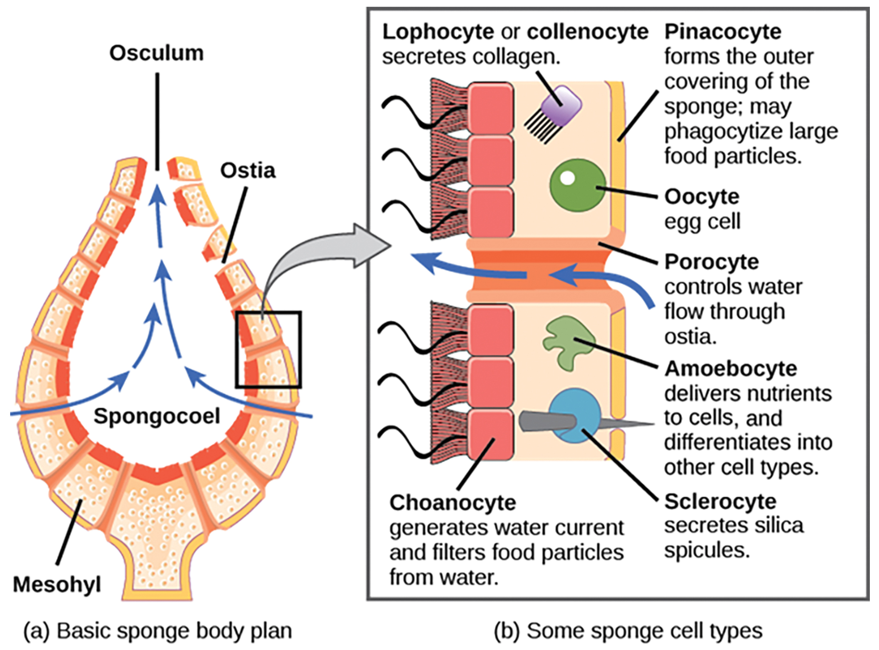
28.1 Figure 4
OpenStax. "Sponge body plan."
Notes:
Figure 4: The sponge's (a) basic body plan and (b) some of the specialized cell types found in sponges are shown.

Slide 17
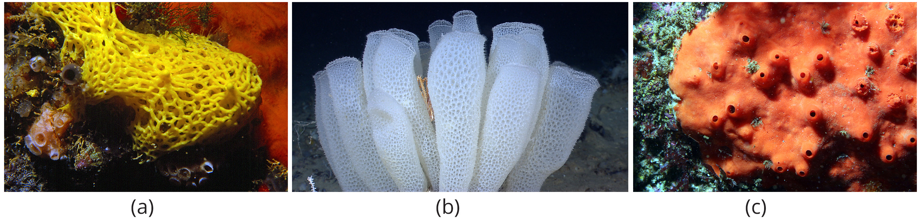
Morphology of Sponges₇
Sponges supported by spicules in mesohyl
Spicules provide support for body and may deter predation
Presence and composition of spicules form basis for differentiating three of four classes of sponges
Class Calcarea: Produce calcium carbonate spicules and no spongin
Class Hexactinellida: Produce six-rayed siliceous spicules and no spongin
Class Demospongia: Contain spongin and may or may not have spicules (if present, spicules are siliceous)
Example: Frequently used as bath sponges
28.1 Figure 5: (a) Clathrina clathrus belongs to class Calcarea, (b) Euplectella aspergillum (common name: Venus' flower basket) belongs to class Hexactinellida, and (c) Acarnus erithacus belongs to class Demospongia.
Parent Géry on Wikimedia Commons. "Clathrina clathrus."
NOAA on Wikimedia Commons. "Venus' flower basket."
SIMoN/MBNMS on Wikimedia Commons. "Red volcano sponge."

Slide 18
Morphology of Sponges₈
Spicules most conspicuous in glass sponges of Hexactinellida
May attain gigantic proportions
Example: Relative to typical glass sponge spicules (3 to 10 mm), some basal spicules (spicules at base of sponge) of Monorhaphis chuni can grow to 3 meters
Most of body cells fuse together to form multinucleate syncytium
Why hexactinellid sponges have no mesohyl
Class Sclerospongiae:
Discovered in underwater tunnels
Commonly called coralline sponges because they have multilayered calcium carbonate skeletons
Are hundreds of years old

Slide 19
Physiological Processes in Sponges
Simple organisms but regulate different physiological processes through variety of mechanisms
Processes regulate metabolism, reproduction, and locomotion

Slide 20
Digestion₁
Lack complex digestive, respiratory, circulatory, and nervous systems
Food trapped as water passes through ostium and out through osculum
Can trap bacteria smaller than 0.5 microns in choanocytes
Food ingested by phagocytosis
Particles larger than ostia phagocytized at sponge's surface by pinacocytes
Amoebocytes transport food from cells that have ingested food to those that have not
Digestion intracellular, so particles must be smaller than sponge cells

Slide 21
Digestion₂
Diffusion used to:
Perform all other major functions (gas exchange, circulation, excretion) by diffusion between cells that line openings within sponge and water passing through those openings
Get oxygen from water to all cell types
Release carbon dioxide into water
Excrete nitrogenous waste produced as byproduct of protein metabolism
Some host green algae or cyanobacteria as endosymbionts within archeaocytes and other cells

Slide 22
Digestion₃
Nearly 150 species of carnivorous sponges
Feed primarily on tiny crustaceans, snaring with sticky threads or hooked spicules
Secrete digestive membrane that surrounds prey and breaks it down into smaller pieces that sponge can absorb
No specialized nervous system but do have intricate cell communication system that enables response to certain stimuli and regulates feeding behavior
Example: System allows sponges to coordinate events like contraction of body or activity of choanocytes

Slide 23
Reproduction₁
Use asexual and sexual reproduction
Asexual reproduction:
Most commonly by fragmentation or budding
Fragmentation: a form of asexual reproduction in which an organism splits into fragments, each of which develops into a new organism
Budding: a type of asexual reproduction where a new organism develops from an outgrowth or bud generated by cell division

Slide 24
Reproduction₂
Asexual reproduction:
Less commonly by formation of gemmules
Gemmule: structure produced by asexual reproduction in freshwater sponges where the morphology is inverted
Environmentally resistant and produced by adult sponges (e.g., freshwater sponge Spongilla)
Inner layer of archaeocytes (amoebocytes) surrounded by pneumatic cellular layer possibly reinforced with spicules
Freshwater sponge gemmules may survive hostile environmental conditions (e.g., changes in temperature) and then recolonize habitat once conditions improve and stabilize

Slide 25
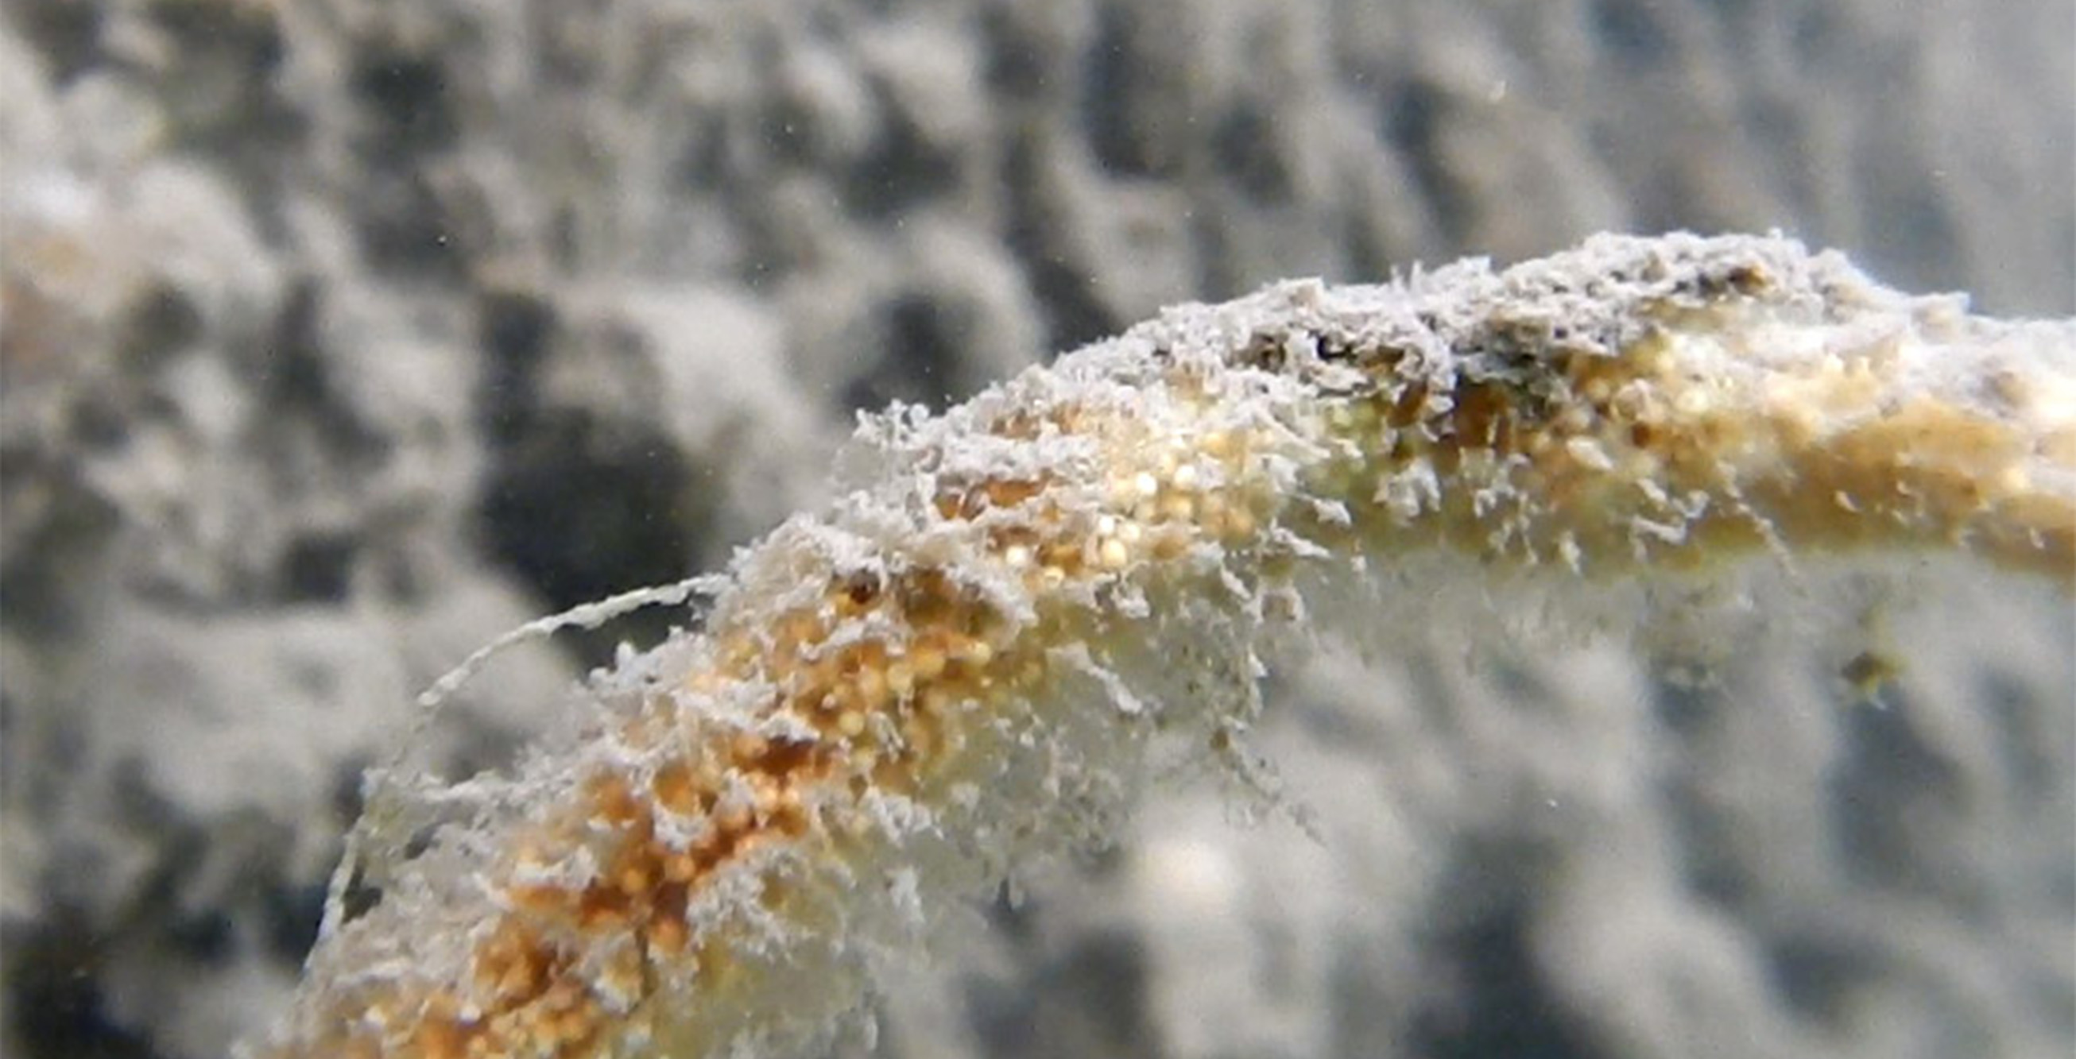
Reproduction₃
Asexual reproduction:
Less commonly by formation of gemmules
Can attach to substratum, generating new sponge
Resistant to desiccation, can remain dormant for long periods, and are excellent means of colonization for sessile organism
28.1 Figure 6: Gemmules are environmentally resistant structures produced by sponges that enable them to survive adverse environmental conditions, such as drought and lack of oxygen.
Lamiot on Wikimedia Commons. "Gemmules."

Slide 26
Reproduction₄
Sexual Reproduction:
Occurs when gametes are generated
Oocytes arise by differentiation of amoebocytes and retained within spongocoel
Spermatozoa result from differentiation of choanocytes and ejected via osculum
Monoecious: describes a species in which the male and female reproductive organs are on the same plant; can produce eggs and sperm simultaneously
Some have production of gametes throughout the year; some show sexual cycles depending on water temperature
May become sequentially hermaphroditic, producing oocytes first and spermatozoa later
Temporal separation encourages cross-fertilization and genetic diversity
Spermatozoa, carried by water, fertilize oocytes borne in mesohyl of other sponges
Early larval development occurs in sponge; free-swimming larvae (e.g., flagellated parenchymula) then released via osculum

Slide 27
Locomotion
Generally sessile and attached to fixed substratum as adults
Sponge cells able to creep along substrata via organizational plasticity (i.e., rearranging their cells)
Do have leading edge for directed movement
Creeping movement may help sponges adjust to microenvironments near point of attachment
Only seen in laboratories so far

Slide 28
Summary
Phylum Porifera and classified as parazoans because they lack formation of true embryonically derived tissues
Do have several specific cell types and "functional" tissues, like pinacoderm
Show very simple organization with rudimentary endoskeleton of spicules and spongin fibers
Glass sponge cells fused to form multinucleated syncytium
Perform most of physiological functions typical of more complex animals

Slide 29

End of Hawkes Learning PowerPoint

