Slide 1
Lesson 28.2
Corals, Jellyfish, and Sea Anemones (Phylum Cnidaria)

Slide 2
Objectives
Compare structural and organization characteristics of Porifera and Cnidaria.
Describe the identifying features of the major cnidarian classes.
Describe the progressive development of tissues and their relevance to animal complexity.
Identify the two general body forms found in the Cnidaria.

Slide 3
Corals, Jellyfish, and Sea Anemones (Phylum Cnidaria)₁
Cnidaria: phylum of animals that are diploblastic (develop from two embryonic layers, ectoderm and endoderm) and have radial or biradial symmetry
Mostly marine species (99%)
Cnidocyte: specialized stinging cell found in Cnidaria; defining cell type of cnidarians
Located around mouth and on tentacles
Capture prey or repel predators
Nematocyst: harpoon-like organelle within cnidocyte with pointed projectile and poison to stun and entangle prey
Contain barbs at base of long, coiled thread
Outer wall of cell has hairlike projection (cnidocil), which detects tactile stimulation; if touched, hollow threads evert at 40,000 times the speed of gravity
Threads then entangle or penetrate flesh of prey or predator, releasing toxins (e.g., neurotoxins and toxins that lead to cell lysis) to immobilize or paralyze

Slide 4
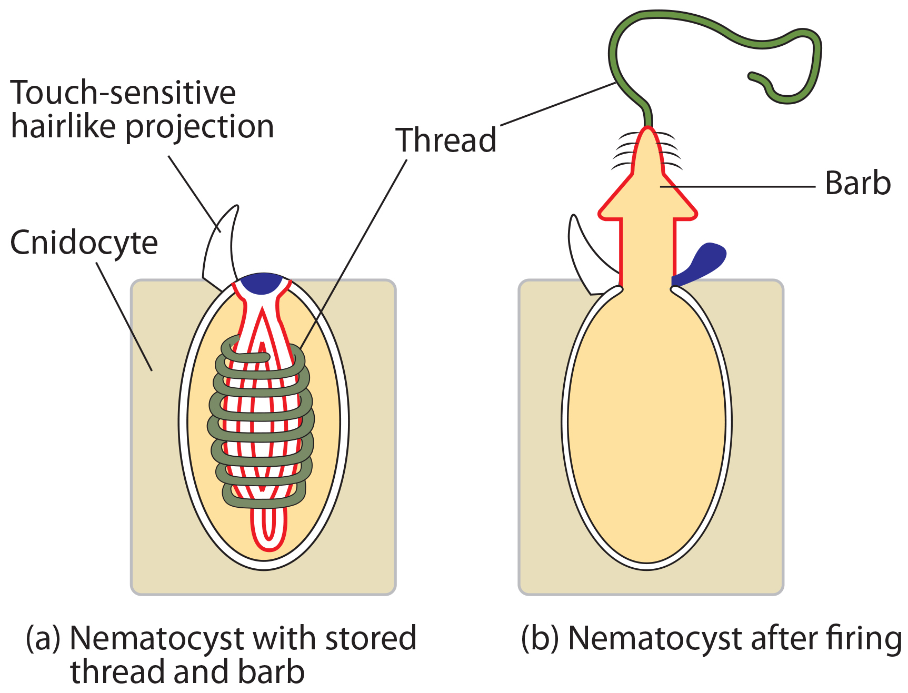
28.2 Figure 1
OpenStax. "Nematocyst." Modified.
Notes:
Figure 1: Animals from the phylum Cnidaria have stinging cells called cnidocytes. Cnidocytes contain large organelles called (a) nematocysts that store a coiled thread and barb. When the hairlike cnidocil on the cell surface is touched, even lightly, (b) the thread, barb, and a toxin are fired from the organelle.

Slide 5
Corals, Jellyfish, and Sea Anemones (Phylum Cnidaria)₂
Two body plans: polyp and medusa
Polyp: stalklike sessile life form of cnidarians with mouth and tentacles facing upward; usually sessile but may be able to glide along surface
Example: Genus Hydra
Medusa: free-floating cnidarian body plan with mouth on underside and tentacles hanging down from a bell
Example: Sea jellies (jellyfish)
Dimorphic: animals exhibiting both polyp and medusa phases during their life cycle
Polyp is asexual phase; medusa is sexual stage and produces gametes
Both forms are diploid

Slide 6
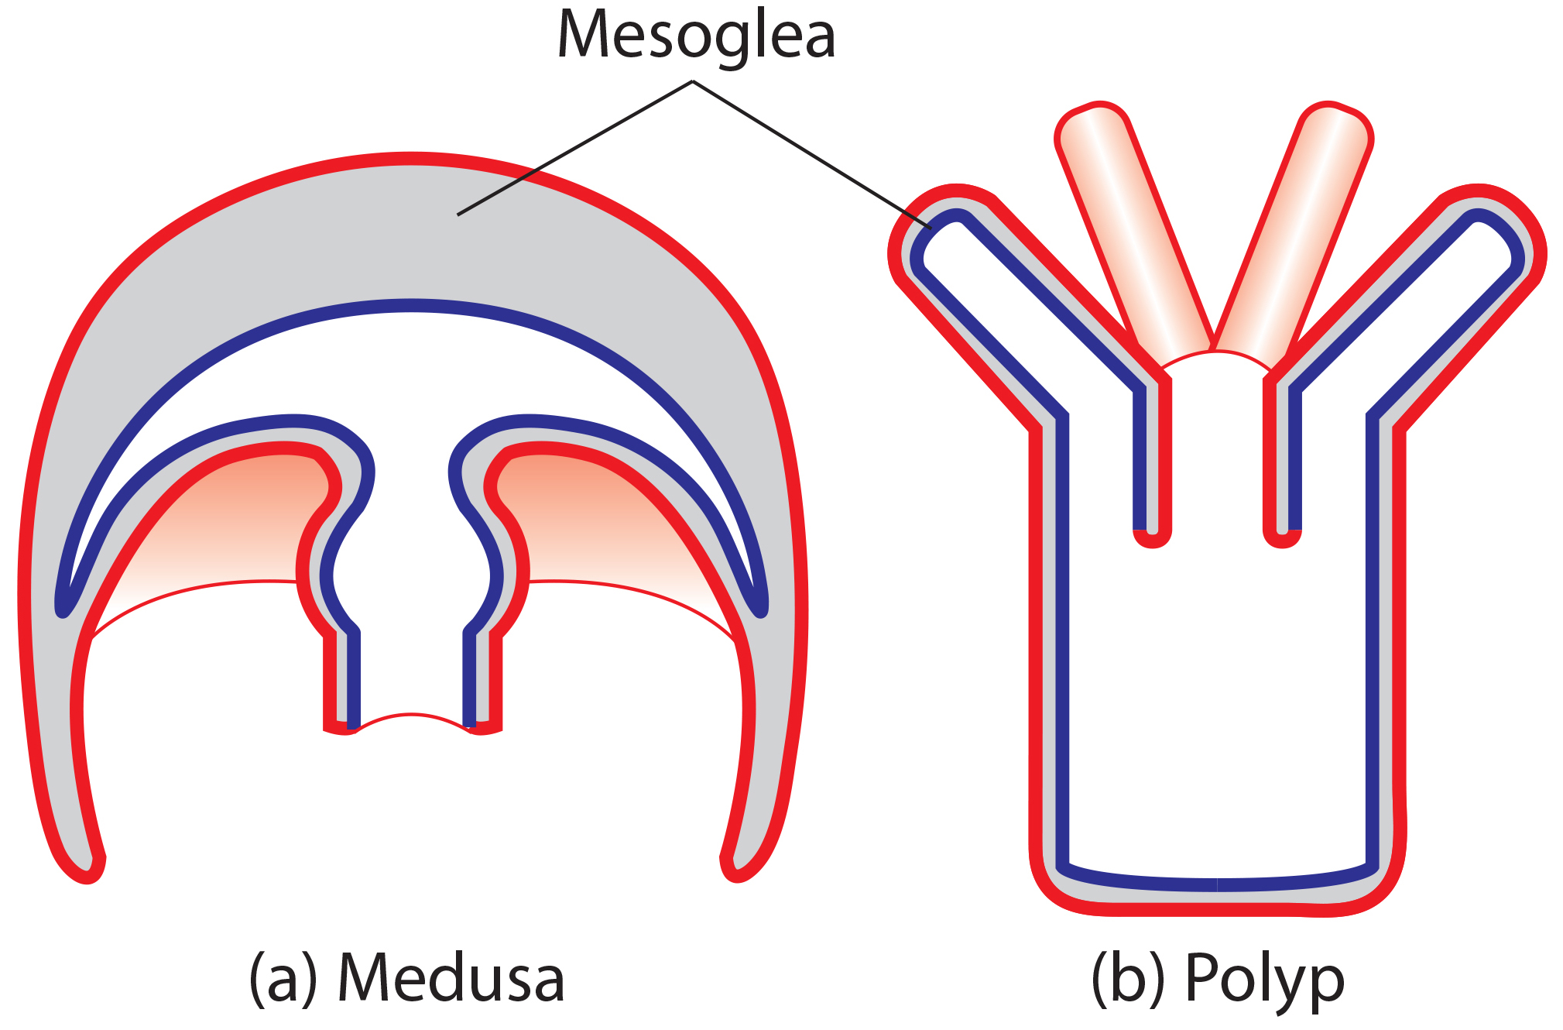
28.2 Figure 2
OpenStax. "Cnidaria body plan." Modified.
Notes:
Figure 2: Cnidarians have two distinct body plans: (a) the medusa and (b) the polyp. All cnidarians have two membrane layers with a jellylike mesoglea between them.

Slide 7
Corals, Jellyfish, and Sea Anemones (Phylum Cnidaria)₃
Example of dimorphism: Colonial hydroid Obelia
Sessile asexual colony has two types of polyps
Gastrozooid: For capturing prey and feeding; all polyps connected through common digestive cavity (coenosarc)
Gonozooid: For asexual budding and production of sexual medusae; reproductive buds break off and mature into free-swimming dioecious medusae
Each medusa has several testes or ovaries in which meiosis occurs, producing sperm or egg cells
Gamete-producing cells migrate into gonad from tissues in gonozooid (separation of gonad and gametes common in Eumetazoa) then released into water
After fertilization, zygote develops into blastula, which becomes ciliated, bilaterally symmetrical planula larva
Free-swimming planula eventually attaches to substrate, becoming single polyp from which new colony of polyps formed by budding

Slide 8
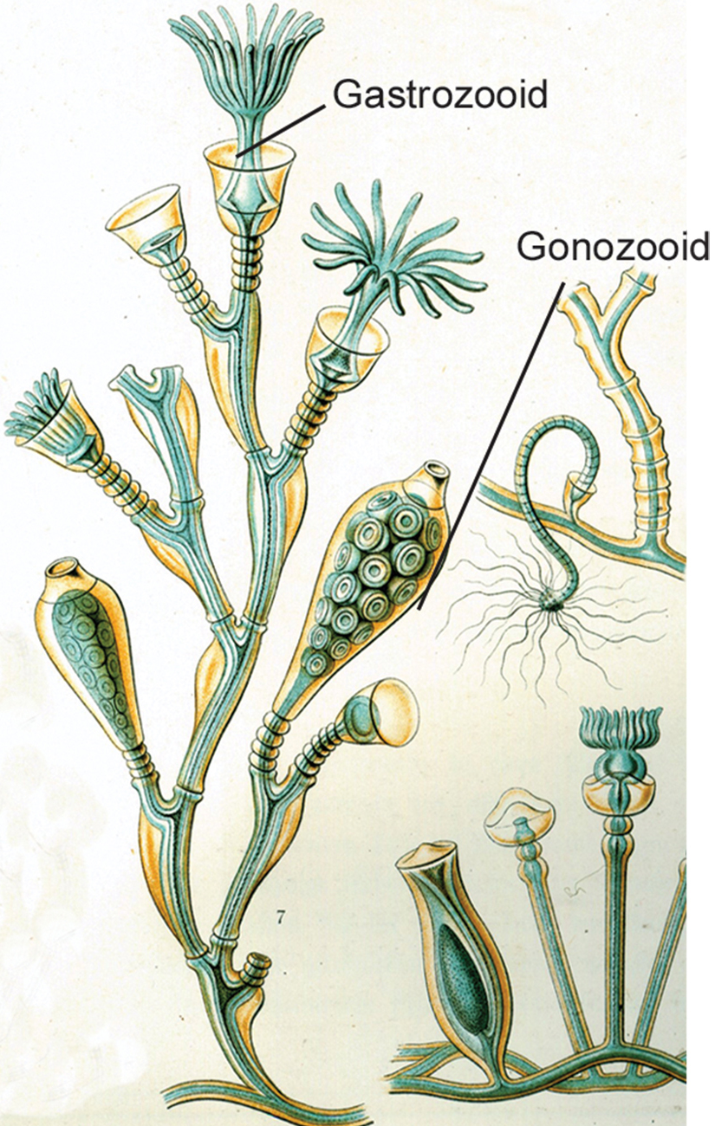
28.2 Figure 3
Kunstformen der Natur (1904) on Wikimedia Commons. "Obelia geniculata."
Notes:
Figure 3: The colonial sessile form of Obelia geniculata has two types of polyps: gastrozooids, which are adapted for capturing prey, and gonozooids, which asexually bud to produce medusae.

Slide 9
Group Activity₁
In groups of three or four, gather materials to construct a model of a functional cnidocyte. Try to get it to fire on contact much like the real life counterparts. Then see if you can use it to snare a "prey" item.

Slide 10
Corals, Jellyfish, and Sea Anemones (Phylum Cnidaria)₄
Diploblastic: Have two "epithelial" layers derived from endoderm and ectoderm
Epidermis: outer layer (from ectoderm) that lines the outside of the animal
Gastrodermis: inner layer (from endoderm) that lines the digestive cavity
In planula larva, layer of ectoderm surrounds solid mass of endoderm; digestive or gastrovascular cavity opens within endoderm as polyp develops
Mesoglea: nonliving, gel-like matrix present between ectoderm and endoderm in cnidarians
Cellular complexity:
Show presence of differentiated cell types in each tissue layer (e.g., nerve cells, contractile epithelial cells, enzyme-secreting cells, nutrient-absorbing cells)
Show presence of intercellular connections
Development of organs or organ systems not advanced (exceptions: statocysts, rhopalia, etc.)

Slide 11
Corals, Jellyfish, and Sea Anemones (Phylum Cnidaria)₅
Nervous system:
Rudimentary, with nerve cells organized in network scattered across the body
Nerve net may show presence of groups of cells that form nerve plexi or nerve cords
Organization in motile medusa more complex than sessile polyp
Nerve ring around edge of medusa bell that controls action of tentacles
Cells show mixed characteristics of motor and sensory neurons
Peptides (short amino acid chains) predominant signaling molecules, performing both excitatory and inhibitory functions
Have acetylcholine, dopamine, and other neurotransmitters found in higher animals
Coordinates complicated movement of tentacles, drawing of captured prey to mouth, digestion of food, and expulsion of waste

Slide 12
Corals, Jellyfish, and Sea Anemones (Phylum Cnidaria)₆
Digestion:
Gastrovascular cavity: opening that serves as both a mouth and an anus, which is termed an incomplete digestive system
Distributes nutrients throughout the body, with nutrients passing from digestive cavity across mesoglea to epidermal cells
Serves both digestive and circulatory functions
Extracellular digestion: when food is taken into the gastrovascular cavity, enzymes are secreted into the cavity, and the cells lining the cavity absorb nutrients
Some intracellular digestion occurs as well

Slide 13
Corals, Jellyfish, and Sea Anemones (Phylum Cnidaria)₇
Circulation of gases:
Cells exchange oxygen and carbon dioxide by diffusion between cells in epidermis and water in environment and cells in gastrodermis and water in gastrovascular cavity
Lack real circulatory system to move dissolved gases, which limits thickness of body wall and necessitates nonliving mesoglea between layers
Cnidarians with thicker mesoglea have canals to help distribute nutrients and gases
No excretory system or organs; nitrogenous wastes diffuse from cells into water or into gastrovascular cavity

Slide 14
Corals, Jellyfish, and Sea Anemones (Phylum Cnidaria)₈
Phylum contains 10,000 species divided into two clades:
Anthozoa: Includes corals, sea fans, sea whips, and sea anemones
Only contains sessile polyp forms
Medusozoa: Includes several classes in two clades
Hydrozoa: Includes sessile forms, medusoid forms, and swimming colonial forms (e.g., Portuguese man o' war)
Other clade has various types of jellies, including Scyphozoa and Cubozoa

Slide 15
Class Anthozoa₁
Includes sea anemones, sea pens, and corals
About 6,100 described species
Sea anemones:
Usually brightly colored
Can grow to 1.8 to 10 cm in diameter
Individuals are cylindrical and attached directly to substrate

Slide 16
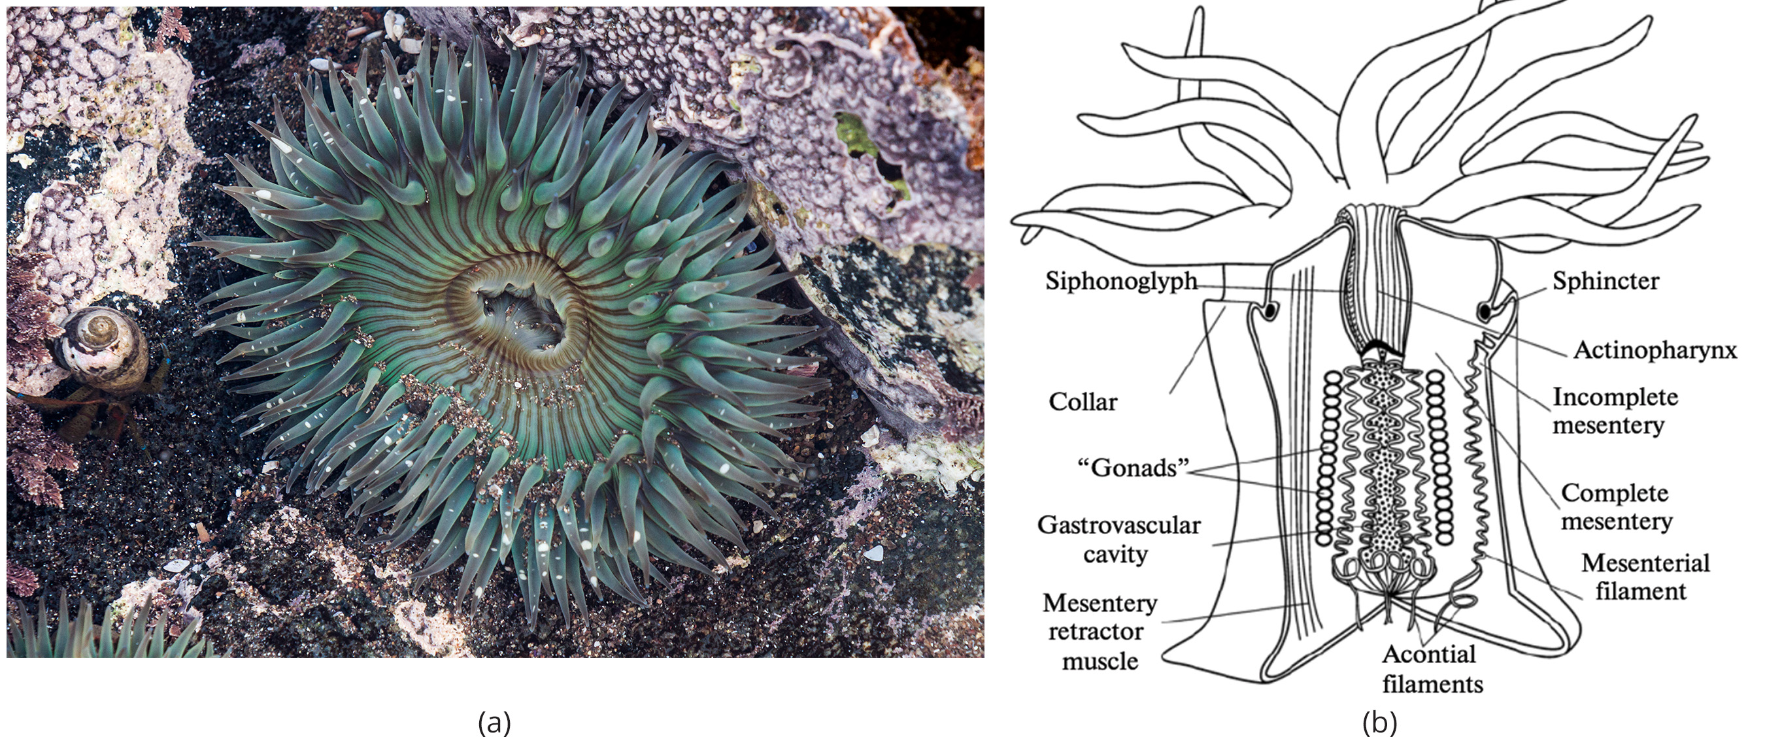
28.2 Figure 4
Tomascastelazo on Wikimedia Commons. "Sea anemone."
Ekaterina Bocharova, Igor A. Kosevich on Wikimedia Commons. "Sea anemone structure."
Notes:
Figure 4: The sea anemone is shown (a) photographed and (b) in a diagram illustrating its morphology.

Slide 17
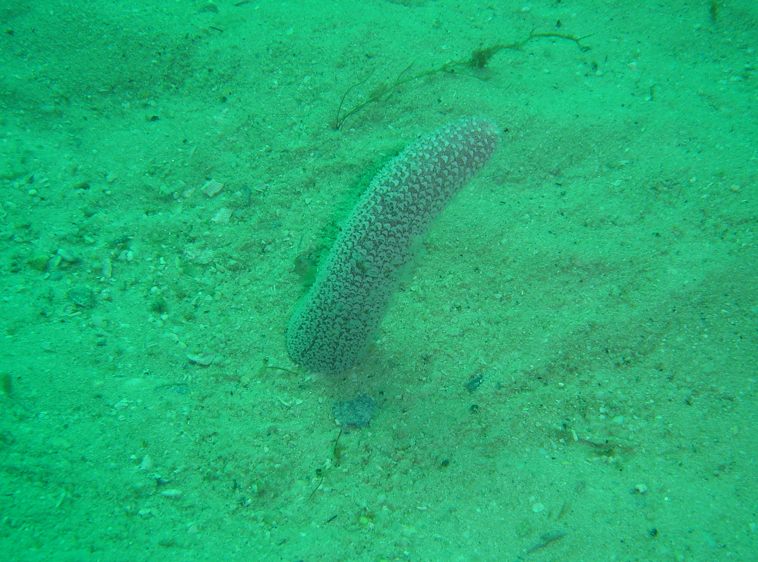
28.2 Figure 5
Peter Southwood on Wikimedia Commons. "Purple sea pen."
Notes:
Figure 5: Sea pens are anthozoans found in marine environments.

Slide 18
Class Anthozoa₂
Sea anemones:
Mouth:
Surrounded by tentacles with cnidocytes
Lined with ectoderm
Pharynx:
Lined with ectoderm
Structure is bilaterally symmetrical
Siphonoglyph: tubular structure that serves as an inlet for water into the mantle cavity; on opposite sides of pharynx
Muscular part of digestive system that ingests and egests (expels) food
May be up to two-thirds length of body before opening into gastrovascular cavity

Slide 19
Class Anthozoa₃
Sea anemones:
Gastrovascular cavity:
Divided into several chambers by longitudinal septa called mesenteries
Septa: cell wall division between hyphae
Consists of fold of gastrodermal tissue with layer of mesoglea between sheets of gastrodermis
Do not divide gastrovascular cavity completely; smaller cavities coalesce at pharyngeal opening
Benefit: Appears to increase surface area for absorption of nutrients and gas exchange and provide mechanical support for body

Slide 20
Class Anthozoa₄
Sea anemones:
Feed on small fish and shrimp, immobilizing them with nematocysts
Some establish mutualistic relationships with hermit crabs when crabs attach them to their shell
Anemone gets food particles from prey caught by crab
Crab protected from predators by stinging cells of anemone
Some establish mutualistic relationships with some species of clownfish (anemone fish)
Clownfish build up immunity to toxins in nematocysts and secrete protective mucus that protects them from being stung

Slide 21
Class Anthozoa₅
Corals:
Structure of polyps like anemones but individual polyps are smaller and part of colony, which can be massive
Feed on smaller planktonic organisms (e.g., algae, bacteria, and invertebrate larvae)
Some have mutualistic, symbiotic associations with dinoflagellate algae (zooxanthellae)
Corals give algae shelter
Algae give reefs their colors and supply both organisms with nutrients
Relationship began over 210 MYA; arose during time of massive worldwide coral-reef expansion and suggests interconnection of algae and coral is crucial for health of coral reefs
Provide habitats for one-fourth of marine life
Threatened by ocean warming and increasing acidification that cause corals to expel algae and turn white (coral bleaching)

Slide 22
Class Anthozoa₆
Remain polypoid (in polyp form) throughout lives
Reproduce asexually by budding or fragmentation or sexually by producing gametes
Male or female gametes produced by polyp fuse, which produces free-swimming planula larva
Larva settles on suitable substratum and develops into sessile polyp

Slide 23
Class Scyphozoa₁
Includes all marine jellies (200 known species)
Medusa prominent life-cycle stage, but there is polyp stage in most species
Most range from 2 to 40 cm in length
Largest species: Cyanea capillata (2 meters in diameter)
Bell-like morphology
Most of life cycle as free-swimming, solitary carnivores

Slide 24
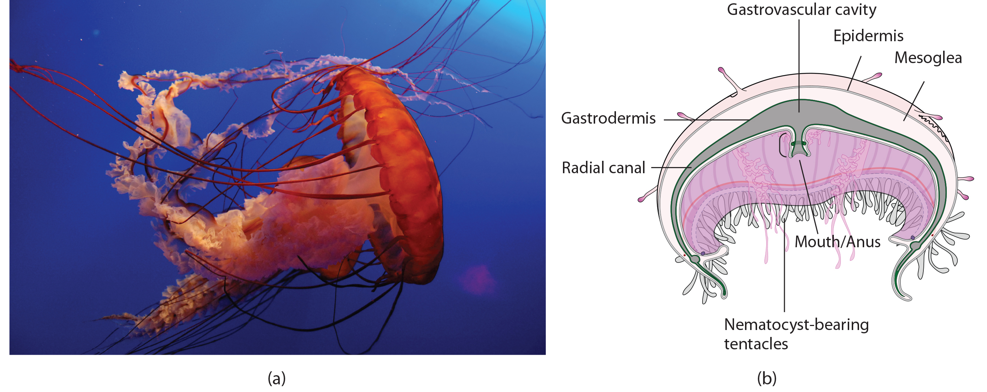
28.2 Figure 6
Leonardolo on Wikimedia Commons. "Sea jelly."
Notes:
Figure 6: A jelly is shown (a) photographed and (b) in a diagram illustrating its morphology.

Slide 25
Class Scyphozoa₂
Digestion:
Mouth opening on underside of animal, surrounded by hollow tentacles with nematocysts
Mouth leads to gastrovascular cavity, which may be sectioned into four interconnected sacs (diverticuli)
Digestive system may branch further into radial canals
Serves two functions: To increase surface area for nutrient absorption and diffusion and to support body of animal
Nerve cells:
Organized in nerve net that extends over entire body, with nerve ring around edge of bell
Rhopalia (clusters of sensory organs) may be present in pockets in edge of bell
Have ring of muscles lining dome of body (provides contractile force required for swimming and drawing in food)

Slide 26
Class Scyphozoa₃
Reproduction:
Separate sexes
Gonads formed from gastrodermis
Gametes expelled through mouth
Planula larvae formed by external fertilization and settle on substratum in polypoid form
Polyps bud to form additional polyps or immediately produce medusa buds
In some, planula larva develop directly into medusa
Life cycle includes both sexual medusoid and asexual polypoid body forms

Slide 27
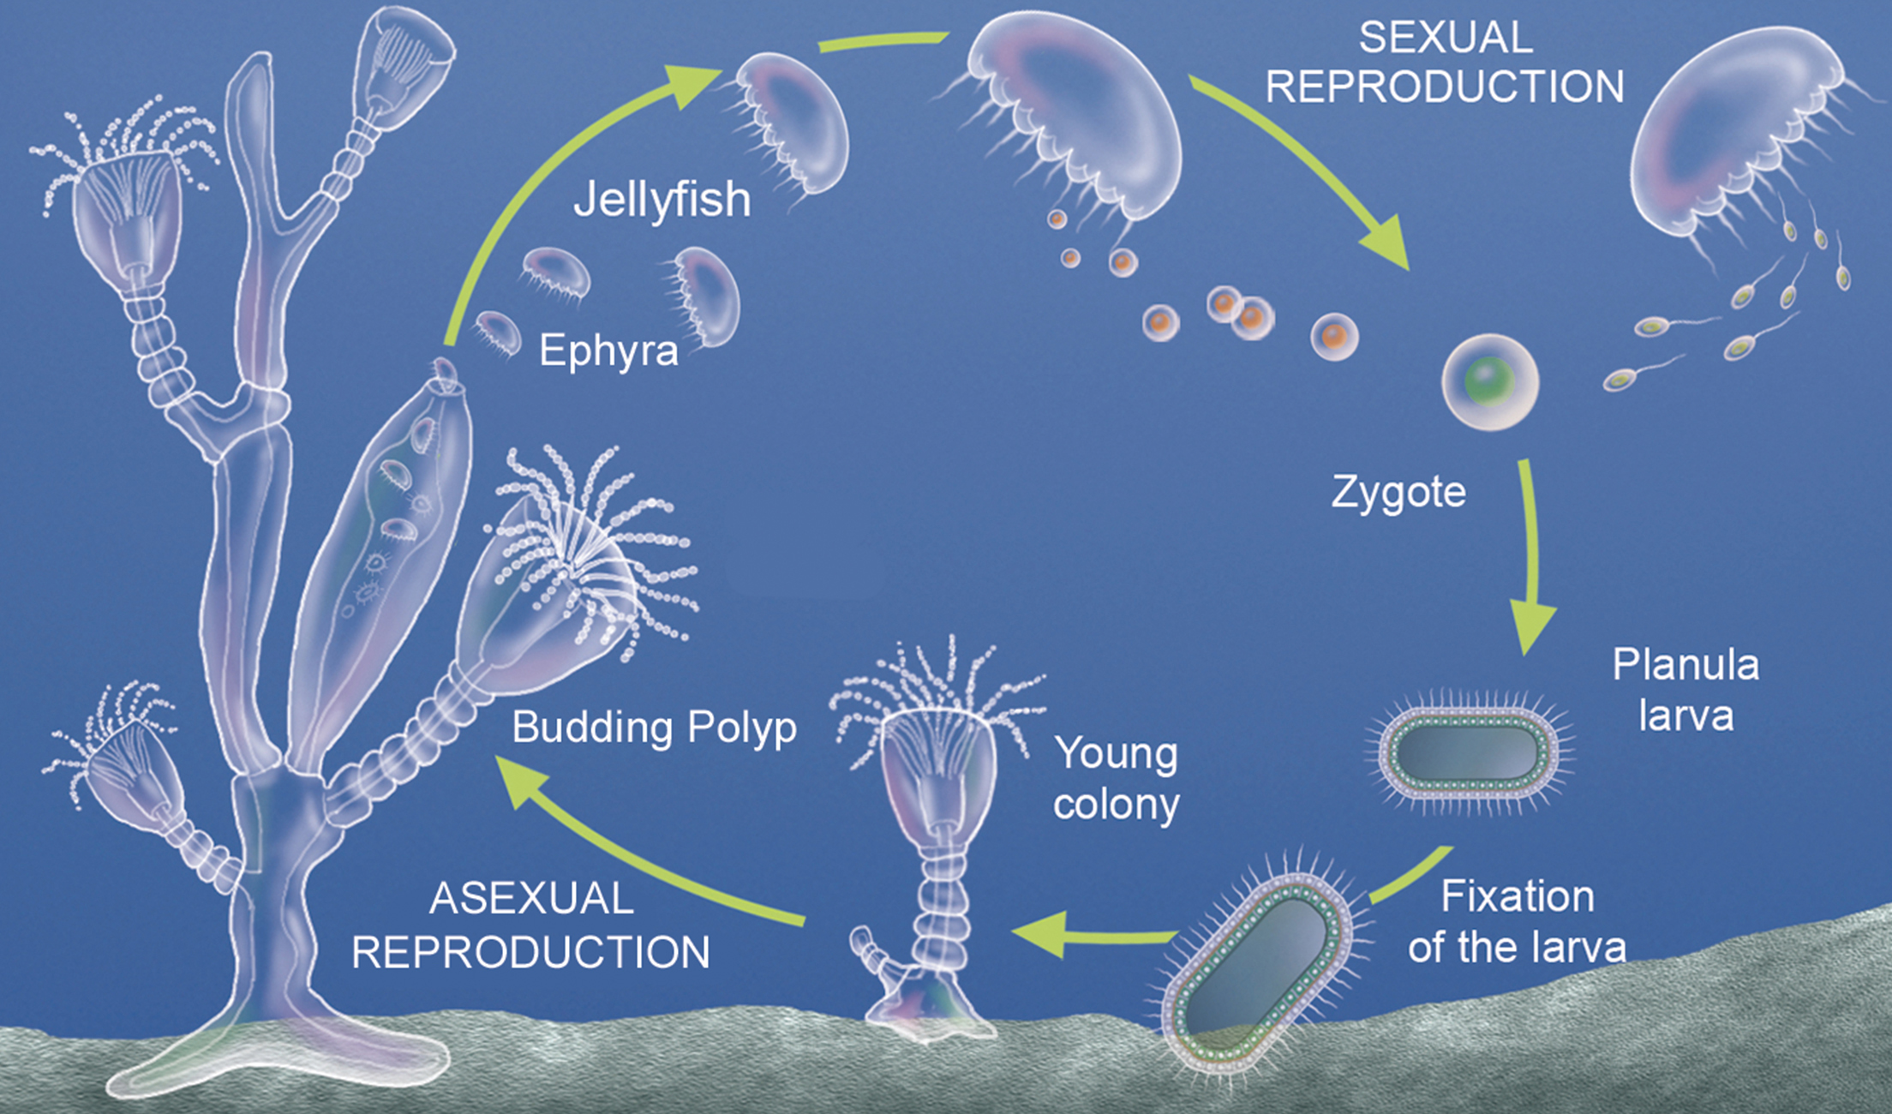
28.2 Figure 7
Notes:
Figure 7: The life cycle of most jellyfish includes two stages: the medusa stage and the polyp stage. The polyp reproduces asexually by budding, and the medusa reproduces sexually.

Slide 28
Class Cubozoa₁
Includes jellies with box-shaped medusa (box jellyfish)
Range from 15 to 25 cm (not as large as Scyphozoa)
Display morphological and anatomical characteristics like scyphozoans; difference in arrangement of tentacles
Have muscular pads (pedalia) at corners of square bell canopy, with one or more tentacles attached to each pedalium

Slide 29
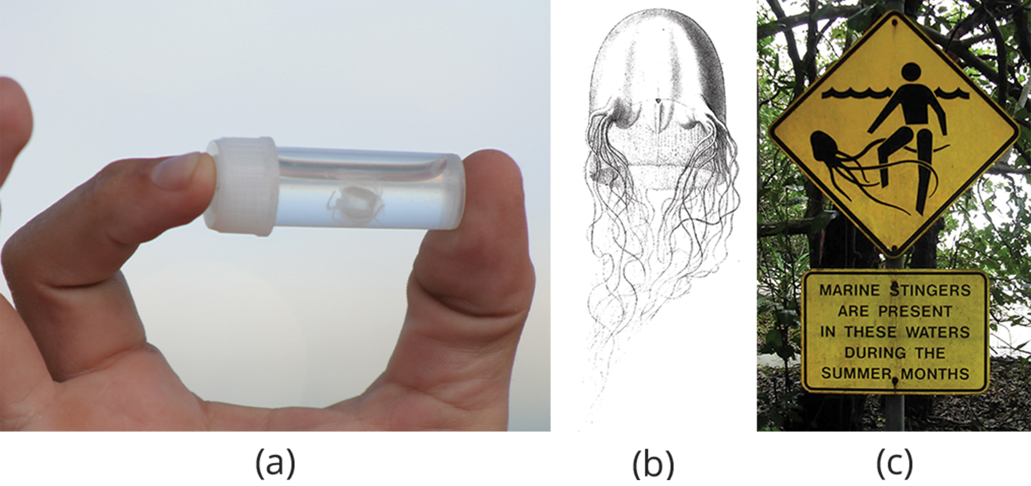
Class Cubozoa₂
Digestion:
May extend into pedalia
Nematocysts arranged in spiral along tentacles, which helps to subdue and capture prey
Most venomous of all cnidarians
28.2 Figure 8: The (a) tiny cubozoan jelly Malo kingi has four muscular pedalia to which the tentacles attach. (b) M. kingi is one of two species of jellies known to cause Irukandji syndrome, a condition characterized by excruciating muscle pain, vomiting, increased heart rate, and psychological symptoms. (c) A sign on a beach in northern Australia warns swimmers of the danger.
GondwanaGirl on Wikimedia Commons. "Irukandji jellyfish."
Ernst Haeckel on Wikimedia Commons. "Malo kingi."
TydeNet on Wikimedia Commons. "Jellyfish warning sign."

Slide 30
Class Cubozoa₃
Structure:
Unusual because of image-forming eyes, including cornea, lens, and retina
Made of several interactive tissues (called true organs)
Eyes in four clusters at each pair of pedalia
Each cluster has four simple eye spots and two image-forming eyes oriented in different directions
How images processed still a mystery because they have extensive nerve nets but no distinct brain
Eyes help them to be active and effective hunters of small marine animals (e.g., worms, arthropods, fish)

Slide 31
Class Cubozoa₄
Reproduction:
Separate sexes
Fertilization occurs inside female
Planula larvae may develop inside female or be released (depends on species)
Planula develops in polyp, which bud to form more polyps to create colony
Polyp transforms into single medusa

Slide 32
Group Activity₂
As a group, research the most venomous cubozoans and their typical prey. Discuss how the nematocyst arrangement helps them subdue and capture their prey.

Slide 33
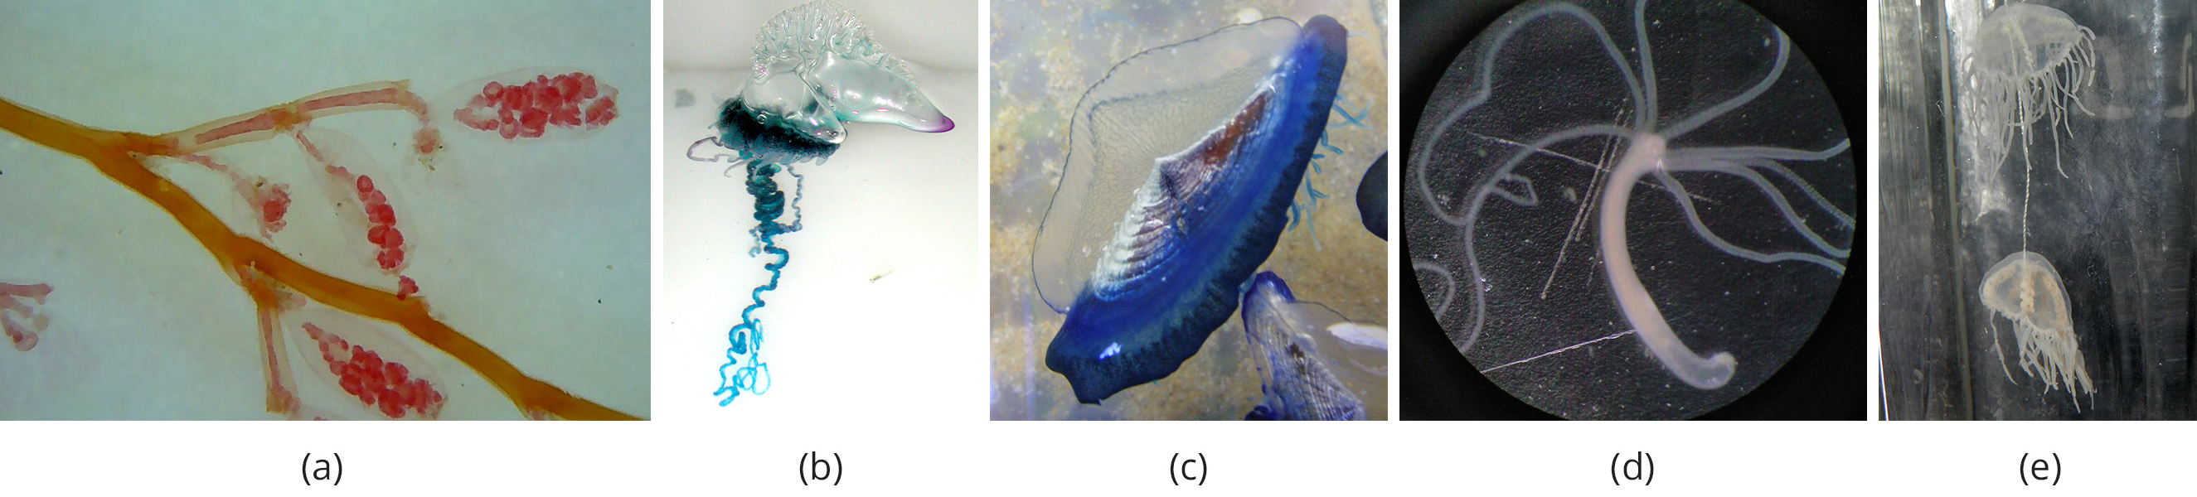
Class Hydrozoa₁
Diverse group (mostly marine but also freshwater) includes 3,200 species
Exhibit both polypoid and medusoid forms
Hydra has only polyp form
Medusoid form has velum (muscular veil below margin of bell), giving it the name hydromedusa
Medusoid form of Scyphozoa lacks velum and called scyphomedusa
28.2 Figure 9: (a) The polyp colony Obelia; (b) siphonophore colonies Physalia physalis, known as the Portuguese man o' war; (c) Velella bae; and (d) the solitary polyp Hydra have different body shapes but all belong to the family Hydrozoa. (e) Gonionemus vertens is a hydromedusa found in brackish water.
The Other 95% on Wikimedia Commons. "Polyp colony Obelia."
NOAA/OER on Wikimedia Commons. "Portuguese man o' war."
Jymm on Wikimedia Commons. "Velella bae."
Oinari-san on Wikimedia Commons. "Hydra polyp."
A.C. Tatarinov on Wikimedia Commons. "Gonionemus vertens."

Slide 34
Class Hydrozoa₂
Structure:
Polyp form shows cylindrical morphology with central gastrovascular cavity lined by gastrodermis
Gastrodermis and epidermis have layer of mesoglea between them
Mouth opening, surrounded by tentacles, present at oral end
Form sessile, branched colonies of specialized polyps that share common, branching gastrovascular cavity (coenosarc), like in colonial hydroid Obelia

Slide 35
Class Hydrozoa₃
Free-floating colonial species call siphonophores
Contain both medusoid and polypoid specialized for feeding, defense, or reproduction
Rainbow float of Portuguese man o' war (Physalia physalis) creates pneumatophore (regulates buoyancy by filling and expelling CO₂ gas)
Appear to be single organism, but even tentacles composed of zooids (individual organisms) with nematocysts
Makes P. physalis a free-floating hydrozoan colony
Each one made up of hundreds of organisms with specialized functions, like motility and buoyancy, feeding, reproduction, and defense
Carnivorous, feeding on soft-bodied marine animals
Lack stomachs and have specialized polyps (gastrozooids) to digest prey in open water

Slide 36
Class Hydrozoa₄
Reproduction:
Male and female colonies that release gametes into water
Zygote develops into single individual, which buds asexually to form new colony
Defining characteristic shared by hydrozoans: Gonads derived from epidermal tissue
Other cnidarian gonads derived from gastrodermal tissue
Examples:
Praya dubia (siphonophores): Largest known floating cnidarian colony (chain of zooids up to 50 meters long)
Hydra: Solitary polyps
Gonionemus: Solitary hydromedusae

Slide 37
Group Activity₃
Break up into groups of four. Each member of the group is responsible for researching a particular species of one of the four cnidarian classes—Anthozoa, Cubozoa, Scyphozoa, and Hydrozoa. Write down three distinguishing characteristics for the species you are presenting on.
Now, rejoin your group and present your results to your fellow group members.

Slide 38
Summary
Represent more complex level of organization than Porifera
Possess outer and inner tissue layers with noncellular mesoglea between them
Possess well-formed digestive system and carry out extracellular digestion in digestive cavity that extends through much of the animal
Mouth surrounded by tentacles that contain cnidocytes (specialized cells with nematocysts for stinging and capturing prey and discouraging predators)
Separate sexes and life cycles that involve medusoid and polypoid forms
In species with both, medusa sexual, gamete-producing stage, and polyp asexual stage
Include individual or colonial polypoid forms, floating colonies, or large individual medusa forms (sea jellies)

Slide 39

End of Hawkes Learning PowerPoint

