Slide 1
Lesson 28.3
Flatworms, Rotifers, and Nemerteans (Superphylum Lophotrochozoa)

Slide 2
Objectives
Describe the unique anatomical and morphological features of flatworms, rotifers, and Nemertea.
Explain the key features of Platyhelminthes and their importance as parasites.
Identify an important extracelomic cavity found in Nemertea.

Slide 3
Flatworms, Rotifers, and Nemerteans (Superphylum Lophotrochozoa)₁
Triploblastic (three germ layers)
Have embryonic mesoderm between ectoderm and endoderm (unlike cnidarians)
Bilaterally symmetrical (longitudinal section divides them into right and left)
Show beginning of cephalization (evolution of concentration of nervous tissues and sensory organs in head of organism)

Slide 4
Flatworms, Rotifers, and Nemerteans (Superphylum Lophotrochozoa)₂
Protostomes: Blastopore (point of invagination of ectoderm) becomes the mouth opening into alimentary canal
Protostomy ("first mouth") development pattern
Include acoelomate, pseudocoelomate, and eucoelomate phyla
Coelom: lined body cavity; separates ectoderm from endoderm
Acoelomates: Solid mass of mesoderm between the ectoderm and endoderm and does not form cavity (or coelom), leaving little room for organ development
Pseudocoelomates: Cavity (or pseudocoelom) that replaces blastocoel (cavity within blastula) but is only lined by mesoderm on the outside of cavity, leaving gut tube and organs unlined

Slide 5
Flatworms, Rotifers, and Nemerteans (Superphylum Lophotrochozoa)₃
Eucoelomates: Cavity that obliterates blastocoel as coelom develops is lined both on outside of cavity (parietal layer) and on inside of cavity around gut tube and internal organs (visceral layer)
Are schizocoels (mesoderm-producing cells migrate into blastocoel during gastrulation and multiply to form solid mass of cell, which then develop into coelom)
Schizocoelom: coelom formed by groups of cells that split from the endodermal layer
Chordates (e.g., humans) develop coelom by enterocoely (pouches of mesoderm pinch off the invaginating primitive gut, or archenteron) and fuse to form complete coelom
Can form coelom by either schizocoely or enterocoely

Slide 6
Flatworms, Rotifers, and Nemerteans (Superphylum Lophotrochozoa)₄
Most possess either lophophore feeding apparatus or trochophore larvae
Lophophore: feeding structure found in members of the superphylum Lophotrochozoa; composed of a set of ciliated tentacles surrounding the mouth
Trochophore: free-swimming larva characterized by two bands of cilia surrounding a top-like body
Some phyla may be missing one or both defining structures, but placement reinforced by comparing ribosomal RNA and other gene sequences
Still some unclear relationships

Slide 7
Phylum Platyhelminthes₁
Acoelomate organisms including free-living and parasitic forms
Lack lophophore and trochophore larvae (except Polycladida, which have larvae homologous to trochophore larvae)
Spiral cleavage seen in polycladids and other basal flatworm groups
Developmental pattern of some free-living forms obscured by blastomere anarchy (temporary feeding larva forms) followed by regrouping of cells within embryo that develops into second-stage embryo
Both monophyly and placement in Lophotrochozoa supported by molecular analysis

Slide 8
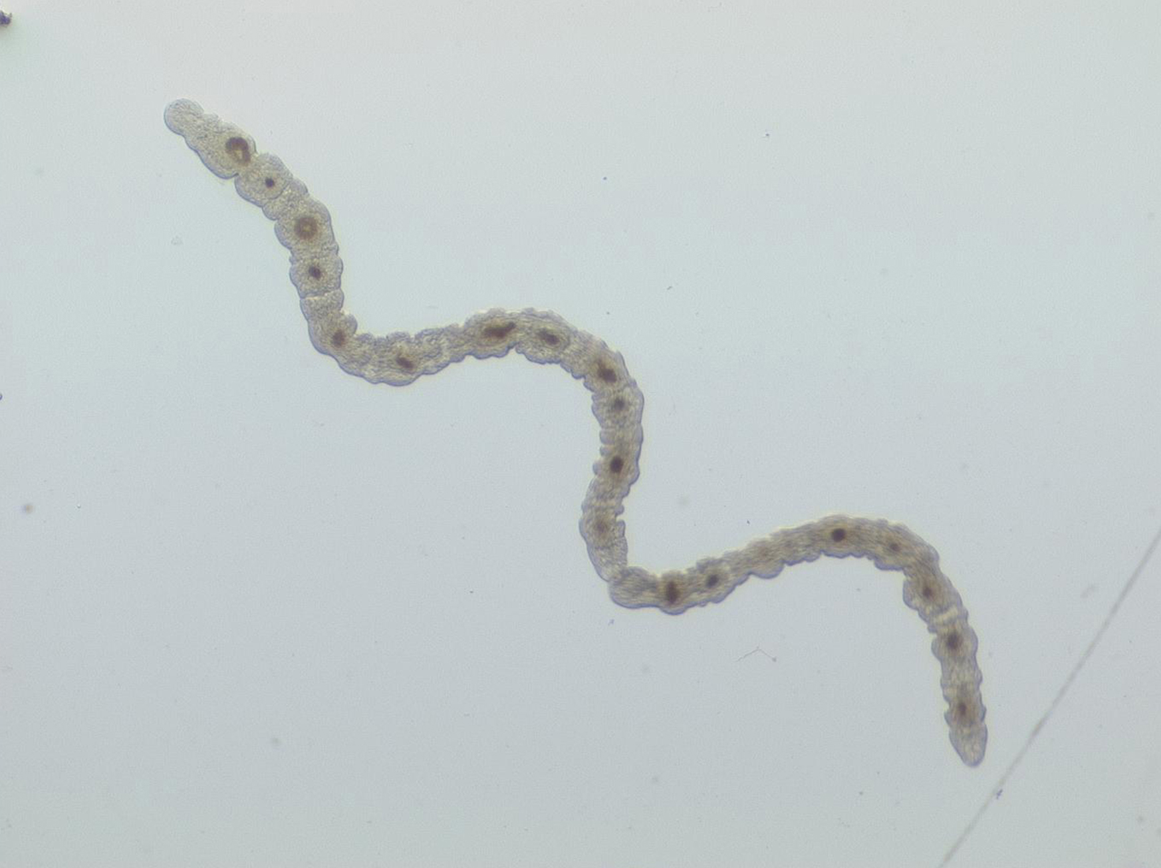
Phylum Platyhelminthes₂
Divided into two monophyletic lineages: Catenulida and Rhabditophora
Catenulida ("chain worms"):
Small clade of over 100 species
Reproduce asexually by budding
Offspring do not fully detach from parents, creating a chain in appearance
28.3 Figure 1: Chain worms are freshwater organisms that belong to the Catenulida class.
Christopher Laumer on Wikimedia Commons. "Chain worms."

Slide 9
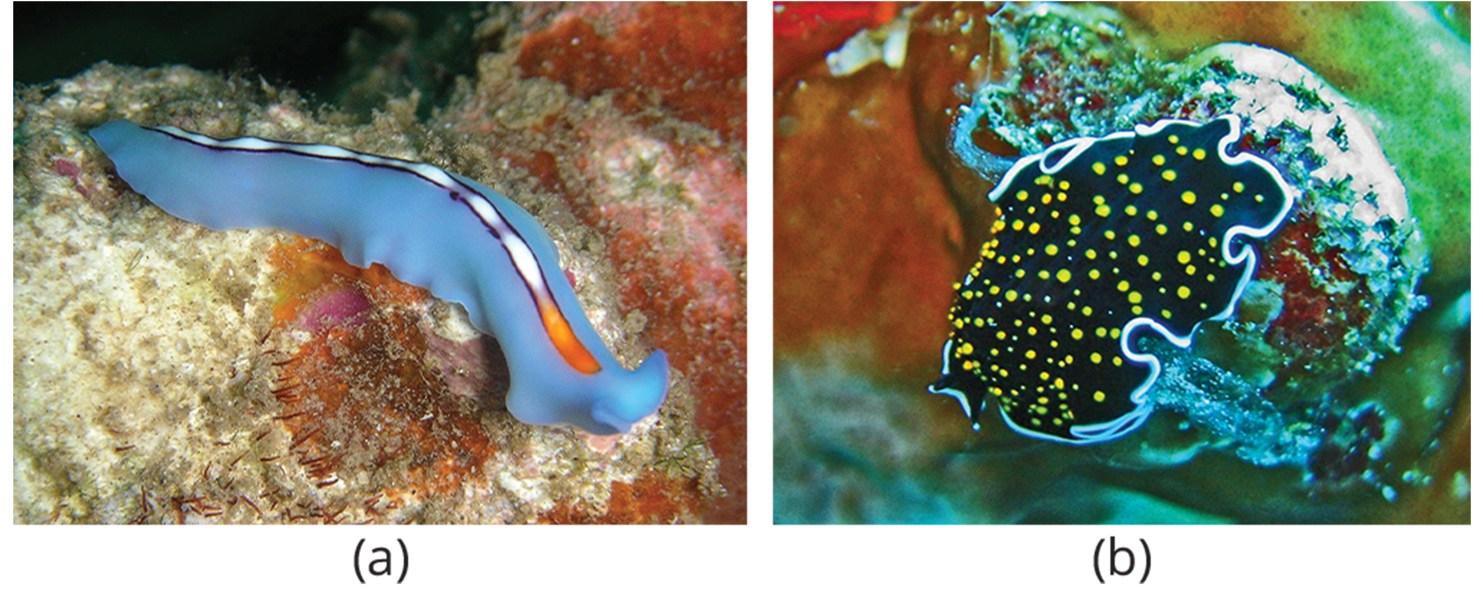
Phylum Platyhelminthes₃
Rhabditophora ("rhabdite bearers"):
Rhabdites: Rodlike structures discharged in mucus produced by some free-living flatworms
Acoelomate protostomes: Schizocoels in which mesoderm-producing cells migrate into blastocoel during gastrulation and likely serve in both defense and to provide traction for ciliary gliding along substrate
Include both free-living flatworms and parasitic flatworms (e.g., trematodes [flukes] and cestodes [tapeworms])
28.3 Figure 2: Flatworms exhibit significant diversity, as observed in (a) a blue Pseudoceros flatworm (Pseudoceros bifurcus) and (b) a gold speckled flatworm (Thysanozoon nigropapillosum).
Stephen Childs on Wikimedia Commons. "Blue Pseudoceros flatworm."
Hectonichus on Wikimedia Commons. "Thysanozoon nigropapillosum."

Slide 10
Phylum Platyhelminthes₄
Three embryonic tissue layers: ectoderm (gives rise to epidermal tissues), mesoderm (gives rise to other internal tissues), and endoderm (gives rise to lining of digestive system)
Epidermal tissue is a single layer of cells or syncytium that covers two layers of muscle, one circular and one longitudinal
Syncytium: multinucleated cell that is formed by the fusion of many single cells
Mesodermal tissues include mesenchymal cells (contain collagen) and support secretory cells (produce mucus and other materials at surface)
Forms solid mass between outer epidermal surface and cavity of digestive system

Slide 11
Physiological Processes of Flatworms₁
Free-living species are predators or scavengers
Parasitic forms absorb nutrients from hosts
Most have a branching gastrovascular cavity for digestion rather than complete digestive system
Mouth serves also to expel waste materials
A few species may have second anal pore or opening
Gut may be simple sac or highly branched
Primarily extracellular (digested materials taken into cells of gut lining by phagocytosis)
One parasitic group, tapeworms (cestodes), lacks digestive system and absorbs digested food from host

Slide 12
Physiological Processes of Flatworms₂
Have excretory system with network of tubules attached to flame cells, whose cilia beat to direct waste fluids concentrated in tubules out of body through excretory pores
Flame cell: excretory cell found in flatworms (also, protonephridia)
System responsible for the regulation of dissolved salts and excretion of nitrogenous wastes
Nervous system consists of pair of lateral nerve cords running length of body with transverse connections between them
Two large cerebral ganglia (concentrations of nerve cell bodies at anterior end of worm) associated with photosensory and chemosensory cells

Slide 13
Physiological Processes of Flatworms₃
No circulatory nor respiratory system
Gas and nutrient exchange dependent on diffusion and cell-to-cell junctions
Limits thickness of body, constraining them to be "flat" worms
Most monoecious (both male and female reproductive organs on same individual) with internal fertilization
Some groups use asexual reproduction by fission

Slide 14
Group Activity₁
As a group, construct a model of a flatworm out of clay or other materials. Make sure to label each of the individual parts.

Slide 15
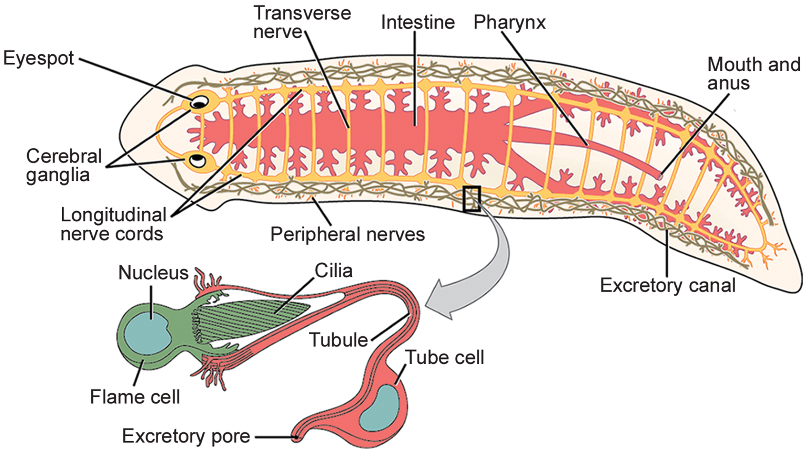
28.3 Figure 3
OpenStax. "Planarian."
Notes:
Figure 3: The planarian is a flatworm that has a gastrovascular cavity with one opening that serves as both mouth and anus. The excretory system is made up of flame cells and tubules connected to excretory pores on both sides of the body. The nervous system is composed of two interconnected nerve cords running the length of the body, with cerebral ganglia and eyespots at the anterior end.

Slide 16
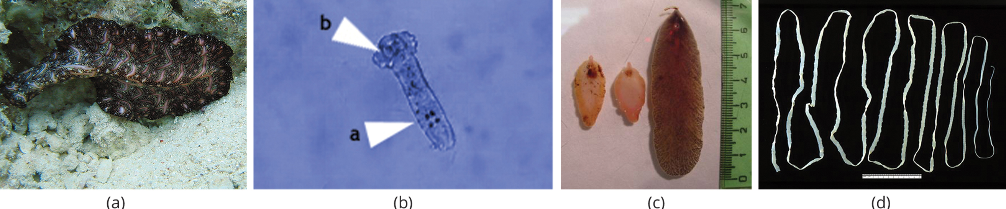
Diversity of Flatworms₁
Traditionally divided into four classes: Turbellaria, Monogenea, Trematoda, and Cestoda
Relationships among these classes recently reassessed, making turbellarians paraphyletic since descendants may include members of the other three classes
28.3 Figure 4: (a) Class Turbellaria includes the free-living polycladid Bedford's flatworm (Pseudobiceros bedfordi). (b) The parasitic class Monogenea includes Dactylogyrus spp., commonly called gill flukes. (c) The class Trematoda includes Fascioloides magna (right) and Fasciola hepatica (two specimens on left, also known as the common liver fluke). (d) Class Cestoda includes tapeworms, such as this Taenia saginata.
Jan Derk on Wikimedia Commons. "Bedford's flatworm."
Gogoschinski on Wikimedia Commons. "Gill flukes."
Flukeman on Wikimedia Commons. "Fasciola hepatica and Fascioloides magna."
CDC on Wikimedia Commons. "Tapeworm."

Slide 17
Diversity of Flatworms₂
Members of Rhabditophora now dispersed among multiple orders of Platyhelminthes:
Polycladida, which contains large marine flatworms
Tricladida, which includes planarians (Dugesia, Planaria, other genera)
Major parasitic orders, which form monophyletic clade:
Monogenea (fish ectoparasites)
Trematoda (flukes)
Cestoda (tapeworms)
Most free-living flatworms are marine polycladids
Tricladid species live in freshwater or moist terrestrial environment
Ventral epidermis ciliated, facilitating locomotion
Some capable of regeneration (regrow head or tail after being severed, or several heads if planaria cut lengthwise)

Slide 18
Diversity of Flatworms₃
Monogeneans:
Ectoparasites of mostly fish
Simple life cycles of free-swimming larva that attaches to fish prior to larva's transformation to ectoparasitic adult
Only one, specific host
Produce enzymes that digest host tissues or graze on surface mucus and skin particles
Hermaphroditic, but male gametes develop first, making cross-fertilization common

Slide 19
Diversity of Flatworms₄
Trematodes (flukes):
Endoparasites of mollusks and other groups (e.g., humans)
Complex life cycles that involve primary host, in which sexual reproduction occurs, and one or more secondary hosts in which asexual reproduction occurs
Primary host usually vertebrate
Secondary host usually mollusk
Attach internally to host via oral or medial sucker

Slide 20
Diversity of Flatworms₅
Responsible for serious human diseases
Example: Schistosomiasis caused by blood fluke Schistosoma spp.
Various forms infect estimated 200 million people in tropics
Leads to organ damage, secondary infection by bacteria, and chronic symptoms like fatigue
Occurs when human enters water, and metacercaria larvae (tailless, infective, late-stage larvae) released from snail host locate and penetrate skin

Slide 21
Diversity of Flatworms₆
Infects various organs in body and feeds on red blood cells before reproducing
After reproduction, many eggs released in feces and enter waterway to reinfect snail host
Eggs (have a barb on them) damage vascular system of human host, causing ulceration, abscesses, bloody diarrhea, which allows other pathogens to cause secondary infections
Many eggs do not go through tissues of host for elimination and swept by blood flow back to liver and other locations, causing severe inflammation
In liver, errant eggs impede circulation, causing cirrhosis
Control and elimination of parasite difficult in impoverished areas in unsanitary, crowded conditions
Prognosis poor with heavy infections of Schistosoma japonicum without early treatment

Slide 22
Diversity of Flatworms₇
Cestodes (tapeworms):
Internal parasites of vertebrates
Example: Taenia spp.
Live in intestinal tract of primary host
Remain fixed using sucker or hooks on anterior end (scolex) of tapeworm body, which is essentially colony of similar subunits called proglottids
Each proglottid contains excretory system with flame cells and reproductive structures, both male and female
Do not need digestive system because they are so long and flat
Absorb nutrients from food matter surrounding them in host's intestine by diffusion

Slide 23
Diversity of Flatworms₈
Life cycle:
Proglottids produced at scolex and migrate to end of tapeworm
They mature, and all structures except fertilized eggs degenerate
Most reproduction occurs by cross-fertilization between different worms in same host but also occur between proglottids
Mature proglottids detach from body and released into feces of organism
Eggs eaten by intermediate host (usually another vertebrate)
Juvenile worm infects intermediate host in muscle tissue
Muscle tissue consumed by primary host, and cycle repeats
Several tapeworm parasites of humans transmitted by eating uncooked or poorly cooked pork, beef, or fish

Slide 24
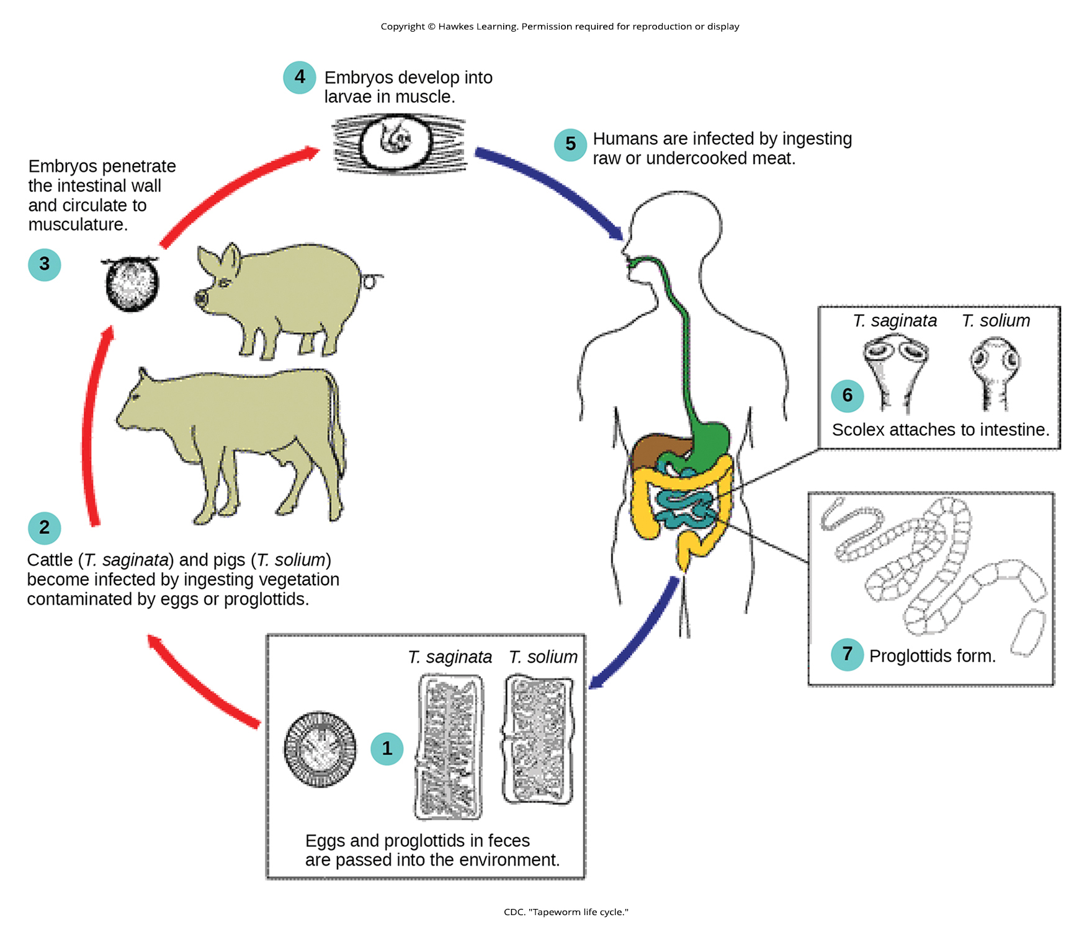
28.3 Figure 5
CDC. "Tapeworm life cycle."
Notes:
Figure 5: Tapeworm (Taenia spp.) infections occur when humans consume raw or undercooked infected meat.

Slide 25
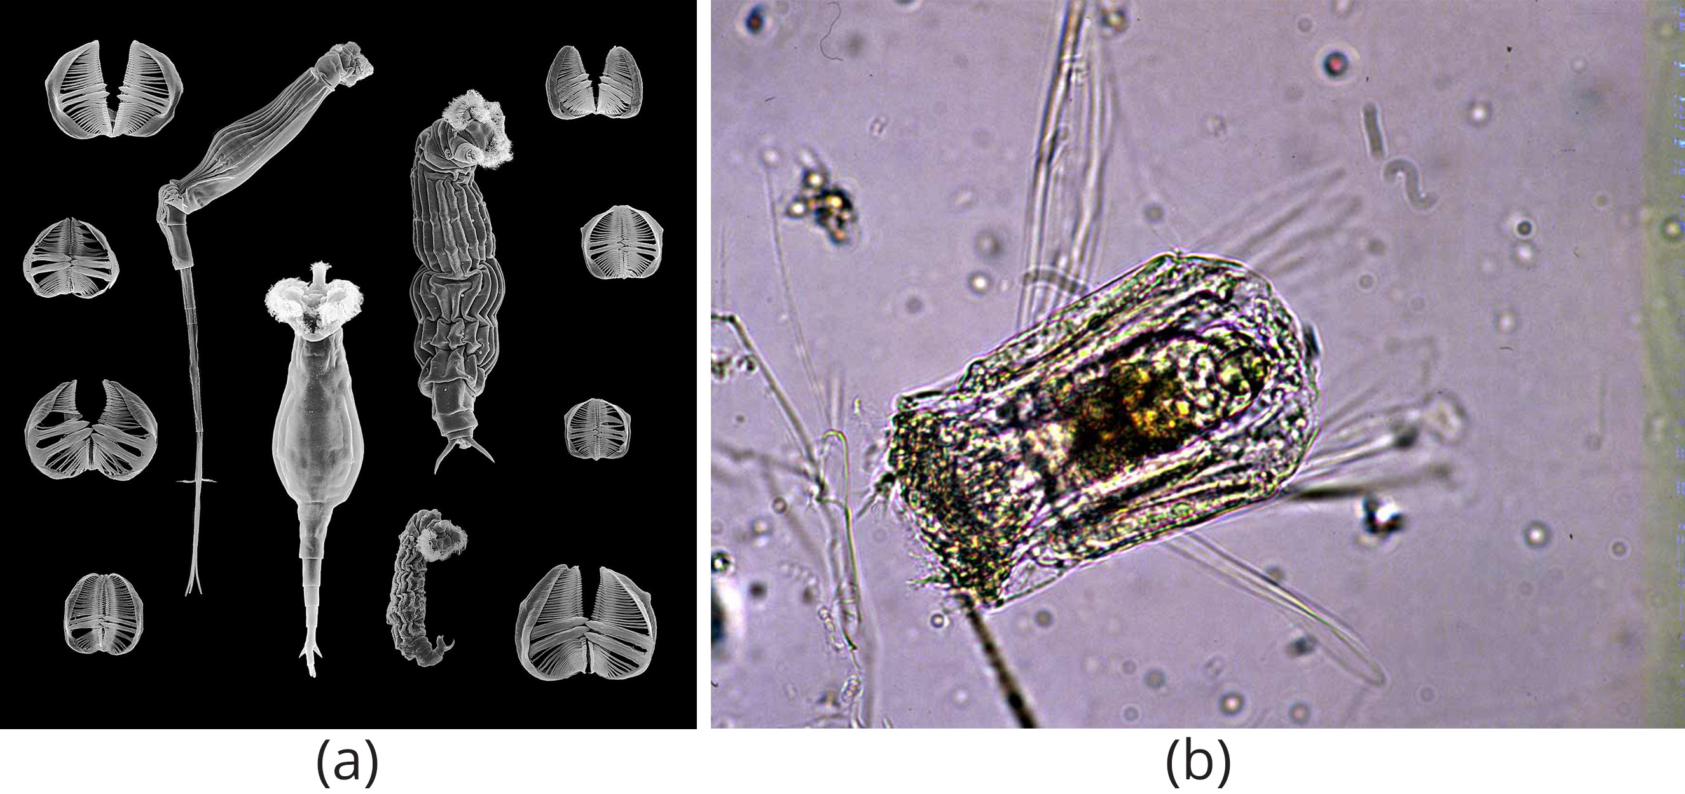
Phylum Rotifera₁
Rotifers ("wheel-bearer") belong to group of microscopic (100 μm to 2 mm), mostly aquatic animals
Get name from corona
Corona: wheel-like structure on the anterior portion of the rotifer that contains cilia and moves food and water toward the mouth
Taxonomic status in flux, but some place rotifers in three classes: Bdelloidea, Monogononta, and Seisonidea
Parasitic "spiny-headed worms" in Acanthocephala appear to be modified rotifers
Pseudocoelomate body remarkably complex
28.3 Figure 6: Shown are examples from two of the three classes of rotifer. (a) Species from the class Bdelloidea are characterized by a large corona. (b) Polyarthra, from the largest rotifer class Monogononta, has a smaller corona than bdelloid rotifers and a single gonad.
Diego Fontaneto on Wikimedia Commons. "Species from the class Bdelloidea."
EPA on Wikimedia Commons. "Polyarthra."

Slide 26
Phylum Rotifera₂
Small animals (roughly size of Paramecium) divided into three sections: head (which contains corona), trunk (which contains most internal organs), and foot
Cuticle (rigid in some species and flexible in others) covers body surface
Have skeletal muscles associated with locomotion and visceral muscles associated with gut (both composed of single cells)
Typically free-swimming or planktonic (drifting)
Toes or extensions of foot can secrete sticky material to help adhere to surfaces
Head contains several eyespots and bilobed "brain," with nerves extending into body

Slide 27
Phylum Rotifera₃
Commonly found in freshwater and some saltwater environments
Filter feeders that eat dead material, algae, and other microscopic living organisms
Very important to aquatic food webs
Food directed toward mouth by current created from movement of coronal cilia
Food enters mouth and travels to mastax
Mastax: jawed pharynx unique to the rotifers
Masticated food passes near digestive and salivary glands, into stomach, and then to intestines
Digestive and excretory wastes collected in cloacal bladder before being released out of anus

Slide 28
Phylum Rotifera₄
About 2,200 species identified
Some are dioecious and exhibit sexual dimorphism (males and females having different forms)
Males are short-lived and smaller with no digestive system and single testis
Eggs capable of extended dormancy for protection during harsh environmental conditions
Exhibit haplodiploidy (method of sex determination in which fertilized egg develops into female, and unfertilized egg develops into male)
Reproduction in bdelloid rotifers exclusively parthenogenetic (takes place without fertilization) and appears to have been so for millions of years
Making all bdelloid rotifers and progeny female
Compensate for genetic insularity by borrowing genes from DNA of other species
10% of bdelloid genome comprises genes imported from related species

Slide 29
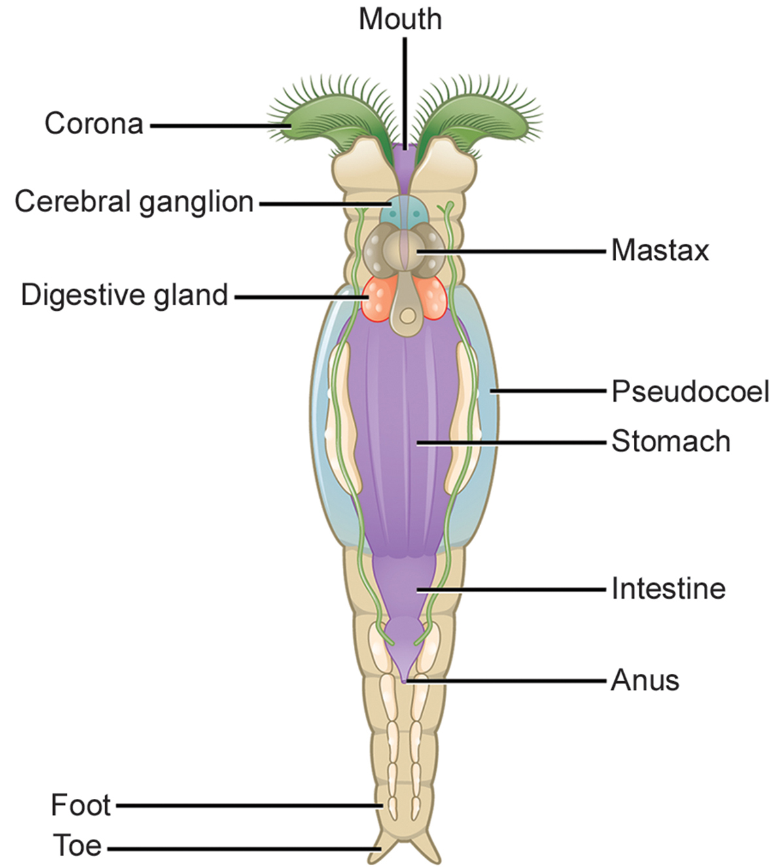
28.3 Figure 7
CNX OpenStax on Wikimedia Commons. "Anatomy of bdelloid rotifer."
Notes:
Figure 7: This illustration shows the anatomy of a bdelloid rotifer.

Slide 30
Group Activity₂
Investigate the different jaw shapes of rotifers. As a group, research how the different shapes help different species of rotifers obtain the food they need.

Slide 31
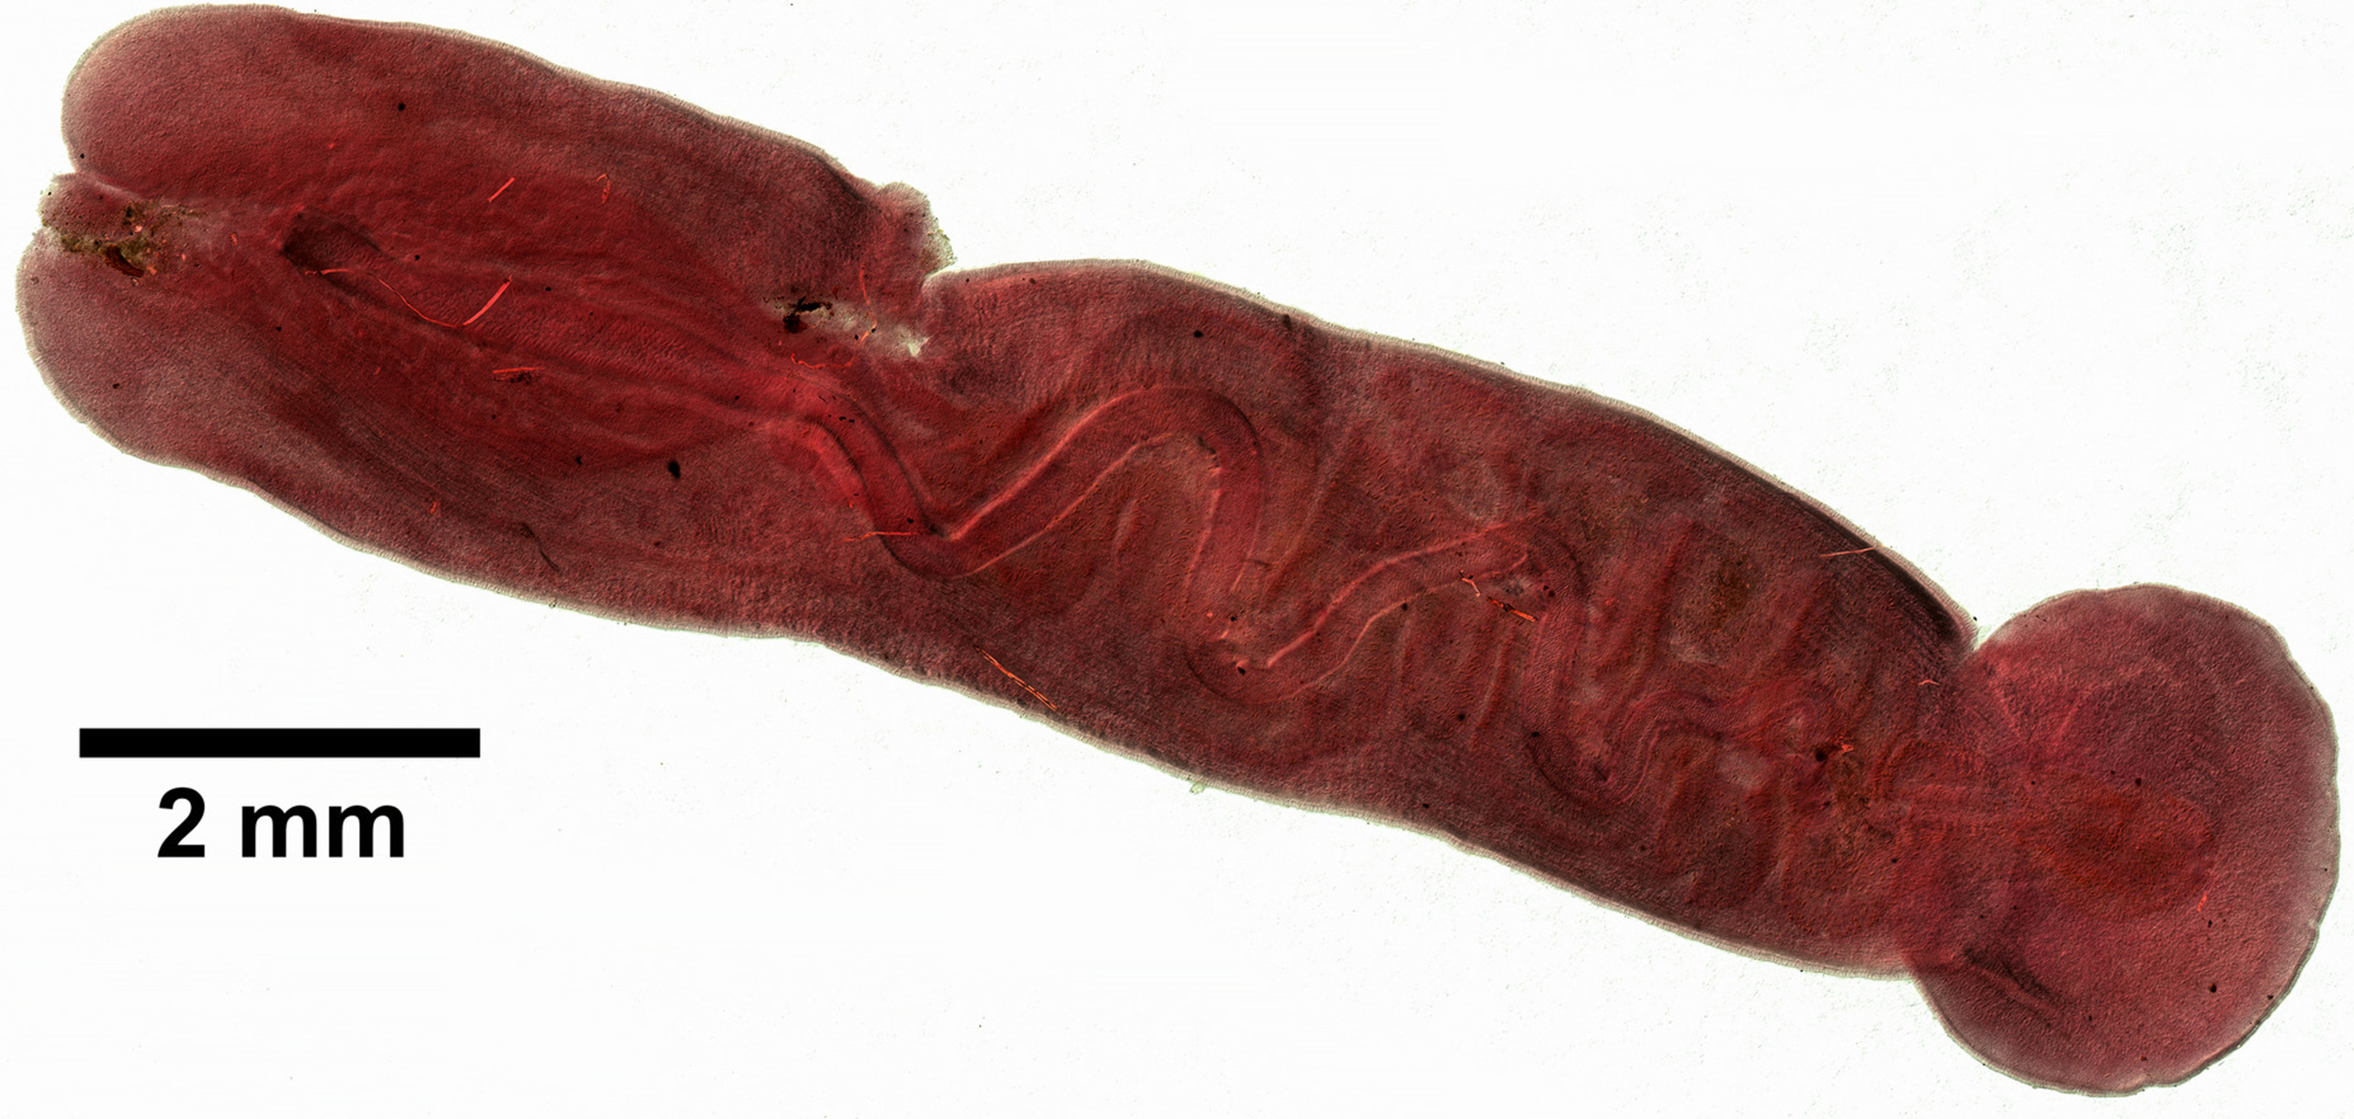
Phylum Nemertea
Nemertea: phylum of dorsoventrally flattened protostomes known as ribbon worms or proboscis worms
Mostly marine and predominately benthic (bottom dwellers)
900 known species
Have been recorded in freshwater and very damp terrestrial habitats
Carnivores, feeding on worms, clams, and crustaceans
Some are scavengers
Some (e.g., Malacobdella grossa) evolved commensal relationships, in which one organism benefits and other is unaffected, with mollusks
Some species have devasted commercial fishing of clams and crabs
Have almost no predators
Two species sold as fish bait
28.3 Figure 8: Malacobdella grossa are nemerteans that have developed commensal relationships with certain mollusks.
Eric A. Lazo-Wasem on Wikimedia Commons. "Malacobdella grossa."

Slide 32
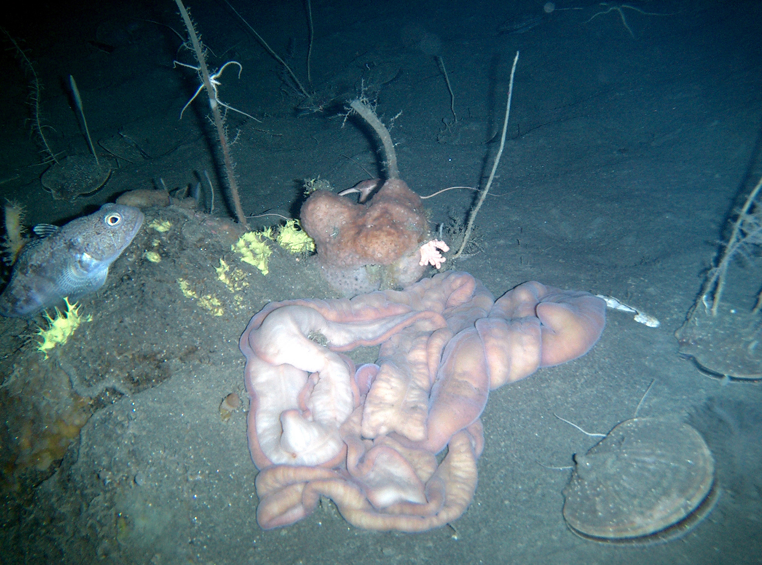
Morphology₁
Size ranges from 1 cm to several meters
Show bilateral symmetry
Remarkable contractile properties
Can change morphological presentation in response to environmental cues
Soft and unsegmented bodies, with morphology like flattened tube
28.3 Figure 9: The proboscis worm (Parborlasia corrugatus) is a scavenger that combs the sea floor for food. The species is a member of the phylum Nemertea. The specimen shown here was photographed in the Ross Sea, Antarctica.
Henry Kaiser, National Science Foundation on Wikimedia Commons. "Proboscis worm."

Slide 33
Morphology₂
Unique characteristic is presence of eversible (able to be turned inside out) proboscis enclosed in rhynchocoel
Rhynchocoel: cavity present above the mouth that houses the proboscis
Fluid-filled and extends from head to nearly two-thirds of length of gut
Proboscis located dorsal to gut but can be pushed out of body to serve as harpoon or tentacle for food capture
Has barbs in some species
May be extended by hydrostatic pressure generated by contraction of muscle of rhynchocoel and retracted by retractor muscle attached to rear wall of rhynchocoel

Slide 34
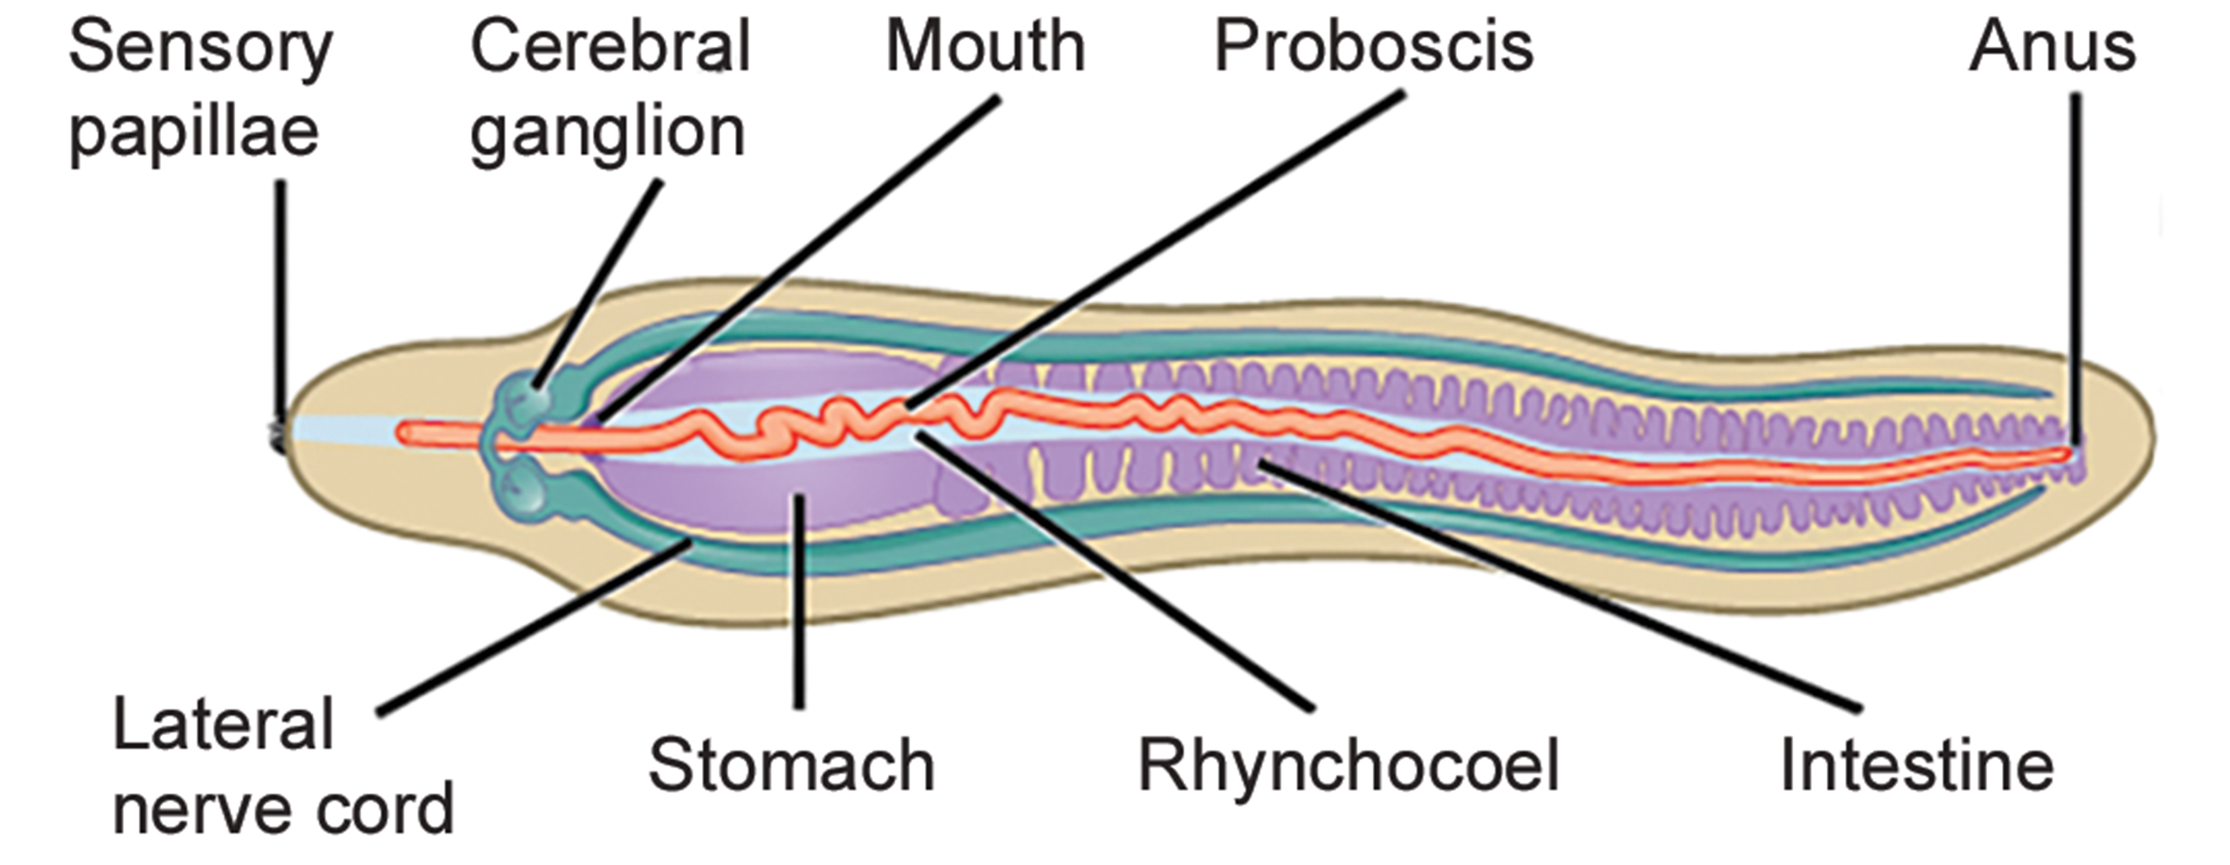
28.3 Figure 10
CNX OpenStax on Wikimedia Commons. "Anatomy of nemertean."
Notes:
Figure 10: The anatomy of a nemertean is shown.

Slide 35
Digestive System₁
Primarily predators of annelids (segmented worms) and crustaceans (e.g., crabs)
Have a well-developed digestive system
Mouth opening (ventral to rhynchocoel) leads to foregut then intestine
Intestine takes form of diverticular pouches and ends in rectum that opens with anus
Gonads interspersed with intestinal diverticular pouches and open outward via genital pores
Once classified as acoelomates (animals without body cavity), but rhynchocoels and closed circulatory systems now recognized as true mesodermally derived coeloms, making them coelomates

Slide 36
Digestive System₂
Circulatory system consists of closed loop formed by connected pair of lateral blood vessels
Some may also have dorsal vessel or cross-connecting vessels as well
Circulatory fluid contains cells but often colorless
Blood cells of some species have hemoglobin (iron-containing protein that transports oxygen) and yellow or green pigments
Blood vessels are contractile, but no regular circulatory pathway; movement in blood facilitated by contraction of muscles in body wall
Circulation of fluids in rhynchocoel largely independent of blood circulation although blind branches from blood vessels into rhynchocoel wall can mediate exchange of materials between them
Pair of protonephridia present to facilitate osmoregulation
Protonephridia: excretory cell found in flatworms (also, flame cell)
Gaseous exchange occurs through skin

Slide 37
Nervous System
Have "brain" composed of four ganglia at anterior end around rhynchocoel
Paired longitudinal nerve cords emerge from brain ganglia and extend to posterior end
Additional nerve cords in some species
Brain can contain hemoglobin, which acts as oxygen reserve
Ocelli (eyespots) present in pairs in multiples of two in anterior portion of body
Speculated that eyespots originate from neural tissue and not from epidermis

Slide 38
Reproduction
Excellent regeneration abilities
Asexual reproduction by fragmentation seen in some
Most are dioecious, but some freshwater species hermaphroditic
Stem cells that become gametes aggregate within gonads along digestive tract
Eggs and sperm released into water, and fertilization occurs externally
Spiral cleavage and direct development, resulting in planuliform larvae
Planuliform: larval form found in phylum Nemertea
Some have trochophore-like larva called pilidium (young worm constructed from series of imaginal discs that begin as invaginations from body surface of larva)
Pilidium: larval form found in some nemertine species

Slide 39
Group Activity₃
Break up into groups of three. Each member of the team is required to present on one of the three phyla we have focused on. Write down two unique traits and two examples of the phylum you are working on. Rejoin your group and take turns presenting your information to your team members.

Slide 40
Think It Through
You come across an unknown organism in fresh water that is approximately 2 feet long. It has an elongated tubelike body that is soft to the touch. You notice that it has a long protrusion that it is using to collect its food, which is mostly tiny shrimp and crayfish.
Based on this description, which Lophotrocozoan phylum does this unknown organism belong to?
Notes:
Originally an On Your Own. This is included here to use as a talking point or for a think-pair-share activity.

Slide 41
Summary₁
Describes three phyla of simple invertebrates:
Flatworms:
Acoelomate, triploblastic
Lack circulatory and respiratory systems
Have rudimentary excretory system
Incomplete digestive system in most; absent in tapeworms
Four groups: largely free-living turbellarians (e.g., polycladid marine worms and tricladid freshwater species), ectoparasitic monogeneans, and endoparasitic trematodes and cestodes
Trematodes have complex life cycles involving molluscan secondary host and primary host in which sexual reproduction takes place
Cestodes (tapeworms) infect digestive system of primary vertebrate hosts

Slide 42
Summary₂
Rotifers:
Microscopic and multicellular
Mostly aquatic
Currently under taxonomic revision
Characterized by ciliated, wheel-like corona located on head
Food collected by corona passed to another structure unique to this group: Mastax (jawed pharynx)
Nemerteans:
Simple eucoelomates
Ribbon-shaped and bear specialized proboscis enclosed in rhynchocoel
Unique characteristic: Development of closed circulatory system derived from coelom
Alimentary, nervous, and excretory systems more developed than other phyla
Embryonic development proceeds via planuliform, or trochophore-like, larval stage

Slide 43

End of Hawkes Learning PowerPoint

