Slide 1
Lesson 28.4
Mollusks and Annelids (Superphylum Lophotrochozoa)

Slide 2
Objectives
Describe the formation of the coelom.
Describe the features of animals classified in phylum Annelida.
Describe the major body regions of Mollusca and how they vary in different molluscan classes.
Describe the unique anatomical and morphological features of mollusks and annelids.
Discuss the advantages of true body segmentation.

Slide 3
Mollusks and Annelids
(Superphylum Lophotrochozoa)₁
Annelids and mollusks are the most typical lophotrochozoans.
Both have free-swimming larvae with wo bands of cilia surrounding a top-like body.
Mollusca has the second greatest number of species of all animal phyla (25% of all marine species).

Slide 4
Mollusks and Annelids
(Superphylum Lophotrochozoa)₂
Annelids and mollusks are both:
Bilateral symmetrical: able to be divided longitudinally into two superficially identical left and right halves
Cephalized: having sensory and neural organs concentrated in an anterior head
Triploblastic: having a body derived from three embryonic germ layers (the endoderm, mesoderm, and ectoderm)
Schizocoelous: having coeloms (body cavities) formed by the splitting of a solid mass of embryonic mesodermal tissue
Eucoelomate: an organism with a true coelom (body cavity) completely lined by mesodermal tissue

Slide 5
Phylum Mollusca₁
Mollusca means "soft" body.
Predominantly a marine group of animals, but also found in freshwater and terrestrial environments.
Chief locomotor structure is the muscular foot.
Most internal organs are in the visceral mass which is covered by the mantle.
The gills are folded over the visceral mass.
Most mollusks (except bivalves) contain a radula, an abrasive feeding structure.
The mantle secretes a calcium carbonate shell.

Slide 6
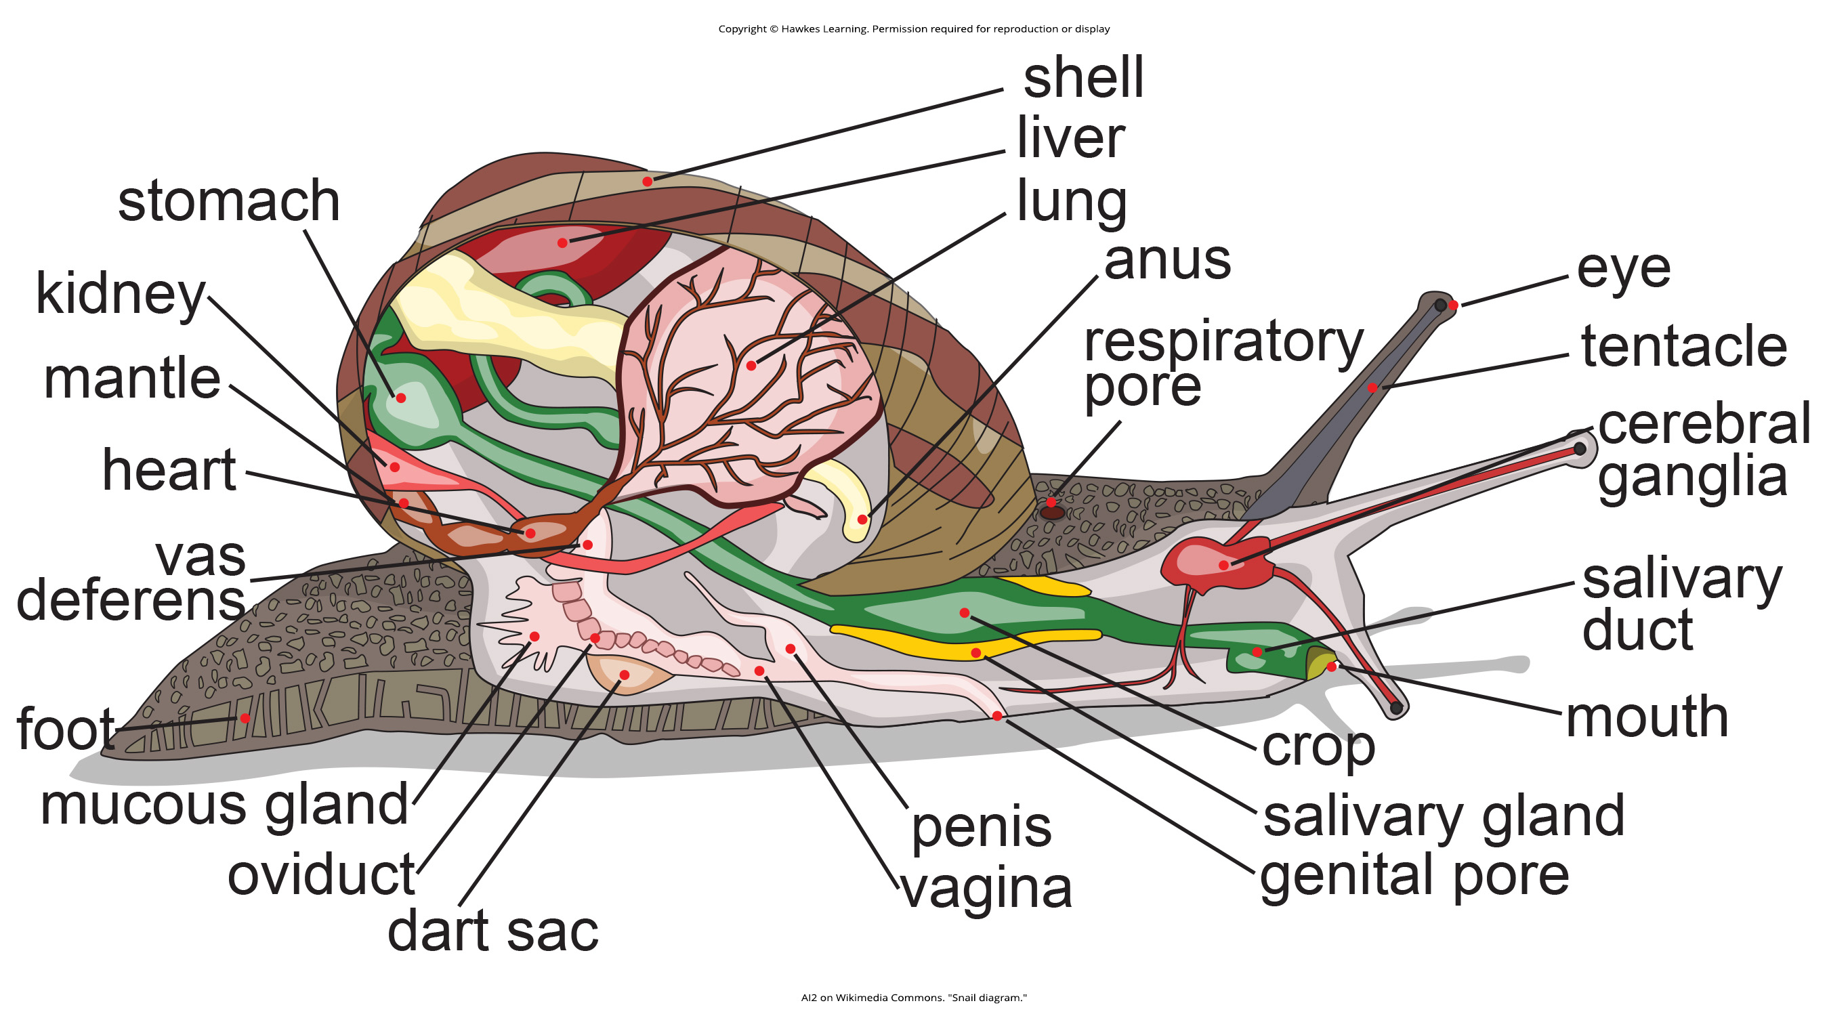
28.4 Figure 1
AI2 on Wikimedia Commons. "Snail diagram."
Notes:
There are many species and variations of mollusks; this illustration shows the anatomy of an aquatic gastropod. In a terrestrial gastropod, the mantle cavity itself would serve as a respiratory organ. The visceral mass is the region that contains the internal organs.

Slide 7
Phylum Mollusca₂
The muscular foot is used for locomotion and anchorage.
Foot is usually the same size as the opening of the shell in shelled mollusks.
Foot is both retractable and extendable.
The visceral mass contains digestive, nervous, excretory, reproductive, and respiratory systems.
Aquatic species have gills and terrestrial species have lungs.
A reduced coelom surrounds the gonads, kidneys, and intestines, making the mantle cavity the major internal body chamber.

Slide 8
Phylum Mollusca₃
Most mollusks have a special rasp-like organ, the radula, which bears chitinous, file-like teeth.
  Shreds or scrapes food before it enters the digestive tract.
The mantle, or pallium, is the dorsal epidermis that secretes a calcareous shell to protect the animal.
Most are dioecious (have either male or female reproductive organs.
  External fertilization (other than terrestrial mollusks)
  Aquatic mollusks produce trochophore larva, which can be followed by additional larval stages such as veliger larva.

Slide 9
Think It Through
For each function, provide the mollusk structure that is described.
Used to shred or scrape food before ingestion
Used for locomotion and anchorage
Contains digestive, nervous, excretory, reproductive, and respiratory systems
Notes:
Originally an On Your Own. This is included here to use as a talking point or for a think-pair-share activity.

Slide 10
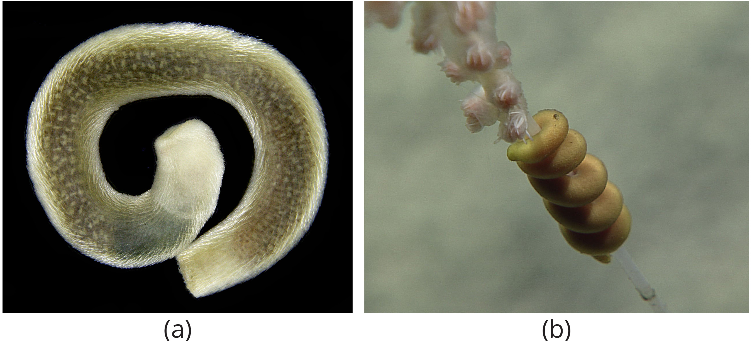
Classification of the Phylum Mollusca₁
The phylum Mollusca is highly diverse, ranging from chitons to intelligent squids, with variations primarily in foot and mantle modifications.
Mollusca is divided into eight classes: Caudofoveata, Solenogastres, Monoplacophora, Polyplacophora, Gastropoda, Cephalopoda, Bivalvia, and Scaphopoda.
Caudofoveata and Solenogastres are shell-less, worm-like marine mollusks with calcareous spicules in their cuticle for protection.
  These two groups lack eyes, tentacles, and nephridia, with Caudofoveata having a radula but no foot, and Solenogastres lacking a radula and gills but having a reduced foot.
28.4 Figure 2: (a) Scutopus robustus, a member of Caudofoveata, (b) Epimenia, a member of Solenogastres.
Elena Gerasimova on Wikimedia Commons. "Scutopus robustus."
NOAA on Wikimedia Commons. "Epimenia."

Slide 11
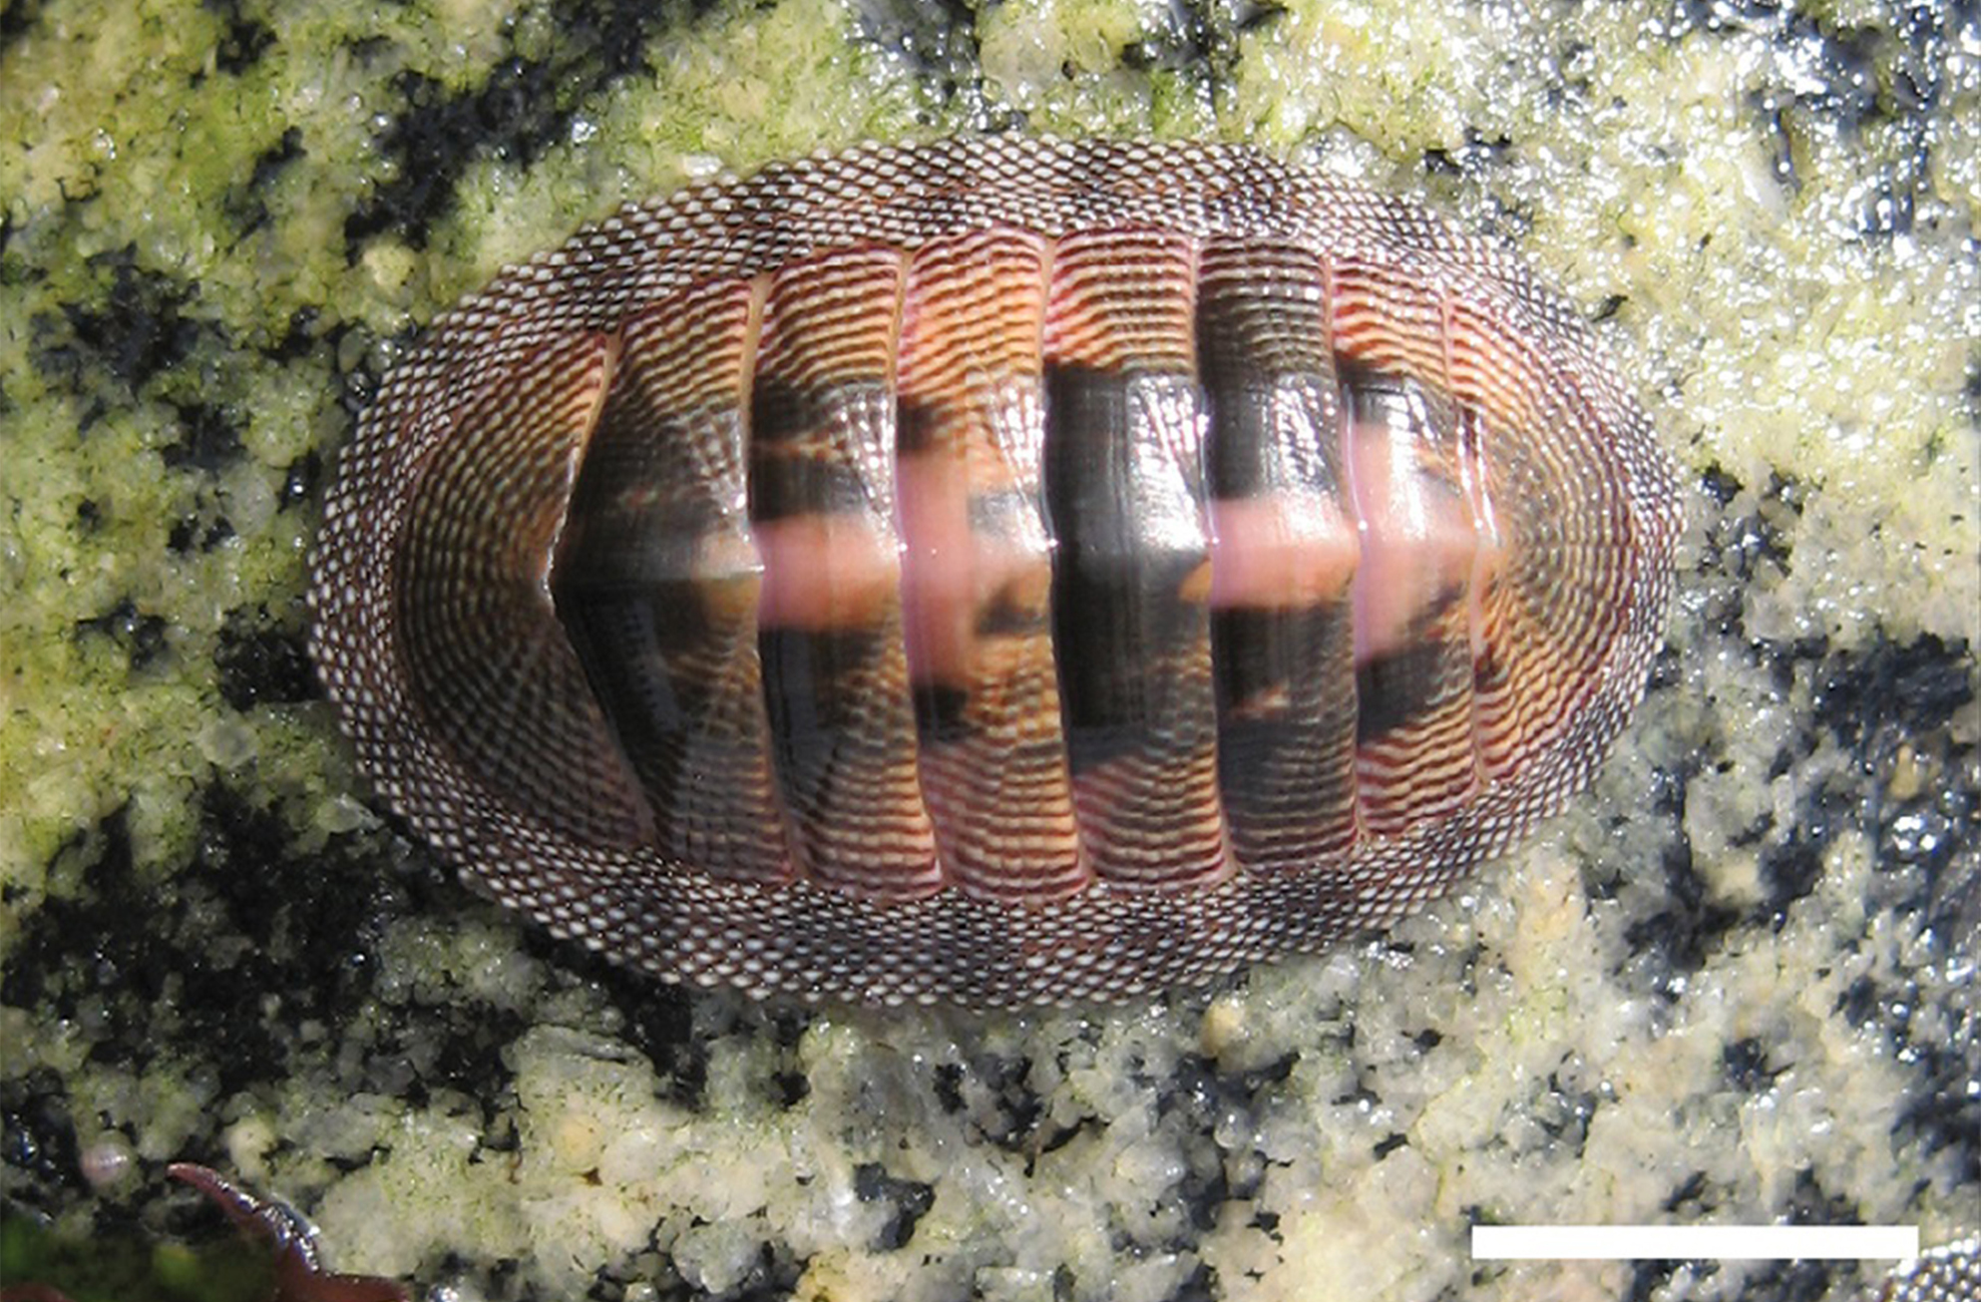
Classification of the Phylum Mollusca₂
Monoplacophora have a simple radula, looped digestive system, multiple excretory organs, paired gonads, and multiple gills between the foot and mantle edge.
Polyplacophora, or chitons, have eight limy dorsal plates, a broad ventral foot for suction, and a mantle extending beyond the shell with protective calcareous spines.
Chitons have multiple gill pairs, an open circulatory system (hemocoel), and a radula with ultra-hard magnetite teeth for scraping food off rocks.
The nervous system of chitons is rudimentary, with buccal ganglia and unique sensory structures called esthetes in the shell, plus a chemoreceptive subradular organ under the radula.
28.4 Figure 3: Chiton
Juan Francisco Araya, Marta Esther Araya on Wikimedia Commons. "Polyplacophora."

Slide 12
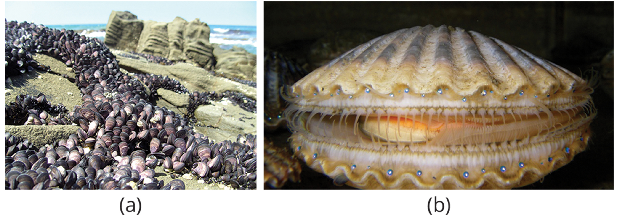
Bivalves₁
Bivalves are two-shelled mollusks found in marine and freshwater habitats, with shells joined by hinge ligaments and teeth, composed of three layers.
Bivalves have a laterally flattened body, wedge-shaped foot, and poorly developed head region, lacking a radula as they are filter-feeders.
Water circulation in bivalves occurs through incurrent and excurrent siphons, with ctenidia (gills) capturing food particles and moving them to the mouth via cilia.
Bivalves have various sensory structures along the mantle edge, including eyespots in some species like scallops.
28.4 Figure 4: (a) These mussels, found in intertidal zones, show the bivalve shell. (b) The scallop Argopecten irradians has a fluted shell and conspicuous eyespots.
Ian Sutton on Wikimedia Commons. "Mussels."
Rachael Norris and Marina Freudzon on Wikimedia Commons. "Scallop."

Slide 13
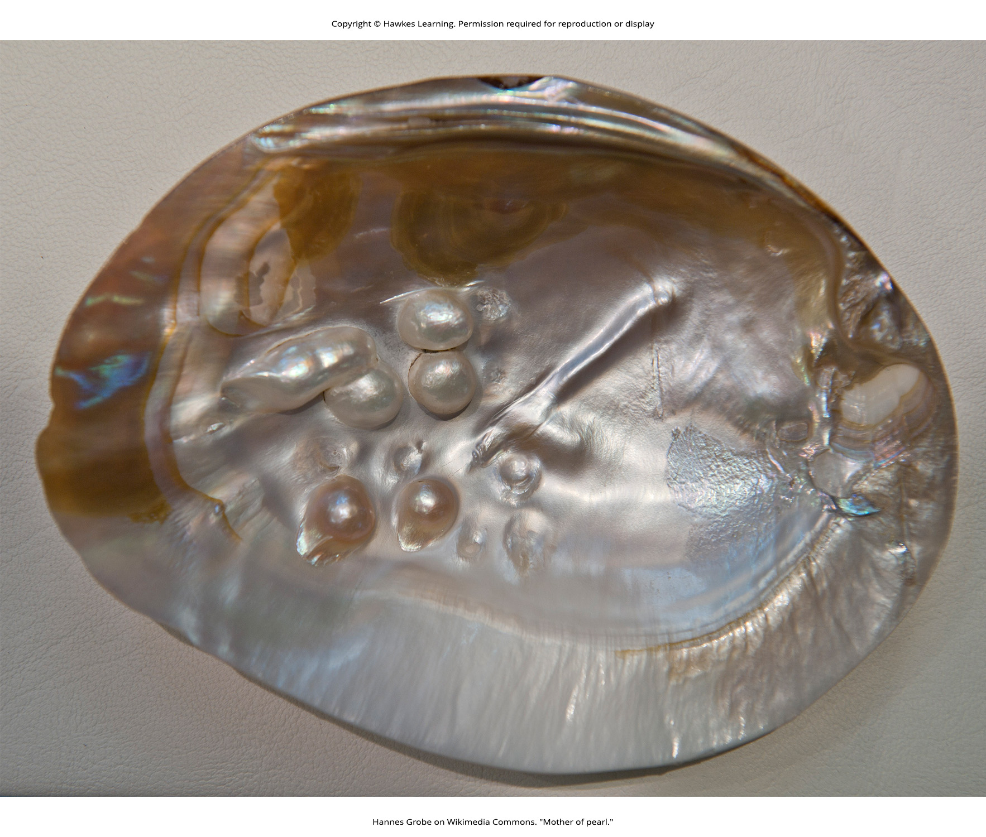
Bivalves₂
Some bivalves, like oysters and mussels, possess the unique ability to secrete and deposit a calcareous nacre or "mother of pearl" around foreign particles that may enter the mantle cavity.
28.4 Figure 5
Hannes Grobe on Wikimedia Commons. "Mother of pearl."

Slide 14
Science and You₁
The ability of some bivalves to secrete excess nacre ("mother of pearl") is used prominently in the jewelry industry.
A small shell bead is surgically implanted into a pearl oyster to serve as the nucleus, or center, of the pearl.
Over time, layer after layer of nacre is secreted onto the surface of the bead and a cultured pearl is formed.
Notes:
This is included as a relevant application for this topic.

Slide 15
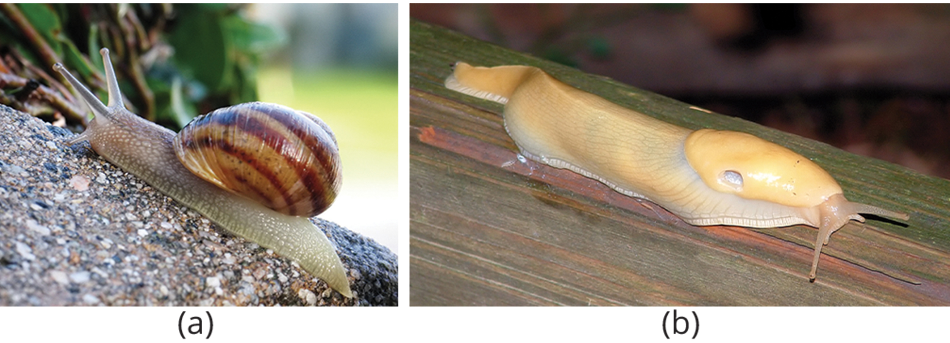
Gastropoda₁
More than half of Mollusks are Gastropoda.
May or may not have a shell
  Usually an asymmetrical, coiled shell
  May be planospiral: like a garden hose wound up or conispiral: like a spiral staircase
28.4 Figure 6: (a) Snails and (b) slugs are both gastropods, but slugs lack a shell.
macrophile on Wikimedia Commons. "Snail."
Paul Harrison on Wikimedia Commons. "Banana slug."

Slide 16
Gastropoda₂
A key characteristic of some gastropods is the embryonic development of torsion, where the mantle and visceral mass are rotated around the perpendicular axis over the center.
Switches which side some organs are on
Allows room for the head to reside in the shell and the foot or operculum to protect the shell opening
Potential problem of waste backwashing over the gills, causing fouling
In land gastropods, the mantle acts as a lung and nephridia (kidneys) are found in the mantle cavity.

Slide 17
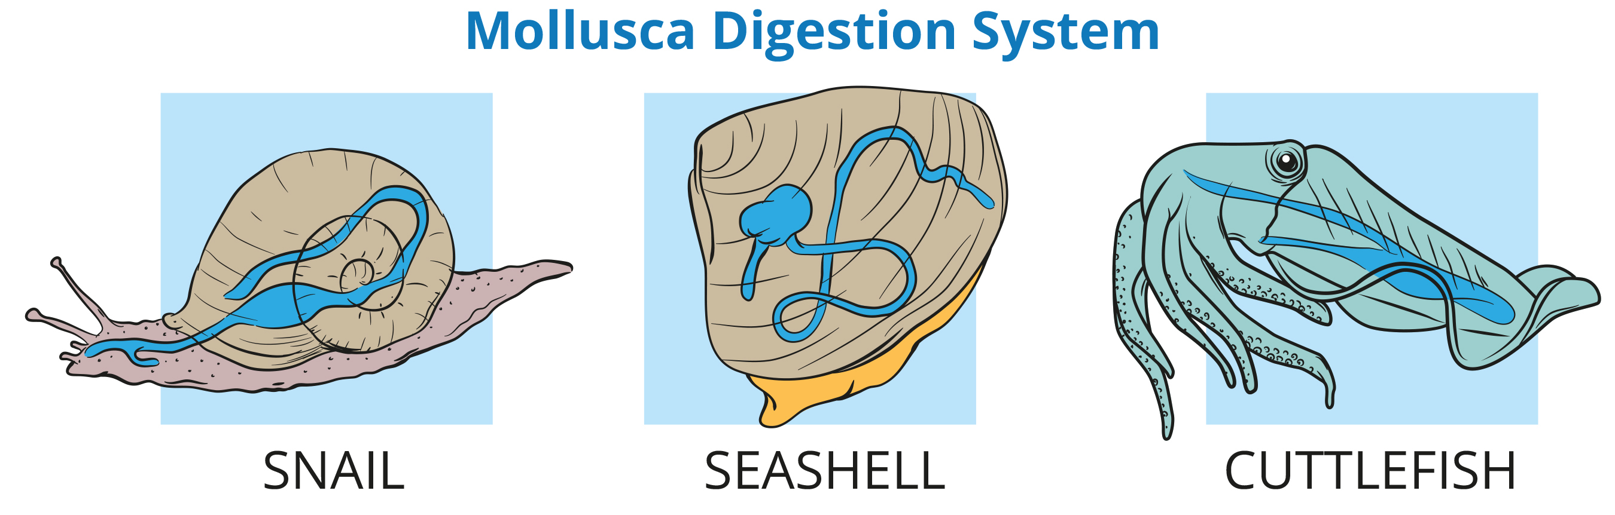
28.4 Figure 7
Notes:
Figure 7: During embryonic development of some gastropods, the visceral mass undergoes torsion, or counterclockwise rotation of the visceral anatomical features. As a result, the anus of the adult animal is located over the head. Although torsion is always counterclockwise, the shell may coil in either direction; thus, coiling of a shell is not the same as torsion of the visceral mass.

Slide 18
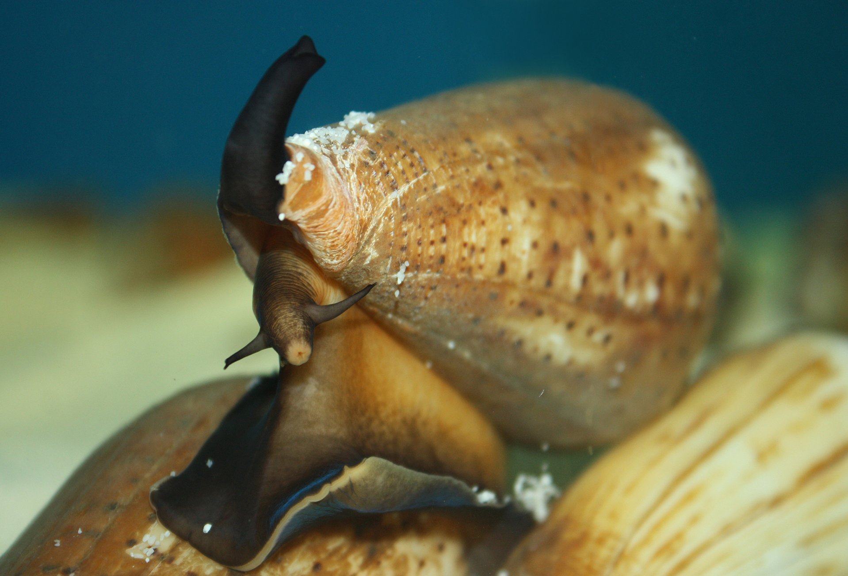
Science and You₂
Can Snail Venom Be Used as a Pharmacological Painkiller?
Marine snails of the genus Conus use a venomous stinger to attack prey, injecting a peptide toxin called conotoxin.
Conotoxins can cause paralysis in humans by targeting the nervous system, specifically by blocking neuronal ion channels.
Researchers are studying conotoxins for potential medical applications due to their ability to inhibit specific neuronal activity.
Current research focuses on using conotoxins or their modifications to treat neurological diseases and relieve chronic pain conditions.
The study of biotoxins like conotoxins exemplifies how biological science can be applied to modern medicine, though research is still in early stages.
28.4 Figure 8
Pengchao-BGI on Wikimedia Commons. "Chinese tubular cone snail."
Notes:
This is included as a relevant application for this topic.

Slide 19
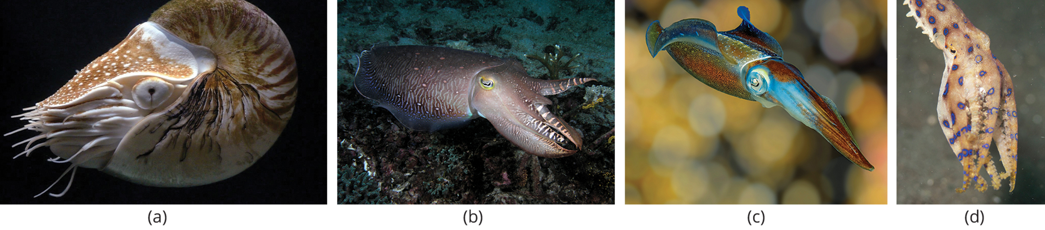
Cephalopods₁
Cephalopods include octopuses, squids, cuttlefish, and nautiluses, with some having external shells (like Nautilus) and others having reduced internal shells or no shells.
They can display rapid color changes using:
  Chromatophores: special pigment cells that expand or contract to produce different color patterns in yellow, red, brown, and black
  Contain iridophores and leucophores beneath them that reflect light and can make blue, green, and white
28.4 Figure 9: The (a) nautilus, (b) giant cuttlefish, (c) reef squid, and (d) blue-ring octopus are all cephalopods.
Hans Hillewaert on Wikimedia Commons. "Nautilus."
Nick Hobgood on Wikimedia Commons. "Cuttlefish."
Betty Wills on Wikimedia Commons. "Caribbean reef squid."
Elias Levy on Wikimedia Commons. "Blue-ringed octopus."

Slide 20
Reflection Question
What benefit would a squid have if it could detect light via its skin?
Notes:
The reflection question is included here to use as a talking point or for a think-pair-share activity.

Slide 21
Cephalopods₂
All cephalopods are carnivorous predators with beak-like jaws and radulae, and they are considered the most intelligent mollusks with well-developed nervous systems and image-forming eyes.
They have a closed circulatory system, with blood contained entirely in vessels.
Their foot is modified into arms and tentacles, often with suckers, and they use water expulsion through siphons as their primary mode of locomotion.
Many cephalopods produce ink for defense, which can be used as a "smoke screen" or to create distracting fake images.

Slide 22
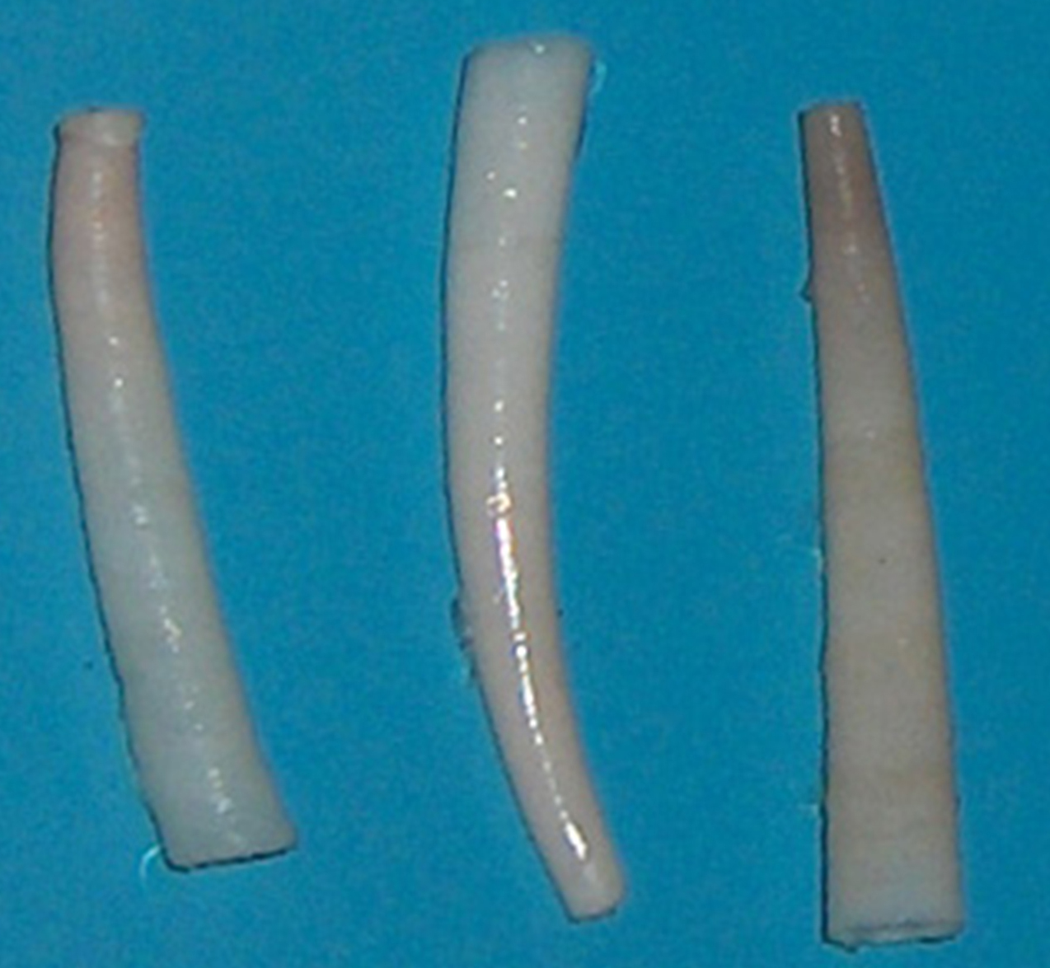
Cephalopods₃
Cephalopods are dioecious; females lay eggs in protected areas and sometimes providing extended care.
Unlike most aquatic mollusks, cephalopod eggs develop directly into juveniles without a larval stage.
Scaphopods, or "tusk shells," have a poorly developed head with a radula-containing mouth surrounded by tentacles, a foot similar to bivalves, and use their mantle cavity for respiration.
28.4 Figure 10: Antalis vulgaris shows the classic Dentaliidae shape that gives these animals their common name of "tusk shell."
Georges Jansoone on Wikimedia Commons. "Tusk shell."

Slide 23
Phylum Annelida
Phylum Annelida comprises the true, segmented worms, which can be fond in marine, terrestrial, and freshwater habitats.
Also known as "segmented worms" due to their key characteristic of metamerism, or true segmentation.
Over 22,000 species including:
  Polychaetes: marine annelids with multiple appendages
  Oligochaetes: earthworms and leeches

Slide 24
Annelid Morphology₁
Annelids display bilateral symmetry and are wormlike in overall morphology.
Have metameric segmentation where several internal and external morphological features are repeated in each body segment
Overall body can be divided into head, body, and pygidium (tail).
During development the segments arise in a pattern called teloblastic growth.
In oligochaetes the clitellum is a reproductive structure that generates mucus to aid sperm transfer.

Slide 25
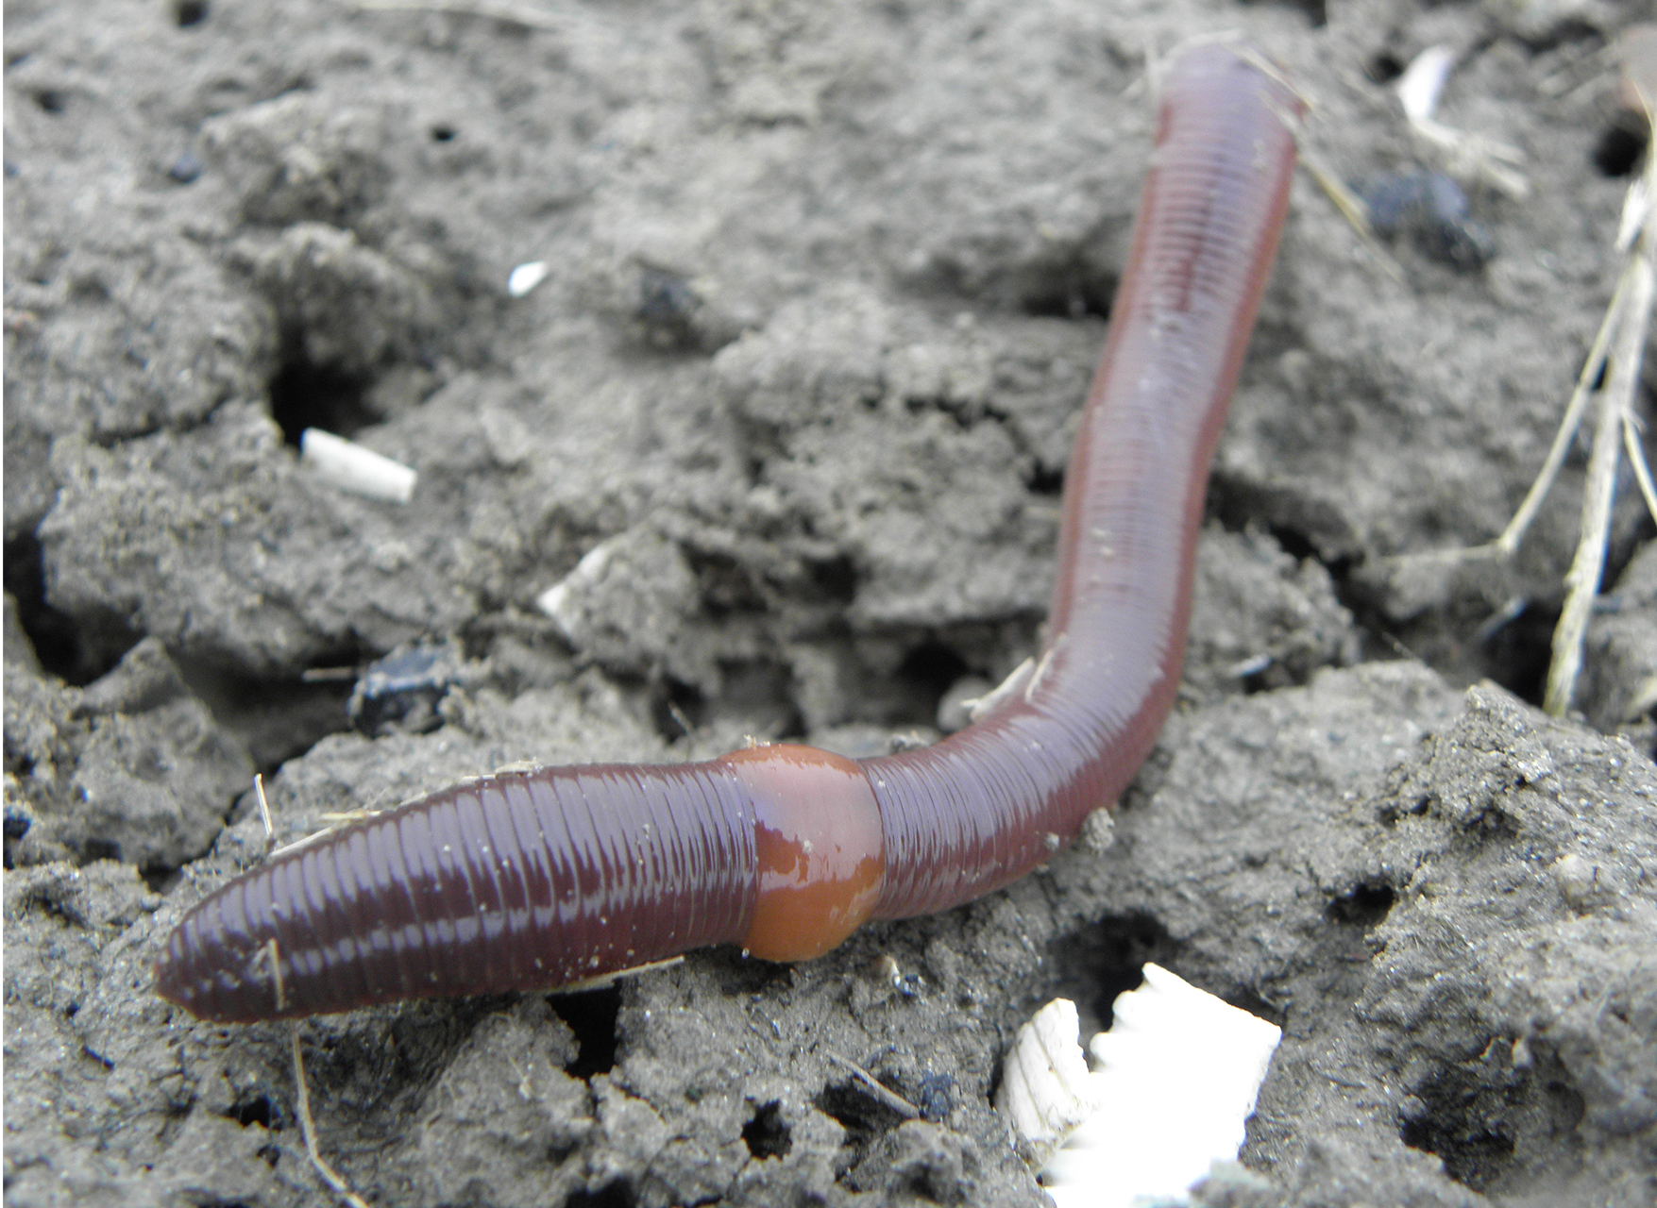
Annelid Morphology₂
In oligochaetes the clitellum is a reproductive structure that generates mucus to aid sperm transfer and produces a cocoon within which fertilization occurs.
28.4 Figure 11
Rob Hille on Wikimedia Commons. "Earthworm."

Slide 26
Annelid Anatomy₁
Annelids have a thin, collagenous external cuticle over their epidermis, with circular and longitudinal muscles underneath, and chitinous bristles (setae) anchored in the epidermis.
  In polychaete worms the setae are paired appendages called parapodia.
Feeding mechanisms vary widely, from filter-feeding polychaetes to soil-ingesting earthworms and blood-feeding leeches.
Most have a well-developed digestive system, with earthworms having a complex tract.

Slide 27
Annelid Anatomy₂
Most have a closed circulatory system with dorsal and ventral blood vessels, though some polychaetes and leeches have an open system.
  Many species have extracellular hemoglobin in their blood for oxygen transport.
Gas exchange occurs across the moist body surface, with polychaetes using vascular parapodia as respiratory structures.
Excretion is facilitated by metanephridia in each segment, and annelids have a well-developed nervous system with a ventral nerve cord and segmental ganglia.

Slide 28
Annelid Anatomy₃
Annelids can be monoecious (earthworms, leeches) or dioecious (polychaetes), with various reproductive strategies including cross-fertilization and sex changes.
Polychaetes typically have external fertilization and indirect development with a trochophore larva.
Oligochaetes have internal fertilization and direct development; polychaetes can also reproduce asexually.

Slide 29
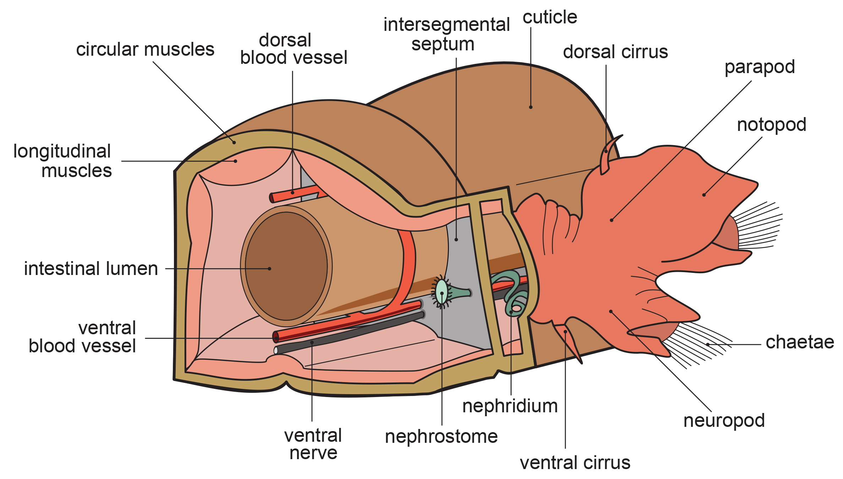
28.4 Figure 12
Hans Hillewaert on Wikimedia Commons. "Annelid anatomy."
Notes:
Figure 12: This schematic drawing shows the basic anatomy of annelids in a cross-sectional view.

Slide 30
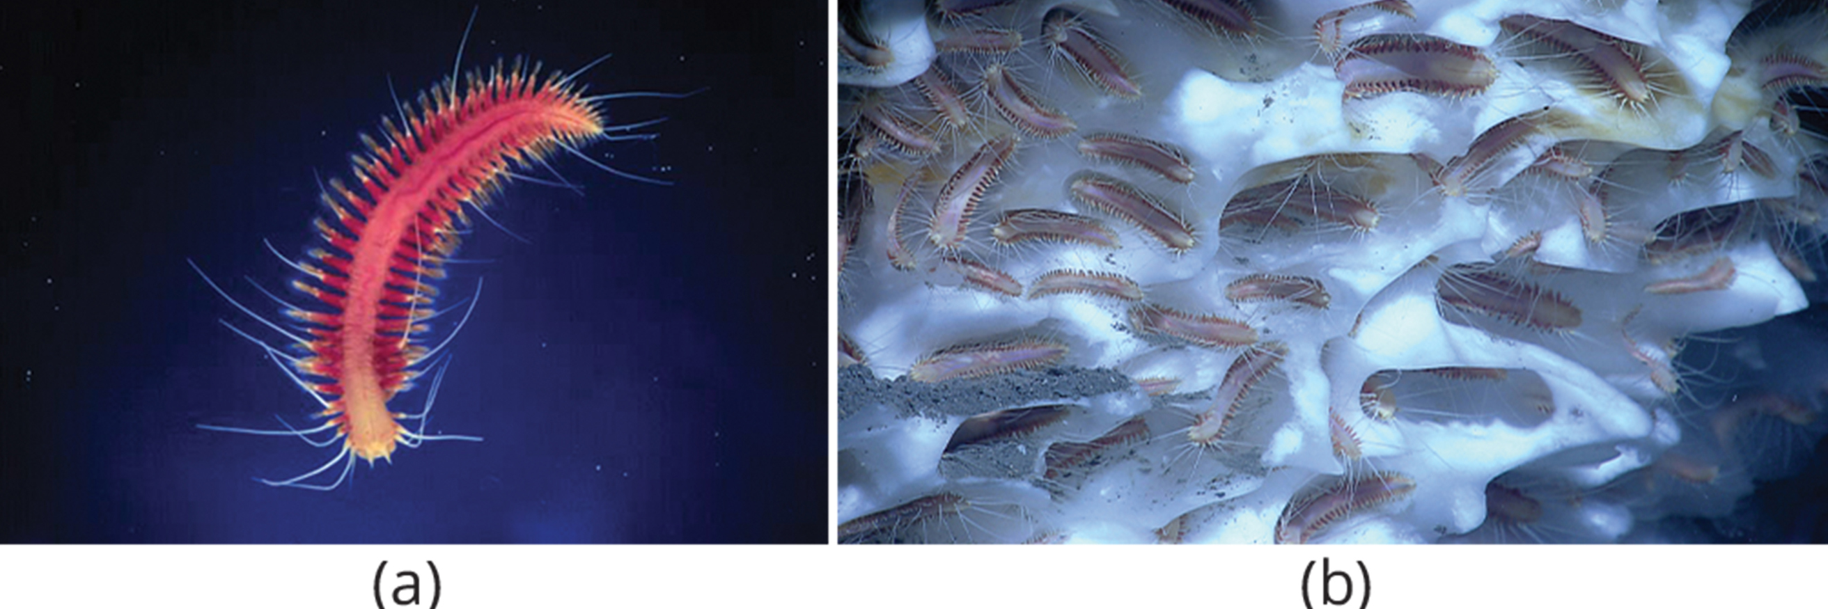
Classification of the Phylum Annelida₁
Over half of the 22,000 annelid species are marine polychaetes ("many bristles").
Chaetae are arranged in clusters on their parapodia (fleshy, flat, paired appendages).
Often use to crawl on the sea floor, swim, or float.
Deepwater, hydrothermal vent polychaetes have no digestive tract but a symbiotic relationship with bacteria.
28.4 Figure 13: (a) The marine polychaete Sirsoe methanicola, the methane ice worm, (b) forms colonies in frozen methane deposits deep below the ocean's surface.
NOAA on Wikimedia Commons. "Methane ice worm."
NOAA on Wikimedia Commons. "Frozen methane deposits on methane ice worms."

Slide 31
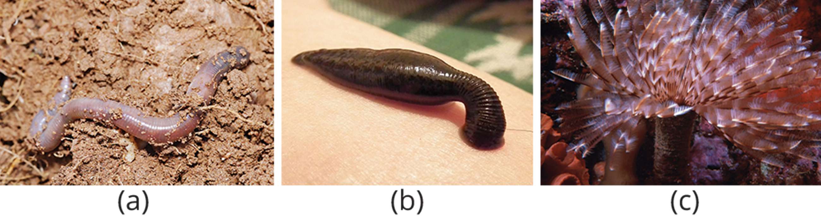
Classification of the Phylum Annelida₂
Earthworms, the most abundant oligochaetes, are characterized by a permanent clitellum and reduced chaetae on each segment, without parapodia.
Leeches have historically been used medicinally to treat circulatory disorders due to their ability to increase blood circulation and break up clots.
Leeches lack setae and have suckers at both ends for attachment to hosts.
The Brachiobdella subclass consists of small, leechlike worms that live on crayfish gills or body surfaces.
28.4 Figure 14: The (a) earthworm, (b) leech, and (c) featherduster are all annelids.
Fir0002/Flagstaffotos on Wikimedia Commons. "Earthworm."
GlebK on Wikimedia Commons. "Sucking leech."
Chris Gotschalk on Wikimedia Commons. "Featherduster worm."

Slide 32
Summary
Phylum Mollusca is a diverse group of protostome invertebrates with seven classes, characterized by a mantle (which secretes a shell in many species) and usually a radula for feeding.
Mollusks have a distinct mantle cavity for respiration (using gills in aquatic species) and a muscular foot adapted for various functions.
Most mollusks have separate sexes and aquatic species often develop through larval stages, including trochophore and veliger larvae.
Phylum Annelida consists of segmented worms with metameric segmentation, well-developed organ systems, and two main groups: polychaetes (with parapodia) and oligochaetes (without parapodia).
Annelids exhibit various reproductive strategies, with oligochaetes having a clitellum for reproduction, and development patterns ranging from indirect (with larval stages in polychaetes) to more direct in oligochaetes.

Slide 33

End of Hawkes Learning PowerPoint

