Slide 1
Lesson 28.5
Nematodes and Tardigrades (Superphylum Ecdysozoa)

Slide 2
Objectives
Describe the features of tardigrades.
Describe the importance of Caenorhabditis elegans in research.
Describe the structural organization of nematodes.

Slide 3
Nematodes and Tardigrades
(Superphylum Ecdysozoa)
Contains two of the most diverse animal phyla:
Nematoda: roundworms
Arthropoda: arthropods
  Most distinguishing feature is the cuticle: a tough but flexible exoskeleton that protects these animals from water loss, predators, and other dangers of the external environment.
The Ecdysozoa is considered monophyletic: a clade consisting of all evolutionary descendants from one common ancestor.
All go through ecdysis—the shedding of an old exoskeleton.

Slide 4
Reflection Question₁
What are some animals that you know of that go through a molting process?
Are there any advantages or disadvantages to having a life cycle that requires molting?
Notes:
The reflection question is included here to use as a talking point or for a think-pair-share activity.

Slide 5
Phylum Nematoda
Nematodes are triploblastic, bilaterally symmetrical pseudocoelomates with a tubular morphology and circular cross-section.
The phylum Nematoda includes over 28,000 known species, with an estimated 16,000 being parasitic, though nematologists believe there may be over 1 million unclassified species.
The name Nematoda comes from the Greek word "nemos," meaning "thread," and includes all true roundworms.
Caenorhabditis elegans, a free-living nematode, is widely used as a model organism in biological research worldwide.

Slide 6
Morphology
Nematodes have a cylindrical body with a complete digestive system, including a mouth, muscular pharynx, intestine, rectum, and anus.
Their epidermis can be a single layer of cells or a syncytium (multinucleated tissue that is formed by the fusion of many cells), covered by a protective cuticle rich in collagen and chitin.
Nematodes have a unique muscle attachment system, with only a longitudinal layer directly attached to dorsal and ventral nerve cords, resulting in their characteristic whiplike movement.

Slide 7
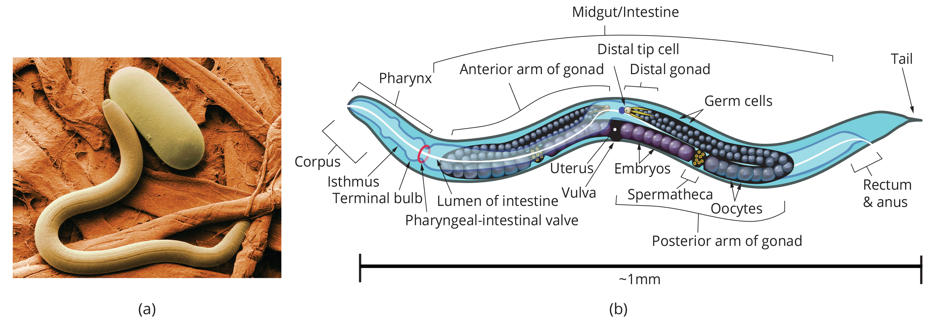
28.5 Figure 1
Agricultural Research Service on Wikimedia Commons. "Soybean cyst nematode and egg."
K.D. Schroeder on Wikimedia Commons. "Nematode anatomy."
Notes:
This scanning electron micrograph shows (a) the soybean cyst nematode (Heterodera glycines) and a nematode egg at 1,000X magnification. (b) A schematic representation shows the anatomy of a typical nematode.

Slide 8
Excretory System
Specialized excretory systems are not well developed.
Usually ammonia (NH₃) is released directly across the body wall.
Osmoregulation and salt balance are performed by simple excretory cells or glands.
In marine nematodes these cells are called renette cells.

Slide 9
Nervous System
Most nematodes have four longitudinal nerve cords that run along the length of the body in dorsal, ventral, and lateral positions.
All fuse at the anterior end forming a pharyngeal nerve ring around the pharynx, acting as the brain.
Similar fusion happens to form a posterior ganglion at the tail.

Slide 10
Nematoda Reproduction
Nematodes employ a variety of reproductive strategies, ranging from monoecious to dioecious to parthenogenetic (reproduction without fertilization).
C. elegans is primarily monoecious with self-fertilizing hermaphrodites and some males; hermaphrodites produce both ova and sperm at different times in the same gonad.
  In anatomical males, specialized structures at the tail of the male called copulatory spicules keep him in place and open the vulva of the female, into which the amoeboid sperm travel into the spermatheca.
  Embryonic development begins shortly after fertilization, followed by four larval stages (L1–L4) with molting between each stage.
  Adverse environmental conditions can lead to the formation of a dauer larva stage (intermediate stage).

Slide 11
Think It Through
What is the difference between a monoecious and dioecious species?
Notes:
Originally an On Your Own. This is included here to use as a talking point or for a think-pair-share activity.

Slide 12
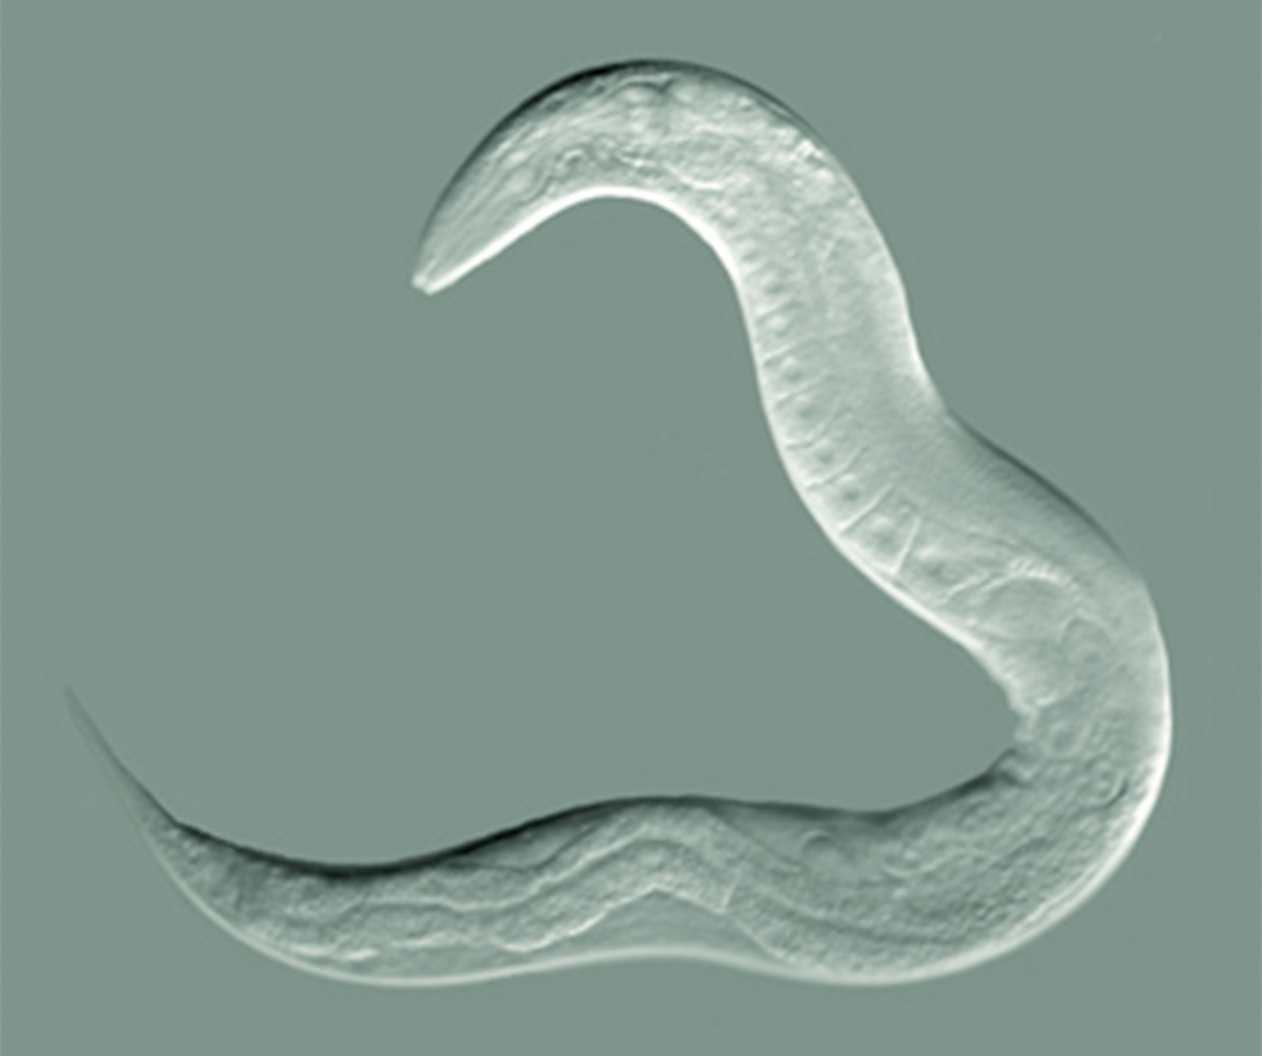
Science and You₁
C. Elegans: The Model System for Linking Developmental Studies with Genetics
C. elegans, introduced by Dr. Sydney Brenner in 1963, is a model organism used to study various biological processes, from nicotine dependence to lipid regulation.
28.5 Figure 2: This light micrograph shows the body of a roundworm. C. elegans are hermaphrodites and consist of exactly 959 somatic cells.
Bob Goldstein, UNC Chapel Hill on Wikimedia Commons. "Adult hermaphrodite."
Notes:
This is included as a relevant application for this topic.

Slide 13
Science and You₂
It's a transparent, free-living soil nematode about 1mm long, easily cultured in lab conditions, with a simple structure and a genome of 20,000 genes.
C. elegans has a short life cycle (3 days from egg to adult) and a total lifespan of 2–3 weeks, facilitating rapid experimentation and observation of age-related phenomena.
The nematode has two sexes (hermaphrodites XX and males XO) and a constant number and position of somatic cells in adult hermaphrodites, making it ideal for studying cell differentiation, communication, and genetics.
C. elegans is amenable to genetic manipulations, and its transparency allows researchers to easily observe internal changes, making it an excellent model for studying various cellular processes.
Notes:
This is included as a relevant application for this topic.

Slide 14
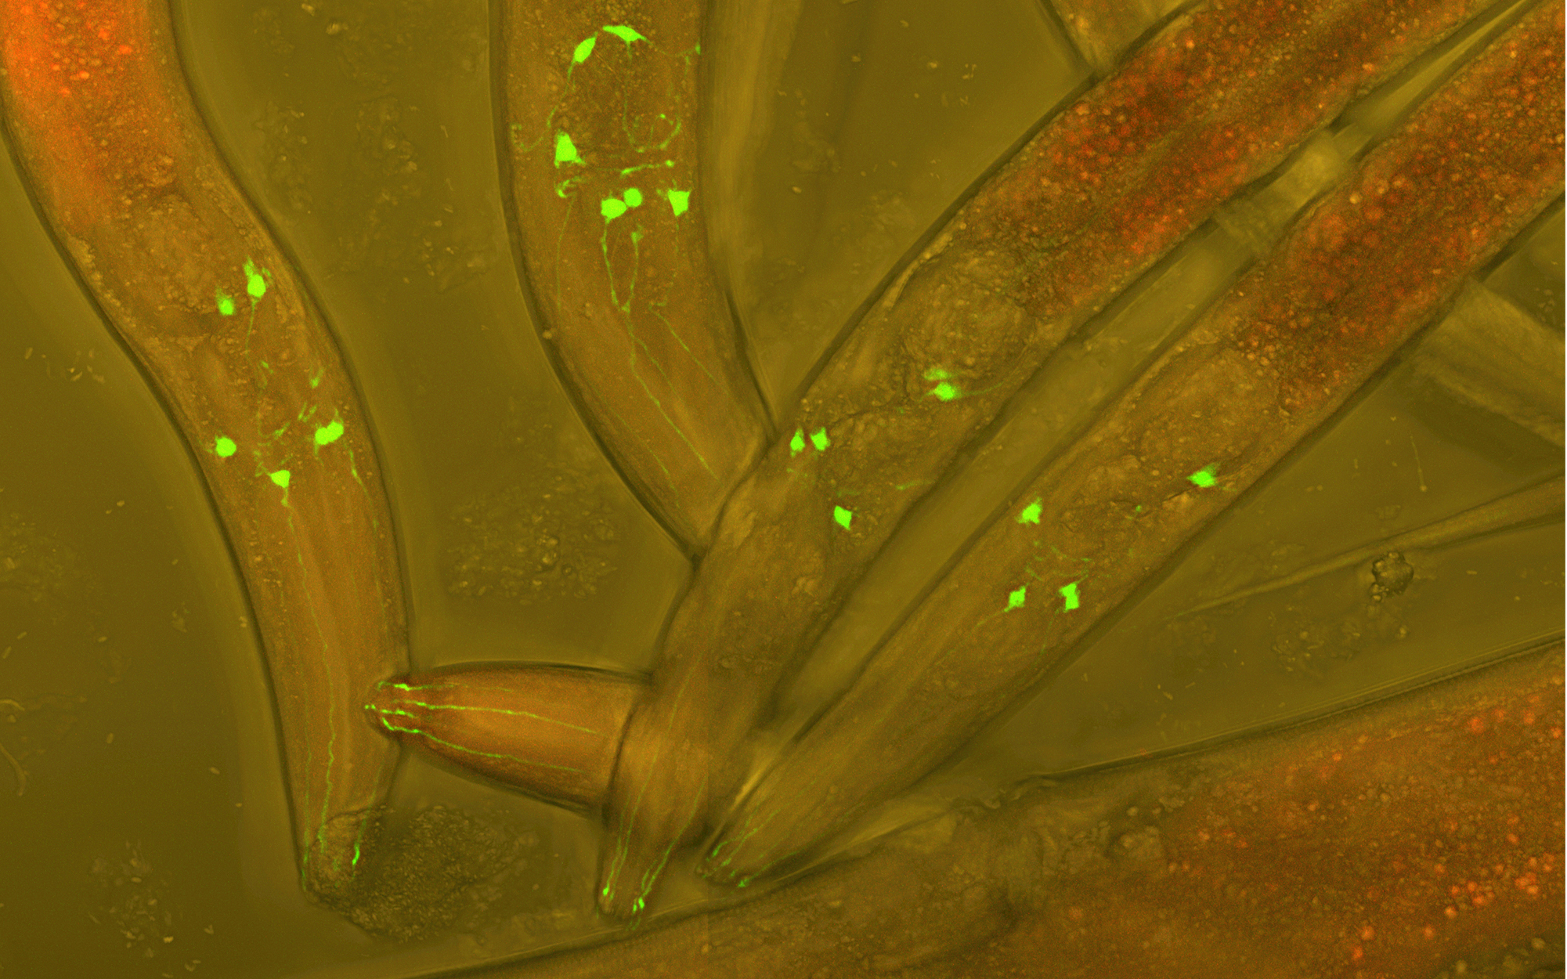
Science and You₃
28.5 Figure 3: C. elegans adults with neurons genetically modified to express green fluorescent protein. Under a fluorescence microscope, neurons glow green to allow visualization of neural development in living worms.
Heiti Paves on Wikimedia Commons. "C. elegans."
Notes:
This is included as a relevant application for this topic.

Slide 15
Parasitic Nematodes
Many nematodes are examples of endoparasitism.
Life cycles often include multiple hosts and have significant medical and veterinary impacts.
  Guinea worms (Dracunculus medinensis) can infect humans through unfiltered water containing copepods.
  Hookworms (Ancylostoma and Necator) infest dogs, cats, and humans.
  Trichina (Trichinella) worms infect humans from undercooked pork.
  Intestinal roundworms (Ascaris) steal nutrients and can cause physical blockages in the intestines.
  Filarial worms (Dirofilaria and Wuchereria) are transmitted by mosquitoes to humans.

Slide 16
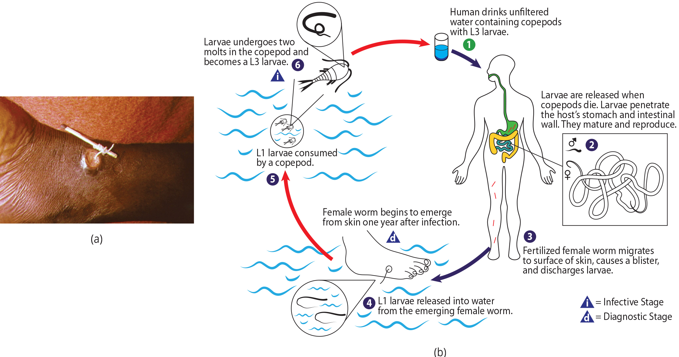
28.5 Figure 4
CDC on Wikimedia Commons. "Guinea worm in leg vein."
CDC on Wikimedia Commons. "Life cycle of Dracunculus medinensis."
Notes:
The guinea worm Dracunculus medinensis infects about 3.5 million people annually, mostly in Africa. (a) Here, the worm is wrapped around a stick so it can be slowly extracted. (b) Infection occurs when people consume water contaminated by infected copepods, but this can easily be prevented by simple filtration systems.

Slide 17
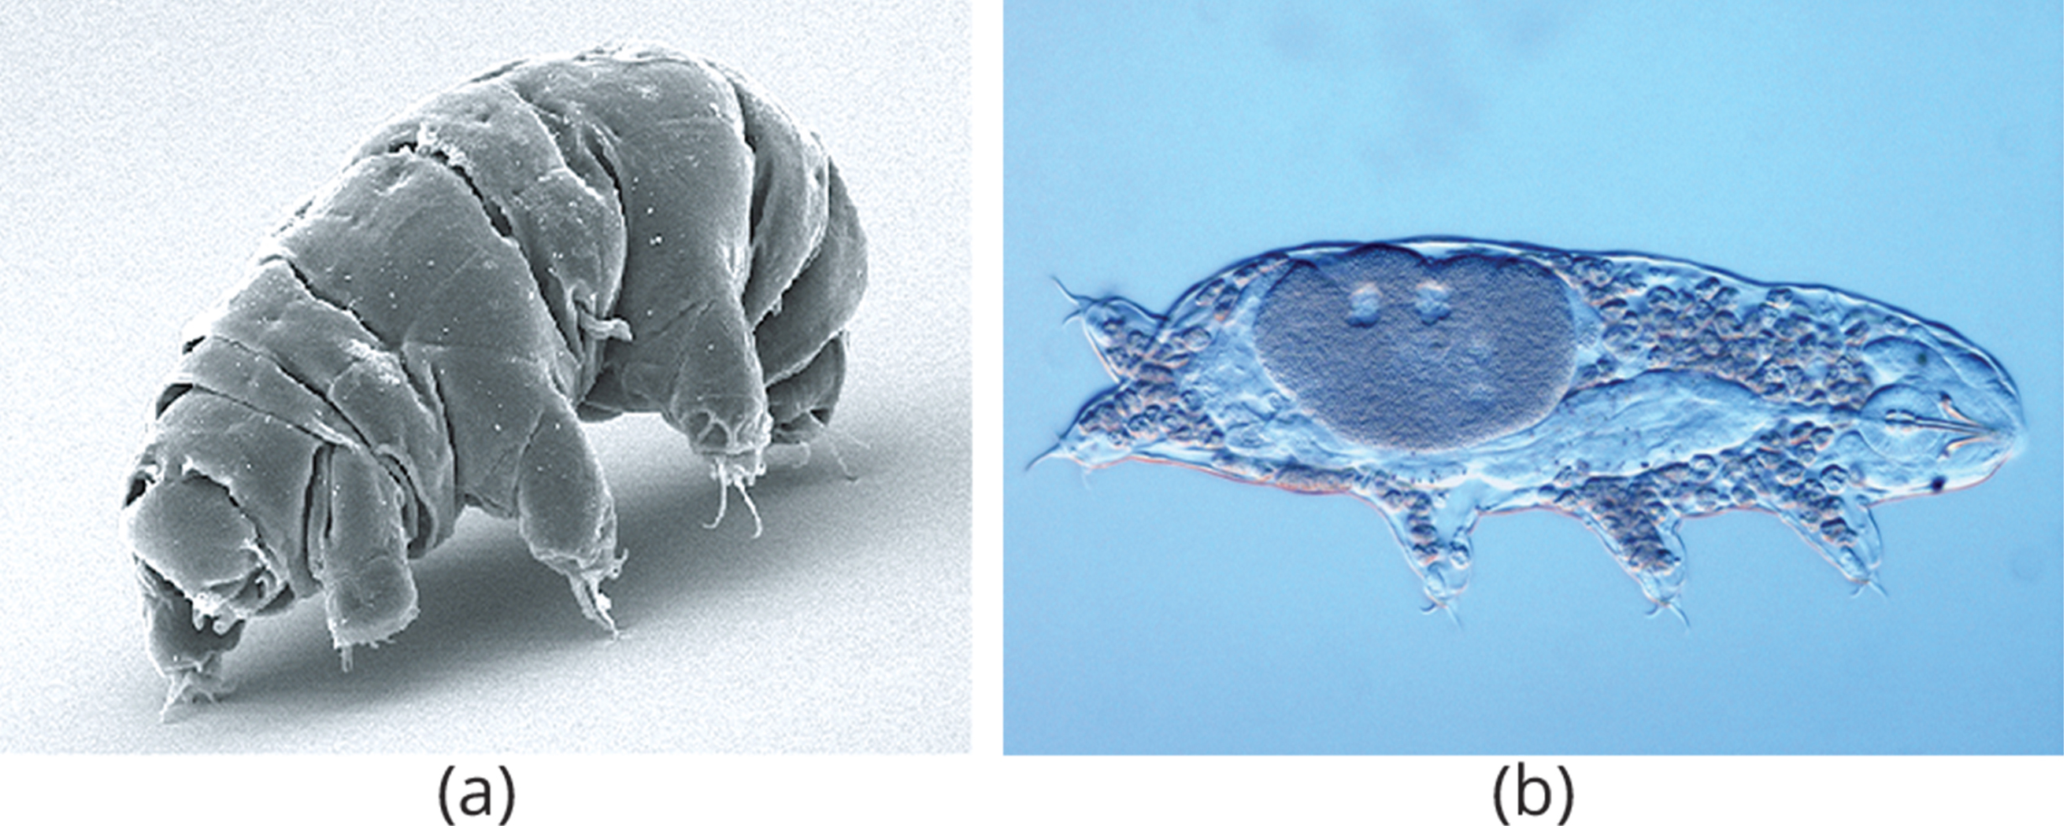
Phylum Tardigrada
The tardigrades ("slow-steppers" or "water-bears") comprise a phylum of inconspicuous little animals living in marine, freshwater, or damp terrestrial environments throughout the world.
Have a chitinous cuticle that covers the body surface and can be divided into plates
Can enter a state called cryptobiosis, providing resistance in multiple environmental challenges including desiccation, low temperatures, vacuum, high pressure, and radiation
28.5 Figure 5
Schokraie E, Warnken U, Hotz-Wagenblatt A, Grohme MA, Hengherr S, et al. (2012) on Wikimedia Commons. "Milnesium tardigradum."
Guidetti, Roberto on Wikimedia Commons. "Tardigrade under microscope."

Slide 18
Morphology and Physiology
Tardigrades have cylindrical bodies with four pairs of clawed legs, used for walking and clinging to substrates, and a cuticle that is periodically shed.
They have a simple digestive system with a circular mouth, muscular pharynx, and salivary glands, feeding on plants, algae, or small animals using a chitinous stylet to pierce plant cells.
Tardigrades have a hemocoel as their main body cavity, use Malpighian tubules for waste removal, and have a simple nervous system with a dorsal brain, ventral nerve cord, and basic sensory structures like eyespots and sensory cilia.

Slide 19
Tardigrada Reproduction
Most tardigrades are dioecious, and males and females each have a single gonad.
  Mating usually occurs at the time of a molt, and fertilization is external.
  Development is direct (no larval stage).
Growth occurs by cell enlargement, not division.

Slide 20
Reflection Question₂
Why are tardigrades able to survive in outer space?
Notes:
The reflection question is included here to use as a talking point or for a think-pair-share activity.

Slide 21
Summary
Ecdysozoa are characterized by a collagenous/chitinous cuticle that requires periodic molting during growth.
Nematodes are roundworms with a pseudocoel, complete digestive system, differentiated nervous system, and rudimentary excretory system.
The phylum Nematoda includes both free-living (e.g., C. elegans) and parasitic species, with various reproductive strategies (dioecious and hermaphroditic).
Nematode development involves several larval stages, and most adults have a fixed number of cells (eutely).
Tardigrades ("water bears") are tiny, segmented animals with four pairs of clawed legs, a pseudocoel, fixed cell numbers as adults, and the ability to enter cryptobiosis to survive harsh conditions.

Slide 22

End of Hawkes Learning PowerPoint

