Slide 1
Lesson 28.6
Arthropods (Superphylum Ecdysozoa)

Slide 2
Objectives
Compare the internal systems and appendage specializations of phylum Arthropoda.
Discuss the reasons for arthropod success and abundance.

Slide 3
Arthropods (Superphylum Ecdysozoa)
Arthropoda: phylum of animals with jointed appendages; one of the most successful on the plant
Coelomate organisms characterized by chitinous exoskeleton and jointed appendages
Over 1 million species identified and estimated 1 million more unidentified
Undergo molting and ecdysis (shedding of exoskeleton) for growth
Eucoelomate and protostomic organisms
Often have complex life cycles

Slide 4
Phylum Arthropoda₁
Name means "jointed feet"
Dominate animal kingdom in species number (estimated 85% of all known species in this phylum)
Originated nearly 500 MYA
Characteristics:
Structural and functional segmentation of body
Presence of jointed appendages
Exoskeleton made primarily of chitin (waterproof, tough polysaccharide composed of N-acetylglucosamine)
Most speciose clade in animal world; insects form largest class within this phylum

Slide 5
Table 1: The Number of Identified Species for Different Phyla
Phylum | Number of Species
Ctenophora | 100
Porifera | 5,000
Cnidaria | 11,000
Platyhelminthes | 25,000
Rotifera | 2,000
Phylum | Number of Species
Nemertea | 1,200
Annelida | 22,000
Mollusca | 112,000
Nematoda | 28,000+
Phylum | Number of Species
Tardigrades | >1,000
Arthropoda | 1,134,000
Echinodermata | 7,000
Chordata | 100,000

Slide 6
Phylum Arthropoda₂
Successfully colonized terrestrial, aquatic, and aerial habitats
Divided into five subphyla:
Trilobita (trilobites, all extinct)
Chelicerata (horseshoe crabs, spiders, scorpions, ticks, mites, and daddy longlegs or harvestmen)
Myriapoda (millipedes, centipedes, and relatives)
Crustacea (crabs, lobsters, crayfish, isopods, barnacles, and some zooplankton)
Hexapoda (insects and their six-legged relatives)

Slide 7
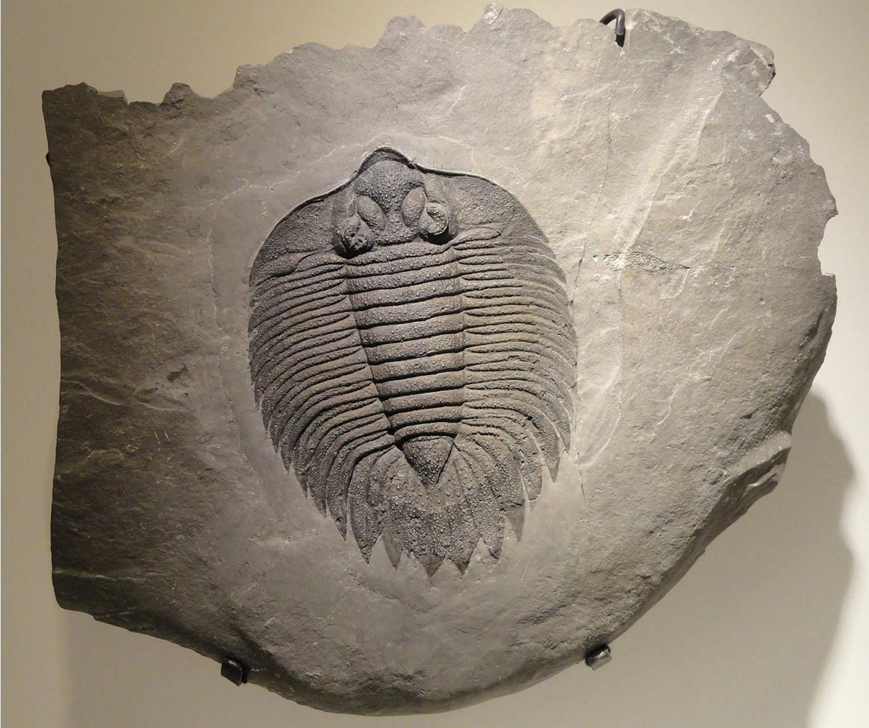
Phylum Arthropoda₃
Trilobites:
Found chiefly in Precambrian (500 MYA)
Most closely related to Chelicerata
Identified based on fossils
Diverse and radiated into thousands of species before extinction at end of Permian Period (240 MYA)
28.6 Figure 1: Trilobites, like the one in this fossil, are an extinct group of arthropods. The name trilobite refers to the three longitudinal lobes making up the body: right pleural lobe, axial lobe, and left pleural lobe.
WikimediaImages on Pixabay. "Trilobite fossil."

Slide 8
Morphology₁
Characteristic features include:
Presence of jointed appendages
Body segmentation
Chitinized exoskeleton

Slide 9
Morphology₂
Fusion of adjacent groups of segments forms functional body regions called tagmata
Depending on taxon, may be in form of:
Head, thorax, and abdomen
Cephalothorax and abdomen
Cephalothorax: fused head and thorax in some species
Head and trunk
May be composed of different numbers of segments
Example: Head of most insects results from fusion of six ancestral segments, but head of another arthropod may have fewer ancestral segments (due to independent evolutionary events)

Slide 10
Morphology₃
Jointed appendages (often in segmental pairs) specialized for various functions:
Sensing environment (antennae)
Capturing and manipulating food (mandibles and maxillae)
Walking, jumping, digging, and swimming
Hemocoel: cavity into which blood is pumped in an open circulatory system
Hemocoel fluids moved by contraction of regions of tubular dorsal blood vessel ("hearts")
Groups differ in organs used for nitrogenous waste excretion
Crustaceans: Possess green glands
Insects: Use Malpighian tubules (work in conjunction with hindgut to reabsorb water while getting rid of nitrogenous waste)

Slide 11
Morphology₄
Nervous system distributed among segments
Larger ganglia in segments with sensory structures or appendages
Ganglia connected by ventral nerve cord
Respiratory systems vary depending on group
Insects and myriapods:
Use series of tubes (tracheae) that branch through body, ending in minute tracheoles that perform gas exchange directly between air and cells
Major tracheae open to surface of cuticle via apertures called spiracles
Tracheal systems of ventilation evolved independently in hexapods, myriapods, and arachnids
Works well in terrestrial environments and freshwater aquatic environments
Numerous aquatic insects (both immature and mature) have tracheal systems
No insects strictly marine because they do not complete entire metamorphosis in salt water

Slide 12
Morphology₅
Examples:
Aquatic crustaceans: Gills
Terrestrial chelicerates: Book lungs
Aquatic chelicerates: Book gills
Book lungs of arachnids (scorpions, spiders, ticks, and mites) contain vertical stack of hemocoel wall tissue (resembles pages of a book)
Between each "page" of tissue is air space, which allows both sides of tissue to be in contact with air at all times, increasing efficiency of gas exchange
Gills of crustaceans: Filamentous structures that exchange gases with surrounding water

Slide 13
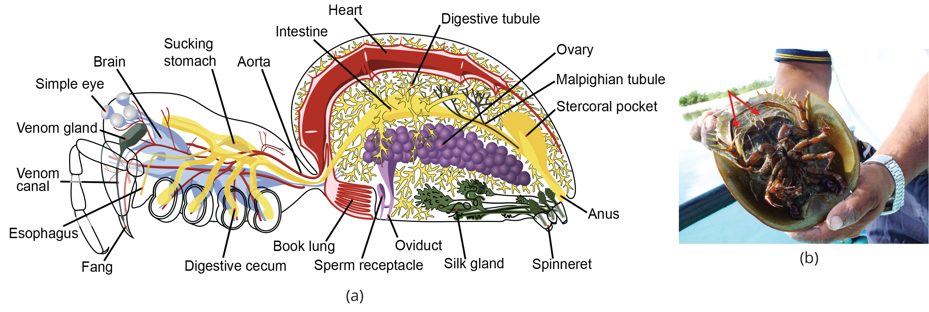
28.6 Figure 2
John Henry Comstock on Wikimedia Commons. "Spider anatomy."
Angel Schatz on Wikimedia Commons. "Horseshoe crab."
Notes:
Figure 2: The book lungs of (a) arachnids are made up of alternating air pockets and hemocoel tissue shaped like a stack of books (hence the name, "book lung"). The book gills of (b) horseshoe crabs are like book lungs but are external so that gas exchange can occur with the surrounding water.

Slide 14
Morphology₆
Cuticle: the tough, external layer possessed by members of the invertebrate class Ecdysozoa that is periodically molted and replaced
Made up of two layers:
Epicuticle: Thin, waxy, water-resistant outer layer containing no chitin
Chitinous procuticle: Composed of an exocuticle and lower endocuticle
Supported by basement membrane
Exoskeleton: Very protective and flexible for increased mobility
Exocuticle (secreted before molt) and endocuticle (secreted after molt) composed of chitin bound with protein
Insoluble in water, alkalis, and weak acids

Slide 15
Morphology₇
Procuticle: Flexible and lightweight and provides protection against dehydration and other biological and physical stresses
Some hexapods (e.g., crustaceans) add calcium salts to exoskeleton, which increases strength of cuticle but does not reduce flexibility
In some cases (like lobsters) amount of calcium salt deposited is extreme
Growth depends on shedding exoskeleton during molting (stripping of outer cuticle, called ecdysis)
Animal is vulnerable to predation while new exoskeleton hardens
Molting and ecdysis allow for growth and change in morphology and diversification in size because number of molts modified through evolution

Slide 16
Subphylum Chelicerata₁
Includes horseshoe crabs, sea spiders, spiders, mites, ticks, scorpions, whip scorpions, and harvestmen
Predominately terrestrial but also freshwater and marine
Estimated 77,000 species almost all in terrestrial habitats

Slide 17
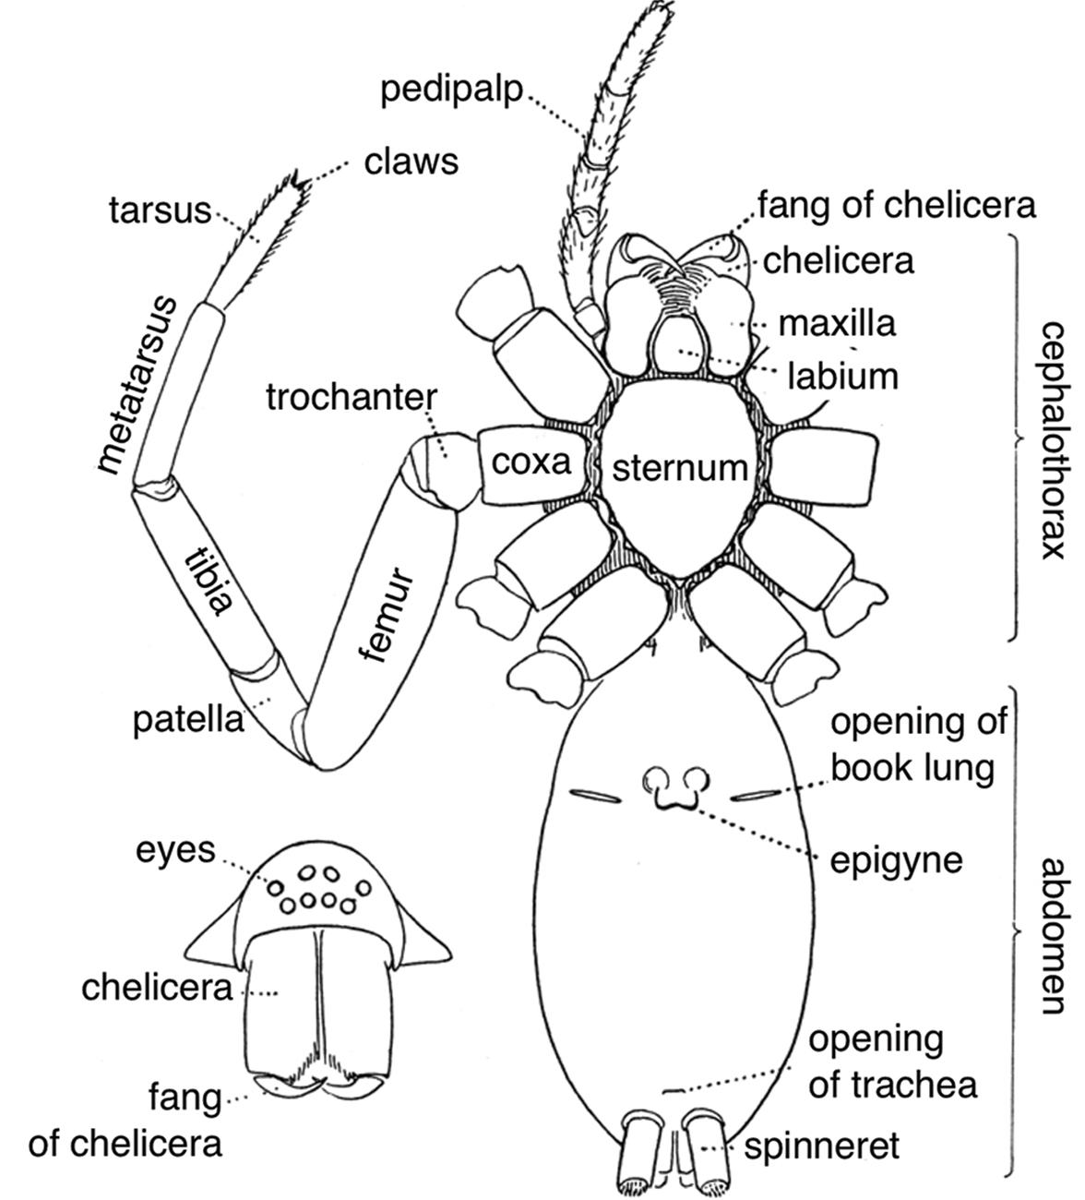
28.6 Figure 3
James Henry Emerton on Wikimedia Commons. "Spider external anatomy."
Notes:
Figure 3: The chelicerate body is divided into two tagmata: cephalothorax (prosoma) and abdomen (opisthosoma). This subphylum derives its name due to the first pair of appendages: the chelicerae. The second pair of appendages, the pedipalps, function to touch, sense the environment, and manipulate food.

Slide 18
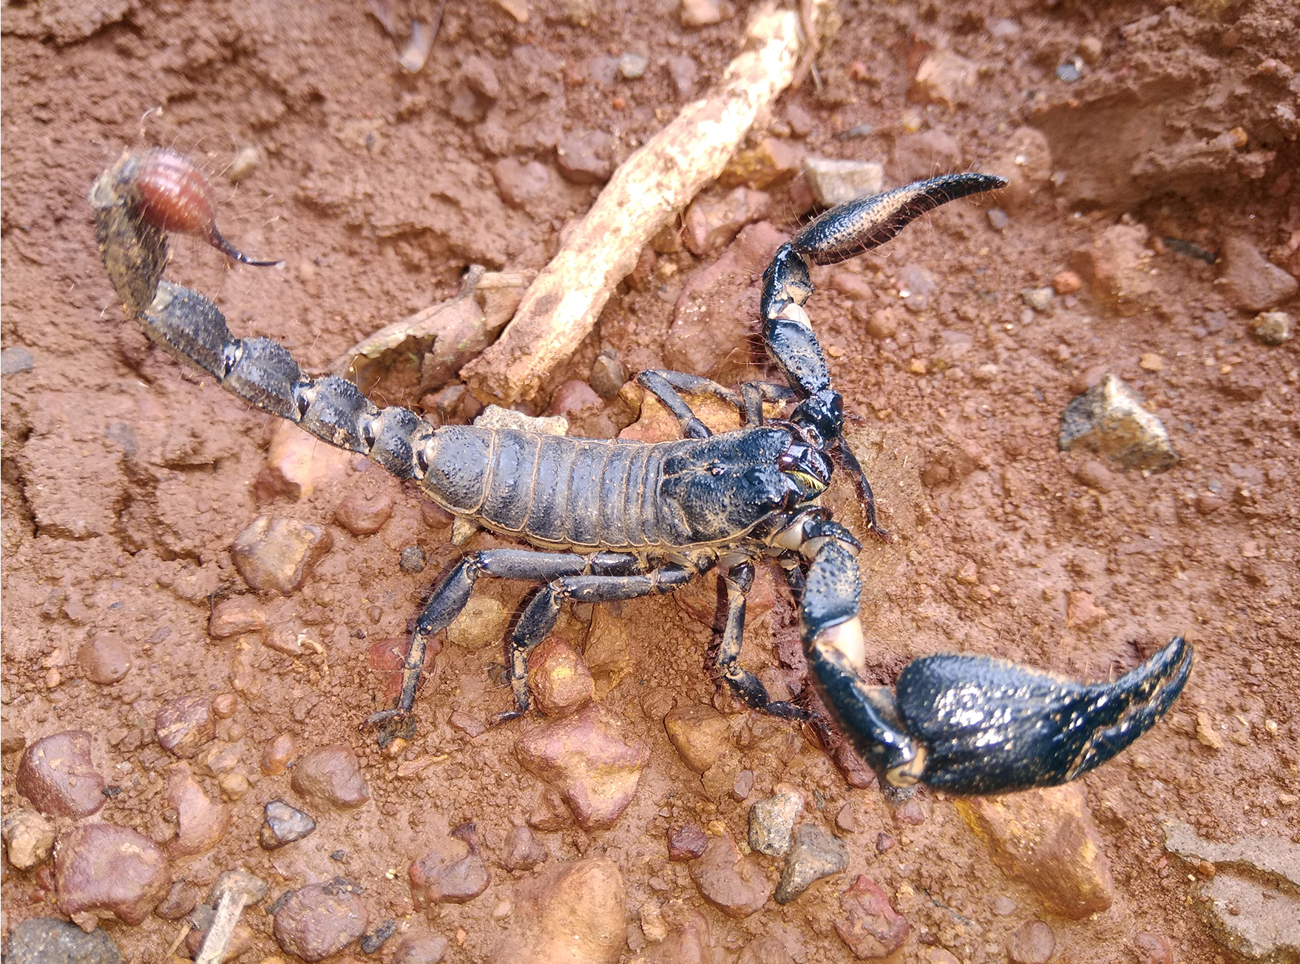
Subphylum Chelicerata₂
Body divided into two tagmata (prosoma and opisthosoma)
Equivalent to cephalothorax (usually smaller) and abdomen (usually larger)
Distinct "head" tagma not discernible
Chelicera: (plural, chelicerae) modified first pair of appendages in subphylum Chelicerata
Serve as specialized clawlike or fang-like mouthparts
Actually modified legs but not equivalent of mandibles (modified leglike chewing mouthparts of insects and crustaceans)
Formed out of first segment making up the prosoma, while mandibles embryonically on fourth segment of mandibulate head
28.6 Figure 4: The chelicerae (first set of appendages) are well developed in the scorpion.
Vijayakumar Blathur on Wikimedia Commons. "Scorpion."

Slide 19
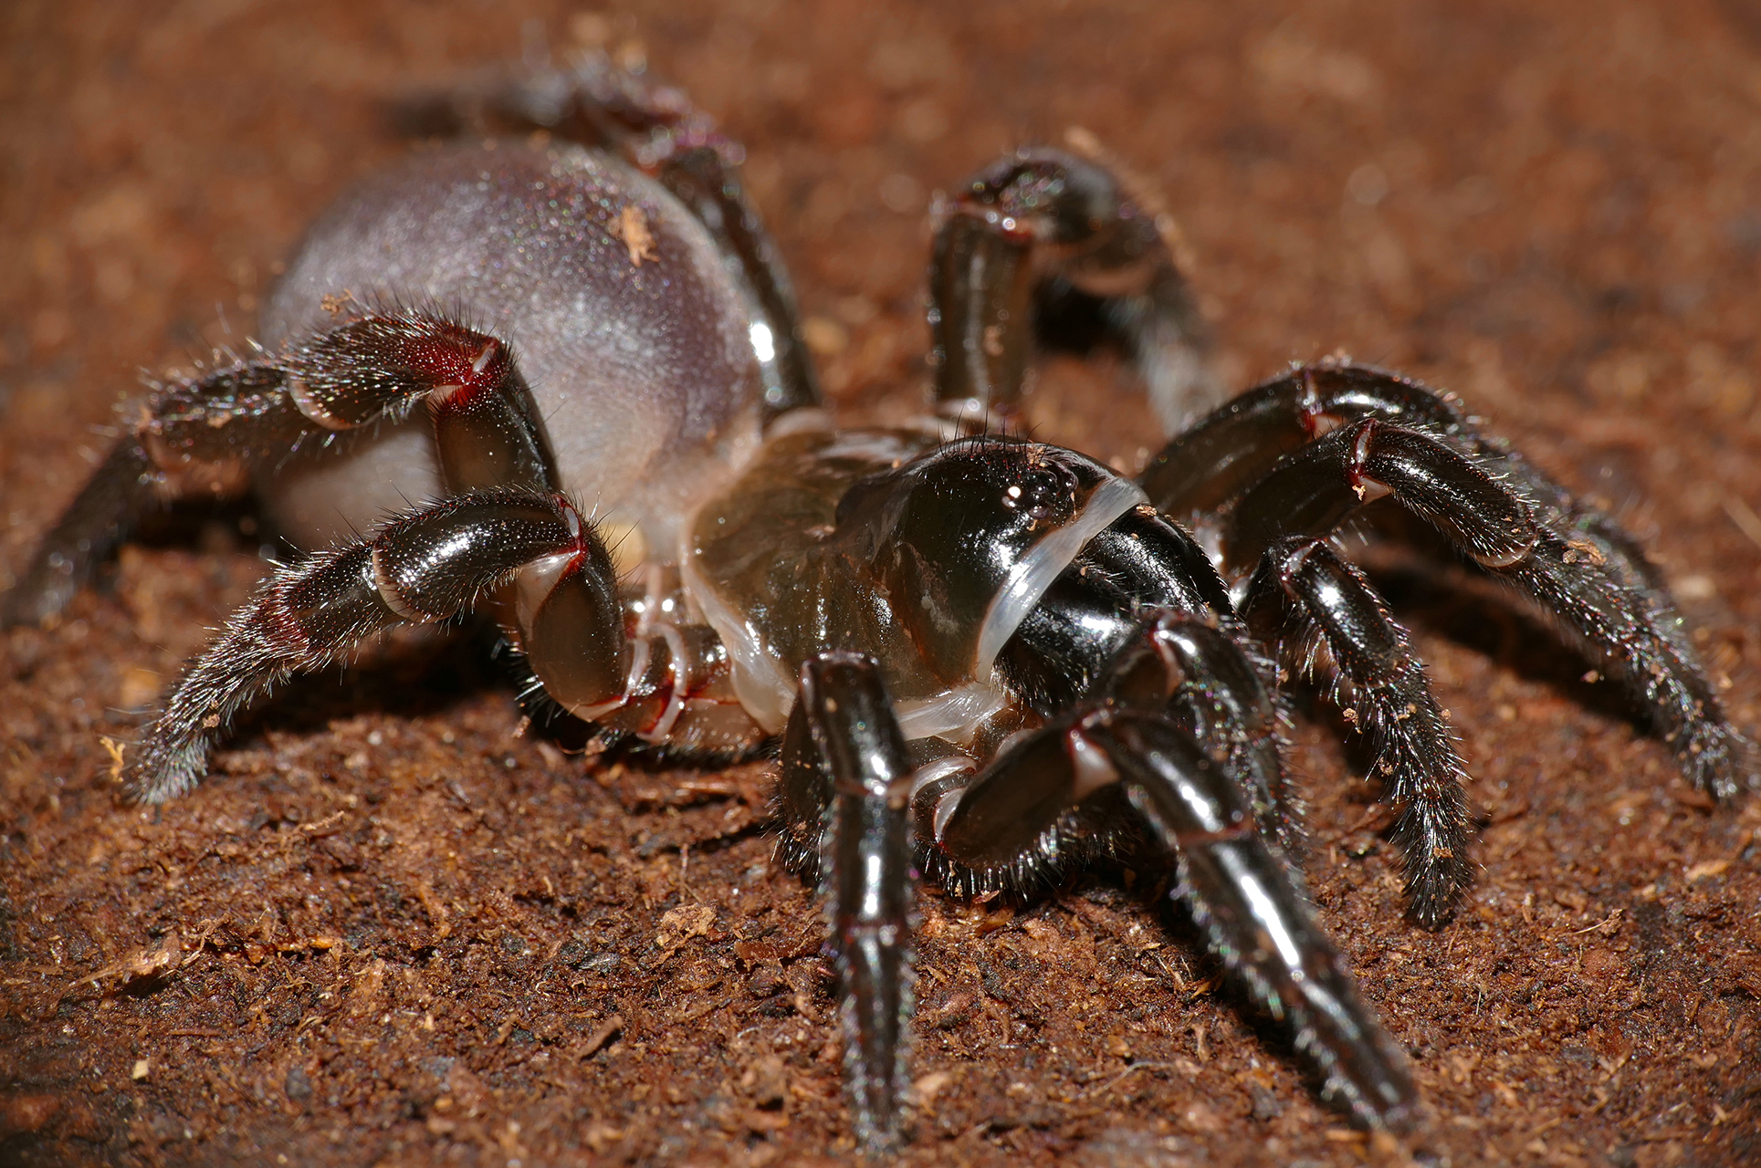
Subphylum Chelicerata₃
Have secondarily lost antennae, so some functions (e.g., touch) performed by pedipalps
Pedipalp: second pair of appendages in Chelicerata
Used for general sensing of environment and manipulation of food
Some species (e.g., sea spiders) have ovigers
Oviger: additional pair of appendages present on some arthropods between the chelicerae and pedipalps
Used for grooming and by males to collect and carry fertilized eggs until hatching
In spiders, chelicera modified and terminate in fangs that inject venom into prey before feeding
28.6 Figure 5: The trapdoor spider, like all spiders, is a member of the subphylum Chelicerata.
Bernard DUPONT on Wikimedia Commons. "Trapdoor spider."

Slide 20
Subphylum Chelicerata₄
Ingest food using preoral cavity formed by chelicerae and pedipalps
May secrete digestive enzymes to predigest food before ingesting it
Parasitic chelicerates (e.g., ticks and mites) have blood-sucking apparatuses
Have open circulatory system with heart that pumps hemolymph (fluid analogous to blood in animals with open circulatory systems) in hemocoel
Hemolymph contains respiratory pigment hemocyanin (copper-containing oxygen transport protein)
Aquatic chelicerates (e.g., horseshoe crabs) have gills to get oxygen and release carbon dioxide
Terrestrial chelicerates have either tracheae or book lungs to exchange gases
Nervous system consists of brain and two ventral nerve cords
Dioecious (sexes are separate)
Use external or internal fertilization depending on species and habitat
Parental care ranges from none to prolonged care

Slide 21
Subphylum Myriapoda₁
Myriapods: arthropods with numerous legs; the number of legs varies from 10 to 750
Includes 16,000 species; most commonly found are millipedes and centipedes
Primarily terrestrial and prefer humid environments
Ancient myriapods (or myriapod-like arthropods) from Silurian to Carboniferous grew up to 10 feet but are all now extinct
Found in moist soils, decaying biological material, and leaf litter

Slide 22
Subphylum Myriapoda₂
Divided into four classes: Chilopoda, Symphyla, Diplopoda, and Pauropoda
Chilopoda:
Example: Centipedes (e.g., Scutigera coleoptrata)
Bear one pair of legs per segment, have mandibles as mouthparts, and somewhat dorsoventrally flattened
Legs in first segment modified to form forcipules that deliver poison to prey (e.g., spiders and cockroaches)
Symphyla:
Similar to centipedes but lack poison claws and are vegetarian

Slide 23
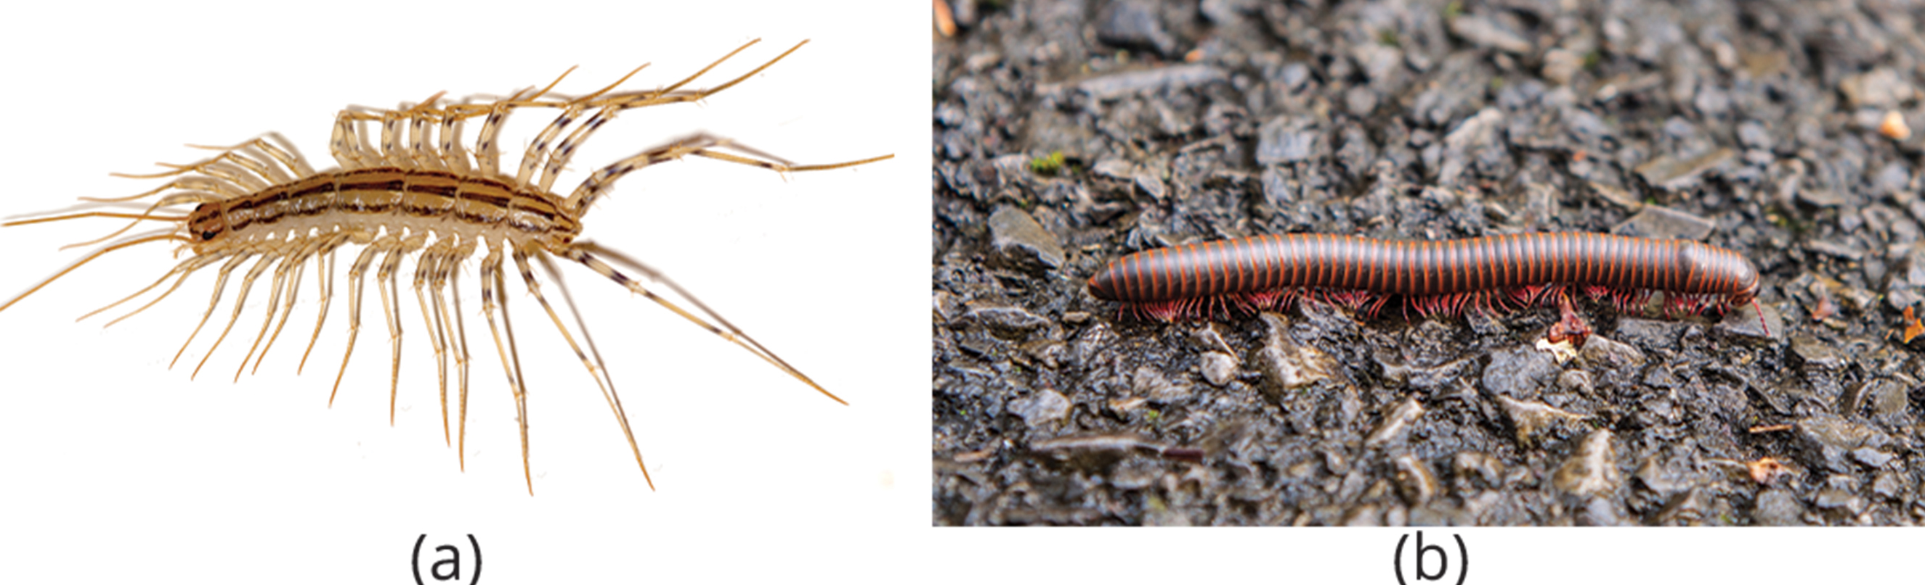
Subphylum Myriapoda₃
Diplopoda:
Example: Millipedes
Two pairs of legs per diplosegment (feature that results from embryonic fusion of adjacent pair of body segments)
Usually rounder in cross section than centipedes
Herbivores or detritivores
Have visibly more legs compared to centipedes but do not have 1,000 legs
Pauropoda:
Similar to millipedes but have fewer segments
28.6 Figure 6: (a) The centipede Scutigera coleoptrata has up to 15 pairs of legs. (b) The North American millipede Narceus americanus bears many legs, although not a thousand, as its name might suggest.
Bruce Marlin on Wikimedia Commons. "Centipede."
Micha L. Rieser on Wikimedia Commons. "Millipede."

Slide 24
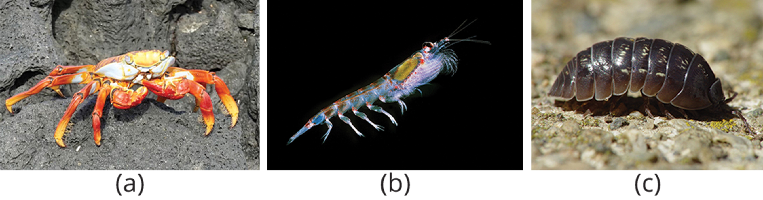
Subphylum Crustacea₁
Crustaceans: most dominant aquatic (both freshwater and marine) arthropods
Total number of marine crustaceans: 70,000 species
Examples: Krill, shrimp, lobsters, crabs, and crayfish
Number of terrestrial crustacean species
Examples: Wood lice or pill bugs (Armadillidium spp.), roly-polies, potato bugs, isopods
Relatively low number of terrestrial species
28.6 Figure 7: The (a) crab and (b) krill are both aquatic crustaceans. The (c) pill bug Armadillidium is a terrestrial crustacean.
MasterfulNerd on Wikimedia Commons. "Sally lightfoot crab."
Krill666 on Wikimedia Commons. "Krill."
Franco Folini on Wikimedia Commons. "Pill bug."

Slide 25
Subphylum Crustacea₂
Have two pairs of antennae, mandibles as mouthparts, and biramous appendages
Biramous: referring to two branches per appendage
Legs are formed in two parts called endopods and exopods (superficially distinct from uniramous legs of myriapods and hexapods)
Uniramous: referring to one branch per appendage
Biramous appendages also seen in trilobites, so likely ancestral, inherited trait of arthropods
Arthropods described as uniramous or biramous but descriptive only and do not reflect evolutionary relationships other than all jointed legs of arthropods sharing common ancestry

Slide 26
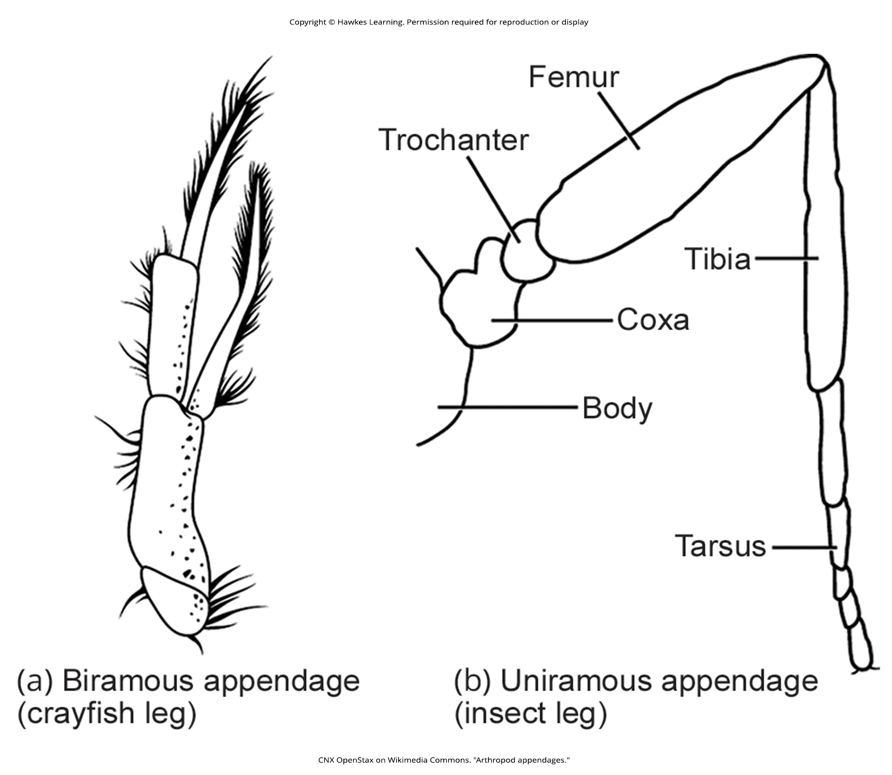
28.6 Figure 8
CNX OpenStax on Wikimedia Commons. "Arthropod appendages."
Notes:
Figure 8: Arthropods may have (a) biramous (two-branched) appendages or (b) uniramous (one-branched) appendages.

Slide 27
Subphylum Crustacea₃
Cephalothorax: fused head and thorax in some species; covered by plate called carapace
Produces body plan comprising two tagmata: cephalothorax and abdomen
Have chitinous exoskeleton shed by molting and ecdysis whenever animal increases in size or continues to next stage of development
Infused with calcium carbonate, making them stronger than other arthropods
Have open circulatory system where blood is pumped into hemocoel by dorsally located heart
Respiratory systems:
Hemocyanin is major respiratory pigment in crustaceans
Hemoglobin found in a few species
Hemocyanin and hemoglobin both dissolved in hemolymph rather than carried in cells

Slide 28
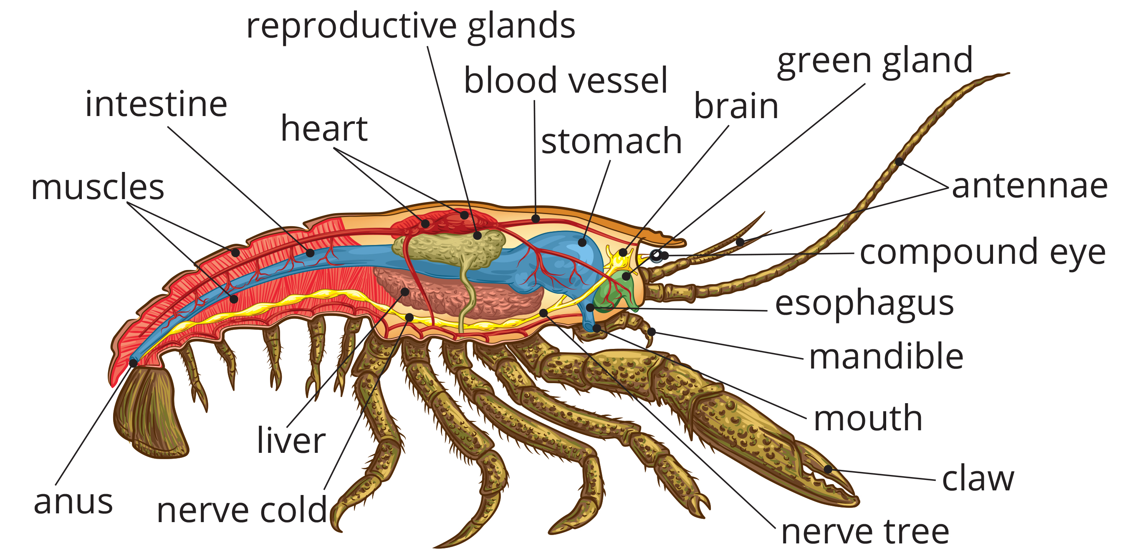
28.6 Figure 9
Notes:
Figure 9: The lobster is an example of a crustacean. It has a carapace around the cephalothorax, and the heart is in the dorsal thorax area.

Slide 29
Subphylum Crustacea₄
Most are dioecious, but some (e.g., barnacles) are hermaphrodites or serial hermaphrodites
Hermaphrodite: referring to an animal where both male and female gonads are present in the same individual
Serial hermaphroditism: Where gonad can switch from producing sperm to ova
Fertilized eggs held within female or released in water
Terrestrial species seek out damp spaces to lay eggs

Slide 30
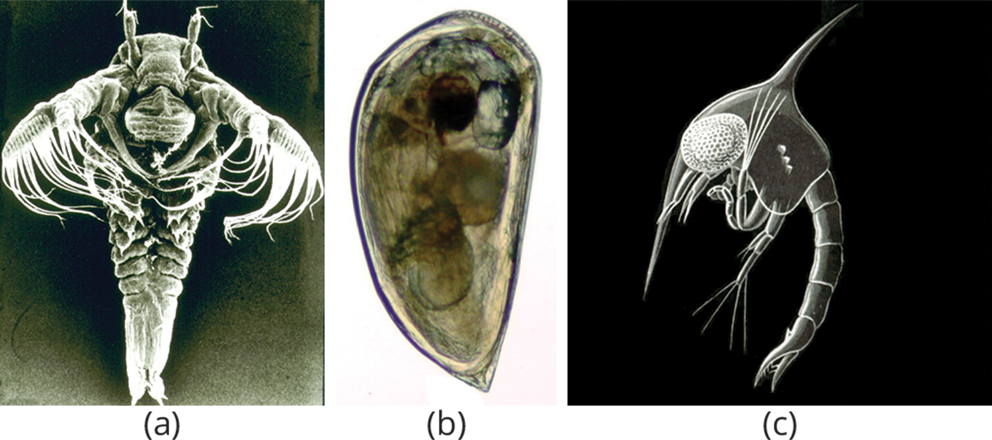
Subphylum Crustacea₅
Nauplius and zoea seen in aquatic crustaceans
Nauplius: larval stage in the early development of crustaceans
Zoea: larval stage in the early development of crustaceans
Cypris in barnacles
Cypris: larval stage in the early development of crustaceans
28.6 Figure 10: All crustaceans go through different larval stages. Shown are (a) the nauplius larval stage of a tadpole shrimp, (b) the cypris larval stage of a barnacle, and (c) the zoea larval stage of a green crab.
USGS on Wikimedia Commons. "Tadpole shrimp larva."
Mª. C. Mingorance Rodríguez on Wikimedia Commons. "Barnacle cypris larva."
Ernst Haeckel on Wikimedia Commons. "Green crab zoea larval stage."

Slide 31
Group Activity₁
Research some different crustaceans to determine their reproductive strategies. Then, come together as a group, and discuss why these variations might be advantageous to the different species.

Slide 32
Subphylum Crustacea₆
Possess brain formed by fusion of first three segmental ganglia and two compound eyes
Ventral nerve cord connects additional segmental ganglia
Most are carnivorous, but there are herbivorous, detritivorous, and endoparasitic species
Example: Endoparasite Sacculina spp. parasitizes crab host and destroys it after forcing host to incubate parasite's eggs
May also be cannibalistic when high populations are present

Slide 33
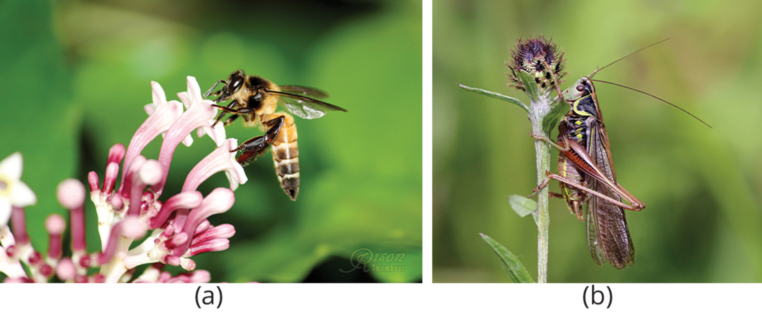
Subphylum Hexapoda₁
Comprise largest class of arthropods in terms of species diversity and biomass (at least in terrestrial habitats)
Hexapoda describes presence of six legs (three pairs), which differentiates them from other arthropods with different numbers of legs
In some cases, number of legs evolutionary reduced or legs modified to accommodate specific conditions (e.g., endoparasitism)
Organized into three tagmata: head, thorax, and abdomen
Individual segments of head have mouthparts derived from jointed legs
Thorax has three pairs of jointed appendages
Wings in most derived groups
Example: Pterygotes: winged insects have a pair of jointed legs on all three segments comprising thorax—prothorax, mesothorax, and metathorax—and veined wings on mesothorax and metathorax
28.6 Figure 11: The (a) giant honeybee and (b) bush cricket are examples of pterygotes (winged insects).
Rison Thumboor on Wikimedia Commons. "Giant honey bee."
Charles J. Sharp/Sharp Photography on Wikimedia Commons. "Bush cricket."

Slide 34
Subphylum Hexapoda₂
Appendages on other body segments derived from modified legs
Head bears upper "lip" (labrum) and lower "lip" (labium), maxillae, and mandible for mouthparts to manipulate food
Head has one pair of sensory antennae and sensory organs (e.g., pair of compound eyes, ocelli [simple eyes], and sensory hairs)
Abdomen has 11 segments and bear external reproductive apertures
Includes some winged insects (e.g., fruit flies) and some secondarily wingless (e.g., fleas)
Only order of "primitively wingless" insects is Thysanura (bristletails)
All other orders are winged or descendants of winged insects

Slide 35
Subphylum Hexapoda₃
Origin of insect wings highly debated
Evolution of wings called de novo (new) development that gave pterygotes (winged insects) domination over Earth
Existed over 325 MYA (with some fossil evidence suggesting as early as 400 MYA)
By Carboniferous, several orders of Paleoptera, which are now extinct, evolved
Good physical evidence that Paleozoic nymphs with thoracic winglets (perhaps hinged, former gill covers of semiaquatic species) used them on land to elevate thoracic temperature (thorax where legs are located), which would enable them to escape predators faster, find more food and mates, and disperse easily
Thoracic winglets selected for thermoregulatory purposes prior to reaching a size that allowed for the capacity for gliding or flapping flight
Modern insects with broadly attached wings (e.g., butterflies), use basal one-third for thermoregulation and outer two-thirds for flight, camouflage, and mate selection

Slide 36
Subphylum Hexapoda₄
Includes many common insects (e.g., ants, beetles, cockroaches, butterflies, crickets, and flies)
Growth and metamorphosis:
Complete metamorphosis from grub-like or caterpillar-like larvae: Adult ants, beetles, flies, and butterflies
Gradual or incomplete metamorphosis from wingless immatures: Adult cockroaches and crickets
All growth during juvenile stages
Adults do not grow (but may become larger) after final molt

Slide 37
Subphylum Hexapoda₅
Variations in wing, leg, and mouthpart morphology
Contribute to enormous variety
Encouraged by activity as pollinators and their coevolution with flowering plants
Some are eusocial (live in large groups with individuals assigned to specific roles or cases [e.g., queen, drone, and worker])
Examples: Termites, ants, bees, and wasps
Use pheromones to communicate and maintain group structure to form cohesive colony
Pheromone: substance released by an animal that can affect the physiology or behavior of other animals

Slide 38
Group Activity₂
As a group, list as many arthropods as you can. If you had to guess, in which subphylum would you classify each arthropod? Discuss as a group if there are disagreements.

Slide 39
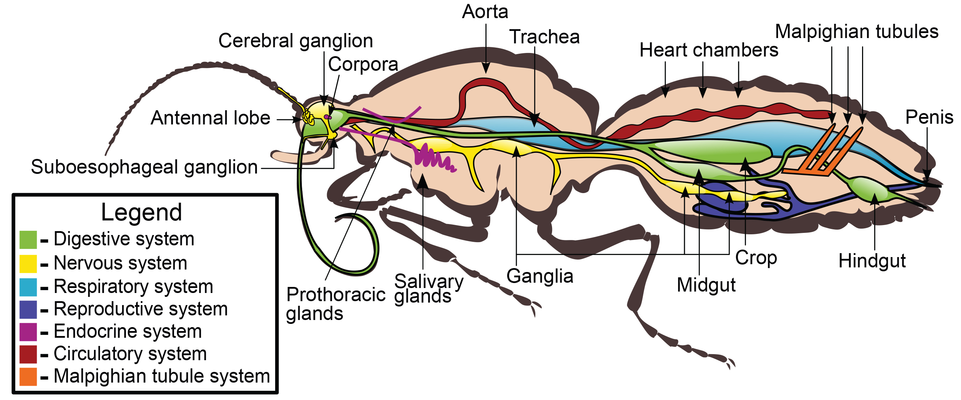
28.6 Figure 12
Nicholas Caffarilla on Wikimedia Commons. "Hexapod insect anatomy."
Notes:
Figure 12: In this basic anatomy of a hexapod insect, note that insects have a well-developed digestive system (including the midgut, crop, and hindgut), a respiratory system (including the trachea that connects to openings called spiracles in the exoskeleton), a circulatory system (including the aorta and heart chambers), and a nervous system (including the cerebral ganglia and other ganglia throughout the body). Note the multiple "hearts" and the segmental ganglia.

Slide 40
Summary
Represent most successful animal phylum, dominating in both species and number of individuals
Members of Ecdysozoa
Key characteristics include:
Protective chitinous cuticle that requires molting and shedding during development or growth
Segmented bodies
Jointed appendages (typically one pair of appendages per segment)
Within phylum, traditional classification based on mouthparts, body subdivisions, number of appendages, and modifications of appendages
Aquatic arthropods have calcified chitinous exoskeleton
Gills, tracheae, and book lungs for respiration
Unique larval stages seen in both aquatic and terrestrial groups

Slide 41

End of Hawkes Learning PowerPoint

