Slide 1
Lesson 28.7
Deuterostomes (Superphylum Deuterostomia)

Slide 2
Objectives
Describe the distinguishing characteristics of chordates.
Describe the distinguishing characteristics of echinoderms.
Identify and describe the defining characteristics of deuterostomes.

Slide 3
Deuterostomes (Superphylum Deuterostomia)₁
Includes phyla Echinodermata and Chordata
  Echinodermata: phylum of deuterostomes with spiny skin; exclusively marine organisms
  Chordata: phylum of animals distinguished by their possession of a notochord, a dorsal hollow nerve cord, pharyngeal slits, an endostyle or thyroid gland, and a postanal tail at some point during their development
Protostomes and deuterostomes differ in embryonic development and which opening of archenteron develops first
  Archenteron: primitive gut cavity within the gastrula that opens outward via the blastopore
  Deuterostomes named for "mouth second" development, where mouth develops as a secondary structure opposite the blastopore, which becomes anus
  Protostomes ("mouth first") develop mouth as first embryonic opening, and second opening becomes anus

Slide 4
Deuterostomes (Superphylum Deuterostomia)₂
Differences in developmental characteristics between protostomes and deuterostomes:
  Type of early cleavage (embryonic cell division)
    Protostomes: Exhibit spiral mosaic cleavage
    Deuterostomes: Exhibit radial regulative cleavage
      Also indeterminant: Developmental fates of early embryonic cells not decided at that point of embryonic development (why we could potentially clone most deuterostomes)

Slide 5
Deuterostomes (Superphylum Deuterostomia)₃
  Mode of formation of coelom (body cavity) of embryo
  Deuterostomes:
    Endodermal lining of archenteron forms buds called coelomic pouches that expand and obliterate embryonic blastocoel (cavity within blastula and early gastrula) to become embryonic mesoderm, the third germ layer
    Happens when mesodermal pouches become separated from invaginating endodermal layer, forming archenteron and then enterocoelom
      Enterocoelom: coelom formed by fusion of coelomic pouches budded from the endodermal lining of the archenteron
    Archenteron develops into alimentary canal
    Mouth opening formed by invagination of ectoderm at pole opposite the blastopore of gastrula
    Blastopore forms anus of alimentary system in juvenile and adult forms

Slide 6
Deuterostomes (Superphylum Deuterostomia)₄
Consist of two major clades: Chordata and Ambulacraria
  Chordata include vertebrates and two invertebrate subphyla (urochordates and cephalochordates)
  Ambulacraria include echinoderms and hemichordates (once considered to be a chordate subphylum)
Echinodermata (one of most ancestral groups of deuterostome invertebrates) produce ossicles that make up true endoskeleton covered by epidermis
  Endoskeleton: skeleton of living cells that produces a hard, mineralized tissue located within the soft tissue of organisms

Slide 7
Deuterostomes (Superphylum Deuterostomia)₅
Hemichordata:
Examples: Acorn worms and pterobranchs
Share with echinoderms:
  Three-part (tripartite) coelom
  Similar larval forms
  Derived metanephridium that rids the animals of nitrogenous wastes
Share pharyngeal slits with chordates
Have dorsal nerve cord in midline of epidermis
Lack neural tube, true notochord, endostyle, and postanal tail

Slide 8
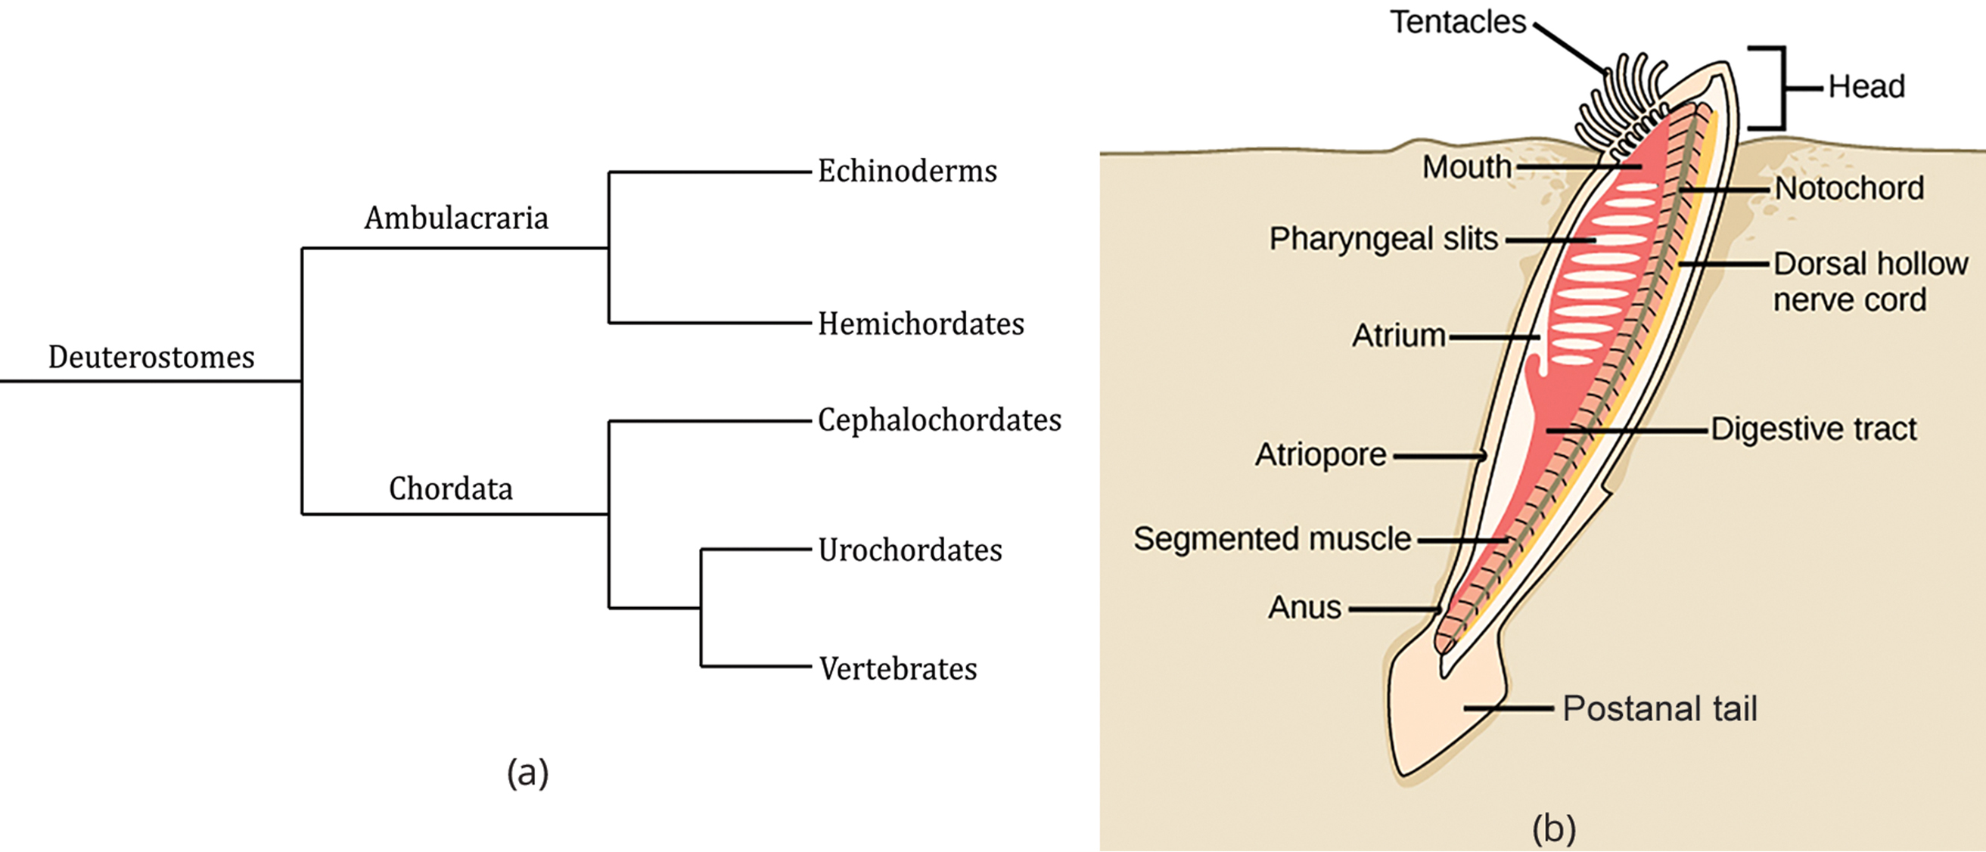
28.7 Figure 1
CNX OpenStax on Wikimedia Commons. "Lancelet anatomy."
Notes:
Figure 1: (a) Ambulacraria and Chordata, the major deuterostome clades, are sister groups (groups derived from a shared common ancestor). (b) This diagram shows the pharyngeal slits in a cephalochordate.

Slide 9
Phylum Echinodermata
Named after "prickly skin"
Collection of about 7,000 living species
Exclusively marine, bottom-dwelling organisms
Include sea stars, sea cucumbers, sea urchins, sand dollars, and brittle stars

Slide 10
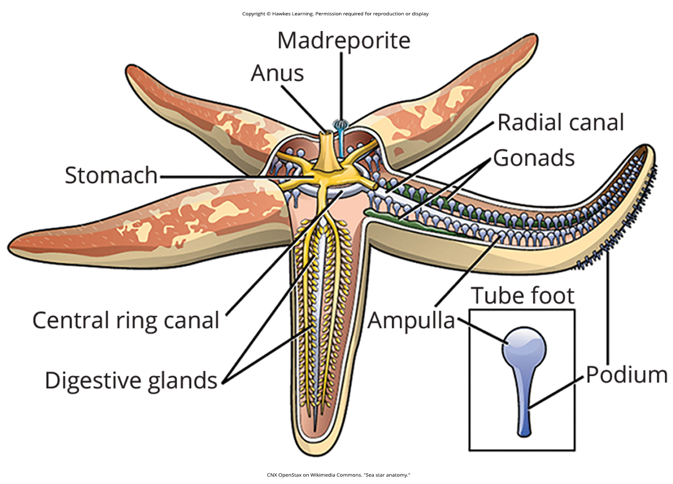
28.7 Figure 2
CNX OpenStax on Wikimedia Commons. "Sea star anatomy."
Notes:
Figure 2: This diagram of a sea star shows the pentaradial pattern typical of adult echinoderms and the water vascular system, which consists of the central ring canal and radial canal that is their defining characteristic.

Slide 11
Morphology and Anatomy₁
Adult echinoderms exhibit pentaradial symmetry with "arms" arrayed in multiples of five around central axis
Have endoskeleton made of calcareous ossicles (small bony plates) covered by epidermis
  Similar endoskeleton to humans, not like exoskeleton of arthropods
  Ossicles may be fused together (embedded separately in connective tissue of dermis) or reduced to minute spicules of bone (like in sea cucumbers)
    Spines may be moved by small muscles or locked in place for defense
    Some species have pedicellaria (tiny, stalked claws) for cleaning, protection of papulae used in respiration, and sometimes aid in food capture
  Produced by dermal cells (which also produce several kinds of pigments, giving animals color)

Slide 12
Morphology and Anatomy₂
  Example: Sea stars
    Fingerlike projections (papillae) of dermal tissue extend through endoskeleton and function as gills
    Some cells glandular and may produce toxins
    Each arm or section contains several different structures (e.g., digestive glands, gonads, and tube feet unique to echinoderms)
    Every arm has two rows of tube feet on oral side (side with mouth), running along external ambulacral groove (groove along oral surface from which tube feet project through body wall)
    Tube feet assist in locomotion, feeding, and chemical sensations and serve to attach species to substratum

Slide 13
Water Vascular and Hemal Systems₁
Echinoderms have unique ambulacral (water vascular) system derived from coelom
Coelom: lined body cavity
Water vascular system: system in echinoderms where water is the circulatory fluid
Consists of central ring canal and radial canals that extend along each arm
Each radial canal connected to double row of tube feet, which project through holes in endoskeleton and function as tactile and ambulatory structures
Tube feet can extend or retract based on volume of water in system of that arm, allowing animal to move and capture prey with sucker-like action
Tube feet controlled by bulblike ampullae

Slide 14
Water Vascular and Hemal Systems₂
  Seawater enters through aboral madreporite (opposite oral area where mouth is) and passes to ring canal through short stone canal
  Water circulation facilitates gaseous change and provides hydrostatic source for locomotion and prey manipulation
  Hemal system circulates nutrients
    Consists of oral, gastric, and aboral rings and other vessels running parallel to water vascular system
  Transport of nutrients and gases shared by water vascular and hemal system as well as visceral body cavity that surrounds major organs

Slide 15
Nervous System
Simple nervous system
Comprised of circumoral nerve ring at center and five radial nerves extending outward along arms
Several networks of nerves located in different parts of body
Lack brain or large ganglia
May have well-developed sensory organs for touch and chemoreception (e.g., within tube feet and on tentacles at tips of arms)
May have photoreceptors and statocysts (sensory organs for balance and orientation)

Slide 16
Digestive and Excretory Systems₁
Mouth (located on oral [ventral] side) opens through short esophagus to large, bag-like stomach
"Cardiac" stomach can evert through mouth during feeding
  Example: When starfish everts stomach into bivalve prey to digest living animal in its own shell
Masses of digestive glands (pyloric caeca) in each arm, running dorsally along arms and overlying reproductive glands
Digested food channeled to small anus (if present) after passing through pyloric caeca in each arm

Slide 17
Digestive and Excretory Systems₂
Podocytes present near center of echinoderm disc at junction of water vascular and hemal systems
  Podocytes: Cells specialized for ultrafiltration of bodily fluids
  Connected by internal system of canals to madreporite, where water enters stone canal
    Madreporite: pore for regulating entry and exit of water into the water vascular system
Adult typically has spacious and fluid-filled coelom
Cilia aid in circulating fluid within body cavity and lead to fluid-filled papulae
  Papulae: Where exchange of oxygen and carbon dioxide takes place and secretion of nitrogenous waste (e.g., ammonia) by diffusion

Slide 18
Reproduction
Dioecious with external fertilization
  Males and females release gametes into water at same time
Early larval stages have bilateral symmetry
  Example: Bipinnaria of asteroid echinoderms, such as sea stars
  Each class of echinoderms has own larval form
Radially symmetrical adults form cluster of cells in larva
Some reproduce asexually by fragmentation and regenerate body parts lost in trauma
  Fragmentation: a form of asexual reproduction in which an organism splits into fragments, each of which develops into a new organism
  Examples: Sea stars, brittle stars, sea cucumbers

Slide 19
Classes of Echinoderms₁
Divided into five extant classes:
Asteroidea (sea stars)
Ophiuroidea (brittle stars)
Echinoidea (sea urchins and sand dollars)
Crinoidea (sea lilies or feather stars)
Holothuroidea (sea cucumbers)

Slide 20
Classes of Echinoderms₂
Asteroidea:
Most well-known
Include sea stars
Come in variety of shapes, color, and sizes
More than 1,800 species

Slide 21
Classes of Echinoderms₃
Asteroidea:
Key characteristics:
  Distinguished from other echinoderm classes
  Thick arms that extend from central disk, from which various organs branch into arms
  End of each arm has simple eye spots and tentacles for touch receptors
  Use rows of tube feet for gripping surfaces and grasping prey
  Mostly carnivores
  Major prey are in Mollusca
    Can open molluscan shells with tube feet
  Have two stomachs (one that protrudes through mouth and secretes digestive juices into or onto prey before ingestion)
    Example: Eating a clam
      Can partially open shell and evert stomach into shell and introduce digestive enzyme into mollusk, which weakens adductor (closing) muscles of bivalve and begins digestion

Slide 22
Classes of Echinoderms₄
Ophiuroidea ("snake-tails"):
Include brittle stars
Have long, thin, flexible arms sharply distinguishable from central disk
Move by lashing out arms or wrapping them around objects and pulling forward
Arms also used for grasping prey
Water vascular system not used for locomotion in contrast to sea stars

Slide 23
Classes of Echinoderms₅
Echinoidea ("prickly"):
Include sea urchins and sand dollars
Do not have arms
Hemispherical or flattened with five rows of tube feet that extend through five rows of pores in continuous internal shell called a test
Tube feet used to keep body surface clean
Skeletal plate around mouth organized into complex, multipart feeding structure called Aristotle's lantern
Graze on algae, but some suspension feeders or feed on small animals or organic detritus (fragmentary remains of plants or animals)

Slide 24
Group Activity
Find a group and choose an echinoderm we have discussed in this lesson. Research its life cycle and method(s) of reproduction. Present your findings to the class.

Slide 25
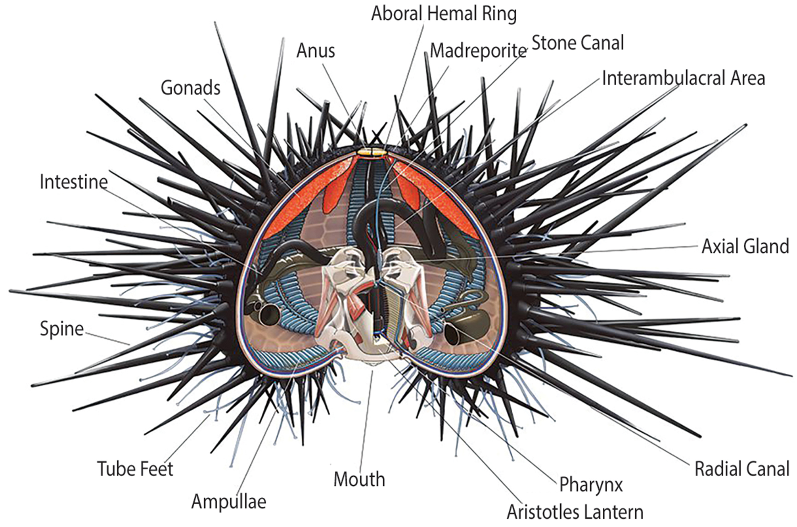
28.7 Figure 3
Alex Ries on Wikimedia Commons. "Sea urchin anatomy."
Notes:
Figure 3: Members of class Echinoidea do not have arms but are hemispherical or flattened.

Slide 26
Classes of Echinoderms₆
Crinoidea:
Include sea lilies and feather stars
Sea lilies:
  Sessile
  Body attached to stalk
Feather stars:
  Move using leglike cirri that emerge from aboral surface
Suspension feeders, collecting small food organisms along ambulacral grooves of feather-like arms
"Feathers" are branched arms lined with tube feet
Tube feet used to move captured food toward mouth
600 extant species but were more numerous in ancient oceans
Many deep-water species, but feather stars inhabit shallow areas, especially subtropical and tropical waters

Slide 27
Classes of Echinoderms₇
Holothuroidea:
Include sea cucumbers
Have extended oral-aboral axis
Only ones with "functional" bilateral symmetry as adults because extended oral-aboral axis compels animal to lie horizontally rather than stand
Tube feet reduced or absent except on side animal lies on
Have single gonad
Digestive tract more typical of bilaterally symmetrical animal
Respiratory trees (pair of gill-like structures) branch from posterior gut; muscles around cloaca pump water in and out of trees
Clusters of tentacles around mouth used for feeding
Feed on detritus or are suspension feeders, sifting out small organisms with oral tentacles
Some species unique because cells containing hemoglobin circulate in coelomic fluid, water vascular system, and/or hemal system

Slide 28
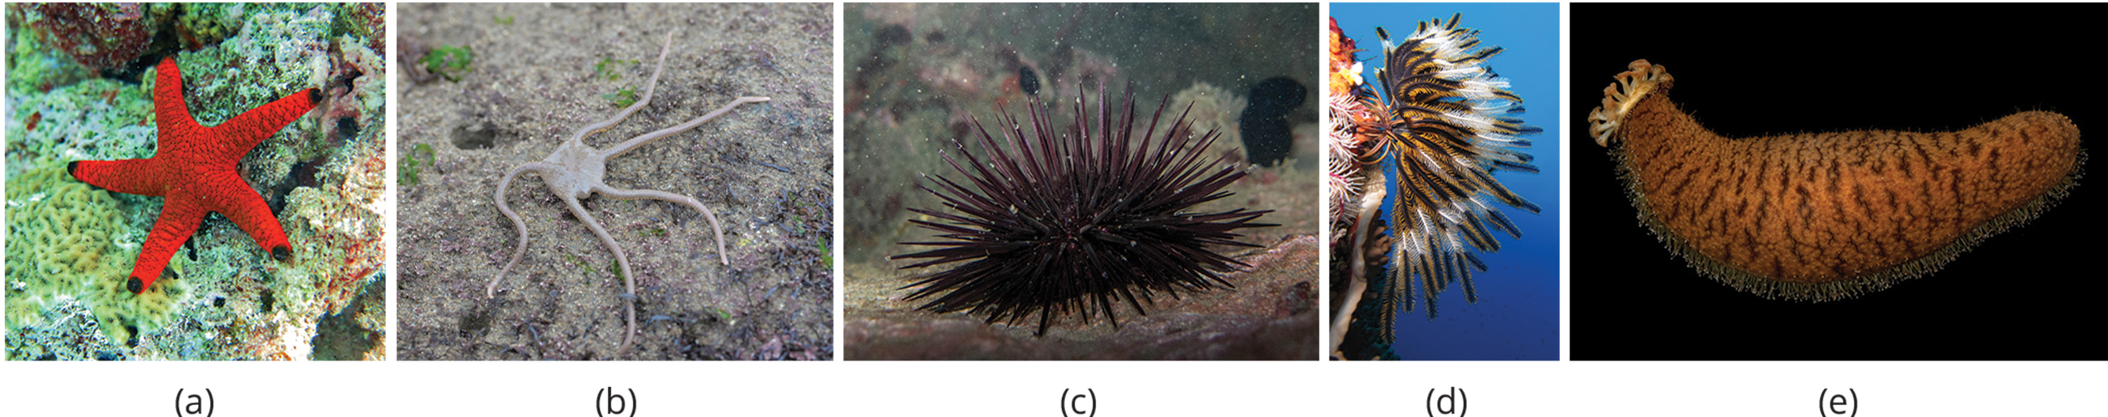
28.7 Figure 4
Frédéric Ducarme on Wikimedia Commons. "Indian sea star."
Diversity Initiative for the Southern California Ocean on Wikimedia Commons. "Brittle star."
João D'Andretta on Wikimedia Commons. "Sea urchin."
Alexander Vasenin on Wikimedia Commons. "Sea lilies."
François Michonneau on Wikimedia Commons. "Brown sea cucumber."
Notes:
Figure 4: Different members of Echinodermata include the (a) sea star of the class Asteroidea, (b) the brittle star of the class Ophiuroidea, (c) the sea urchins of the class Echinoidea, (d) the sea lilies belonging to the class Crinoidea, and (e) sea cucumbers, representing the class Holothuroidea.

Slide 29
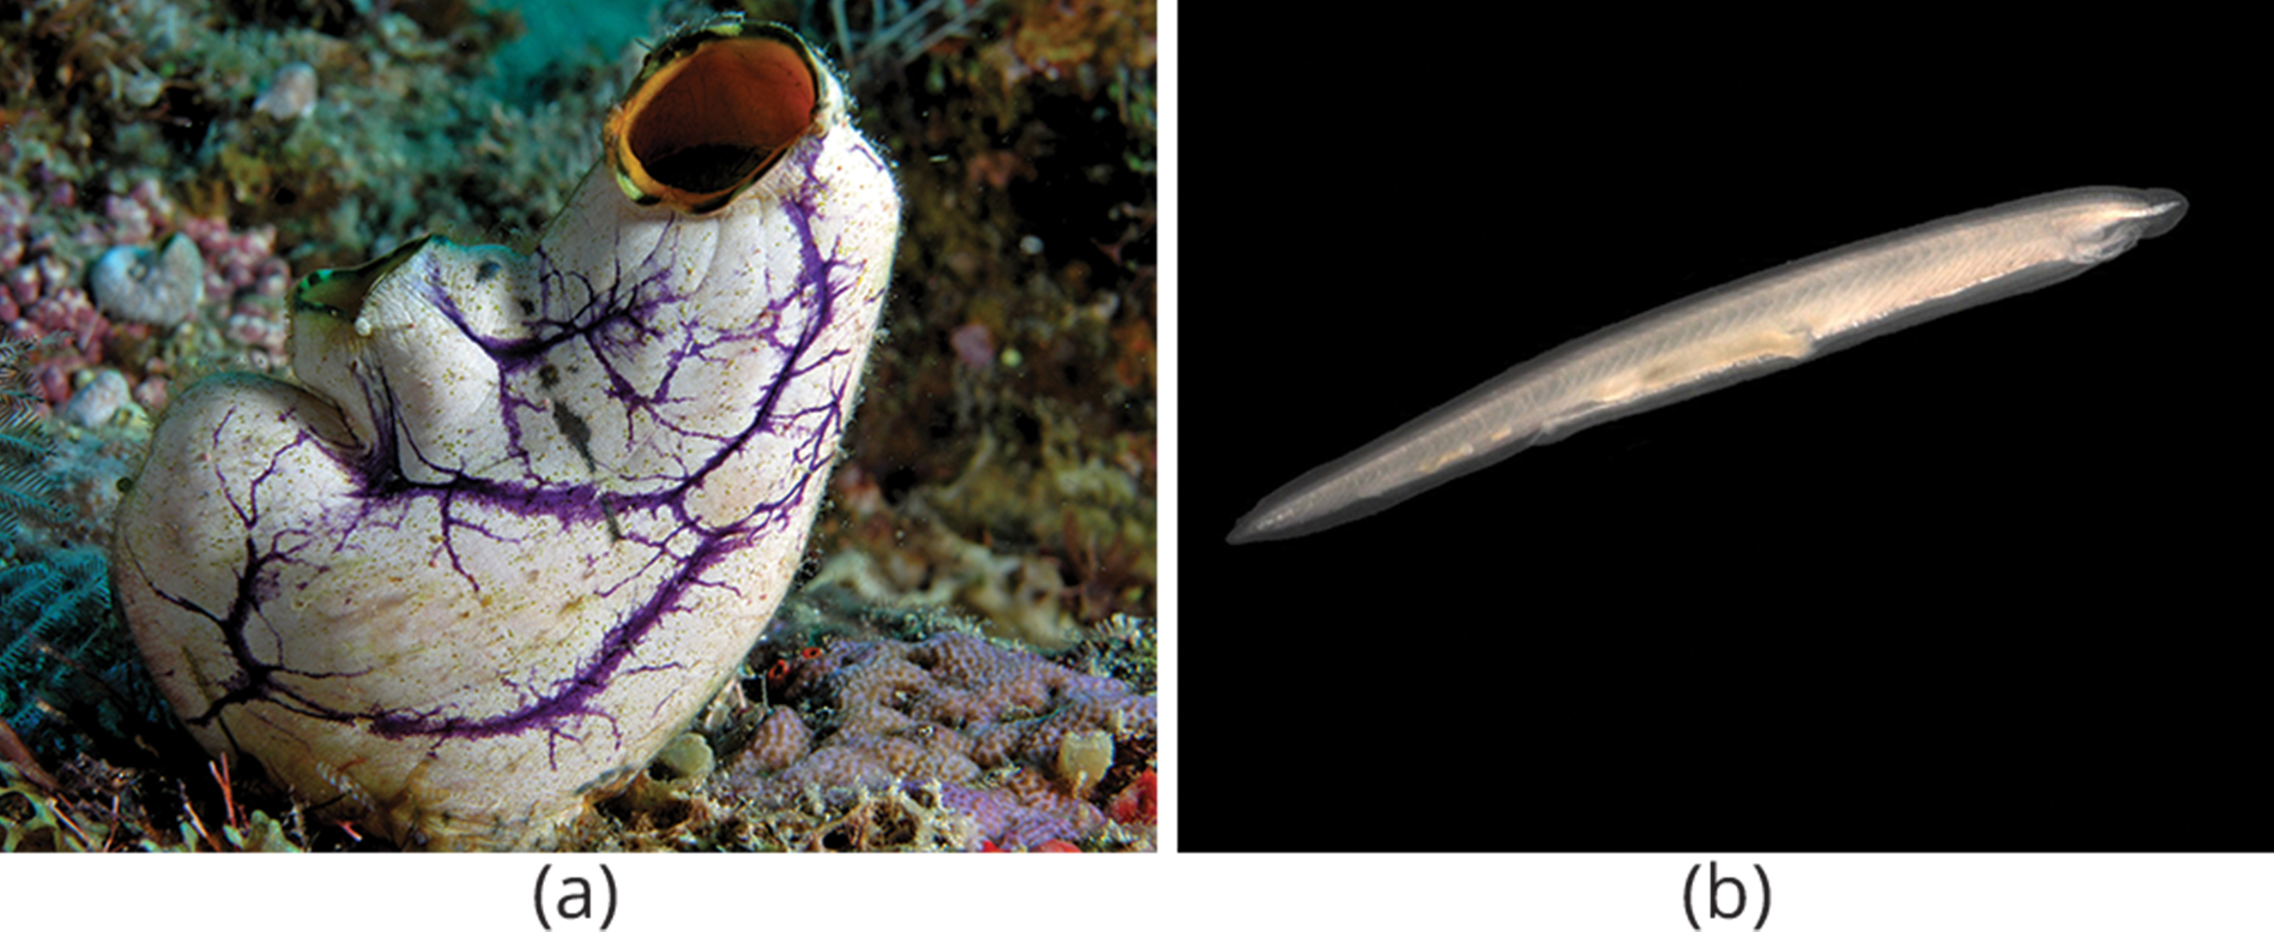
Phylum Chordata
Five key features that appear at some stage of development:
  Notochord
  Dorsal hollow nerve cord
  Pharyngeal slits
  Postanal tail
  Endostyle/thyroid gland that secretes iodinated hormones
Some of these traits only present during embryonic development
Contains vertebrate classes and two clades of invertebrates:
  Urochordata (tunicates, salps, and larvaceans)
    Most tunicates live on ocean floor as suspension feeders
  Cephalochordata (lancelets)
    Lancelets are suspension feeders and feed on phytoplankton and other microorganisms
28.7 Figure 5: The (a) tunicates and (b) lancelets are examples of invertebrate chordates.
Nick Hobgood on Wikimedia Commons. "Tunicate."
Hans Hillewaert on Wikimedia Commons. "Lancelet."

Slide 30
Summary₁
Echinoderms:
  Deuterostome, marine animals with adults showing five-fold symmetry
  Have calcareous endoskeleton composed of ossicles (body plates)
  Epidermal spines attached to some ossicles and serve as protection
  Have water vascular system used for respiration and locomotion
    Other respiratory structure (e.g., papulae and respiratory trees) found in some species
    Large aboral madreporite is point of entry and exit for seawater pumped into water vascular system
  Have variety of feeding techniques, from predation to suspension feeding
  Osmoregulation carried out by podocytes associated with hemal system

Slide 31
Summary₂
Chordata:
  Key features are notochord, dorsal hollow nerve cord, pharyngeal slits, postanal tail, and endostyle/thyroid that secrete iodinated hormones
  Contains Vertebrata and two clades of invertebrates: Urochordata (tunicates, salps, and larvaceans) and Cephalochordata (lancelets)
    Most tunicates live on ocean floor as suspension feeders
    Lancets are suspension feeders and feed on phytoplankton and other microorganisms
  Sister taxon is Ambulacraria
    Includes echinoderms and hemichordates, which share pharyngeal slits with chordates

Slide 32

End of Hawkes Learning PowerPoint

