Slide 1
Lesson 29.1
Chordates

Slide 2
Objectives
Describe the developmental fate of the notochord in vertebrates.
Describe the distinguishing characteristics of chordates.
Identify the derived characteristics of craniates that set them apart from other chordates.

Slide 3
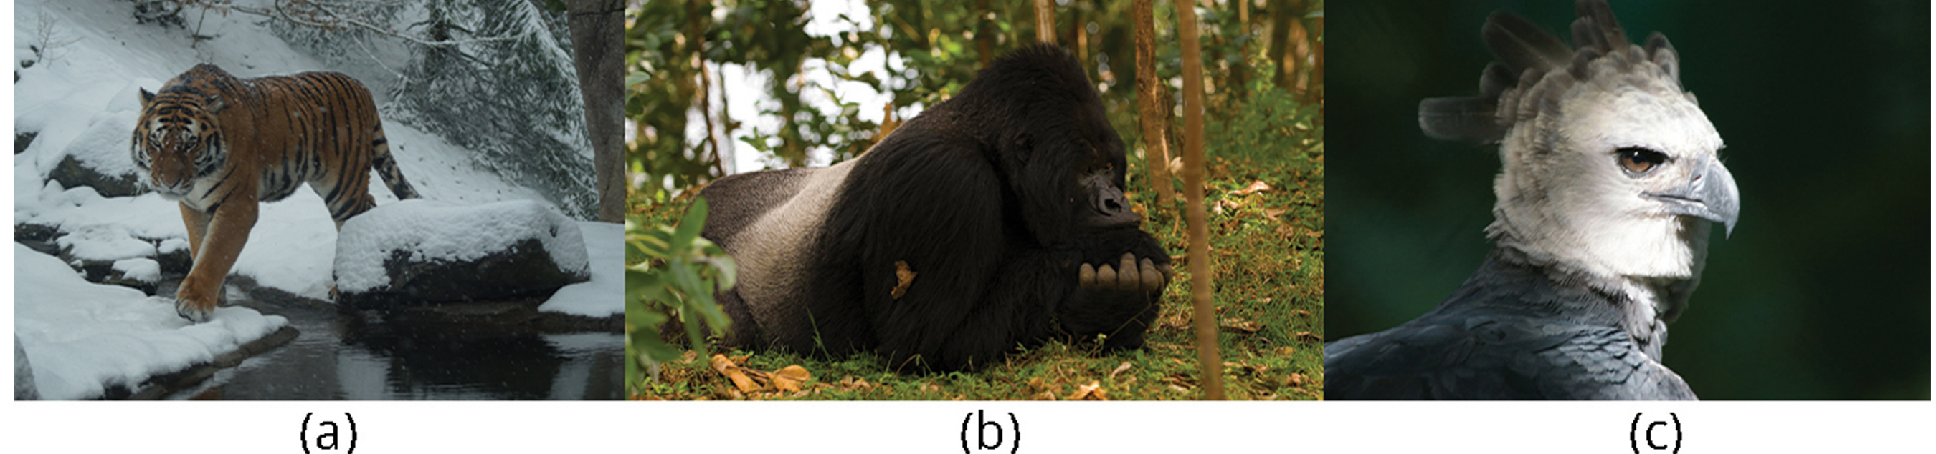
Vertebrates
Most recognizable organisms in animal kingdom
Over 62,000 identified vertebrate species
Living species only small portion of all species that have existed
Best-known extinct vertebrates are dinosaurs (unique group of reptiles of unusual size)
Dominant terrestrial animals for 150 million years until dying out in mass extinction near end of Cretaceous Period (except for feathered theropod ancestors of modern birds, which have now 10,000 species)
Cause of mass extinction unknown, but fossil record gives information about anatomy of dinosaurs and early birds because of preservation of skeletal elements, nests, eggs, and embryos
29.1 Figure 1: Examples of critically endangered vertebrate species include (a) the Siberian tiger (Panthera tigris), (b) the mountain gorilla (Gorilla beringei), and (c) the harpy eagle (Harpia harpyja). The harpy eagle is considered "near threatened" globally but critically endangered in much of its former range in Mexico and Central America.
Albinfo on Wikimedia Commons. "Siberian tiger."
Maxime Ishmax on Wikimedia Commons. "Mountain gorilla."
Haui Ared on Wikimedia Commons. "Harpy eagle."

Slide 4
Chordates₁
Vertebrates exhibit two major innovations in evolution that differentiate them from invertebrate chordates
May be associated with whole genome duplications that resulted in quadruplication of basic chordate genome, including Hox genes that regulate placement of structures along three axes of body
Innovations:
Emergence of quadrupeds in form of amphibians
Evolution of amniotic egg (freed terrestrial animals from dependence on water for fertilization and embryonic development)
Amniote innovation: Modifications of keratinous epidermal structures, which gave rise to scales, claws, hair, and feathers
Scales of reptiles sealed skin against water loss
Hair and feathers provided insulation to support evolution of endothermy (ability to generate body heat to maintain relatively constant internal temperature)
Hair and feathers also provided camouflage and helped with mate attraction in vertebrate lineages that led to birds and mammals

Slide 5
Chordates₂
Several vertebrate species going extinct because of habitat loss and pollution
IUCN reports more than 6,000 vertebrate species classified as threatened
Amphibians and mammals at the greatest risk: 29% of amphibians and 21% of mammals threatened
Attempts to prevent extinction:
Biodiversity Action Plan: International program (ratified by 188 countries) designed to protect species and habitats

Slide 6
Chordates₃
Vertebrates: Members of kingdom Animalia and phylum Chordata
Possess bilateral symmetry
Divided into two groups based on patterns of embryonic development: Protostomes and deuterostomes
Deuterostomes divided into two major phyla: Echinodermata and Chordata
Echinoderms: Invertebrate marine animals with pentaradial symmetry and spiny body covering (include sea stars, sea urchins, and sea cucumber)
Chordata: Most conspicuous and familiar members are vertebrates but also includes two groups of invertebrate chordates

Slide 7
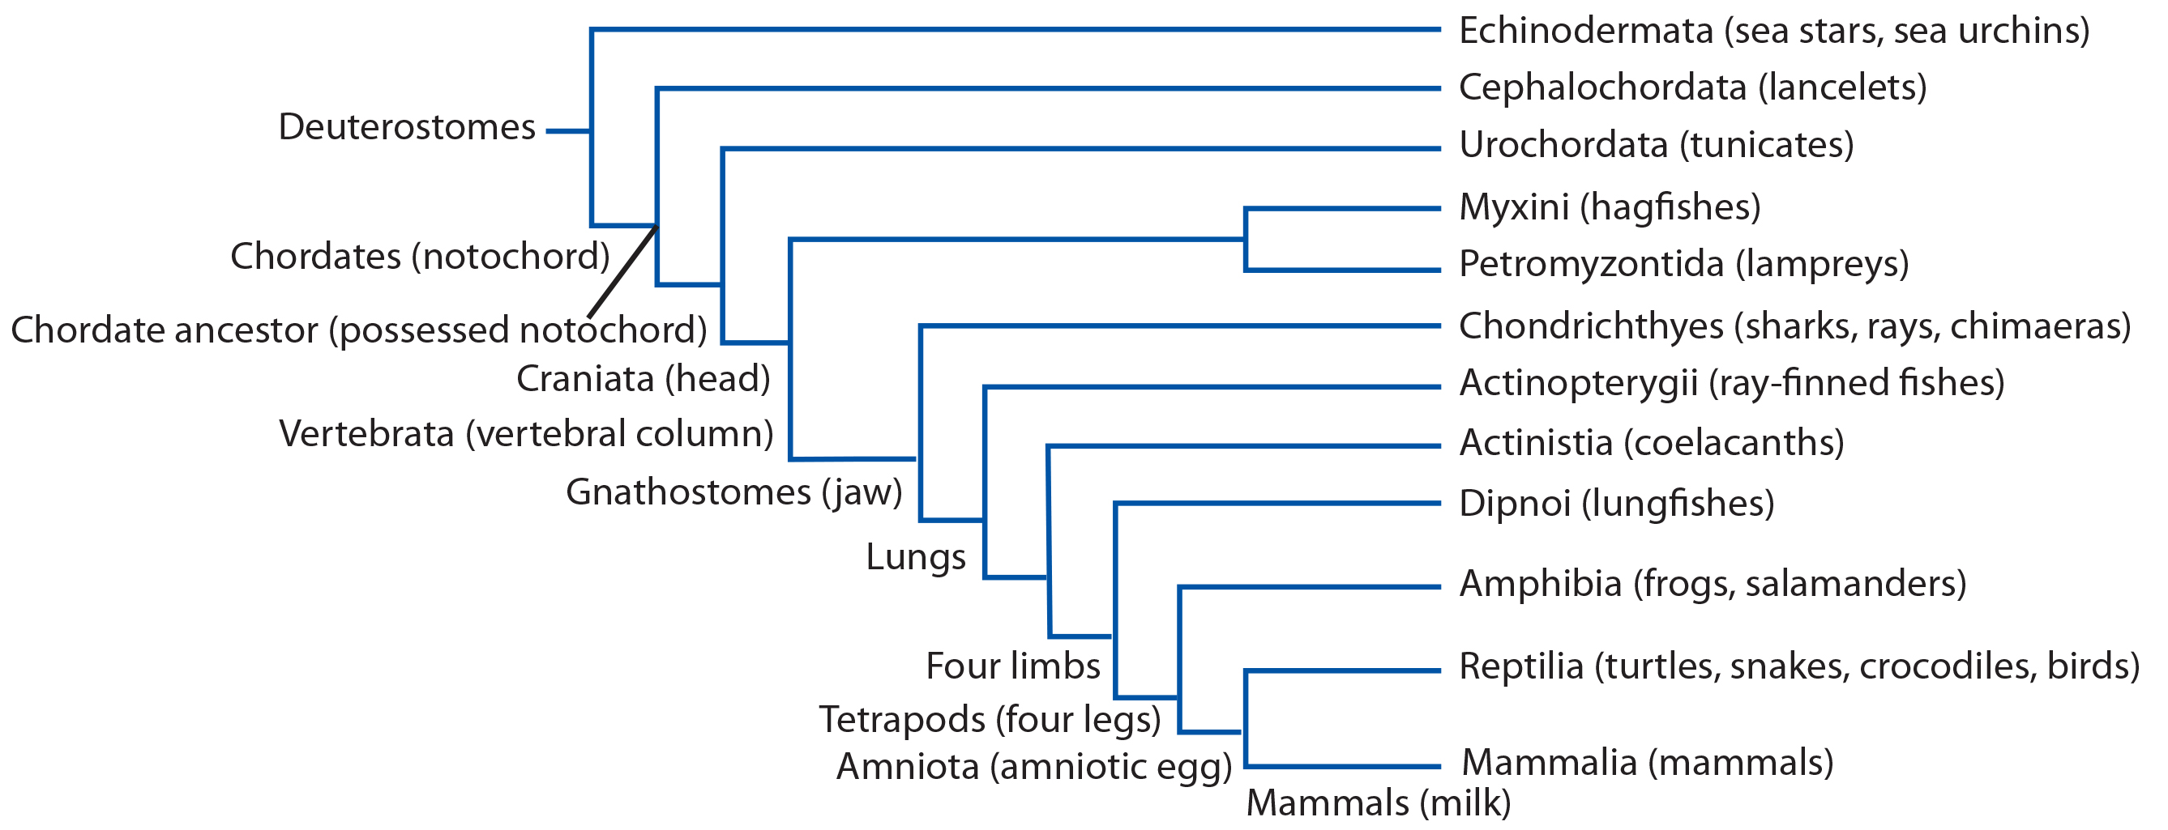
29.1 Figure 2
CNX OpenStax on Wikimedia Commons. "Phylogeny of deuterostomes."
Notes:
Figure 2: The phylogeny of deuterostomes is shown. All chordates are deuterostomes possessing a notochord at some stage of their life cycle.

Slide 8
Reflection Question
Bilateral symmetry is commonly seen across vertebrate species. Can you think of why bilateral symmetry might be an advantageous body plan that was selected for by evolutionary processes?
Notes:
The reflection question is included here to use as a talking point or for a think-pair-share activity.

Slide 9
Characteristics of Chordata₁
Chordata: phylum of animals distinguished by their possession of a notochord, a dorsal hollow nerve cord, pharyngeal slits, an endostyle or thyroid gland, and a postanal tail at some point during their development
Some characteristics only present during embryonic development in certain groups

Slide 10
Characteristics of Chordata₂
Notochord: flexible, rod-shaped support structure that is found in the embryonic stage of all chordates and in the adult stage of some chordates
Strengthened with glycoproteins similar to cartilage and covered with collagenous sheath
Located between digestive tube and nerve cord
Provides rigid skeletal support and flexible location for attachment of axial muscles
In some, it acts as primary axial support of body throughout lifetime
In vertebrates, only present during embryonic development to induce development of neural tube (hollow structure from which the brain and spinal cord form) and support developing embryonic body
Replaced by vertebral column

Slide 11
Characteristics of Chordata₃
Dorsal hollow nerve cord: hollow, tubular structure derived from ectoderm, which is located dorsal to the notochord in chordates
Derived from ectoderm that rolls into hollow tube during development
Develops into brain and spinal cord in vertebrates, which comprise central nervous system
Peripheral nervous system includes peripheral nerves (including cranial nerves) lying outside of brain and spinal cord
Protostome animal phyla have solid nerve cords located ventrally and/or laterally to gut

Slide 12
Characteristics of Chordata₄
Pharyngeal slit: opening in pharynx (region just posterior to mouth) that extends to outside environment
In aquatic environments, slits allow for exit of water that enters mouth during feeding
Some invertebrate chordates use slits to filter food out of water that enters mouth
In vertebrate fishes, slits modified into gill supports
In jawed fishes, slits modified into jaw supports
In tetrapods (land vertebrates), slits highly modified into components of ear, tonsils, and thymus glands
In other vertebrates, pharyngeal arches (derived from all three germ layers) forms oral jaw from first pharyngeal arch, and second arch becomes hyoid and jaw support

Slide 13
Characteristics of Chordata₅
Endostyle: a longitudinal, ciliated groove on the floor of the pharynx that produces mucus to gather food particles to assist in filter feeding
Food particles trapped in mucus move along endostyle toward gut
Produces substances like thyroid hormones and homologous to thyroid gland in vertebrates
In vertebrates, thyroid hormones produced by thyroid gland regulate metabolism, growth, and development
Postanal tail: muscular, posterior elongation of the body extending beyond the anus in chordates
Contains skeletal elements and muscles, which provide source of locomotion in aquatic species (e.g., fishes)
In some terrestrial vertebrates, tail also helps with balance, courting, and danger signaling
In humans and other great apes, tail reduced to vestigial coccyx ("tail bone") and aids in balance during sitting

Slide 14
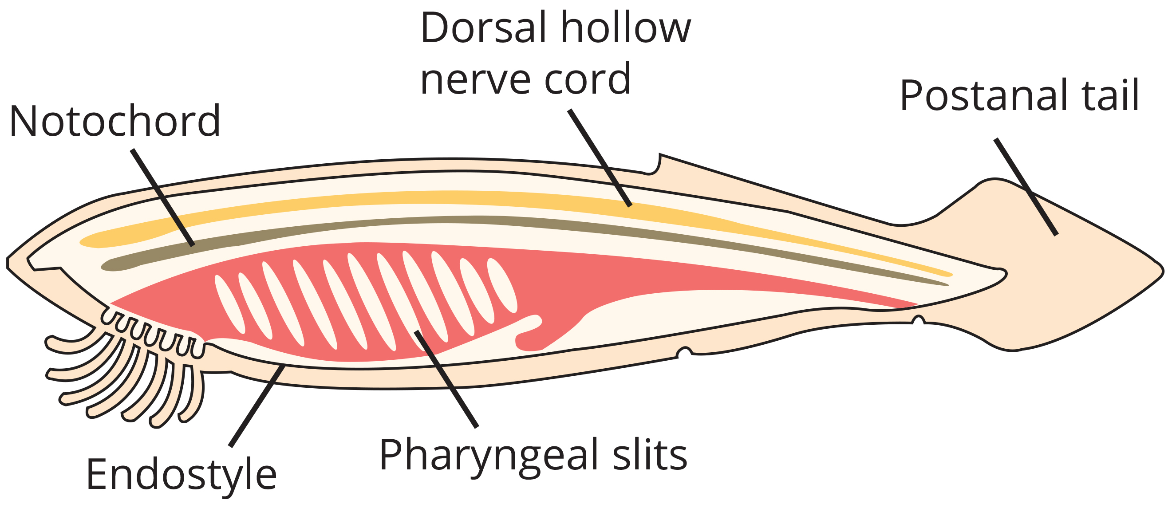
29.1 Figure 3
CNX OpenStax on Wikimedia Commons. "Characteristics of chordates."
Notes:
Figure 3: In chordates, five common features appear at some point during development: a notochord, a dorsal hollow nerve cord, pharyngeal slits, an endostyle/thyroid gland, and a postanal tail. The endostyle is embedded in the floor of the pharynx.

Slide 15
Chordates and the Evolution of Vertebrates
Two clades of invertebrate chordates:
Cephalochordata
Urochordata
Members possess the five features of chordates at some point during development

Slide 16
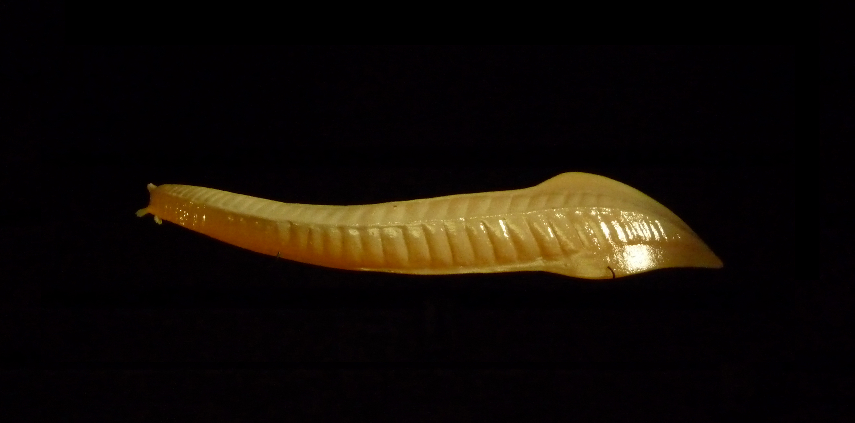
Cephalochordata₁
Cephalochordata: chordate clade whose members possess a notochord, a dorsal hollow nerve cord, pharyngeal slits, an endostyle, and a postanal tail in the adult stage
Notochord extends into head, which gives subphylum its name
No well-defined brain
Nervous system centered around hollow nerve cord lying above notochord
Extinct members include Pikaia, oldest known cephalochordate
Preserved fossils recovered from Burgess Shale in Canada and date to middle of Cambrian Period (more than 500 million years old)
Anatomy resembles extant lancelet in genus Branchiostoma
29.1 Figure 4: This is a rendering of a Pikaia, the oldest known cephalochordate. It was believed to be prevalent in marine environments approximately 500 MYA.
Citron on Wikimedia Commons. "Pikaia."

Slide 17
Cephalochordata₂
Lancelet: member of Cephalochordata; named for its bladelike shape
Few centimeters long
Usually found buried in sand at bottom of warm temperate and tropical seas
Suspension feeders
Water current created by cilia in mouth and filtered through oral tentacles
Water from mouth enters pharyngeal slits, which filter out food particles
Filtered water collects in gill chamber called an atrium and exits through atriopore
Trapped food particles caught in stream of mucus produced by endostyle in ventral ciliated fold (or groove) of pharynx and carried to gut
Most gas exchange occurs across body surface
Sexes separate
Gametes released into water through atriopore for external fertilization

Slide 18
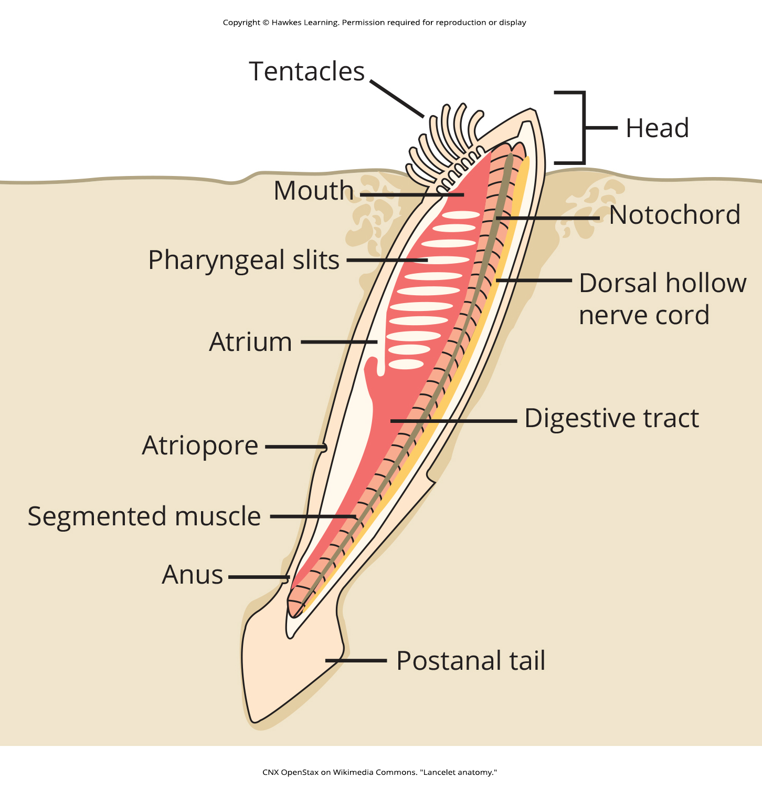
29.1 Figure 5
CNX OpenStax on Wikimedia Commons. "Lancelet anatomy."
Notes:
Figure 5: In the lancelet and other cephalochordates, the notochord extends into the head region. Adult lancelets retain all five key characteristics of chordates: a notochord, a dorsal hollow nerve cord, pharyngeal slits, an endostyle, and a postanal tail.

Slide 19
Urochordata₁
Urochordata: clade composed of tunicates
Approximately 3,000 species
Tunicate: sessile chordate that is a member of Urochordata
Name derived from cellulose-like carbohydrate material called tunic that covers outer body of tunicates
Classified as chordates, but adults do not have notochord, dorsal hollow nerve cord, or postanal tail
Do have pharyngeal slits and endostyle
Larval form has all five structures
Most are hermaphrodites
Larvae hatch from eggs inside adult
After hatching, larva (possessing all five chordate features) swims until it finds suitable surface to attach to, usually dark or shaded location
Then attaches via head to surface and undergoes metamorphosis into adult form, when notochord, nerve cord, and tail disappears (pharyngeal gill slits and endostyle remain)

Slide 20
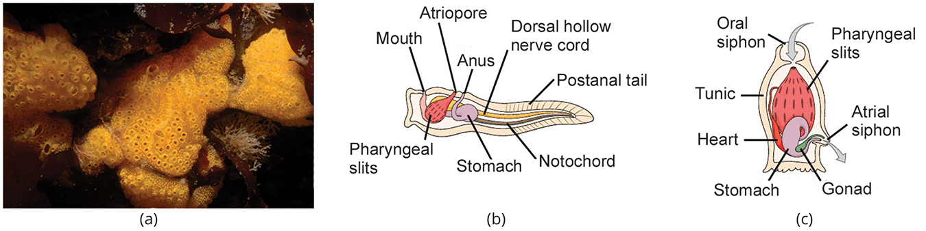
29.1 Figure 6
U.S. Geological Survey/photo by Dann Blackwood (USGS) on Wikimedia Commons. "Botrylloides violaceus."
OpenStax on Wikimedia Commons. "Tunicate larva anatomy."
OpenStax on Wikimedia Commons. "Tunicate adult anatomy."
Notes:
Figure 6: (a) This photograph shows a colony of the tunicate Botrylloides violaceus. (b) The larval stage of the tunicate possesses all of the features characteristic of chordates: a notochord, a dorsal hollow nerve cord, pharyngeal slits, an endostyle, and a postanal tail. (c) In the adult stage, the notochord, nerve cord, and tail disappear, leaving just the pharyngeal slits and endostyle.

Slide 21
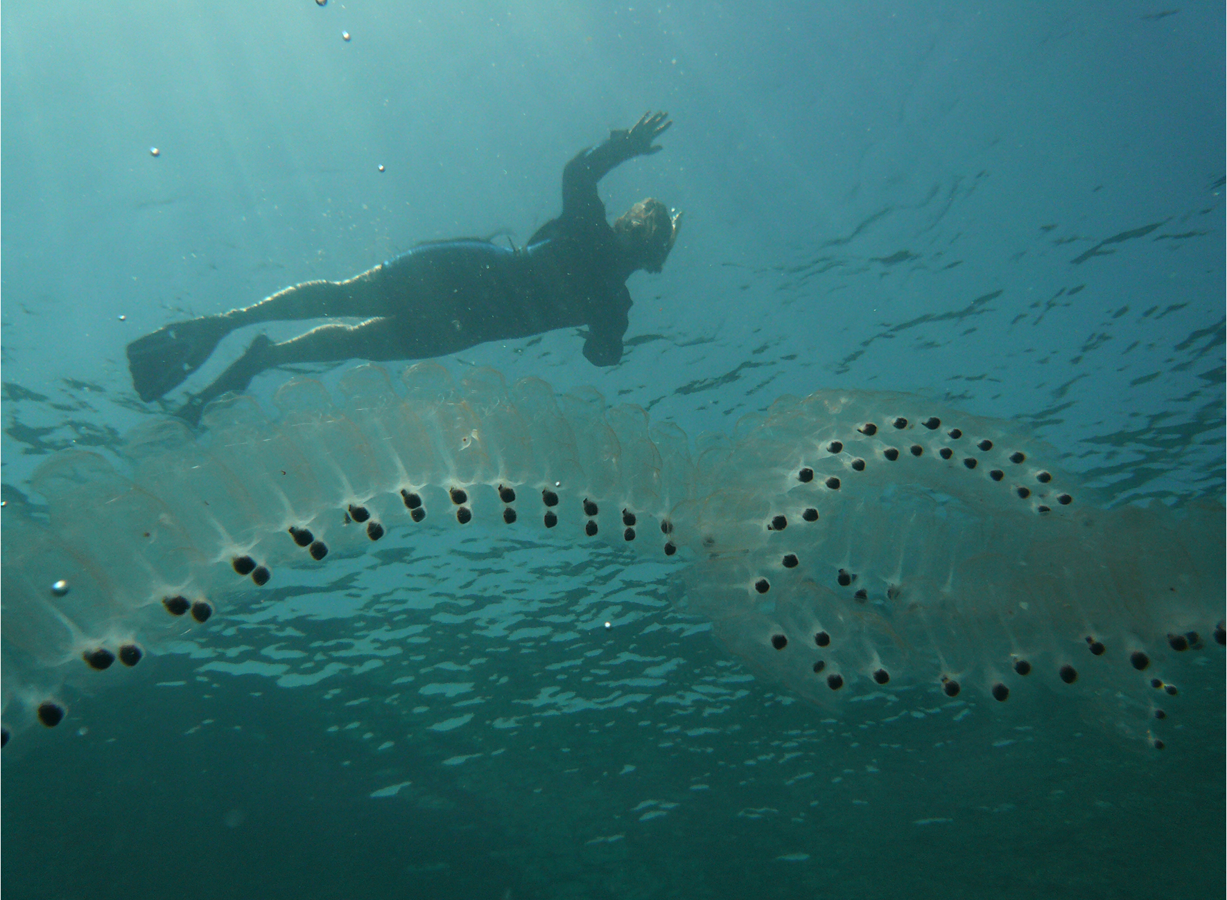
Urochordata₂
Adults may be either solitary or colonial forms
May reproduce by budding
Live sessile existence on ocean floor
Suspension feeders
However, chains of tunicates called salps (members of class Thaliacea) can swim while feeding, propelling themselves as they move water through pharyngeal slits
Primary food are plankton and detritus
Seawater enters body through oral siphon (incurrent siphon)
Suspended material filtered out of water by mucous net produced by endostyle and passed into intestine via action of cilia
Anus empties into atrial siphon (excurrent siphon), which expels wastes and water
Found in shallow ocean waters around the world
29.1 Figure 7: These colonial tunicates feed on phytoplankton. Salps are sequential hermaphrodites, with younger female colonies fertilized by older male colonies.
Lars Plougmann on Wikimedia Commons. "Salps."

Slide 22
Subphylum Vertebrata (Craniata)₁
Cranium: bony, cartilaginous, or fibrous structure surrounding the brain, jaw, and facial bones
Most bilaterally symmetrical animals have head
Those with cranium comprise clade Craniata/Vertebrata (include primitively jawless Myxini [hagfishes], Petromyzontida [lampreys], and all vertebrates)
Myxini have cranium but no backbone
Craniata: clade composed of chordates that possess a cranium; includes Vertebrata together with hagfishes
Vertebrata: members of the phylum Chordata that possess a backbone
Display five characteristics of chordates and share derived characteristics to distinguish them from invertebrate chordates

Slide 23
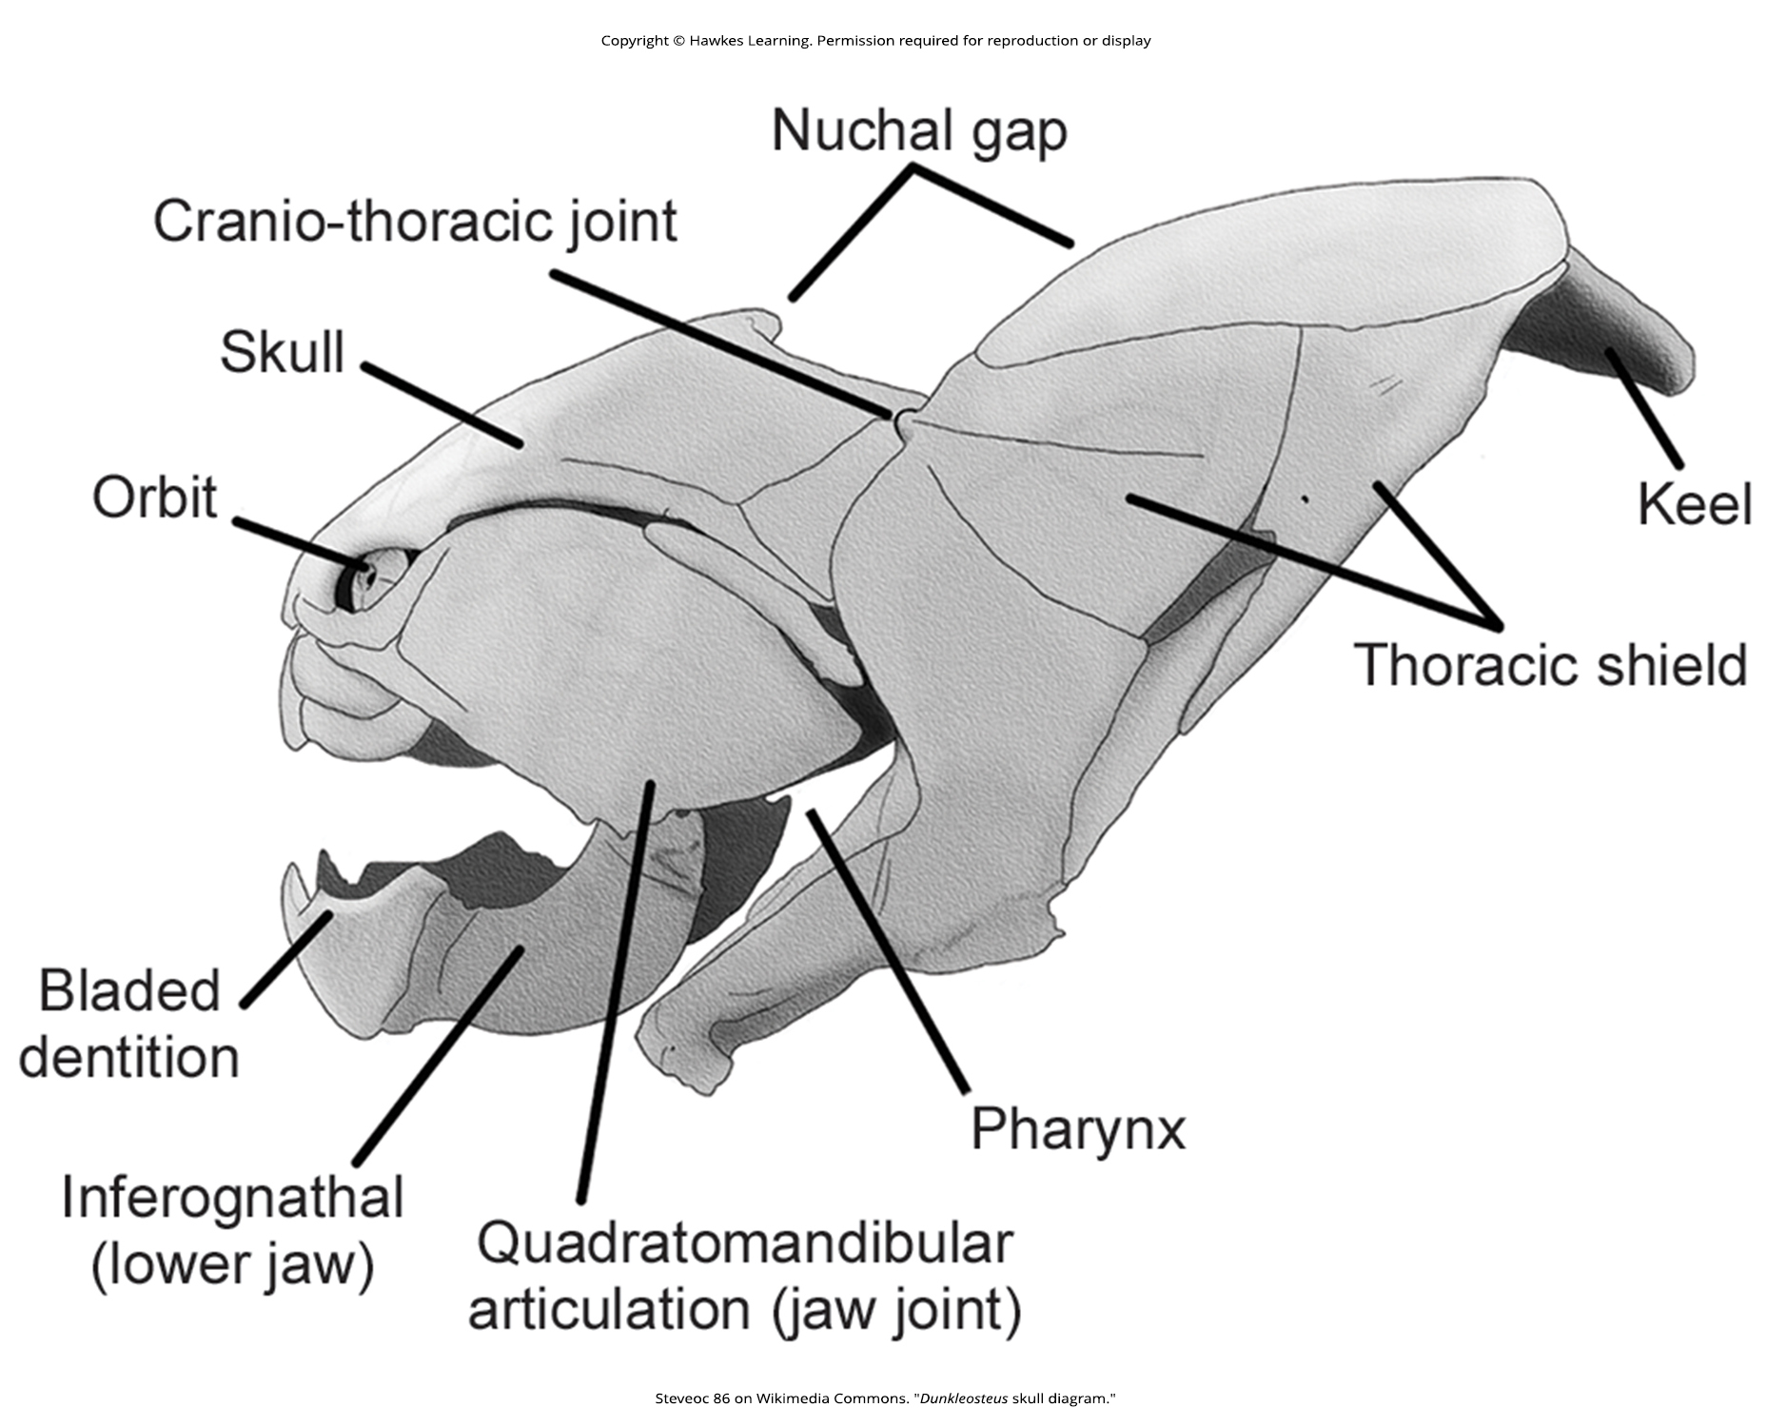
29.1 Figure 8
Steveoc 86 on Wikimedia Commons. "Dunkleosteus skull diagram."
Notes:
Figure 8: The subphylum Craniata (or Vertebrata), including this placoderm fish (Dunkleosteus sp.), is characterized by the presence of a cranium, mandible, and other facial bones.

Slide 24
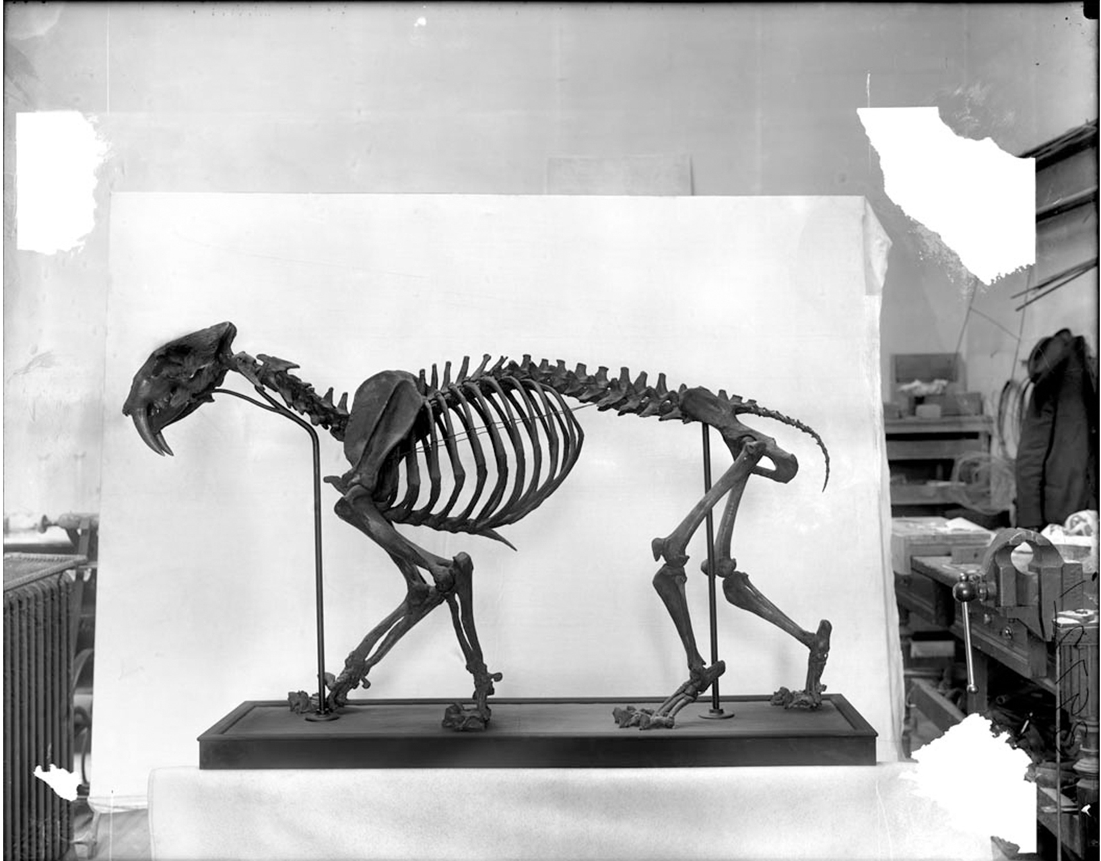
Subphylum Vertebrata (Craniata)₂
Named for vertebral column composed of vertebrae (series of separate, irregularly shaped bones joined together to form a backbone)
Vertebral column: surrounds and protects the spinal cord, supports the head, and acts as an attachment point for ribs and muscles of the back and neck (also, spine)
Vertebrae form in segments around embryonic notochord and eventually replace it in adults
Notochord becomes nucleus pulposus of intervertebral discs that cushion and support adjacent vertebrae
29.1 Figure 9: Vertebrata are characterized by the presence of a backbone, such as the one that runs through the middle of this sabertooth skeleton. All vertebrates are in the Craniata clade and have a cranium.
The Field Museum Library on Wikimedia Commons. "Sabertooth skeleton."

Slide 25
Subphylum Vertebrata (Craniata)₃
Relationship of vertebrates to invertebrate chordates debated
Cladistic relationship still being examined
Appears Craniata/Vertebrata are monophyletic group that shares five basic chordate characteristics with two subphyla, Urochordata and Cephalochordata
Traditional phylogenies place urochordates as basal chordate
Modern molecular analyses indicated cephalochordates likely the ancestral chordate

Slide 26
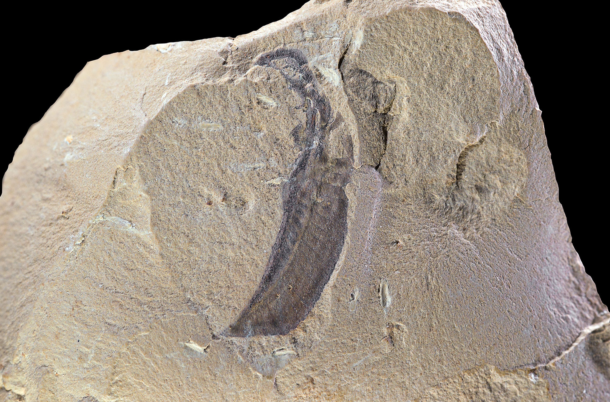
Subphylum Vertebrata (Craniata)₄
Urochordates closest living relative (and sister taxa) of vertebrates
Believed to have evolved during Cambrian explosion (541 MYA–531 MYA)
Earliest fossils come from early Cambrian fossil deposits, the Maotianshan Shales in China, dated to 520 MYA
Had notochord, rudimentary vertebrae, and defined skulls, though lacked jaws
29.1 Figure 10: A Haikouella fossil discovered in China is shown. Haikouella is conjectured to be one of the oldest members of the vertebrates in the fossil record.
Didier Descouens on Wikimedia Commons. "Haikouella fossil."

Slide 27
Subphylum Vertebrata (Craniata)₅
Largest group of chordates (more than 62,000 living species) grouped based on anatomical and physiological traits
More than one classification or naming scheme, but traditional groups, which constitute classes in subphylum Craniata/Vertebrata, are:
Agnatha
Hagfishes and lampreys together as jawless fishes, though classification schemes separate them into chordate jawless fishes (hagfishes) and vertebrate jawless fishes (lampreys)
Chondrichthyes
Osteichthyes
Amphibia
Reptilia
Birds classified within Reptilia, which reflects evolutionary heritage
Divided into non-avian and avian reptiles
Aves
Mammalia

Slide 28
Subphylum Vertebrata (Craniata)₆
Gnathostome: jawed fish
Include fishes and tetrapods
Tetrapod: phylogenetic reference to an organism with a four-footed evolutionary history; includes amphibians, reptiles, birds, and mammals
"Four-footed" refers to phylogenetic history of various land vertebrates even though some tetrapods' limbs may have been modified for purposes other than walking
Include amphibians, reptiles, birds, and mammals and could include extinct fishlike groups that gave rise to tetrapods
Divided into two groups: Amphibians and amniotes
Amniotes:
Animals whose eggs contain four extraembryonic membranes (yolk sac, amnion, chorion, and allantois) that provide nutrition and water-retaining environment for embryos
Adapted for terrestrial living and include mammals, reptiles, and birds

Slide 29
Summary
Five characteristic features: Notochord, dorsal hollow tubular nerve cord, pharyngeal slits, endostyle/thyroid gland, and postanal tail
Contains two clades of invertebrates: Urochordata (tunicates) and Cephalochordata (lancelets)
Contain vertebrates: Craniata/Vertebrata
Lancelets:
Suspension feeders
Feed on phytoplankton and other microorganisms
Tunicates:
Live on ocean floor
Suspension feeders
Debate continues about relationship between invertebrate clades and vertebrates, but molecular evidence suggests urochordates most closely related to vertebrates
Vertebrata: Named for vertebral column
Craniata (organisms with cranium) synonymous with Vertebrata

Slide 30

End of Hawkes Learning PowerPoint

