Slide 1
Lesson 29.2
Fishes

Slide 2
Objectives
Describe the difference between jawless and jawed fishes.
Compare and contrast cartilaginous fishes and bony fishes.
Identify and define the terminology of various fishes.

Slide 3
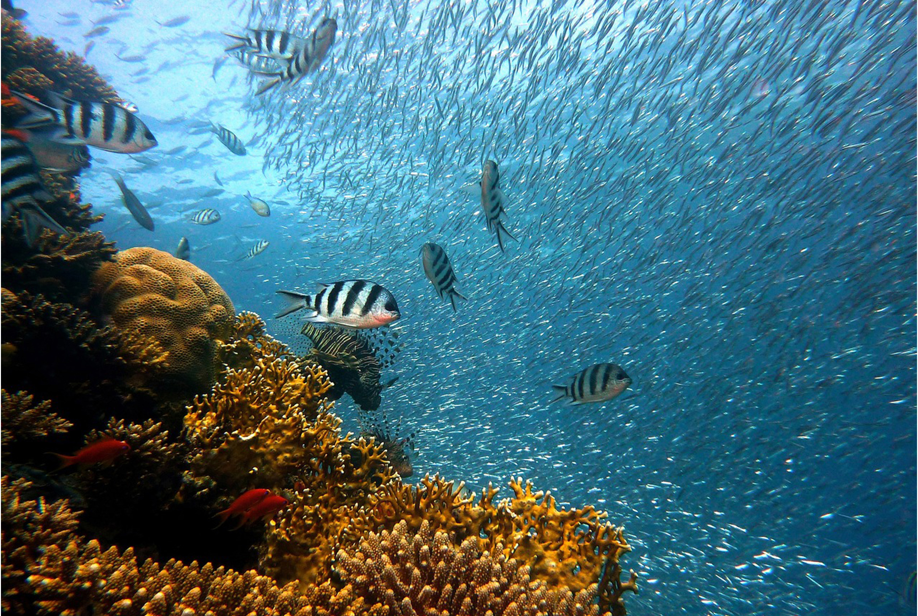
Fishes
Estimated 32,000 species, largest clade within Vertebrata
Earliest vertebrates, with jawless species evolving first
Active feeders rather than sessile, suspension feeders
Agnatha (jawless fishes that include hagfishes and lampreys) have distinct cranium and complex sense organs, including eyes
Distinguishes them from invertebrate chordates (urochordates and cephalochordates)
29.2 Figure 1: More than any other vertebrate clade, an estimated 32,000 fish species exist today.
joakant on Pixabay. "Fish."

Slide 4
Jawless Fishes: Superclass Agnatha₁
Craniates, representing ancient vertebrate lineage, arose over 550 MYA
Include hagfishes and lampreys
Recent molecular data (rRNA and mtDNA) and embryological data support hypothesis that living agnathans (previously cyclostomes) are monophyletic and share recent common ancestry
Defining features: Lack of jaws, paired lateral appendages (fins)
Also lack internal ossification and scales but not defining features in clade

Slide 5
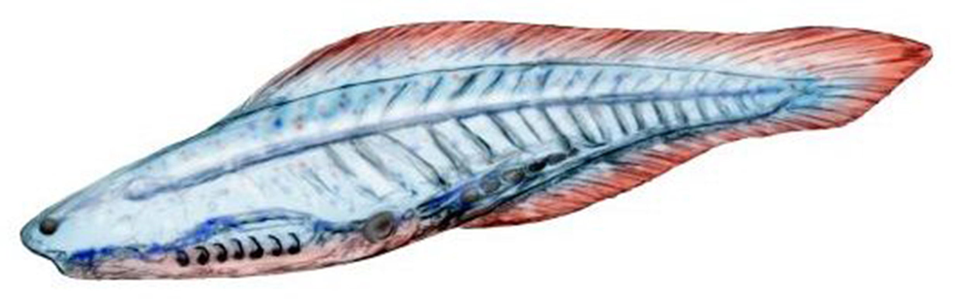
Jawless Fishes: Superclass Agnatha₂
Earliest forms were armored ostracoderms
Ostracoderm: one of the earliest jawless fish covered in bone
Some may have had paired fins, unlike living jawless fishes
Represent an assemblage of heavily armored extinct jawless fishes that may not form a natural evolutionary group
Fossils of genus Haikouichthys dated to 520 million years
Show many typical vertebrate characteristics: Paired eyes, auditory capsules, and rudimentary vertebrae
29.2 Figure 2: This reconstruction of Haikouichthys, one of the earliest jawless fishes, is based on fossils from approximately 520 MYA.
Nobu Tamura on Wikimedia Commons. "Haikouichthys."

Slide 6
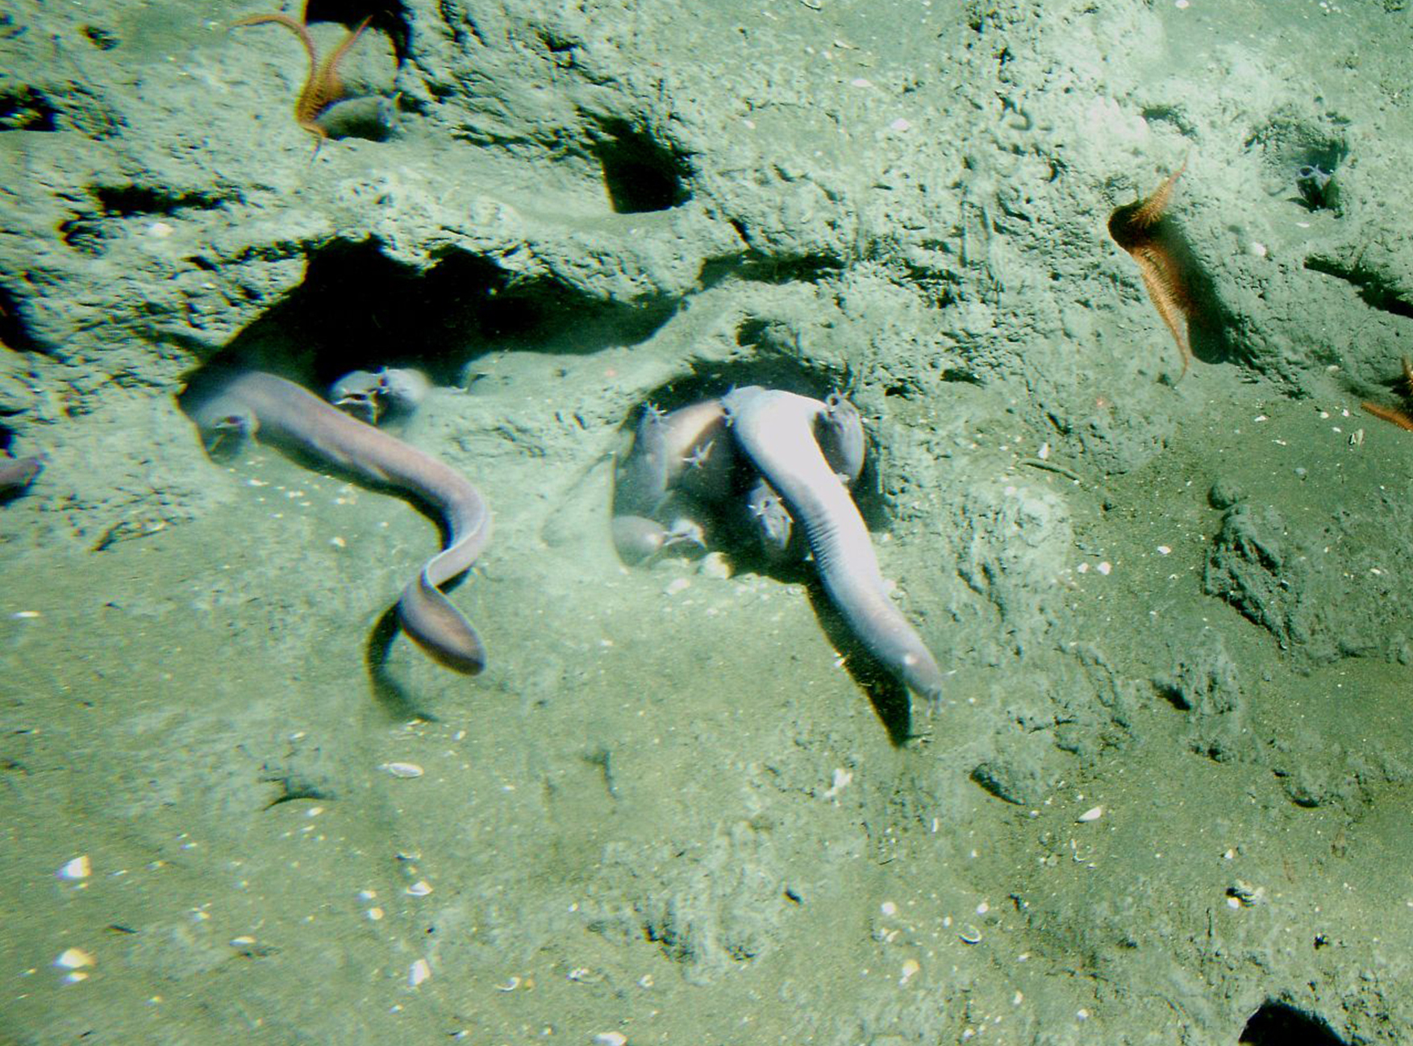
Class Myxini: Hagfishes₁
Myxini: hagfishes
Hagfish: eel-like jawless fish that live on the ocean floor and are scavengers
Feeding:
Feed on living or dead invertebrates, fishes, and marine mammals
Almost completely blind, but sensory barbels around mouth help them locate food by smell or touch
Feed using keratinized teeth on movable cartilaginous plate in mouth, which rasp pieces of flesh from prey
Allows gills to be used exclusively for respiration, not filter feeding (like in urochordates and cephalochordates)
Entirely marine and found in oceans worldwide, expect in polar regions
29.2 Figure 3: Pacific hagfishes are scavengers that live on the ocean floor.
Linda Snook, NOAA/CBNMS on Wikimedia Commons. "Pacific hagfish."

Slide 7
Class Myxini: Hagfishes₂
Structure:
Slime glands beneath skin release milky mucus (through surface pores) that becomes slippery upon contact with water, making animal impossible to hold
Allows hagfish to escape from predators
Can twist body into knot, providing leverage to feed
Sometimes enter bodies of dead animals and eat from inside out
Do not have a stomach
Alimentary (digestive) canal is straight, membrane-enclosed tube that passes from pharynx to intestine, where nutrients are absorbed
Have cartilaginous skull and fibrous and cartilaginous skeleton
Major supportive structure is notochord that runs length of body
Not replaced by vertebral column

Slide 8
Class Myxini: Hagfishes₃
Evidence suggests hagfish evolved from ancestor that did have vertebral column and lost vertebrae over time
Believed to form monophyletic group with other jawless fishes, the lampreys (both make up basal clade among skull-bearing chordates)

Slide 9
Class Petromyzontida: Lampreys₁
Petromyzontida: clade of lampreys
Lamprey: jawless fish characterized by a toothed, funnel-like, sucking mouth
Approximately 40 species
Similar to hagfishes in size and shape
Defining features (also shared with gnathostomes, vertebrates with jawed mouths and paired appendages):
Extrinsic eye muscles
At least two semicircular canals
True (small) cerebellum
Simple vertebral elements called arcualia (cartilaginous structures arranged above the notochord)
Dorsal tubular nerve cord with well-differentiated brain
Ten pairs of nerves

Slide 10
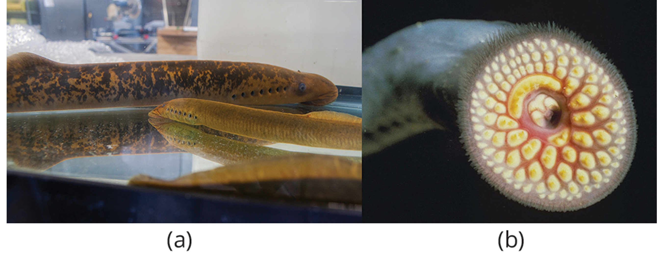
Class Petromyzontida: Lampreys₂
Classification still debated, but they represent one of the oldest divergences of vertebrate lineage
Lack paired appendages but do have fleshy dorsal fins
Adult lampreys characterized by rasping tongue within toothed, funnel-like sucking mouth
Many species have parasitic stage of life cycle during which they are fish ectoparasites
Sometimes called predators because they attach and eventually fall off
29.2 Figure 4: (a) The parasitic sea lamprey, Petromyzon marinus, and the chestnut lamprey, Ichthyomyzon castaneus, attach by suction to their host and use their (b) rough tongues to rasp away flesh in order to feed on the host's blood.
USFWS Midwest Region on Wikimedia Commons. "Sea lamprey and chestnut lamprey."
USFWS on Wikimedia Commons. "Sea lamprey."

Slide 11
Class Petromyzontida: Lampreys₃
Live primarily in coastal and freshwater environments
Have worldwide distribution except tropics and polar regions
Some are marine, but all spawn in fresh water
Northern lampreys have highest number of chromosomes (164 to 174) among vertebrates
Eggs fertilized externally
Larvae (called ammocoetes) differ from adults, which resemble adult cephalochordate amphioxus
Spend 3 to 15 years as suspension feeders in rivers and streams until reaching sexual maturity
Adults swim upstream, reproduce, and die within days after one to three years of feeding on fish as ectoparasites in open water

Slide 12
Gnathostomes: Jawed Fishes₁
Gnathostome: jawed fish
Jaw: a pair of hinged cartilaginous or bony structures attached to the cranium that allows an animal to grasp and tear its food
Milestone in evolution of vertebrates
Probably derived from first pair of gill arches supporting the gills of jawless fishes

Slide 13
Think It Through
Why was the evolution of true jaws such a significant development in the evolution of vertebrates? Contrast the efficiency and function of "true jaws" with the mouth function of the hagfish.
Notes:
Originally an On Your Own. This is included here to use as a talking point or for a think-pair-share activity.

Slide 14
Gnathostomes: Jawed Fishes₂
Early gnathostomes possessed two sets of paired fins for maneuvering
Pectoral fins typically located on anterior body and pelvic fins on posterior
Evolution of jaw and paired fins expanded food options from scavenging and suspension feeding of jawless fishes to active predation
Probably contributed to gnathostomes replacing most jawless fishes during Devonian Period

Slide 15
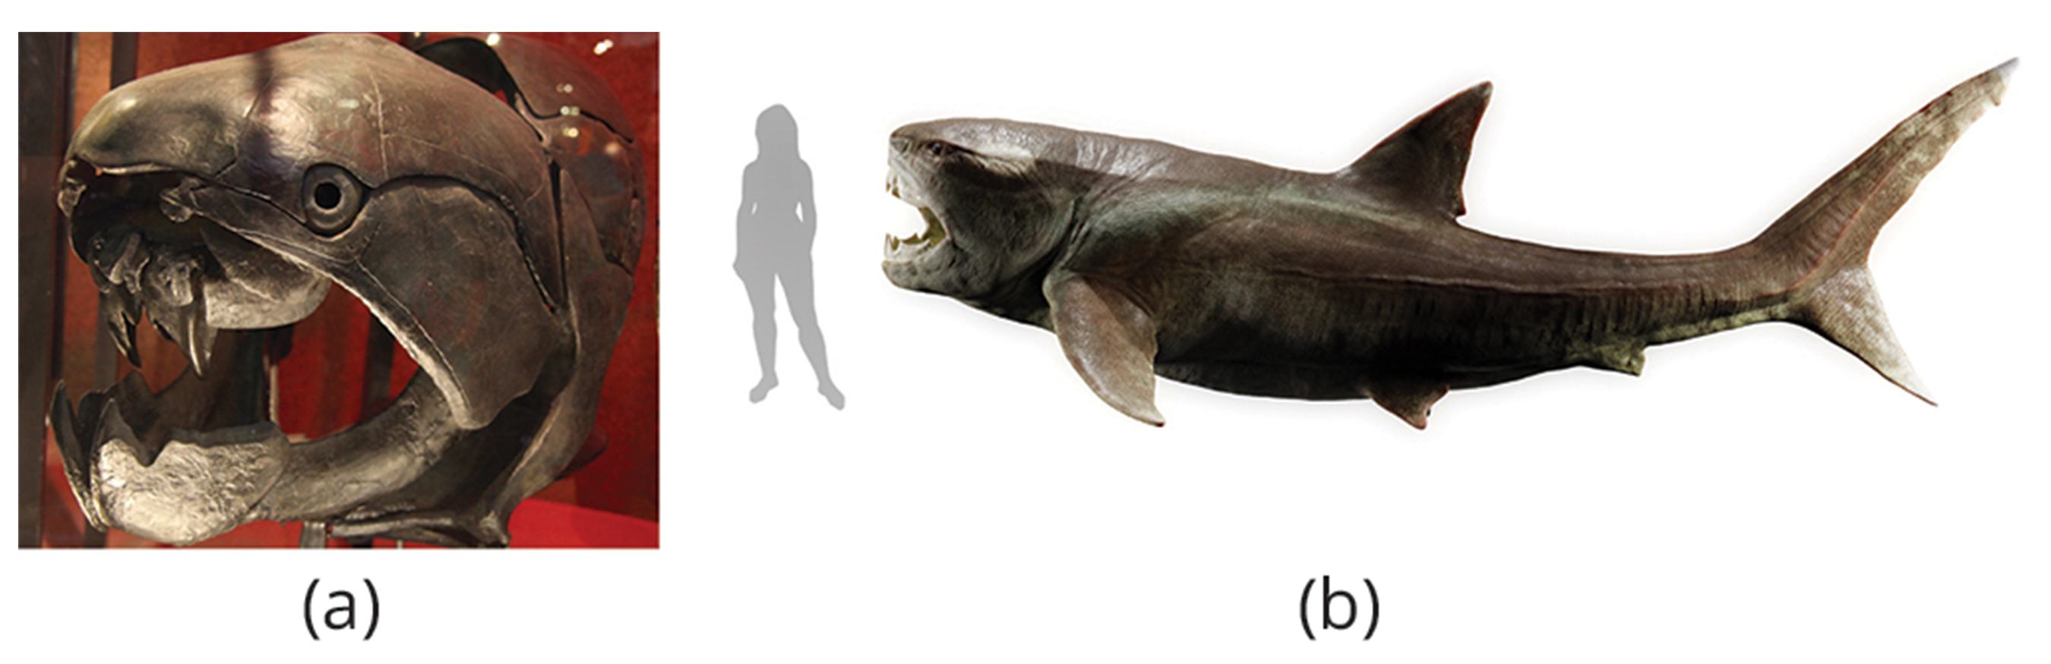
Gnathostomes: Jawed Fishes₃
Two early groups: Acanthodians and placoderms
Arose in late Silurian Perion
Now extinct
Most modern fishes are gnathostomes in class Chondrichthyes and superclass Osteichthyes (includes class Actinopterygii and class Sarcopterygii)
29.2 Figure 5: These images show (a) a placoderm 3-D cranial fossil and (b) a digital reconstruction with a human figure for scale. Dunkleosteus was an enormous placoderm (ancient armored fish) from the Devonian Period, 419 to 359 million years ago.
Tim Evanson on Wikimedia Commons. "Dunkleosteus terrelli skull fossil."
Prehistorica on Wikimedia Commons. "Dunkleosteus terrelli."

Slide 16
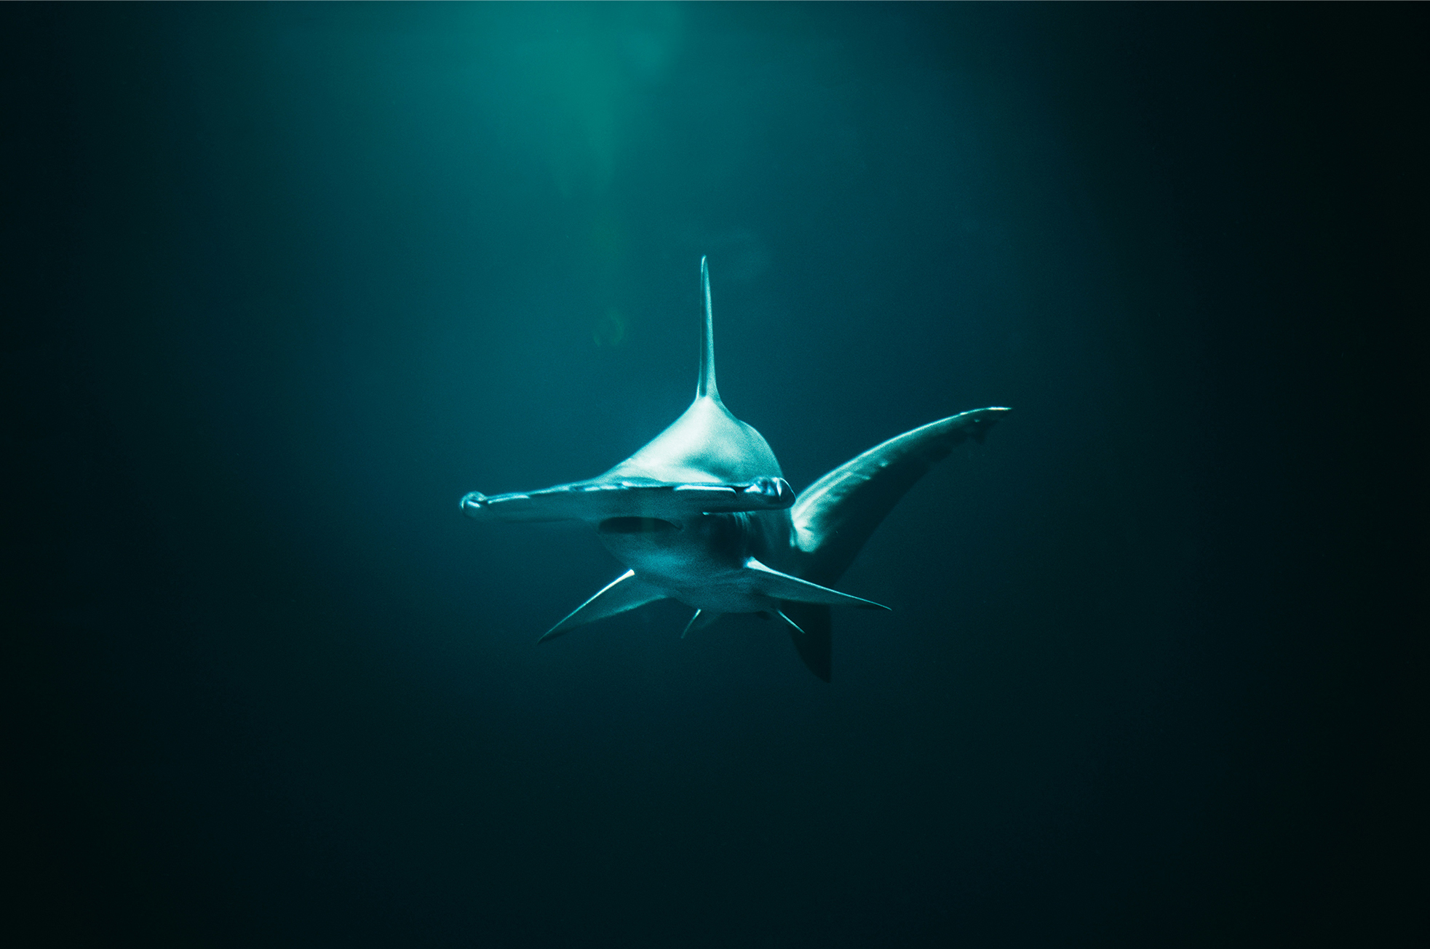
Class Chondrichthyes: Cartilaginous Fishes₁
Chondrichthyes: jawed fish with paired fins and a skeleton made of cartilage
About 1,000 species
Morphologically diverse clade, consisting of subclass Elasmobranchii
Includes sharks, rays, skates, critically endangered sawfishes, and chimaeras ("ghost sharks" in subclass Holocephali)
Arose 430 MYA in early or middle Silurian Period
Thought to be descended from placoderms, which had endoskeletons made of bone, making lighter cartilaginous skeleton of Chondrichthyes a secondarily derived evolutionary development (characteristic that was not inherited from last common ancestor with other vertebrates)
Parts of shark skeleton strengthen by granules of calcium carbonate but not the same as bone
29.2 Figure 6: Hammerhead sharks tend to school during the day and hunt prey at night.
Jonas Allert on Unsplash. "Hammerhead shark."

Slide 17
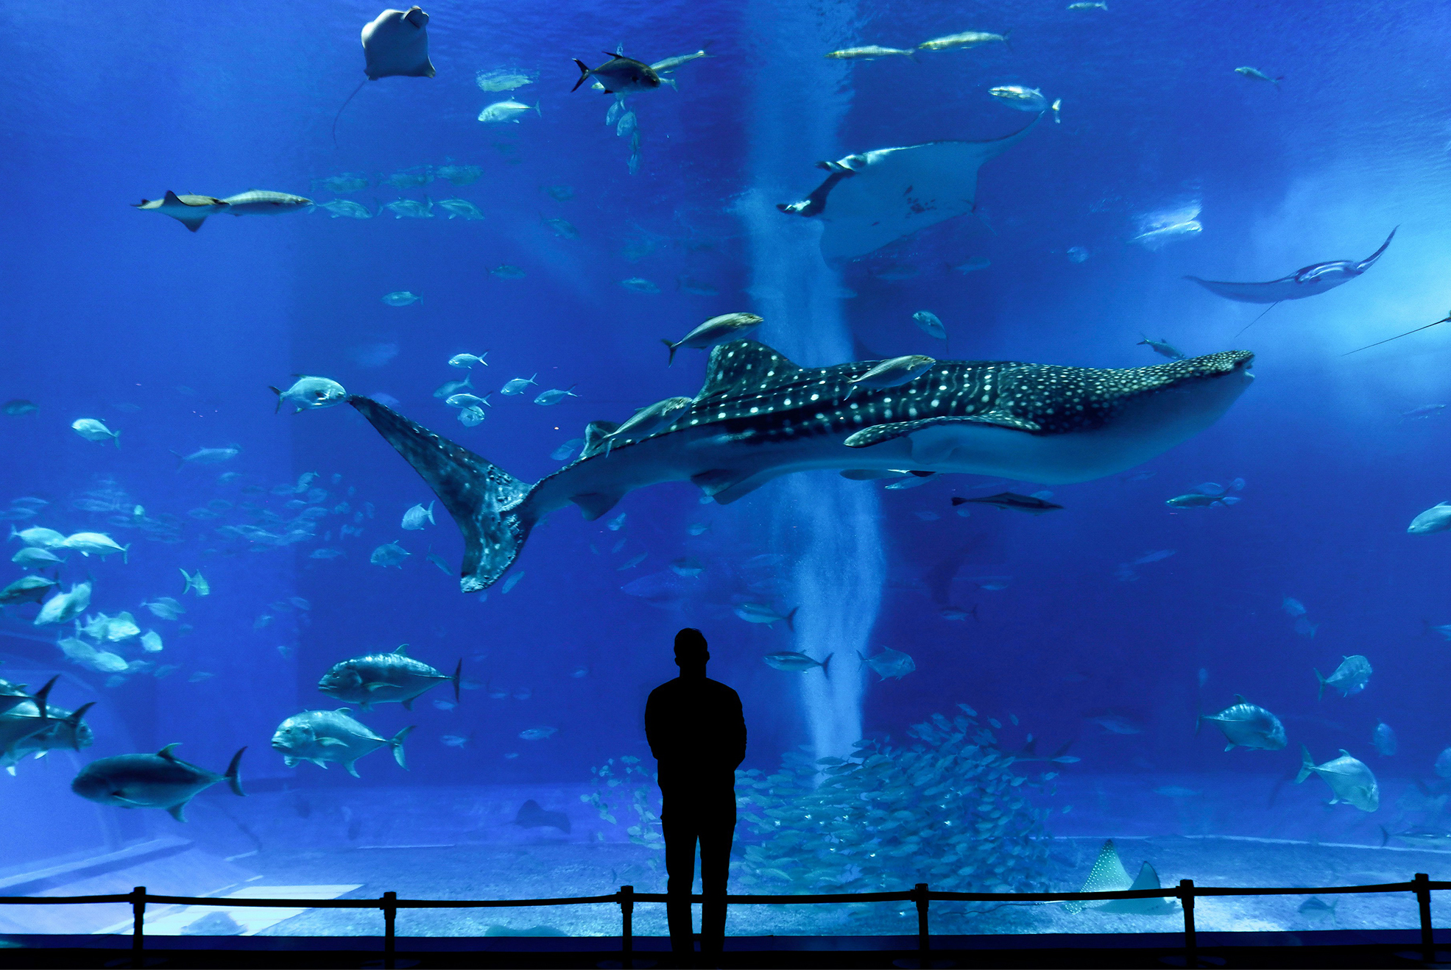
Class Chondrichthyes: Cartilaginous Fishes₂
Mostly marine, with species living in fresh water for part of all of their lives
Most carnivores that feed on live prey, swallowing it whole or using jaws and teeth to tear it into smaller pieces
Have abrasive skin covered with toothlike scales called placoid scales
Teeth probably evolved from rows of scales lining the mouth
Few species of sharks and rays (e.g., enormous whale shark) are suspension feeders, feeding on plankton
Sawfishes have extended rostrum (beaklike projection or snout) that looks like double-edged saw
Rostrum covered with electrosensitive pores that allow sawfish to detect slight movement of prey hiding in muddy sea floor
Teeth in rostrum actually modified toothlike structures called denticles, similar to scales
29.2 Figure 7: This whale shark lives in the Okinawa Churaumi Aquarium. Whale sharks are filter feeders and can grow to be over 10 meters long.
Susann Schuster on Unsplash. "Whale shark."

Slide 18
Class Chondrichthyes: Cartilaginous Fishes₃
Well-developed sense organs that aid in locating prey:
Keen sense of smell
Ability to detect electromagnetic fields
Ampullae of Lorenzini: sensory organ that allows sharks to detect electromagnetic fields produced by living things
Electroreception only been observed in aquatic or amphibious animals
Sharks have most sensitive electroreceptors
Lateral line: sense organ that runs the length of a fish's body; used to detect vibration in the water
Functionally similar to "hearing" in terrestrial vertebrates
Present in sharks, most fishes, and aquatic and larval amphibians
Visible as darker stripe that runs along length of fish's body
Sharks have no mechanism for neutral buoyancy and must swim continuously to stay suspended in water
Some must swim in order to ventilate gills, but others have muscular pumps in mouths to keep water flowing over gills

Slide 19
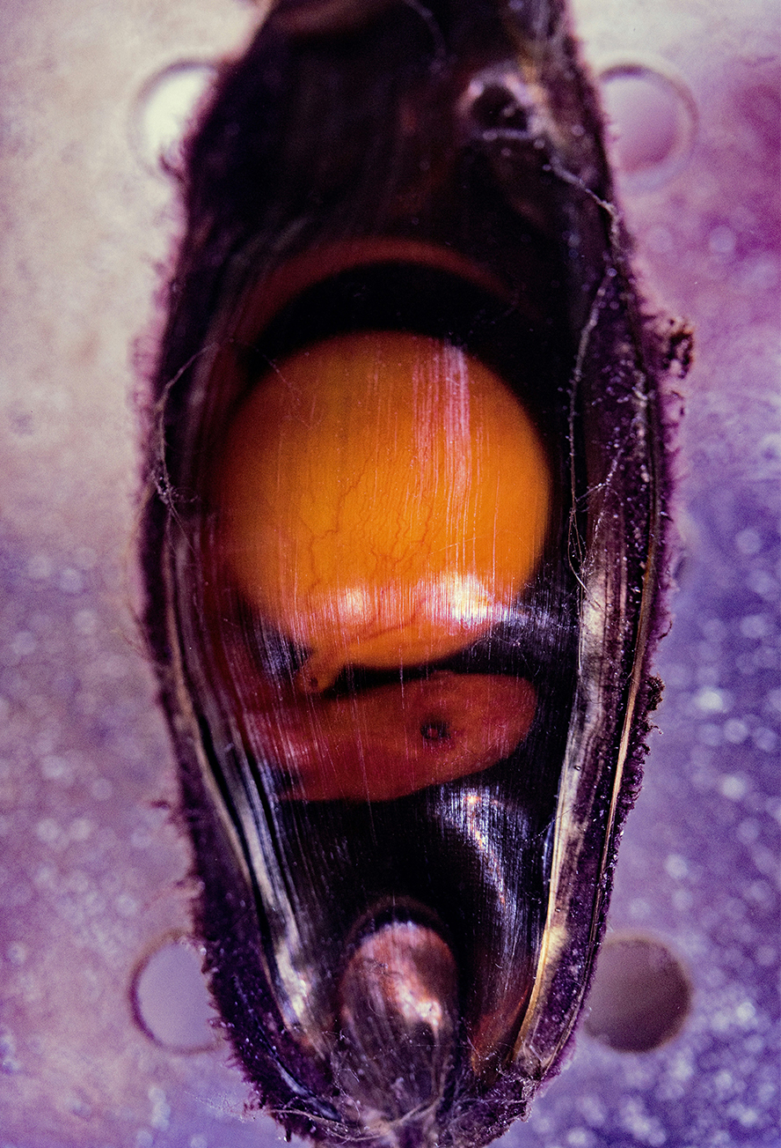
Class Chondrichthyes: Cartilaginous Fishes₄
Reproduce sexually with internal fertilization
Most ovoviviparous:
Fertilized egg retained in oviduct of female's body
Embryo nourished by egg yolk
Eggs hatch in uterus
Young born alive and fully functional
Some are oviparous:
Lay eggs that hatch outside of female's body
Embryos protected by shark egg case or "mermaid's purse" that has consistency of leather
Egg case has tentacles that snag in seaweed and give newborn shark cover
29.2 Figure 8: Shark embryos are clearly visible through this transparent egg case. The round structure is the yolk that nourishes the growing embryo.
David Clode on Unsplash. "Shark embryo."

Slide 20
Class Chondrichthyes: Cartilaginous Fishes₅
Few species (e.g., tiger sharks and hammerheads) are viviparous:
Yolk sac that initially contains egg yolk and transfers its nutrients to the growing embryo becomes attached to oviduct of female
Nutrients transferred directly from female to growing embryo (similar to reproduction in humans, also viviparous)
In both viviparous and ovoviviparous, gas exchange uses yolk sac transport

Slide 21
Class Chondrichthyes: Cartilaginous Fishes₆
Distinct characteristics:
Fusiform or dorsoventrally flattened body
Heterocercal caudal fin or tail (unequally sized fin lobes, with tail vertebrae extending into the larger upper lobe)
Paired pectoral and pelvic fins (in males, these may be modified as claspers)
Exposed gill slits (elasmobranch)
Intestine with spiral valve that condenses the length of the intestine
Three pairs of semicircular canals
Excellent senses of smell, vibration, vision, and electroreception
Large lobed liver produces squalene oil (lightweight biochemical precursor to steroids) that aids with buoyancy because it is lighter than seawater

Slide 22
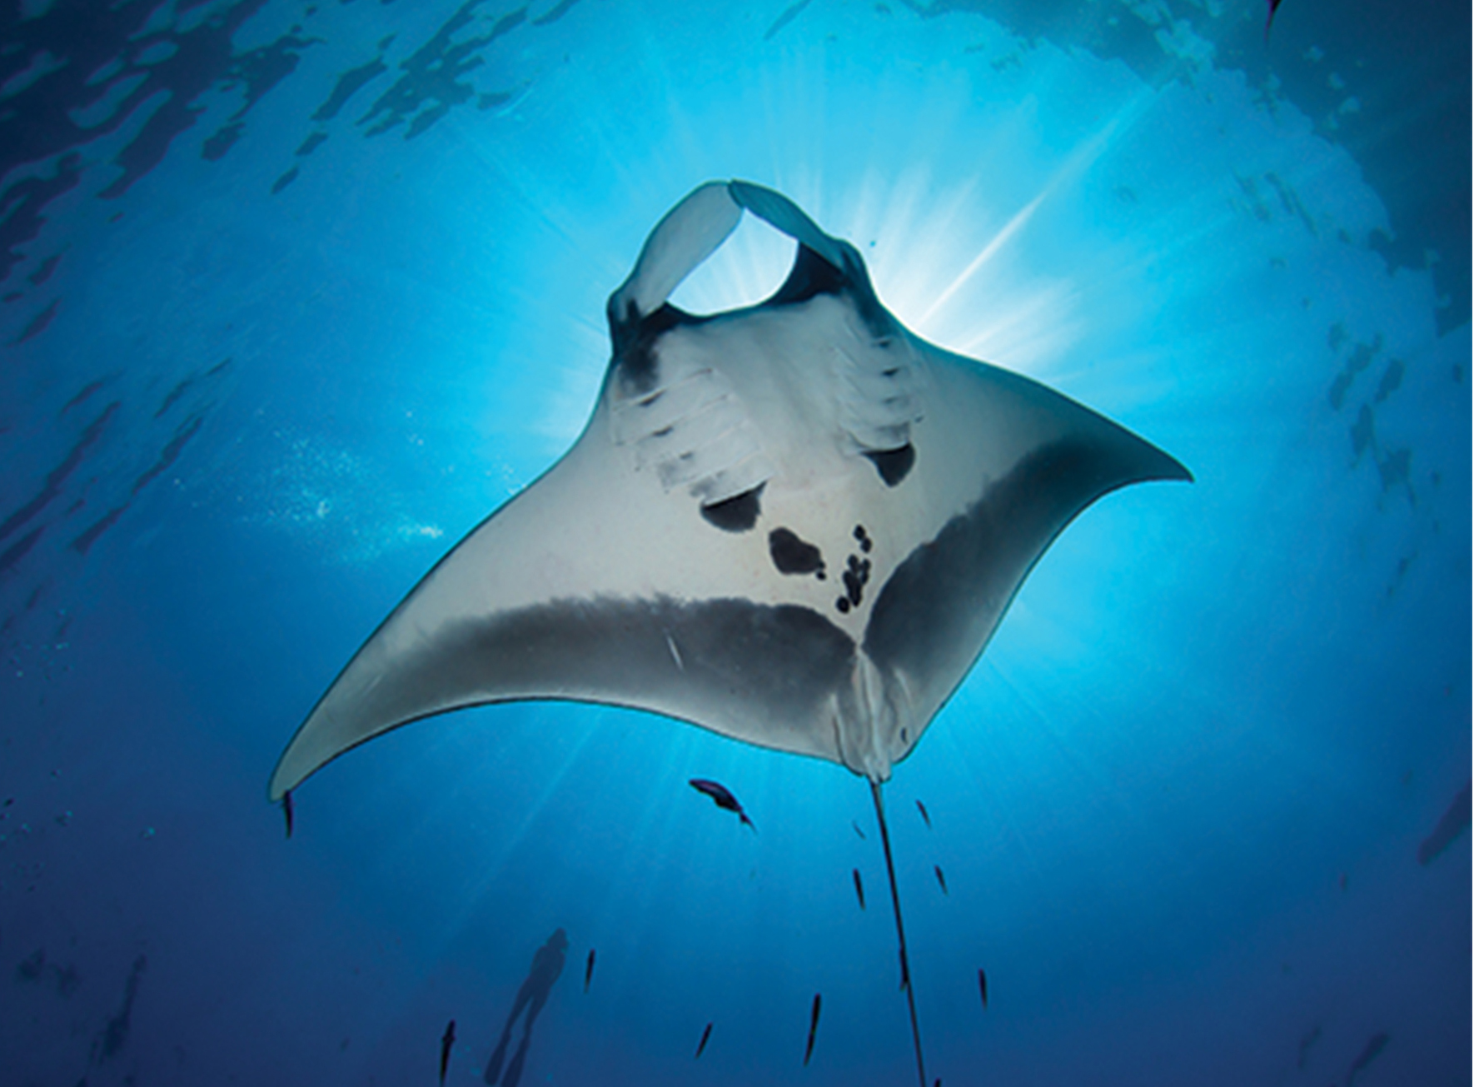
Class Chondrichthyes: Cartilaginous Fishes₇
Ray and skates comprise ~630 species
Closely related to sharks but distinguished by flattened bodies, pectoral fins that are enlarged and fused to head, and gill slits on ventral surface
Have cartilaginous skeletons
Mostly marine and live on sea floor with worldwide distribution
29.2 Figure 9: Rays and skates, such as this manta ray (Mobula), generally have exposed gill slits.

Slide 23
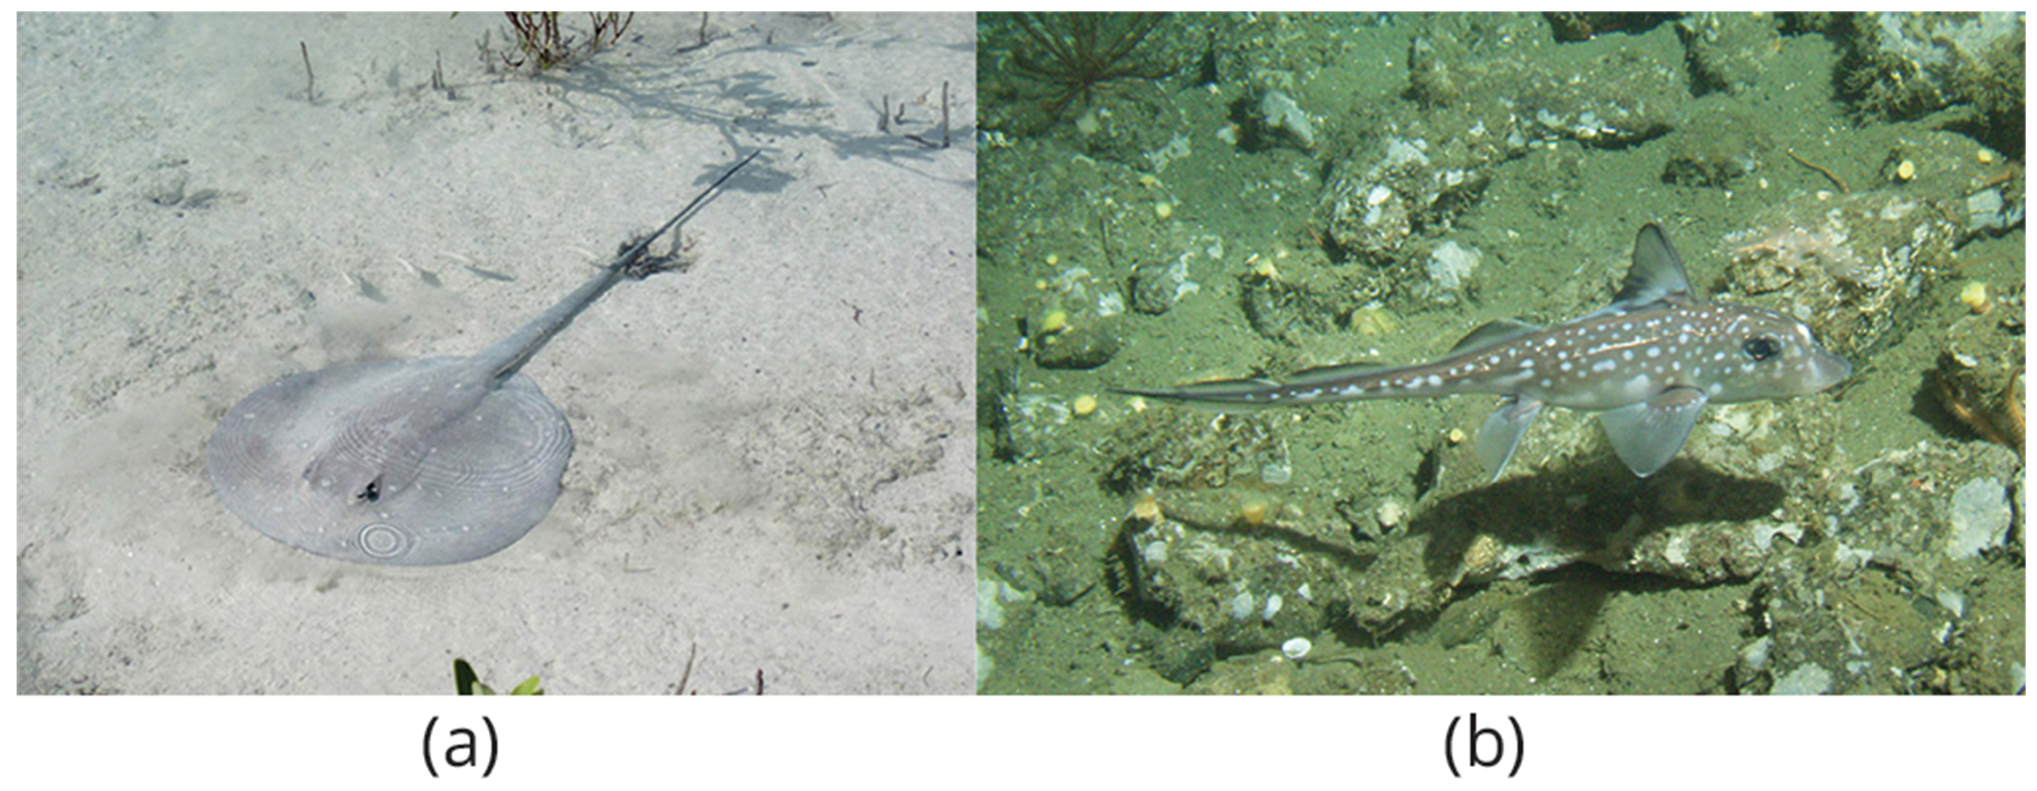
Class Chondrichthyes: Cartilaginous Fishes₈
Holocephali (chimaeras or ratfish):
Have diphycercal tail (equally sized fin lobes, with tail vertebrae located between them)
Lack scales (lost secondarily in evolution)
Have teeth modified as grinding plates that are used to feed on mollusks and other invertebrates
Have four pairs of gills covered by an operculum (external gill covering)
Appear iridescent and attractive
29.2 Figure 10: (a) This stingray blends into the sandy bottom of the ocean floor. (b) A spotted ratfish Hydrolagus colliei glides along the bottom of the ocean.
Salin1 on Flickr. "Ray."
Linda Snook / MBNMS on Wikimedia Commons. "Ratfish."

Slide 24
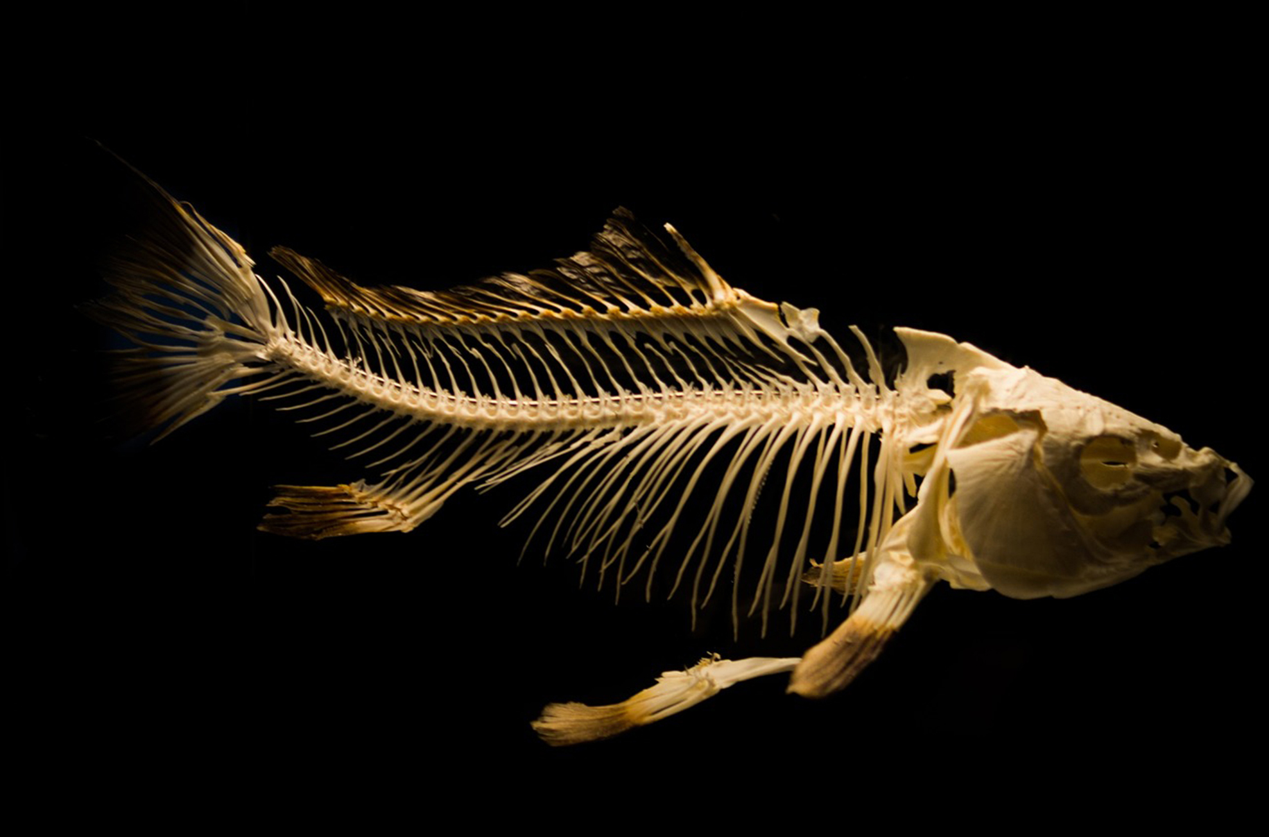
Osteichthyes: Bony Fishes₁
Osteichthyes: bony fish
Characterized by bony skeleton
~28,000 species, making it largest class of vertebrates in existence today
Almost all have ossified skeleton with specialized bone cells (osteocytes) that produce and maintain calcium phosphate matrix
Has been reversed in a few groups (e.g., sturgeons and paddlefish, which have primarily cartilaginous skeletons)
29.2 Figure 11: Bony skeletons characterize the clade Osteichthyes.
Rudy and Peter Skitterians on Pixabay. "Bony fish."

Slide 25
Osteichthyes: Bony Fishes₂
Skin often covered by overlapping scales
Glands in skin secrete mucus that reduces drag when swimming and aids in osmoregulation (salt and fluid balance)
Have lateral line system that detects vibrations in water
Use gills to breathe
Water drawn over gills that are located in chambers covered and ventilated by protective, muscular flap called operculum
Have swim bladder
Swim bladder: in fishes, a gas-filled organ that helps to control the buoyancy of the fish
Gases of swim bladder exchanged directly with blood
Believed to be homologous to lungs of lungfish and land vertebrates

Slide 26
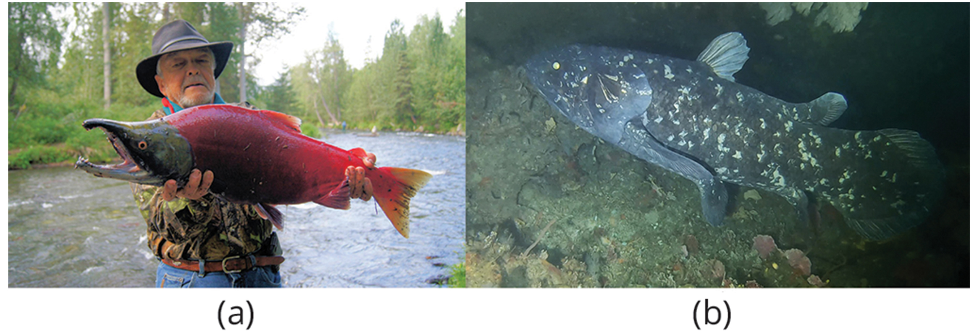
Osteichthyes: Bony Fishes₃
Divided into two extant clades: class Actinopterygii and class Sarcopterygii
Actinopterygii: ray-finned fishes
Include tuna, bass, trout, salmon, etc.
Represent about half of all vertebrate species
Named for fan of slender bones that supports their fins
Sarcopterygii: lobe-finned fish
Fleshy and lobed, supported by bones similar in type and arrangement to bones in limbs of early tetrapods
Few extant members
Include several species of lungfishes and two species of coelacanths (which were thought to be extinct until discovered between Africa and Madagascar)
29.2 Figure 12: The (a) sockeye salmon and (b) coelacanth are both bony fishes of the Osteichthyes clade.
BarbaraJackson on Pixabay. "Sockeye salmon."
Bruce A.S. Henderson on Wikimedia Commons. "Coelacanth."

Slide 27
Summary₁
Agnathan jawless fishes (hagfishes and lampreys) were earliest vertebrates diverged from invertebrate chordates
Hagfishes:
Eel-like scavengers that feed on dead invertebrates and other fishes
Lampreys:
Characterized by toothed, funnel-like sucking mouth
Most species parasitic or predaceous on other fishes

Slide 28
Summary₂
Gnathostomes (jawed fishes) evolved after jawless fishes
Jaws allow exploitation of new food sources
Include cartilaginous fishes, bony fishes, and tetrapods (e.g., amphibians, reptiles, mammals)
Cartilaginous fishes:
Include sharks, rays, skates, and ghost sharks
Live in marine environments with few species living in fresh water for part or all of lives
Osteichthyes (bony fishes):
Majority of present-day fishes (28,000 species)
Two clades: Actinopterygii (ray-finned fishes, virtually all extant species) and Sarcopterygii (lobe-finned fishes, fewer than 10 extant species but sister group of tetrapods)

Slide 29

End of Hawkes Learning PowerPoint

