Slide 1
Lesson 29.3
Amphibians

Slide 2
Objectives
Describe the evolutionary history of amphibians.
Describe the important difference between the life cycle of amphibians and the life cycles of other vertebrates.
Distinguish between the characteristics of Urodela, Anura, and Apoda.

Slide 3
Amphibians
Amphibia: frogs, salamanders, and caecilians
Vertebrate tetrapods ("four limbs")
Name derived from Greek, meaning "dual life"; reference to metamorphosis that many frogs and salamanders undergo and unique mix of aquatic and terrestrial phases required in life cycle
Require aquatic environments for reproduction
Evolved during the Devonian Period as earliest terrestrial tetrapods
Represent evolutionary transition from water to land that occurred over many millions of years
Only living true vertebrates to make transition from water to land in ontogeny (life development) and phylogeny (evolution)
Morphology relatively unchanged for 350 million years

Slide 4
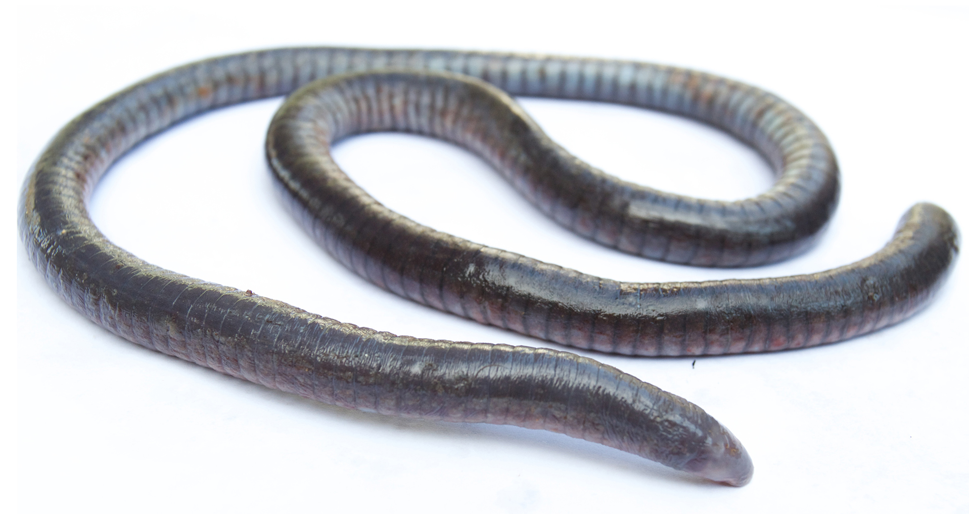
Characteristics of Amphibians₁
Characterized by four well-developed limbs, with some exceptions
  Some species of salamanders have reduced or absent hindlimbs
  Some caecilians (amphibian found in tropical environments) have no limbs
  Limb losses, or reductions, occurred over time after descent from common four-limbed ancestor (secondary, or derived, characteristics)
Important characteristic is moist, permeable skin with mucous glands
  Water taken in across skin rather than by drinking
Three respiratory surfaces: Skin, lungs, and buccal (mouth) cavity
  Air taken first into mouth through nostrils and pushed by positive pressure into lungs by elevating throat and closing nostrils
29.3 Figure 1: Caecilians are limbless amphibians found primarily in tropical regions.
Brian Gratwicke on Wikimedia Commons. "Oscaecilia ochrocephala."

Slide 5
Characteristics of Amphibians₂
All extant adults are carnivorous
Some terrestrial amphibians have sticky tongue used to capture prey
  Also multiple small teeth at edge of jaws
    Salamanders and caecilians: Teeth present in both jaws, sometimes multiple rows
    Frogs and toads: Teeth only in upper jaw, additional teeth (vomerine teeth) in roof of mouth
    Teeth are pedicellate (root and crown calcified, separated by zone of noncalcified tissue)
Have image-forming eyes and color vision

Slide 6
Characteristics of Amphibians₃
Ears best developed in frogs and toads, which vocalize to communicate
Frogs use separate regions of inner ear for detecting higher and lower sounds:
  Papilla amphibiorum: Sensitive to frequencies below 10,000 hertz and unique to amphibians
  Papilla basilaris: Sensitive to higher frequencies, including mating calls, transmitted from eardrum through stapes bone
Amphibians also have extra cartilaginous element in ear, operculum (unrelated to operculum covering of gills of bony fishes), which transmits low-frequency vibrations from forelimbs and shoulders to inner ear and used for detection of seismic signals (ground vibrations)

Slide 7
Evolution of Amphibians₁
Fossil record shows evidence of first tetrapods: A now-extinct species dated to 368 MYA
Evolved from lobe-finned freshwater fishes (similar to coelacanths and lungfish)
  Represented significant change in body plan from organisms that respired and swam to organisms that breathed air and moved onto land
    Occurred over span of 50 million years during Devonian Period

Slide 8
Evolution of Amphibians₂
Early aquatic tetrapods: Ichthyostega and Acanthostega
  Ichthyostega: one of the earliest known tetrapods; aquatic
  Acanthostega: one of the earliest known tetrapods
Both aquatic and may have had both gills and lungs
Had four limbs, with skeletal structure of limbs found in present-day tetrapods, including amphibians
  Limbs could not be pulled under body and would not have supported bodies well out of water
Likely lived in shallow freshwater environments and may have taken brief terrestrial excursions
In Ichthyostega, forelimbs more developed than hindlimbs so might have dragged along when venturing onto land

Slide 9
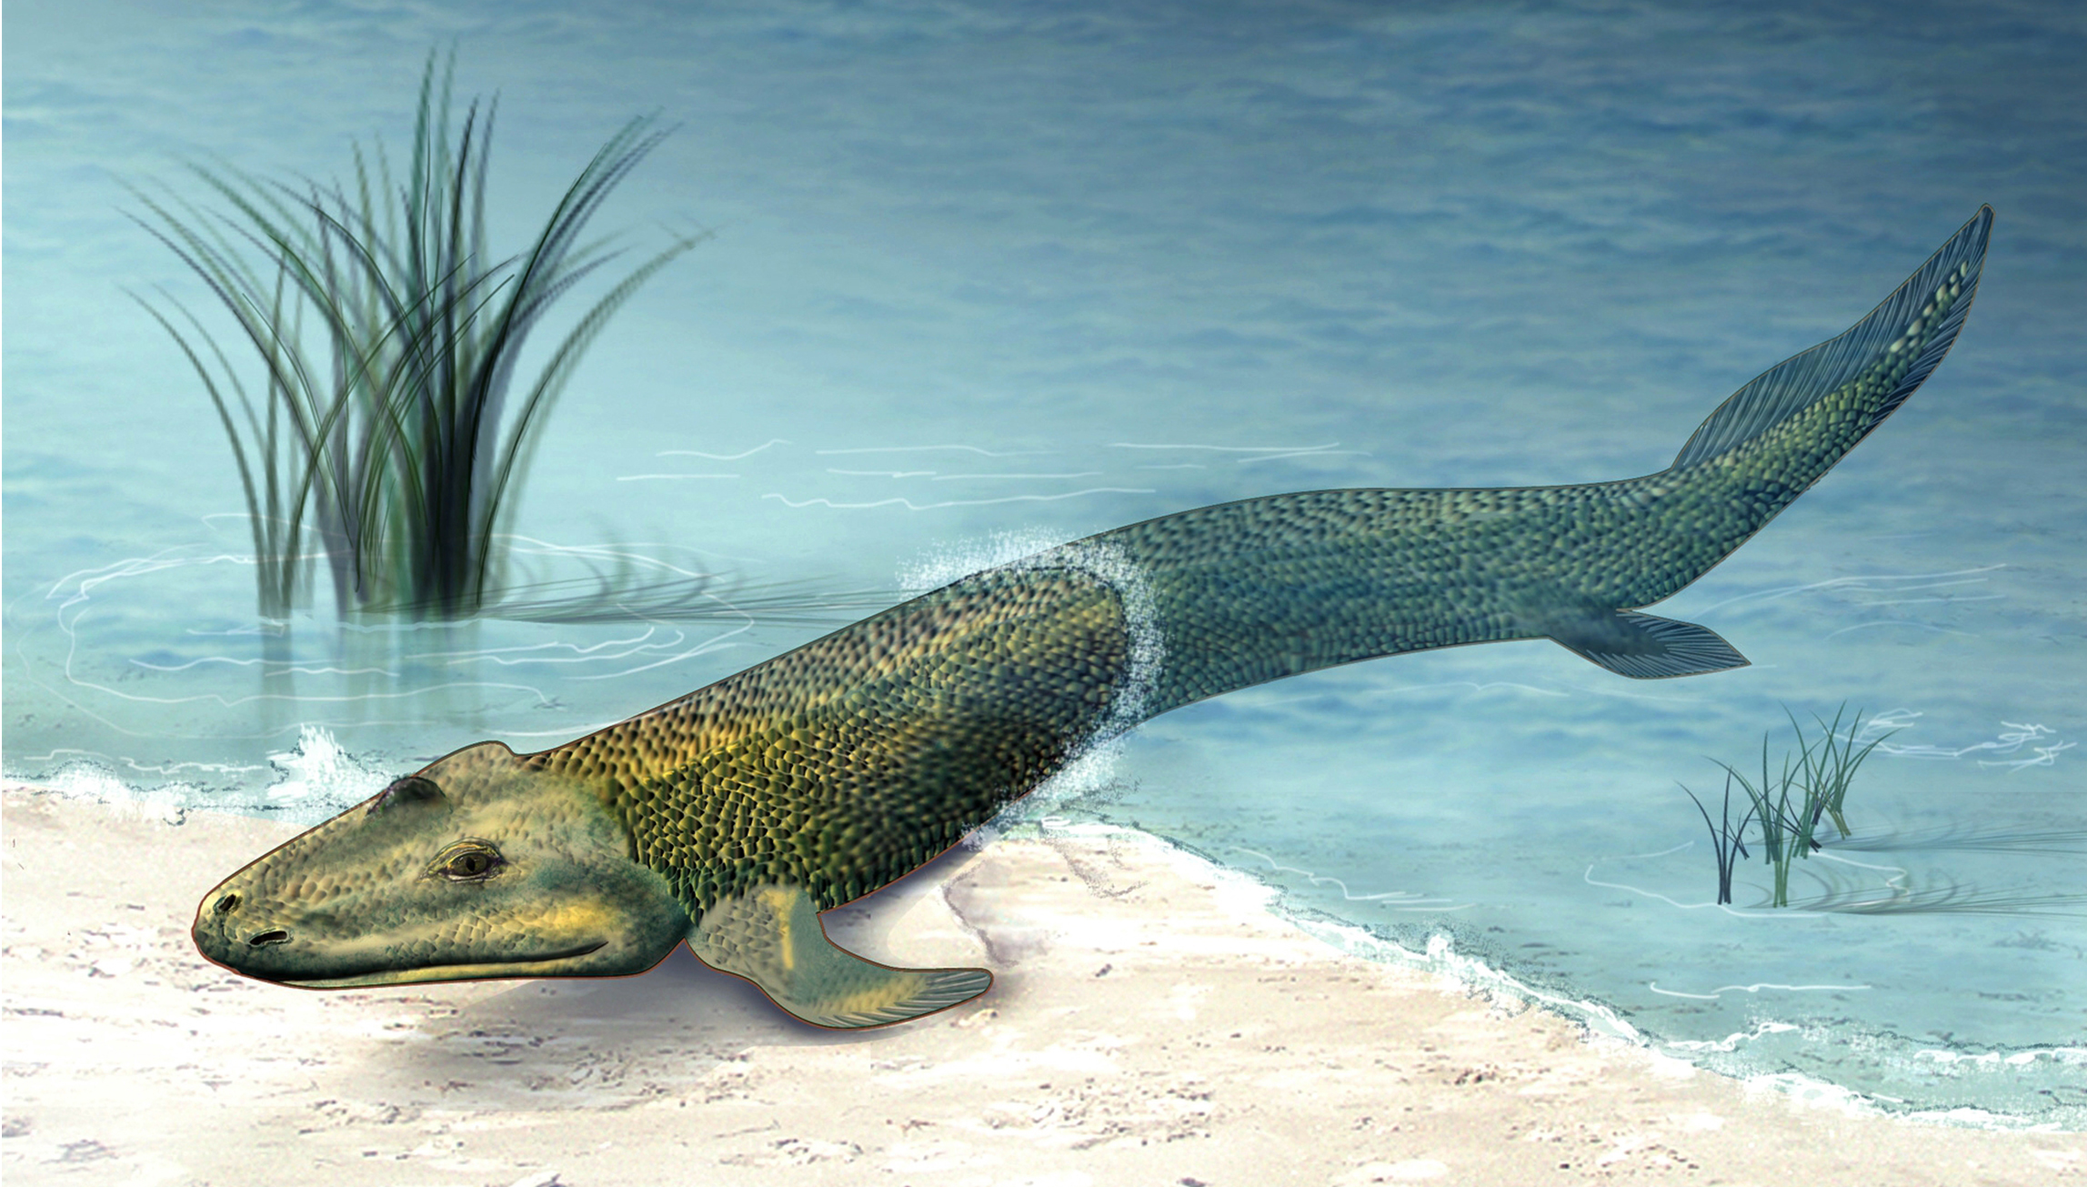
Evolution of Amphibians₃
Tiktaalik roseae: Morphologically "intermediate form" between sarcopterygian fishes (with feet-like fins) and early tetrapods (with true limbs)
Lived in shallow water about 375 MYA
Had gills and lungs, but loss of some gill elements gave it a neck, allowing head to move sideways for feeding
Eyes on top of head
Had fins, but attachment of fin bones to shoulder suggested they may have been weight-bearing
Preceded Acanthostega and Ichthyostega, with their four limbs, by 10 million years
Considered to be true intermediate clade between fish and amphibians
29.3 Figure 2: This is an artistic representation of Tiktaalik. The recent fossil discovery of Tiktaalik roseae suggests evidence for an animal intermediate to finned fish and legged tetrapods, sometimes called a "fishapod."
Zina Deretsky, National Science Foundation on Wikimedia Commons. "Tiktaalik roseae."

Slide 10
Evolution of Amphibians₄
Early tetrapods that moved onto land had access to new nutrient sources and few predators
Led to widespread distribution of tetrapods during early Carboniferous Period ("age of the amphibians")

Slide 11
Science and You
In 2004, three Tiktaalik skeletons were discovered in Ellesmere Island, Nunavut, in northern Canada. Tiktaalik is an Inuktitut word that means "large freshwater fish." The discovery of Tiktaalik was fundamental as it served as the missing link between fish and amphibians.
Notes:
This is included as a relevant application for this topic.

Slide 12
Modern Amphibians
Comprises 6,770 extant species
Inhabit tropical and temperate regions worldwide
Classified in subclass Lissamphibia ("smooth amphibian"), which is divided into three clades:
  Urodela ("tailed"): salamanders
  Anura ("tailless"): frogs
  Apoda ("legless ones"): caecilians

Slide 13
Urodela: Salamanders₁
Salamander: tailed amphibian that belongs to the clade Urodela (or Caudata)
Most similar to ancestral amphibians
Include ~620 species, some aquatic, others terrestrial, and some on land only as adults
Have generalized tetrapod body plan with four limbs and tail
  Placement of legs makes it difficult to lift their bodies off the ground
  Move by bending body from side to side (lateral undulation) in fishlike manner while "walking" their arms and legs fore and aft
  Gait similar to that used by early tetrapods

Slide 14
Urodela: Salamanders₂
Respiration varies and can involve combination of lungs, gills, skin, and/or membranes of mouth and throat
Some entirely lungless and rely on either gills or skin for gas exchange
Lungs (if present) vary from small and smooth (salamanders that live in cold water) to large and highly folded (salamanders that live in warm water with low oxygen levels)
Some have both gills and lungs
Example: Giant Japanese salamander
  Largest living amphibian
  Has single lung but used primarily for buoyancy
  Skin has additional folds to enlarge respiratory surface

Slide 15
Think It Through
Why does the giant Japanese salamander, the largest living amphibian, have folds in its skin?
Notes:
Originally an On Your Own. This is included here to use as a talking point or for a think-pair-share activity.

Slide 16
Urodela: Salamanders₃
Reproduce by internal fertilization of eggs
Mating involves elaborate and prolonged courtship
  Ends in deposition of sperm by males in packet called spermatophore, which is subsequently picked up by female
All (except fire salamander) are oviparous (produce young through eggs that hatch after they have been laid outside parent)

Slide 17
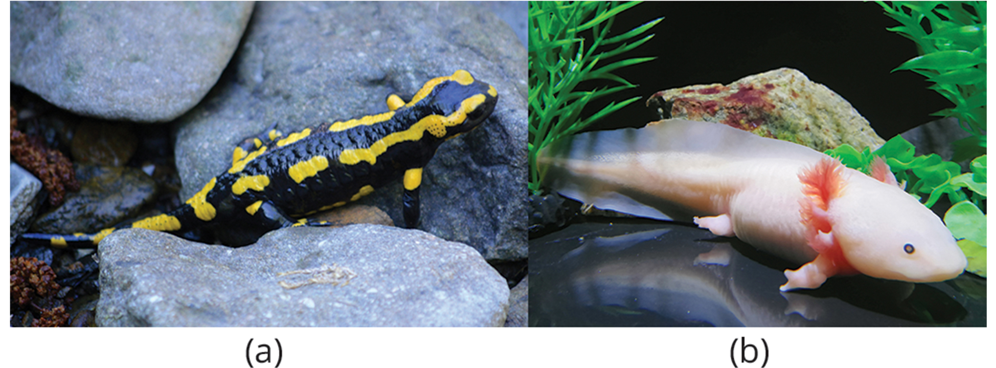
Urodela: Salamanders₄
Aquatic salamanders lay eggs in water, which develop into legless larvae called efts
Terrestrial salamanders lay eggs in damp nests, where eggs are guarded by mother
  Embryos go through larval stage and complete metamorphosis before hatching into tiny adult forms
One aquatic salamander (Mexican axolotl) never leaves larval stage and becomes sexually mature without metamorphosis
29.3 Figure 3: (a) Salamandra salamandra, the fire salamander, is a terrestrial species with fully formed limbs for crawling over the ground, and (b) Ambystoma mexicanum, the axolotl, is an aquatic species that generally remains in the larval stage, with gills and shortened limbs, for its entire life.
Ragnar1904 on Wikimedia Commons. "Salamandra salamandra."
salamander724 on Wikimedia Commons. "Axolotl."

Slide 18
Anura: Frogs₁
Frog: tailless amphibian that belongs to the clade Anura or Salientia ("jumpers")
Most diverse group of vertebrates
Approximately 5,965 species
Found worldwide with the exception of Antarctica
Range from 7 mm (minute New Guinea frog) to 32 cm (huge goliath frog of tropical Africa)

Slide 19
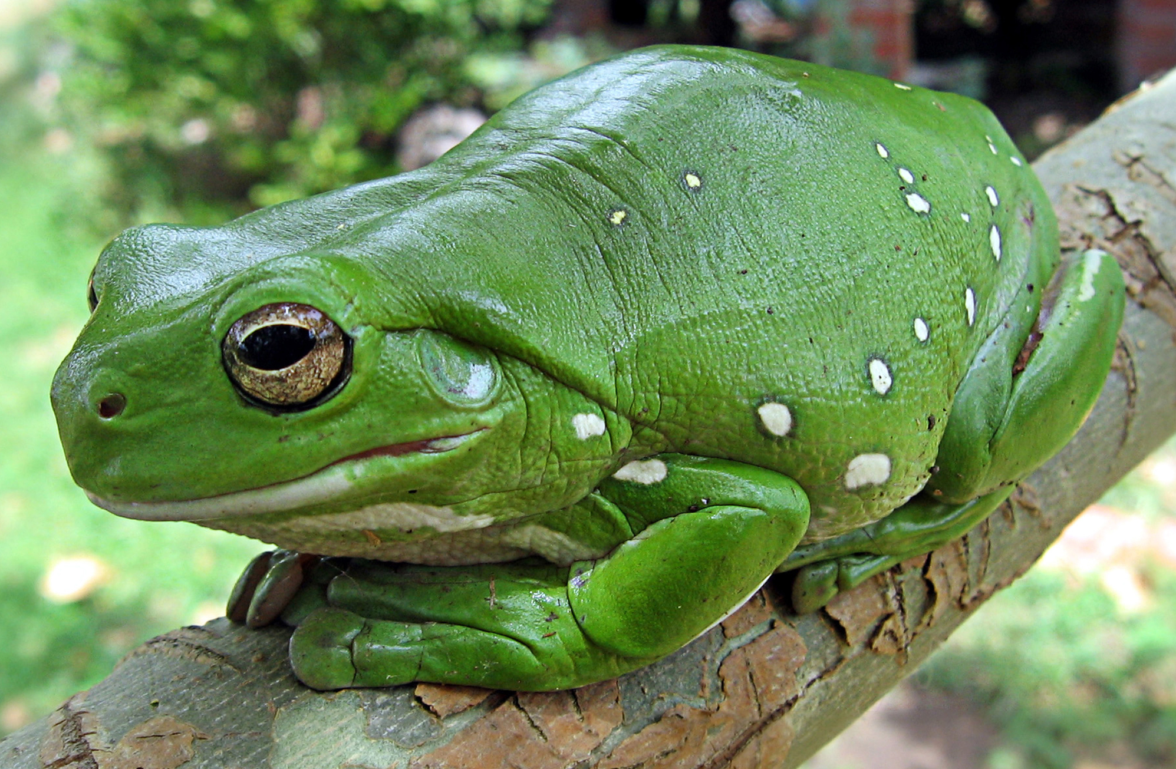
Anura: Frogs₂
Have specialized body plan for movement
  Use hindlimbs and arrow-like endoskeleton to jump to capture prey on land
  Tree frogs have hands adapted for grasping branches while climbing
  In tropical areas, "flying frogs" glide from perch to perch on extended webs of feet
Modifications that allow for avoidance of predators
  Skin acting as camouflage
  Many frogs and salamanders release defensive chemicals from glands in skin that are poisonous to predators
    Frogs with more toxic skins have bright warning (aposematic) coloration
29.3 Figure 4: The Australian green tree frog is a nocturnal predator that lives in the canopies of trees near a water source.
LiquidGhoul on Wikimedia Commons. "Green tree frog."

Slide 20
Reflection Question
Why do you think frogs with toxic skin secretions display bright warning coloration?
Notes:
The reflection question is included here to use as a talking point or for a think-pair-share activity.

Slide 21
Anura: Frogs₃
Eggs fertilized externally
Lay eggs in moist environments
Eggs protected by thick jelly layer but would still dehydrate quickly in dry environment
Great diversity of parental behaviors:
  Some lay many eggs and exhibit little parental care
  Some carry eggs and tadpoles on hind legs or embedded in backs
    Examples:
      Males of Darwin's frogs carry tadpoles in vocal sac
      Many tree frogs lay eggs off ground in folded leaf located over water so that tadpoles drop into water as they hatch

Slide 22
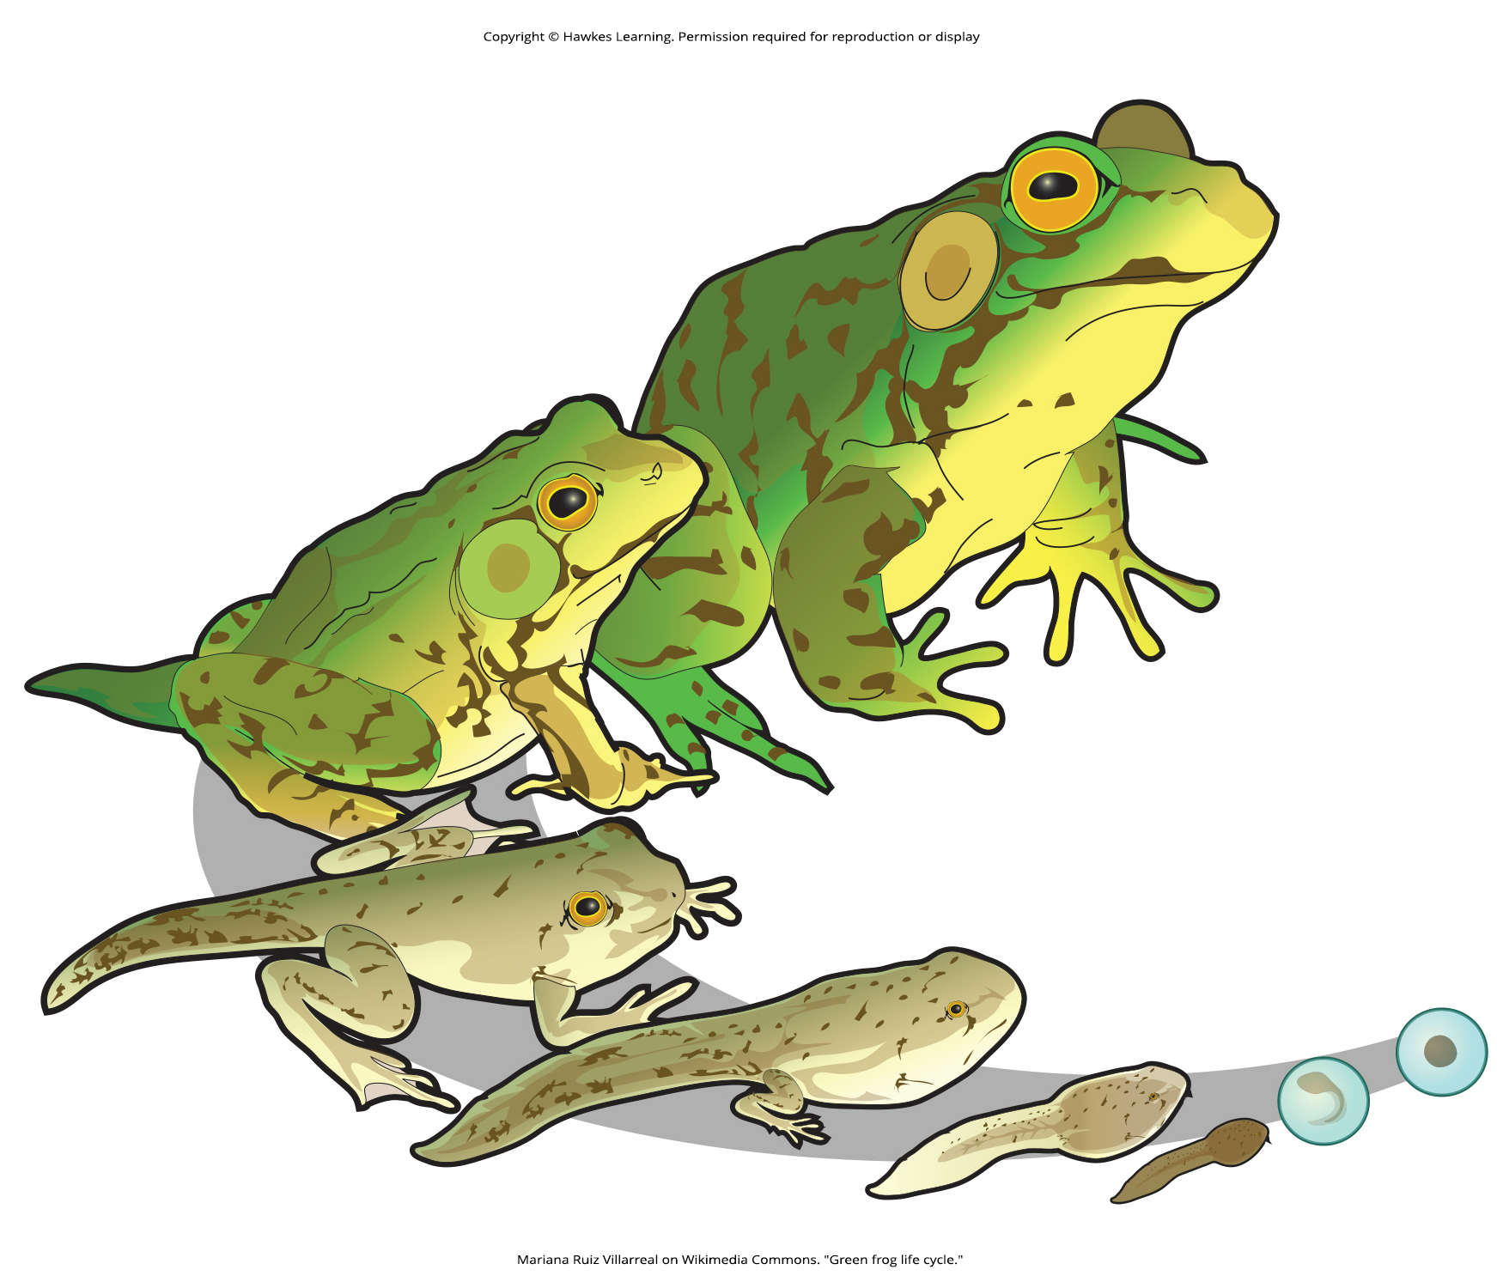
29.3 Figure 5
Mariana Ruiz Villarreal on Wikimedia Commons. "Green frog life cycle."
Notes:
Figure 5: Amphibians, including frogs, have two distinct stages in their life cycle: a larval (tadpole) stage and an adult stage.

Slide 23
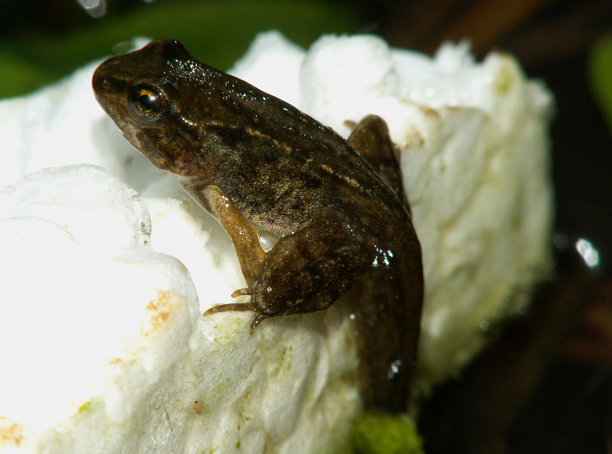
Anura: Frogs₄
Life cycle consists of two distinct stages: Larval stage followed by metamorphosis to adult stage
Exception: Eggs in frogs genus Eleutherodactylus develop into froglets, which are guarded by parent
Tadpole often filter-feeding herbivore
  Tadpole: larval stage of a frog
  Have gills, lateral line system, long-finned tails, and lack limbs
29.3 Figure 6: A juvenile frog metamorphoses into a frog. Here, the frog has started to develop limbs, but its tadpole tail is still evident.
Viridiflavus on Wikimedia Commons. "Juvenile frog."

Slide 24
Anura: Frogs₅
  Undergo metamorphosis into adult form
  Gills, tail, and lateral line system disappear, and four limbs develop
  Jaws become larger and suited for carnivorous feeding
  Digestive system transforms into short gut of a predator
  Develop eardrums and air-breathing lungs
  Changes allow larvae to move onto land in adult stage

Slide 25
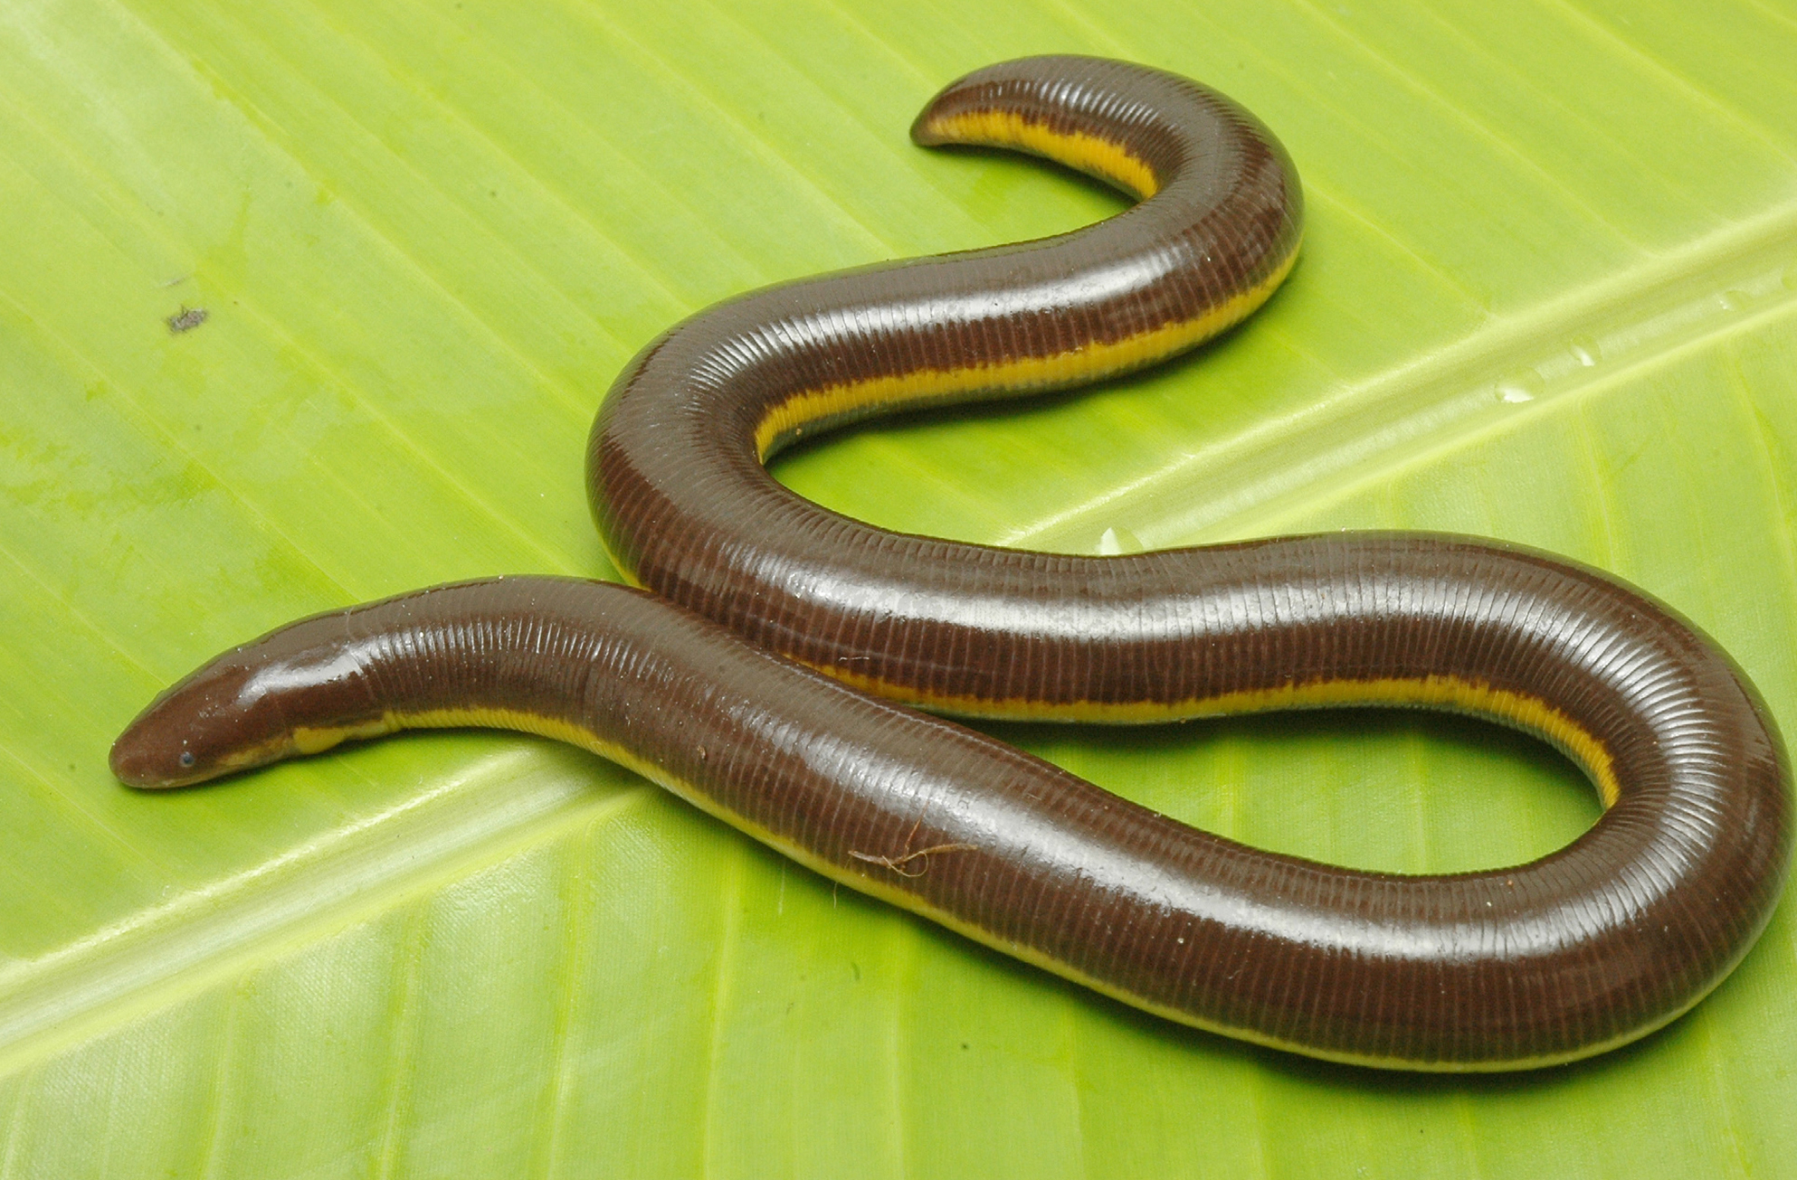
Apoda: Caecilians₁
Caecilian: legless amphibian that belongs to the clade Apoda
Approximately 185 species
No limbs but evolved from legged vertebrate ancestor
  Makes them resemble earthworms because of folds of skin that look like segments of an earthworm
29.3 Figure 7: Ichthyophis kodaguensis, like all caecilians, is limbless and resembles a snake or earthworm.
G. Bhatta on Wikimedia Commons. "Ichthyophis kodaguensis."

Slide 26
Apoda: Caecilians₂
Unlike earthworms, they have teeth in both jaws and feed on variety of small organisms found in soil, including earthworms
Adapted for burrowing or aquatic lifestyle
Nearly blind, with tiny eyes sometimes covered by skin
Have single lung and rely on cutaneous respiration
  Cutaneous respiration: gas exchange through the skin
Found in tropics of South America, Africa, and Southern Asia
Reproduction:
  Only amphibians in which males have copulatory structures (organs used by males for insemination)
  Internal fertilization
  Oviparous, but most bear live young, where females help nourish young with tissue from their oviduct before birth and from skin after birth

Slide 27
Evolution Connection₁
The Paleozoic Era and the Evolution of Vertebrates
Transition and diversification of vertebrates onto land related to changes in Earth's climate and geography throughout Paleozoic Era
Vertebrates arose during Paleozoic Era (541 to 252 MYA)
  Climate and distribution of land masses very different
Land distribution:
  Two large supercontinents near equator: Laurentia and Gondwana
    Included most of today's continents in different configuration
  During latter half of Paleozoic, landmasses began moving together and formed Laurasia (large northern block that contained parts of North America, Greenland, Europe, and Siberia)
  Starting latter third of Paleozoic, single supercontinent formed called Pangaea

Slide 28
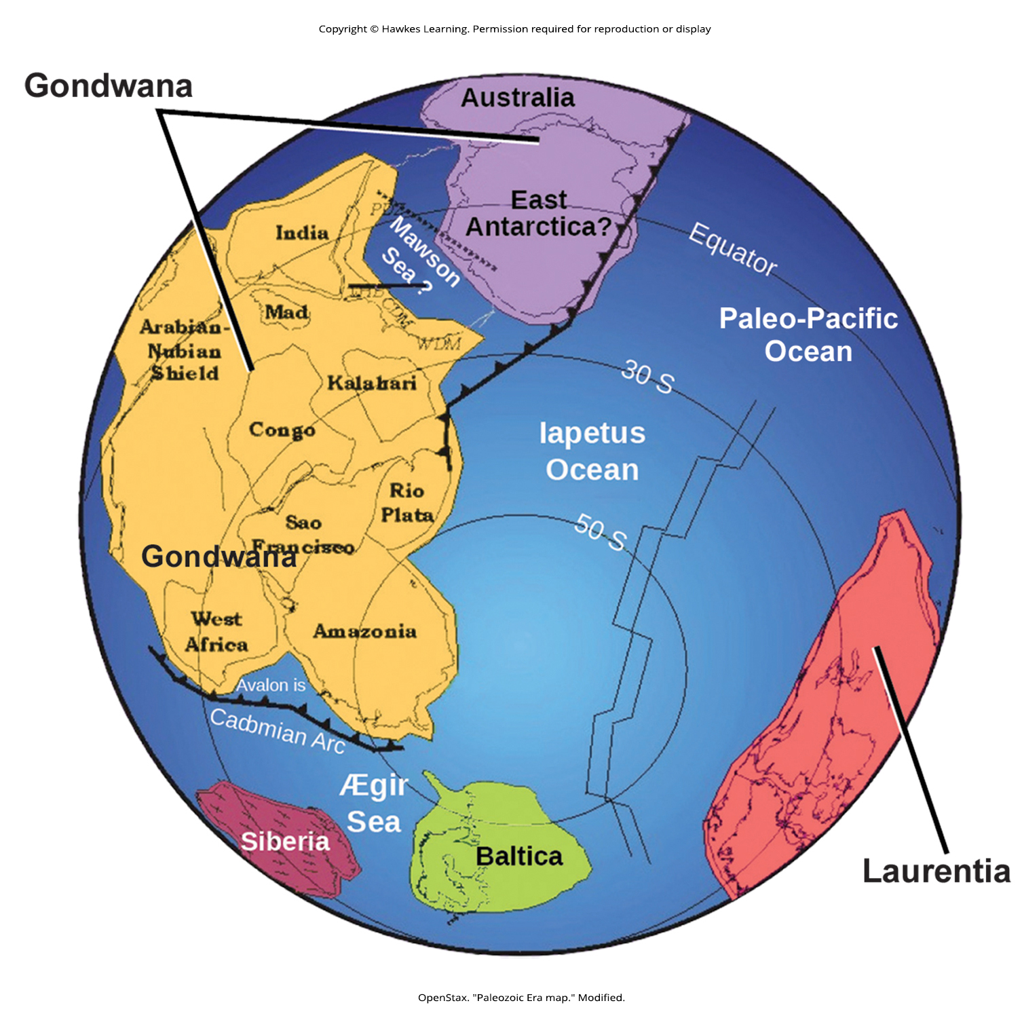
29.3 Figure 8
OpenStax. "Paleozoic Era map." Modified.
Notes:
Figure 8: During the Paleozoic Era, around 541 million years ago, the continent Gondwana formed. Both Gondwana and the continent Laurentia were located near the equator.

Slide 29
Evolution Connection₂
The Paleozoic Era and the Evolution of Vertebrates
Climate:
  Sea levels were very high; hasn't been that high since
  Glaciations created cool global climate
  Conditions warmed near end of first half of Paleozoic
  Glaciations began to affect Pangaea's climate in distribution of vertebrate life during latter third of Paleozoic

Slide 30
Evolution Connection₃
The Paleozoic Era and the Evolution of Vertebrates
Plants and animals:
  Amount of CO₂ greater during early Paleozoic but began to change when land plants became more common
    Roots of land plants infiltrated rock and soil, drawing CO₂ out of atmosphere and trapping it in rock
    Reduced CO₂ levels and increased oxygen levels, so by end of Paleozoic, atmosphere was similar to today
  Plants more common through latter half of Paleozoic
  Microclimates emerged, and ecosystems changed
  Plants and ecosystems grew and became more complex

Slide 31
Evolution Connection₄
The Paleozoic Era and the Evolution of Vertebrates
  Vertebrates moved from water to land (presence of shoreline vegetation may have contributed to move)
    Hypothesis: Fins of aquatic vertebrates used to maneuver through vegetation, providing precursor to movement of fins on land and further development of limbs
  Diversification of vertebrates, and amniotes emerged in late Paleozoic
  Amniotes split into synapsids and mammals in one group and codonts, reptiles, dinosaurs, and birds in other
  Marine vertebrates extinct near end of Devonian Period (359 MYA)
  Marine and terrestrial vertebrates extinct by mass extinction at end of Permian Period (250 MYA)

Slide 32
Summary₁
Tetrapods characterized by four well-developed limbs, though some salamanders and all caecilians are limbless
Key characteristics:
  Moist, permeable skin used for cutaneous respiration
  Lungs found in adults of many species
  Carnivores with many small teeth
Fossil record shows evidence of amphibians (now extinct) around 370 MYA as first tetrapods

Slide 33
Summary₂
Divided into three classes:
  Salamanders (Urodela)
  Frogs (Anura)
  Caecilians (Apoda)
Development occurs in two stages:
  Gilled, aquatic larval stage that metamorphoses into adult
  Adult stage has lungs and legs (losing tail in Anurans)
Few species skip free-living larval stage
Various levels of parental care

Slide 34

End of Hawkes Learning PowerPoint

