Slide 1
Lesson 29.4
Reptiles

Slide 2
Objectives
Describe the derived characteristics in birds that facilitate flight.
Describe the evolutionary history of birds.
Describe the main characteristics of amniotes.
Discuss the evolution and characteristics of reptiles.
Explain the difference between anapsids, synapsids, and diapsids, and give an example of each.

Slide 3
Reptiles₁
Distinguished from amphibians by terrestrially adapted egg, which is supported by four extraembryonic membranes: Yolk sac, amnion, chorion, and allantois
  Chorion and amnion develop from folds in body wall
  Yolk sac and allantois are extensions of midgut and hindgut, respectively
  Amnion forms fluid-filled cavity that provides embryo with its own internal aquatic environment
Evolution of extraembryonic membranes led to less dependence on water for development and allowed amniotes to go to drier environments
  Amniote: animal that produces a terrestrially adapted egg protected by amniotic membranes

Slide 4
Reptiles₂
Eggs of birds, reptiles, and a few mammals have shells
Amniote embryo enclosed in amnion, which is encased in extraembryonic coelom contained within chorion
Between shell and chorion is albumin, which provides additional fluid and cushioning
  Significant development that distinguishes amniotes from amphibians (which are restricted to moist environments due to shell-less eggs)
All eggs permit retention of water and nutrients for developing embryo
Egg shells of birds (avian reptiles) hardened with calcium carbonate, making them rigid but fragile
Eggs shells of non-avian reptiles (e.g., turtles) are leathery and require moist environment
Most mammals (though they are amniotes) don't lay eggs (except monotremes like echidnas and platypuses)
  Embryo grows within female's body, with placenta derived from two extraembryonic membranes

Slide 5
Characteristics of Amniotes₁
Amniotic egg is key characteristic of amniotes
  Shell of egg provides protection while being permeable enough to allow for exchange of carbon dioxide and oxygen
  Albumin (egg white) outside chorion provides embryo with water and protein
  Egg yolk contained in yolk sac provides nutrients (like in other animals)
Functions of extraembryonic membranes:
  Blood vessels in yolk sac transport yolk nutrients to circulatory system of embryo
  Chorion facilitates exchanges of oxygen and carbon dioxide between embryo and egg's external environment
    Chorion: membrane of the egg that surrounds the embryo and yolk sac
  Allantois: membrane of the egg that stores nitrogenous wastes produced by the embryo; also facilitates respiration
  Amnion: membrane of the egg that protects the embryo from mechanical shock and prevents dehydration

Slide 6
Characteristics of Amniotes₂
In mammals, yolk sac very reduced, but embryo still cushioned and enclosed within amnion
  Placenta (transports nutrients and functions in gas exchange and waste management) derived from chorion and allantois
Additional derived characteristics of amniotes:
  Waterproof skin
  Accessory keratinized structures (hardened external structures, such as scales, feathers, claws, and beaks)
  Costal (rib) ventilation of the lungs (ability to move ribs to drive respiration)
    Increased the efficiency of breathing, enabling transition away from cutaneous breathing seen in amphibians and allowing surface of skin to become hard and dry

Slide 7
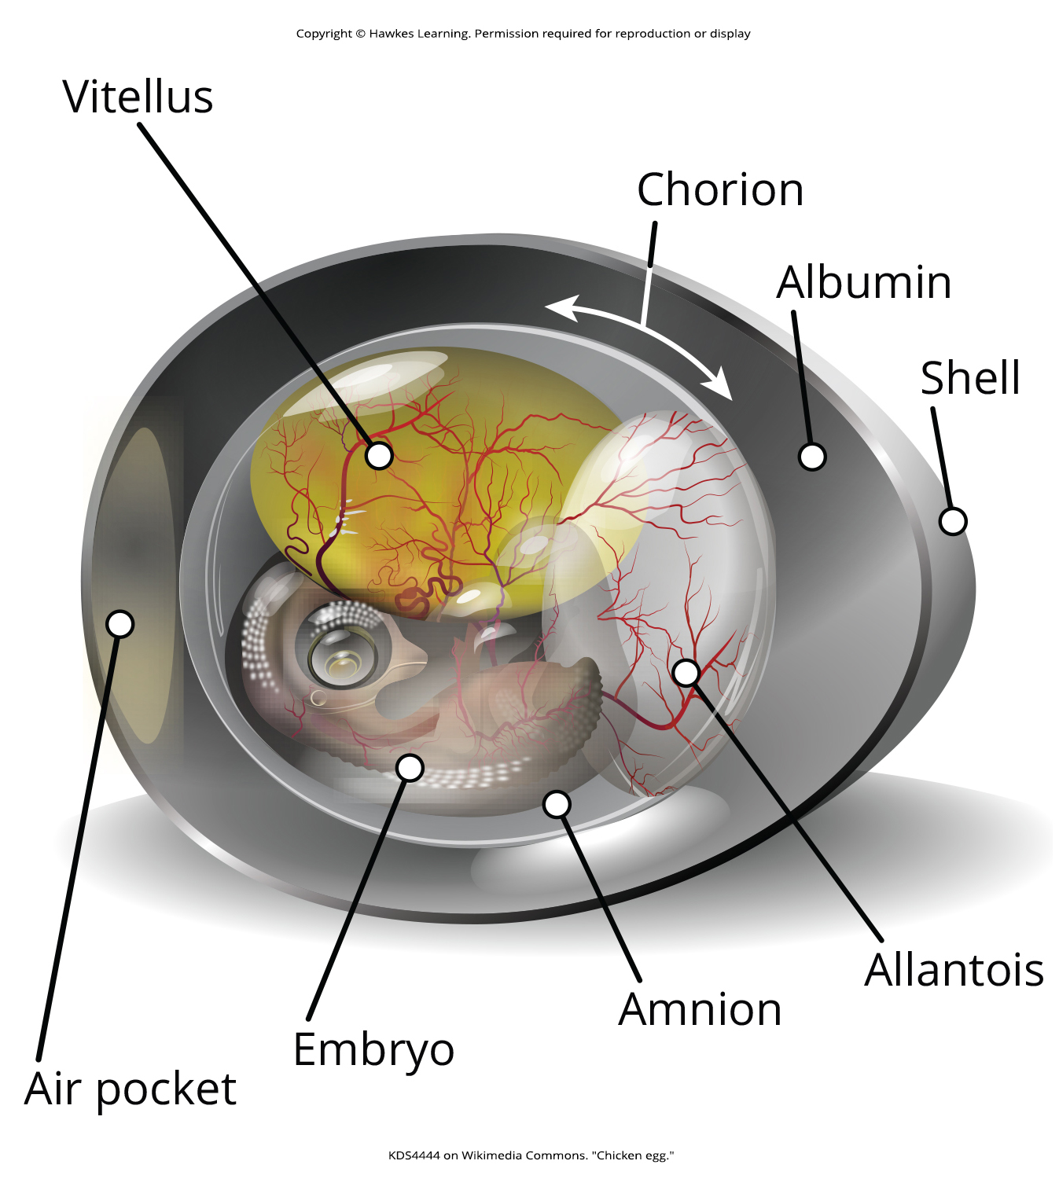
29.4 Figure 1
KDS4444 on Wikimedia Commons. "Chicken egg."
Notes:
Figure 1: The key features of an amniotic egg are shown. The vitellus is the yolk sac.

Slide 8
Evolution of Amniotes₁
Evolved from tetrapod ancestors ~340 MYA during Carboniferous Period
Quickly diverged into synapsids and sauropsids
  Synapsid: mammal having one temporal fenestra
    Included therapsids, clade from which mammals evolved
  Sauropsid: reptile or bird
    Further divided into anapsids and diapsids

Slide 9
Evolution of Amniotes₂
Diapsid: animal having two temporal fenestrae in the cranium
  Gave rise to reptiles, including dinosaurs and birds
  Many (e.g., birds) have highly modified diapsid skulls
  Molecular and fossil evidence show turtles arose within diapsid line and secondarily lost temporal fenestrae
  Canonical diapsids include dinosaurs, birds, and all other extinct and living reptiles
Anapsid: animal having no temporal fenestrae in the cranium
Key difference between synapsids, anapsids, and diapsids are structures of skull and number of temporal fenestrae behind each eye
  Temporal fenestra: non-orbital opening in the skull that may allow muscles to expand and lengthen

Slide 10
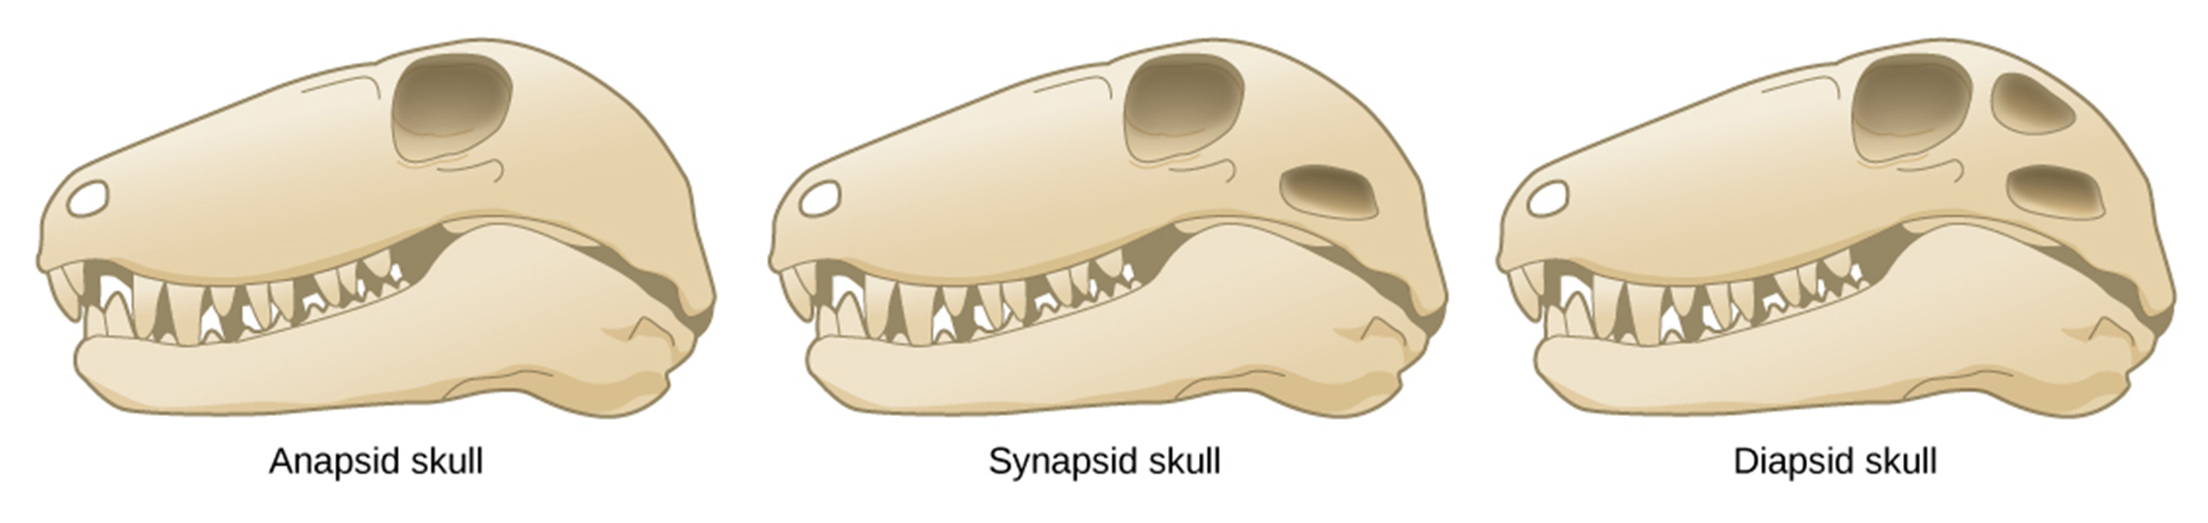
29.4 Figure 2
CNX OpenStax on Wikimedia Commons. "Amniote skulls."
Notes:
Figure 2: Pictured are different amniote skulls. Compare the skulls and temporal fenestrae of anapsids, synapsids, and diapsids. Anapsids have no openings, synapsids have one opening, and diapsids have two openings.

Slide 11
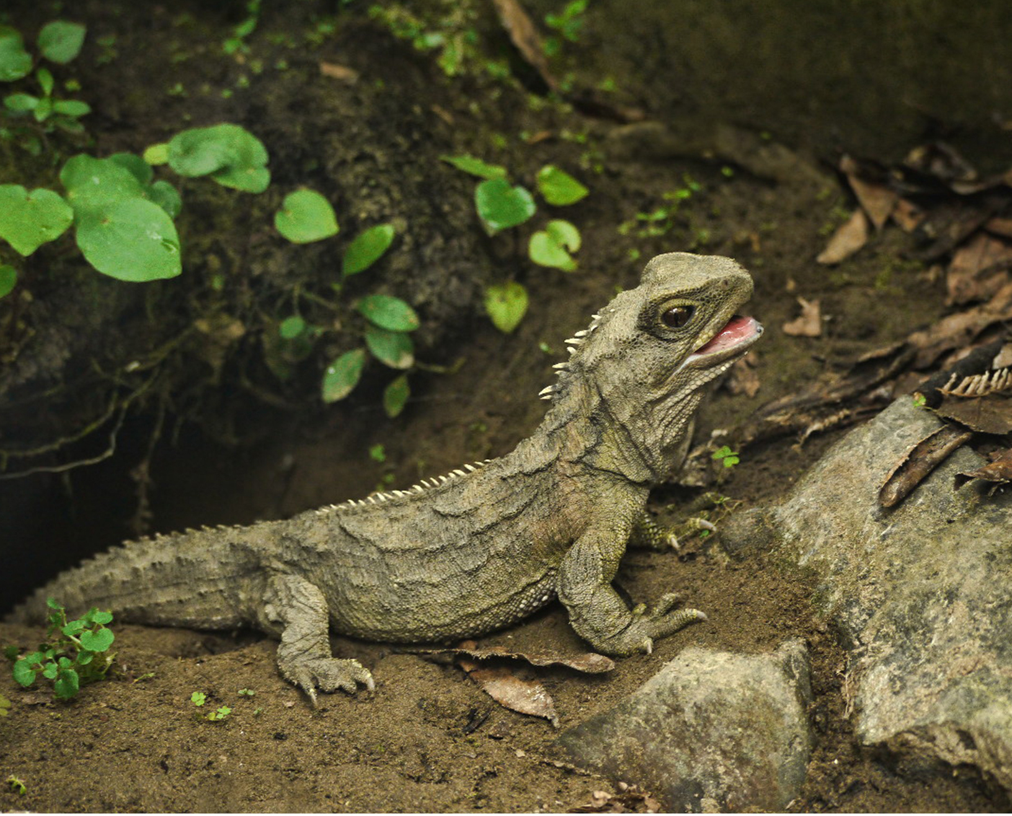
Evolution of Amniotes₃
During Mesozoic, diapsids diverged into two groups: Archosauromorpha ("ancient lizard form") and Lepidosauromorpha ("scaly lizard form")
Lepidosaur: modern lizards, snakes, and tuataras
Archosaur: modern crocodilian or bird, or an extinct pterosaur ("winged lizards"), ichthyosaur ("fish lizards" resembling dolphins), or dinosaur ("terrible lizards")
  Clade Dinosauria includes birds, which evolved from branch of maniraptoran theropod dinosaurs, a group of bipedal saurischian dinosaurs that included large terrestrial carnivores like T. rex in Mesozoic
    Theropod: dinosaur group ancestral to birds
29.4 Figure 3: Tuataras are a type of reptile found only in New Zealand. They are the only surviving member of the reptile order Rhynchocephalia, which evolved approximately 250 MYA.
Sid Mosdell on Wikimedia Commons. "Tuatara."

Slide 12
Evolution of Amniotes₄
Evolutionarily derived characteristics:
  Amniotic egg and its four extraembryonic membranes
  Thicker and more waterproof skin
  Rib ventilation in lungs
    Ventilation performed by drawing air into and out of lungs by muscles such as costal rib muscles and diaphragm
Past common division of amniotes: Classes Mammalia, Reptilia, and Aves
  But birds and mammals descended from different amniote branches: Synapsids giving rise to therapsids and mammals, and diapsids giving rise to lepidosaurs and archosaurs
Will consider both birds and mammals as groups distinct from reptiles with understanding that this does not accurately reflect phylogenetic history and relationships

Slide 13
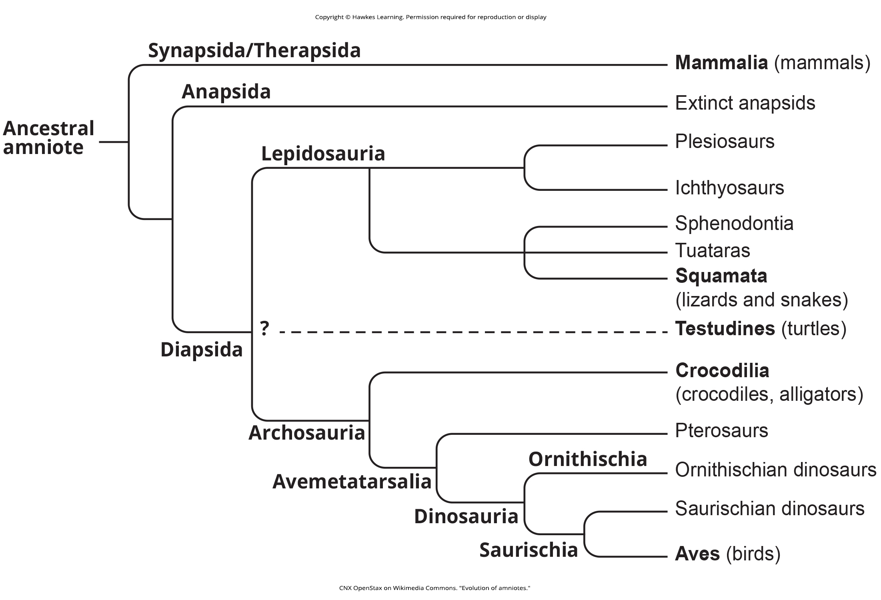
29.4 Figure 4
CNX OpenStax on Wikimedia Commons. "Evolution of amniotes."
Notes:
Figure 4: This chart shows the evolution of amniotes. As shown, the synapsids include the mammals, while the diapsids include all modern-day reptiles. Birds form a clade within the diapsids. The placement of Testudines (turtles) is currently still debated.

Slide 14
Characteristics of Reptiles₁
Tetrapods (four-limbed animals)
  Limbless reptiles (e.g., snakes and legless lizards) classified as tetrapods because descended from four-limbed ancestors
Lay calcareous or leathery eggs in shells on land
  Aquatic reptiles return to land to lay eggs
Reproduce sexually with internal fertilization
  Some display ovoviviparity (eggs remaining in female's body until hatching)
    Most nutrients supplied by egg yolk
    Chorioallantois assists with respiration
  Others display viviparity (offspring born alive)
    Development supported by yolk sac-placenta, chorioallantoic-placenta, or both

Slide 15
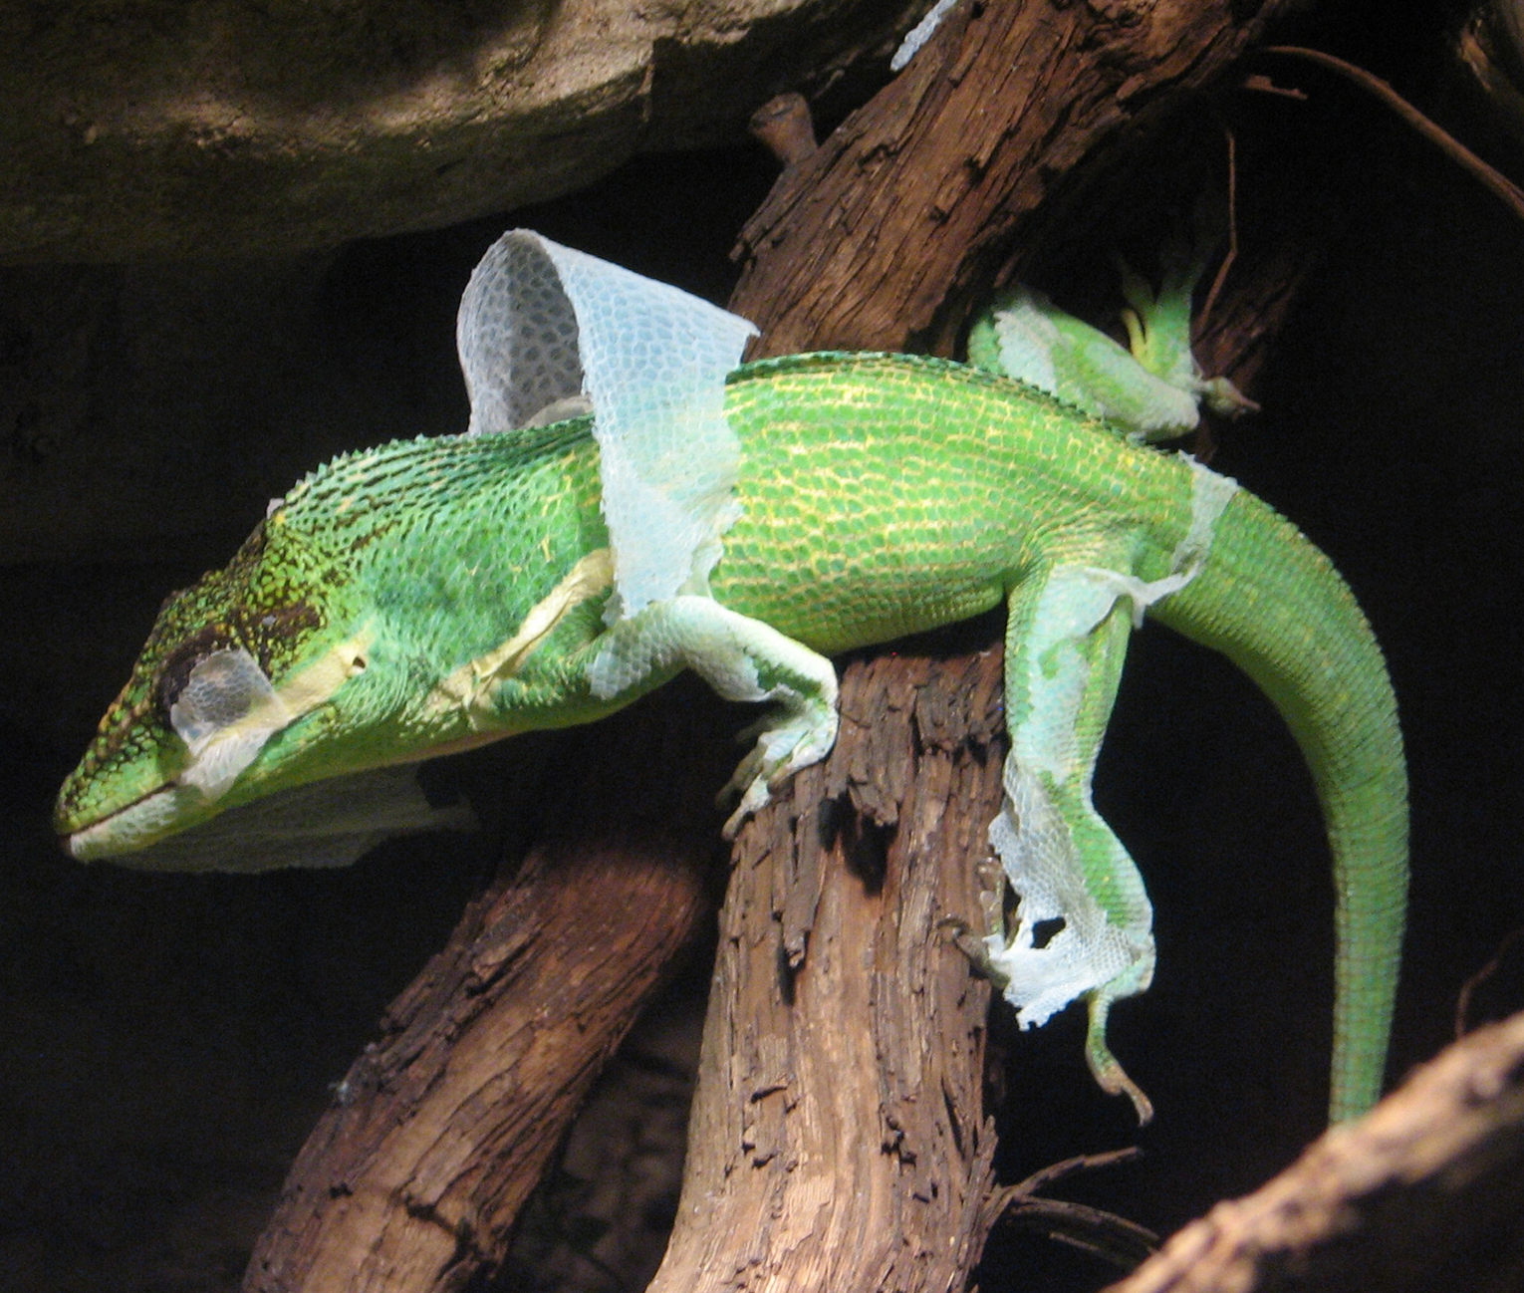
Characteristics of Reptiles₂
Key adaptation that permitted move to living on land:
  Development of scaly skin, containing the protein keratin and waxy lipids, reduced water loss from skin
Number of keratinous epidermal structures: Scales, claws, nails, horns, feathers, and hair
  Covered skin means it cannot be used for respiration, like amphibians
  All amniotes breathe with lungs
Regular shedding of skin to accommodate growth and get rid of ectoparasites
  Snakes shed entire skin at one time; others shed skin in patches
29.4 Figure 5: This Anolis equestris, the knight anole, is shedding its skin to accommodate growth.
Ltshears on Wikimedia Commons. "Knight anole shedding."

Slide 16
Characteristics of Reptiles₃
Ventilate lungs using various muscular mechanisms to produce negative pressure (low pressure) within lungs, allowing lungs to expand and draw in air
In squamates (e.g., snakes and lizards), muscles of spine and ribs used to expand or contract rib cage
  Walking or running interferes with this so cannot breathe well while running
  Some squamates supplement rib movement with buccal pumping through nose with mouth closed (rhythmically moving floor of mouth to pump air into lungs)
In crocodilians, lung chamber expands and contracts by moving liver, which is attached to pelvis
Turtles cannot expand rib cage for breathing but can change pressure around lungs by pulling limbs in and out of shell and moving internal organs
  Some also have posterior respiratory sac that opens off hindgut that aids in diffusion of gases

Slide 17
Characteristics of Reptiles₄
Mostly ectotherms
  Ectotherm: animal incapable of maintaining a relatively constant internal body temperature
Some crocodilians maintain elevated thoracic (chest) temperatures, making them regional endotherms
  Contrast to true endotherms, which use heat produced by metabolism and muscle contraction to regulate body temperature over narrow temperature range (referred to as homeotherms)
  Endotherm: animal capable of maintaining a relatively constant internal body temperature
Have behavioral adaptations to regulate body temperature (e.g., basking in sunny places to warm up through absorption of solar radiation or finding shady spots or going underground to minimize absorption of solar radiation)
Advantage of ectothermy is that metabolic energy from food is not required to heat body, so animals can survive on 10% of the calories required by endotherm

Slide 18
Characteristics of Reptiles₅
In cold weather, some reptiles (e.g., garter snake) brumate
Brumation: period of much reduced metabolism and torpor that occurs in any ectotherm in cold weather
Similar to hibernation
Differs from hibernation in that brumating reptiles are not asleep or living off fat reserves; metabolism is slowed in response to cold temperatures, and animal is sluggish

Slide 19
Evolution of Reptiles₁
Originated ~300 MYA during Carboniferous Period
Casineria: one of the oldest known amniotes; had both amphibian and reptilian characteristics
Hylonomus: one of the earliest reptiles
  Lizard-like animal about 20 cm long
Amniotes diverged into synapsids, anapsids, and diapsids during Permian Period
  Also saw second major divergence of diapsid reptiles into stem archosaurs (predecessors of thecodonts, crocodilians, dinosaurs, and birds) and lepidosaurs (predecessors of snakes and lizards)
  Remained inconspicuous until Triassic Period
    Archosaurs became dominant terrestrial group due to extinction of large-bodied anapsids and synapsids during Permian-Triassic extinction
About 250 MYA, archosaurs radiated into pterosaurs and both saurischian "lizard-hip" and ornithischian "bird-hip" dinosaurs

Slide 20
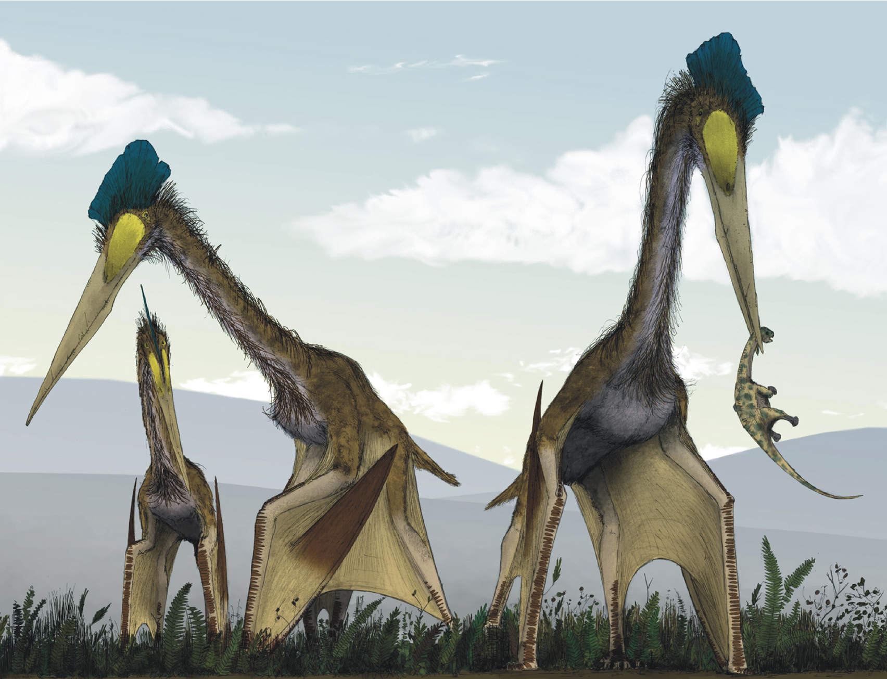
Evolution of Reptiles₂
Pterosaurs distinct from dinosaurs
Had number of adaptations for flight:
  Hollow bones
    Birds also have hollow bones (example of convergent evolution)
  Wings formed by membranes of skin attached to long, fourth finger of each arm and extended along the body to the legs
29.4 Figure 6: Pterosaurs, such as this Quetzalcoatlus (which existed from the late Triassic to the Cretaceous Period [230 to 66 MYA]), possessed wings but are not believed to have been capable of powered flight. Instead, they may have been able to soar after launching from cliffs.
Mark Witton and Darren Naish on Wikimedia Commons. "Quetzalcoatlus northropi."

Slide 21
Archosaurs: Pterosaurs₁
More than 200 species
Rulers of the skies during Mesozoic, starting in 230 MYA for over 170 million years
Fossil evidence suggests hundreds of pterosaur species lived during any given period
Variety of shapes and sizes, ranging from size of small songbird to enormous Quetzalcoatlus northropi (6 meters tall and 14-meter wingspan)
  Quetzalcoatlus northropi possibly largest flying animal ever

Slide 22
Archosaurs: Pterosaurs₂
Some male pterosaurs had brightly colored crests (some higher than actual head), possibly for sexual displays
Had hollow skeletons with pteroid bone (unique to pterosaurs) that strengthened forewing membrane
Much of wingspan exaggerated by greatly elongated fourth finger that supported half of wing
Not like birds
  Proportions: Quetzalcoatlus had head and neck region that was three to four times as large as torso
  Wings: had layer of muscles, connective tissue, and blood vessels reinforced with webbing of fibrous cords

Slide 23
Archosaurs: Dinosaurs₁
Include Saurischia ("lizard-hipped") with simple, three-pronged pelvis and Ornithischia ("bird-hipped") with complex pelvis, superficially similar to birds
  However, birds evolved from saurischian "lizard-hipped" lineage, not ornithischian "bird-hipped" lineage
Dinosaurs and theropod descendants (birds) remnants of diverse group of reptiles (including Argentinosaurus, which was 40 meters long and weighed 80,000 kg, largest land animal to have lived)

Slide 24
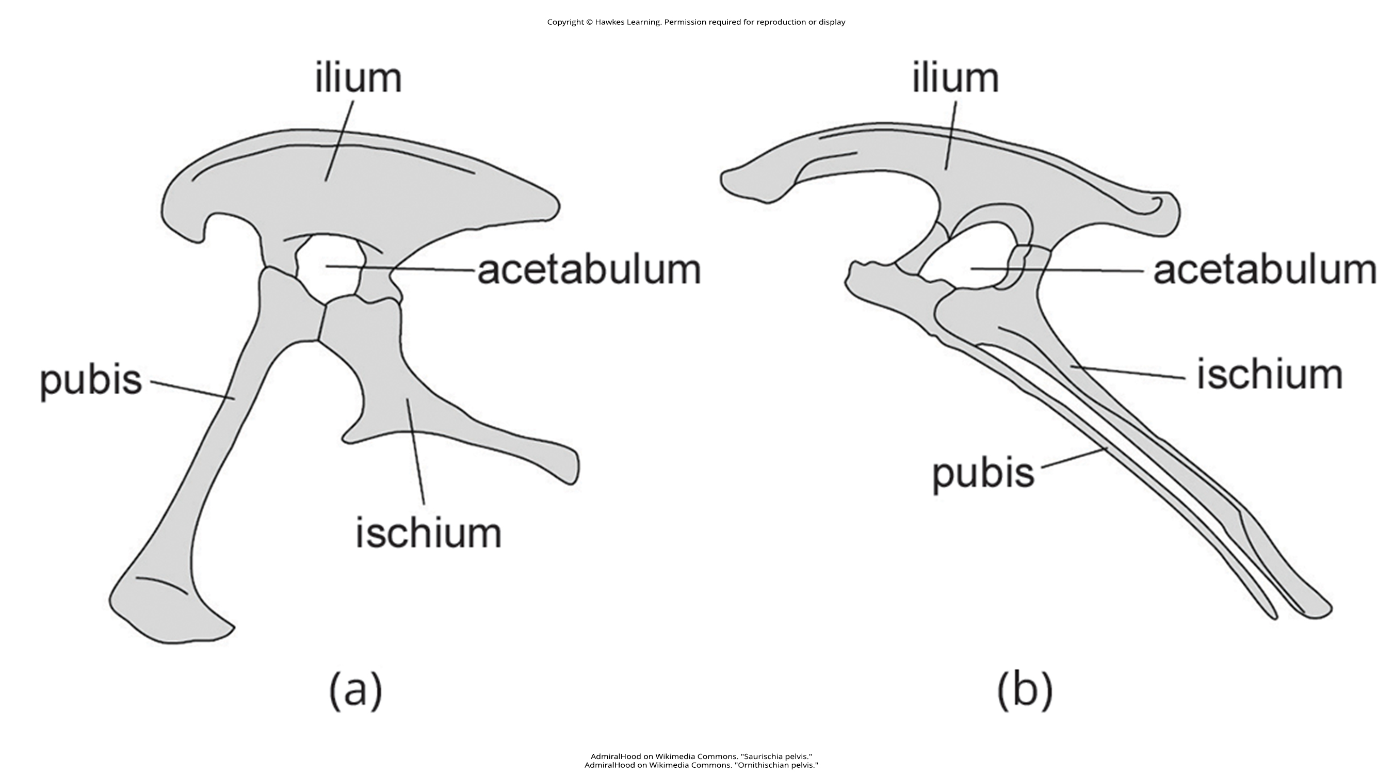
29.4 Figure 7
AdmiralHood on Wikimedia Commons. "Saurischia pelvis."
AdmiralHood on Wikimedia Commons. "Ornithischian pelvis."
Notes:
Figure 7: Dinosaurs are classified into the clades (a) Saurischia and (b) Ornithischia based on pelvic structure.

Slide 25
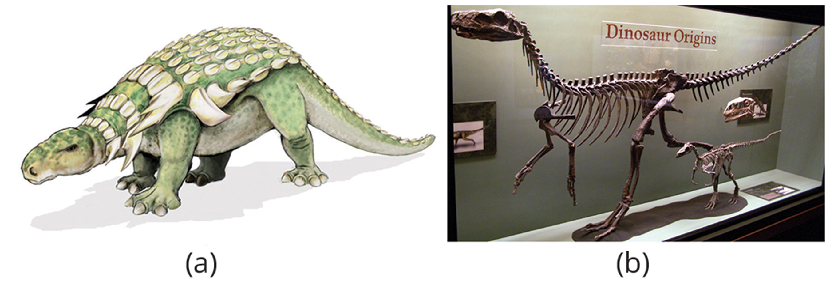
Archosaurs: Dinosaurs₂
Diverse group of terrestrial reptiles with more than 1,000 species and more continuing to be discovered
Some were quadrupeds; others were bipeds
  Example: Herrerasaurus (bipedal dinosaur from Argentina, one of the earliest dinosaurs that walked upright with legs directly below pelvis rather than splayed outward to the sides)
Some carnivorous; others herbivorous
  Ornithischia were all herbivores and sometimes had unusual shapes (e.g., ankylosaur "armored tanks" and horned dinosaurs like Triceratops)
29.4 Figure 8: (a) Edmontonia was an armored dinosaur that lived in the late Cretaceous Period, 145 to 66 MYA. (b) Herrerasaurus and Eoraptor were late Triassic saurischian dinosaurs dating to about 230 MYA.
Mariana Ruiz Villarreal on Wikimedia Commons. "Edmontonia dinosaur."
Zach Tirrell on Wikimedia Commons. "Herrerasaurus skeleton."

Slide 26
Archosaurs: Dinosaurs₃
Both ornithischian and saurischian likely provided parental care
  Fossil evidence supports this
  Comparative biology supports this since archosaur birds and crocodilians display extensive parental care
Laid eggs (number of nests containing fossilized eggs with intact embryos found)
Unknown whether they were homeotherms (able to maintain constant internal body temperature regardless of external environment) or facultative endotherms (able to use internal generated heat to maintain body temperature when needed)
  Saurischians likely endothermic because modern birds are

Slide 27
Archosaurs: Dinosaurs₄
Dominated in Mesozoic Era ("Age of Reptiles") and lasted until end of Cretaceous Period (last period of Mesozoic)
End of Cretaceous coincided with impact of large asteroid (produced Chicxulub crater) in Yucatan Peninsula of Mexico
  Impact at about 45,000 miles per hour
  Immediate environmental disasters
  Helped generate series of volcanic eruptions that changed distribution and abundance of plant life worldwide as well as climate
  Resulted in Cretaceous–Tertiary (K–T) extinction
    Loss of most large-bodied animals of Mesozoic like pterosaurs and majority of dinosaurs
    Only a clade of small, beaked theropods (evolving birds) survived

Slide 28
Modern Reptiles
Class Reptilia includes four living clades:
Crocodilia (24 species)
Sphenodontia (2 species)
Squamata (9,200 species)
Testudines (360 species)

Slide 29
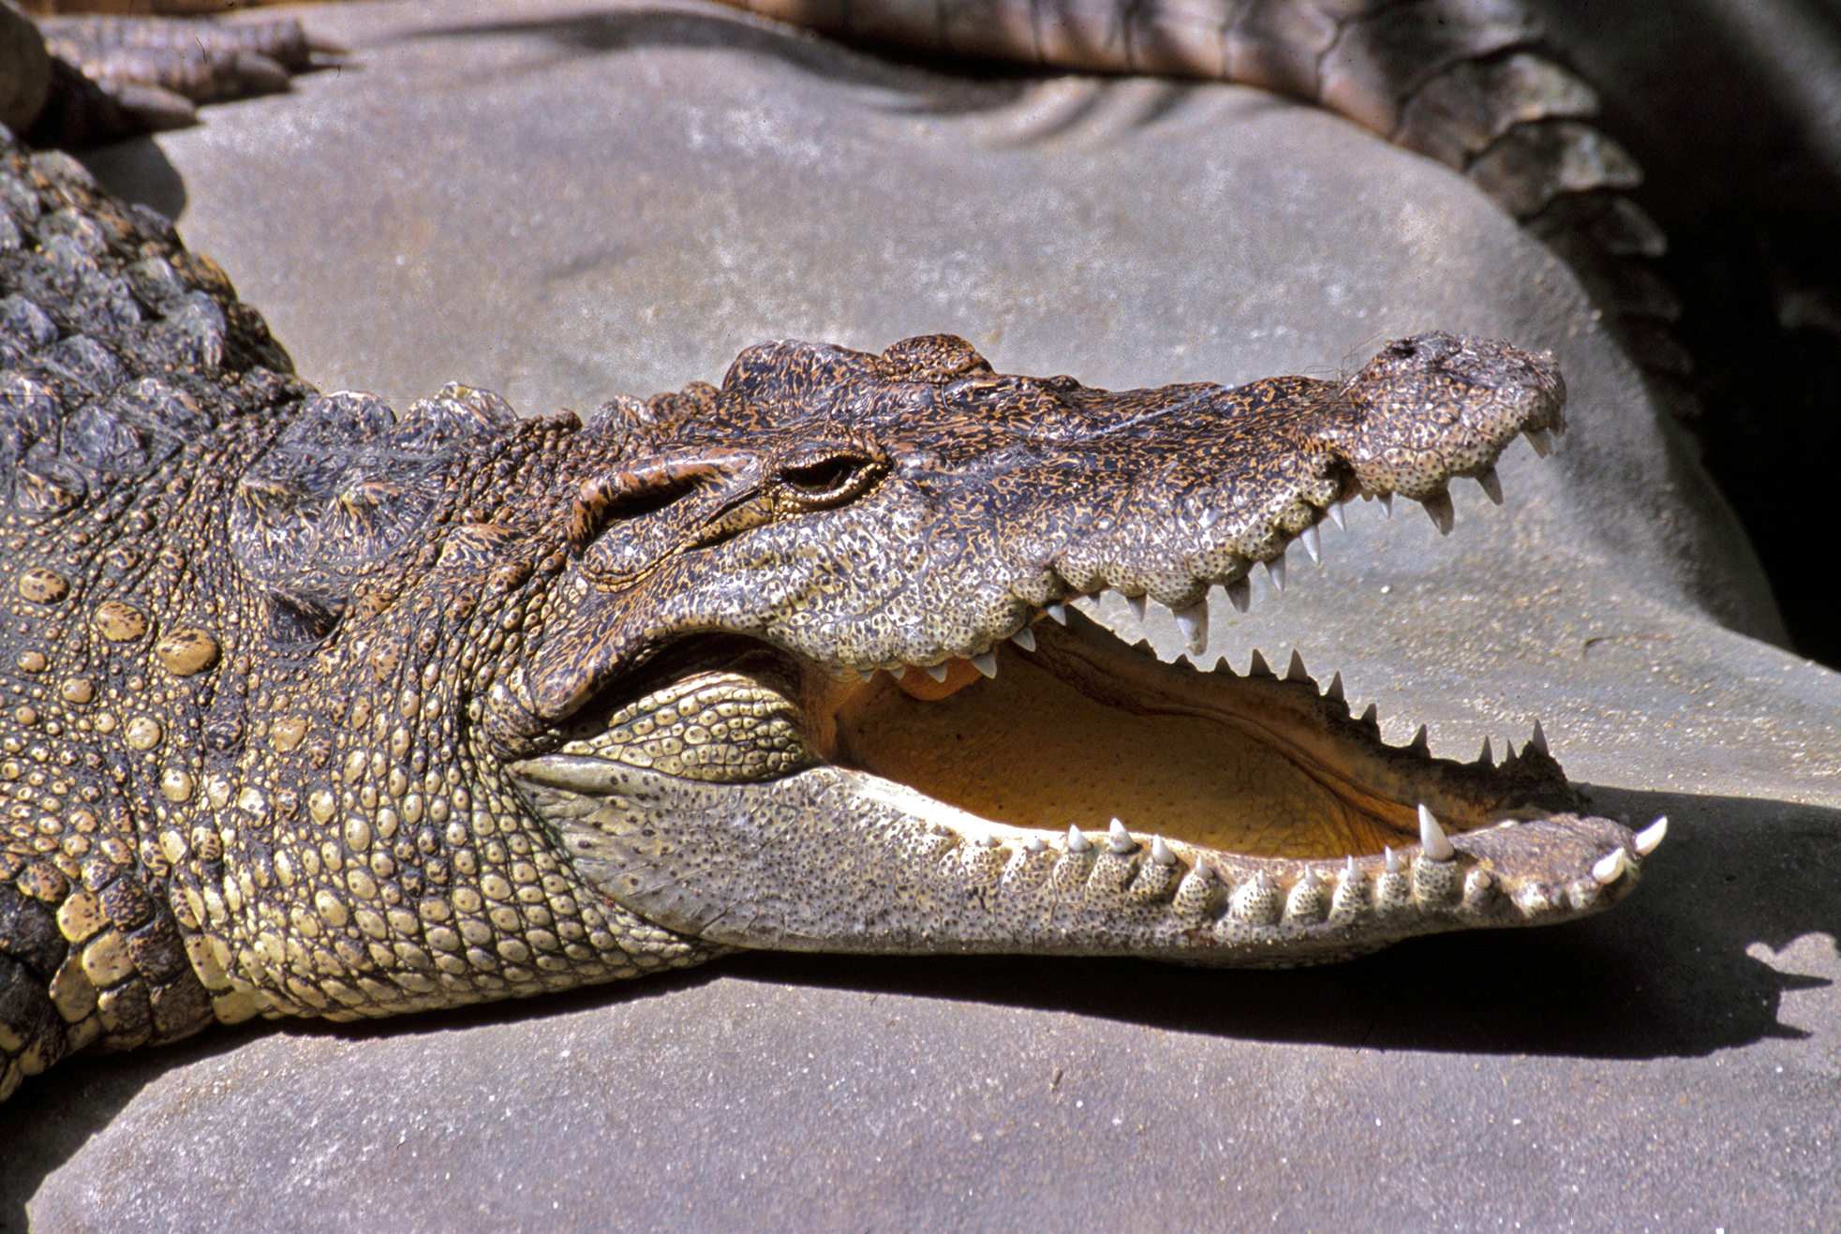
Crocodilia₁
Crocodilia ("small lizard"): crocodiles and alligators
Arose as distinct lineage by middle Triassic Period
Include alligators, crocodiles, gharials, and caimans
Live throughout tropics and subtropics of Africa, South America, southern Florida, Asia, and Australia
Found in freshwater, saltwater, and brackish habitats, like rivers and lakes
Spend most time in water
29.4 Figure 9: Crocodilians, such as this Siamese crocodile (Crocodylus siamensis), provide parental care for their offspring.
Bernard DUPONT on Wikimedia Commons. "Siamese crocodile."

Slide 30
Crocodilia₂
Descended from terrestrial reptiles and can still walk and run on land
Move on their bellies in swimming motion, propelled by alternate movements of legs
Some species can lift their bodies off the ground, pulling legs under body with feet rotated forward
  Takes a lot of energy and mostly used for clearing ground obstacles
Some can gallop, pushing off hind legs and moving hind and forelegs alternately in pairs
  Can make speeds of 17 kph over short distances

Slide 31
Crocodilia₃
Extensive parental care:
Females protect eggs until hatching
Offspring remain together under protection of female for several weeks or months after hatching
Female keeps offspring in her mouth to transport them between nest and water
Males sometimes participate by helping eggs to hatch and transporting offspring to water

Slide 32
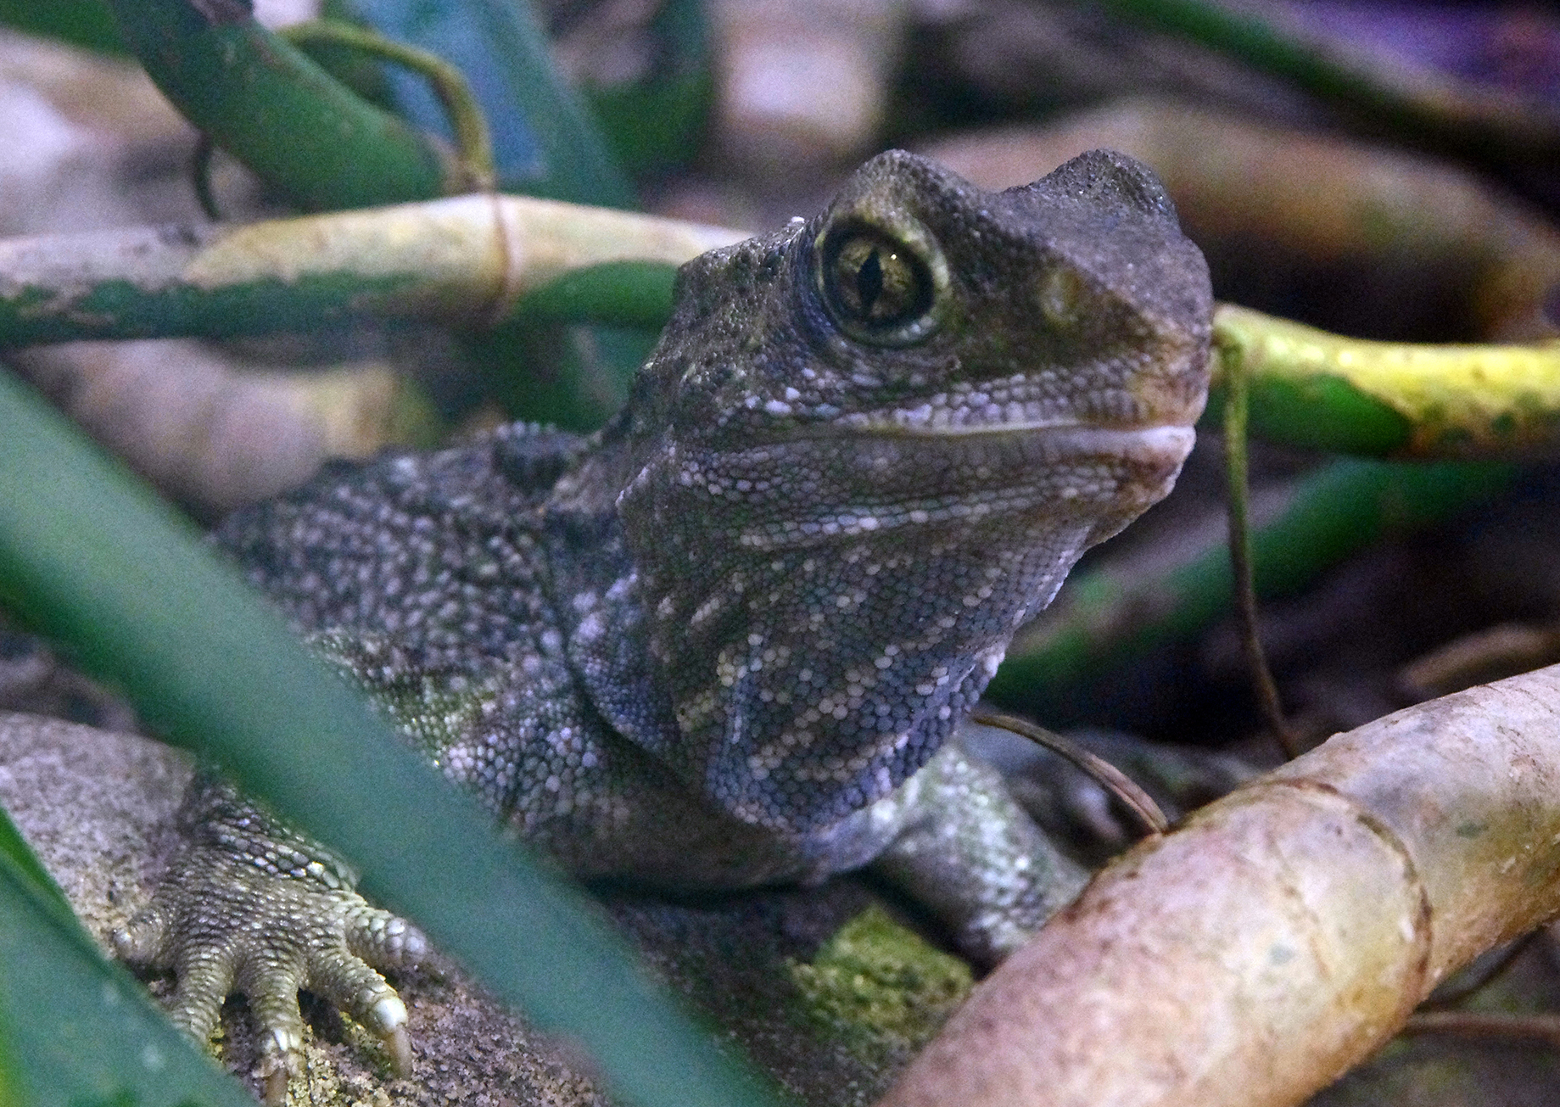
Sphenodontia₁
Sphenodontia ("wedge tooth"): clade of tuataras
Arose in early Mesozoic Era and experienced moderate radiation
Now represented by two living species: Sphenodon punctatus and Sphenodon guntheri
Found in offshore islands in New Zealand
Name comes from Māori word describing crest along its back
29.4 Figure 10: This tuatara from New Zealand may resemble a lizard but belongs to a distinct lineage: the Sphenodontidae family.
NAPARAZZI on Wikimedia Commons. "Tuatara."

Slide 33
Sphenodontia₂
Have primitive diapsid skull with biconcave vertebrae (vertebrae that scoop inward on each side)
About 80 cm long and weigh about 1 kg
Superficially similar to iguanid lizard but have skull and jaws that distinguish them from Squamata
  No external ears
  Briefly have third exposed (parietal) eye with lens, retina, and cornea in the middle of forehead
    Only visible in very young animals and soon covered with skin though it can still perceive light with limited color discrimination
  Jaws have two rows of teeth in upper jaw that bracket a single row of teeth in lower jaw
    Teeth are projections from jawbones and not replaced as they wear down

Slide 34
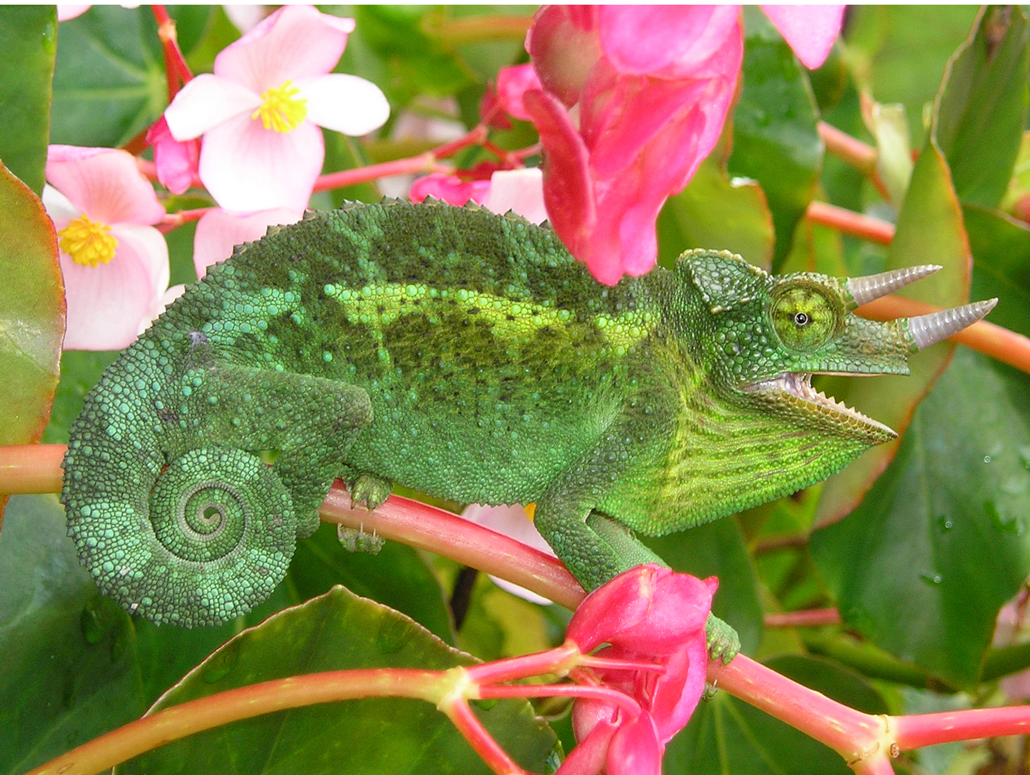
Squamata₁
Squamata ("scaly or having scales"): clade of lizards and snakes
Arose during late Permian Period
Include lizards and snakes
Found on all continents except Antarctica
Most closely related to tuataras; both having evolved from lepidosaurian ancestor
Largest extant clade of reptiles
29.4 Figure 11: This Jackson's chameleon (Trioceros jacksonii) blends in with its surroundings.
Movingsaletoday on Wikimedia Commons. "Jackson's chameleon."

Slide 35
Squamata₂
Differences between lizards and snakes:
Lizards have four limbs although often lost or significantly reduced in at least 60 lineages
Snakes lack eyelids and external ears
6,000 species of lizards
  Range from tiny chameleons and geckos (1 cm in length) to Komodo dragons (3 meters in length)
3,900 species of snakes (600 are venomous)
  Range from smallest snake (Barbados threadsnake) at about 10 cm in length to largest snakes of python and boa families at about 6 meters in length

Slide 36
Squamata₃
Lizards can have spines, crests, and frills with bright colors
  Some lizards (e.g., chameleons) can change skin by redistributing pigment within chromatophores in skin for camouflage or social signaling
Lizards have multiple-colored oil droplets in retinal cells that given good range of color vision
  Can focus eyes by changing shape of lens, and some (e.g., chameleons) can move eyes independently
  Some have skin-covered parietal eye
Both lizards and snakes use tongues to sample environment, and pit in the roof of the mouth (Jacobson's organ) evaluates sample

Slide 37
Squamata₄
Lizards are carnivorous, but some (e.g., iguanas) are herbivores
Some ambush predators; others patient foragers
Tongues long and sticky and can be extended at high speed for capturing insects and other small prey
Only venomous lizards: Gila monster and beaded lizard
  Venom glands identified in several species of monitors and iguanids, but venom not injected directly and more regarded as toxin delivered with bite

Slide 38
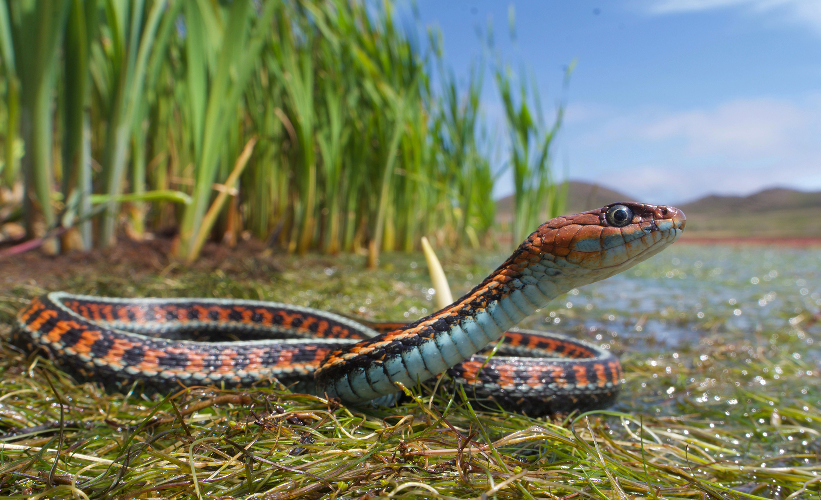
Squamata₅
Specialized feature of jaw related to adaptation for feeding and evolved to feed on large prey (though some current species reversed this trend)
Snakes thought to have descended from either burrowing or aquatic lizards over 100 MYA
All snakes are legless except boids (e.g., boa constrictors), which have vestigial hindlimbs in form of pelvic spurs
Narrow bodies of snakes have single functional lung
Snakes are carnivorous and eat small animals, birds, eggs, fish, and insects
29.4 Figure 12: The garter snake belongs to the genus Thamnophis, the most widely distributed reptile genus in North America.
Jaden Clark on Wikimedia Commons. "Red-sided garter snake."

Slide 39
Squamata₆
Snakes have flexible skull with eight rotational joints
Snakes have mandibles (lower jaws) that lack bones or muscle, allowing for great dynamic expansion of gape (opening mouth) and independent motion of two sides (both help with swallowing prey)
Most snakes are nonvenomous, swallowing prey alive or subdue it by constriction before swallowing
Venomous snakes use venom to kill or immobilize prey and help digestion

Slide 40
Squamata₇
Snake eyes protected with transparent scale (no eyelids)
  Retinas have both rods and cones and do not have receptor pigments for red light
  Can see in ultraviolet, which allows tracking of ultraviolet signals of rodent trails
  Can adjust focus by moving head
Snakes have lost both external and middle ears, but inner ears are sensitive to ground vibrations
Snakes have sensory structures for tracking prey
  Pit vipers (e.g., rattlesnakes) have sensory pit between eye and nostrils that is sensitive to infrared ("heat") emissions from warm-blooded prey
  Row of similar pits on upper lip of boids
  Use Jacobson's organ for detecting olfactory signals

Slide 41
Testudines₁
Testudines ("having a shell"): order of turtles
Include turtles, terrapins, and tortoises
Characterized by bony or cartilaginous shell
  Shell incorporated into skeletal system
    Dorsal shell (carapace) includes backbone and ribs
    Ventral shell (plastron)
      Both shells covered with keratinous plates or scutes
      Shells held together by bridge
      Some have hinged plastron to allow head and legs to withdraw under shell

Slide 42
Testudines₂
Two living groups: Pleurodira and Cryptodira
  Have significant anatomical differences and most easily recognized by how they retract necks
    Cryptodira: Retract neck in vertical S-curve; appear to simply pull head backward when retracting (more common)
    Pleurodira ("side-neck"): Retract neck with horizontal curve, folding neck to the side
Arose ~200 MYA, predating crocodiles, lizards, and snakes
About 360 extant species of turtles and tortoises
Are ectotherms
Are oviparous, laying eggs on land, though many species live near water
No parental care

Slide 43
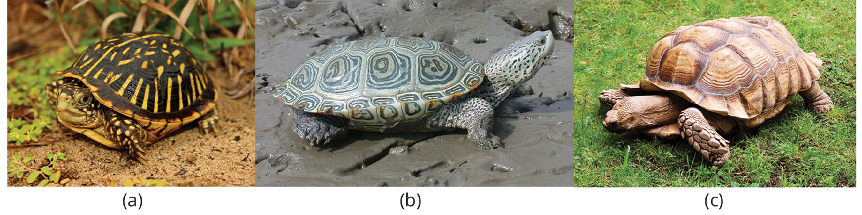
Testudines₃
Range in size from speckled padloper tortoise (8 cm) to leatherback sea turtle (200 cm)
Turtle usually describes species that live in the sea; tortoise and terrapin used to refer to species that live on land and in fresh or brackish water, respectively
29.4 Figure 13: (a) The ornate box turtle (Terrapene ornata) is one of two terrestrial species of turtle native to the Great Plains of the United States. (b) Diamondback terrapins (Malaclemys terrapin) is the only species of turtle in the world that lives exclusively in brackish water and is found in the marshes along the east coast and Gulf of Mexico in the United States. (c) The African spurred tortoise (Geochelone sulcata) lives at the southern edge of the Sahara Desert. It is the third largest tortoise in the world.
Peter Paplanus on Wikimedia Commons. "Ornate box turtle."
J.D. Wilson on Wikimedia Commons. "Diamondback terrapin."
MartinThoma on Wikimedia Commons. "African spurred tortoise."

Slide 44
Birds
Over 11,000 identified species; most speciose of land vertebrate classes
Extant clade that evolved from maniraptoran theropod dinosaurs about 150 MYA
  Feathers that set them apart from other extant vertebrates probably appeared in common ancestor of both ornithischian and saurischian lineages of dinosaurs
    Feathers homologous to reptilian scales and mammalian hair
    Wings of vertebrates like bats function without feathers, but birds rely on feathers and wings (with other modifications of body structure and physiology) for flight

Slide 45
Characteristics of Birds₁
Endothermic, more specifically homeothermic (maintain elevated and constant body temperature)
  Body temperature significantly above average body temperature of most mammals because (in part) active flight requires enormous amounts of energy, necessitating high metabolic rate
Have several different types of feathers that keep "heat" (infrared energy) within core of the body and away from surface where it can be lost by radiation and convection to the environment

Slide 46
Characteristics of Birds₂
Two main types of feathers: Contour feathers and down feathers
Contour feather: feather that creates an aerodynamic surface for efficient flight
  Have several parallel barbs that branch from central shaft
  Barbs have microscopic branches called barbules that are linked by minute hooks, making the vane of feather a strong, flexible, and uninterrupted surface
Down feather: feather specialized for insulation
  Barbules do not interlock, making feathers good for insulation (trapping air in spaces between loose, interlocking barbules of adjacent feathers to decrease rate of heat loss by convection and radiation)
  Certain parts of body covered in down feathers, and base of feathers has downy portion
  Newly hatched birds covered almost entirely in down (excellent coat of insulation), increasing boundary layer between skin and outside environment

Slide 47
Characteristics of Birds₃
Feathers also allow for flight, producing lift and thrust necessary for flying
Flight feather: feather specialized for flight
  Flexible, so feathers at end of wing separate as air moves over them, reducing drag
  Asymmetrical and curved so air flowing over them generates lift
  Two types of flight feathers: Primary feathers and secondary feathers
    Primary feather: feather located at the tip of the wing that provides thrust as bird moves wings downward with pectoralis major muscles
    Secondary feather: feather located at the base of the wing that provides lift
  Contour feathers found on body and help reduce form drag produced by wind resistance against body during flight
    Create smooth, aerodynamic surface, preventing turbulence and creating ideal conditions for flight

Slide 48
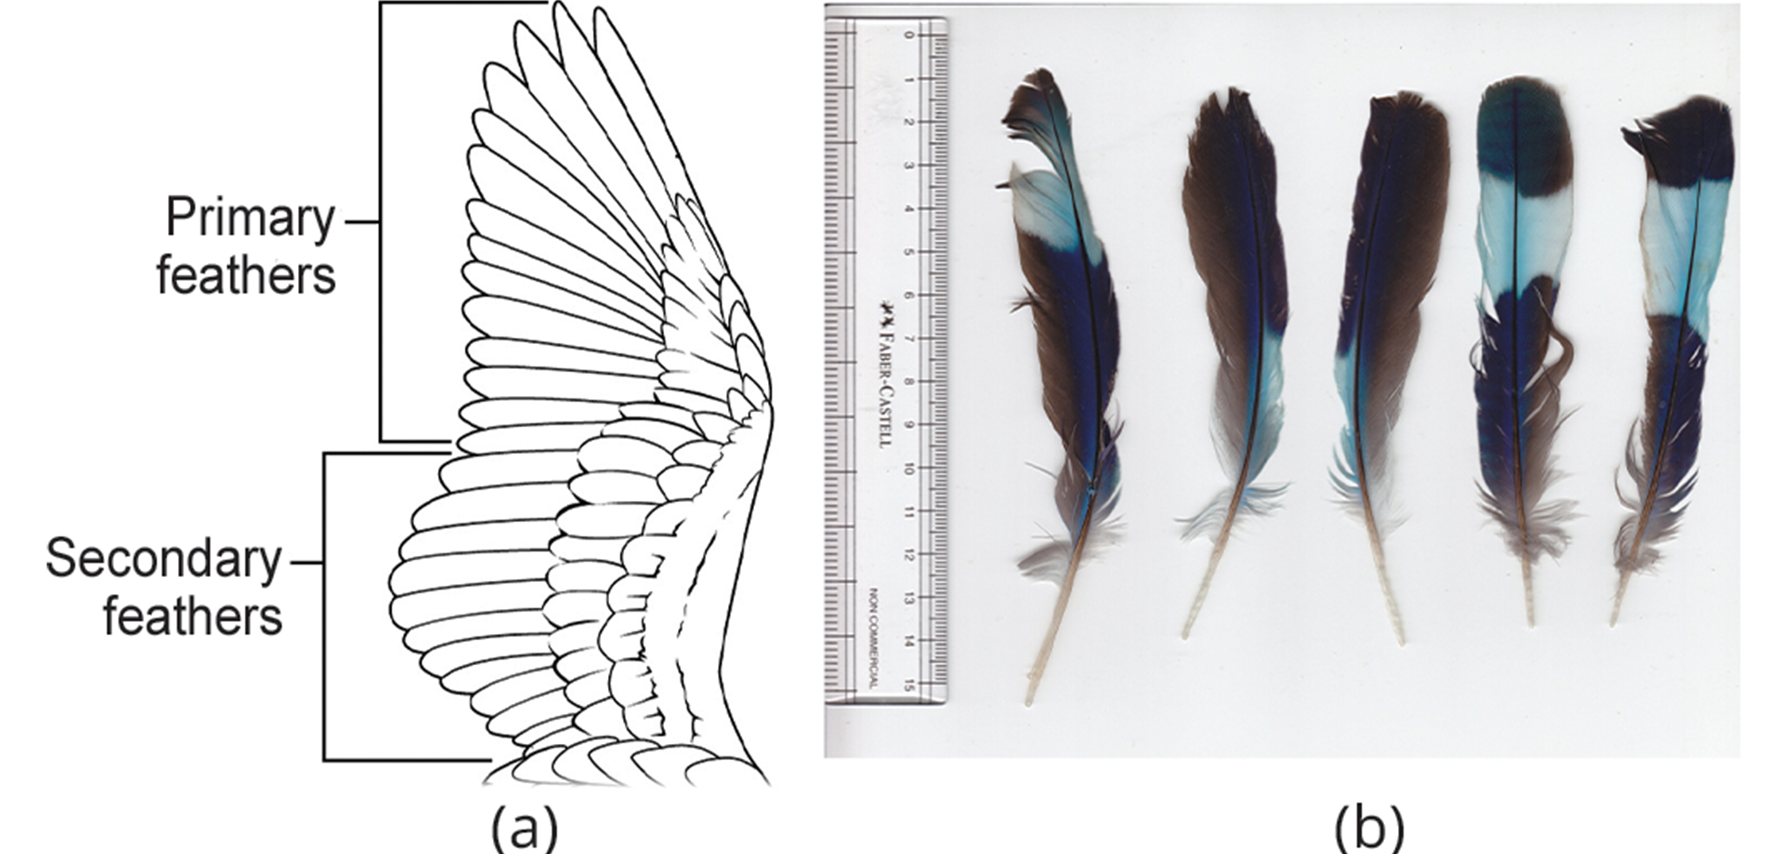
29.4 Figure 14
CNX OpenStax on Wikimedia Commons. "Primary and secondary feathers."
L. Shyamal on Wikimedia Commons. "Indian roller feathers."
Notes:
Figure 14: (a) Primary feathers are located at the wing tip and provide thrust; secondary feathers are located close to the body and provide lift. (b) These are primary, secondary, and tail feathers (from left to right: one primary, two secondaries, and two tail feathers) from an Indian roller (Coracias benghalensis).

Slide 49
Group Activity
As a group, create your own reproductions of contour feathers, down feathers, and flight feathers (both primary and secondary) using different materials, like clay or paper. Discuss how these types of feathers help birds produce lift and thrust for flying and maintain body temperature.

Slide 50
Characteristics of Birds₄
Flapping occurs through actions of chest muscles
  Contraction of pectoralis major moves wings downward (downstroke)
  Contraction of supracoracoideus moves wings upward (upstroke) via tendon that passes over coracoid bone at top of humerus
Both muscles attached to keel of sternum
  Flight muscles attach to blade-shaped keel projecting ventrally from sternum
  Sternum deeper than other vertebrates to accommodate large flight muscles
Flight muscles highly developed and account for higher percentage body mass than most mammals
  For active flyers, muscles are rich with oxygen-storing myoglobin
Most birds have fusion of two clavicles, forming furcula
  Furcula: wishbone formed by the fusing of the clavicles
  Flexible enough to bend and provide support to the shoulder girdle during flapping

Slide 51
Characteristics of Birds₅
Flight requires low body weight
  As body weight increases, muscle output required for flying increases
  Example: Ostrich, largest living bird, secondarily flightless
Modification for reducing weight: Pneumatization of bones
  Pneumatic bone: air-filled bone
    Cross struts of bone called trabeculae provide structural reinforcement
    Not found in all birds
    More extensive in large birds than small ones
    Not all bones of skeleton are pneumatic, but skulls of most birds are
    Jaw lightened by replacement of heavy jawbones and teeth with beak made of keratin

Slide 52
Think It Through
What does it mean if a bird is secondarily flightless?
Notes:
Originally an On Your Own. This is included here to use as a talking point or for a think-pair-share activity.

Slide 53
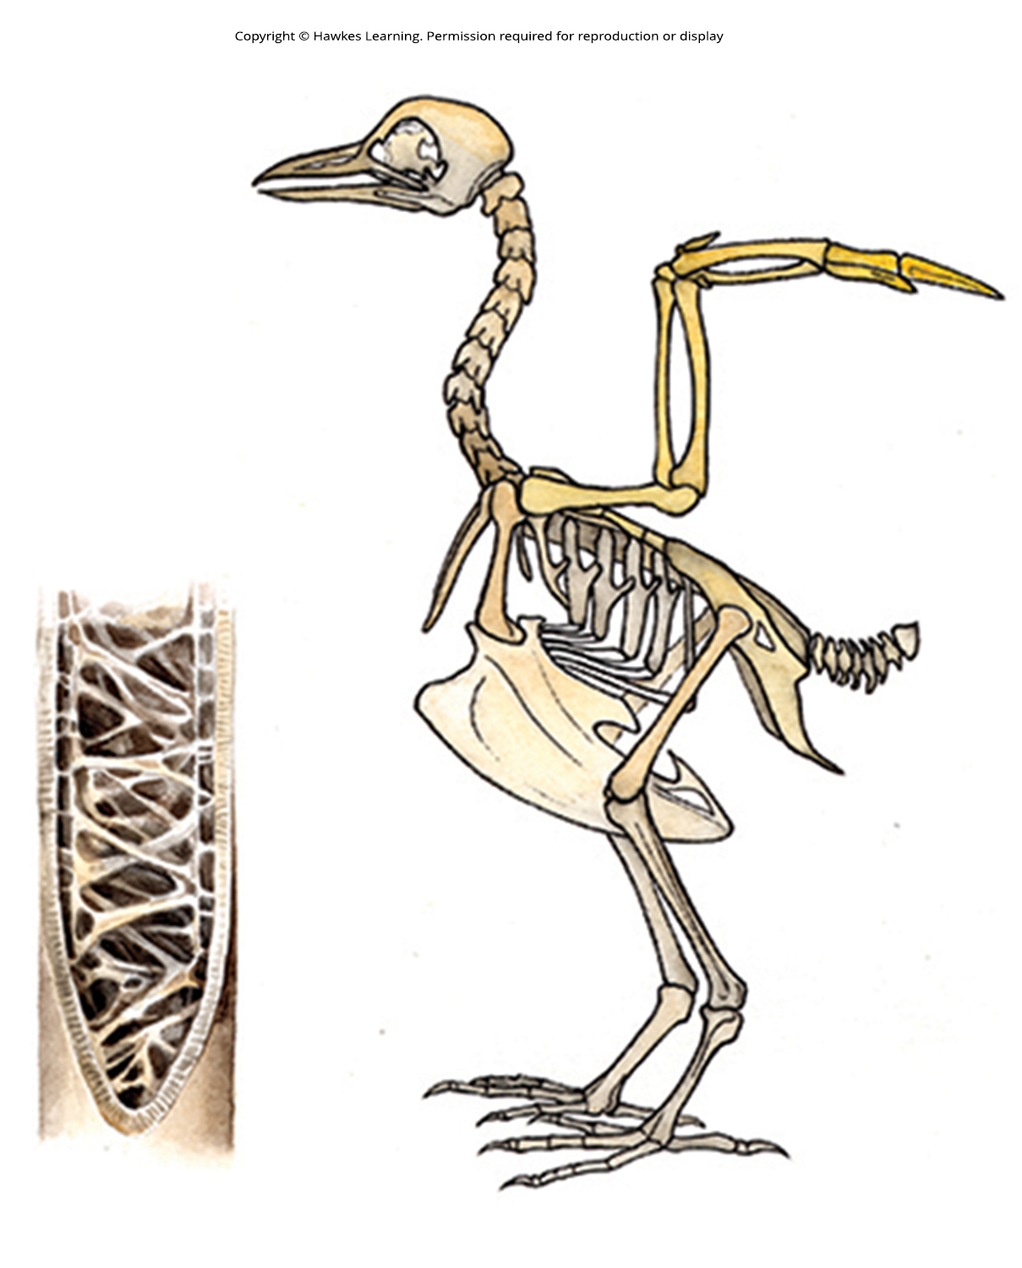
29.4 Figure 15
Notes:
Figure 15: Many birds have hollow, pneumatic bones, which make flight easier.

Slide 54
Characteristics of Birds₆
Modification for reducing weight: Lack of urinary bladder
  Cloaca: common body opening for the digestive, excretory, and reproductive systems found in non-mammals, such as birds
    Allows water to be reabsorbed from waste back into bloodstream
    Uric acid concentrated into urate salts that are expelled along with fecal matter
    Keep water from being held in bladder, increasing weight
Modification for reducing weight: Females only have one functional ovary

Slide 55
Characteristics of Birds₇
Respiratory system:
Dramatically different from reptiles and mammals
Well adapted for high metabolic rate required for flight
Air spaces of pneumatic bone sometimes connected to air sacs in body cavity, which replace coelomic fluid and lighten body
  Air sacs: terminal region of the lung where gas exchange occurs (also, alveolus)
Air sacs also connected to path of airflow through bird's body and function in respiration
Airflow is unidirectional

Slide 56
Characteristics of Birds₈
  Gas exchange occurs in air capillaries or microscopic air passages
  Arrangement of air capillaries in lungs creates countercurrent exchange system with pulmonary blood
    Air flows in one direction and blood flows in opposite direction, producing favorable diffusion gradient and creating efficient means of gas exchange
    Effective oxygen-delivery system that supports birds' higher metabolic activity
  Ventilation provided by parabronchi (minimally expandable lungs) with thin air sacs located among visceral organs and skeleton
  Syrinx (voice box) is near junction of trachea and bronchi but not homologous to mammalian larynx, which is within upper part of trachea

Slide 57
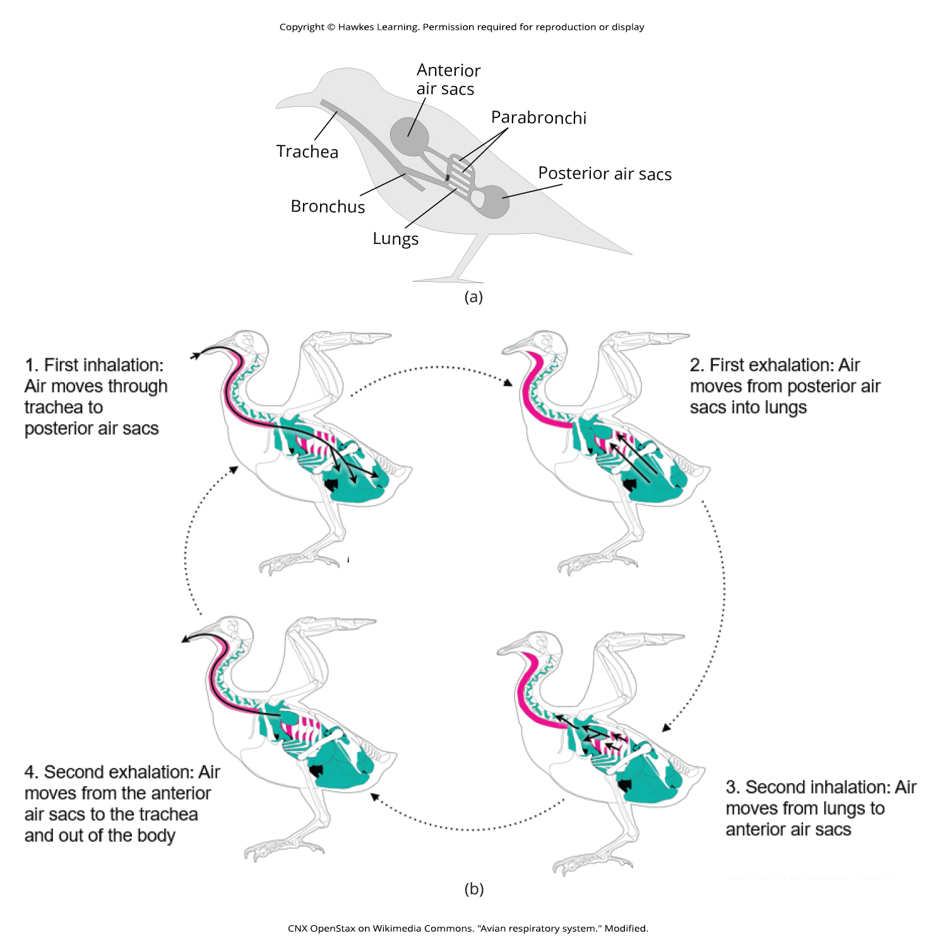
29.4 Figure 16 A
CNX OpenStax on Wikimedia Commons. "Avian respiratory system." Modified.
Notes:
Figure 16: (a) The avian respiratory system consists of the trachea, bronchus, lungs composed of parabronchi, and posterior and anterior air sacs.

Slide 58
29.4 Figure 16 B
CNX OpenStax on Wikimedia Commons. "Avian respiratory system." Modified.
Notes:
Figure 16: (b) Avian respiration is an efficient system of gas exchange with air flowing unidirectionally. A full ventilation cycle takes two breathing cycles. During the first inhalation, air passes from the trachea into posterior air sacs, then during the first exhalation into the lungs, where it delivers oxygen (O2) and picks up the carbon dioxide (CO2) waste. The second inhalation moves the air in the lungs to the anterior air sacs, and the second exhalation moves the air in the anterior air sacs out of the body. Overall, each inhalation moves air into the air sacs, while each exhalation moves fresh air through the lungs and "used" air out of the body. The air sacs are connected to the hollow interior of bones.

Slide 59
Characteristics of Birds₉
Other unusual characteristics:
Have elongated S-shaped neck but short tail (pygostyle) produced from fusion of caudal vertebrae
Only one occipital condyle, allowing for extensive movement of head and neck
Thin epidermis without sweat glands
Have specialized uropygial gland or sebaceous "preening gland" at dorsal base of tail
  Essential for preening because it produces oily substance that helps waterproof feathers and keeps them flexible for flight
  Some birds (e.g., pigeons, parrots, hawks, and owls) lack uropygial gland but have specialized feathers that "disintegrate" into powdery down and serve the same purpose as oils of uropygial gland
Have 12 pairs of cranial nerves, large cerebellum, and large optic lobes
Only have single bone in middle ear (columella), stapes in mammals
Closed circulatory system with two atria and two ventricles, with "right-bending" aortic arch and nucleated red blood cells

Slide 60
Characteristics of Birds₁₀
One of the most conspicuous and successful groups of vertebrate animals
Fill range of ecological niches
Range in size from bee hummingbird of Cuba (2 grams) to ostrich (140,000 grams)
Large brains, keen senses, and ability to imitate vocalization and use tools make them some of the most intelligent vertebrates

Slide 61
Evolution of Birds₁
Fossil discoveries in China paint clear picture of evolutionary history even though bird bones do not fossilize as well as other vertebrates
Highly modified diapsids that make it difficult to see trace of original diapsid condition, but presence of two small protrusions at base of skull are "shadow" of original diapsid arches
Belong to group of diapsids called archosaurs
  Archosaur: modern crocodilian or bird, or an extinct pterosaur or dinosaur
  Includes three other groups: Living crocodilians, pterosaurs, and dinosaurs
Evolved within clade Dinosauria, which is divided into Saurischia ("lizard-hipped") and Ornithischia ("bird-hipped")
  Saurischia diverged into long-necked herbivorous dinosaurs (e.g., Apatosaurus) and bipedal predators called theropods (which gave rise to birds)
  Numerous similarities between late (maniraptoran) theropod fossils and birds
    Structure of hip and wrist bones
    Presence of a wishbone, formed by fusion of clavicles

Slide 62
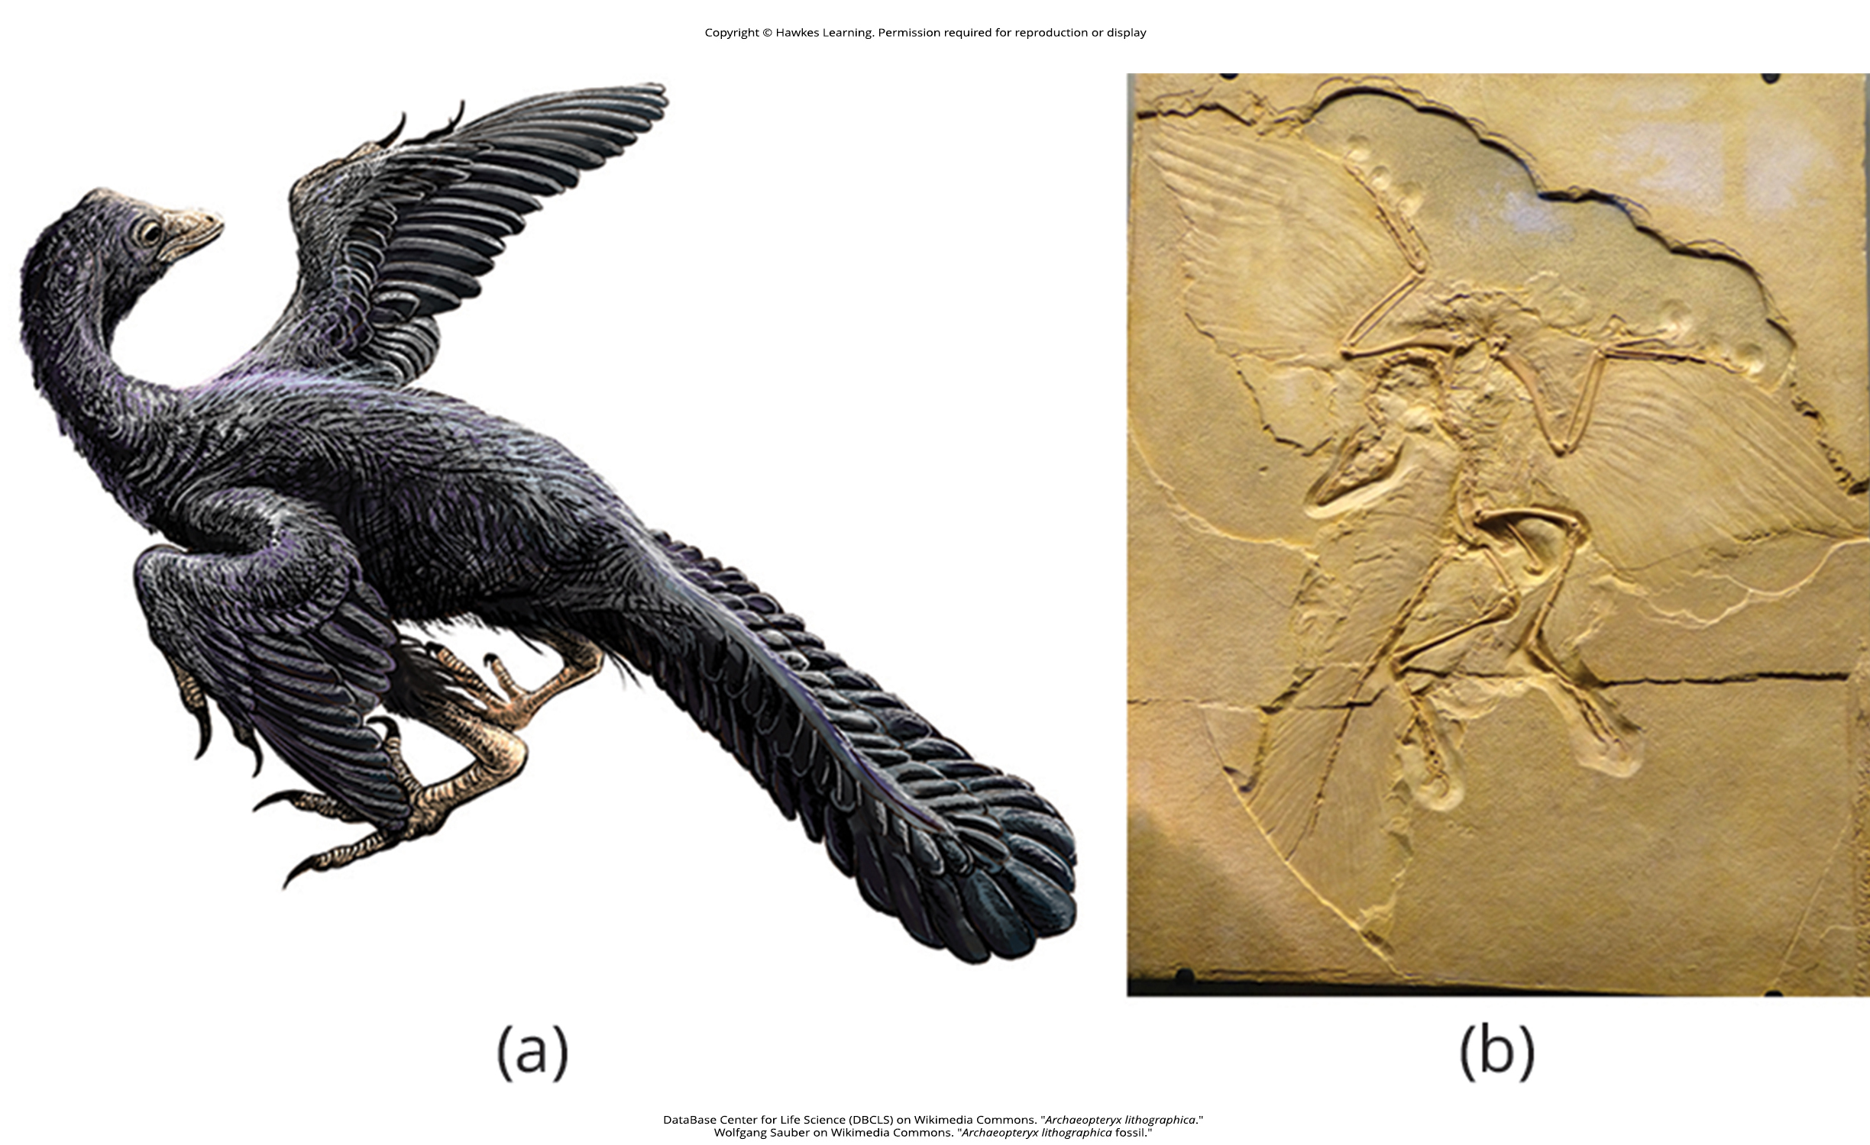
Evolution of Birds₂
Neornithes: modern birds
  Includes avian crown group, which comprises all living birds and descendants from their most recent common maniraptoran ancestor
"Intermediate" fossil between dinosaurs and birds is Archaeopteryx
  Archaeopteryx: transition species from dinosaur to bird from the Jurassic Period (201 to 145 MYA)
  Had characteristics of both maniraptoran dinosaurs and modern birds
    Dinosaur-like traits: Jaw with teeth and long, bony tail
      Are fossils of older feathered dinosaurs, but feathers may not have had characteristics of modern flight feathers
    Bird-like traits: Feathers modified for flight on forelimbs and tail (trait associated only with birds among modern animals)
29.4 Figure 17: (a) Archaeopteryx lived in the late Jurassic Period around 150 MYA. It had cuplike thecodont teeth like a dinosaur but had (b) flight feathers like modern birds, which can be seen in this fossil.
DataBase Center for Life Science (DBCLS) on Wikimedia Commons. "Archaeopteryx lithographica."
Wolfgang Sauber on Wikimedia Commons. "Archaeopteryx lithographica fossil."

Slide 63
The Evolution of Flight in Birds₁
Two hypotheses to explain how flight may have evolved in birds:
Arboreal ("tree") hypothesis: Tree-dwelling precursors to modern birds jumped from branch to branch using feathers for gliding before becoming fully capable of flapping flight
  More likely and improved chances of escaping enemies, finding mates, and obtaining prey like flying insects
  Greatly increased opportunity for species dispersal
Terrestrial ("land") hypothesis: Running was stimulus for flight, and wings used to capture prey and were preadapted for balance and flapping flight
  Example: Ostriches hold wings out as they run, possibly for balance
    Could represent behavioral relict of clade of flying birds that were their ancestors

Slide 64
Science and You₁
Career: Veterinarian
Concerned with diseases, disorders, and injuries in animals, primarily vertebrates
Treat pets, livestock, and animals in zoos and laboratories
Education:
  Required to complete degree in veterinary medicine, including courses in comparative zoology, animal anatomy and physiology, microbiology, pathology, chemistry, physics, and mathematics
  Trained to perform surgery on many different vertebrate species, requiring knowledge of anatomy of different species
    Examples: Stomach of ruminants (e.g., cows) has four "compartments"; birds have anatomical adaptations for flight
Notes:
This is included as a relevant application for this topic.

Slide 65
Science and You₂
Career: Veterinarian
Conduct research in academic settings, broadening knowledge of animals and medical science
  Research to understand transmission of animal diseases to humans (zoonotic diseases)
    Examples:
      Transmission of avian flu (H5N1) from birds to humans in Asia, Europe, Africa, and Middle East
      Coronaviruses (e.g., SARS-CoV-2) might have passed from bats to humans through secondary reservoir
Notes:
This is included as a relevant application for this topic.

Slide 66
The Evolution of Flight in Birds₂
Unknown how endothermy evolved in birds
Question of if feathers or endothermy came first
  Feathers provide insultation but only beneficial for thermoregulatory purposes if body heat is produced internally
  Internal heat production only viable for evolution of endothermy if insulation is present to retain infrared energy
Suggested that one or the other—feathers or endothermy—evolved in response to selective pressure (e.g., ability to be active at night, provide camouflage, repel water, or serve as signals for mate selection)
Probable that feathers and endothermy coevolved together: Improvement and evolutionary advancement of feathers reinforcing evolutionary advancement of endothermy

Slide 67
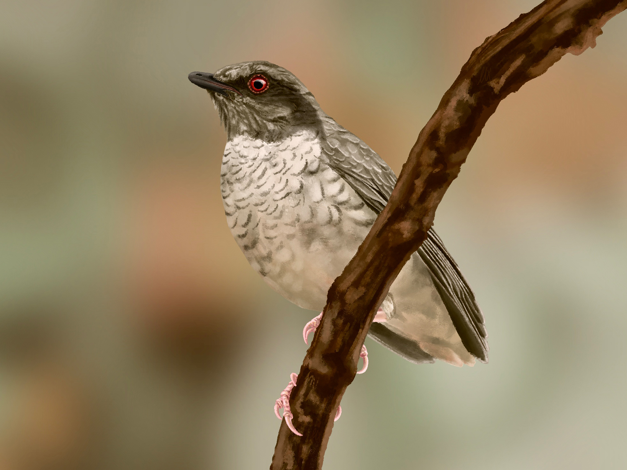
The Evolution of Flight in Birds₃
Enantiornithes ("opposite birds"): dominant bird group during the Cretaceous Period (145 to 66 MYA)
Certain bones of shoulder joined differently than bones in modern birds
Retain their teeth in jaws (like Archaeopteryx) but had shortened tail
Some fossils preserved "fans" of tail feathers
Formed evolutionary lineage separate from modern birds but did not survive past Cretaceous
29.4 Figure 18: This reconstruction of Kizylkumavis cretacea, a species of Enantiornithes that did not survive past the Cretaceous Period, is based on fossil evidence.
Luxquine on Wikimedia Commons. "Kizylkumavis cretacea."

Slide 68
The Evolution of Flight in Birds₄
Ornithurae ("bird tails")
Evolved with Enantiornithes
Had short, fused tail (pygostyle)
Emerged from evolutionary line that includes modern birds
Also present in Cretaceous
Became dominant birds, with large and rapid radiation after extinction of dinosaurs during Cenozoic Era (66 MYA to present)

Slide 69
The Evolution of Flight in Birds₅
Molecular analysis shows three major clades:
  Paleognathae ("old jaw"): ratites (polyphyletic); flightless birds, including ostriches, emus, rheas, and kiwis
  Galloanserae: Include pheasants, ducks, geese, and swans
  Neoaves ("new birds"): Includes all other birds
    Divided into five clades:
      Strisores (nightjars, swifts, and hummingbirds)
      Columbaves (turacos, bustards, cuckoos, pigeons, and doves)
      Gruiformes (cranes)
      Aequorlitornithes (diving birds, wading birds, and shorebirds)
      Inopinaves (large clade of land birds, including hawks, owls, woodpeckers, parrots, falcons, crows, and songbirds)
Phylogenetic revisions still taking place

Slide 70
Summary₁
Amniotes distinguished by presence of terrestrially adapted egg protected by four extraembryonic membranes
  Include reptiles, birds, and mammals
  Diverged into two main groups: Synapsids (mammals) and sauropsids (which is divided into anapsids and diapsids [crocodiles, dinosaurs, birds, and modern reptiles])
Reptiles:
  Tetrapods that ancestrally had four limbs, but some extant species have secondarily lost them or reduced them
    Example: Limbless reptiles (e.g., snakes) classified as tetrapods because descended from ancestors with four limbs
  Key adaptation for life on land was development of scaly skin containing keratin, which prevented water loss from skin
  Reptilia contains four living clades of non-avian organisms: Crocodilia (crocodiles and alligators), Sphenodontia (tuataras), Squamata (lizards and snakes), and Testudines (turtles)
    Classification is paraphyletic and leaves out birds (now classified as avian reptiles)

Slide 71
Summary₂
Birds:
Most speciose group of land vertebrates
Display adaptations for flying that were first present in theropod (maniraptoran) ancestors
Endothermic (and homeothermic), have very high metabolism that produces considerable amount of heat and have structures like feathers that allow them to retain body heat
  Used to regulate internal temperature, making them independent of ambient thermal conditions
Have feathers, which allow for insulation and flight and used for mating and warning signals
  Flight feathers: Broad and continuously curved vane that produces lift

Slide 72
Summary₃
Birds:
Some have pneumatic bones containing air spaces that are sometimes connected to air sacs in body cavity
Air flow through lungs travels in one direction, creating countercurrent gas exchange with blood
Highly modified diapsids and belong to archosaurs
Most likely evolved from theropod (maniraptoran) dinosaurs
Oldest known fossil of intermediate between dinosaurs and birds is Archaeopteryx (dated from Jurassic Period)
Modern birds classified into: Paleognathae, Galloanserae, and Neoaves

Slide 73

End of Hawkes Learning PowerPoint

