Slide 1
Lesson 29.5
Mammals

Slide 2
Objectives
Describe the likely line of evolutionary descent that produced mammals.
Identify the major clades of eutherian mammals.
List some derived features that may have arisen in response to mammals' need for constant, high-level metabolism
Name and describe the distinguishing features of the three main groups of mammals.

Slide 3
Mammals
Mammal: one of the groups of endothermic vertebrates that possess hair and mammary glands
About 5,400 species
Other distinctive characteristics, including certain features of:
Jaw
Skeleton
Integument
Internal anatomy
Belong to three clades:
Monotremes
Marsupials
Eutherians (placental mammals)

Slide 4
Characteristics of Mammals₁
Hair
Composed of keratin protein
Most obvious characteristic of mammals, though not obvious on some (e.g., whales)
Functions of hair:
Insultation: Mammals are endothermic; hair traps boundary of layer of air close to body, retaining heat generated by metabolic activity
Sensory mechanism: Specialized hairs called vibrissae (whiskers) attach to nerves that transit information about tactile vibration produced by sound
Useful to nocturnal or burrowing mammals
Protective coloration
Social signaling (e.g., hair stands "on end" to warn enemies or make them look bigger)

Slide 5
Characteristics of Mammals₂
Integument (Skin)
Includes number of different types of secretory glands, unlike birds
Sebaceous gland: in mammals, a skin gland that produces a lipid mixture called sebum
Secreted onto hair and skin, providing water resistance and lubrication for hair
Located over most of body
Eccrine gland: sweat gland
Sweat mainly composed of water but also metabolic waste and sometimes compounds with antibiotic activity
Limited to certain areas of body (e.g., forehead, palms, soles of feet) and some don't have any
In humans, located over most of body and help regulate body temperature through evaporative cooling

Slide 6
Characteristics of Mammals₃
Apocrine gland: scent gland that secretes substances that are used for chemical communication (e.g., skunks)
Mammary gland: in female mammals, a gland that produces milk for newborns
Monotremes and eutherians have them in both males and females (exception: opossums)
Likely modified sebaceous or eccrine glands
Evolutionary origin unclear

Slide 7
Characteristics of Mammals₄
Jaw
Lower jaw consists of only one bone (dentary)
Dentary: single bone that comprises the lower jaw of mammals
Jaw hinge connects dentary to squamosal (flat) part of temporal bone in skull
Other vertebrates include quadrate bone at back of skull and articular bone at back of jaw, and jaw is connected between quadrate and articular bones
Ears and Eyes
In other vertebrates, vibrations transmitted to inner ear by stapes
In mammals, quadrate and articular bones moved into middle ear
Malleus derived from articular bone, and incus originated from quadrate
Arrangement of jaw and ear bones in fossils distinguishes mammals from other synapsids
Movable eyelids and fleshy external ears (pinnae)
Unlike naked external auditory openings in birds

Slide 8
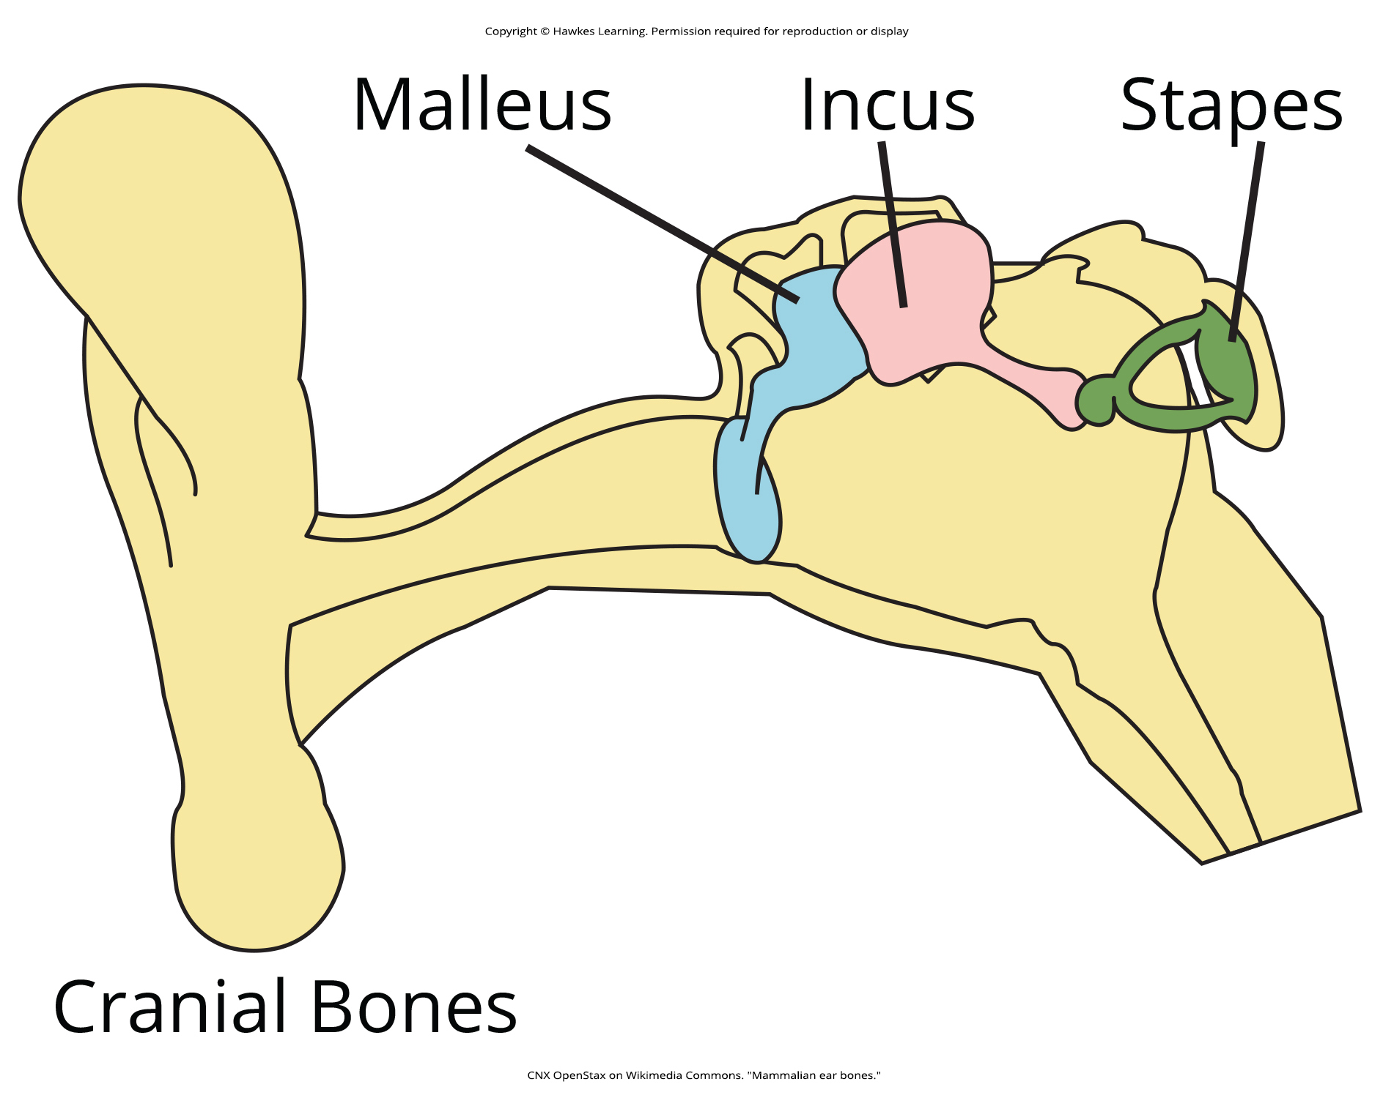
29.5 Figure 1
CNX OpenStax on Wikimedia Commons. "Mammalian ear bones."
Notes:
Figure 1: Bones of the mammalian middle ear are modified from bones of the jaw and skull in reptiles. The stapes found in mammals is also found in other vertebrates (e.g., the columella of birds), whereas in mammals, the malleus and incus are derived from the articular and quadrate bones, respectively.

Slide 9
Reflection Question
Why do you think the quadrate and articular bones are located in the middle ear of mammals rather than as part of the jaw and skull? What advantage does this have for mammals?
Notes:
The reflection question is included here to use as a talking point or for a think-pair-share activity.

Slide 10
Characteristics of Mammals₅
Muscular System
Adductor muscles that close jaw comprise two major muscles: temporalis and masseter
Permit up-and-down and side-to-side movements of jaw needed for chewing (unique to mammals)
Have muscular diaphragm that is lacking in birds
Teeth
Most have heterodont teeth (different types and shapes of teeth like incisors, canines, premolars, and molars)
Also diphyodont
Diphyodont: refers to the possession of two sets of teeth in a lifetime (deciduous, or "baby" teeth, and permanent teeth)
Most other vertebrates are polyphyodonts (teeth replaced continually)

Slide 11
Characteristics of Mammals₆
Circulatory System
Possess four-chambered heart
Example of convergent evolution with birds since birds and mammals arose independently from different groups of tetrapod ancestors
Have specialized group of cardiac cells (fibers) located in walls of right atrium called sinoatrial node (pacemaker), which determines heart rate
Erythrocytes (red blood cells) do not have nuclei
Other vertebrates have nucleated erythrocytes

Slide 12
Think It Through
Humans are examples of mammalian diphyodonts, whereas elephants are mammalian polyphyodonts. What is the difference?
Notes:
Originally an On Your Own. This is included here to use as a talking point or for a think-pair-share activity.

Slide 13
Characteristics of Mammals₇
Excretory System
Kidneys have portion of nephron called loop of Henle (nephritic loop)
Allows mammals to produce urine with high concentration of solutes (higher than that of blood)
Lack renal portal system (system of veins that moves blood from the hind or lower limbs and region of the tail to kidneys)
Renal portal system present in all other vertebrates except jawless fishes
Possess urinary bladder

Slide 14
Characteristics of Mammals₈
Skeletal System
Have two occipital condyles (bones at base of skull that articulate with first vertebra)
Have secondary palate at rear of pharynx that helps to separate the pathway of swallowing from breathing
Turbinate bones (conchae in humans) located along sides of nasal cavity and help warm and moisten air when inhaled
Pelvic bones fused
Typically seven cervical vertebrae (except in some edentates and manatees)

Slide 15
Characteristics of Mammals₉
Nervous System
In some, cerebral cortex (outermost part of cerebrum) is highly convoluted and folded, allowing for greater surface area
Optic lobes (located in midbrain) divided into two parts
Other vertebrates possess single, undivided lobe
Eutherian mammals possess corpus callosum (links two cerebral hemispheres together)
Functions to integrate motor, sensory, and cognitive functions between left and right cerebral cortexes

Slide 16
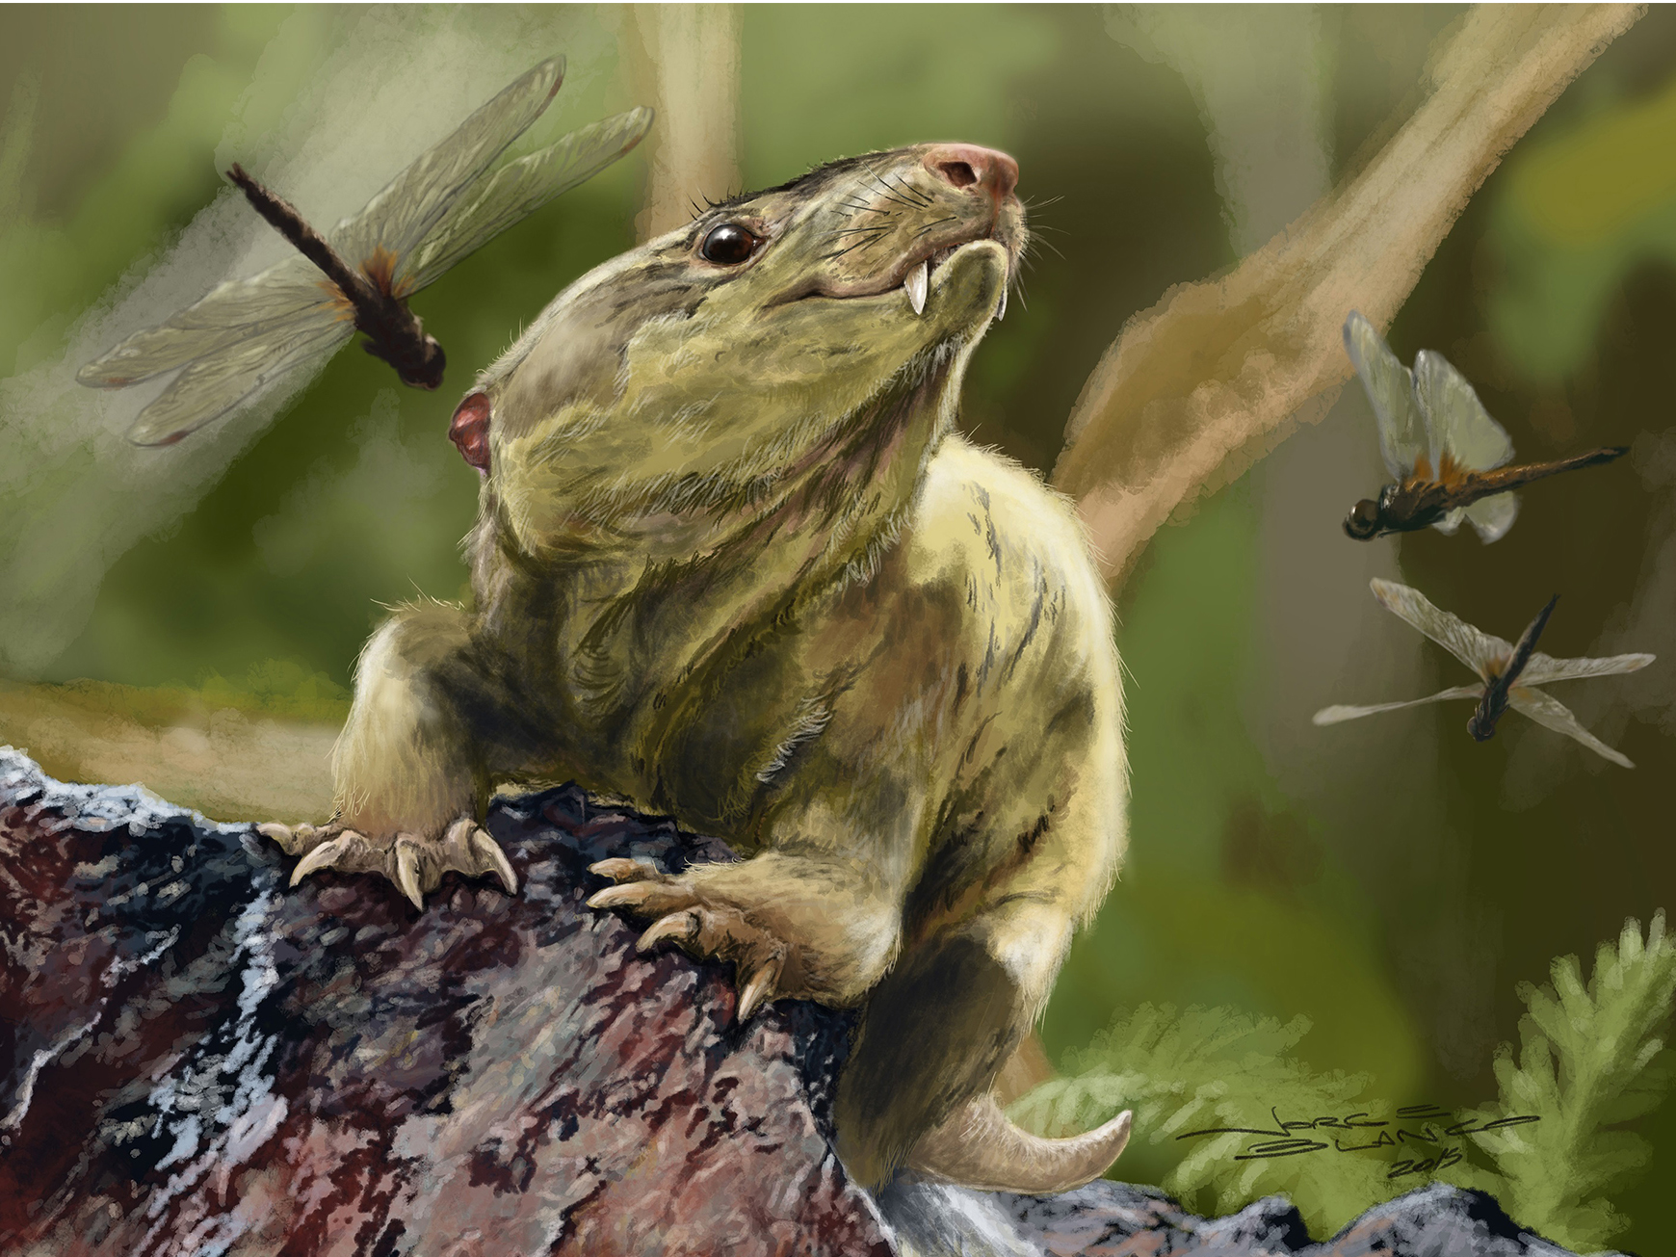
Evolution of Mammals₁
Synapsid Ancestry
Have single, ancestrally fused, postorbital opening in skull
Only living synapsids; earlier forms became extinct by Jurassic Period
Early nonmammalian synapsids divided into pelycosaurs and therapsids
Group in therapsids called cynodonts may have been ancestors of mammals
29.5 Figure 2: Cynodonts ("dog teeth"), which first appeared in the late Permian Period 260 MYA, are thought to be the ancestors of modern mammals. Holes in the upper jaws of cynodonts suggest that they had whiskers, which might also indicate the presence of hair. Bonacynodon schultzi is an extinct species of cynodont that lived in what is now southern Brazil.
Jorge Blanco, Martinelli AG, Soares MB, Schwanke C on Wikimedia Commons. "Bonacynodon schultzi reconstruction."

Slide 17
Evolution of Mammals₂
Key Characteristics and Adaptations
Endothermy rather than ectothermy like other vertebrates (e.g., fish, amphibians, and most reptiles)
Increased metabolic rate required to internally modify body temperature likely went hand-in-hand with changes to certain skeletal structures that improved food processing and walking
Later synapsids (have more evolved characteristics unique to mammals) possess cheeks for holding food and heterodont teeth
Heterodont teeth: different types of teeth that are modified for different purposes like breaking down food to speed digestion and release energy needed to produce heat

Slide 18
Evolution of Mammals₃
Secondary palate facilitates ability to breathe while chewing
Comprises bony palate and posterior continuation of soft palate
Separates area of the mouth where chewing occurs from area above where respiration occurs, allowing uninterrupted breathing while chewing
Not found in pelycosaurs but is present in cynodonts and mammals
Jawbone shows changes from early synapsids to later ones
Zygomatic arch (cheekbone) present in mammals and advanced therapsids (e.g., cynodonts) but not in pelycosaurs
Presence suggests presence of masseter muscles, which close jaw and function in chewing

Slide 19
Evolution of Mammals₄
Shoulder girdle of therian mammals modified from other vertebrates
Consists of three bones: Clavicle (collarbone), scapula (shoulder blade), humerus (upper arm bone)
Does not possess coracoid bone (bone connecting scapula to front of sternum, or breastbone) or interclavicle (bone in front of sternum and between clavicle)
Scapula is dominant bone

Slide 20
Evolution of Mammals₅
Evolved from therapsids in late Triassic Period
Earliest known mammal fossils from early Jurassic Period (~205 MYA)
Transitional mammals: Morganucodonts (small nocturnal insectivores)
Jaws were "transitional," with features of both reptilian and mammalian jaws
Had differentiated teeth and were diphyodonts
Began to diversify in Mesozoic Era (from Jurassic to Cretaceous Periods)
Small gliding mammals appear in fossil record during this time
Most Jurassic mammals extinct by end of Mesozoic Era
Another radiation (diversification) of mammals began during Cretaceous Period and continued through Cenozoic Era (65 MYA)

Slide 21
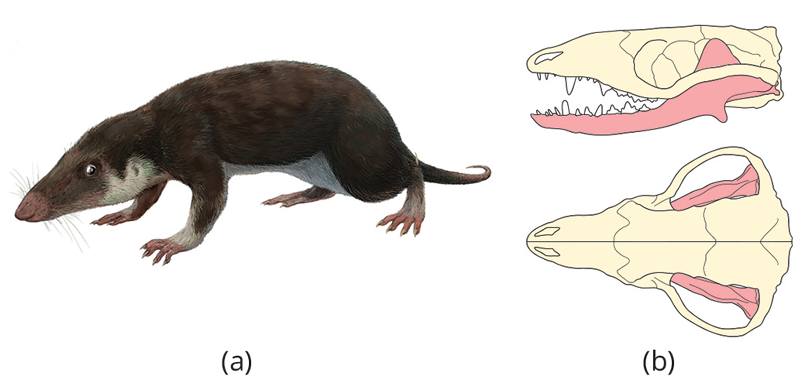
29.5 Figure 3
FunkMonk (Michael B.H.) on Wikimedia Commons. "Morganucodon oehleri life restoration."
Hemiauchenia on Wikimedia Commons. "Morganucodon oehleri skull."
Notes:
Figure 3: (a) This morganucodont, an extinct basal mammal, may have been nocturnal and insectivorous. (b) The jaw of a morganucodont has a double hinge, one between the dentary and squamosal and one between the articular and quadrate bones. In living mammals, the articular and quadrate bones have been incorporated into the middle ear.

Slide 22
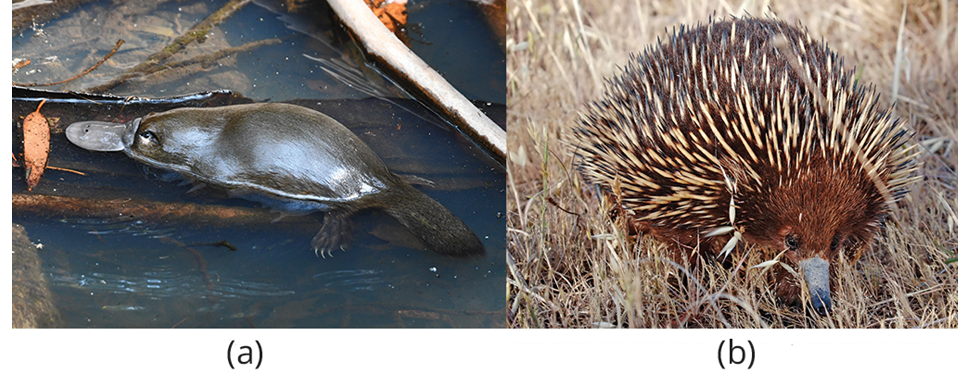
Living Mammals₁
Three groups of living mammals: Monotremes (prototheria), marsupials (metatheria), and placental (eutheria) mammals
Eutherians and marsupials comprise clade of therian mammals
Monotremes form sister clade to marsupials and eutherians
Monotreme: egg-laying mammal
Few living species (platypus and four species of echidnas)
Ornithorhynchidae ("bird beak"): clade that includes the duck-billed platypus
Tachyglossidae ("sticky tongue"): clade that includes the echidna or spiny anteater
Found in Australia and New Guinea
29.5 Figure 4: (a) The platypus, a monotreme, possesses a leathery beak and lays eggs rather than giving birth to live young. (b) The echidna is another monotreme, with long hairs modified into spines.
Fir0002 on Wikimedia Commons. "Echidna."

Slide 23
Living Mammals₂
Unique among mammals for laying eggs rather than giving birth to live young
Shells have leathery shell similar to reptile eggs
Retain their eggs through two-thirds of developmental period, then lay them in nests
Yolk-sac placenta helps support development
Babies hatch in fetal state and complete development in nest, nourished by milk secreted by mammary glands opening directly to skin
Young do not have teeth
Body temperature maintained at 30°C, lower than marsupials and placental mammals (35 to 38°C)

Slide 24
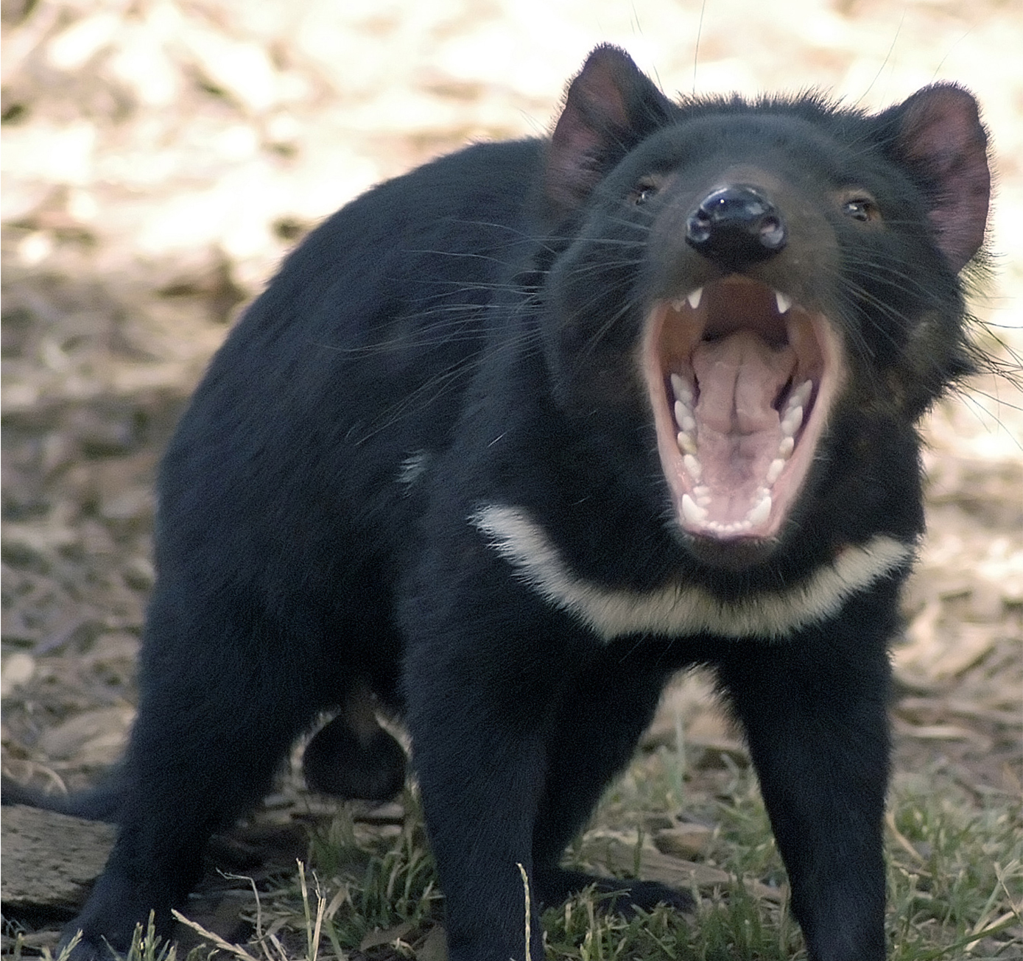
Living Mammals₃
Marsupial: one of the groups of mammals that includes the kangaroo, koala, bandicoot, Tasmanian devil, and several other species; young develop within a pouch
Two-thirds of ~330 living species of marsupials found in Australia, New Guinea, and surrounding islands; rest found in Americas, especially South America
29.5 Figure 5: The Tasmanian devil is one of several marsupials native to Australia.
Wayne McLean (jgritz) on Wikimedia Commons. "Tasmanian devil."

Slide 25
Living Mammals₄
Embryos nourished during short gestational period (a month in kangaroos) by yolk-sac placenta but no eggshell
Can enter embryonic diapause (temporary suspension of embryonic development) and delay implantation; resuming when implantation is completed
Young effectively fetal at birth
Most species possess pouch where premature young reside, receiving milk and continuing development
Young kangaroos nurse for about year and a half

Slide 26
Living Mammals₅
Eutherian mammal: mammal that possesses a complex placenta, which connects a fetus to the female; sometimes called placental mammals
Most widespread and numerous of mammals
All species possess complex chorioallantoic placenta that connects fetus to female, allowing for gas, fluid, and nutrient exchange
4,000 species in 18 to 20 orders with various adaptations for burrowing, flying, swimming, hunting, running, and climbing
Evolutionarily success in form, diversity, and abundance

Slide 27
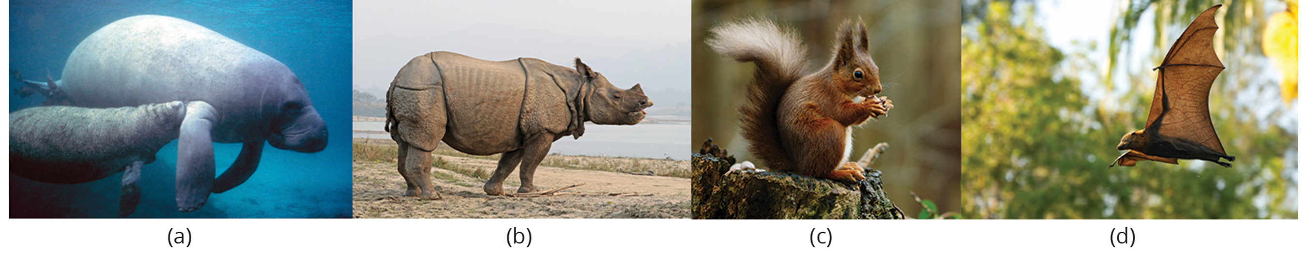
Living Mammals₆
Classified into two major clades: Atlantogenata and Boreoeutheria
Atlantogenata include Afrotheria (e.g., elephants, hyraxes, and manatees) and Xenarthra (e.g., anteaters, armadillos, and sloths)
Boreoeutheria contains two large groups: Euarchontoglires and Laurasiatheria
29.5 Figure 6: The eutherians are widespread across the world and are also known as placental mammals. Examples include (a) manatees, (b) rhinoceros, (c) squirrels, and (d) flying foxes.
Galen Rathbun on Wikimedia Commons. "Manatees."
Charles J. Sharp on Wikimedia Commons. "Rhinoceros."
Peter Trimming on Wikimedia Commons. "Squirrel."
Andrew Mercer on Wikimedia Commons. "Bat."

Slide 28
Living Mammals₇
Euarchontoglires include Scandentia (e.g., tree shrews), Rodentia (e.g., rats, mice, squirrels, and porcupines), Lagomorpha (e.g., rabbits and hares), and Primates (e.g., humans)
Laurasiatheria include Perissodactyla (e.g., horses and rhinos), Cetartiodactyla (e.g., cows, giraffes, pigs, hippos, and whales), Carnivora (e.g., cats, dogs, and bears), and Chiroptera (e.g., bats and flying foxes)
Two largest orders are rodents (2,000 species) and bats (1,000 species), which constitute 60% of all eutherian species

Slide 29
Summary
Vertebrates that possess hair and mammary glands
Integument includes various secretory glands (including sebaceous glands, eccrine glands, apocrine glands, and mammary glands)
Synapsids, meaning they have single opening in skull behind eye
Probably evolved from therapsids in late Triassic Period
Earliest known mammal fossils from the early Jurassic Period
Key characteristic of synapsids is endothermy, and most mammals homeothermic
Three living groups: monotremes, marsupials, and eutherians
Monotremes unique in that they lay eggs rather than give birth to live young
Marsupials give birth to immature young that complete development in pouch
Eutherians (placental mammals) possess complex placenta that connects fetus to female, allowing for gas, fluid, and nutrient exchange
All nourish young with milk derived from modified sweat or sebaceous glands

Slide 30

End of Hawkes Learning PowerPoint

