Slide 1
Lesson 29.6
Primate Evolution and Diversity

Slide 2
Objectives
Describe the defining features of the major groups of primates.
Describe the derived features that distinguish primates from other animals.
Explain why scientists are having difficulty determining the true lines of descent in hominids.
Identify the major hominin precursors to modern humans.

Slide 3
Primate Evolution and Diversity
In clade Euarchontoglires
Order of Primates of class Mammalia includes lemurs, tarsiers, monkeys, apes, and humans
Nonhuman primates live primarily in tropical or subtropical regions of South America, Africa, and Asia
Range in size from mouse lemur (30 grams) to mountain gorilla (200 kilograms)
Characteristics and evolution of primates increase understanding of evolution of humans

Slide 4
Characteristics of Primates₁
Primate: order of lemurs, tarsiers, monkeys, apes, and humans
Possess adaptations for climbing trees or brachiation
Brachiation: movement through tree branches via suspension from the arms
Descended from tree-dwellers

Slide 5
Characteristics of Primates₂
Adaptations:
Hands and feet adapted for climbing or brachiation
Rotating shoulder joint
Big toe that is widely separated from the other toes (except humans) and thumbs sufficiently separated from fingers to allow for gripping branches
Stereoscopic vision, which allows for perception of depth and gauging distance
Stereoscopic vision: two overlapping fields of vision from the eyes that produces depth perception
Unique characteristics:
Brains larger than other mammals
Claws modified into flattened nails
Typically one offspring per pregnancy
Trend toward holding body upright

Slide 6
Characteristics of Primates₃
Divided into two groups: Strepsirrhini ("turned-nosed") and Haplorhini ("simple-nosed")
Strepsirrhines:
Also called wet-nosed primates
Include prosimians
Prosimians: division of primates that includes bush babies and pottos of Africa, lemurs of Madagascar, and lorises of Southeast Asia
Tend to be nocturnal
Have larger olfactory centers in brain
Exhibit smaller size and smaller brain than anthropoids (humanlike primates, such as apes)
Have enzymes for making vitamin C

Slide 7
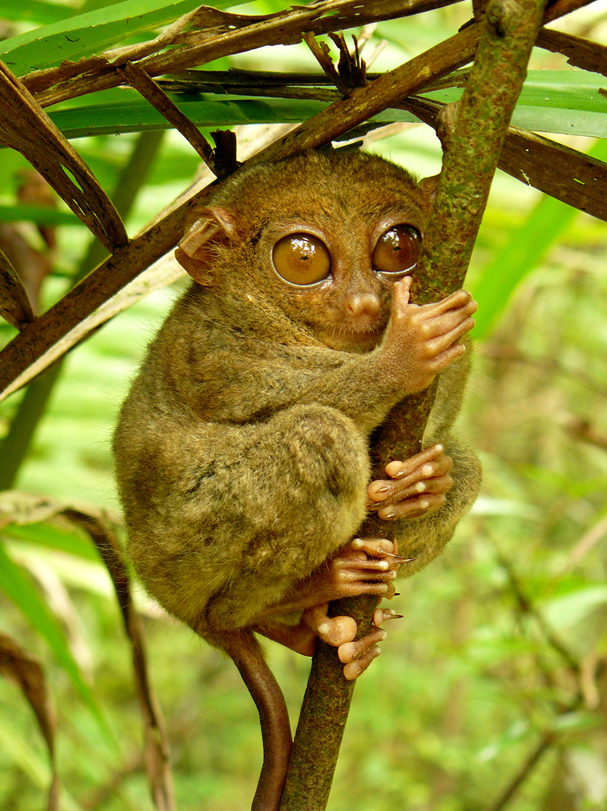
Characteristics of Primates₄
Haplorhines:
Also called dry-nosed primates
Include tarsiers and simians (New World monkeys, Old World monkeys, apes, and humans)
Diurnal (active during the day), with a few exceptions
Depend more on vision
Have to get vitamin C from food
29.6 Figure 1: This tarsier, Carlito syrichta, is one of the smallest primates at about 5 inches long, from the nose to the base of the tail.
Kok Leng Yeo on Wikimedia Commons. "Philippine tarsier."

Slide 8
Evolution of Primates₁
Proto-primates: Earliest primate-like mammals
Roughly like squirrels and tree shrews in size and appearance
Existing fossil evidence (mostly from North Africa) very fragmented; largely mysterious creatures
Genetic evidence suggests primates diverged from other mammals 85 MYA, but oldest known primate-like mammals with fossil record date to 65 MYA
Controversial Plesiadapis had some features of teeth and skeleton like true primates
Plesiadapis: oldest known primate-like mammal
Found in North America and Europe in Cenozoic Era and extinct by end of Eocene Epoch

Slide 9
Evolution of Primates₂
First true primates date to 55 MYA in Eocene Epoch
Found in North America, Europe, Asia, and Africa
Resembled present-day prosimians (e.g., lemurs)
Evolutionary changes led to larger brains and eyes and smaller muzzles
By end of Eocene Epoch, many went extinct due to cooler temperatures or competition from first monkeys

Slide 10
Evolution of Primates₃
Anthropoid: monkeys, apes, and humans
Evolved from prosimians during Oligocene Epoch
40 MYA monkeys were present in New World (South America) and Old World (Africa and Asia)
Platyrrhini: clade of New World monkeys
Characteristic broad noses
Uncertainty about their origins
Arose when South America and Africa had drifted apart
Thought that monkeys arose in Old World and reached New World either by drifting on log rafts or crossing land bridges, which created reproductive isolation that caused New and Old World monkeys to undergo separate adaptive radiations over millions of years
All arboreal and reflect possession of prehensile or grasping tails

Slide 11
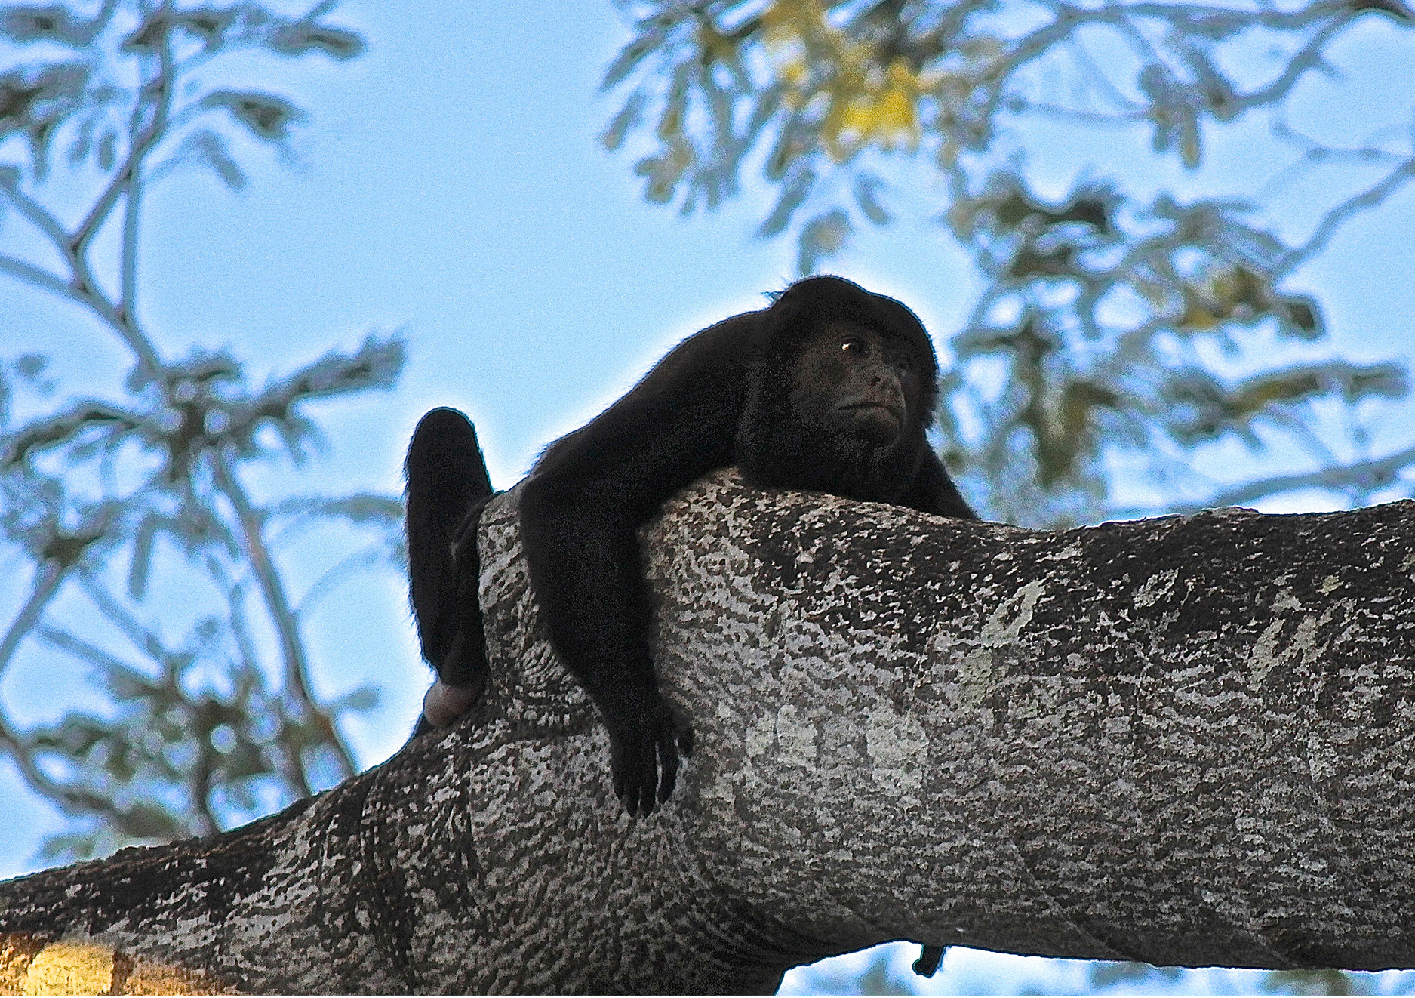
29.6 Figure 2
Bob Hendricks on Wikimedia Commons. "Howler monkey."
Notes:
Figure 2: The howler monkey is native to Central and South America (the New World). It makes a call that sounds like a lion roaring.

Slide 12
Evolution of Primates₄
Catarrhini: clade of Old World monkeys
Characteristic narrow, downward-pointed noses
Both arboreal and ground-dwelling
Tails never prehensile and often reduced
Some species have ischial callosities (thickened patches of skin on their seats)

Slide 13
Evolution of Primates₅
Apes evolved from catarrhines in Africa midway through Cenozoic Era (25 MYA)
Generally larger than monkeys
Do not possess a tail
Can move through trees though many species spend most time on ground
Walk quadrupedally, supporting upper body on knuckles; in contrast, monkeys walk on palms
More intelligent than monkeys and have larger brains relative to body size
Divided into two groups:
Lesser apes comprise family Hylobatidae
Hylobatidae: family of gibbons and siamangs
Great apes include genera Pan, Gorilla, Pongo, and Homo
Pan: genus of chimpanzees and bonobos
Gorilla: genus of gorillas
Pongo: genus of orangutans
Homo: genus of humans

Slide 14
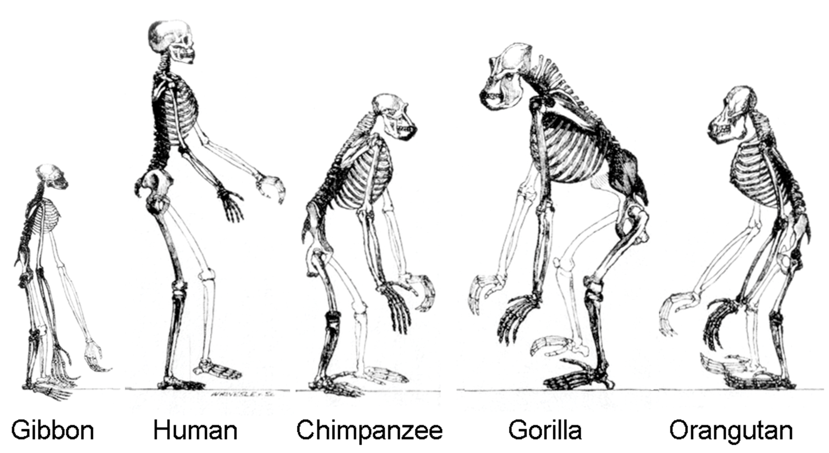
29.6 Figure 3
TimVickers on Wikimedia Commons. "Skeletal structures."
Notes:
Figure 3: All great apes have a similar skeletal structure.

Slide 15
Evolution of Primates₆
Very arboreal gibbons:
Smaller than great apes
Low sexual dimorphism (though in some species sexes differ in color)
Longer arms used for swinging through trees

Slide 16
Evolution of Primates₇
Orangutans:
Two species of orangutan native to different islands in Indonesia:
Borneo (P. pygmaeus)
Sumatra (P. abelii)
Third species of orangutan (Pongo tapanuliensis) reported in 2017 from Batang Toru forest in Sumatra
Arboreal and solitary
Males much larger than females and have cheek and throat pouches when mature
Diets include foods from multiple sources though predominant food is fruits

Slide 17
Evolution of Primates₈
Gorillas:
Live in Central Africa; eastern and western populations recognized as separate species, G. berengei and G. gorilla
Strongly sexually dimorphic, with males twice the size of females
In older males (silverback), hair on the back turns white or gray
Diets include foods from multiple sources though predominant food is foliage

Slide 18
Evolution of Primates₉
Chimpanzees and bonobos:
Chimpanzees considered to be most closely related to humans; however, species most closely related is bonobo
Chimpanzee and human lineages separated 5 to 7 MYA
Chimpanzee (Pan troglodytes) and bonobo (Pan paniscus) lineages separated 2 MYA
Live in Central Africa (but separated by Congo River)
Bonobos slighter than chimpanzees and have longer legs and more hair on heads
Chimpanzees have white tail tufts as juveniles, but bonobos keep white tails
Bonobos have higher-pitched voices than chimpanzees
Chimpanzees more aggressive and sometimes kill other animals; bonobos do not
Both omnivorous

Slide 19
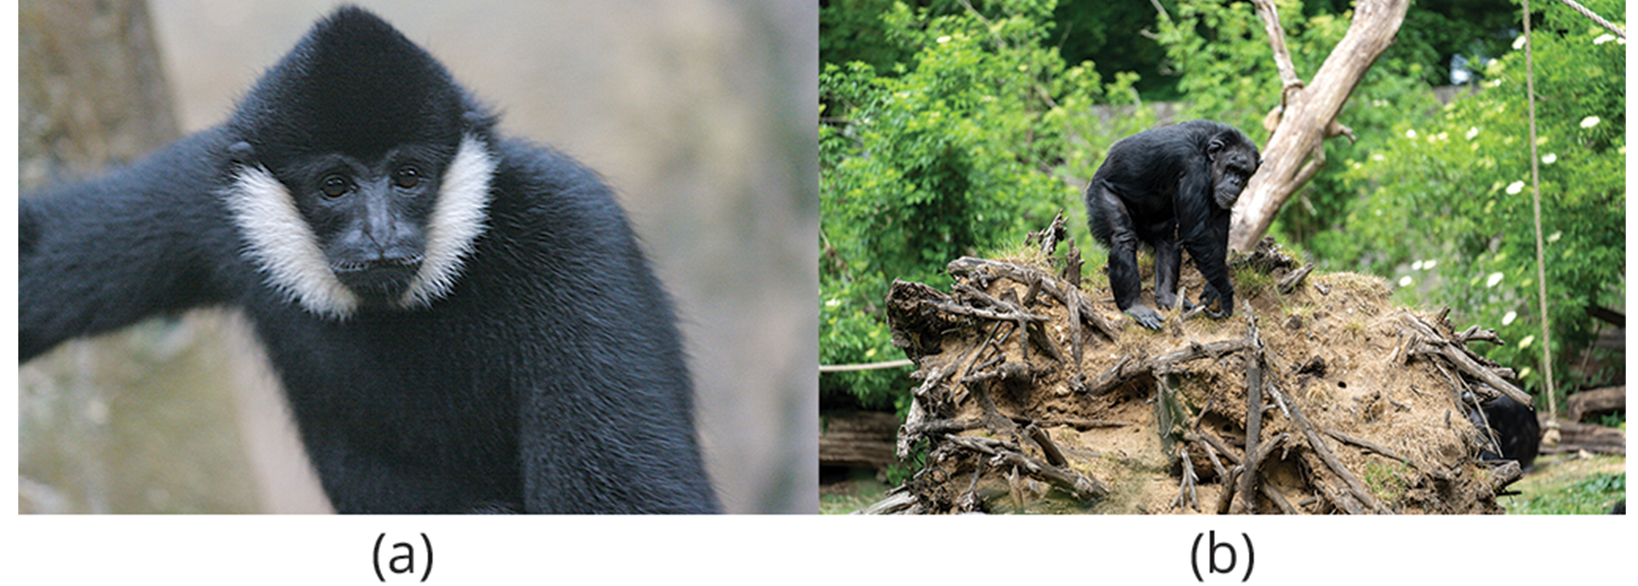
29.6 Figure 4
Ryan E. Poplin on Wikimedia Commons. "White-cheeked gibbon."
Mira Meijer Burgers' Zoo on Wikimedia Commons. "Chimpanzee."
Notes:
Figure 4: (a) This male white-cheeked gibbon is a lesser ape. In gibbons of this species, females and infants are buff, and males are black. (b) This chimpanzee is one of the great apes. It possesses a relatively large brain and has no tail.

Slide 20
Group Activity
As a group, choose one of the great ape species within Pan, Gorilla, or Pongo. Put together a presentation that describes the defining characteristics of your chosen species as well as their current population and habitat.

Slide 21
Human Evolution₁
Family Hominidae of order Primates includes all hominoids
Hominoid: pertaining to great apes and humans
Fossil record and comparison of human and chimpanzee DNA suggests they diverged from common hominoid ancestor 6 MYA
Several species evolved from branch that includes humans though humans are only surviving member
Hominin: species that are more closely related to humans than chimpanzees
Characteristics that differentiate humans from other hominoids:
Bipedalism or upright posture
Increase in size of brain
Fully opposable thumb that can touch little finger

Slide 22
Human Evolution₂
Bipedal hominins include several groups probably part of modern human lineage:
Australopithecus
Homo habilis
Homo erectus
Several non-ancestral groups that are considered "cousins" to modern humans (e.g., Neanderthals and Denisovans)
Determining true lines of descent in hominins is difficult
Many new fossils have been found, which show more than one species alive at any one time
Many fossils (and species named) represent hominin species that died out and not ancestral to modern humans

Slide 23
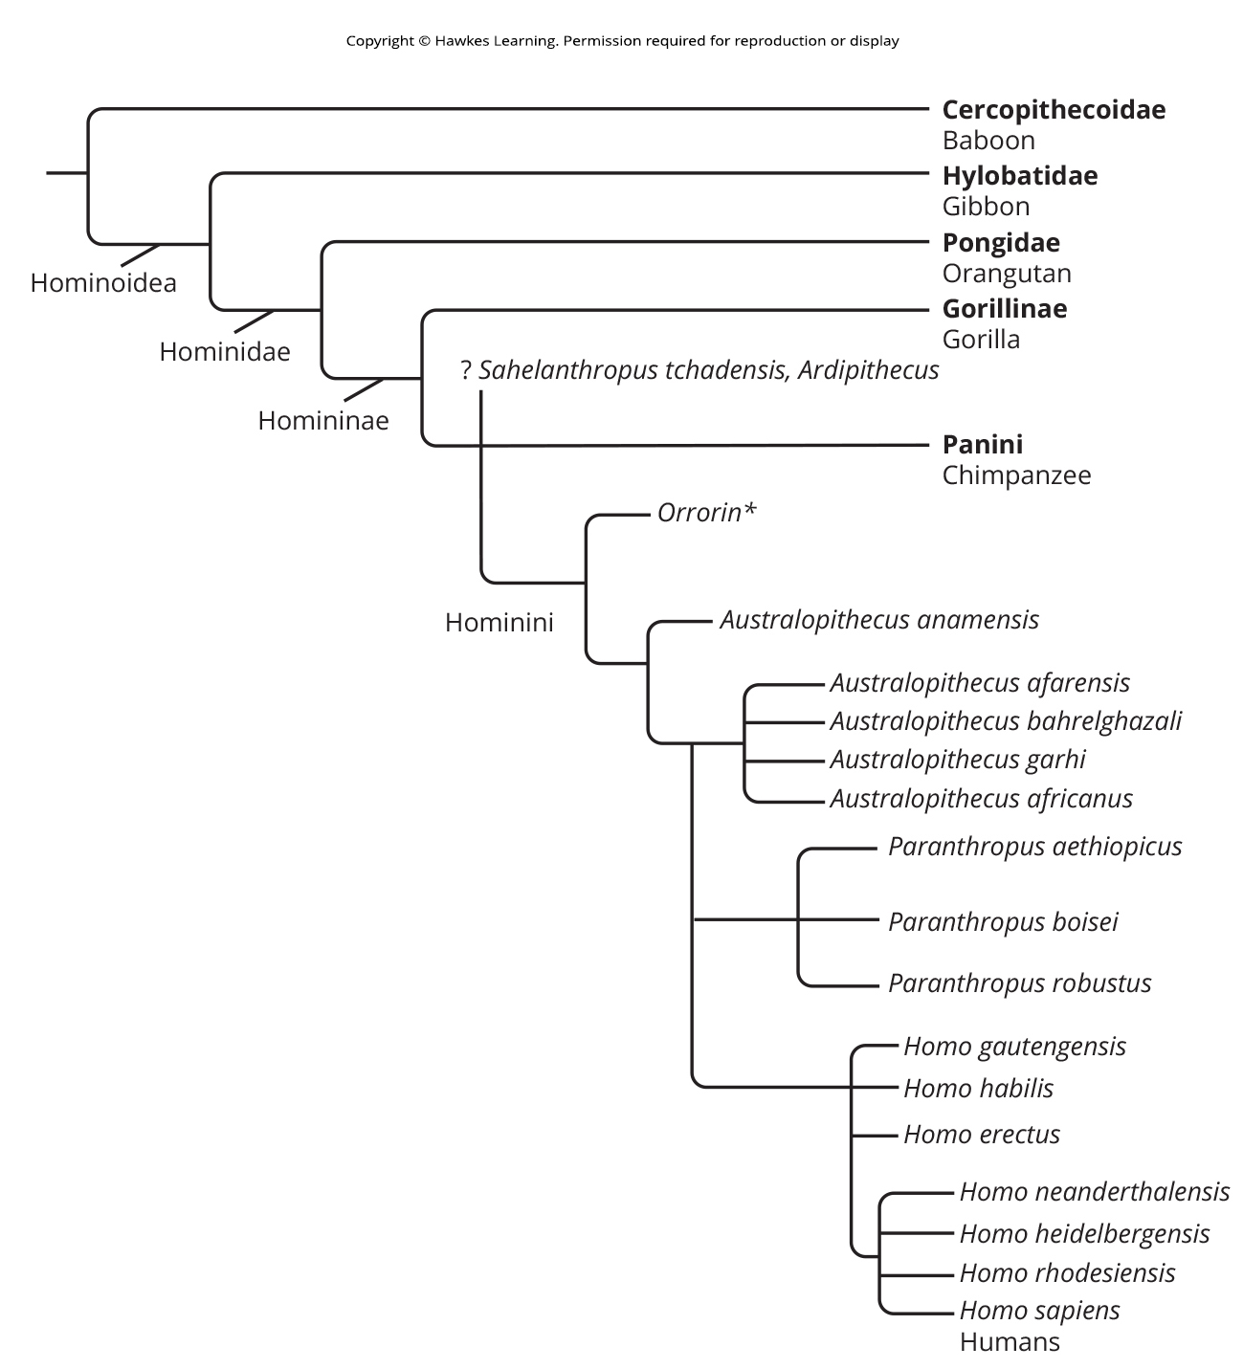
29.6 Figure 5
CNX OpenStax on Wikimedia Commons. "Hominin phylogeny." Modified.
Notes:
Figure 5: This chart shows evolutionary relationships among hominins and the hypothesized relations to modern humans. (*still debated phylogeny position)

Slide 24
Very Early Hominins₁
Three species of notable very early hominids:
Ardipithecus
Youngest of the three species
Discovered in 1990s and dates to 4.4 MYA
Bipedality uncertain at first but now confirmed
Two different species: A. ramidus and A. kadabba (dating to 5.6 MYA)
Status as human ancestor uncertain

Slide 25
Very Early Hominins₂
Sahelanthropus
Sahelanthropus tchadensis discovered in 2001–2002 and dated to 7 MYA
Single specimen: A skull found in Chad
Called "Toumai"
Has primitive and evolved characteristics
Unclear how it fits based on molecular data; line leading to modern humans and chimpanzees bifurcated 6 MYA
Not thought to be ancestor of modern humans

Slide 26
Very Early Hominins₃
Orrorin
Orrorin tugenesis discovered in 2000 and dated to 6 MYA
Several specimens
Some features more like modern human than australopithecines though Orrorin is older
If Orrorin is human ancestor, then australopithecines may not be in human lineage; additional specimens required to determine

Slide 27
Early Hominins: Genus Australopithecus₁
Australopithecus ("southern ape"): genus of hominins that evolved in eastern Africa approximately four million years ago
Went extinct 2 MYA
Thought that human genus, Homo, evolved from common ancestor shared with Australopithecus about 2 MYA (after passing through transitional states)
Several characteristics more similar to great apes than humans:
Sexual dimorphism more exaggerated than humans
Males up to 50% larger than females (more like modern gorillas and orangutans)
Modern human males ~15 to 20% larger than females
Brain size relative to body mass smaller than humans and more like great apes
Key feature in common with modern humans: Bipedalism (though likely spent some time in trees)
Hominin footprints (like humans) found in Laetoli, Tanzania and dated to 3.6 MYA, showing walking upright

Slide 28
Early Hominins: Genus Australopithecus₂
Several species, referred to as australopiths
Australopithecus anamensis dated to 4.2 MYA
Australopithecus afarensis dated to between 3.9 and 2.9 MYA
Demonstrates trend in human evolution: Reduction of dentition and jaw in size
Had smaller canines and molars compared to apes but larger than modern humans
Brain size was 380 to 450 cubic centimeters (about the size of a modern chimpanzee brain)
Had prognathic jaw
Prognathic jaw: long jaw

Slide 29
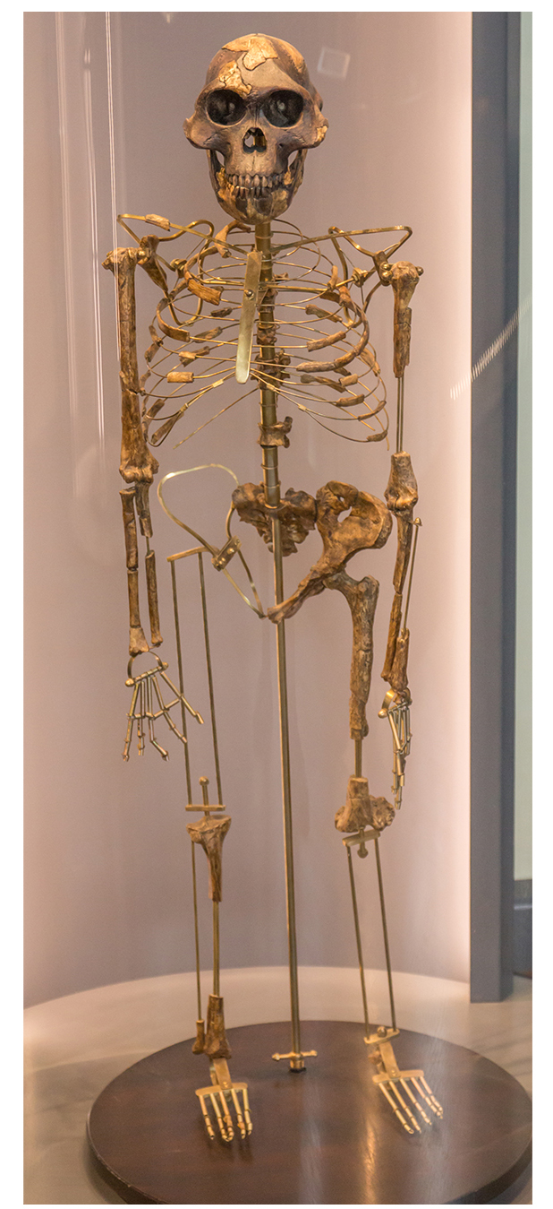
Early Hominins: Genus Australopithecus₃
Fossil called "Lucy"
Found in 1970s in Afar region of Ethiopia
Adult female A. afarensis
Dated to 3.24 MYA
Most complete australopith found (40% of skeleton recovered)
29.6 Figure 6: This adult female Australopithecus afarensis skeleton, nicknamed Lucy, was discovered in the mid-1970s.
Johannes Maximilian on Wikimedia Commons. "Lucy."

Slide 30
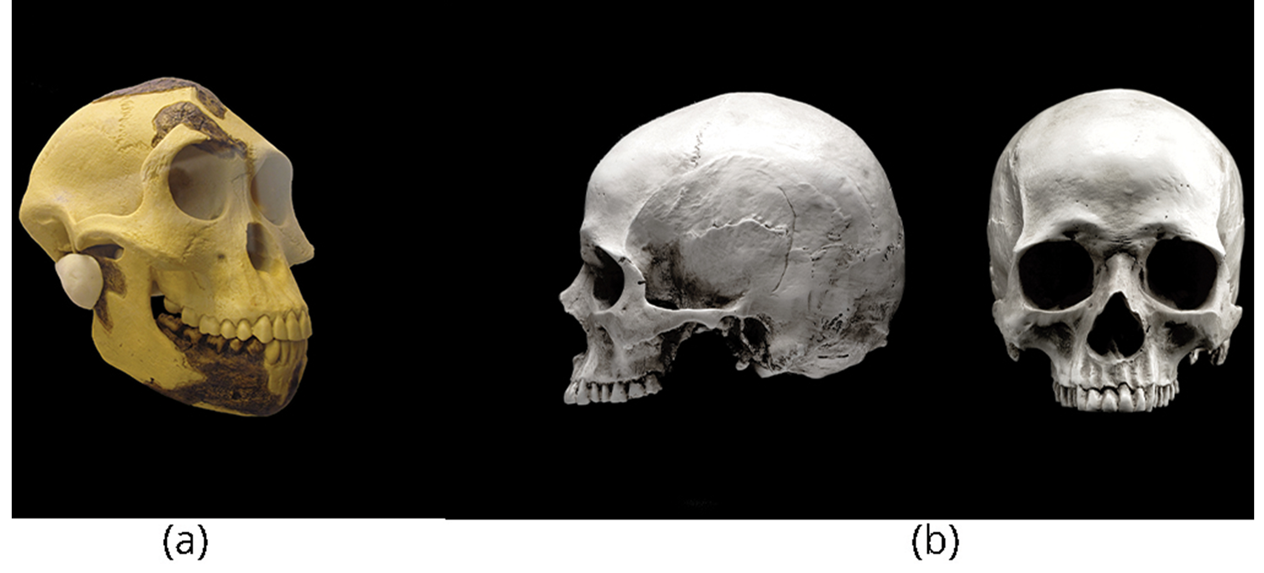
Early Hominins: Genus Australopithecus₄
Australopithecus africanus dated to between 2 and 3 MYA
Slender build and robust arms
Bipedal but likely spent time in trees
Brain larger than A. afarensis at 500 cubic centimeters, which is slightly less than one-third the size of modern human brains
Australopithecus bahrelghazali and Australopithecus garhi recently discovered
A. bahrelghazali only australopith found in Central Africa
29.6 Figure 7: (a) The skull of an Australopithecus afarensis, an early hominid that lived between two and three million years ago, resembles that of (b) modern humans but was smaller than humans, with a sloped forehead, larger teeth, and a prominent jaw.
Cantonal Museum of Geology in Lausanne on Wikimedia Commons. "Australopithecus afarensis skull."

Slide 31
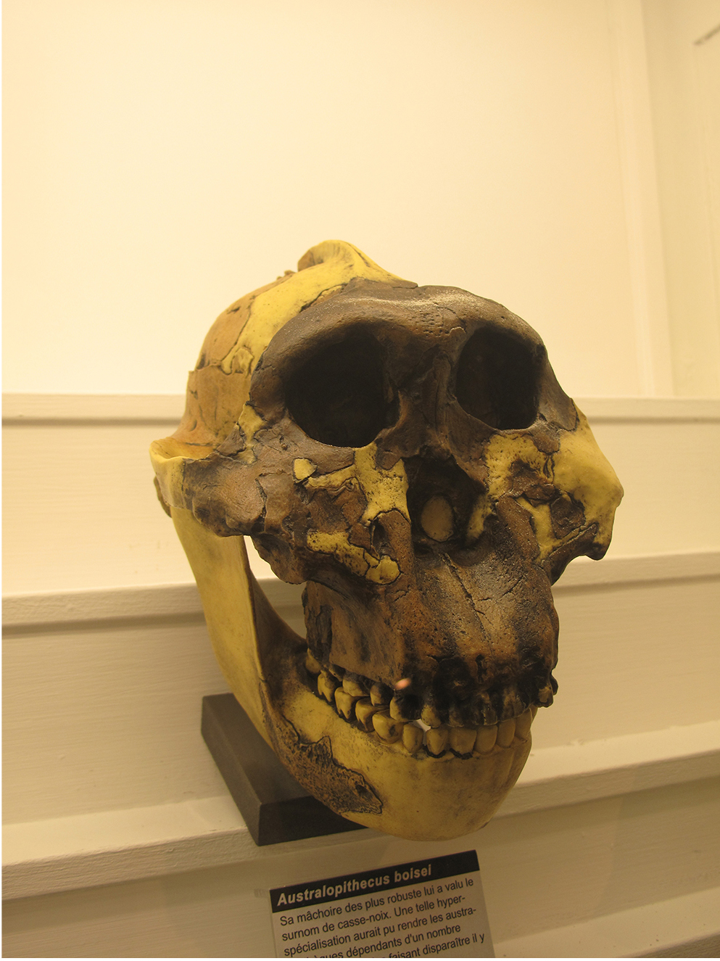
A Dead End: Genus Paranthropus
Dated to 2.5 MYA
Muscular, stood at 1.3 to 1.4 meters tall, and had large grinding teeth
Molars showed heavy wear, suggesting coarse and fibrous vegetarian diet as opposed to partially carnivorous diet of australopiths
Includes Paranthropus robustus of South Africa and Paranthropus aethiopicus and Paranthropus boisei of East Africa
Went extinct more than one million years ago
Not thought to be ancestral to humans
Thought to be members of evolutionary branch on hominin tree that had no descendants
29.6 Figure 8: Paranthropus is an extinct branch on the hominin tree that is believed to have disappeared approximately a million years ago.
Cantonal Museum of Geology in Lausanne on Wikimedia Commons. "Paranthropus boisei skull."

Slide 32
Early Hominins: Genus Homo₁
Homo: genus of humans
First appeared between 2.5 to 3 MYA
Includes H. habilis and H. gautengensis
H. habilis:
Thought to be oldest example of Homo until H. gautengensis discovered
Several features like modern humans:
Jaw that was less prognathic
Larger brain (600 to 750 cubic centimeters)
Retain some features of older hominins (e.g., long arms)
Means "handy man"; reference to stone tools discovered with remains
H. gautengensis:
Discovered in 2010
Oldest example of Homo

Slide 33
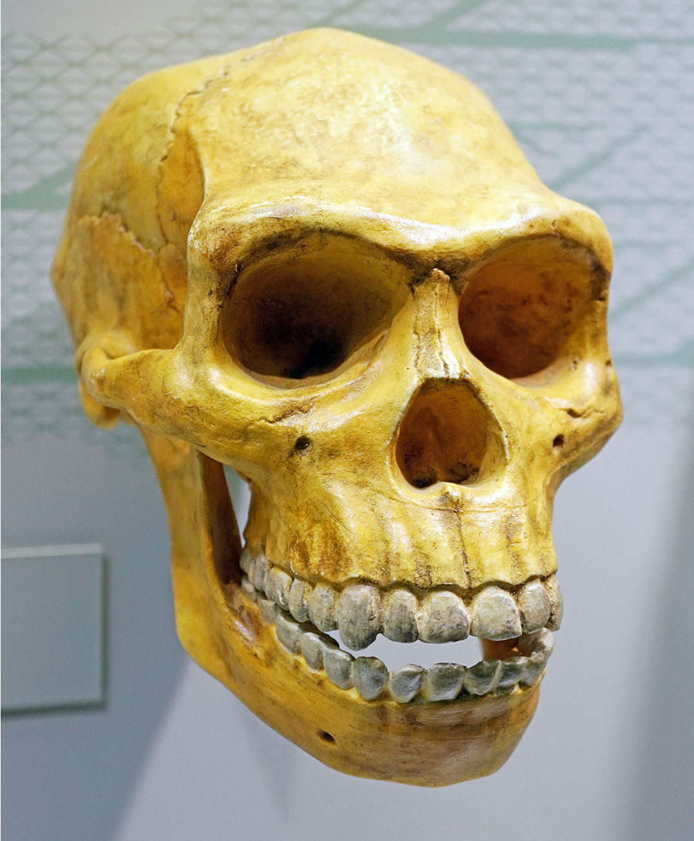
Early Hominins: Genus Homo₂
Homo erectus:
Dated to 1.8 MYA
Originated in East Africa and first hominin species to migrate out of Africa
Fossils found in India, China, Java, and Europe
Known in past as "Java Man" or "Peking Man"
29.6 Figure 9: Homo erectus had a prominent brow and a nose that pointed downward rather than forward.
Tiia Monto on Wikimedia Commons. "Homo erectus skull."

Slide 34
Early Hominins: Genus Homo₃
Several features more like modern humans than H. habilis
Larger in size (reaching heights up to 1.85 meters and weighing up to 65 kilograms, similar to modern humans)
Lower sexual dimorphism (males 20 to 30% larger than females, closer to modern humans)
Larger brain (775 to 1,100 cubic centimeters, similar to modern humans at 1,130 to 1,260 cubic centimeters)
Nose with downward-facing nostrils, allowing for warming of cold air before it enters lungs and may have been adaptation to colder climates
Artifacts suggest they were first hominins to use fire, hunt, and have home base
Thought to have lived 50,000 years ago

Slide 35
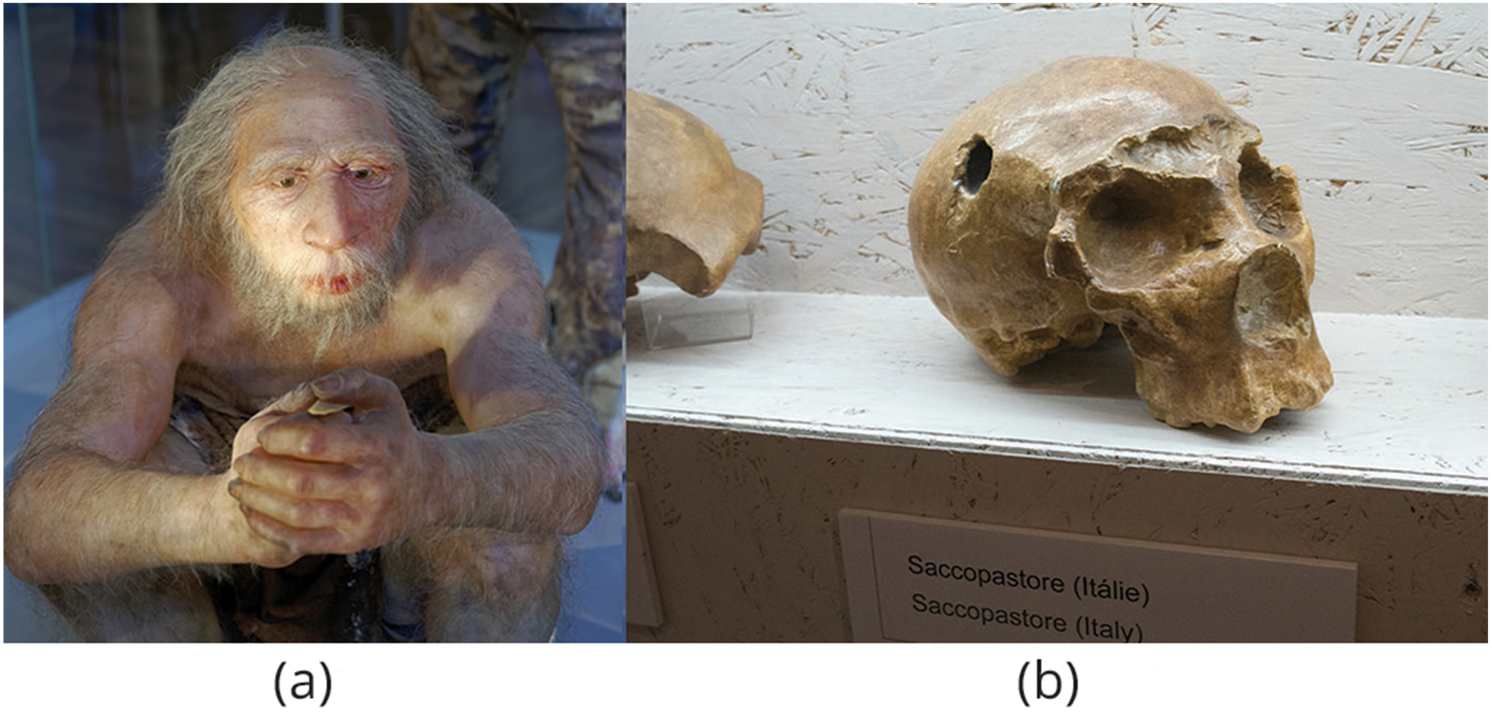
Humans: Homo sapiens₁
Several species (sometimes called archaic Homo sapiens) evolved from H. erectus starting 500,000 years ago: Homo heidelbergensis, Homo rhodesiensis, and Homo neanderthalensis
Had brain size like modern humans (1,200 to 1,400 cubic centimeters)
Differ from modern humans by having:
Thick skull
Prominent brow ridge
Receding chin
Some species survived until 30,000 to 10,000 years ago, overlapping with modern humans
29.6 Figure 10: (a) The Homo neanderthalensis used tools and may have worn clothing. This model is displayed at the Natural History Museum in Vienna. (b) This image shows a neanderthal skull.
Jakub Hałun on Wikimedia Commons. "Homo neanderthalensis."
Zde on Wikimedia Commons. "Neanderthal skull."

Slide 36
Humans: Homo sapiens₂
Considerable debate about origins of anatomically modern humans
Homo sapiens sapiens: anatomically modern humans
Thought to have arisen in African from H. erectus and migrated out of Africa 100,000 years ago in second major migration wave
Modern humans replaced H. erectus that had migrated into Asia and Europe in first wave
Supported by molecular evidence
Studying origins of modern humans by examining mitochondrial DNA (mtDNA) from populations around world
Fetus develops from egg containing female parent's mitochondria (which have their own, non-nuclear DNA); mtDNA passed entirely through maternal line
Mutations in mtDNA can be used to estimate timeline of genetic divergence
Evidence suggests that modern humans have mtDNA inherited from common ancestor that lived in Africa about 160,000 years ago

Slide 37
Humans: Homo sapiens₃
Studying origins of modern humans by examining Y chromosome
Passed from male parent to male offspring
Evidence suggests all males today inherited Y chromosome from male that lived in Africa 140,000 years ago
Studying mtDNA led to identification of another human species or subspecies: Denisovans
DNA from teeth and finger bones suggested:
mtDNA was different from that of modern humans and Neanderthals
Genomic DNA suggested Denisovans shared common ancestor with Neanderthals
Genes from both Neanderthals and Denisovans identified in modern human populations, indicating interbreeding among the three groups

Slide 38
Summary₁
Possess adaptations for climbing trees and probably descended from arboreal ancestors (though not all living species are arboreal)
Characteristics of primates:
Brain larger and more relative to body size than other mammals
Claws modified to flattened nails
Typically, one young per pregnancy
Stereoscopic vision
Trend toward holding body upright
Divided into two groups: strepsirrhines (include prosimians) and haplorhines (include simians)
Monkeys evolved from prosimians during Oligocene Epoch
Simian line includes both platyrrhine and catarrhine branches
Apes evolved from catarrhines in Africa during Miocene Epoch
Divided into lesser apes and greater apes

Slide 39
Summary₂
Hominins include groups that gave rise to modern humans (e.g., Australopithecus, H. erectus, and groups considered "cousins" of humans, like Neanderthals and Denisovans)
Fossil evidence shows hominins at time of Australopithecus were walking upright (first evidence of bipedal hominins)
Several species, sometimes called H. sapiens, evolved from H. erectus 500,000 years ago
Considerable debate about origins of anatomically modern humans (H. sapiens sapiens); need more evidence from fossil finds and genetic analysis

Slide 40

End of Hawkes Learning PowerPoint

