Slide 1
Lesson 3.1
Synthesis of Macromolecules

Slide 2
Objectives
Explain dehydration (or condensation) and hydrolysis reactions.
Understand macromolecule synthesis.

Slide 3

Biological Macromolecules
Food provides nutrients like biological macromolecules that are necessary for life.
3.1 Figure 1
Karolina Grabowska on Pexels. "Charcuterie board."

Slide 4
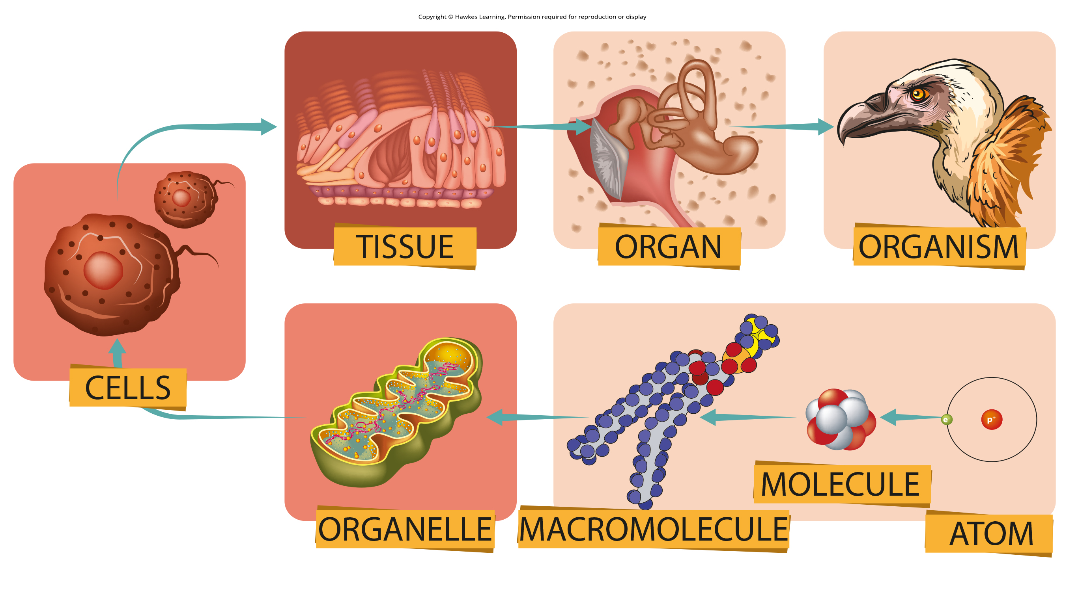
Synthesis of Macromolecules
Biological macromolecules are large molecules built from smaller organic units.
Carbohydrates, lipids, proteins, and nucleic acids
Comprise most of a cell's dry mass
Organic (contain carbon)
May contain other elements
3.1 Figure 2
Karolina Grabowska on Pexels. "Charcuterie board."

Slide 5
Science and You₁
Nucleic acids create DNA, the genetic code containing all human genes.
The 3.3 billion nucleotide human genome weighs only 3.59 picograms or 0.00000000359 milligrams.
Each body cell contains the entire human genome.
Since there are trillions of cells, this means there is a vast amount of nucleic acid in the human body.
Notes:
This is included as a relevant application for this topic.

Slide 6
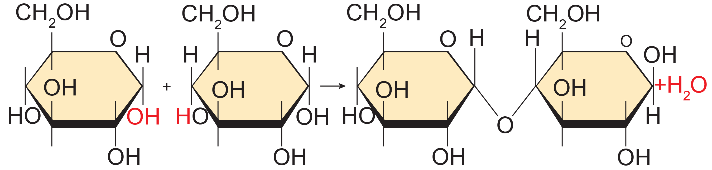
Dehydration Synthesis
Monomers covalently bond to each other to create polymers by dehydration synthesis.
Forms a water molecule when monomers bond
Different monomers and configurations form various macromolecule polymers.
Glucose (monomer) can form starch, glycogen, and cellulose (polymers).
3.1 Figure 3
OpenStax. "Dehydration synthesis." Modified.

Slide 7
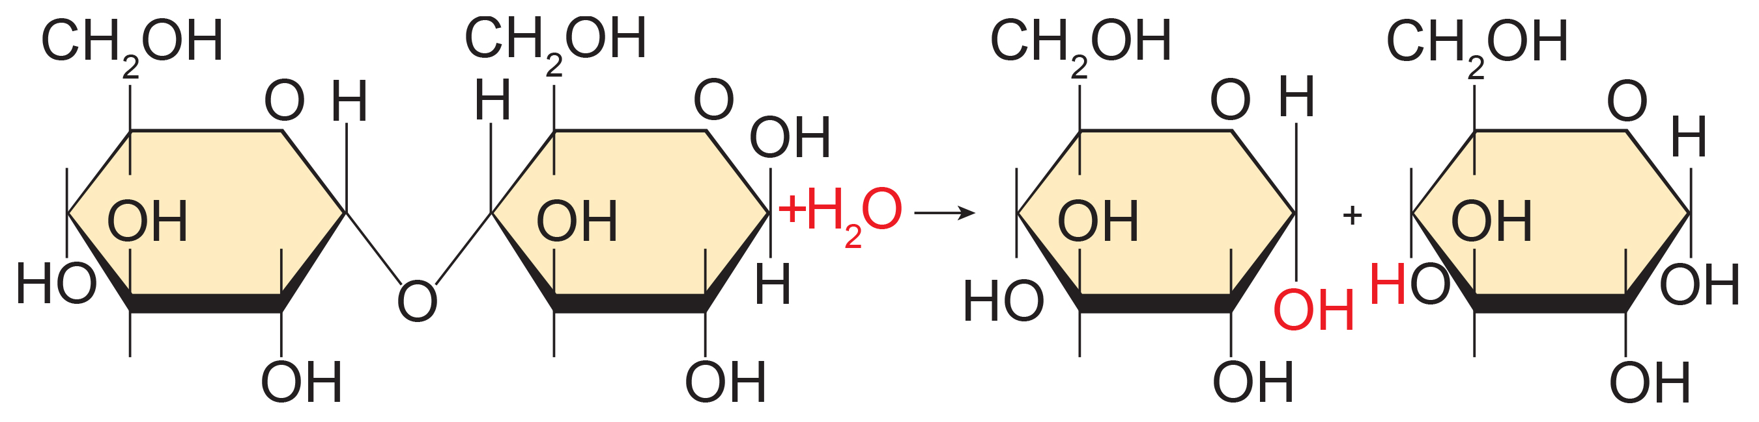
Hydrolysis
Polymers break down into monomers during hydrolysis, where the insertion of a water molecule breaks a covalent bond.
In these reactions, one monomer gains a hydrogen atom and the other a hydroxyl group from the split water molecule.
3.1 Figure 4
OpenStax. "Hydrolysis." Modified.

Slide 8
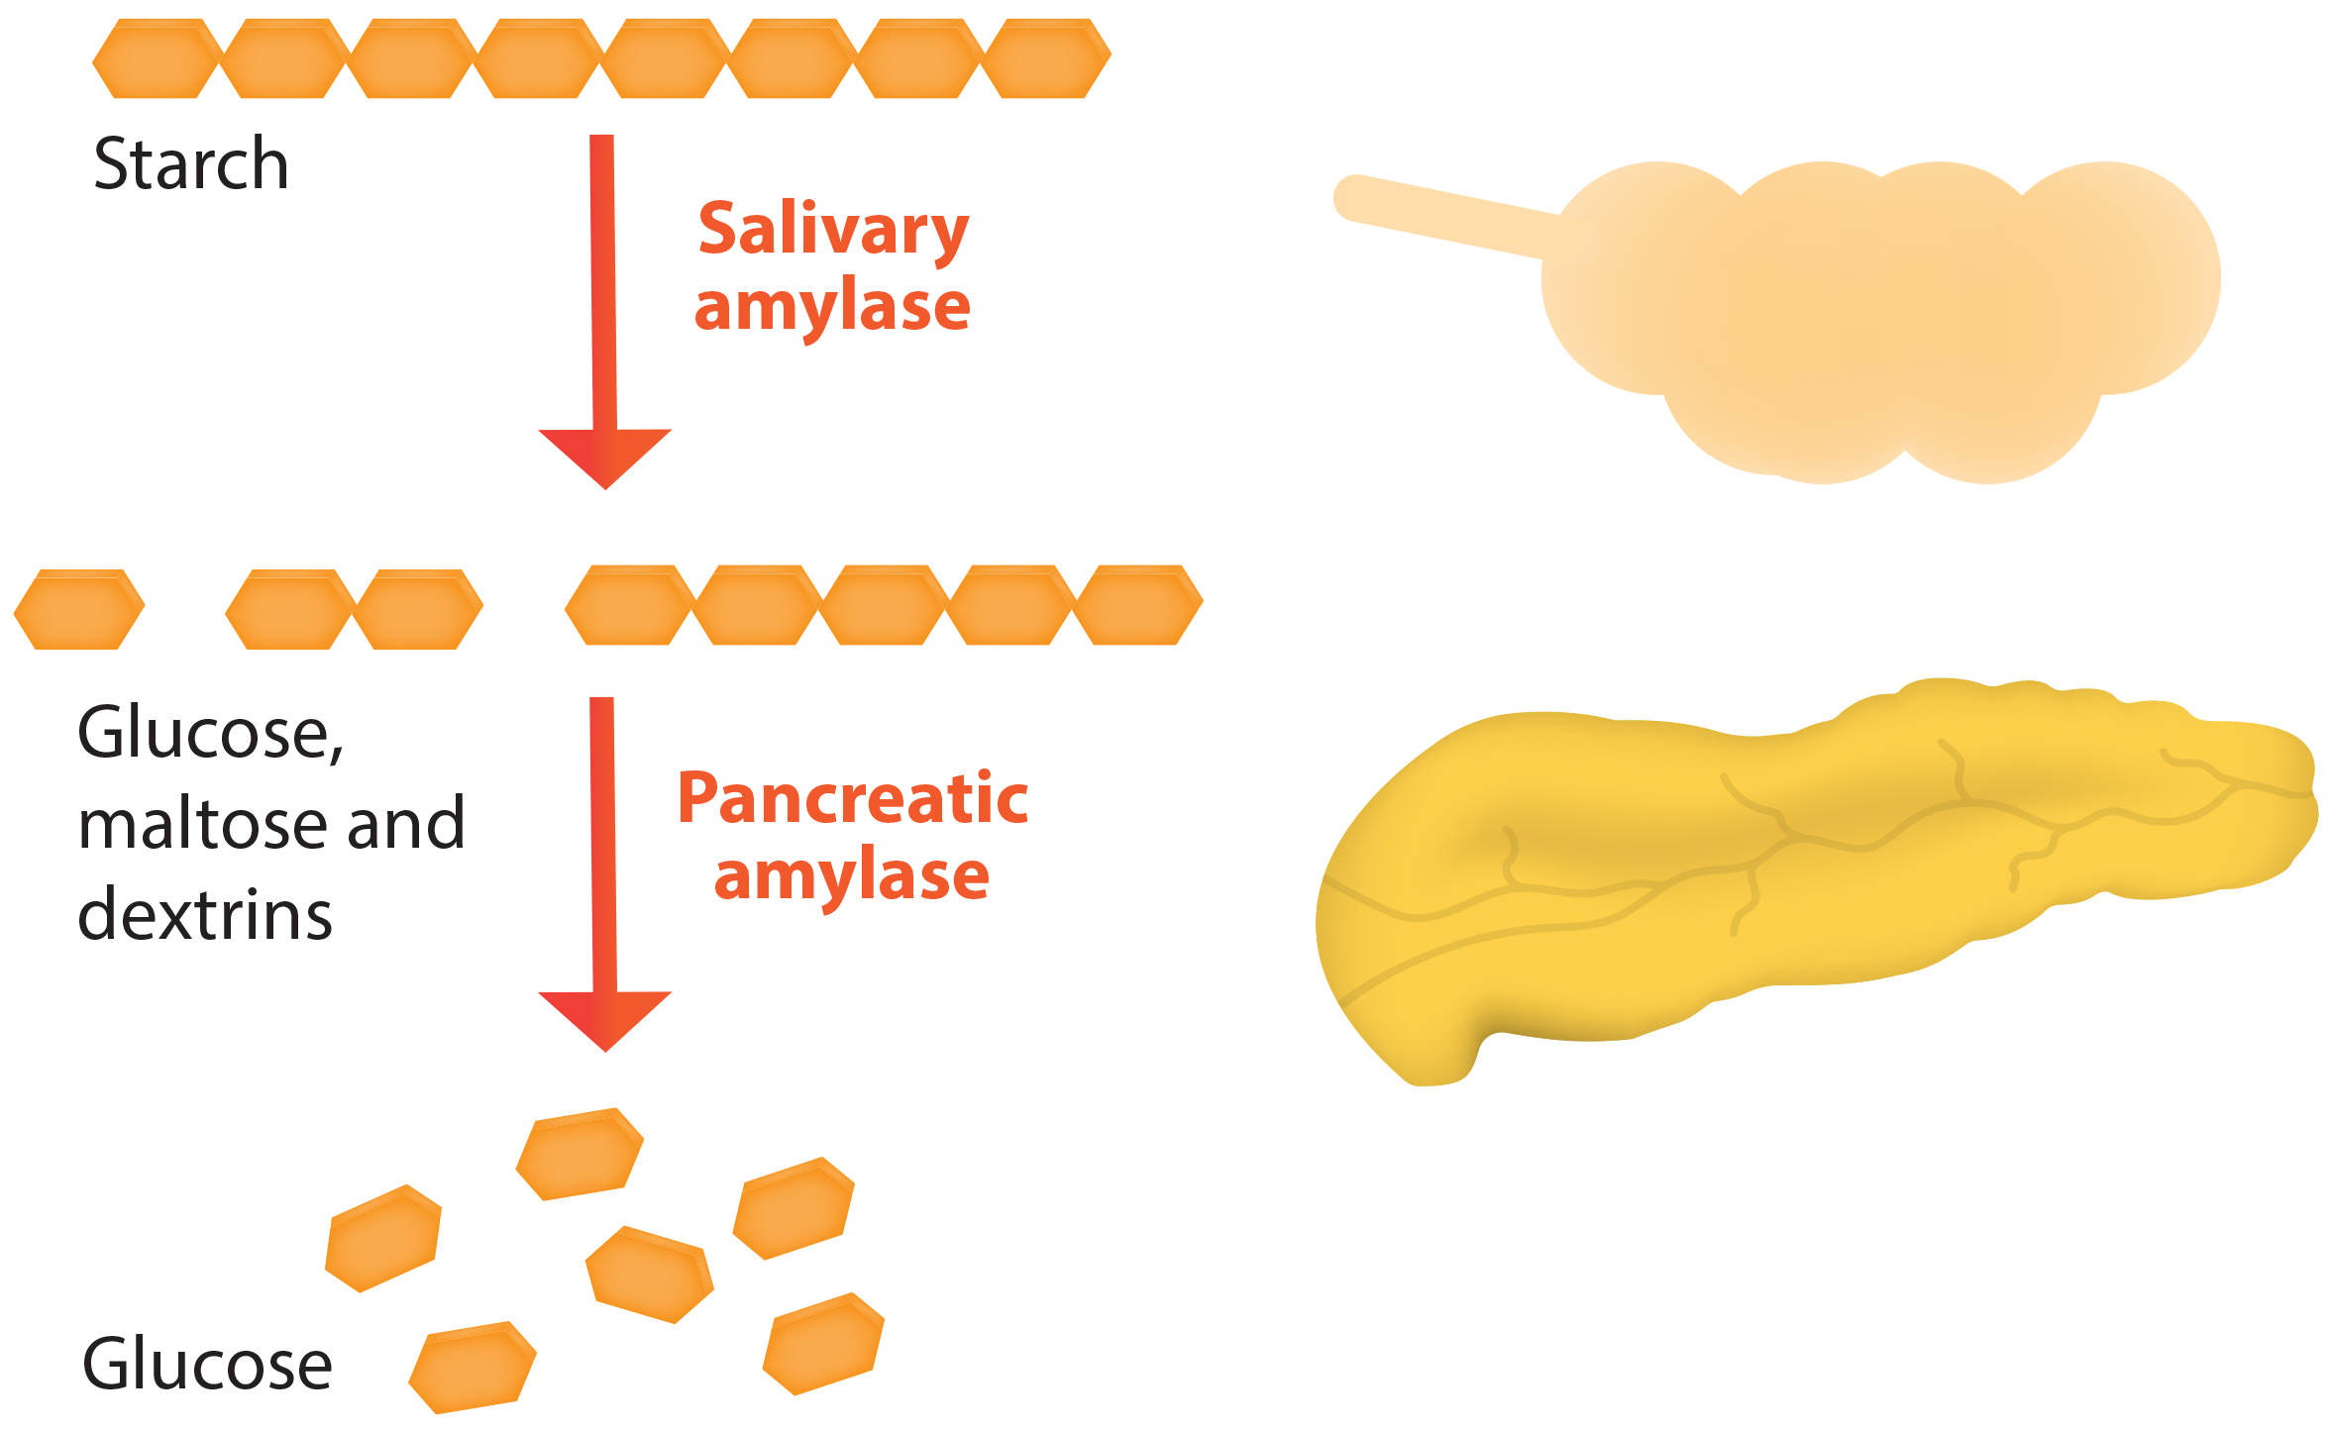
Enzyme-Catalyzed Macromolecule Reactions
Specific enzymes catalyze dehydration (energy-requiring) and hydrolysis (energy-releasing) reactions for each macromolecule class.
Digestive enzymes hydrolyze food macromolecules, providing energy by breaking them into smaller molecules that cells can absorb.
3.1 Figure 5

Slide 9
Summary
Biological macromolecules are large, life-essential molecules built from smaller organic monomers.
The four major macromolecules are proteins, carbohydrates, nucleic acids, and lipids.
Monomers joined by covalent bonds form polymers with new properties and lower osmotic pressure.
Dehydration/condensation reactions join monomers together and release water; hydrolysis breaks polymers down using water.
Dehydration reactions require energy input, while hydrolysis releases energy.

Slide 10


End of Hawkes Learning PowerPoint

