Slide 1
Lesson 3.2
Carbohydrates

Slide 2
Objectives
Discuss the role of carbohydrates as a structural and functional macromolecule of animal and plant cells.
Explain carbohydrate classifications.
List common monosaccharides, disaccharides, and polysaccharides.

Slide 3

Carbohydrates
Carbohydrates: macromolecules with a ratio of carbon to hydrogen to oxygen of 1:2:1 that are essential in our diet:
Providing energy through glucose
Present in natural sources like grains, fruits, and vegetables
3.2 Figure 1
Miomir Magdevski on Wikimedia Commons. "Fruits."

Slide 4
Molecular Structures
The stoichiometric formula (CH₂O)n represents carbohydrates, where n is the number of carbons in the molecule.
Ratio of carbon to hydrogen to oxygen in carbohydrate molecules is 1:2:1
Glucose has the chemical formula C₆H₁₂O₆
The term "carbohydrate" originates from the components carbon (carbo-) and water (-hydrate).
Scientists classify carbohydrates into three subtypes: monosaccharides, disaccharides, and polysaccharides.

Slide 5
Think It Through₁
Ascorbic acid is a compound made of C, H, and O atoms and has a chemical formula of C₆H₈O₆. Why is it not considered to be a carbohydrate?

Slide 6
Monosaccharides₁
Monosaccharides: (mono- means "one"; sacchar- means "sweet") simple sugars, such as glucose, that typically contain three to seven carbon atoms with names ending in "-ose"
Aldoses contain an aldehyde group (R-CH=O).
Ketoses contain a ketone group (RC(=O)R’).
Can be trioses (three carbons), pentoses (five carbons), or hexoses (six carbons).
All biologically relevant monosaccharides have a linear arrangement with a carbonyl group (C=O).

Slide 7
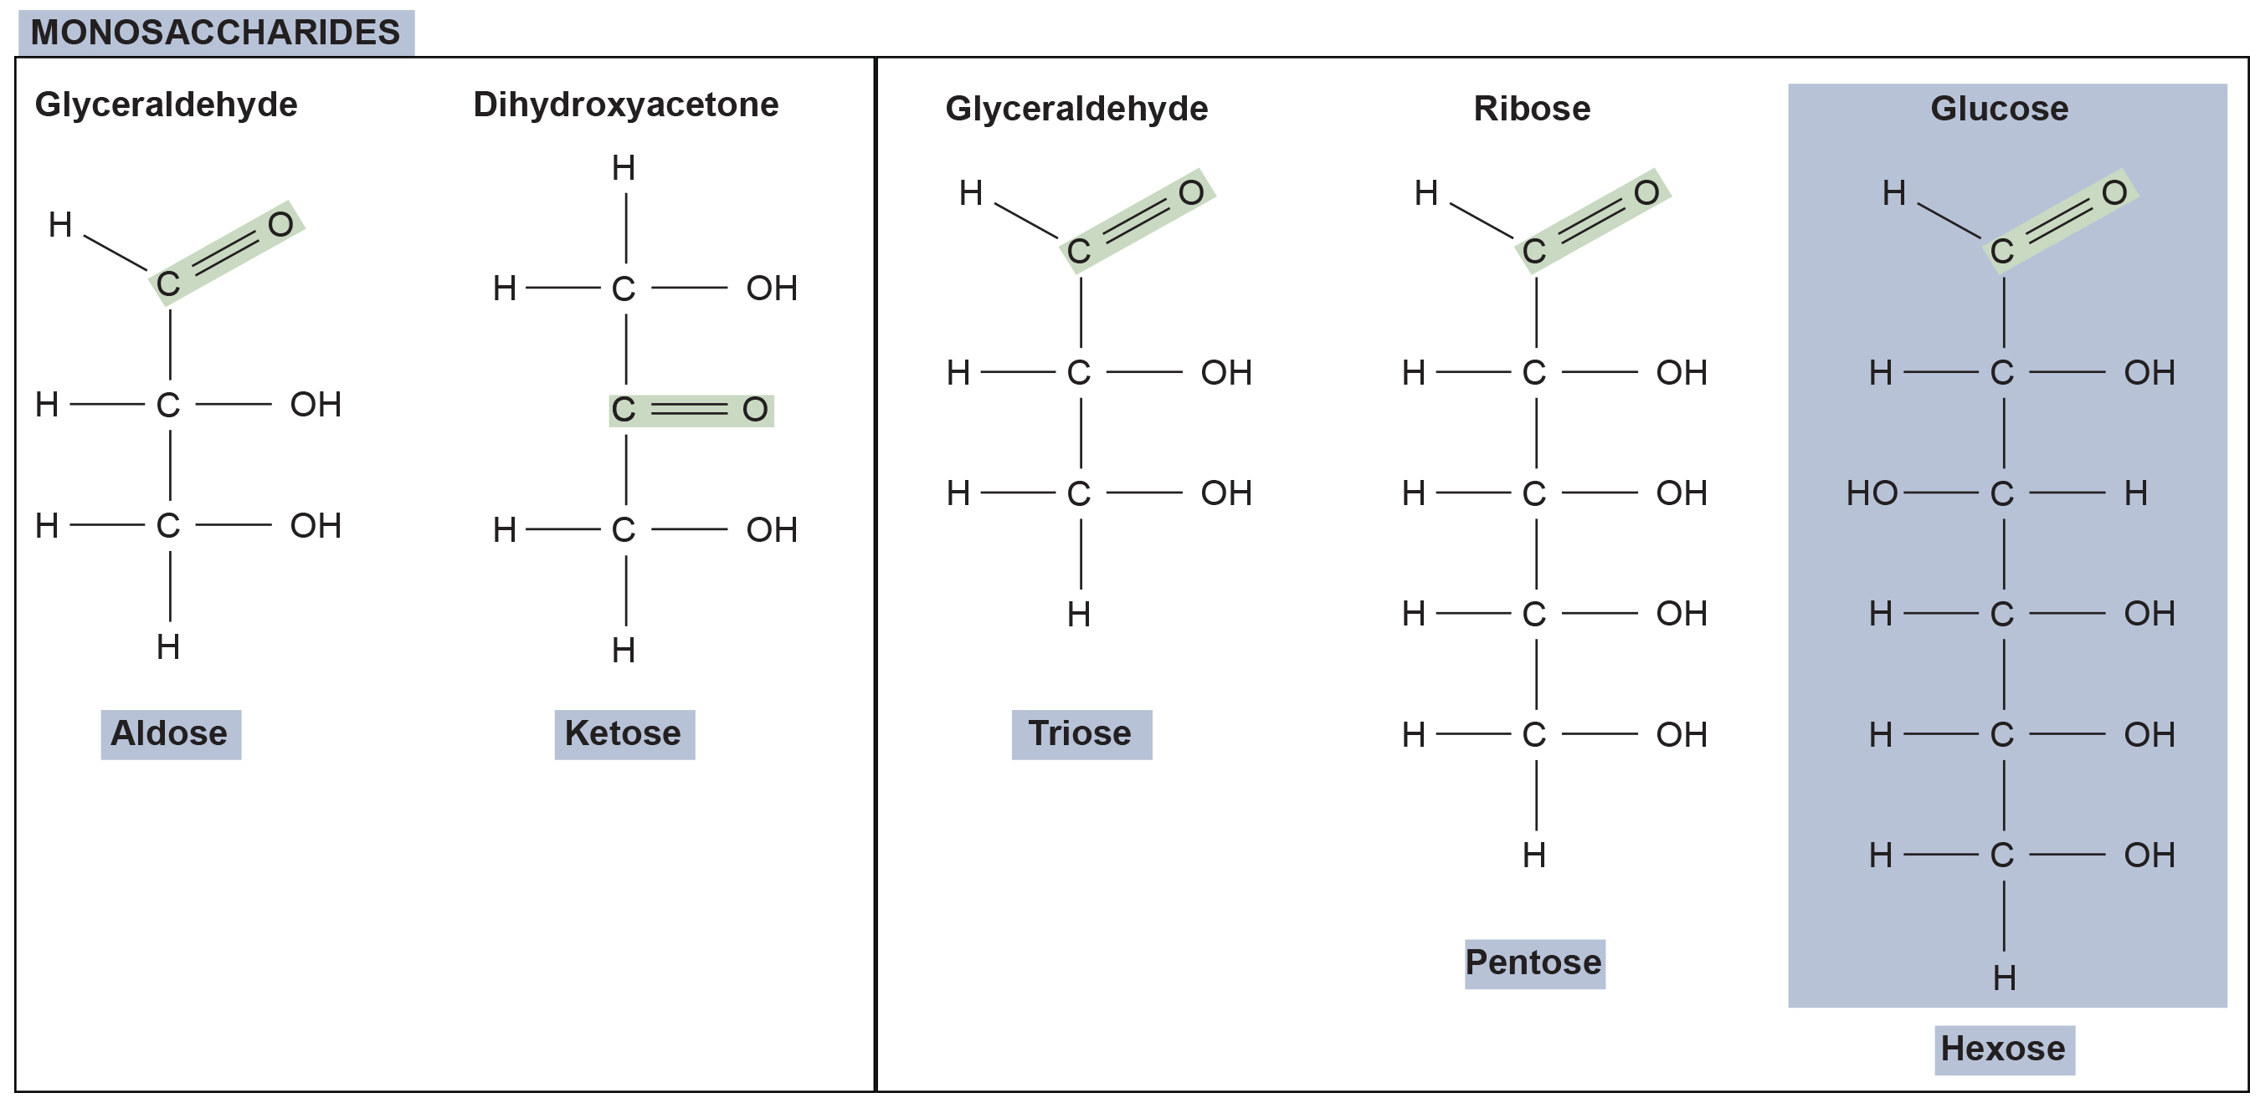
3.2 Figure 2
OpenStax. "Monosaccharides." Modified.
Notes:
Scientists classify monosaccharides based on the position of their carbonyl group and the number of carbons in the backbone. Aldoses have a carbonyl group (C=O) at the end of the carbon chain, and ketoses have a carbonyl group in the middle of the carbon chain. Trioses, pentoses, and hexoses have 3, 5, and 6 carbon backbones, respectively.

Slide 8
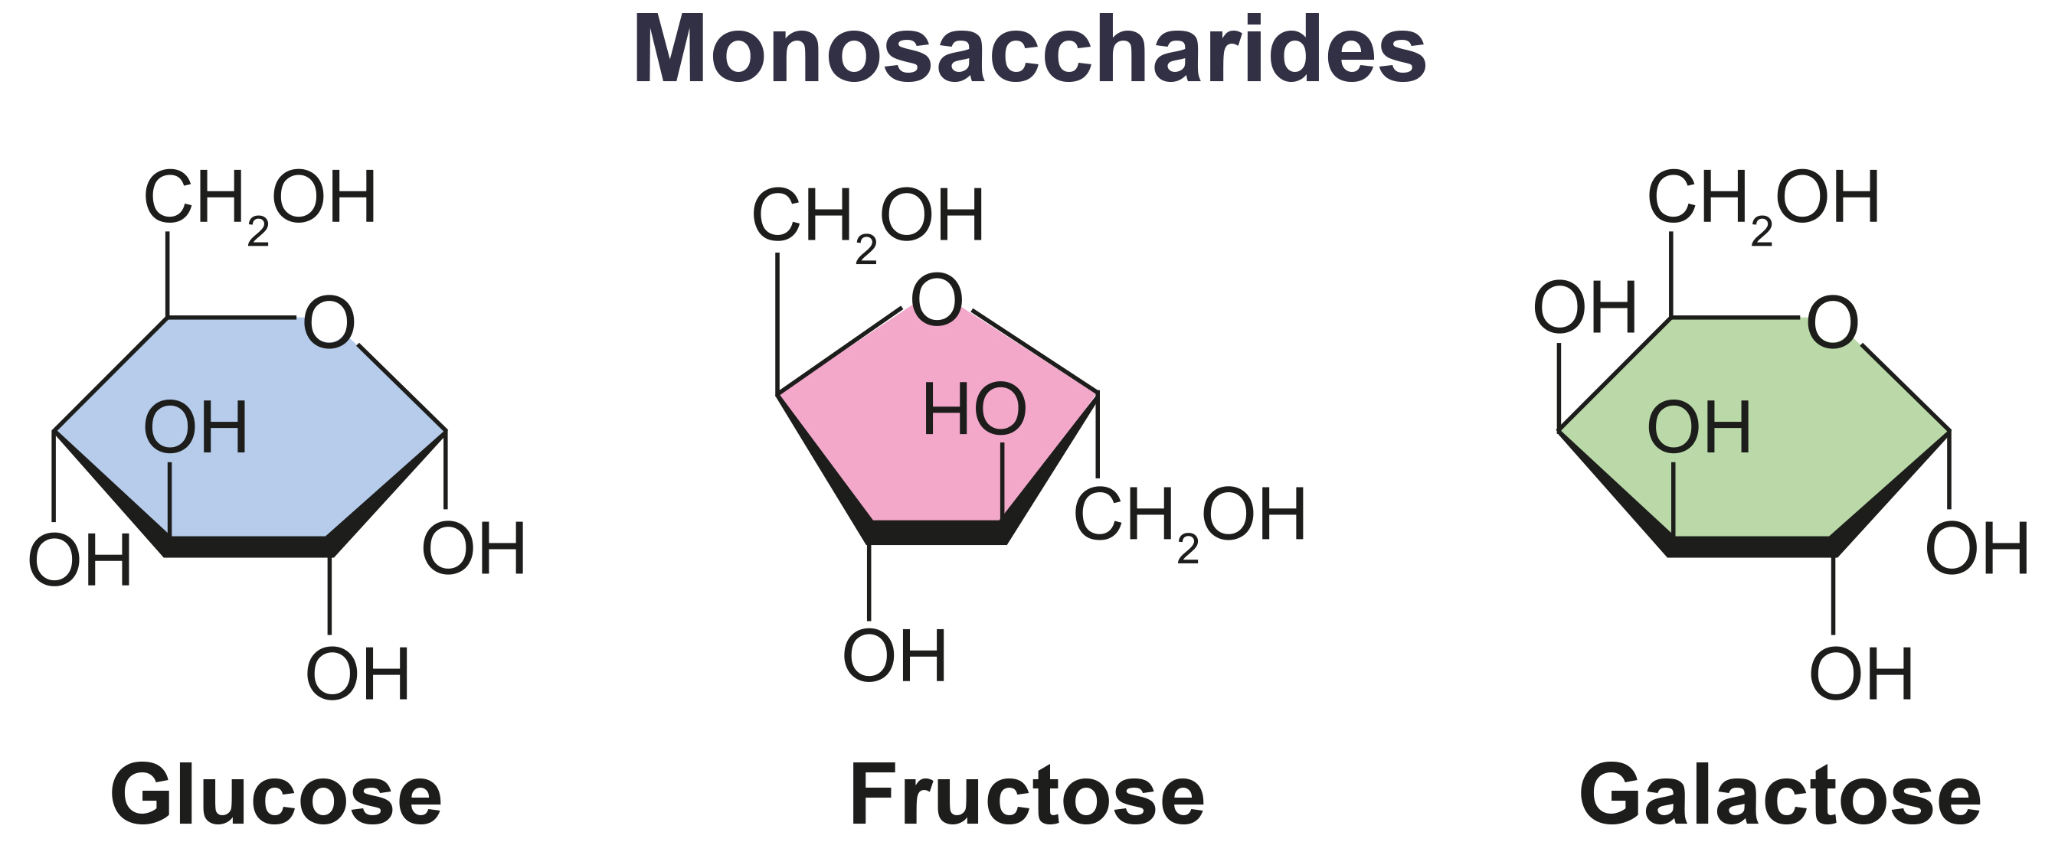
Monosaccharides₂
In humans, glucose is an important energy source that helps produce ATP during cellular respiration.
Plants synthesize glucose during photosynthesis, assemble it into starch, and humans obtain glucose by breaking down this starch.
Galactose, fructose, and glucose are isomers with the same chemical formula but different structural arrangements of functional groups.
3.2 Figure 3

Slide 9
Think It Through₂
What kind of sugars are these: aldose or ketose? Also, what would be the biological consequence of these isomers having different shapes?
3.2 Figure 3

Slide 10
Monosaccharides₃
Monosaccharides can form linear chains or ring forms
Favor ring forms in aqueous solutions
Ring formation makes the carbon at end of the chain (C=O) lose its double bond to oxygen to complete its attachment to the ring.
Hydroxyl group on carbon-1 can be alpha (α) (below ring) or beta (ß) (above ring) position.
These orientations create structural isomers of monosaccharides.

Slide 11
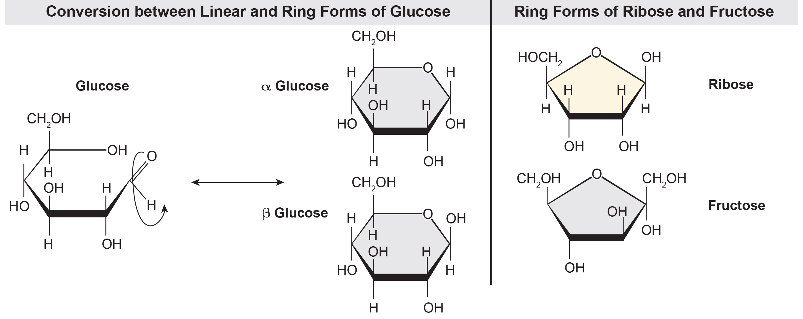
3.2 Figure 4
CNX OpenStax on Wikimedia Commons. "Glucose molecules." Modified.
Notes:
Five and six carbon monosaccharides exist in equilibrium between linear and ring forms. When the ring forms, the side chain it closes on locks into an α or β position. Fructose and ribose also form rings although they form five-membered rings instead of the six-membered ring of glucose.

Slide 12
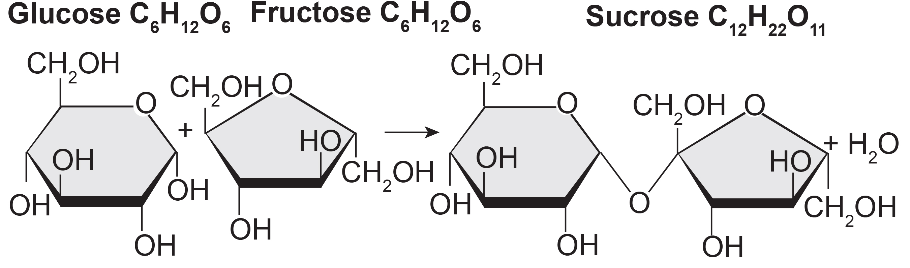
Disaccharides
Disaccharides: (di- means two) form via dehydration reaction between two monosaccharides, creating a glycosidic bond (covalent bond between monosaccharides).
The glycosidic bond is alpha when the carbon-1 OH group is below the ring plane and beta when the carbon-1 OH group is above the ring plane.
3.2 Figure 5

Slide 13
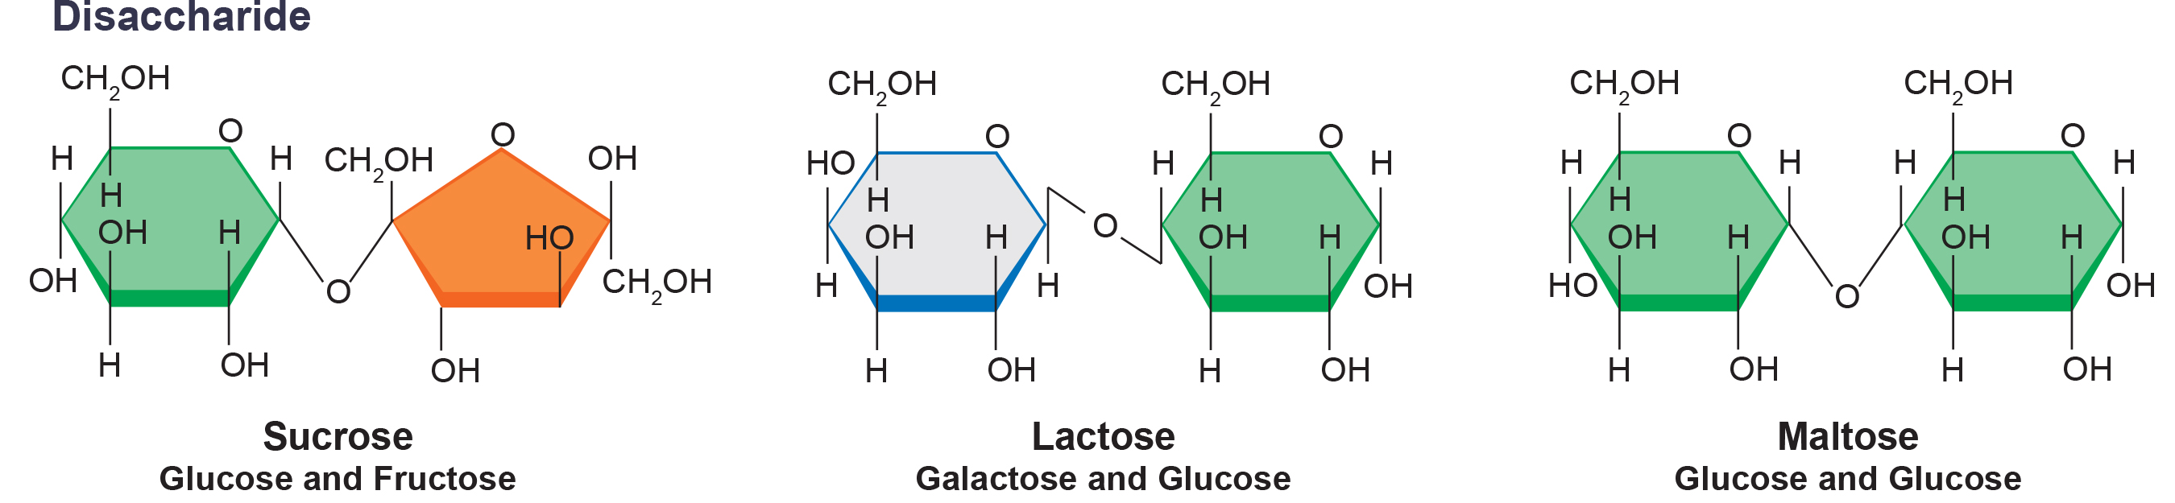
Common Disaccharides
Common disaccharides are formed by combining different monosaccharides:
Lactose (milk) consists of glucose and galactose.
Maltose (malt sugar) is formed from two glucose molecules.
Sucrose (table sugar) comprises glucose and fructose monomers.
3.2 Figure 6

Slide 14
Reflection Questions
Many people across the world are lactose intolerant. These individuals experience digestive discomfort when they consume foods containing lactose, such as milk and cheese, but they can consume lactose-free milk. What do you think has been added to the lactose-free milk to make it consumable by these individuals?
Notes:
The reflection question is included here to use as a talking point or for a think-pair-share activity.

Slide 15
Polysaccharides
Polysaccharide: a long chain of monosaccharides linked by glycosidic bonds, which can be:
Unbranched (linear) or branched (into multiple chains)
Branches are strengthened by hydrogen bonds.
Examples include starch, glycogen, cellulose, and chitin.

Slide 16
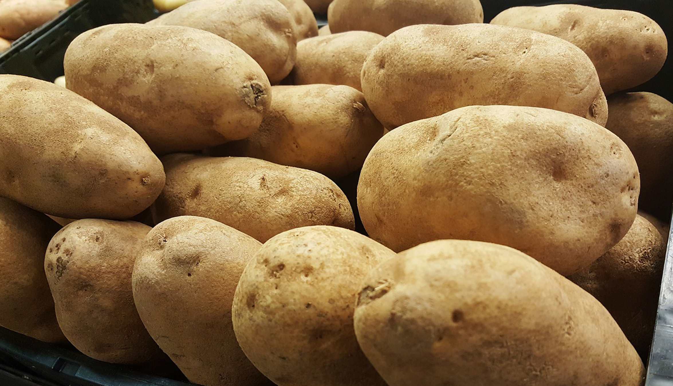
Polysaccharides: Starch
Starch: polymers that store excess glucose storage in plants such as amylose (unbranched glucose polymer) and amylopectin (branched glucose polymer)
Stored in the roots and seeds of plants
Enzymes like amylase in saliva break down starch into smaller molecules like maltose and glucose for cellular respiration.
Glucose monomers in starch are joined by α 1-4 or α 1-6 glycosidic bonds.
3.2 Figure 7
Brett_Hondow on Pixabay. "Potatoes."

Slide 17
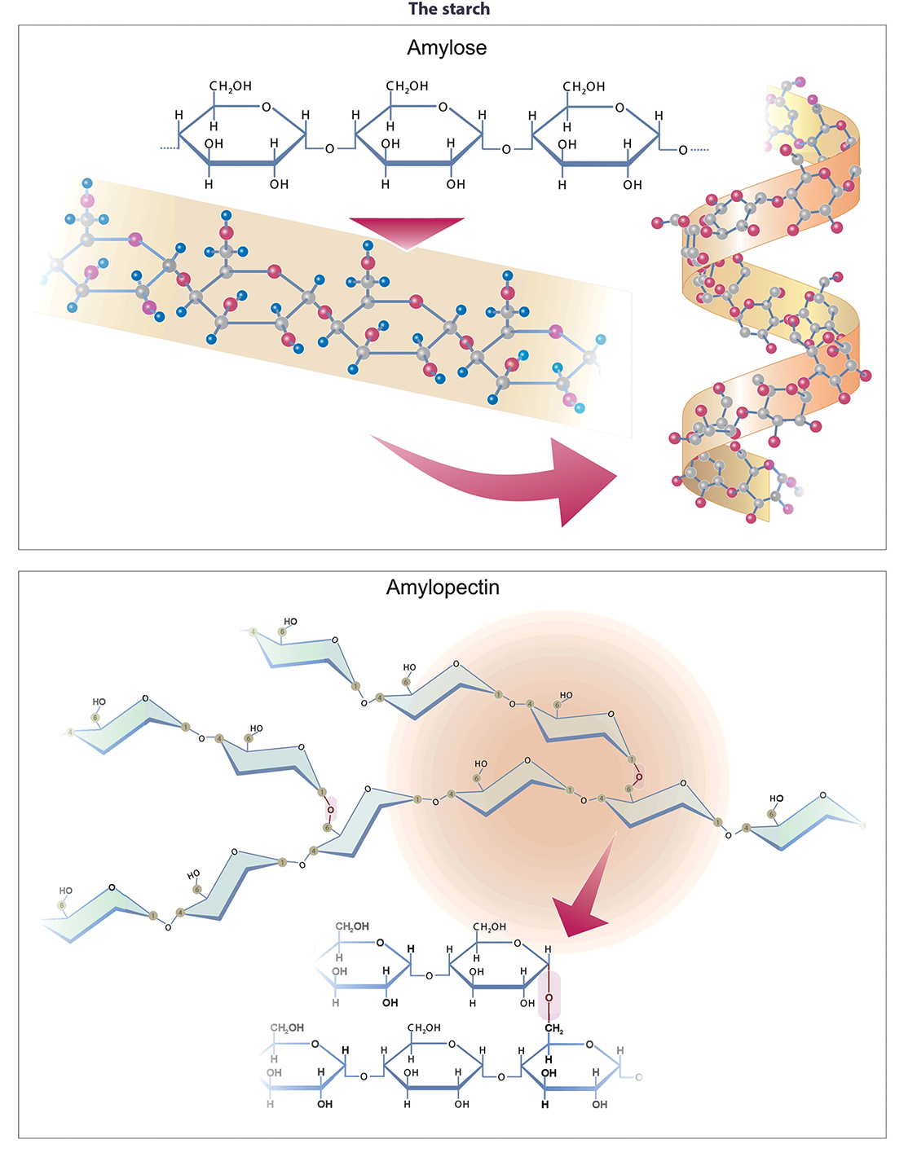
3.2 Figure 8
Notes:
Amylose and amylopectin are two different starch forms. Amylose (top) consists of unbranched chains of glucose monomers connected by α 1-4 glycosidic linkages. Amylopectin (bottom) consists of branching chains of glucose monomers connected by α 1-4 and α 1-6 glycosidic linkages. Because of the way the subunits are joined, the glucose chains have a helical structure. Glycogen (not shown), a type of starch found in animal cells, is similar in structure to amylopectin but more highly branched.

Slide 18
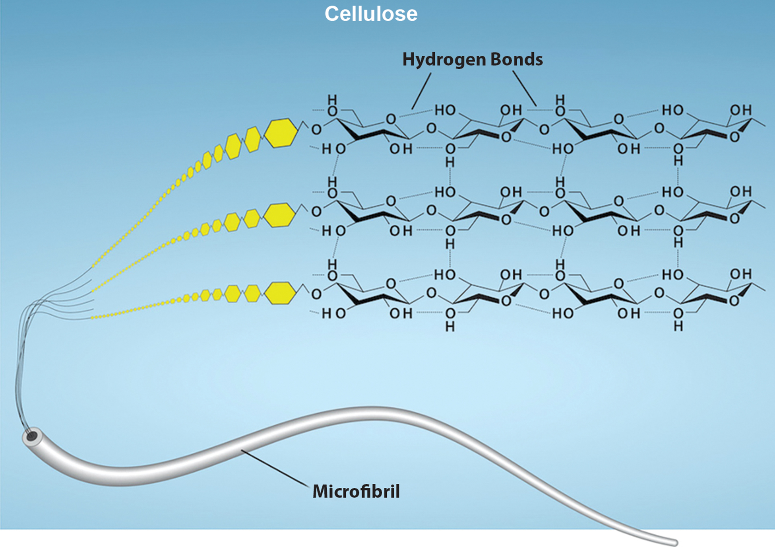
Polysaccharides: Glycogen and Cellulose
Glycogen: branched polymer for glucose storage in animals
Glycogenolysis: break down of glycogen to release glucose into the bloodstream
Cellulose: the most abundant biopolymer that forms rigid plant cell walls
Humans cannot breakdown cellulose, but herbivores and bacteria can.
3.2 Figure 9: In cellulose, glucose monomers are linked in unbranched chains by β 1-4 glycosidic linkages.
Ryan, K. Rao, A. and Hawkins, A. Department of Biology, Texas A&M University. "Cellulose structure."

Slide 19
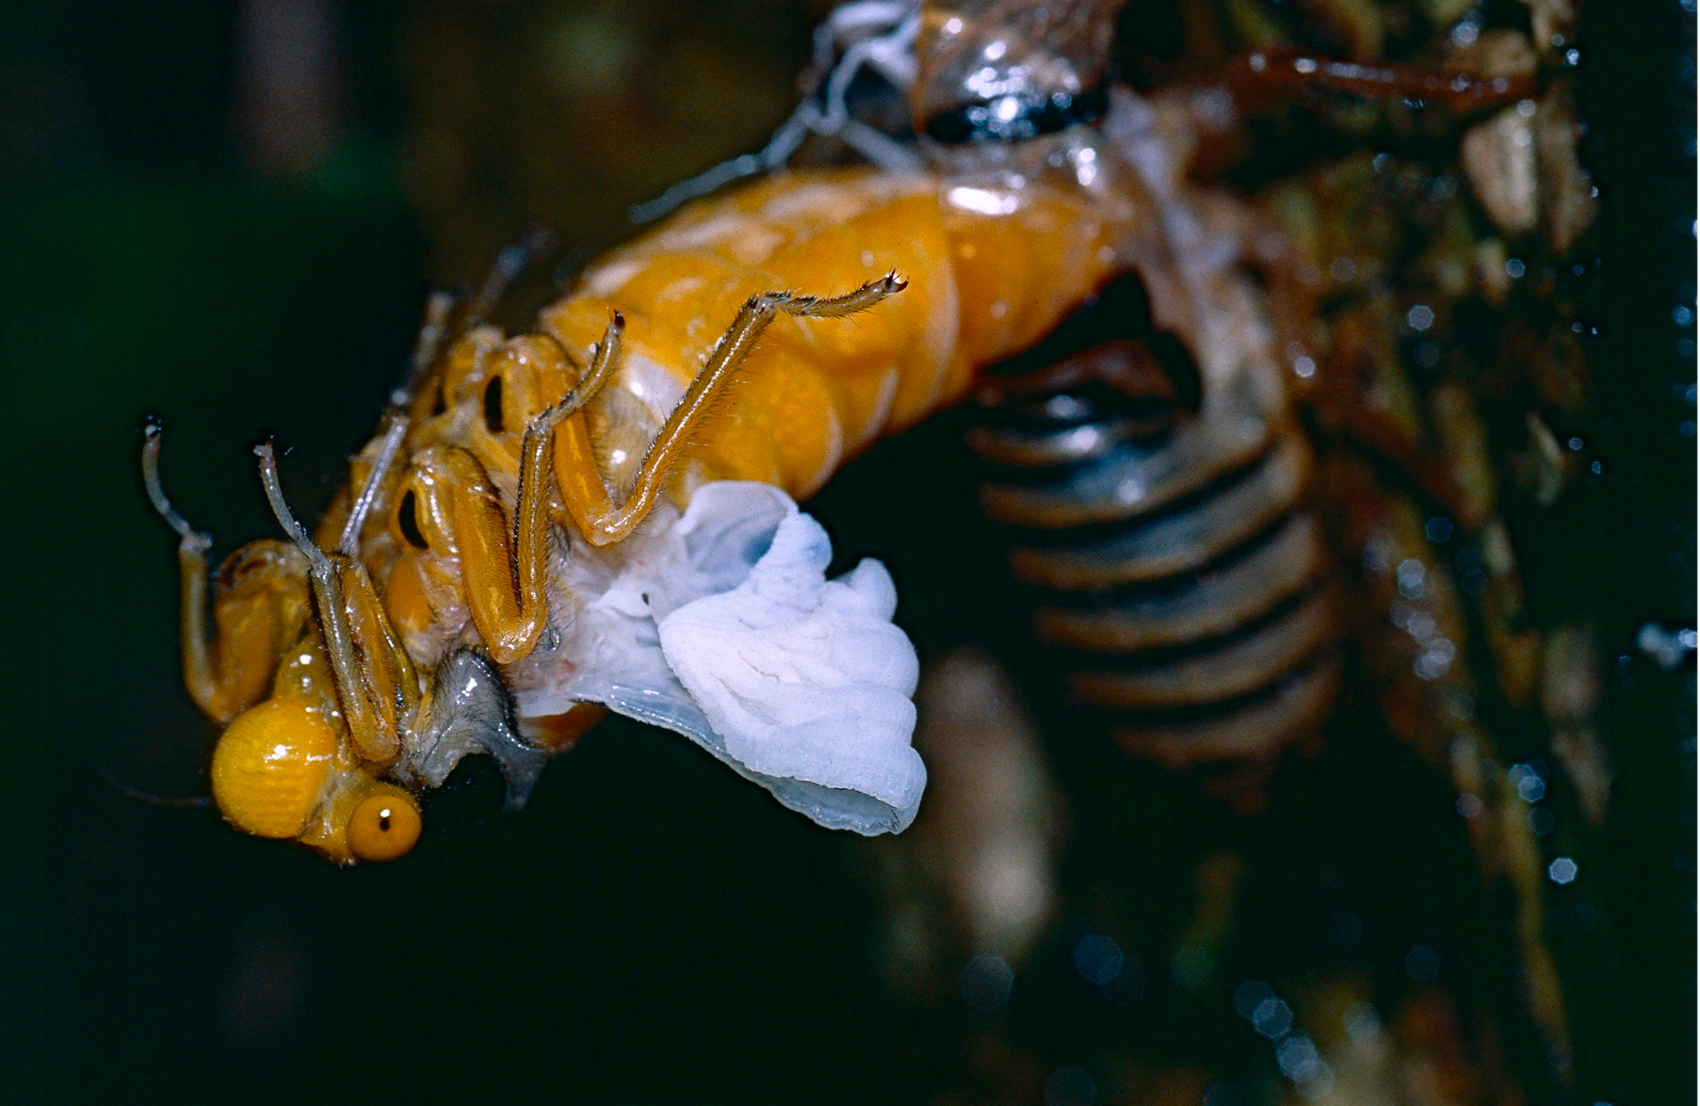
Polysaccharides: Chitin
Chitin, a nitrogen-containing polysaccharide that forms:
Exoskeletons of arthropods, like insects and crustaceans
A major component of fungal cell walls
Composed of repeating N-acetyl-b-d-glucosamine (NAG) units
3.2 Figure 10
Bernard Dupont on Wikimedia Commons. "Black and golden cicada."

Slide 20
Science and You
Career: Registered Dietitian
Many seek registered dietitians for tailored nutrition plans for health needs or athletics.
Dietitians design nutrition plans to treat and prevent diseases across various settings.
Becoming a registered dietitian requires a relevant bachelor's degree, internship, and national exam.
Dietetics involves studying food sciences to become a food expert, including like nutrition, chemistry, biochemistry, and physiology.
Notes:
This is included as a relevant application for this topic.

Slide 21
Benefits of Carbohydrates
Benefits of carbohydrates for overall health:
Provide energy (4.3 Kcal/g) through glucose breakdown and ATP production
Contain fiber which aids in digestion and cholesterol regulation
Importance of carbohydrates in a balanced diet:
Have been a part of human diet for thousands of years
Should be supplemented with proteins, vitamins, and fats for a well-balanced diet

Slide 22
Summary
Carbohydrate are classified as monosaccharides, disaccharides, or polysaccharides.
Monosaccharides form disaccharide or polysaccharides through dehydration reactions that form glycosidic bonds.
Monosaccharides are glucose, galactose, fructose and common disaccharides are lactose, maltose, sucrose.
Polysaccharides can store glucose as starch in plants and glycogen in animals.

Slide 23


End of Hawkes Learning PowerPoint

