Slide 1
Lesson 3.3
Lipids

Slide 2
Objectives
Define the basic structure of a steroid and some steroid functions.
Describe phospholipids and their role in cells.
Describe the four major types of lipids.
Differentiate between saturated and unsaturated fatty acids.
Explain the role of fats in storing energy.

Slide 3
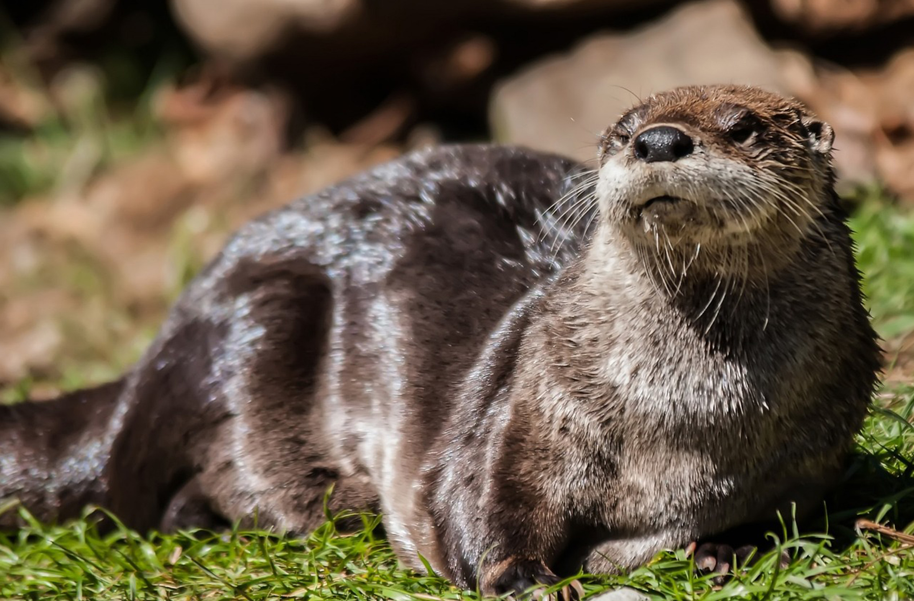
Lipids
Lipids: nonpolar, hydrophobic compounds composed of hydrocarbon chains
They serve as energy reserves, insulation, and structural components in cells.
Major types include fats, oils, waxes, phospholipids, and steroids.
3.3 Figure 1: Hydrophobic lipids in aquatic mammals' fur, such as the fur of this river otter, protect the mammals from the elements.
PublicDomainPictures on Pixabay. "Otter."

Slide 4
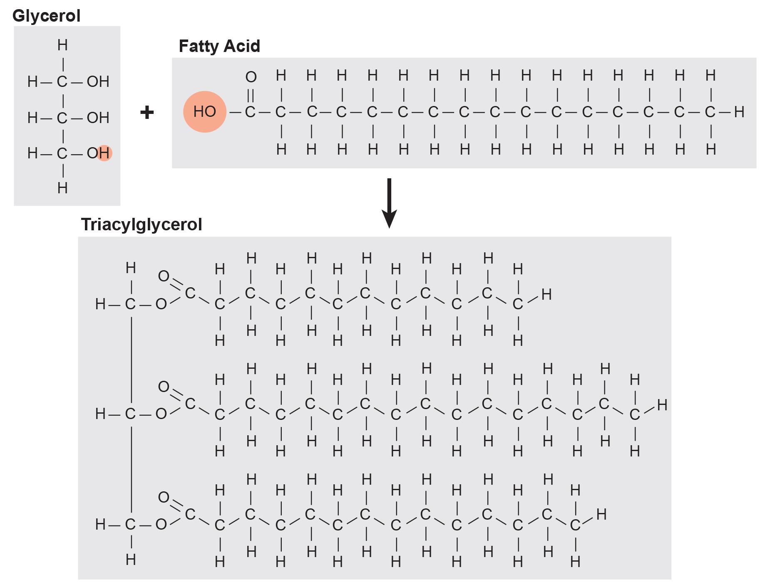
Fats and Oils₁
Fat molecules consist of glycerol and fatty acids.
Glycerol is a three-carbon alcohol with three hydroxyl groups.
Fatty acids are long hydrocarbon chains with a carboxyl group, linked to glycerol by an ester bond.
Ester bond: connects the carbon doubly bonded to oxygen of the fatty acid to an oxygen in the glycerol
3.3 Figure 2
OpenStax. "Triglycerol formation." Modified.

Slide 5
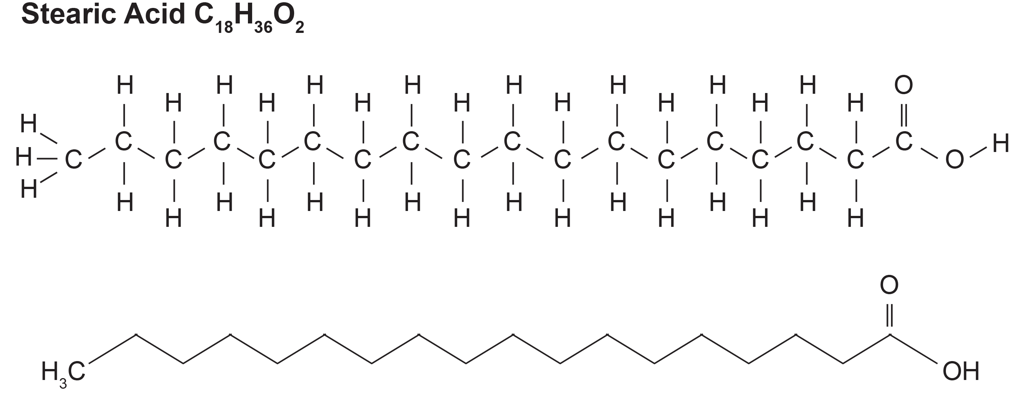
Fats and Oils₂
Triacylglycerols: fats consisting of three fatty acids linked to a glycerol molecule, created by dehydration synthesis which releases three water molecules
Saturated fatty acids: fatty acids with single carbon-carbon bonds in the hydrocarbon chain (saturated in hydrogens).
Pack tightly together making them solid at room temperature, like butter
3.3 Figure 3: Stearic acid is a common saturated fatty acid.

Slide 6
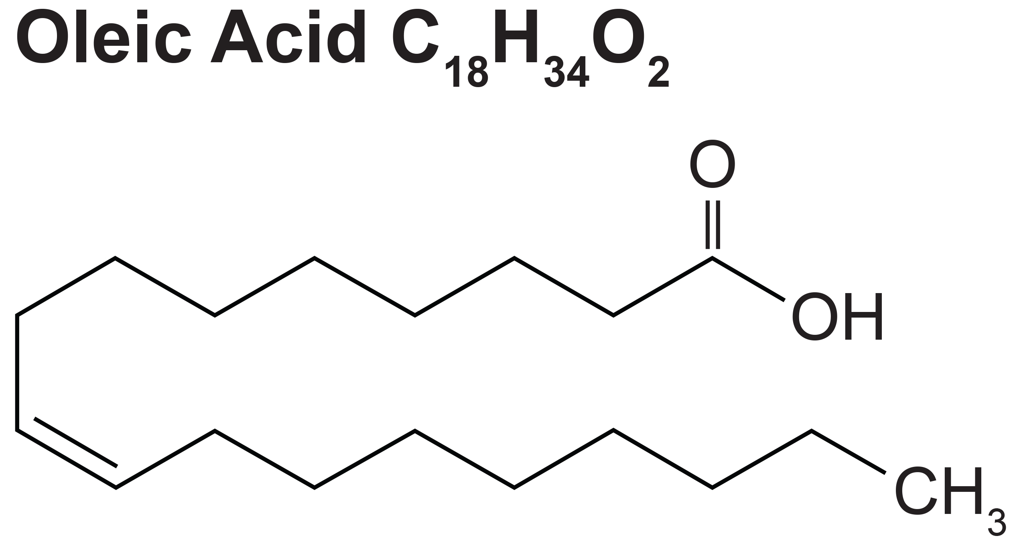
Fats and Oils₃
Unsaturated fatty acids: fatty acids containing double bonds between carbon atoms in the hydrocarbon chains
Kinked chains cannot pack closely together, resulting in a liquid state at room temperature.
Examples: olive and canola oil
3.3 Figure 4: Oleic acid is a common unsaturated fatty acid.
Paginazero on Wikimedia Commons. "Oleic acid."

Slide 7
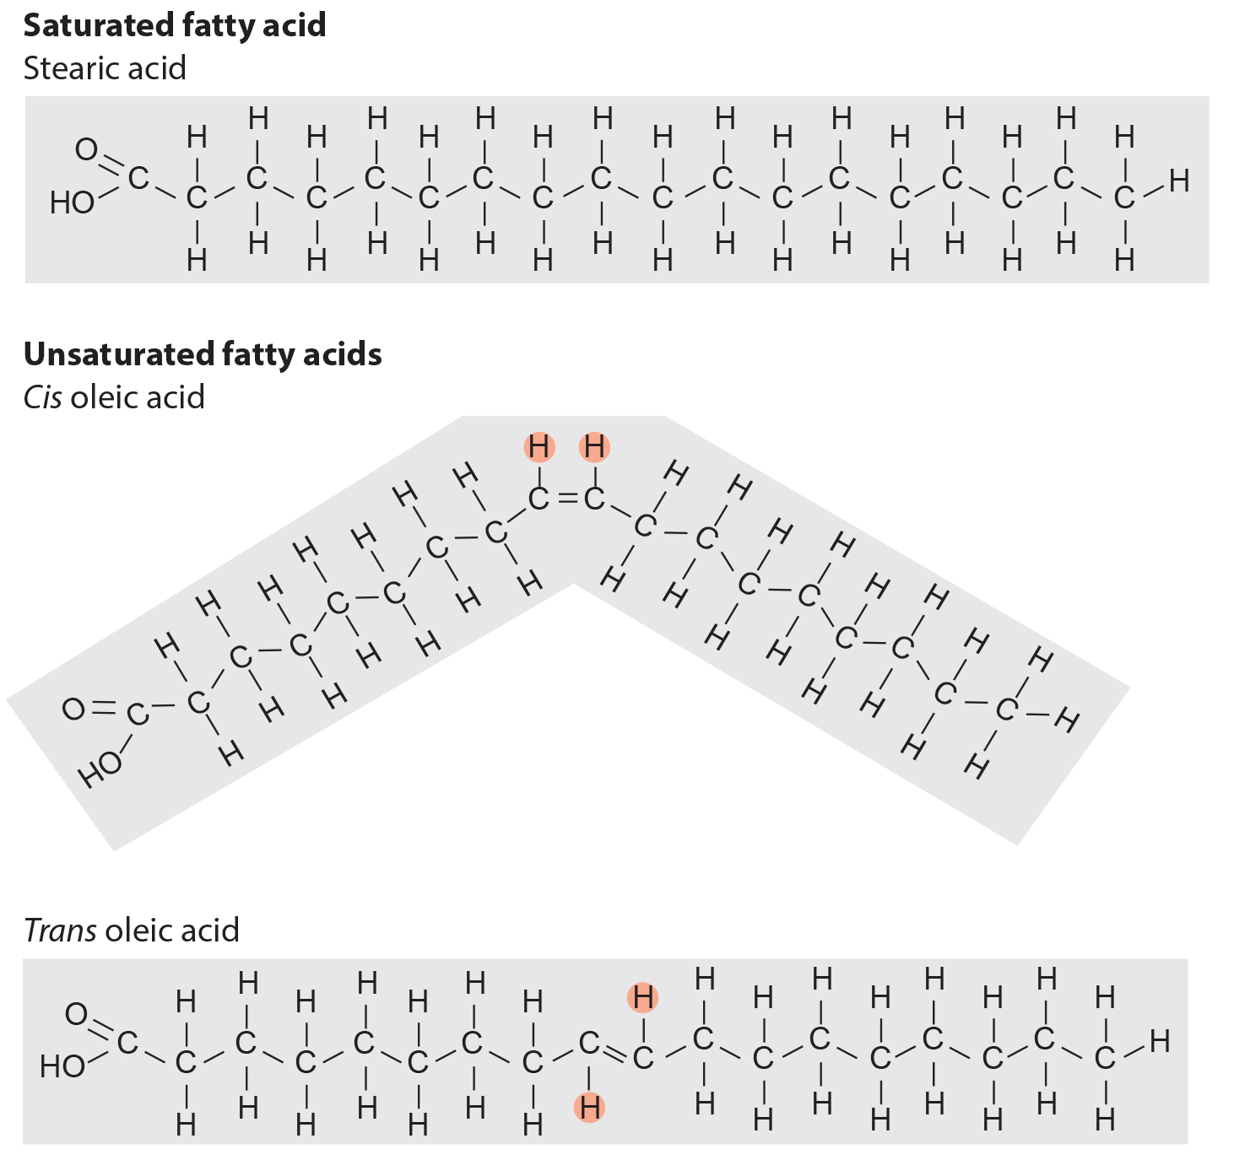
Fats and Oils₄
Unsaturated fats are in either a cis or trans configuration
Cis: hydrogens are on the same plane, causing a kink
Trans: hydrogens are on different planes
3.3 Figure 5
CNX OpenStax on Wikimedia Commons. "Fatty acids." Modified.

Slide 8
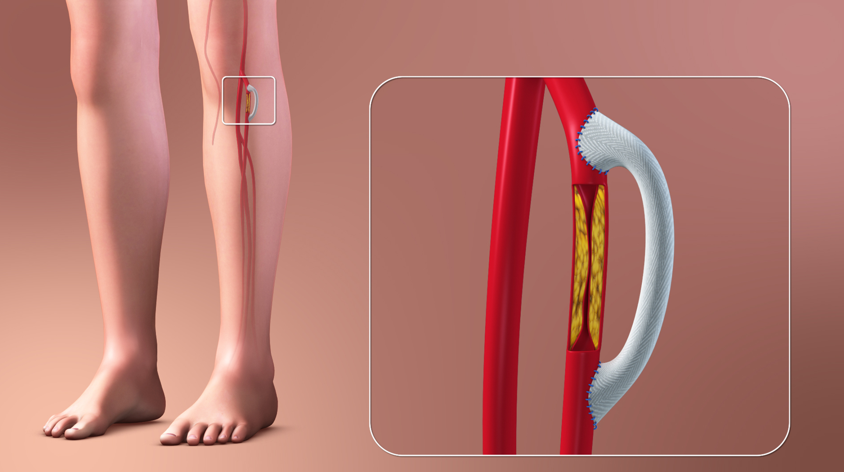
Trans Fats
Trans fats: formed artificially by hydrogenating oils, leading to a trans configuration that does not naturally occur
Examples: margarine, some peanut butters, and shortening
Linked to higher low-density lipoproteins (LDL) levels or "bad“ cholesterol
3.3 Figure 6: Deposition of plaque within arteries is partially due to an intake of trans fats and causes a reduction of blood flow to that tissue. One way to address this is to insert a graft which reroutes blood flow around the blocked blood vessel.
www.scientificanimations.com on Wikimedia Commons. "Plaque in arteries."

Slide 9
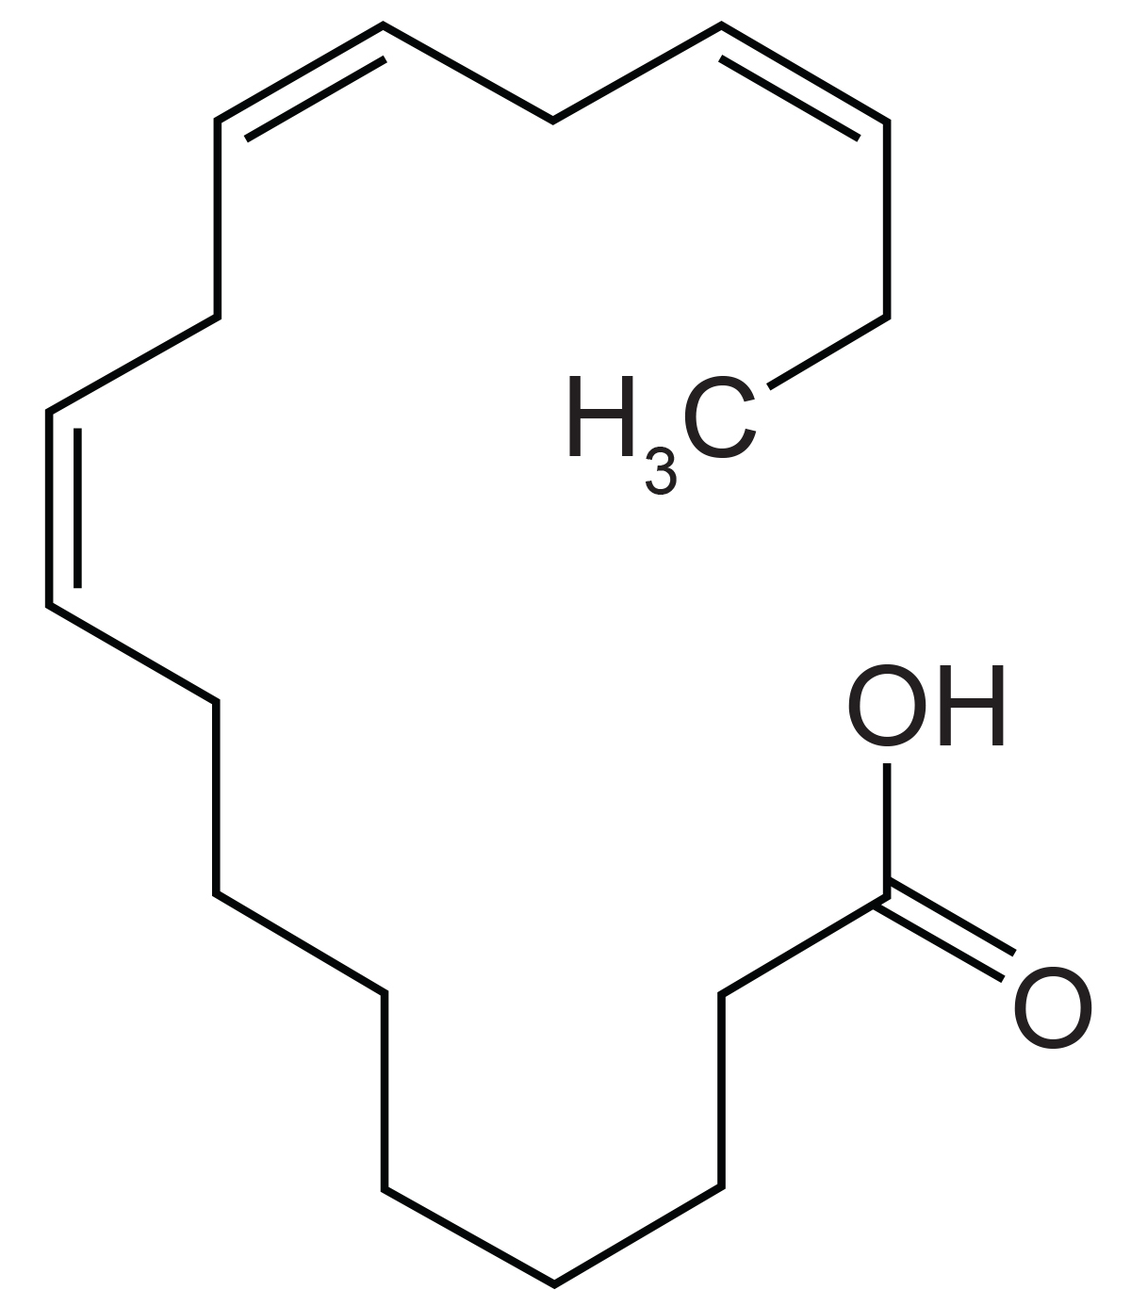
Omega Fatty Acids
Omega fat: polyunsaturated fat that the body requires but does not synthesize
Omega-3 fatty acids have a double bond connecting the 3rd and 4th carbons from the omega end (farthest end from the carboxyl group)
Examples: ALA, EPA, and DHA
Good dietary sources include salmon, trout, and some plant oils.
Omega-3s reduce heart disease risks and inflammation.
3.3 Figure 7: Alpha-linolenic acid is an example of an omega-3 fatty acid.
Jü on Wikimedia Commons. "Alpha-linolenic acid."

Slide 10
Reflection Question
How much salmon or other fish rich in omega-3 fatty acids do you eat in your diet? Do you think you eat enough to reap the benefits described?
Notes:
The reflection question is included here to use as a talking point or for a think-pair-share activity.

Slide 11
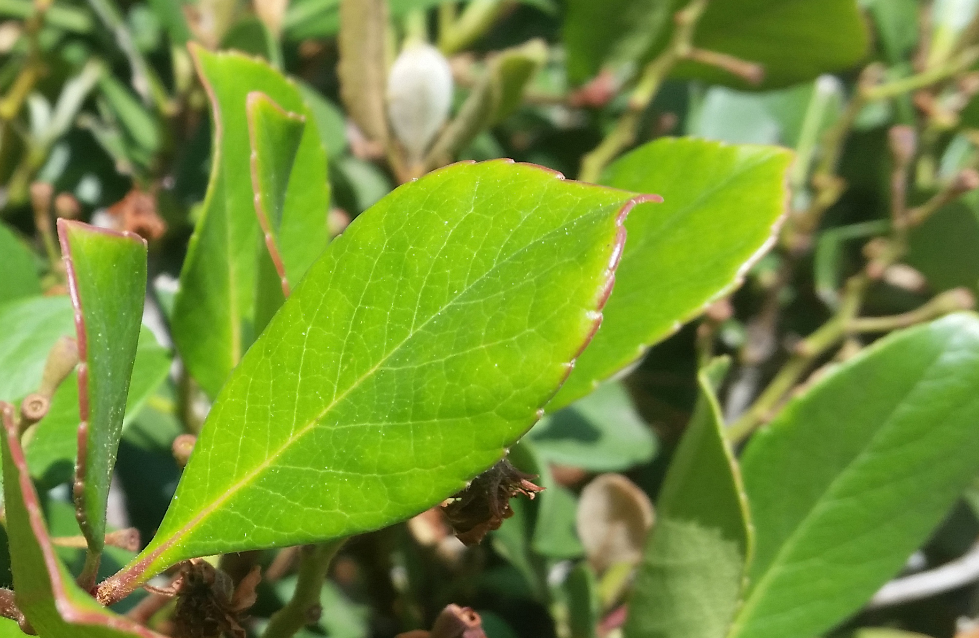
Waxes
Wax: made of long fatty acid chains esterified to long-chain alcohols.
Coat the feathers of aquatic birds and some leaves
Hydrophobic nature prevents water from sticking to these surfaces
3.3 Figure 8: Lipids comprise waxy coverings on some leaves.
Ushafl on Wikimedia Commons. "Leaf wax."

Slide 12
Phospholipids
Phospholipids: consist of fatty acid chains attached to a glycerol or sphingosine (amino alcohol) backbone
Unlike triglycerides, glycerol-based phospholipids have two fatty acids and a modified phosphate group instead of a third fatty acid.
They make up the plasma membrane, mostly in the form of phosphatidylcholine and phosphatidylserine.
Phospholipids are amphipathic: contain a hydrophobic (fatty acid) and a hydrophilic (phosphate) part

Slide 13
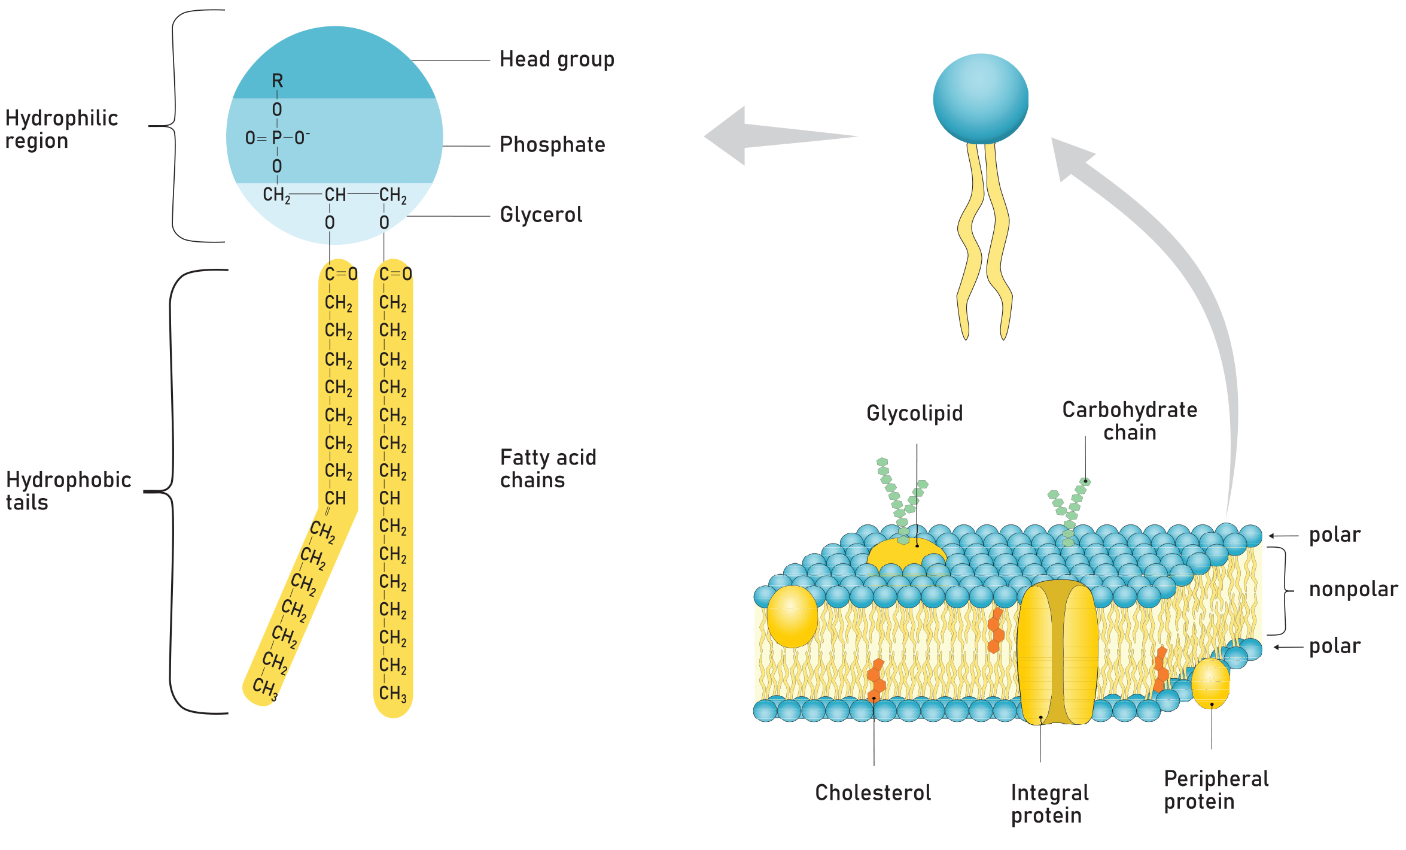
3.3 Figure 9
Notes:
A phospholipid is a molecule with two fatty acids and a modified phosphate group attached to a glycerol backbone. Adding a charged or polar chemical group may modify the phosphate.

Slide 14
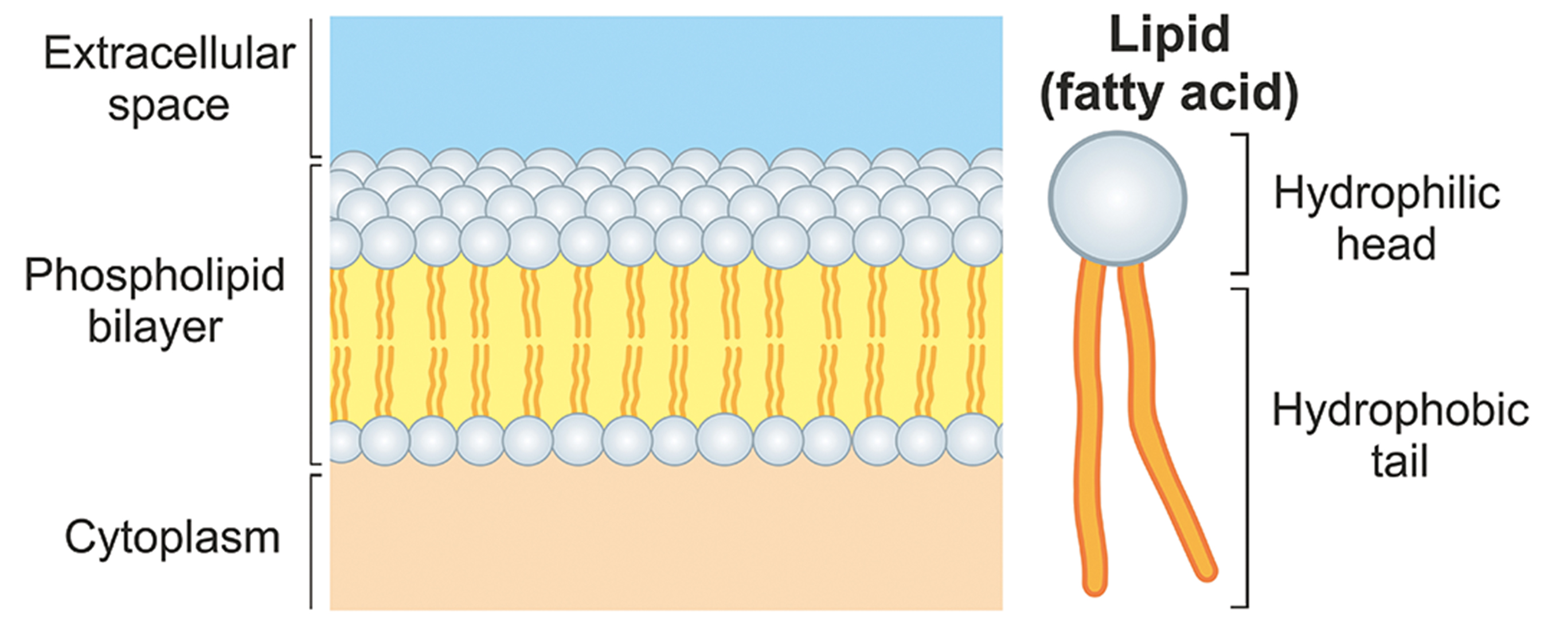
Structure and Properties of Phospholipid Bilayers
Form phospholipid bilayer membranes
Hydrophobic fatty acid tails face inward, forming the matrix.
Hydrophilic phosphate heads face outward, interacting with the extracellular and intracellular environments.
3.3 Figure 10

Slide 15
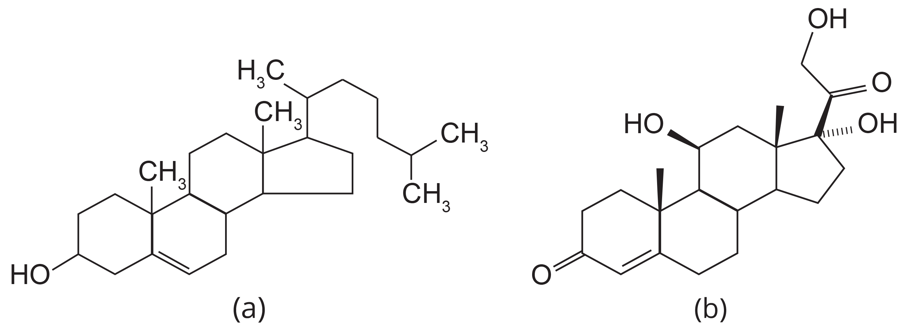
Steroids₁
Steroid: lipid with four fused hydrocarbon rings forming a planar structure
Hydrophobic and insoluble in water
Some, such as cholesterol, also have a short hydrocarbon tail.
3.3 Figure 11: Steroid examples: (a) cholesterol and (b) cortisol
Wesalius on Wikimedia Commons. "Cholesterol."Rhododendronbusch on Wikimedia Commons. "Cortisol."

Slide 16
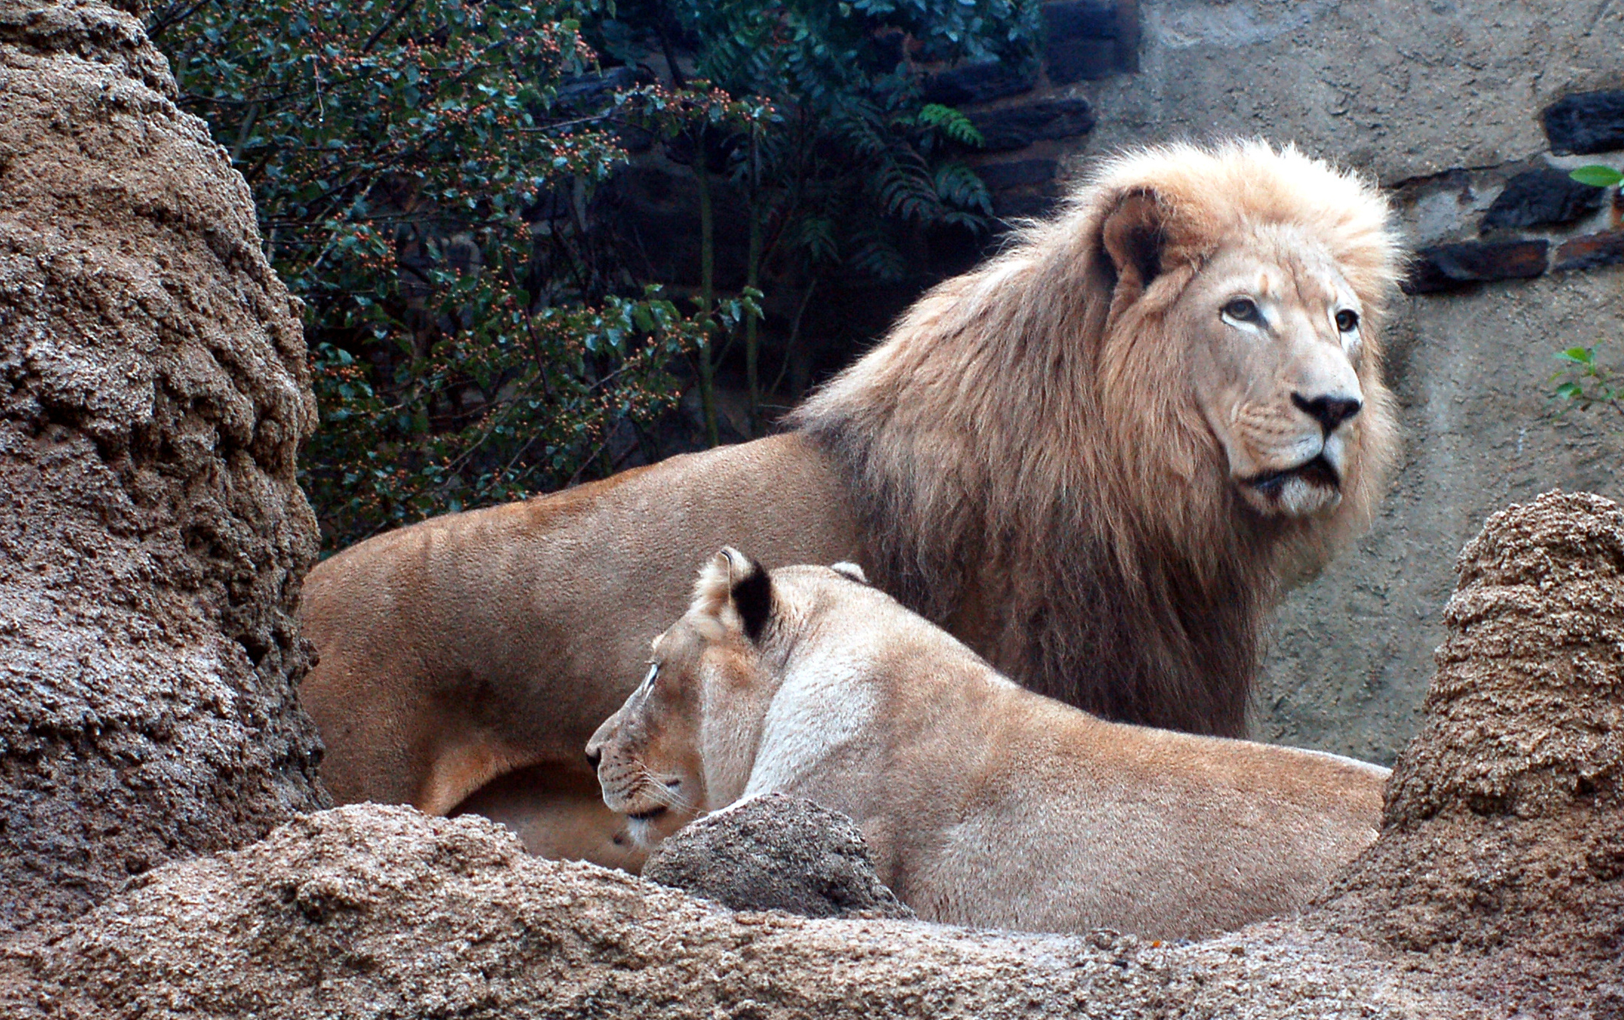
Steroids₂
Many steroids have an -OH functional group, classifying them as sterols, such as estrogen and testosterone.
Cholesterol is the most common steroid, synthesized by the liver, and is a precursor for steroid hormones, vitamin D, and bile salts.
Sterols like cholesterol and phytosterols are components of the phospholipid bilayer.
3.3 Figure 12: The different physical characteristics of the male and female lions are due, in part, to the different expression of steroids, such as testosterone and estrogen, in each animal.
Derek Ramsey on Wikimedia Commons. "Lions."

Slide 17
Summary
Lipids are nonpolar, hydrophobic macromolecules including fats, oils, waxes, phospholipids, and steroids.
Fats (triglycerides) store energy and are made of fatty acids and either glycerol or sphingosine backbones.
Fatty acids can be saturated with single bonds or unsaturated with double bonds in their hydrocarbon chains.
Phospholipids form membranes and have a glycerol or sphingosine backbone attached to two fatty acid tails and a phosphate head group.

Slide 18


End of Hawkes Learning PowerPoint

