Slide 1
Lesson 3.4
Proteins

Slide 2
Objectives
Describe the functions proteins perform in the cell and in tissues.
Describe the ways in which protein shape and function are linked.
Understand the relationship between amino acids and proteins.
Explain the four levels of protein organization.

Slide 3
Proteins
Proteins have diverse functions in living systems.
Some proteins provide structural support
Others regulate processes or protect against diseases
Can act as toxins, enzymes, or control substance movement
Proteins are constructed from amino acid polymers.

Slide 4
Types and Functions of Proteins
Enzymes are catalytic proteins that increase the rate of biochemical reactions.
Catabolic enzymes break down substrates, while anabolic ones build complex molecules.
Hormones like insulin are chemical signaling molecules that regulate physiological processes.
Changes in temperature, pH, and exposure to chemicals can lead to denaturation and loss of function.

Slide 5
Table 1: Proteins Exist in a Variety of Types and Perform Several Functions in Biology
Type | Examples | Functions
Digestive enzymes | Amylase, lipase, pepsin, trypsin | Help break down food by catabolizing nutrients into monomeric units
Transport | Hemoglobin, albumin | Carry substances in the blood or lymph (a colorless fluid that bathes the tissues) throughout the body
Structural | Actin, tubulin, keratin | Construct different structures, like the cytoskeleton
Hormones | Insulin, thyroxine | Coordinate different body systems' activities
Defense | Immunoglobulins | Protect the body from foreign pathogens
Contractile | Actin, myosin | Affect muscle contraction
Storage | Legume storage proteins, egg white (albumin) | Provide nourishment in early embryo development and in seedlings

Slide 6
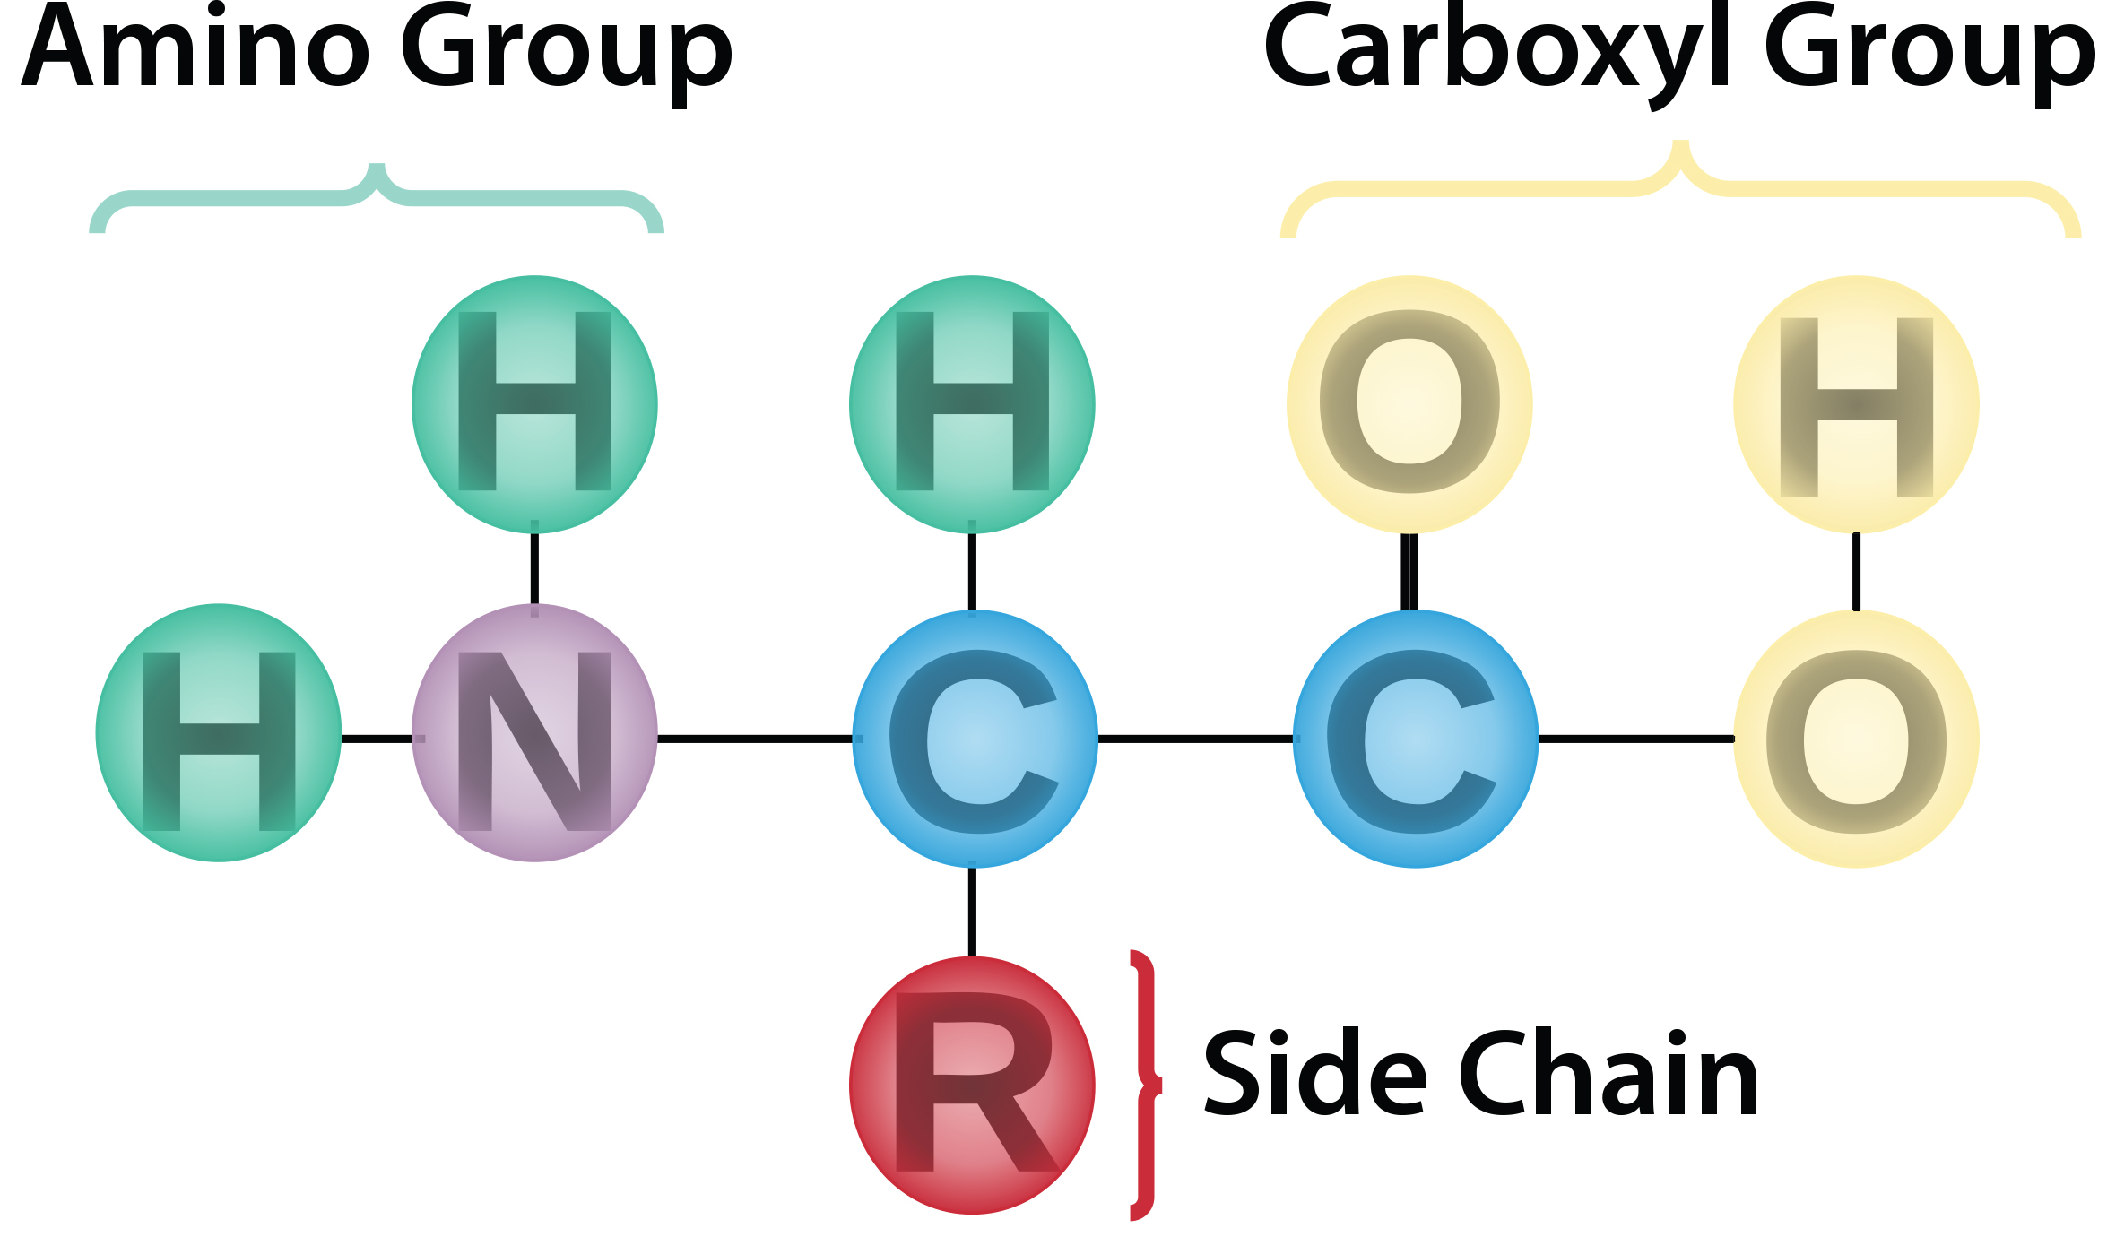
Amino Acids₁
Amino acids are the monomers that comprise proteins.
Each amino acid has a central carbon bonded to an amino group (NH₂), carboxyl group (COOH), hydrogen, and an R group.
Named after the amino and a carboxyl-acid group
The R group, or side chain, distinguishes each amino acid.
3.4 Figure 1
Scott Henry Maxwell on Wikimedia Commons. "Amino acid structure."

Slide 7
Amino Acids₂
There are 20 common amino acids found in proteins.
Nine are essential that humans must obtain through diet because they cannot produce them.

Slide 8
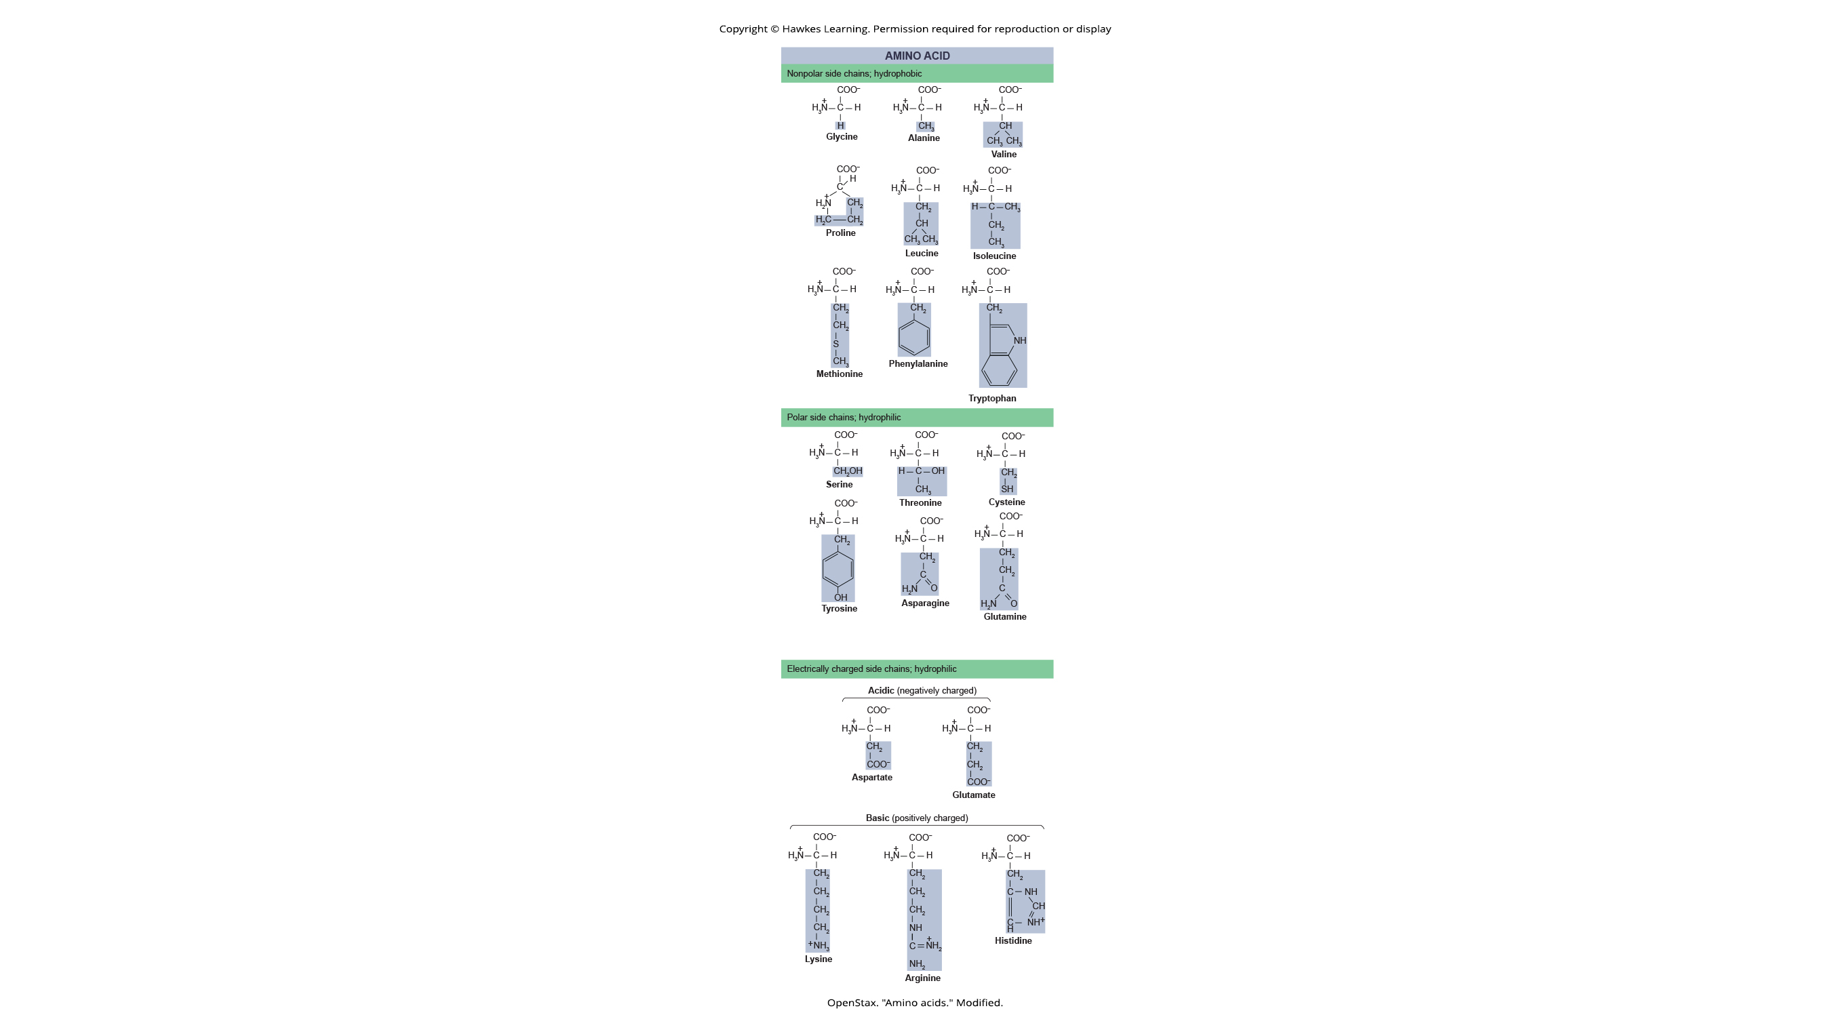
Amino Acids₃
The side chain determines an amino acid's properties (acidic, basic, polar, or nonpolar).
Some have nonpolar or hydrophobic side chains.
Examples: glycine, valine, methionine, and alanine
3.4 Figure 2
OpenStax. "Amino acids." Modified.

Slide 9
Amino Acids₄
Some have polar and hydrophilic side chains.
Serine, threonine, and cysteine are.
3.4 Figure 2
OpenStax. "Amino acids." Modified.

Slide 10
Amino Acids₅
Some amino acids have negatively charged (acidic) side chains.
Glutamate and aspartate have carboxyl groups that can lose a proton, giving the side chain a negative charge.
Other amino acids have positively charged (basic) side chains.
Lysine and arginine have amine groups that can accept protons, making the side chains positively charged.
3.4 Figure 2
OpenStax. "Amino acids." Modified.

Slide 11
Think It Through₁
Proteins are made of amino acids. Which categories of amino acid would you expect to find on the surface of a water-soluble protein, and which would you expect to find in the interior? What distribution of amino acids would you expect to find in a protein embedded in a lipid bilayer?
Notes:
Originally an On Your Own. This is included here to use as a talking point or for a think-pair-share activity.

Slide 12
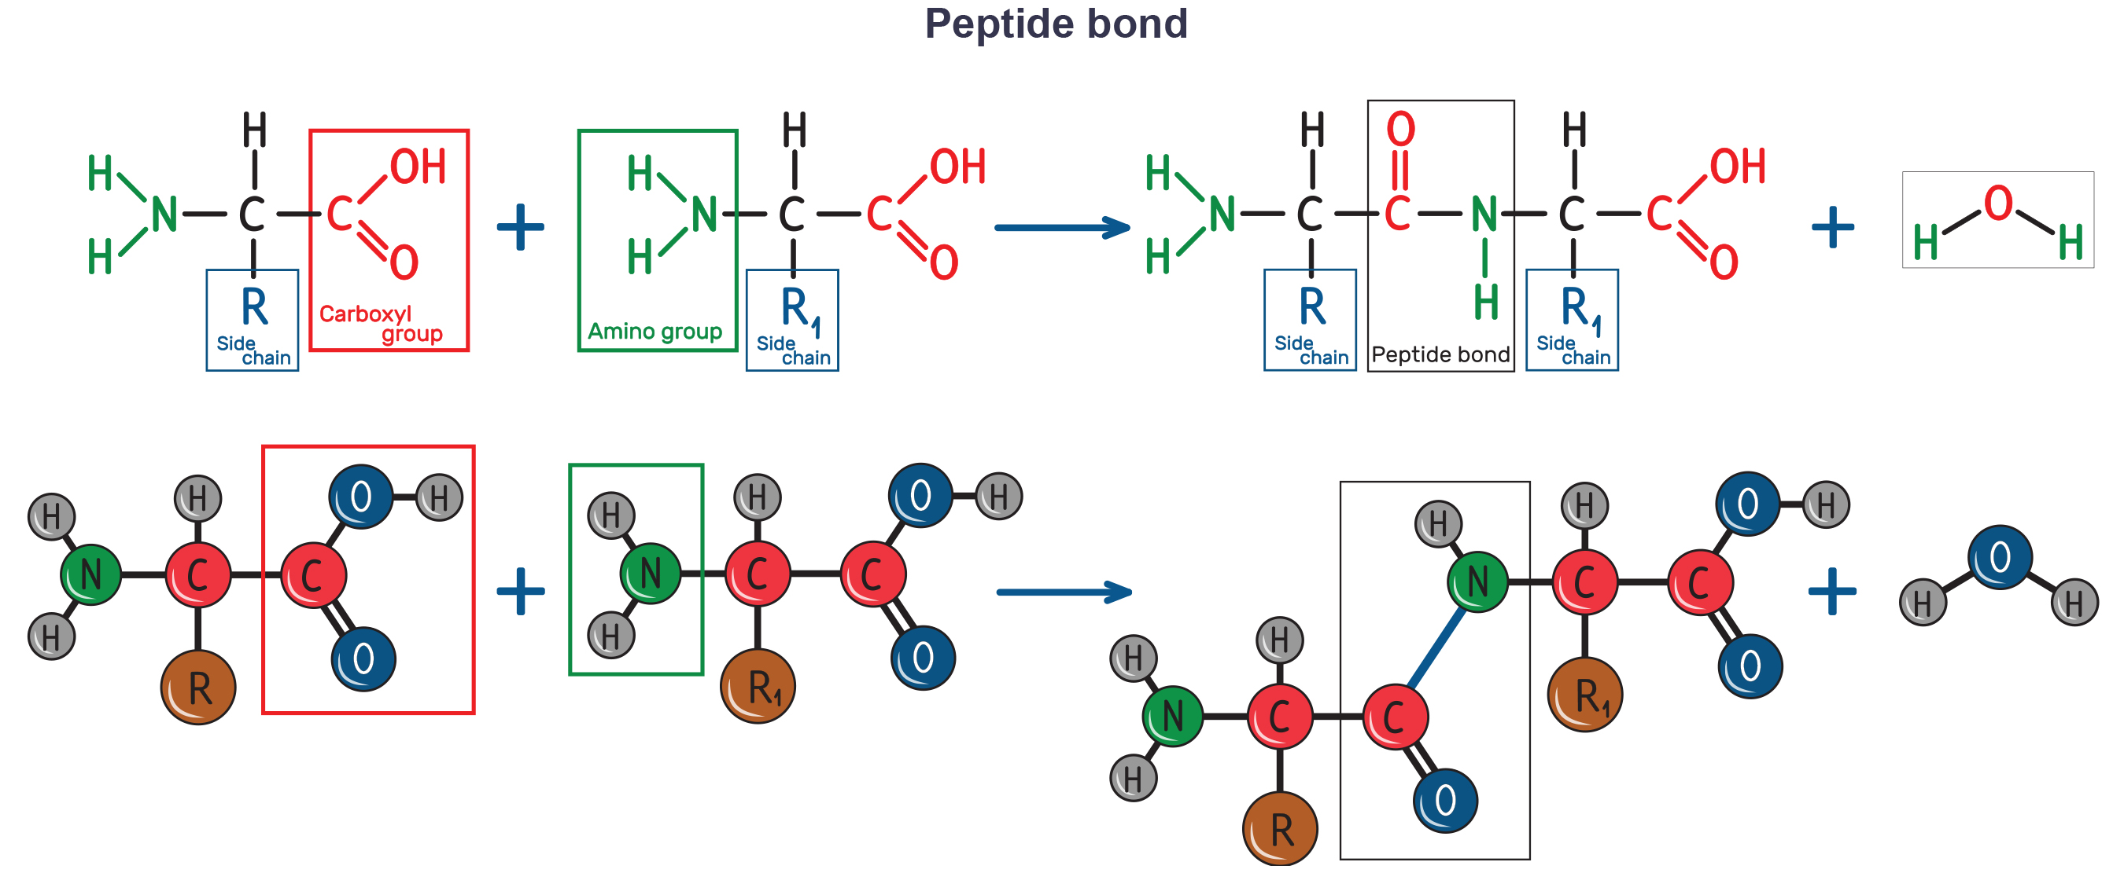
Peptide Bonds
Amino acids attach to each other via a peptide bond (covalent bond) during dehydration synthesis.
One amino acid’s carboxyl group and another's amino group combine, releasing a water molecule.
3.4 Figure 3

Slide 13
The Evolutionary Significance of Cytochrome c
Cytochrome c is a crucial protein in the electron transport chain containing a heme group with an iron (Fe) ion that is reduced and oxidized during electron transfer.
Cytochrome c has high amino acid sequence homology (similarity) across species, indicating its importance and common ancestry.
Human cytochrome c contains 104 amino acids, 37 of which are the same position as other species.

Slide 14
Polypeptide Structure
A polypeptide is a chain of linked amino acids with distinct terminals.
A free amino group at one end (N terminal) and a free carboxyl group at the other end (C terminal)
After synthesis, polypeptides undergo post-translational modifications like cleavage or phosphorylation.
Often have bound prosthetic groups (non-peptide group needed for the biological function of the protein)
Fold into distinct three-dimensional shape essential for their biological function

Slide 15
Protein Structure
A protein's shape or conformation is crucial for its function, like an enzyme binding its substrate.
The active site of an enzyme must have the proper shape to bind its specific substrate and catalyze the reaction.
Alterations in the active site or overall protein structure can prevent proper substrate binding.
There are four levels of protein structure: primary, secondary, tertiary, and quaternary.

Slide 16
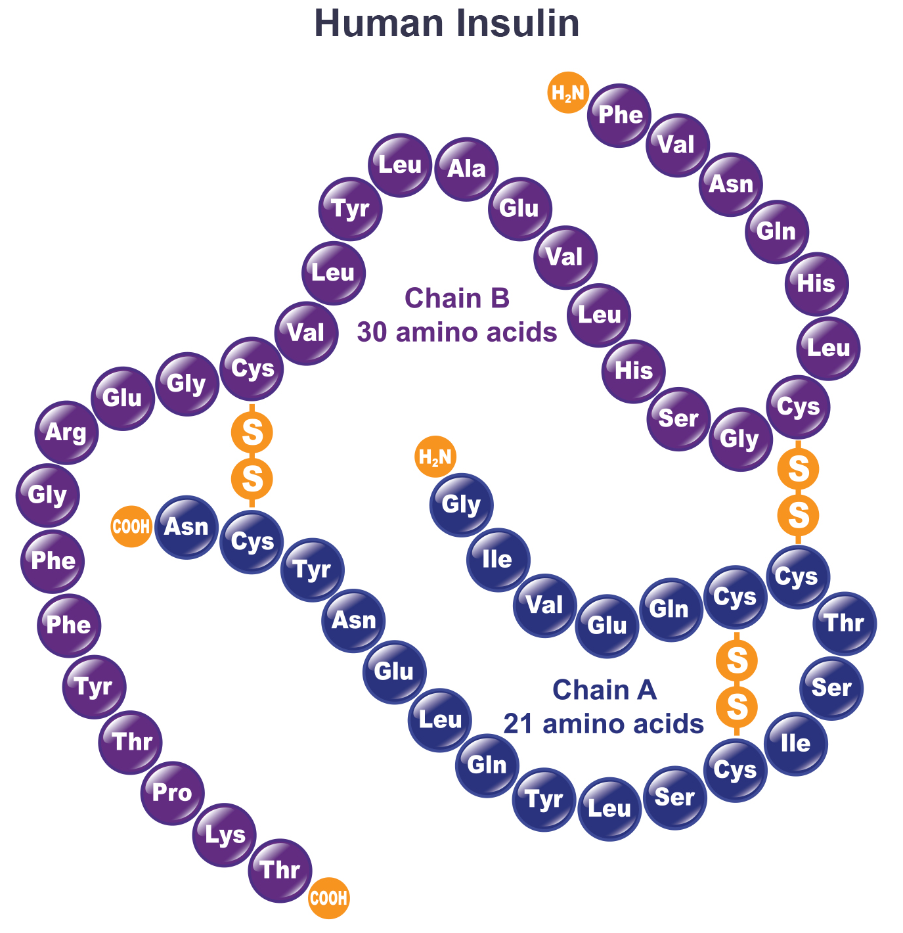
Primary Structure
A protein’s primary structure is its unique sequence of amino acids in the polypeptide chain.
Mutations result in the wrong amino acid being placed within the chain.
3.4 Figure 4

Slide 17
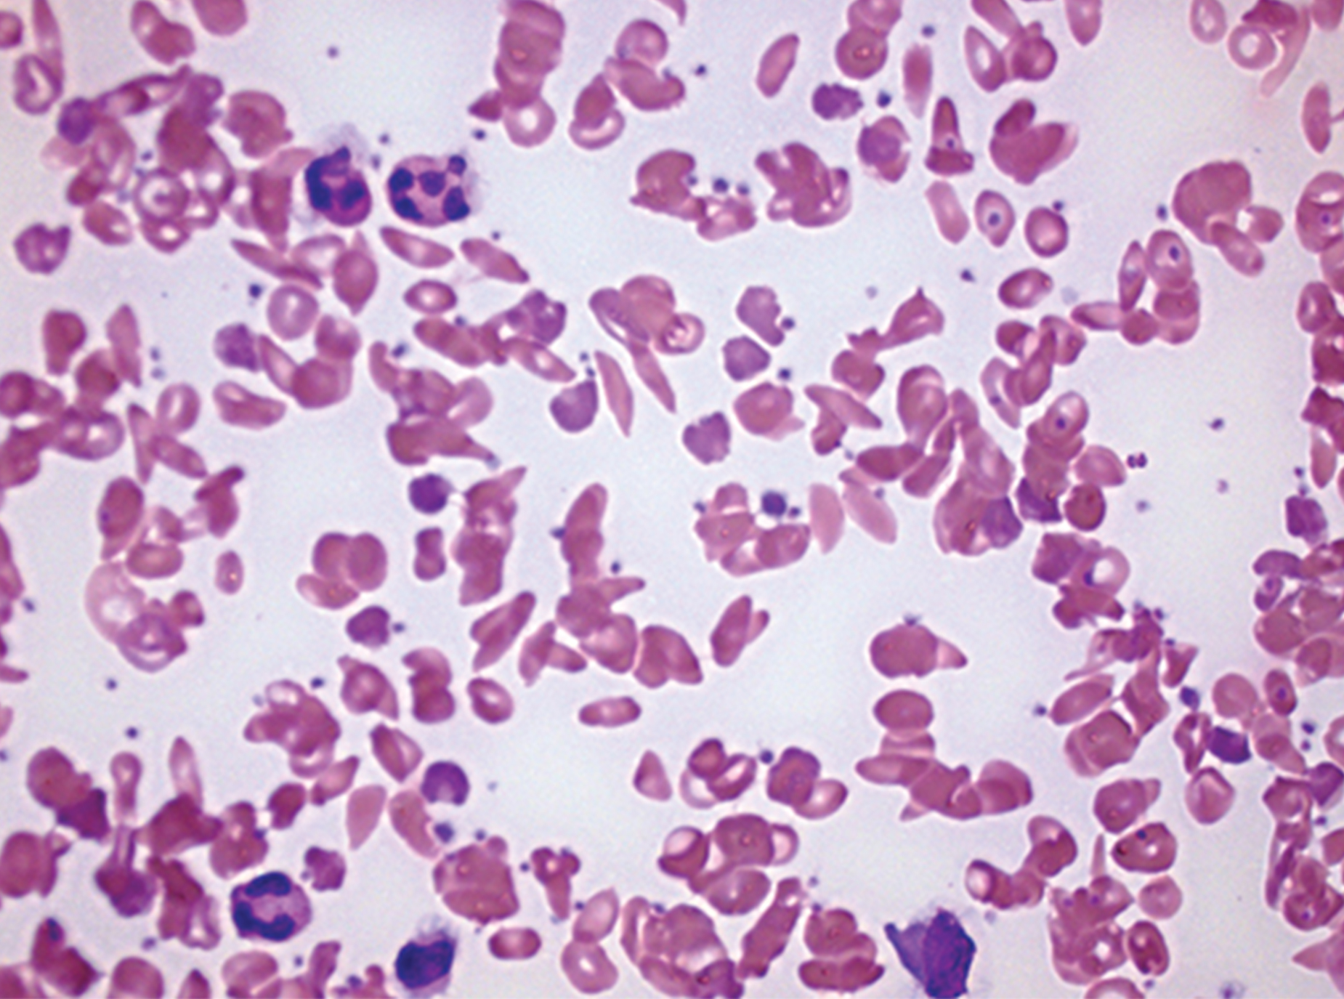
Sickle Cell Anemia
Sickle cell anemia results from a single amino acid substitution in the hemoglobin β chain.
Hemoglobin forms long fibers, distorting red blood cells into sickle shapes that clog vessels, leading to serious health issues.
Complications include breathlessness, dizziness, headaches, abdominal pain.
3.4 Figure 6
Rick Jan Kluitenberg on Wikimedia Commons. "Sickle cell blood cells."

Slide 18
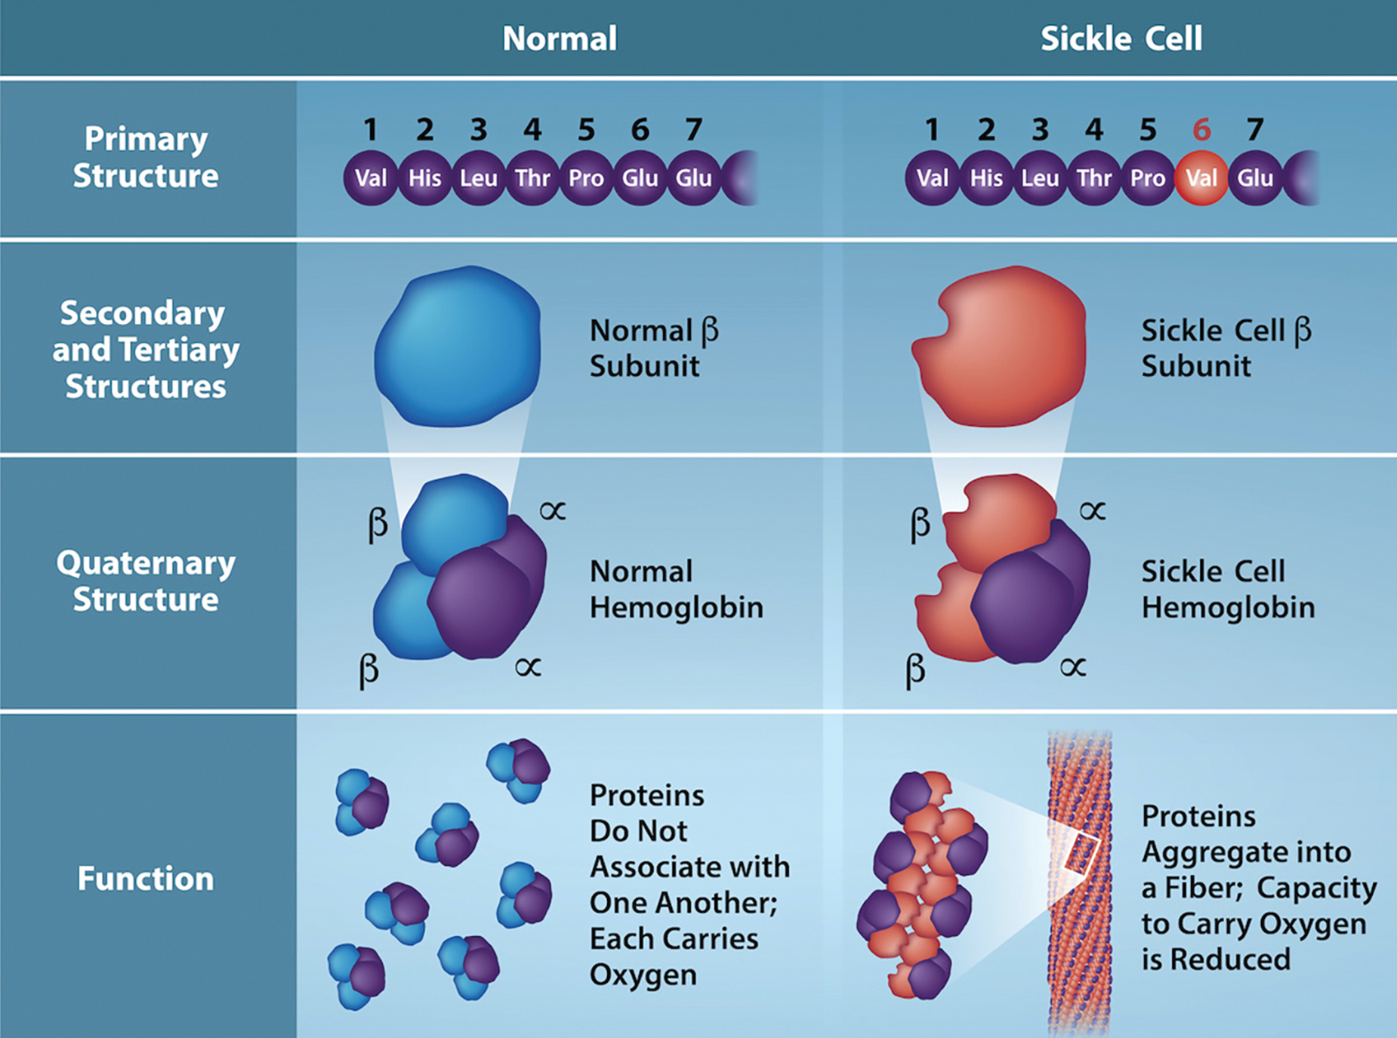
3.4 Figure 5
Rao, A., Tag, A. Ryan, K. and Fletcher, S. Department of Biology, Texas A&M University. "Sickle cell."
Notes:
The beta chain of haemoglobin is 147 residues in length, yet a single amino acid substitution leads to sickle cell anaemia. In normal haemoglobin, the amino acid at position seven is glutamate. In sickle cell haemoglobin, a valine replaces glutamate.

Slide 19
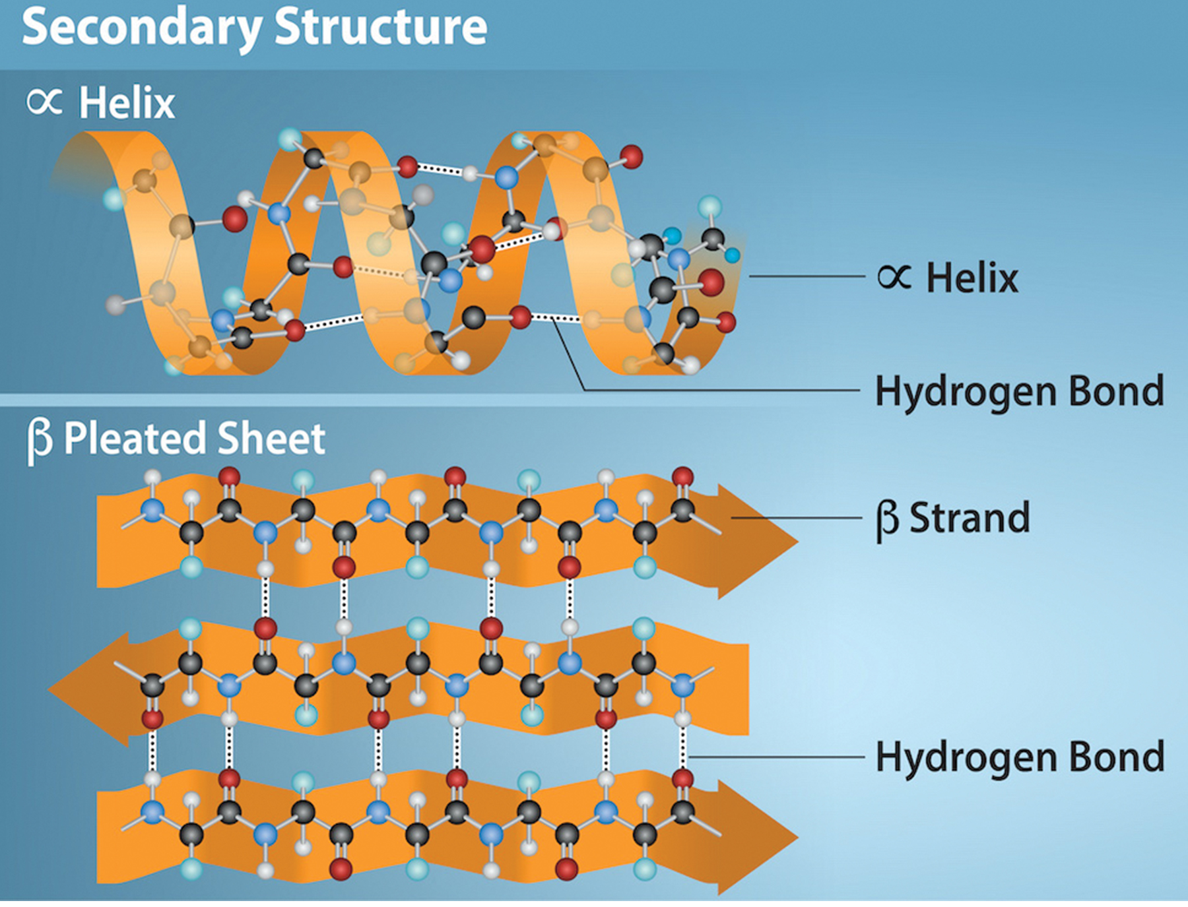
Secondary Structure₁
Local folding of the polypeptide causes the secondary structure of a protein.
Most common structures are α-helices and β-pleated sheets stabilized by amino acid hydrogen bonds.
α-helix: hydrogen bonds between the amino acids twists the polypeptide into helical coil.
3.6 amino acid residues per helical turn
R groups protrude outwards
3.4 Figure 7
Rao, A., Ryan, K. Fletcher, S. and Tag, A. Department of Biology, Texas A&M University. "Secondary protein structures."

Slide 20
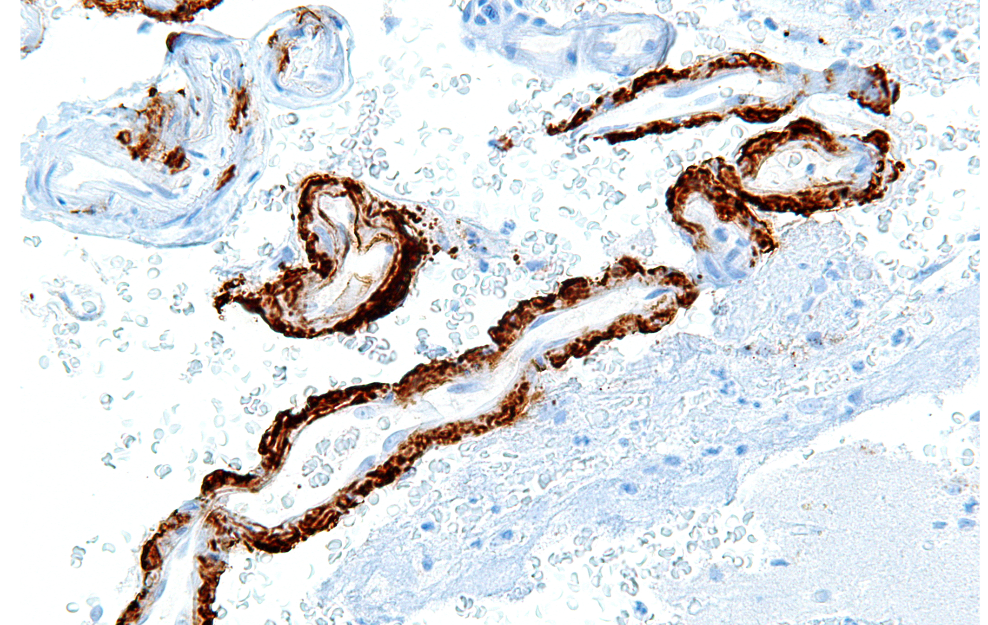
Secondary Structure₂
The β-pleated sheet consists of linear β strands connected laterally.
Strands can be parallel or antiparallel to each other.
Hydrogen bonds between adjacent strands form the pleated folds.
R groups extend above and below the pleated folds.
3.4 Figure 8: Alzheimer's disease is believed to be caused by the deposition of amyloid plaques in specific regions in the brain. Amyloid plaques are made up of β-amyloid segments that are sticky because they are made of short amino acid chains that arrange themselves in a secondary structure of β sheets.
Nephron on Wikimedia Commons. "Alzheimer's disease in brain."

Slide 21
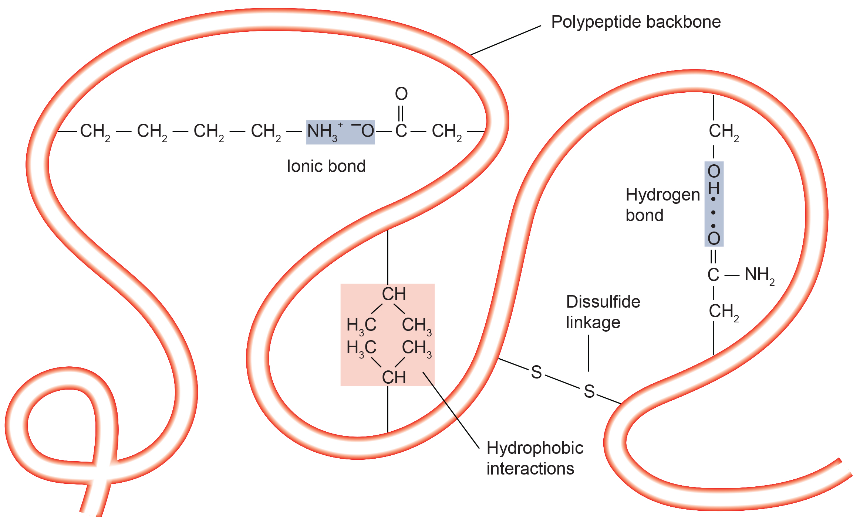
Tertiary Structure
The tertiary structure is a protein's unique 3D shape caused primarily by R group interactions.
Hydrogen bonds, ionic bonds, hydrophobic interactions, and disulfide bridges contort the polypeptide chain.
Hydrophobic R groups interact on the inside of the protein with the hydrophilic R groups on the outside.
Loss of tertiary structure can make a protein nonfunctional.
3.4 Figure 9
OpenStax. "Tertiary structure." Modified.

Slide 22
Quaternary Structure
Proteins with multiple polypeptide subunits have a quaternary structure made up of the interactions between the subunits.
Weak interactions stabilize overall structure.
Insulin's two subunits are held together by hydrogen and disulfide bonds.
Silk forms β-pleated sheets from the hydrogen bonding between chains.

Slide 23
Think It Through₂
If you were able to eliminate hydrogen bonding entirely, which levels of protein structure (primary, secondary, tertiary, quaternary) would be affected?
Notes:
Originally an On Your Own. This is included here to use as a talking point or for a think-pair-share activity.

Slide 24
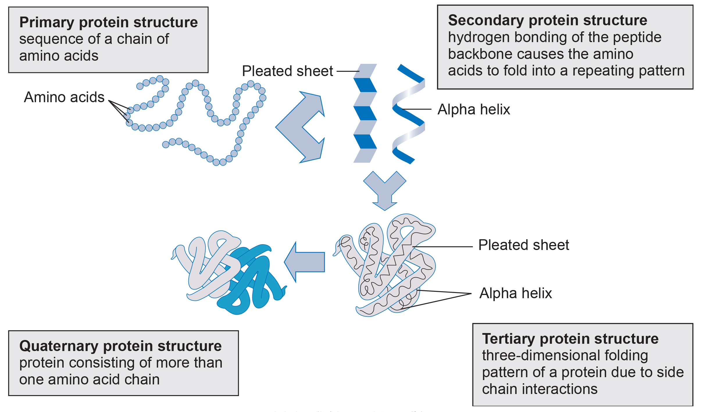
3.4 Figure 10
CNX OpenStax on Wikimedia Commons. "Protein structure." Modified.
Notes:
Proteins have primary, secondary, tertiary, and quaternary structures.

Slide 25
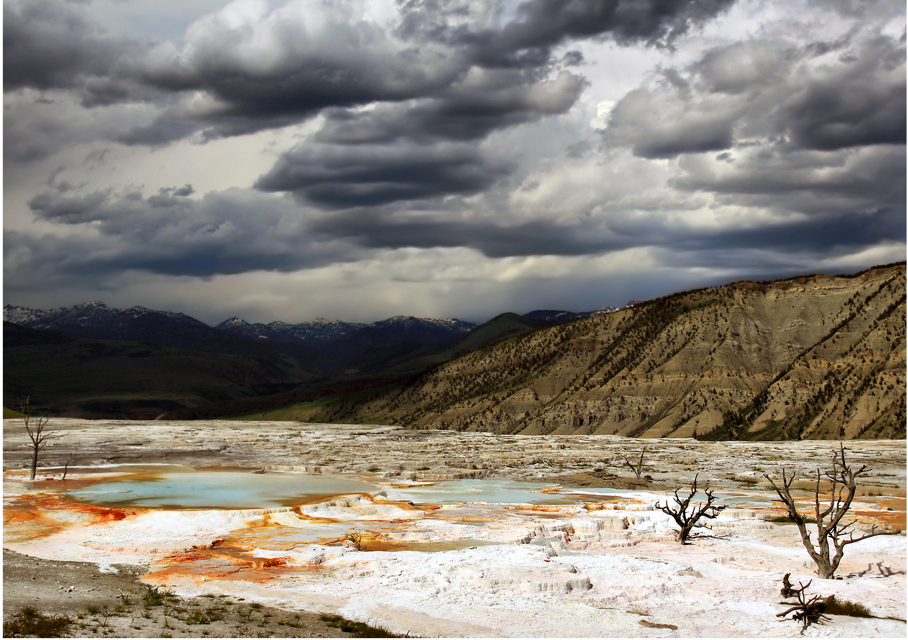
Denaturation and Protein Folding
Environmental changes (temperature, pH, and chemical exposure) can denature proteins.
Denaturation disrupts shape, conserves primary sequence.
Can sometimes be reversed if the agent removed, other times it is irreversible
Chaperone proteins assist protein folding.
Protect and surround the unfolded protein so that all parts are close enough for interactions to occur
HSP70 protects proteins during stress
3.4 Figure 11
Brocken Inaglory on Wikimedia Commons. "Hot springs."

Slide 26
Summary
Proteins are amino acid macromolecules with diverse cellular functions.
Protein structure is organized at four levels: primary, secondary, tertiary, and quaternary (optional).
Amino acid sequence forms its primary structure folding into 3D shape.
The locally folding that forms α-helices and β-pleated sheets constitutes the secondary structure.
The overall three-dimensional structure is the tertiary structure
Multiple polypeptide subunits combine into protein's quaternary structure.
Protein denaturation from conditions like temperature or pH changes alter protein shape, causing loss of function.

Slide 27


End of Hawkes Learning PowerPoint

