Slide 1
Lesson 3.5
Nucleic Acids: DNA and RNA

Slide 2
Objectives
Describe nucleic acids' structure and define the two types of nucleic acids.
Explain DNA's structure and role.
Explain RNA's structure and roles.

Slide 3
Nucleic Acids
Nucleic acids (DNA and RNA) carry genetic instructions for the cell’s functioning.
DNA and RNA are polynucleotides (chain of nucleotide monomers).
Each nucleotide contains a nitrogenous base, pentose sugar, and phosphate group.

Slide 4
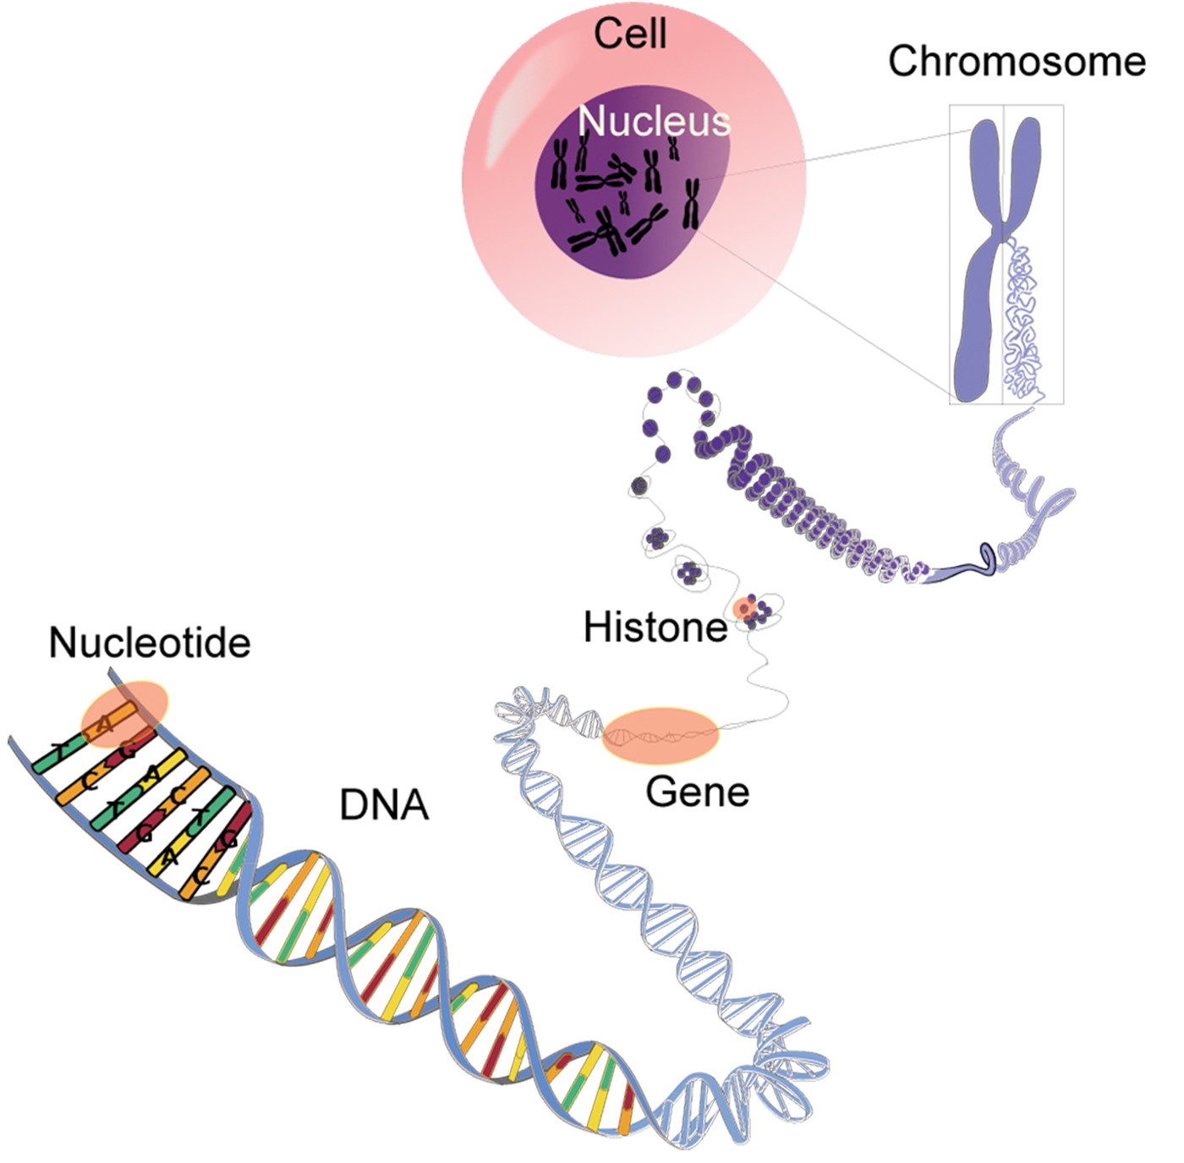
Deoxyribonucleic Acid (DNA)
Deoxyribonucleic acid (DNA) is the genetic material in both eukaryotes (housed in organelles) and prokaryotes (in the cytoplasm).
A cell's entire set of genes is its genome.
DNA regulates cellular activities by controlling gene expression for proteins and RNAs.
3.5 Figure 1
WaSu-Bio on Wikimedia Commons. "DNA packing."

Slide 5
Ribonucleic Acid (RNA)
Ribonucleic acid (RNA) is involved in protein synthesis, using messenger RNA (mRNA) transcribed from DNA.
Other RNA types (rRNA, tRNA, miRNA) regulate protein synthesis.

Slide 6
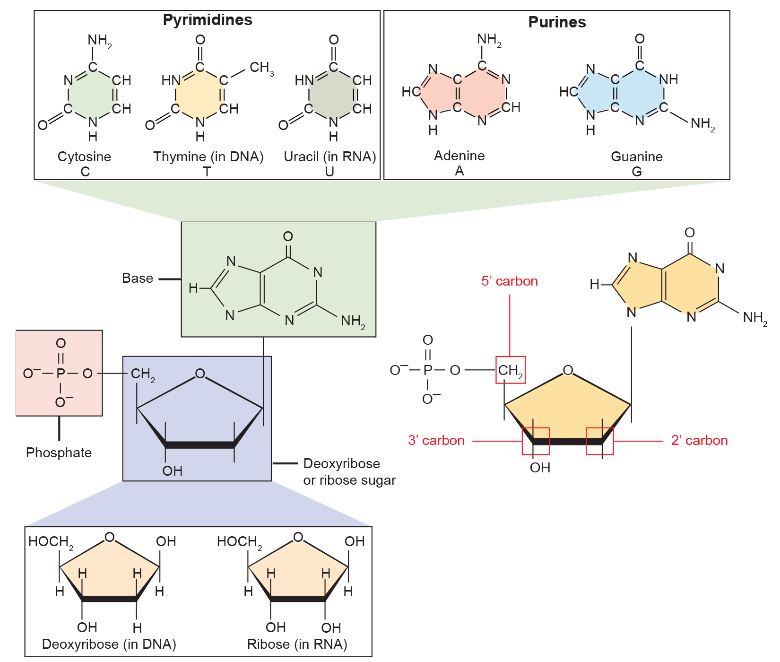
3.5 Figure 2
OpenStax. "Nucleotides." Modified.
Notes:
Three components comprise a nucleotide: a nitrogenous base, a pentose sugar, and one or more phosphate groups. Carbon (C) residues in the pentose are numbered 1′ through 5′. The prime distinguishes these residues from those in the base, which are numbered without using a prime notation. The base is attached to the ribose's 1′ position, and the phosphate is attached to the 5′ position. When a polynucleotide forms, the incoming nucleotide's 5′ phosphate attaches to the 3′ hydroxyl group at the end of the growing chain. Two types of pentose are in nucleotides: deoxyribose (found in DNA) and ribose (found in RNA). Deoxyribose is similar in structure to ribose, but it has an H instead of an OH at the 2′ position. We can divide bases into two categories, purines and pyrimidines, where purines have a double ring structure, and pyrimidines have a single ring.

Slide 7
DNA and RNA₁
DNA nucleotide bases are adenine, guanine, cytosine, and thymine (replaced by uracil in RNA).
Adenine and guanine are purines (two rings) and cytosine, thymine, and uracil are pyrimidines (one ring).
DNA contains deoxyribose sugar while RNA contains a ribose sugar.

Slide 8
DNA and RNA₂
Nucleotides link via a 3’, 5’ phosphodiester linkage, or bond, between sugar and phosphate.
Phosphodiester bonds form the sugar-phosphate backbones of DNA and RNA.

Slide 9
Think It Through₁
Would you naturally find a nucleotide that contains ribose as its sugar and thymine as its nitrogenous base?

Slide 10
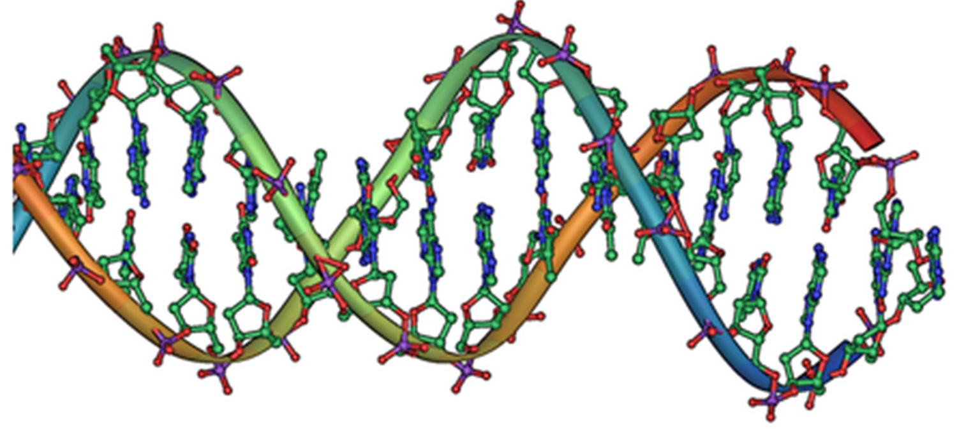
DNA Double-Helix Structure₁
DNA is a double-helix with a sugar-phosphate backbone (exterior) and paired bases (interior).
Strands are antiparallel, running in opposite 5' to 3' directions.
Adenine (A) pairs with thymine (T), and guanine (G) pairs with cytosine (C) through complementary base pairing.
Replication creates new complementary strands from the parental templates.
3.5 Figure 3
Jerome Walker on Wikimedia Commons. "DNA structure."

Slide 11
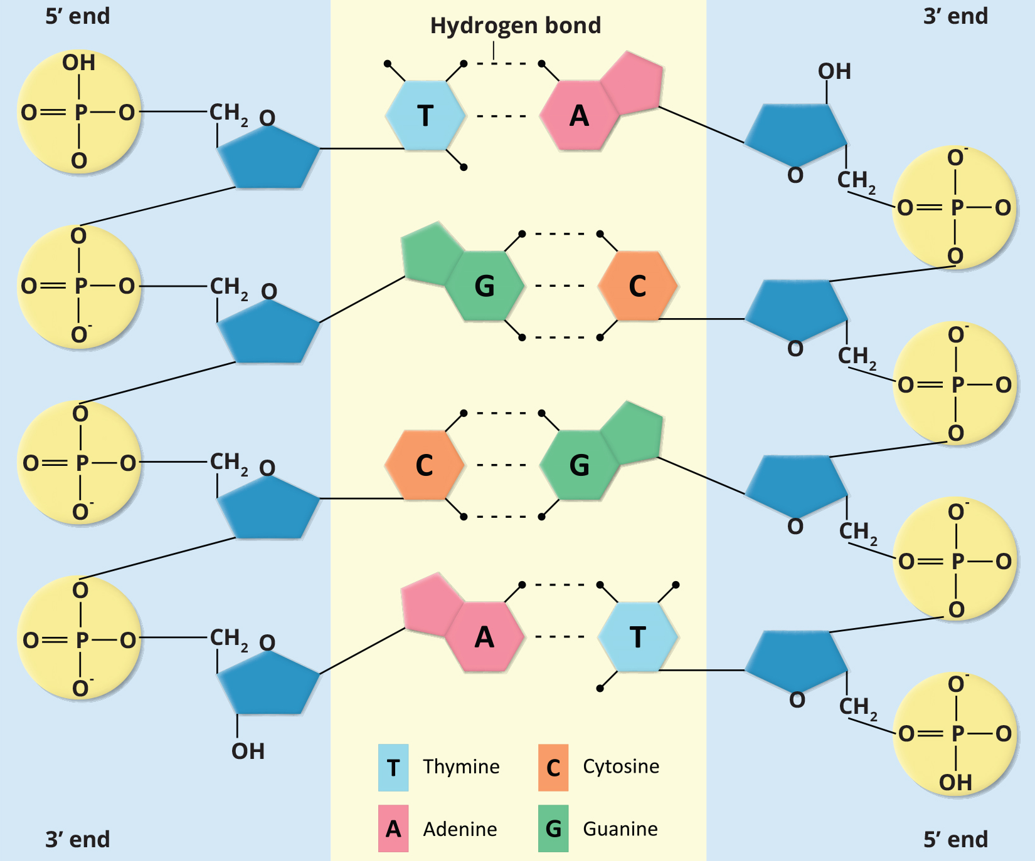
Think It Through₂
A mutation occurs, and adenine replaces cytosine. What impact do you think this will have on the DNA structure?
3.5 Figure 4

Slide 12
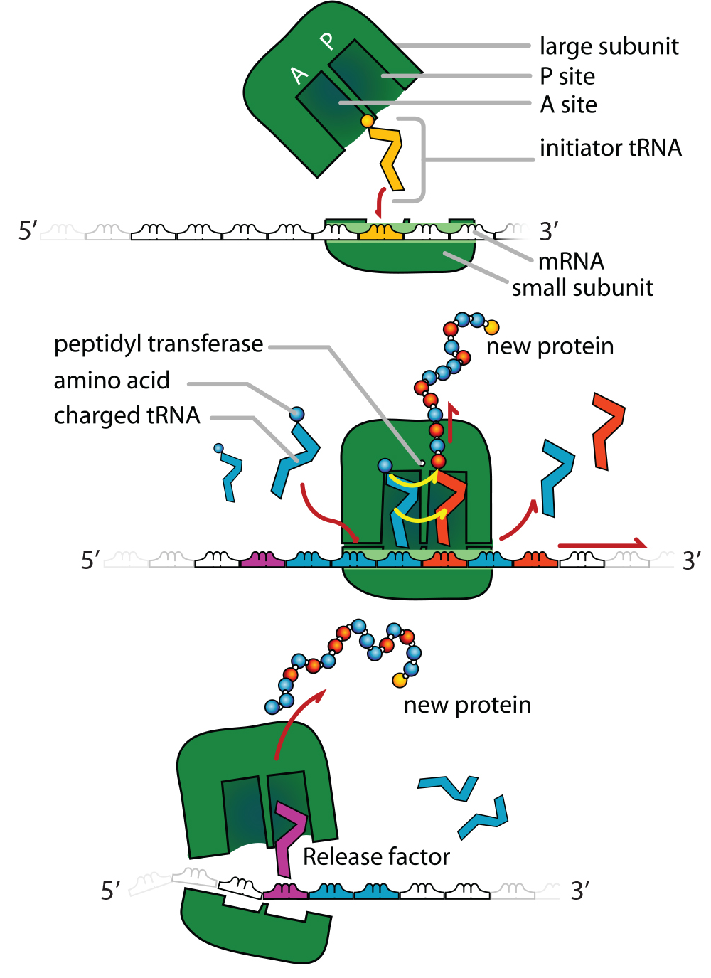
Ribonucleic Acid (RNA)₁
3.5 Figure 5
RNA is a single-stranded polynucleotide made of ribonucleotides.
Bases: adenine, guanine, cytosine, and uracil (replaces thymine)
mRNA is transcribed as a complementary copy of DNA
ATG (DNA) → TAC (RNA)
mRNA carries DNA's instructions to ribosomes for protein synthesis.
Ribosomes translate mRNA into proteins.
Mariana Ruiz Villarreal on Wikimedia Commons. "Ribosome subunits."

Slide 13
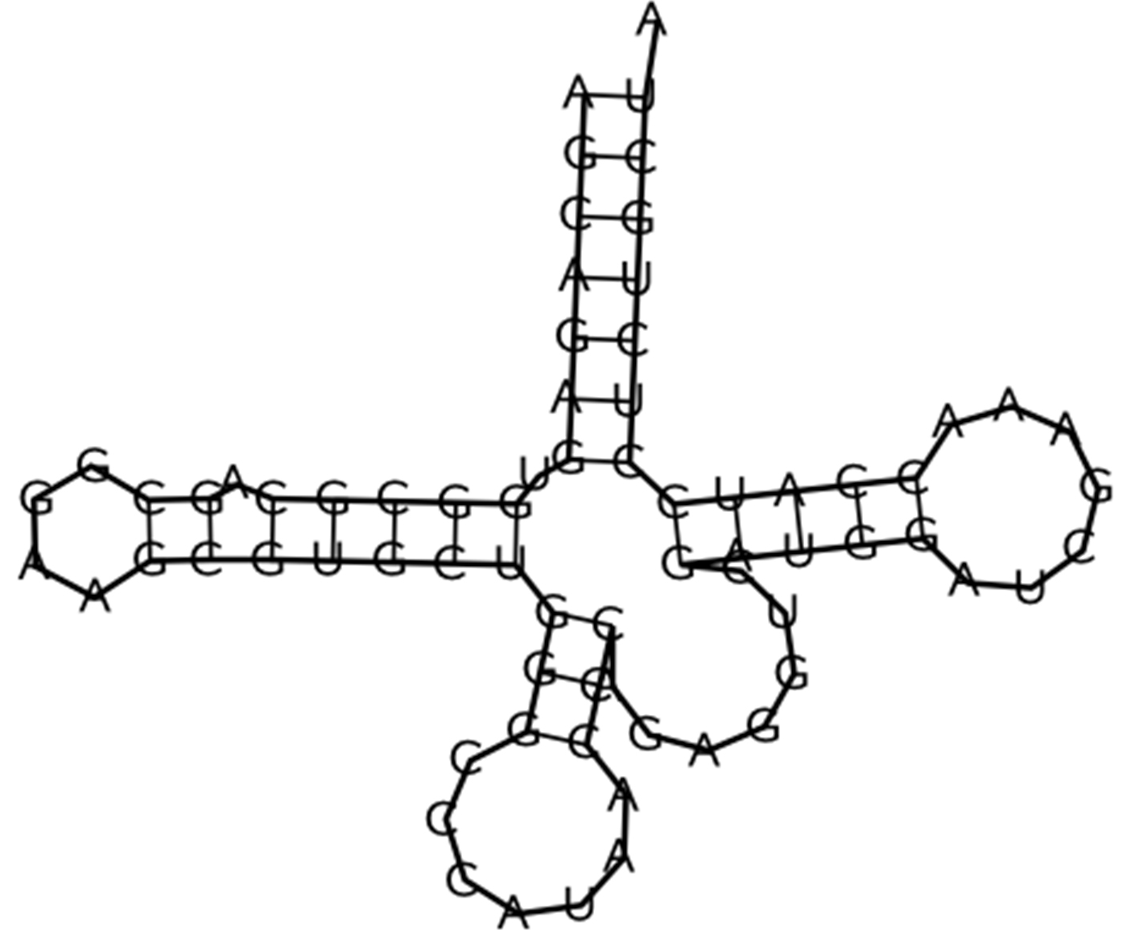
Ribonucleic Acid (RNA)₂
Codons (triplet bases) in mRNA code for specific amino acids for protein synthesis.
rRNA is a major ribosomal component that aligns mRNA and catalyzes peptide bond formation (peptidyl transferase).
tRNAs carry amino acids to ribosomes.
Anticodons are complementary to mRNA codons.
MicroRNA regulates gene expression by binding and blocking certain mRNAs from translation.
3.5 Figure 6: RNA is capable of secondary structures like this tRNA.
http://rna.tbi.univie.ac.at/cgi-bin/RNAfold.cgi on Wikimedia Commons. "RNA secondary structures."

Slide 14
Table 1: Comparison Between RNA and DNA
 | DNA | RNA
Function | carries genetic information | involved in protein synthesis
Location | remains in the nucleus | leaves the nucleus
Structure | double helix | usually, single stranded
Sugar | deoxyribose | ribose
Pyrimidines | cytosine, thymine | cytosine, uracil
Purines | adenine, guanine | adenine, guanine

Slide 15
Summary
Nucleic acids (DNA and RNA) are polymers of nucleotides (sugar, nitrogenous base, and phosphate group).
DNA is double-stranded with a helical structure, carrying a cell’s genetic blueprint.
RNA is single-stranded and involved in protein synthesis and regulation.
mRNA carries genetic instructions for protein synthesis.
rRNA, tRNA, and miRNA play roles in the protein synthesis and regulation.

Slide 16


End of Hawkes Learning PowerPoint

