Slide 1
Lesson 30.1
The Plant Body

Slide 2
Objectives
Compare simple plant tissue with complex plant tissue.
Describe the shoot organ system and the root organ system.
Distinguish between meristematic tissue and permanent tissue.
Identify and describe the three regions where plant growth occurs.
Summarize the roles of dermal tissue, vascular tissue, and ground tissue.

Slide 3
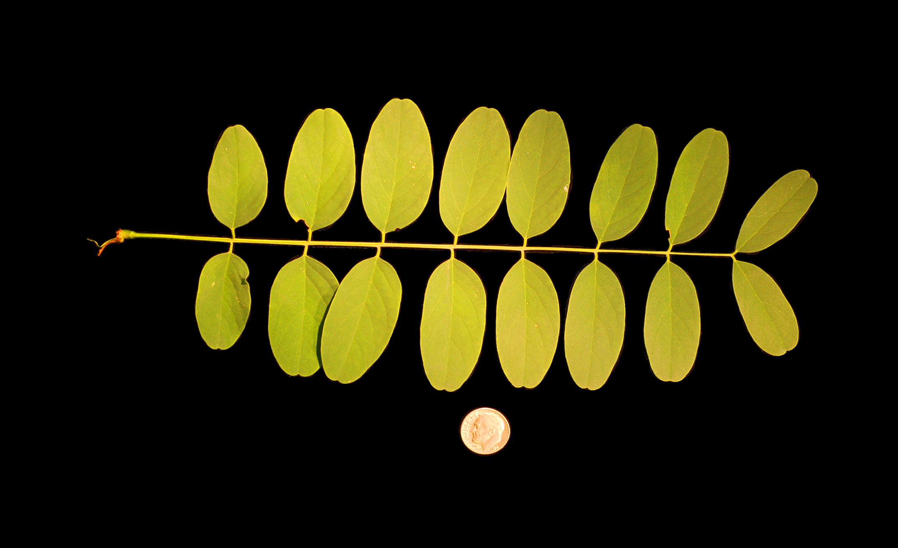
Plant Physiology
Plants are essential for human existence, providing oxygen, food, shelter, medicines, and industrial products.
Vascular plants, which have tissues for conducting food and water, are divided into gymnosperms (e.g., conifers) and angiosperms (flowering plants).
All plants share a common structure consisting of stems, roots, and leaves, and they transport water, minerals, and sugars throughout their bodies.
Plants universally respond to environmental factors like light, gravity, competition, temperature, and predation.
30.1 Figure 1: A locust leaf consists of leaflets arrayed along a central midrib.
Ninjatacoshell on Wikimedia Commons. "Black locust leaf."

Slide 4
The Plant Body
Plant cells contain characteristics that animal cells do not.
Photosynthesize
Contain cell walls, plastids, and a central vacuole

Slide 5
Plant Organ Systems
Vascular plants have two distinct organ systems:
The shoot system consists of two portions: the vegetative parts of the plant (leaves and the stems) and the reproductive parts of the plant (flowers and fruits).
The root system, which supports the plant and absorbs water and minerals, is usually underground.

Slide 6
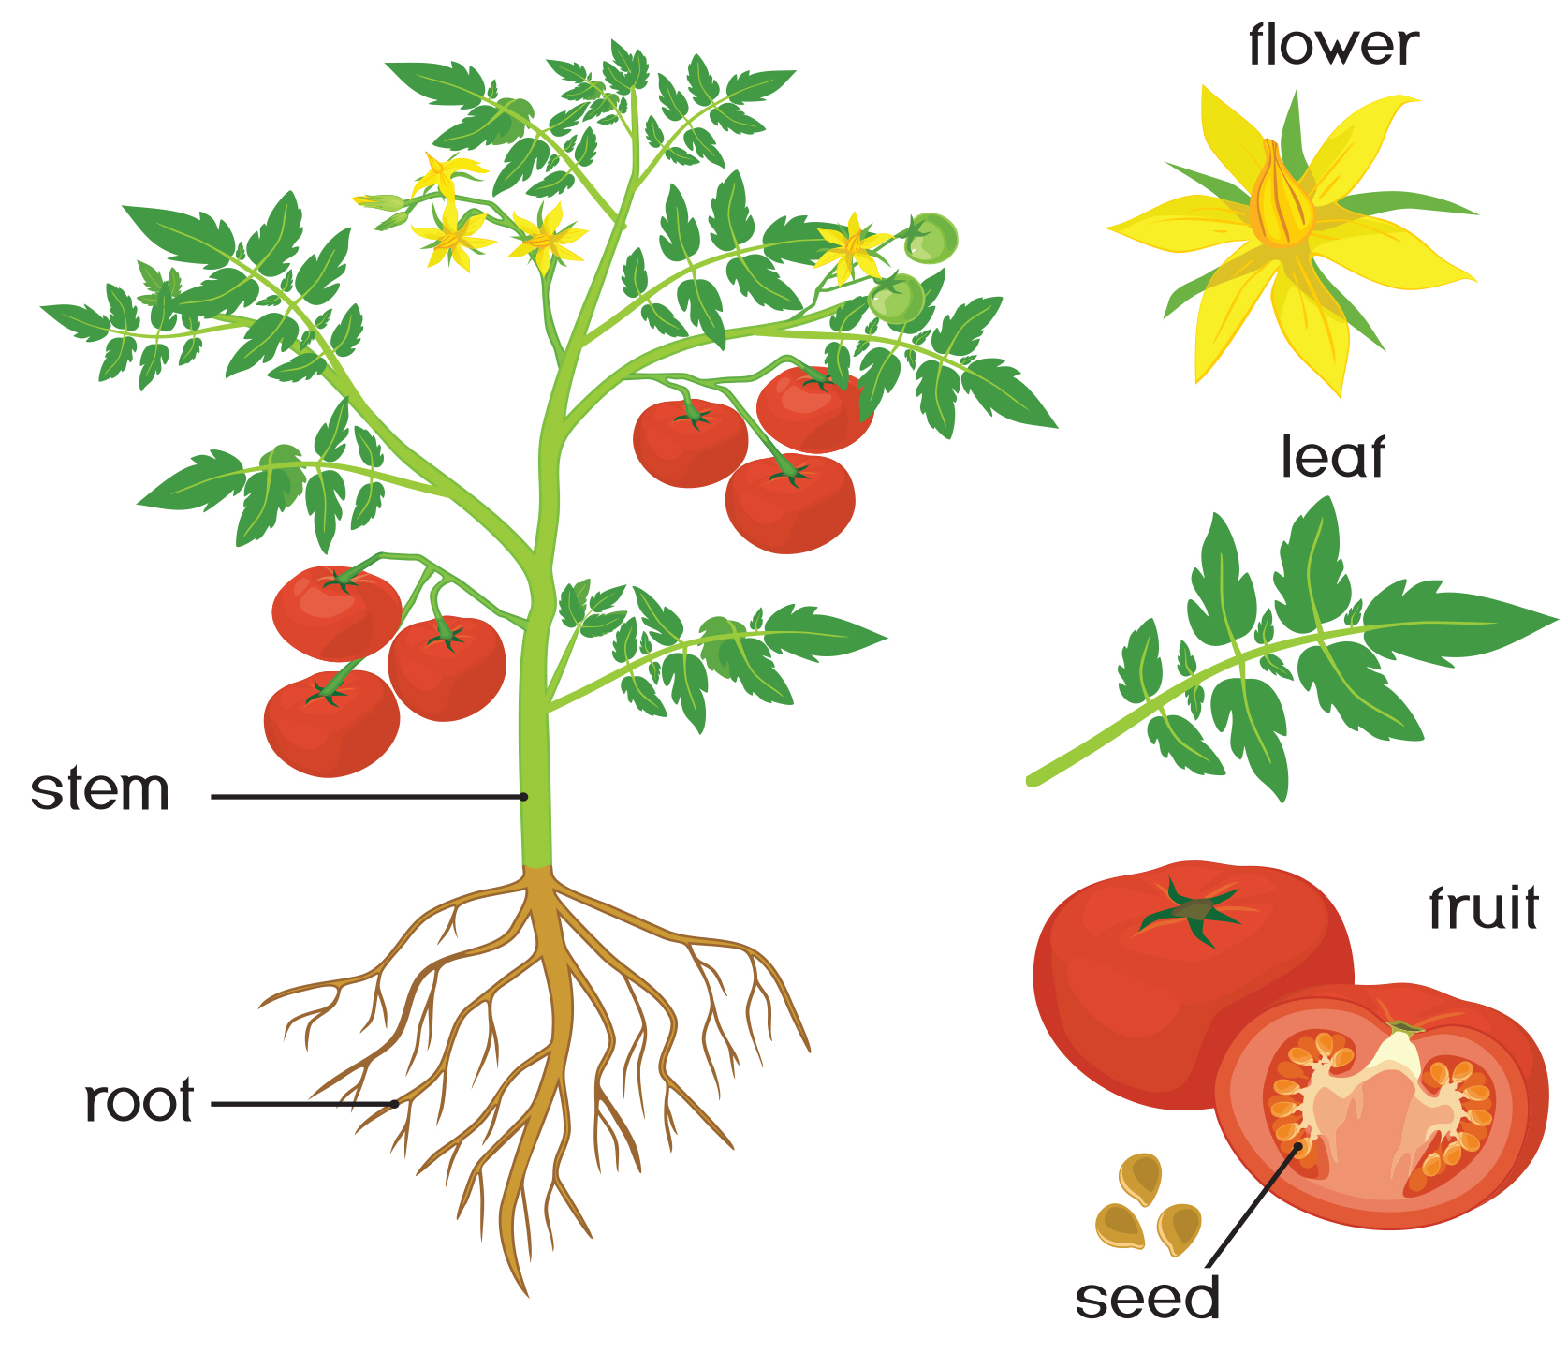
30.1 Figure 2
Notes:
Figure 2: The shoot system of a plant consists of leaves, stems, flowers, and fruits. The root system anchors the plant while absorbing water and minerals from the soil.

Slide 7
Think It Through₁
Which part of the plant is responsible for reproduction?
Root
Flower
Stem
Shoot System
Notes:
Originally an On Your Own. This is included here to use as a talking point or for a think-pair-share activity.

Slide 8
Plant Tissues₁
Plant tissue systems fall into two general types:
Meristematic tissue contains cells that constantly divide and contribute to plant growth.
These cells are undifferentiated and are found in meristems.
Permanent tissue consists of plant cells that are no longer actively dividing.

Slide 9
Think It Through₂
Describe the main difference between meristem and permanent tissues in plants.
Notes:
Originally an On Your Own. This is included here to use as a talking point or for a think-pair-share activity.

Slide 10
Meristematic Tissues
Meristematic tissues consist of three types:
Apical meristems are located at the tips of stems and roots enabling a plant to extend in length.
Lateral meristems facilitate growth in thickness or girth in a maturing plant.
Intercalary meristems occur only in monocots at the base of leaf blades and at nodes.

Slide 11
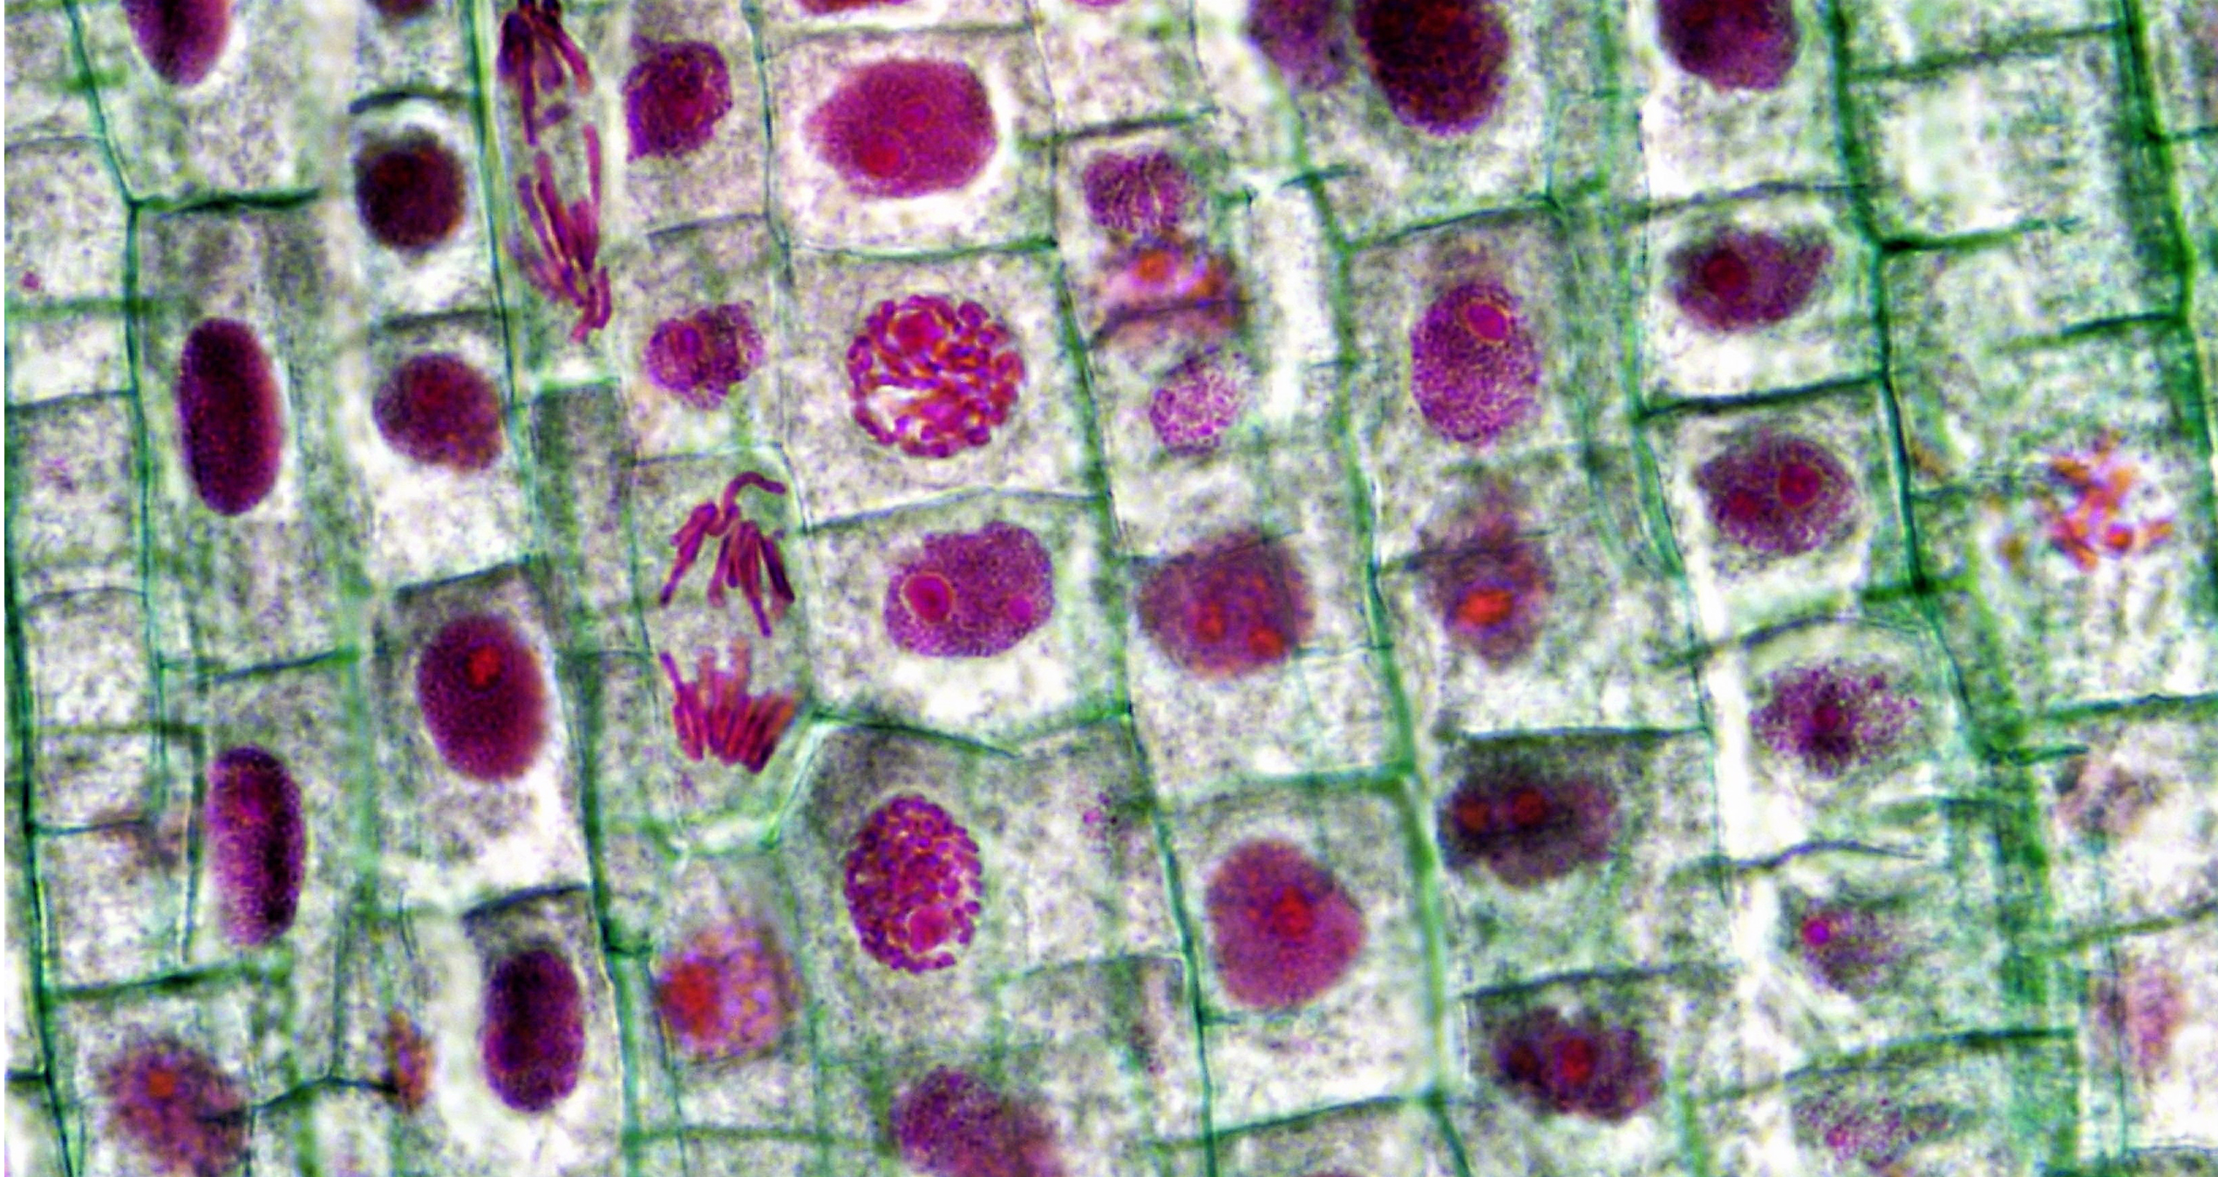
Plant Tissues₂
Meristems produce cells that quickly differentiate into three main types:
Dermal tissue covers and protects the plant.
Vascular tissue transports water, minerals, and sugars to different parts of the plant.
Ground tissue serves as a site for photosynthesis, provides a supporting matrix for the vascular tissue, and helps to store water and sugars.
30.1 Figure 3: Stages of mitosis observed in the meristem tissue of a growing root tip
Berkshire Community College Bioscience Image Library on Wikimedia Commons. "Onion root tip."

Slide 12
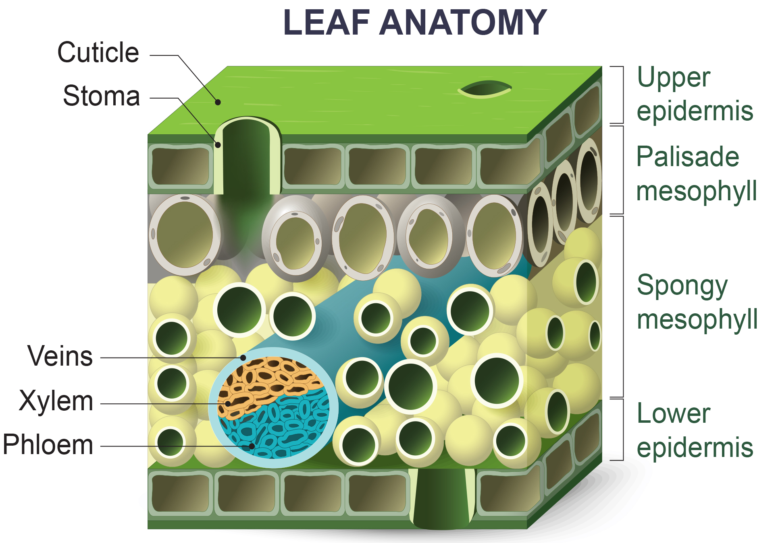
30.1 Figure 4

Slide 13
Plant Tissues₃
Plant tissues are classified as simple (composed of similar cell types) or complex (composed of different cell types).
Vascular tissue is a complex tissue consisting of:
Xylem tissue transports water and nutrients from the roots to different parts of the plant and includes three different cell types: vessel elements, tracheids, and xylem parenchyma.
Phloem transports organic compounds and consists of sieve cells, companion cells, phloem parenchyma, and phloem fibers.
Xylem and phloem always lie adjacent to each other, forming vascular bundles in stems and vascular steles or cylinders in roots.

Slide 14
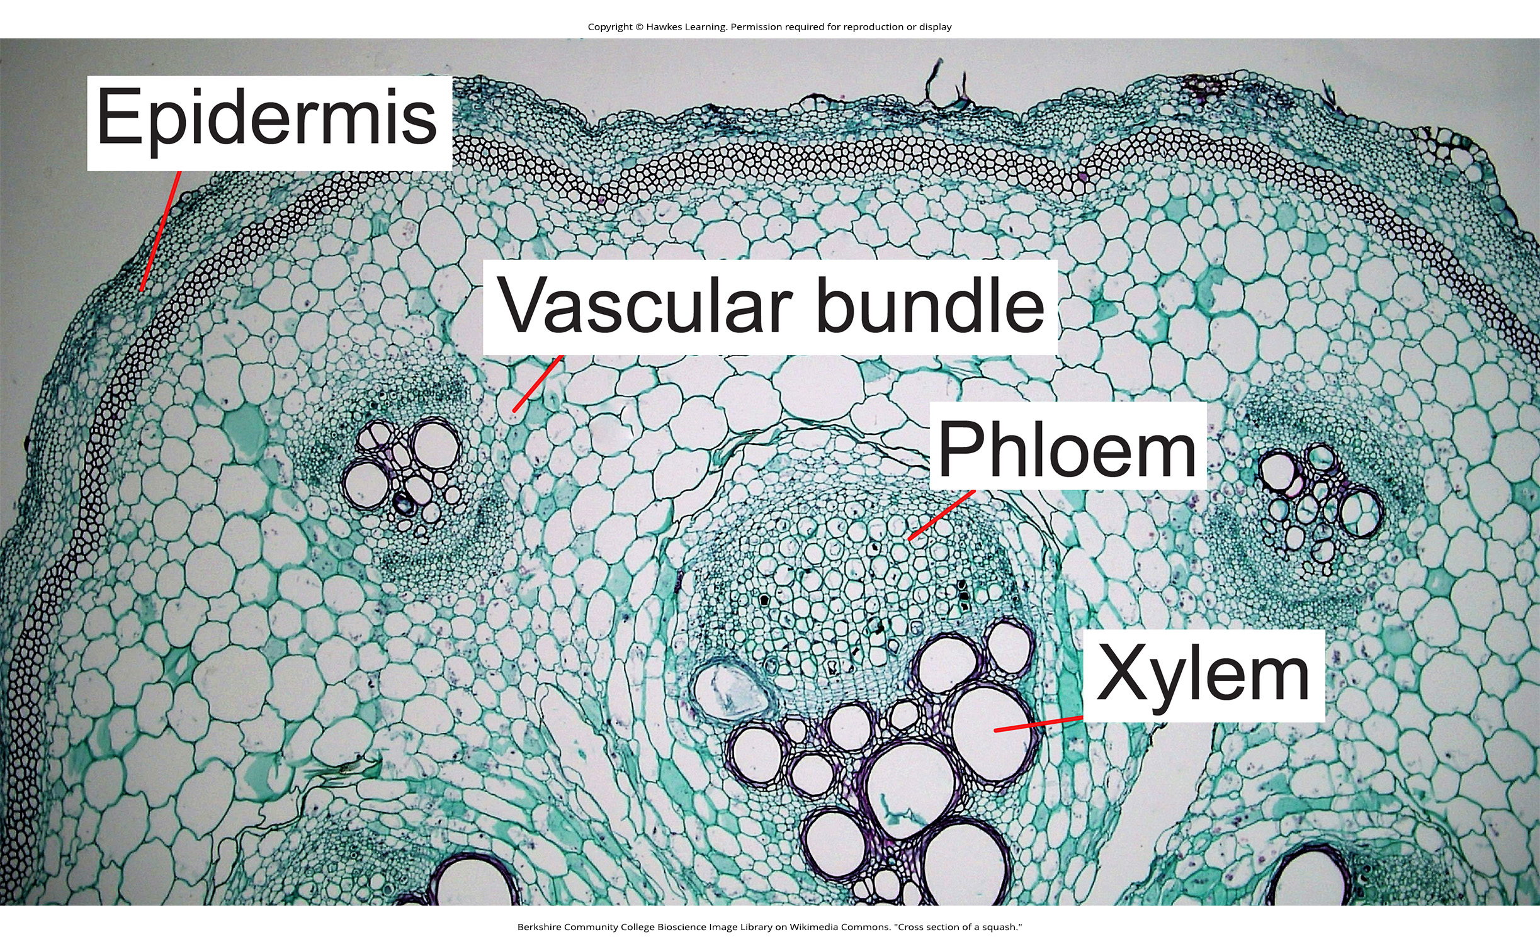
30.1 Figure 5
Berkshire Community College Bioscience Image Library on Wikimedia Commons. "Cross section of a squash."

Slide 15
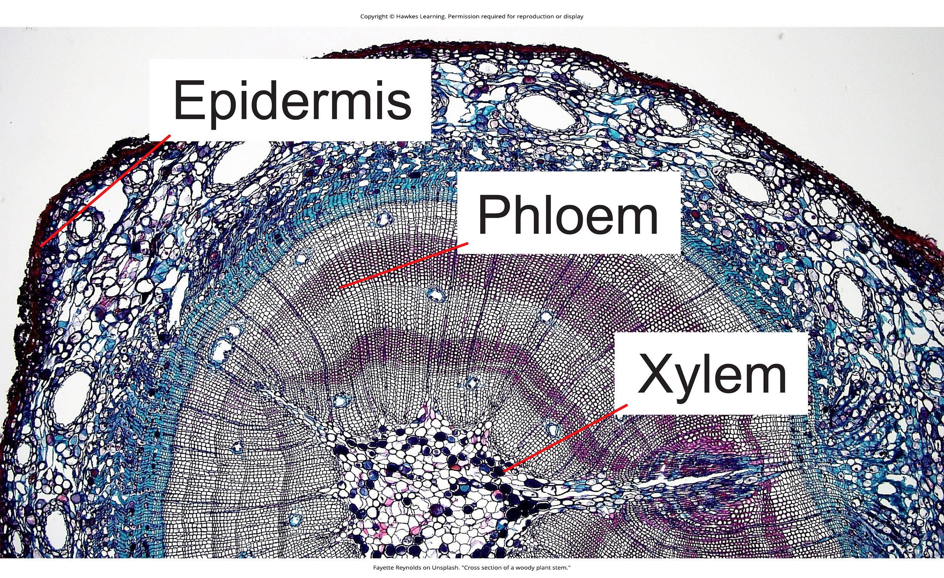
30.1 Figure 6
Fayette Reynolds on Unsplash. "Cross section of a woody plant stem."

Slide 16
Summary
A vascular plant consists of two organ systems: the shoot system and the root system.
The shoot system includes the aboveground vegetative portions (stems and leaves) and reproductive parts (flowers and fruits).
The root system supports the plant and is usually underground.
A plant is composed of two main types of tissue: meristematic tissue and permanent tissue.
Meristematic tissue consists of actively dividing cells found in root and shoot tips.
As growth occurs, meristematic tissue differentiates into permanent tissue, which is categorized as either simple or complex.
Simple tissues are made up of similar cell types; examples include dermal tissue and ground tissue.
Dermal tissue provides the outer covering of the plant.
Ground tissue is responsible for photosynthesis; it also supports vascular tissue and may store water and sugars.
Complex tissues are made up of different cell types. Vascular tissue, for example, is made up of xylem and phloem cells.

Slide 17

End of Hawkes Learning PowerPoint

