Slide 1
Lesson 30.2
Stems

Slide 2
Objectives
Compare and contrast the roles of dermal tissue, vascular tissue, and ground tissue.
Describe the main function and basic structure of stems.
Distinguish between primary growth and secondary growth in stems.
List and describe examples of modified stems.
Summarize the origin of annual rings.

Slide 3
Stems
Part of the plant's shoot system
Range from millimeters to hundreds of meters in length
Vary in diameter, depending on plant type
Can be aboveground or underground (e.g., potato)
May be herbaceous (soft) or woody
Main functions: provide support; hold leaves, flowers, and buds; store food
Can be unbranched (palm tree) or highly branched (magnolia tree)
Connect roots to leaves, aiding in water and nutrient transport

Slide 4
Nodes and Internodes
Plant stems are characterized by the presence of nodes and internodes.
Nodes: points of attachment for leaves, aerial roots, and flowers
Internodes: stem regions between two nodes
Petiole: stalk extending from stem to leaf base
Axillary bud: found in the axil (area between leaf base and stem) and can give rise to branches or flowers
Apex: tip of shoot; contains the apical meristem within the apical bud

Slide 5
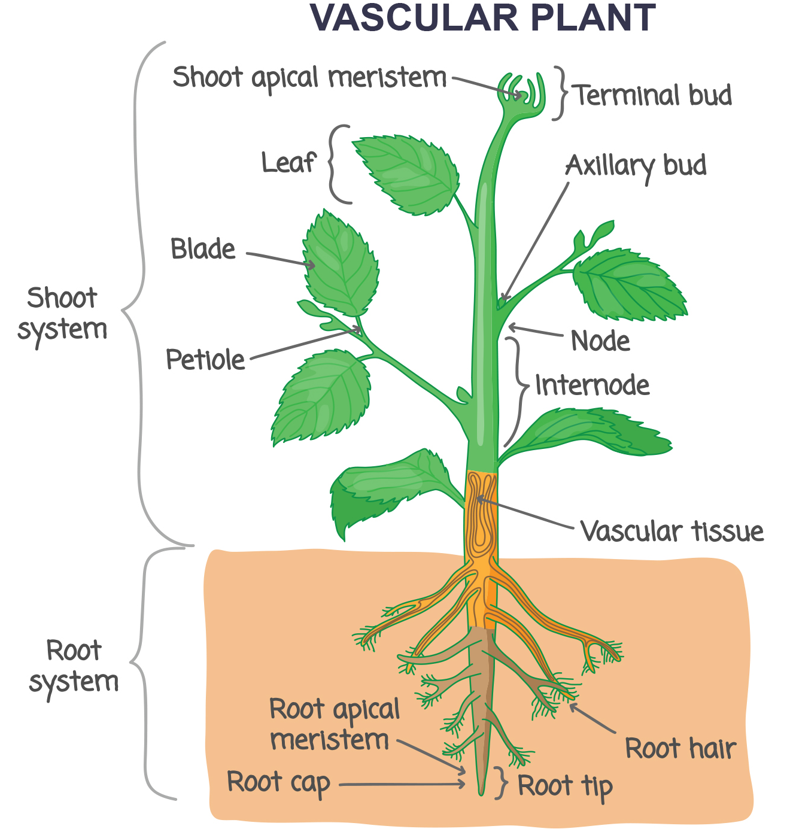
30.2 Figure 1
Notes:
Leaves are attached to the plant stem at areas called nodes. An internode is the stem region between two nodes. The petiole is the stalk connecting the leaf to the stem. The leaves just above the nodes arose from axillary buds.

Slide 6
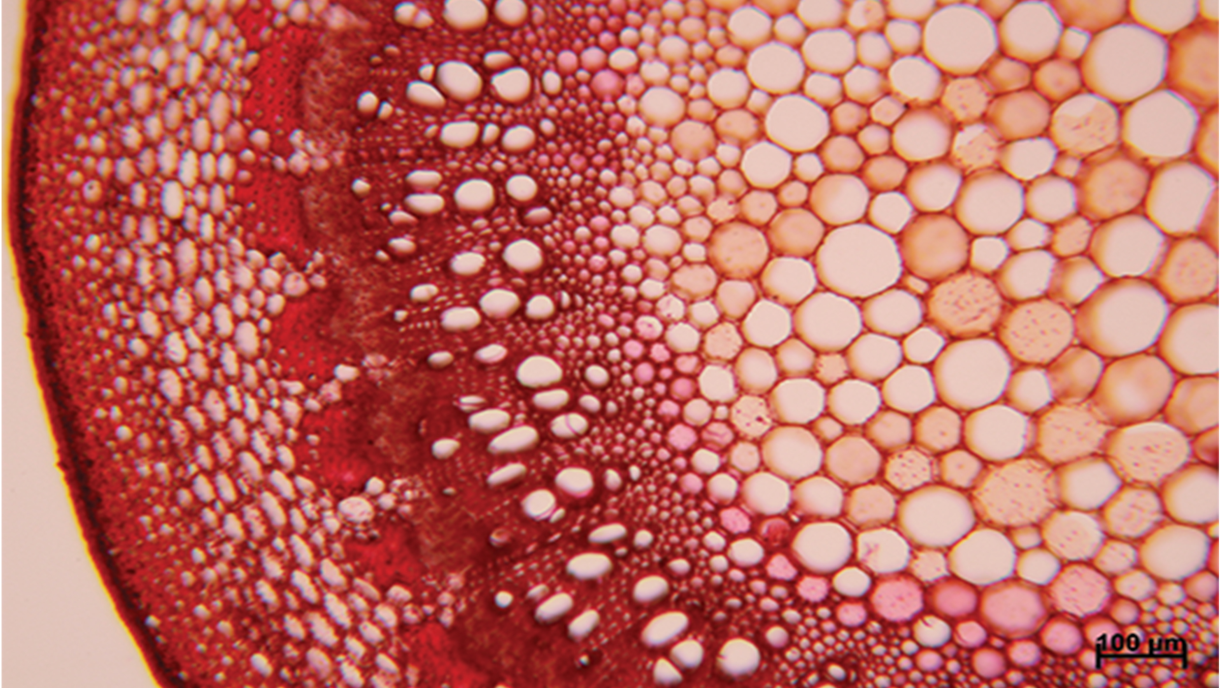
Parenchyma Cells
The stem and other plant organs rise from ground tissue and are made up of simple tissues from three types of cells: parenchyma, collenchyma, and sclerenchyma.
Parenchyma cells: most common plant cells
Found in stem, root, leaf interior, and fruit pulp
Form central pith and outer cortex in stems
Responsible for metabolic functions and wound repair
Store starch
30.2 Figure 2: The central pith (orange in the center) and peripheral cortex (narrow zone 3–5 cells thick just inside the epidermis) are composed of parenchyma cells. Vascular tissue composed of xylem (with some larger openings halfway through the image) and phloem tissue (between the xylem and cortex) surrounds the pith.

Slide 7
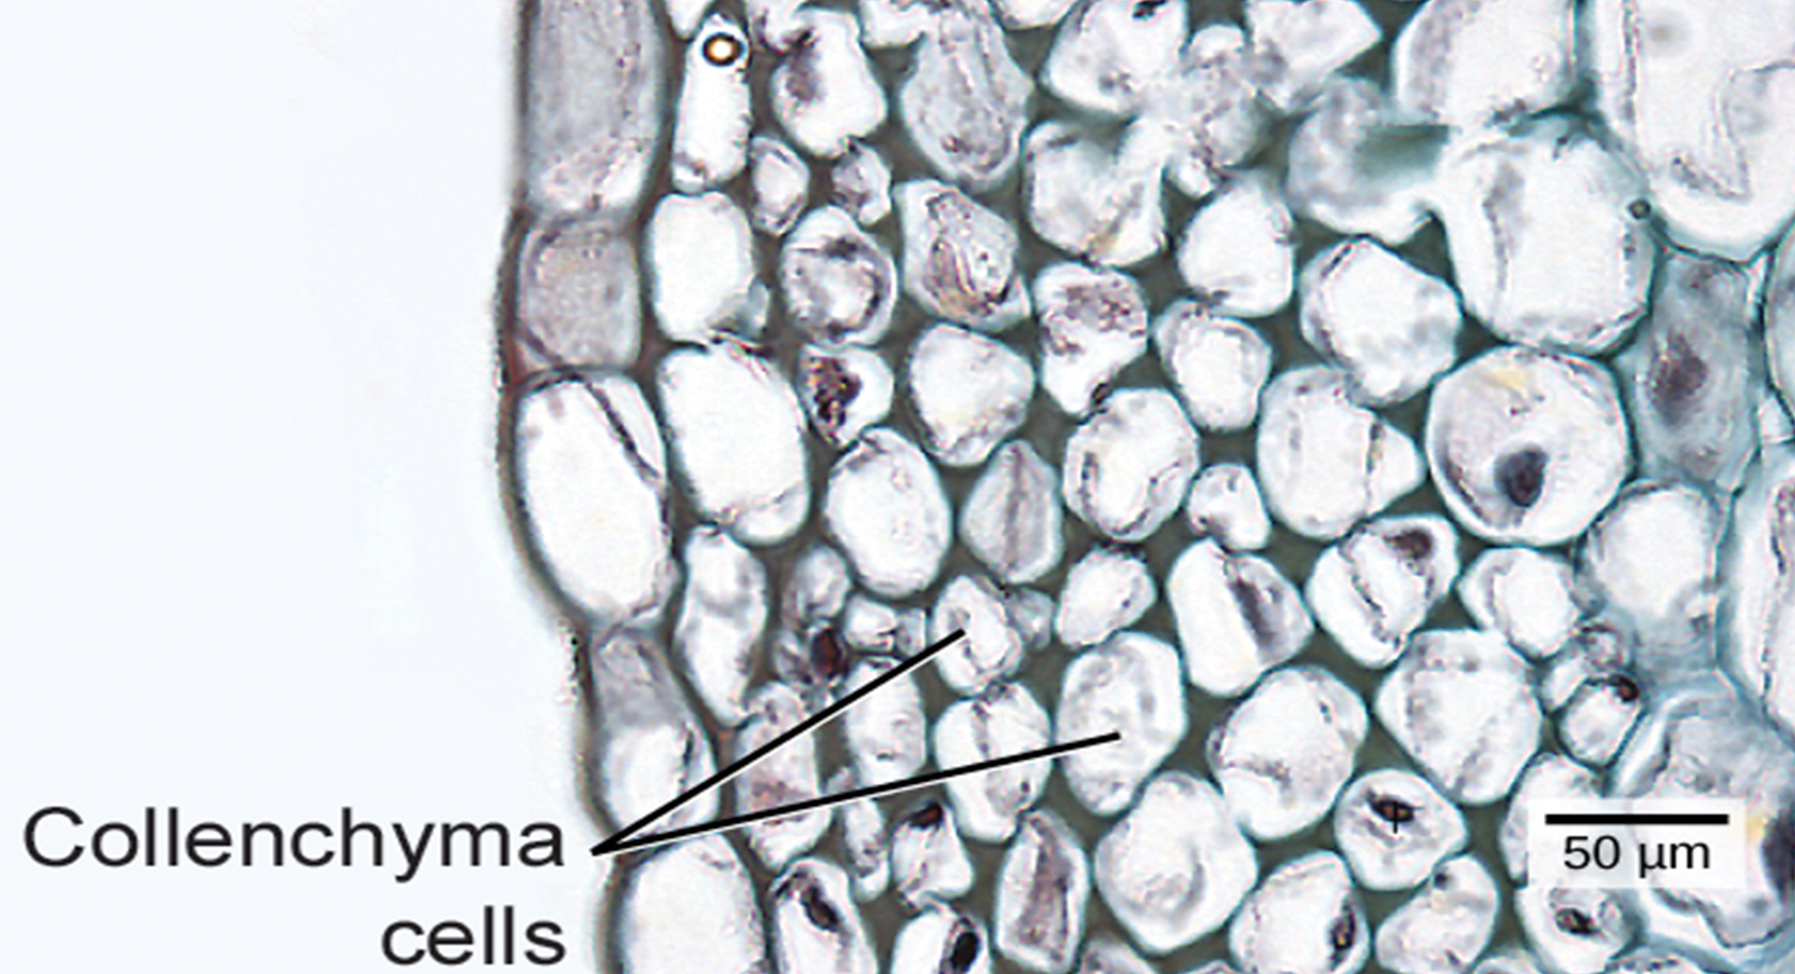
Collenchyma Cells
Collenchyma cells: elongated cells with unevenly thickened walls
Provide structural support to stem and leaves
Alive at maturity and usually found below the epidermis
Example: "strings" in celery stalks
30.2 Figure 3: Collenchyma cell walls are uneven in thickness—as shown in this light micrograph—and make up the outermost area of the cortex. Collenchyma cells provide support to plant structures.
Carl Szczerski; scale-bar data from Matt Russell. "Collenchyma cell walls."

Slide 8
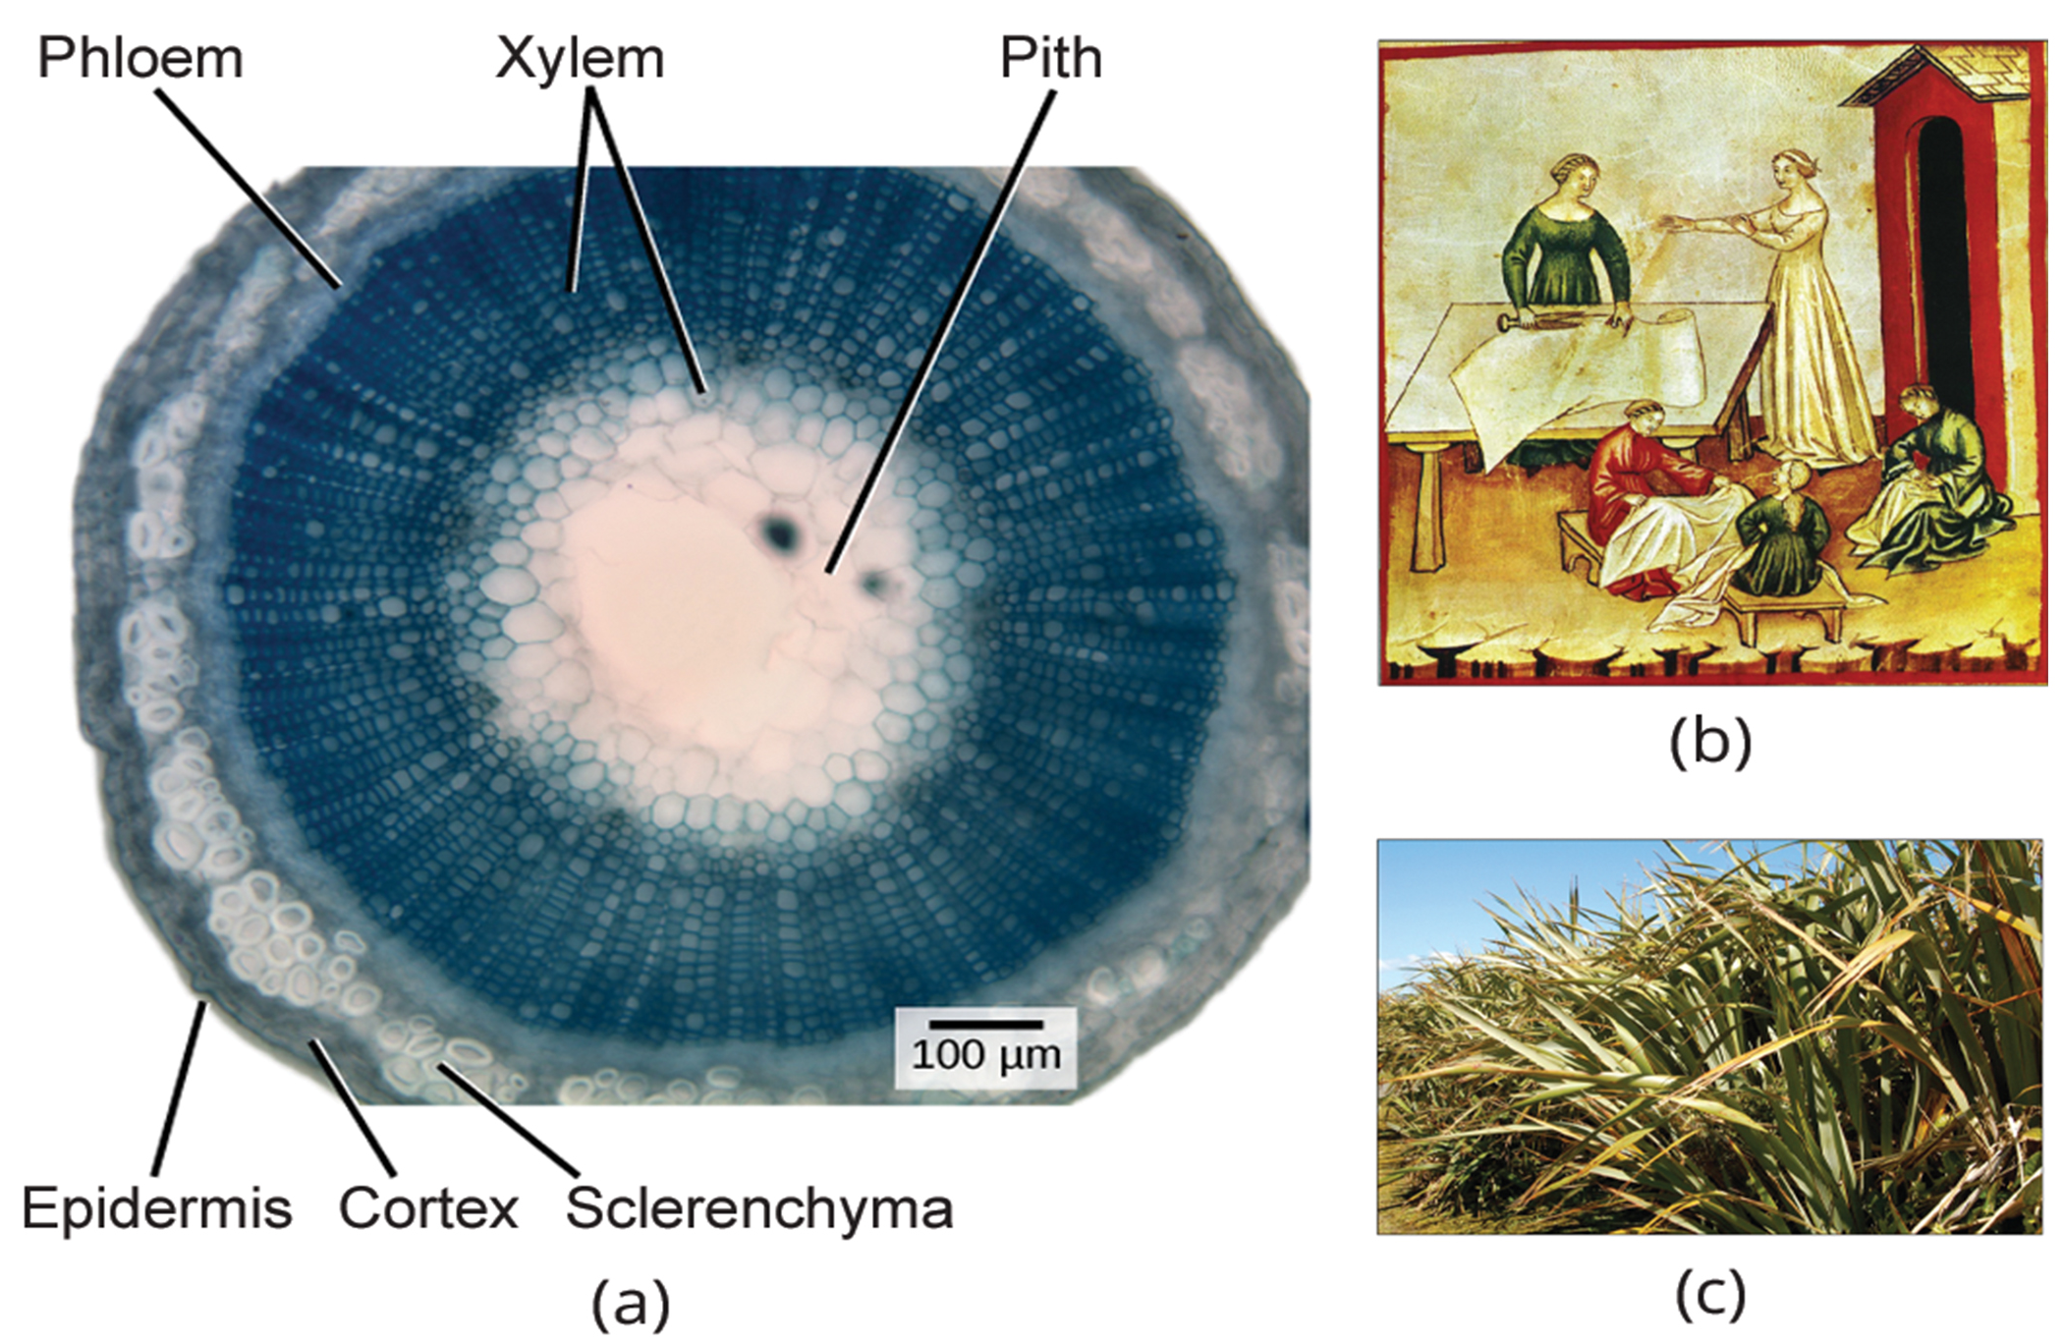
Sclerenchyma Cells
Ryan R. Mackenzie modified by Emmanuel Boutet on Wikimedia Commons. "Flax stem central pith and outer cortex."
Sclerenchyma cells: provide support to the plant, but many are dead at maturity
Have secondary cell walls thickened with lignin deposits
Two types: fibers and sclereids
Fibers: long, slender cells
Sclereids: smaller-sized cells, give pears their gritty texture
Used by humans to make linen and rope
CNX OpenStax on Wikimedia Commons. "Flax plant."
30.2 Figure 4: The central pith and outer cortex of the (a) flax stems are made up of parenchyma cells. Inside the cortex is a layer of sclerenchyma cells, which make up the fibers in flax rope and clothing. (b) In this drawing, fourteenth-century women prepare linen. (c) The flax plant is grown and harvested for its fibers, which are used to weave linen, and for its seeds, which are the source of linseed oil.

Slide 9
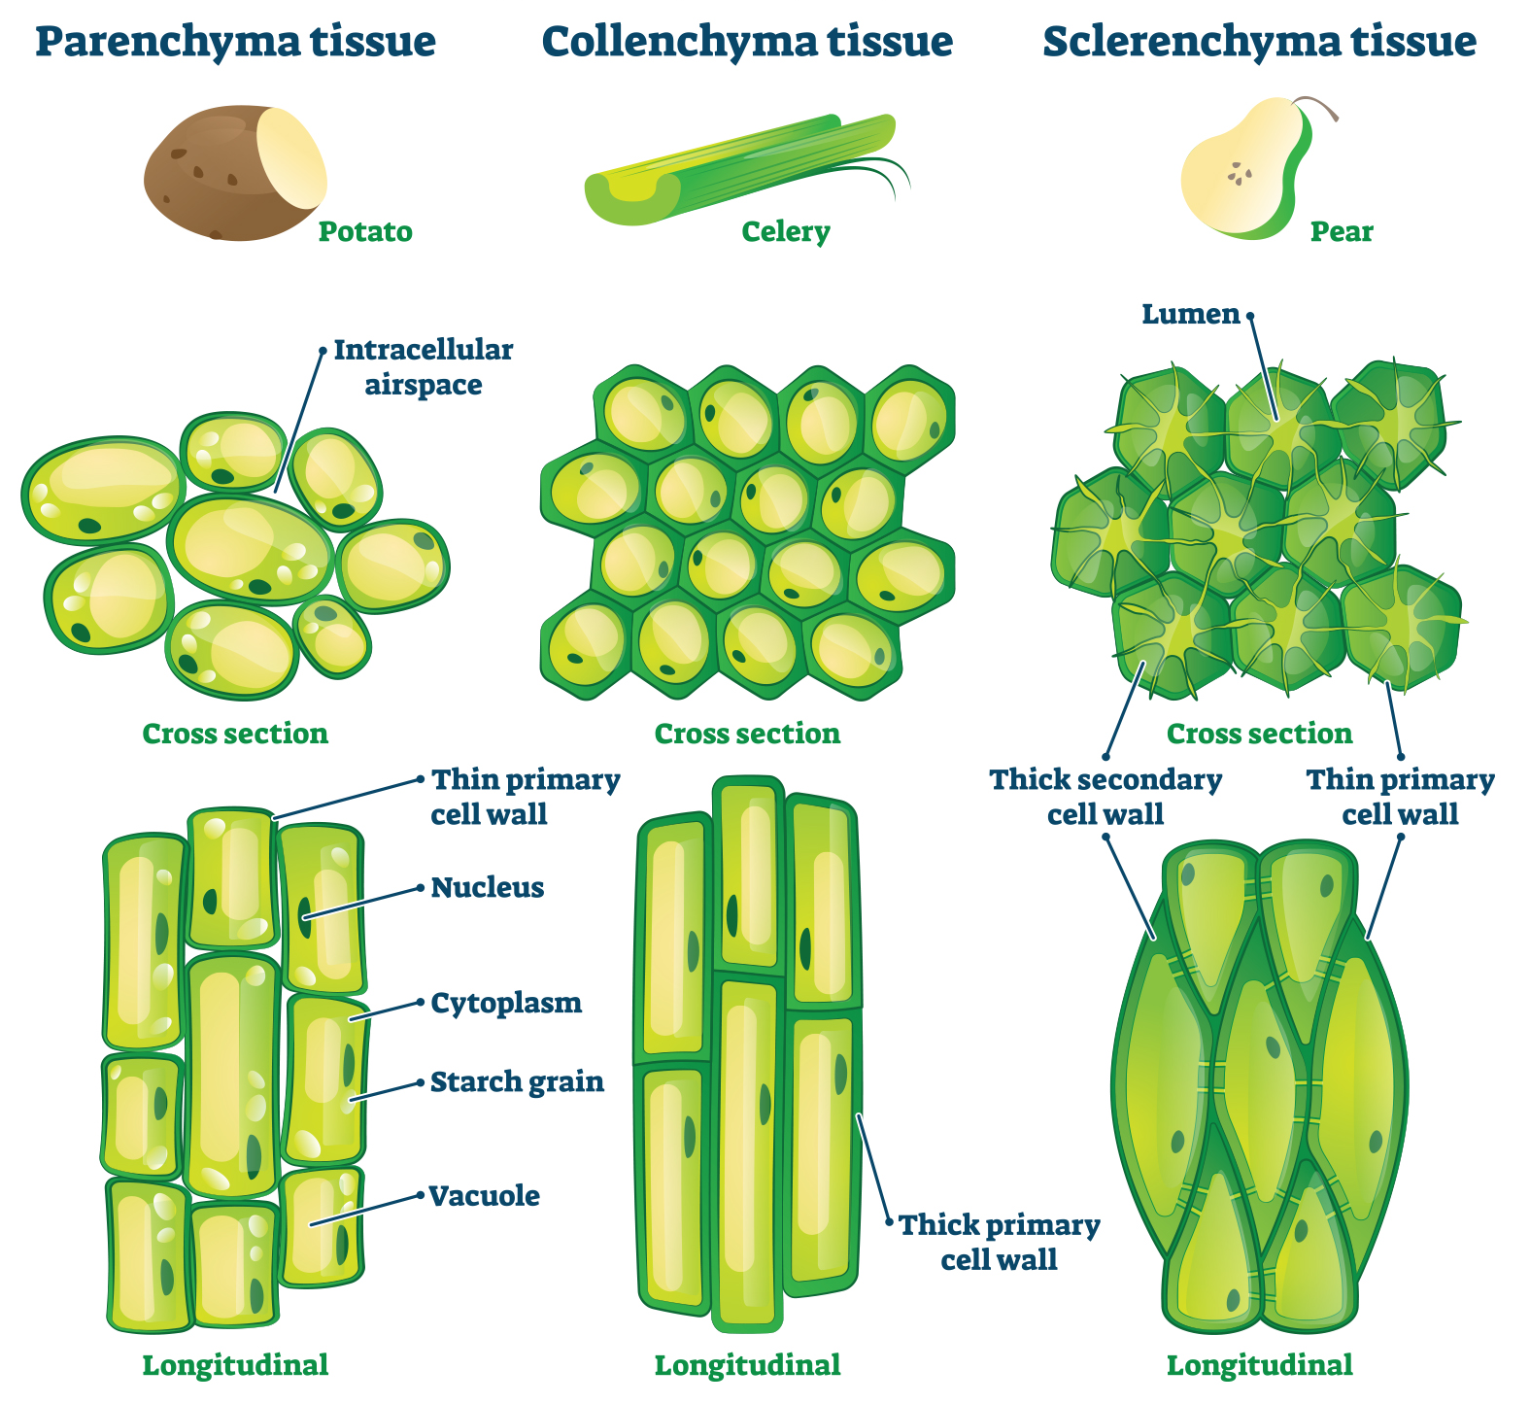
30.2 Figure 5
Notes:
Examples of parenchyma tissue from potatoes, collenchyma tissue from celery, and sclerenchyma tissue from pears are shown in cross section (middle row) and longitudinal (lengthwise) sections (last row). Potato tissue consists of parenchyma cells, which have thin primary walls. The ribs (strings) in celery consist of collenchyma tissue, which have thick primary cell walls. Pears have a high abundance of small, slender sclereids (a type of sclerenchyma cell) with thin primary and thick secondary cell walls.

Slide 10
Reflection Question₁
What do you think are the advantages and disadvantages of the different types of cells found in stems?
Notes:
The reflection question is included here to use as a talking point or for a think-pair-share activity.

Slide 11
Stem Tissue Systems
There are three tissue systems in the stem:
Dermal
Vascular
Ground
Each system has characteristic cell types that perform specific tasks for plant growth and survival.

Slide 12
Dermal Tissue₁
Consists primarily of epidermis: a single layer of cells covering and protecting the underlying tissue
Have transparent and non-photosynthetic cells
Bark: a tough, waterproof outer layer of woody plants
Further protects the plant from damage

Slide 13
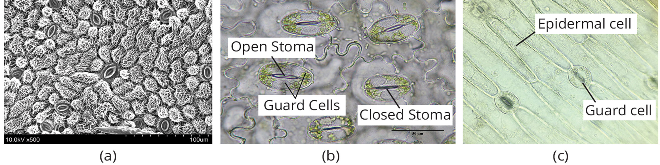
Dermal Tissue₂
Epidermal cells: most numerous and least differentiated of the cells in the epidermis
Contain stomata: openings for gas exchange, surrounded by guard cells that control opening/closing and regulating uptake of CO₂ and release of oxygen and water vapor
Trichomes: hairlike structures on epidermal surface
Help to reduce transpiration, increase solar reflectance, and store compounds
30.2 Figure 6: (a) The scanning electron micrograph shows multiple stomata in various degrees of openness. (b) Each stoma is flanked by two guard cells that regulate its opening and closing. (c) The guard cells sit within the layer of epidermal cells.
Windchu on Wikimedia Commons. "SEM image of stomata."
Emilio Ermini on Wikimedia Commons. "Guard cells and epidermal cells."

Slide 14
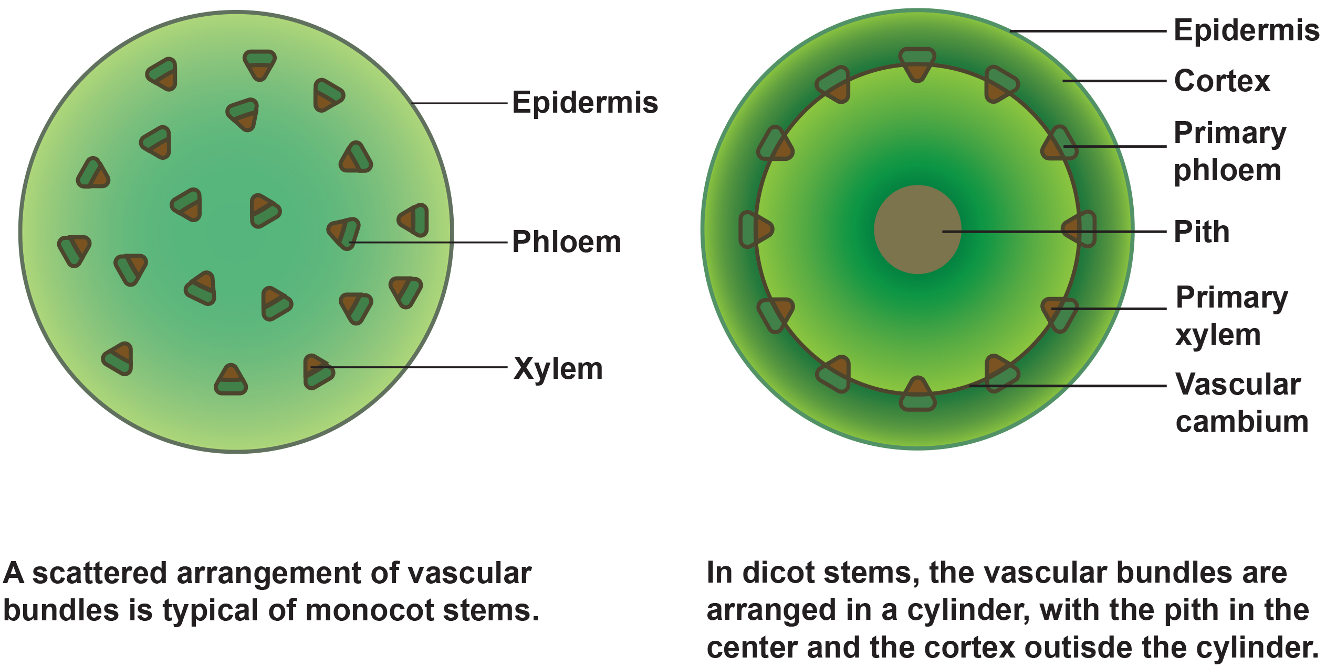
Vascular Tissue
Composed of xylem and phloem
Arranged in vascular bundles running up and down the stem
Dicot stems: vascular bundles arranged in a ring
Monocot stems: vascular bundles scattered throughout ground tissue
30.2 Figure 7: (left) In monocot stems, vascular bundles composed of xylem and phloem tissues are scattered throughout the ground tissue. (right) In dicot stems, vascular bundles are arranged around the periphery of the ground tissue. The xylem tissue is located toward the interior of the vascular bundle, and phloem is located toward the exterior. Sclerenchyma fibers cap the vascular bundles.

Slide 15
Reflection Question₂
Why do you think monocot stems have a scattered arrangement and dicot stems have a ring arrangement of vascular bundles? Research the differences between monocots and dicots to help you formulate your answer.
Notes:
The reflection question is included here to use as a talking point or for a think-pair-share activity.

Slide 16
Think It Through
What is the major difference between the vascular bundles found in the stems of monocot and dicot plants?
Notes:
Originally an On Your Own. This is included here to use as a talking point or for a think-pair-share activity.

Slide 17
Xylem Tissue Cells
Three types:
Xylem parenchyma: living cells that store nutrients, aid in water conduction, and help with healing and regeneration of the plant after stress
Tracheids: dead at maturity; have thick lignified secondary walls
Vessel elements: dead at maturity; have thinner walls and are shorter than tracheids
Water movement: pits (tracheids) and perforation plates (vessel elements)

Slide 18
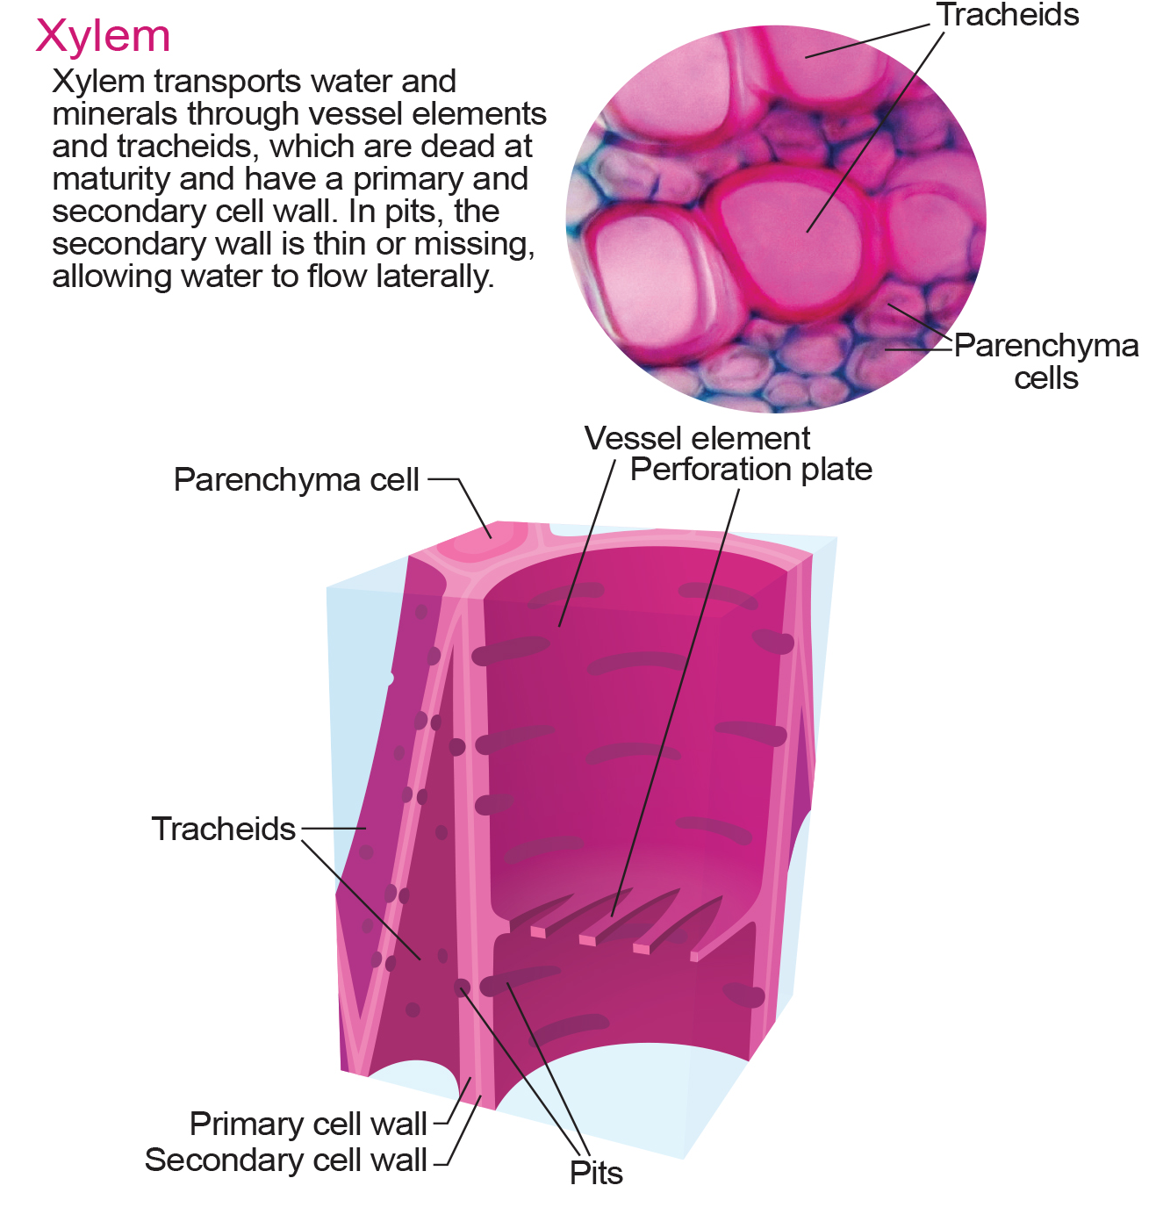
30.2 Figure 8
Kelvinsong on Wikimedia Commons. "Xylem tissue diagram."
Notes:
Xylem tissue consists of living parenchyma cells, dead vessel elements, and tracheids.

Slide 19
Phloem Tissue Cells
Sieve-tube cells: transport organic substances; arranged end-to-end to make a sieve tube
Companion cells: provide metabolic support to sieve-tube cells; located alongside sieve-tube cells
Phloem parenchyma: store and help transport food; located near the ends of sieve tubes
Phloem fibers: provide support to sieve cells and strength to the stem; found throughout the phloem

Slide 20
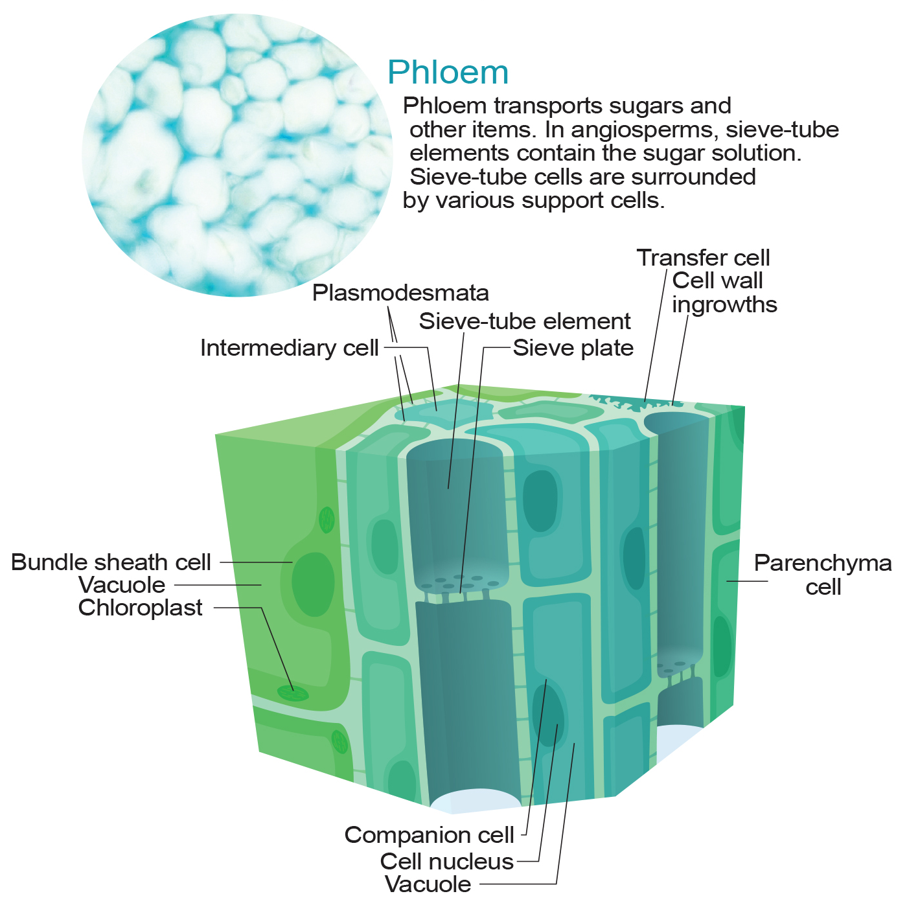
30.2 Figure 9
Kelvinsong on Wikimedia Commons. "Phloem tissue diagram."
Notes:
Cells of phloem tissue

Slide 21
Ground Tissue
Mostly made up of parenchyma cells but may contain collenchyma and sclerenchyma cells for support
Pith: ground tissue interior to vascular tissue
Made of soft, spongy parenchymal cells that store nutrients, provide support, and aid in nutrient transport
Cortex: layer between vascular tissue and epidermis
Stores carbohydrates and other substances
Helps transport materials made by the plants into the roots
Gives structural support to the plant

Slide 22
Growth in Stems
Growth in plants occurs as stems and roots lengthen, though woody plants increase in thickness during their life span.
Primary growth: increase in shoot length due to cell division in the shoot apical meristem
Secondary growth: increase in thickness (girth) due to cell division in the lateral meristem
Indeterminate growth: continuous growth in the stem and roots throughout a plant's life
Determinate growth: growth that ceases when a plant part reaches a particular size

Slide 23
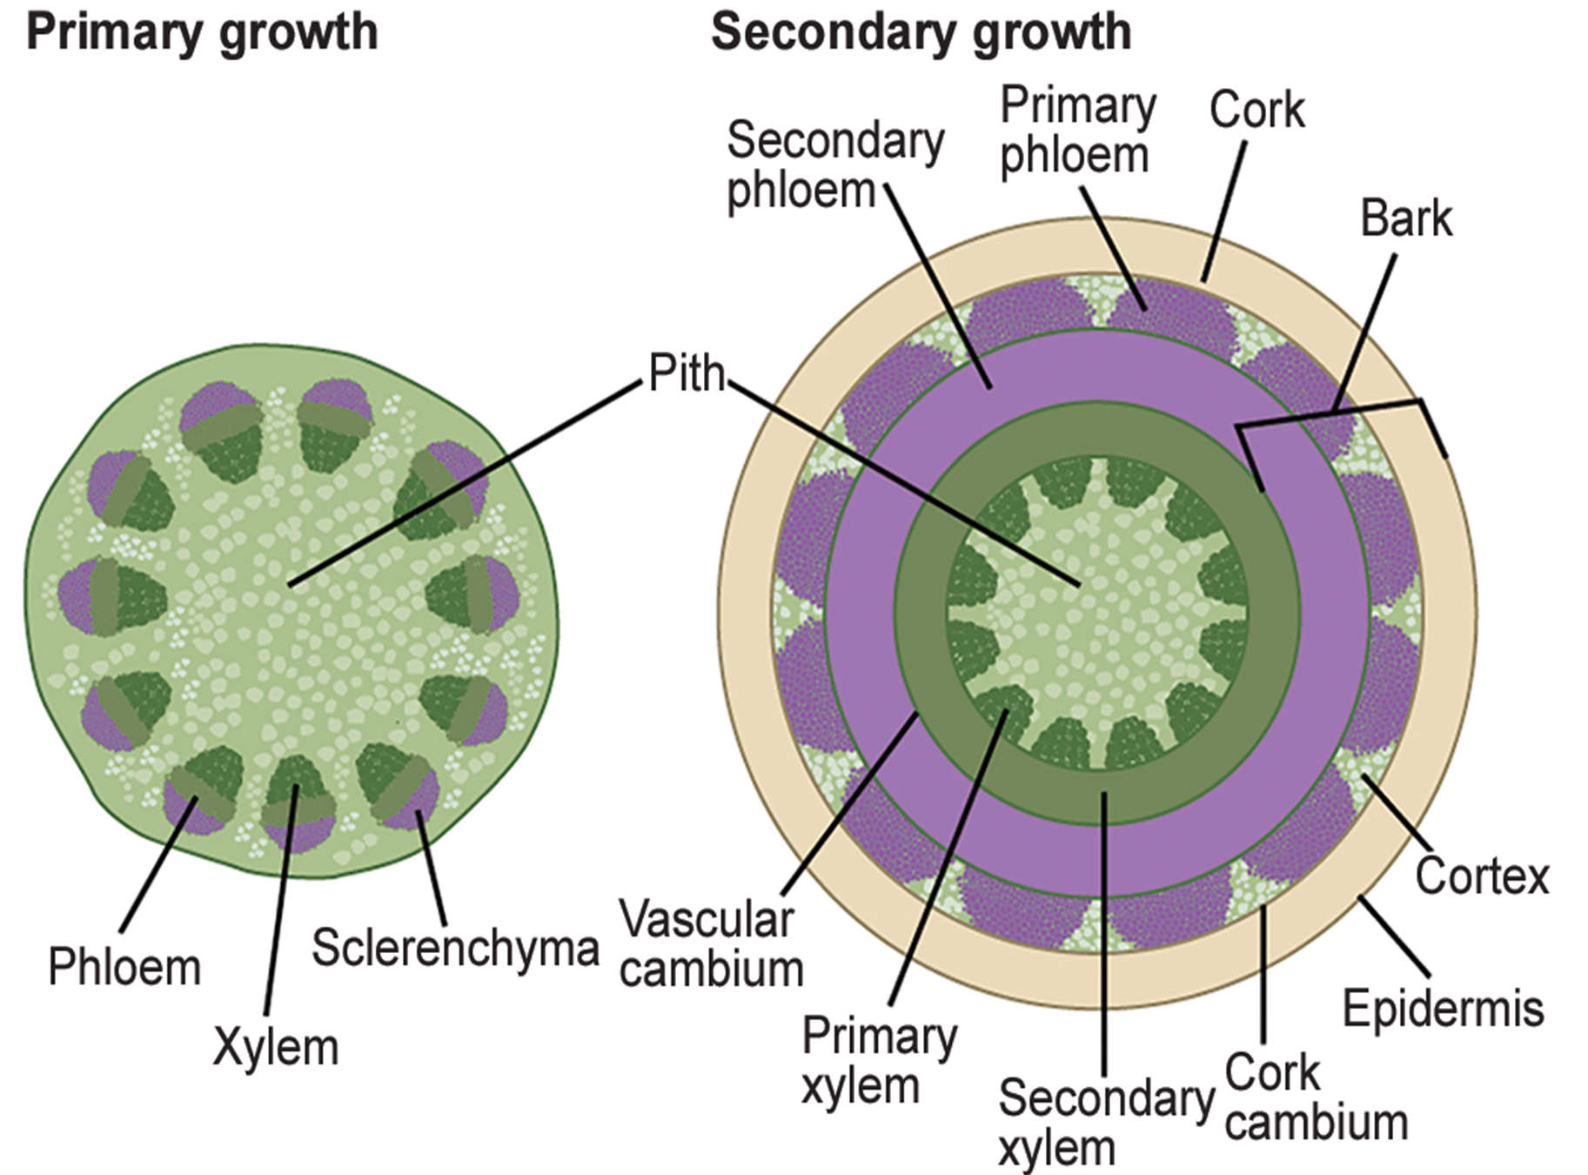
30.2 Figure 10
CNX OpenStax on Wikimedia Commons. "Stem primary and secondary growth." Modified.
Notes:
In woody plants, primary growth is followed by secondary growth, which allows the plant stem to increase in thickness, or girth. Secondary vascular tissue and a cork layer are added as the plant grows. The bark of a tree extends from the vascular cambium to the epidermis.

Slide 24
Primary Growth
Mostly occurs at apices (tips) of stems and roots
Result of rapidly dividing cells in apical meristems and subsequent cell elongation
Enables continuous seeking of water (roots) or sunlight (shoots)
Apical dominance: influence of apical bud on overall plant growth
Diminishes growth of axillary buds on branches and stems
Example: coniferous trees and their conical shape

Slide 25
Secondary Growth
Increase in stem thickness due to lateral meristem activity (lacking in herbaceous plants)
Include vascular cambium and cork cambium (in woody plants)
Vascular cambium: forms secondary xylem (tracheids and vessel elements inside) and phloem (sieve elements and companion cells outside)
Located just outside the primary xylem and interior to the primary phloem
Contain lignin, providing hardiness and strength

Slide 26
Cork Cambium₁
Outermost lateral meristem in woody plants
Produces cork cells (bark) containing suberin (waxy, water-repellent substance)
Protects the plant against physical damage, reduces water loss
Produces phelloderm (layer of cells that grows inward from the cambium)

Slide 27
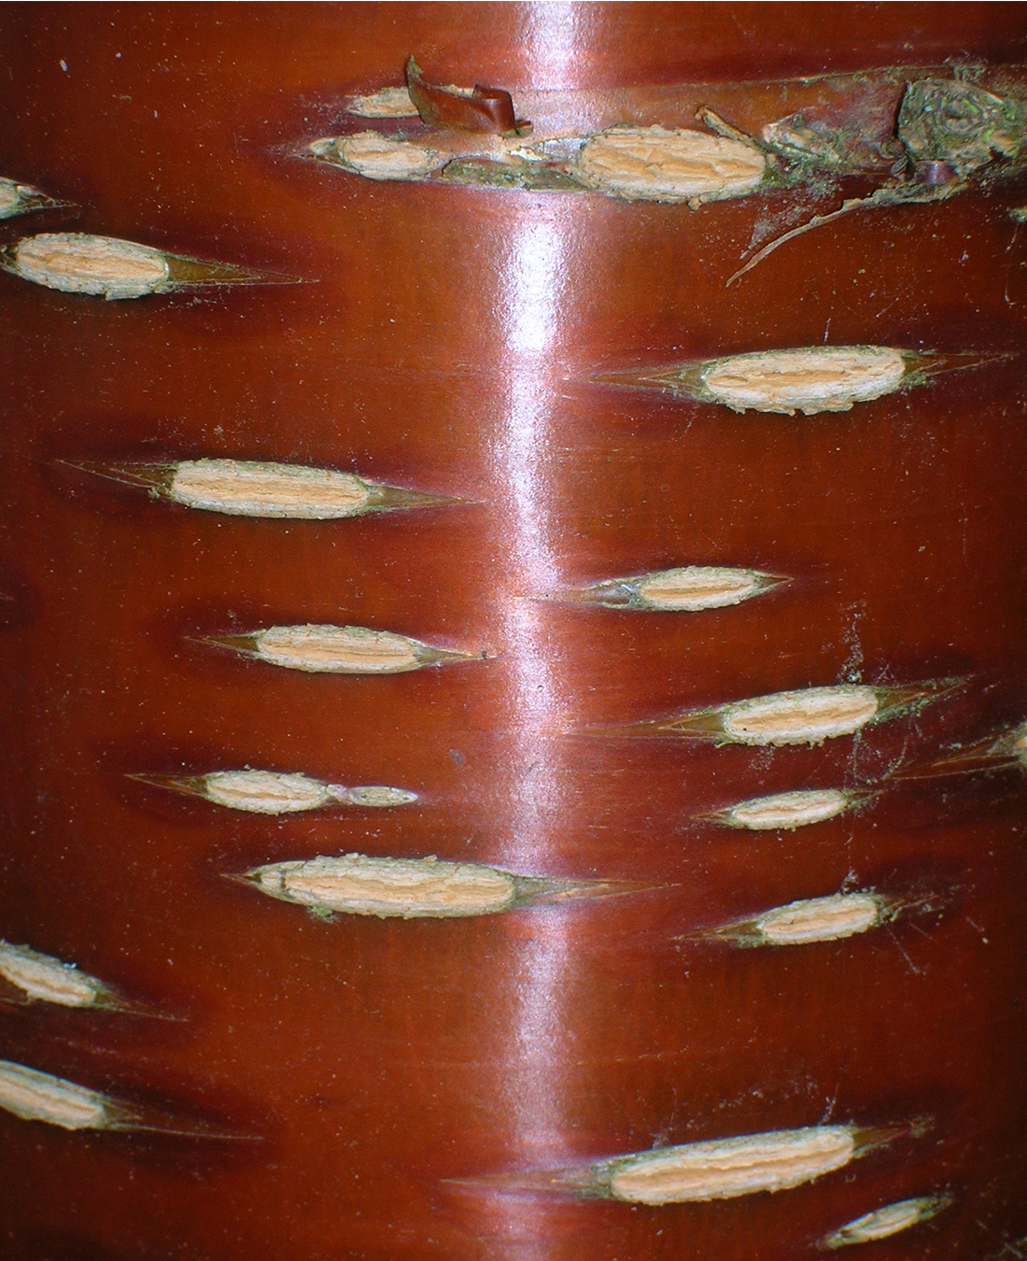
Cork Cambium₂
Cork cambium, cork cells, and phelloderm collectively form the periderm (replaces the epidermis as plant matures).
Lenticels: openings in periderm for gas exchange
Supplies oxygen to the living and metabolically active cells of the cortex, xylem, and phloem
Serve same function as stomata in leaves, but structurally different
Regions of porous tissue separated by large intercellular spaces
30.2 Figure 11: Lenticels on the bark of this cherry tree enable the woody stem to exchange gases with the surrounding atmosphere.
Rosser1954 Roger Griffith on Wikimedia Commons. "Lenticels on bark."

Slide 28
Science and You
Cork is a durable material produced by woody plants.
Renewable resource harvested from certain oak tree species
Produced as part of secondary growth, which laterally thickens trunks, branches, and stems
Differs from primary growth, which extends stem and branch length towards the apex
Notes:
This is included as a relevant application for this topic.

Slide 29
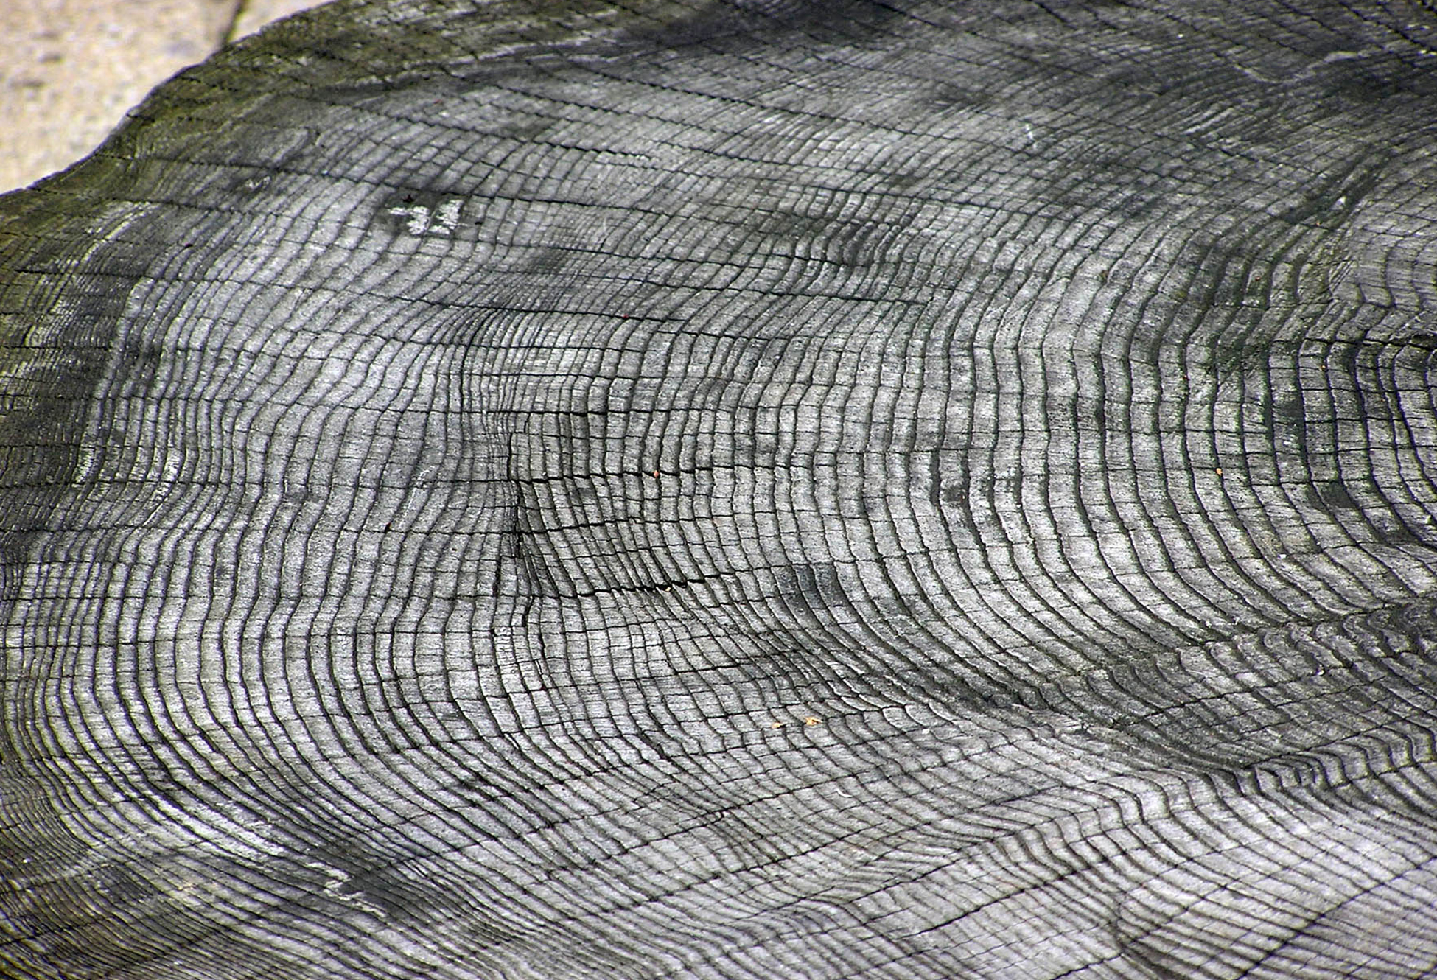
Annual Rings
Formed by vascular cambium activity
Early wood (spring wood): cells of the secondary xylem large in cell diameter with thin cell walls
Late wood (autumn wood): secondary xylem with thickened cell walls, denser than early wood
Alternation due to seasonal decrease in vessel elements and increase in tracheids
Results in formation of annual rings, visible as circular rings in stem cross section
Reveal tree age and past climatic conditions
30.2 Figure 12: The rate of wood growth increases in summer and decreases in winter, producing a characteristic ring for each year of growth. Seasonal changes in weather patterns can also affect the growth rate; note how the rings vary in thickness.
Arpingstone on Wikimedia Commons. "Growth rings."

Slide 30
Stem Modifications
Rhizomes: horizontal underground stems with nodes and internodes
Corms: rounded, fleshy underground stems for food storage
Stolons: stems running parallel to or just below ground surface
Runners: above-ground stolons producing clone plants at nodes (e.g., strawberries)
Tubers: modified stems storing starch (e.g., potatoes)
Bulbs: underground storage units with fleshy leaves (e.g., onions)

Slide 31
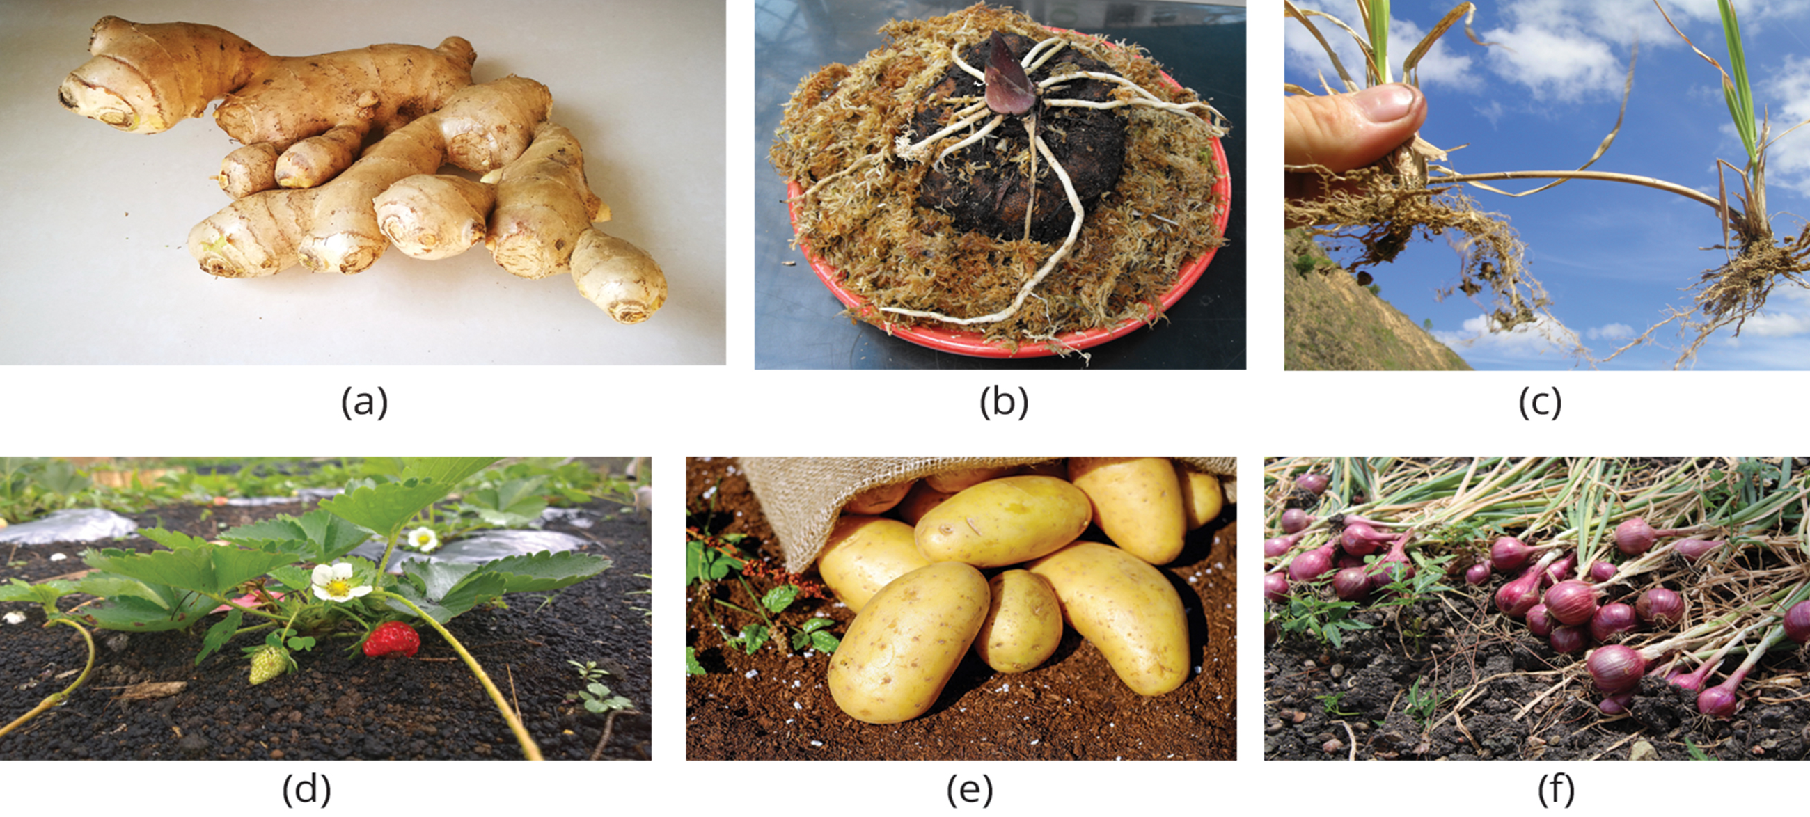
30.2 Figure 13
Mk2010 on Wikimedia Commons. "Ginger rhizome."
Stickpen on Wikimedia Commons. "Carrion flower corm."
Macleay Grass Man on Wikimedia Commons. "Rhodes grass stolons."
Kenrick95 on Wikimedia Commons. "Strawberry plant."
Couleur on Pixabay. "Potatoes."
Kasyap on Wikimedia Commons. "Onions."
Notes:
Stem modifications enable plants to thrive in a variety of environments. Shown are (a) ginger (Zingiber officinale) rhizomes, (b) a carrion flower (Amorphophallus titanum) corm, (c) Rhodes grass (Chloris gayana) stolons, (d) strawberry (Fragaria ananassa) runners, (e) potato (Solanum tuberosum) tubers, and (f) red onion (Allium) bulbs.

Slide 32
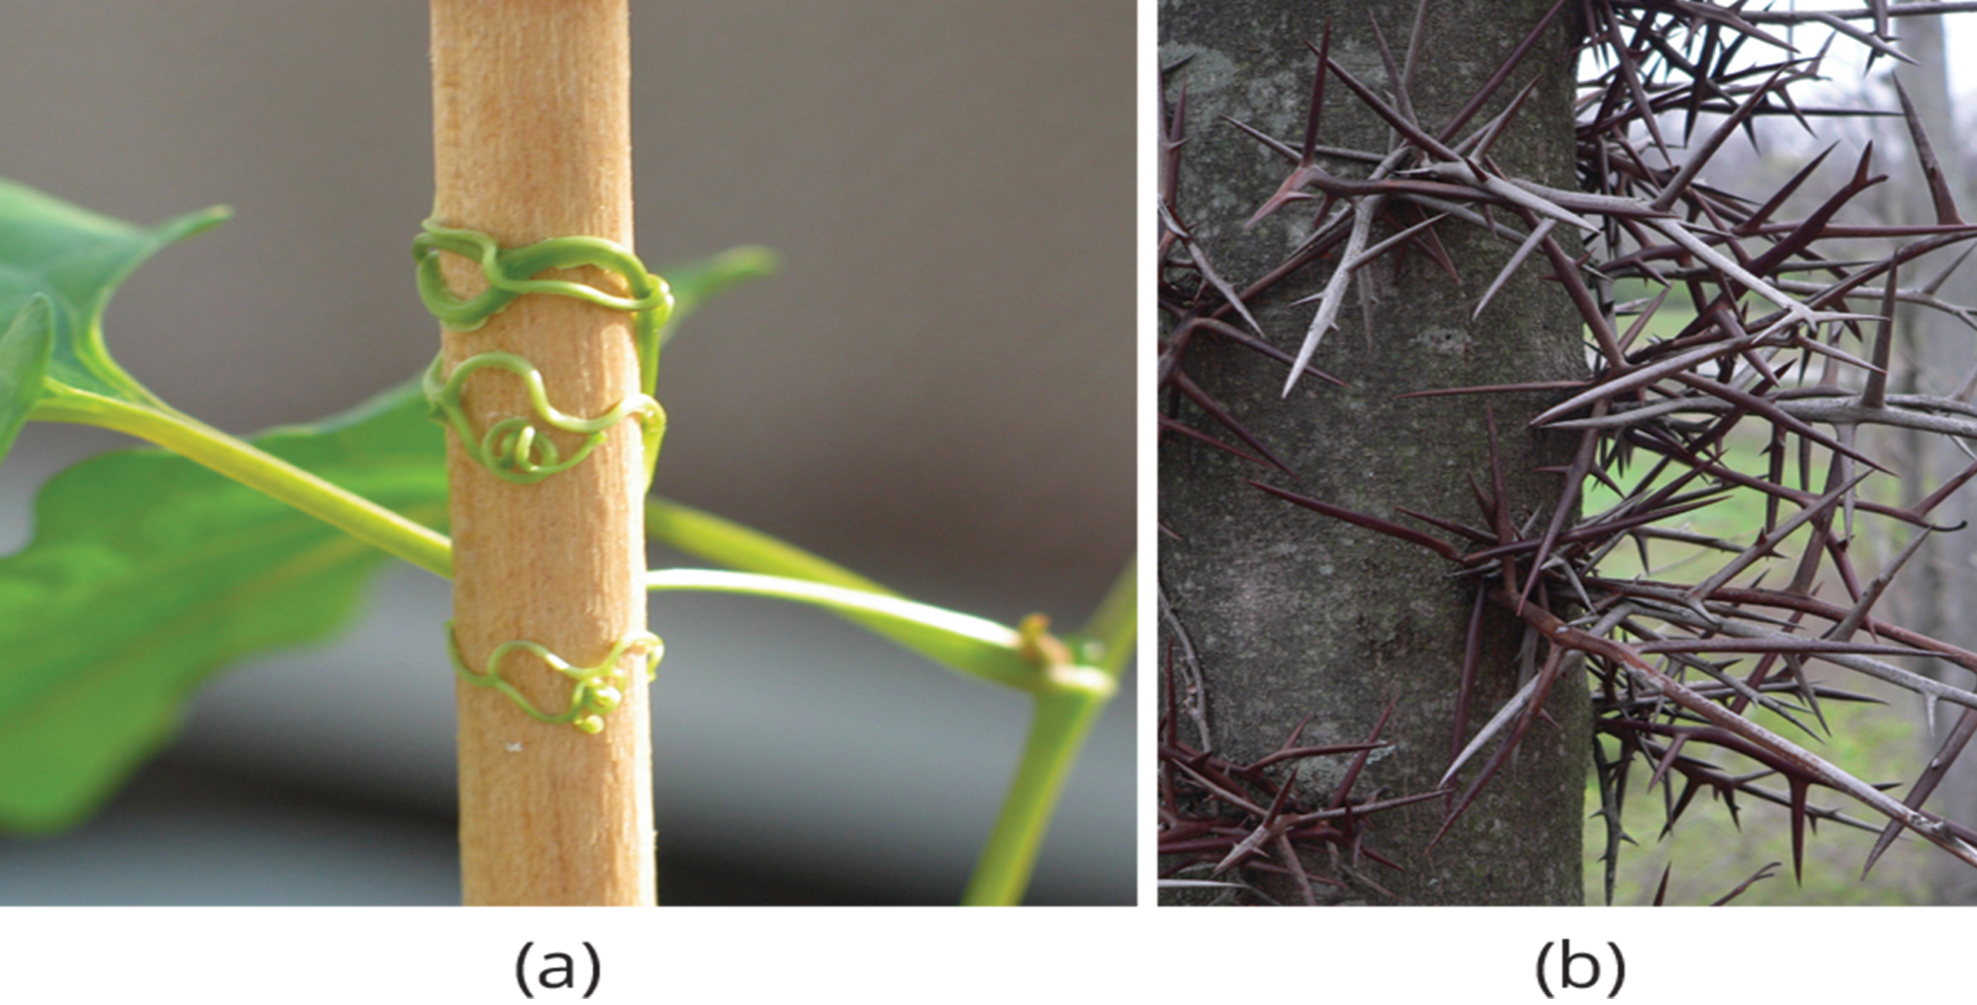
Aerial Modifications
Tendrils: slender, twining strands for climbing support (seen in pumpkins and vines)
Thorns: sharp outgrowths for plant protection (seen in roses, Osage oranges, and devil's walking sticks)
Agricultural Research Service on Wikimedia Commons. "Redvine tendrils."
Greg Hume on Wikimedia Commons. "Honey locust tree thorns."
30.2 Figure 14: Found in the southeastern United States, (a) the buckwheat vine (Brunnichia ovata) is a weedy plant that climbs with the aid of tendrils. This one is shown climbing up a wooden stake. (b) Thorns are modified branches.

Slide 33
Group Activity
A number of stem modifications were described in this section, including tendrils, thorns, rhizomes, corms, stolons, runners, tubers, and bulbs. As a group, discuss common plants with such adaptations. For example, what stem adaptation is commonly associated with tulips? Refer to Figure 13 for additional examples.

Slide 34
Summary
Stems bear leaves, flowers, and fruits.
Characterized by presence of nodes and internodes
Composed of three tissue systems: dermal, vascular, and ground
Primary growth increases length, and secondary growth increases thickness.
Modified stems (rhizomes, corms, stolons, runners, tubers, bulbs, tendrils, and thorns) adapt plants to specific habitats and functions.

Slide 35

End of Hawkes Learning PowerPoint

