Slide 1
Lesson 30.3
Roots

Slide 2
Objectives
Describe the structure of the root.
Describe the three zones of the root tip and summarize the role of each zone in root growth.
Identify the two types of root systems.
List and describe examples of modified roots.

Slide 3
Roots
Roots have three major functions:
Anchoring plants to the soil
Absorbing water and minerals, transporting them upwards
Storing the products of photosynthesis
Most roots are underground, though some have adventitious roots.
Adventitious roots: roots that emerge above the ground from the shoot

Slide 4
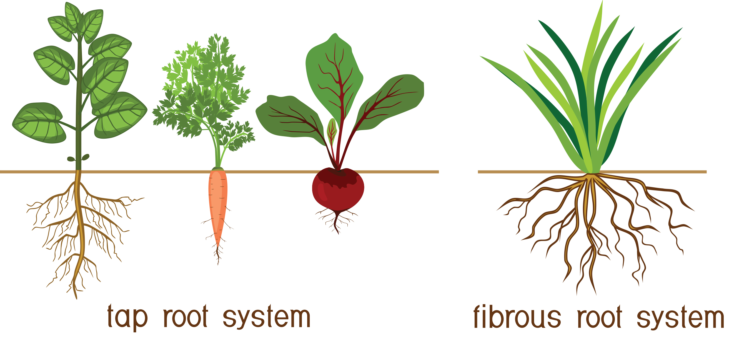
Types of Root Systems
There are two types of root systems, and some plants have a combination of both.
Tap root system: main root that grows down vertically with many smaller lateral roots; penetrates deep into the soil
Used by dicots
Example: dandelions, carrots, and beets
Fibrous root system: located closer to the soil surface and forms a dense network of roots; helps to prevent soil erosion
Used by monocots
Examples: lawn grass, wheat, rice, and corn
30.3 Figure 1

Slide 5
Root Growth and Anatomy
Root growth begins with seed germination.
The radicle of the embryo forms the root system.
The root tip is protected by the root cap: a structure exclusive to roots.
Continuously replaced because it gets damaged easily

Slide 6
Root Tip Zones
The root tip is divided into three zones, all within the first centimeter of the root tip:
Zone of cell division: closest to the root tip; made up of actively dividing cells of root meristem
Zone of elongation: where newly formed cells increase in length, lengthening the root
Zone of maturation/differentiation: starts at the first root hair; where cells differentiate into special cell types

Slide 7
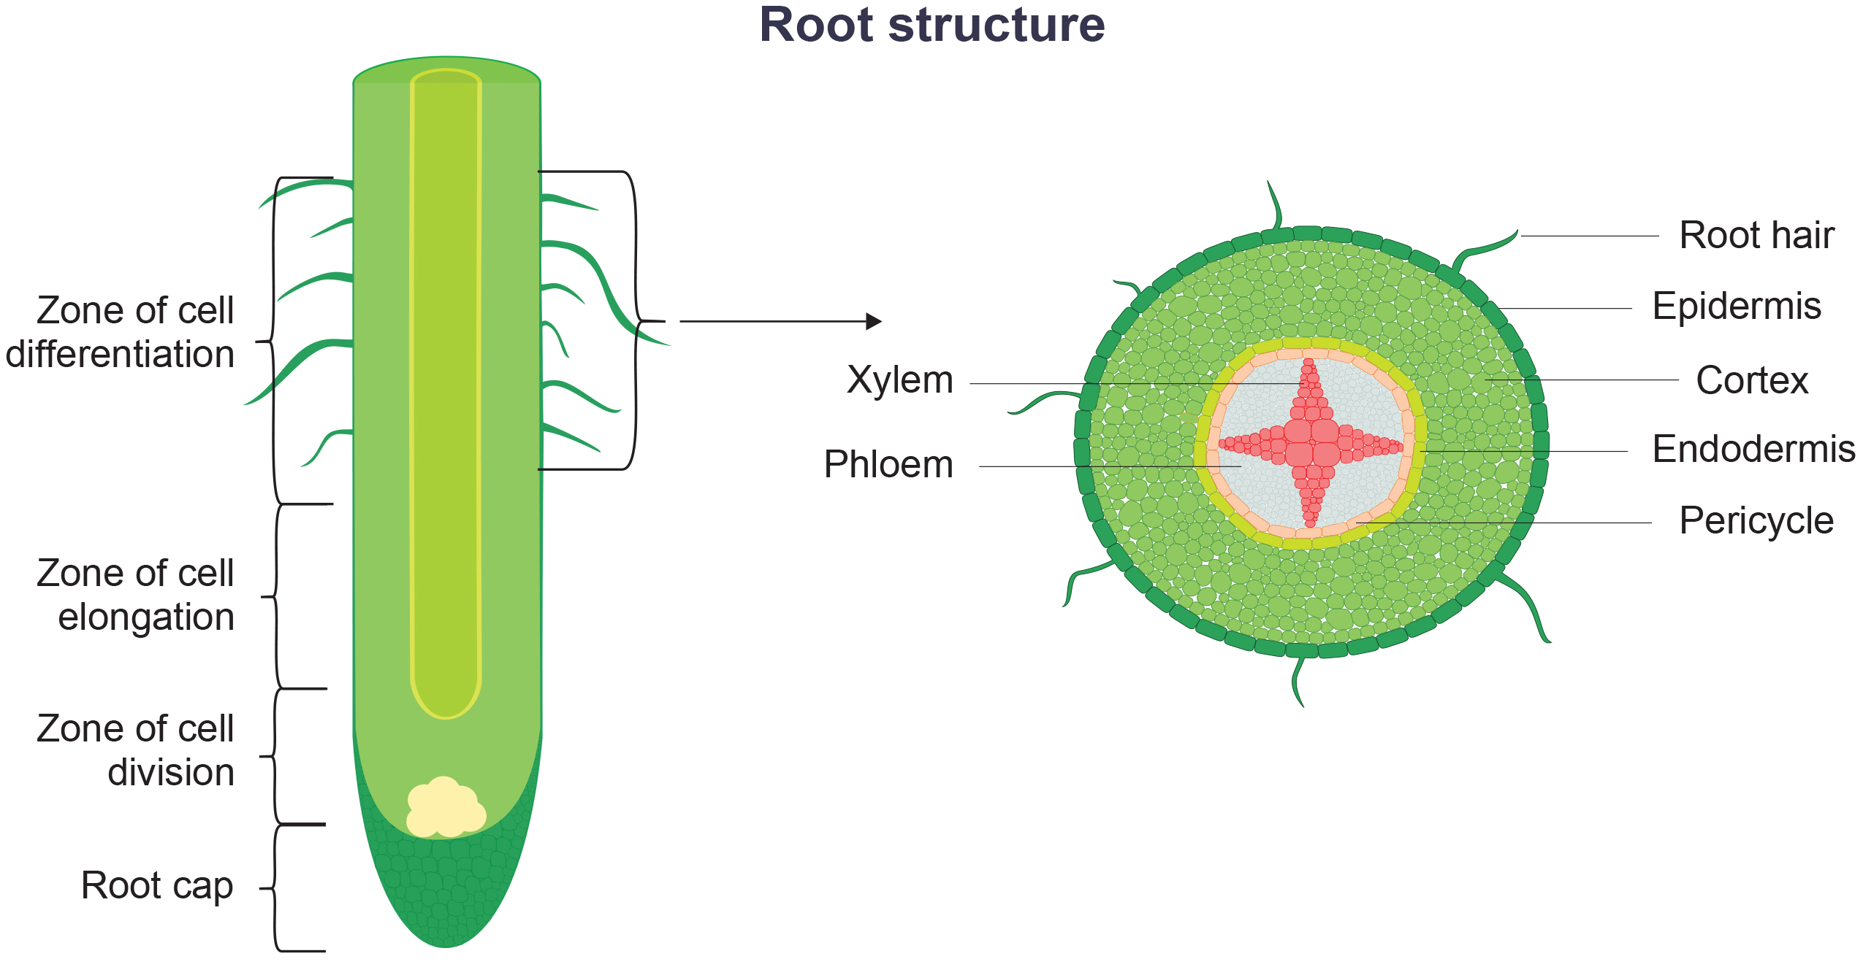
30.3 Figure 2
Notes:
A longitudinal view of the root reveals the zones of cell division, elongation, and maturation. The zone of cell division corresponds to the apical meristem, located right behind the root cap.

Slide 8
Root Epidermis and Ground Tissue
The root has an outer layer of cells called the epidermis.
Surrounds areas of ground tissue and vascular tissue
Provides protection and helps in absorption
Root hairs: extensions of root epidermal cells
Found in both tap root and fibrous root systems
Increase surface area of the root
Contribute to the absorption of water and minerals
Ground tissue forms two regions that have cells that store photosynthetic products:
Cortex: between epidermis and vascular tissue
Pith: between vascular tissue and center of root

Slide 9
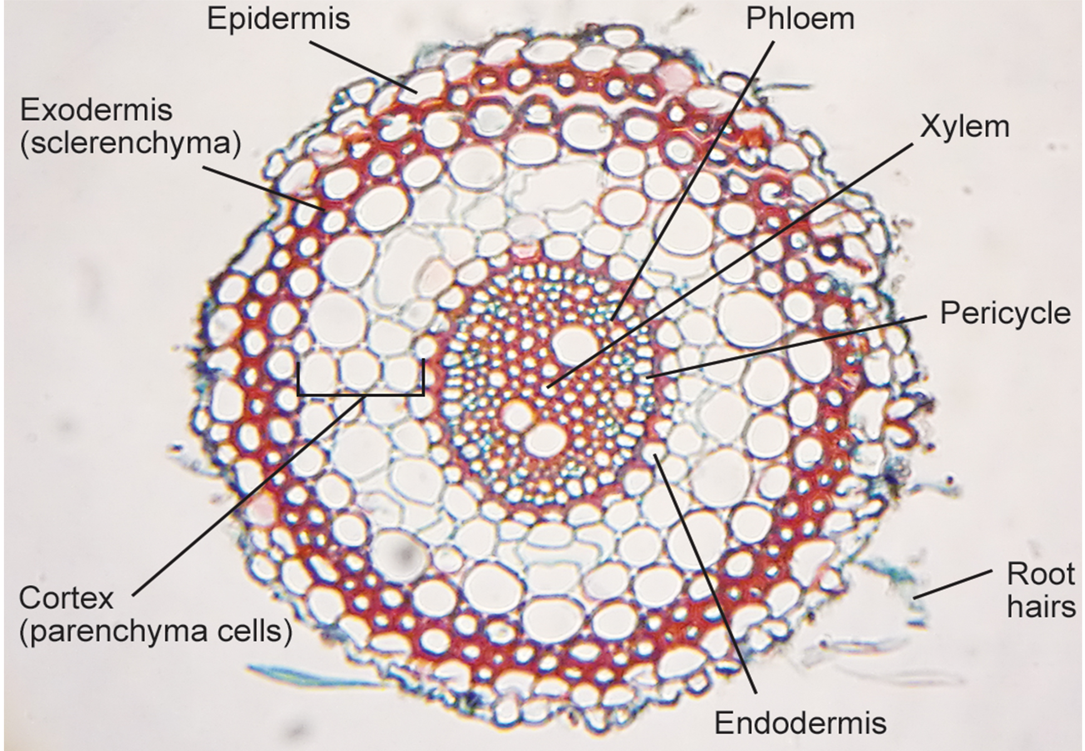
30.3 Figure 3
Lord of Konrad on Wikimedia Commons. "Cross section of root."
Notes:
In this light micrograph, staining reveals the different cell types of a wheat (Triticum) root cross section. Sclerenchyma cells of the exodermis and xylem cells stain red, and phloem cells stain blue. Other cell types stain black. The stele, or vascular tissue, is the area inside the endodermis. Root hairs are visible outside the epidermis.

Slide 10
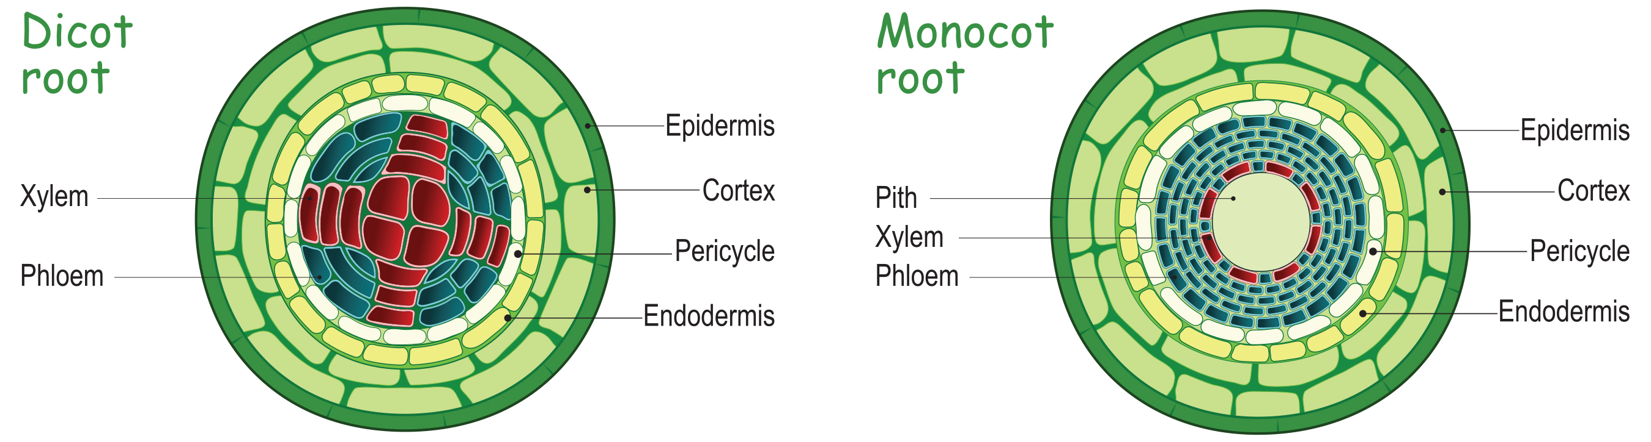
Vascular Tissue in the Root
Located in the stele (inner portion of the root)
Endodermis: layer of cells that separates stele from ground tissue
Exclusive to roots
Serves as a checkpoint for the root's vascular system
Suberin (waxy substance) on the walls of endodermal cells
Casparian strip: in endodermis; regulates material entry
Forces water and solutes to cross the plasma membranes
Pericycle: outermost layer of vascular tissue
Can give rise to lateral roots
Different arrangement of xylem and phloem in dicots and monocots
30.3 Figure 4: In typical dicots, the vascular tissue forms an X shape in the center of the root. In typical monocots, the phloem cells and the larger xylem cells form a characteristic ring around the central pith.

Slide 11
What Are the Differences between Dicot and Monocot Plants?
One of the major differences is their root structure at the cellular level.
Monocots: xylem forms ring around central pith
Dicots: xylem forms X shape across central pith
Both: stele surrounded by endodermis and separated from epidermis by the cortex

Slide 12
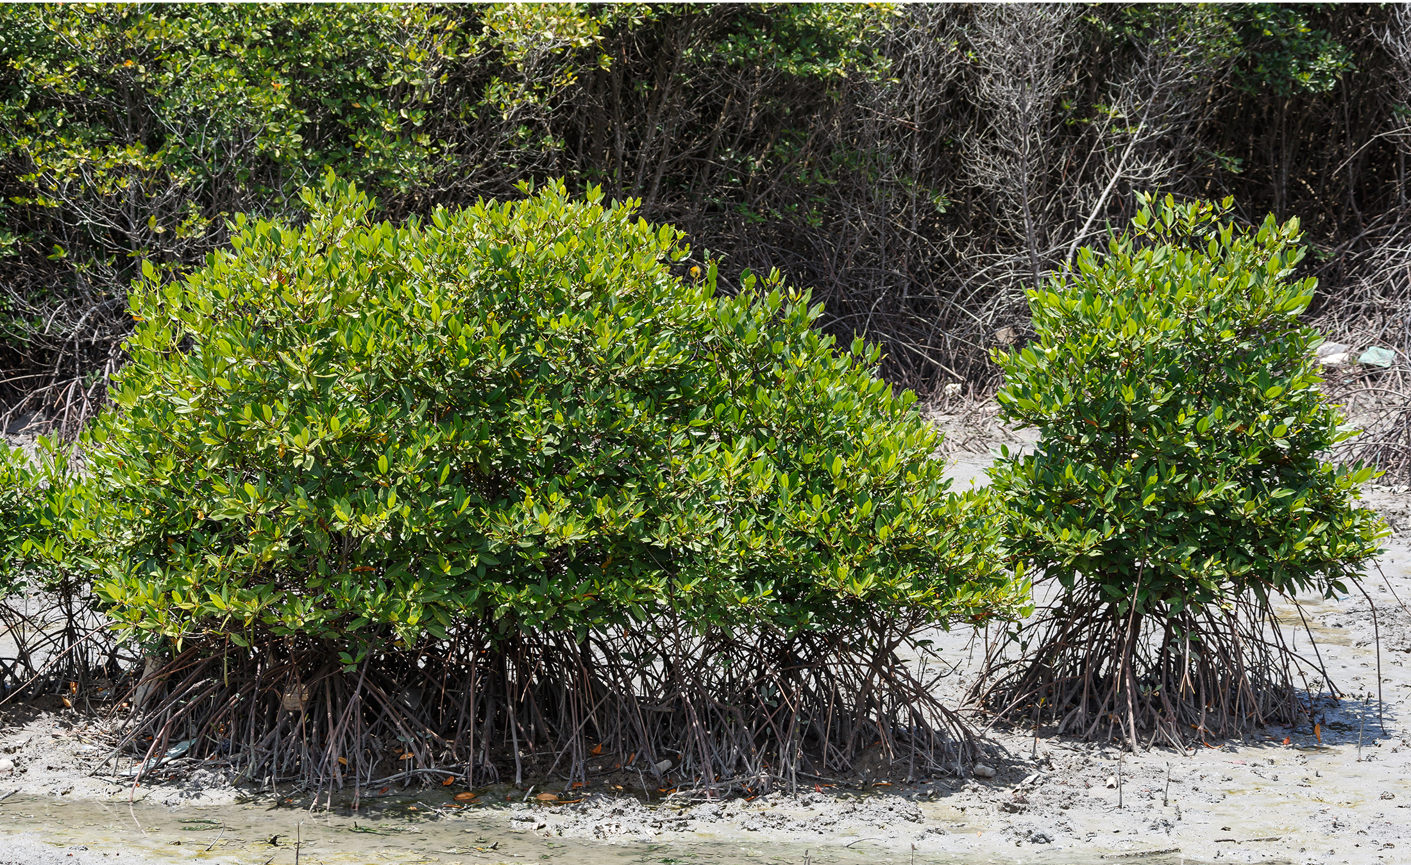
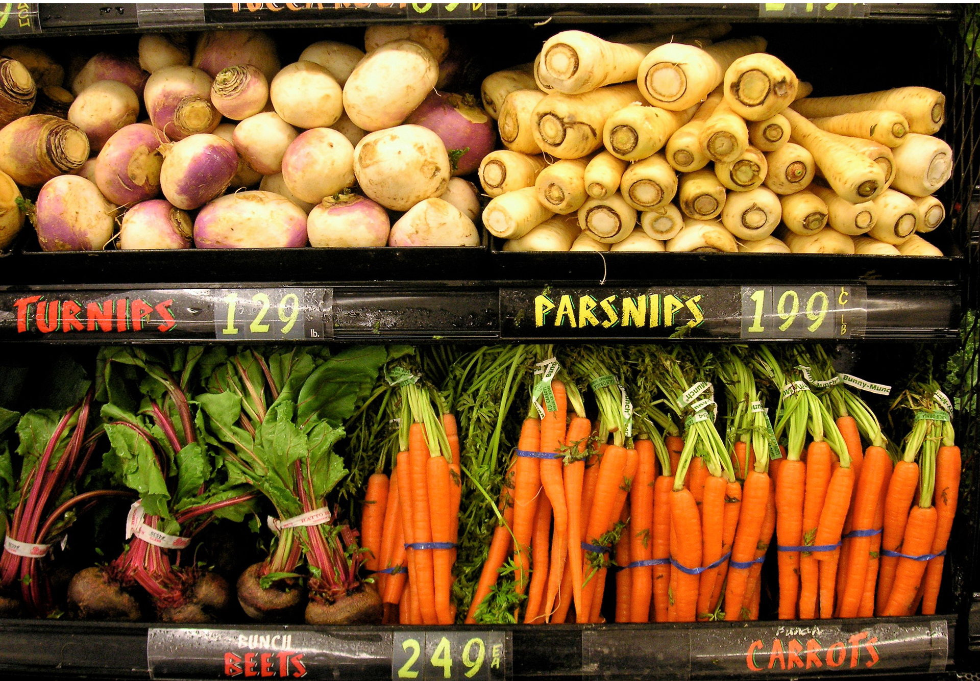
Root Modifications
30.3 Figure 5
Root structures may be modified for specific purposes.
Bulbous roots store starch.
Aerial and prop roots (mangrove trees) are aboveground roots that provide additional support to anchor the plant.
Tap roots (carrots and beets) are modified for food storage.
30.3 Figure 6

Slide 13
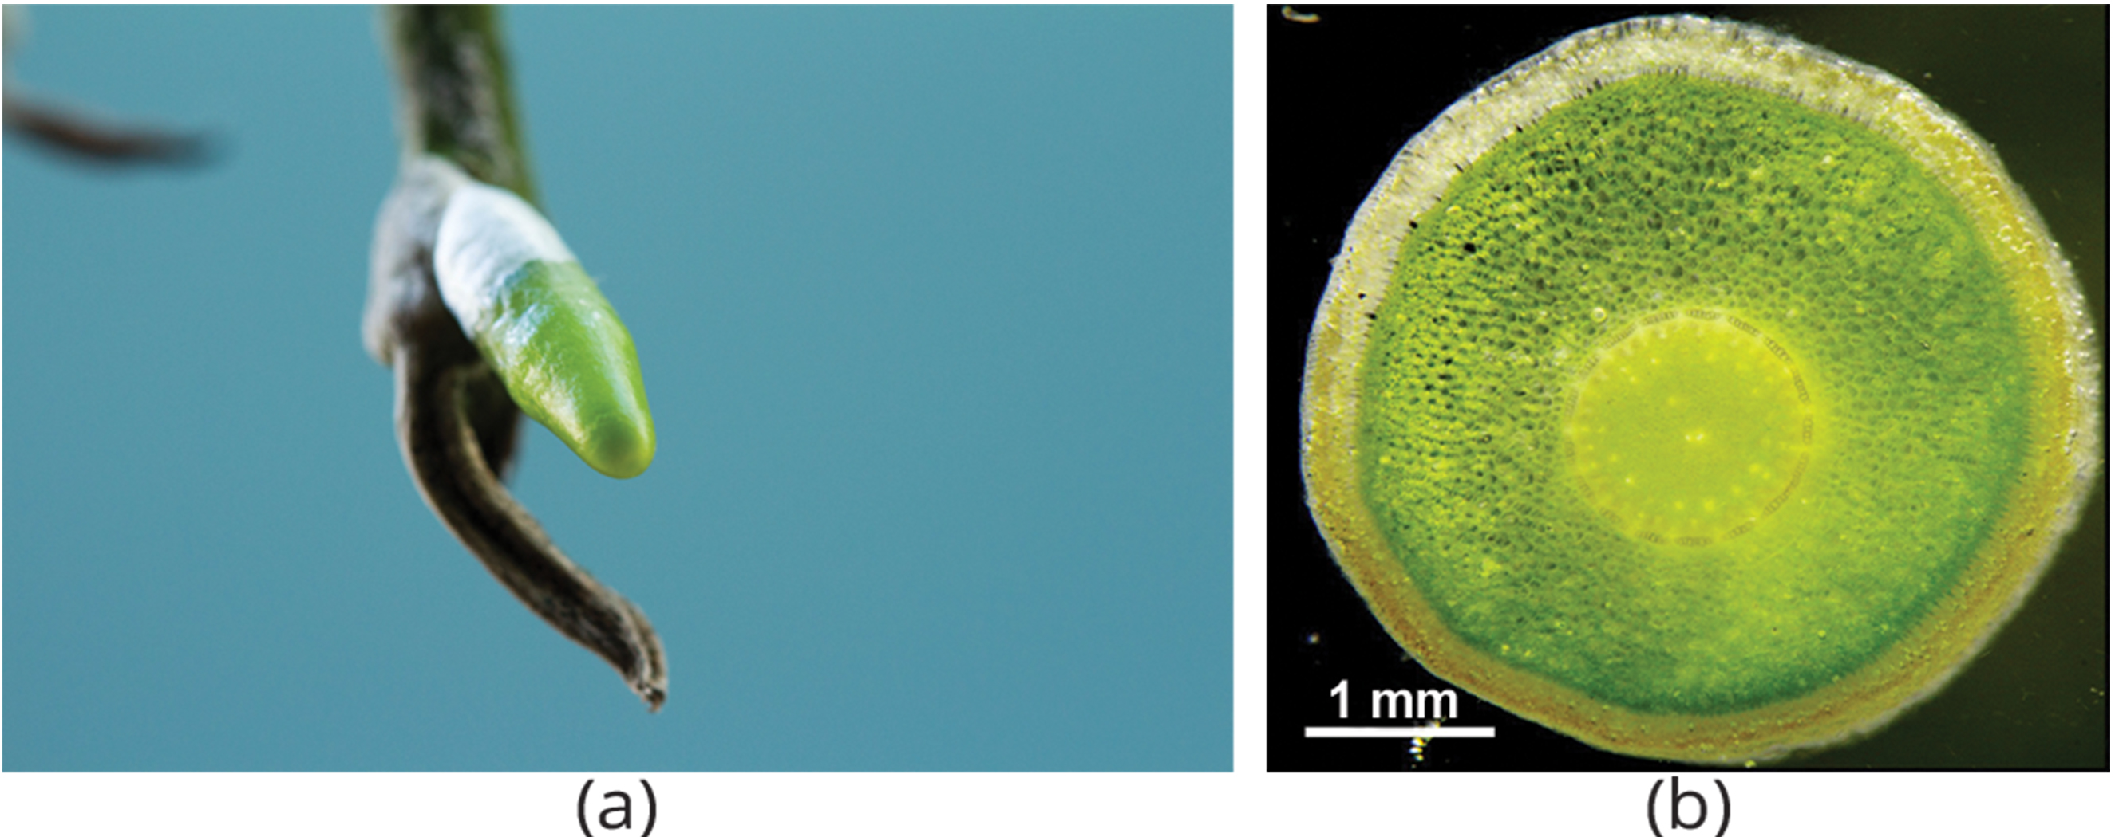
Epiphytic Roots₁
Type of aerial root that enables plants to grow on other plants
Example: thick, spongy epiphytic roots of orchids
Epiphytes: plants with epiphytic roots
Do not harm their hosts; only use them for support
30.3 Figure 7: (a) Pictured is the growing root tip of an epiphytic orchid. (b) This is a cross section of an orchid root showing spongy tissue that is used to absorb moisture.
MATHIAS, M H on Wikimedia Commons. "Orchid aerial root."
J. Ponert on Wikimedia Commons. "Orchid root cross section."

Slide 14
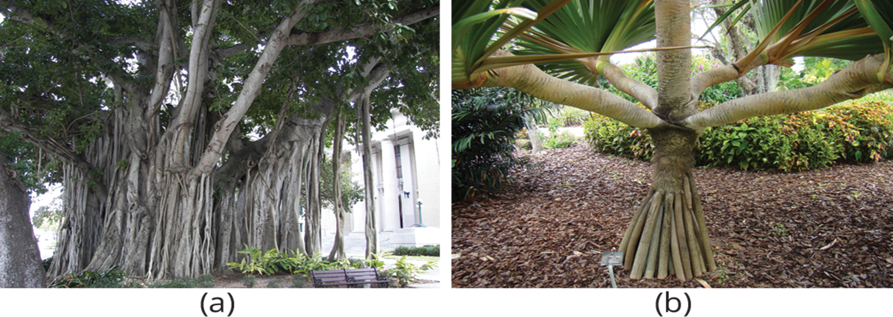
Epiphytic Roots₂
Most epiphytes do not harm their hosts, but an exception is the banyan tree (Ficus sp.), or strangler fig.
Begins as an epiphyte, germinating in the branches of a host tree
Develops aerial roots from the branches and eventually reaches the ground
Coils root system over the host, "strangling" it and eventually killing it
30.3 Figure 8: The (a) banyan tree, also known as the strangler fig, begins life as an epiphyte in a host tree. Aerial roots extend to the ground and support the growing plant, which eventually strangles the host tree of a different species, such as an oak or palm tree. (b) The screwpine develops aboveground roots that help support the plant in sandy soils.
Wknight94 on Wikimedia Commons. "Banyan tree."
Asit K. Ghosh on Wikimedia Commons. "Screwpine."

Slide 15
Science and You
Table sugar is produced from two major crop plants.
Sap from cane sugar comes from tropical grass of the Saccharum genus.
Sugar beets (Beta vulgaris) are used outside of the tropics.
Contain high concentrations of sucrose stored in tubers, which are thinly sliced to extract it
Sugar is crystallized by remove excess water by boiling.
Notes:
This is included as a relevant application for this topic.

Slide 16
Summary
Roots anchor plants, absorb water and minerals, and store food.
Tap roots grow vertically downward with few lateral roots.
Fibrous roots arise at the base of the stem with a dense network shallower than a tap root.
The root tip is protected by a root cap and has three growth zones: cell division, elongation, and maturation.
Root vascular tissue conducts water, minerals, and sugars.
Some roots are modified for specific functions (e.g., aerial, epiphytic).

Slide 17

End of Hawkes Learning PowerPoint

