Slide 1
Lesson 30.4
Leaves

Slide 2
Objectives
Compare and contrast simple leaves and compound leaves.
Describe the internal structure and function of a leaf.
Identify the parts of a typical leaf.
List and describe examples of modified leaves.

Slide 3
Leaves
Main sites for photosynthesis in plants
Usually green due to chlorophyll, but can have other colors
Thickness, shape, and size adapted to the environment
Maximizes chances of survival in particular habitats
Example: larger surface areas in tropical rainforests and smaller surface areas in desert or cold climates to minimize water loss

Slide 4
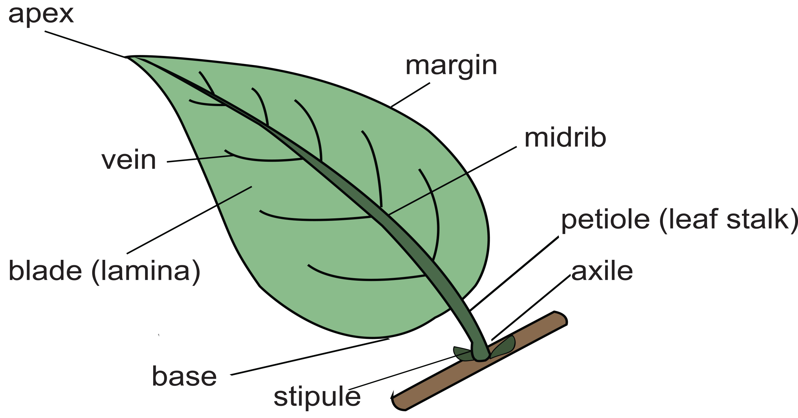
Structure of a Typical Leaf
Lamina: leaf blade; widest part of the leaf
Petiole: attaches leaf to stem
Sessile: leaves that lack petioles; attach directly to stem
Stipules: small, green appendages at base of petiole
Midrib: central vein branching into smaller veins
Margin: edge of the leaf
30.4 Figure 1: Deceptively simple in appearance, a leaf is a highly efficient structure.

Slide 5
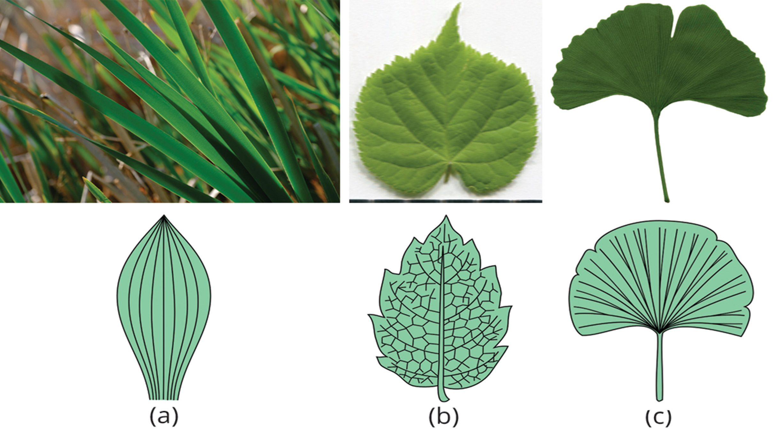
Leaf Venation
Venation is the arrangement of veins in a leaf.
Differs in monocots and dicots
Monocots: parallel venation (straight veins)
Dicots: reticulate venation (netlike pattern)
Ginkgo biloba: dichotomous venation (forking veins)
30.4 Figure 2: (a) Grass, a monocot, has leaves with parallel venation. (b) The netlike venation in this linden (Tilia cordata) leaf distinguishes it as a dicot. (c) The Ginkgo biloba tree has dichotomous venation.
Peter Balcerzak on Wikimedia Commons. "Grass blades."
Dmitry Makeev on Wikimedia Commons. "Tilia cordata leaf."
Andrew Butko on Wikimedia Commons. "Ginkgo biloba leaf."

Slide 6
Think It Through₁
Explain the difference between parallel and reticulate venation.
Notes:
Originally an On Your Own. This is included here to use as a talking point or for a think-pair-share activity.

Slide 7
Leaf Arrangement (Phyllotaxy)
The arrangement of leaves on a stem is phyllotaxy.
Varies depending on species
Classified as either alternate, spiral, or opposite
Alternate: one leaf per node, alternating sides
Spiral: one leaf per node, arranged in a spiral
Opposite: two leaves per node, directly across from each other
Decussate: opposite leaves with each pair at right angles to the next
Whorled: three or more leaves per node

Slide 8
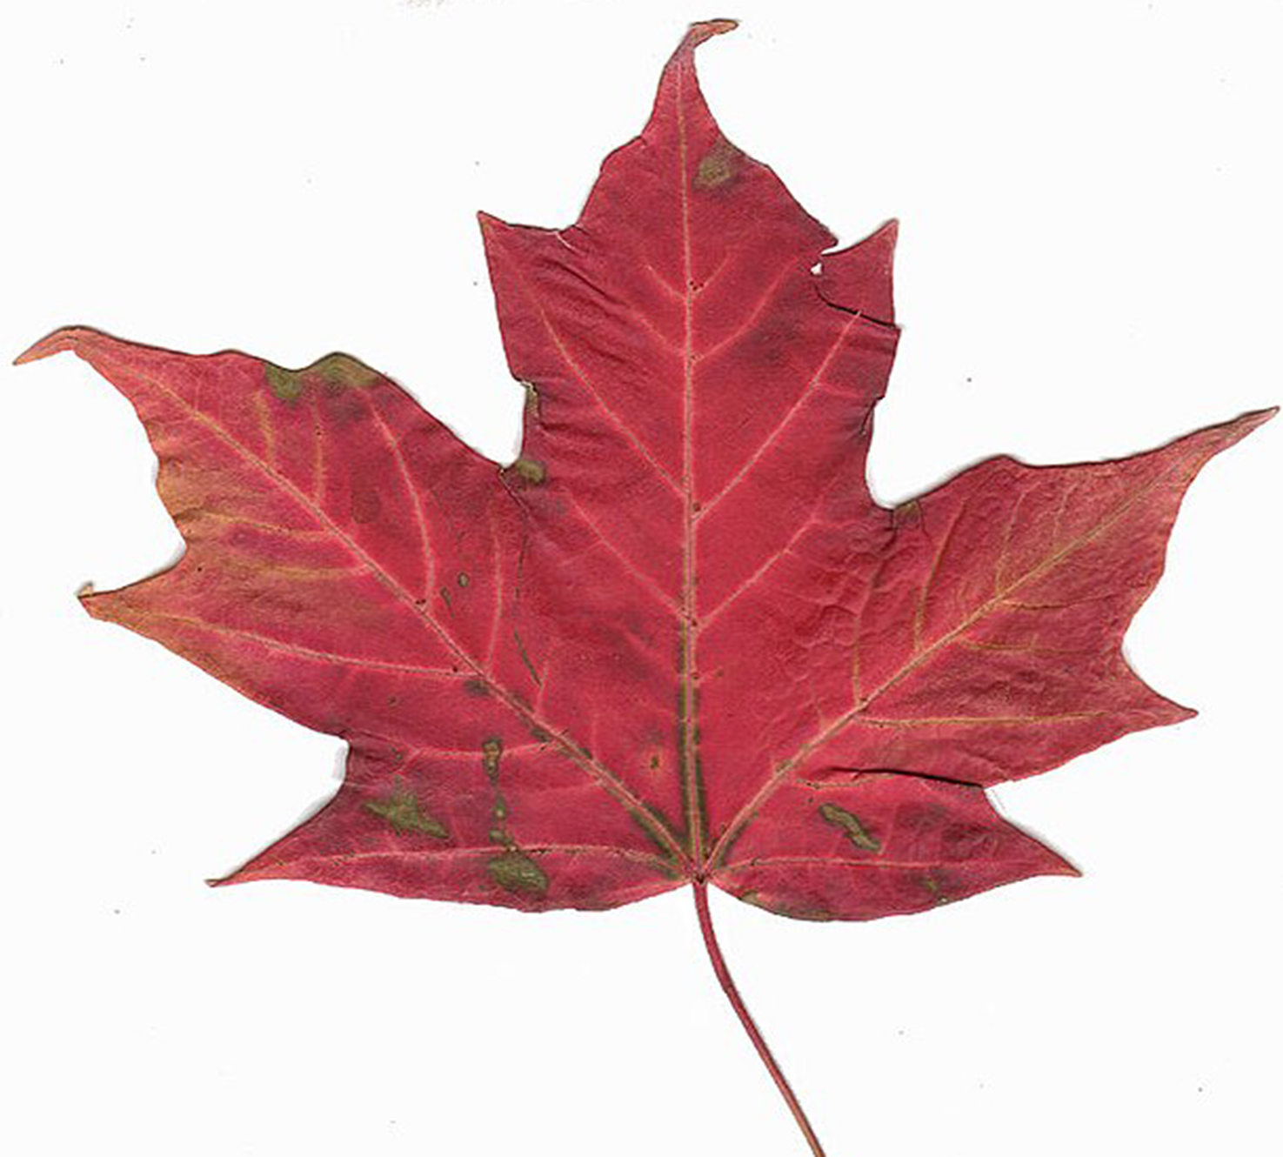
Simple and Compound Leaves
Leaves can be simple or compound.
Simple leaf: either completely undivided blade (banana leaf) or lobed but not reaching midrib (maple leaf)
Compound leaf: completely divided blade forming leaflets (locust tree)
Leaflets attached to the rachis; might have their own stalks
30.4 Figure 3: The maple leaf is a simple leaf because while the lobes are separated, this separation does not reach the midrib.
Samir on Wikimedia Commons. "Canadian maple leaf."

Slide 9
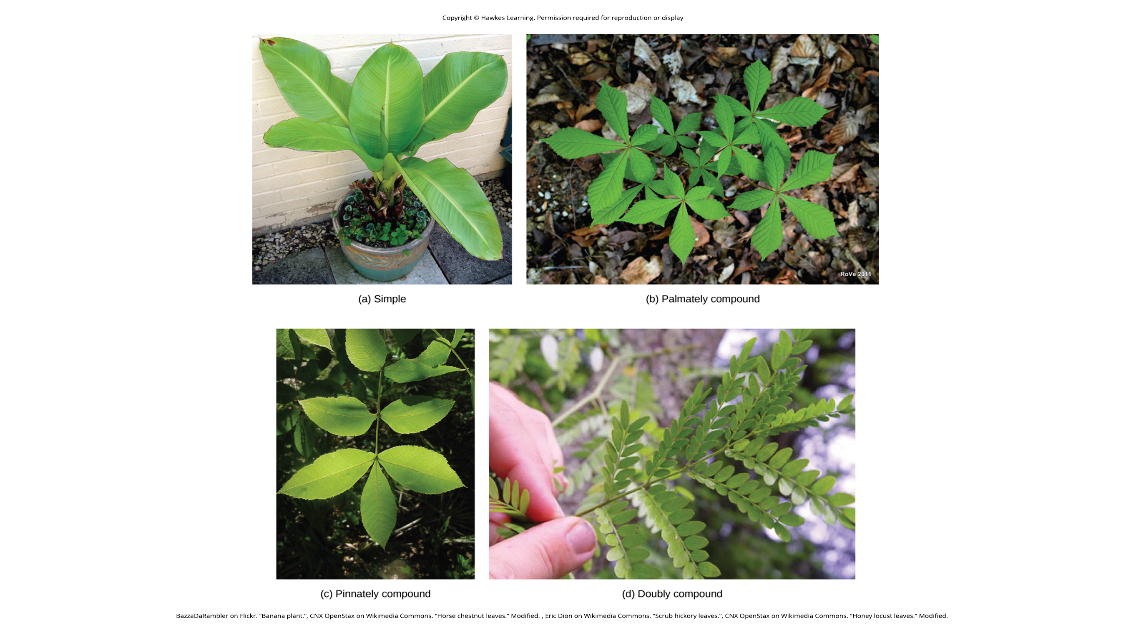
Palmately and Pinnately Compound Leaves
Palmately compound leaf: leaflets radiate from one point; resembles palm of a hand
Examples: poison ivy, buckeye tree, and Schefflera sp.
Pinnately compound leaf: leaflets arranged along midrib; feather-like appearance
Examples: rose leaves (Rosa sp.), hickory, pecan, ash, and walnut trees
30.4 Figure 4: Leaves may be simple or compound. (a) The banana plant (Musa sp.) has simple leaves. (b) The horse chestnut (Aesculus hippocastanum) has palmately compound leaves. (c) The scrub hickory (Carya floridana) has pinnately compound leaves. (d) The honey locust has double compound leaves.
BazzaDaRambler on Flickr. "Banana plant."
CNX OpenStax on Wikimedia Commons. "Horse chestnut leaves." Modified.
Eric Dion on Wikimedia Commons. "Scrub hickory leaves."
CNX OpenStax on Wikimedia Commons. "Honey locust leaves." Modified.

Slide 10
Think It Through₂
Identify the leaf form that corresponds with each of the following descriptions.
Leaf blade undivided
Leaflets radiate outwards from one point, resembling palm of hand
Feather-like appearance with leaflets arranged along the midrib
Leaf blade completely divided, forming leaflets
Notes:
Originally an On Your Own. This is included here to use as a talking point or for a think-pair-share activity.

Slide 11
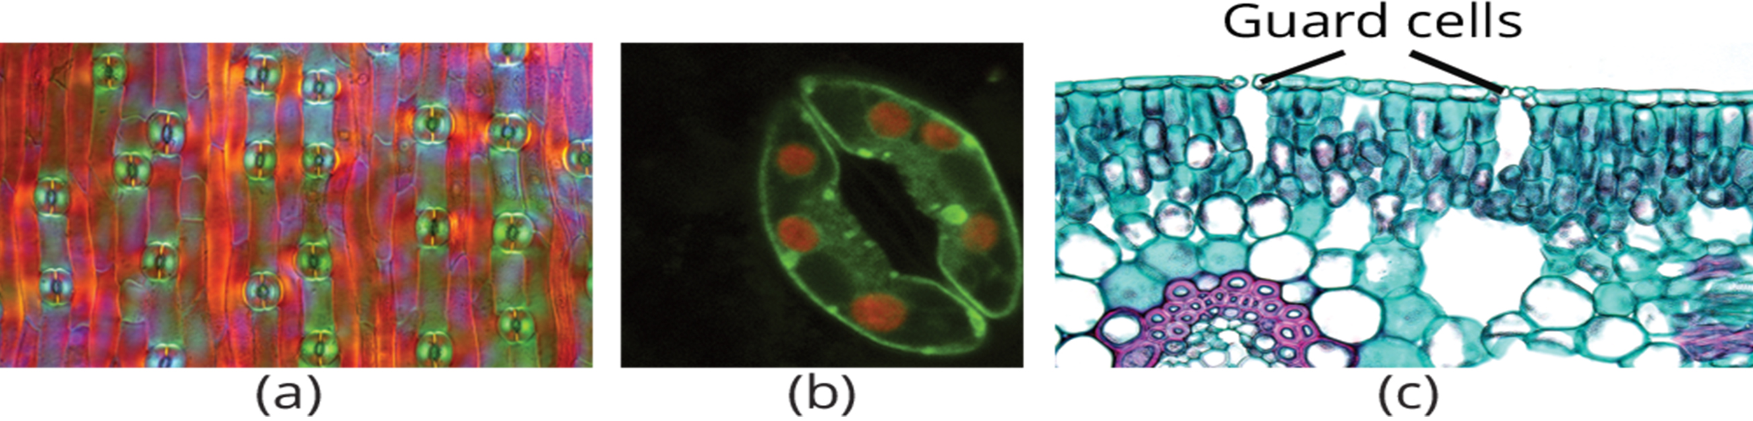
Leaf Structure and Function
Epidermis: outermost layer on top and bottom of leaf
Helps in regulation of gas exchange
Adaxial surface: upper side (also, adaxis)
Abaxial surface: lower side (also, abaxis)
Stomata: openings in epidermis for gas exchange
Surrounded by two guard cells to regulate opening and closing
30.4 Figure 5: (a) Several stomata are clearly visible on the surface of a tulip leaf. (b) A single stoma has the appearance of lips that surround the opening. (c) In this cross section of a leaf, the guard cell pair is visible along with the large, sub-stomatal air space in the leaf.
MarekMiś on Wikimedia Commons. "Stomata in tulip leaf epidermis."
Alex Costa on Wikimedia Commons. "Stomata."
Berkshire Community College Bioscience Image Library on Wikimedia Commons. "Cross section of leaf."

Slide 12
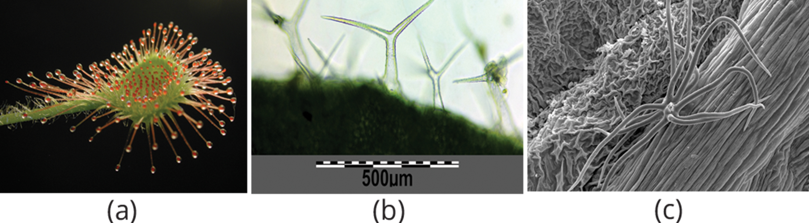
Leaf Epidermis
Usually one cell layer thick, though can be several layers thick in hot or cold conditions
Protects against excessive water loss from transpiration
Cuticle: waxy layer covering the leaf's surface to reduce water loss
Trichomes: small hairs on some leaves
Deter herbivory by restricting insect movements
Store toxic or bad-tasting compounds
Reduce transpiration by blocking air flow on the leaf surface
30.4 Figure 6: Trichomes give leaves a fuzzy appearance, as in this (a) sundew (Drosera sp.). Leaf trichomes include (b) branched trichomes on the leaf of Arabidopsis thaliana and (c) multibranched trichomes on a mature Physocarpus opulifolius leaf.
Petr Dlouhý on Wikimedia Commons. "Sundew leaf."
Stefan.lefnaer on Wikimedia Commons. "Arabidopsis thaliana."
Marchellos1977 on Wikimedia Commons. "Physocarpus opulifolius."

Slide 13
Mesophyll
Comes from the Greek words for middle (meso) and leaf (phullon)
Located between the upper and lower epidermis in dicot leaves
Typically contains two arrangements of parenchyma cells, both with chloroplasts
Palisade parenchyma: column-shaped, tightly packed cells (also, palisade mesophyll)
Spongy parenchyma: loosely arranged cells of irregular shape (also, spongy mesophyll)
Allows gaseous exchange between leaf and atmosphere through the stomata
Helps leaves float in aquatic plants
Guard cells: only epidermal cells to contain chloroplasts

Slide 14
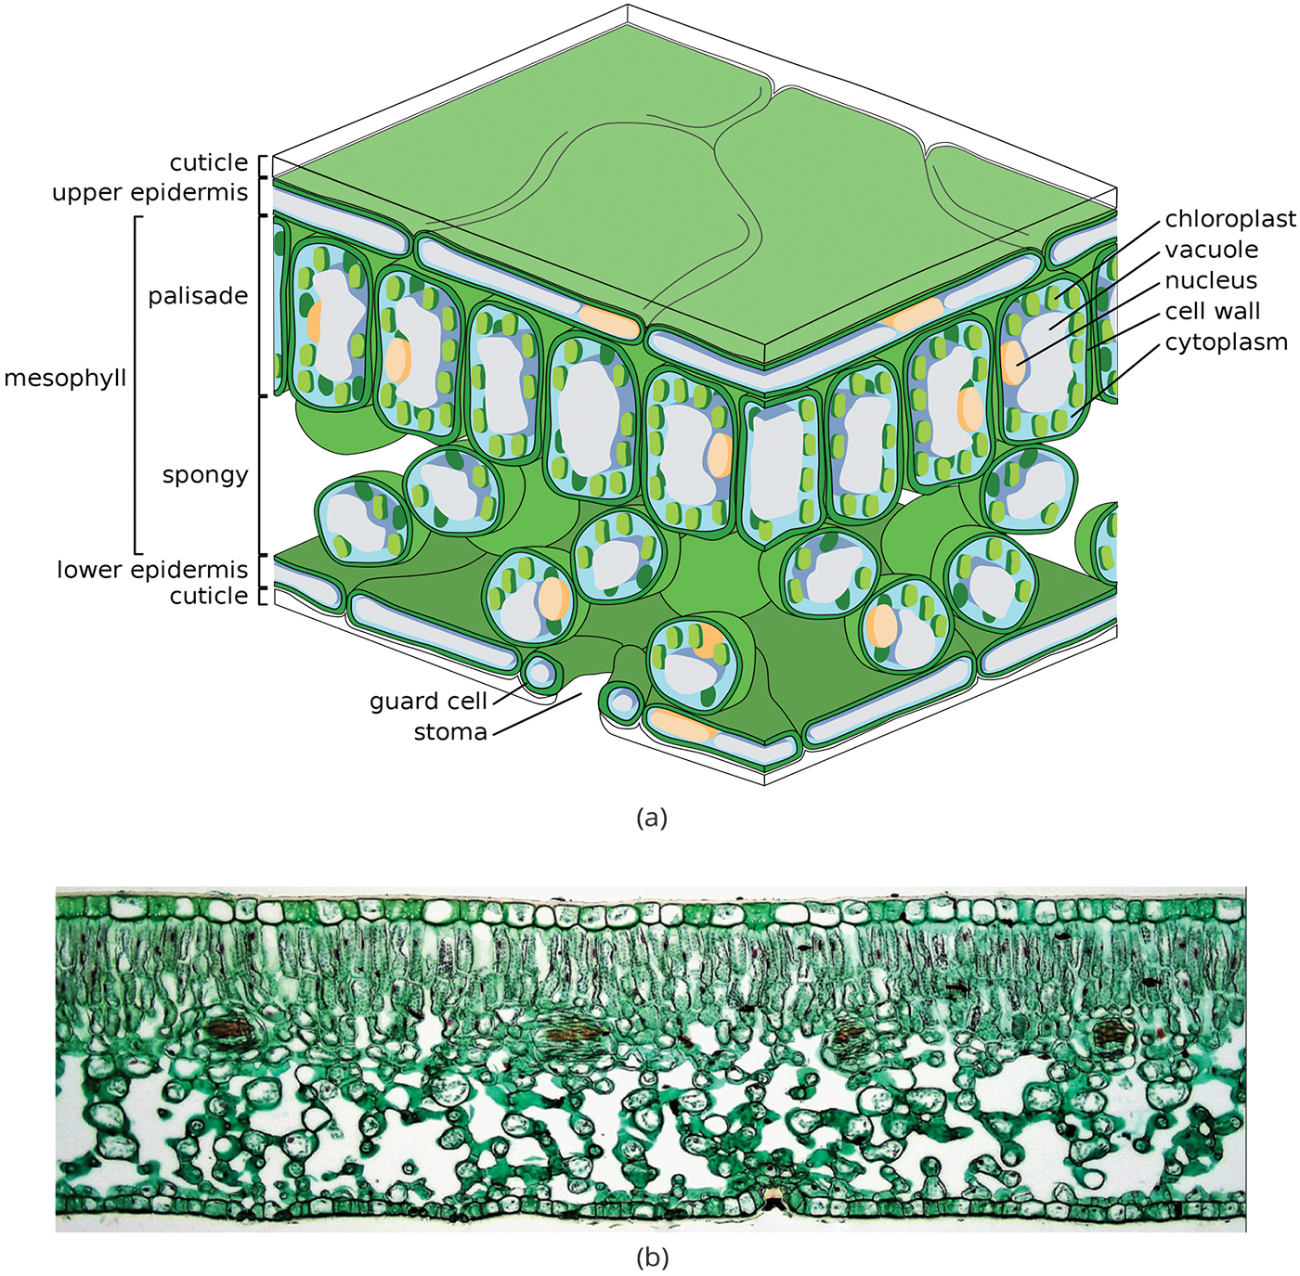
30.4 Figure 7
Zephyris on Wikimedia Commons. "Leaf tissue structure."
Berkshire Community College Bioscience Image Library on Wikimedia Commons. "Ligustrum leaf cross section."
Notes:
(a) In the leaf drawing, the central mesophyll is sandwiched between an upper and lower epidermis. The mesophyll has two layers: an upper palisade layer comprised of tightly packed, columnar cells and a lower spongy layer, comprised of loosely packed, irregularly shaped cells. Stomata on the leaf's underside allow gas exchange. A waxy cuticle covers all aerial surfaces of land plants to minimize water loss. (b) These leaf layers are clearly visible in the 100X cross section of a Ligustrum leaf.

Slide 15
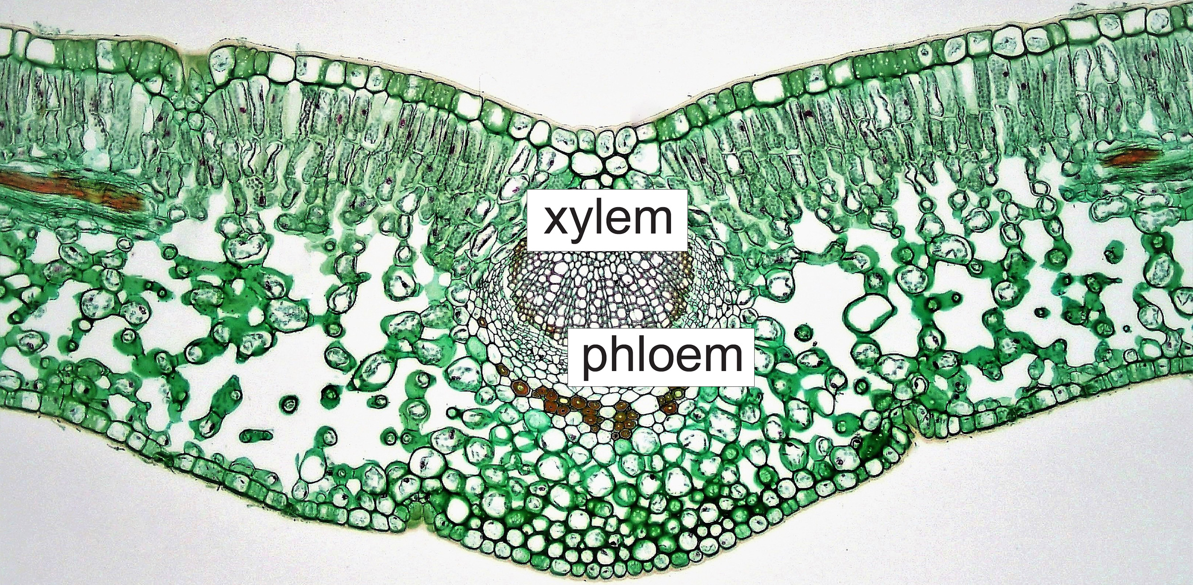
Vascular Bundles
Composed of xylem and phloem tissues
Xylem: consists of tracheids and vessels; transports water and minerals to leaves
Phloem: transports photosynthetic products from leaves to other parts of the plant
Always contain both xylem and phloem, regardless of vascular bundle size
30.4 Figure 8: This cross section of leaf tissue shows xylem and phloem in the vascular bundle of a Ligustrum leaf.
Berkshire Community College Bioscience Image Library on Wikimedia Commons. "Midrib tissues."

Slide 16
Leaf Adaptations
In cold environments:
Coniferous plants (spruce, fir, pine) have needlelike leaves with sunken stomata and smaller surface area.
Aid in reducing water loss
In hot environments:
Cacti have spine leaves and succulent stems that help to conserve water.
In aquatic environments:
Plants have wide lamina for floating and a waxy cuticle to repel water.

Slide 17
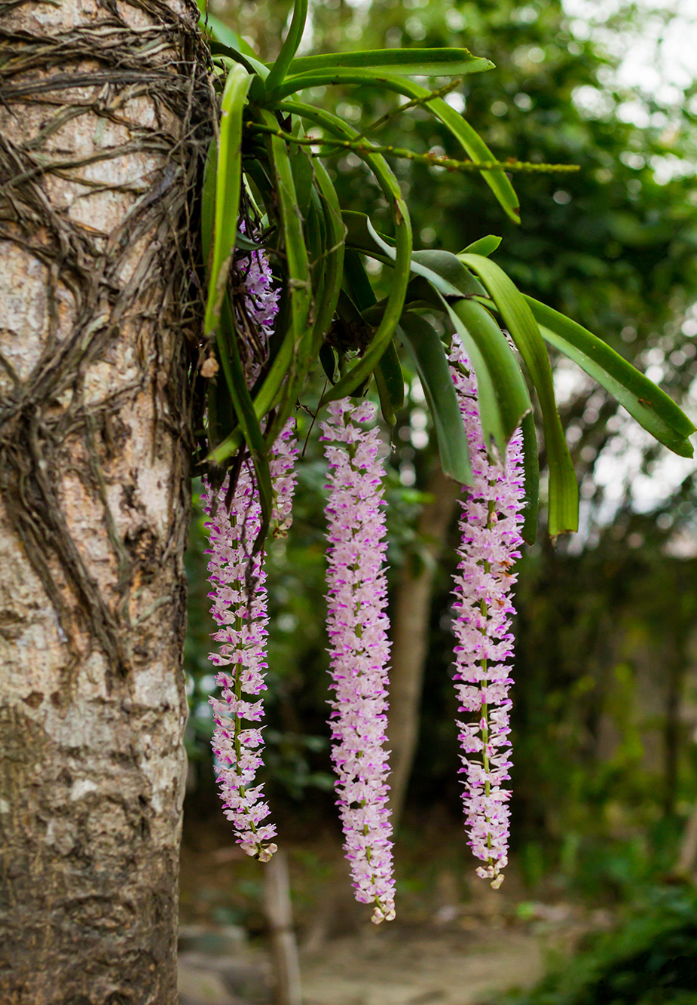
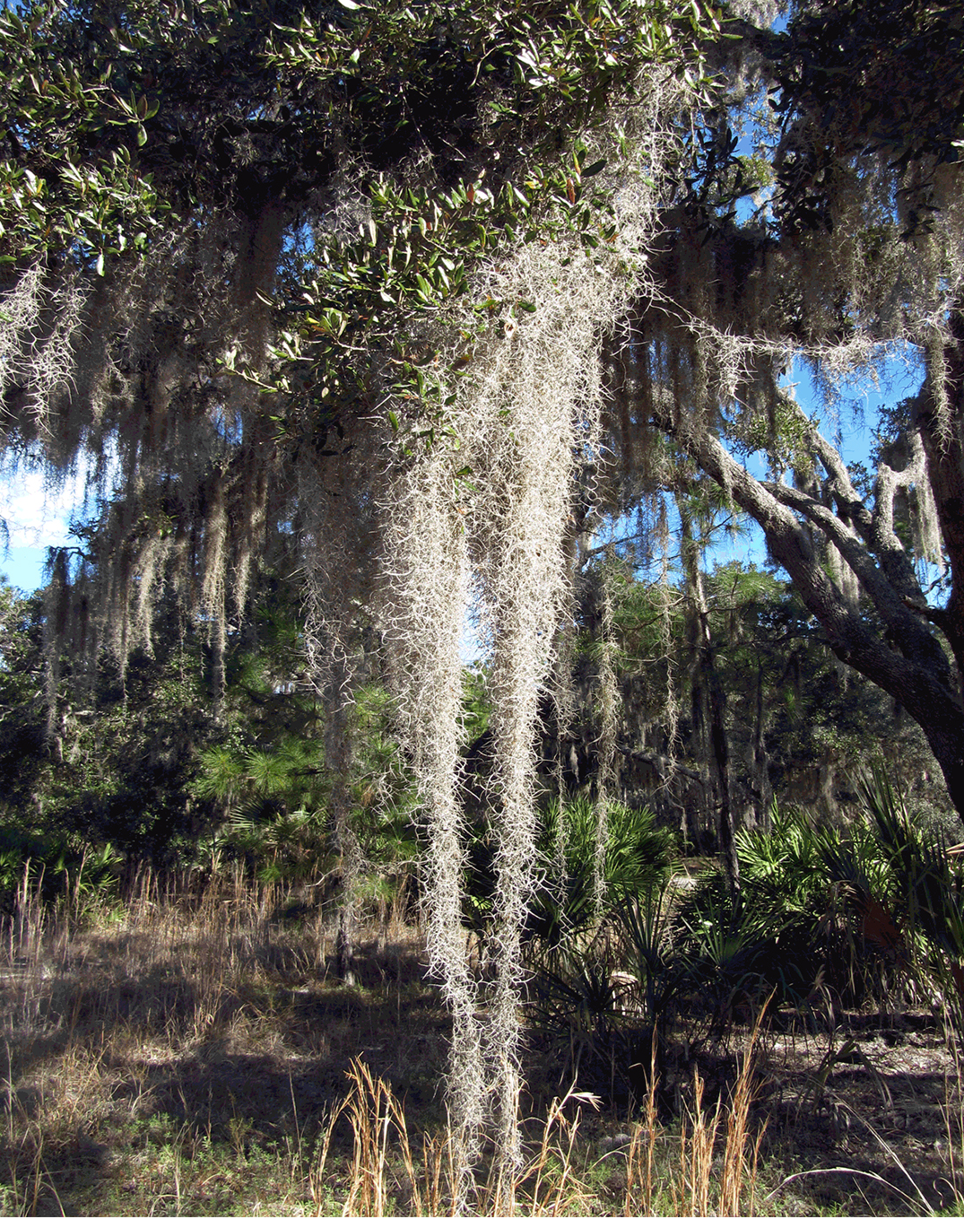
Plant Adaptations in Resource-Deficient Environments₁
In the tropical rainforest, light is scarce, so many plants have broad leaves to maximize sunlight capture.
Others are epiphytes and grow on other plants that serve as physical supports and sources of rain and minerals.
Have specialized tissues to capture and store water
Examples: bromeliads (pineapple family), ferns, and orchids
30.4 Figure 9: One of the most well-known bromeliads is Spanish moss (Tillandsia usneoides), shown here in an oak tree.
30.4 Figure 10: Pictured is an epiphytic orchid.
Pranab Kumar Ojah on Wikimedia Commons. "Foxtail orchid."
Homer Edward Price on Wikimedia Commons. "Spanish moss."

Slide 18
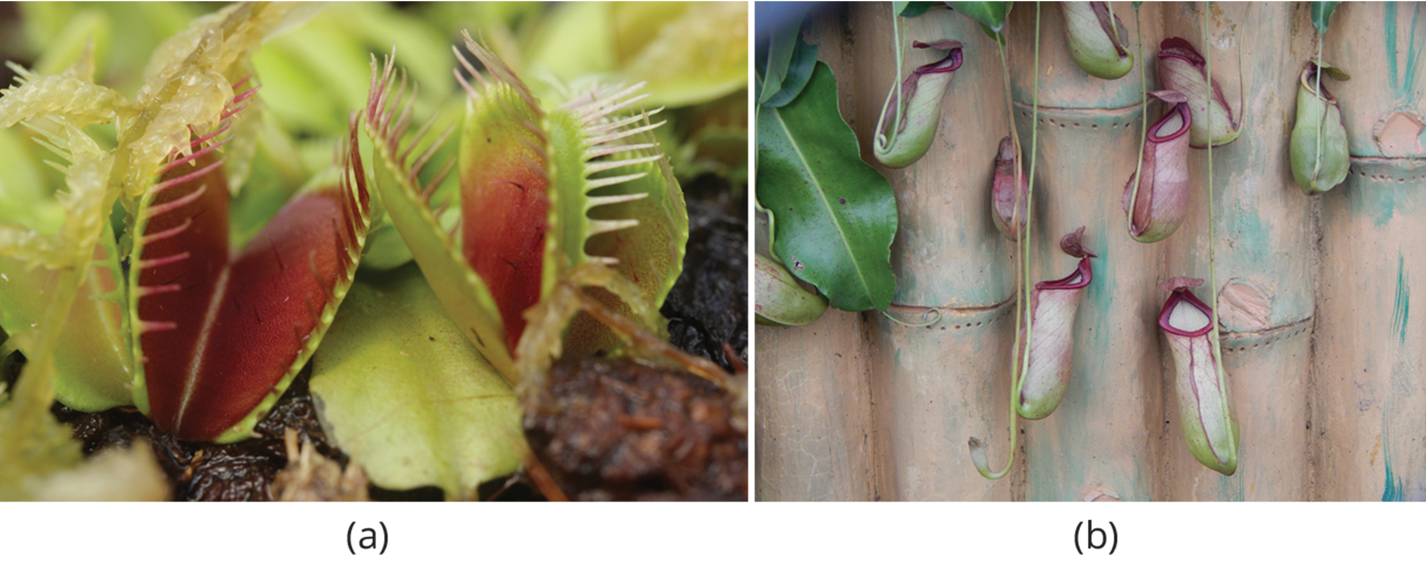
Plant Adaptations in Resource-Deficient Environments₂
Some plants have special adaptations to survive in nutrient-poor environments.
Carnivorous plants have modified leaves to capture insects for nitrogen.
Grow in bogs where soil is low in nitrogen
Examples: Venus flytrap and pitcher plants
30.4 Figure 11: (a) The Venus flytrap has modified leaves that can capture insects. When an unlucky insect touches the trigger hairs inside the leaf, the trap suddenly closes. (b) The opening of the pitcher plant is lined with a slippery wax. Insects crawling on the lip slip and fall into a pool of water in the bottom of the pitcher, where they are digested by bacteria. The plant then absorbs the smaller molecules.
Björn S… on Wikimedia Commons. "Venus flytrap."
Chinmayee Mishra on Wikimedia Commons. "Pitcher plant."

Slide 19
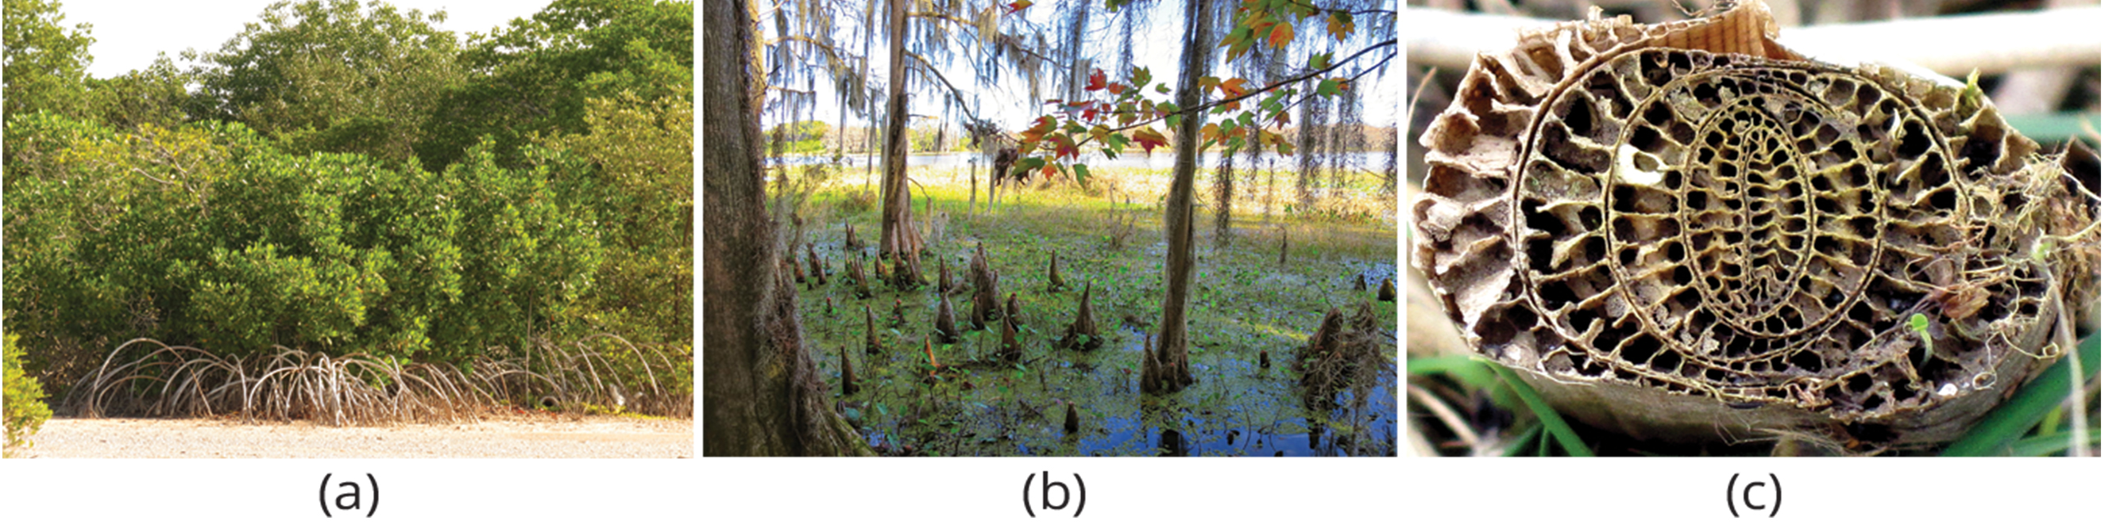
Plant Adaptations in Resource-Deficient Environments₃
Swamp plants have adaptations that enable them to thrive in wet areas.
Grow roots submerged underwater
Unstable soil and little oxygen to reach the roots
Example: mangroves (Rhizophora sp.) producing aboveground roots for support in coastal waters
Pneumatophores: specialized roots for gas exchange in aquatic environments
Example: wild rice having large air spaces in their roots
Aerenchyma: air-filled tissue in aquatic plant roots for oxygen diffusion
30.4 Figure 12: (a) The branches of mangrove trees develop aerial roots. (b) Cypress trees and some mangrove species have upward-growing roots, called pneumatophores. (c) Aquatic plants, such as the common bulrush, have large spaces in the stem and root cortex called aerenchyma.
Katja Schulz on Wikimedia Commons. "Red mangroves."
Art Anderso on Wikimedia Commons. "Cypress knees."
Bj.schoenmakers on Wikimedia Commons. "Common bulrush."

Slide 20
Summary
Leaves are primary photosynthetic organs with diverse adaptations.
Typical leaf structure includes a lamina, petiole, and various tissue layers (epidermis, mesophyll, vascular tissue).
Leaf arrangement (alternate, opposite, spiral, whorled) and form (simple, compound) vary among plant species.
Specialized leaf structures (needles, spines, etc.) exist for different environmental conditions.

Slide 21

End of Hawkes Learning PowerPoint

