Slide 1
Lesson 30.5
Transport of Water and Nutrients in Plants

Slide 2
Objectives
Define water potential and explain how it is influenced by solutes, pressure, gravity, and the matric potential.
Describe how water potential, evapotranspiration, and stomatal regulation influence how water is transported in plants.
Explain how photosynthates are transported in plants.

Slide 3
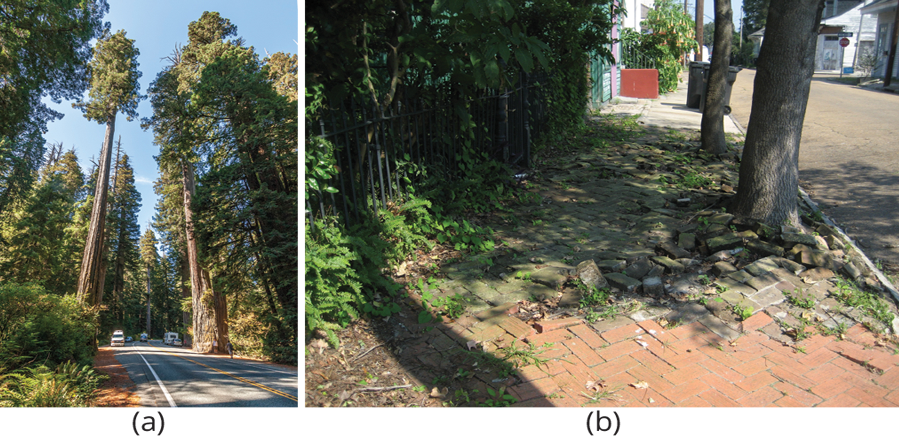
Transport of Water and Nutrients in Plants
Plants move water, nutrients and photosynthates throughout their system using xylem and phloem.
Water potential, evapotranspiration and stomata regulation influence this transportation system.
30.5 Figure 1: (a) Coastal redwoods (Sequoia sempervirens) are the tallest trees in the world. Plant roots can easily (b) buckle and break sidewalks.
Acroterion on Wikimedia Commons. "Redwood trees."
Infrogmation on Wikimedia Commons. "Bywater neighborhood."

Slide 4
Water Potential₁
Water potential is the measure of the potential energy in water.
Water potential is denoted by the Greek letter Ψ (psi) and is expressed in units of pressure called megapascals (Mpa).
The potential of pure water (Ψ_{w}pure^{H20}) is zero.
Water potential values for water inside of a plant are expressed relative to Ψ_{w}pure^{H20}.

Slide 5
Water Potential₂
Water potential in plants can be influenced by solute concentration(Ψ_{s}), pressure (Ψ_{p}), gravity(Ψ_{g}) and matrix effects(Ψ_{m}).
Water potential can be calculated using the equation,
Ψ_{system}= Ψ_{total}= Ψ_{s}+ Ψ_{p}+ Ψ_{g}+ Ψ_{m}.
Ψ_{system} can refer to the water potential of soil water(Ψ^{soil}), root water (Ψ^{root}), stem water (Ψ^{stem}), or leaf water (Ψ^{leaf}), or water in the atmosphere (Ψ^{atmosphere}).
For water to move through the plant from the soil to the air,
Ψ^{soil} must be > Ψ^{root}> Ψ^{stem}> Ψ^{leaf}> Ψ^{atmosphere}.

Slide 6
Solute Potential₁
Solute potential (Ψ_{s}) (also called the osmotic potential) is related to the solute concentration and is defined by the following equation.
Ψ_{s} = -iCRT
i = the osmotic coefficient
C = the concentration in moles of solute per liter of solution
R = ideal gas constant
T = temperature in Kelvin

Slide 7
Solute Potential₂
The solute potential in a plant is negative, and zero in distilled water.
The amount of available potential energy is reduced when solutes are added to an aqueous system.
The internal water potential of a plant cell is more negative than pure water and this difference causes water to move from the soil into plant roots.
Plant cells can manipulate Ψ_{s} by adding or removing solute molecules. Plants have control over Ψ_{total} by their ability to modify Ψ_{s} .

Slide 8
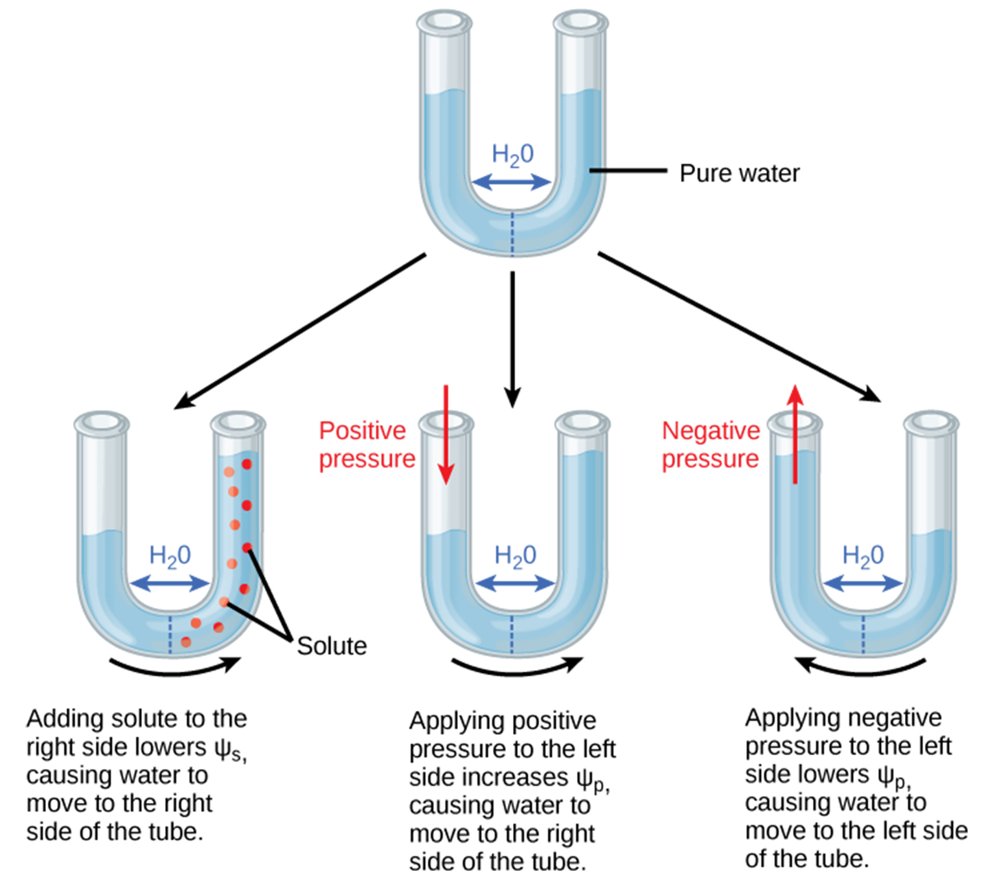
30.5 Figure 2
CNX OpenStax on Wikimedia Commons. "Semipermeable membrane."
Notes:
Figure 2: In this example with a semipermeable membrane between two aqueous systems, water will move from a region of higher water potential to a region of lower water potential until equilibrium is reached. Solutes (Ψs), pressure (Ψp), and gravity (Ψg) influence total water potential for each side of the tube (Ψtotalright or left) and, therefore, the difference between Ψtotal on each side (ΔΨ). (Ψm, the potential due to interaction of water with solid substrates, is ignored in this example because glass is not especially hydrophilic.) Water moves in response to the difference in water potential between two systems (the left and right sides of the tube).

Slide 9
Think It Through
Consider a U-shaped tube, as shown in Figure 2, with the two sides separated by a semipermeable membrane and with equal water level on each side. Then, positive pressure is applied to the left side, increasing Ψ_{p} such that the water level rises on the right side.
Could you equalize the water level on each side of the tube by adding solute, and if so, how?
Notes:
Originally an On Your Own. This is included here to use as a talking point or for a think-pair-share activity.

Slide 10
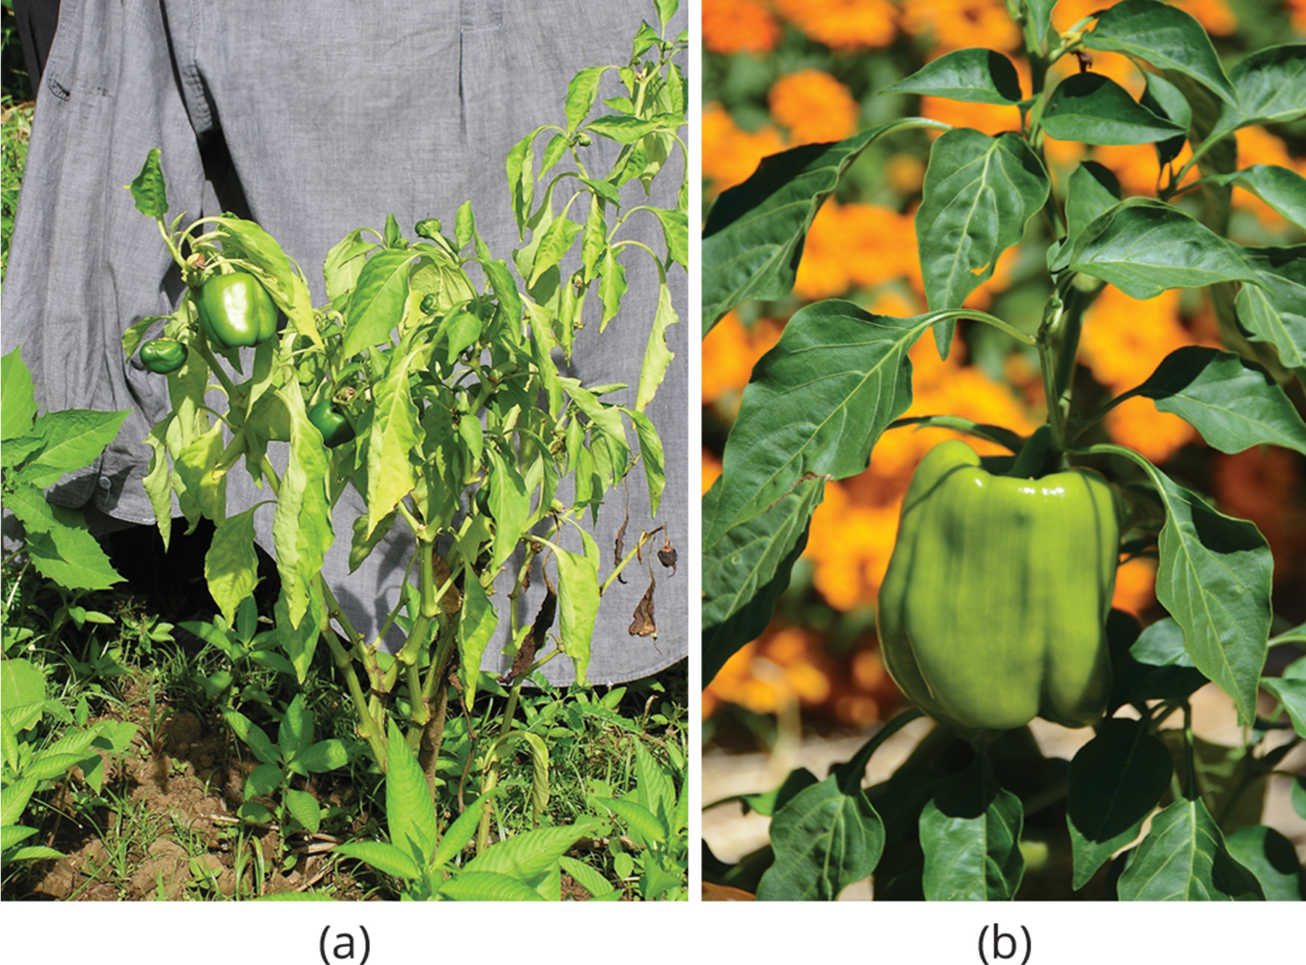
Pressure potential₁
Pressure potential is also called turgor potential.
Can be negative or positive pressure
Effects of turgor pressure can be seen when watering a wilted plant.
30.5 Figure 3: (a) When total water potential (Ψ_{total}) is lower outside the cells than it is inside, water moves out of the cells, and the plant wilts. (b) When the total water potential is higher outside the plant cells than it is inside, water moves into the cells, resulting in turgor pressure (Ψ_{p}) and keeping the plant erect.
Scot Nelson on Wikimedia Commons. "Bacterial wilt of bell pepper."
Rob Bertholf on Wikimedia Commons. "Bell pepper."

Slide 11
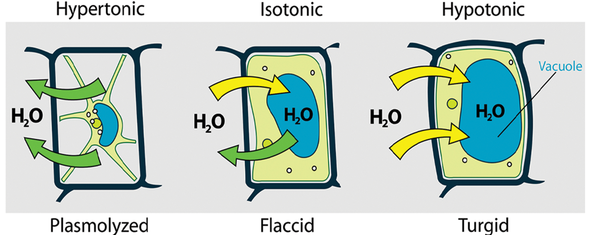
Pressure Potential₂
A plant can manipulate Ψ_{p} by manipulating Ψ_{s} and the use of osmosis.
If a plant cell increase cytoplasmic solute concentration compared to surrounding tissues, water will move into the cell by osmosis.
Ψ_{p} is also under indirect plant control through the opening and closing of stomata.
30.5 Figure 4
Mariana Ruiz Villarreal on Wikimedia Commons. "Turgot pressure diagram."
Notes:
Figure 4: An extreme lack of water outside of the cell results in a hypertonic extracellular environment (an environment with a greater solute concentration than the interior of the cell). In a hypertonic environment, water leaves the cell in a process called plasmolysis (which can also result in a plant cell detaching from the cell wall). When a plant cell is in an isotonic environment (an environment with the same solute concentration as the interior of the cell), water flows equally in both directions (into and out of the cell). These cells become flaccid (the cell is not swollen and its membrane is not tightly pressed against the cell wall), resulting in wilting. When a plant cell is in a hypotonic environment (an environment with a lower solute concentration than the interior of the cell), water moves into the cell, causing it to become turgid (swollen and with its cell membrane tightly pressed against the cell wall). Plants that have sufficient turgor pressure can prevent wilting.

Slide 12
Reflection Question
Remember, water moves from areas of high water potential to areas of low water potential. When water potential is high inside the cell and low outside of the cell, water flows out of the cell and the pressure potential in the cell decreases, leading to wilting.
What are some situations in which water potential would be higher inside the cell than out?
What mechanism do plants have to decrease water potential in their cells to prevent water loss?
Notes:
The reflection question is included here to use as a talking point or for a think-pair-share activity.

Slide 13
Gravity Potential
Gravity potential is due to the position of water in relation to Earth's gravitational field.
Gravity potential ( Ψ_{g}) is always negative to zero, with water higher above ground having a greater (less negative) gravity potential than water closer to ground.
As plants get taller, the effect of Ψ_{g} on water transportation increases.

Slide 14
Matric Potential
Matric Potential is due to the adhesion of water molecules to the nondissolved structures of the system, such as the cell walls or plasma membranes.
Matric potential (Ψ_{m}) is always negative to zero.
The binding of water to a matrix always removes potential energy from the system
Ψ_{m} can not be manipulated by the plant and is typically ignored in well-watered roots, stems and leaves.

Slide 15
Movement of Water and Minerals in the Xylem
The transport of water throughout the plant is driven by differences in water potential.
Transpiration (the loss of water from a plant through evaporation at the leaf surface) is the main driver of water movement in the xylem.
At night, when stomata cells are closed and transpiration stops, water is held in the stem and leaf by the adhesion of water to the cell walls of the xylem vessels and tracheids, and the cohesion of water molecules to each other (cohesion theory of sap ascent)

Slide 16
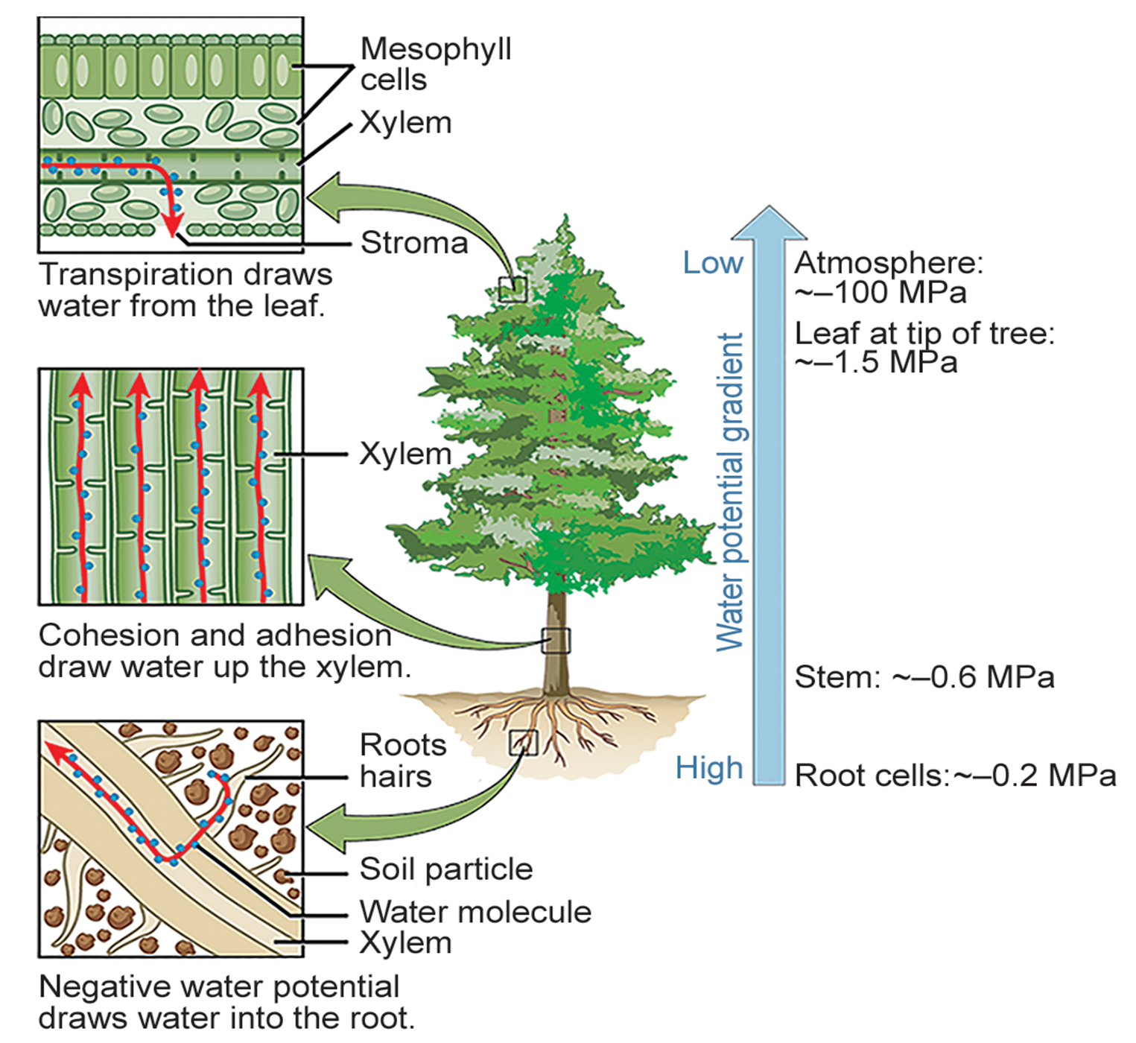
30.5 Figure 5
CNX OpenStax on Wikimedia Commons. "Cohesion-tension theory."
Notes:
Figure 5: The cohesion-tension theory of sap ascent is shown. Evaporation from the mesophyll cells produces a negative water potential gradient that causes water to move upwards from the roots through the xylem.

Slide 17
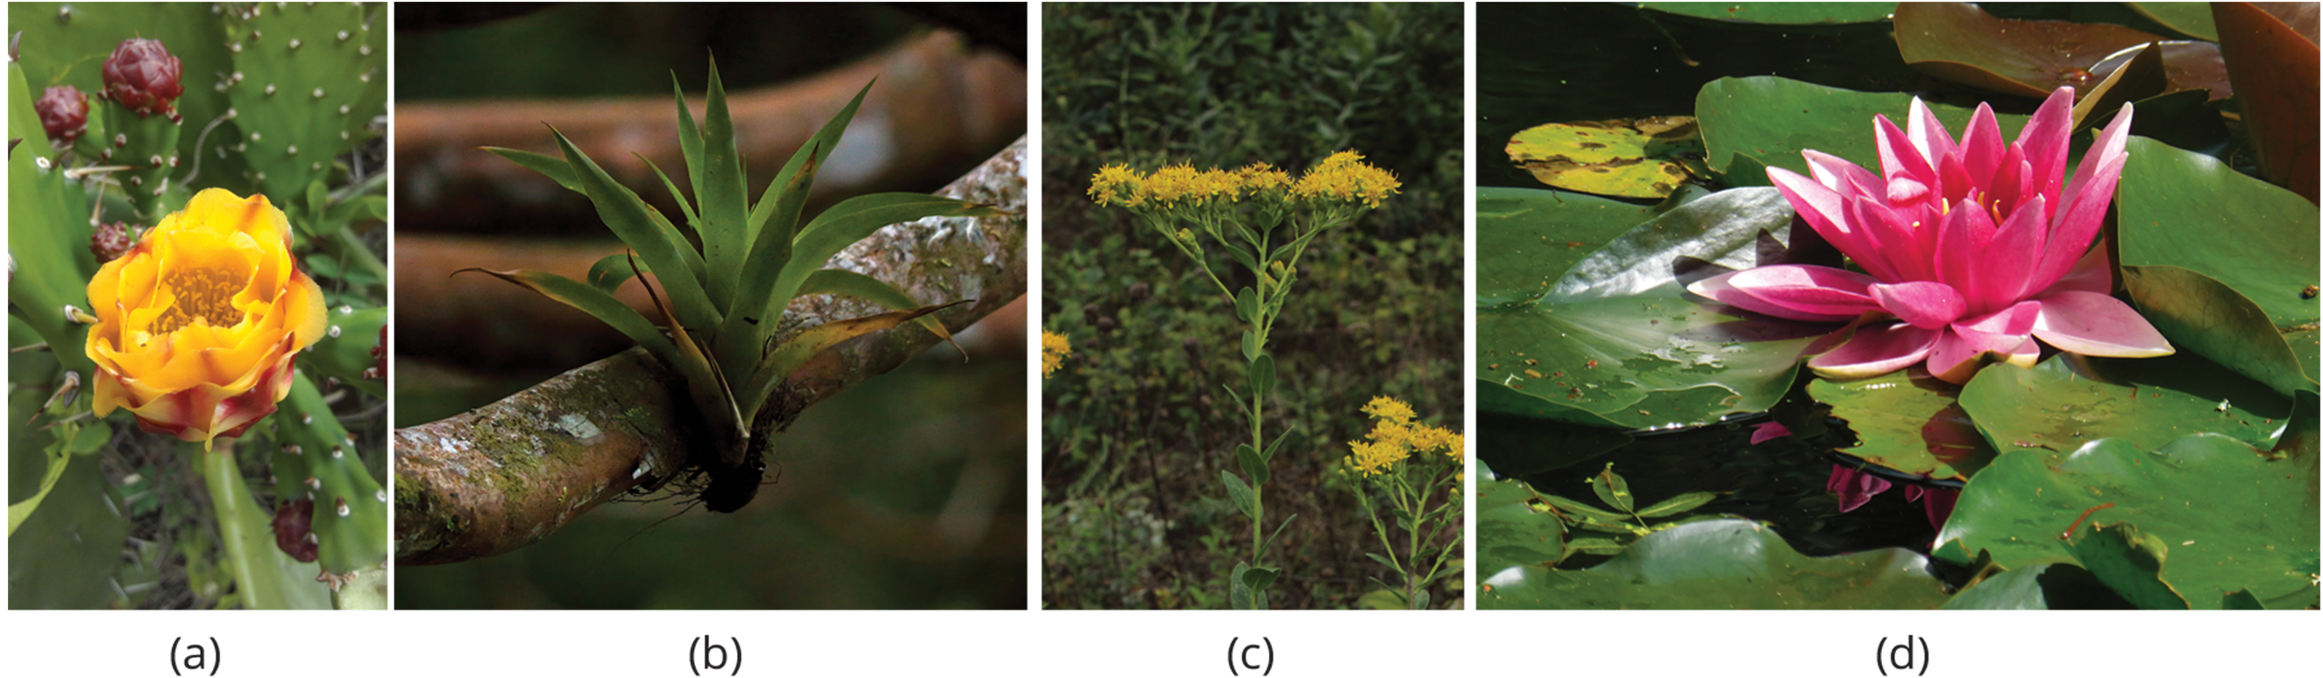
Control of Transpiration
Up to 90% of water taken up by plant roots may be lost through transpiration.
Leaves are covered by a waxy cuticle on the outer surface that prevents water loss through the leaves.
Regulation of transpiration is achieved mostly by controlling the stomata.
The stomata are surrounded by two guard cells which open and close due to different environmental conditions.
Plants have evolved over time to adapt to their local environment and reduce transpiration.
30.5 Figure 6: Plants are suited to their local environment like (a) xerophytes, (b) epiphytes, (c) goldenrod, and (d) hydrophytes.
Aanu97 on Wikimedia Commons. "Prickly pear cactus."
Julius Falck on Wikimedia Commons. "Epiphyte."
Daniel McClosky on Wikimedia Commons. "Solidago rigida plant."
Flappy Pigeon on Wikimedia Commons. "Purple water lily."
Notes:
Figure 6: Plants are suited to their local environment. (a) Xerophytes, like this prickly pear cactus (Opuntia sp.) and (b) epiphytes, such as this tropical Julius Falck, have adapted to very limited water resources. For instance, the leaves of a prickly pear are modified into spines, which lowers the surface-to-volume ratio and reduces water loss. Photosynthesis takes place in the stem, which also stores water. (c) Goldenrod (Solidago sp.) is a mesophyte, well suited for moderate environments. (d) Hydrophytes, like this fragrant water lily (Nymphaea odorata), are adapted to thrive in aquatic environments.

Slide 18
Transportation of Photosynthates in Phloem
Photosynthates (products of photosynthesis) are produced by sources, such as leaves.
The photosynthates (sugars) must be delivered to the rest of the plant via the phloem in a process called translocation.
The points of delivery such as roots, young shoots and developing seeds are called sinks.
The products from the source are generally translocated to the nearest sink through the phloem.
The pattern of photosynthate flow changes are the plant grows and develops.

Slide 19
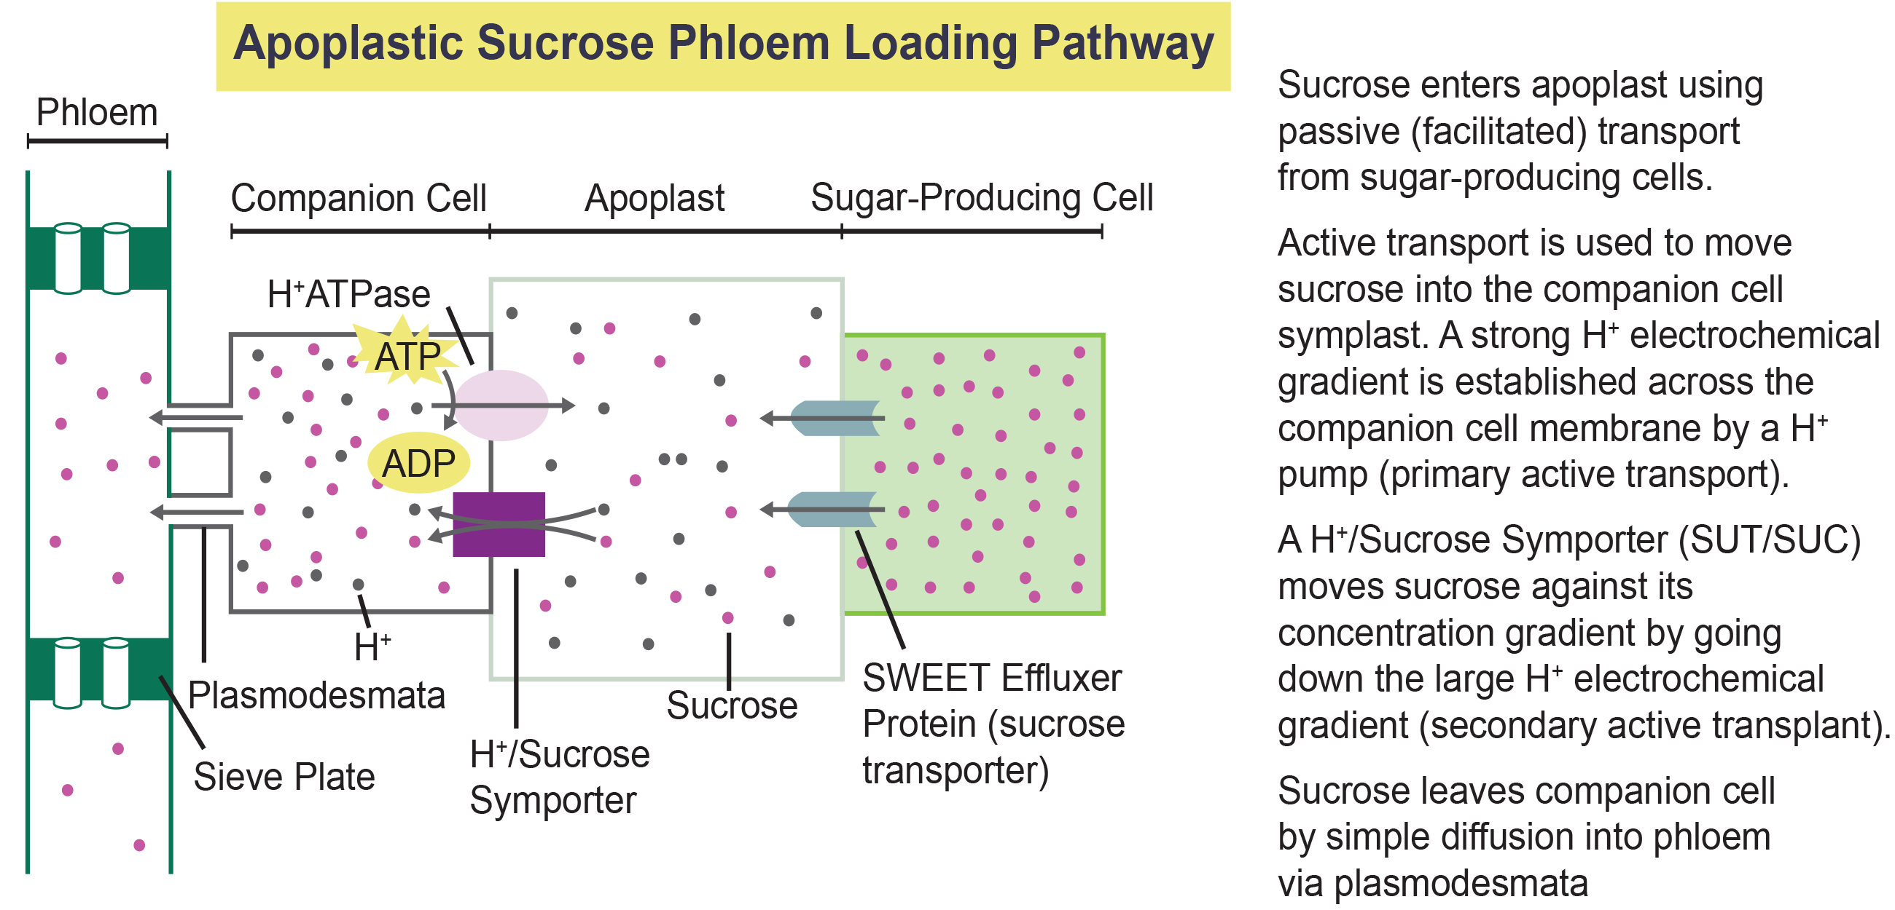
Lesson 30.5 Figure 7
Miairo on Wikimedia Commons. "Phloem loading pathways."
Notes:
Figure 7: During phloem loading, sucrose produced in a sugar-producing mesophyll cell first diffuses into the apoplast through transporters called SWEET proteins. Protons are actively transported out of the companion cell through an ATP-powered pump to generate a buildup of protons in the apoplast. As protons passively return to the companion cell through the H+/sucrose symporter, sucrose molecules are transported with them. Sucrose travels through plasmodesmata to reach the sieve tube element.

Slide 20
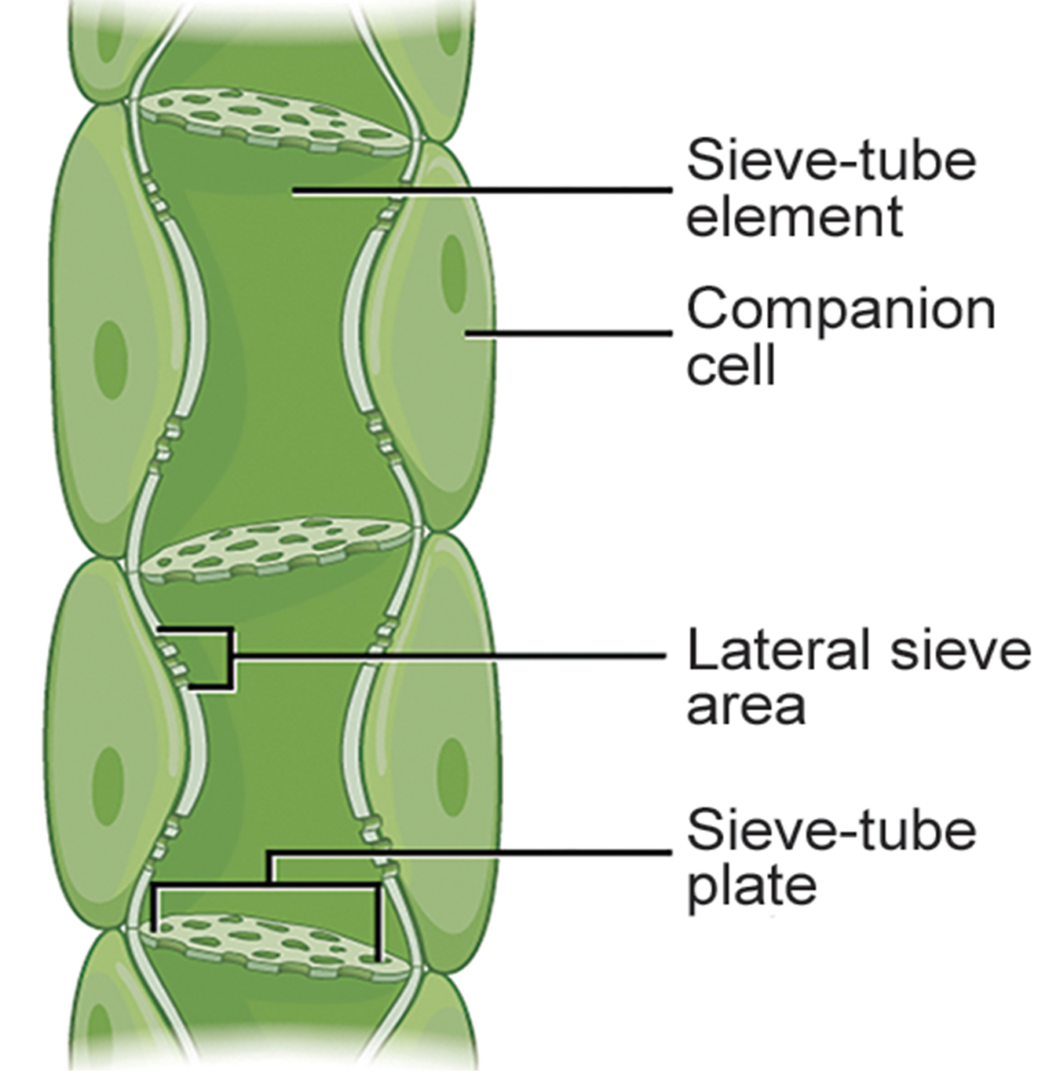
Translocation: Transport from Source to Sink
Photosynthates are produced in mesophyll cells before being translocated to companion cells in the phloem tissue.
Photosynthates move through plasmodesmata in the companion cells to reach the sieve-tube elements (STEs) in the vascular bundle.
Once in the phloem, the photosynthates are translocated to the nearest sink.
30.5 Figure 8
CNX OpenStax on Wikimedia Commons. "Phloem."
Notes:
Figure 8: Phloem is comprised of cells called sieve-tube elements. Phloem sap travels through perforations called sieve-tube plates. Neighboring companion cells carry out metabolic functions for the sieve-tube elements and provide them with energy. Lateral sieve areas connect the sieve-tube elements to the companion cells.

Slide 21
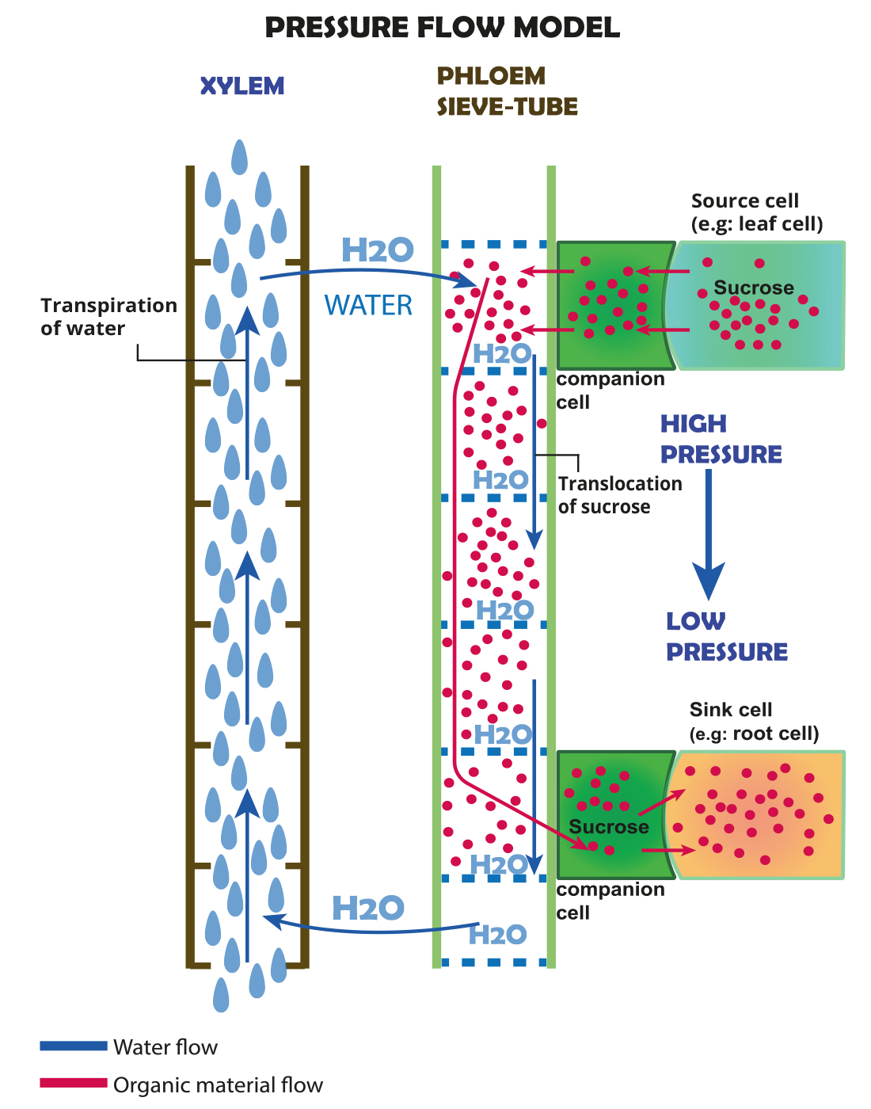
30.5 Figure 9
Notes:
Figure 9: Sucrose is actively transported from source cells into companion cells and then into the sieve-tube elements. This reduces the water potential, which causes water to enter the phloem from the xylem. The resulting positive pressure forces the sucrose-water mixture down toward the roots, where sucrose is unloaded. Transpiration causes water to return to the leaves through the xylem vessels.

Slide 22
Group Activity
We know that water expands when it freezes, which can kill plant cells by water crystals breaking through the cell membrane and destroying the integrity of the cell wall. So, how do trees survive the winter? The key is in the sap.
As a group, research and brainstorm how sap helps trees survive freezing winters.

Slide 23
Summary
The water potential in plant solutions is influenced by solute concentration, pressure, gravity and matric potential.
Water potential and transpiration influence how water is transported through the xylem in plants.
Transpiration is regulated by opening and closing the stomata.
Photosynthates move from sources to sinks using the plants phloem.
The movement of solutes is a mixture of active transport of sugars and water moving via osmosis.

Slide 24

End of Hawkes Learning PowerPoint

