Slide 1
Lesson 30.6
Plant Sensory Systems and Responses

Slide 2
Objectives
Describe how red and blue light affect plant growth and metabolic activities.
Describe thigmotropism, thigmonasty, and thigmogenesis.
Discuss gravitropism.
Explain how plants defend themselves from predators and respond to wounds.
Understand how hormones affect plant growth and development.

Slide 3
Plant Responses to Light
Plants use light for more than just photosynthesis.
Photomorphogenesis: the growth and development of plants in response to light.
Photoperiodism: the ability to use light to track time.
Phototropism: a directional response which allows plants to grow toward or away from light.
The response of the plant to light is mediated by different photoreceptors, which are comprised of a protein covalently bonded to a light absorbing pigment called a chromophore. Together they a chromoprotein.
The red/far-red and violet-blue regions of the visible light spectrum trigger structural development in plants.

Slide 4
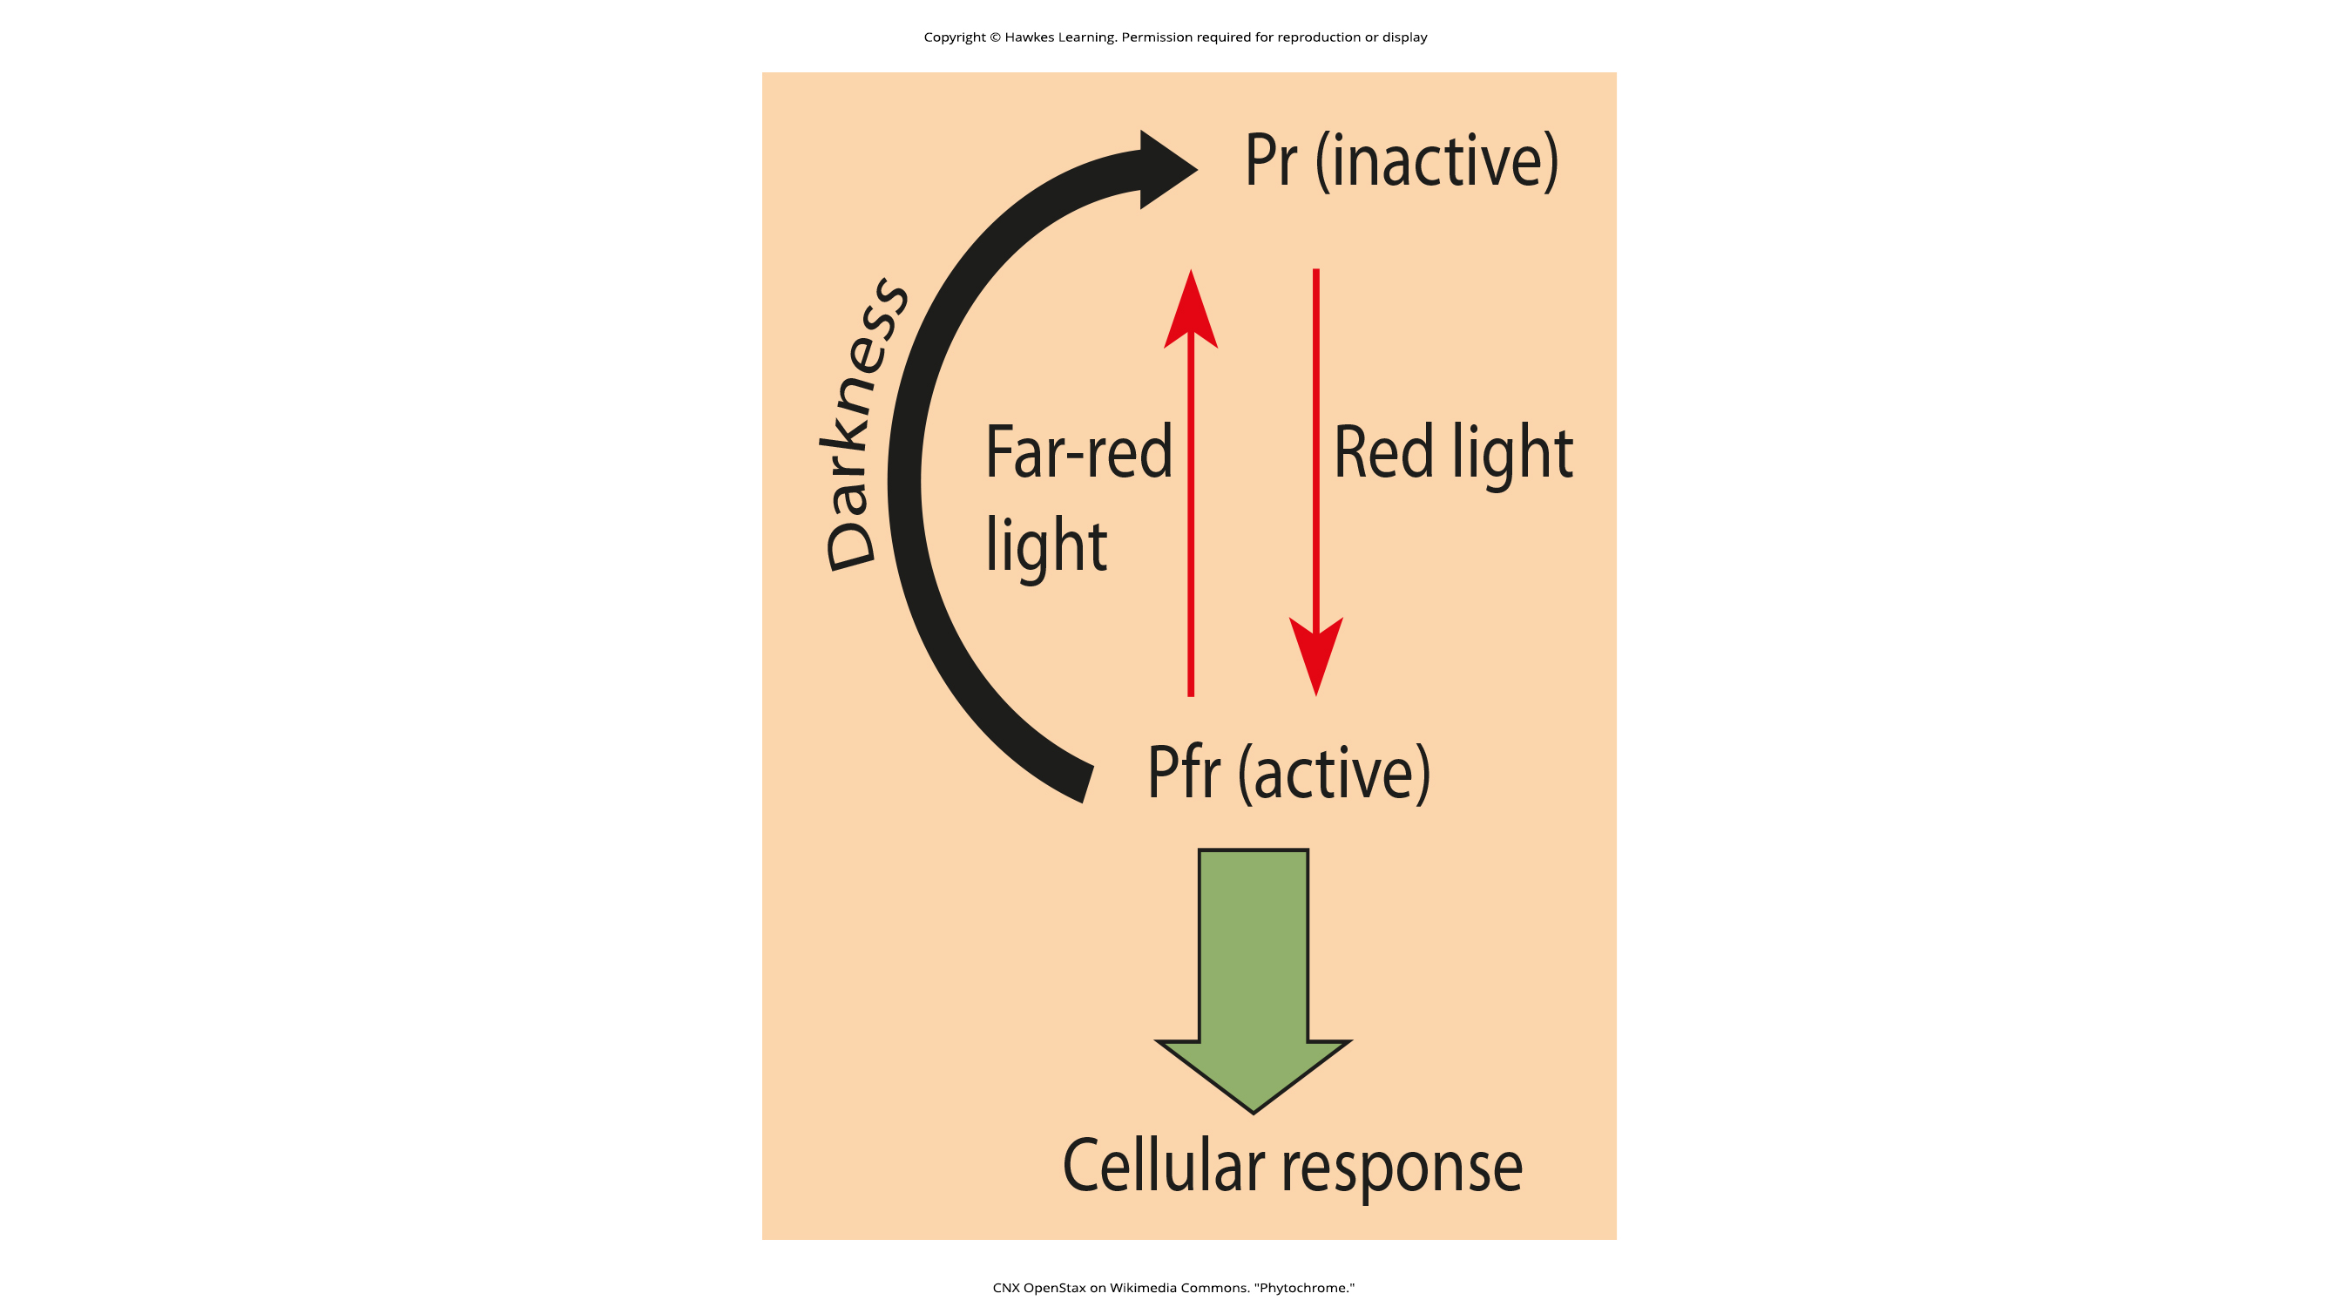
The Phytochrome System and the Red/Far-Red Response₁
30.6 Figure 1
The phytochromes are a family of chromoproteins with a linear tetrapyrrole (a type of light absorbing molecule).
The phytochromes have two photo-interconvertible forms: Pr and Pfr.
Pr absorbed red light (~677nm).
Pfr absorbed far-red light(~730nm).
CNX OpenStax on Wikimedia Commons. "Phytochrome."
Notes:
Figure 1: The biologically inactive form of phytochrome (Pr) is converted to the biologically active form (Pfr) under illumination with red light. Far-red light and darkness convert the molecule back to the inactive form.

Slide 5
The Phytochrome System and the Red/Far-Red Response₂
The phytochrome system acts as a biological light switch and monitors the level, intensity, duration and color of environmental light.
Once the phytochrome system evolved, plants adapted it to serve a variety of needs.
Plant shoots use the phytochrome system to grow away from shade and toward light.
In seeds, the phytochrome system is used to determine if any light is present.
Plants use the phytochrome system to detect the change in season.
Notes:
Figure 1: The biologically inactive form of phytochrome (Pr) is converted to the biologically active form (Pfr) under illumination with red light. Far-red light and darkness convert the molecule back to the inactive form.

Slide 6
Reflection Question
Why do you think some plants prefer longer days and some plants prefer shorter days?
Notes:
The reflection question is included here to use as a talking point or for a think-pair-share activity.

Slide 7
Science and You
Career: Horticulturalist
Horticulturalists manipulate plants to increase leaf, flower or fruit production by understanding how environmental factors affect plant growth and development. They utilize greenhouse management to manipulate the environmental factors to encourage production of their desired traits.
Horticulturalists find employment in a variety of places, from private and government laboratories to botanical gardens and production fields.
Students interested in horticulture take classes such as botany and plant physiology, landscape design and plant breeding. Many aspiring horticulturists may also take economics, business, computer science or communication classes.
Notes:
This is included as a relevant application for this topic.

Slide 8
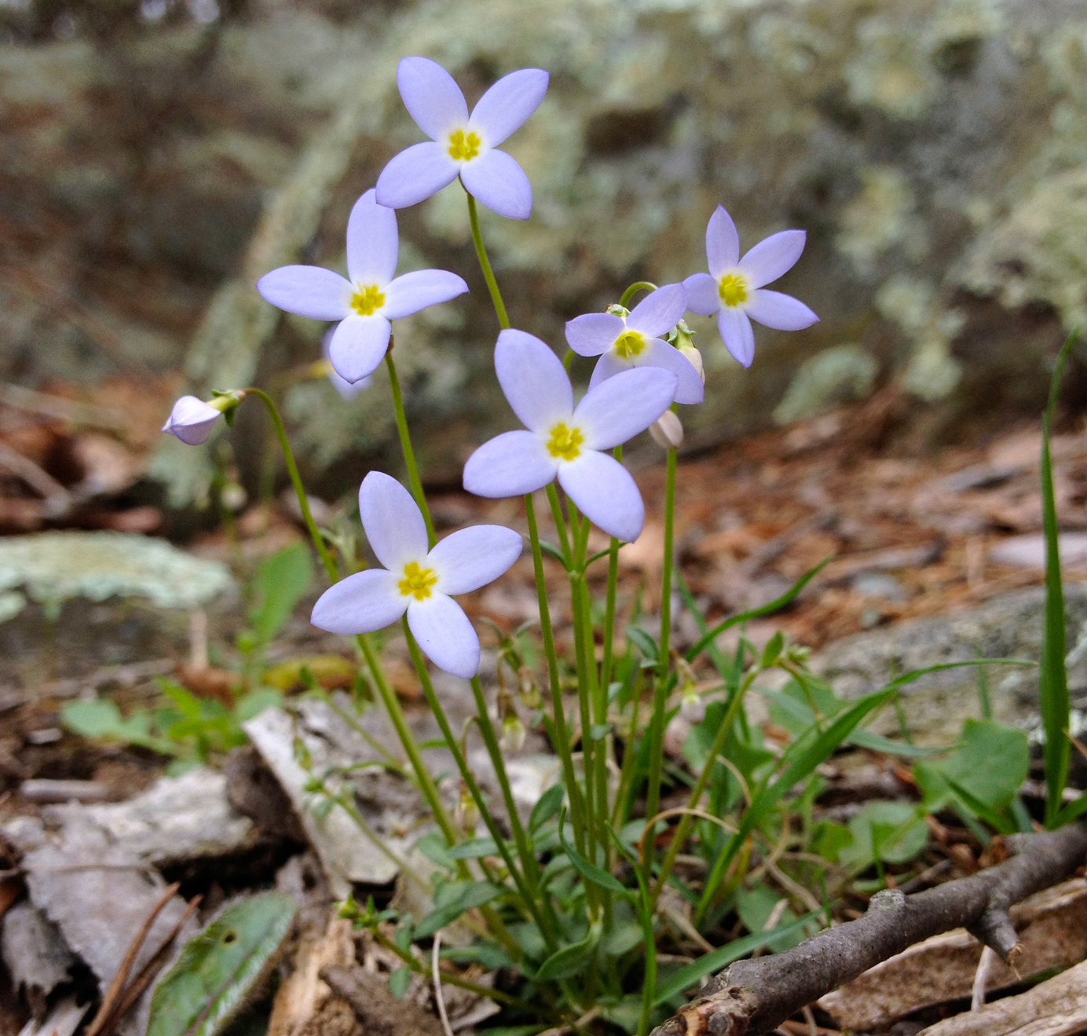
Blue Light Response
Phototropism (directional bending of the plant) is a response to blue wavelengths of light.
Phototropins are protein-based receptors responsible fore mediating the phototropism response.
Leaf opening, chloroplast movement and the opening of stomata are also under the control of the phototropins.
Cryptochromes (another class of blue-light absorbing photoreceptor) are responsible for setting the plants’ circadian rhythm.
30.6 Figure 2
Fritzflohrreynolds on Wikimedia Commons. "Houstonia caerulea."
Notes:
Figure 2: Azure bluets (Houstonia caerulea) display a phototropic response by bending toward the light.

Slide 9
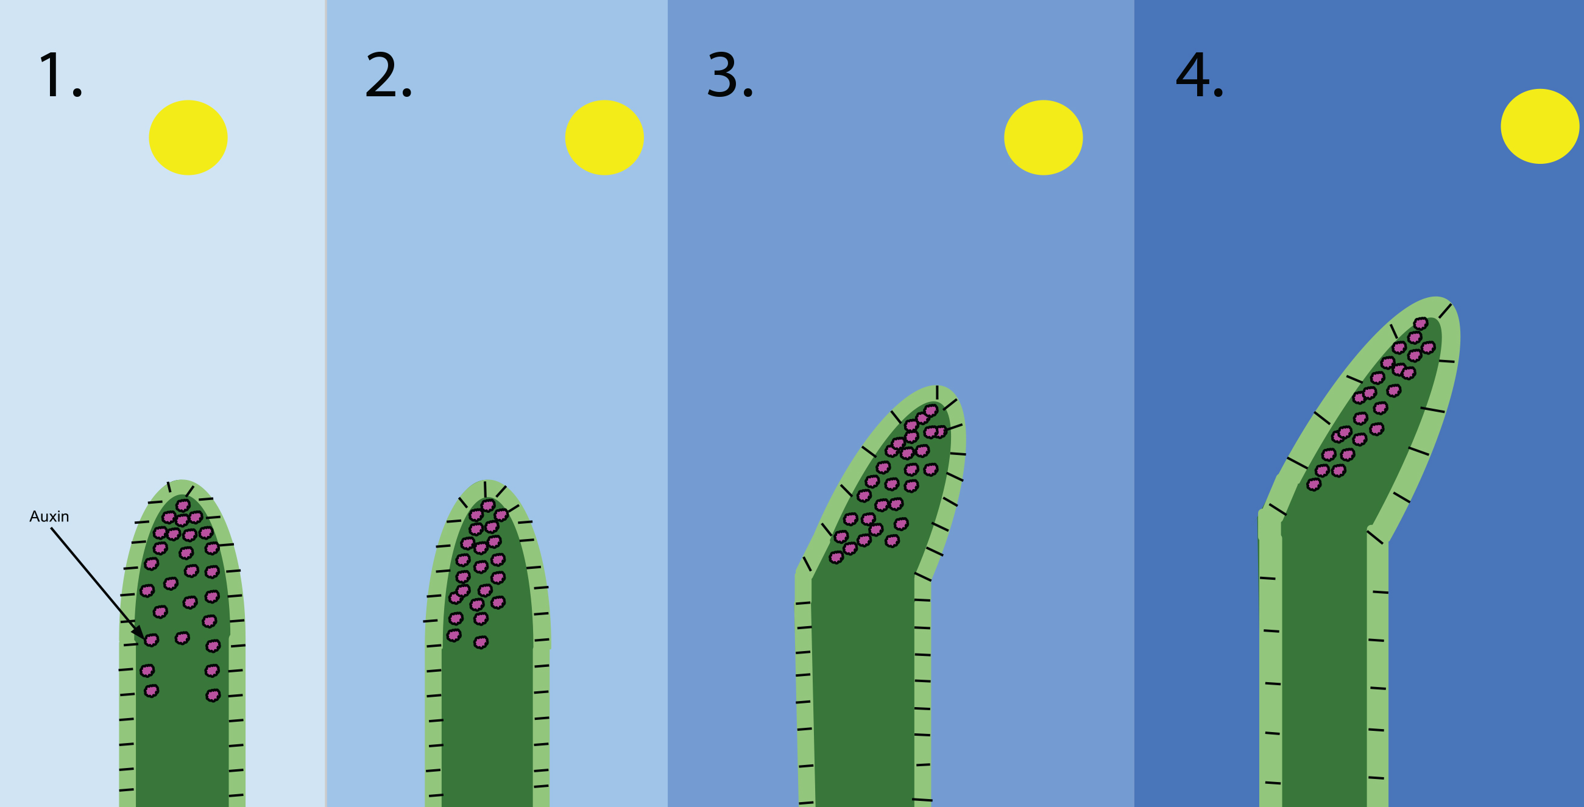
30.6 Figure 3
MacKhayman on Wikimedia Commons. "Phototropism diagram."
Notes:
Figure 3: Normally, IAA (auxin) is evenly distributed on either side of a growing plant stem. If one side of the plant receives more light than the other, IAA accumulates on the shaded side. The increased concentration of IAA in the shaded side stimulates cell elongation, causing the stem to bend toward the light.

Slide 10
Plant Responses to Gravity
Gravitropism ensures that roots grow into the soil and shoots grow toward sunlight.
Growth of the shoot apical tip upward is negative gravitropism, while the growth of the roots downward is positive gravitropism.
Gravity-sensing cells (statocytes) contain amyloplasts are called statoliths.
Amyloplasts are specialized storage plasmids that contain starch granules.
Statoliths settle at the bottom of the cell in response to gravity, setting off a signaling cascade which releases plant hormone IAA.
IAA has opposite effects on roots and shoots.

Slide 11
Growth Responses
Plant hormones affect all aspects of plant life.
Plant hormones are a group of unrelated chemical substances that affect plant morphogenesis (development of tissue, organ and overall shape).
Five major plant hormones: auxins, cytokinins, gibberellins, ethylene and abscisic acid.
Nutrients and environmental conditions can be characterized as growth factors.

Slide 12
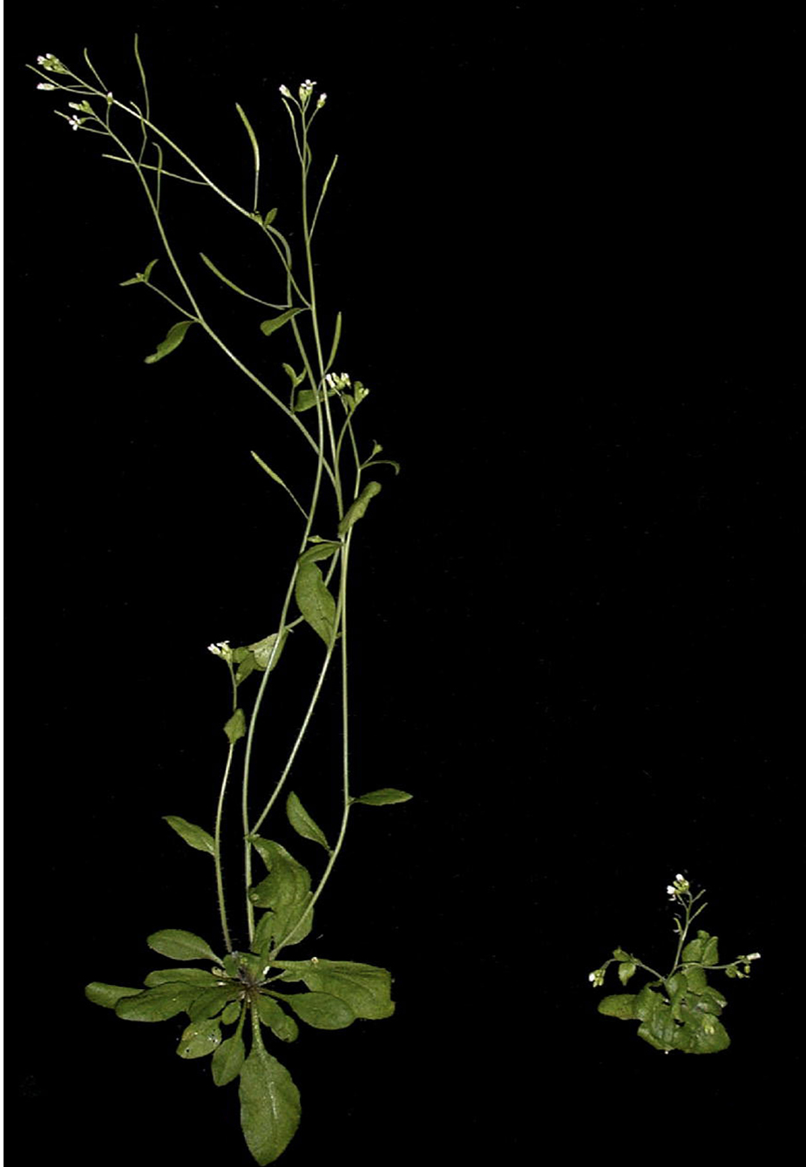
Auxins
30.6 Figure 4
Auxins: the main hormones responsible for cell elongation in phototropism and gravitropism, differentiation of meristem into vascular tissue and promoting leaf development and arrangement.
IAA is the only naturally occurring auxin which shows physiological activity.
IAA is responsible for flowering, fruit setting, ripening and inhibition of abscission(leaf falling).
William M. Gray on Wikimedia Commons. "Arabidopsis thaliana."
Notes:
Figure 4: Arabidopsis thaliana showing growth in wild type (left) and in a plant carrying a mutation in a gene required for auxin signaling (right). Note the reduced size and failure to elongate in the mutant compared to the wild type.

Slide 13
Cytokinins
Cytokinins are hormones which promote cytokinesis (cell division).
Almost 200 naturally occurring or synthetic cytokinins have been identified.
Cytokinins are most abundant in growing tissues such as roots, embryos or fruits.
Cytokinins are known to delay senescence (cell aging, deterioration and death) in leaf tissues.
Cytokinins promote mitosis and promote growth in roots and stems.

Slide 14
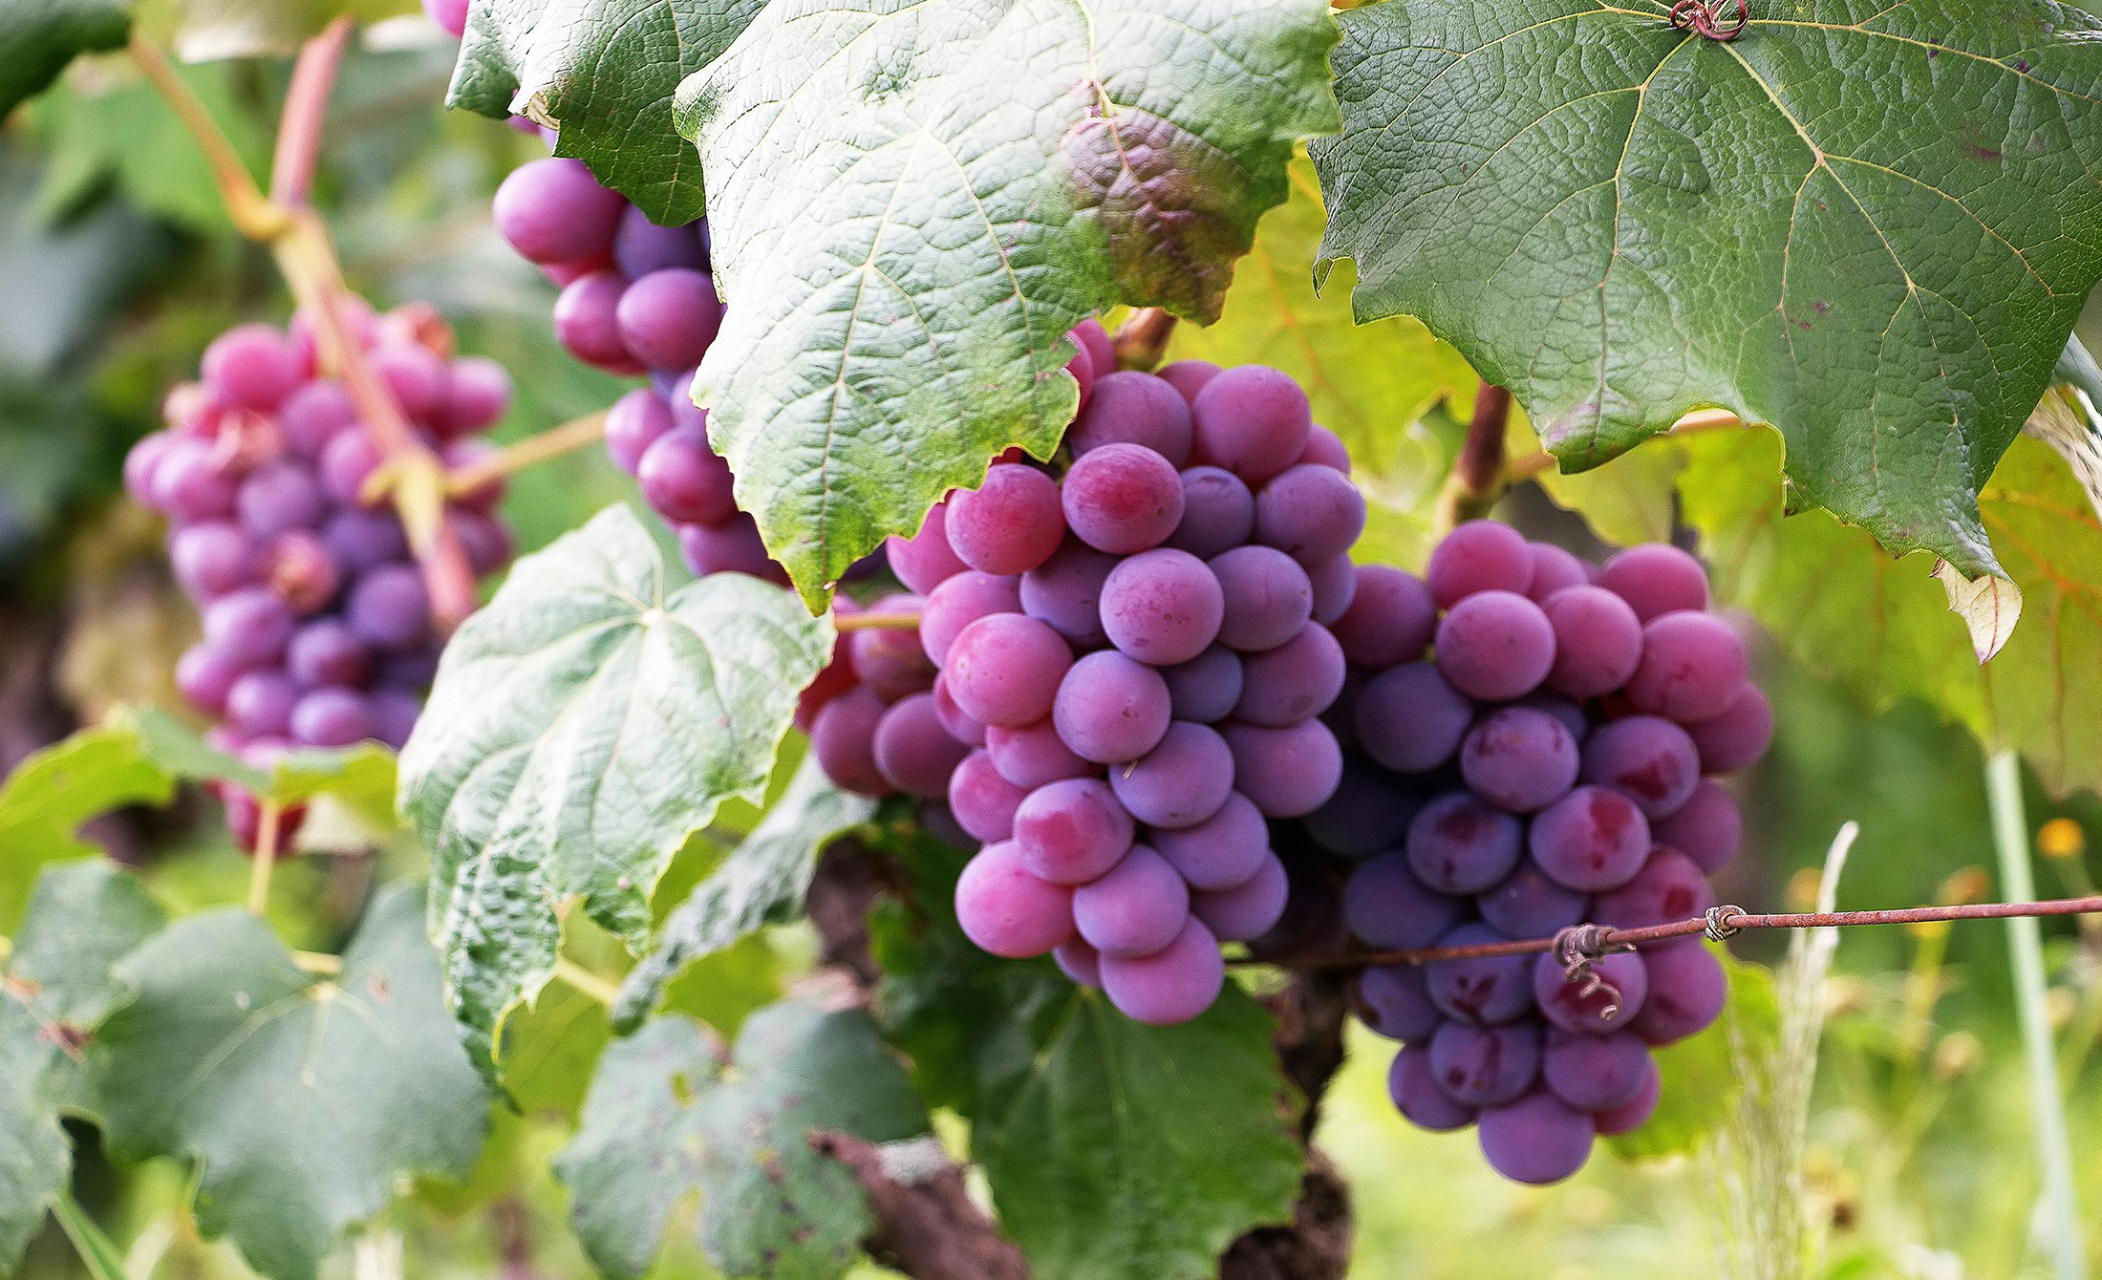
Gibberellins
Gibberellins (gibberellic acids, or GAs) are a group of 125 closely related plant hormones that stimulate shoot elongation, seed germination and fruit and flower maturation.
GAs are synthesized in the root, apical meristems, young leaves and seed embryos.
30.6 Figure 5
Luiz M. Santos on Wikimedia Commons. "Grapes."

Slide 15
Abscisic Acid
Abscisic Acid (ABA) counters many of the growth-promoting effects of GAs and auxins.
ABA inhibits stem elongation and induces dormancy in lateral buds.
ABA accumulates in response to environmental stresses such as dehydration, cold temperatures and short day length.
ABA induces dormancy in seeds and promotes the development of winter buds on plants.

Slide 16
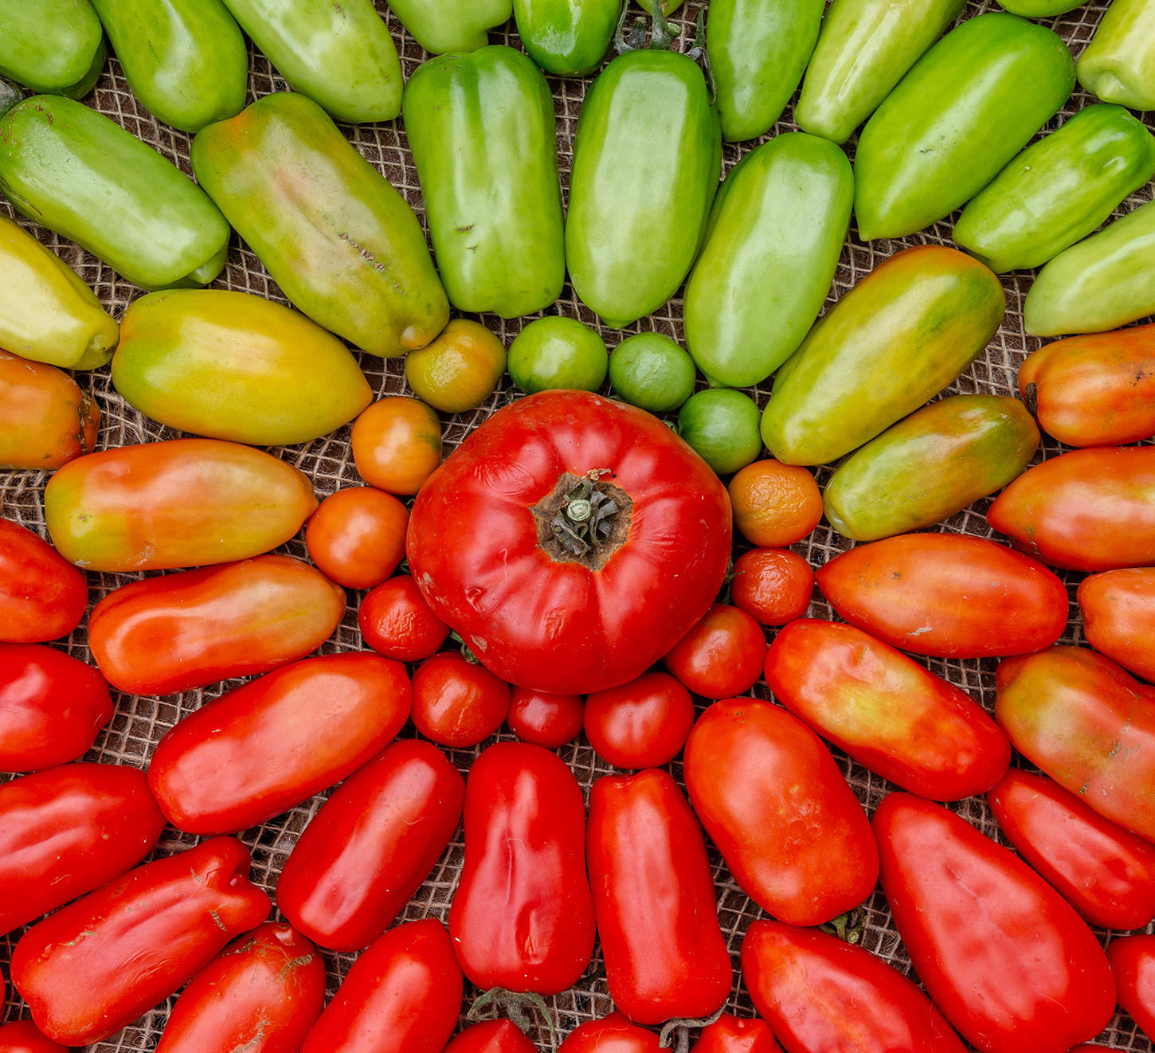
Ethylene
Ethylene is associated with fruit ripening, flower wilting and leaf fall.
Ethylene is a volatile gas produced by aging tissues and nodules of stems.
Ethylene stimulates the conversion of starches and acids to sugars.
Commercial growers control the timing of fruit ripening with the application of ethylene.
30.6 Figure 6
Michal Klajban on Wikimedia Commons. "Tomatoes."
Notes:
Figure 6: Ethylene gas can be used to induce ripening of fruits, such as tomatoes.

Slide 17
Nontraditional hormones
Recent research has discovered several compounds which influence plant development.
Jasmonates play a major role in defense responses to herbivory. Levels increase when the plant is wounded by a predator, resulting in toxic molecules being produced.
Oligosaccharins play a role in defense against bacterial and fungal infection by working locally at the site of the injury.
Strigolactones promote seed germination in some species and inhibit lateral apical development in the absence of auxins.
Brassinosteroids are important for various processes for plant growth, development and adaptation to stress.

Slide 18
Think It Through
Name five traditional plant hormones.
Notes:
Originally an On Your Own. This is included here to use as a talking point or for a think-pair-share activity.

Slide 19
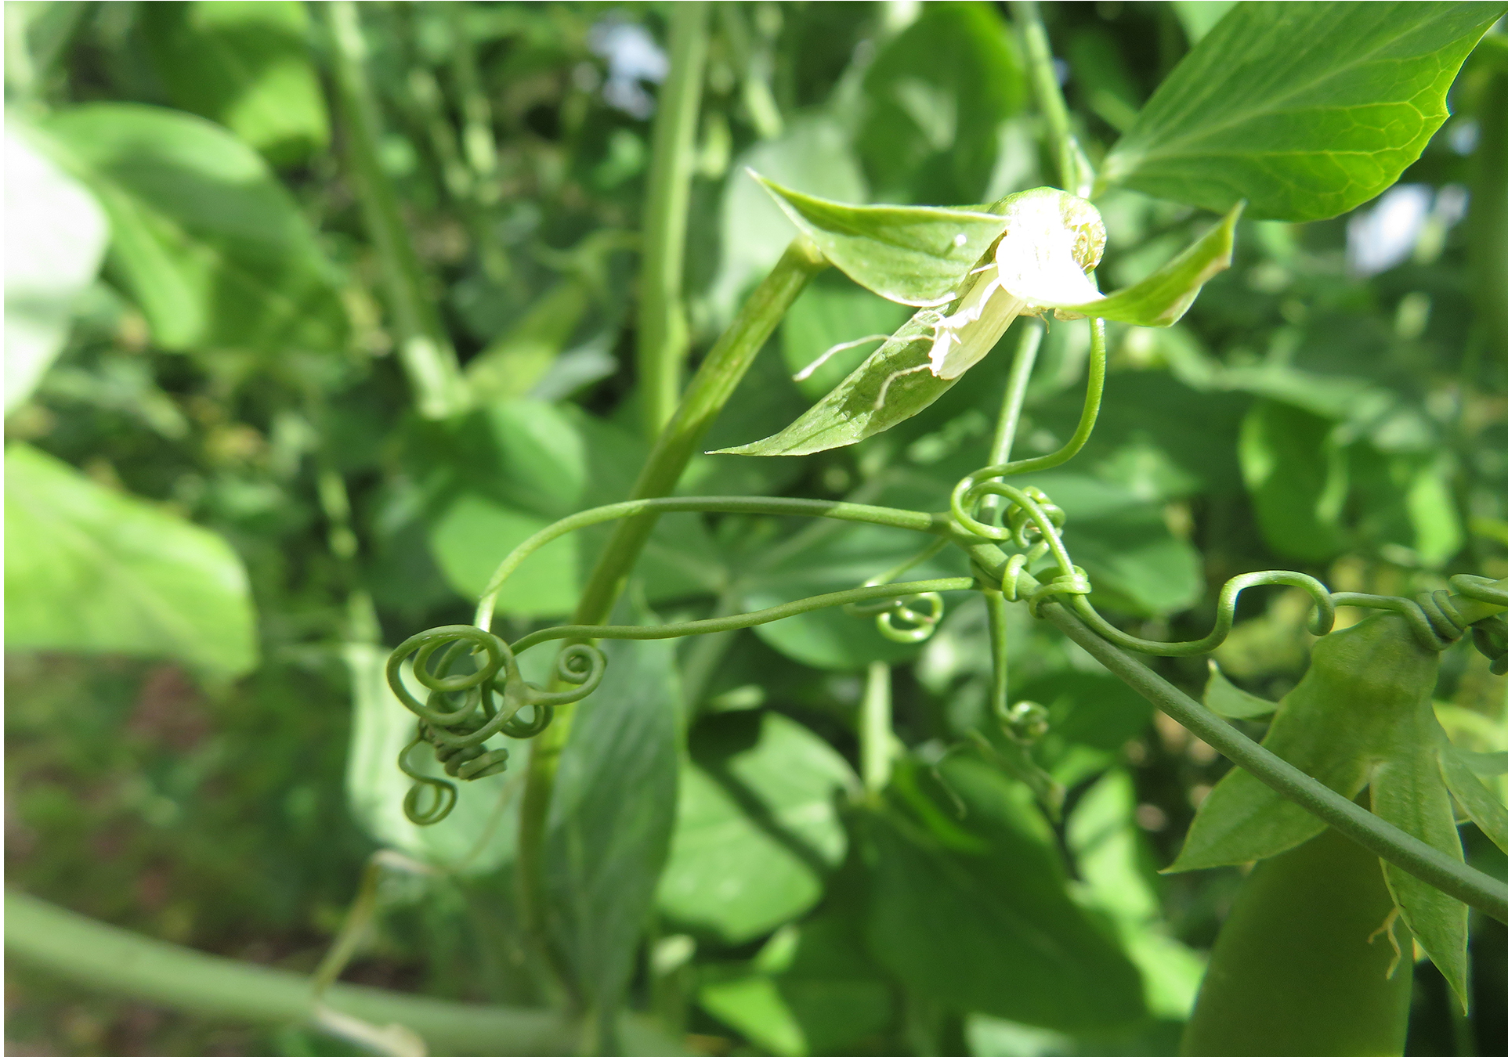
Plant Response to Wind and Touch
The movement of a plant subjected to constant directional pressure is called thigmotropism.
A thigmonastic response is a touch response independent of the direction of stimulus
Thigmomorphogenesis is a slow developmental change in the shape of a plant subjected to continuous mechanical stress.
30.6 Figure 7
Forest and Kim Starr on Wikimedia Commons. "Snow pea tendrils."
Notes:
Figure 7: Plant tendrils, such as pea tendrils, are touch sensitive, allowing them to detect and respond by coiling around support surfaces.

Slide 20
Defense Responses against Herbivores and Pathogens
The first line of defense in plants is an intact impenetrable barrier of bark and waxy cuticle.
Other adaptations such as thorns and spines can discourage animals by causing physical damage and inducing rashes and allergic reactions.
Secondary metabolites are compounds that are not directly derived from photosynthesis and are not necessary for respiration or growth and development.
Many secondary metabolites are toxic, produce noxious odors or repellent tastes.

Slide 21
Summary
Plants respond to light by changes in morphology and activity.
Plant hormones are produced by the plant or synthetically and are responsible for growth and development of the plant, fruit development and ripening and dormancy in seeds and buds.
Plants evolved defense mechanisms against predators and pathogens, using both physical barriers and chemical defenses.

Slide 22

End of Hawkes Learning PowerPoint

