Slide 1
Plant Nutrients and Soil
Lesson 31.1

Slide 2
Objectives
Describe a composition and a soil profile.
Describe an essential nutrient.
Describe how plants obtain nutrients.
Describe how soils are formed.
List the elements and compounds required for proper plant nutrition.

Slide 3
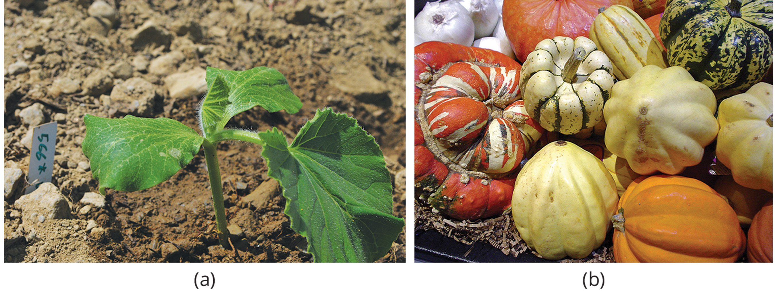
Plant Nutrients and Soil
For plants to be able to grow and develop into mature, fruit-bearing plants, many requirements must be met, and many events coordinated.
Soil quality and climate are major determinates in pant distribution and growth.
The combination of soil nutrients, water and carbon dioxide, along with sunlight are required for growth.
30.1 Figure 1: (a) squash seedling and (b) squash fruit
Juliancolton on Wikimedia Commons. "Giant squash plant seedling."
Californiacondor on Wikimedia Commons. "Winter squashes."
Notes:
Figure 1: For this (a) squash seedling to develop into a mature plant bearing (b) fruit, numerous nutritional requirements must be met.

Slide 4
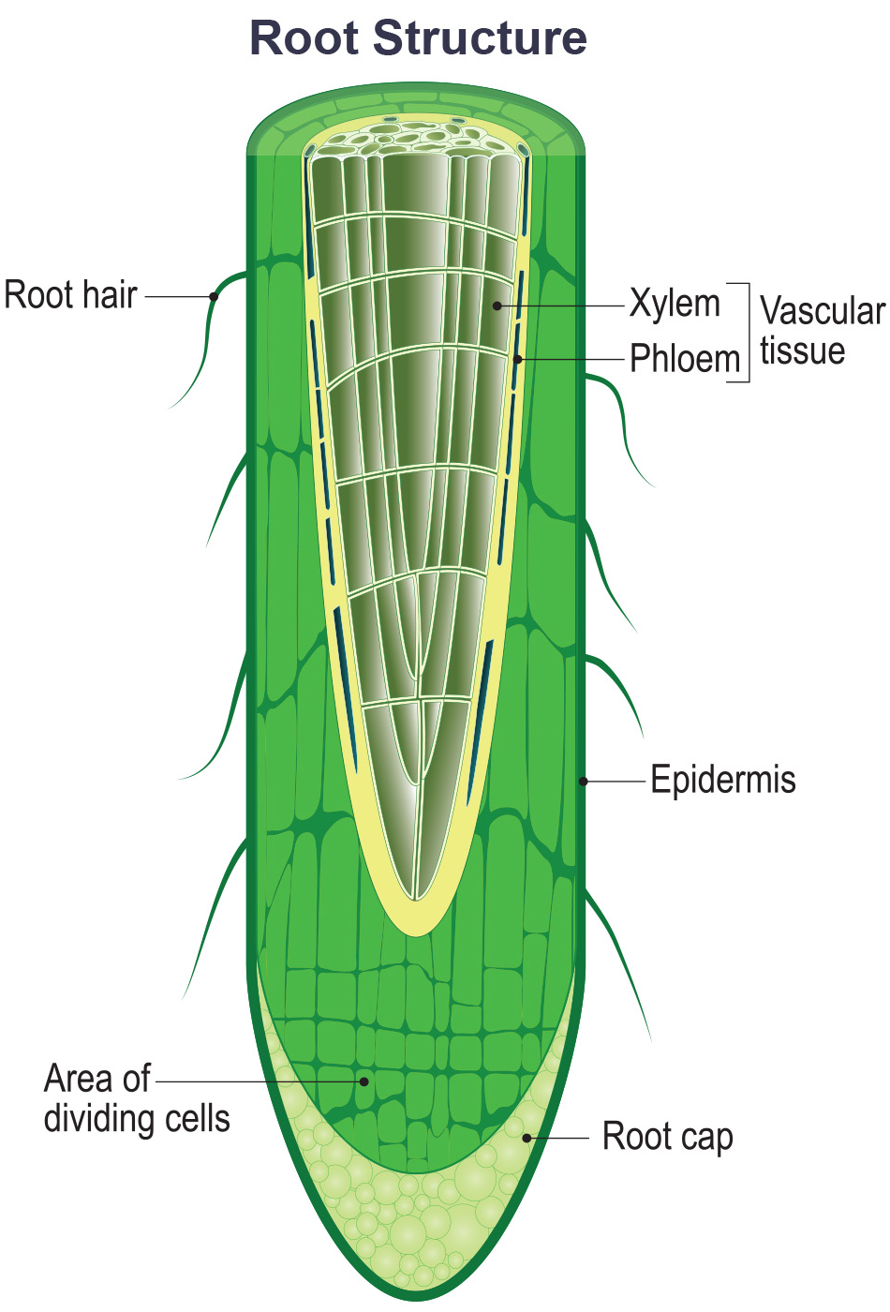
The Chemical Composition of Plants₁
80–90% of a plant's volume is water.
Plants absorb water from the soil through the root hairs and transports it up to the leaves through the xylem.
Plants need water to support cell structure, metabolic function, carry nutrients and for photosynthesis.
31.1 Figure 2
Notes:
Figure 2: Water is absorbed through the root hairs and moves up the xylem to the leaves.

Slide 5
Chemical Composition of Plants
Plants need nutrients to sustain life. There are two types of nutrients:
Organic nutrients: compounds that contain a carbon-carbon bond or carbon hydrogen bond.
Examples are carbohydrates, lipids, proteins and nucleic acids
Inorganic Compounds: compounds which do not have a carbon-carbon bond or carbon-hydrogen bond.
Examples are nitrogen and potassium.

Slide 6
Think It Through₁
Identify the substances described in the following table as organic or inorganic.
Cellulose is a carbohydrate produced by plants.
Calcium (Ca) is an element found in soil.
Nitrate (NO₃²⁻) is a compound produced by soil bacteria.
Phosphate (PO₄³⁻) is a phosphorus-containing compound found in minerals.
Notes:
Originally an On Your Own. This is included here to use as a talking point or for a think-pair-share activity.

Slide 7
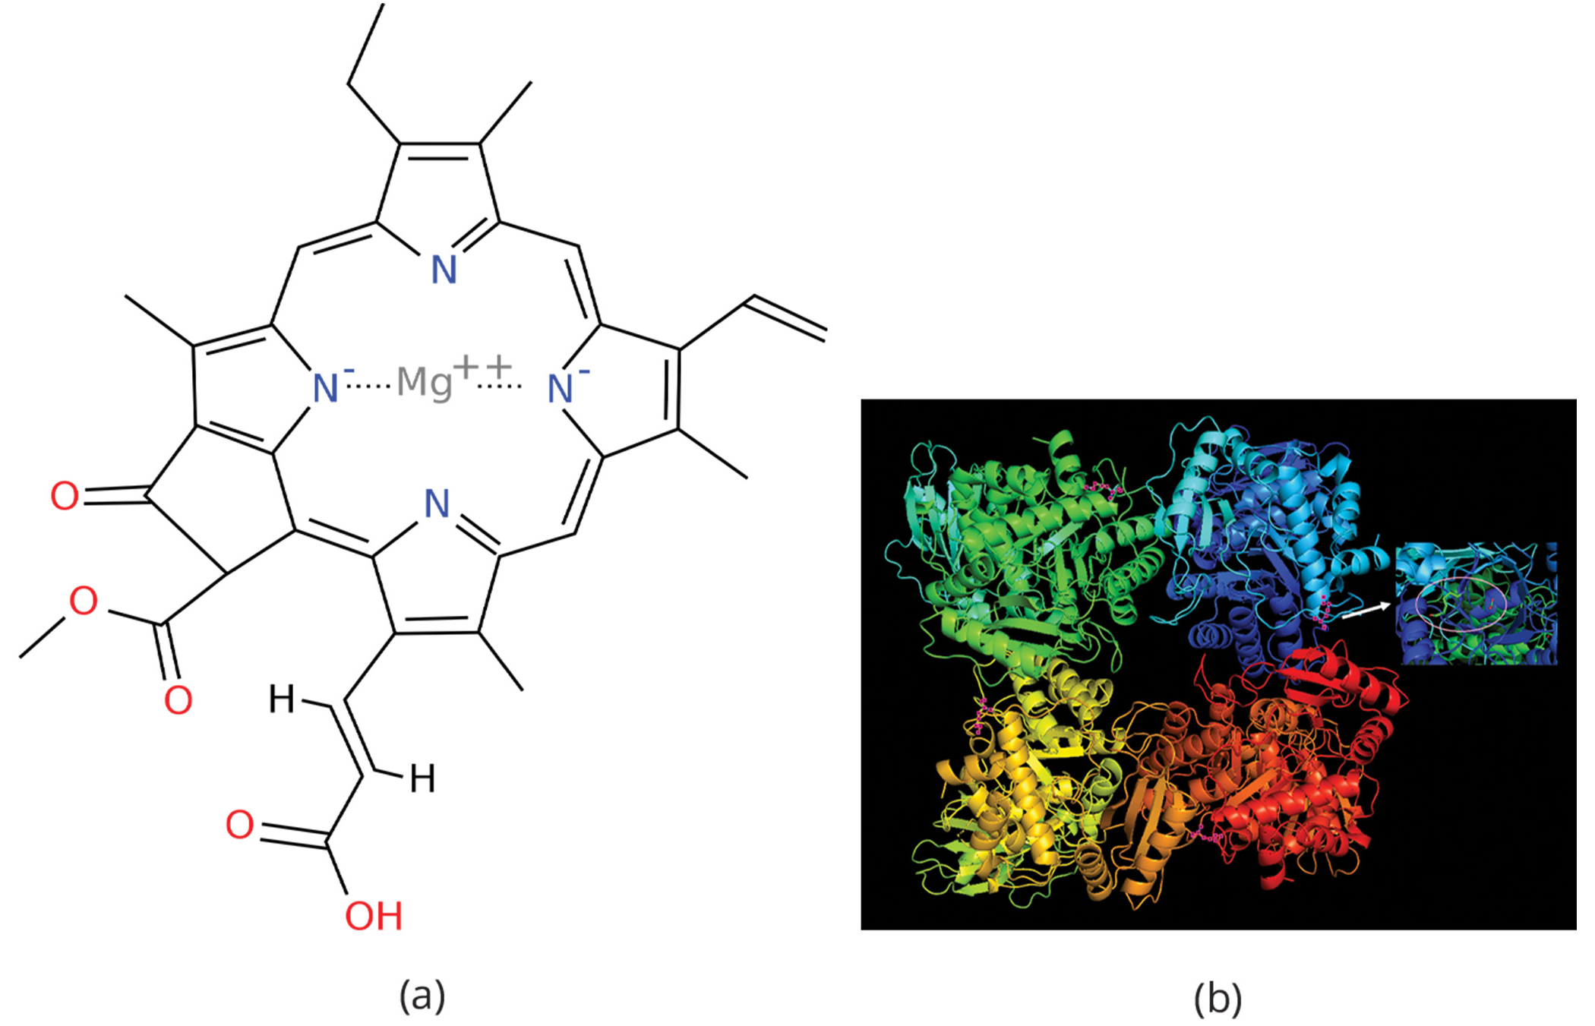
Essential Nutrients
Plants require light, water, and about 20 elements (essential nutrients) to support all biochemical needs.
To be an essential nutrient it must meet the three criteria:
A plant cannot complete its life cycle without the element.
No other element can perform the function of the element.
The element is directly involved in plant nutrition.
31.1 Figure 3: Magnesium is an essential component of (a) chlorophyll and a cofactor for the enzyme (b) RuBisCo.
David Richfield on Wikimedia Commons. "Chlorophyll c1 chemical structure."
Ericlin1337 on Wikimedia Commons. "RuBisCO from spinach."

Slide 8
Group Activity
Work in a group of two to four people. Have each group member select one of the micronutrients from Table 1 and research its importance to plants.
Then, share your findings with the members of your group.

Slide 9
Table 1: Essential Nutrients for Plant Growth
Macronutrients | Micronutrients
carbon (C) | iron (Fe)
hydrogen (H) | manganese (Mn)
oxygen (O) | boron (B)
nitrogen (N) | molybdenum (Mo)
phosphorus (P) | copper (Cu)
potassium (K) | zinc (Zn)
calcium (Ca) | chlorine (Cl)
magnesium (Mg) | nickel (Ni)
sulfur (S) | cobalt (Co)
 | sodium (Na)
 | silicon (Si)

Slide 10
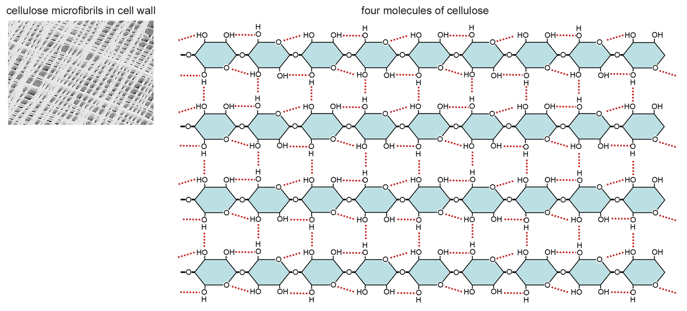
Macronutrients₁
Macronutrients are required in larger amounts by the plants.
Carbon accounts for about 50% of the dry weight of a cell and is required to form many compounds.
Nitrogen is also important for vitamin synthesis in addition to being part of proteins and nucleic acids.
Hydrogen and oxygen are part of many organic compounds and form water.
Phosphorus is required for synthesizing nucleic acids and phospholipids.
31.1 Figure 4
Eunice Laurent on Wikimedia Commons. "Cellulose."

Slide 11
Macronutrients₂
Sulfur is a part of certain amino acids such as cysteine and methionine and plays a part on photosynthesis.
Potassium helps to regulate the opening of the stomata.
Calcium regulates nutrient transport and help support enzyme functions.
Magnesium is important for the functioning of chlorophyll.

Slide 12
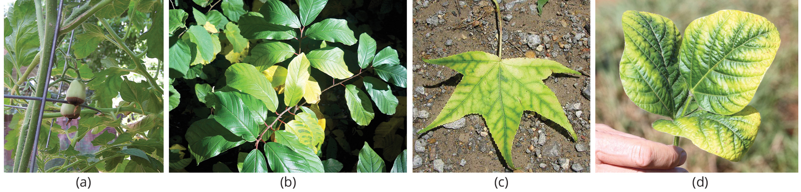
Micronutrients and Nutrient Deficiencies
Micronutrients are needed by the plants in small amounts.
Deficiencies in any nutrient (especially the macronutrients) can adversely affect plant growth.
31.1 Figure 5: Nutrient deficiency is evident in the symptoms these plants show. This (a) grape tomato suffers from blossom end rot caused by a calcium deficiency. The yellowing in this (b) Frangula alnus results from a magnesium deficiency. Inadequate magnesium also leads to interveinal chlorosis, seen here in a (c) sweetgum leaf. This (d) palm is affected by a potassium deficiency.
Jim Conrad on Wikimedia Commons. "Intervenial chlorosis."

Slide 13
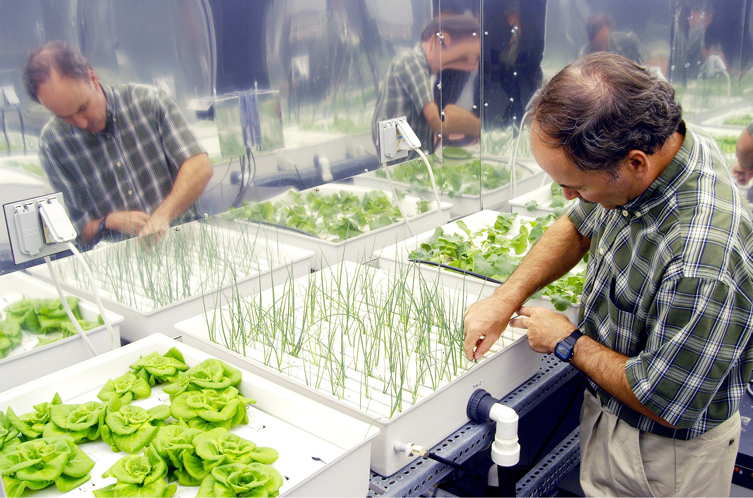
Science and You₁
Hydroponics is a method of growing plants in a water-nutrient solution instead of soil.
Scientists interested in studying plant nutrient deficiencies can use hydroponics to study the effects of the deficiencies under strictly controlled conditions.
Today, many lettuces and tomatoes in your market have been hydroponically grown.
31.1 Figure 6
NASA on Wikimedia Commons. "Plant growth chamber."
Notes:
This is included as a relevant application for this topic.
Figure 6: A plant physiologist checks onions being grown using hydroponic techniques. The other plants are Bibb lettuce (left) and radishes (right).

Slide 14
The Soil
Soil is the outer loose layer that covers the surface of the earth.
Soil quality depends on chemical composition of the soil, topography and the presence of living organisms.
Organic soils are formed from sedimentation and primarily composed of organic matter.
Mineral soils are formed from weathering rocks and are composed primarily of inorganic material.

Slide 15
Reflection Question
Jan Baptist van Helmont (1580–1644) conducted one of the earliest experiments on plant nutrition and growth. Research this experiment. What did it show?
How do van Helmont's conclusions compare to what we now know about plant growth?
Notes:
The reflection question is included here to use as a talking point or for a think-pair-share activity.

Slide 16
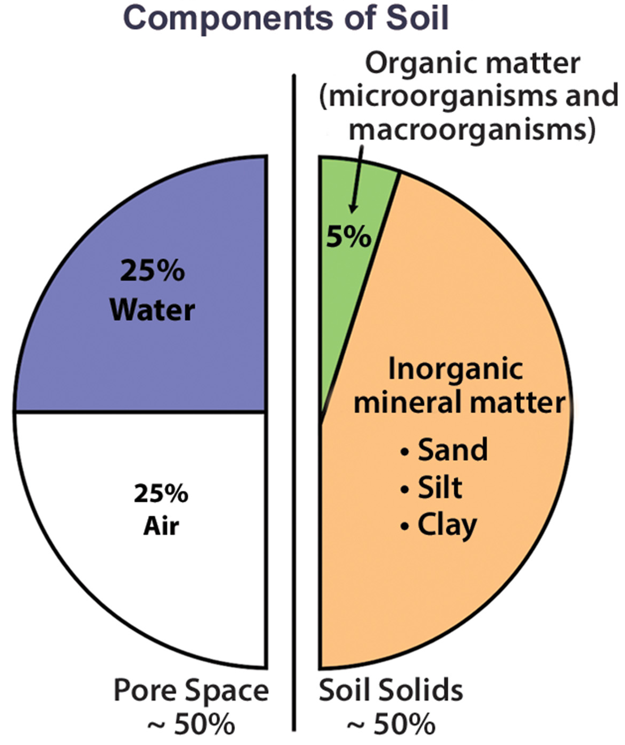
Soil composition₁
Soil consists of the following components:
40–45% inorganic mineral matter
5% organic matter
50% water and air
A healthy soil has sufficient air, water minerals and organic material to promote and sustain plant life.
31.1 Figure 7
JasonHS on Wikimedia Commons. "Soil pie chart."

Slide 17
Think It Through₂
Soil compaction can result when soil is compressed by heavy machinery or even foot traffic. How might this compaction change the soil composition?
Notes:
Originally an On Your Own. This is included here to use as a talking point or for a think-pair-share activity.

Slide 18
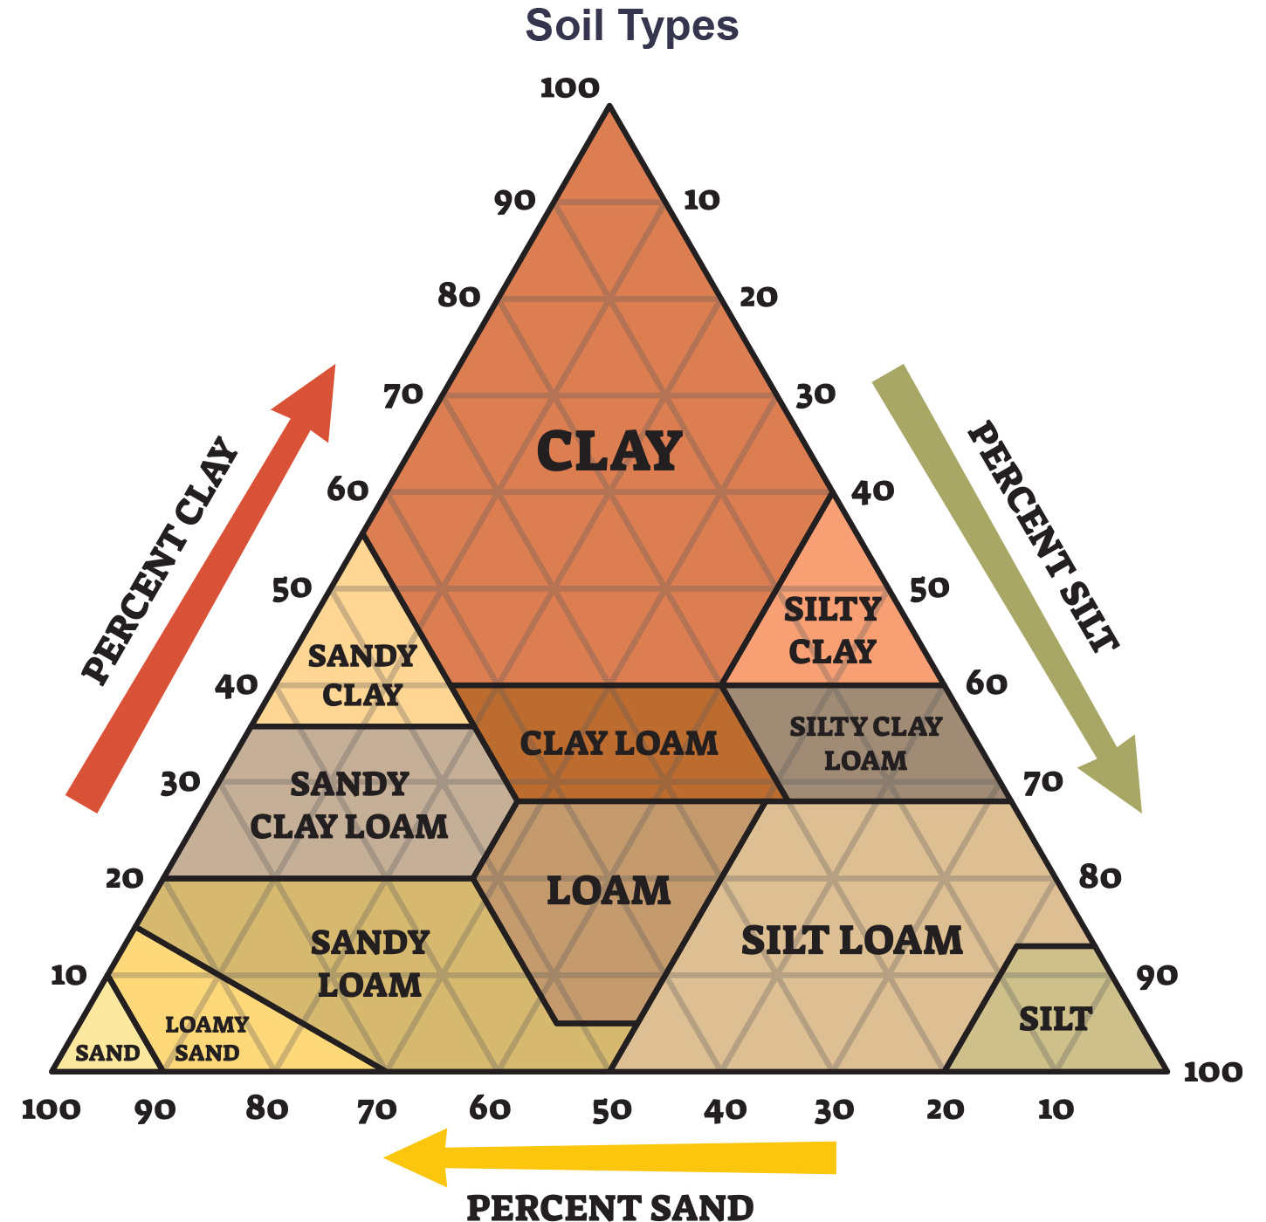
Soil Composition₂
The organic material of soil (humus) is made of microorganisms and dead animal and plants in varying states of decay.
Inorganic material of soil consists of particles of rock of varying sizes.
Sand: particles 0.1 to 2mm in size
Silt: particles 0.002 and 0.1 mm in size
Clay: particles less that 0.002 mm in size
Soils with no dominant particle size and are a mixture of sand, silt and clay are called loams.
31.1 Figure 8
Notes:
Figure 7: The four major components of soil are shown: inorganic minerals, organic matter, water, and air.

Slide 19
Soil Formation
Soil formation is a consequence of a combination of biological, physical and chemical processes.
Soil should ideally contain 50% solid materials and 50% pore space.
Soil distribution is not homologous because its formation results in the production of layers; together, the vertical section of soil is the soil profile.
Within the soil profile, scientists define zones called horizons. A horizon is a soil layer with distinct physical and chemical properties that differ from other layers.

Slide 20
Parent Material
Parent material is the organic and inorganic material that form soil.
Mineral soils are formed directly from weathering the bedrock: the solid rock that lies beneath the soil.
Other soils form in materials that came from elsewhere, such as sand and glacial drift.

Slide 21
Climate
Soil characteristics are affected by different patterns of temperature, moisture, and wind causing different patterns of weathering.
The presence of moisture and nutrients from weathering will also promote biological activity.

Slide 22
Topography
Regional surface features can have a major influence on the characteristics and fertility of a soil.
Topography affects water runoff, which can strip away parent material and affect plant growth.
Steep soils are more prone to erosion.

Slide 23
Biological Factors
The presence of living organisms greatly affects soil formation and structure.
Animals and microorganisms can produce pores and crevice, and plants can penetrate crevices to break up the soil.
Plant secretions promote the development of microorganisms around the root in an area know as the rhizosphere.

Slide 24
Time
Time is an important factor in soil formation as soils develop over long periods and is dynamic process.
Materials are deposited over time, decompose and transform into other materials that can be used by living organisms or deposited onto the surface of the soil.

Slide 25
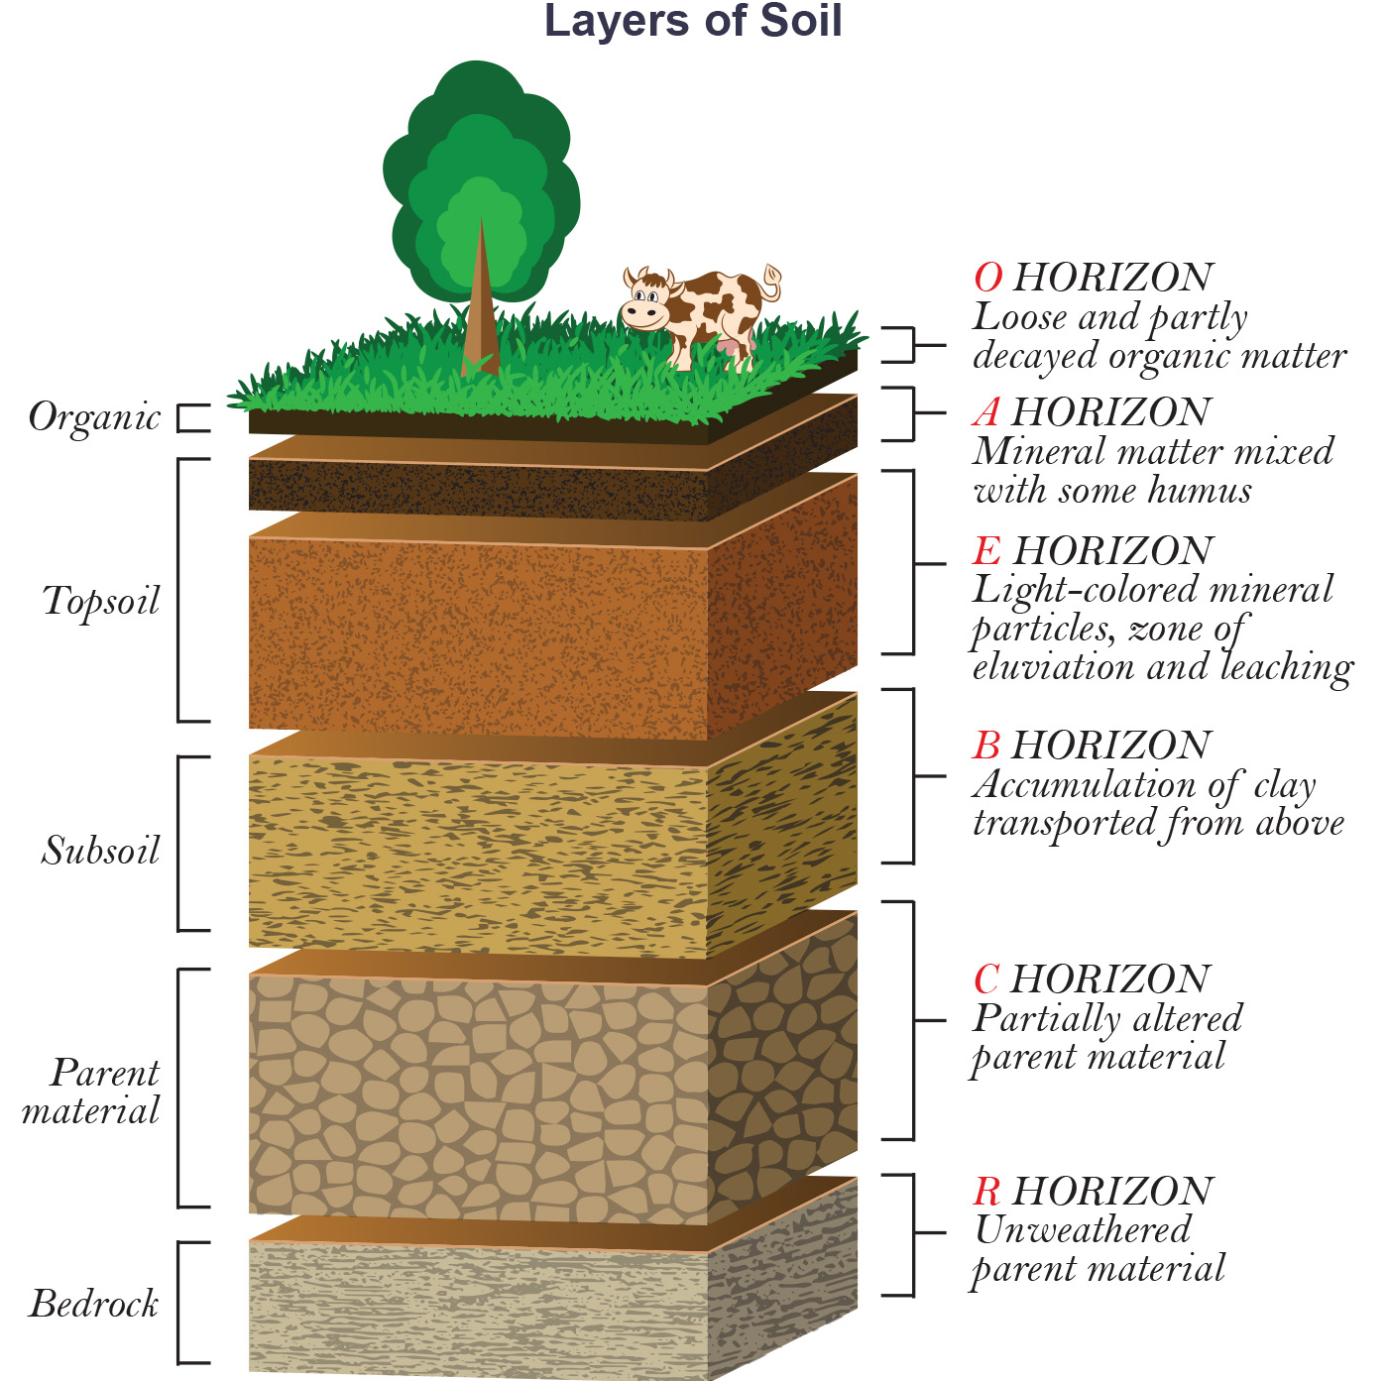
Physical Properties of the Soil₁
The soil profile has several distinct layers:
O horizon: decomposing organic matter (humus) at the surface with decomposed vegetation at its base.
A horizon: a mixture of organic soil with organic products of weathering (also known as topsoil).
E horizon: a mineral layer where most organic material and clay is washed out.
B horizon: an accumulation of mostly fine material that has resulted in a dense layer in the soil.
C horizon: includes the parent material plus the organic and inorganic material broken down to become soil.
R horizon: bedrock
31.1 Figure 9
Notes:
Figure 9: This soil profile shows the different soil layers (O horizon, A horizon, B horizon, C horizon, and R horizon) found in typical soils, as well as the E horizon that is often found in forest soils.

Slide 26
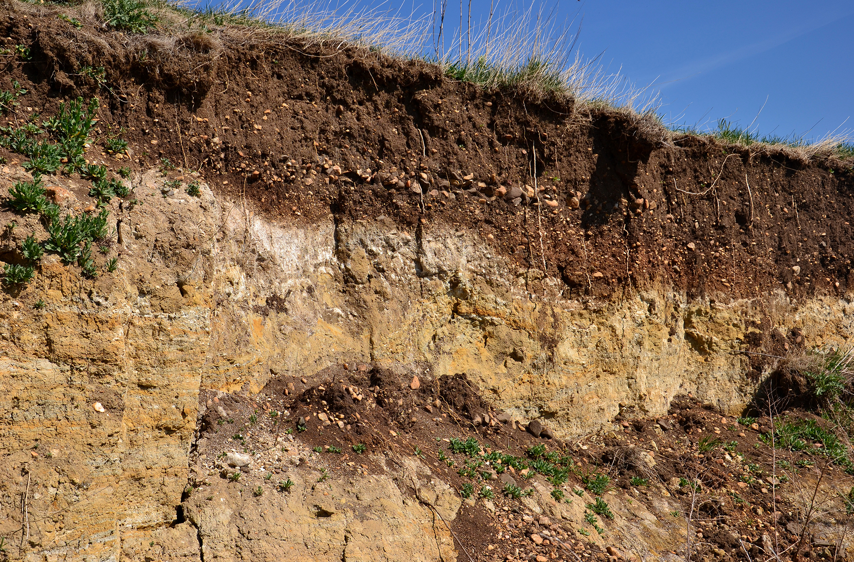
Physical Properties of Soil₂
Some soils may have additional layers or lack one of the layers.
In general, immature soils may have O, A and C horizons, where mature soils display all these plus additional layers.
31.1 Figure 10
Notes:
Figure 10: This Libedice, Czech Republic, soil profile shows multiple horizons.

Slide 27
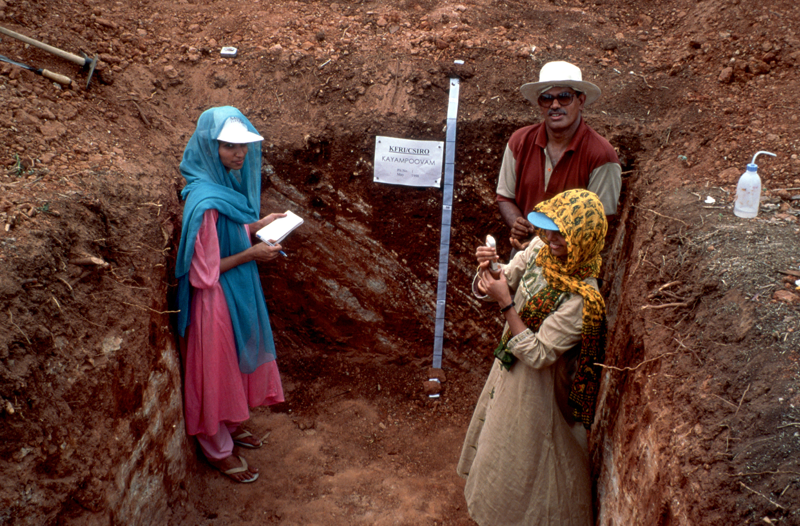
Science and You₂
Career: Soil Scientist
A soil scientist studies all aspects of the soil, from morphology to chemical composition.
Soil scientists play a key role in understanding a soil's past, its present conditions and provide future recommendations for the soil.
31.1 Figure 11
T. Grove, CSIRO on Wikimedia Commons. "Soil scientists."
Notes:
This is included as a relevant application for this topic.
Figure 6: A plant physiologist checks onions being grown using hydroponic techniques. The other plants are Bibb lettuce (left) and radishes (right).

Slide 28
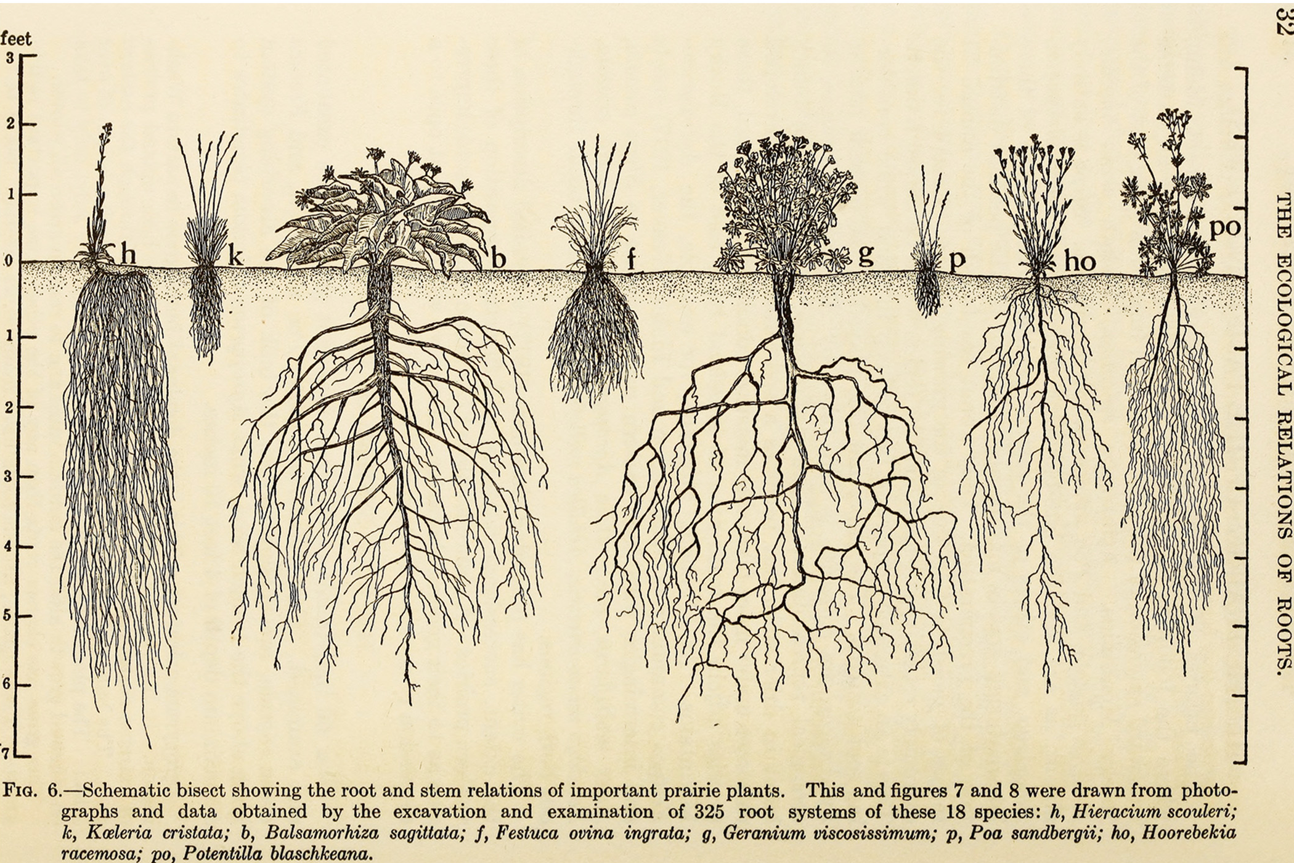
Lesson 31.1 Figure 12
Weaver, John E. (John Ernest) on Wikimedia Commons. "Ecological relations of roots."
Notes:
Figure 12: Native prairie plants have extensive root systems that can potentially interact with multiple soil horizons

Slide 29
Summary
Plants absorb essential macronutrients, micronutrient and water through their root system, and carbon dioxide from the environment.
Soil quality depends on the chemical composition of the soil, topography, presence of living organisms, climate and time.
Factors which affect soil formation are parent material, climate, topography, biological factors and time.

Slide 30

End of Hawkes Learning PowerPoint

