Slide 1
Lesson 31.2
Nutrient Acquisition in Plants

Slide 2
Objectives
Describe mycorrhizae.
Explain nitrogen fixation.
Understand the nutritional adaptations of plants.

Slide 3
Nutrient Acquisition in Plants
Autotrophic plants can make their own food from inorganic raw materials such as CO₂ and H₂O through photosynthesis.
Holoparasitic plants are heterotrophic and are unable to make their own carbon-based molecules, lack chlorophyll and completely rely on their host plants for nutrients.
Plants may also enlist help from microbial partners in nutrient acquisition.
Nodules in legumes and mycorrhization are some of the nutritional adaptations in plants.

Slide 4
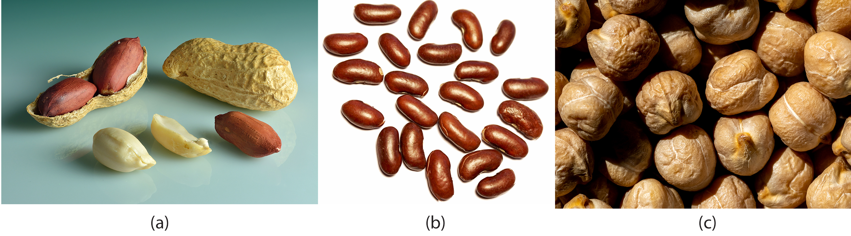
Nitrogen fixation: Root and Bacterial Interactions₁
Plants do not have the needed enzymes to convert atmospheric nitrogen (N₂) to biologically useful fixed form (NH₃).
Biological nitrogen fixation (BNF) is carried out by prokaryotes.
The most important source of BNF is the symbiotic relationship between soil bacteria and legumes.
31.2 Figure 1: Some common edible legumes—like (a) peanuts, (b) beans, and (c) chickpeas—can interact symbiotically with soil bacteria that fix nitrogen.
Ivar Leidus on Wikimedia Commons. "Peanuts."
Tiia Monto on Wikimedia Commons. "Kidney beans."
Ajay Suresh on Wikimedia Commons. "Chickpeas."

Slide 5
Think It Through
Farmers often rotate corn (a cereal crop) and soybeans (a legume), planting a field with each crop in alternate seasons.
What advantage might this crop rotation have?
Notes:
Originally an On Your Own. This is included here to use as a talking point or for a think-pair-share activity.

Slide 6
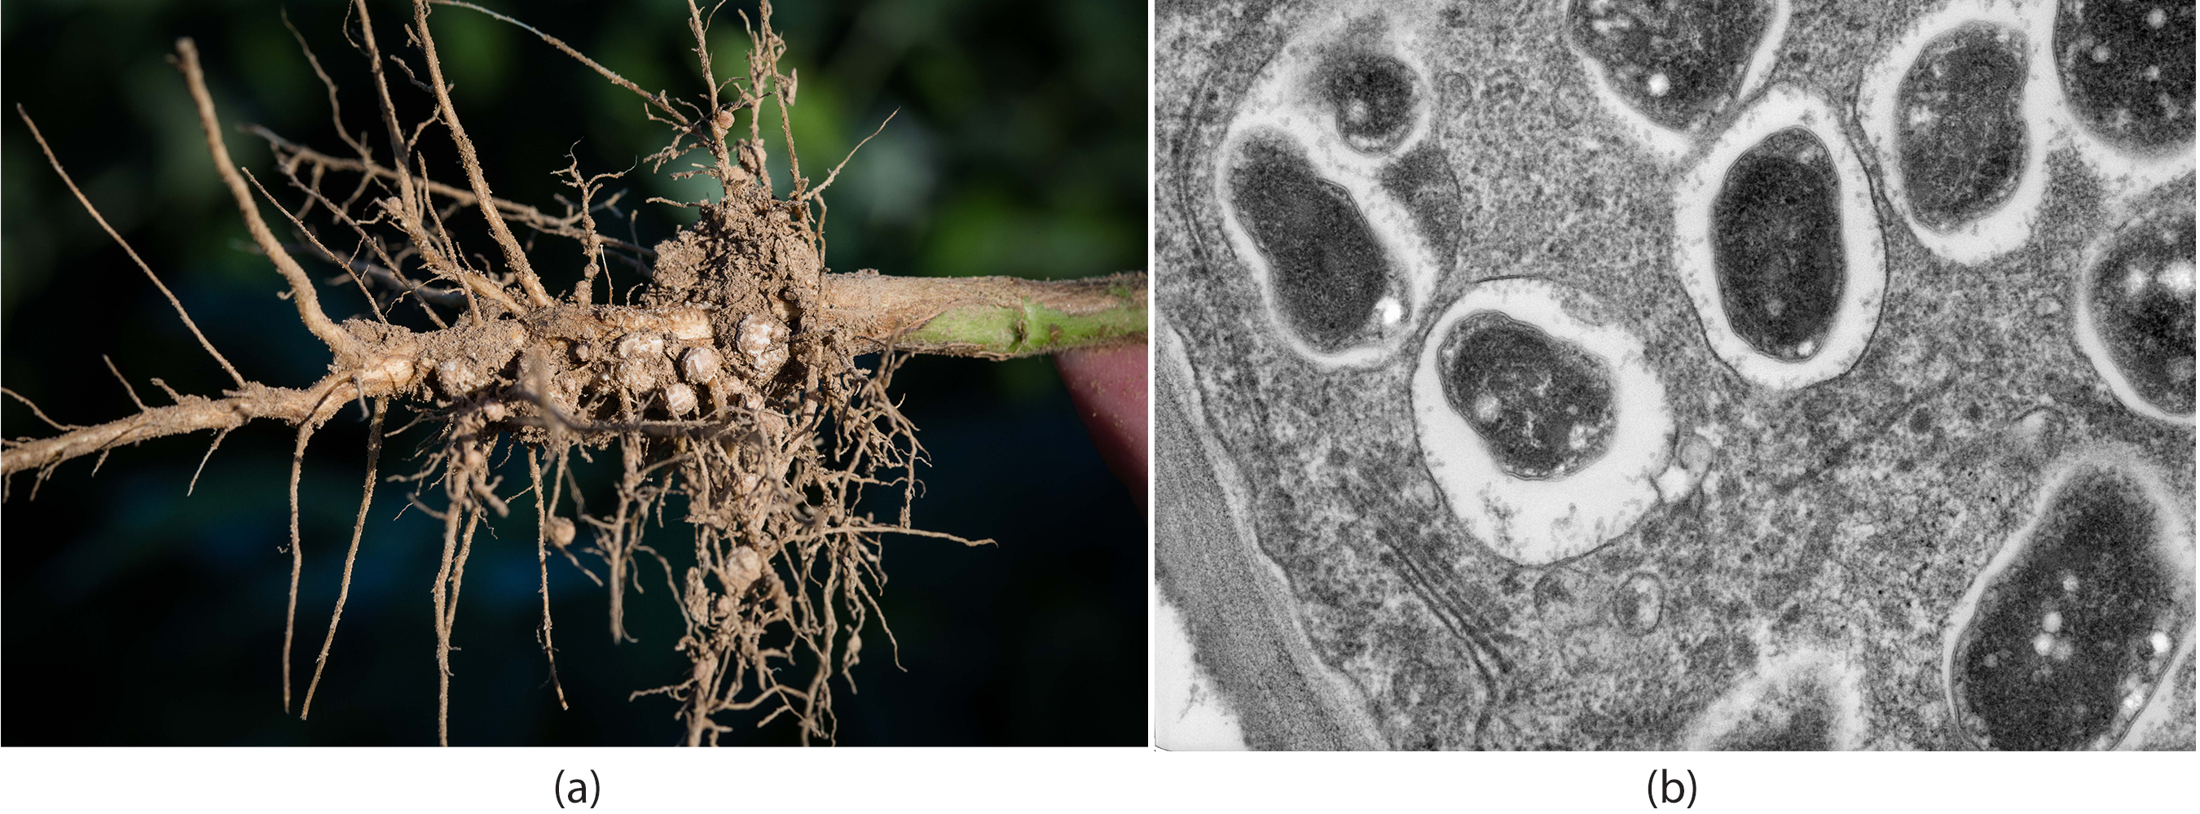
Nitrogen Fixation: Root and Bacterial Interactions₂
Rhizobia are soil bacteria which symbiotically interact with legume roots to form nodules (specialized structures where nitrogen fixation takes place).
The nitrogenase enzyme converts N₂ to NH₃.
This interaction is mutualistic, with the plant gaining NH₃ and the bacteria getting a protected niche to grow in.
31.2 Figure 2: Soybean roots contain (a) nitrogen-fixing nodules that are infected with Bradyrhyzobium japonicum, a rhizobium, or "root-loving" bacterium. The bacteria are encased in (b) vesicles inside the cell.
Notes:
Figure 2: Soybean roots contain (a) nitrogen-fixing nodules that look like spheres connected to the roots. Cells within the nodules are infected with Bradyrhyzobium japonicum, a rhizobium, or "root-loving" bacterium. The bacteria are encased in (b) vesicles inside the cell, as shown in this transmission electron micrograph.

Slide 7
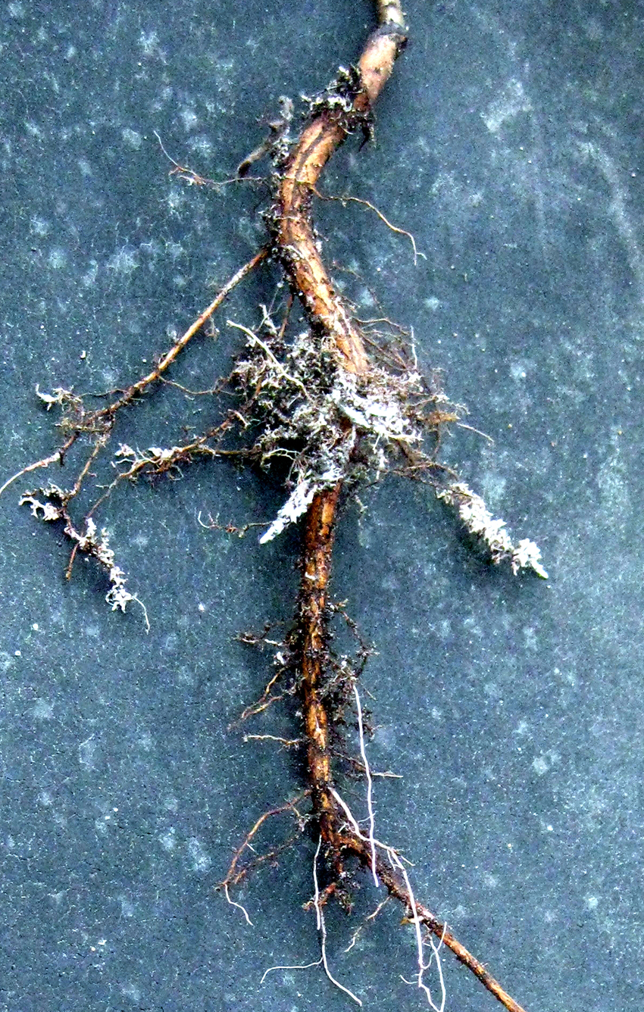
Mycorrhizae: The Symbiotic Relationship between Fungi and Roots
Fungal mycorrhizae integrate into the physical structure of the root. Plants obtain phosphate from the fungi and the fungi get nutrients from the plants.
The fungi may also provide antibiotic compounds to protect the plant.
Ectomycorrhizae form a dense sheath called a mantle around the roots.
Endomycorrhizae do not form a dense sheath around the roots.
31.2 Figure 3
United Soybean Board on Wikimedia Commons. "Roots with nodes."
Notes:
Figure 3: Root tips proliferate in the presence of mycorrhizal infection, which appears as off-white fuzz in this image.

Slide 8
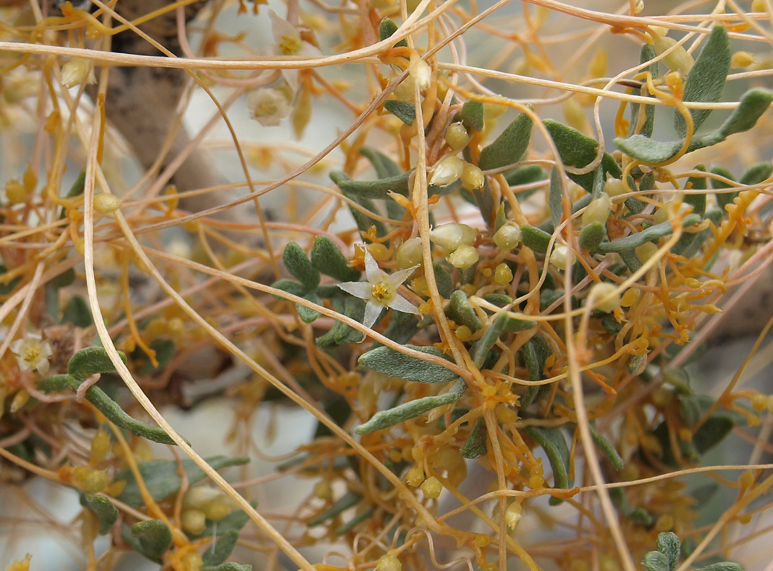
Plant Parasites
A parasitic plant depends on its host for survival.
Some parasitic plants have no leaves and connect with the vascular bundles of the host for water and nutrients.
Some parasitic plants undergo photosynthesis and only depend on the host plant for water.
31.2 Figure 4
Jim Morefield on Wikimedia Commons. "California dodder."
Notes:
Figure 4: The dodder is a holoparasite that penetrates the host's vascular tissue and diverts nutrients for its own growth. Note that the vines of the dodder, which has white flowers, are beige. The dodder has no chlorophyll and cannot produce its own food.

Slide 9
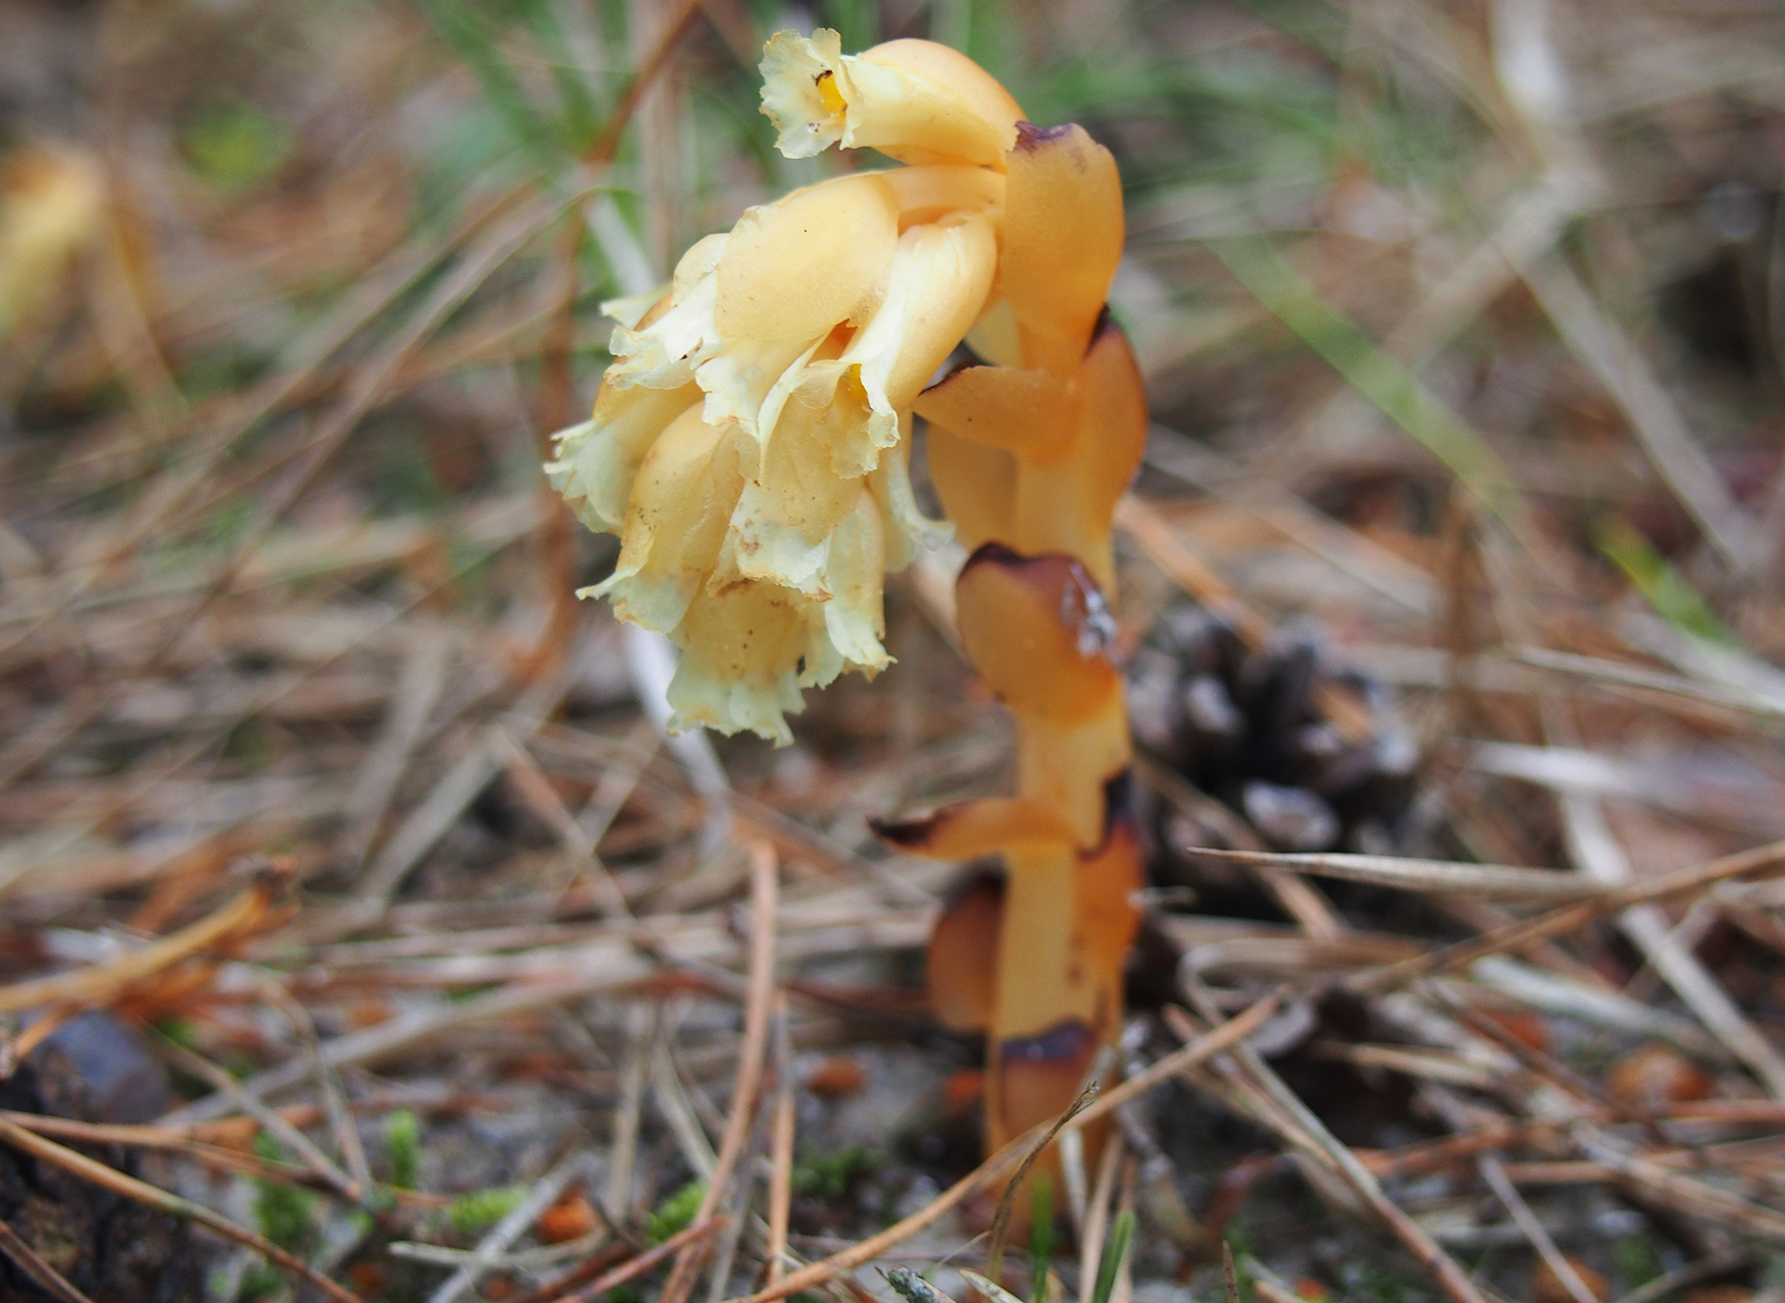
Saprophytes
A saprophyte is an organism that gets its food from dead organisms and decaying organic matter.
Saprophytic plants lack chlorophyll and use enzymes to convert organic materials into simpler forms they can digest.
31.2 Figure 5
Agnieszka Kwiecień, Nova on Wikimedia Commons. "Dutchmen's pipe."
Notes:
Figure 5: Saprophytes, like this Dutchmen's pipe (Monotropa hypopitys), obtain their food from dead matter and do not have chlorophyll.

Slide 10
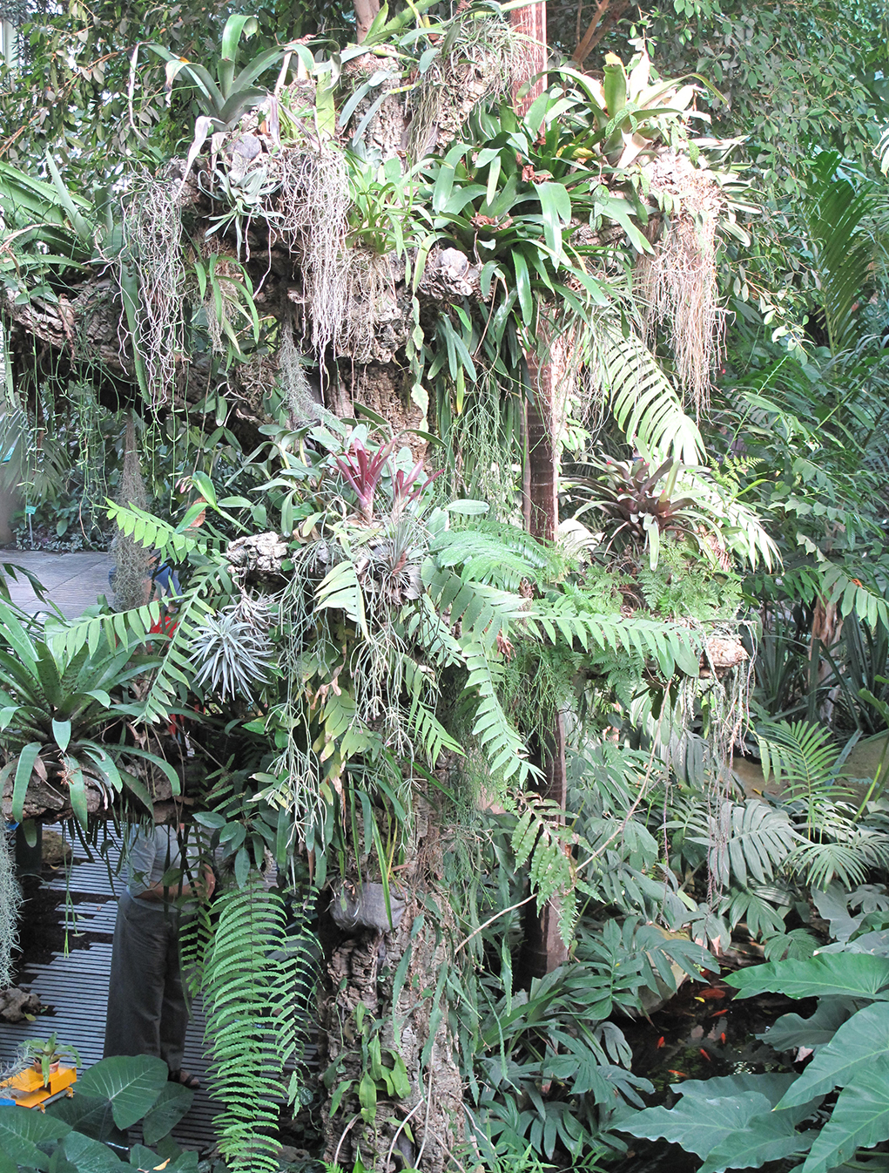
Epiphytes
An epiphyte is a plant that grows on other plants but does not depend on that plant for nutrition.
Epiphytes maximize their ability to receive sunlight by growing on top of other plants.
Epiphytes have two types of roots.
Clinging arial roots (absorb nutrients from humus that accumulates in tree crevices)
Aerial roots (absorb moisture from atmosphere)
31.2 Figure 6
Tangopaso on Wikimedia Commons. "Epiphyte plants."
Notes:
Figure 6: These epiphyte plants grow in the main greenhouse of the Jardin des Plantes in Paris.

Slide 11
Group Activity
Parasitic and epiphytic plants depend on other plant species for survival. In a group, compare and contrast the defining differences between these groups and their effects on the host plants.

Slide 12
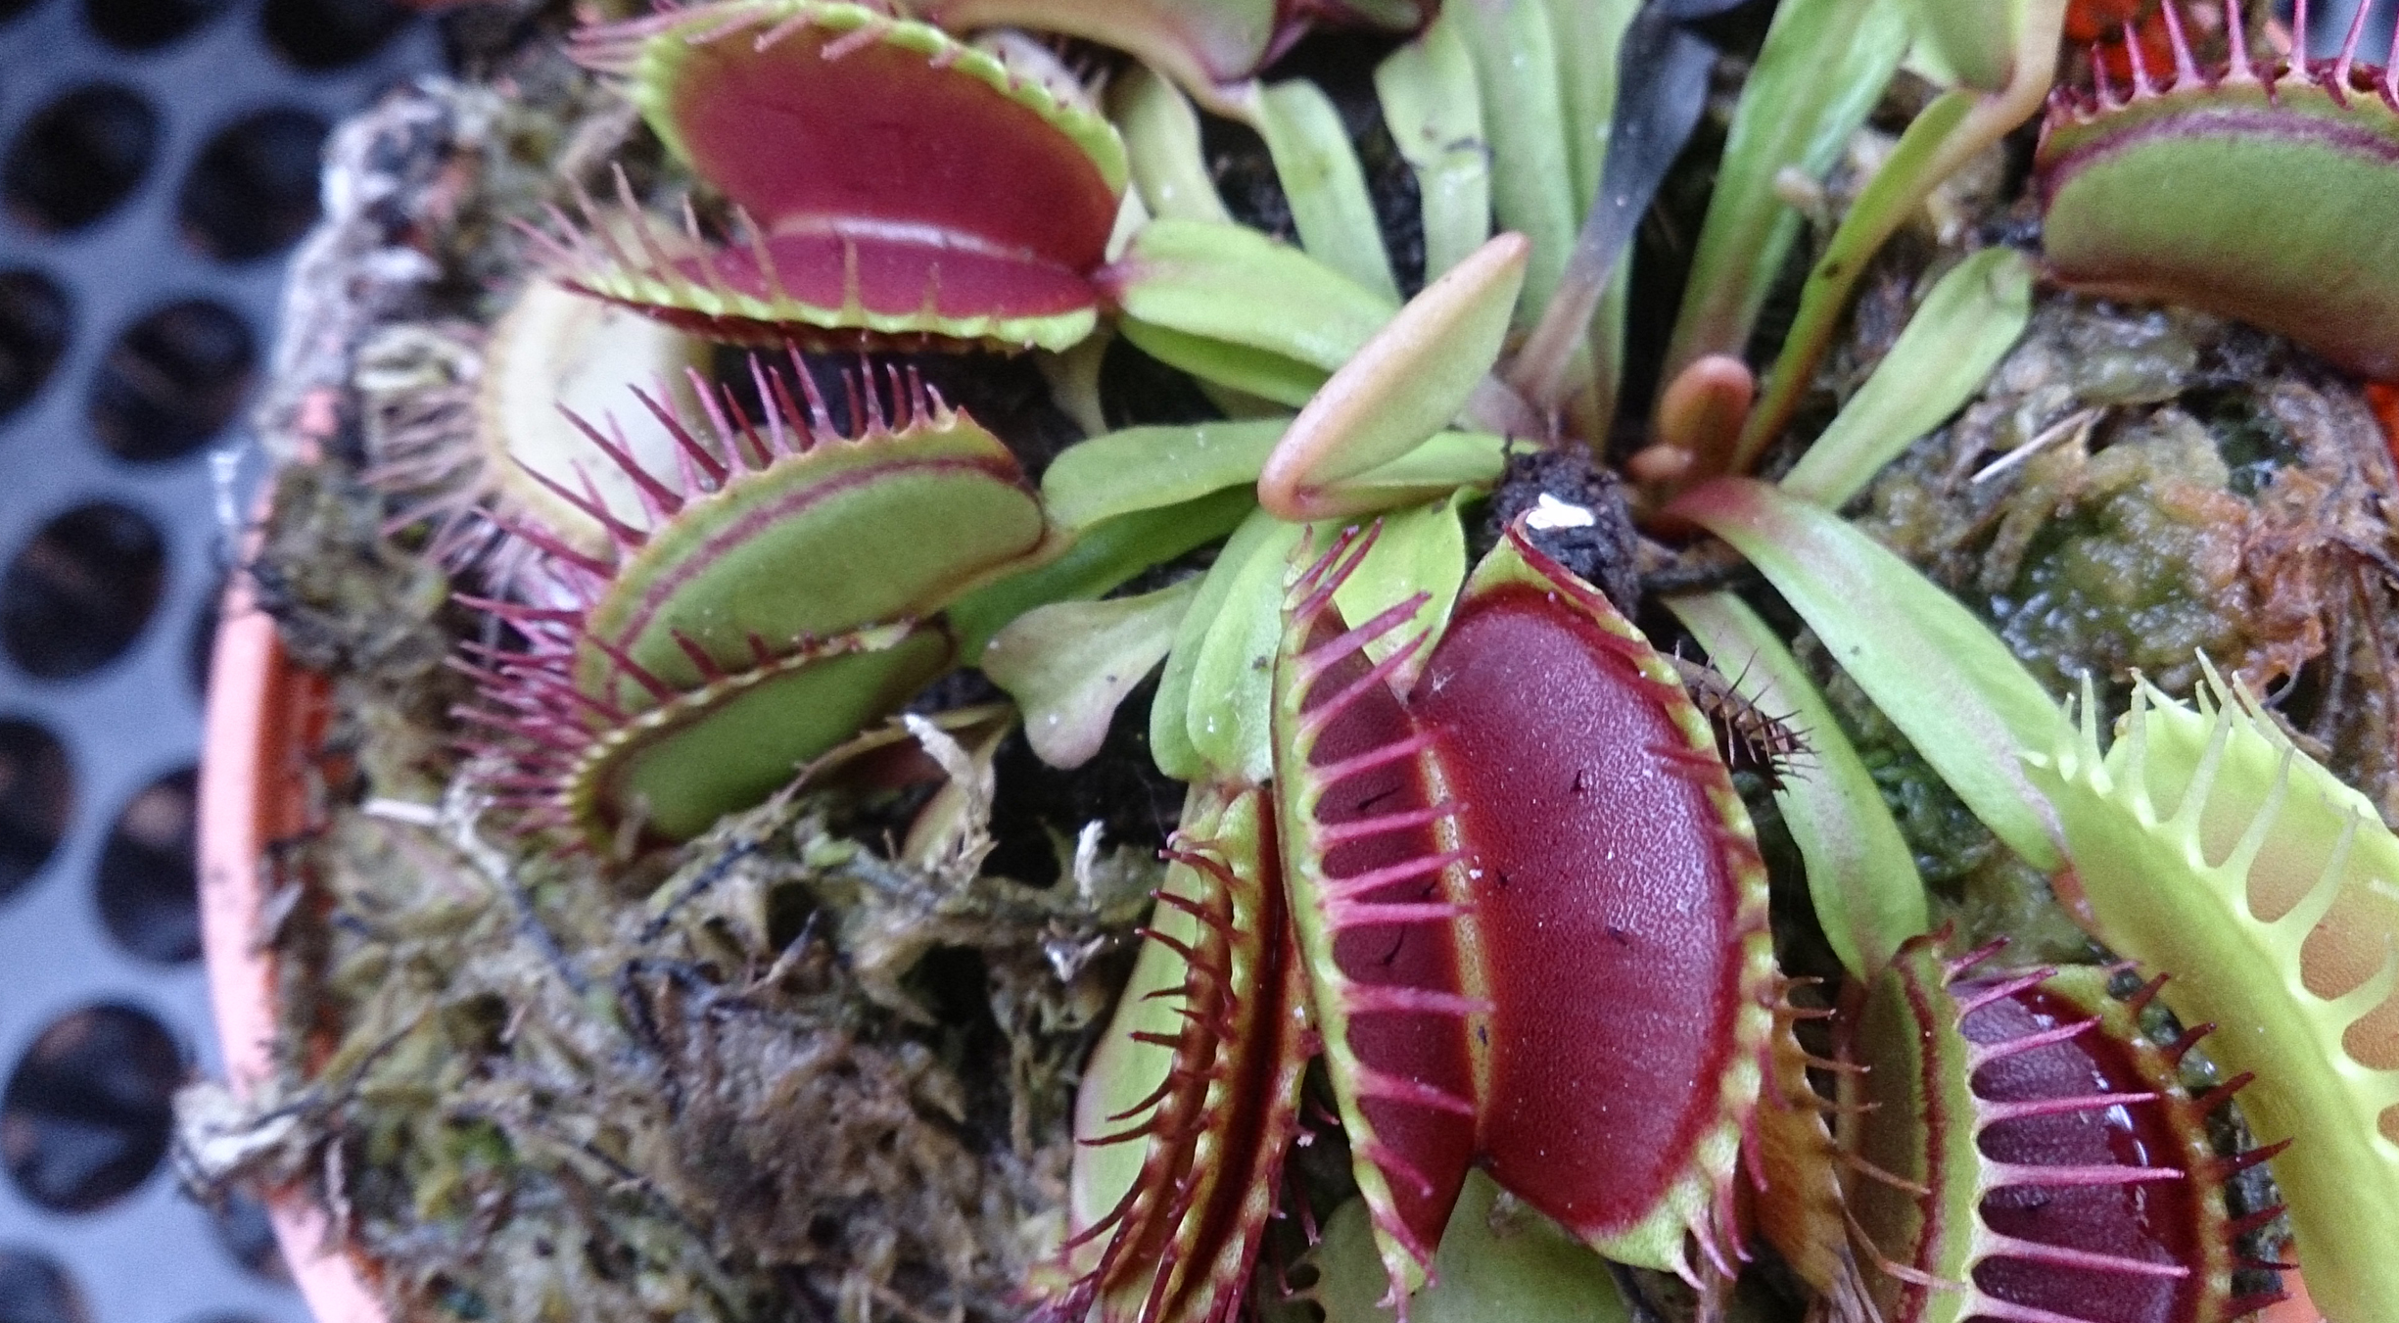
Insectivorous Plants
An insectivorous plant has specialized leaves to attract and digest insects.
Minerals obtained from prey insects helps to compensate for soil deficiencies.
The Venus fly trap is a threatened plant in its original habitat.
31.2 Figure 8
Mokkie on Wikimedia Commons. "Venus flytrap."
Notes:
Figure 7: A Venus flytrap has specialized leaves to trap insects.

Slide 13
Summary
Biological nitrogen fixation (BNF) is the conversion of atmospheric nitrogen to ammonia.
The most important source of BNF is the symbiotic interaction between soil bacteria and legumes.
Fungi form symbiotic associations (mycorrhizae) with plants, integrating into the root system.
Some plants have evolved adaptations to obtain organic and mineral nutrients from a variety of sources.

Slide 14

End of Hawkes Learning PowerPoint

