Slide 1
Lesson 32.1
Reproductive Development and Structure

Slide 2
Objectives
Compare and contrast male and female gametophytes and explain how they form in angiosperms.
Describe the components of a complete flower.
Describe the development of microsporangium and megasporangium in gymnosperms.
Describe the reproductive structures of a plant.
Describe the two stages of a plant's lifecycle.

Slide 3
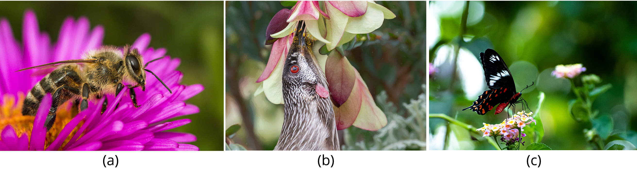
Plant Reproduction
Some plants reproduce sexually, while others reproduce asexually.
Sexually reproducing plants rely on pollinators.
Flowers, with their bright colors, strong scents and interesting shapes and sizes attract birds, insects and animals to serve their pollination needs.
32.1 Figure 1: Plants that sexually reproduce are often fertilized with the help of pollinators such as (a) bees, (b) birds, and (c) butterflies.
Fotoworkshop4You on Pixabay. "Bee."
Gallpix on Wikimedia Commons. "Red wattle bird."
Krishna Varun Moleyaru on Wikimedia Commons. "Crimson rose butterfly."

Slide 4
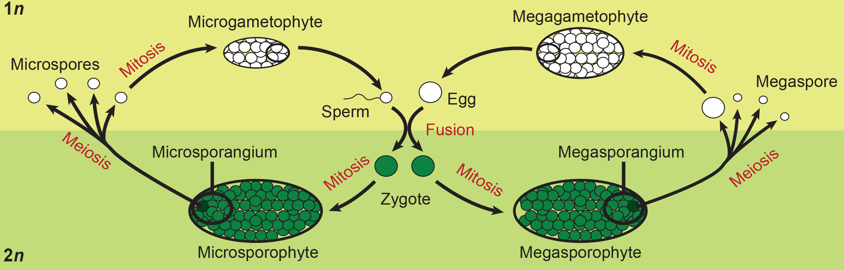
Reproductive Development and Structure₁
Plants have two distinct stages of the life cycle: the gametophyte stage and the sporophyte stage.
The haploid gametophyte produces male and female gametes via mitosis.
The male and female gametes fuse to form the diploid zygote which develops into the sporophyte.
32.1 Figure 2
Peter Coxhead on Wikimedia Commons. "Alternation of generations."
Notes:
Figure 2: The alternation of generations in angiosperms is depicted in this diagram.

Slide 5
Reproductive Development and Structure₂
The sporophyte stage dominates the life cycle of higher plants, with the sporophyte ultimately bearing the gametophytes.
In ferns, the gametophyte is free-living and distinct in structure from the sporophyte.
In bryophytes, such as mosses, the haploid gametophyte is more developed than the sporophyte.

Slide 6
Flower Structure₁
A typical flower has four main parts—or whorls—know as the calyx, corolla, androecium and gynoecium.
The outermost whorl has green sepals (collectively called the calyx) to protect the unopened bud.
The second whorl is comprised of petals which are bright in color. Collectively, the petals of a flower are called the corolla.
Together the calyx and corolla are known as the perianth.
The third whorl, the androecium contains the male reproductive structures.
The fourth whorl is the gynoecium, or female reproductive structures. The carpel is the individual unit of the gynoecium and has a stigma, style and ovary.

Slide 7
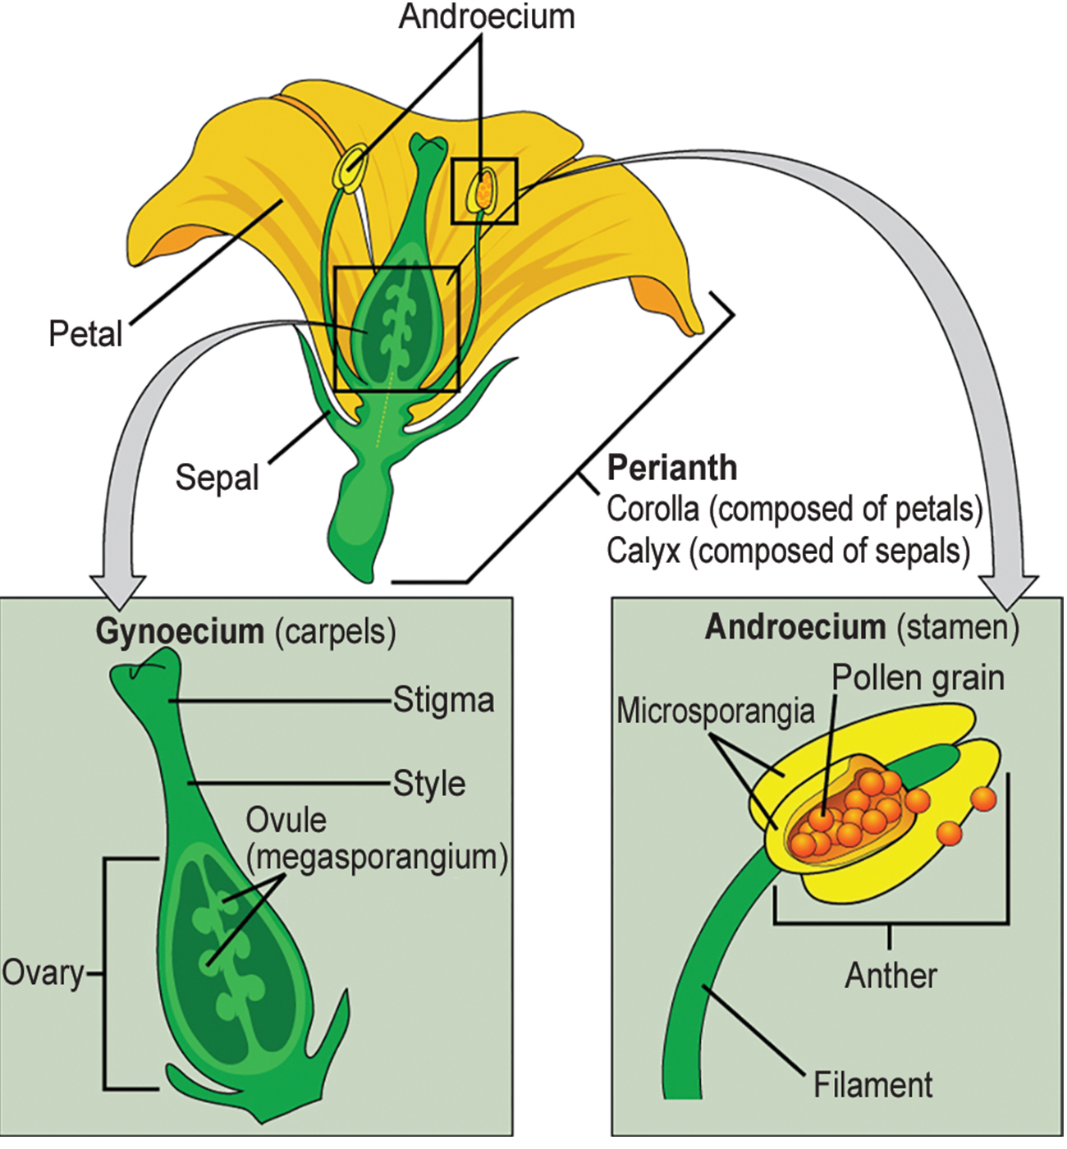
Lesson 32.1 Figure 3
Mariana Ruiz Villarreal on Wikimedia Commons. "Angiosperm flower parts." Modified.
Notes:
Figure 3: The four main parts of the flower are the calyx, corolla, androecium, and gynoecium. The androecium is the sum of all the male reproductive organs, and the gynoecium is the sum of the female reproductive organs.

Slide 8
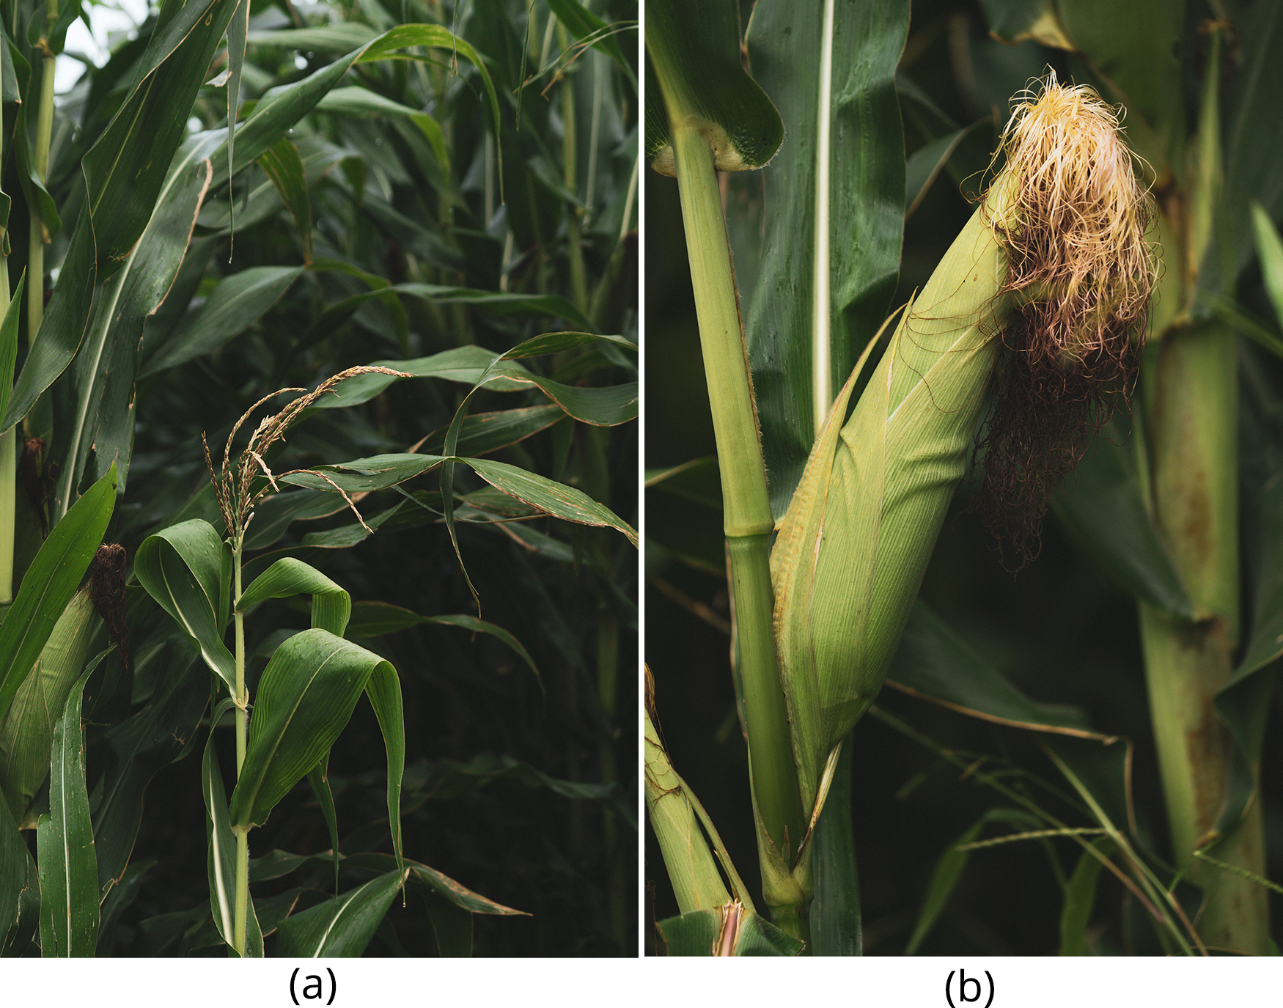
Flower Structure₂
If all four whorls are present, the flower is described as complete.
If any parts are missing, it is known as an incomplete flower.
Flowers which contain both an androecium and a gynoecium are called perfect, androgynous or hermaphroditic.
Flowers which only contain the androecium are staminate flowers while flowers with only gynoecium are carpellate flowers.
31.2 Figure 4: (a) corn pollen and (b) an ear of corn
Los Muertos Crew on Pexels. "Corn plant."
Notes:
Figure 4: The corn plant has both staminate (male) and carpellate (female) flowers. (a) Staminate flowers, which are clustered in the tassel at the tip of the stem, produce pollen grains. (b) Carpellate flowers are clustered in the immature ears. Each strand of silk is a stigma, and the corn kernels are seeds that develop on the ear after fertilization.

Slide 9
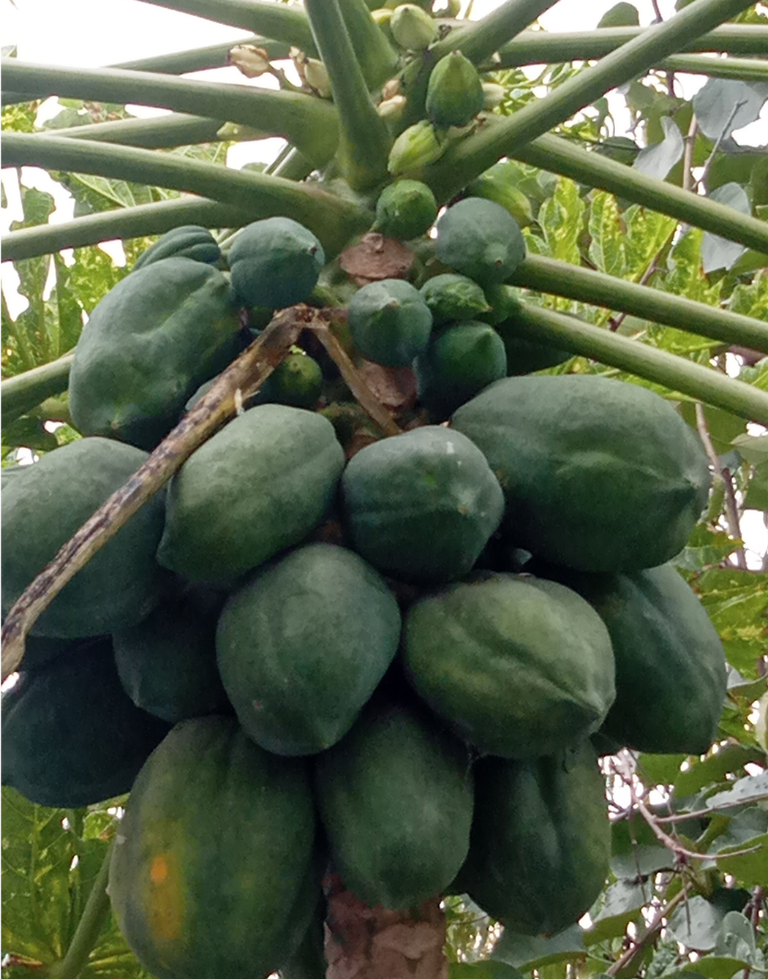
Flower Structure₃
Monoecious plants have male and female flowers on the same plant.
Dioecious plants have male and female flowers on separate plants.
If the ovary is places above the rest of the flower parts it is called superior, and if it is below other parts, it is called inferior.
32.1 Figure 5
Davinder singh01 on Wikimedia Commons. "Papaya tree."
Notes:
Figure 5: A female papaya tree bearing fruit

Slide 10
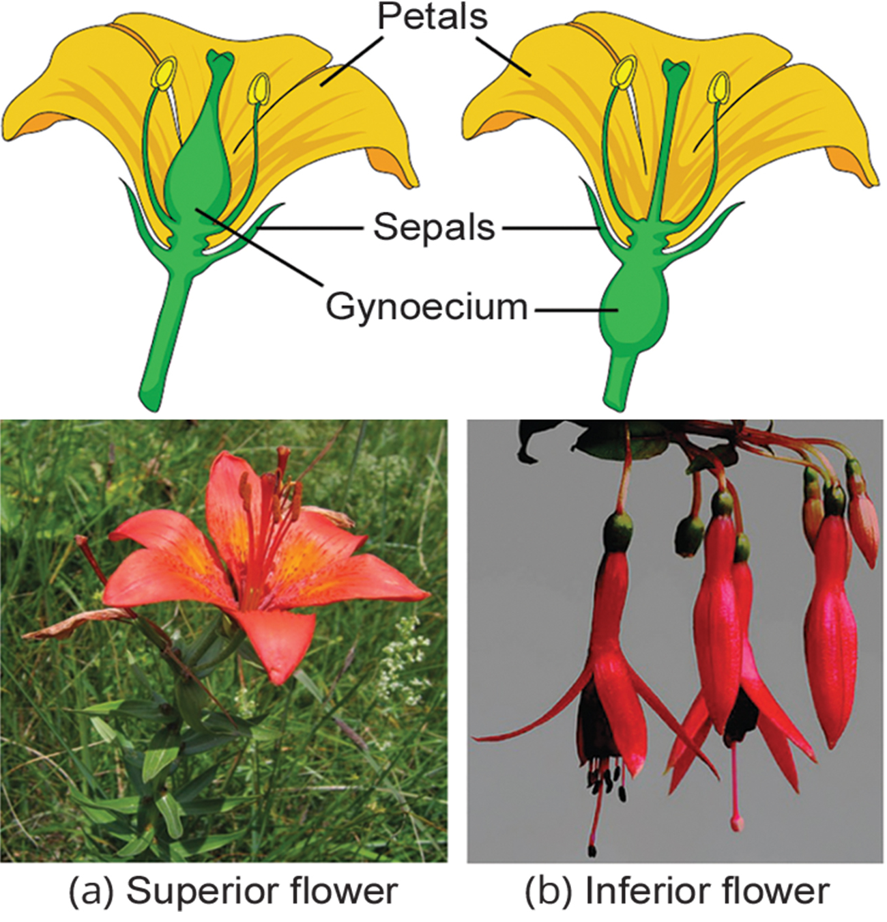
Lesson 32.1 Figure 6
CNX OpenStax on Wikimedia Commons. "Lily." Modified.
Koshy Pixels on Flickr. "Fuchsia."
Notes:
Figure 6: The (a) lily is a superior flower, which means the ovary is placed above the other flower parts. (b) Fuchsia is an inferior flower, which means the ovary is placed beneath other flower parts.

Slide 11
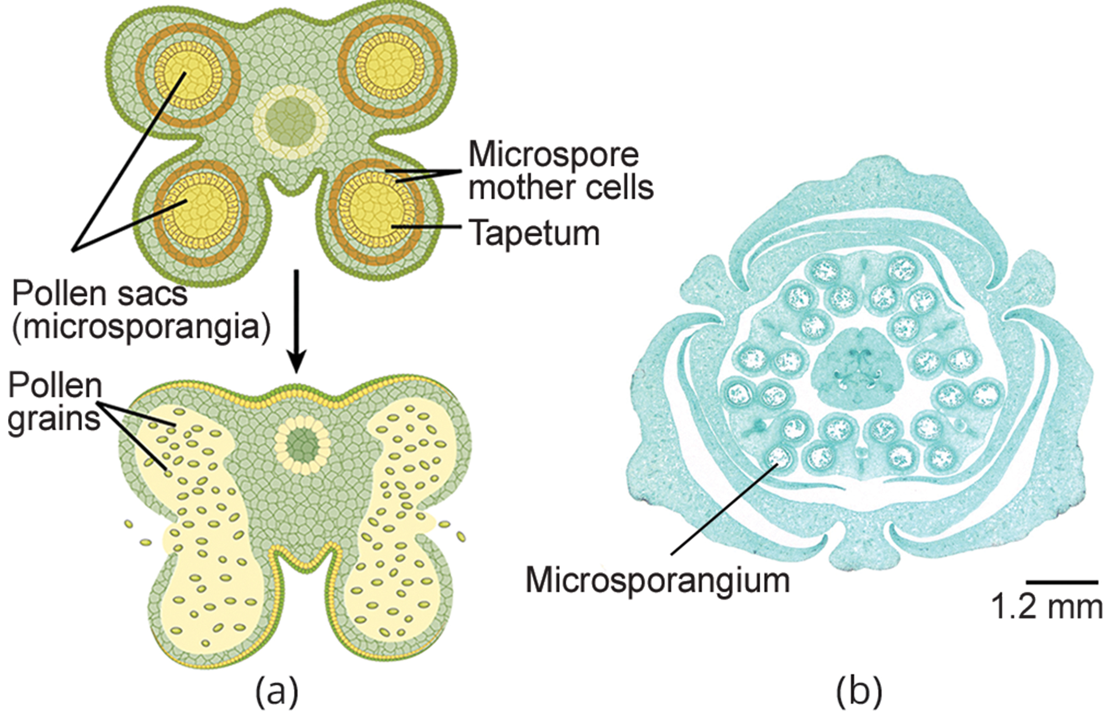
Male Gametophyte (Pollen Grain)₁
The male gametophyte develops and reaches maturity within an immature anther.
Pollen development takes place in a structure called the microsporangium
The microsporangium are pollen sacs where the microspores develop into pollen.
32.1 Figure 7
Jon Houseman and Matthew Ford on Wikimedia Commons. "Lilium anther."
Notes:
Figure 7: Shown is (a) a cross section of an anther at two developmental stages. The immature anther (top) contains four microsporangia, or pollen sacs. Each microsporangium contains hundreds of microspore mother cells that will each give rise to four pollen grains, or male gametophytes. The inner layer of cells, called the tapetum, supports the development and maturation of the pollen grains. Upon maturation of the pollen (bottom), the pollen sac walls split open, and the pollen grains are released, as shown in the (b) micrograph of an immature lily anther. In this scanning electron micrograph, pollen sacs are ready to burst, releasing their grains.

Slide 12
The Male Gametophyte (Pollen Grain)₂
The microspore mother cells in the microsporangium divide by meiosis to produce four microspores, each of which will become a pollen grain.
Mature pollen grains have two cells, a generative cell and a pollen tube cell.
The pollen tube cell creates the pollen tube, while the generative cell will divide to form two sperm cells.
Each pollen grain has two coverings, the exine (thick outer layer) and the intine.
The exine contains the sporopollenin, which is a waterproof coating.

Slide 13
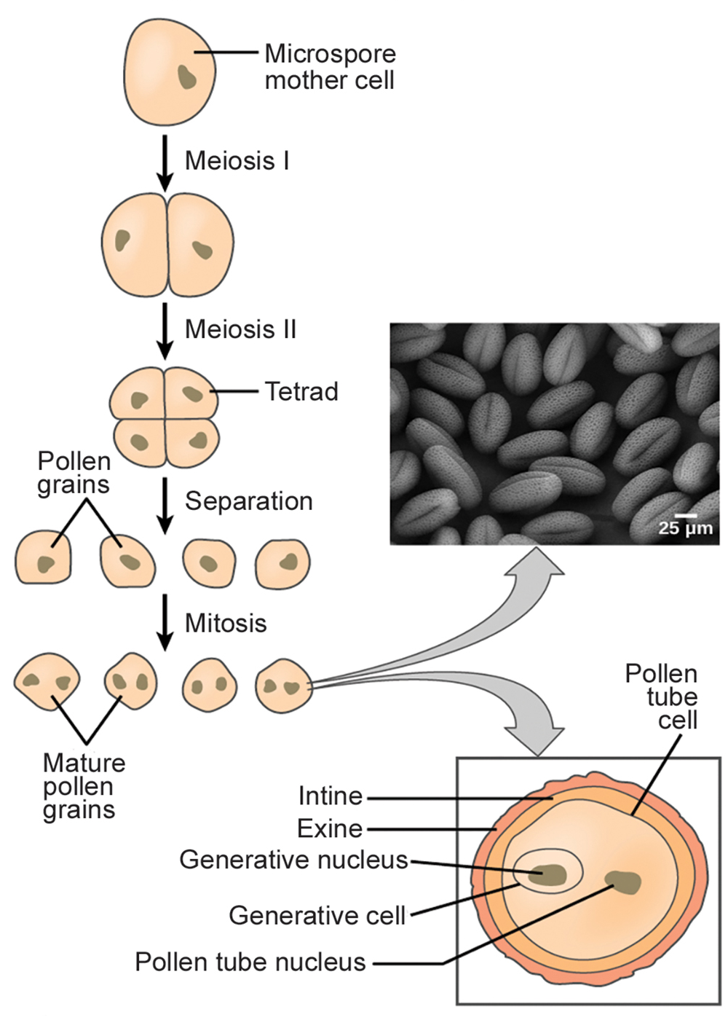
32.1 Figure 8
CNX OpenStax on Wikimedia Commons. "Pollen micrograph." Modified.
Notes:
Figure 8: Pollen develops from the microspore mother cells. The mature pollen grain is composed of two cells: the pollen tube cell and the generative cell inside the tube cell. The pollen grain also has two coverings: an inner layer (intine) and an outer layer (exine). The inset scanning electron micrograph shows Arabidopsis lyrata pollen grains.

Slide 14
Group Activity
Sporopollenin is an important, waterproof substance in the reproduction of plants.
Break up into a small group (three to five peers) and write down a couple chemical characteristics that you would expect sporopollenin to have.
Share your predictions with your peers and combine your answers.
Next, find a reliable source about sporopollenin and determine what your group assumed correctly and incorrectly.

Slide 15
Female Gametophyte (Embryo Sac)
Female gametophyte development has two stages:
Megasporogenesis: a single cell dividing in the megasporangium (an area of tissue in the ovary) undergoes meiosis to create four megaspores, only one of which will survive.
Megagametogenesis: the surviving haploid megaspore undergoes mitosis to produce a female gametophyte with eight nuclei and seven cells, also known as the megagametophyte, or embryo sac.

Slide 16
Megagametophyte₁
Two of the nuclei in the Megagametophyte—the polar nuclei—move to the equator a fuse to form a single diploid central cell.
The central cell will fuse with a sperm to form the triploid endosperm.
Three nuclei position themselves on the end of the embryo sac opposite the micropyle and develop into the antipodal cells (where growth hormones accumulate).
The nucleus closest to the micropyle becomes the female gamete and the two adjacent nuclei develop into synergid cells.

Slide 17
Megagametophyte₂
A double-layered integument protects the megasporangium.
After fertilization, the integument will develop into the seed coat and protect the entire seed.
The ovule wall becomes part of the fruit.
The integument do not enclose it completely but leave an opening called the micropyle.
The micropyle allows the pollen tube to enter the female gametophyte for fertilization.

Slide 18
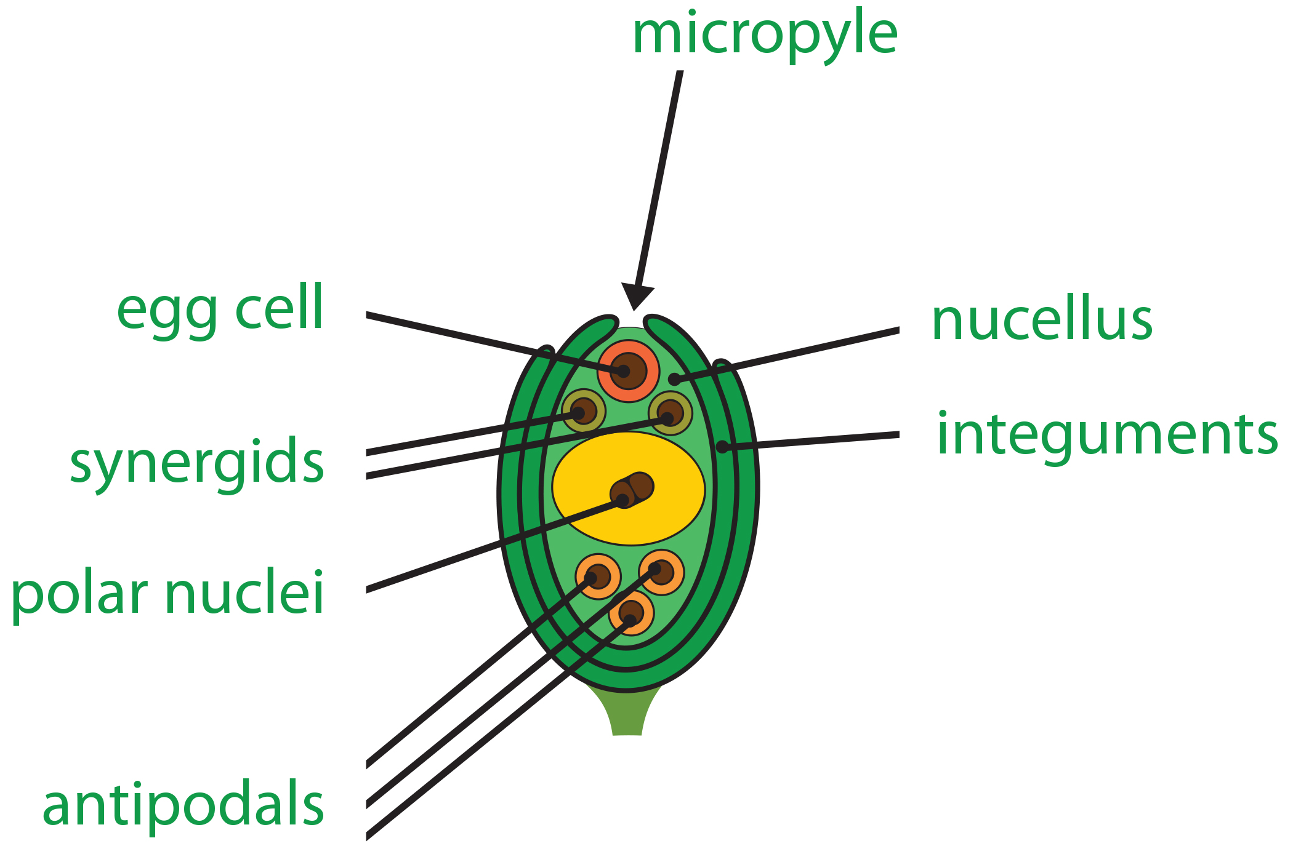
Lesson 32.1 Figure 9
Notes:
Figure 9: As shown in this diagram of the embryo sac in angiosperms, the ovule is covered by integuments and has an opening called a micropyle. Inside the embryo sac are three antipodal cells, two synergids, a central cell, and the egg cell.

Slide 19
Think It Through
An embryo sac is missing the synergids. What specific impact would you expect this to have on fertilization?
Notes:
Originally an On Your Own. This is included here to use as a talking point or for a think-pair-share activity.

Slide 20
Sexual Reproduction in Gymnosperms
The leafy green part of the conifer is the sporophyte, while the pinecone contains the male and female gametophytes.
Male cones are present on the lower regions of the tree, while female (larger cones) are positioned on the top regions of the tree.
Pollination occurs by wind, so self-fertilization is unlikely.

Slide 21
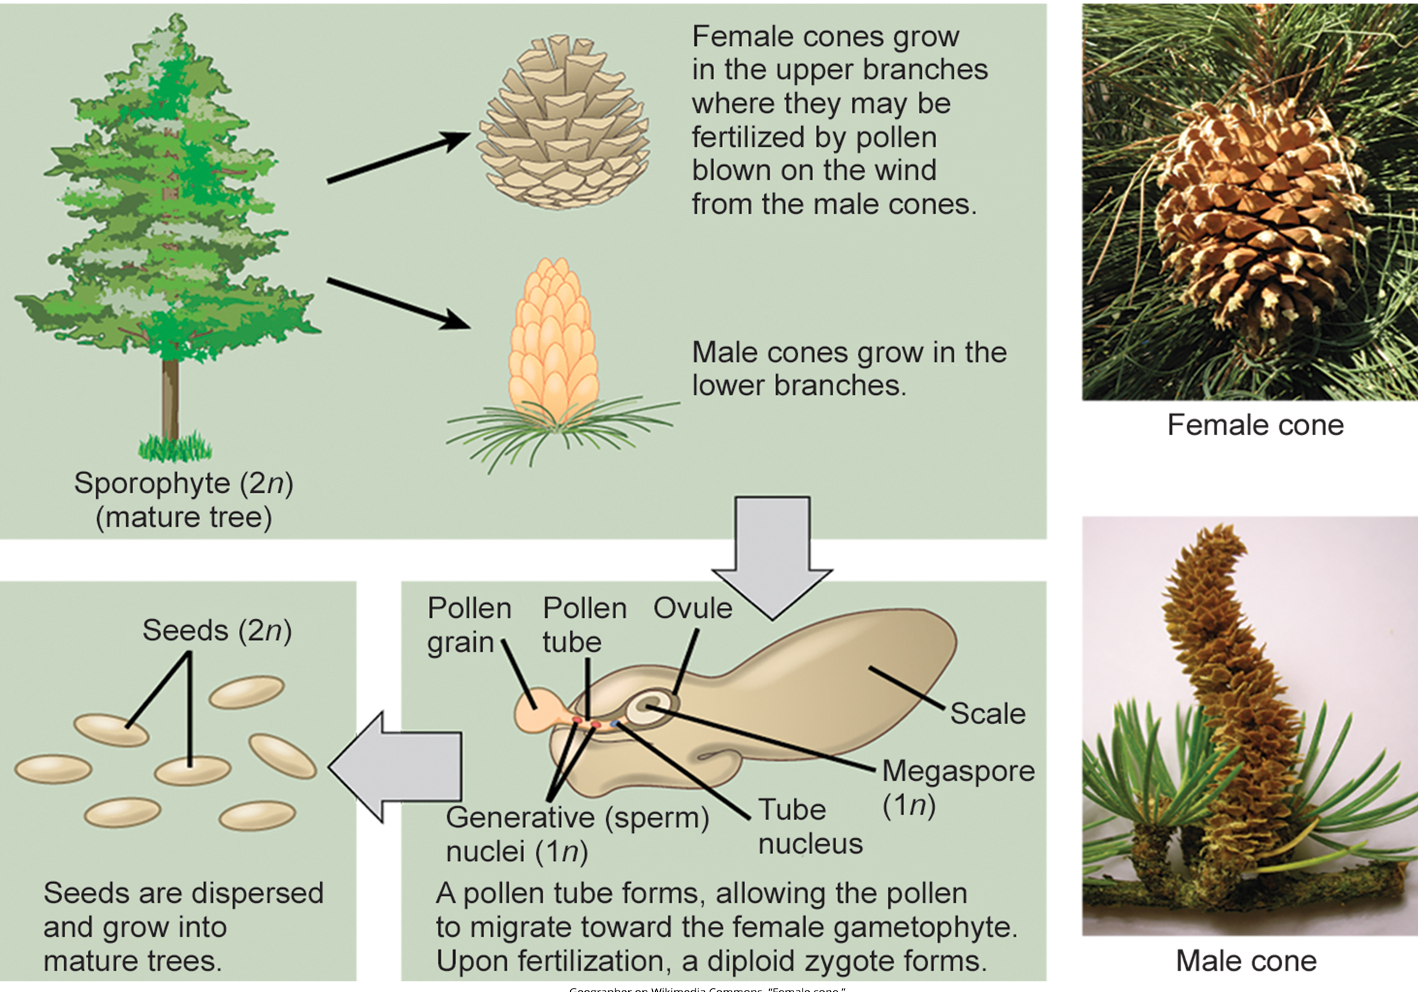
Lesson 32.1 Figure 10
Geographer on Wikimedia Commons. "Female cone."
Roger Griffith on Wikimedia Commons. "Male cone."
Notes:
Figure 10: This image shows the life cycle of a conifer. Pollen from male cones blows into the upper branches, where it fertilizes female cones. Pollen and the ovules within the seed cone's scales are haploid gametes. Once a pollen grain fertilizes the ovule, the seed is diploid.

Slide 22
Gymnosperm Male Gametophyte
A male cone has a central axis where bracts (modified leaves), or microsporophylls are attached.
Microsporangia (pollen sacs) are present on the lower surface of the microsporophylls and are where microspores develop.
Microsporocytes divide by meiosis to produce four haploid microspores.
Each microspore undergoes mitosis to produce two nuclei: the generative nucleus and the tube nucleus. Upon maturity, the male gametophyte (pollen) is released and carried by the wind.

Slide 23
Gymnosperm Female Gametophyte
The female cone also has a central axis where megasporophylls are present.
Megaspore mother cells reside in the megasporangium.
The megaspore mother cell divides by meiosis to produce four haploid megaspores.
One of the megaspores divides to form the multicellular female gametophyte.
The other three divide to form the rest of the archegonium.

Slide 24
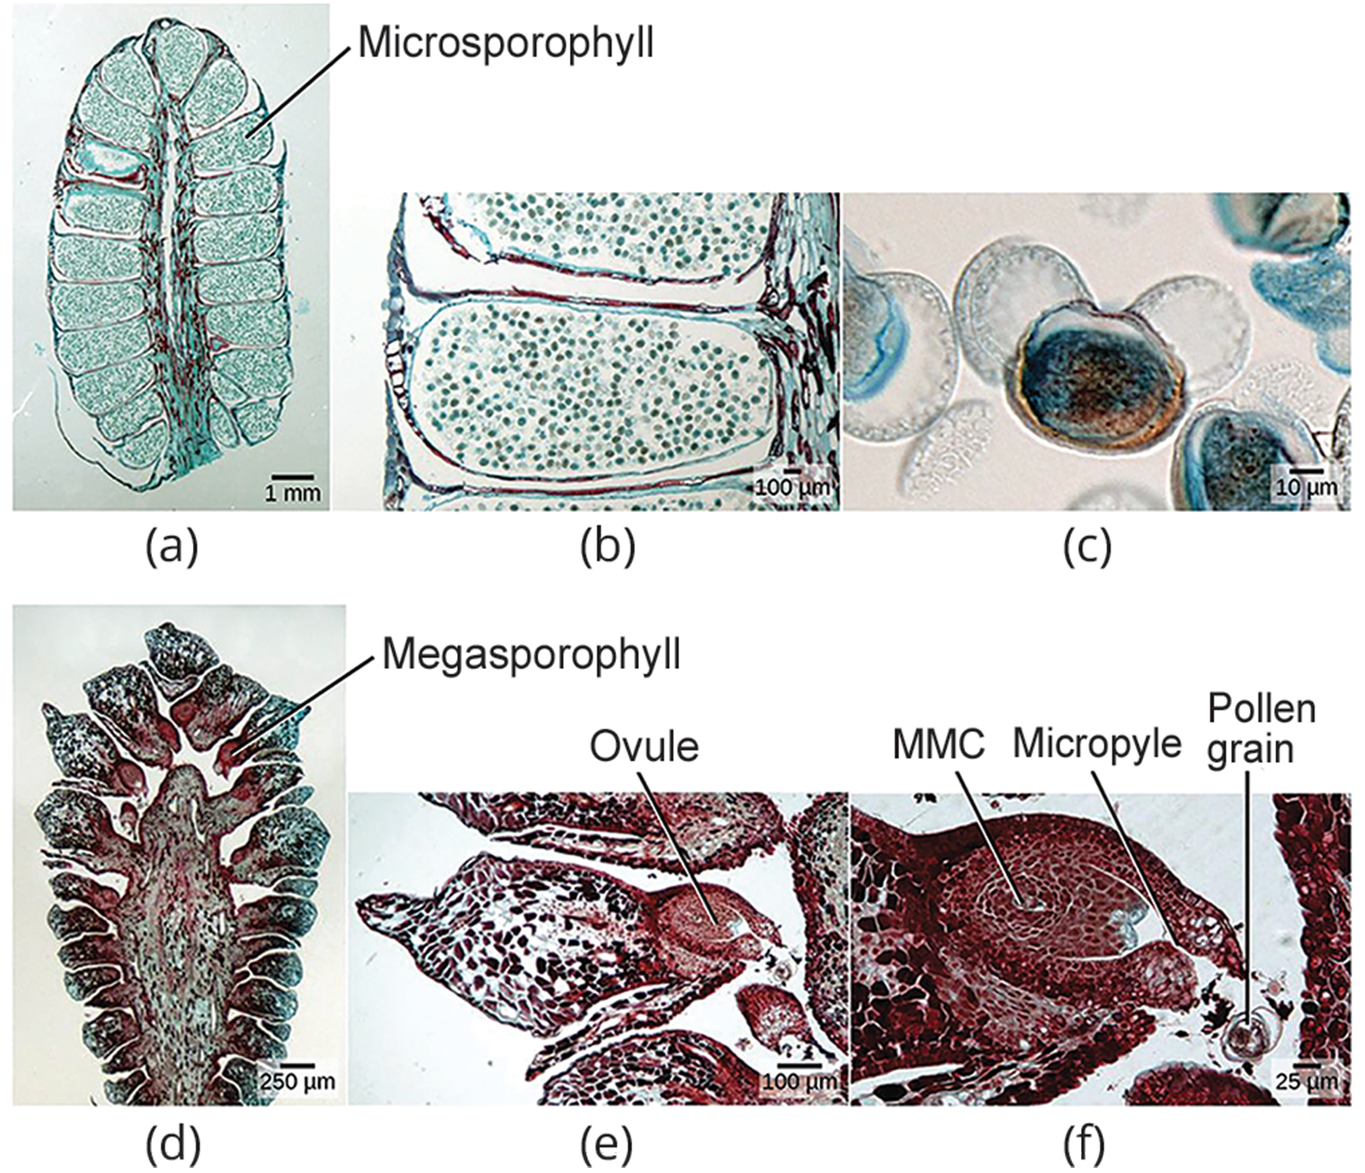
Lesson 32.1 Figure 11
CNX OpenStax on Wikimedia Commons. "Pollen micrograph." Modified.
Notes:
Figure 11: This series of micrographs shows male and female gymnosperm gametophytes. (a) This cross section of a male cone has approximately 20 microsporophylls, each of which produces hundreds of male gametophytes (pollen grains). (b) In this single microsporophyll, small dots represent pollen grains. (c) This micrograph shows an individual pollen grain. (d) This cross section of a female cone shows portions of about 15 megasporophylls. (e) In this single megasporophyll, the ovule is visible. (f) Within this single ovule are the megaspore mother cell (MMC), micropyle, and a pollen grain.

Slide 25
Gymnosperm Reproductive Process
A pollen gain lands on the female cone, and forms the pollen tube, which allows the generative cell to migrate to the female gametophyte.
This process takes approximately a year.
The male gametophyte generative cell splits into two sperm nuclei; one of which fuses with the egg.
After the egg is fertilized, the zygote forms and divides by mitosis to form the embryo.
The scales of the cones are closed during seed development.
Seed development takes one to two years.
Once the seed is ready to be dispersed, the bracts of the female cones open to allow dispersal.

Slide 26
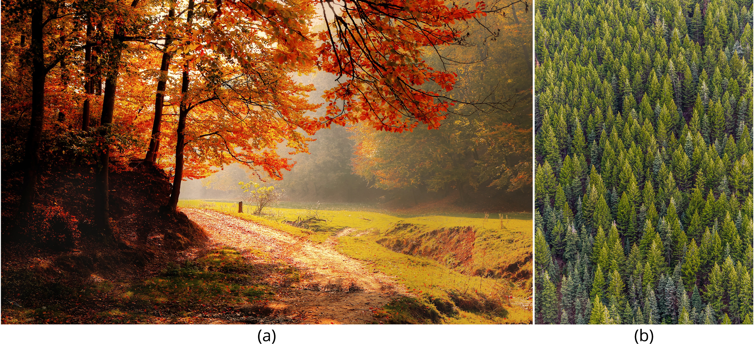
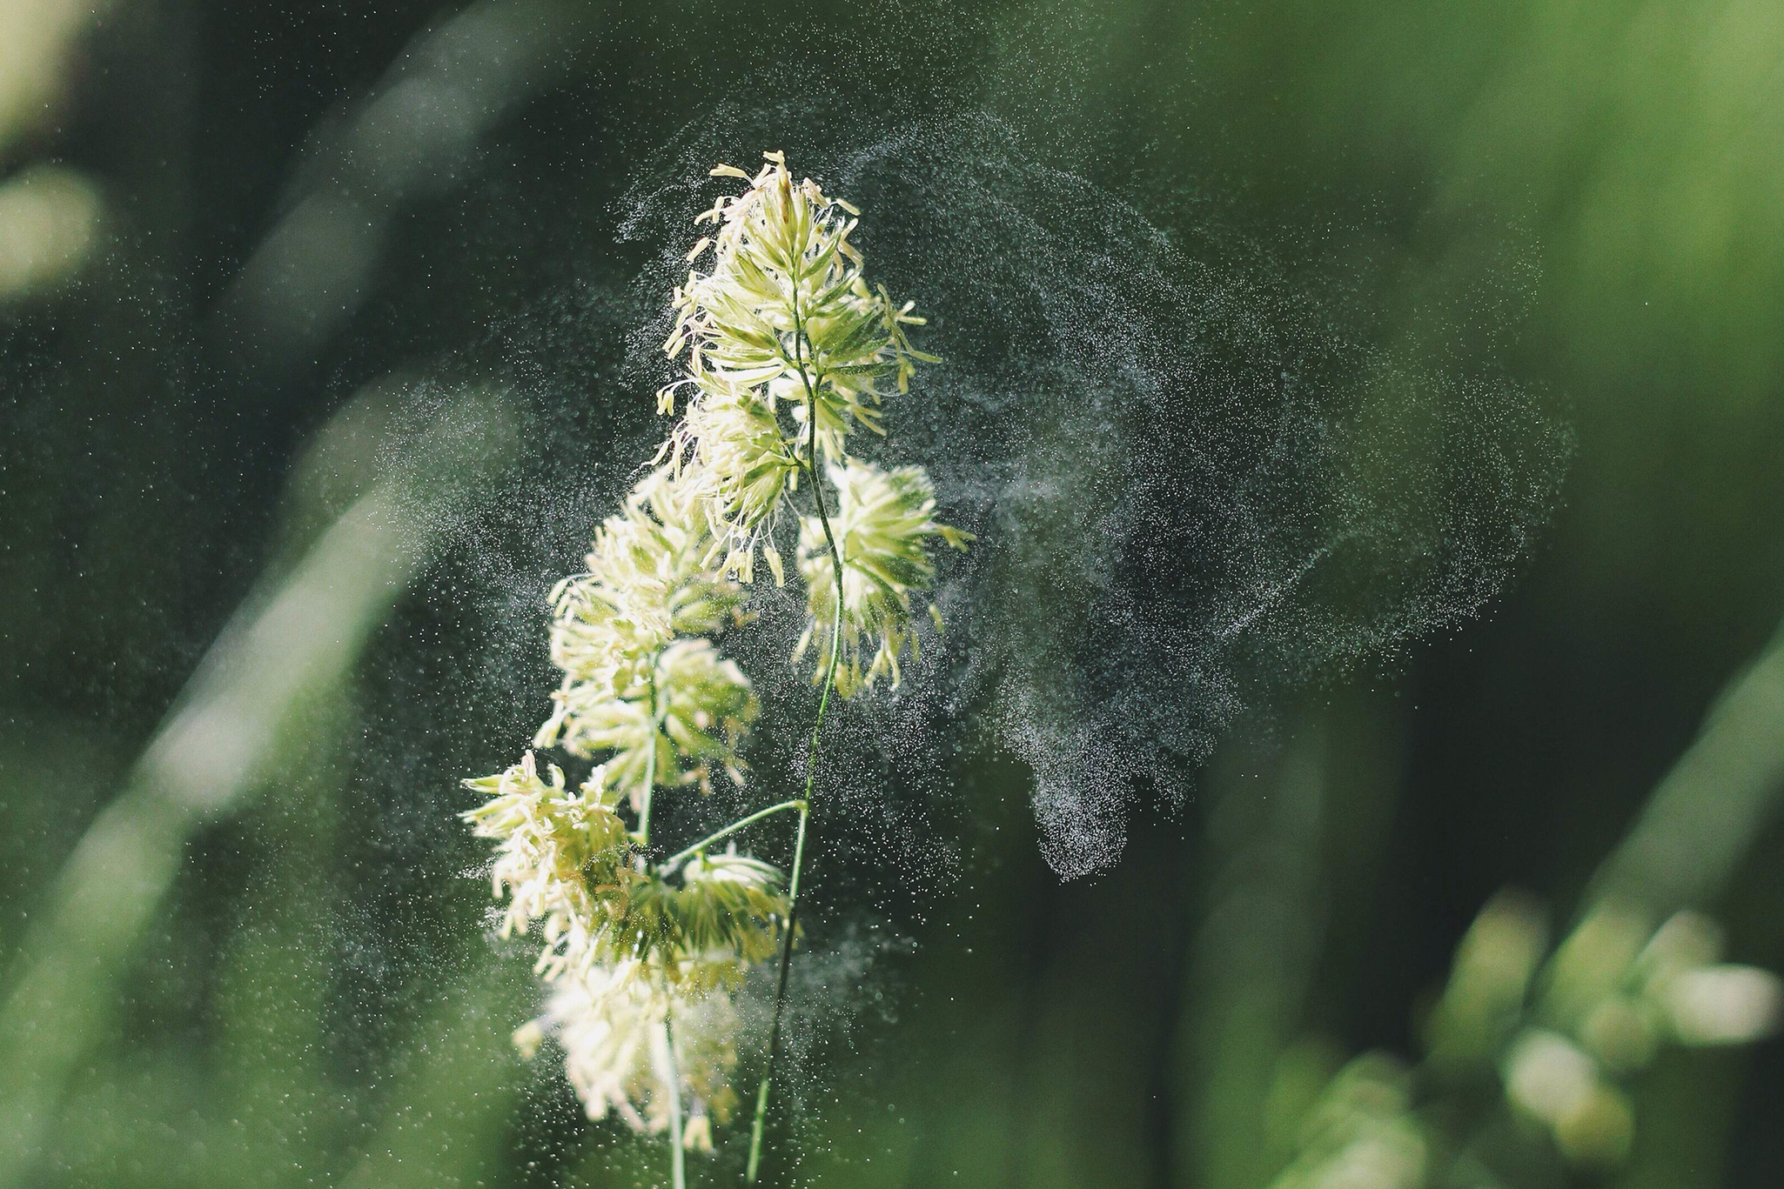
Angiosperms vs. Gymnosperms
In angiosperms, the female gametophyte exists in the ovule.
Double fertilization happens in angiosperms.
Male and female gametophytes are part of a flower rather than separate cones.
Animal pollination is a more common than wind pollination in angiosperms.
32.1 Figure 12
Pixabay on Pexels. "Forest path."
Matthew Montrone on Pexels. "Pine trees."
32.1 Figure 13
Alex Jones on Wikimedia Commons. "Pollen dispersal."
Notes:
Figure 12: (a) Angiosperms are flowering plants and include grasses, herbs, shrubs, and most deciduous trees, while (b) gymnosperms are conifers. Both produce seeds but have different reproductive strategies.
Figure 13: Wind dispersal is a strategy of pollen dispersal seen in both gymnosperms and angiosperms, such as the Dactylis glomerata shown here.

Slide 27
Summary
The flower contains the reproductive structures of a plant. All complete flowers contain four whorls: the calyx, corolla, androecium, and gynoecium.
Pollen is produced in the stamen, while the carpel is the female reproductive structure.
The longest living stage of the lifecycle of angiosperms and gymnosperms are the multicellular sporophyte generation.
The sporophytes produce sporangia which are dedicated to the production of spores, and ultimately egg and sperm.

Slide 28

End of Hawkes Learning PowerPoint

