Slide 1
Lesson 32.2
Pollination and Fertilization

Slide 2
Objectives
Define double fertilization.
Describe the process that leads to the development of a seed.
Describe what must occur for plant fertilization.
Explain cross-pollination and the ways in which it takes place.

Slide 3
Pollination₁
Pollination is:
The placement or transfer of pollen from the anther to the stigma of the same flower or another flower (in angiosperms)
The transfer of pollen from the male cone to the female cone (in gymnosperms)
Purposeful pollination has been used for research and plant breeding for centuries.
  Gregor Mendel carried out pollination in his studies of the genetics of garden peas.
  Today's crops are a result of plant breeding to produce present-day cultivars.
    Today’s corn is quite different from its ancestor, teosinte, cultivated by ancient Mayans.

Slide 4
Pollination₂
Pollination takes 2 forms:
Self-pollination occurs when the pollen from the anther is deposited on the stigma of the same flower or another flower of the same plant.
  This occurs in flowers where the stamen and carpel mature at the same time and are positioned so that pollen can land on the stigma.
  This eliminates the need for the plant to provide nectar and pollen as food for pollinators.
  This produces plants with less genetic diversity.
Cross-pollination (or out-crossing) is the transfer of pollen from the anther of one flower to the stigma of another flower on a different individual of the same species.
  This increases genetic diversity, promoting population survival when faced with environmental change or stress.

Slide 5
Some Plants Cannot Self-Pollinate₁
Because cross-pollination allows more genetic diversity, some plants have evolved strategies to avoid self-pollination.
The pollen and ovary mature at different times.
The plant has physical features to prevent self-pollination.
  Primroses show heterostyly, having 2 flower types that differ in anther and stigma length.
  Cucumbers have male and female flowers located on different parts of the plant.
  Dioecious plants produce male and female flowers on different plants.

Slide 6
Cross-Pollinating Plants Require Pollinators
Cross-pollinating plants depend on pollinators to transfer pollen.
Biotic (living) pollinators:
  Insects (bees, flies, butterflies)
  Bats
  Birds
  Other animals
Abiotic (nonliving) agents of pollination:
  Wind
  Water

Slide 7
Science and You
Incompatibility Genes in Flowers
Incompatibility genes in angiosperms prevent pollen from germinating or growing into the stigma of a flower.
Self-incompatibility is controlled by the S (sterility) locus.
  In some plants like cabbage, pollen is rejected at the surface of the stigma, and unwanted pollen does not germinate.
  In other plants, pollen tube germination stops after growing 1/3 the style's length, leading to pollen tube death by apoptosis or pollen tube RNA degradation via an S-locus-encoded ribonuclease.
Understanding this is important for plant breeders.
Notes:
This is included as a relevant application for this topic.

Slide 8
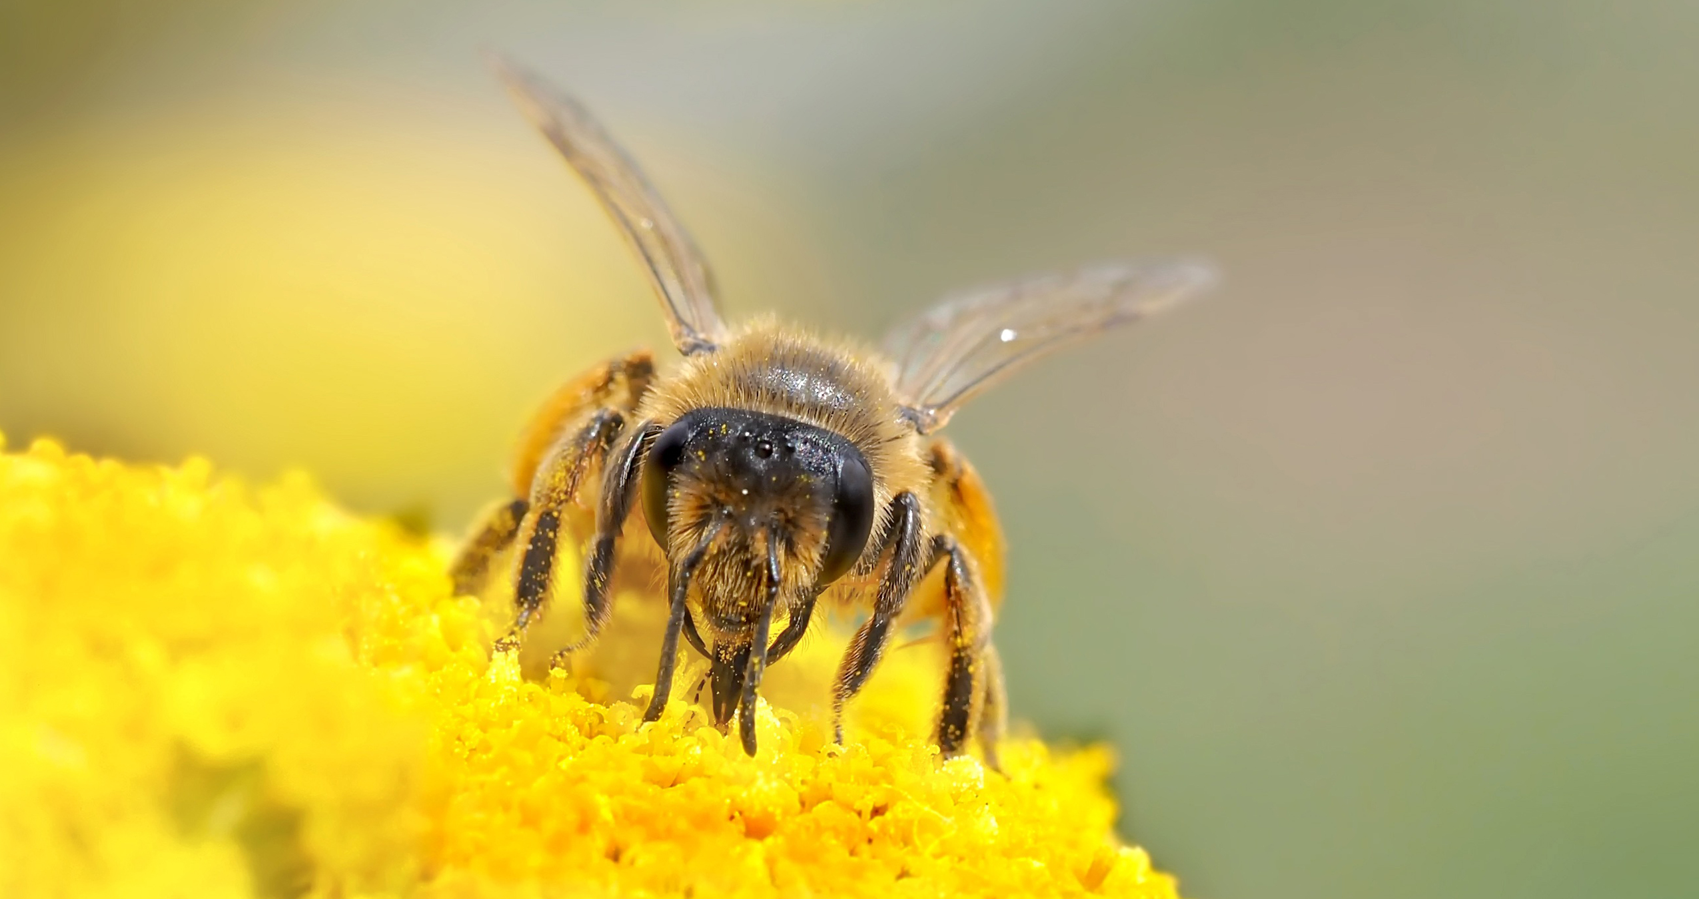
Bees Are a Very Important Pollinator₁
Bees are the most important pollinator of many garden plants and most commercial fruit trees.
Bumblebees and honeybees are the most common species.
Because bees cannot see the color red, bee-pollinated flowers are usually blue, yellow, or other colors.
Bees collect energy-rich nectar or pollen for their own energy needs.
  Nectar provides energy.
  Pollen provides protein.
32.2 Figure 1
kie-ker on Pixabay. "Bee."

Slide 9
Bees Are a Very Important Pollinator₂
Bees visit flowers that:
  Are open during the day
  Are brightly colored
  Have a strong aroma/scent
  Have a tubular shape
  Have nectar guides, regions on the flower petals visible only to bees and not humans that guide bees to the flower's petal where pollination is more efficient
Pollen sticks to the bees' fuzzy hair and is transferred when a bee visits another flower
Declines in the honeybee population could be devastating to commercial fruit growers.

Slide 10
Other Insects are Pollinators Too
Many flies are attracted to flowers that smell like decay or rotting fish with dull colors (brown or purple).
  Examples: corpse flower, voodoo lily, dragon arum, carrion flower
Wasps are also important pollinators and pollinate many fig species.
Butterflies (such as the monarch) pick up pollen on their limbs and then pollinate many garden and wildflowers, which are usually clustered, brightly colored, have a strong fragrance, open during the day, and have nectar guides.
Moths pollinate flowers in the late afternoon/evening, and these flowers are pale, white, and flat to allow moth landing.
  Example: Yucca plant pollination
    Moths deposit pollen on the sticky stigma.
    Female moths deposit their eggs into the ovary, and as eggs develop, they obtain food from the flower and seeds.

Slide 11
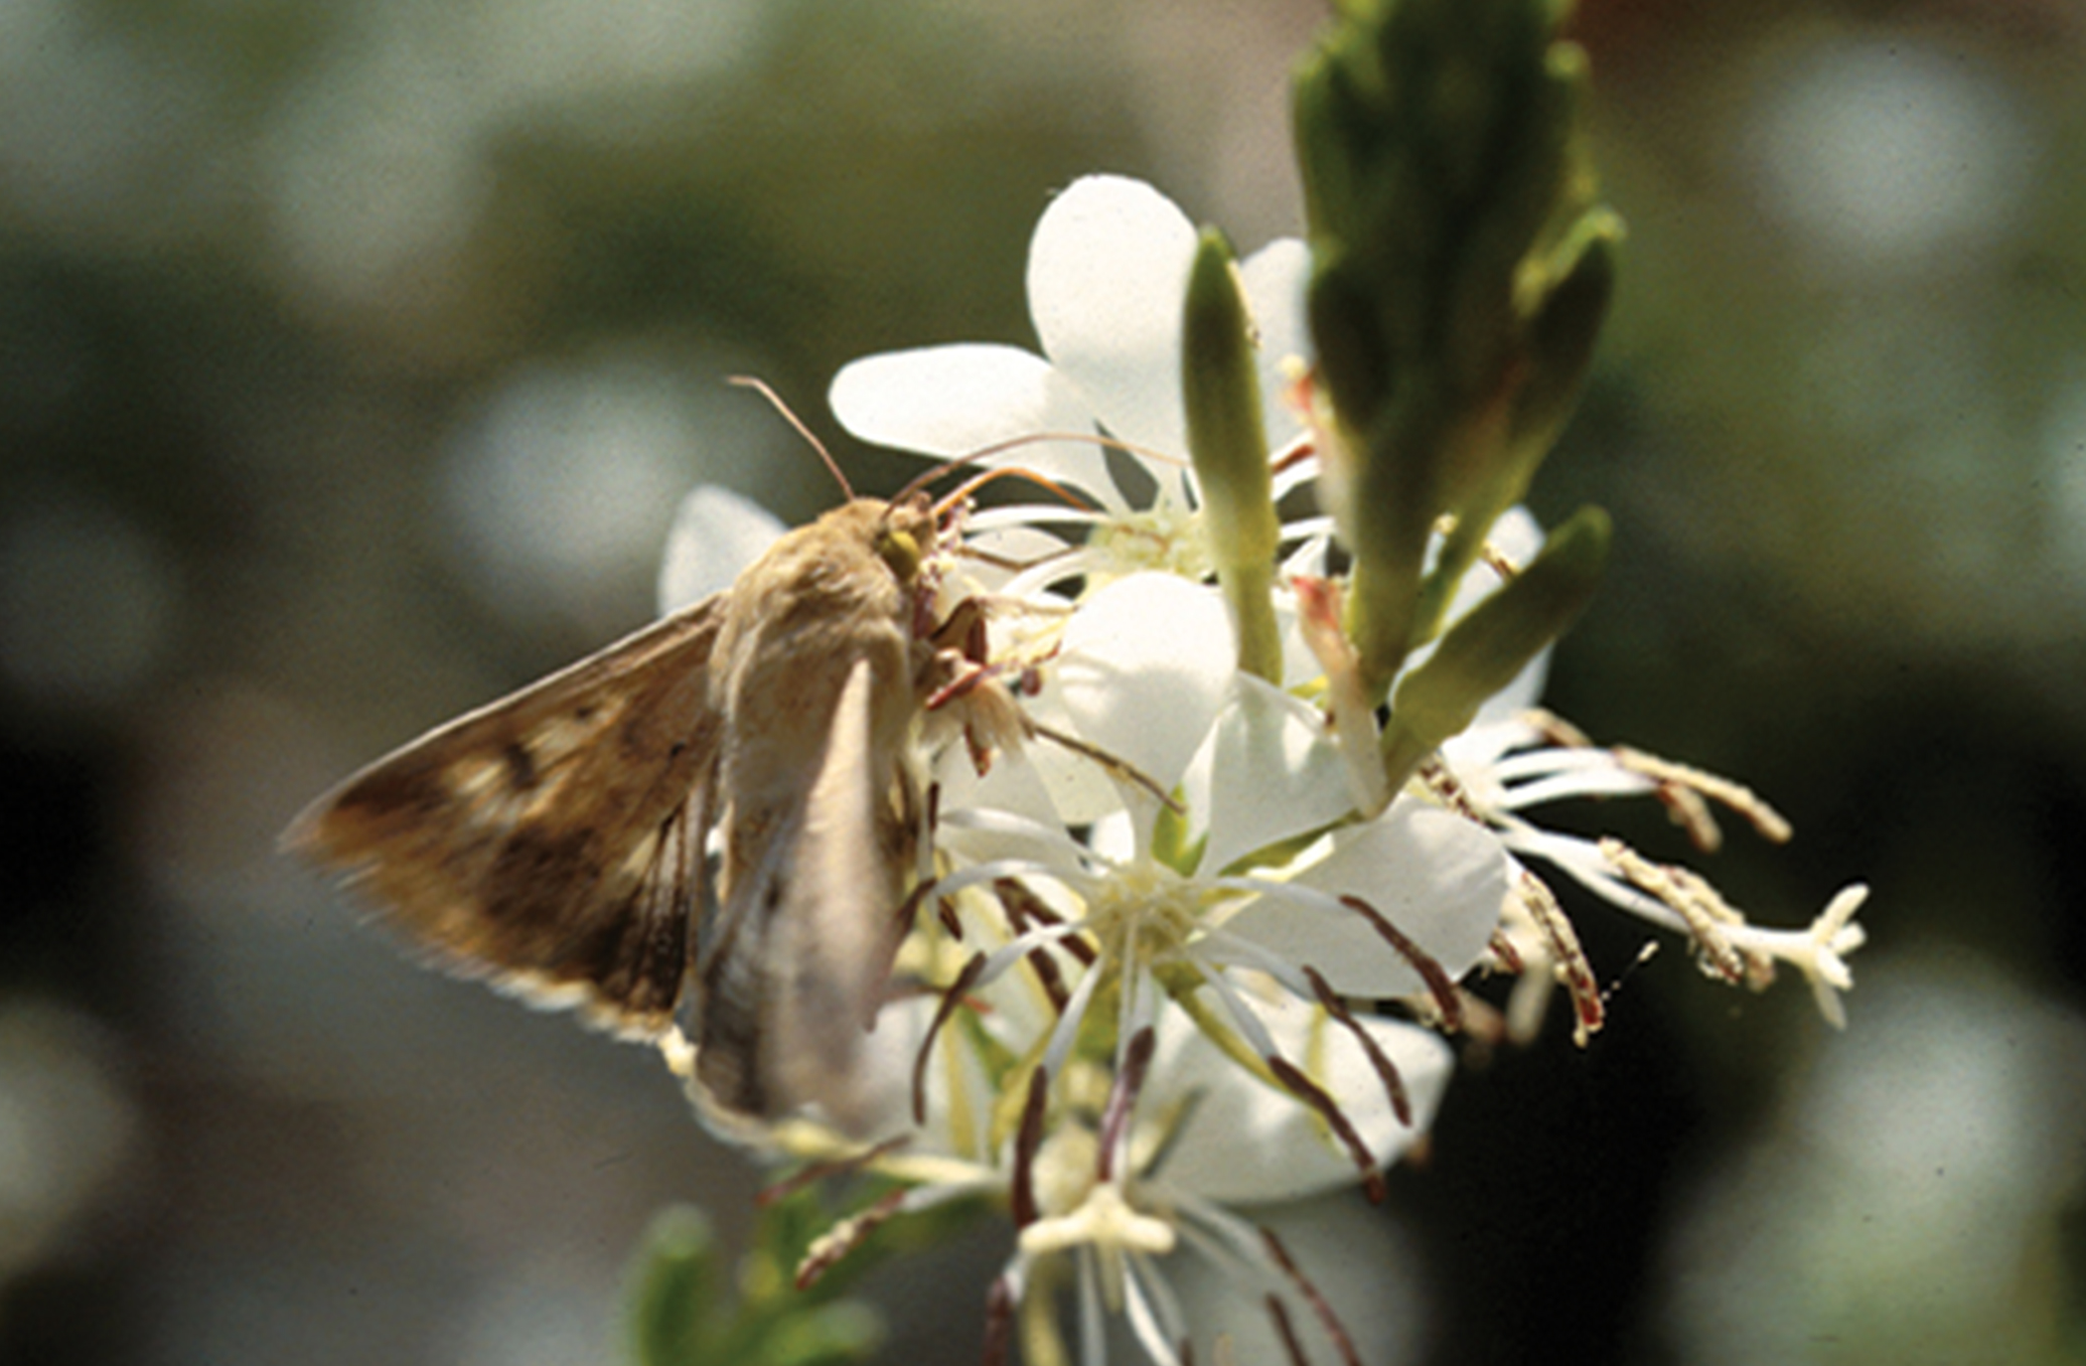
32.2 Figure 2
Notes:
32.2 Figure 2: A corn earworm (Helicoverpa zea) sips nectar from a night-blooming Gaura plant.

Slide 12
Bats Are Important Pollinators in Some Environments
In the tropics and deserts, bats are the pollinators of nocturnal flowers such as:
  Agave
  Guava
  Morning glory
Bat-pollinated flowers
  Are usually white or pale so that bats can distinguish them from the dark at night
  Have a strong, fruity, or musky scent
  Produce lots of nectar
  Are naturally large and wide-mouthed to fit the bat's head
Bats' faces are covered with pollen, which is transferred.

Slide 13
Small Birds Are Important Pollinators
Many species of small birds, such as the hummingbird and sun bird, pollinate plants like orchids and other wildflowers.
Bird-pollinated flowers:
  Are sturdy
  Are oriented such that they are accessible without the bird getting caught up in other flowers
  Are brightly colored
  Are odorless
  Are open during the day
  Have a curved, tubular shape accessible for a bird’s beak
As birds eat energy-rich nectar, their heads and neck are covered in pollen, which is deposited at the next flower.
  Botanists have used pollen from bird specimens to determine the range of extinct plants.

Slide 14
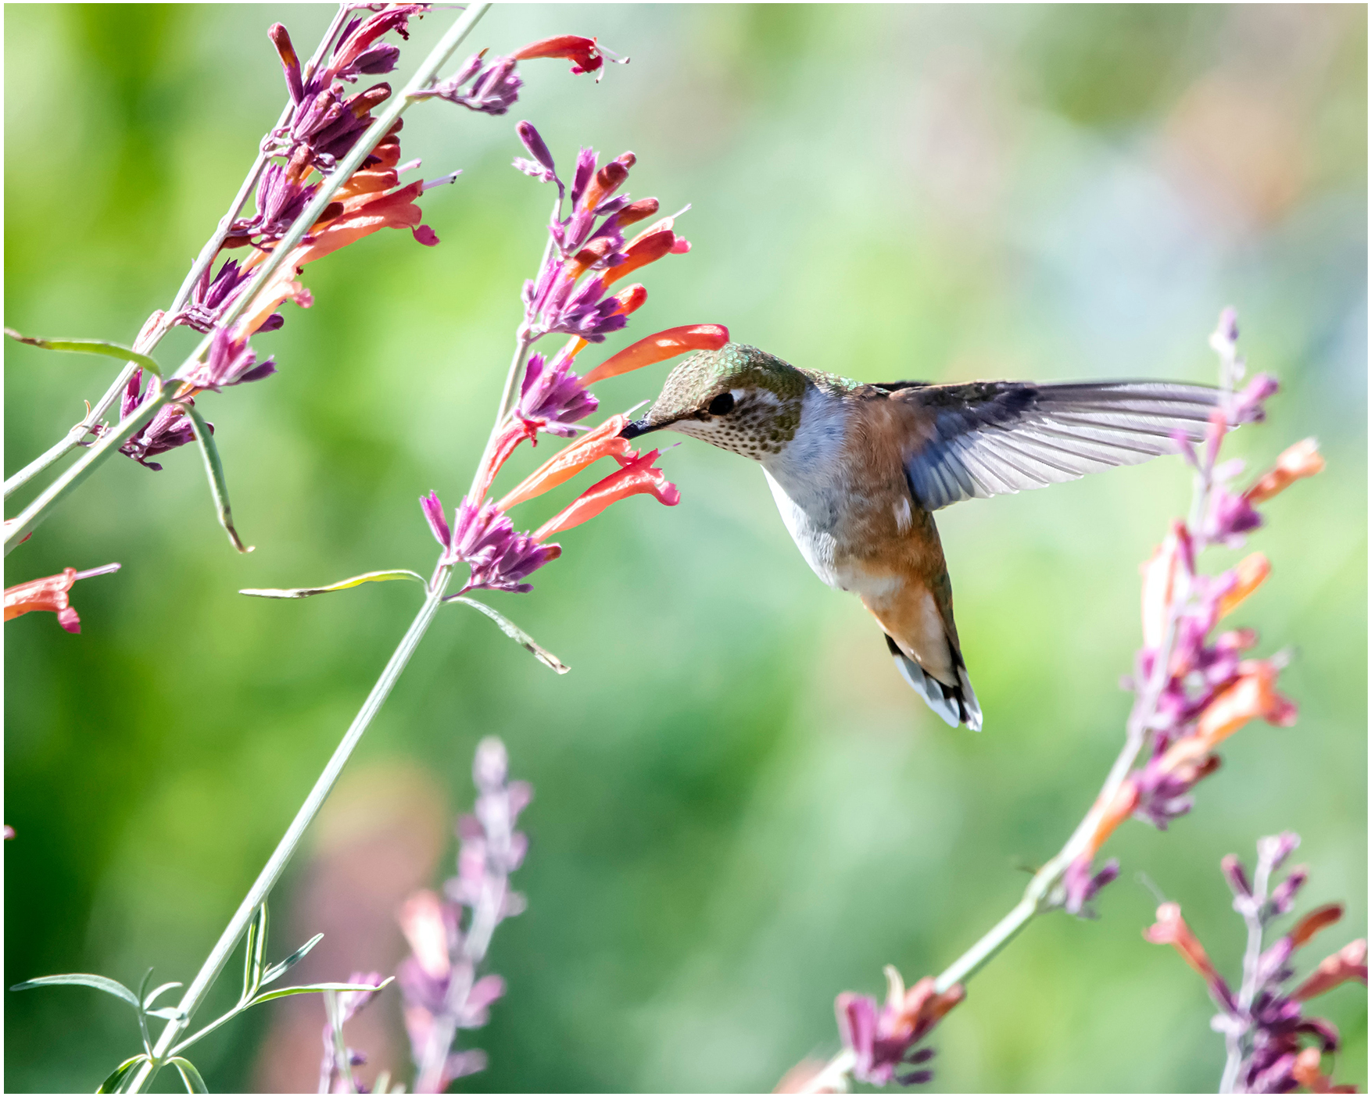
32.2 Figure 3
Frank Cone on Pexels. "Hummingbird."
Notes:
32.2 Figure 3: Hummingbirds have adaptations, like their long beaks, that allow them to reach the nectar of certain tubular flowers.

Slide 15
Wind Is an Important Pollinator
Wind is an important pollinator of conifers and many angiosperms including grasses, maples, and oaks.
Wind-pollinated flowers:
  Have no scent and produce no nectar
  Come in a variety of shapes, sizes, and colors
    Pine cones are brown and unscented.
    Flowers of wind-pollinated angiosperms are usually green, small, have tiny or no petals, and produce lots of pollen.
  Have their microsporangia hanging out of the flower for wind to capture their lightweight pollen as it blows
  Usually emerge in early spring before leaves so that leaves do not block the wind
Pollen is deposited on the feathery stigma of the flower.

Slide 16
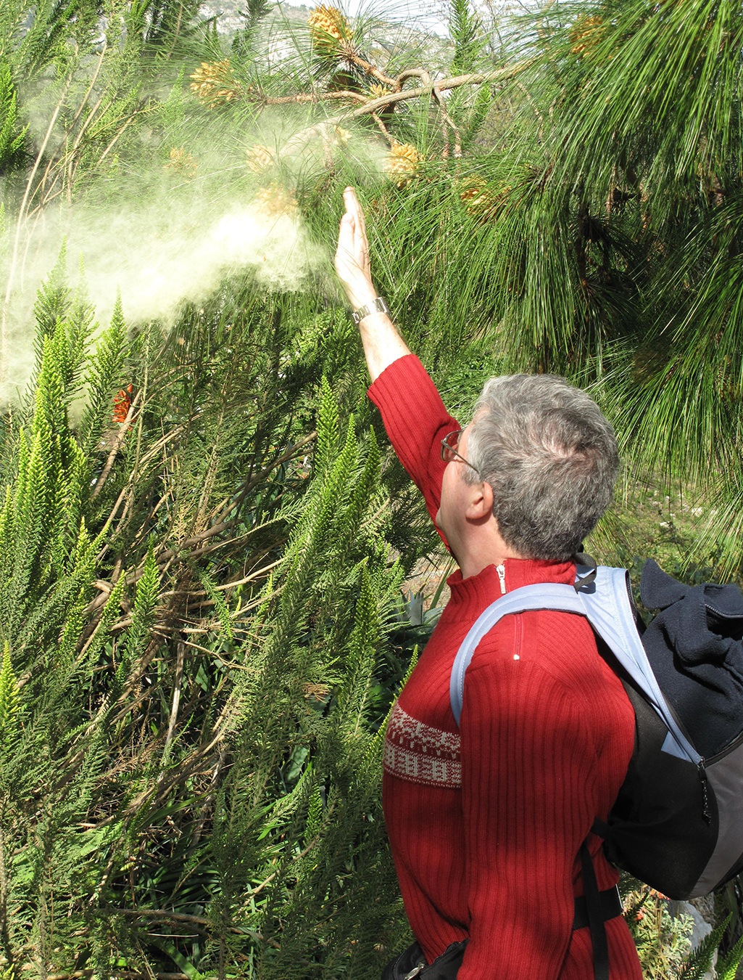
32.2 Figure 4
Tangopaso on Wikimedia Commons. "Pine tree pollen."
Notes:
32.2 Figure 4: A person knocks pollen from a pine tree in the wind.

Slide 17
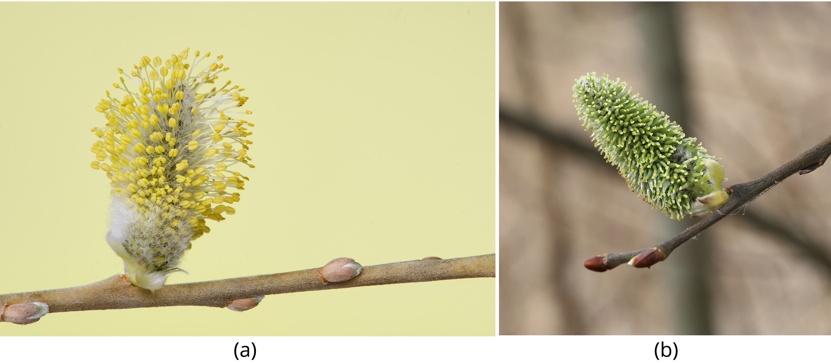
32.2 Figure 5
Bernie on Wikimedia Commons. "Male catkin on goat willow tree."
T. Kebert on Wikimedia Commons. "Female catkin on goat willow tree."
Notes:
32.2 Figure 5: These (a) male and (b) female catkins are from the goat willow tree (Salix caprea). Note how both structures are light and feathery to better disperse and catch the windblown pollen

Slide 18
Even Water Can Be a Pollinator
Some weeds, such as Australian sea grass and pond weeds, can be pollinated by water.
The pollen floats on water and is deposited inside flowers as it passes by.

Slide 19
Evolution Connection
Pollination by Deception
Orchids are highly valued with many rare varieties and can grow in a range of tropical habitats.
Some orchid species use food deception to attract pollinators.
  Bright colors and perfumes are used, but no nectar.
    Example: The green-winged orchid has purple flowers and a strong scent to attract bumblebees, but there is no nectar.
  Other orchids use sexual deception.
    Example: Chiloglottis trapeziformis smells like a female wasp pheromone to attract male wasps.
    Example: The Australian hammer orchid flower looks and smells like a female wasp to attract male wasps that try to mate with it.

Slide 20
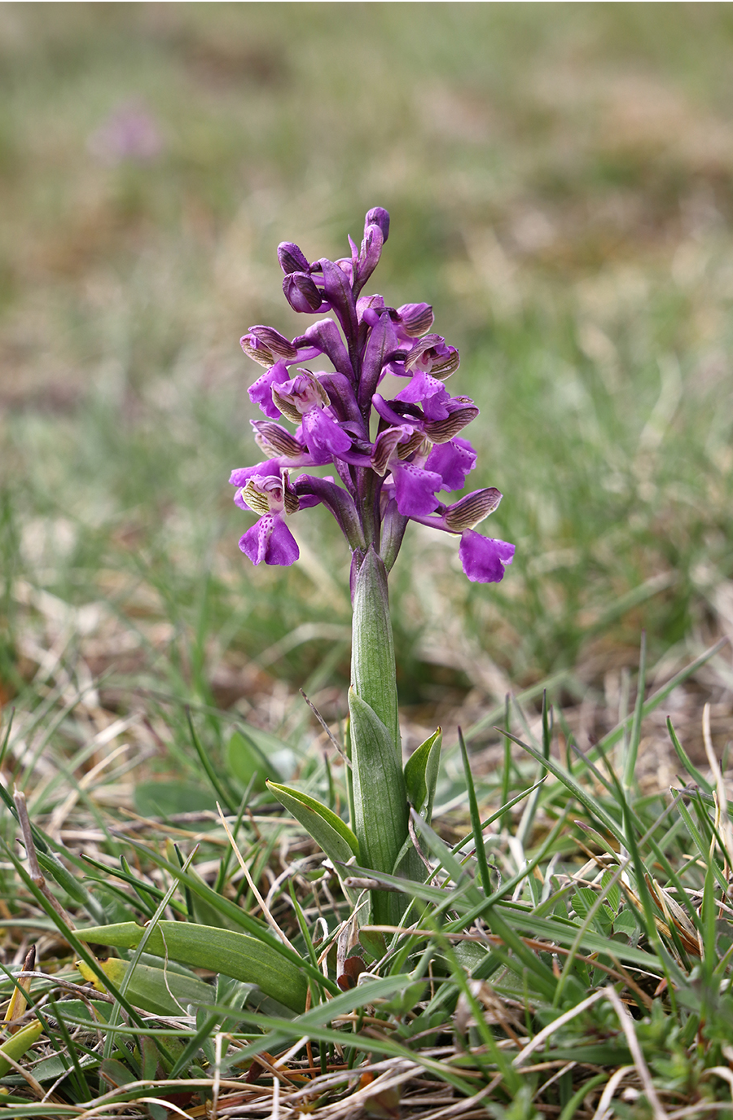
32.2 Figure 6
T. Kebert on Wikimedia Commons. "Green-winged orchid."
Notes:
32.2 Figure 6: Certain orchids use food deception or sexual deception to attract pollinators. Shown here is the green-winged orchid, Anacamptis morio.

Slide 21
Double Fertilization₁
Each microspore (pollen grain) contains 2 cells:
  Pollen tube cell
  Generative cell
After pollen deposition on the stigma,
  The pollen tube cell grows into a pollen tube
  The generative cell travels through the pollen tube
Pollen tube germination requires water, oxygen, and chemical signals.
  Its growth through the style is supported by style tissue and directed by chemicals secreted by the embryo sac's synergids.
  The pollen tube enters the ovule sac through the micropyle.

Slide 22
Double Fertilization₂
The generative cells divides into 2 sperm cells, allowing for double fertilization.
  One fertilizes the egg to form a diploid zygote.
  The other fuses with 2 polar nuclei to form the triploid endosperm.
After fertilization, no other sperm can enter.
  The fertilized ovule forms the seed.
  The ovary tissues become the fruit, protecting the seed.

Slide 23
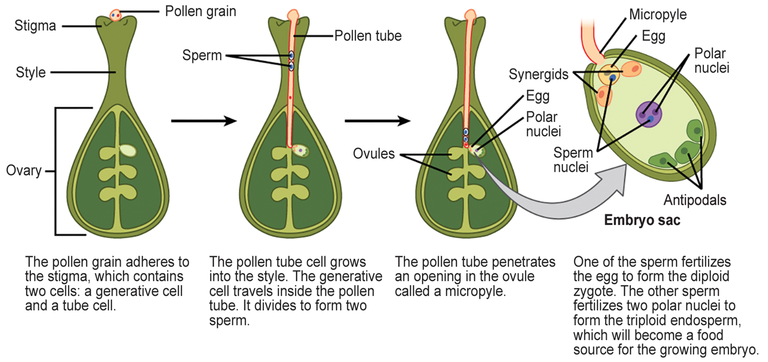
32.2 Figure 7
CNX OpenStax on Wikimedia Commons. "Double fertilization."
Notes:
32.2 Figure 7: In angiosperms, one sperm fertilizes the egg to form the 2n zygote, and the other sperm fertilizes the central cell to form the 3n endosperm. This is called a double fertilization.

Slide 24
Early Embryo Development After Fertilization₁
The zygote divides to form 2 cells:
  The upper cell (terminal cell)
  The lower cell (basal cell)
Division of the basal cell forms the suspensor which will connect the embryo to the maternal tissue, providing a route for nutrients to be transported.
The terminal cell divides to form a globe-shaped proembryo.

Slide 25
Early Embryo Development After Fertilization₂
In dicots (eudicots), the developing embryo has a heart shape due to the presence of 2 early cotyledons (embryonic leaves).
In non-endospermic dicots, the endosperm is quickly digested and the food reserves moved to the cotyledons.
  The cotyledons typically need to bend within the developing seed.
The embryo and cotyledons fill the seed, which is now ready for dispersal.
Embryonic development suspends.
Upon germination, embryonic development resumes, with the developing seedling using food reserves in the cotyledons until photosynthesis starts.

Slide 26
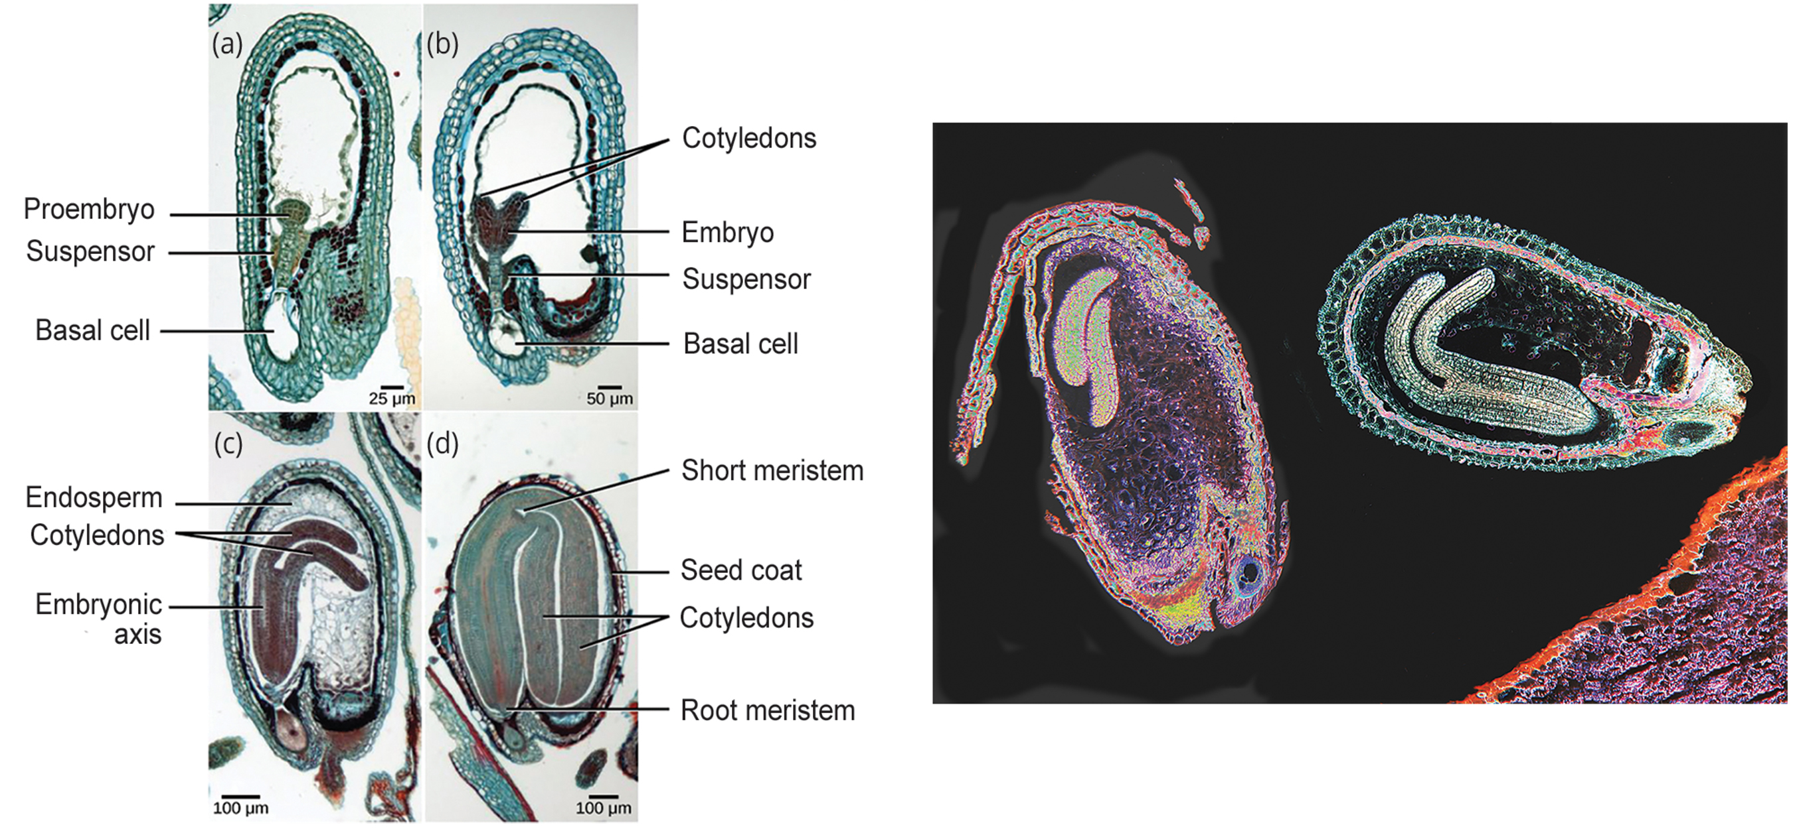
32.2 Figure 8
CNX OpenStax on Wikimedia Commons. "Embryo development."
Notes:
32.2 Figure 8: (left) Shown are the stages of embryo development in the ovule of a shepherd's purse (Capsella bursa). After fertilization, the zygote divides to form an upper terminal cell and a lower basal cell. (a) In the first stage of development, the terminal cell divides, forming a globe-shaped proembryo. The basal cell also divides, giving rise to the suspensor. (b) In the second stage, the developing embryo has a heart shape due to the presence of cotyledons. (c) In the third stage, the growing embryo runs out of room and starts to bend. (d) Eventually, it completely fills the seed. (right) Here are cross sections of two developing Capsella embryos.

Slide 27
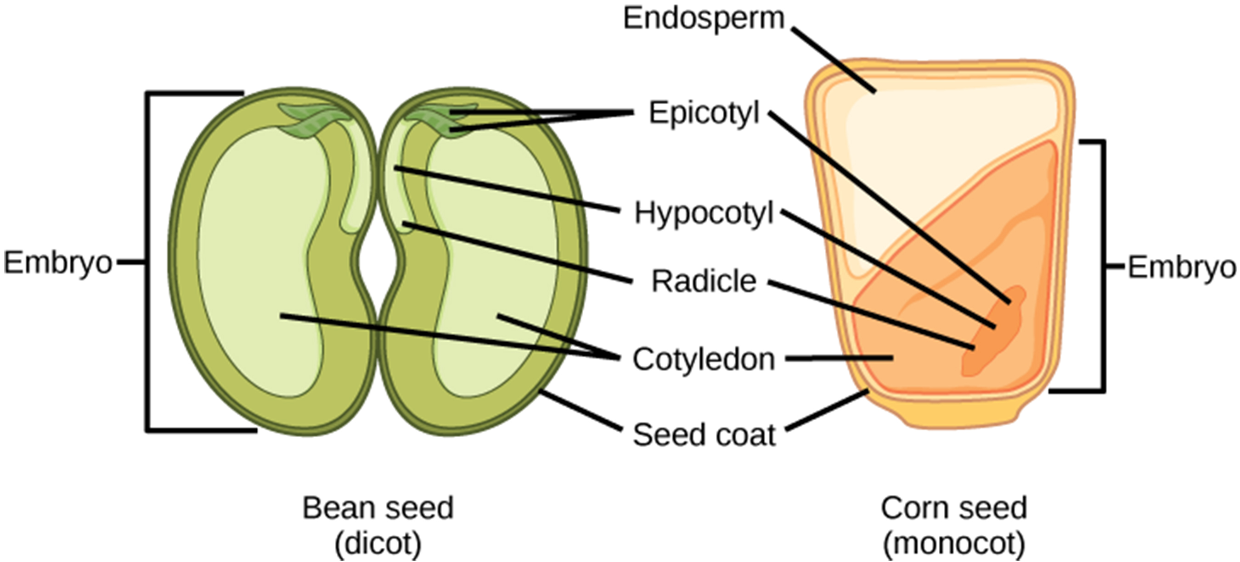
Seed Development
The mature ovule develops into a seed, which contains a seed coat, cotyledons, endosperm, and a single embryo.
32.2 Figure 9
CNX OpenStax on Wikimedia Commons. "Seed structure."

Slide 28
Think It Through
Which of the following statements is true?
Both monocots and dicots have an endosperm.
The radicle develops into the root.
The plumule is part of the epicotyl.
The endosperm is part of the embryo.
Notes:
Originally an On Your Own. This is included here to use as a talking point or for a think-pair-share activity.

Slide 29
Food Storage in Monocot Seeds
Monocots (like corn and wheat) each have a single cotyledon called a scutellum connected directly to the embryo by vascular tissue (xylem and phloem).
  Food reserves are stored in the large endosperm.
  Upon germination, enzymes secreted by the aleurone (a single cell layer just inside the seed coat surrounding the endosperm and embryo) degrade the stored carbohydrates, proteins, and lipids.
  The scutellum absorbs these and transports them via vasculature to the developing embryo.
  Thus, the scutellum is an absorptive (not storage) organ.

Slide 30
Food Storage in Dicot Seeds
Dicots each have 2 cotyledons with vasculature connections to the embryo.
In endospermic dicots, the endosperm stores the food reserves.
  Upon germination, the cotyledons act as absorptive organs to take up enzymatically released food reserves, as in monocots.
  Examples: tobacco, tomato, pepper
In non-endospermic dicots, the food reserves found in the triploid endosperm formed following double fertilization are quickly moved into the developing cotyledons for storage.
  Examples: peanut halves, split peas (these are the cotyledons)

Slide 31
Seed and Embryo Anatomy
A seed coat formed from the integuments of the ovule sac protects the seed and ovule.
In dicots, the seed coat is further divided into the testa (an outer coat) and the tegmen (an inner coat).
The embryonic axis has 3 parts:
The hypocotyl is the portion of the embryo between the cotyledon attachment point and the radicle.
  Dicot hypocotyls extend above ground, giving rise to the stem.
  The monocot hypocotyl does not show above ground because it does not exhibit stem elongation.
The radicle (embryonic root) from which the root will develop is located at the end of the embryonic axis.
The plumule is composed of the epicotyl, young leaves, and the shoot apical meristem (area of shoot growth).
  The epicotyl is the part of the embryonic axis that projects above the cotyledons.

Slide 32
Dicot Seed Germination
Upon germination in dicot seeds, the epicotyl is hook-shaped with the plumule pointing down, a shape called the plumule hook.
  The plumule hook persists in the dark.
  The plumule hook protects the burgeoning plant from damage.
Upon light exposure,
  The plumule hook straightens.
  The young foliage leaves face the sun and expand.
  The epicotyl elongates.
The radicle produces a primary root, forming a tap root with lateral branching roots as it grows.

Slide 33
Monocot Seed Germination
The testa and tegmen are fused in monocots.
As the seed germinates, the primary root emerges, protected by the root-tip covering (the coleorhiza).
The primary shoot emerges next, protected by the shoot tip covering (the coleoptile).
Upon light exposure (after the plumule has exited the soil),
  Coleoptile elongation stops.
  Leaves expand and unfold.
At the other end of the embryonic axis,
  The primary root dies.
  Adventitious roots emerge at the stem's base, providing a fibrous root system.

Slide 34
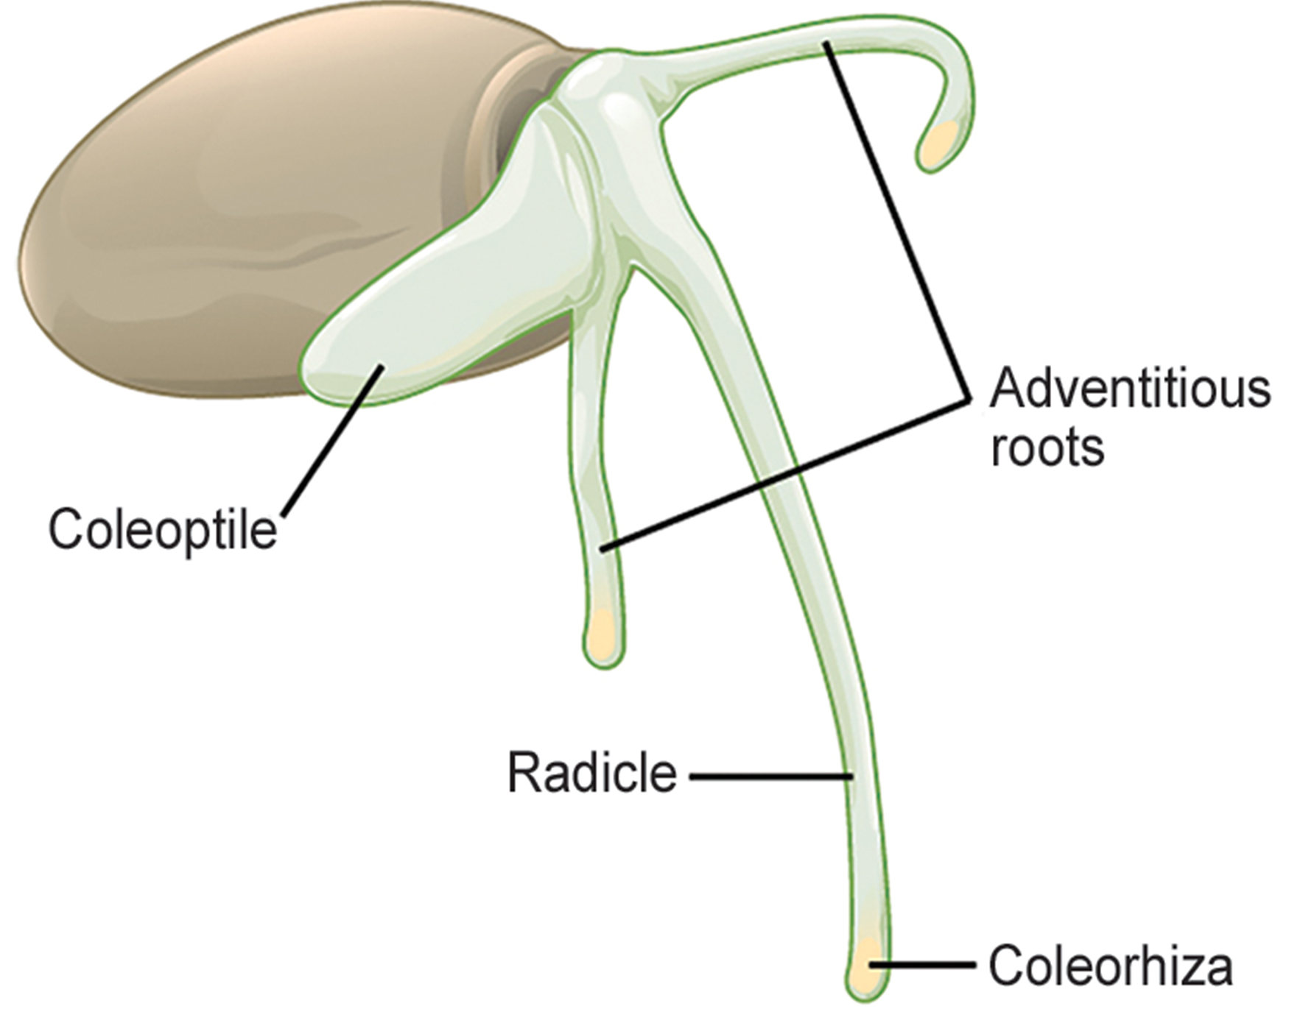
32.2 Figure 10
CNX OpenStax on Wikimedia Commons. "Germinating seed."
Notes:
32.2 Figure 10: As this monocot grass seed germinates, the primary root, or radicle, emerges first, followed by the primary shoot, or coleoptile, and the adventitious roots.

Slide 35
Seed Dormancy
Many mature seeds enter dormancy, a period of inactivity or very low metabolic activity, that may last for months, years, or centuries.
Dormancy keeps seeds viable during unfavorable conditions.
Seed germination occurs after a return to favorable conditions like:
  Moisture
  Light
  Cold
  Fire
  Chemical treatments

Slide 36
Vernalization, Heat Treatment, and Scarification
Some seeds require vernalization (cold treatment) before germinating to guarantee that temperate climate plants won't germinate until spring.
Conversely, seeds of plants growing in hot climates may require a heat treatment to germinate to avoid germination in hot, dry summers.
Some seeds having thick seed coats that retard germination require scarification, mechanical or chemical processes that soften the seed coat, before germination.
  Examples: soaking in hot water, passing through an acid environment (like an animal's digestive tract)

Slide 37
Effects of Seed Size and Light on Germination
Species with large seeds have enough food reserves to germinate deep below ground and extend their epicotyl to the soil's surface.
Species with small seeds need light as a germination cue to ensure that seeds only germinate at or near the soil’s surface where light is abundant.
  If they germinated too far underground, the developing seedlings would not have enough food to reach the sunlight.

Slide 38
Fruit Development
After fertilization, the flower's ovary develops into the fruit.
  Fruit is a ripened ovary that encloses the seeds of the developing embryo, providing it protection.
  As the fruit matures, so do its seeds.
Fruits may be true fruits or accessory fruits.
  True fruits develop from the ovary.
  Accessory fruits develop from other parts of the female gametophyte.
Many but not all fruits are sweet.
Fruits vary in their origin and texture.
  Examples: blackberry tissue, tomato flesh, peanut shell, corn hull

Slide 39
Fruit Classification
Fruits may be classified as follows:
A fruit is a simple fruit if it develops from a single carpel or the fused carpels of a single ovary.
  Examples: nuts and beans
An aggregate fruit is one that develops from more than one carpel in the same flower that fuse together.
  Example: raspberry
Multiple fruit develops from an inflorescence (flower cluster).
  Example: pineapple
Accessory fruits (false fruits) are derived from another flower part, not from the ovary.
  Example: strawberry from receptacle
  Example: apples and pears from hypanthium

Slide 40
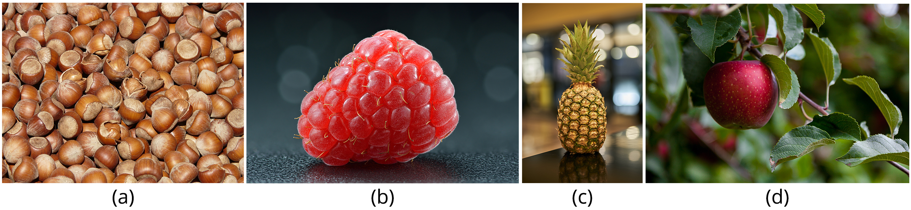
32.2 Figure 11
Pixabay on Pexels. "Hazelnuts."
Ivar Leidus on Wikimedia Commons. "Raspberry."
George E. Koronaios on Wikimedia Commons. "Pineapple."
Mark Stebnicki on Pexels. "Apple."
Notes:
32.2 Figure 11: There are four main types of fruits. (a) Simple fruits, such as these hazelnuts, are derived from a single ovary. (b) Aggregate fruits, like raspberries, form from many carpels that fuse together. (c) Multiple fruits, such as pineapple, form from a cluster of flowers called an inflorescence. (d) Accessory fruits, like the apple, are formed from a part of the plant other than the ovary.

Slide 41
Fruit Anatomy
Fruits each have 3 parts:
  The exocarp (the outermost skin or covering)
  The mesocarp (the middle part of the fruit)
  The endocarp (the middle part of the fruit)
The pericarp are all 3 of these together.
In most fruits, the mesocarp is the edible part, but the endocarp is instead in others like almonds.
In many fruits, 2 or 3 of these parts are fused and indistinguishable at maturity.
Fruits can be dry or fleshy.

Slide 42
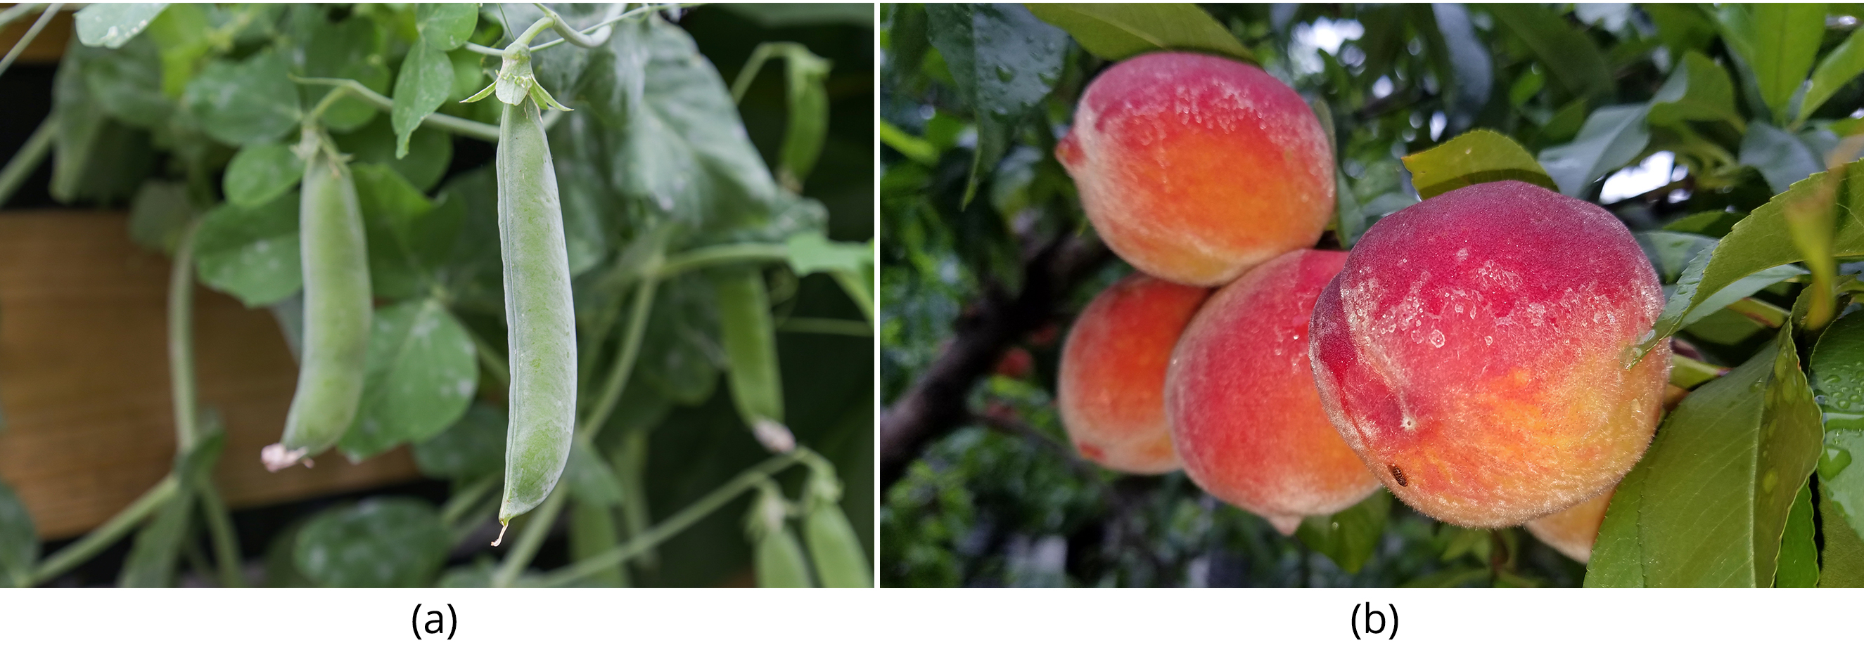
Seed Release from Fruits
Fruits can be divided based upon their seed release strategy.
Dehiscent fruits (such as peas) release their seeds.
Indehiscent fruits (such as peaches) rely on decay for seed release.
32.2 Figure 12
Maja Dumat on Wikimedia Commons. "Peas."
Daderot on Wikimedia Commons. "Peaches."

Slide 43
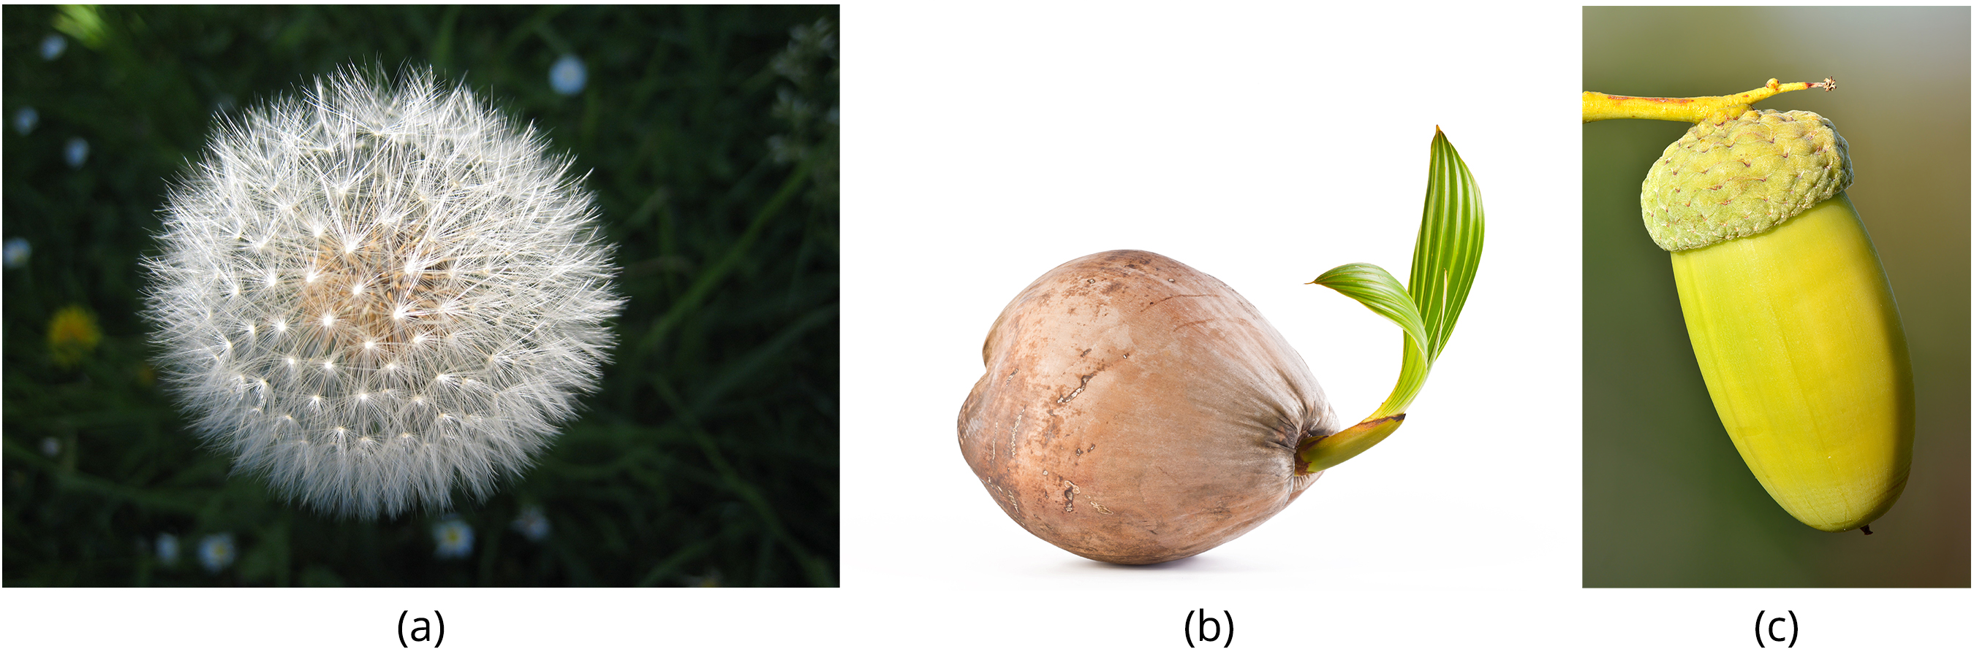
Seed Dispersal: Wind
Some fruits have built-in mechanisms so that they can disperse by themselves.
Some fruits that require wind for dispersal have modifications:
  They are lightweight.
  They may have winglike appendages.
  Some have a parachute-like structure to keep them afloat.
  Example: dandelion
32.2 Figure 13
Avenue on Wikimedia Commons. "Dandelion seeds."
Ivar Leidus on Wikimedia Commons. "Acorn."

Slide 44
Seed Dispersal: Animals
Some fruits require animals for dispersal.
  Animals and birds eat fruits, and the undigested seeds are excreted in their droppings some distance away.
  Some animals bury seeds for later use, and these can germinate if the squirrel does not find its stash.
  Some fruits, like cocklebur, have hooks or sticky features to stick to animal coats and be transported.
  Humans carry fruits to new places and throw away the inedible part with the seeds.
Seed dormancy allows for dispersal through time, waiting for the proper conditions for germination.

Slide 45
Summary
Pollination is the transfer of pollen to a flower's stigma and is required for fertilization.
  In gymnosperms, pollen is transferred from a male to a female cone.
  Self-pollination is pollen transfer to the stigma of the same flower or another flower on the same plant.
  Cross-pollination is pollen transfer from one plant to another, requires pollinating agents, and increases genetic diversity.
After the pollen lands on the stigma, the tube cell forms the pollen tube (extending into the ovule sac) through which the generative nucleus migrates.
  The generative nucleus divides into 2 sperm cells.
  Through double fertilization, 1 sperm fertilizes the egg to form the zygote, while the other fuses with the polar nuclei to form the triploid endosperm.
After fertilization, the zygote divides to form the embryo, the fertilized ovule forms the seed, and the ovary becomes the fruit.
Seed germination occurs under favorable conditions to give rise to the diploid sporophyte.

Slide 46

End of Hawkes Learning PowerPoint

