Slide 1
Lesson 32.3
Asexual Reproduction and Plant Propagation

Slide 2
Objectives
Compare the mechanisms and methods of natural and artificial asexual reproduction.
Describe the advantages and disadvantages of natural and artificial asexual reproduction.
Discuss plant life spans.

Slide 3
Plant Asexual Reproduction
Many plants can propagate using asexual reproduction.
This does not require the investment needed to:
Produce a flower
Attract pollinators
Disperse seeds
The resultant plants are genetically identical to the parent and well-suited to stable environmental conditions.
There are advantages to asexual reproduction:
The new plant is sturdier than a seedling.
The resulting plant reaches maturity faster.
Asexual reproduction can happen naturally or by artificial (human) means.

Slide 4
Many Roots Exhibit Asexual Reproduction
Many root types exhibit asexual reproduction.
Garlic and the gladiolus plant use corms, solid tissue roots that look like bulbs.
Bulbs are another example and have an underground stem surrounded by modified leaves.
Lilies make scaly bulbs.
Daffodils make tunicate bulbs.
A potato is a stem tuber.
Parsnips propagate from a taproot.
Ginger and iris make masses of stems called rhizomes.
Ivy uses an adventitious root (a root arising from a plant part other than the primary root).
A strawberry plant has a stolon (a runner) that grows at the soil surface or just below ground.

Slide 5
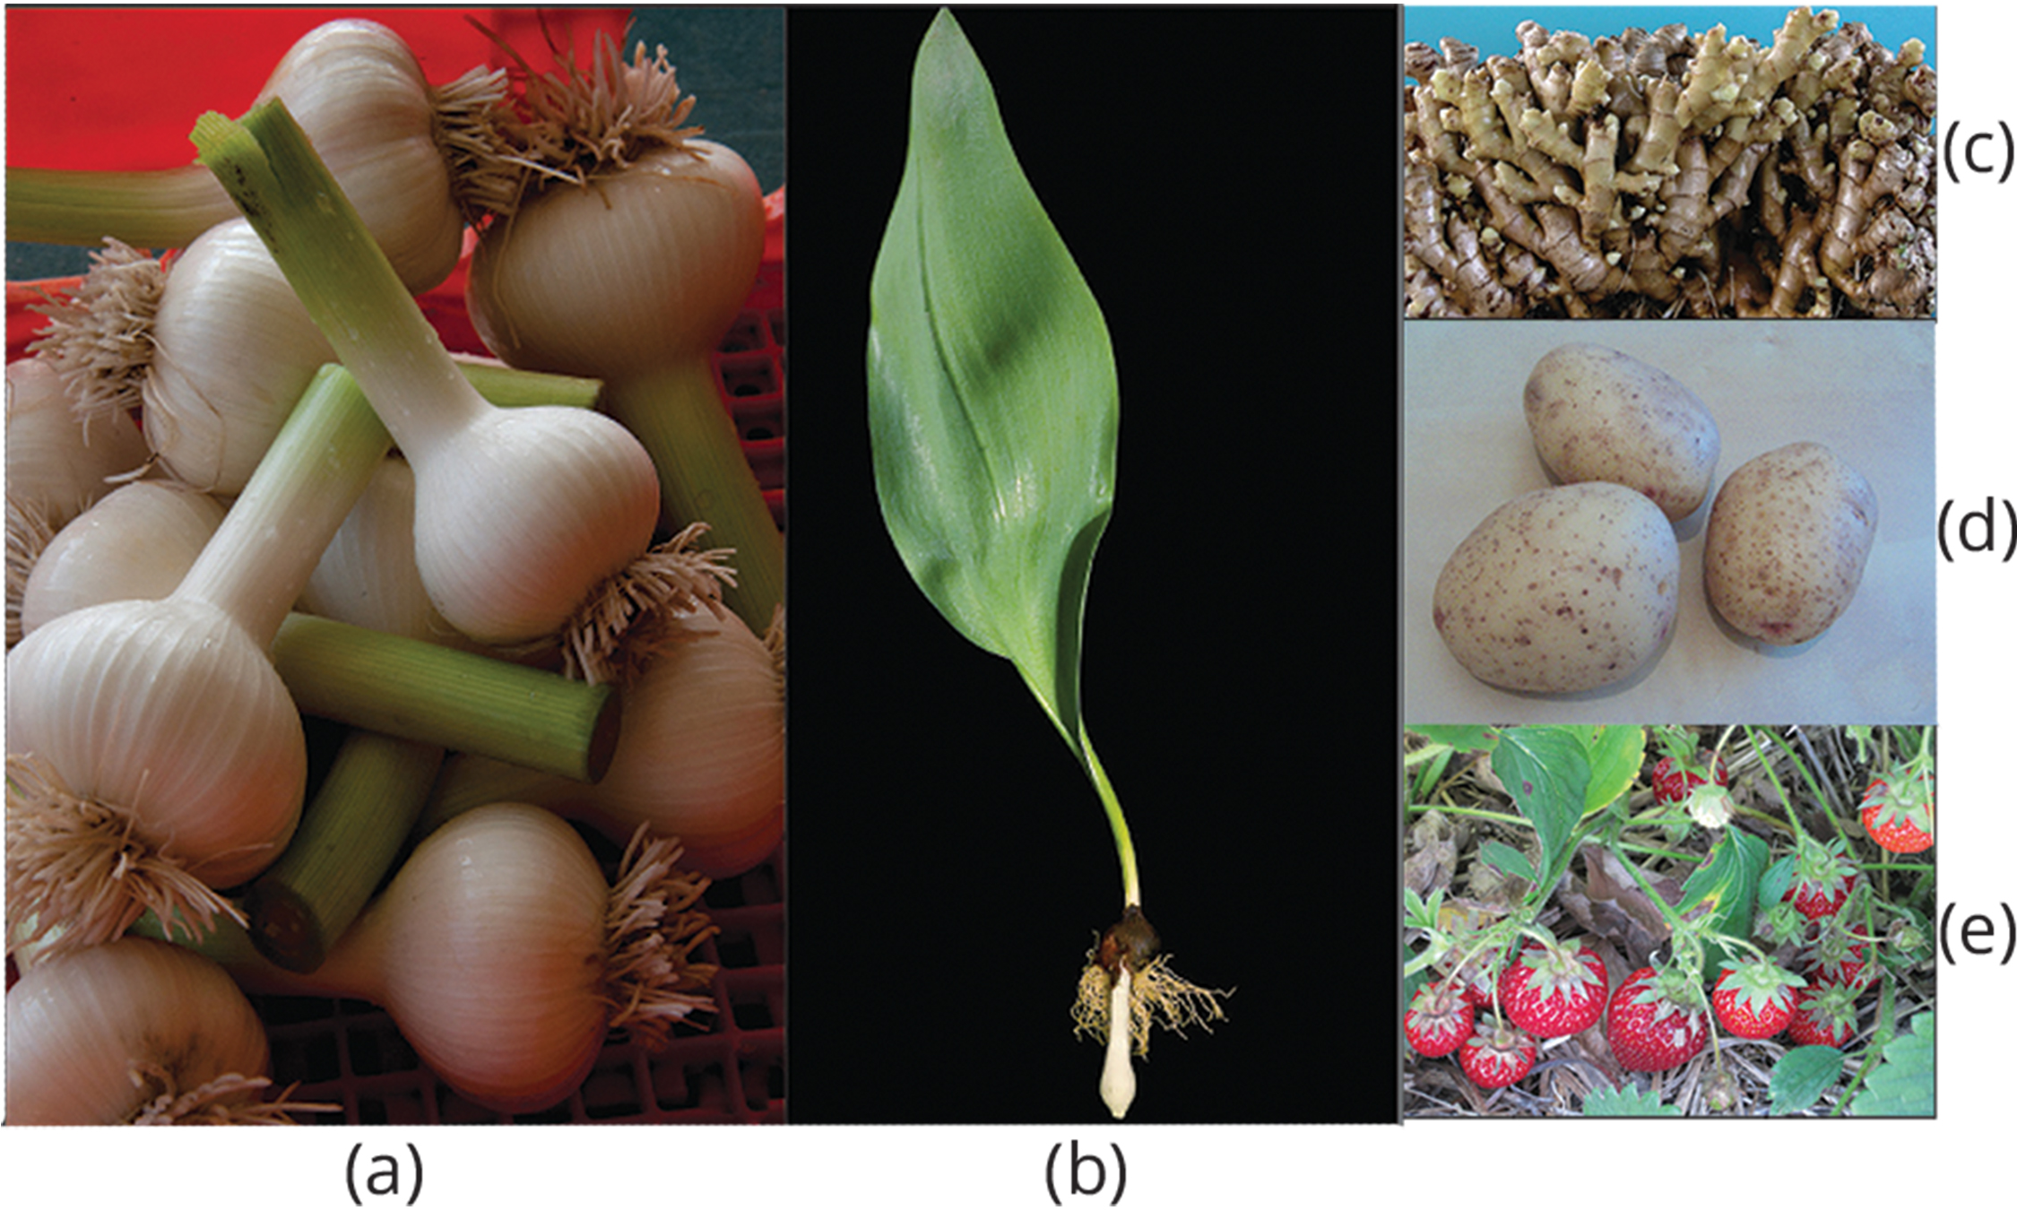
32.3 Figure 1
Dwight Sipler on Flickr. "Garlic bulb."
US Pacific Basin Agricultural Research Center on Wikimedia Commons. "Ginger." Modified.
Richard North on Flickr. "Potatoes."
Julie Magro on Flickr. "Strawberry plant."
Notes:
32.3 Figure 1: Different types of stems allow for asexual reproduction. (a) The corm of a garlic plant looks similar to (b) a tulip bulb, but the corm is solid tissue, while the bulb consists of layers of modified leaves that surround an underground stem. Both corms and bulbs can self-propagate, giving rise to new plants. (c) Ginger forms masses of stems called rhizomes that can give rise to multiple plants. (d) Potato plants form fleshy stem tubers. Each eye in the stem tuber can give rise to a new plant. (e) Strawberry plants form stolons—stems that grow at the soil surface or just below ground—and can give rise to new plants.

Slide 6
Some Plants Produce Seeds Without Fertilization
Some plants can produce seeds without fertilization.
In a process known as apomixis, the diploid ovule or part of the ovary gives rise to a new seed.

Slide 7
Think It Through₁
When a plant is able to produce seeds in the absence of fertilization, it is called [blank].
Apomixis
Cross-pollination
Self-fertilization
Conjugation
Notes:
Originally an On Your Own. This is included here to use as a talking point or for a think-pair-share activity.

Slide 8
Natural Methods of Asexual Reproduction
Natural methods of asexual reproduction include strategies plants have developed to self-propagate.
Many plants (like ginger, onion, gladioli, and dahlia) grow from buds present on the stem’s surface.
Some plants (like the sweet potato) have adventitious roots or runners that give rise to new plants.
In Bryophyllum and kalanchoe, their leaves have small buds on their margins that, when detached or touching the ground, may grow into independent plants.
Some plants can be propagated through cuttings.

Slide 9
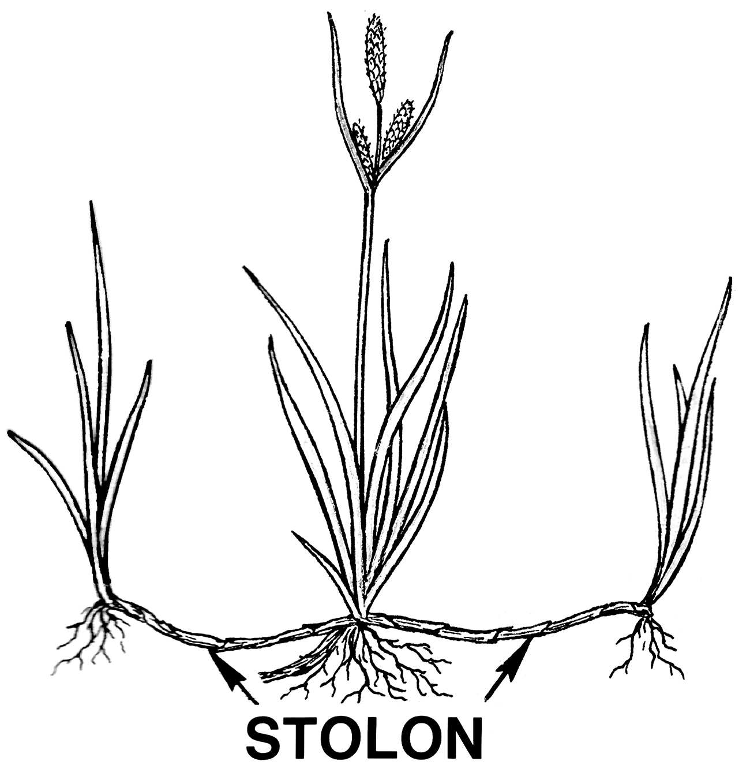
32.3 Figure 2
Pearson Scott Foresman on Wikimedia Commons. "Stolon drawing."
Notes:
32.3 Figure 2: A stolon, or runner, is a stem that runs along the ground. At the nodes, it forms adventitious roots and buds that grow into a new plant.

Slide 10
Artificial Methods of Asexual Reproduction
These methods are used to give rise to new, sometimes novel, plants.
These include:
Grafting
Cutting
Layering
Micropropagation

Slide 11
Artificial Methods: Grafting
In grafting, 2 plant species are used.
Part of the desirable plant's stem (called the scion) is grafted onto a rooted plant (called the stock).
Both are cut at an oblique angle and held together so that the vascular systems grow and fuse to form a graft.
After a while, the scion will form shoots and bear flowers and fruits.
This is widely used in viticulture and the citrus industry, grafting varieties onto root stock with disease resistance.

Slide 12
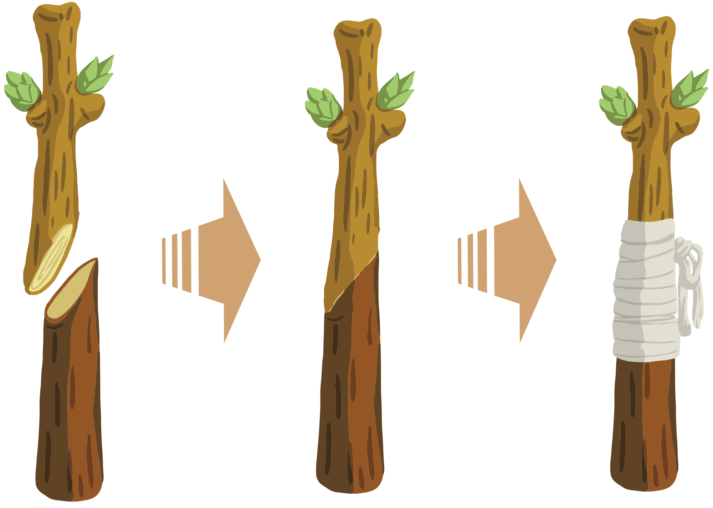
32.3 Figure 3
Notes:
32.3 Figure 3: Grafting is an artificial method of asexual reproduction used to produce plants with favorable stem characteristics and favorable root characteristics. The stem of the plant to be grafted is known as the scion, and the root is called the stock.

Slide 13
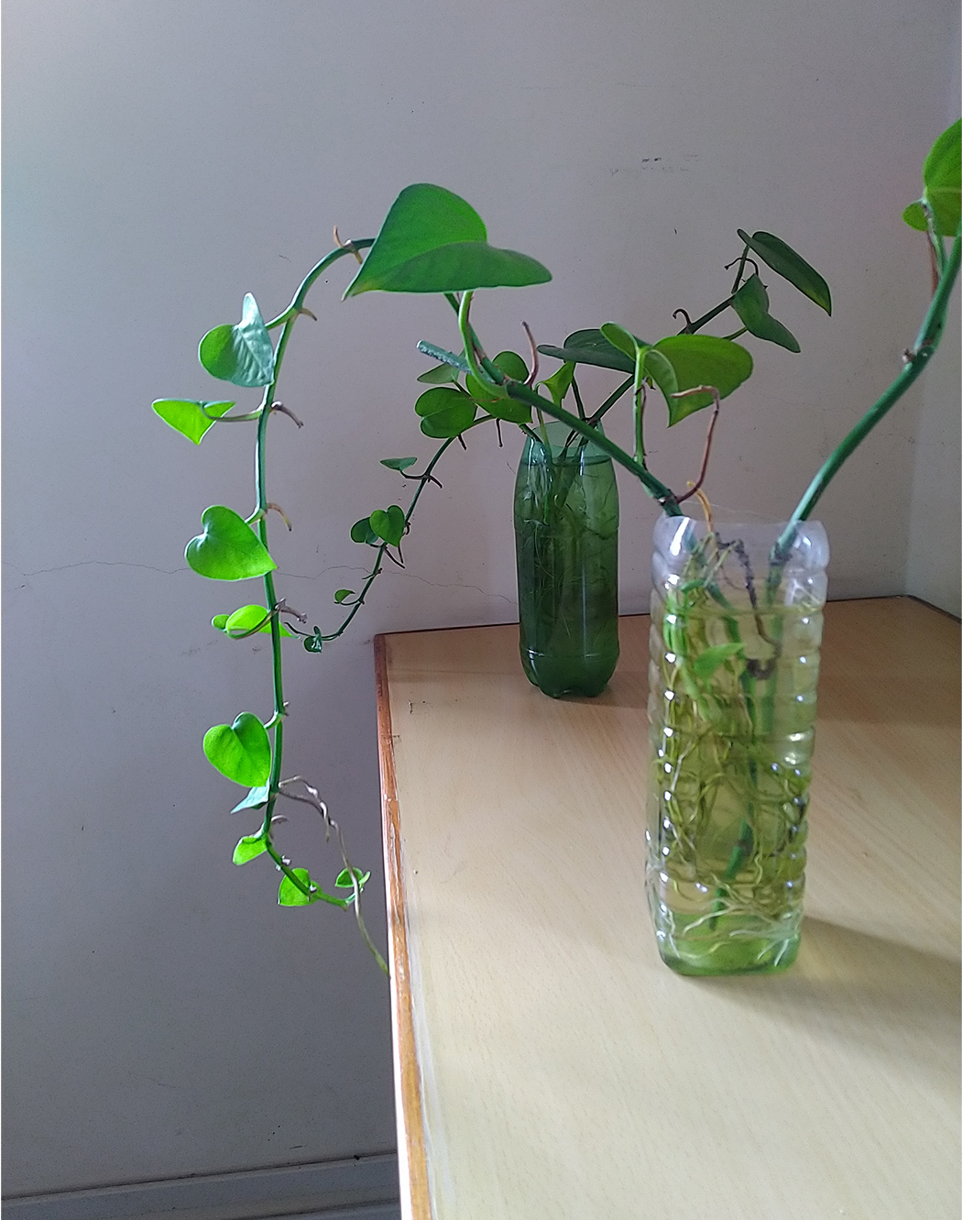
Artificial Methods: Cutting
A cutting is when a portion of the stem that contains nodes and internodes is placed in moist soil or water and allowed to root.
Examples:
Coleus
Money plant
African violet
32.3 Figure 4
Dr. Chinchu C. on Wikimedia Commons. "Money plants."

Slide 14
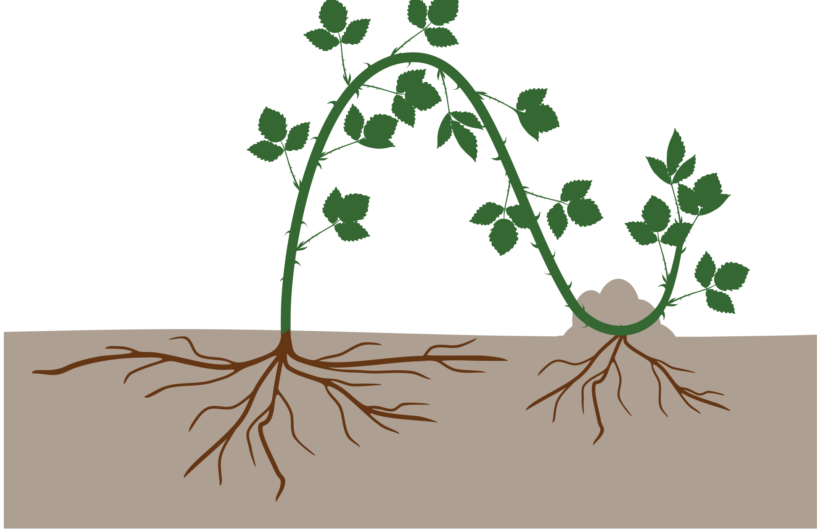
Artificial Methods: Layering₁
Layering is when a stem attached to a plant is bent and covered with soil.
Young stems are easily bent without injury.
Examples: jasmine and bougainvillea
32.3 Figure 5

Slide 15
Artificial Methods: Layering₂
Air layering is a modification of layering.
A portion of the bark or outermost covering of the stem is removed, covered with moss, and taped.
Some gardeners also apply rooting hormone.
After some time, roots will appear.
This new portion of the plant can be removed and transplanted into a separate pot.

Slide 16
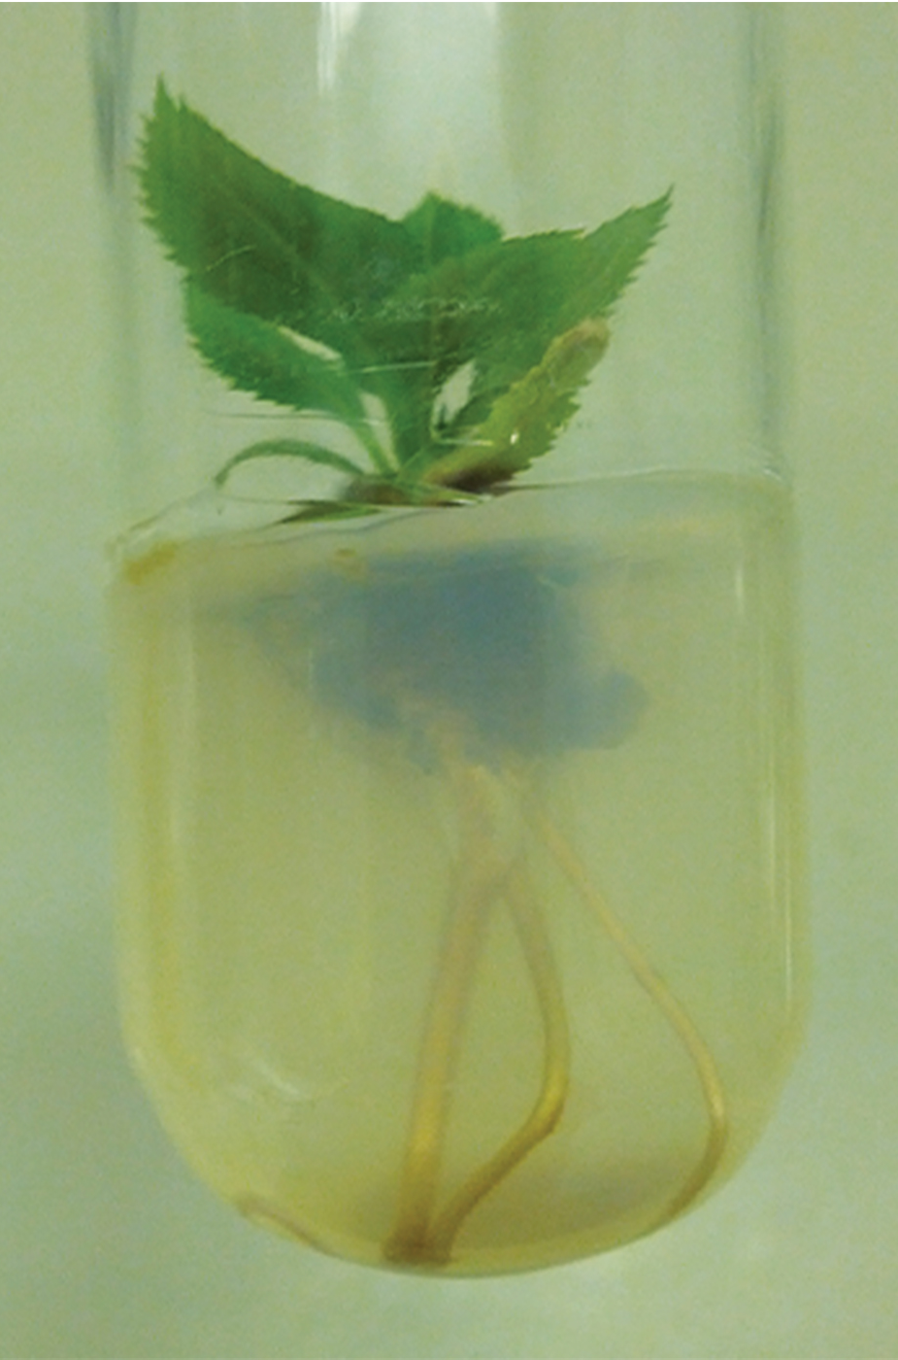
Artificial Methods: Micropropagation
Micropropagation (plant tissue culture) is a way to propagate many plants from one plant in a short time under lab conditions.
This allows for propagating rare, endangered plants that are difficult to grow naturally, are economically important, or are in demand as disease-free plants.
The process is as follows:
A plant part (stem, leaf, embryo, anther, or seed) is sterilized and placed on a culture medium.
An undifferentiated mass called a callus grows first, from which individual plantlets grow.
These plantlets are separated and are next grown in a greenhouse.
32.3 Figure 6
Samson90 on Wikimedia Commons. "Rooted apple."

Slide 17
Plant Life Spans
A plant's life span is the length of time from the beginning of development to death.
A plant's life cycle is the sequence of stages a plant goes through from seed germination to seed production.
Plant life spans vary widely.
Annuals each have a life span of a few weeks.
The bristlecone pine lives for up to 4,500 years.
As some parts continue to grow, others undergo apoptosis to produce dead cells (resulting in cork).

Slide 18

32.3 Figure 7
Rick Goldwaser on Wikimedia Commons. "Bristlecone pine forest."
Notes:
32.3 Figure 7: The bristlecone pine, shown here in the Ancient Bristlecone Pine Forest in the White Mountains of eastern California, has been known to live for 4,500 years.

Slide 19
Types of Plants Based Upon Life Cycle Lengths
Annuals are plants that complete their life cycles in one season.
Example: Arabidopsis
Biennials complete their life cycle in 2 seasons.
In season 1, the plant has a vegetative phase (plant growth prior to maturity).
In season 2, the plant completes its reproductive phase.
Example: Carrots are biennials, but their roots are typically harvested after the first year.
Perennials complete their life cycle in 2+ years.
Example: magnolia

Slide 20
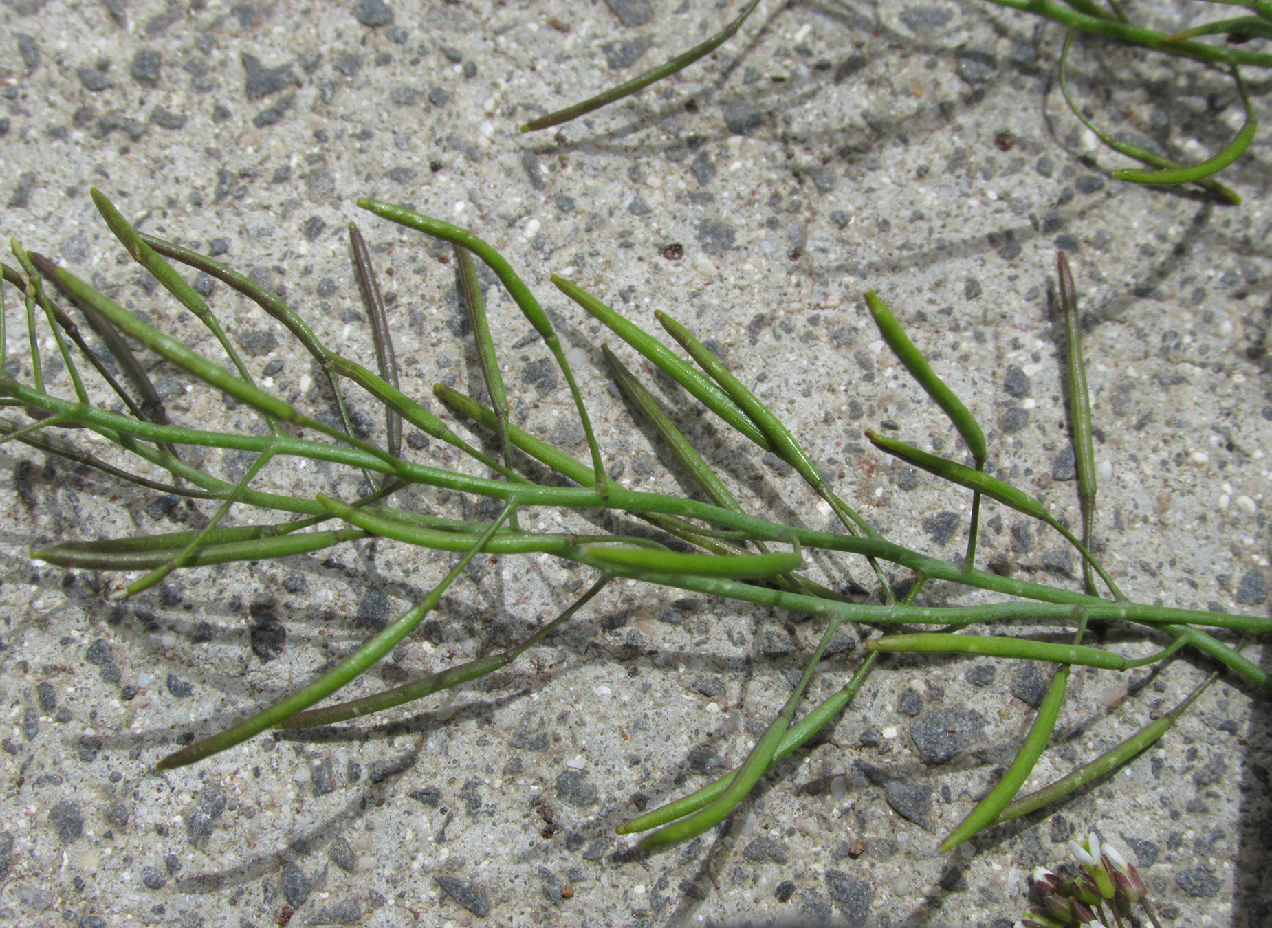
32.3 Figure 8
Forest and Kim Starr on Wikimedia Commons. "Mouse-ear cress."
Notes:
32.3 Figure 8: Arabidopsis plants are annuals, completing their life cycle in a single year.

Slide 21
Types of Plants Based on Flowering Frequency
Monocarpic plants flower only once in their lives.
Examples: bamboo, yucca
During their vegetative period (up to 120 years in bamboo), these plants reproduce asexually and accumulate food for their one-time flowering and seed-setting.
Soon after flowering, they die.
Polycarpic plants flower many times in their lives.
Examples:
Fruit trees (apple and orange trees) flower every year.
Perennials flower several times in their lives but not every year, so they don't need to use all nutrients towards flowering annually.

Slide 22
Other Factors Affecting Plant Life Spans
Environmental and genetic factors that influence life spans include the following:
Disease susceptibility
Changing environmental conditions
Drought
Cold
Competition for nutrients
Plants can keep growing despite having dead tissue (like cork).
Different plant parts have different survival rates.
Older leaves turn yellow and fall, caused by decreased photosynthetic efficiency or oxidative damage.
Nutrient recycling recycles components of parts to be shed so that they can be used for other plant processes.

Slide 23
Plant Aging
Senescence refers to aging of a plant and all of the associated processes.
Chloroplasts breakdown, causing yellowing of the leaves.
All of the chloroplast components (membrane, protein, and DNA) are broken down by enzymes, and their components are used by other plant tissues.
Hormones play a role.
Cytokinin and ethylene applications delay or prevent senescence.
Abscisic acid application can cause premature senescence.

Slide 24
Think It Through₂
You obtain some carrot seeds from your neighbor and plant them. The carrots grow long, orange roots in the first year, flower in the second year, then die. Based on these observations, you would characterize carrots as what? Select all that apply.
Polycarpic
Monocarpic
Biennials
Annuals
Notes:
Originally an On Your Own. This is included here to use as a talking point or for a think-pair-share activity.

Slide 25
Summary
Many plants reproduce asexually as well as sexually.
In asexual reproduction, part of the parent plant is used to generate a new plant.
Grafting, cutting, layering, and micropropagation are methods of artificial asexual reproduction.
The new plant is genetically identical to the parent.
Asexually reproducing plants thrive well in stable environments.
Plants have different life spans dependent on species, genetics, and environmental conditions.
In a plant, some plant parts continue to grow while others undergo apoptosis.
Leaves that are not photosynthetically active are shed as part of senescence, and their nutrients are recycled by the plant.
Hormones can influence the onset of senescence.

Slide 26

End of Hawkes Learning PowerPoint

