Slide 1
Lesson 33.1
Animal Body Plans

Slide 2
Objectives
Describe limits on animal size and shape.
Describe the various types of body plans that occur in animals.
Relate bioenergetics to body size, levels of activity, and the environment.

Slide 3
Complex Animals Adapt to Their Environments
Complex animals:
Adapt to their environments
Illustrate the relationships between form and function
Have primary tissues that make up complex organs, which make up organ systems
Maintain homeostasis, balancing their internal and external environments

Slide 4
Animal Body Plans₁
Animals vary in form and function.
All organisms, including animals, have distinct body plans that limit their sizes and shapes.
Animal bodies are designed to interact with their different environments including the:
Deep sea
Rainforest canopy
Desert
Studying an organism's environment can be very useful in learning about its
Anatomy (the organism's body)
Physiology (the function of its cells, tissues, and organs)

Slide 5
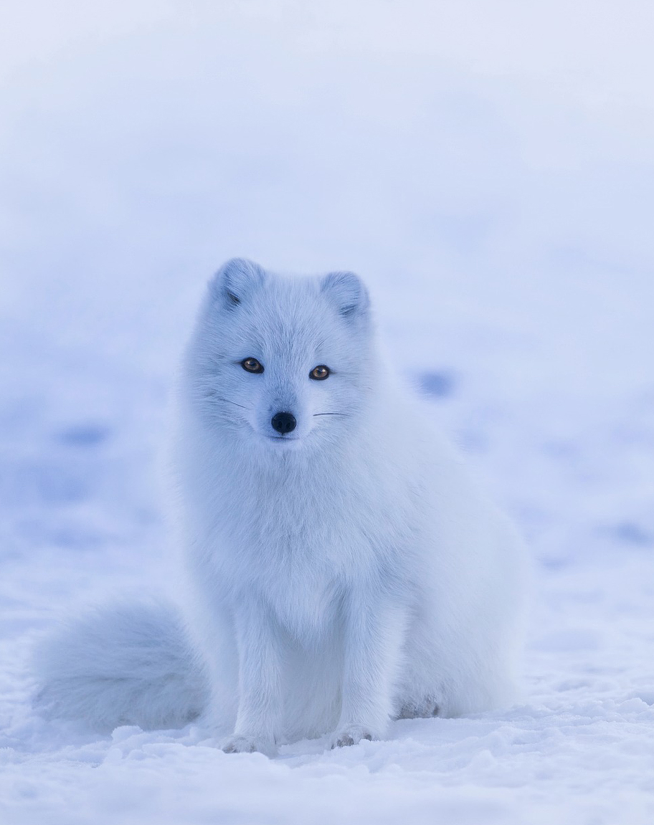
Evolution Connection
Animals such as the arctic fox have evolved to change their coat color to blend in with their seasonal changes in their surroundings.
Global climate change endangers them by making them conspicuous to predators.
When seasons change more quickly, animals may not have enough time to change coat colors.
33.1 Figure 1
David Mark on Wikimedia Commons. "Arctic fox."

Slide 6
Animal Body Plans₂
There are 3 main animal body plans related to symmetry:
Asymmetrical
Radial
Bilateral

Slide 7
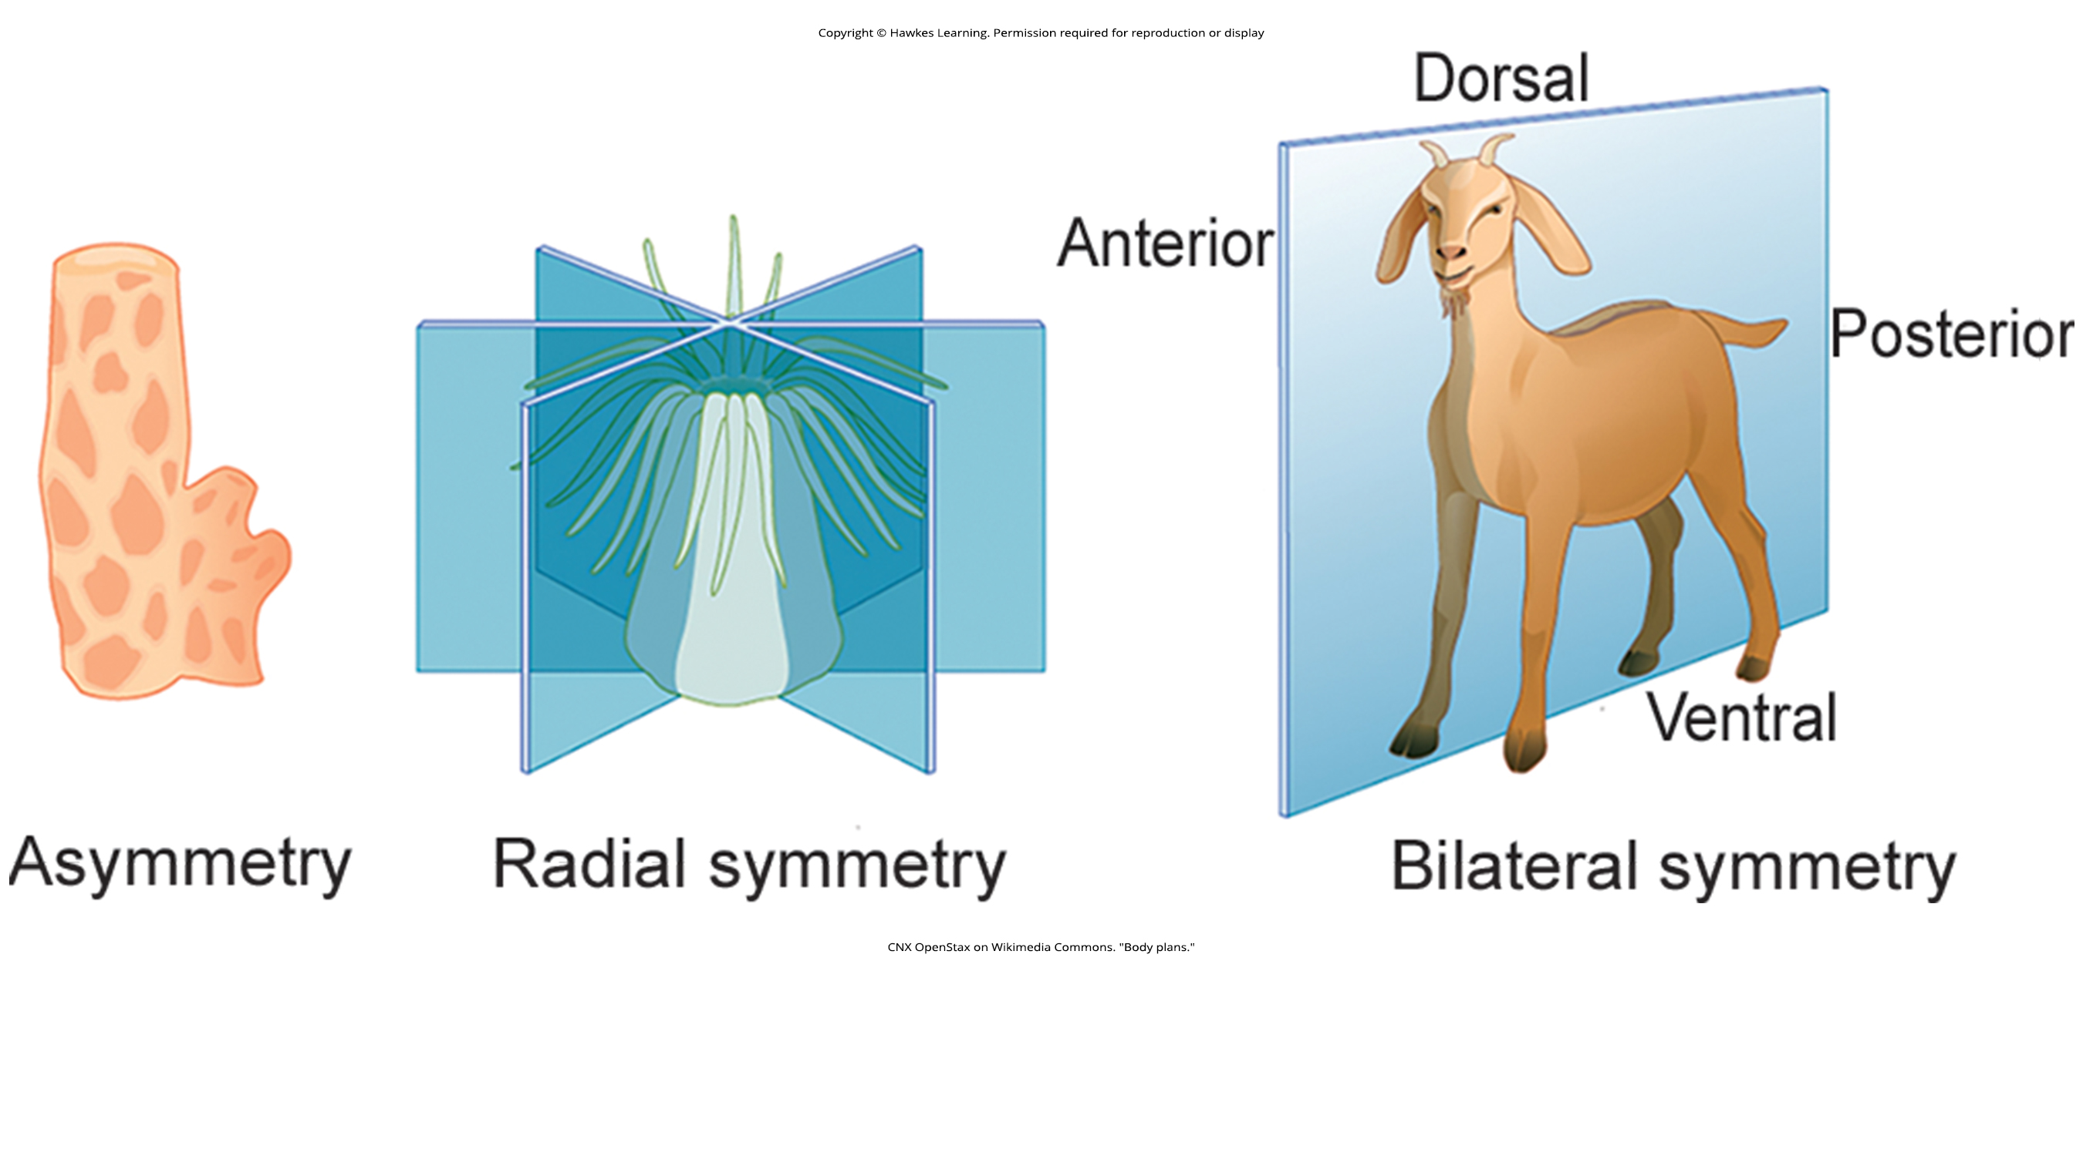
Animal Body Plan: Asymmetry
Asymmetrical animals have no pattern or symmetry.
Example: sponge
33.1 Figure 2
CNX OpenStax on Wikimedia Commons. "Body plans."

Slide 8
Animal Body Plan: Radial Symmetry
Radial symmetry describes an organism that has an up-and-down orientation.
Any plane cut along its longitudinal axis produces equal halves but not a definitive left or right.
This body plan is most common in aquatic organisms that attach to a base (a rock or boat) and extract their food from water as it flows around the organism.
33.1 Figure 2
CNX OpenStax on Wikimedia Commons. "Body plans."

Slide 9
Animal Body Plan: Bilateral Symmetry₁
Bilateral symmetry is seen in animals that
Have an upper and lower component AND
Have definite right and left sides when cut by a plane from front to back.
Anterior means front.
Posterior means rear.
Dorsal means towards the back.
Ventral means towards the stomach.
Bilateral symmetry provides much mobility and is found in both land-based and aquatic animals.

Slide 10
Animal Body Plan: Bilateral Symmetry₂
Goats have bilateral symmetry.
33.1 Figure 2
CNX OpenStax on Wikimedia Commons. "Body plans."

Slide 11
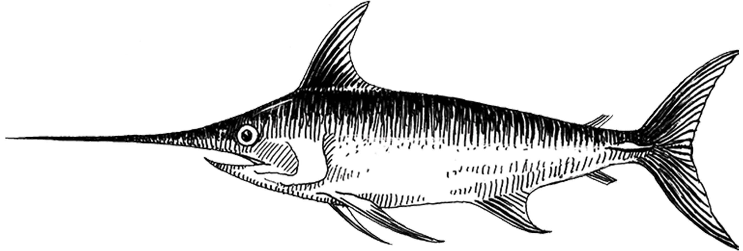
The Fusiform Shape
Most animals with bilateral symmetry that live in water have a fusiform shape, a tubular body tapered at both ends.
This shape decreases drag on the body as it moves through water at high speeds.
Some sharks can swim at 50 km/hr.
Some dolphins can swim at 32–40 km/hr.
33.1 Figure 3
Pearson Scott Foresman on Wikimedia Commons. "Swordfish drawing."

Slide 12
Table 1: Maximum Speed of Assorted Land and Marine Animals
Some land animals can travel faster than aquatic animals, while others travel slower.
Animal | Speed (kmh) | Speed (mph)
cheetah | 113 | 70
quarter horse | 77 | 48
fox | 68 | 42
shortfin mako shark | 50 | 31
domestic house cat | 48 | 30
human | 45 | 28
dolphin | 32–40 | 20–25
mouse | 13 | 8
snail | 0.05 | 0.03

Slide 13
Most Animals Have an Exoskeleton
Most animals have an exoskeleton, including:
Insects
Spiders
Scorpions
Horseshoe crabs
Centipedes
Crustaceans
The exoskeleton is a hard covering or shell that provides the animal:
Protection from predators
Protection from water loss (for land animals)
Attachment sites for muscles

Slide 14
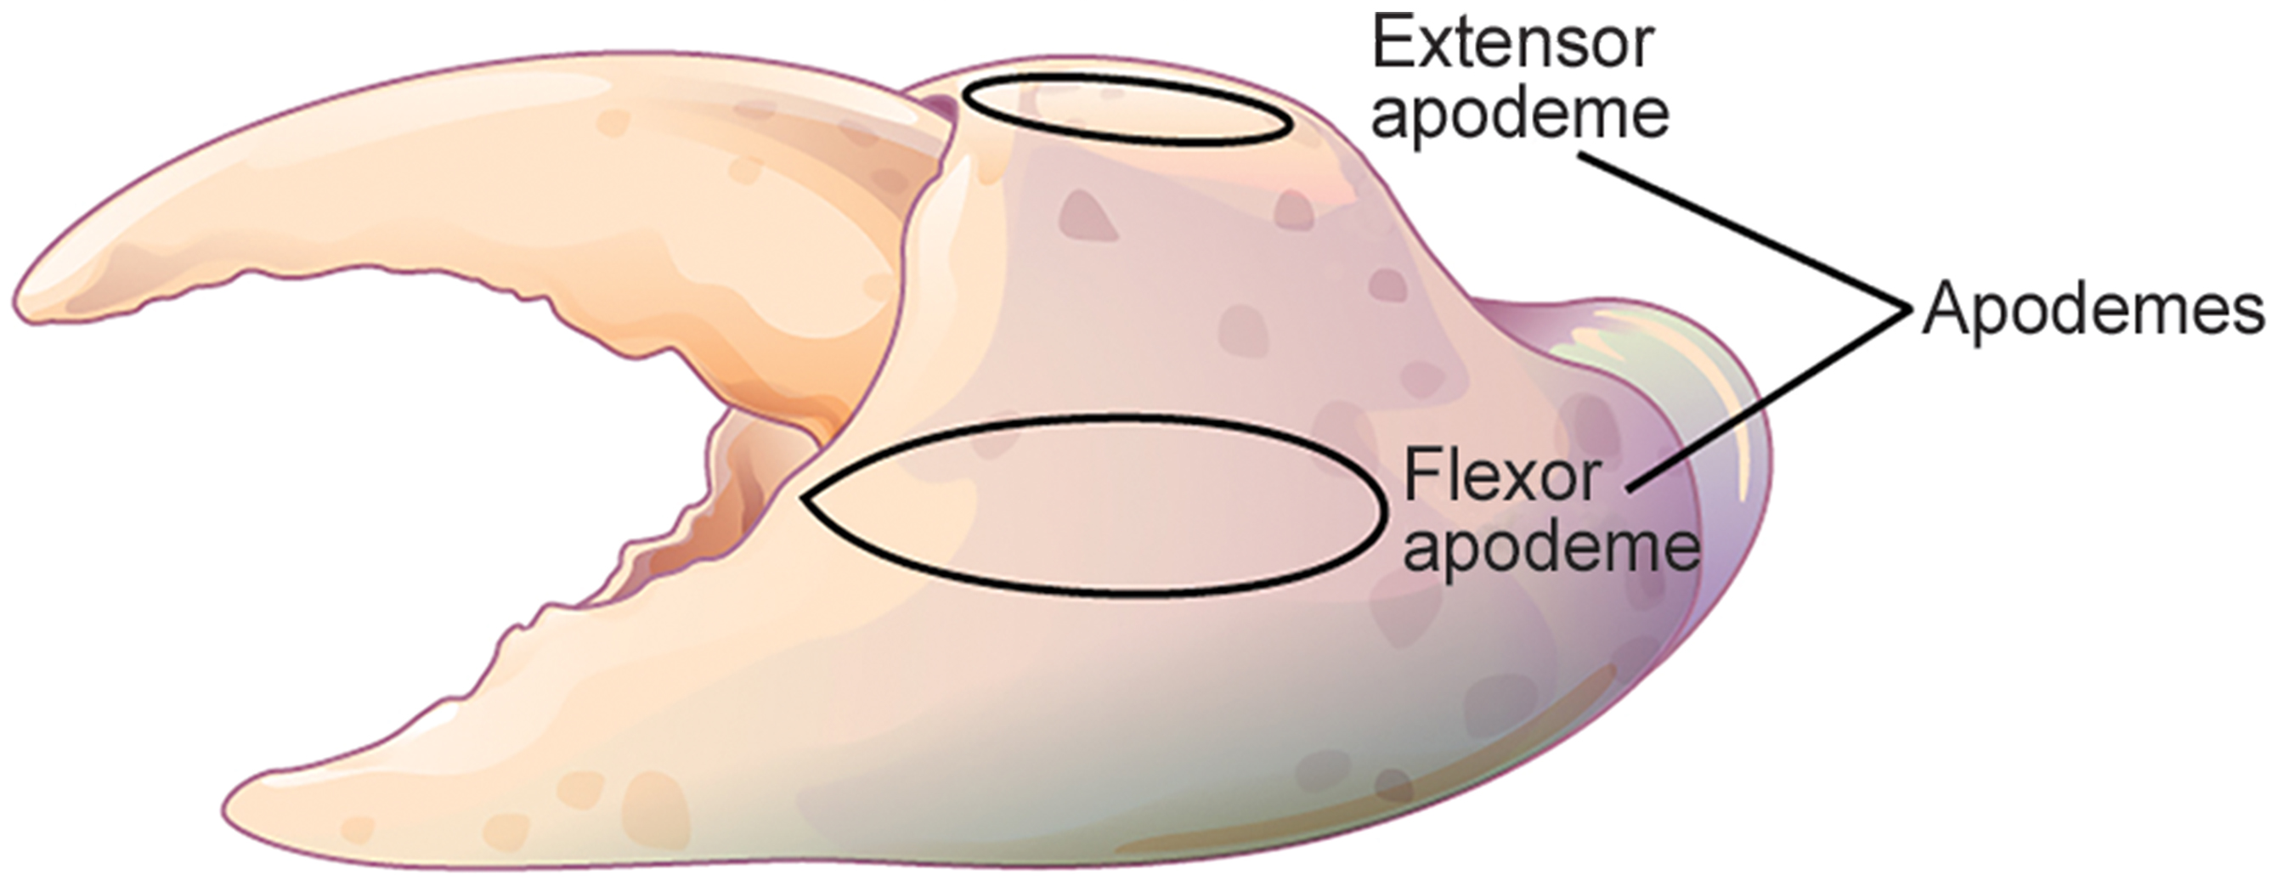
Exoskeleton Composition
Arthropod exoskeletons:
Are composed of chitin, a tough polymer
Are often biomineralized (hardened by minerals produced by the organism) with substances such as CaCO₃
Are fused to the epidermis
Have ingrowths called apodemes where muscles attach
33.1 Figure 4
CNX OpenStax on Wikimedia Commons. "Apodemes."

Slide 15
Growth of Animals with Exoskeletons
For animal growth,
A new exoskeleton is synthesized under the old one
The old one is shed or molted
This prevents continual growth of the animal.
If molting does not occur at the correct time, this may limit maturity.
Exoskeleton thickness must be increased significantly to accommodate weight increases.
It is estimated that doubling the body size increases the body weight by 8X.
The increasing chitin thickness needed to support the weight limits the body size of animals with exoskeletons.
Most are relatively small.

Slide 16
Some Animals Have Endoskeletons
Some animals have endoskeletons (internal skeletons) with muscles attached on the outside.
Body size is determined by what is needed to support other tissue and the amount of muscle needed for movement.
As body size increases, both bone and muscle mass increase.
An animal's achievable speed is a balance between its overall size and the amount of bone and muscle it has.

Slide 17
Diffusion Limits Cell Size
Diffusion
Allows for the exchange of nutrients and wastes between a cell and its watery environment
Is effective only over specific distance
Limits cell size
A smaller cell can often meet all of its nutrient and waste needs through diffusion.
Diffusion may be not effective for a larger cell.
Works best when there is a larger surface-area-to-volume ratio (which is 3/r for spheres).
As a cell grows in size, it has less surface area for diffusion.

Slide 18
Multicellularity Evolved As a Strategy for Producing Larger Organisms
The solution to producing larger organisms is multicellularity, allowing for cellular specialization.
Circulatory systems bring nutrients and remove wastes.
Respiratory systems provide O₂ and remove CO₂.
Other organ systems control various bodily functions.
The surface-area-to-volume ratio applies to animal development in other ways.
There is a relationship between muscle mass and:
Cross-sectional area in supporting skeletons
Heat generation and dissipation

Slide 19
Animal Bioenergetics
All animals obtain energy from nutrients in the food they ingest or absorb.
The energy in these nutrients is converted to:
ATP for short-term storage and use by cells
Glycogen (a glucose polysaccharide) for longer-term storage of energy
Triglycerides (a type of fat) for much longer-term storage of energy
Because no energy conversion is 100% efficient, an animal's metabolism produces heat as waste.
An endotherm (warm-blooded animal) can conserve heat and maintain a relatively stable body temperature.
An ectotherm cannot conserve this heat and instead relies on the environment to maintain its body temperature.
These organisms commonly lack insulation.

Slide 20
Metabolic Rate
Metabolic rate:
Is the amount of energy expended by an animal over a specific time period.
Can be measured in joules, calories, or kilocalories (each of which is 1,000 calories).
Carbohydrates and proteins each contain 4.5–5 kcal/g.
Fat contains 9 kcal/g.
Is estimated as the basal metabolic rate (BMR) in endotherms at rest
Human males have BMR of 1,600–1,800 kcal/day (average).
Human females have a BMR of 1,300–1,500 kcal/day (average).
Even with insulation, endotherms require lots of energy to maintain their body temperatures.
Is estimated as the standard metabolic rate (SMR) in ectotherms
An alligator has an SMR of 60 kcal/day.

Slide 21
Group Activity
Compare and contrast the behavioral and physical characteristics of endothermic and ectothermic animals. For example, discuss an American alligator (Alligator mississippiensis) and a Florida panther (Puma concolor coryi) and how their metabolic rates differ.

Slide 22
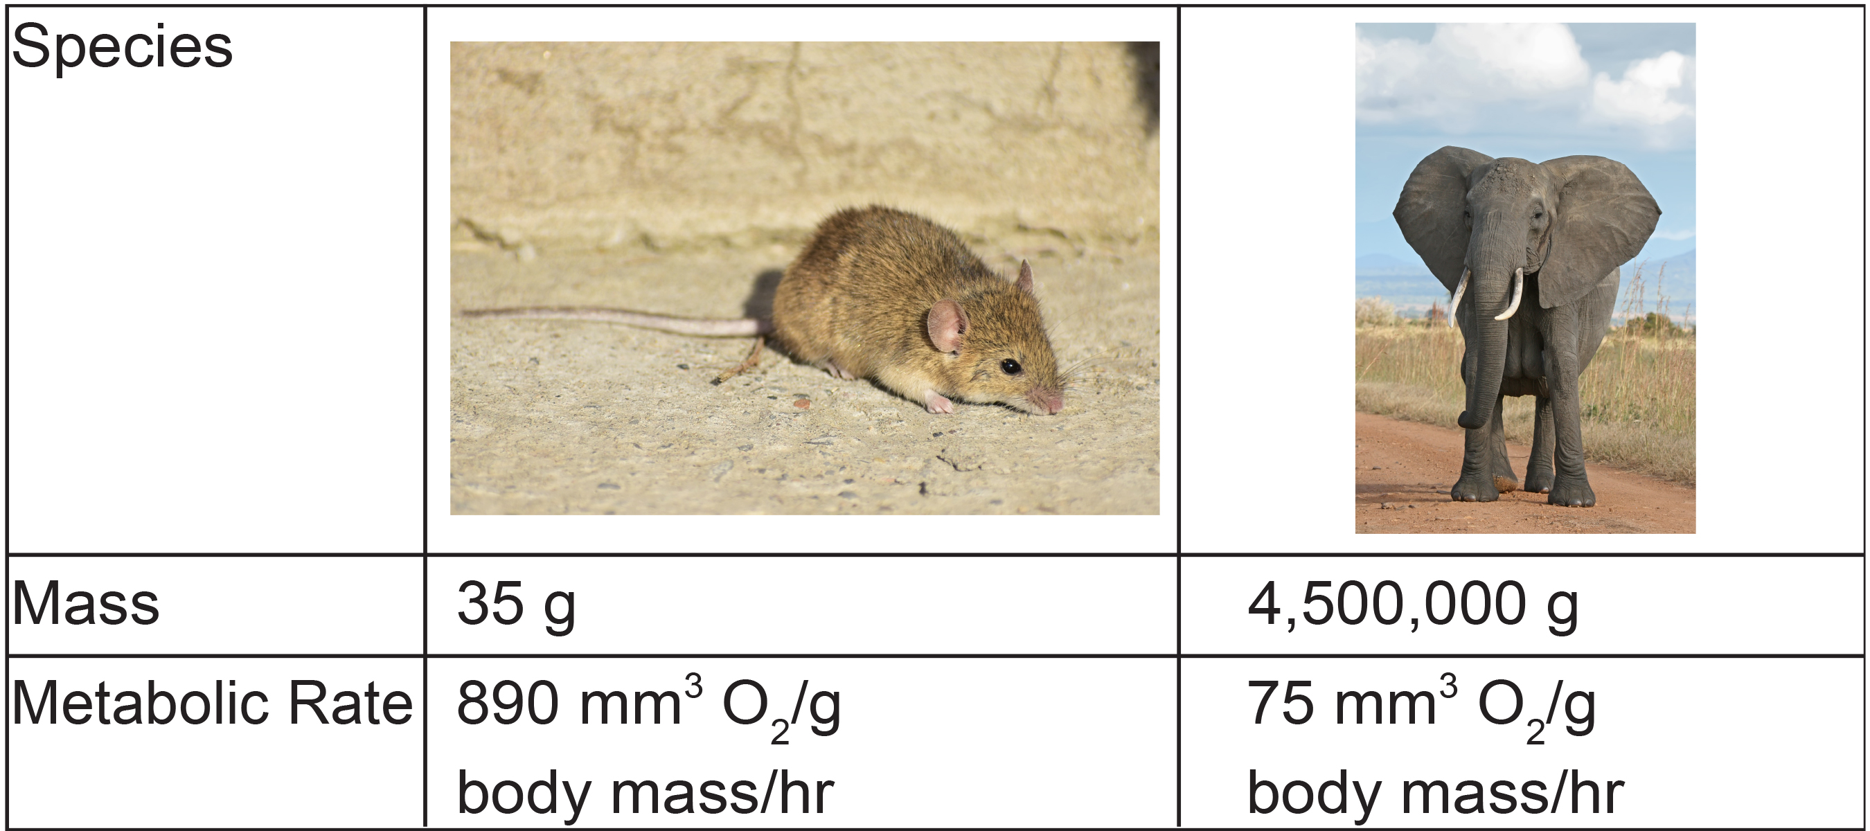
Energy Requirements Are Related to Body Size
Smaller endotherms:
Have a greater surface area for their mass than larger endotherms
Lose heat at a faster rate than larger animals
Require more energy to maintain a constant internal temperature
Have a higher BMR per body weight than larger endotherms
33.1 Figure 5
Amirekul on Wikimedia Commons. "Mouse."
Muhammad Mahdi Karim on Wikimedia Commons. "Elephant."

Slide 23
Energy Requirements Are Related to Activity Levels
More active animals:
Need more energy
Have higher BMRs or SMRs
The average daily consumption rate is 2–4X an animal's BMR or SMR.
Humans are more sedentary, so their consumption rate is only 1.5X the BMR.
An endotherm’s diet is determined by its BMR because different foods have different numbers of calories.
The relative caloric content of herbivore foods is as follows: tall grasses > legumes > short grasses > forbs > subshrubs > annuals/biennials.

Slide 24
Energy Requirements Are Related to the Environment
Torpor is a process that decreases activity and metabolism, allowing animals to survive temperature extremes or lack of food.
Hibernation is a long period of torpor during the winter months during which the animal maintains a reduced body temperature.
Hibernating ground squirrels can achieve an abdominal temperature of 0℃ (32℉).
Hibernating bears maintain an internal temperature of about 37℃ (99℉).
Estivation is torpor during the summer months.
Some desert animals use this to survive harsh summers.
Torpor can occur daily in bats and hummingbirds.
This allows some smaller animals to be endotherms, conserving energy during the cold parts of the day and consuming more food to maintain body temperature.

Slide 25
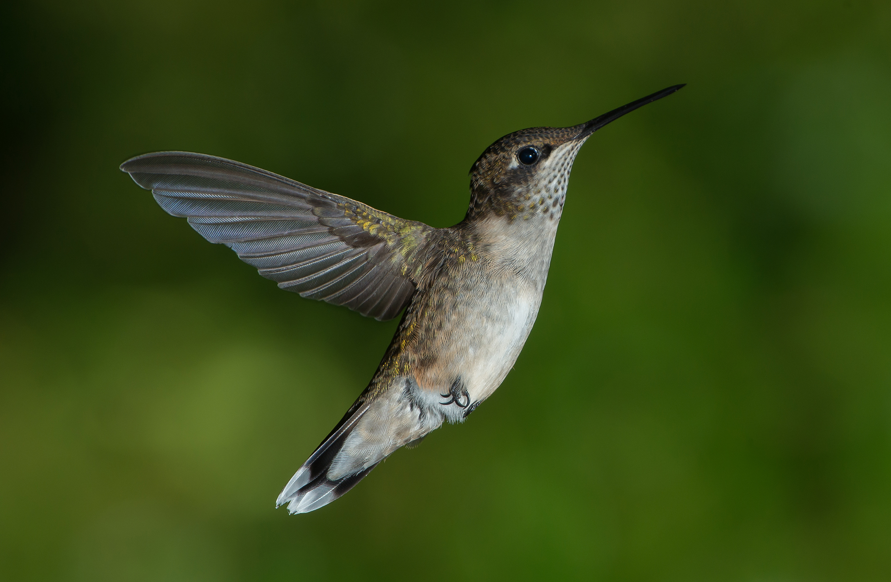
Think It Through
Based on your reading of body size, explain why some species of hummingbirds must undergo a state of torpor every night during sleep.
33.1 Figure 6
Pslawinski on Wikimedia Commons. "Hummingbird."
Notes:
Originally an On Your Own. This is included here to use as a talking point or for a think-pair-share activity.

Slide 26
Planes in Vertebrate Animals
A sagittal plane divides the body into right and left.
A midsagittal plane divides the body exactly in the middle, making 2 equal right and left halves.
A frontal plane (or coronal plane) separates the front from the back.
A transverse plane (or horizontal plane, or a cross-section) divides an animal into upper and lower portions.
An oblique plane is a transvers plane cut at an angle.

Slide 27
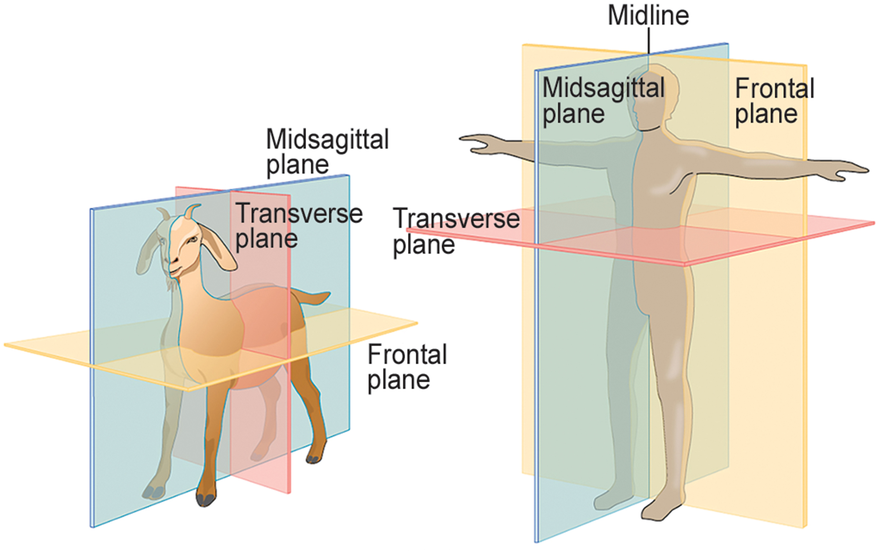
33.1 Figure 7
OpenStax. "Body plans."
Notes:
33.1 Figure 7: Shown here are the planes of a quadrupedal goat and a bipedal human. The midsagittal plane divides the body exactly in half, into right and left portions. The frontal plane divides the front and back, and the transverse plane divides the body into upper and lower portions.

Slide 28
Body Cavities in Vertebrate Animals
There are 2 major cavities with smaller cavities within:
The dorsal cavity contains:
The cranial cavity
The vertebral (spinal) cavity
The ventral cavity contains:
The thoracic cavity, which contains:
The pleural cavity around the lungs
The pericardial cavity around the heart
The abdominopelvic cavity, which contains:
The abdominal cavity
The pelvic cavity

Slide 29
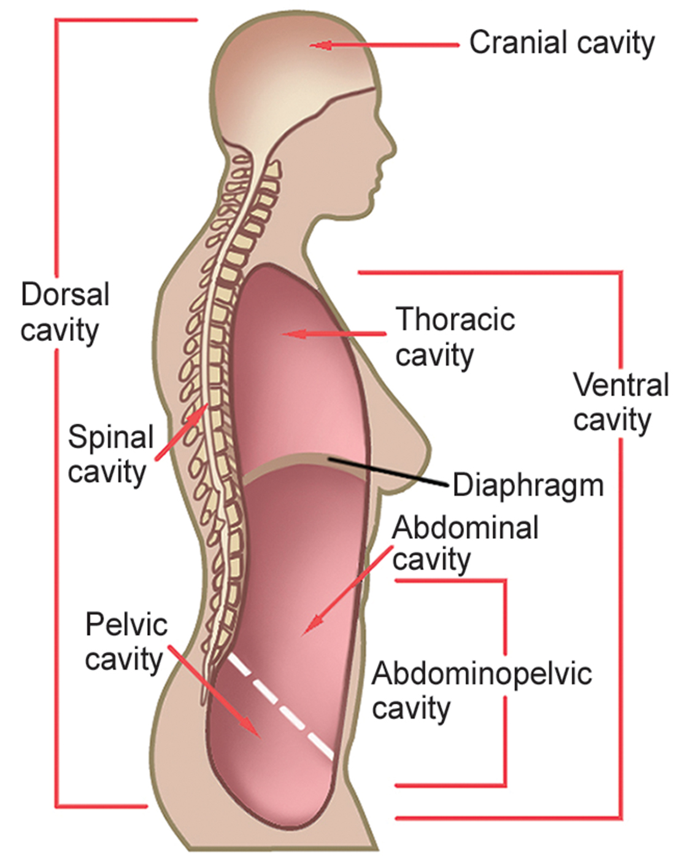
33.1 Figure 8
NCI on Wikimedia Commons. "Body cavities."
Notes:
33.1 Figure 8: Vertebrate animals have two major body cavities: the dorsal cavity and the ventral cavity. The dorsal cavity contains the cranial and the spinal cavity. The ventral cavity contains the thoracic cavity and the abdominopelvic cavity. The thoracic cavity is separated from the abdominopelvic cavity by the diaphragm. The abdominopelvic cavity is separated into the abdominal cavity and the pelvic cavity by an imaginary line parallel to the pelvis bones.

Slide 30
Science and You
Career: Physical Anthropologist
They study the adaptations, variability, and evolution of humans, including their living and fossil relatives.
They can work in many different settings
Most work as academics in universities in the departments of anthropology, biology, genetics, or zoology.
They can work in nonacademic industries, focused on human size, shape, and anatomy.
In the automotive and aerospace industries, they study reactions to car crashes and seat design.
In museums of natural history, anthropology, archaeology, or science and technology, they educate others, maintain collections, and write publications
In zoos, they work in collection management and captive breeding programs.
In forensic science, they identify human and animal remains, determining the cause of death and providing testimony.
Notes:
This is included as a relevant application for this topic.

Slide 31
Summary
Animal bodies come in many sizes and shapes.
An animal's size and shape is limited by impacts to their movement.
Diffusion also affects their size and development.
Bioenergetics describes how animals use and obtain energy in relation to their:
Body size
Activity level
Environment

Slide 32

End of Hawkes Learning PowerPoint

