Slide 1
Lesson 33.2
Primary Tissues of Animals

Slide 2
Objectives
Describe the different types of epithelial tissues.
Describe nervous tissue.
Describe three types of muscle tissues.
Discuss the different types of connective tissues in animals.

Slide 3
Internal Organization of Complex Multicellular Animals
Complex multicellular animals have internal organization.
A tissue is a group of similar cells that carry out related functions.
Tissues combine to form organs, each having a specific, specialized function in the body.
Examples: skin, kidney
Organs are organized into organ systems.
The circulatory system consists of the heart and blood vessels.
The digestive system consists of the stomach, intestines, liver, and pancreas.
Organ systems comprise the entire organism.

Slide 4
Four Primary Tissue Types in Complex Multicellular Animals
There are 4 primary tissue types in multicellular complex animals:
Epithelial
Connective
Muscle
Nervous

Slide 5
Epithelial Tissues
Epithelial tissues:
Cover the outside of organs and structures in the body
Line the lumens (channels within tubular structures) of organism in 1+ layers of cells
Are classified by:
The shapes of cells
The number of cellular layers
Simple epithelia are each composed of a single layer of cells.
Stratified epithelia are each composed of multiple layers of cells.

Slide 6
Table 1: Different Types of Epithelial Tissues
Cell Shape | Description | Location
squamous | flat, irregular round shape | simple: lung alveoli, capillaries; stratified: skin, mouth, vagina
cuboidal | cube-shaped with central nucleus | glands, renal tubules
columnar | tall, narrow, nucleus toward base; tall, narrow, nucleus along cell | simple: digestive tract; pseudostratified: respiratory tract
transitional | round, simple but appear stratified | urinary bladder

Slide 7
Epithelial Tissue: Squamous Epithelia
Squamous epithelial cells:
Are round, flat, and each have a small, centrally located nucleus
Are slightly irregular in shape but fit together to form a covering or lining
Simple squamous epithelium facilitates diffusion in tissue, including
Gas exchange in the lungs
Nutrient and waste exchange at blood capillaries
Stratified squamous epithelium provides protection from outside abrasion and damage, including in the
Skin
Linings of the mouth and vagina

Slide 8
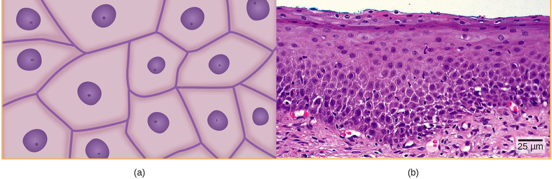
33.2 Figure 1
Ed Uthman on Flickr. "Squamous epithelia cells." Modified.
Notes:
33.2 Figure 1: Squamous epithelial cells (a) have a slightly irregular shape and a small, centrally located nucleus. These cells can be stratified into layers, as in (b) this human cervix specimen.

Slide 9
Epithelial Tissue: Cuboidal Epithelia
Cuboidal epithelial cells:
Are cube-shaped each with a single, central nucleus
Are most commonly found in a single layer (simple) in glandular tissues throughout the body where they prepare and secrete glandular material such as:
Saliva
Digestive juices
Hormones
Are also found in the walls of the tubules of the kidney and liver

Slide 10
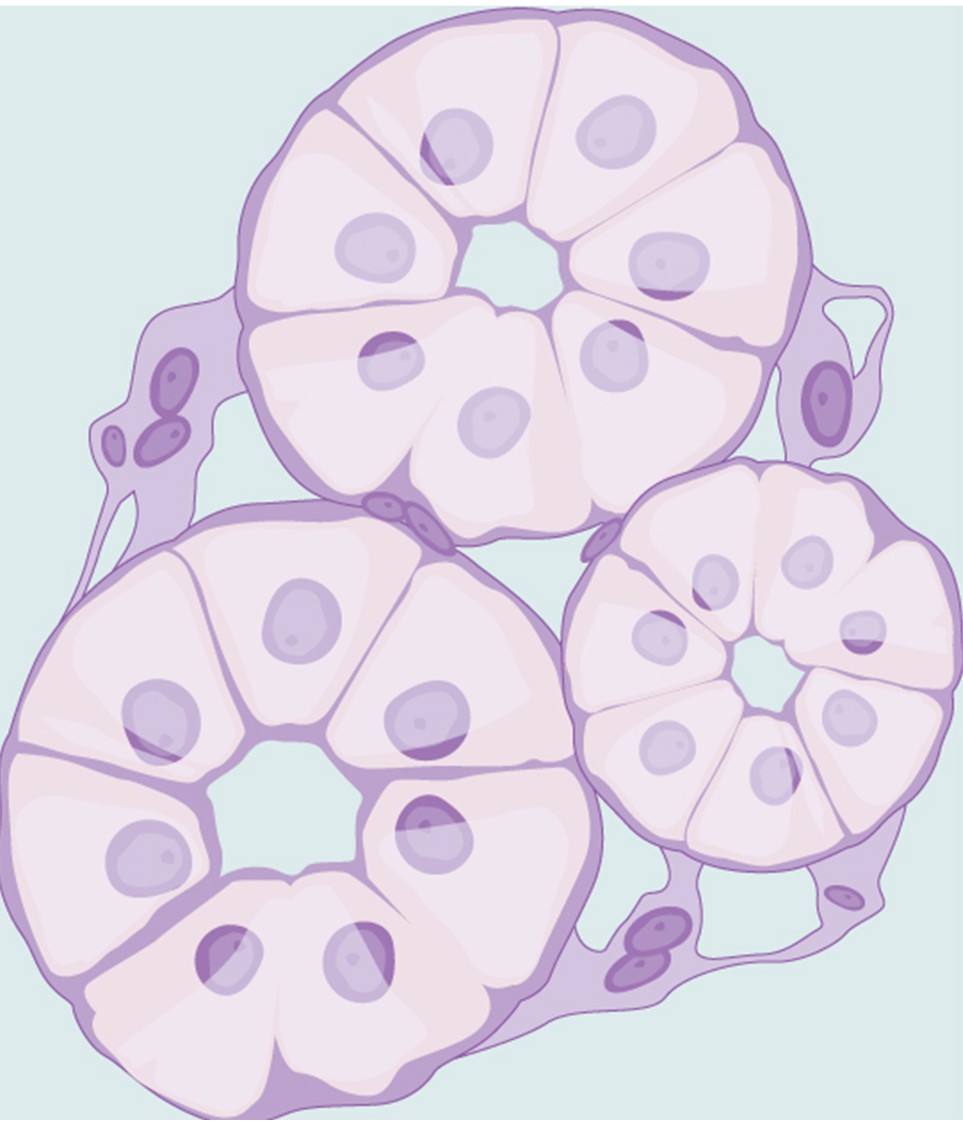
33.2 Figure 2
OpenStax. "Simple cuboidal cells."
Notes:
33.2 Figure 2: Simple cuboidal epithelial cells line tubules in the mammalian kidney where they are involved in filtering the blood.

Slide 11
Epithelial Tissue: Columnar Epithelia
Columnar epithelial cells:
Are taller than they are wide
Resemble a stack of columns in an epithelial layer
Are most commonly found in a single-layer (simple) arrangement
The columnar epithelia cells of the digestive tract:
Have their nuclei lined up at the cells' bases
Absorb material from the digestive tract's lumen
Prepare that material for entry into the circulatory and lymphatic systems
Include mucus-secreting goblet cells

Slide 12
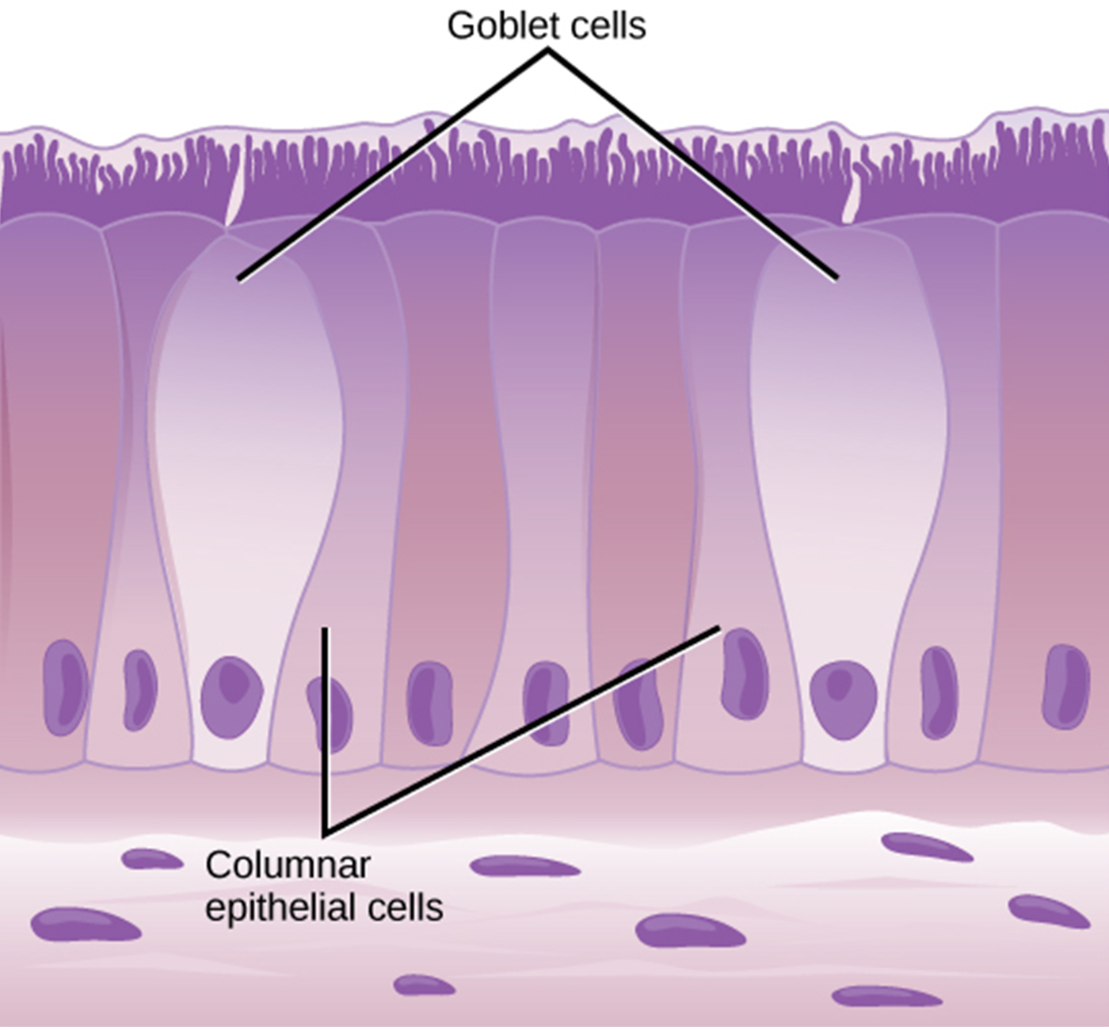
33.2 Figure 3
OpenStax. "Simple columnar epithelium."
Notes:
33.2 Figure 3: Simple columnar epithelial cells absorb material from the digestive tract. Goblet cells secrete mucus into the digestive tract lumen.

Slide 13
Epithelial Tissue: Pseudostratified Columnar Epithelia
Columnar epithelial cells that line the respiratory tract are pseudostratified because they:
Are each attached to the base membrane, meaning that they make up a single layer
Have their nuclei arranged at different layers, making it appear like there is more than one layer
Have cilia at their apical surfaces to enhance the movement of mucus and trapped particles out of the digestive tract
This protects the system from invasive microbes and harmful material breathed in.
Include interspersed goblet cells in some tissues (such as the trachea), which secrete mucus, trap irritants, and keep irritants from entering the lungs

Slide 14
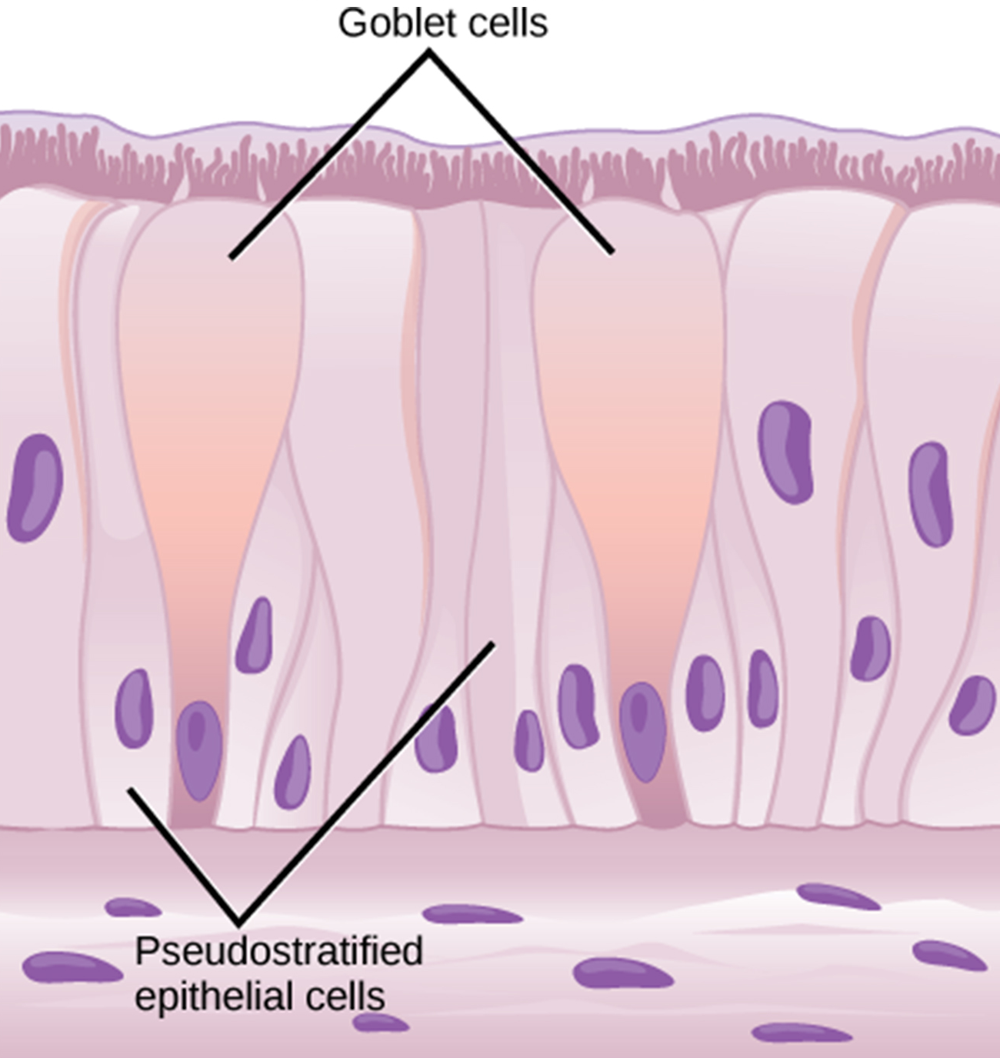
33.2 Figure 4
OpenStax. "Pseudostratified columnar epithelium."
Notes:
33.2 Figure 4: Pseudostratified columnar epithelia line the respiratory tract. They exist in one layer, but the arrangement of nuclei at different levels makes it appear like there is more than one layer. Goblet cells interspersed between the columnar epithelial cells secrete mucus into the respiratory tract.

Slide 15
Epithelial Tissue: Transitional Epithelia
Transitional (or uroepithelial cells):
Are found only in the urinary system, primarily in the bladder and ureter
Are arranged in a stratified layer
Can appear to pile up on top of each other in a relaxed, empty bladder
As the urinary bladder fills, the epithelial layer
Unfolds and expands to hold the urine volume introduced
Becomes thinner

Slide 16
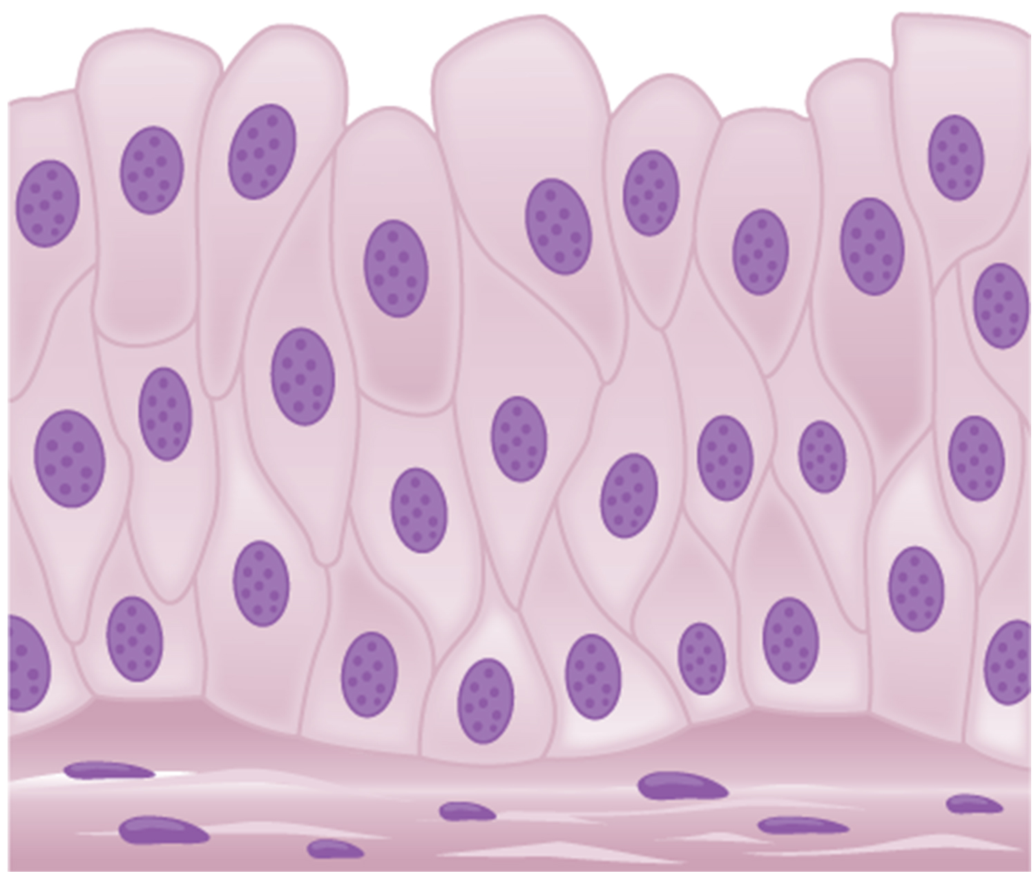
33.2 Figure 5
CNX OpenStax on Wikimedia Commons. "Transitional epithelia."
Notes:
33.2 Figure 5: Transitional epithelia of the urinary bladder undergo changes in thickness depending on how full the bladder is.

Slide 17
Think It Through₁
Which of the following statements about types of epithelial cells is false?
Simple columnar epithelial cells line the tissue of the lung.
Simple cuboidal epithelial cells are involved in the filtering of blood in the kidney.
Pseudostratified columnar epithelia occur in a single layer, but the arrangement of nuclei makes it appear that more than one layer is present.
Transitional epithelia change in thickness depending on how full the bladder is.
Notes:
Originally an On Your Own. This is included here to use as a talking point or for a think-pair-share activity.

Slide 18
Connective Tissues₁
Connective tissues:
Are made up of living cells embedded in a nonliving matrix, itself made up of protein fibers and ground substance
Ground substance is a gel-like fluid composed of water and large inorganic molecules such as polysaccharides.
The protein fibers give the tissue its density, with tissues having more fibers being more dense.
Fibroblasts
Are the principal cells of connective tissues
Make the protein fibers in connective tissues
Are motile, able to carry out mitosis, and can make the matrix components
Sometimes contain specialized cells such as macrophages, lymphocytes, and leukocytes

Slide 19
Connective Tissues₂
The protein fibers found in connective tissues are one of 3 types:
Collagen fibers provide strength, preventing tearing or separation from surrounding tissue.
Elastic fibers made of elastin provide flexibility to the tissues, with the ability to stretch to 1.5X their lengths and return to their original size and shape.
Reticular fibers each consist of thin strands of collagen that form a network of fibers to support the tissue and other organs to which they are connected.

Slide 20
Table 2: Comparison of Connective Tissues₁
Tissue | Cells | Fibers | Location
loose/areolar | fibroblasts, macrophages, some lymphocytes, some neutrophils | few: collagen, elastic, reticular | around blood vessels; anchors epithelia
dense, fibrous connective tissue | fibroblasts, macrophages | mostly collagen | irregular: skin; regular: tendons, ligaments
cartilage | chondrocytes, chondroblasts | few collagen: hyaline; large amount of collagen: fibrocartilage | shark skeleton, fetal bones, human ears, intervertebral discs

Slide 21
Table 2: Comparison of Connective Tissues₂
Tissue | Cells | Fibers | Location
bone | osteoblasts, osteocytes, osteoclasts | some: collagen, elastic | vertebrate skeletons
adipose | adipocytes | few | adipose (fat)
blood | red blood cells, white blood cells | none | blood

Slide 22
Connective Tissue: Loose Connective Tissue
Loose connective tissue (also called areolar connective tissue):
Has a sampling of all connective tissue components
Includes some fibroblasts and macrophages
Has collagen fibers that are relatively wide and stain light pink
Has elastic fibers that are thick and stain dark blue or black
Has matrix between its cells
Has a loose consistency similar to a cotton ball that ha been pulled apart
Is found around every blood vessels to keep it in place
Is also found around and between most organs
Is tough, flexible, and comprises membranes

Slide 23
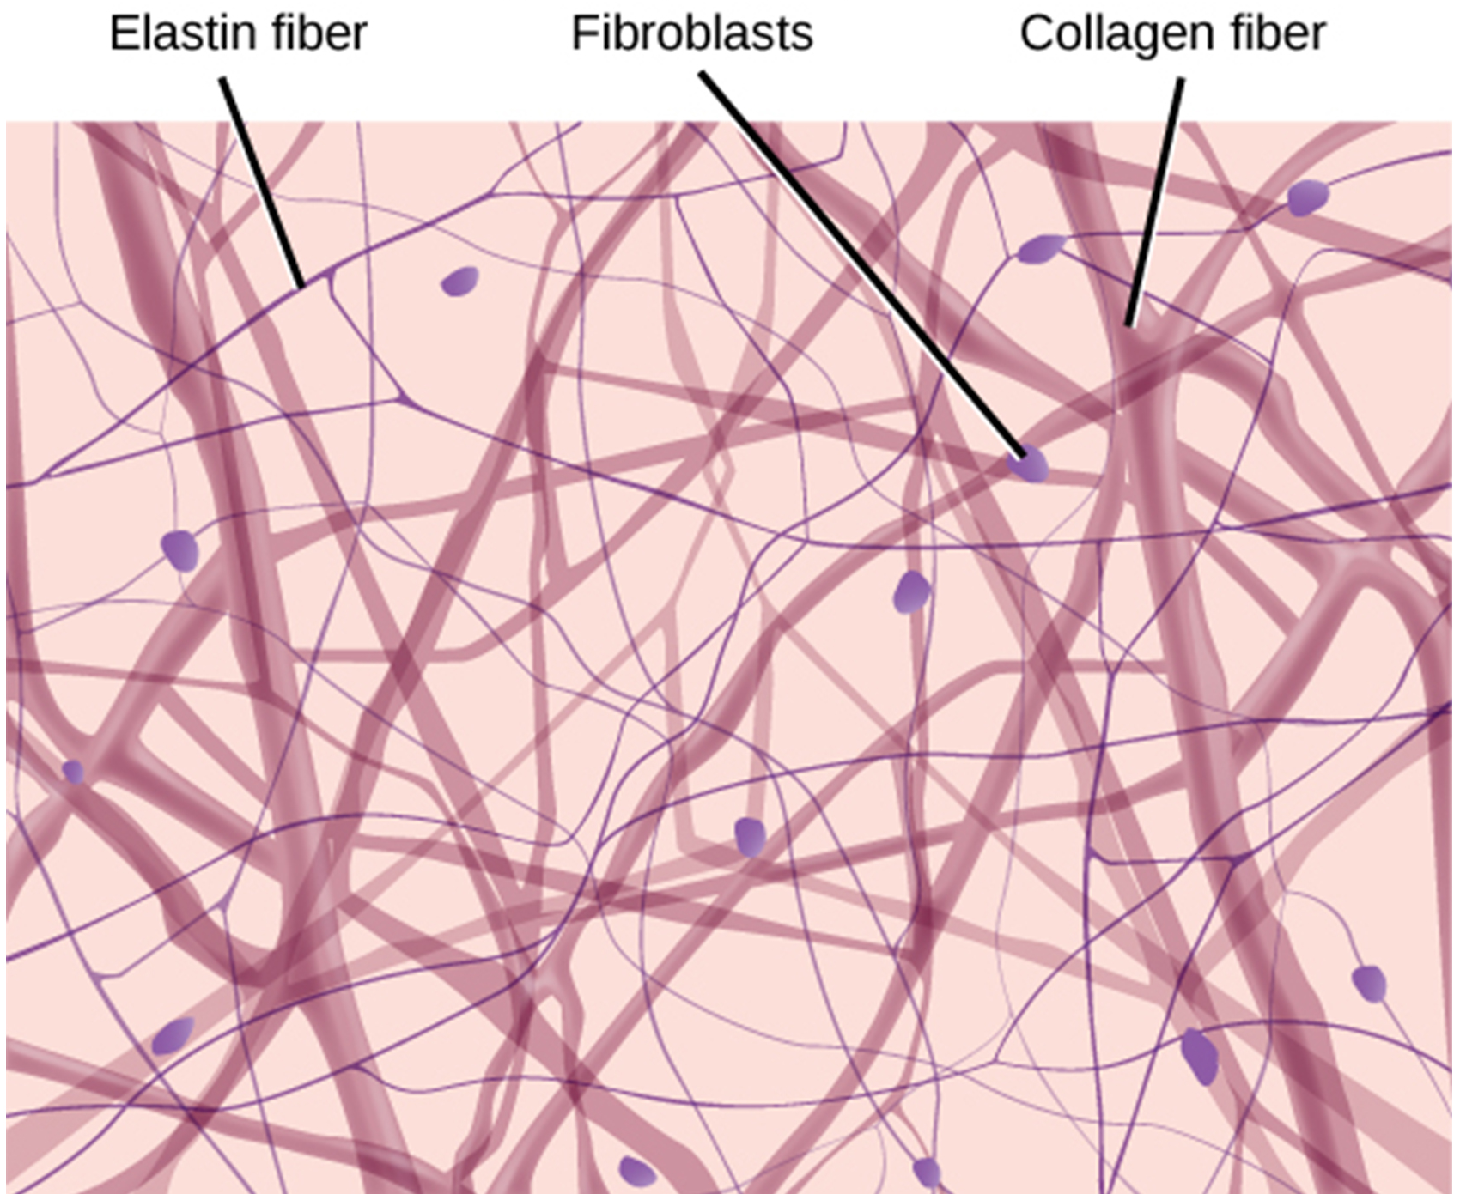
33.2 Figure 6
OpenStax. "Loose connective tissue."
Notes:
33.2 Figure 6: Loose connective tissue is composed of loosely woven collagen and elastic fibers. The fibers and other components of the connective tissue matrix are secreted by fibroblasts.

Slide 24
Connective Tissue: Fibrous Connective Tissue
Fibrous connective tissue:
Contains large amounts of collagen but only a few cells
Have fibers arranged either irregularly or regularly (with the strands lined up in parallel)
Irregularly arranged fibrous connective tissue is found in bodily areas where stress occurs from all directions, such as the dermis of the skin.
Regular fibrous connective tissue is found in:
Tendons (which connect muscles to bones)
Ligaments (which connect bones to bones)

Slide 25
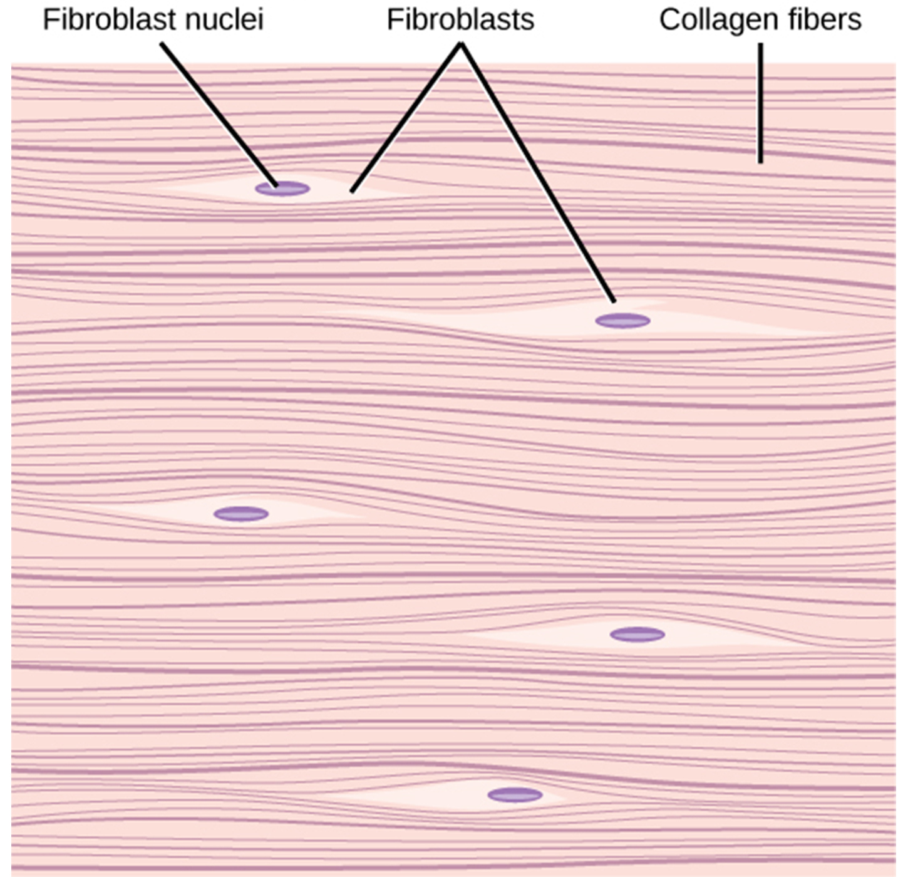
33.2 Figure 7
CNX OpenStax on Wikimedia Commons. "Fibrous connective tissue."
Notes:
33.2 Figure 7: Fibrous connective tissue from the tendon has strands of collagen fibers lined up in parallel.

Slide 26
Connective Tissue: Cartilage
Cartilage:
Has a large amount of fibrous matrix
Has cells called chondrocytes, found in tissue spaces called lacunae, that make the fibers and other matrix components
May be one of 3 types:
Hyaline cartilage
Elastic cartilage
Fibrocartilage

Slide 27
Connective Tissue: Hyaline Cartilage
Hyaline cartilage:
Has few collagen and elastic fibers
Has lacunae randomly scattered throughout, which take on a milky or scrubbed appearance microscopically
Composes sharks' cartilaginous skeletons for their entire lives
Composes the skeletons of humans at birth, but is replaced with bone during development
Composes the human nose
Is found at the end of long bones, reducing friction and cushioning articulations of these bones

Slide 28
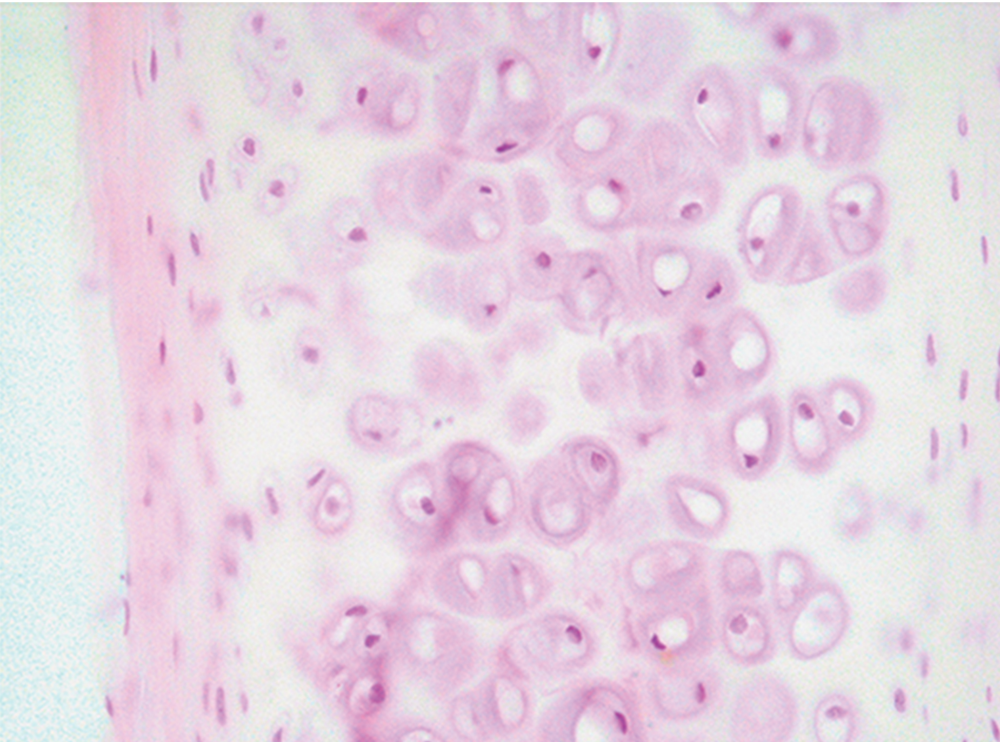
33.2 Figure 8
Echinaceapallida on Wikimedia Commons. "Hyaline cartilage."
Notes:
33.2 Figure 8: Hyaline cartilage consists of a matrix with cells called chondrocytes embedded in it. The chondrocytes exist in cavities in the matrix called lacunae.

Slide 29
Connective Tissue: Elastic Cartilage and Fibrocartilage
Elastic cartilage:
Has a large amount of elastic fibers
Is very flexible
Composes the ears of most vertebrates
Composes the larynx (voice box) of most vertebrates
Is found in movable joints like the knee and shoulder, and can become damaged due to age or trauma
Fibrous cartilage:
Contains a large amount of collagen fibers
Is very strong
Comprises the intervertebral discs of vertebrates
Replaces hyaline cartilage in joints when it is damaged, resulting in "stiff" joints

Slide 30
Science and You₁
Cartilage Takes Time to Repair After Injury
After a joint injury, cartilage is the most difficult tissue to heal. There is a relatively low density of nucleated cartilage producing cells, known as chondrocytes. So, when cartilage is injured, there are few cells available to produce and replace lost cartilage matrix, which is rich in collagen fibers. In addition, the cartilage that is replaced is of a different type that is less flexible, known as fibrocartilage. That's why when you sprain an ankle, tear a ligament, or dislocate a shoulder, for example, pain is persistent and normal mobility takes a while to recover.
Notes:
This is included as a relevant application for this topic.

Slide 31
Connective Tissue: Bone₁
Bone (or osseous tissue):
Is composed of 2 different types of matrix material:
Organic matrix is similar to the matrix of other connective tissues, including some collagen and elastic fibers that give strength and flexibility.
Without enough of this, the tissue breaks.
Inorganic matrix contains mineral salts, mostly calcium salts, that give the tissue hardness.
Without enough of this, the tissue bends.
Forms the internal skeleton of vertebrates, providing structure and points of attachment for tendons.

Slide 32
Connective Tissue: Bone₂
There are 3 types of cells in bone:
Osteoblasts are active in making bone for growth and remodeling because they deposit bone material into the matrix.
Osteocytes are osteoblasts that are surrounded by matrix in lacunae and have a reduced metabolic state.
Osteoclasts, usually found on bone tissue's surface, are active in breaking down bone for remodeling, and they provide access to calcium stored in the bone tissue.

Slide 33
Connective Tissue: Bone₃
Bone can be divided into 2 types:
Compact bone:
Is found in the shaft (diaphysis) of a long bone and on the surface of flat bones
Spongy bone:
Is found on the end (or epiphysis) of a long bone

Slide 34
Connective Tissue: Compact And Spongy Bone
Compact bone:
Is organized into subunits called osteons
The central Haversian canal contains a blood vessel and a nerve.
The canal is surrounded by radiating circles called lamellae that contain the lacunae.
Lacunae are connected by canaliculi (microchannels).
Spongy bone:
Is made of tiny plates called trabeculae, which serve as struts to give spongy bone strength
These plates can break over time, causing the bone to be less resilient.

Slide 35
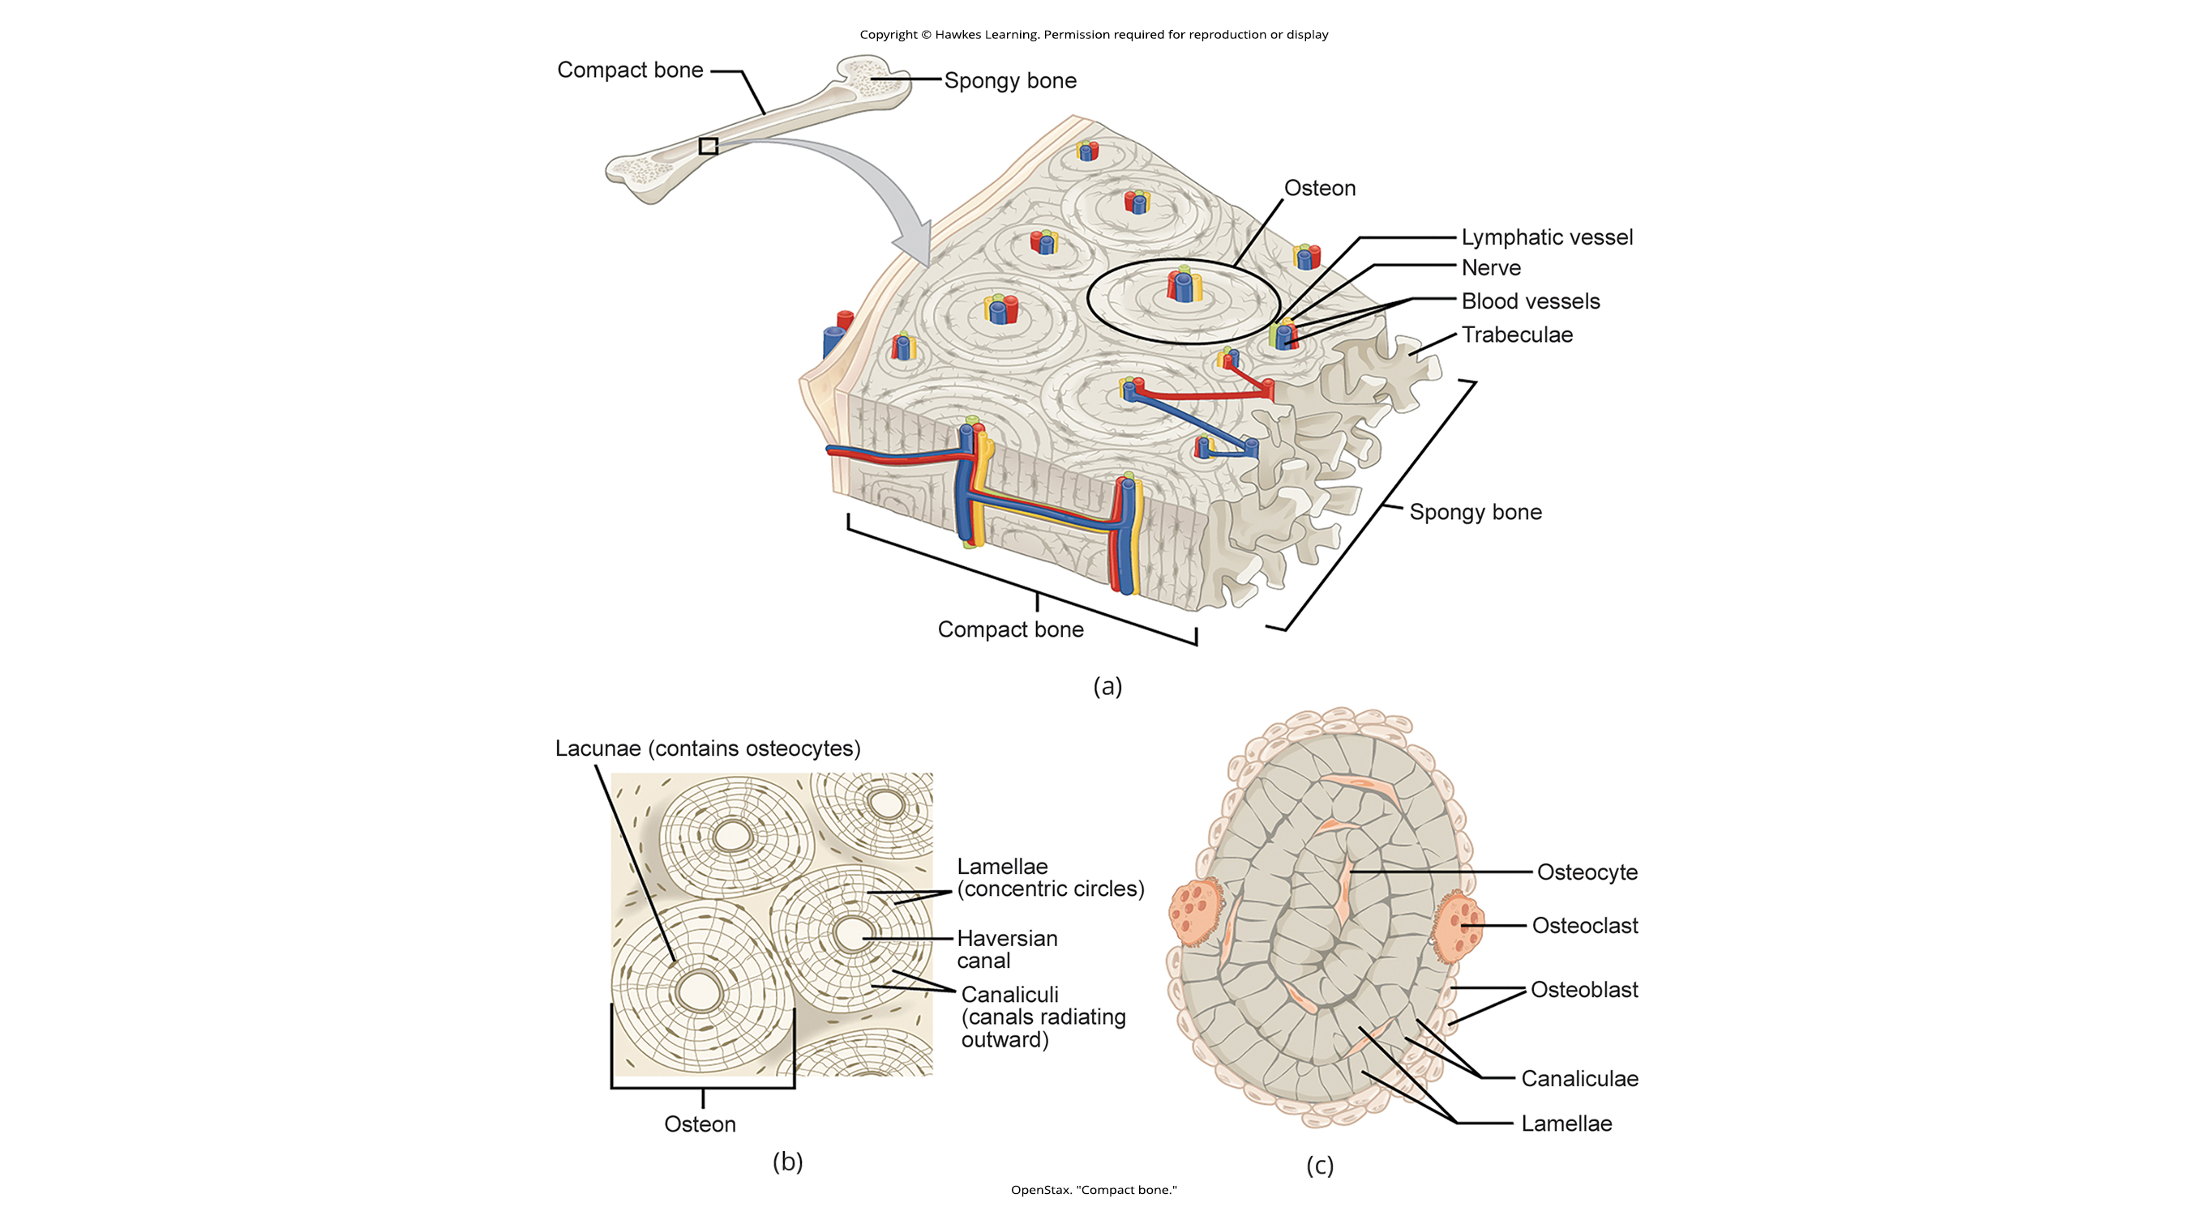
33.2 Figure 9 (a)
OpenStax. "Compact bone."
Notes:
33.2 Figure 9: (a) Compact bone is a dense matrix on the outer surface of bone. Spongy bone, inside the compact bone, is porous with weblike trabeculae.

Slide 36
33.2 Figure 9 (b)
OpenStax. "Compact bone."
Notes:
33.2 Figure 9: (b) Compact bone is organized into rings called osteons. Blood vessels, nerves, and lymphatic vessels are found in the central Haversian canal. Rings of lamellae surround the Haversian canal. Between the lamellae are cavities called lacunae. Canaliculi are microchannels connecting the lacunae together.

Slide 37
33.2 Figure 9 (c)
OpenStax. "Compact bone."
Notes:
33.2 Figure9 : (c) Osteoblasts surround the exterior of the bone. Osteoclasts bore tunnels into the bone, and osteocytes are found in the lacunae.

Slide 38
Think It Through₂
Bones are not solid but are rather porous, containing blood vessels, lymphatic vessels, nerves, and bone marrow, where blood cell development takes place.
Which two cell types in the bone keep bones both rigid and porous?
osteoclasts and osteoblasts
osteoblasts and microglia
osteoclasts and Kupffer cells
endothelial cells and Kupffer cells
Notes:
Originally an On Your Own. This is included here to use as a talking point or for a think-pair-share activity.

Slide 39
Connective Tissue: Adipose Tissue
Adipose tissue (or fat tissue):
Is considered a connective tissue although it only has a few fibers and does not have fibroblasts
Is composed of cells called adipocytes that collect and store fat in the form of triglycerides for energy metabolism
Adipocytes appear empty microscopically because the fat is dissolved by the chemicals used to process the specimens
Serves as insulation to help endotherms maintain body temperatures
Functions as cushioning for the body organs

Slide 40
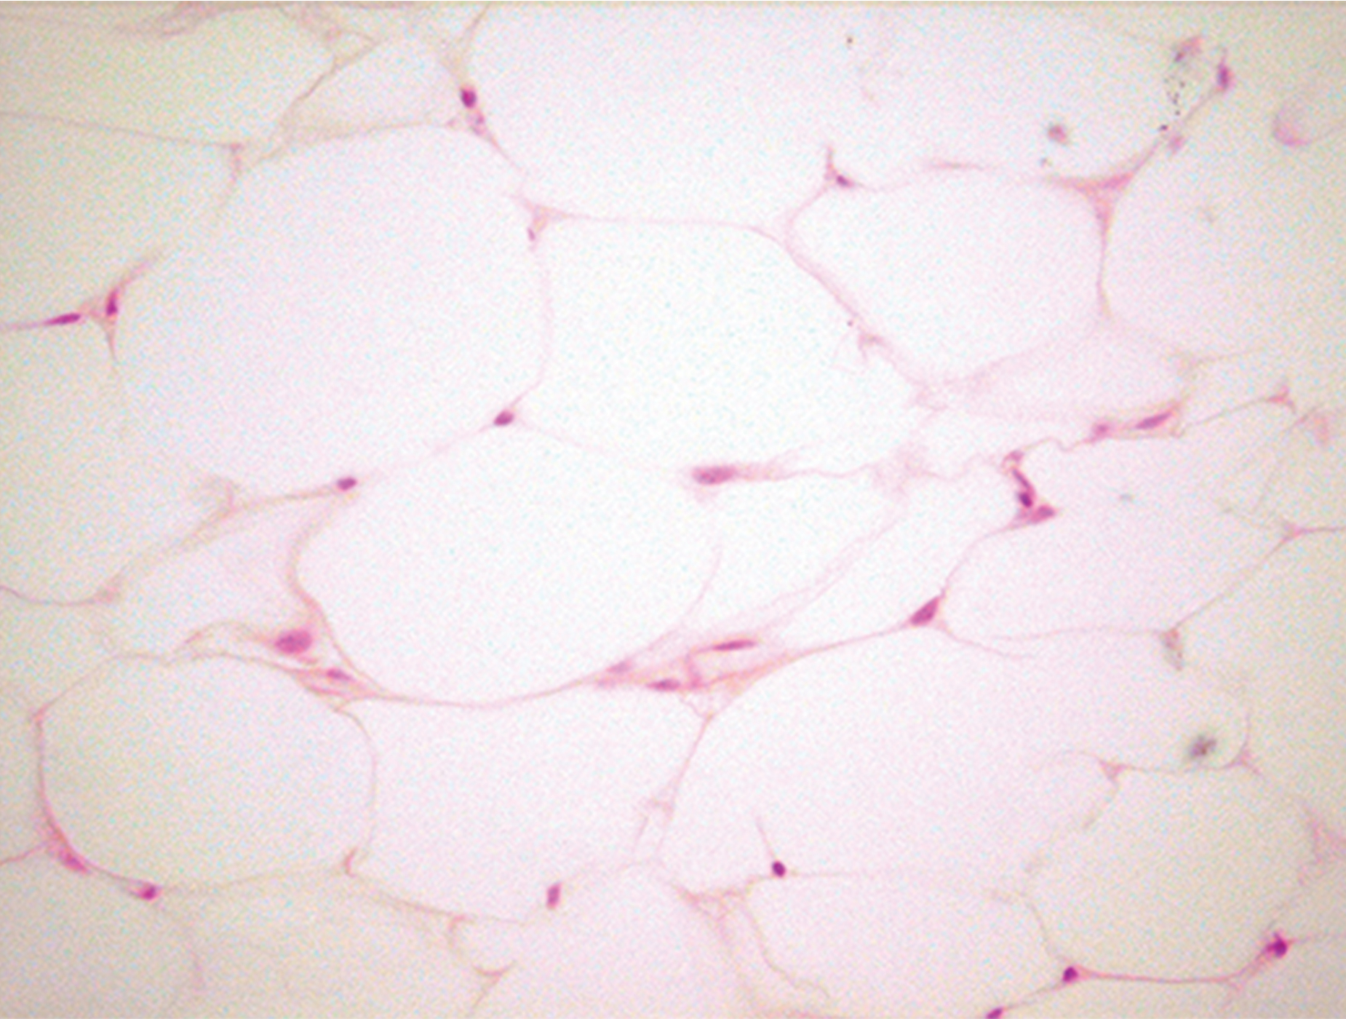
33.2 Figure 10
Echinaceapallida on Wikimedia Commons. "Adipose tissue."
Notes:
33.2 Figure 10: Adipose is a connective tissue made up of cells called adipocytes. Adipocytes have small nuclei localized at the cells' edges.

Slide 41
Connective Tissue: Blood
Blood:
Is considered a connective tissue because it has a matrix
Has living cell types:
Red blood cells (RBC), also called erythrocytes
White blood cells (WBC), also called leukocytes
Has a matrix called plasma that is 92% water and also contains:
Proteins (such as albumin, antibodies, and clotting factors)
Salts
Sugars
Hormones
Fats

Slide 42
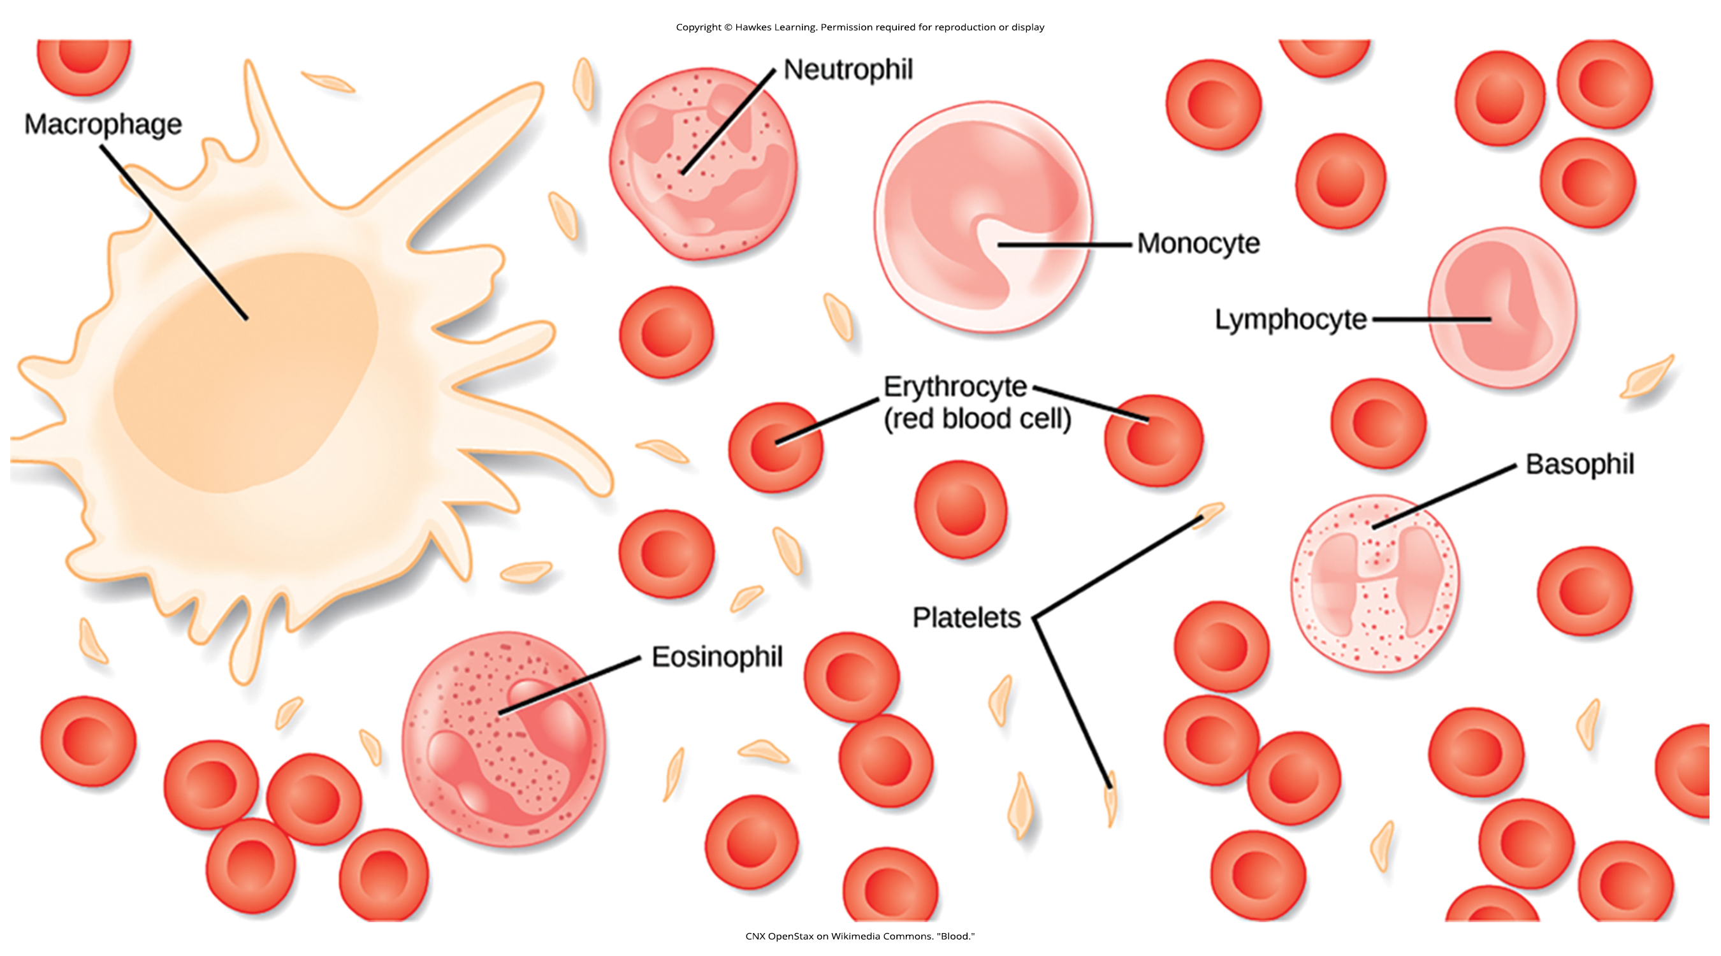
33.2 Figure 11
CNX OpenStax on Wikimedia Commons. "Blood."
Notes:
33.2 Figure 11: Blood is a connective tissue that has a fluid matrix, called plasma, and no fibers. Erythrocytes (red blood cells), the predominant cell type, are involved in the transport of oxygen and carbon dioxide. Also present are various leukocytes (white blood cells) involved in immune response.

Slide 43
Connective Tissue: Blood's Red Blood Cells
Red blood cells:
Carry and deliver O₂ to tissues
Are counted in millions in a blood sample
The average number of RBCs in primates is 4.7–5.5 million cells per μl.
Are a consistent size in a species but vary between species
Average diameter of a primate RBC = 7.5 μm
Average diameter of a dog RBC = 7.0 μm
Average diameter of a cat RBC = 5.9 μm
Average diameter of a sheep RBC = 4.6 μm
Upon release from the bone marrow where they are made:
Mammalian RBCs lose their nuclei and mitochondria
Fish, amphibian, and avian RBCs maintain their nuclei and mitochondria throughout the cell's life.

Slide 44
Connective Tissue: Blood's White Blood Cells₁
White blood cells:
Are counted in the thousands in the blood and measurements are expressed as ranges
Primates: 4,800–10,800 cells per μl
Dogs: 5,600–19,200 cells per μl
Cats: 8,000–25,000 cells per μl
Cattle: 4,000–12,000 cells per μl
Pigs: 11,000–22,000 cells per μl

Slide 45
Connective Tissue: Blood's White Blood Cells₂
There are 5 types of white blood cells:
Lymphocytes function primarily in immune responses to foreign antigens or material.
Lymphocytes can make antibodies tailed to the foreign antigens and control antibody production.
Neutrophils are phagocytes that serve as an early line of defense against invading microbes.
Monocytes, found in the peripheral blood, give rise to phagocytic macrophages that clean up dead and damaged cells in the body, either foreign or from the host.
Eosinophils and basophils both help facilitate the inflammatory response.

Slide 46
Connective Tissue: Blood's Platelets
Platelets (also called thrombocytes):
Are cytoplasmic fragments of large cells called megakaryocytes that grow in bone marrow
Are involved in blood clotting in that they initiate coagulation (clot formation) to stop bleeding through damaged blood vessels

Slide 47
Muscle Tissues
There are 3 types of muscle in animal bodies:
Smooth
Skeletal
Cardiac
These differ by:
The presence or absence of striations (bands)
The number and location of nuclei
Whether they can be controlled voluntarily or involuntarily
Their bodily location

Slide 48
Table 3: Comparison of Muscle Types
Type of Muscle | Striations | Nuclei | Control | Location
smooth | no | single, in center | involuntary | visceral organs
skeletal | yes | many, at periphery | voluntary | skeletal muscles
cardiac | yes | single, in center | involuntary | heart

Slide 49
Muscle Tissue: Smooth Muscle
Smooth muscle (also called nonstriated muscle):
Lacks striations
Has cells each having a centrally located nucleus
Is under the control of the autonomic nervous system
Constricts involuntarily in response to local conditions
Is found:
In the walls of blood vessels
In the tubes of the digestive system
In the tubes of the reproductive system

Slide 50
Muscle Tissue: Skeletal Muscle
Skeletal muscle (also called nonstriated muscle):
Has striations across its cells due to the arrangement of the contractile proteins (actin and myosin)
Has cells that are relatively long and each have multiple nuclei along the cell's edge
Is under the control of the somatic nervous system
Constricts voluntarily
Is found:
In the muscles that move bones

Slide 51
Muscle Tissue: Cardiac Muscle
Cardiac muscle:
Has cross striations in its cells
Has cells each having a single, centrally located nucleus
Is under the control of the autonomic nervous system
Constricts involuntarily
Has an intercalated disc along the end of each muscle cell as it borders the next cardiac cell in the row
The intercalated disc aids in passing electrical impulse efficiently from cell to cell, maintaining a strong connection between adjacent cardiac cells.
Is found only in the heart

Slide 52
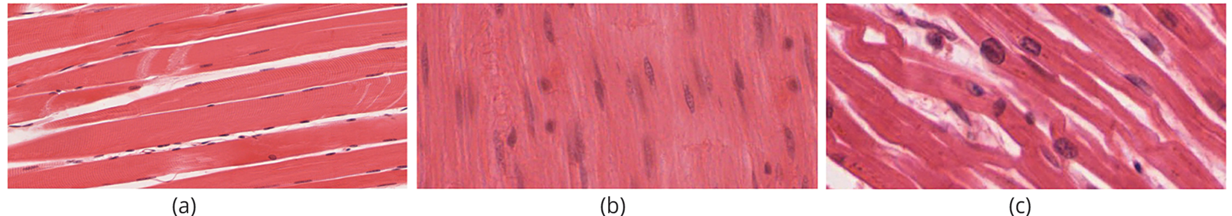
33.2 Figure 12
OpenStax. "Types of muscle tissue."
Notes:
33.2 Figure 12: (a) Skeletal muscle cells have striations, while (b) smooth muscle cells do not. (c) Cardiac muscle cells have striations, but unlike the multinucleate skeletal cells, they have only one nucleus. Cardiac muscle tissue also has intercalated discs, specialized regions running along the plasma membrane that join adjacent cardiac muscle cells and assist in passing an electrical impulse from cell to cell.2

Slide 53
Nervous Tissues₁
Nervous tissues are made of cells specialized to receive and transmit electrical impulses.
A nerve includes neurons and glial cells.
Each neuron contains:
A cell body containing a central nucleus
Dendrites, projections from the cell body specialized for receiving input
An axon, a projection from the cell body for transmitting impulses

Slide 54
Nervous Tissues₂
A nerve includes neurons and glial cells.
There are several types of glial cells.
Astrocytes regulate the neuron's chemical environment.
Oligodendrocytes insulate the axon for increased efficiency of nerve impulse transmission.
Other glial cells support the neuron's nutritional and waste requirements.
Some glial cells are phagocytic and remove debris or damaged cells.

Slide 55
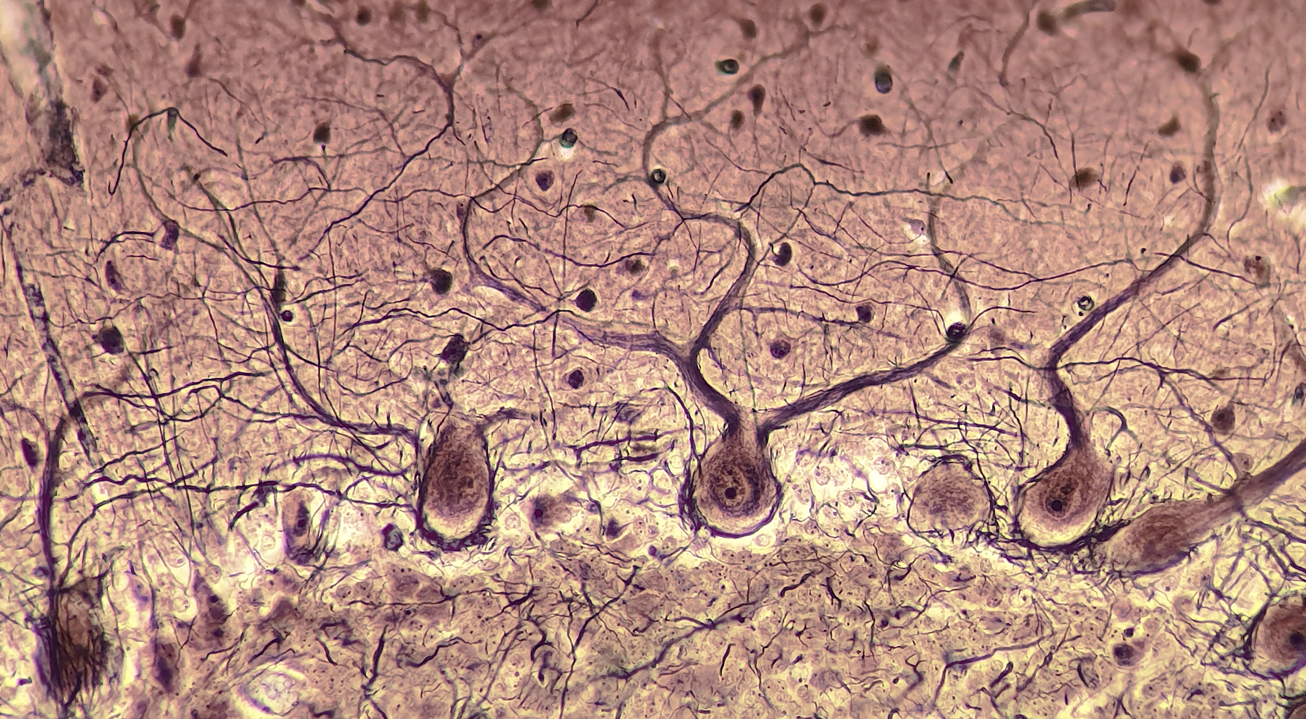
33.2 Figure 13
Lennart Rikk on Wikimedia Commons. "Purkinje cells."
Notes:
33.2 Figure 13: Microscope image of neurons in the cerebellum of the brain

Slide 56
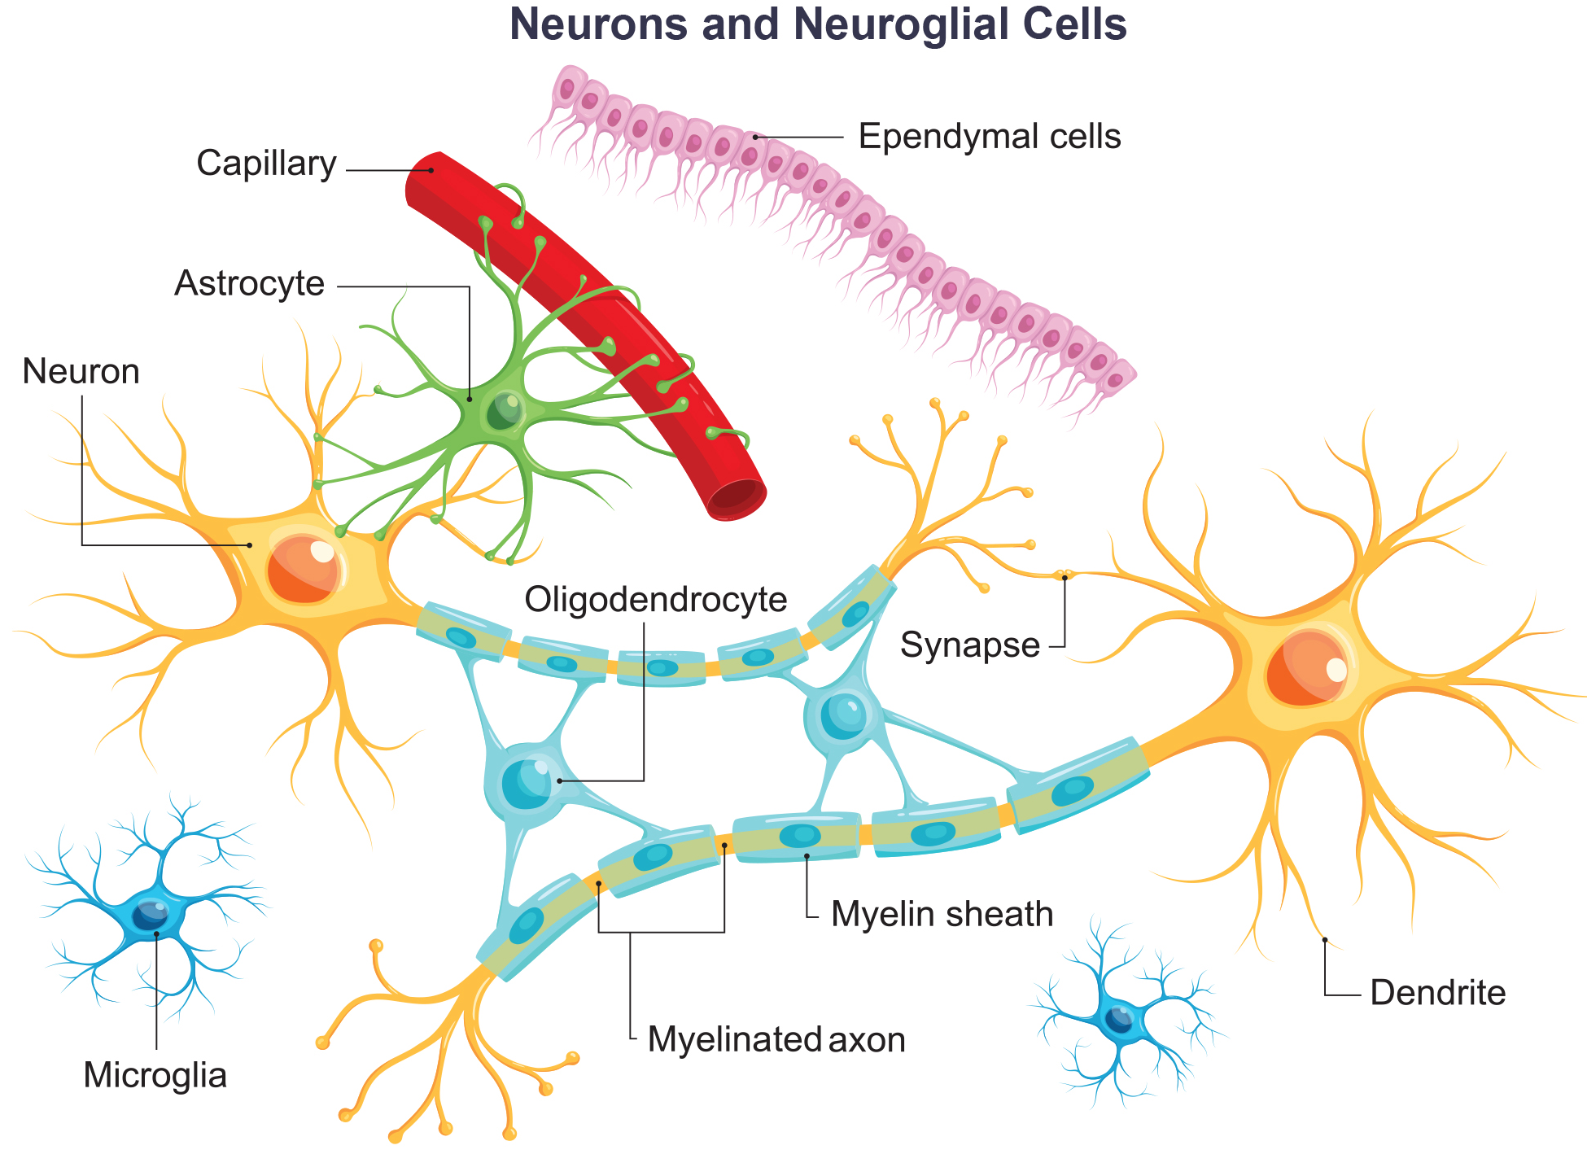
33.2 Figure 14
Notes:
33.2 Figure 14: The neuron has projections called dendrites that receive signals and projections called axons that send signals. Also shown are two types of glial cells; astrocytes regulate the chemical environment of the nerve cell, and oligodendrocytes insulate the axon so that the electrical nerve impulse is transferred more efficiently.

Slide 57
Science and You₂
Career: Pathologist
A pathologist is a medical doctor or veterinarian who specializes in the laboratory detection of disease in animals, including humans.
A pathologist completes medical school and follows it with a postgraduate residency at a medical center.
A pathologist may oversee clinical laboratories that evaluate body tissue and blood samples for the detection of disease or infection.
They examine tissue specimens through a microscope to identify cancers and other diseases.
Some pathologists perform autopsies to determine the cause of death and the progression of disease.
Notes:
This is included as a relevant application for this topic.

Slide 58
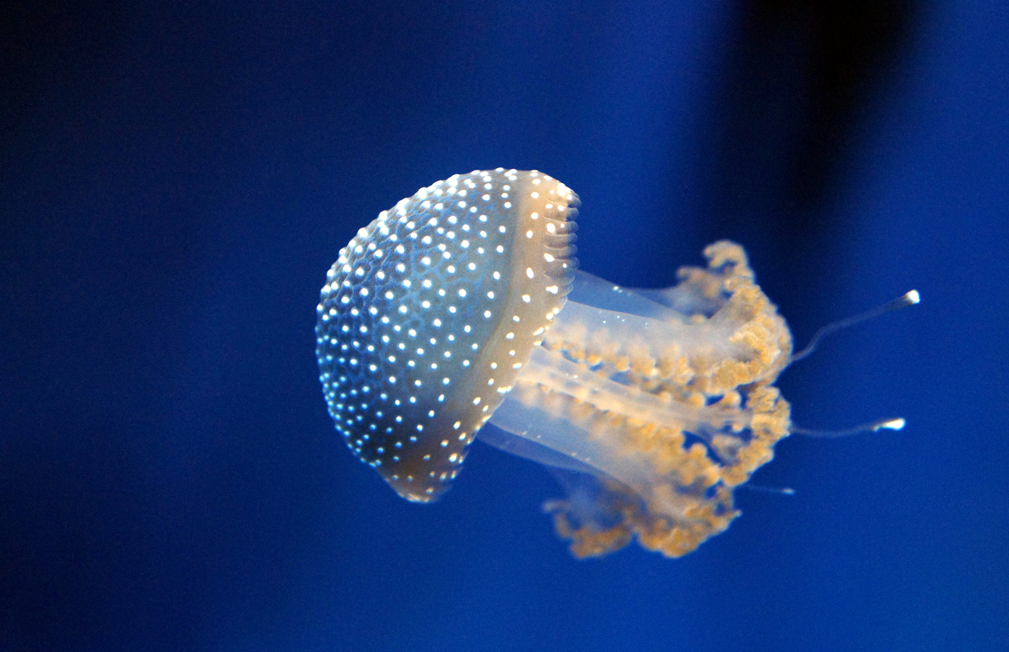
33.2 Figure 15
Superchilum on Wikimedia Commons. "Jellyfish."
Notes:
33.2 Figure 15: Jellyfish (phylum Cnidaria) are among the simplest animals in terms of the tissues that make up the organisms. They have epithelial tissue, muscle tissue, and a simple network of nerves that make up a nervous system.

Slide 59
Summary
The basic building blocks of complex animals are 4 primary tissues:
Epithelia
Connective tissues
Muscle tissues
Nervous tissues
These 4 combine in various combinations to form organs, each of which has a specialized function in the body.
The organs are organized together into organ systems to perform common functions.

Slide 60

End of Hawkes Learning PowerPoint

