Slide 1
Lesson 33.3
Homeostasis

Slide 2
Objectives
Define homeostasis.
Describe the factors affecting homeostasis.
Describe thermoregulation of endothermic and ectothermic animals.
Discuss positive and negative feedback mechanisms used in homeostasis.

Slide 3
Homeostasis
Homeostasis ("steady state") is the process by which animal organs and organ systems constantly adjust to internal and external changes to maintain dynamic equilibrium in the body.
Body functions are kept within a specific range.
Examples:
Maintaining blood glucose level
Maintaining blood calcium level
Maintaining a consistent body temperature despite external temperature

Slide 4
Homeostatic Process
The goal of homeostasis is to maintain equilibrium around a point or value called a set point.
While there are normal fluctuations, the body's systems will attempt to return to the set point.
The homeostatic process includes the following steps:
A stimulus (a change in the internal or external environment) occurs.
A receptor detects the stimulus.
The system responds by returning the parameter to the set point.
Examples:
If the body is too warm, adjustments cool the animal.
If blood glucose rises after a meal, adjustments are made to lower the blood glucose level by getting the nutrient to tissues that need it or to store it for later use.

Slide 5
Control of Homeostasis
When a receptor senses the change in the environment, it sends a signal to the control center (usually in the brain).
The control center generates a response, signaled to the effector.
The effector may be:
A muscle that contracts or relaxes
A gland that secretes a substance (often a hormone)
Homeostasis is controlled by 2 systems in mammals:
The nervous system
The endocrine system

Slide 6
Negative Feedback Loops
A negative feedback loop:
Is the predominant mechanism used to maintain homeostasis
Occurs when a homeostatic process changes the direction of the stimulus (leading to the term negative feedback)
The stimulus may increase or decrease, but it cannot continue in the same direction as before the receptor sensed it.
If a level is too high, the body does something to reduce it, and vice versa.

Slide 7
Negative Feedback Loop: Blood Glucose Levels₁
An animal's blood glucose level rises after a meal.
This change is sensed by cells in the pancreas, which release the hormone insulin in response.
Insulin:
Helps blood to enter body cells
Stimulates the liver to store glucose as glycogen
Blood glucose levels decrease (negative feedback).

Slide 8
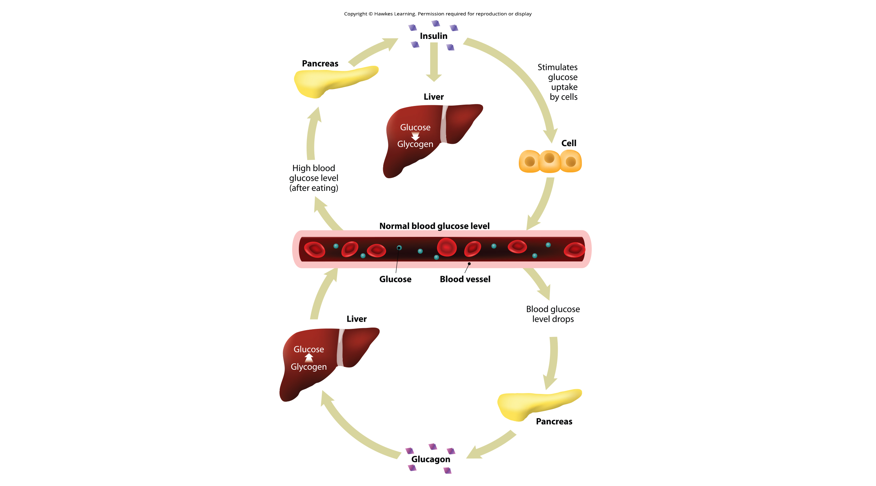
Negative Feedback: Reducing Blood Glucose Level
33.3 Figure 1
Notes:
Figure 1: Blood sugar levels are controlled by a negative feedback loop.

Slide 9
Negative Feedback Loop: Blood Glucose Levels₂
An animal's blood glucose level decreases when it hasn't eaten in a while.
This change is sensed by different cells in the pancreas, which release the hormone glucagon in response.
Glucagon stimulates the liver to convert glycogen back into glucose, which it releases into the blood.
Blood glucose levels increase (negative feedback).

Slide 10
Negative Feedback: Increasing Blood Glucose Level
33.3 Figure 1
Notes:
Figure 1: Blood sugar levels are controlled by a negative feedback loop.

Slide 11
Negative Feedback Loop: Blood Calcium Levels
An animal's blood calcium level decreases.
This change is sensed by cells in the parathyroid gland, which release parathyroid hormone (PTH).
PTH:
Increases calcium absorption in the intestines and kidneys
Increases the rate at which bones are broken down to move calcium from the bones to the blood
Blood calcium levels increase (negative feedback).

Slide 12
Positive Feedback Loops
A positive feedback loop:
Maintains the direction of a stimulus, possibly accelerating it
Examples:
Coagulation (clotting)
Once one clotting factor is activated, it activates the next in a sequence until a fibrin clot is produced.
Uterine contractions during childbirth
The hormone oxytocin stimulates uterine contraction.
The nervous system senses the pain.
More oxytocin is produced until the contractions can push the child out of the body.

Slide 13
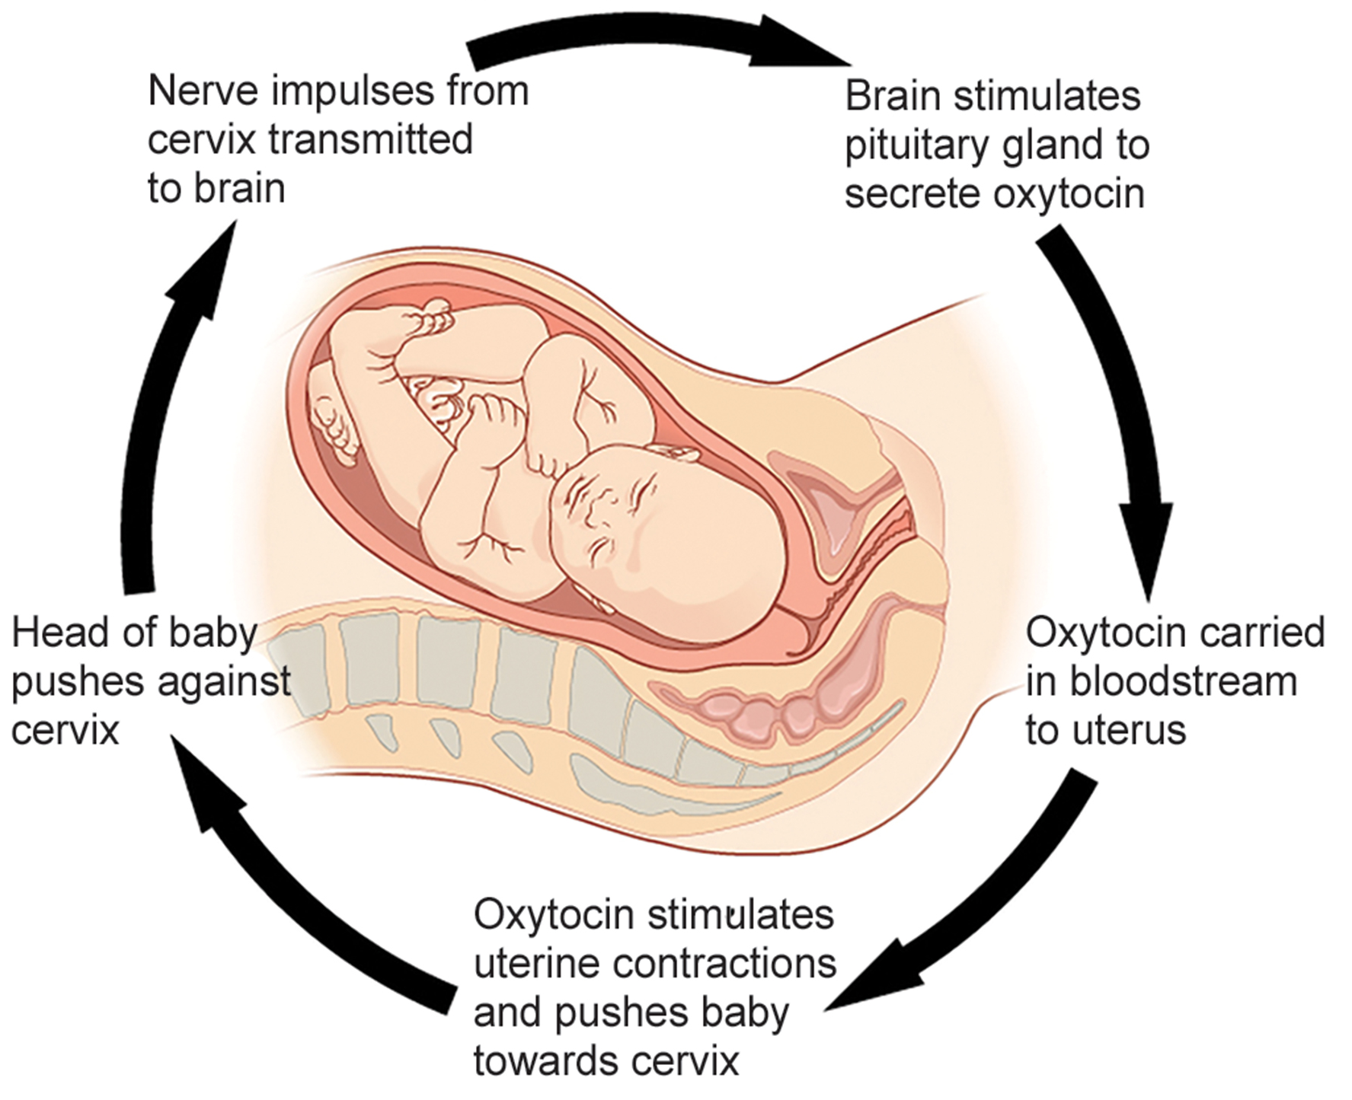
33.3 Figure 2
Notes:
33.2 Figure 2: The birth of a human infant is the result of positive feedback.

Slide 14
Think It Through₁
State whether each of the following processes is regulated by a positive feedback loop or a negative feedback loop.
A person feels satiated after eating a large meal.
The blood has plenty of red blood cells. As a result, erythropoietin, a hormone that stimulates the production of new red blood cells, is no longer released from the kidney.
Notes:
Originally an On Your Own. This is included here to use as a talking point or for a think-pair-share activity.

Slide 15
Set Point Adjustments: Alteration
Alteration is the changing of the set point in a feedback loop.
When this occurs, the feedback loop works to maintain the new setting.
Example: blood pressure
Over time the normal or set point for blood pressure can increase as a result of continued increases in blood pressure.
The body no longer recognizes the elevation as abnormal, so it does not try to lower it.
This results in elevated blood pressure, which is harmful to the body.
Medication can lower blood pressure and the set point to a healthier level.

Slide 16
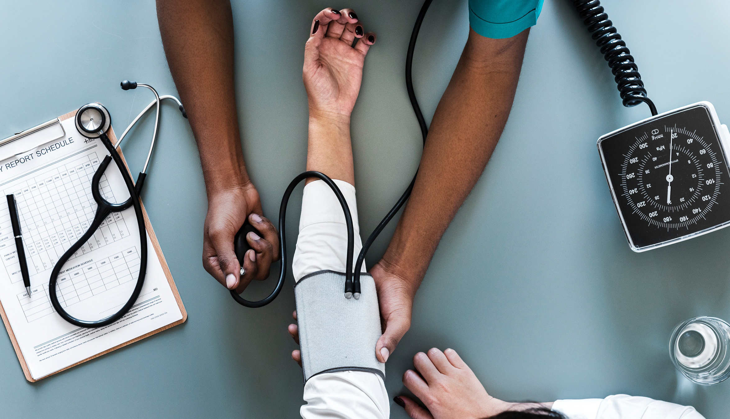
33.3 Figure 3
rawpixel.com on Wikimedia Commons. "Blood pressure."
Notes:
33.2 Figure 3: Blood pressure monitoring is used to determine the body's set point.

Slide 17
Set Point Adjustments: Acclimatization
Acclimatization is when the body makes changes in a group of body organ systems to maintain a set point in another system.
Example: changes resulting from animal migration to a higher altitude
To adjust to lower oxygen levels at the higher altitude, the body increases the number of RBCs in the blood.
Example: animals' seasonal changes in their coats
Animals make heavier coats in the winter to keep them warm.
Animals make light coats in the summer to keep them cool.

Slide 18
Homeostasis: Thermoregulation
Thermoregulation is the regulation of body temperature, which affects body activities.
When body temperature rises, enzyme activity generally also rises.
For every 10°C temperature increase, enzyme activity doubles up to a certain point (about 50°C for mammals), at which proteins (enzymes) denature and lose function.
For every 10°C temperature decrease, enzyme activity halves until the point of freezing is reached.
Exception: Some fish can withstand freezing solid and then fully thaw, returning to normal.

Slide 19
Think It Through₂
While fevers are a normal response to infection, why would excessively high fevers be dangerous?
Notes:
Originally an On Your Own. This is included here to use as a talking point or for a think-pair-share activity.

Slide 20
Thermoregulation: Ectotherms and Endotherms
Animals can be divided into 2 groups based upon how they maintain their body temperatures.
A homeotherm maintains a constant body temperature in the face of different environmental temperatures.
An endotherm is a homeotherm that uses internal sources to maintain a relatively constant body temperature in varying environmental temperatures.
An ectotherm (formerly "cold-blooded") has a body temperature the same as its environment.
A poikilotherm is an ectotherm whose internal temperature can vary widely as the environmental temperature changes.
An ectothermic homeotherm (like some deep-sea fish) has a relatively constant body temperature due to a constant environmental temperature in its habitat.

Slide 21
Heat Exchange Between Animal and Environment
Heat can be exchanged between an animal and its environment through 4 mechanisms:
Radiation is the emission of electromagnetic "heat" waves.
Examples: the sun, heat radiating from dry skin
Evaporation is how heat is removed with liquid from a surface.
Example: mammals sweating
Convection involves air currents removing heat from a surface as the air passes over it.
Example: heat removal via air from the surface of dry skin
Conduction involves the transfer of heat from one surface to another due to direct contact.
Example: an animal resting on a warm rock

Slide 22
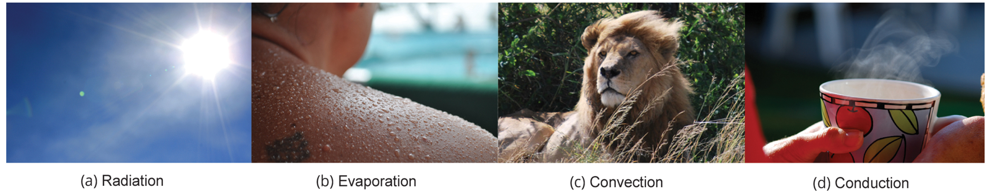
33.3 Figure 4
Kullez on Flickr. “Evaporation.” Modified.
CNX OpenStax on Wikimedia Commons. “Lion." Modified.
Stacey.d on Flickr. “Conduction.”
Notes:
33.2 Figure 4: Heat can be exchanged by four mechanisms: (a) radiation, (b) evaporation, (c) convection, or (d) conduction.

Slide 23
Heat Conservation and Dissipation₁
Animals use various strategies to conserve or dissipate heat.
Some endotherms have insulation (such as fur, fat, and/or feathers).
Animals with thick fur or feather create an insulating layer of air between their skin and internal organs.
Example: The arctic fox curls up with its tail to sleep.
Mammals shiver.
Arrector pili at the base of hair follicles cause "goose bumps," making hairs stand up when it's cold to make an insulating layer.
The increased muscle activity increases body temperature.

Slide 24
Heat Conservation and Dissipation₂
Endotherms use their circulatory systems to help maintain body temperature.
Vasodilation (blood vessel widening) brings more blood and heat to the body surface, facilitating radiation and evaporative heat loss to cool the body.
Vasoconstriction (blood vessel narrowing) reduces blood flow in peripheral blood vessels, forcing blood toward the core to conserve heat.
Some animals have circulatory adaptations allowing for countercurrent heat exchange that enable heat transfer from arteries and veins to warm blood returning to the heart.
This can be shut down in animals to prevent overheating of internal organs.
Examples: dolphins, sharks, bony fish, bees, hummingbirds
Similar adaptations can help cool endotherms when needed.

Slide 25
Heat Conservation and Dissipation₃
Some ectotherms change their behaviors to regulate body temperatures.
A desert ectotherm may:
Seek cooler areas during the heat of the day
Climb on a rock to capture heat at night
Some animals (such as reptiles) seek water to aid evaporation in cooling them.
Some use group activity, such as when bees gather together in a hive to keep warm and survive winter.

Slide 26
Heat Conservation and Dissipation₄
Endotherms, including mammals, use metabolic waste as a heat source.
When muscles contract, most of the energy from the ATP used is wasted and becomes heat.
Severe cold triggers a shivering reflex for heat generation.
Many also have brown fat, a type of adipose tissue, that generates heat.

Slide 27
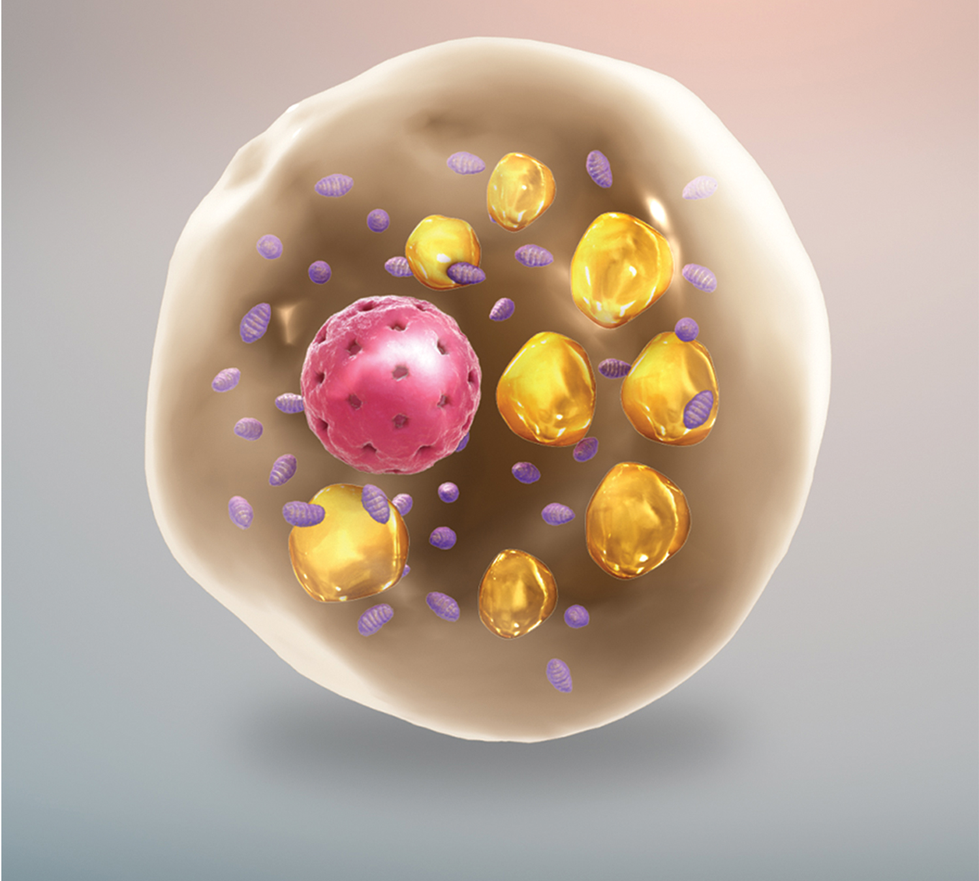
33.3 Figure 5
www.scientificanimations.com on Wikimedia Commons. "Brown fat cell."
Notes:
33.2 Figure 5: This is a brown fat cell containing lipid bodies (the medium-sized spheres) and numerous mitochondria (the small flecks).

Slide 28
Think It Through₃
Brown fat cells have large stores of lipids and numerous mitochondria.
How are these two key facts related to the generation of heat?
Notes:
Originally an On Your Own. This is included here to use as a talking point or for a think-pair-share activity.

Slide 29
Thermoregulation Is Controlled by the Hypothalamus
The hypothalamus in the advanced animal brain controls the processes of homeostasis and thermoregulation.
It maintains the set point for body temperature.
When it senses the body is too warm, it activates:
Vasodilation
Sweating
When it senses the body is too cold, it activates:
Vasoconstriction
Shivering

Slide 30
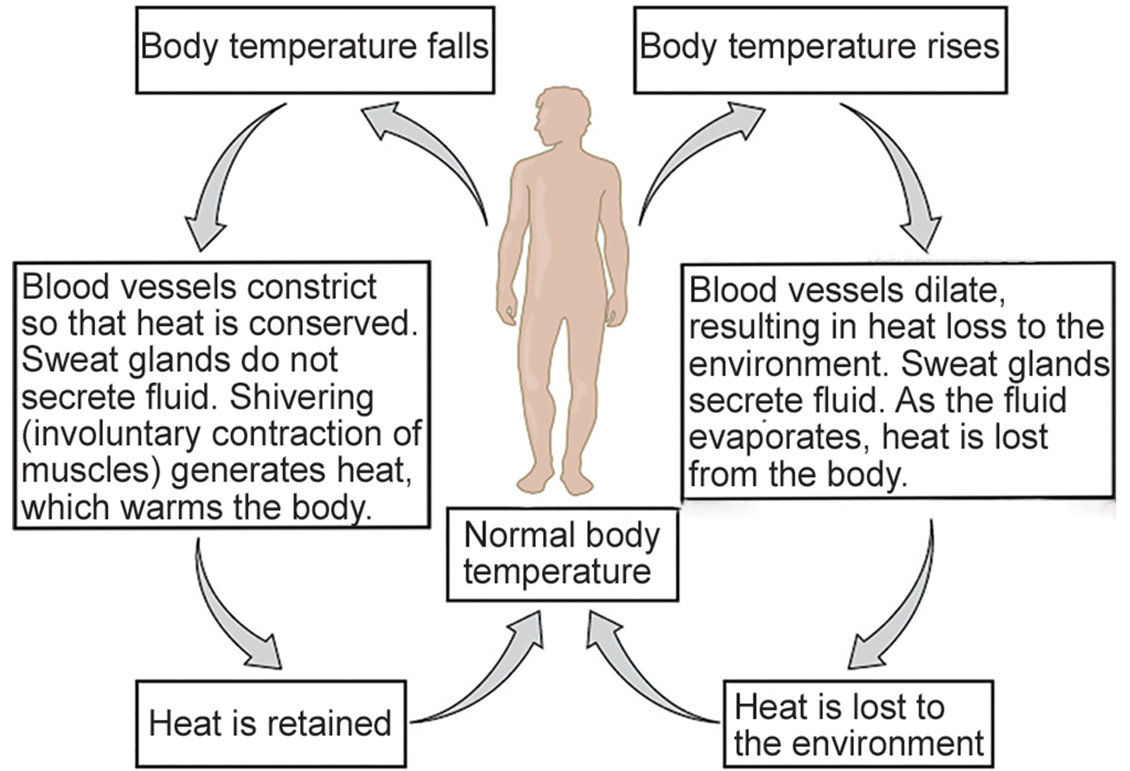
33.3 Figure 6
CNX OpenStax on Wikimedia Commons. "Thermal regulation."
Notes:
33.2 Figure 6: The body is able to regulate temperature in response to signals from the nervous system.

Slide 31
The Fever Response
A fever is a normal defense mechanism in response to infection.
When a pathogen is destroyed by phagocytic leukocytes, endogenous pyrogens (chemical made in the body) are released into the blood.
When the pyrogens reach the hypothalamus, they raise its set point.
The body's temperature increases, resulting in fever.
This leads to:
The conservation of iron, which the pathogen needs.
An increase in the activity of the animal's enzymes and protective cells
A decrease in the activity of the pathogen's enzymes
Possible killing of the pathogen itself

Slide 32
Think It Through₄
When the hypothalamus is acted upon by pyrogens, it is less able to sense heat and more able to sense cold. As a result, it interprets the current body temperature as below the set point and activates processes that will increase temperature.
What processes does the hypothalamus likely activate to increase body temperature?
Notes:
Originally an On Your Own. This is included here to use as a talking point or for a think-pair-share activity.

Slide 33
Summary
Homeostasis is a dynamic equilibrium that is maintained in body tissues and organs.
It is dynamic because it is constantly adjusting to the changes that the system encounters.
It is in equilibrium because body functions are kept within a normal range, with some fluctuations around a set point.

Slide 34

End of Hawkes Learning PowerPoint

