Slide 1
Lesson 34.1
Digestive Systems

Slide 2
Objectives
Compare and contrast different types of digestive systems.
Describe the ways in which organs work together to digest food and absorb nutrients.
Explain the processes of digestion and absorption.
Explain the specialized functions of the organs involved in processing food in the body.

Slide 3
Digestion Overview
All living organisms require nutrients.
  Plants can make their own by photosynthesis.
  Animals must consume other organisms to obtain theirs.
The biological molecules needed for animal function are:
  Proteins
  Fats
  Complex carbohydrates
Animals convert macromolecules to simpler molecules to maintain cellular function, including building new molecules, cells, and tissues.
The conversion of food to nutrients involves:
  Digestion: the breakdown of food particles to smaller components
  Absorption: the take-up of nutrients into the bloodstream

Slide 4
Human Nutrition
Human nutrition must balance:
Food intake
Storage
Energy expenditures
Imbalances can have serious health consequences.
If food intake exceeds energy expenditures, this leads to obesity.
  Obesity is associated with type 2 diabetes, cardiovascular disease, and other illnesses.

Slide 5
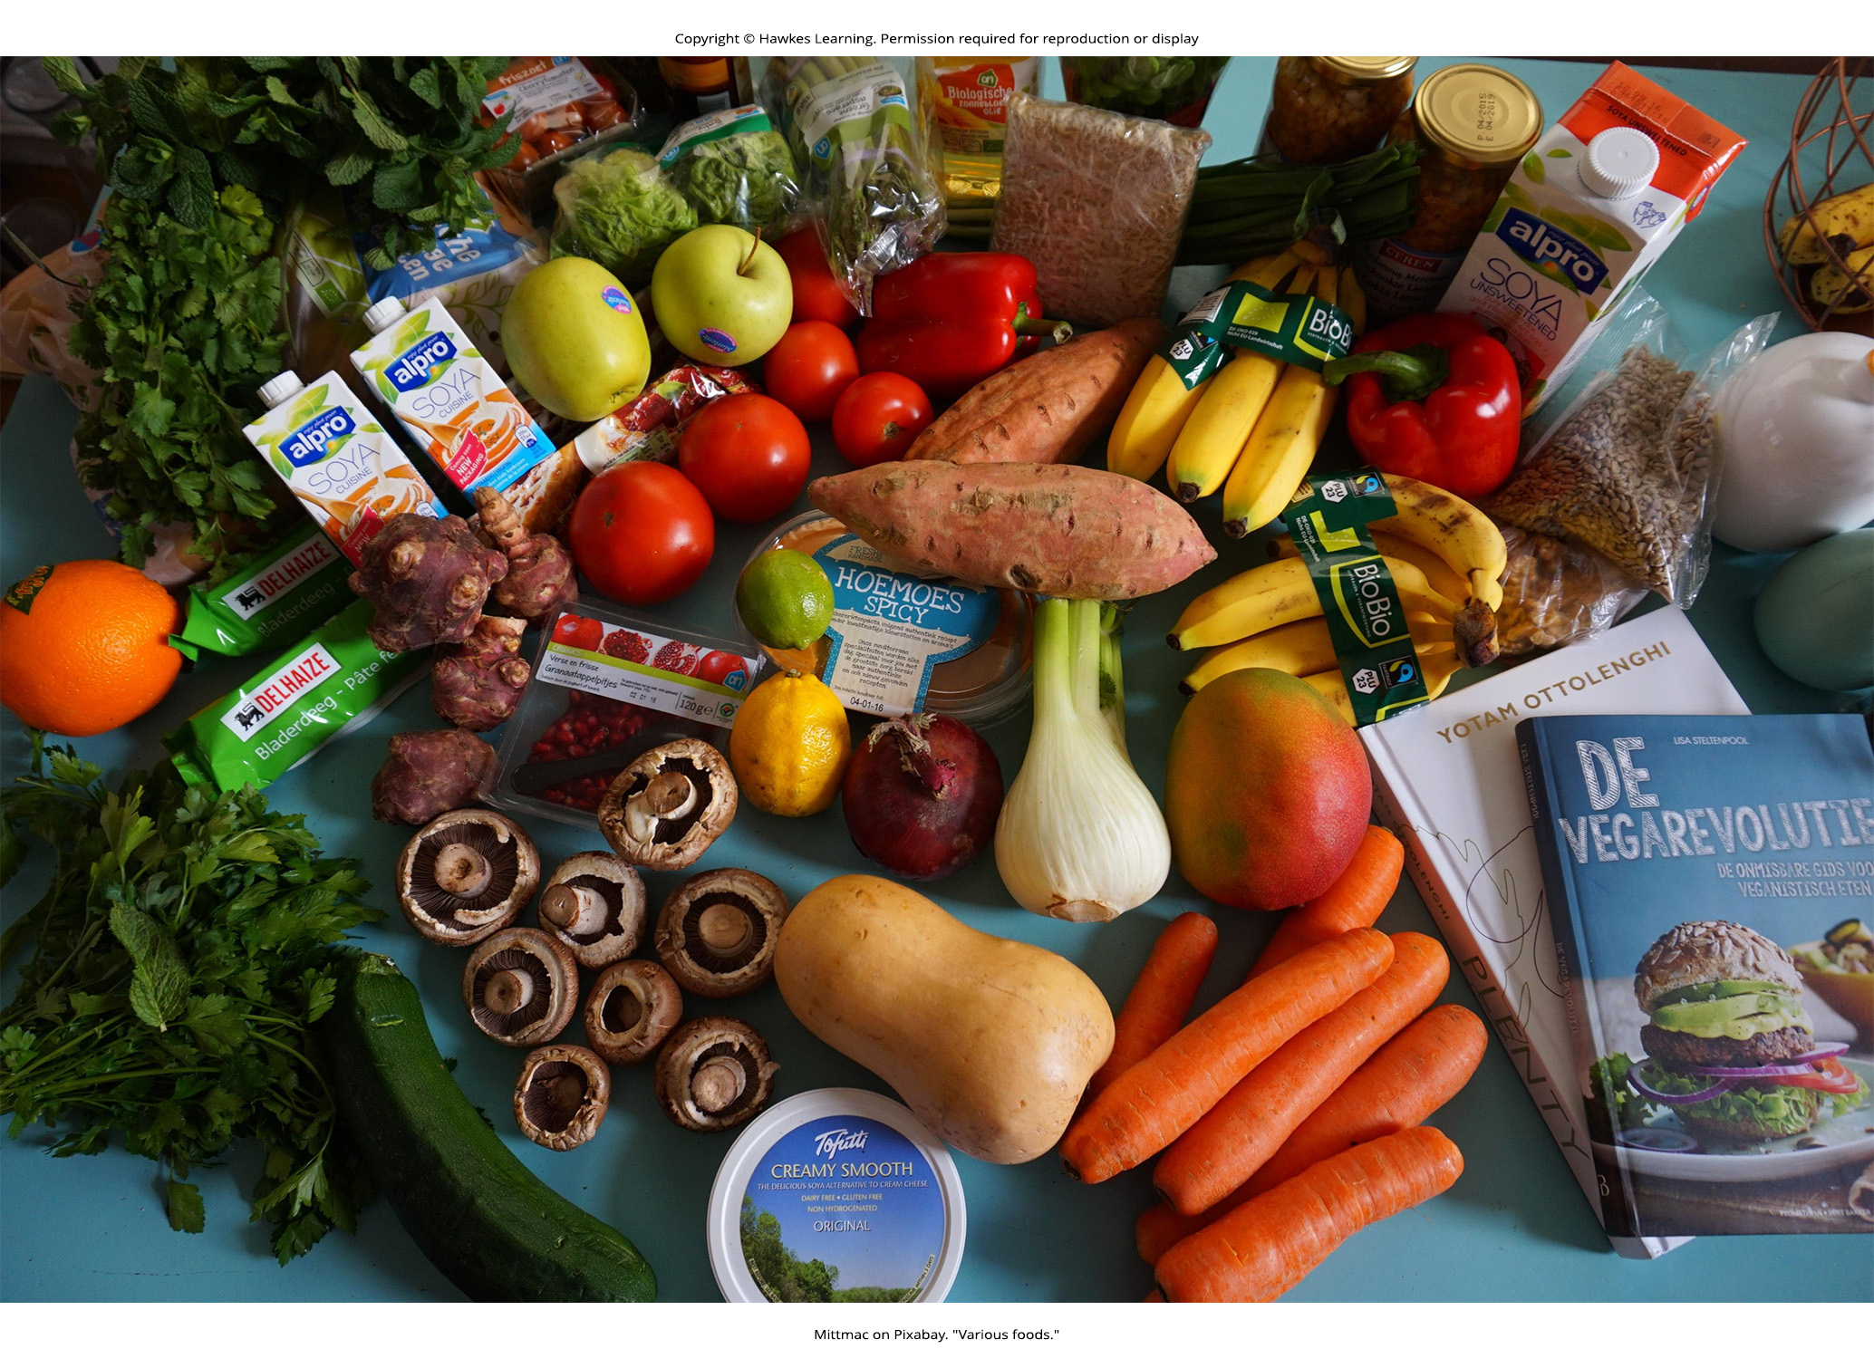
34.1 Figure 1
Mittmac on Pixabay. "Various foods."
Notes:
34.1 Figure 1: For humans, fruits and vegetables are important in maintaining a balanced diet.

Slide 6
Classifications of Animals Based Upon Diet
Animals can be classified into 3 categories based upon diet:
  Herbivores (plant eaters)
  Carnivores (meat eaters )
  Omnivores (those that eat both plants and animals)
The nutrients and macromolecules in food must be processed to make the nutrients accessible for cellular function.
Animal digestive systems have evolved to accommodate their various dietary needs.

Slide 7
Herbivores
Herbivores (“plant eaters”) use plant material as their primary food source.
Vertebrate herbivores include deer, koalas, and some birds.
Invertebrate herbivores include crickets and caterpillars.
They have digestive systems that can handle large amounts of plant material.
They are further classified into:
  Frugivores (fruit eaters)
  Granivores (seed eaters)
  Nectivores (nectar feeders)
  Folivores (leaf eaters)

Slide 8
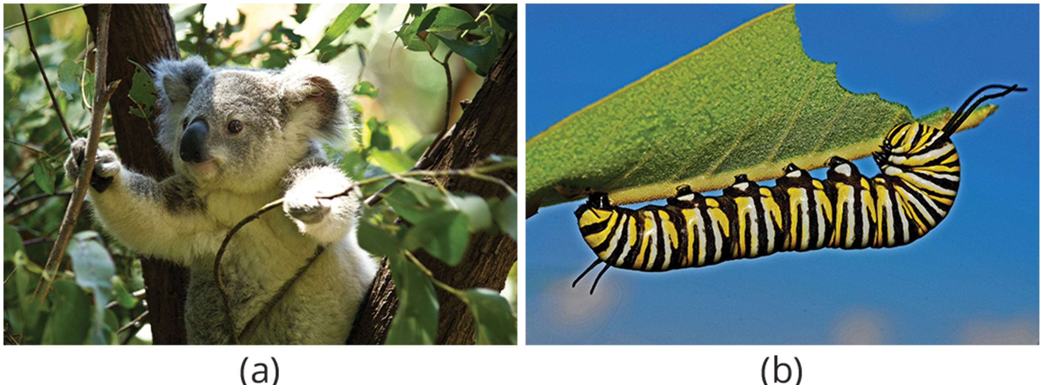
34.1 Figure 2
Syahir Hakim on Pixabay. "Koala."
631372 on Pixabay. "Caterpillar."
Notes:
34.1 Figure 2: Herbivores, like this (a) koala and (b) monarch caterpillar, primarily eat plant material.

Slide 9
Carnivores
Carnivores (“meat eaters”) eat other animals.
Vertebrate carnivores include wild cats (lions and tigers), snakes, and sharks.
Invertebrate carnivores include sea stars, spiders, and ladybugs.
Obligate carnivores rely entirely on animal flesh.
  Examples include members of the cat family (lions and cheetahs).
Facultative carnivores are those that also eat nonanimal food in addition to animal food.
  There is no clear line distinguishing them from omnivores.
  Domesticated dogs are facultative carnivores.

Slide 10
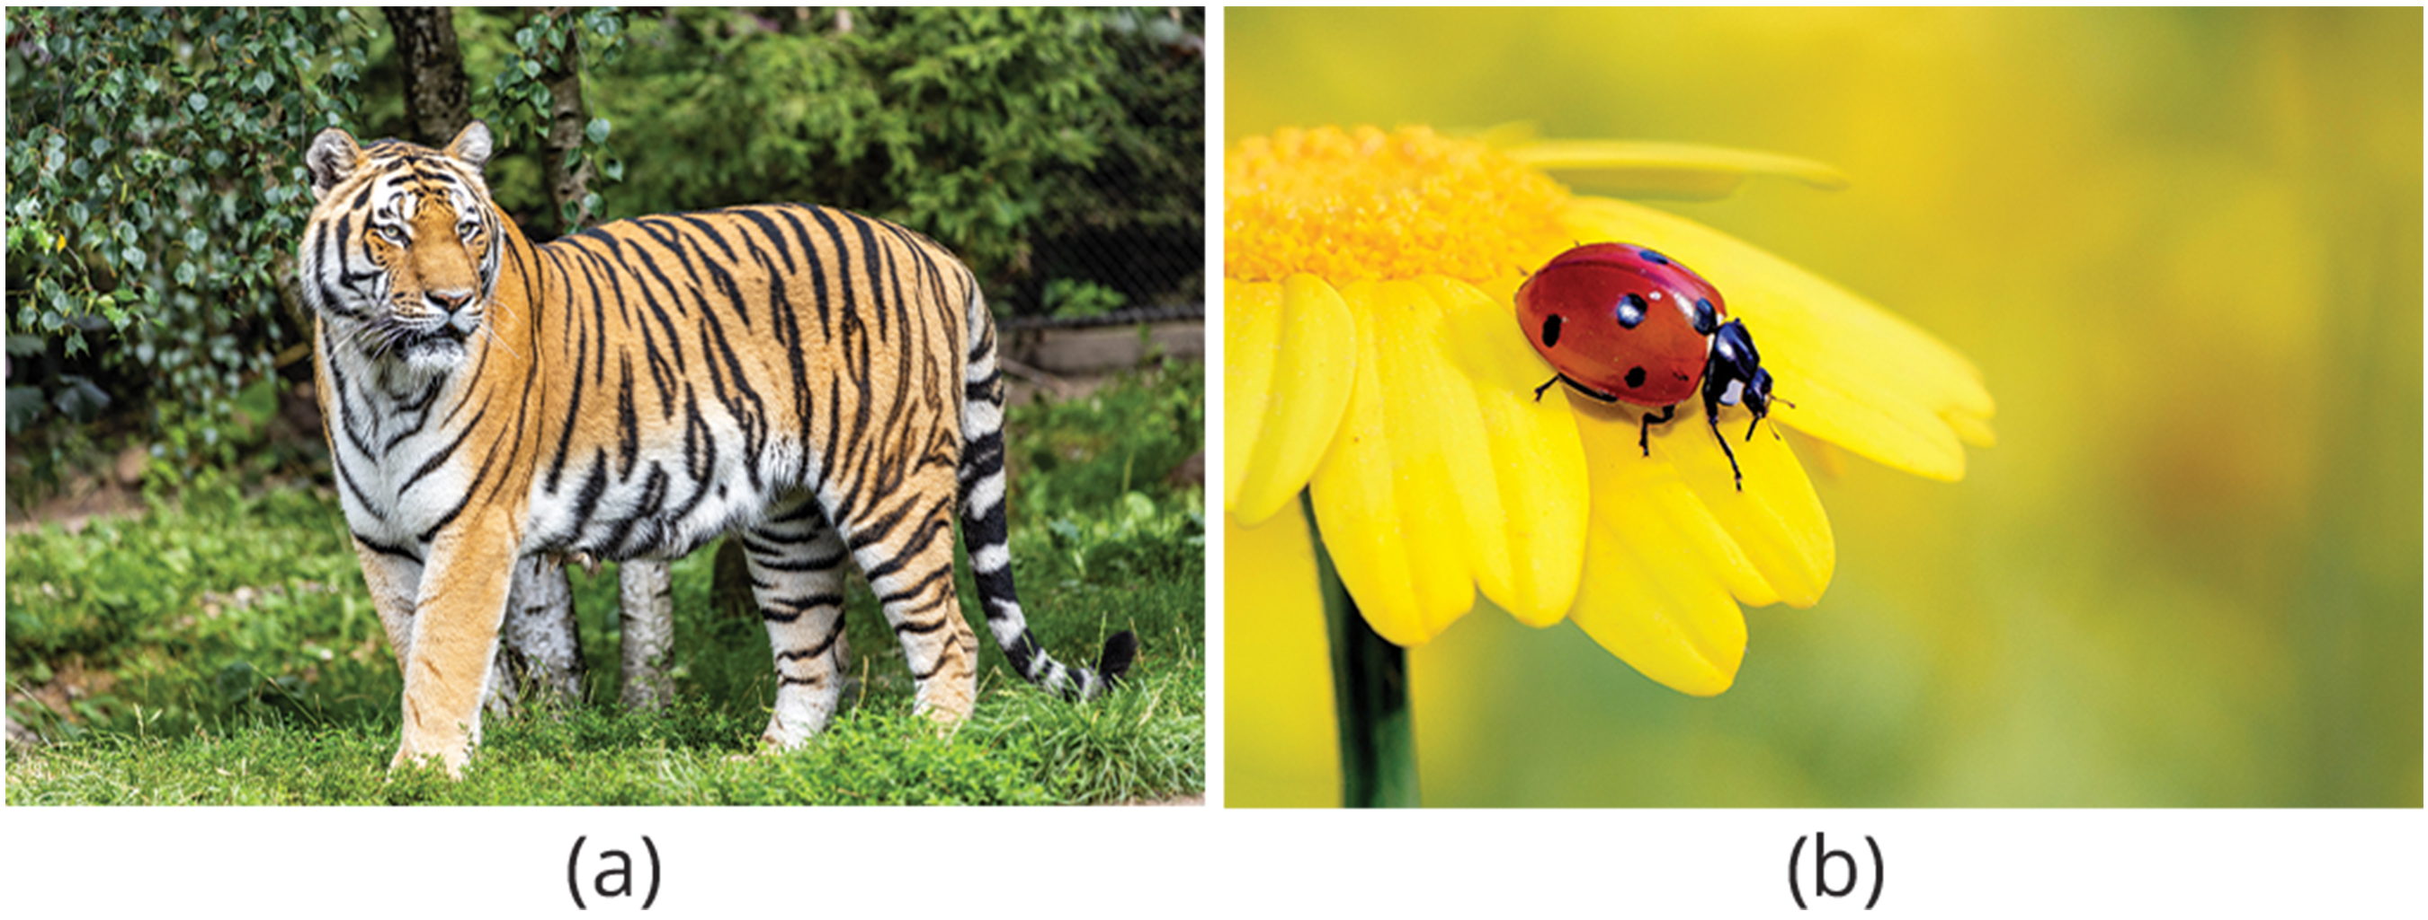
34.1 Figure 3
Dominik Lückmann on Unsplash. “Tiger.”
Nimrod Oren on Pixabay. “Ladybug.”
Notes:
34.1 Figure 3: (a) Carnivores like the tiger eat primarily meat. (b) The ladybug is also a carnivore because it consumes small insects, such as aphids.

Slide 11
Omnivores
Omnivores (“eat everything”) eat food derived from both animals and plants.
Vertebrate examples include humans, bears, and chickens.
Invertebrate examples include cockroaches and crayfish.

Slide 12
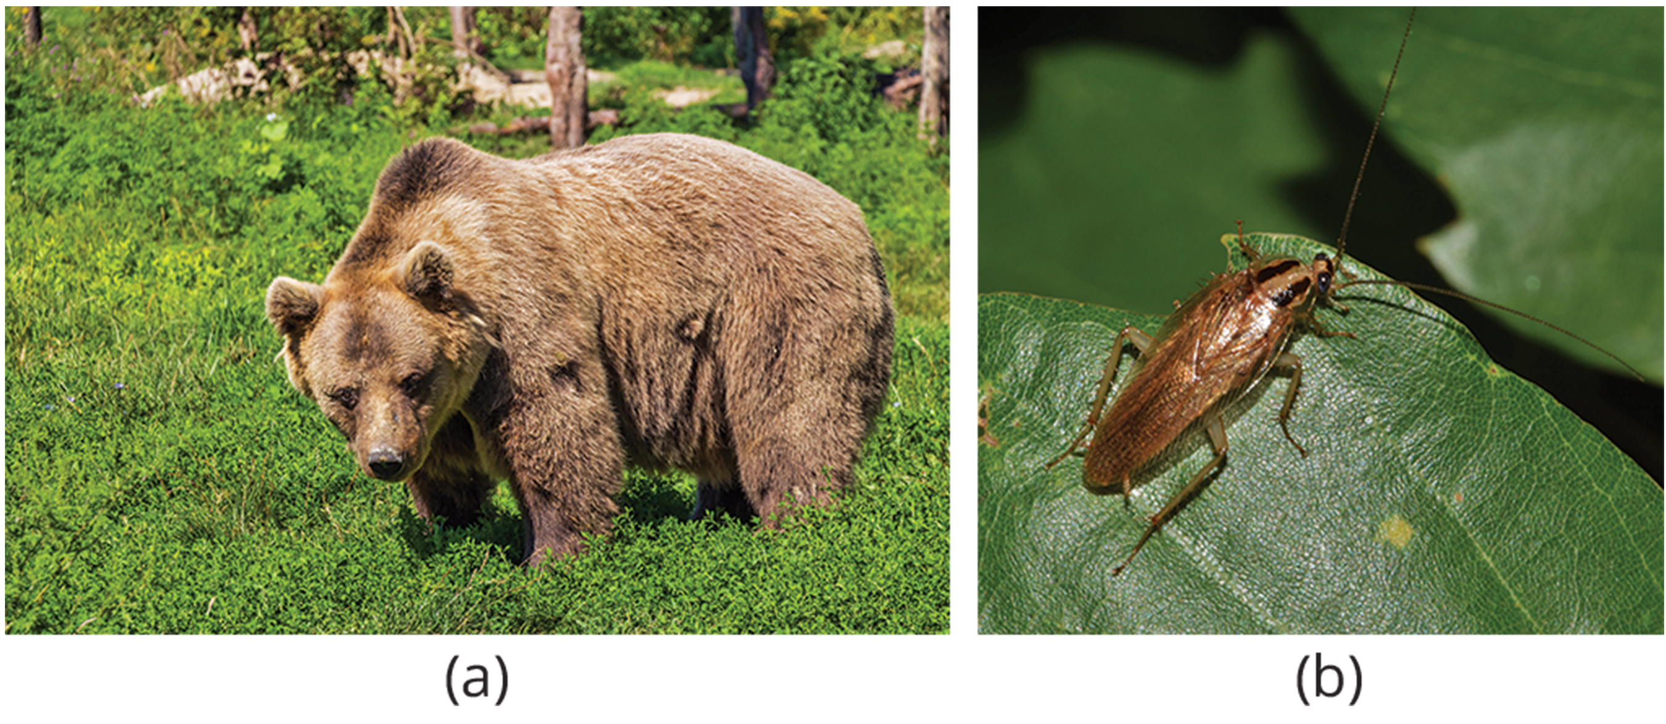
34.1 Figure 4
Bergadder on Pixabay. "Bear."
Brett_Hondow on Pixabay. "Cockroach."
Notes:
34.1 Figure 4: Omnivores like the (a) bear and (b) cockroach eat both plant- and animal-based food.

Slide 13
Invertebrate Digestive Systems: Gastrovascular Cavity
The gastrovascular cavity:
Is the simplest type of digestive system
Is typically a blind tube or cavity with a single opening that serves as both the:
  Mouth AND
  Anus
Is found in Platyhelminthes (earthworms), Ctenophora (comb jellies), and Cnidaria (coral, jelly fish, and sea anemones).
Digestion occurs as follows:
Ingested material enters the mouth.
It then passes through a hollow, tubular cavity where cells in the cavity secrete digestive enzymes to degrade the food.
Cells lining the cavity then engulf the food particles.

Slide 14
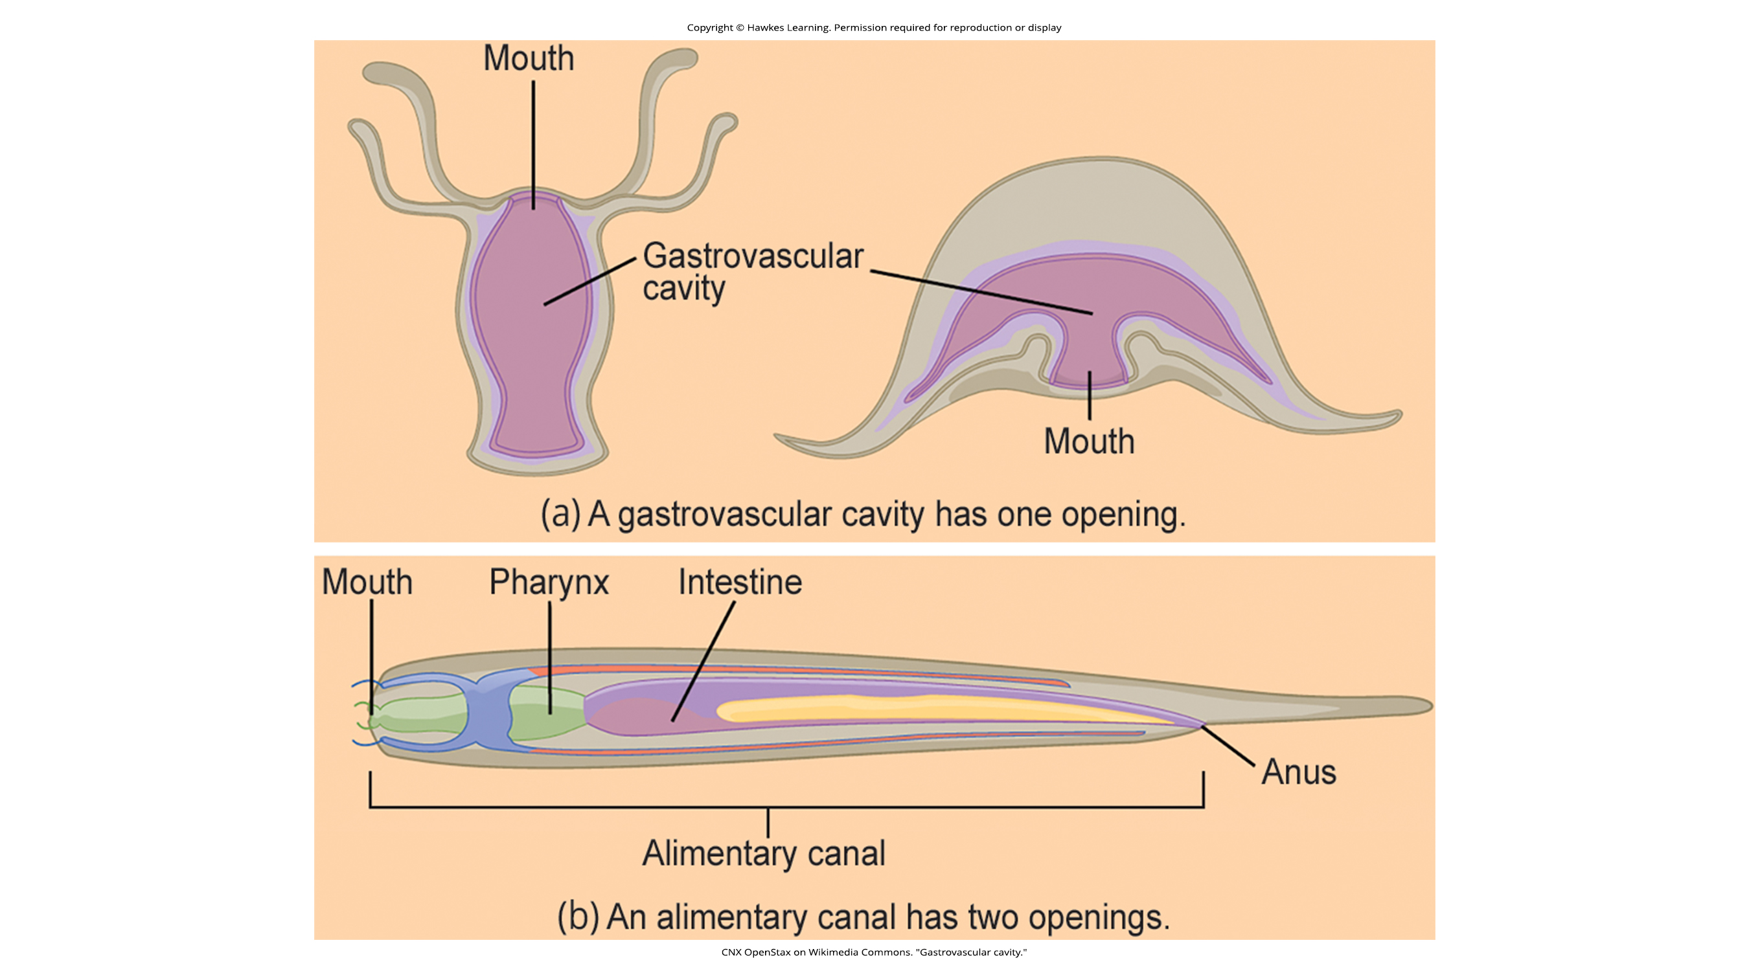
34.1 Figure 5 (a)
CNX OpenStax on Wikimedia Commons. "Gastrovascular cavity."
Notes:
34.1 Figure 5: (a) A gastrovascular cavity has a single opening through which food is ingested, and waste is excreted, as shown in this hydra (left) and in this jellyfish medusa (right).

Slide 15
Invertebrate Digestive Systems: Alimentary Canal
The alimentary canal:
Is a more advanced digestive system
Consists of one tube with a
  Mouth at one end AND an
  Anus at the other end
Is found in earthworms
Digestion occurs as follows:
Ingested material enters the mouth.
It then passes through the esophagus.
It is stored in an organ called the crop.
It then passes into the gizzard where it is churned and digested.
It then moves to the intestine, where nutrients are absorbed.
Waste (feces), called castings, is eliminated through the anus.

Slide 16
34.1 Figure 5 (b)
CNX OpenStax on Wikimedia Commons. "Gastrovascular cavity."
Notes:
34.1 Figure 5: (b) An alimentary canal has two openings: a mouth for ingesting food and an anus for eliminating waste, as shown in this nematode.

Slide 17
Think It Through₁
Identify the most accurate statement from the following choices.
Omnivores are animals that only eat plant-derived food.
Carnivores are animals that eat animal- and plant-derived food.
A gastrovascular cavity contains a single opening that functions for food entry and exit of waste.
An alimentary canal consists of two tubes—one functions as the mouth, and the other functions as the anus.
Notes:
Originally an On Your Own. This is included here to use as a talking point or for a think-pair-share activity.

Slide 18
Vertebrate Digestive Systems: Monogastric Digestive System₁
A monogastric digestive system has a single-chambered stomach.
Digestion begins in the mouth with food intake.
  Physical digestion involves mastication (chewing) by the teeth.
  Chemical digestion involves enzymes in the saliva.
The esophagus is a long tube connecting the mouth to the stomach.
  Peristalsis (wavelike smooth muscle contractions) push food to the stomach.
The stomach is very acidic (pH 1.5–2.5) to enhance enzymatic action.
  Further chemical digestion of food involves enzymes in the gastric juices.

Slide 19
Vertebrate Digestive Systems: Monogastric Digestive System₂
The small intestine is the next place food is moved to.
  Further chemical digestion of food occurs using enzymes produced by the small intestine, the liver, and the pancreas.
  This is the primary site of nutrient absorption into the bloodstream across the epithelial lining of the small intestine.
The large intestine is where waste material travels to.
  It is the primary site for water absorption.
  The drier waste material is compacted into feces, stored, and excreted through the rectum.

Slide 20
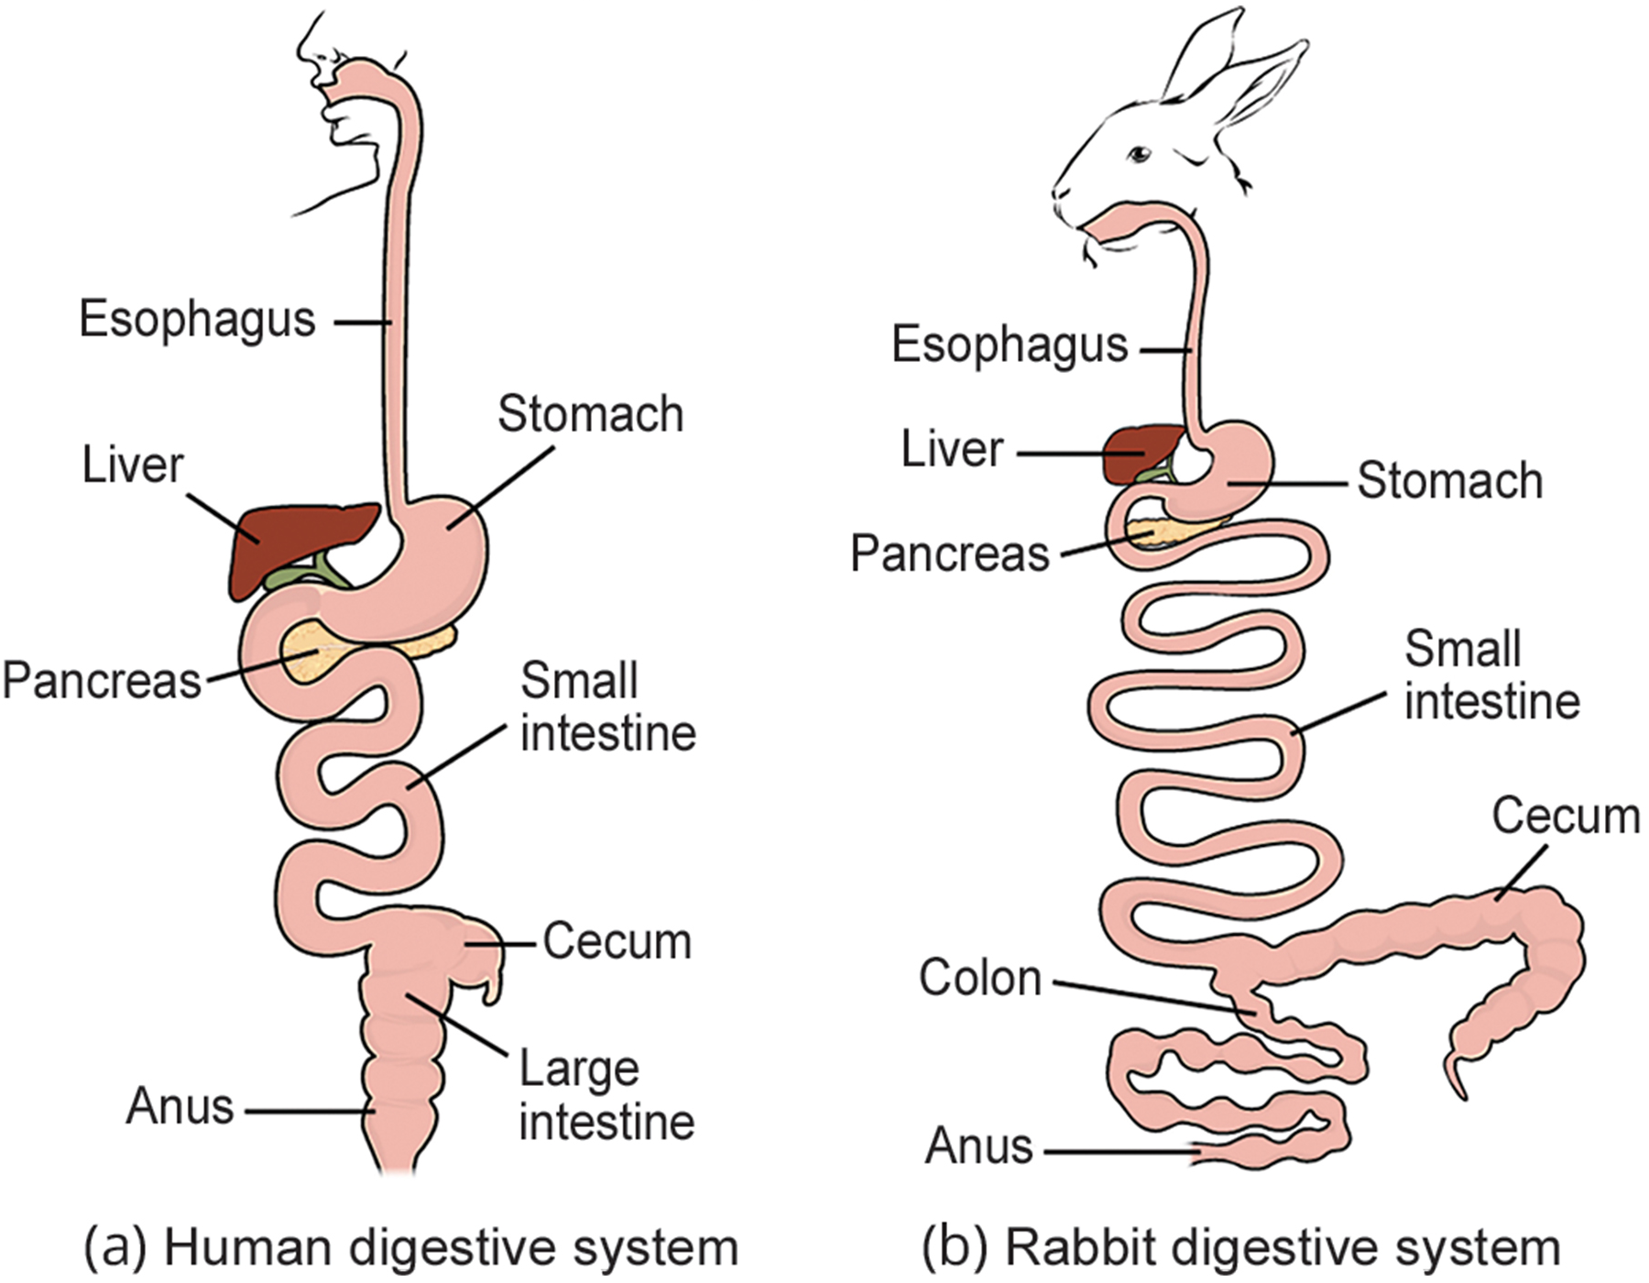
34.1 Figure 6
CNX OpenStax on Wikimedia Commons. "Digestive system."
Notes:
34.1 Figure 6: (a) Humans and herbivores, such as the (b) rabbit, have a monogastric digestive system. However, the rabbit small intestine and cecum (a pouch connected to the junction of the small and large intestines) are enlarged to allow more time to digest plant material. The enlarged organ provides more surface area for breakdown and absorption of nutrients. Rabbits digest their food twice; the first time food passes through the digestive system, it collects in the cecum, and then it passes as soft feces called cecotropes. The rabbit re-ingests these cecotropes directly from the anus to further digest them.

Slide 21
Vertebrate Digestive Systems: Avian Digestive System₁
Birds face challenges in obtaining nutrition from food.
  Because they lack teeth, their digestive system must process unmasticated food.
Birds have evolved various beak types that reflect the vast variety in their diet (from seeds and insects to fruits and nuts).
Birds have high metabolic rates to keep their body weights low to support flying.

Slide 22
Vertebrate Digestive Systems: Avian Digestive System₂
The stomach of a bird has 2 chambers:
  The proventriculus is where gastric juices are produced to digest food before it enters the stomach.
  The gizzard is where food is stored, soaked, and mechanically ground.
Undigested material forms food pellets that are sometimes regurgitated.
Most chemical digestion and absorption happen in the intestine.
Waste is excreted through the cloaca (a common opening that is used for the digestive, reproductive, and urinary tract in most vertebrates, except mammals).

Slide 23
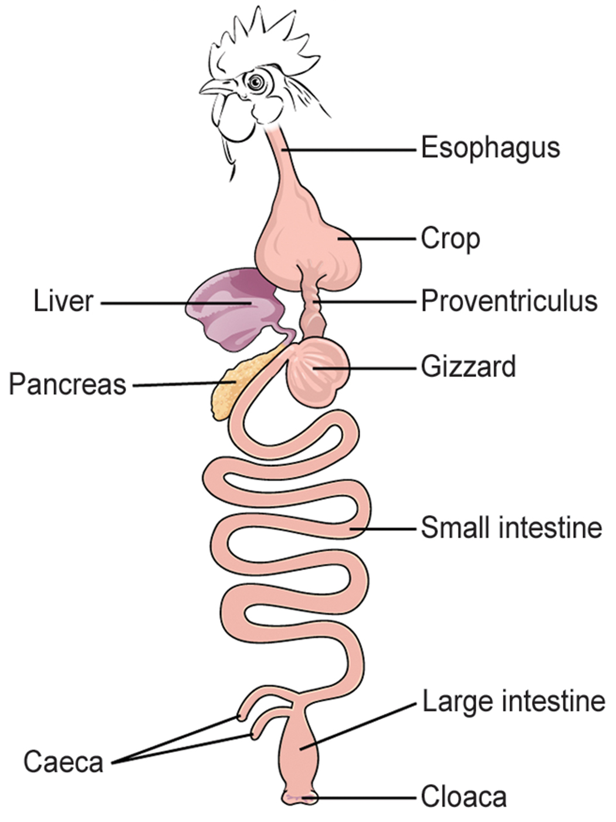
34.1 Figure 7
CNX OpenStax on Wikimedia Commons. "Bird digestive system."
Notes:
34.1 Figure 7: The avian esophagus has a pouch, called a crop, which stores food. Food passes from the crop to the first of two stomachs, called the proventriculus, which contains digestive juices that break down food. From the proventriculus, the food enters the second stomach, called the gizzard, which grinds food. Some birds swallow stones or grit, which are stored in the gizzard to aid the grinding process. Birds do not have separate openings to excrete urine and feces. Instead, uric acid from the kidneys is secreted into the large intestine and combined with waste from the digestive process. This waste is excreted through an opening called the cloaca.

Slide 24
Evolution Connection
Avian Adaptations
Recent fossil evidence shows that the divergence of birds from other land animals is characterized by birds’ simplifying and streamlining their digestive system.
  Unlike many other land animals, birds lack teeth and lips, but have pointy beaks instead.
  The horny beak, lack of jaws, and smaller tongue of birds can be traced back to their dinosaur ancestors.
    The emergence of these traits corresponds to the inclusion of seeds in their diets.
    Seed-eating birds have beaks shaped for grabbing seeds.
  Bird metabolic rates are high to keep birds lightweight for flight, but they need to eat often.

Slide 25
Vertebrate Digestive Systems: Ruminant Digestive Systems₁
Ruminants are mainly herbivores whose entire diet consists of eating lots of roughage (fiber).
Examples include cows, sheep, and goats.
They have digestive systems that allow them to digest lots of cellulose.
They lack upper incisor teeth, but use their lower teeth, tongue, and lips to tear and chew their food.
Food moves from the mouth to the esophagus to the stomach.

Slide 26
Vertebrate Digestive Systems: Ruminant Digestive Systems₂
A ruminant’s stomach has 4 chambers
  The rumen
  The reticulum
  The omasum
  The abomasum (the “true stomach”, like the monogastric stomach chamber that secretes gastric juices)
Each chamber contains may microbes to break down cellulose and ferment ingested food.
The multiple chambers provides more space for microbes to digest plant materials.
The gas produced by fermentation must be eliminated.
The small intestine is important in nutrient absorption.
The large intestine aids in waste elimination.

Slide 27
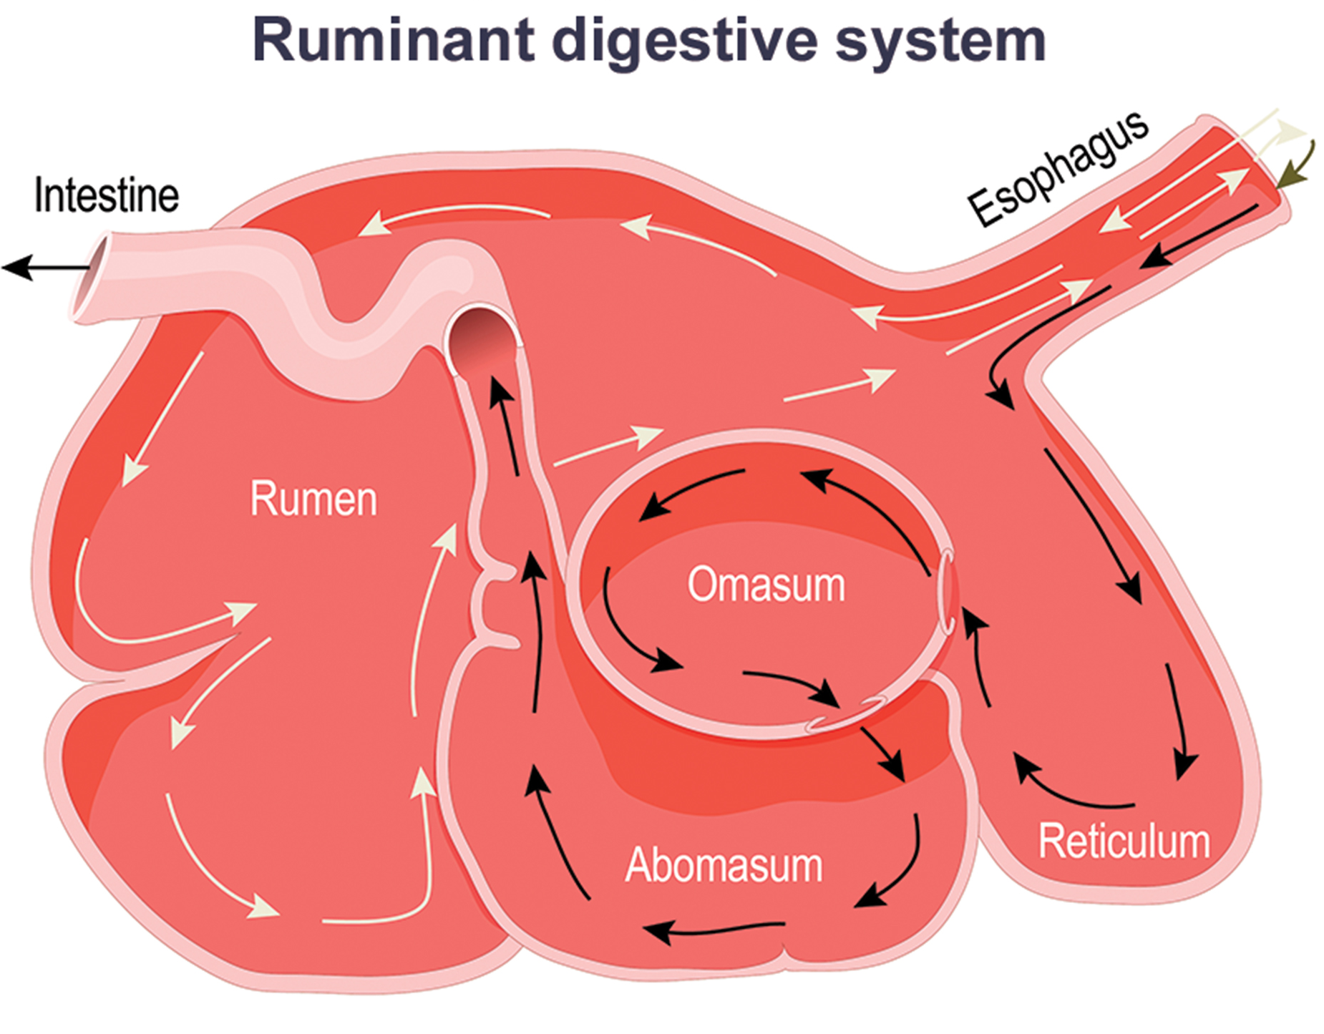
34.1 Figure 8
Notes:
34.1 Figure 8: Ruminant animals, such as goats and cows, have four chambers to their stomach. The first two chambers—the rumen and the reticulum—contain prokaryotes and protists that can digest cellulose. The ruminant regurgitates cud from the reticulum, chews it, and swallows it into a third chamber—the omasum—which removes water. The cud then passes onto the fourth chamber, the abomasum, where it is digested by enzymes produced by the ruminant.

Slide 28
Vertebrate Digestive Systems: Pseudo-Ruminant Digestive Systems
A pseudo-ruminant:
Eats a lot of plant material and roughage
Lacks its own digestive enzymes to break down cellulose from plants
Has a 3-chambered stomach including an omasum, an abomasum, and a reticulum, but lacking a rumen
Instead has a large cecum, a pouch organ at the beginning of the large intestine that houses microbes that ferment and digest roughage
Examples of pseudo-ruminants include camels and alpacas.

Slide 29
Human Digestive System
The human digestive system includes the:
Mouth (oral cavity)
Salivary glands (accessory organs)
Esophagus
Stomach
Small intestine
Colon (large intestine)
Rectum
Anus
Pancreas (an accessory organ)
Liver (an accessory organ)
Gallbladder (an accessory organ)

Slide 30
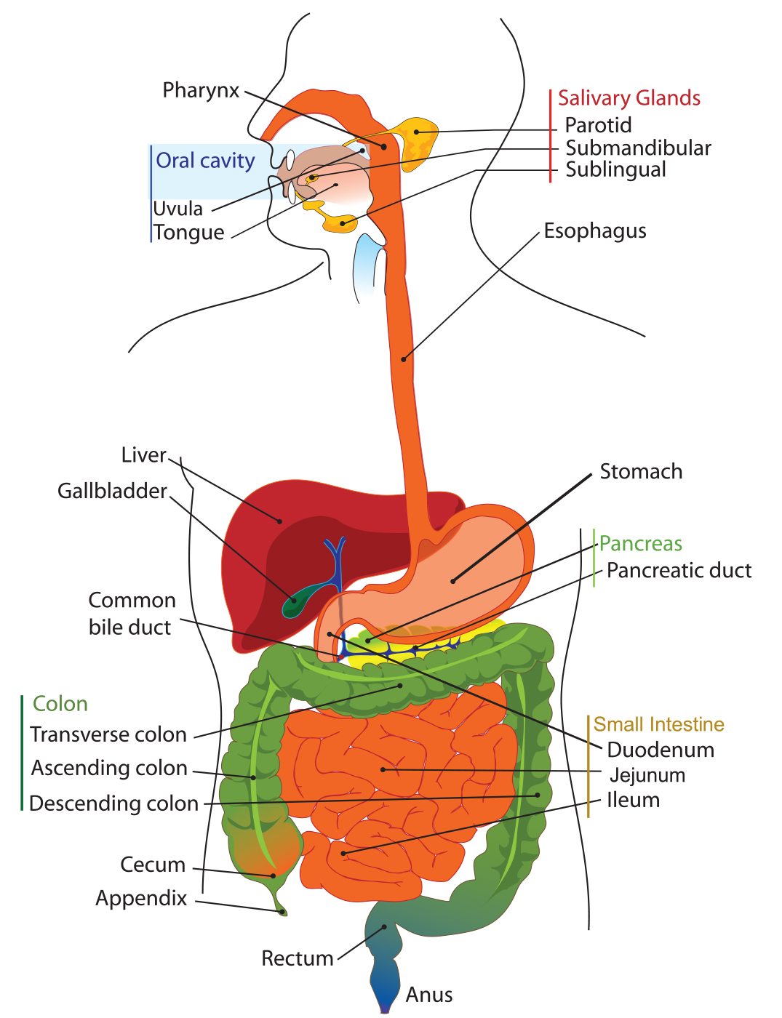
34.1 Figure 9
Clker-Free-Vector-Images on Pixabay. "Digestive system diagram."
Notes:
34.1 Figure 9: The human digestive system is composed of the oral cavity, esophagus, stomach, small intestine, colon (large intestine), rectum, anus, and accessory organs, such as the pancreas and liver.

Slide 31
Group Activity
As a group, create a list of at least ten vertebrates.
What type of digestive system do each of them have?
Discuss as a group why you think so.

Slide 32
Human Digestive System: Oral Cavity₁
The mouth (oral cavity) is where food enters.
Food is broken into smaller particles by mastication and mixed with saliva, a watery substance.
Chemical digestion begins here.
  Saliva is made by three major glands:
    The parotid gland (in front of the ears on either side of the face)
    The submandibular glands (below the jaw)
    The sublingual glands (under the floor of the mouth on either side of the tongue)

Slide 33
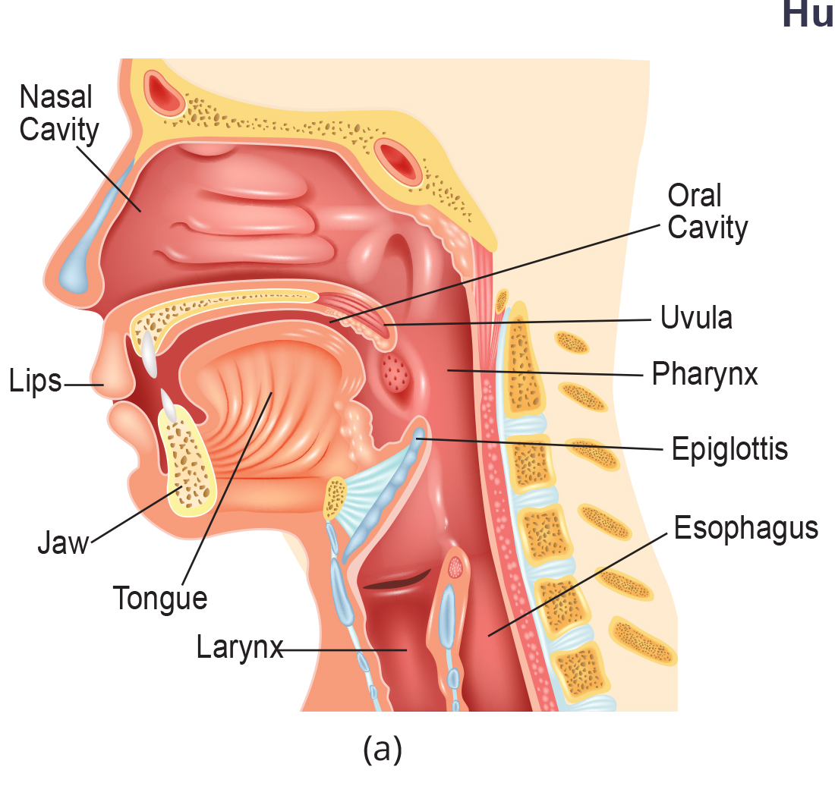
34.1 Figure 10 (a)
Notes:
34.1 Figure 10: (a) Digestion of food begins in the oral cavity. Food is masticated by teeth.

Slide 34
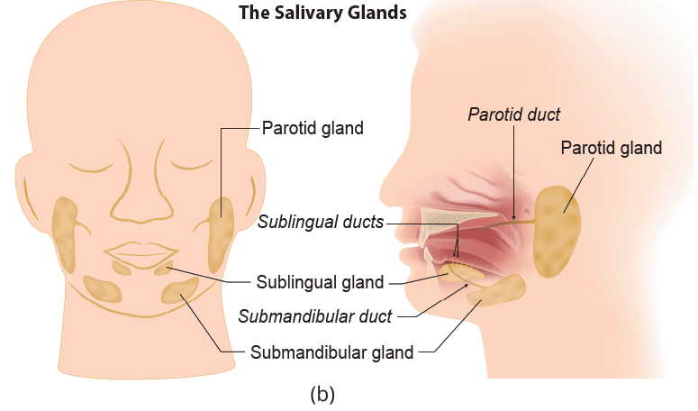
34.1 Figure 10 (b)
Notes:
34.1 Figure 10: Food is masticated by teeth and (b) moistened by saliva secreted from the salivary glands. Enzymes in the saliva begin to digest starches and fats. With the help of the tongue, the resulting bolus is moved into the esophagus by swallowing.

Slide 35
Human Digestive System: Oral Cavity₂
Saliva contains:
  Mucus, which moistens food and buffers the food’s pH
  Immunoglobulins (antibodies) and lysozymes (antimicrobial enzymes) to defend the body against pathogens and reduce tooth decay
  Salivary amylase, and enzyme that converts starches into maltose (a disaccharide)
Lingual lipase is produced by tongue cells.
  It breaks down triglycerides (fats).

Slide 36
Human Digestive System: Oral Cavity₃
Swallowing involves the following:
The chewing and wetting actions of the teeth and saliva prepare the food into a mass called a bolus.
The tongue moves the bolus from the mouth into the pharynx in preparation for swallowing.
The pharynx opens to 2 passageways:
  The trachea, which leads to the lungs
  The esophagus, a tube leading to the stomach
The epiglottis, a cartilaginous flap that covers the opening to the trachea (the glottis) closes during swallowing, keeping food out of the trachea and lungs.

Slide 37
Human Digestive System: Esophagus
The esophagus is a tubular organ connecting the mouth to the stomach through which softened food enters after being swallowed.
Its smooth muscles undergo peristalsis, a series of involuntary wavelike movements that push the food down unidirectionally toward the stomach in response to swallowing.
Ringlike muscles called sphincters are digestive system valves.
The gastroesophageal sphincter is a valve between the esophagus and the stomach that opens in response to swallowing and pressure from the bolus.
  Acid reflux (“heartburn”) results when digestive juices escape into the esophagus.
Many animals have true sphincters, but humans do not.

Slide 38
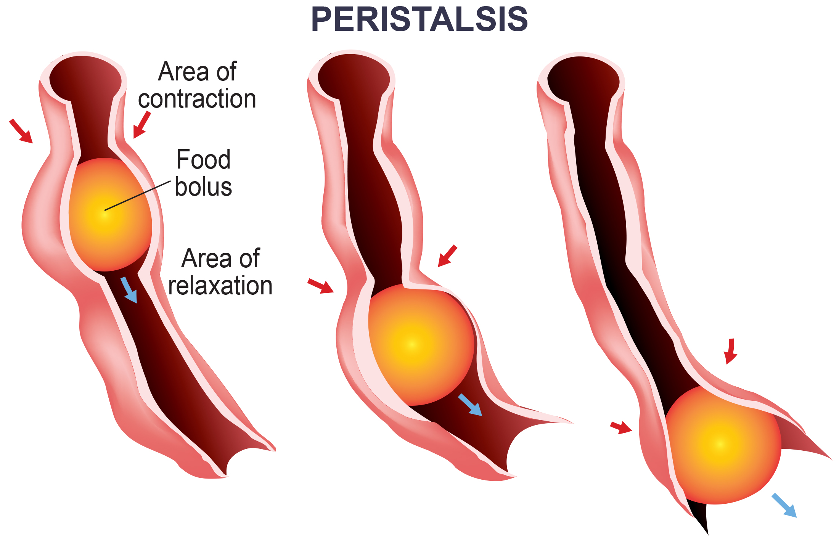
34.1 Figure 11
Notes:
34.1 Figure 11: The esophagus transfers food from the mouth to the stomach through peristaltic movements.

Slide 39
Human Digestive System: Stomach₁
The stomach:
Is a saclike organ that secretes gastric juices
Has a pH of 1.5–2.5, which is needed for chemical breakdown of food and nutrient extraction
Is small when empty
Can expand to 20X its size when full, allowing animals to eat when food is available

Slide 40
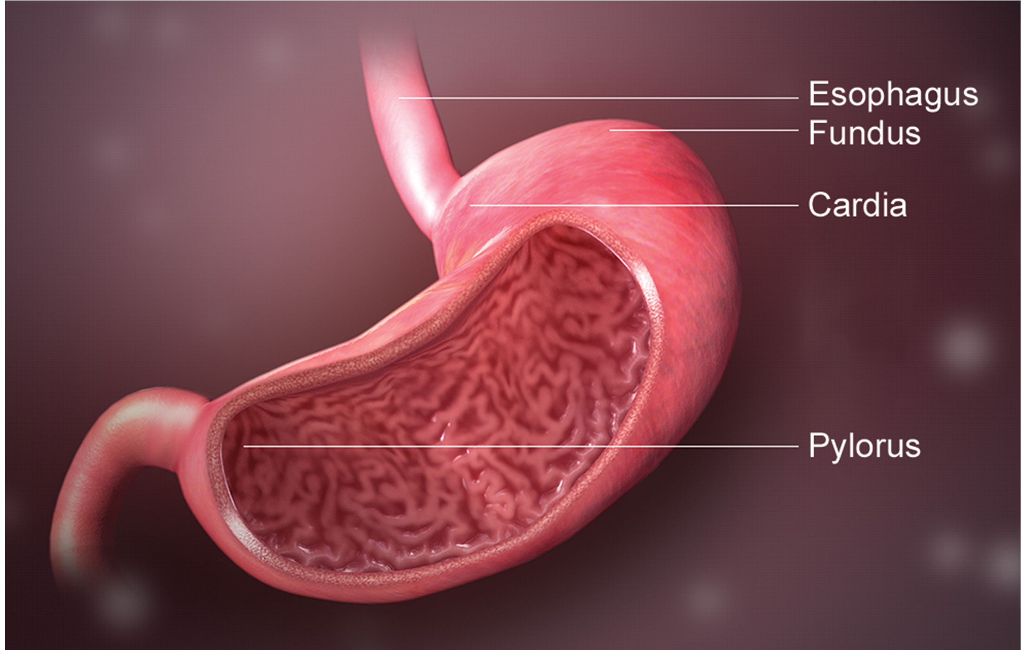
34.1 Figure 12
www.scientificanimations.com on Wikimedia Commons. "Stomach diagram."
Notes:
34.1 Figure 12: The human stomach has an extremely acidic environment where most of the protein gets digested.

Slide 41
Human Digestive System: Stomach₂
Protein digestion occurs in the stomach of animals other than ruminants.
Chief cells secrete pepsinogen (an inactive enzyme).
Parietal cells secrete H⁺ and Cl⁻ ions, which combine to form HCl.
  HCl makes the stomach acidic, which kills many food microbes.
  HCl helps to convert pepsinogen into active pepsin.
Pepsin breaks peptide bonds and cleaves proteins into smaller polypeptides, an activity enhanced by HCl.
  It helps to active more pepsinogen through positive feedback.

Slide 42
Human Digestive System: Stomach₃
Churning of the stomach facilitates chemical digestion.
Contraction and relaxation of smooth muscles mixes the stomach contents about every 20 minutes.
Chyme, the partially digested food and gastric juice mixture, passes from the stomach to the small intestine through the pyloric sphincter.
  Gastric emptying occurs within 2–6 hours after a meal.
  The sphincter regulates the movement of chyme into the stomach only a small amount at a time.

Slide 43
Human Digestive System: Stomach₄
The stomach lining is protected from pepsin digestion in 2 ways:
The pepsin is synthesized in an inactive form, protecting the chief cells that make it.
The stomach has a thick mucus lining that protect underlying tissues from the action of digestive juices.
  When the mucus lining is disrupted, ulcers (open wounds) can form.
  Ulcers are also caused by infection with Helicobacter pylori bacteria.

Slide 44
Think It Through₂
Provide the digestive enzyme that performs each function.
Breaks down triglycerides in food
Breaks peptide bonds and cleaves proteins into smaller polypeptides
Converts starches into disaccharides
Notes:
Originally an On Your Own. This is included here to use as a talking point or for a think-pair-share activity.

Slide 45
Human Digestive System: Small Intestine₁
The small intestine is a long, tubelike organ that completes the digestion of protein, fats, and carbohydrates.
It has a highly folded surface with fingerlike projections called villi.
The apical surface (facing the lumen) has many microscopic projections (membrane protrusions) called microvilli.
Together, these increase the surface area for absorption of digested food across the epithelial cells into:
  Capillaries: where amino acids, carbohydrates, and salts are absorbed into the blood stream, then carried in the hepatic portal vein to the liver for distribution to the body and detoxification
  Lacteals: where fats are absorbed into lymphatic fluid and are transported by the lymphatic network to the thoracic duct which empties lymph into the blood

Slide 46
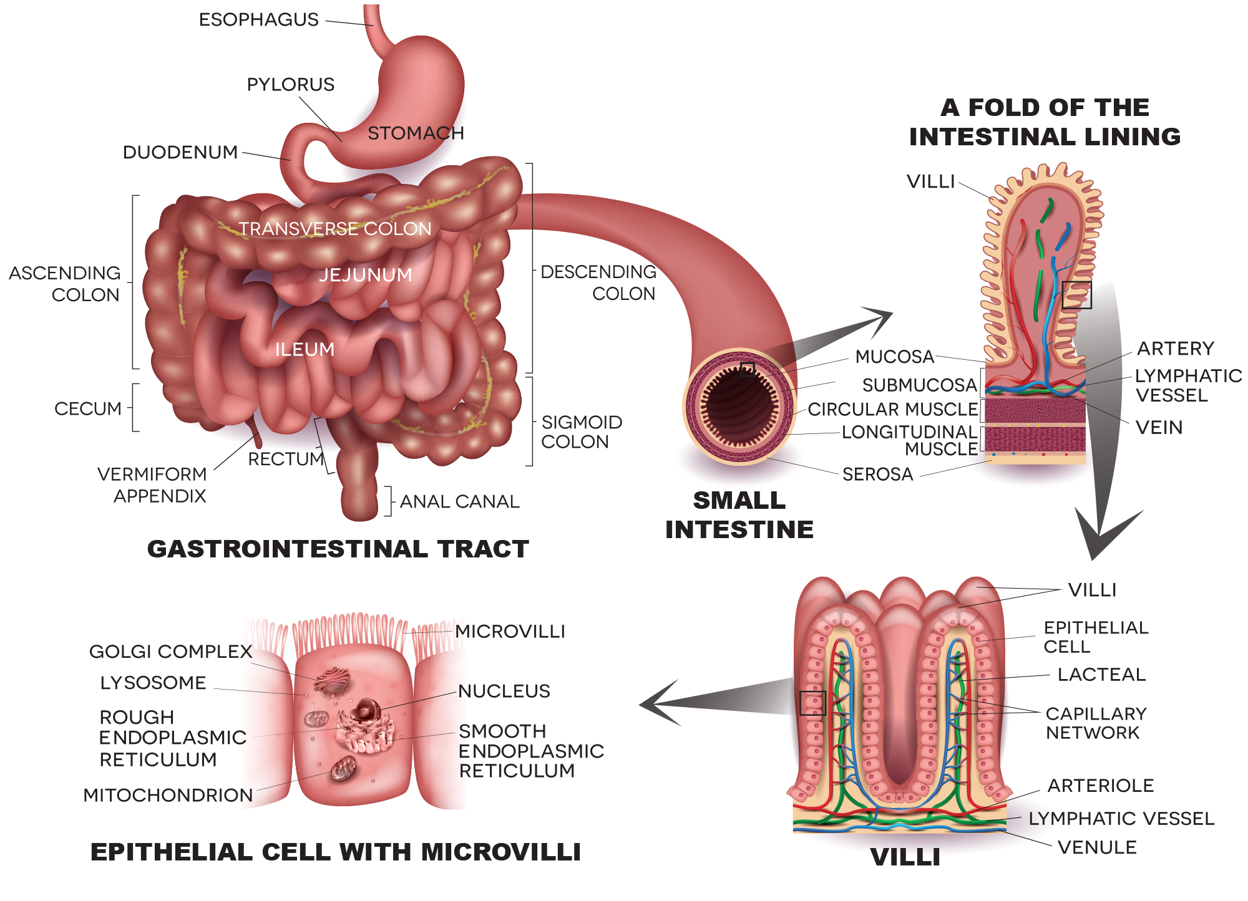
34.1 Figure 13
Notes:
34.1 Figure 13: Villi are fingerlike folds on the small intestine's surface. Enterocytes—epithelial cells of the intestines—line the villi. The apical surface of each enterocyte contains microscopic membrane protrusions called microvilli. These microvilli increase surface area to allow for absorption of nutrients.

Slide 47
Think It Through₃
Which of the following statements about the small intestine is false?
Absorptive cells that line the small intestine have microvilli—small projections that increase surface area and aid in the absorption of food.
The inside of the small intestine has many folds called villi.
Microvilli absorb nutrients from the capillaries and lacteals that line the interior of the small intestine.
Villi contain blood vessels as well as lymphatic vessels.
Notes:
Originally an On Your Own. This is included here to use as a talking point or for a think-pair-share activity.

Slide 48
Human Digestive System: Small Intestine₂
The small intestine is over 6 m long and divided into 3 parts:
The duodenum
The jejunum
The ileum

Slide 49
Small Intestine: The Duodenum
The duodenum:
Is C-shaped and fixed
Is separated from the stomach by the pyloric sphincter
Is where chyme is mixed with pancreatic juices in an alkaline solution rick in bicarbonate to neutralize the chyme’s acidity
Is where digestive juices from the pancreas, liver and gall bladder, as well as intestinal gland cells, enter
  Bile, produced by the liver and stored and concentrated in the gall bladder, contains bile salts that emulsify lipids.
  The pancreas produce enzymes that break down starches, disaccharides, proteins, and fats.
  These juices break down food to glucose, triglycerides, and amino acids.
Is where some chemical digestion and fatty acid absorption occur

Slide 50
Small Intestine: The Jejunum and Ileum
The jejunum:
Is where the bulk of both chemical digestion and nutrient absorption occurs
  Most carbohydrates and amino acids are absorbed here.
The ileum:
Is the last part of the small intestine
Is where bile salts and vitamins are absorbed into the blood stream
Sends undigested food to the colon via peristaltic movements
Is connected to the colon at the ileocecal valve
  The appendix, a wormlike structure with no role in digestion and a small role in immunity, is located here.

Slide 51
Human Digestive System: Large Intestine
The large intestine:
Reabsorbs water from undigested food
Processes the waste material
Is much smaller in length than the small intestine
Has 3 parts:
  The cecum
  The colon
  The rectum

Slide 52
Large Intestine: The Cecum and Colon
The cecum joins the ilium to the colon and is a receiving pouch for waster matter.
The colon:
    Is home to many bacteria that aid in digestion
    Can be divided into 4 parts: ascending, transverse, descending, and sigmoid
    Extracts water and mineral salts
    Stores waste material
    Is shorter in carnivores than in herbivores due to dietary differences

Slide 53
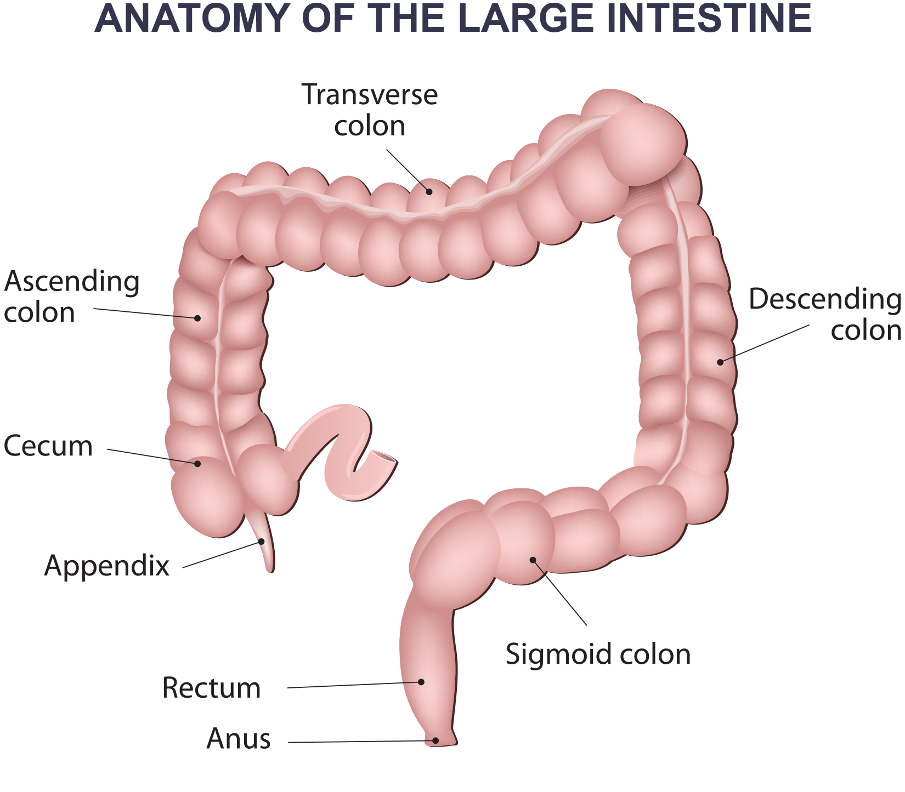
34.1 Figure 14
Notes:
34.1 Figure 14: The large intestine reabsorbs water from undigested food and stores waste material until it is eliminated.

Slide 54
Think It Through₄
Which of the following statements about the digestive system is false?
Chyme is a mixture of food and digestive juices that is produced in the stomach.
Food enters the large intestine before the small intestine.
In the small intestine, chyme mixes with bile, which emulsifies fats.
The stomach is separated from the small intestine by the pyloric sphincter.
Notes:
Originally an On Your Own. This is included here to use as a talking point or for a think-pair-share activity.

Slide 55
Large Intestine: The Rectum and Anus
The rectum:
Is the terminal end of the large intestine
Stores feces until defecation
  Feces is propelled by peristalsis during elimination.
The anus:
Is an opening at the far end of the digestive tract
Is the exit point for waste material
Two sphincters between the rectum and anus control elimination:
  The inner sphincter is involuntary.
  The outer sphincter is voluntary.

Slide 56
Human Digestive System: Accessory Organs₁
Accessory organs:
Add secretions (enzymes) that catabolize food into nutrients
Include:
  The salivary glands
  The liver
  The pancreas
  The gall bladder
All (except the salivary glands) are hormonally regulated in response to food consumed

Slide 57
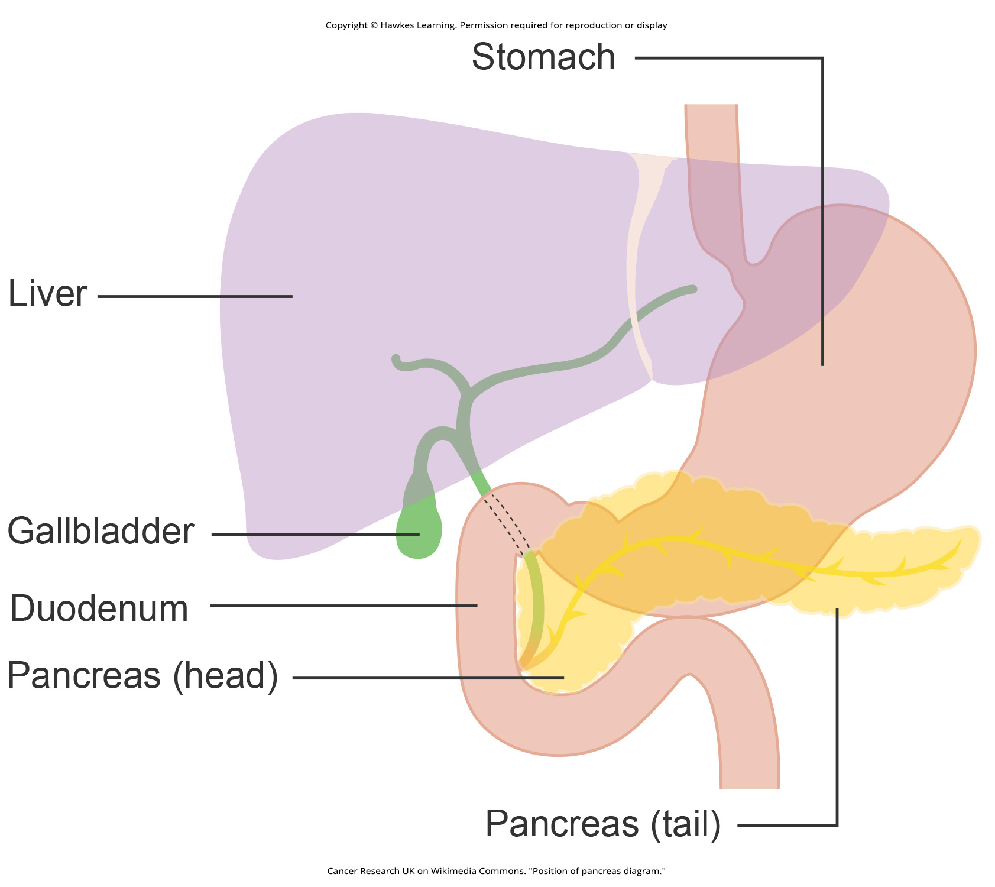
34.1 Figure 15
Cancer Research UK on Wikimedia Commons. "Position of pancreas diagram."
Notes:
34.1 Figure 15: The accessory organs of the digestive system include the salivary glands, liver, gallbladder, and pancreas.

Slide 58
Accessory Organs: The Liver
The liver:
Is the largest internal organ in humans
Plays an important role in fat digestion and detoxification of the blood
Produces bile that breaks down fats in food in the duodenum
Processes vitamins and fats
Synthesizes many plasma proteins

Slide 59
Accessory Organs: The Pancreas and Gallbladder
The pancreas:
Secretes digestive juices that contain:
  Bicarbonate to neutralize acidic chyme
  Enzymes to digest proteins and carbohydrates
The gallbladder:
Is a small organ that stores bile and concentrates bile salts
Releases bile into the duodenum when chyme containing fatty acids enters the duodenum

Slide 60
Reflection Question
What effect would a cholecystectomy (surgical removal of the gallbladder) have on the digestive system of a human?
Notes:
The reflection question is included here to use as a talking point or for a think-pair-share activity.

Slide 61
Summary
Different animals evolved different types of digestive systems to meet their dietary needs.
Humans and many other animals have monogastric digestive systems (having a single-chambered stomach).
Birds have evolved a digestive system including a gizzard for crushing food because they lack teeth.
Ruminants have multi-chambered stomachs to digest plants.
Pseudo-ruminants have similar stomachs but lacking rumens.
Food processing includes ingestion, digestion, absorption, and elimination, and in humans, many organs work together.
The mouth is the point of ingestion and where mechanical and chemical digestion (via amylase) begin.
The food bolus moves through the esophagus to an extremely acidic stomach, where pepsin digests protein.
Further digestion and absorption occur in the small intestine.
The large intestine reabsorbs water and stores waste.

Slide 62

End of Hawkes Learning PowerPoint

