Slide 1
Lesson 34.2
Nutrition and Energy Production

Slide 2
Objectives
Describe the primary components of food.
Describe how excess carbohydrates and energy are stored in the body.
Describe the essential nutrients required for cellular function that cannot be synthesized by the animal body.
Explain how energy is produced through diet and digestion.
Explain why an animal’s diet should be balanced and meet the needs of the body.

Slide 3
Nutrition and Energy Production
An animal’s diet provides materials for building DNA, complex molecules for growth, maintenance, reproduction.
It is the source of materials for ATP production in cells
The diet must be balanced to provide required minerals and vitamins.

Slide 4
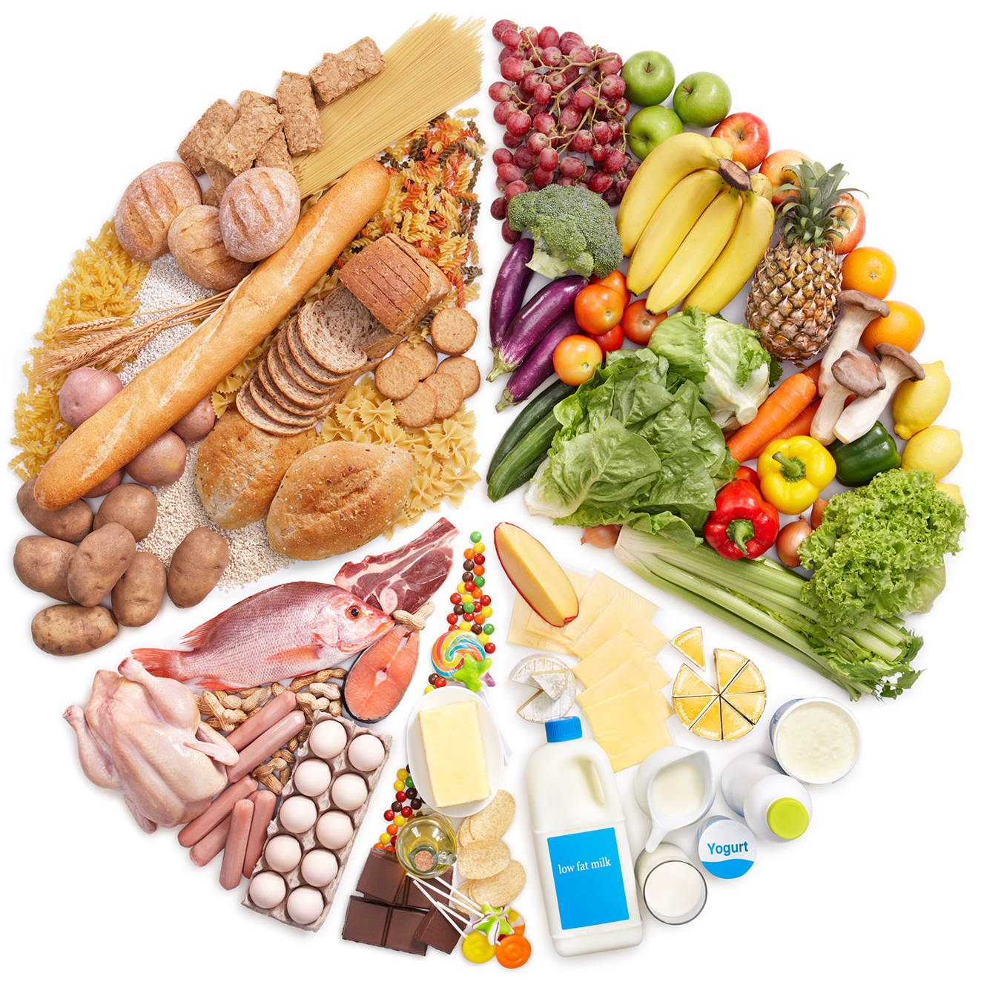
Food Requirements
Animal diet should provide the nutrients required for bodily function.
Provides minerals and vitamins for structure, regulation, health, reproduction
34.2 Figure 1

Slide 5
Think It Through₁
What does it mean for a diet to be "balanced?"
Notes:
Originally an On Your Own. This is included here to use as a talking point or for a think-pair-share activity.

Slide 6

Organic Precursors₁
Carbohydrates (sugars) are a primary source of organic carbons that break down into glucose.
Cellulose can’t be broken down and aids movement of waste through the intestines.
Glucose is used for energy through metabolic pathways and excess is stored as glycogen.
34.2 Figure 2: Glycogen in the muscles and liver is a storage form of glucose and provides readily available energy for aerobic activities such as running.
Quino Al on Unsplash. "Runner."

Slide 7
Organic Precursors₂
Proteins are a source of organic nitrogen (N).
They provide amino acids, nitrogen for nucleotides, nucleic acids, cells, tissues.
Fats add flavor to food, promote the feeling of satiety, and are a significant energy source (contain more calories than carbohydrates and protein).

Slide 8
Essential Nutrients
Essential nutrients must be consumed from food because they cannot be produced by the body.
Omega-3 alpha-linolenic acid and omega-6 linolenic acid are essential fatty acids for membrane phospholipids
Vitamins are essential organic coenzymes (required for enzymes to function) and are either fat or water-soluble.
Minerals are inorganic essential nutrients that act as cofactors and structure and regulation.
9 of 20 required amino acids can’t be synthesized and must be obtained from food.

Slide 9
Group Activity
Native Americans learned that the combination of corn, beans, and squash provided powerful nutritional benefits. They even had a name for this trio—the Three Sisters.
Work in groups of three. Each group member should research one of the Three Sisters. Place special emphasis on amino acid content. Then, discuss how the combined amino acids in this dietary staple, called succotash, contributed to its nutritional benefits.

Slide 10
Table 1: Water-Soluble Essential Vitamins
Vitamin | Function | Deficiencies Can Lead To | Sources
vitamin B₁ (thiamine) | needed by the body to process lipids, proteins, and carbohydrates; coenzyme removes CO₂ from organic compounds | muscle weakness, beriberi: reduced heart function, CNS problems | milk, meat, dried beans, whole grains
vitamin B₂ (riboflavin) | takes an active role in metabolism, aiding in the conversion of food to energy (FAD and FMN) | cracks or sores on the outer surface of the lips (cheliosis); inflammation and redness of the tongue; moist, scaly skin inflammation (seborrheic dermatitis) | meat, eggs, enriched grains, vegetables
vitamin B₃ (niacin) | used by the body to release energy from carbohydrates and to process alcohol; required for the synthesis of sex hormones; component of coenzyme NAD⁺ and NADP⁺ | pellagra, which can result in dermatitis, diarrhea, dementia, and death | meat, eggs, grains, nuts, potatoes

Slide 11
Table 1: Water-Soluble Essential Vitamins (Cont.)₁
Vitamin | Function | Deficiencies Can Lead To | Sources
vitamin B₅ (pantothenic acid) | assists in producing energy from foods (lipids, in particular); component of coenzyme A | fatigue, poor coordination, retarded growth, numbness, tingling of hands and feet | meat, whole grains, milk, fruits, vegetables
vitamin B₆ (pyridoxine) | the principal vitamin for processing amino acids and lipids; also helps convert nutrients into energy | irritability, depression, confusion, mouth sores or ulcers, anemia, muscular twitching | meat, dairy products, whole grains, orange juice
vitamin B₇ (biotin) | used in energy and amino acid metabolism, fat synthesis, and fat breakdown; helps the body use blood sugar | hair loss, dermatitis, depression, numbness and tingling in the extremities; neuromuscular disorders | meat, eggs, legumes, and other vegetables

Slide 12
Table 1: Water-Soluble Essential Vitamins (Cont.)₂
Vitamin | Function | Deficiencies Can Lead To | Sources
vitamin B₉ (folic acid) | assists the normal development of cells, especially during fetal development; helps metabolize nucleic and amino acids | deficiency during pregnancy associated with birth defects, such as neural tube defects and anemia | leafy green vegetables, whole wheat, fruits, nuts, legumes
vitamin B₁₂ (cobalamin) | maintains healthy nervous system and assists with blood cell formation; coenzyme in nucleic acid metabolism | anemia, neurological disorders, numbness, loss of balance | meat, eggs, animal products
vitamin C (ascorbic acid) | helps maintain connective tissue: bone, cartilage, and dentin; boosts the immune system | scurvy, which results in bleeding, hair and tooth loss; joint pain and swelling; delayed wound healing | citrus fruits, broccoli, tomatoes, red sweet bell peppers

Slide 13
Table 2: Fat-Soluble Essential Vitamins
Vitamin | Function | Deficiencies Can Lead To | Sources
vitamin A (retinol) | critical to the development of bones, teeth, and skin; helps maintain eyesight, enhances the immune system, fetal development, gene expression | night-blindness, skin disorders, impaired immunity | dark green leafy vegetables, yellow-orange vegetables, fruits, milk, butter
vitamin D | critical for calcium (Ca) absorption for bone development and strength; maintains a stable nervous system; maintains a normal and strong heartbeat; helps in blood clotting | rickets, osteomalacia, immunity | cod liver oil, milk, egg yolk
vitamin E (tocopherol) | lessens oxidative damage of cells and prevents lung damage from pollutants; vital to the immune system | deficiency is rare; anemia, nervous system degeneration | wheat germ oil, unrefined vegetable oils, nuts, seeds, grains
vitamin K (phylloquinone) | essential to blood clotting | bleeding and easy bruising | leafy green vegetables, tea

Slide 14
Table 3: Minerals and Their Function in the Human Body
Mineral | Function | Deficiencies Can Lead To | Sources
calcium* (Ca) | needed for muscle and neuron function; heart health; builds bone and supports synthesis and function of blood cells; nerve function | osteoporosis, rickets, muscle spasms, impaired growth | milk, yogurt, fish, green leafy vegetables, legumes
chlorine* (Cl) | needed for production of hydrochloric acid (HCl) in the stomach and nerve function; osmotic balance | muscle cramps, mood disturbances, reduced appetite | table salt
copper (Cu; trace amounts) | required component of many redox enzymes, including cytochrome c oxidase; cofactor for hemoglobin synthesis | copper deficiency rare | liver, oysters, cocoa, chocolate, sesame, nuts
iodine (I) | required for the synthesis of thyroid hormones | goiter | seafood, iodized salt, dairy products
*greater than 200mg/day required

Slide 15
Table 3: Minerals and Their Function in the Human Body (Cont.)₁
Mineral | Function | Deficiencies Can Lead To | Sources
iron (Fe) | required for many proteins and enzymes, notably hemoglobin, to prevent anemia | anemia, which causes poor concentration, fatigue, and poor immune function | red meat, leafy green vegetables, fish (tuna, salmon), eggs, dried fruits, beans, whole grains
magnesium* (Mg) | required cofactor for ATP formation; bone formation; normal membrane functions; muscle function | mood disturbances, muscle spasms | whole grains, leafy green vegetables
manganese (Mn; trace amounts) | a cofactor in enzyme functions; trace amounts are required | manganese deficiency rare | common in most foods
molybdenum (Mo; trace amounts) | acts as a cofactor for three essential enzymes in humans: sulfite oxidase, xanthine oxidase, and aldehyde oxidase | molybdenum deficiency rare | legumes, whole grains, dairy, meats
*greater than 200mg/day required

Slide 16
Table 3: Minerals and Their Function in the Human Body (Cont.)₂
Mineral | Function | Deficiencies Can Lead To | Sources
phosphorus* (P) | a component of bones and teeth; helps regulate acid-base balance; nucleotide synthesis | weakness, bone abnormalities, calcium loss | milk, hard cheese, whole grains, meats
potassium* (K) | vital for muscles, heart, and nerve function | cardiac rhythm disturbance, muscle weakness | legumes, potato skin, tomatoes, bananas
selenium (Se; trace amounts) | a cofactor essential to activity of antioxidant enzymes like glutathione peroxidase; trace amounts are required | selenium deficiency rare | common in most foods
sodium* (Na) | systemic electrolyte required for many functions; acid-base balance; water balance; nerve function | muscle cramps, fatigue, reduced appetite | table salt
zinc (Zn; trace amounts) | required for several enzymes such as carboxypeptidase, liver alcohol dehydrogenase, and carbonic anhydrase | anemia, poor wound healing, can lead to short stature | common in most foods
*greater than 200mg/day required

Slide 17
Table 4: Essential Amino Acids
Amino Acids that Must Be Consumed | Amino Acids Anabolized By the Body
isoleucine | alanine
leucine | selenocysteine
lysine | aspartate
methionine | cysteine
phenylalanine | glutamate
tryptophan | glycine
valine | proline
histidine* | serine
threonine | tyrosine
arginine* | asparagine
*The human body can synthesize histidine and arginine but not in the quantities required, especially for growing children.

Slide 18

Think It Through₂
For each patient description, provide a vitamin or mineral that, if deficient, would provide one possible explanation.
Patient suffers from depression and complains of brain fog. Patient eats a vegan diet.
Patient has limited access to fresh fruits and vegetables. Patient suffers from bleeding gums and hair loss.
Patient bruises easily and expresses great dislike for spinach.
Patient suffers from osteoporosis.
34.2 Figure 3
Anh Nguyen on Unsplash. "Salad."
Notes:
Originally an On Your Own. This is included here to use as a talking point or for a think-pair-share activity.

Slide 19
Food Energy and ATP₁
Animals need food to obtain energy and maintain homeostasis (stable internal environment).
  Example: humans maintain an internal temperature of 37°C (98.6°F)
The primary source of energy for animals is carbohydrates, mainly glucose.
Adenosine triphosphate (ATP) is the primary energy currency in cells.
  Stores energy in bonds between its phosphate groups.
  Produced by aerobic cellular respiration
    A process where glucose and other carbon-containing molecules are broken down to release the energy used to synthesize new molecules of ATP from ADP and phosphate.

Slide 20
Science and You₁
Why Are Energy Drinks So High in B Vitamins?
Some popular brands contain over 1,000 times your daily value of B₁₂ and B₆.
B vitamins play an important role in the processes that metabolize food into ATP, including serving as coenzymes during cellular respiration (converting food into ATP).
Since the body can only absorb so much, most B vitamins from energy drinks are eliminated as excess in urine.
Notes:
This is included as a relevant application for this topic.

Slide 21

Food Energy and ATP₂
When the body has enough ATP, excess glucose is stored as glycogen (glucose polymer) in the liver and muscles.
Synthesis is initiated when blood sugar levels rise above what can be used by cells.
34.2 Figure 4: This cheetah constantly consumes and regenerates its ATP to maintain speed.
Sammy Wong on Unsplash. "Cheetahs."

Slide 22

Food Energy and ATP₃
When the body has enough glucose and the liver and muscles are full of glycogen, excess sugar is converted to fatty acids.
Excess amino acids from proteins can be converted to fatty acids through pathways that begin with the conversion of amino acids to glucose, pyruvate, or acetyl-CoA.
Fatty acids are stored in adipose (fat) cells .
34.2 Figure 5: Polar bears have a thick layer of insulating fat to protect them from losing body heat in the frigid Arctic climate.
Hans-Jurgen Mager on Unsplash. "Polar bears."

Slide 23
Science and You₂
Why Is Obesity Problematic?
Obesity is linked to various health issues like type 2 diabetes, cancer, and cardiovascular disease.
Fatty foods are calorie-dense, containing more calories per gram than carbohydrates or proteins.
Foods rich in fatty acids promote satiety, influencing eating behaviors and contributing to overconsumption.
Michelle Obama's Let's Move! campaign promotes healthy nutrition and active lifestyles among children to combat obesity, involving communities and emphasizing access to nutritious foods and physical activity.
Notes:
This is included as a relevant application for this topic.

Slide 24
Summary
Carbohydrates, proteins, and fats are the primary components of food.
Some essential nutrients are required for cellular function but cannot be produced by the animal body.
  These include vitamins, minerals, some fatty acids, and some amino acids.
ATP is the energy currency of the cell and is obtained from metabolic pathways.
Excess carbohydrates and energy are stored as glycogen in the body and may be converted to fatty acids for storage as fat.
  Excess adipose storage can lead to obesity.

Slide 25

End of Hawkes Learning PowerPoint

