Slide 1
Lesson 34.3
Digestive System Processes and Regulation

Slide 2
Objectives
Define elimination.
Describe the process of digestion.
Detail the steps involved in digestion and absorption.
Discuss the role of neural regulation in digestive processes.
Explain how hormones regulate digestion.

Slide 3
Ingestion
Large molecules in food need to be broken down prior to passing through cell membranes.
Ingestion is the process of taking in food through the mouth.
In vertebrates, the teeth, saliva and tongue play important roles in mastication (chewing and preparing the food into bolus).
The breakdown of food is both mechanical and chemical in nature.

Slide 4
Digestion and Absorption
Digestion is the mechanical and chemical breakdown of food into small, organic fragments.
Molecules must be broken down into smaller fragments for absorption across the intestinal epithelium.
Different organs play specific roles in the digestive process

Slide 5
Think It Through₁
What is the difference between ingestion and digestion?
Notes:
Originally an On Your Own. This is included here to use as a talking point or for a think-pair-share activity.

Slide 6
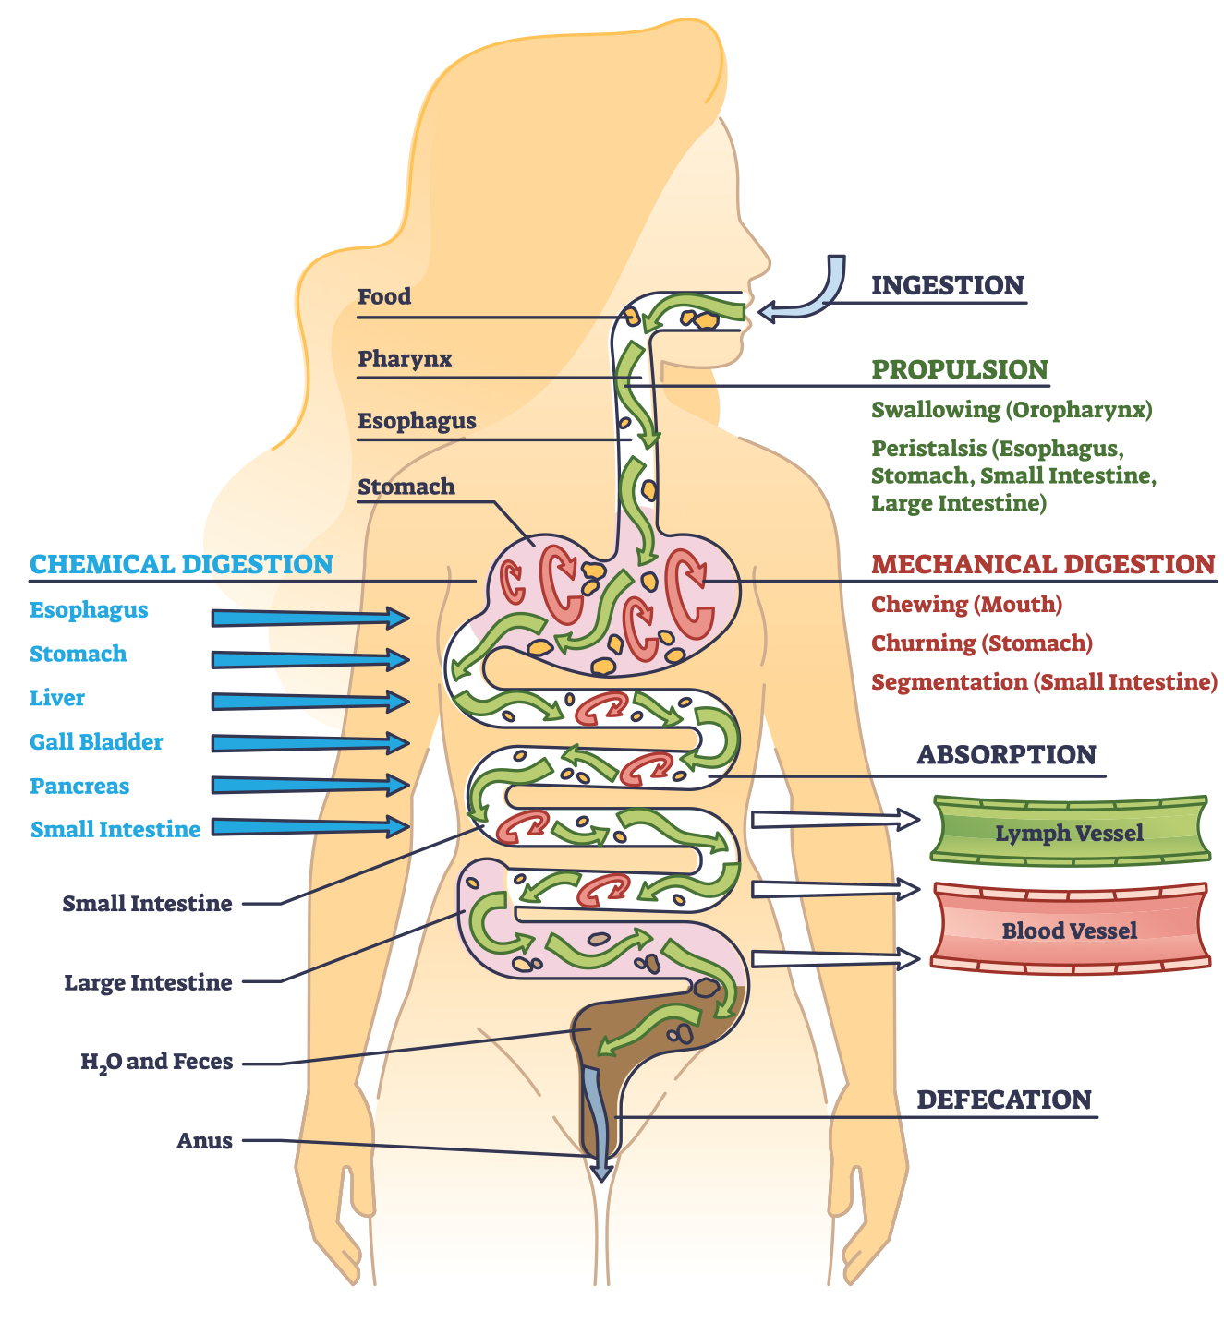
Lesson 34.3 Figure 1
Notes:
Figure 1: The digestive processes include ingestion, propulsion (swallowing and peristalsis), mechanical digestion, chemical digestion, absorption, and elimination (defecation).

Slide 7
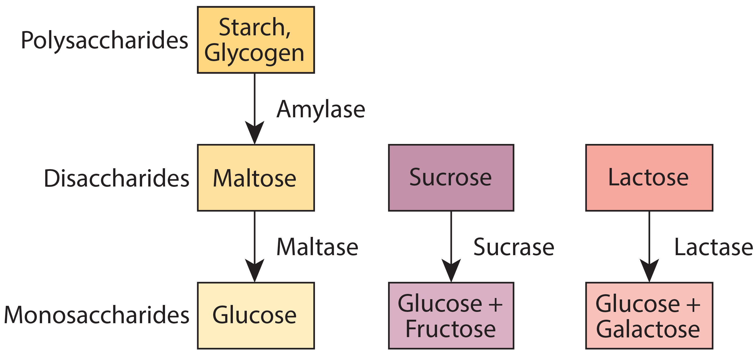
Carbohydrates
Carbohydrate digestion begins in the mouth, with amylase breaking down starches.
Carbohydrate digestion continues in the duodenum.
Maltase breaks down maltose into glucose.
Sucrase breaks down sucrose into glucose and fructose.
Lactase breaks down lactose into glucose and galactose.
34.3 Figure 2
OpenStax. "Digestion of carbohydrates."
Notes:
Figure 2: Digestion of carbohydrates is performed by several enzymes. Starch and glycogen are broken down into glucose by amylase. Maltose, sucrose (table sugar), and lactose (milk sugar) are broken down by maltase, sucrase, and lactase, respectively.

Slide 8
Table 1: Digestion of Carbohydrates and Their End Products
Enzyme | Produced By | Site of Action | Substrate Acting on | End Products
salivary amylase | salivary glands | mouth | polysaccharides (starch) | disaccharides (maltose), oligosaccharides
pancreatic amylase | pancreas | small intestine | polysaccharides (starch) | disaccharides (maltose), monosaccharides
oligosaccharidases | lining of the intestine; brush border membrane | small intestine | disaccharides | monosaccharides (e.g., glucose, fructose, galactose)

Slide 9
Protein
Most protein digestion occurs in the stomach.
Pepsin breaks down the whole protein into peptides.
In the duodenum trypsin, elastase and chymotrypsin act on peptides, reducing them to smaller peptides.
Carboxypeptidase, dipeptidase and aminopeptidase play important roles in reducing the peptides to free amino acids.
The animo acids are then absorbed into the bloodstream through the small intestines.

Slide 10
Table 2: Digestion of Proteins by Enzymes and Their End Products
Enzyme | Produced By | Sites of Action | Substrate It Acts on | End Products
pepsin | stomach chief cells | stomach | proteins | peptides
trypsin, elastase, chymotrypsin | pancreas | small intestine | proteins | peptides
carboxypeptidase | pancreas | small intestine | peptides | amino acids and peptides
aminopeptidase, dipeptidase | lining of the intestine | small intestine | peptides | amino acids

Slide 11
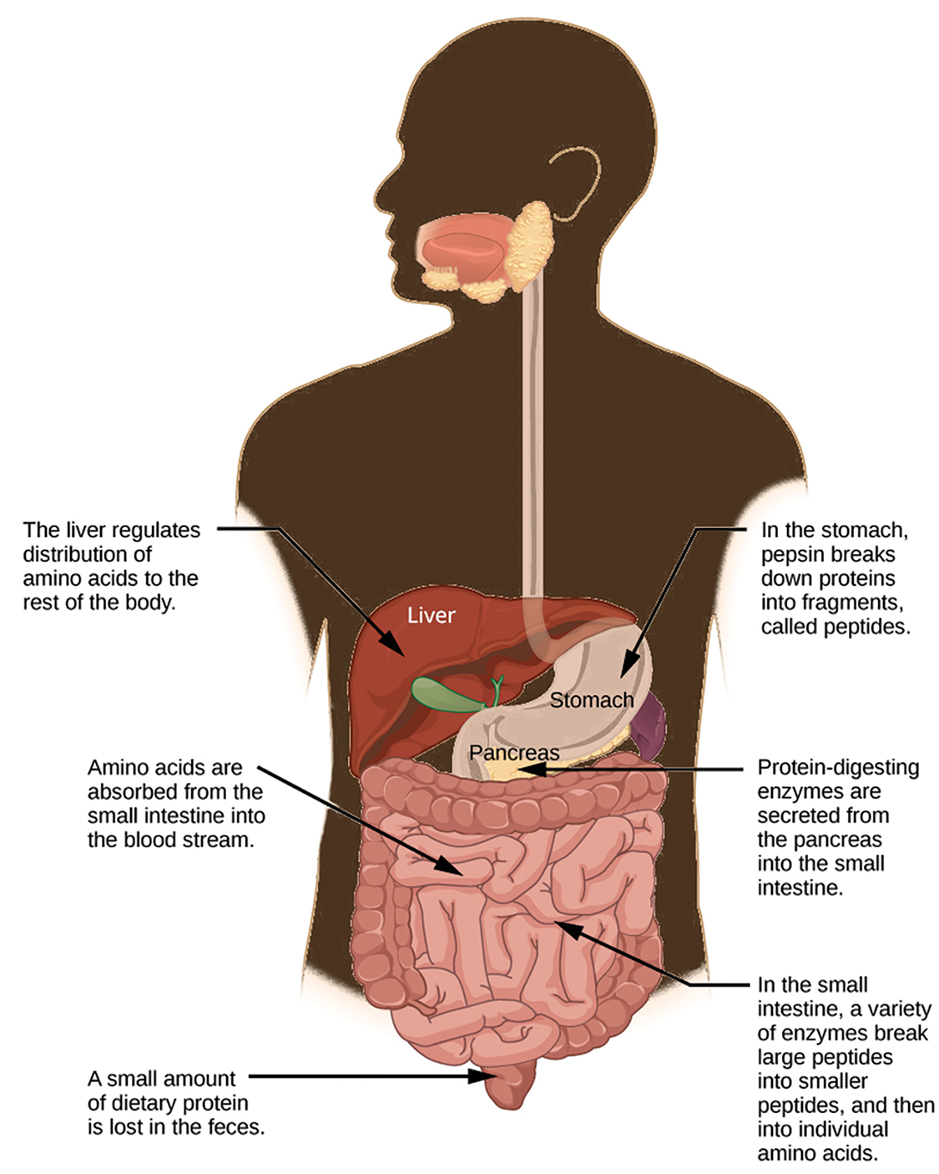
Lesson 34.3 Figure 3
OpenStax. "Protein digestion." Modified.
Notes:
Figure 3: Protein digestion is a multistep process that begins in the stomach and continues through the intestines.

Slide 12
Lipids₁
Lipid digestion begins in the mouth with lingual lipase and continues in the stomach with gastric lipase.
The bulk of lipid digestion occurs in the small intestine due to pancreatic lipase.
Bile, which is produced by the liver and stored in the gallbladder aids in the digestion of triglycerides through emulsification.
Emulsification occurs through lipid interaction with bile salts.

Slide 13
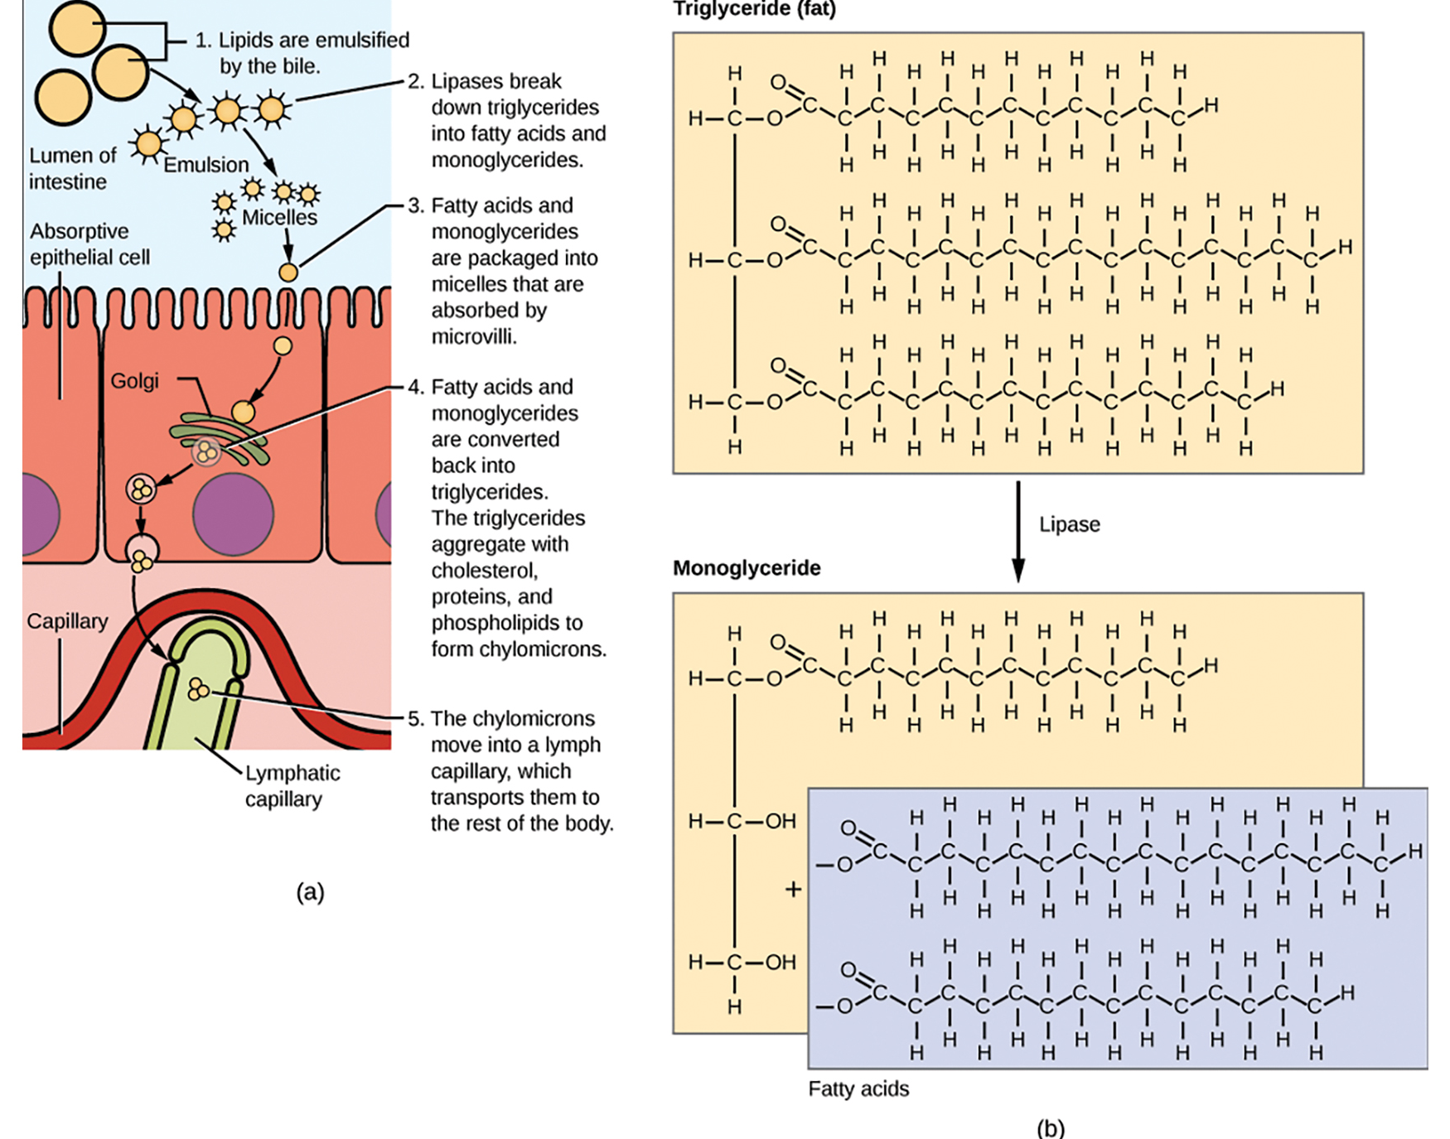
Lesson 34.3 Figure 4
OpenStax. "Lipid digestion." Modified.
Notes:
Figure 4: (a) In the small intestine, lipids are emulsified, absorbed across epithelial cells, and transported into lymphatic vessels. (b) During digestion, lipase breaks down triglycerides into monoglycerides and fatty acids for absorption by epithelial cells.

Slide 14
Lipids₂
Emulsification is important, as it increases the surface area available for lipases to act on, allowing for more efficient digestion of lipids.
Lipases break lipids into glycerol and fatty acids, which enter the epithelial cells in the intestine.
The long fatty acid chains and monoglycerides recombine in absorptive cells to form and triglycerides.
These triglycerides aggregate into globules, are coated with proteins and are called chylomicrons.
Chylomicrons leave absorptive cells via exocytosis and enter the lymphatic system.

Slide 15
Think it Through₂
Why are patients recommended to eat a low-fat diet after gallbladder removal surgery?

Slide 16
Vitamins
Vitamins can be either water or lipid (fat) soluble. Fat-soluble vitamins are absorbed in the same manner as lipids.
Water-soluble vitamins can be directly absorbed into the bloodstream from the intestine.

Slide 17
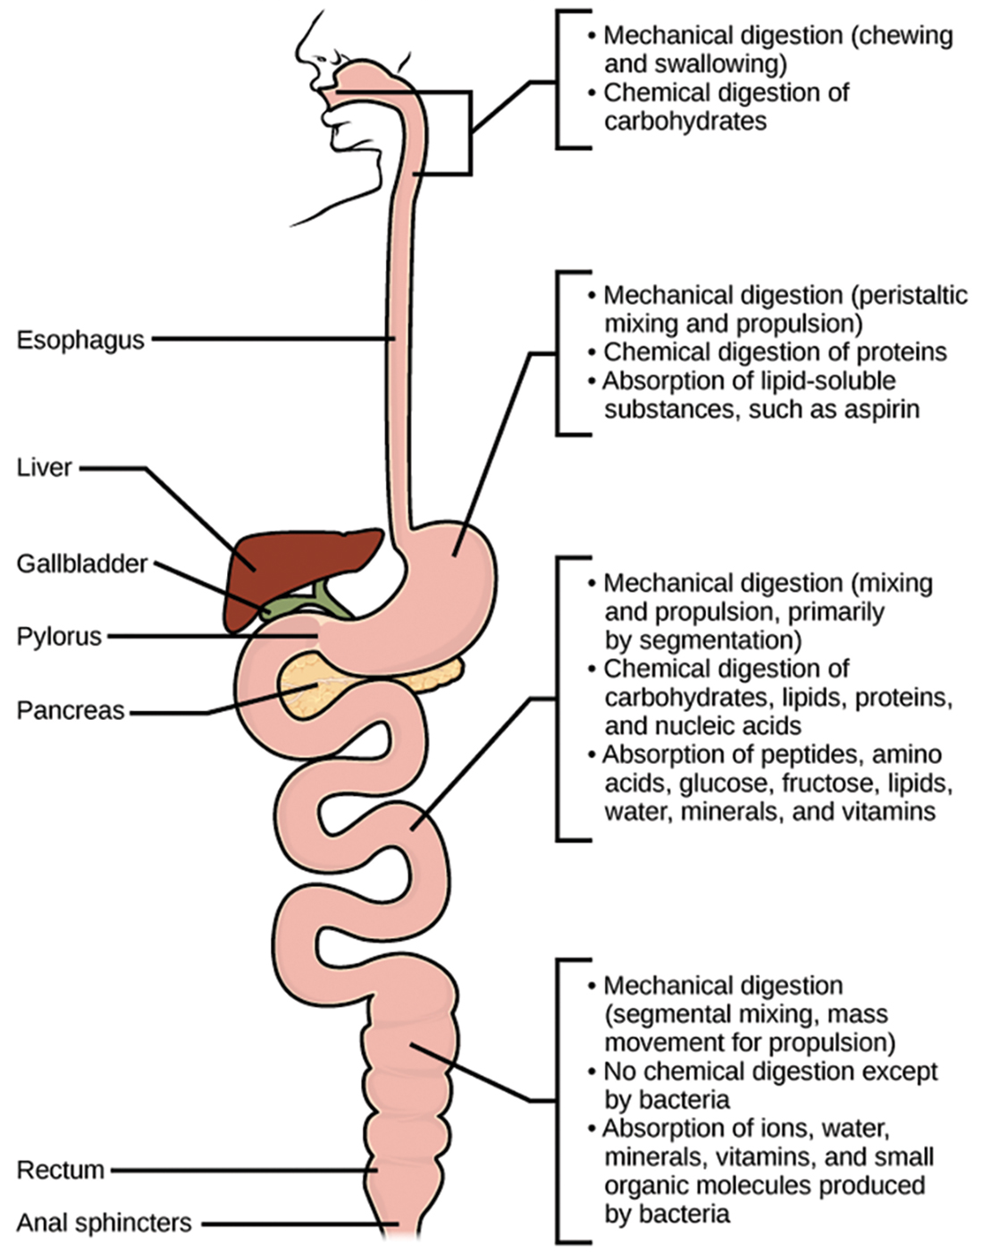
34.4 Figure 5
CNX OpenStax on Wikimedia Commons. "Mechanical and chemical digestion."

Slide 18
Elimination
The final step of digestion is the elimination of undigested food content and waste products.
Undigested food enters the colon, where most of the water is reabsorbed.
The semisolid waste is moved through the colon using peristatic movements of the muscle and is stored in the rectum.
The solid waste is eliminated through the anus using peristaltic movements of the rectum.

Slide 19
Common Problems with Elimination
Diarrhea and constipation are common heath concerns which impact digestion.
Constipation is a condition where the feces are hardened due to excess water removal in the colon.
If not enough water is removed in the colon, it results in diarrhea.
Many bacteria, including those which cause choler, affect the proteins involved in water reabsorption and result in excessive diarrhea.

Slide 20
Emesis
Emesis, or vomiting, is the elimination of food by forceful expulsion through the mouth.
This is often a response to an irritant which affects the digestive tract, such as viruses, bacteria, emotions sights or food poisoning.
The process of emesis is regulated by the medulla, the lowest part of the brain.

Slide 21
Reflection Question₁
Based on what you know about constipation versus diarrhea, how do you think antidiarrheal medications function?
Notes:
The reflection question is included here to use as a talking point or for a think-pair-share activity.

Slide 22
Science and You₁
Persistent emesis can disrupt the body's acid-base balance and result in metabolic alkalosis (when the blood is too basic). This is due to the body's loss of hydrochloric acid from the stomach. Severe metabolic alkalosis can result in neurological symptoms such as agitation, disorientation, seizures, and coma.
Notes:
This is included as a relevant application for this topic.

Slide 23

Neural Responses to Food
The first response to the smell, sight or thought of food is salivation.
The salivary glands secrete more saliva in response to stimulation by the autonomic nervous system.
Simultaneously, the stomach begins to produce hydrochloric acid (HCL) to digest food.
There are three overlapping phases of gastric control- the cephalic phase, the gastric phase and the intestinal phase.
34.3 Figure 6
buffetcrush on Pixabay. "Platter of food."
Notes:
Figure 6: Seeing a plate of food triggers the secretion of saliva in the mouth and the production of HCl in the stomach.

Slide 24
Reflection Question₂
Imagine eating your favorite food.
What are you eating?
Does the thought of the food make you salivate?
Notes:
The reflection question is included here to use as a talking point or for a think-pair-share activity.

Slide 25
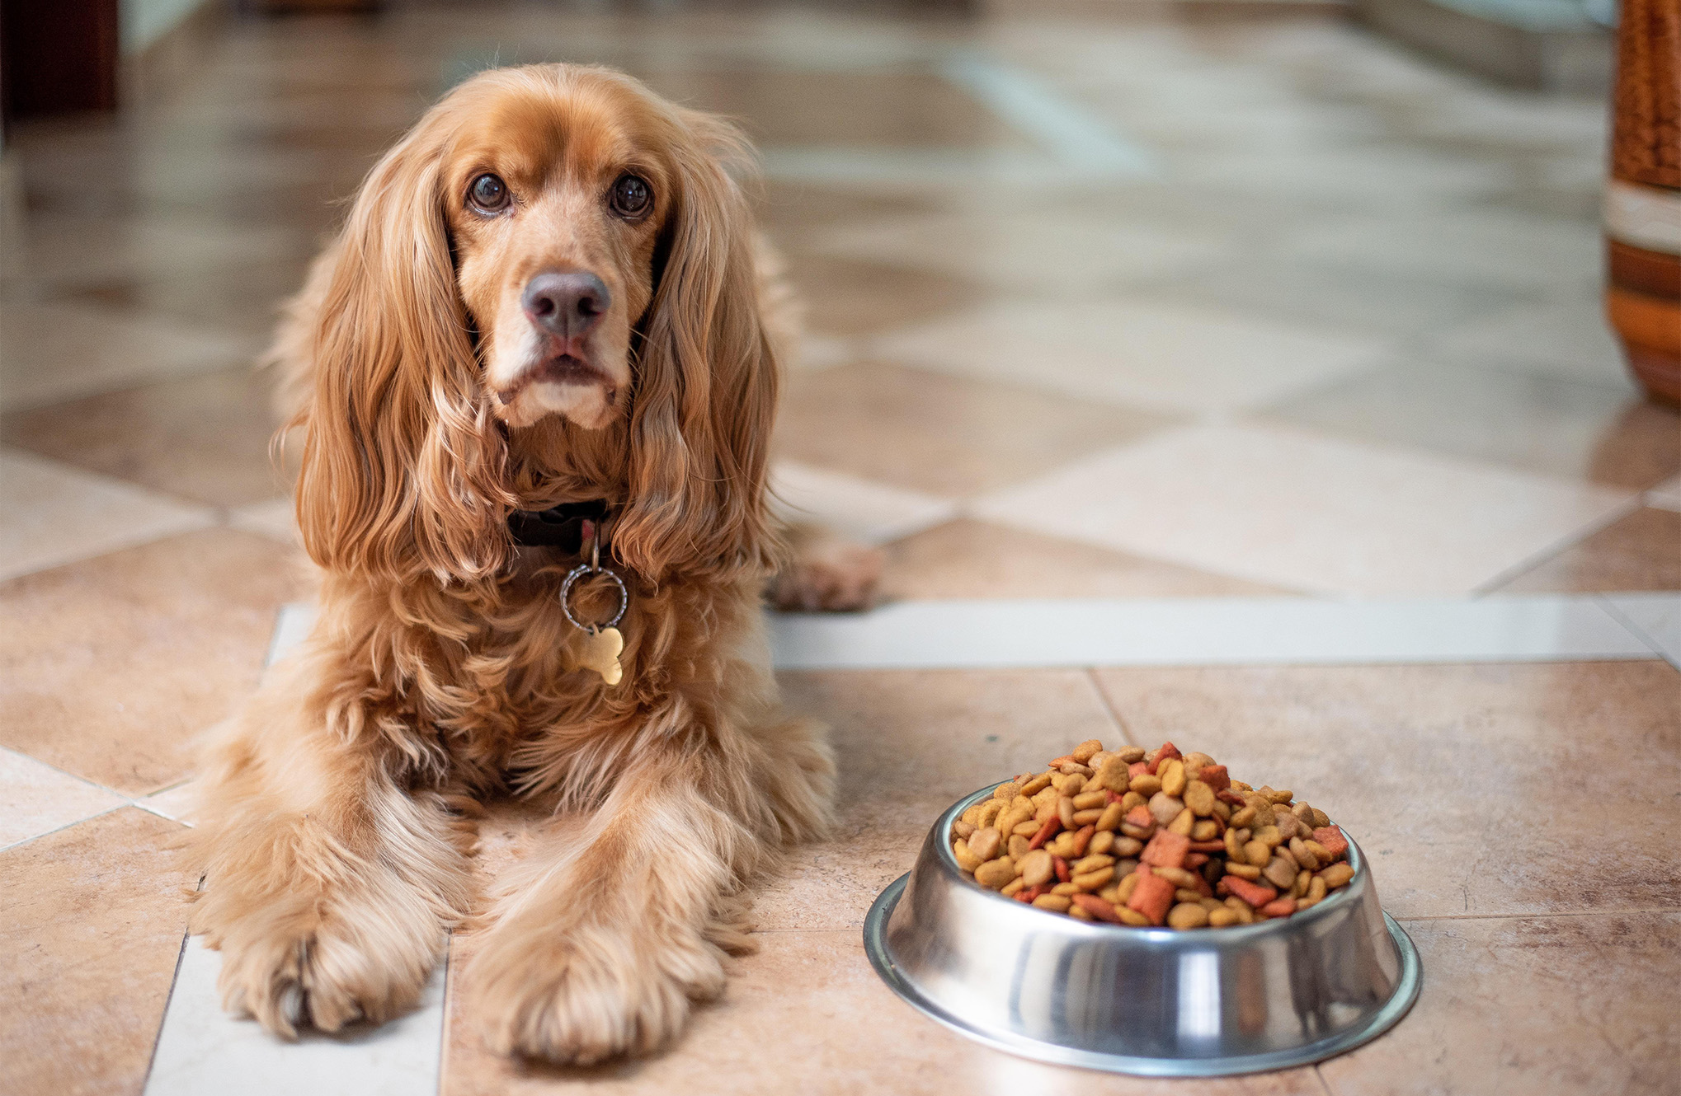
Digestive Phases
The cephalic phase is the first phase of digestion and is controlled by the neural response to food. This triggers increased salivation and release of gastric juices.
The gastric phase begins once food arrives at the stomach. This phase is stimulated by the stretching of the stomach and the increased pH of gastric content.
The intestinal phase begins when chyme enters the small intestine, triggering digestive secretions.
34.3 Figure 7
Alkhaine on Pixabay. "Dog with food."

Slide 26
Hormonal Responses to Food₁
The endocrine system controls the response of the various glands in the body and the release of hormones at the appropriate times.
During the gastric phase, gastrin is secreted by G cells in the stomach.
Gastrin stimulates the release of HCL, which aids in the digestion of protein.
When the stomach is empty, somatostatin stops the release of HCL.

Slide 27
Hormonal Responses to Food₂
In the duodenum, secretin stimulates the pancreas to release alkaline bicarbonate solution to neutralize the acidic chyme.
Secretin works in tandem with cholecystokinin (CCK), which stimulates the pancreas to produce pancreatic juices and the gallbladder to release bile salts.
Food high in lipids takes a long time to digest.
Gastric inhibitory peptide is secreted by the small intestine to slow down the peristaltic movement of the intestine, allowing more time for digestion.

Slide 28
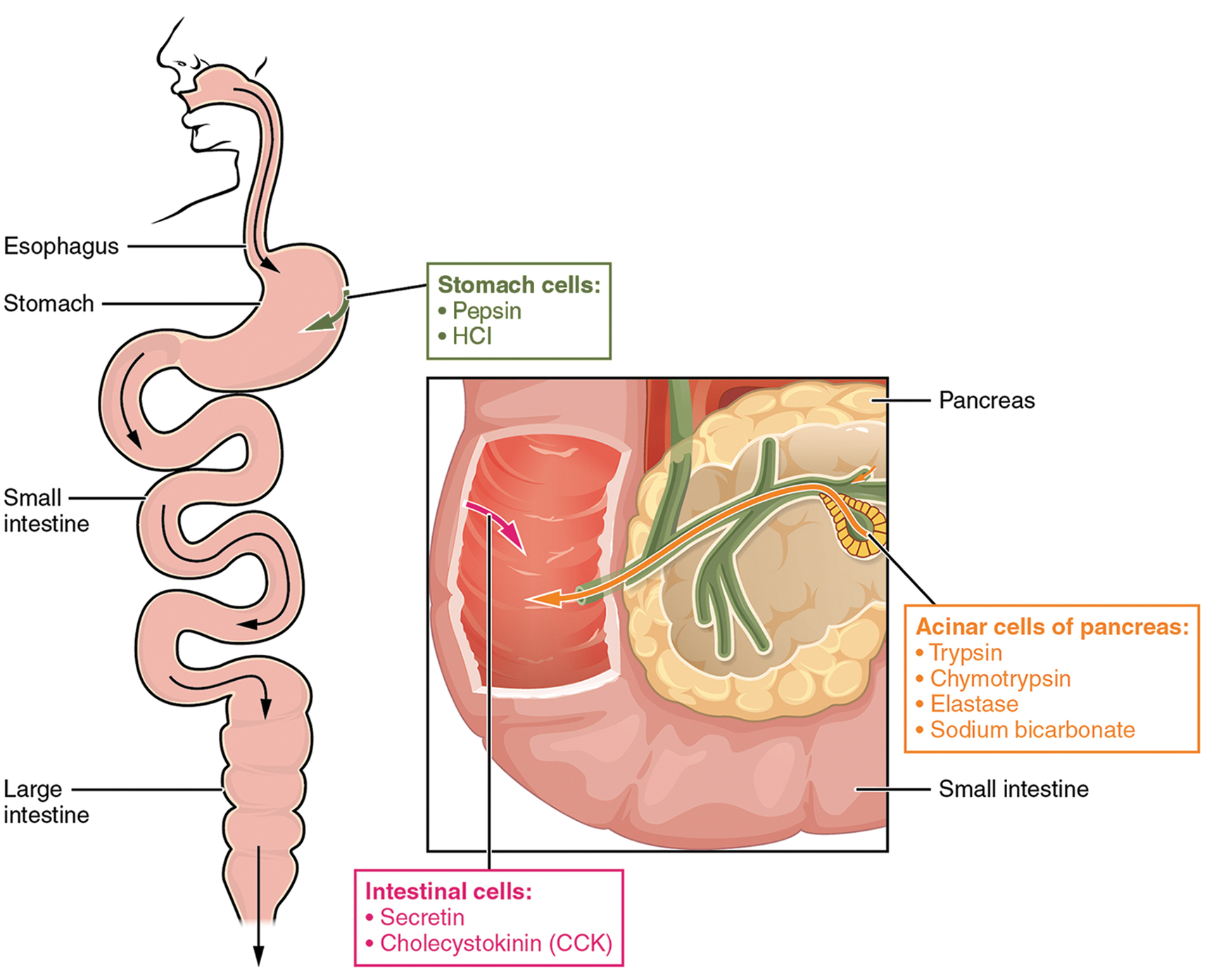
Lesson 34.3 Figure 8
OpenStax College on Wikimedia Commons. "Digestive enzymes and hormones."
Notes:
Figure 8: Selection of digestive enzymes and hormones involved in protein digestion

Slide 29
Science and You₂
Have you ever experienced heartburn? Heartburn is a burning sensation in your chest or throat that may be triggered by the foods you eat as the acid in your stomach digests them.
Hormone regulation and imbalances may be the culprit behind cases of heartburn!
Some people may take antacids to cope with heartburn. The main ingredient in these medications is often calcium carbonate, which is basic.
When exposed to the hydrochloric acid (HCl) in your stomach, the carbonate binds to the hydrogen and reduces the free-floating acid.
Notes:
This is included as a relevant application for this topic.

Slide 30
Summary
Digestion begins with ingestion of food.
Digestion and absorption occur in multiple steps with the help of many different enzymes.
Most nutrient absorption occurs in the small intestine.
Elimination removes undigested food while reabsorbing water.
The brain and the endocrine system control the digestive processes.

Slide 31

End of Hawkes Learning PowerPoint

