Slide 1
Lesson 35.1
Overview of the Circulatory System

Slide 2
Objectives
  Compare and contrast the organization and evolution of the vertebrate circulatory system.
  Describe an open and closed circulatory system.
  Describe interstitial fluid and hemolymph.

Slide 3
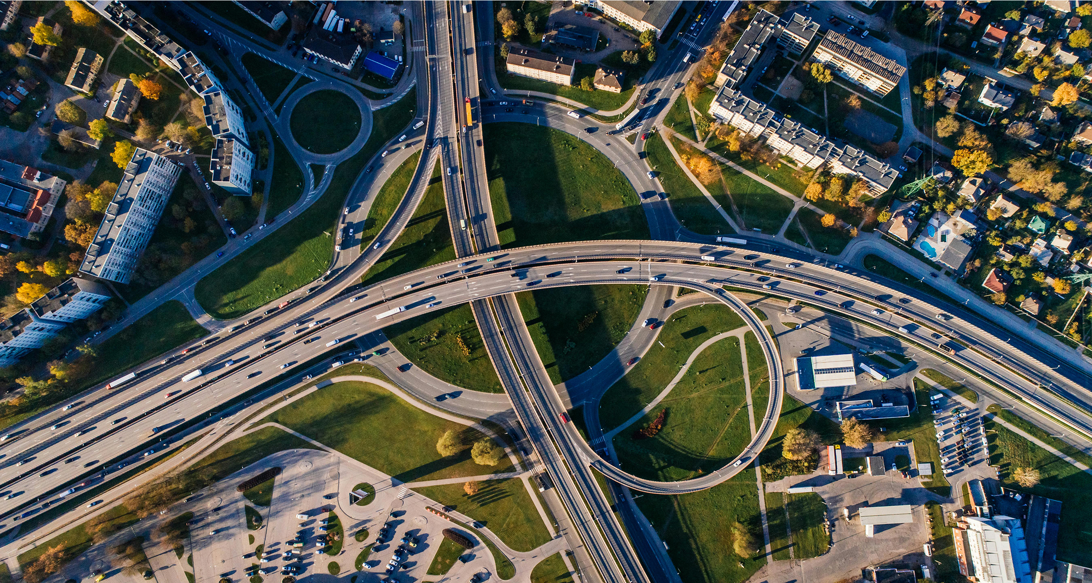
The Circulatory System₁₁₁
Complex organisms require a mechanism to transport nutrients throughout the body and remove waste products.
The circulatory stem is a complex network which supplies cells, tissues and organs with oxygen and nutrients, while removing waste.
The core of the circulatory system is the heart.
Gas exchange is an essential part of the circulatory system.
35.1 Figure 1
Aleksejs Bergmanis on Pexels. "Aerial view."
Notes:
Figure 1: Just as highway systems transport people and goods through a complex network, the circulatory system transports nutrients, gases, and wastes throughout the animal body.

Slide 4

The Circulatory System₂
In complex animals, the circulatory system is used to transport nutrients and gases throughout the body.
In complex organisms, simple diffusion would not be capable of accessing all parts of the body.
35.1 Figure 2
Flickr on Pexels. "Red panda."
Notes:
Figure 2: For large, complex animals, such as this red panda (Ailurus fulgens), bulk flow gas exchange is necessary to get oxygen to all parts of the body.

Slide 5
Circulatory System Architecture
The circulatory system is a network of cylindrical vessels, including the arteries, veins, and capillaries, that emanate from a pump: the heart.
In a closed circulatory system, blood is contained inside blood vessels and circulates unidirectionally from the heart, around the systemic circulatory route, and back to the heart again.
In an open circulatory system, the blood is pumped into a central cavity called a hemocoel. The blood is called hemolymph because it mixes with the interstitial fluid (the fluid that surrounds the body's cells).
As the heart beats and the animal moves, the hemolymph circulates around the organs within the body cavity and then re-enters the hearts through ostia (openings in the heart).

Slide 6
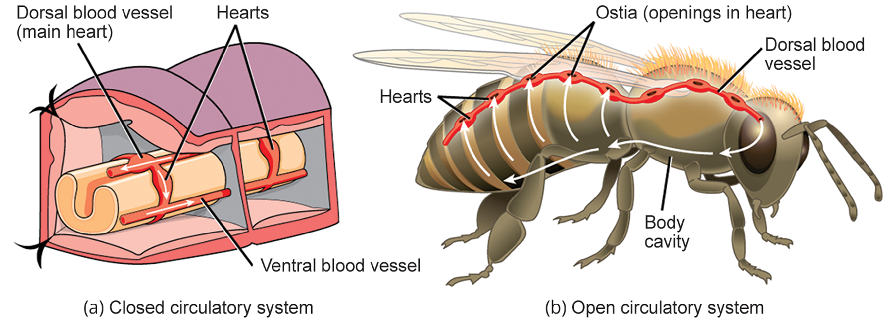
Lesson 35.1 Figure 3
CNX OpenStax on Wikimedia Commons. "Open and closed circulatory system."
Notes:
Figure 3: (a) In closed circulatory systems, the heart pumps blood through vessels that are separate from the interstitial fluid of the body. Most vertebrates and some invertebrates, like this annelid earthworm, have a closed circulatory system. (b) In open circulatory systems, a fluid called hemolymph is pumped through a blood vessel that empties into the body cavity. Hemolymph returns to the blood vessel through openings called ostia. Arthropods like this bee and most mollusks have open circulatory systems.

Slide 7
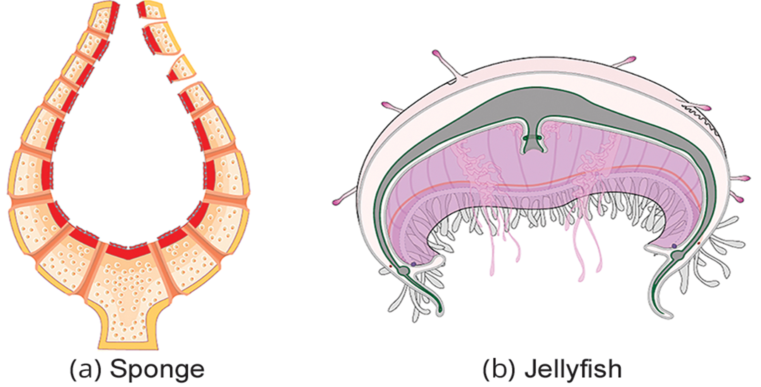
Circulatory System Variation in Animals₁
Simple animals such as sponges, and rotifer use simple diffusion instead of a circulatory system.
Jellies and comb jellies use diffusion in their epidermis and internally in the gastrovascular cavity.
The exchange of fluids is assisted by the pulsing of the jellyfish body.
35.1 Figure 4
CNX OpenStax on Wikimedia Commons. "Jellyfish and sponge circulatory system."

Slide 8
Circulatory System Variation in Animals₂
As more complex organisms evolved, so did more complex circulatory systems.
Most arthropods have open circulatory systems.
Closed circulatory systems are characteristic of vertebrates.
  There are significant differences in the structure of the heart and blood circulation among vertebrate groups.

Slide 9
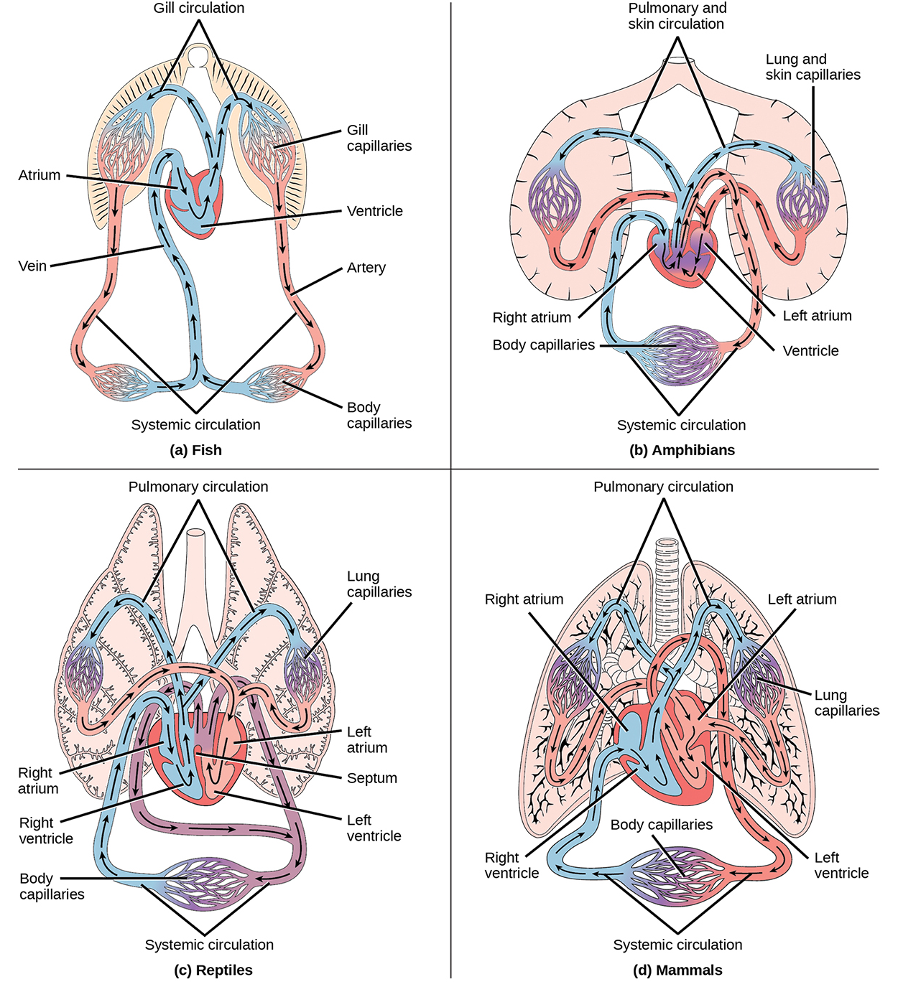
Lesson 35.1 Figure 5
CNX OpenStax on Wikimedia Commons. "Systemic circulation."
Notes:
Figure 5: (a) Fish have the simplest circulatory systems of the vertebrates. Blood flows unidirectionally from the two-chambered heart, through the gills, and then to the rest of the body. (b) Amphibians have two circulatory routes: one for oxygenation of blood through the lungs and skin, and the other to take oxygen to the rest of the body. The blood is pumped from a three-chambered heart with two atria (chambers where blood is received) and a single ventricle (a chamber from which blood is released to other parts of the body). (c) Reptiles also have two circulatory routes; however, blood is only oxygenated through the lungs. The heart has three chambers, but the ventricles are partially separated, so some mixing of oxygenated and deoxygenated blood occurs, except in crocodilians and birds. (d) Mammals and birds have the most efficient heart with four chambers that completely separate the oxygenated and deoxygenated blood; it pumps only oxygenated blood through the body and deoxygenated blood to the lungs.

Slide 10
Fish Circulatory Systems
Fish have a single circuit for blood flow and a two-chambered heart that has only a single atrium and a single ventricle. The atrium collects blood that has returned from the body and the ventricle pumps the blood to the gills where the blood absorbs oxygen and releases carbon dioxide.
The movement of blood between the heart and the gills is called gill circulation.
The blood continues through the rest of the body before arriving back at the atrium; the movement of blood between the body and the heart is called systemic circulation.
This unidirectional flow of blood produces a gradient of oxygenated to deoxygenated blood around the fish's systemic circuit and is called unidirectional circulation.

Slide 11
Amphibian, Reptile, Bird and Mammalian Circulatory Systems
In amphibians, reptiles, birds, and mammals, blood flow is directed in two circuits: one through the lungs and back to the heart, called pulmonary circulation, and the other throughout the rest of the body and its organs including the brain (systemic circulation).
In amphibians, gas exchange also occurs through the skin during pulmonary circulation and is referred to as pulmocutaneous circulation.

Slide 12
Think It Through
Describe pulmonary circulation.
Notes:
Originally an On Your Own. This is included here to use as a talking point or for a think-pair-share activity.

Slide 13
Amphibian Circulatory Systems
Instead of the two-chambered heart that fish have, amphibians have a three-chambered heart that has two atria and one ventricle.
The two atria receive blood from the pulmocutaneous and systemic circuit, and then some of the blood mixes in the heart's ventricle which reduces oxygenation efficiency.
The advantage is that high pressure in the vessels pushes blood to the lungs and body.
The mixing is mitigated by a ridge in the ventricle which diverts oxygen-rich blood to the systemic circulatory system and deoxygenated blood to the pulmocutaneous circuit.
For this reason, amphibians are often described as having double circulation.

Slide 14
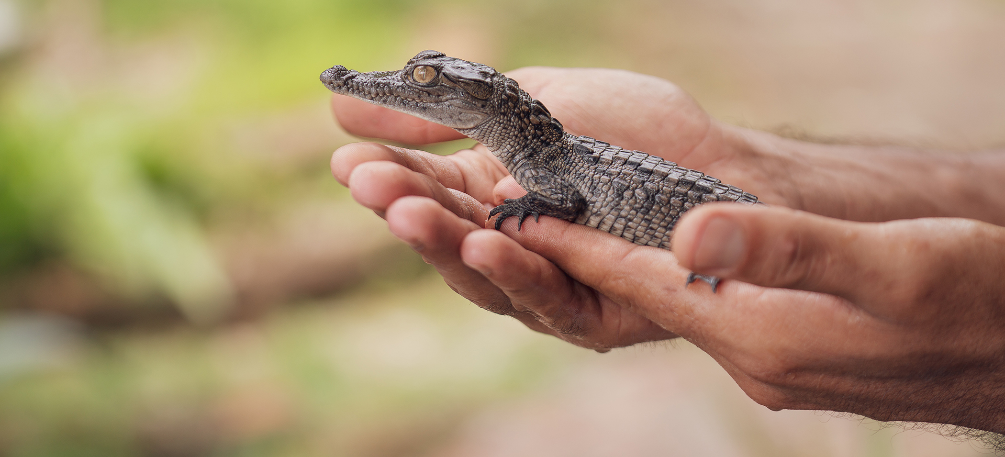
Reptile Circulatory Systems
Most reptiles also have a three-chambered heart that directs blood to the pulmonary and systemic circuits.
The ventricle is divided more effectively by a partial septum which results in less mixing of oxygenated and deoxygenated blood.
Crocodiles have multiple adaptations which aid in their ability to stay submerged.
35.1 Figure 6
Los Muertos Crew on Pexels. "Baby crocodile."

Slide 15
Mammals and Birds
In mammals and birds, the heart is also divided into four chambers: two atria and two ventricles.
Oxygenated blood is separated from the deoxygenated blood, which improves the efficiency of double circulation and is probably required for being warm-blooded.
The four-chambered heart of birds evolved separately from the four-chambered heart of mammals, rather than being inherited from a shared common ancestor.
  The independent evolution of the same or a similar biological trait is referred to as convergent evolution.

Slide 16
Reflection Question
Imagine how humans might be different if we evolved to have an open circulatory system. Come up with three ways the human body would be different.
For example, would a human with an open circulatory system need to be bigger, smaller, or about the same size as a human with a closed circulatory system?
Which would demand more energy?
If humans had an open circulatory system, do you think we could have accomplished the same feats and technological achievements we have?
Notes:
The reflection question is included here to use as a talking point or for a think-pair-share activity.

Slide 17
Summary
In most animals, the circulatory system is used to transport blood throughout the body.
Complex organisms use the circulatory system to transport gases, nutrient and waste throughout the body.
Circulatory systems can be open or closed systems.
While closed circulatory systems are characteristic of vertebrates, there is significant variation in the anatomy.

Slide 18

End of Hawkes Learning PowerPoint

