Slide 1
Lesson 35.2
Components of Blood

Slide 2
Objectives
Compare red and white blood cells.
Describe blood plasma and serum.
List the basic components of the blood.

Slide 3
Components of the Blood
Hemoglobin—the iron-containing protein—gives blood its red color and is responsible for distributing oxygen through the circulatory system.
Blood includes plasma (the liquid portion, which contains water, proteins, salts, lipids, and glucose), the cells (red and white blood cells), and cell fragments called platelets.
In humans, cellular components make up approximately 45% of the blood, and liquid plasma makes up 55%. Blood is 20% of a person's extracellular fluid and 8% of a person's weight.

Slide 4
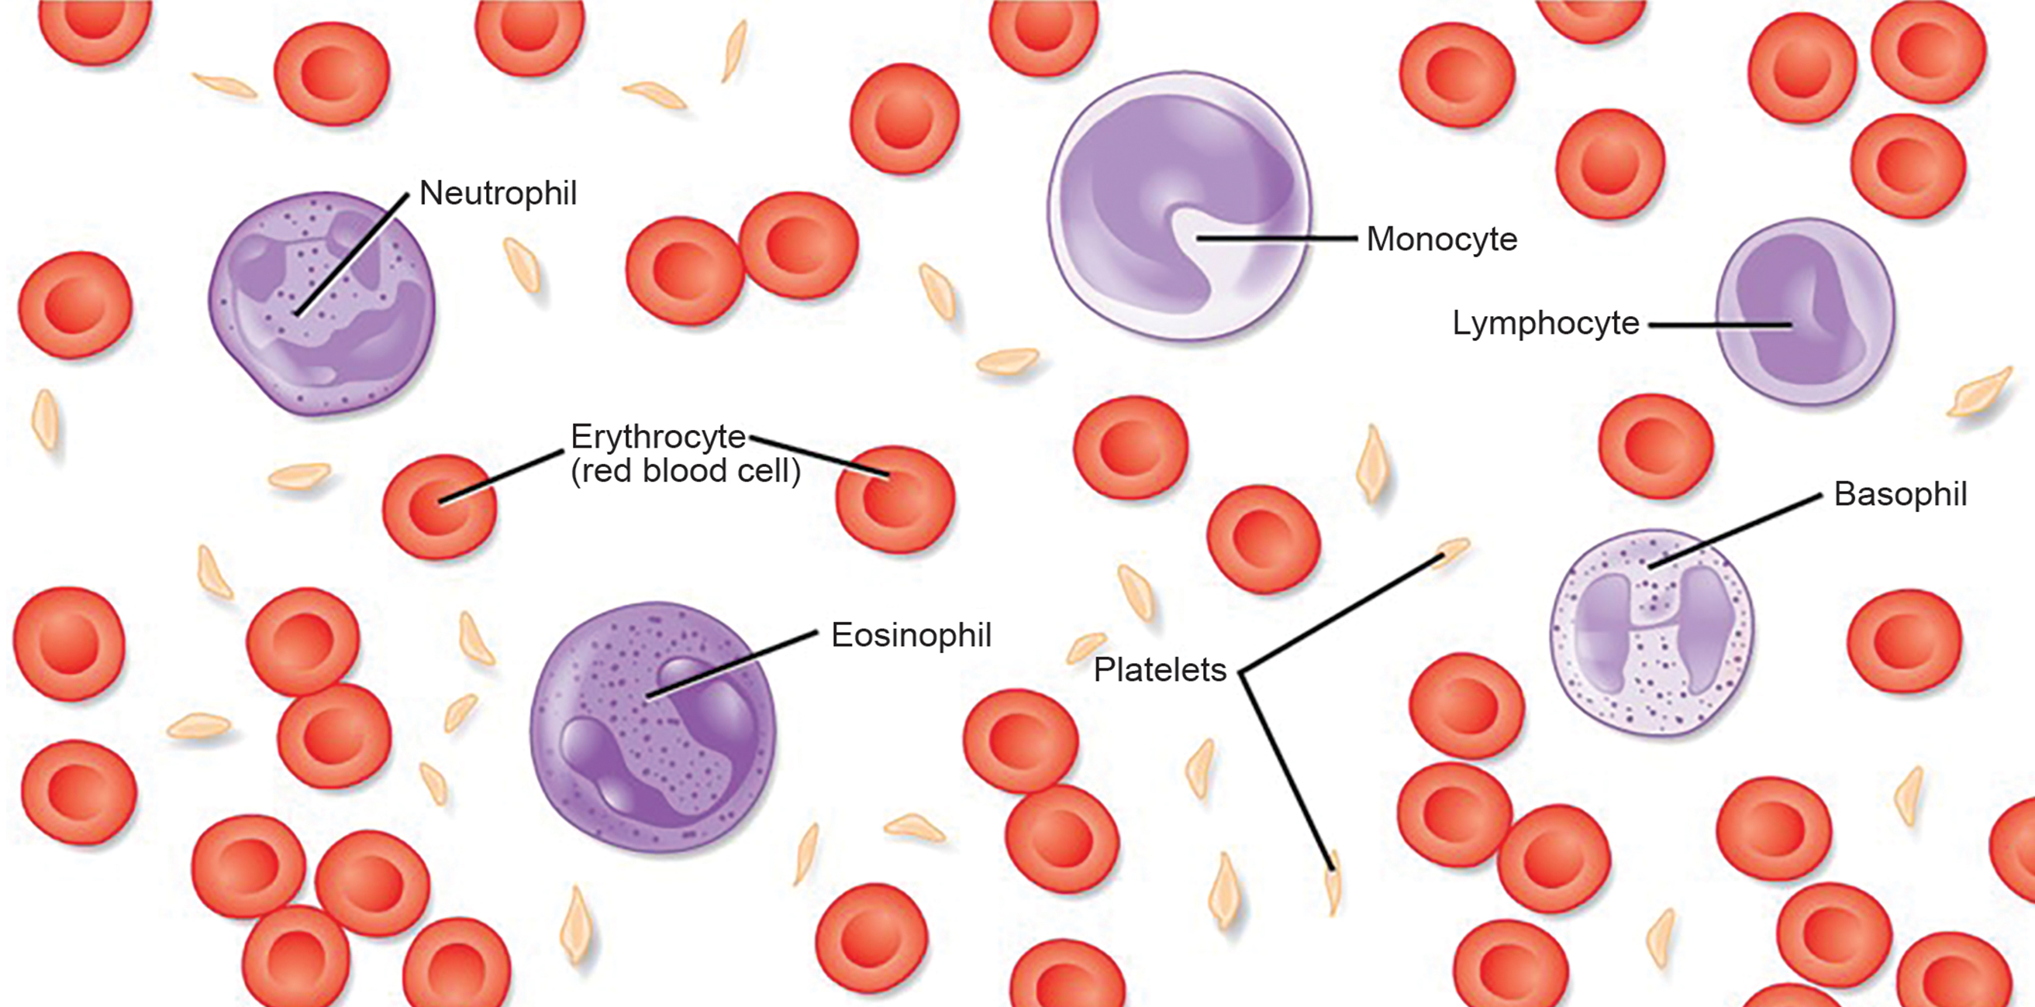
The Role of Blood in the Body
Blood is important for the regulation of the body's systems and homeostasis.
Blood helps maintain homeostasis by stabilizing blood pH, temperature, osmotic pressure and eliminating excess heat.
Blood supports growth by distributing nutrients and hormones and eliminating waste.
Blood also transports clotting factors and white blood cells to the site of infection.
35.2 Figure 1
CNX OpenStax on Wikimedia Commons. "Components of blood."
Notes:
Figure 1: The cells and cellular components of human blood are shown. Red blood cells, or erythrocytes, deliver oxygen (O2) to the cells and remove carbon dioxide (CO2). White blood cells—including neutrophils, monocytes, lymphocytes, eosinophils, and basophils—are involved in the immune response. Platelets form clots that prevent blood loss after injury.

Slide 5

Red Blood Cells
Red Blood Cells, or erythrocytes are specialized cells that circulate through the body delivering oxygen to the cells.
Blood's color comes from hemoglobin (an iron-containing protein).
Its principal job is to carry oxygen and to a lesser extent carbon dioxide.
Some animals have nucleated red blood cells while others are enucleated.
35.2 Figure 2
Los Muertos Crew on Pexels. "Bone marrow."

Slide 6
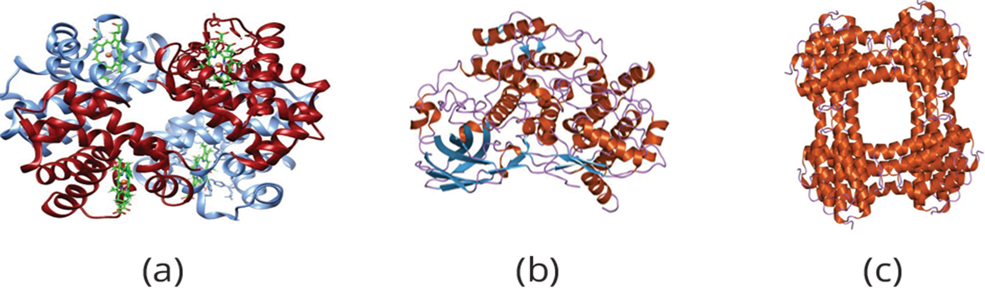
Oxygen Transport in Red Blood Cells₁
Not all organisms use hemoglobin as a methods of oxygen transport.
Hemocyanin, a blue-green copper-containing protein, is found in mollusks and some arthropods.
Chlorocruorin, a green-colored iron containing pigment, is found in four families of tubeworms.
Hemerythrin, a red, iron-containing protein, is found in dome polychaetes and other annelids.
35.2 Figure 3: (a) hemoglobin, (b) hemocyanin, and (c) hemerythrin
Belle2018 on Wikimedia Commons. "Hemoglobin."
Jawahar Swaminathan and MSD staff at the European Bioinformatics Institute on Wikimedia Commons. "Hemocyanin and hemerythrin."
Notes:
Figure 3: In most vertebrates, (a) hemoglobin delivers oxygen to the body and removes some carbon dioxide. Hemoglobin is composed of four protein subunits, two alpha chains and two beta chains, and a heme group that has iron associated with it. The iron reversibly associates with oxygen, and in doing so is oxidized from Fe2+ to Fe3+. In most mollusks and some arthropods, (b) hemocyanin delivers oxygen. This illustration shows arthropod hemocyanin. Unlike hemoglobin, hemocyanin is not carried in blood cells but floats free in the hemolymph. Copper, instead of iron, binds the oxygen, giving the hemolymph a blue-green color. In annelids, such as the earthworm, and some other invertebrates, (c) hemerythrin carries oxygen. Like hemoglobin, hemerythrin is carried in blood cells and has iron associated with it, but despite its name, hemerythrin does not contain heme.

Slide 7
Oxygen Transport in Red Blood Cells₂
The small size and large surface area of red blood cells allows for rapid diffusion of oxygen and carbon dioxide.
Hemoglobin also binds nitrous oxide (NO).
Nitroglycerin, is converted to NO to help relax blood vessels and increase oxygen flow in the body.
Surface glycoproteins and glycolipids produce the different blood types in humans.

Slide 8
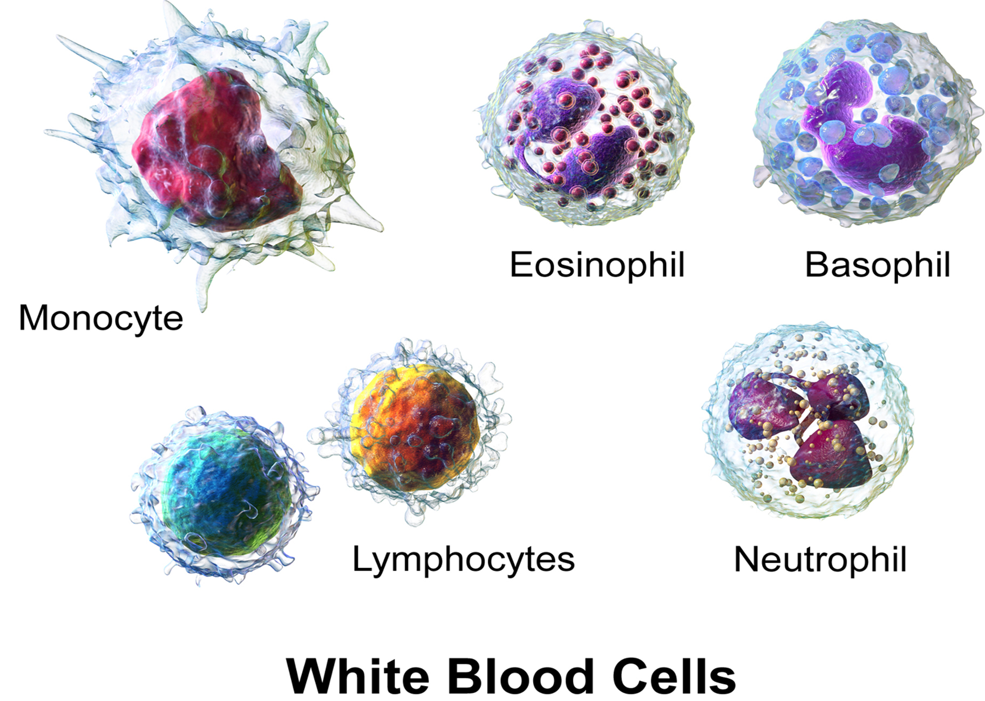
White Blood Cells₁
White blood cells, also called leukocytes, make up approximately 1% of the cells in blood by volume. White blood cells are primarily involved in the immune response to identify and target pathogens.
White blood cells have nuclei and do not contain hemoglobin.
Granulocytes, which contain neutrophils, eosinophils and basophils.
Agranulocytes, which include monocytes and lymphocytes.
35.2 Figure 4
BruceBlaus on Wikimedia Commons. "White blood cells."
Notes:
Figure 4: Granulocytes—including neutrophils, eosinophils, and basophils—are characterized by a lobed nucleus and granular inclusions (stored substances, such as enzymes destined for secretion from the cell) in the cytoplasm. Granulocytes are typically first responders during injury or infection. Agranulocytes include lymphocytes and monocytes. Lymphocytes, including B and T cells, are responsible for adaptive immune response. Monocytes differentiate into macrophages and dendritic cells, which in turn respond to infection or injury.

Slide 9
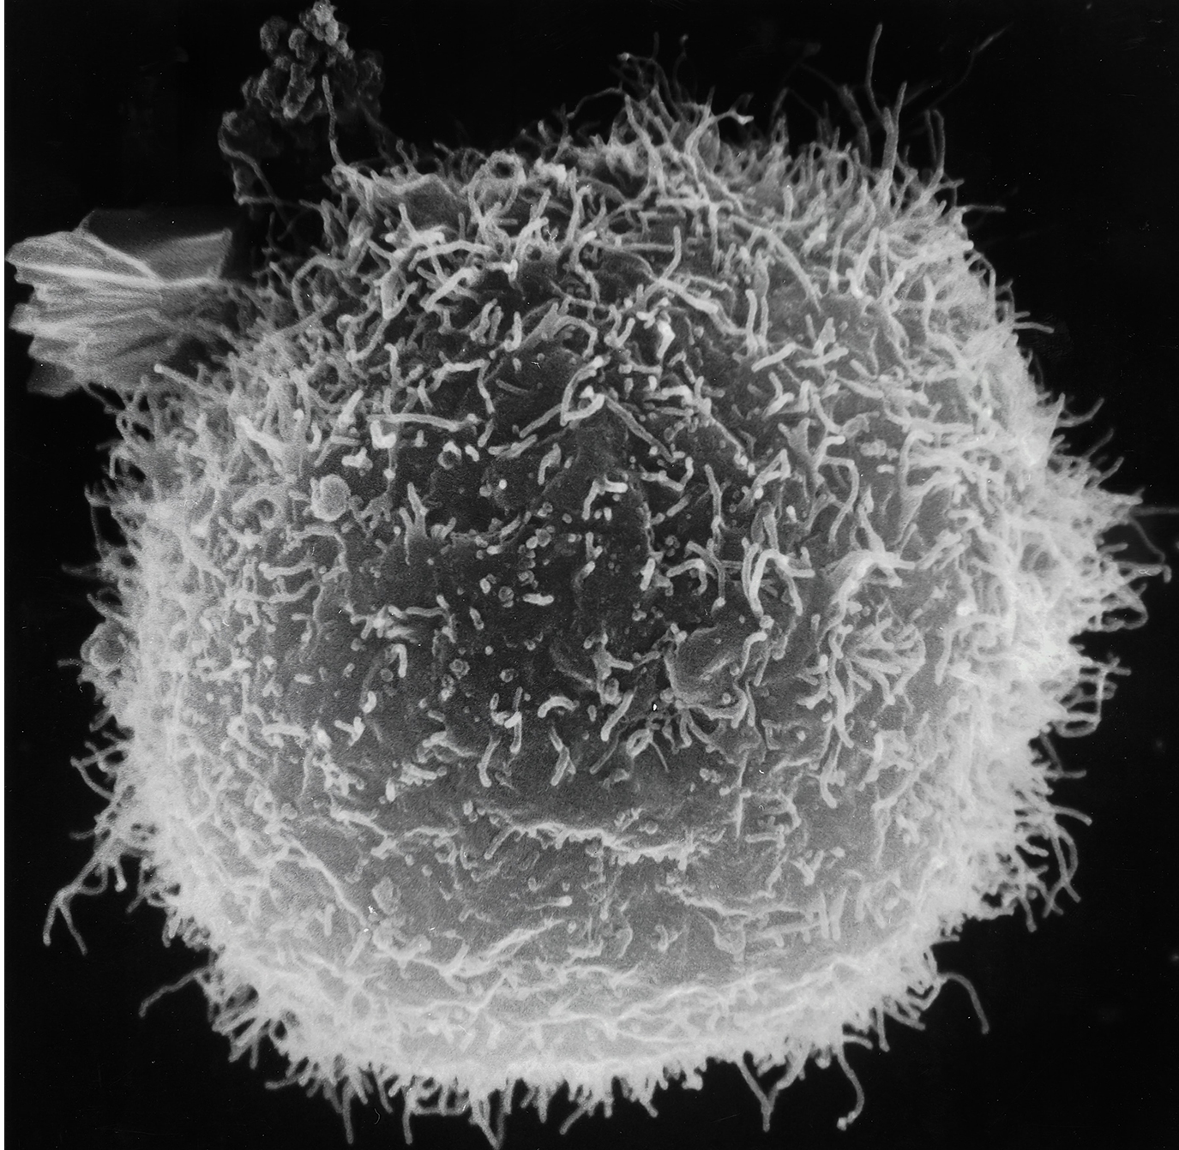
White Blood Cells₂
Lymphocytes are the primary cells of the immune system and include B cells, T cells and natural killer cells.
B cells destroy bacteria and inactivate their toxins.
T cells attack viruses.
Natural killer cells attack a variety of infectious microbes and certain tumor cells.
35.2 Figure 5
National Cancer Institute on Unsplash. "Macrophage."

Slide 10
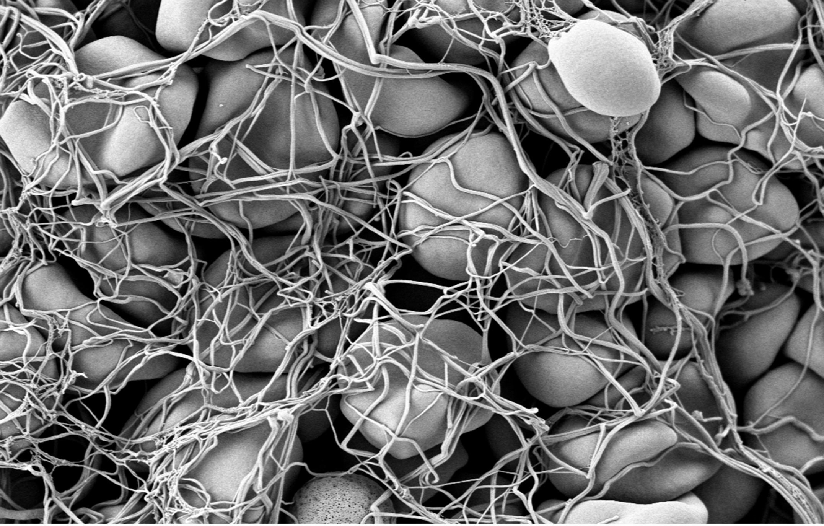
Platelets and Coagulation Factors₁
Blood must clot wounds and prevent excess blood loss.
Platelets are attracted to the wound where they adhere and interact with other coagulation factors, causing a clot to form.
35.2 Figure 6
Fuzis on Wikimedia Commons. "Blood clot."
Notes:
Figure 6: This scanning electron micrograph of a blood clot shows red blood cells trapped in a fibrin network.

Slide 11
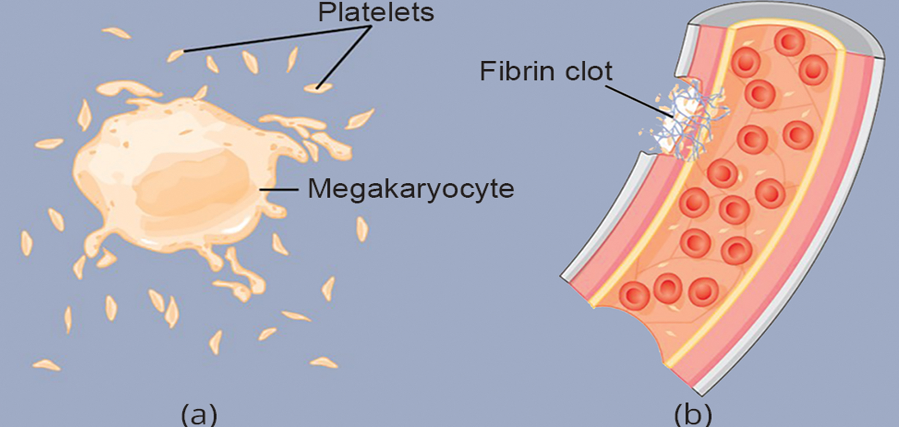
Platelets and Coagulation Factors₂
Many clotting factors rely on Vitamin K to work.
Many platelets converge and stick together at the wound site to form a platelet plug.
Each platelet is disc shaped, 2–4 µm in diameter and do not contain a nucleus.
35.2 Figure 7: (a) Platelets are formed from large cells called megakaryocytes. (b) Platelets are required for blood clotting.
CNX OpenStax on Wikimedia Commons. "Platelets."
Notes:
Figure 7: (a) Platelets are formed from large cells called megakaryocytes. The megakaryocyte breaks up into thousands of fragments that become platelets. (b) Platelets are required for blood clotting. The platelets collect at a wound site in conjunction with other clotting factors, such as fibrinogen, to form a fibrin clot that prevents blood loss and allows the wound to heal.

Slide 12
Plasma and Serum
The liquid component of blood is called plasma.
Plasma consists of 90% water along with various substances required for maintaining to body's pH, osmotic load and for protecting the body.
The plasma component of blood without the coagulation factors is called the serum.
Serum is similar to interstitial fluid in that the correct composition of key ions acting as electrolytes is essential for normal functioning of muscles and nerves.
Human serum albumin is the most abundant protein in human blood plasma and is synthesized in the liver.

Slide 13
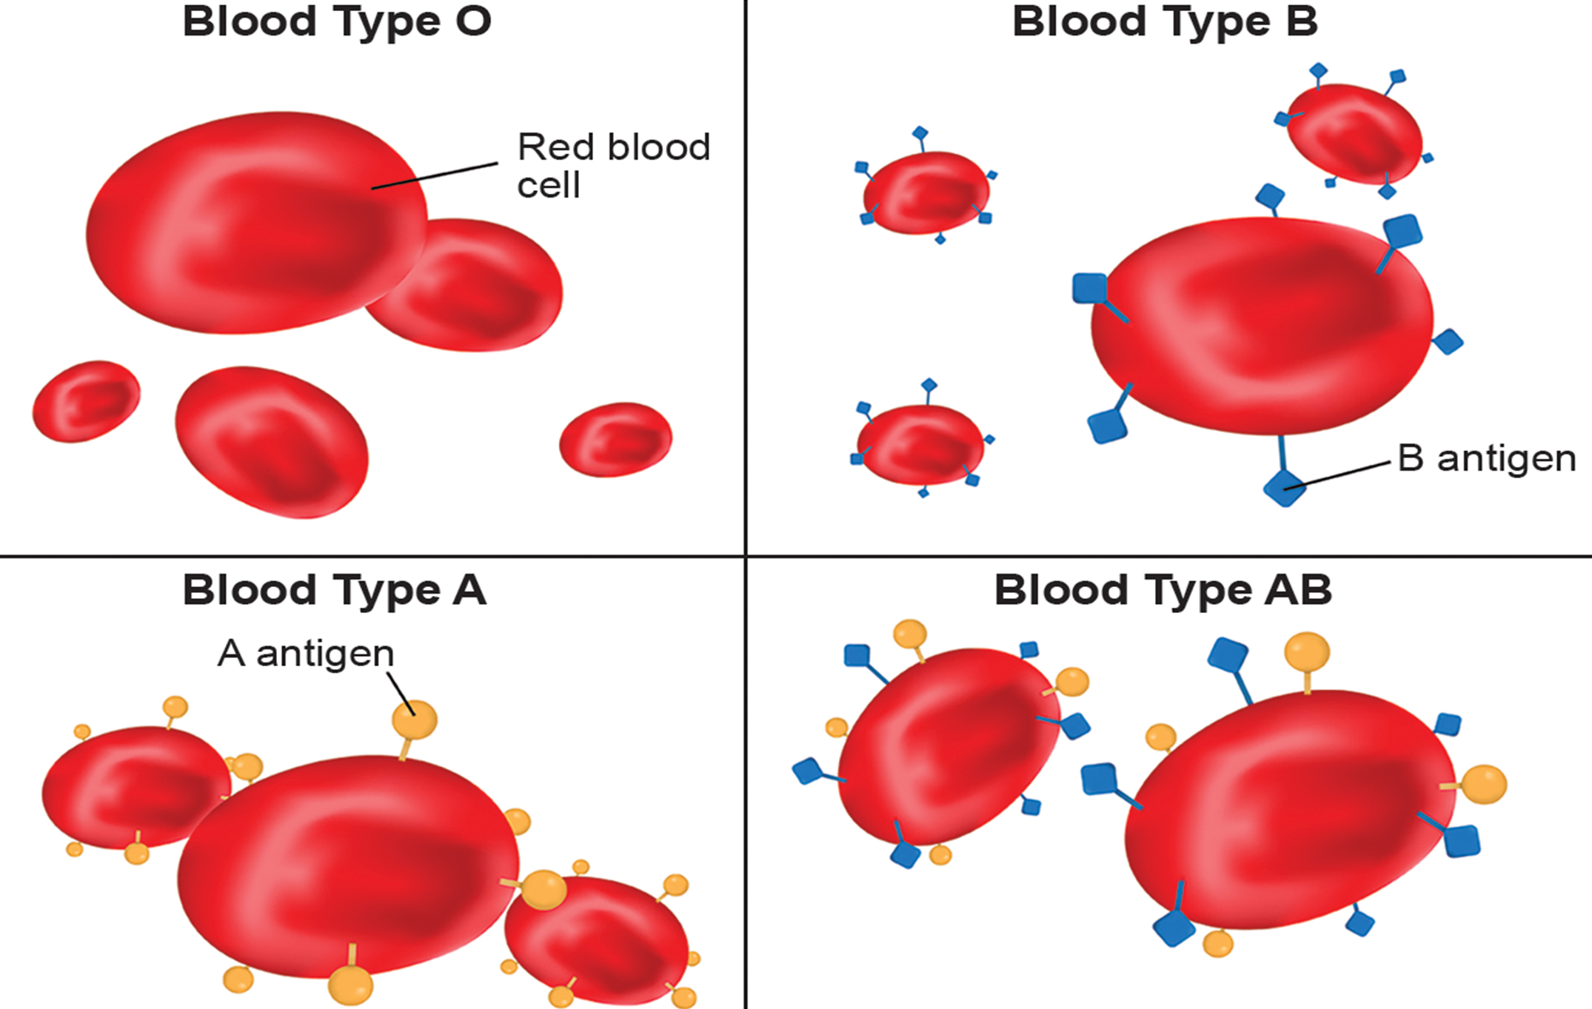
Evolution Connection
The blood groups are created by surface glycolipids on the red blood cells.
Blood Cells may have either the A or B type glycoprotein, both (AB blood type) or neither (type O).
Type O is considered a universal donor.
Most people have the Rh antigen (Rh+) and do not have the anti-Rh antigen antibodies in their blood.
35.2 Figure 8
Notes:
Figure 8: Human red blood cells may have either type A or B glycoproteins on their surface, both glycoproteins combined (AB), or neither (O). The glycoproteins serve as antigens and can elicit an immune response in a person who receives a transfusion containing unfamiliar antigens. Type O blood, which has no A or B antigens, does not elicit an immune response when injected into a person of any blood type. Thus, O is considered the universal donor. Persons with type AB blood can accept blood from any blood type; type AB is considered the universal acceptor.

Slide 14
Summary
Specific components of the blood include red blood cells, white blood cells, platelets, and the plasma, which contains coagulation factors and serum.
Blood is important for regulation of many body functions, such as the body's pH, temperature, osmotic pressure, and the circulation of nutrients and removal of waste.
White blood cells are involved in the immune response to identify and target invading bacteria, viruses, and other foreign organisms.

Slide 15

End of Hawkes Learning PowerPoint

