Slide 1
Lesson 35.4
Blood Flow and Blood Pressure Regulation

Slide 2
Objectives
Describe how blood pressure is regulated.
Describe the system of blood flow through the body.

Slide 3
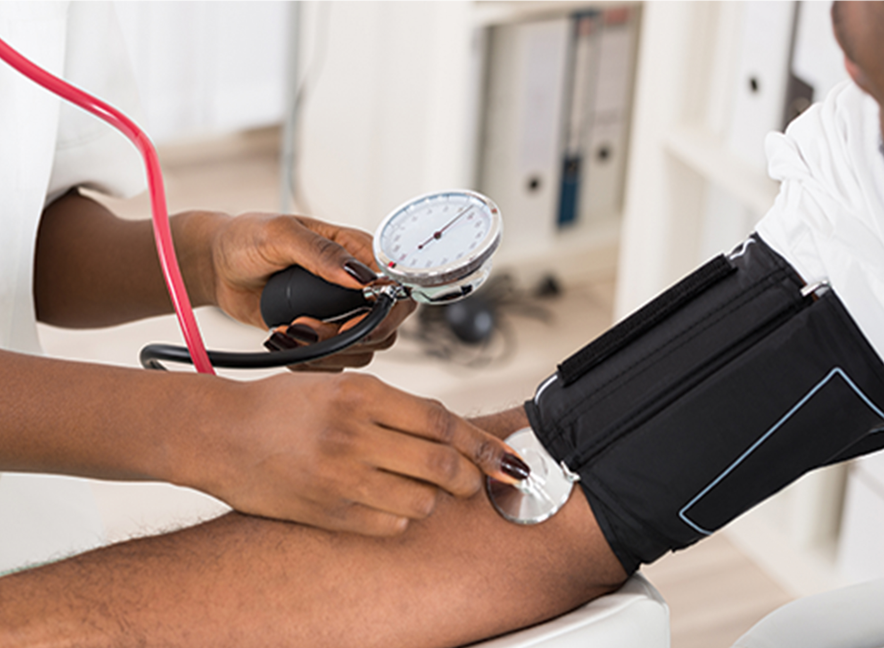
Blood Flow and Blood Pressure Regulation
Blood pressure (BP) is the pressure exerted by blood on the walls of a blood vessel that helps to push blood through the body.
Systolic blood pressure measures the amount of pressure that blood exerts on vessels when the heart contracts.
Diastolic blood pressure measures the pressure in the vessels when the heart is relaxed between heartbeats.
35.4 Figure 1
Notes:
Figure 1: Blood pressure is an important indicator of cardiovascular health. The optimal systolic blood pressure for humans is 120 mmHg. The optimal diastolic blood pressure is 80 mmHg.

Slide 4
How Blood Flows through the Body₁
With each pump of the heart, blood is pushed away from the heart at high velocity and pressure.
As blood moves from the arteries to the arterioles to the capillaries, the rate of blood movement slows due to the increased combined diameter of the capillary beds.
The slow rate of blood movement allows for nutrient and waste exchange and diffusion of fluid into the interstitial space.

Slide 5
How Blood Flows through the Body₂
After the blood has passed through the capillary beds to the venules, veins, and finally to the main venae cavae, the rate of flow increases.
Blood primarily moves in the veins by the rhythmic movement of smooth muscle in the vessel wall and by the action of the skeletal muscle as the body moves.
Most veins move blood against the pull of gravity and blood does not flow backward in the veins due to one-way valves.

Slide 6
Think It Through₁
How does the rate of blood flow change as blood travels through the body?
Notes:
Originally an On Your Own. This is included here to use as a talking point or for a think-pair-share activity.

Slide 7
How Blood Flows through the Body₃
Blood flow through the capillary beds is regulated depending on the body's needs and is directed by nerve and hormone signals.
During exercise, blood is diverted to the skeletal muscles through vasodilation while blood to the digestive system is lessened through vasoconstriction.
The blood entering some capillary beds is controlled by small muscles, called precapillary sphincters.
If the sphincters are open, the blood will flow into the associated branches of the capillary bed.
At any given moment, only about 5–10% of our capillary beds have blood flowing through them.

Slide 8
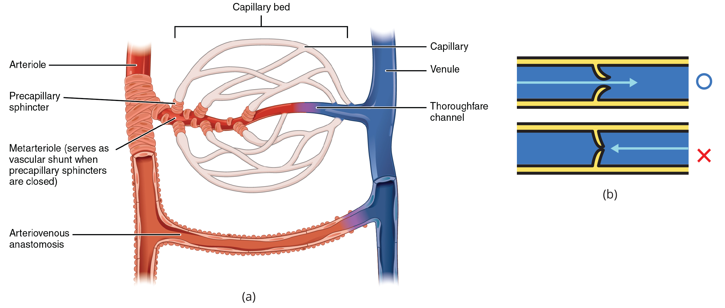
Lesson 35.4 Figure 2
OpenStax College on Wikimedia Commons. "Capillary bed."
ZooFari on Wikimedia Commons. "Venous valve."
Notes:
Figure 2: (a) Precapillary sphincters are rings of smooth muscle that regulate the flow of blood through capillaries; they help control the location of blood flow to where it is needed. (b) Valves in the veins prevent blood from moving backward.

Slide 9
Think It Through₂
Varicose veins are veins that become enlarged because the valves no longer close properly, allowing blood to flow backward. Varicose veins are often most prominent in the legs.
Why do you think this is the case?
Notes:
Originally an On Your Own. This is included here to use as a talking point or for a think-pair-share activity.

Slide 10
Interstitial Fluid and the Lymphatic System₁
Proteins and other large solutes cannot leave the capillaries.
The loss of the watery plasma creates a hyperosmotic solution within the capillaries, especially near the venules.
This causes about 85% of the plasma that leaves the capillaries to eventually diffuse back into the capillaries near the venules.
The remaining 15% of blood plasma drains out from the interstitial fluid into nearby lymphatic vessels.

Slide 11
Interstitial Fluid and the Lymphatic System₂
The lymph fluid passes through lymph nodes before it returns to the heart via the vena cava.
Lymph nodes are specialized organs that filter the lymph by percolation through a maze of connective tissue filled with white blood cells.
The white blood cells remove infectious agents, such as bacteria and viruses, to clean the lymph before it returns to the bloodstream.

Slide 12
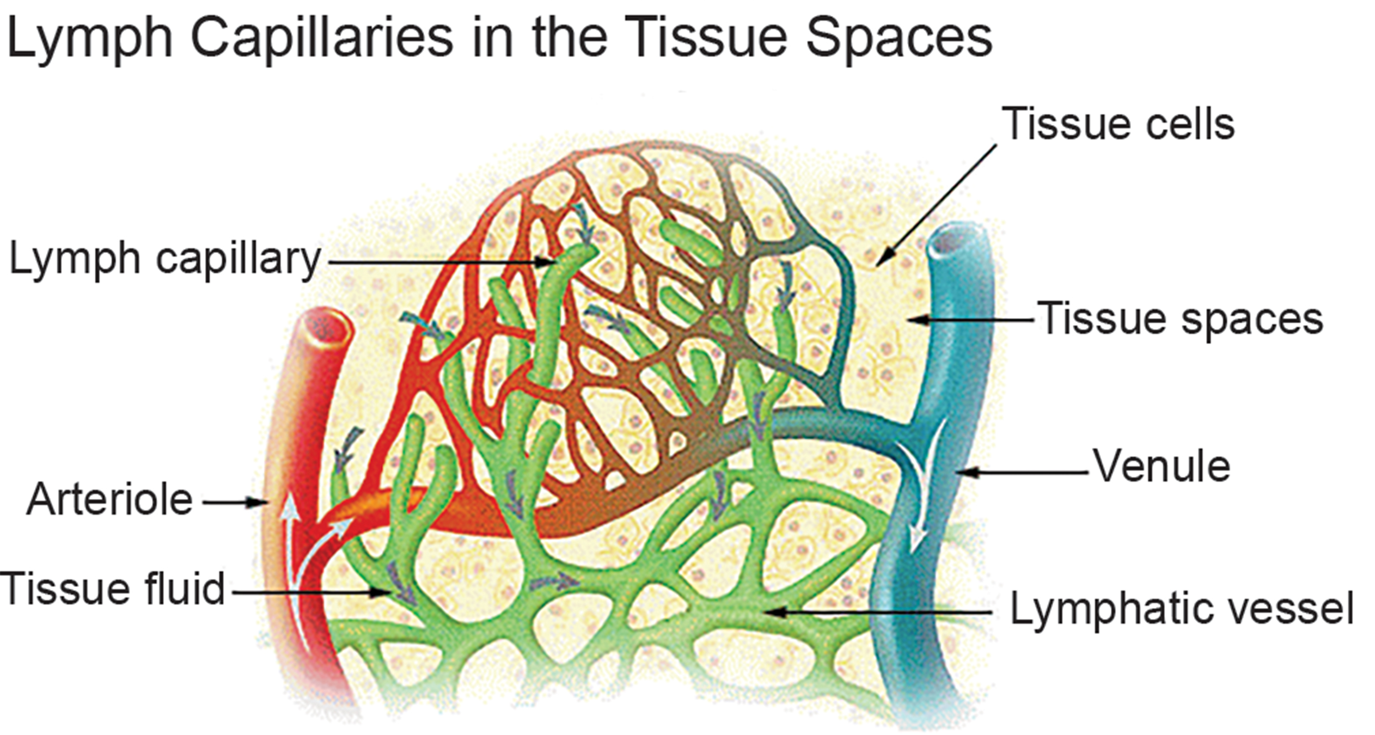
Lesson 35.4 Figure 3
SEER on Wikimedia Commons. "Lymph capillaries."
Notes:
Figure 3: Fluid from the capillaries moves into the interstitial space and lymph capillaries by diffusion down a pressure gradient; this can also occur by osmosis. Out of 7,200 liters of fluid pumped by the average heart in a day, over 1,500 liters are filtered.

Slide 13
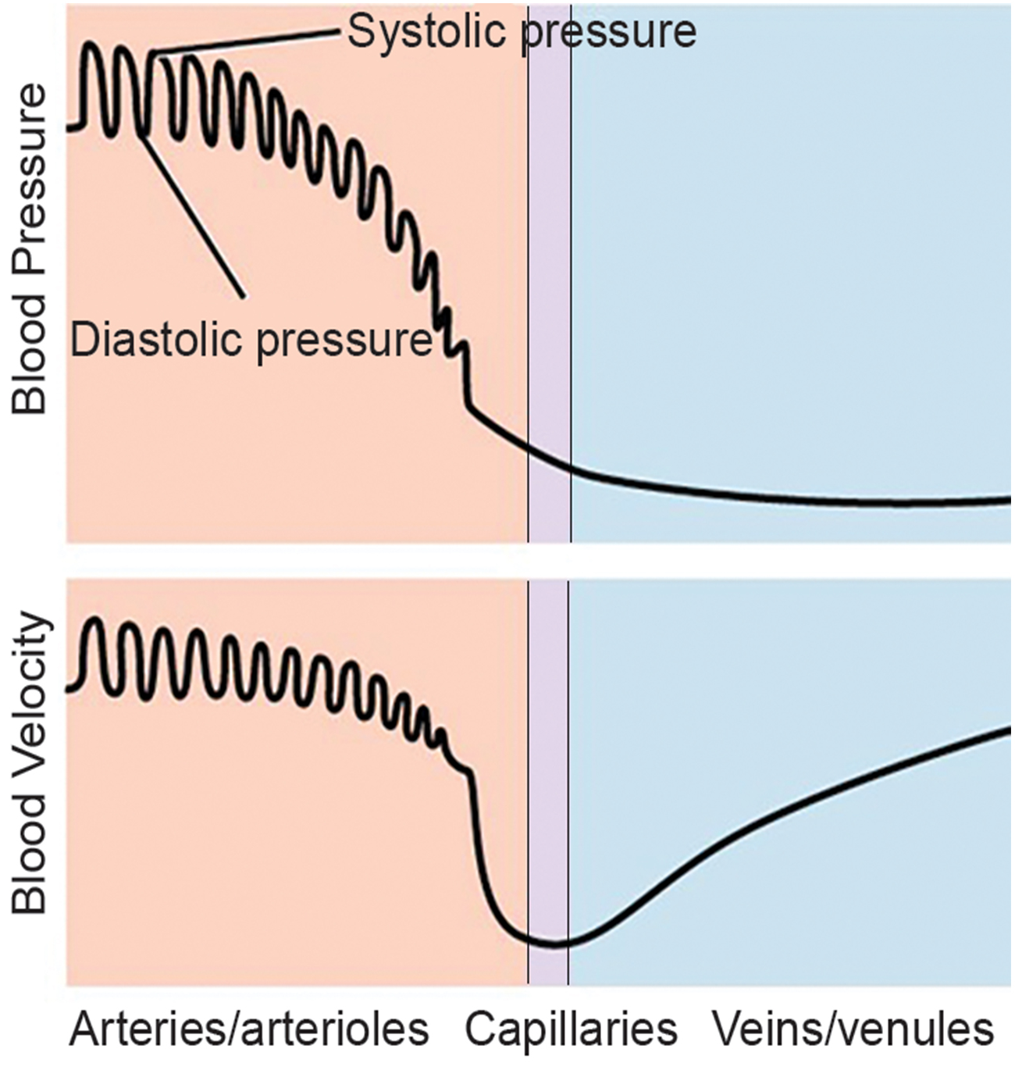
Blood Pressure
The pressure of the blood flow in the body is produced by the hydrostatic pressure of blood against the walls of the blood vessels.
During systole, when new blood is entering the arteries, the artery walls stretch to accommodate the increase of pressure of the extra blood; during diastole, the walls return to normal because of their elastic properties.
Throughout the cardiac cycle, the blood continues to empty into the arterioles at a relatively even rate. This resistance to blood flow is called peripheral resistance.
35.4 Figure 4
CNX OpenStax on Wikimedia Commons. "Blood pressure."
Notes:
Figure 4: Blood pressure is related to the blood velocity in the arteries and arterioles. In the capillaries and veins, the blood pressure continues to decrease but velocity increases.

Slide 14
Blood Pressure Regulation
Cardiac output is the volume of blood pumped by the heart in one minute. It is calculated by multiplying the number of heart contractions that occur per minute (heart rate) times the stroke volume (the volume of blood pumped into the aorta per contraction of the left ventricle).
Cardiac output can be increased by increasing heart rate, or stroke volume.
Stress triggers a decrease in the diameter of the blood vessels, consequently increasing blood pressure.
Changes can also be caused by nerve signals or hormones, and even standing up or lying down can have a great effect on blood pressure.

Slide 15
Vertebrate Diversity in Blood Circulation
Blood circulation has evolved differently in vertebrates and may show variation in different animals for the required amount of pressure, organ and vessel location, and organ size.
Animals with long necks and those that live in cold environments have distinct blood pressure adaptations.
Long-necked animals have higher blood pressure, but also have valves and feedback mechanisms which make it possible to drop the head to drink water.
Cold water animals maintain blood temperature by having the arteries and veins close to each other to allow for heat exchange, as well as thick layers of blubber.

Slide 16
Summary
Blood primarily moves through the body by the rhythmic movement of smooth muscle in the vessel wall and by the action of the skeletal muscle as the body moves.
Blood flow through the capillary beds is controlled by precapillary sphincters to moderate flow, depending on the body's needs, and is directed by nerve and hormone signals.
The blood pressure of the systole phase and diastole phase gives the two pressure readings for blood pressure.

Slide 17

End of Hawkes Learning PowerPoint

