Slide 1
Lesson 36.1
Systems of Gas Exchange

Slide 2
Objectives
Describe the passage of air from the outside environment to the lungs.
Explain how the lungs are protected from particulate matter.

Slide 3
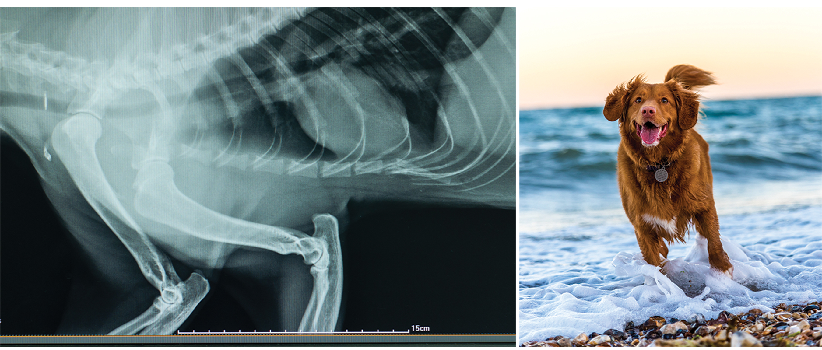
Breathing
Breathing in an involuntary event.
When they aren't exerting themselves, humans breathe approximately 15 times per minute on average. Canines have a respiratory rate of about 15–30 breaths per minute.
36.1 Figure 1
Oscar Sutton on Unsplash. "Dog running."
Notes:
Figure 1: (left) Lungs, which appear as nearly transparent tissue surrounding the heart in this X-ray of a dog, are the central organs of the respiratory system. The left lung is smaller than the right lung to accommodate space for the heart. (right) A dog's nose has a slit on the side of each nostril. When tracking a scent, the slits open, blocking the front of the nostrils. This allows the dog to exhale though the now-open area on the side of the nostrils without losing the scent that is being followed.

Slide 4
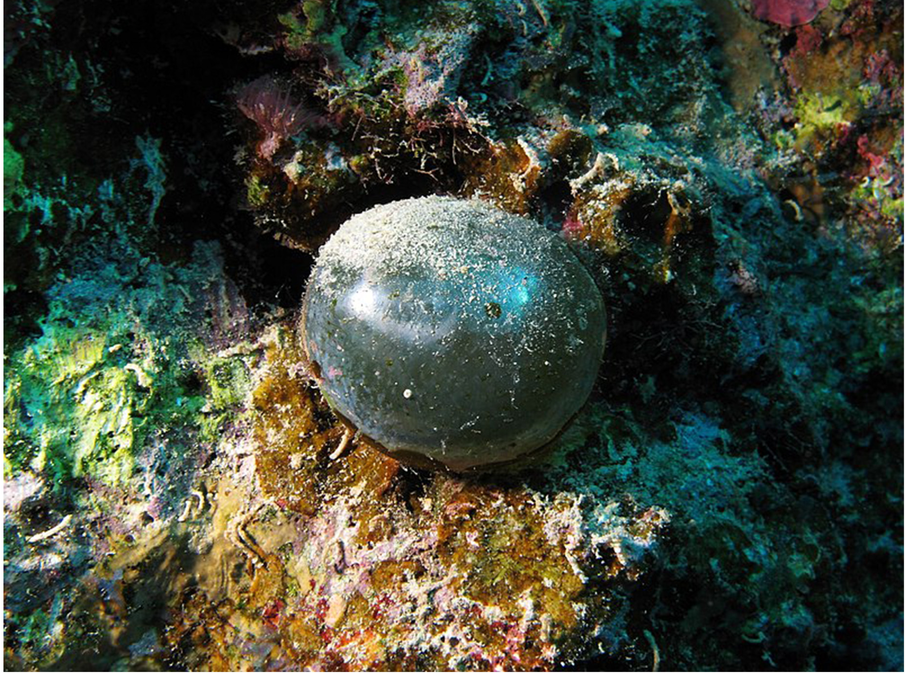
Systems of Gas Exchange
The primary function of the respiratory system is to deliver oxygen to the cells of the body's tissues and remove carbon dioxide—a cell waste product. The main structures of the human respiratory system are the nasal cavity, the trachea, and the lungs.
In unicellular organisms, diffusion across the cell membrane is sufficient for supplying oxygen to the cell.
36.1 Figure 2
Alexander Vasenin on Wikimedia Commons. "Valonia ventricosa."
Notes:
Figure 2: The cell of the unicellular alga Valonia ventricosa is one of the largest known, reaching 1 to 5 centimeters in diameter. Like all single-celled organisms, V. ventricosa exchanges gases across the cell membrane.

Slide 5
Diffusion
Diffusion is a slow, passive transport process in which material travels from regions of high concentration to low concentration until equilibrium is reached.
For diffusion to be a feasible means of providing oxygen to the cell, the rate of oxygen uptake must match the rate of diffusion across the membrane.
Dependance on diffusion to obtain oxygen and remove carbon dioxide remains feasible only for small organisms or those with highly flattened bodies, such as many flatworms (Platyhelminthes).
Larger organisms had to evolve specialized respiratory tissues—such as gills, lungs, and respiratory passages accompanied by complex circulatory systems—to transport oxygen throughout their entire body.

Slide 6
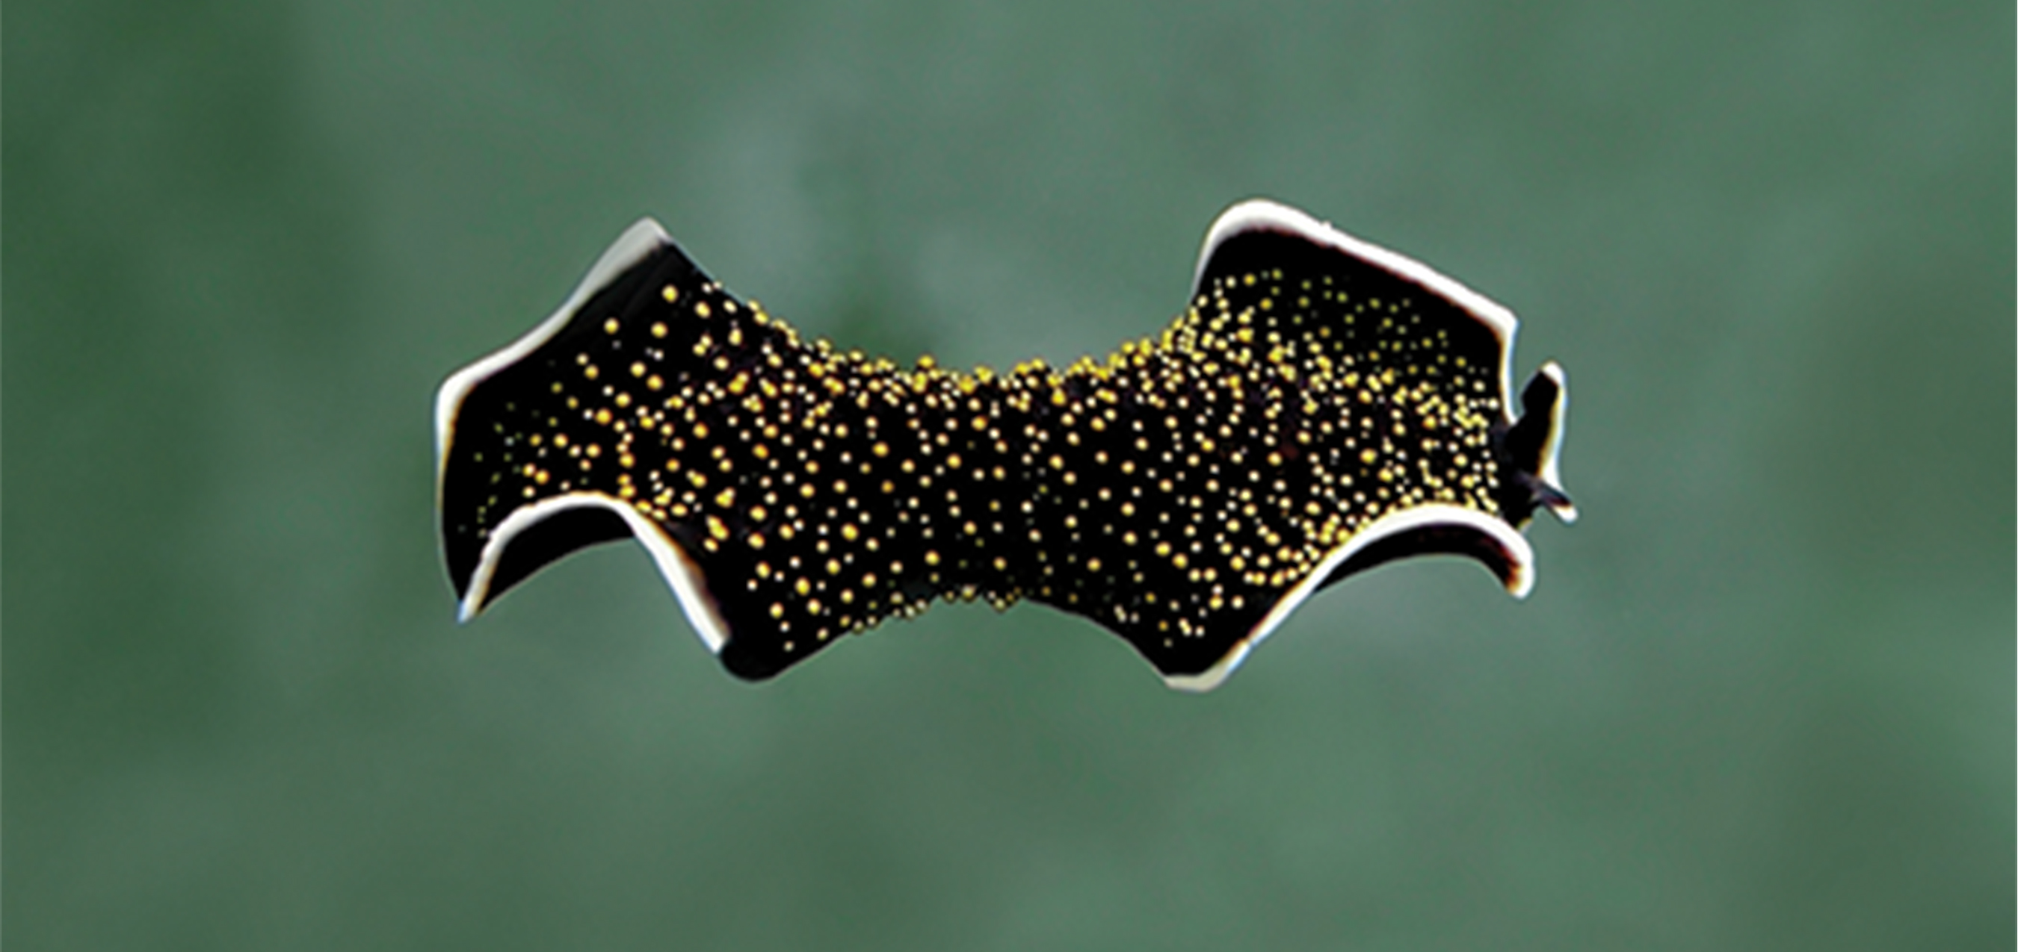
Direct Diffusion
Diffusion across the outer membrane is sufficient to meet the oxygen needs of small multicellular organisms.
Gas exchange by direct diffusion across surface membranes is efficient for organisms less than 1 mm in diameter.
In cnidarians and flatworms, every cell in the body is close to the external environment.
Their cells are kept moist, and gases diffuse quickly via direct diffusion.
Flatworms are small, literally flat worms, which "breathe" through diffusion across the outer membrane.
36.1 Figure 3
Betty Wills on Wikimedia Commons. "Yellow papillae flatworm."
Notes:
Figure 3: This yellow papillae flatworm's process of respiration works by diffusion across the outer membrane.

Slide 7
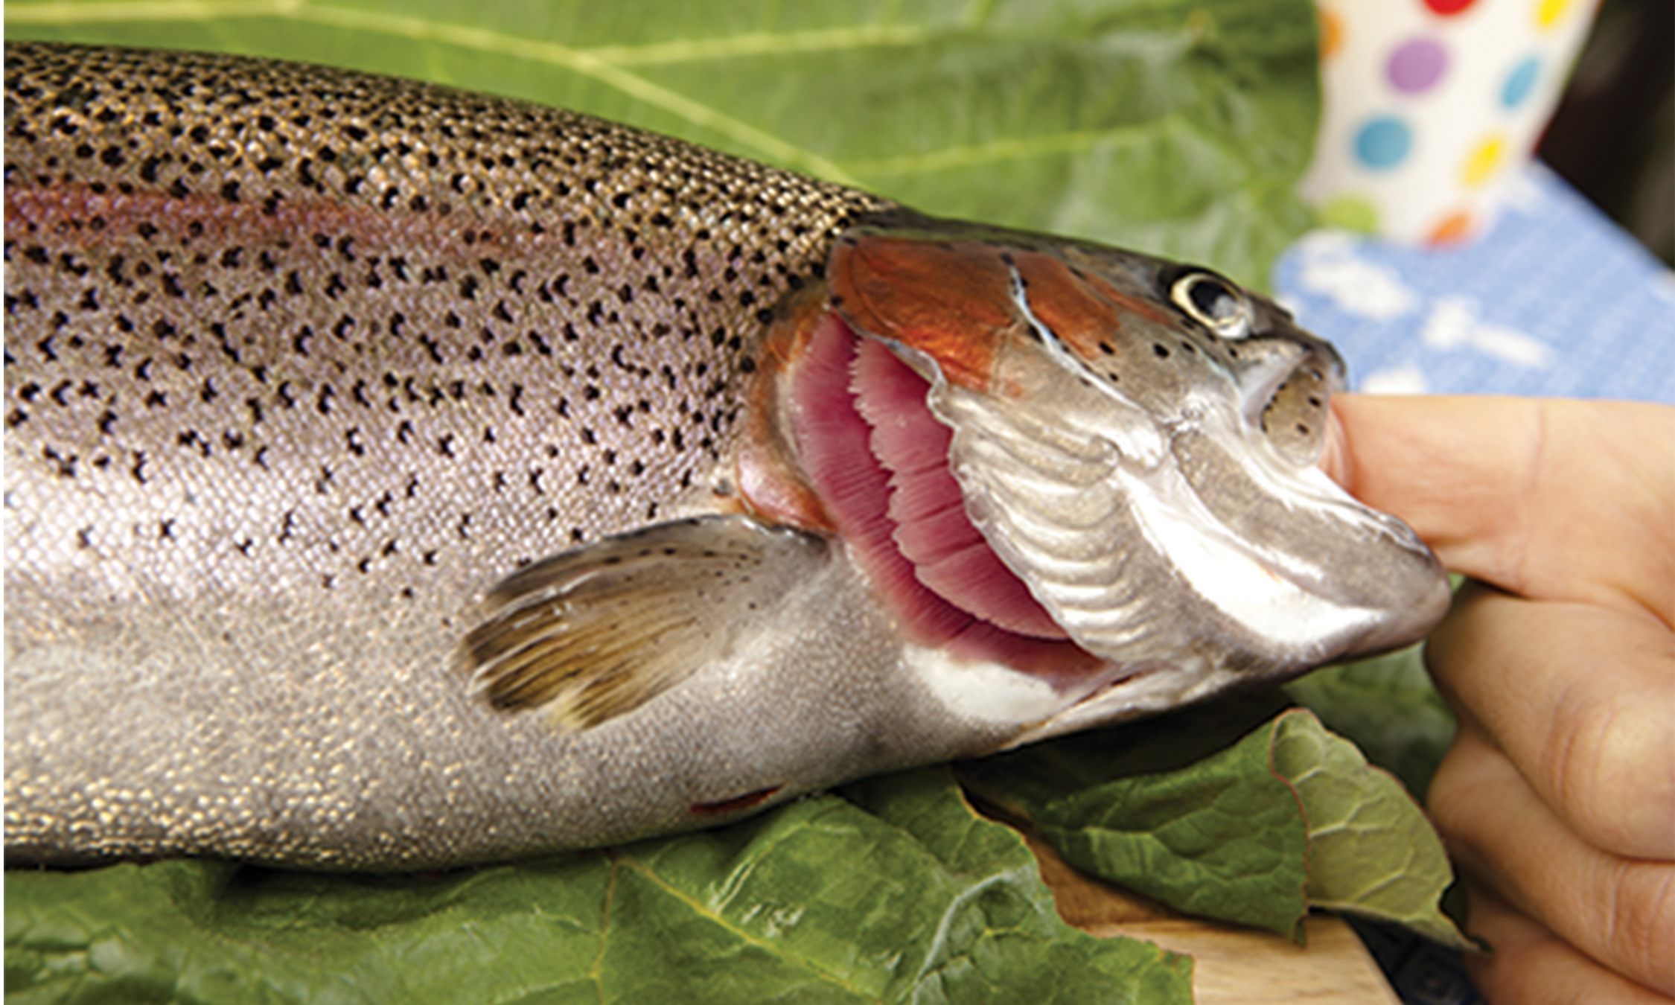
Skin and Gills
Earthworms and amphibians use their skin (integument) as a respiratory organ.
The respiratory surface must be kept moist for the gases to dissolve and diffuse across cell membranes.
Organisms that live in water need to obtain oxygen (O₂) from the water.
Gills are thin tissue filaments that are highly branched and folded.
When water passes over the gills, the dissolved oxygen in water rapidly diffuses across the gills into the bloodstream.
36.1 Figure 4

Slide 8
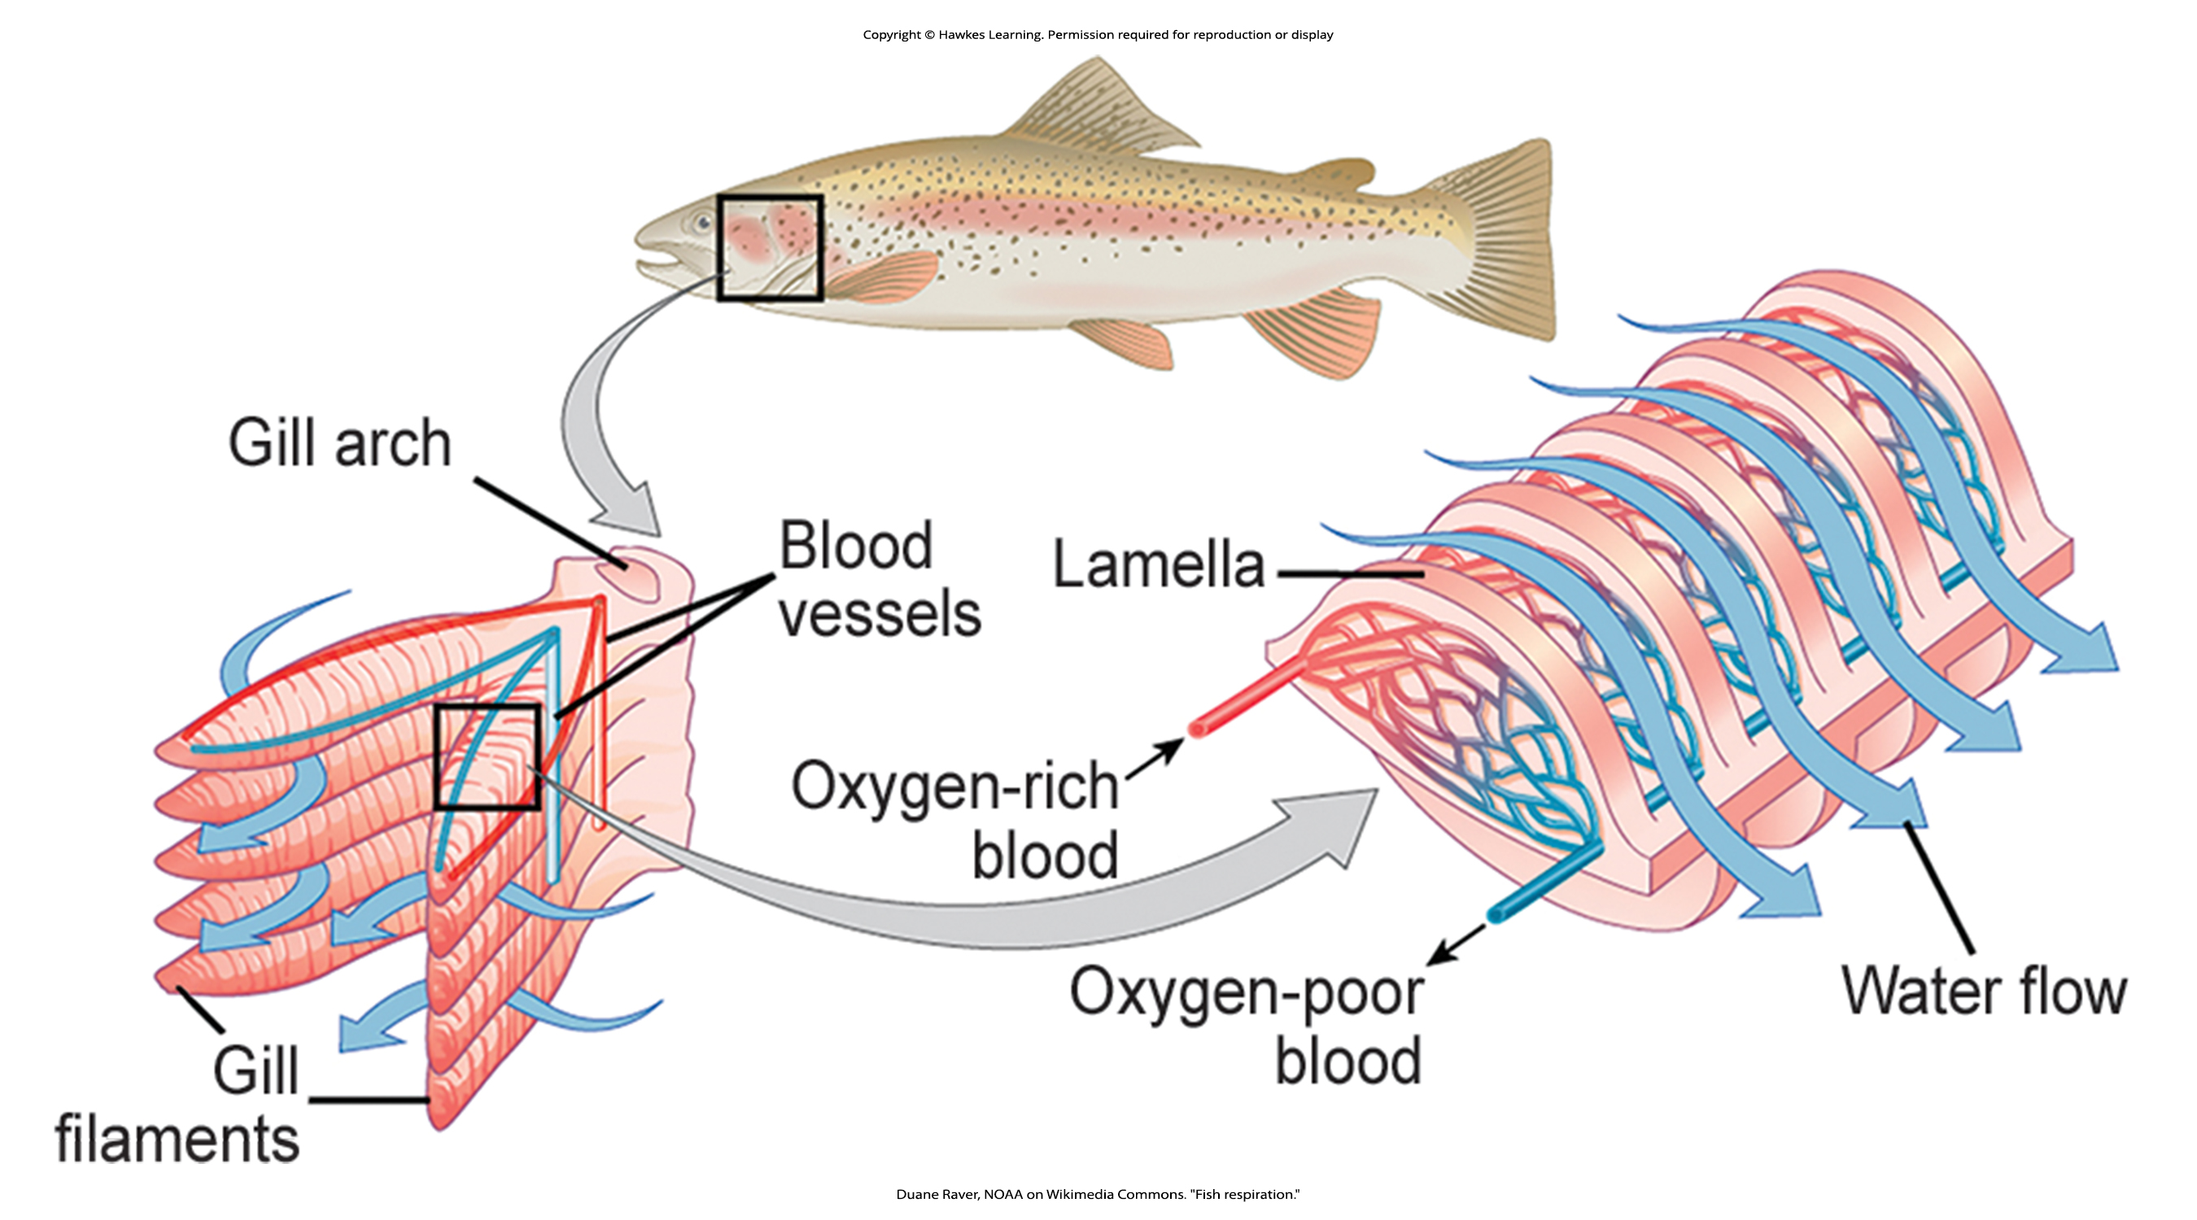
Lesson 36.1 Figure 5
Duane Raver, NOAA on Wikimedia Commons. "Fish respiration."
Notes:
Figure 5: Gills consist of plate-like structures called filaments, each of which is covered by an array of lamellae that enclose the capillaries. As water flows between the lamellae, blood in the capillaries absorbs oxygen and releases carbon dioxide.

Slide 9
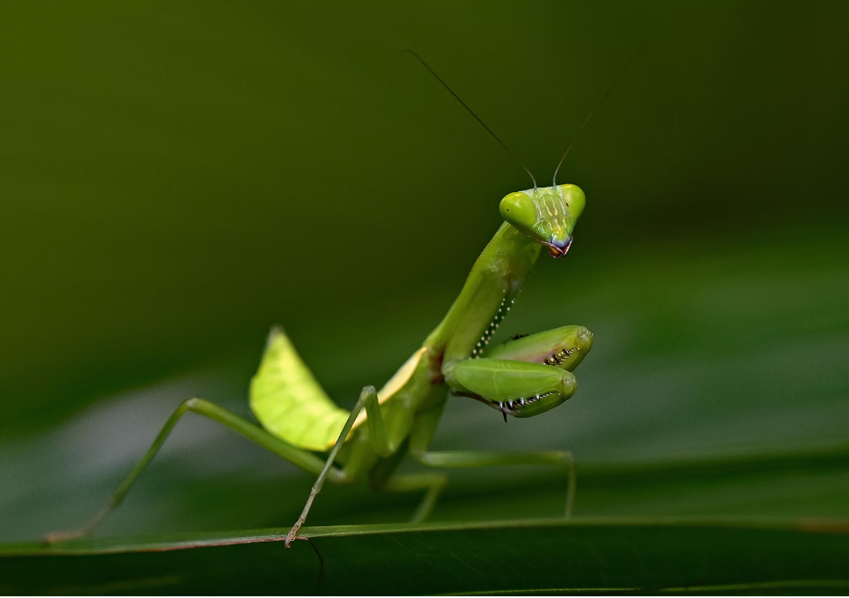
Tracheal Systems₁
Insects use a respiratory system called the tracheal system, which consists of a network of small tubes that carries oxygen to the entire body.
The tracheal system is the most direct and efficient respiratory system in active animals. The tubes in the tracheal system are made of a polymeric material called chitin.
36.1 Figure 6
David Clode on Unsplash. "Praying mantis."
Notes:
Figure 6: Chitin is a polymeric material that makes up the tracheal system of insects as well as their exoskeletons—such as that of this praying mantis.

Slide 10
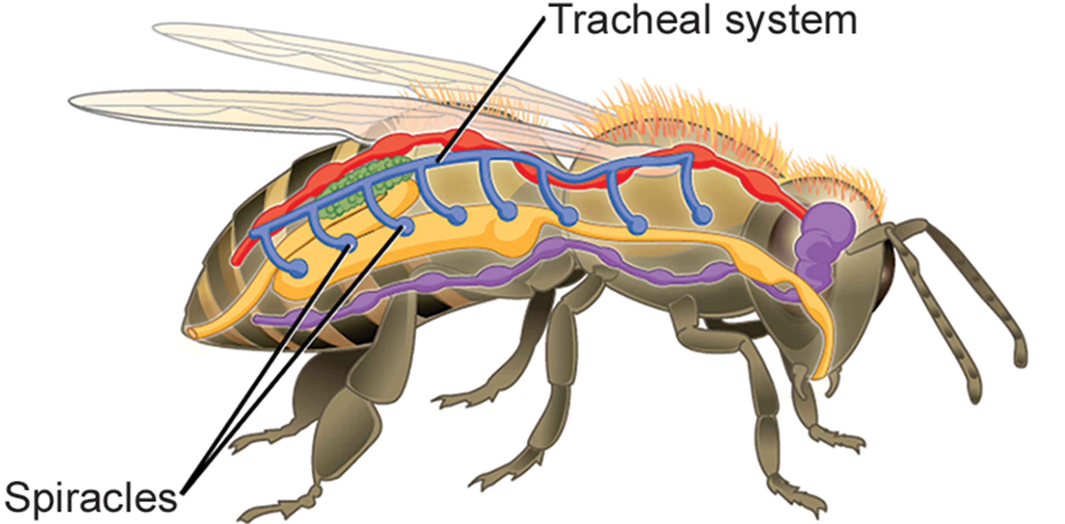
Tracheal Systems₂
Insect bodies have openings, called spiracles, along the thorax and abdomen.
These openings connect to the tubular network, allowing oxygen to pass into the body and regulating the diffusion of CO₂ and water vapor.
Air enters and leaves the tracheal system through the spiracles.
36.1 Figure 7
CNX OpenStax on Wikimedia Commons. "Insect respiratory system."
Notes:
Figure 7: Insects perform respiration via a tracheal system. Air enters and leaves this system via the spiracles.

Slide 11
Mammalian Systems₁
In mammals, pulmonary ventilation occurs via inhalation (breathing).
During inhalation, air enters the body through the nasal cavity, located just inside the nose. As air passes through the nasal cavity, the air is warmed to body temperature and humidified.
The respiratory tract is coated with mucus, a sticky substance made of mucin (a complex glycoprotein) as well as salts and water that traps particulates and seals tissues from direct contact with air.
Particulate matter floating in the air is removed in the nasal passages via mucus and cilia.
The processes of warming, humidifying, and removing particles are important protective mechanisms that prevent damage to the trachea and lungs.

Slide 12
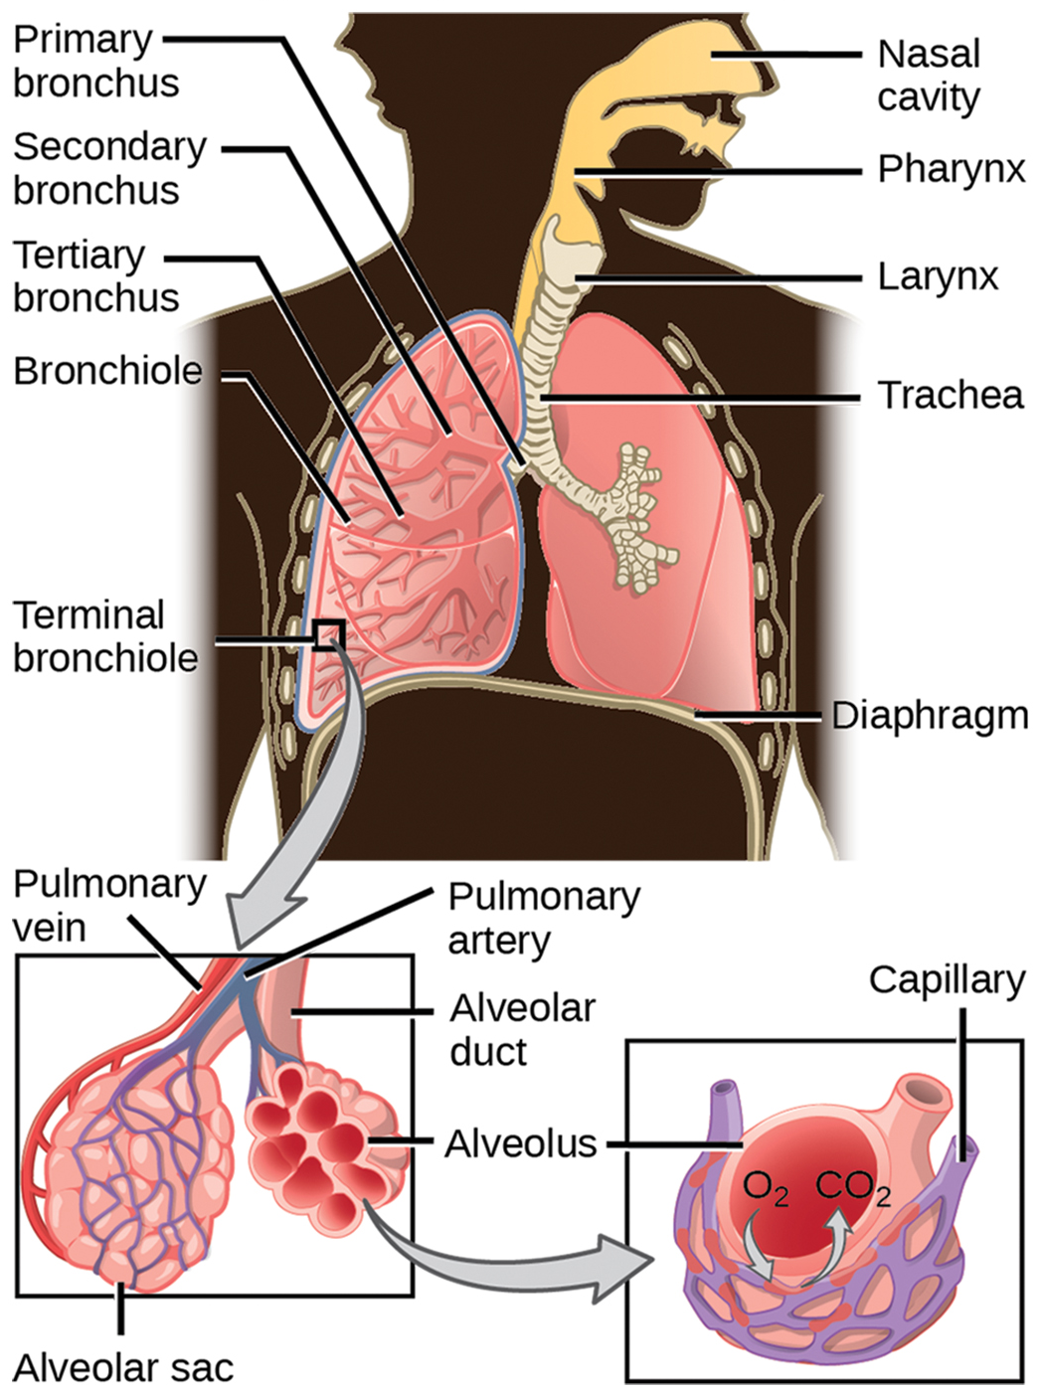
Lesson 36.1 Figure 8
NCI. "Human respiratory system."
Notes:
Figure 8: Air enters the respiratory system through the nasal cavity and pharynx, then passes through the trachea and into the bronchi, which bring air into the lungs.

Slide 13
Mammalian Systems₂
From the nasal cavity, air passes through the pharynx (throat) and the larynx (voice box) as it makes its way to the trachea.
The trachea functions to funnel inhaled air to the lungs and the exhaled air back out of the body.
The human trachea is a cylinder which sits in front of the esophagus and extends from the larynx into the chest cavity, where it divides into the two primary bronchi at the midthorax.
It is made of incomplete rings of hyaline cartilage and smooth muscle.
The cartilage provides strength and support to the trachea to keep the passage open.
The trachea is lined with mucus-producing goblet cells and ciliated epithelia. The cilia propel foreign particles trapped in the mucus toward the pharynx.

Slide 14
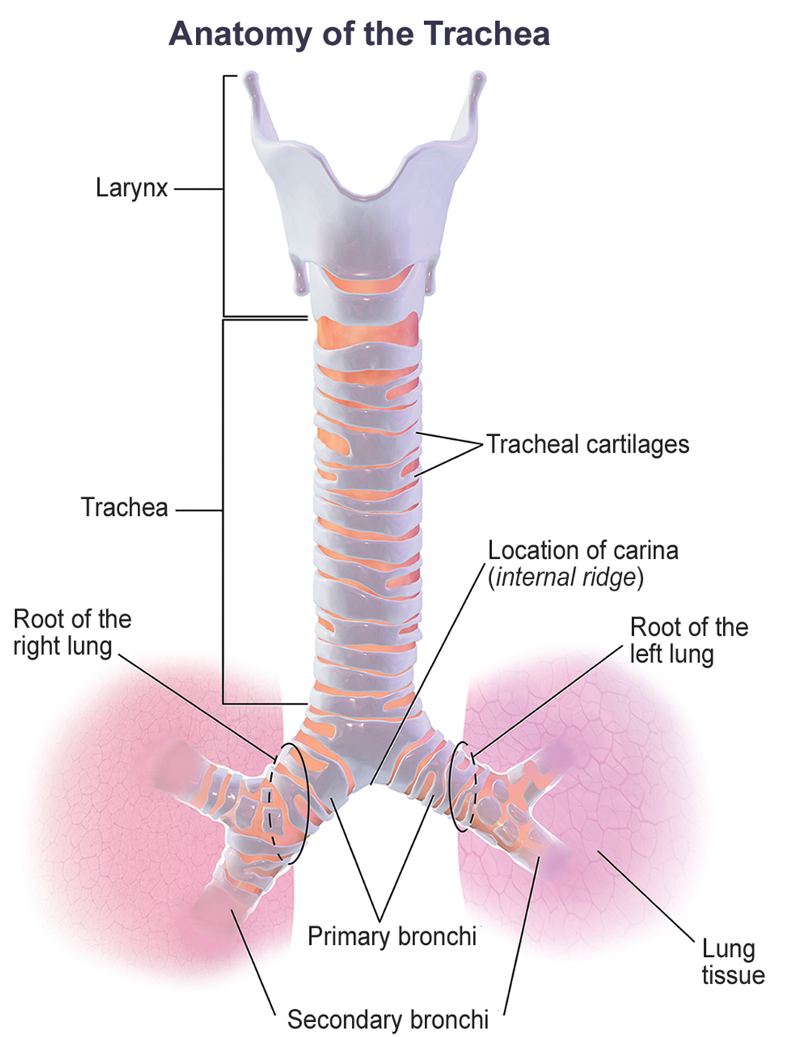
Lesson 36.1 Figure 9
BruceBlaus on Wikimedia Commons. "Trachea anatomy."
Notes:
Figure 9: The trachea and bronchi are made of incomplete rings of cartilage.

Slide 15
Lungs: Bronchi and Alveoli₁
The end of the trachea divides to the right and left lungs.
The lungs are not identical; the right lung is larger and contains three lobes, whereas the left lung is smaller and contains two lobes.
The muscular diaphragm, which facilitates breathing, is below the lungs and marks the end of the thoracic cavity.

Slide 16
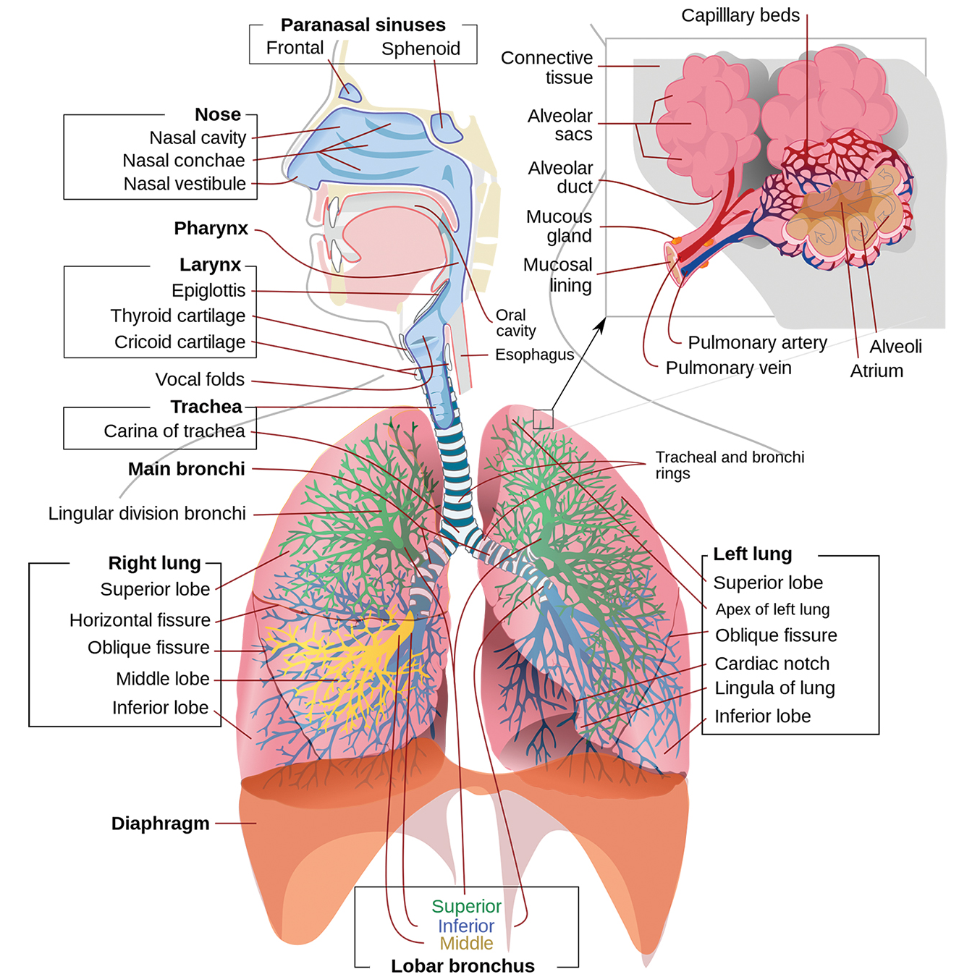
Lesson 36.1 Figure 10
Mariana Ruiz Villarreal on Wikimedia Commons. "Respiratory system diagram."
Notes:
Figure 10: Air enters the respiratory system through the nose and mouth, then travels through the pharynx and larynx to reach the trachea. The trachea bifurcates into the right and left bronchi in the lungs. The right lung is larger and made of three lobes. To accommodate the heart, the left lung is smaller and has only two lobes. In each lung, the bronchi divide into bronchioles and then alveolar ducts, which connect to the alveolar sacs. Gases are exchanged between the air entering the alveoli in each alveolar sac and the blood in the capillaries surrounding each alveoli.

Slide 17
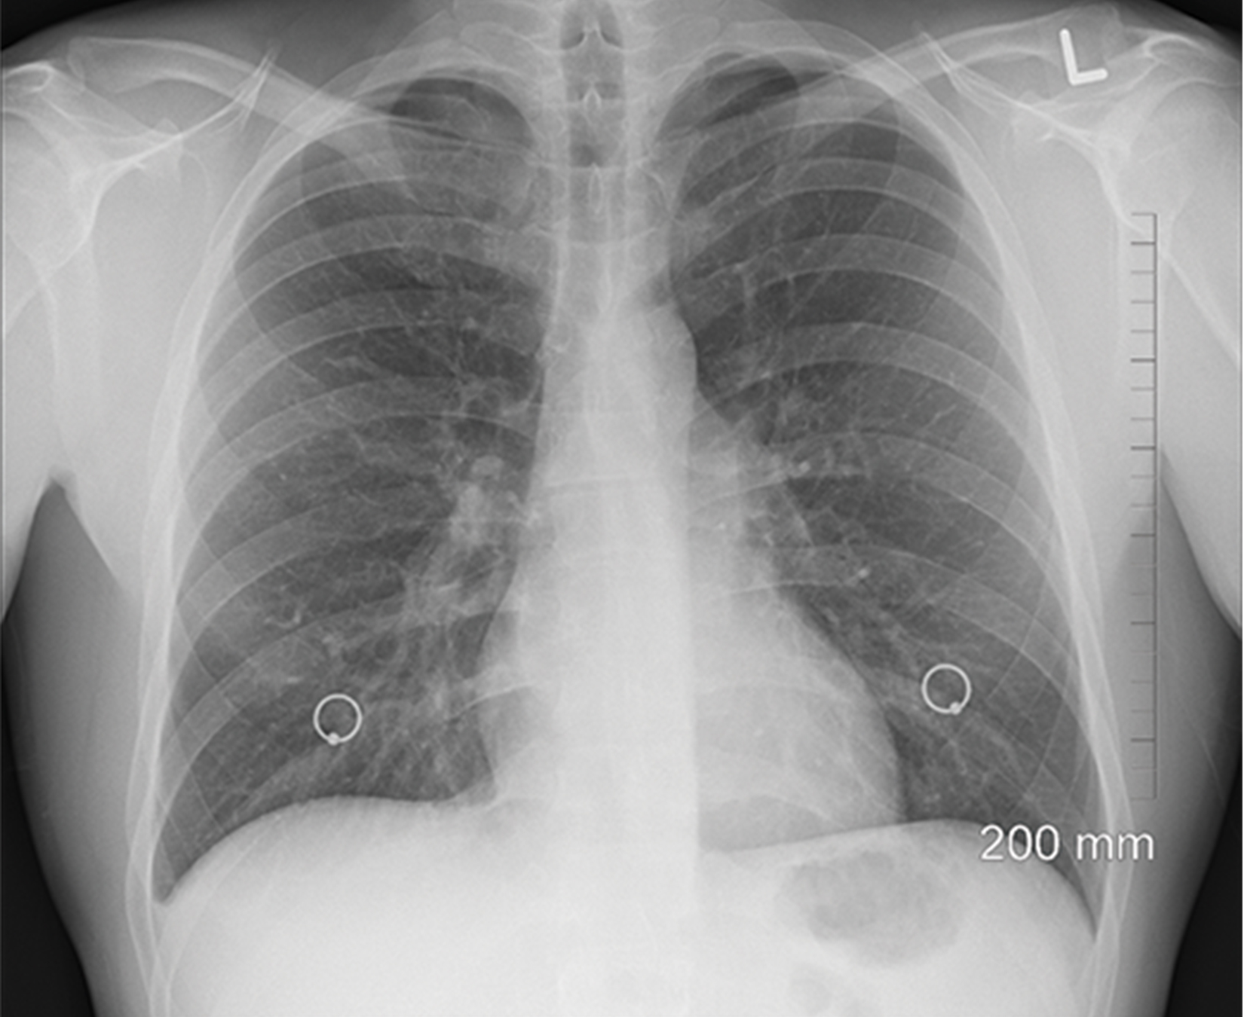
Lungs: Bronchi and Alveoli₂
In the lungs, air is diverted into smaller and smaller passages, or bronchi.
Air enters the lungs through the two main bronchi. Each bronchus divides into secondary bronchi, then into tertiary bronchi, which further divide, creating bronchioles of smaller and smaller diameter as they split and spread through the lung.
Bronchi are innervated by nerves of both the parasympathetic and sympathetic nervous systems that control muscle contraction (parasympathetic) or relaxation (sympathetic) in the bronchi and bronchioles, depending on the nervous system's cues.
In humans, bronchioles with a diameter smaller than 0.5 mm are the respiratory bronchioles. They lack cartilage and, therefore, rely on inhaled air to support their shape.
36.1 Figure 11
oracast on Pixabay. "Chest X-ray."
Notes:
Figure 11: Lungs work by diverting air into smaller and smaller passages. These branching airways can be seen in this chest X-ray.

Slide 18
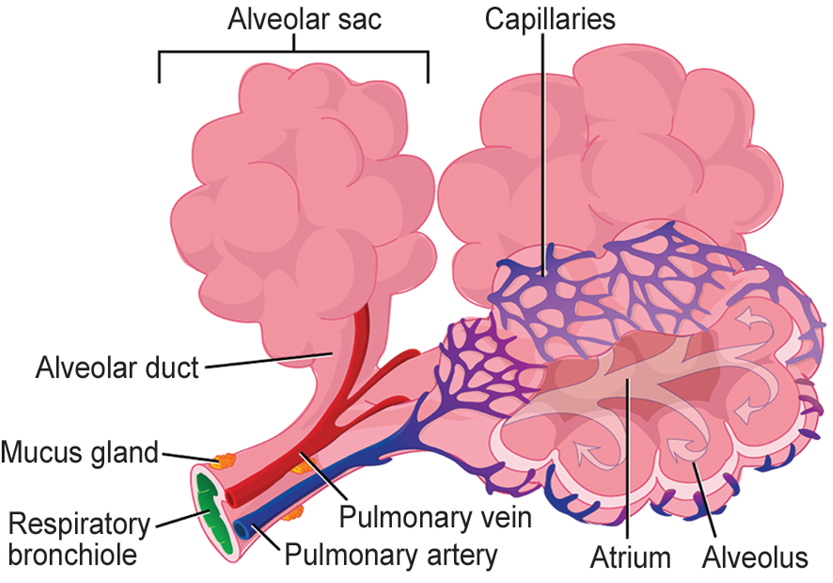
Lungs: Bronchi and Aveoli₃
The terminal bronchioles subdivide into microscopic branches called respiratory bronchioles, which further subdivide into several alveolar ducts.
Numerous alveoli and alveolar sacs surround the alveolar ducts. The alveolar sacs resemble bunches of grapes tethered to the end of the bronchioles.
In the acinar region, the alveolar ducts are attached to the end of each bronchiole. At the end of each duct are approximately 100 alveolar sacs, each containing 20 to 30 alveoli that are 200 to 300 microns in diameter.
36.1 Figure 12
Mariana Ruiz Villarreal on Wikimedia Commons. "Terminal bronchioles."
Notes:
Figure 12: Terminal bronchioles are connected by respiratory bronchioles to alveolar ducts and alveolar sacs. Each alveolar sac contains 20 to 30 spherical alveoli and has the appearance of a bunch of grapes. Air flows into the atrium of the alveolar sac then circulates into alveoli, where gas exchange occurs with the capillaries. Mucus glands secrete mucus into the airways, keeping them moist and flexible.
Further Resources

Slide 19
Alveoli and Gas Exchange
Gas exchange occurs only in alveoli.
Alveoli are made of thin-walled parenchymal cells, typically one-cell thick, that look like tiny bubbles within the sacs. Alveoli are in direct contact with capillaries of the circulatory system.
This allows oxygen (O₂) will diffuse from alveoli into the blood.
Carbon dioxide (CO₂) produced by cells as a waste product will diffuse from the blood into alveoli to be exhaled.
There are so many alveoli (∼300 million per lung) within each alveolar sac and so many sacs at the end of each alveolar duct, the lungs have a spongelike consistency.
This organization produces a very large surface area that is available for gas exchange.

Slide 20
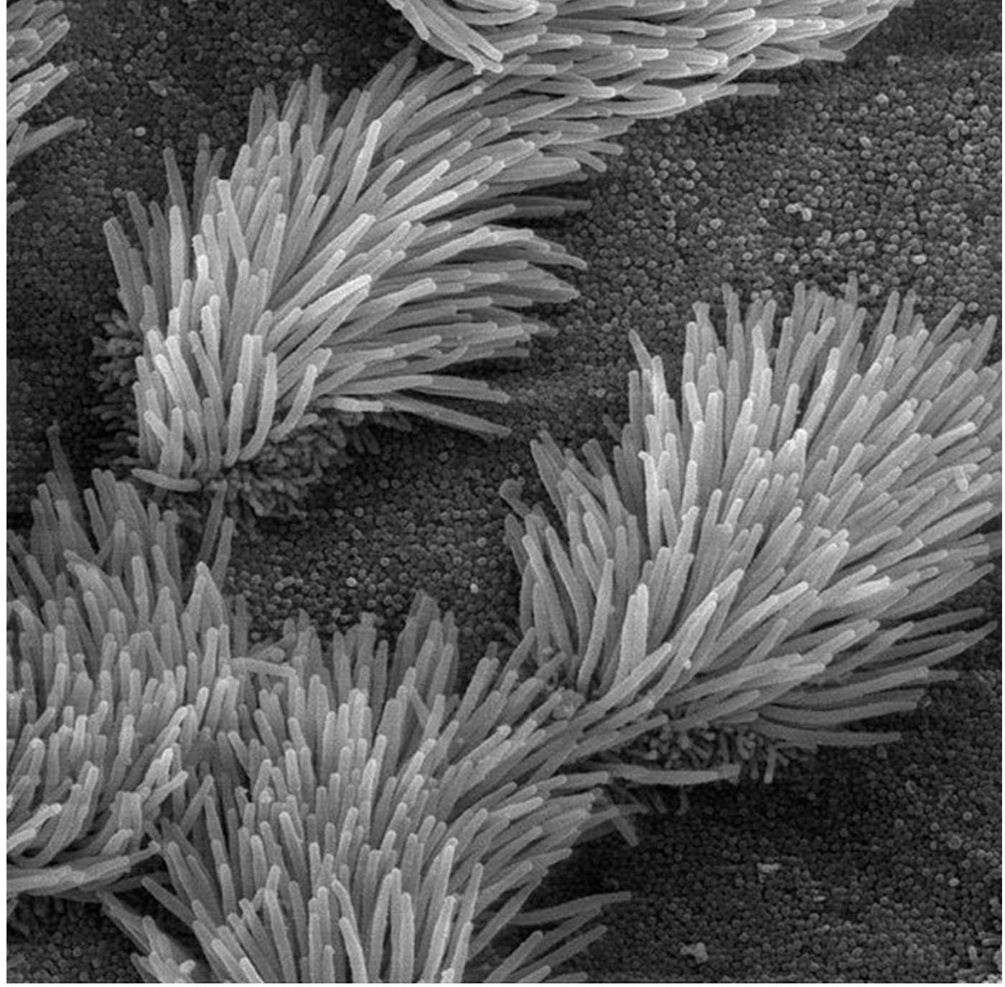
Protective Mechanisms
The air that organisms breathe contains particulate matter such as dust, dirt, viral particles, and bacteria that can damage the lungs or trigger allergic immune responses.
In the nasal cavity, hairs and mucus trap small particles, viruses, bacteria, dust, and dirt to prevent.
Mucus produced by the lungs traps small particles, such as pollen, pathogens, or particulates in smoke.
The bronchi and bronchioles contain cilia, small hairlike projections that line the walls of the bronchi and bronchioles.
These cilia beat in unison and move mucus and particles out of the bronchi and bronchioles back up to the throat where it is swallowed and eliminated via the esophagus.
36.1 Figure 13
Charles Daghlian on Wikimedia Commons. "Cilia."
Notes:
Figure 13: The bronchi and bronchioles contain cilia that help move mucus and other particles out of the lungs.

Slide 21
Reflection Question
Why do you think that inhaling a gust of campfire smoke makes you cough?
Which parts of the respiratory system do you think are responsible for the coughing reaction?
Notes:
The reflection question is included here to use as a talking point or for a think-pair-share activity.

Slide 22
Summary
Respiratory systems are designed to facilitate gas exchange.
In humans, the respiratory bronchioles, which house the alveolar sacs and alveoli are the site of gas exchange in the lungs.
Several protective mechanisms, such as hair and mucus prevent dust and other particulate matter from entering the respiratory system.

Slide 23

End of Hawkes Learning PowerPoint

